Slide 1




BRADFORD VTS TEACHING DECK
EVIDENCE-BASED PRIMARY CARE
Sore Throat and RTI Scoring Tools
FeverPAIN, Centor, STARWAVe
www.bradfordvts.co.uk
Created July 2026
Updated to NICE NG84

Slide 2












BRADFORD VTS TEACHING DECK
Sore Throat Context & NICE NG84 Strategy
The Clinical Context
NICE NG84 (Current)
Recommended Management Strategy
One of the most common presentations in primary care.
Default strategy: No antibiotic or Delayed antibiotic.
~2 million antibiotic prescriptions/year for sore throat in UK.
Antibiotic prescribing for URTI increased 40% (1999-2011) — major driver of AMR.
Use evidence-based scoring tools (FeverPAIN or Centor) to guide decisions.
Immediate antibiotics reserved ONLY for patients with high-risk features or systemic unwellness.
~70%
~30%
VIRAL (SELF-LIMITING)
BACTERIAL (GABHS)
Strategy aims to reduce unnecessary prescribing and combat antimicrobial resistance.
Antibiotic Limitations
Key Stewardship Principles
Symptom duration reduced by only ~16 hours (modest benefit).
Patient education on natural history (typically 1 week).
Evidence shows antibiotics do NOT prevent peritonsillar abscess, otitis media, or rheumatic fever in UK settings.
Promote self-care (analgesia, fluids) as first-line.
Safety-netting is essential for all "No/Delayed" strategies.
www.bradfordvts.co.uk
Updated to NICE NG84 | July 2026

Slide 3


FeverPAIN Score Criteria
F
Fever in the past 24 hours
Self-reported by patient/parent or measured temperature ≥38°C.
P
Purulence
Presence of pus (exudate) visible on the tonsils during examination.
A
Attend rapidly
Symptom duration of 3 days or less before seeking medical attention.
I
Inflamed tonsils
Severe inflammation or redness of the tonsillar tissue.
N
No cough or coryza
Absence of viral symptoms like cough, runny nose, or nasal congestion.
Scoring Mechanism: Each criterion scores 1 point MAX 5 POINTS | Used to identify likelihood of GABHS infection in Primary Care.

Slide 4













FeverPAIN Interpretation & Prescribing
Score
Strep Likelihood
NICE NG84 Strategy
13% – 18%
0 – 1
No antibiotic strategy
Antibiotics offer little benefit; focus on self-care and safety-netting.
34% – 40%
2 – 3
Delayed antibiotic strategy
Offer prescription to use if symptoms do not improve within 3-5 days.
62% – 65%
4 – 5
Immediate antibiotic strategy
Offer immediate Abx if the patient is systemically unwell or severe symptoms.
NICE NG84 CURRENT RECOMMENDATIONS
Preferred Tool: FeverPAIN is the preferred clinical tool in UK primary care (NICE NG84).
Clinical Judgement: Tools support, but do not replace, clinical assessment of severity.
Rapid Onset: Consider immediate Abx for scores of 4-5 specifically if symptoms are severe.

Slide 5
















Centor Score for GABHS Assessment
Centor Criteria (Max 4)
FeverPAIN vs. Centor
Tonsillar exudate
NICE NG84 Preference: FeverPAIN is the preferred tool (developed in UK primary care).
Tender anterior cervical lymphadenopathy
History of fever (>38°C)
Centor Role: Older, widely used tool; useful when FeverPAIN criteria are unavailable.
Absence of cough
Evidence: Absence of 3-4 Centor criteria = 80% chance it is NOT GABHS.
Clinical Judgment: Tools support, but do not replace, clinical assessment.
Score Interpretation
Clinical Context & Risk
Score
GABHS Likelihood
Strategy
Score 3-4 indicates a 40-60% chance of GABHS; these patients are most likely to benefit from antibiotics.
3 - 17%
0 - 2
No Antibiotic
32 - 56%
Quinsy Risk: 1:60 in unwell patients with 3/4 criteria vs. 1:400 in those with lower scores.
3 - 4
Consider Antibiotic

Slide 6











Paediatric Streptococcal Score Card
Clinical Criteria (1 point each, Max 6)
Score 6 / 6
Age: 5 – 15 years
75%
Season: Late autumn, winter, or early spring
Probability of GABHS Positive Culture
Fever: Recorded temperature ≥38.3°C
Lymphadenopathy: Tender cervical nodes
Score 5 / 6
59%
Pharyngeal signs: Erythema, oedema, or exudate
No viral symptoms: No conjunctivitis, rhinorrhoea, or cough
Probability of GABHS Positive Culture
Clinical Application
This tool is specifically validated for the paediatric population (5-15y) to help differentiate bacterial GABHS from viral pharyngitis during peak seasons.
BRADFORD VTS TEACHING DECK
www.bradfordvts.co.uk | July 2026

Slide 7





STARWAVe Tool for RTI Hospitalisation
Predicting Clinical Severity
STARWAVe
Validated tool for children (3m–16y) presenting with acute cough and RTI to predict hospitalisation risk and support antibiotic stewardship.
S
Short duration of illness
<3 days since onset of symptoms
T
Temperature
≥37.8°C on exam OR parent-reported severe fever in past 24h
A
Age <2 years
Higher physiological risk in infants and toddlers
R
Respiratory distress
Recession (intercostal/subcostal) or increased work of breathing
W
Wheeze
Clinician reported on auscultation
A
Asthma
Current diagnosis of asthma
Ve
Vomiting
Moderate or severe vomiting in the previous 24 hours
N = 8,394 Children
0.9% Admission Rate
Reduces "Just-in-case" prescribing

Slide 8



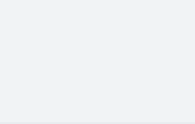
























STARWAVe: Risk Stratification & Clinical Limitations
RISK STRATIFICATION FRAMEWORK
CRITICAL LIMITATIONS
Score
Risk Category
Prevalence
Admission Risk
Recommended Strategy
Predicts Hospitalisation Only
Does NOT distinguish between bacterial and viral aetiology. 73% of admissions were non-bacterial.
0–1
67%
0.3% (1:320)
No antibiotic strategy
VERY LOW
Predictive Accuracy
AUROC 0.81: Good predictive accuracy but not perfect. Not yet externally validated in a large RCT.
2–3
30%
1.5% (1:70)
No or delayed antibiotic
NORMAL
Supplement, Not Replace
Must be used alongside clinical judgement, especially in children with underlying conditions.
≥4
3%
11.8%
Same-day F/U; Immediate Abx; Consider admission
HIGH
Tool Selection
Still prefer Centor/FeverPAIN for sore throat; STARWAVe is better for general RTI/Cough severity.
STARWAVe aims to reduce 'just in case' prescribing by identifying children at extremely low risk of admission.

Slide 9














Antibiotic Choice and Dosing for Children
1st Choice: Phenoxymethylpenicillin (Penicillin V)
Duration: 5–10 Days
Penicillin Allergy Alternatives
Age Group
Recommended Dosing Strategy (Oral)
Clarithromycin (5 days):
62.5 mg QDS or 125 mg BD
Weight-based dosing (consult BNF). Avoid in pregnancy.
1–11 Months
Erythromycin: Preferred alternative for macrolide use in pregnancy.
125 mg QDS or 250 mg BD
1–5 Years
CLINICAL CONTEXT
Antibiotics reduce symptom duration by approximately 16 hours. Strategy should prioritize no/delayed prescribing unless high-risk features are present (NICE NG84).
250 mg QDS or 500 mg BD
6–11 Years
Source: NICE NG84 | BNF Current Guidance
500 mg QDS or 1000 mg BD
12–17 Years

Slide 10


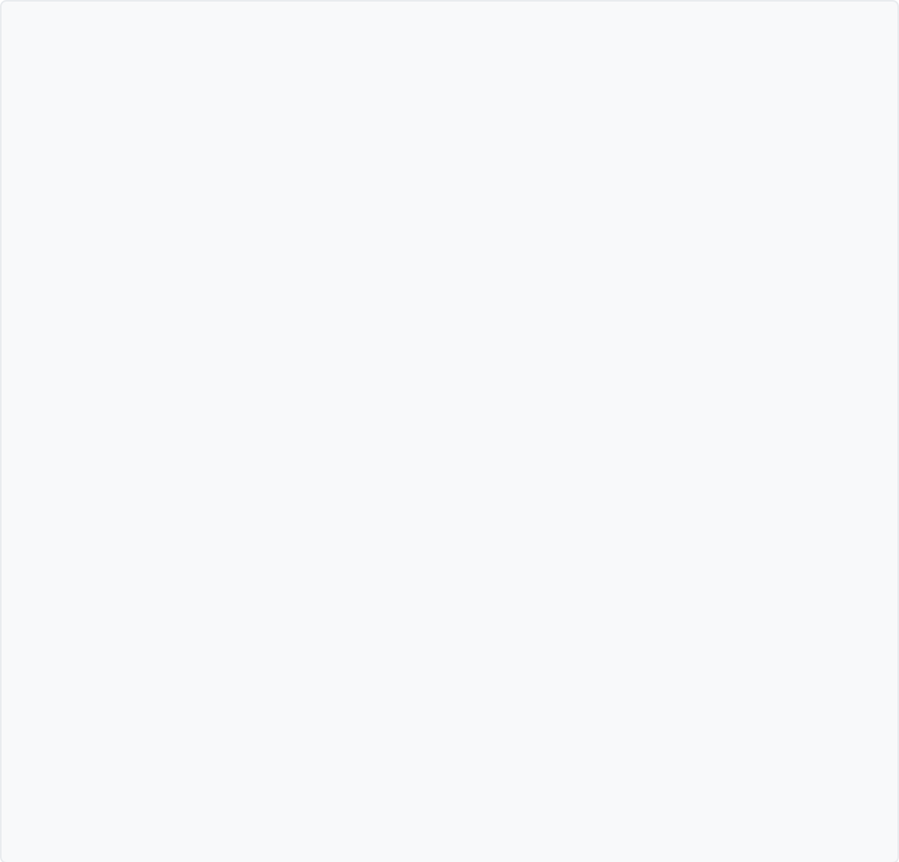









Avoiding Amoxicillin and Identifying EBV
CONTRAINDICATION WARNING
Clinical Signs of Glandular Fever
Do NOT use Amoxicillin if Epstein-Barr Virus (Glandular Fever) is suspected or possible as the underlying cause of a sore throat.
Demographics: Most common in teenagers and young adults.
Lymphadenopathy: Significant, often posterior cervical or generalized nodes.
Infectious Mononucleosis (EBV) can closely mimic streptococcal pharyngitis. Administering amoxicillin in these patients triggers a severe reaction:
Profound Fatigue: Extreme lethargy that persists beyond the acute throat pain.
Pharyngeal Exudate: Thick, white/grey coating on tonsils (often severe).
~90% Risk of Severe Maculopapular Rash
Organomegaly: Splenomegaly or hepatomegaly (risk of splenic rupture).
Note: This is not a true penicillin allergy, but an immune-mediated drug eruption specific to EBV infection.
Clinical Tip: If the patient is a teenager with significant fatigue, always consider EBV before reaching for any penicillin-class antibiotic.
BRADFORD VTS TEACHING DECK
www.bradfordvts.co.uk | Updated July 2026

Slide 11



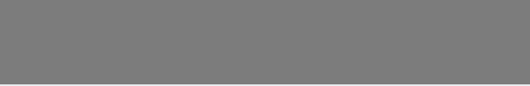
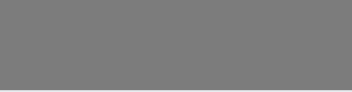











Self-Care Advice and Natural History
Symptom Management
Typical Recovery Timelines
Analgesia: Paracetamol and/or Ibuprofen for pain and fever management.
Condition
Typical Duration
Hydration: Maintain adequate fluid intake, especially if febrile.
Sore Throat
~1 week
Lozenges: Medicated lozenges (e.g., flurbiprofen) show some evidence of pain relief in adults.
Otitis Media
Limited Evidence: Non-medicated lozenges, mouthwashes, or local anaesthetic sprays lack clinical evidence.
~4 days
Common Cold
~1.5 weeks
Acute Cough / Bronchitis
~3 weeks
Manage expectations: Antibiotics reduce symptoms by only ~16 hours.
Shared decision making relies on accurate natural history info.

Slide 12








Delayed Prescribing & Safety-Netting
Delayed Prescribing Strategy
Critical Safety-Netting Advice
Evidence-Based Issue
GENERAL WORSENING
Provide prescription to use ONLY if symptoms do not settle or worsen significantly within 3-5 days.
Worsens rapidly, child becomes systemically very unwell, or symptoms persist beyond 1 week.
Patient Education
QUINSY SIGNS (URGENT)
Explain that antibiotics make little difference (~16 hours faster recovery) and carry side effect risks (diarrhoea, rash).
Unilateral swelling, uvular deviation, trismus (difficulty opening mouth), or "hot potato" voice.
Management Goals
Reduce unnecessary use; most patients accept this approach with clear safety-netting and explanation.
AIRWAY & SWALLOWING
Stridor, difficulty breathing, drooling, or complete inability to swallow fluids/saliva.
SCARLET FEVER
Widespread sandpaper-like rash with sore throat; requires immediate Penicillin V.
"I'll give you a prescription to keep 'just in case'—only use it if things aren't improving in a few days."
"If they start drooling, can't open their mouth, or have any trouble breathing, you must seek urgent medical help."
www.bradfordvts.co.uk | NICE NG84 Strategy

Slide 13

















Red Flags and Urgent Clinical Features
Stridor or Respiratory Distress
URGENT ACTION RAIL
Potential epiglottitis. Do NOT examine throat. High risk of total airway obstruction.
CALL 999
EMERGENCY
Unilateral Swelling + Uvular Deviation
Signs of Quinsy (peritonsillar abscess). Often accompanied by Trismus (limited jaw opening).
URGENT A&E
REFERRAL
Drooling or Inability to Swallow
Severe oropharyngeal obstruction or deep neck space infection. Risk of rapid deterioration.
URGENT A&E
REFERRAL
Scarlet Fever / iGAS Signs
UKHSA
NOTIFICATION
Sore throat + Fever + Sandpaper rash. High clinical suspicion for invasive Group A Strep.
High-Risk RTI (STARWAVe ≥4)
SAME-DAY
FOLLOW-UP
Systemically very unwell child with respiratory distress, vomiting, or wheeze.
EBV (Glandular Fever) Risk
DIAGNOSTIC
CAUTION
Teenager + Fatigue + Significant Lymphadenopathy. AVOID Amoxicillin (rash risk).

Slide 14









AKT and SCA Exam Pearls
AKT: ANTIBIOTIC SELECTION
Penicillin V is first-line (5-10 days). Avoid Amoxicillin due to 90% rash risk in EBV (Glandular Fever).
TOP EXAM PEARL
SCA: CLINICAL SHARED DECISION
"Antibiotics only make about 16 hours difference to symptoms. Let's issue a script to use only if things worsen."
FeverPAIN is the NICE NG84 preferred tool for sore throat assessment. Use it to guide antibiotic strategy rather than clinical impression alone.
AKT: STARWAVE PREDICTION
STARWAVe predicts hospitalisation (not bacteria). Score ≥4 = High risk (11.8% admission).
Score 0-1
No Antibiotic
Score 2-3
Delayed Script
Score 4-5
Immediate Script*
SCA: SAFETY NETTING
Watch for Quinsy (unilateral swelling, trismus) or Epiglottitis (stridor, drooling) — these are 999 emergencies.
*Offer immediate antibiotic only if patient is very unwell or systemically affected.
AKT PEARL: Erythromycin is the macrolide of choice in pregnancy.

Slide 15












BRADFORD VTS TEACHING DECK
www.bradfordvts.co.uk | July 2026
Quick Recall Summary: Sore Throat & RTI
FeverPAIN (Preferred)
Antibiotic Choices
Clinical Red Flags
Mnemonic: Fever, Purulence, Attend rapid (<3d), Inflamed tonsils, No cough
1st Line: Penicillin V (Phenoxymethylpenicillin) for 5-10 days
Quinsy: Unilateral swelling, uvular deviation, trismus (lockjaw)
0-1 No antibiotic strategy
Allergy: Clarithromycin (5 days) or Erythromycin (if pregnant)
Epiglottitis: Stridor, drooling, distress (999 - do not examine!)
2-3 Delayed antibiotic strategy
4-5 Immediate Abx if systemically unwell
CRITICAL: AVOID Amoxicillin (EBV risk - 90% develop severe rash)
Scarlet Fever: Rash + Fever + Sore throat (Treat & Notify)
Natural History: Typical recovery ~1 week
Systemic: STARWAVe ≥4 or systemically very unwell
Centor Score
STARWAVe (RTI)
SCA Communication
1. Tonsillar Exudate
Predicts hospitalisation in children with RTI/Cough
Explain VIRAL vs BACTERIAL prevalence
2. Tender Cervical Lymphadenopathy
Mention Abx benefit (~16 hours only)
3. History of Fever
High Risk (Score ≥4): 11.8% admission risk
Features: Short illness, Temp, Age <2, Resp distress, Wheeze, Asthma, Vomiting
Use scoring tools to aid "Evidence-based conversations"
4. Absence of Cough
Score 3-4: 40-60% GABHS likelihood
Safety-net clearly for swallowing/breathing
FINAL DISCLAIMER
This teaching deck is for educational purposes for GP trainees. Clinical decisions should be based on the individual patient presentation. Always verify antibiotic doses and guidance against the latest NICE NG84 (Sore Throat) and the current BNF/BNFC. Information accurate as of July 2026.

