Slide 1


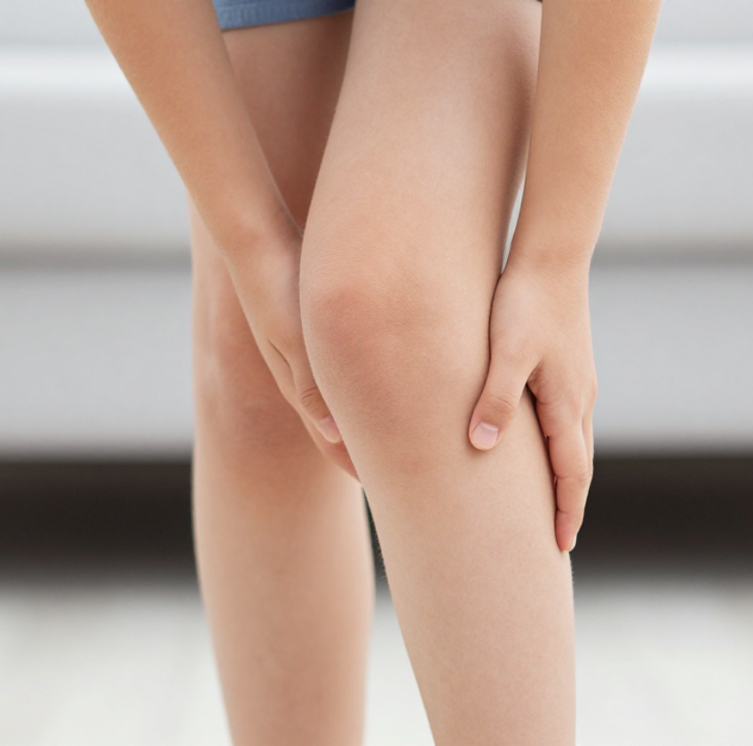
BRADFORD VTS TEACHING DECK
The Limping Child —
A Primary Care Guide
Clinical Assessment, Management & Exam Preparation
Created June 2026 | Updated to NICE CKS 2024 Standards
www.bradfordvts.co.uk
⚠ Disclaimer: Always double check this advice and drug doses with the latest NICE/BNF guidance. This document is for educational purposes only.

Slide 2










BRADFORD VTS TEACHING DECK
Clinical Guidance 2026
Definition and Gait Patterns
A limp is a deviation from a normal, age-appropriate gait pattern. Source: NICE CKS (Current)
A limp is a clinical presentation — NOT a final diagnosis.
Clinical Definition
Presentation vs. Diagnosis
The most common pattern observed in painful childhood conditions:
The Antalgic Gait
Clinical Mindset
Always take a limping child seriously.
Many life-changing or life-threatening conditions (Septic Arthritis, SUFE, Malignancy) present with a "minor" limp.
A high index of suspicion is required, especially in the very young.

Slide 3






BRADFORD VTS TEACHING DECK
Clinical Guidance 2026
Age-Specific Differential Diagnosis
< 3 Years
3–10 Years
10–18 Years
DDH(missed presentation)
Transient Synovitis(Most common)
SUFE(Don't miss hip!)
Toddler's Fracture
Perthes Disease
Osgood-Schlatter
NAI(Always consider)
Septic Arthritis
Stress Fractures
Septic Arthritis / Osteo
Osteomyelitis
Reactive Arthritis
ALL AGES
Trauma/Fracture (most common overall), Septic Arthritis, Osteomyelitis, Malignancy, NAI, Juvenile Idiopathic Arthritis (JIA)
Memory Aid: "STOP Walking"
S
T
O
P
W
Septic Arthritis / Synovitis
Trauma / Tumour
Osteomyelitis
Perthes / SUFE
Who hurt this child?
Inflammatory vs Infectious
Fracture or Malignancy
Bone infection
Age-dependent structural
Always screen for NAI

Slide 4






BRADFORD VTS TEACHING DECK
Clinical Guidance 2026
Transient Synovitis (Irritable Hip)
Clinical Presentation
Primary Care Management Criteria
Most common cause of non-traumatic limp in children.
Manage in GP ONLY if ALL of the following are met:
Apyrexial: No fever or very low-grade (<38°C).
Typically follows a recent viral illness (e.g., URTI).
Weight-Bearing: Able to walk (even if uncomfortable).
Sudden onset of unilateral hip pain (may refer to thigh/knee).
Full ROM: Normal or near-normal hip movements.
Self-limiting: usually resolves within 3–10 days.
3 – 10 yrs
3 : 1
Systemically Well: No signs of sepsis or malignancy.
PEAK AGE RANGE
MALE : FEMALE
Age 3–10: Lower threshold for referral outside this range.
Management & Essential Safety-Netting
Treatment: Bed rest and simple analgesia (Paracetamol & Ibuprofen).
URGENT RETURN if: Development of fever, inability to bear weight, worsening pain, or systemic upset.
Follow-up: Routine clinical review in 1 week to ensure resolution.
*Transient synovitis is a diagnosis of exclusion; rule out septic arthritis first.

Slide 5








BRADFORD VTS TEACHING DECK
Clinical Guidance 2026
Perthes Disease and SUFE
Perthes Disease
SUFE (Slipped Epiphysis)
Age: 4–10 years (peak 4–8); Boys >> Girls (4:1)
Age: 10–18 years; more common in overweight children
Pathology: Idiopathic avascular necrosis of the femoral head
Risk: Hip, thigh, or knee pain (15% present with knee pain only)
Presentation: Gradual onset hip/knee pain and intermittent limp
Proximal femoral epiphysis slips relative to the neck
Safety: Do NOT ask child to bear weight if suspected
Child usually appears systemically well
KEY CLINICAL SIGN
PATHOGNOMONIC SIGN
Reduced Range of Motion (ROM) at the hip, especially internal rotation and abduction.
Loss of internal rotation + obligate external rotation on hip flexion (FABER test).
Urgent Orthopedic Referral (within 1–2 weeks)
Same Day Urgent Referral to Ortho / ED

Slide 6










BRADFORD VTS TEACHING DECK
Clinical Guidance 2026
Septic Arthritis and Osteomyelitis
Septic Arthritis (Emergency)
Kocher’s Criteria
Fever:Typically >38.5°C; systemically unwell
1. Inability to bear weight on the affected limb
Joint:Hot, swollen, red (hip most common)
2. Oral temperature >38.5°C
Pain:Severe; refusal to move or bear weight
3. ESR >40 mm/hr
Risk:Permanent joint damage or sepsis/death
4. WBC >12,000 cells/mm³
3 or 4 criteria = High Probability
Osteomyelitis
Note: Clinical guide in primary care; validated in secondary care.
Localised:Intense bone pain and tenderness
Focus:Over the bone, not directly over the joint
Systemic:Fever and malaise; often mimics sepsis
SAME DAY EMERGENCY REFERRAL
Pathology:Bacterial infection of bone structure
Refer to ED or Orthopaedics immediately. Do not delay.
Bloods (FBC, CRP, ESR) and cultures needed before antibiotics.

Slide 7











BRADFORD VTS TEACHING DECK
Clinical Guidance 2026
DDH, Malignancy, NAI, and Toddler’s Fracture
Missed DDH
Bone Malignancy
Risk Factors: Female, breech, FHx, first child, >4kg.
RED FLAG Night Pain: Deep, boring pain waking the child.
May be missed at neonatal NIPE/6-week checks.
Systemic: Weight loss, night sweats, pallor, anorexia.
Signs: Asymmetric skin folds, leg length discrepancy.
Osteosarcoma (peak >10y) or Ewing sarcoma (any age).
Limited hip abduction; Trendelenburg gait in walkers.
Leukaemia can present with limb or back bone pain.
Urgent orthopedic referral if suspected beyond neonatal period.
Action: Urgent 2WW (NG12) referral.
Non-Accidental Injury
Toddler’s Fracture
History: Inconsistent, vague, or delayed presentation.
Pattern: Undisplaced spiral fracture of the distal tibia.
Bruising: Unusual sites (ears, neck, buttocks, cheeks).
Age: Common in children 9 months to 3 years.
Multiple fractures at different stages of healing.
Follows minor twisting injury (often unwitnessed).
CRITICAL: Always consider NAI in pre-ambulatory children presenting with a "limp" or refusal to weight bear.
X-ray: Often appears normal initially (subtle).
Immediate safeguarding referral; involve senior lead.
Repeat X-ray in 2 weeks or refer if suspicion remains high.

Slide 8




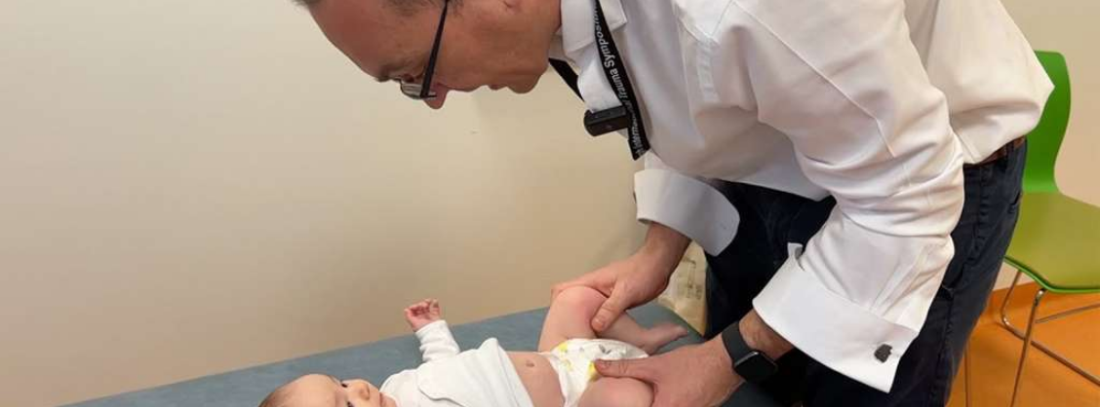

BRADFORD VTS TEACHING DECK
Clinical Guidance 2026
Systematic Clinical Assessment
Key History Questions
Physical Examination
Age: Your first and most useful guide to differential.
Onset: Sudden (trauma/infection) vs. Gradual (Perthes/DDH/Tumour).
Site of Pain: Note that hip pain often refers to the knee.
Weight Bearing: Can the child walk at all? Refusal to walk is a red flag.
Systemic: Fever, tachycardia, recent viral URTI (Transient Synovitis).
Night Pain: Does it wake the child? (Suspicion of Malignancy).
Safeguarding: Any trauma? Is the history inconsistent or delayed?
History: Birth (breech/DDH), Development, Family history (JIA).
General: Fever, pallor, lymphadenopathy, skin rashes (HSP/JIA).
Gait: Observe pattern (Antalgic, Trendelenburg, stiff).
Always ask specifically about night pain and systemic upset.
Look/Feel/Move: Check for leg length discrepancy, warmth, swelling.
Hip ROM: Test flexion, abduction, and internal/external rotation.
Spine: Exclude scoliosis or spinal pathology as a cause of gait change.
Loss of internal rotation + pain = SUFE until proven otherwise.
Clinical Mantra: Hip pathology often presents as knee pain in children — ALWAYS examine the hip in any child with knee pain or a limp.

Slide 9

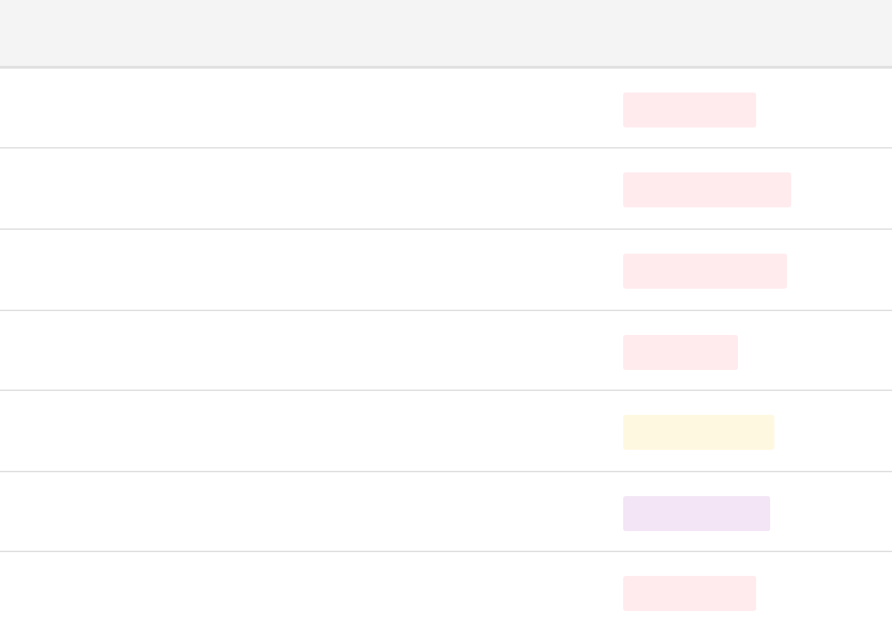















BRADFORD VTS TEACHING DECK
Clinical Guidance 2026
Primary Care Management and Referrals
Home Management (Irritable Hip)
Referral & Timing Guide
Condition / Scenario
Urgency
Strict Eligibility Criteria
No fever (or low-grade <38°C)
Septic Arthritis / Osteomyelitis
SAME DAY ED
Weight-bearing (may be uncomfortable)
SUFE (Slipped Upper Femoral Epiphysis)
Full or near-full range of hip movement
SAME DAY ORTHO
No signs of systemic illness or sepsis
Child <3 years with unexplained limp
Age 3–10 years (outside this, refer)
SAME DAY PAEDS
Suspected NAI (Non-Accidental Injury)
IMMEDIATE
Management Plan
Perthes Disease / Missed DDH
URGENT ORTHO
• Rest: Avoid vigorous physical activity/sports
Suspected Malignancy (Bone/Leukaemia)
• Analgesia: Paracetamol & Ibuprofen regularly
2WW PATHWAY
• Safety-net: Review in 1 week (sooner if fever/worsening)
Fever + Unable to bear weight (Any age)
• Reassurance: Self-limiting (resolves in 1–2 weeks)
SAME DAY ED

Slide 10






BRADFORD VTS TEACHING DECK
Clinical Guidance 2026
Clinical Red Flags: Immediate Action Required
RED FLAGS
Fever + Unable to Bear Weight SAME DAY ED
Must exclude Septic Arthritis immediately.
Night Pain Waking the Child 2WW CANCER
Strong indicator for Malignancy (Osteosarcoma, Leukaemia).
Loss of Internal Rotation (Obese Adolescent) SAME DAY ORTHO
Suspected SUFE; do not allow weight-bearing.
Unexplained Limp in Child < 3 Years URGENT REFER
Exclude NAI, DDH, or Toddler's Fracture.
Petechial Rash or Systemic Upset 999 SEPSIS
Meningococcal sepsis or severe systemic infection.
Unexplained Bruising (Non-Ambulatory) SAFEGUARDING
High index of suspicion for Non-Accidental Injury.
⚠ Safety Note: Any child with red flags must be referred for same-day hospital assessment. Document reasoning and safety-netting clearly.

Slide 11












BRADFORD VTS TEACHING DECK
Clinical Guidance 2026
Top Tips and Common Pitfalls
Clinical Training Pearls
Common Diagnostic Traps
Age is your first filter: Use age groups to prioritize DDH (<3y), Perthes (4-10y), or SUFE (10-18y) immediately.
The "Growing Pains" Trap
Examine the hip: Hip pathology frequently presents as referred knee pain. Always check hip ROM in knee presentations.
Never diagnose growing pains in a child with a unilateral limp or without a full hip and knee examination. Growing pains are typically bilateral and nocturnal.
Loss of internal rotation: Pathognomonic for SUFE in an overweight adolescent until proven otherwise.
Accepting transient synovitis in a child <3 years old. This is rare; suspect infection, DDH, or NAI first.
Diagnosis of exclusion: Transient synovitis must only be diagnosed once Septic Arthritis is ruled out.
Assuming a normal X-ray excludes Perthes or SUFE. Early changes are subtle; MRI/Repeat imaging may be needed.
The 1-Week Safety Net: Always book a formal review in 7 days for irritable hip cases to ensure resolution.
Treating isolated knee pain without hip rotation testing. This is a classic missed SUFE presentation.
Think NAI: Especially in non-ambulatory children or when the history is inconsistent with the injury.
Dismissing night pain as simple trauma. Bone malignancy often presents with intermittent pain that wakes the child.
When in doubt: Refer and document your reasoning. A normal examination today does not preclude evolving pathology tomorrow.

Slide 12





BRADFORD VTS TEACHING DECK
Clinical Guidance 2026
AKT and SCA Exam Pearls
AKT Clinical Knowledge
SCA Communication Skills
Kocher Criteria
Explore ICE & Concerns
WBC >12k, Temp >38.5°C, ESR >40, Non-weight bearing.3/4 criteria = High probability of Septic Arthritis.
"What worries you most about the limp?" "What do you think might be causing it?" Address parental anxiety early.
Safety-Netting Script
SUFE vs. Perthes
Essential for Transient Synovitis:"Return in 1 week, or sooner if they get a fever, can't walk, or seem more unwell."
SUFE: Obese 10-18y, loss of internal rotation.
Perthes: 4-10y boys, avascular necrosis, gradual onset.
Malignancy & DDH
Osteosarcoma: Peak >10y, metaphysis.
DDH Risks: Female, Breech, 1st child, Family history.
Breaking News Sensitively
For SUFE/Perthes: "I think we need to have this looked at today at the hospital to make sure we don't miss anything serious."
Toddler's Fracture
Spiral tibial fracture (9m-3y). X-ray often normal initially; repeat in 2 weeks if suspicion remains.
NAI & Safeguarding
Document carefully. Involve safeguarding lead. Act quickly without necessarily alerting parents if it compromises safety.

Slide 13












Bradford VTS Teaching Deck
Clinical Guidance 2026
Quick Recall Summary
SAFE ASSESSMENT FOCUS
Age Filter
Kocher's
The Mantra
Rule out "The Big Three" through systematic filtering.
< 3 Years: High risk for NAI, DDH, or Infection. Same-day referral.
Non-Weight Bearing
Knee Pain? Always examine the hip.
Fever >38.5°C
WBC >12,000 cells/mm³
Loss of IR? Suspect SUFE (obese adolescent).
4–10 Years: Peak for Synovitis and Perthes Disease.
Prioritize Septic Arthritis, SUFE, and NAI by applying age-specific diagnostic filters and high-yield criteria at the first point of clinical contact.
ESR >40 mm/hr
Night Pain? Exclude malignancy urgently.
10–18 Years: Suspect SUFE until proven otherwise.
Primary Filter
3/4 = Septic Arthritis
Safe Exam Pattern
Always safety-net irritable hip with a mandatory 1-week review.

Slide 14






BRADFORD VTS TEACHING DECK
Clinical Guidance 2026
Final Disclaimer and Guidance
MANDATORY SAFETY DISCLAIMER
Always double check this advice and drug doses with the latest NICE/BNF guidance. This document is for educational purposes only and should not be used as a substitute for professional clinical judgment.
Clinical Standards
Trainee Resources
NICE CKS: Acute Childhood Limp (2024)
RCGP AKT & SCA Preparation Guides
NICE NG12: Suspected Cancer Recognition
Bradford VTS Clinical Teaching Modules
British National Formulary for Children (BNFc)
Local Safeguarding Children Board (LSCB) Protocols
Created: June 2026
Updated to: 2024 NICE CKS Standards
For further educational materials, visit:
Slide 14 of 14 | Bradford VTS Teaching Deck
www.bradfordvts.co.uk

