Slide 1


BRADFORD VTS TEACHING DECK
Amitriptyline
in Primary Care
Updated May 2026
NICE CG173 (2020) & BNF 2023 Standards
Covering TCA pharmacology and clinical management in primary care
Created May 2026
www.bradfordvts.co.uk
⚠️ Always double check this advice and drug doses with the latest
NICE/BNF guidance. This document is for educational purposes only.

Slide 2
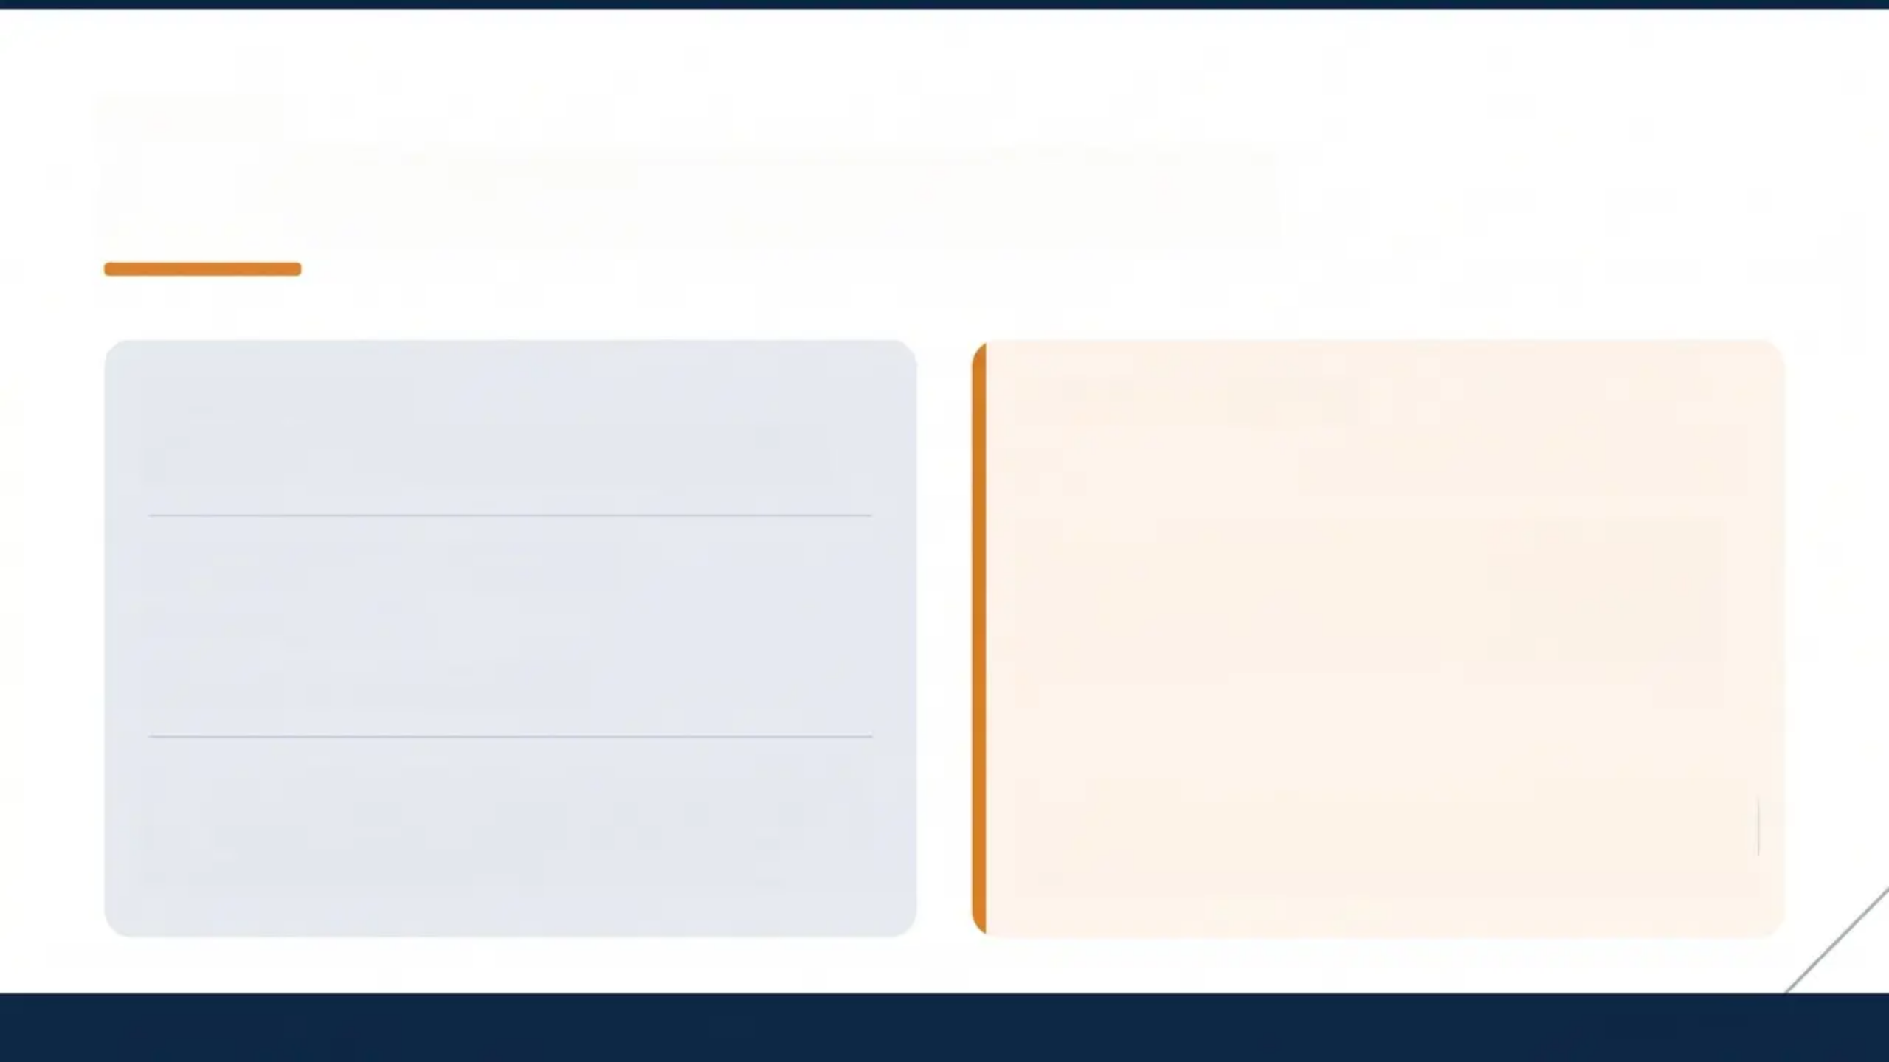



SECTION 1
Introduction to Amitriptyline
CLASSIFICATION
PRIMARY CARE ROLE
Tricyclic Antidepressant (TCA)
Used for Pain — Not Depression
In primary care, amitriptyline is predominantly
prescribed at low doses for pain management —
particularly neuropathic pain. Antidepressant
doses are significantly higher and rarely used in
general practice.
Type: Second-generation TCA
Introduced: 1961
Amine class: Tertiary amine
Tertiary amines (amitriptyline, imipramine, clomipramine,
doxepin) generally cause more side effects than secondary
amines (desipramine, nortriptyline) due to greater muscarinic,
histaminergic, and adrenergic blockade.
Dose Range
Purpose
Pain
10–75 mg nocte
Neuropathic pain
Depression
75–200 mg/day
Antidepressant
Bradford VTS Teaching Deck — Amitriptyline in Primary Care
www.bradfordvts.co.uk

Slide 3

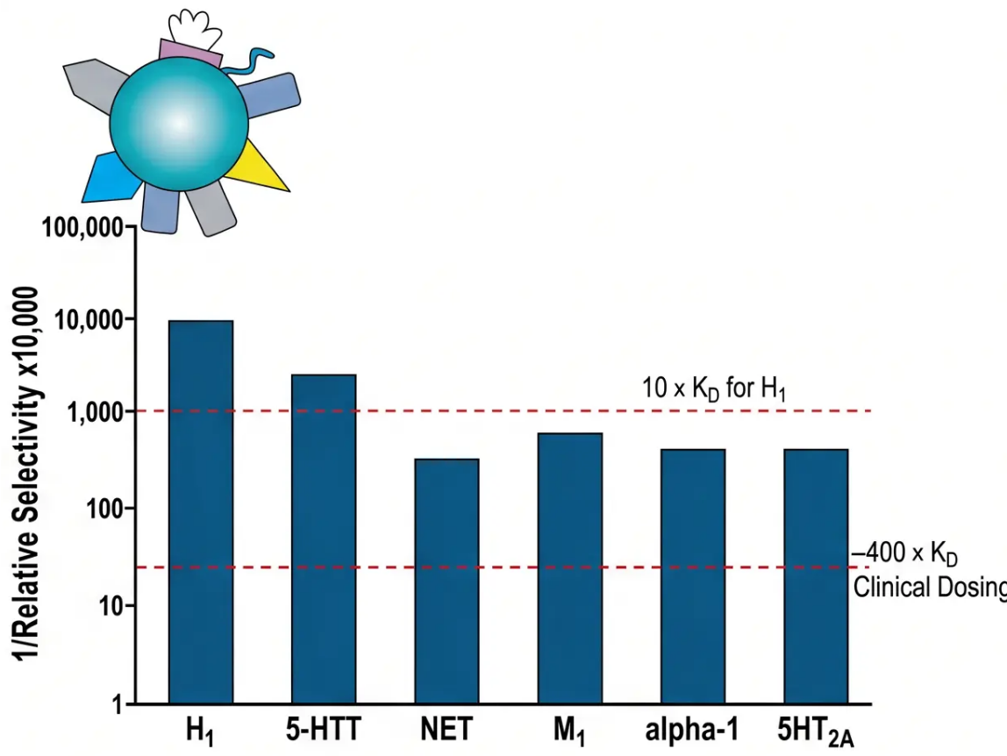
SECTION 2
Mechanism of Action
MECHANISM 1
Neurotransmitter Reuptake Inhibition
Blocks reuptake of serotonin (5-HT) and noradrenaline (NA)
Increases neurotransmitter concentration in the synaptic cleft
→ Enhances descending inhibitory pain pathways
(Primary analgesic mechanism at pain doses)
*Also the antidepressant mechanism — but requires higher doses (75–200mg)
MECHANISM 2
Receptor Blockade
Dry mouth, constipation, urinary retention,
blurred vision
Muscarinic (M
)
1
Alpha-1 adrenergic
Orthostatic hypotension, dizziness
H1 histamine
Sedation, weight gain
Sodium channels
QTc prolongation, arrhythmia risk
Relative receptor selectivity of amitriptyline
*Receptor blockade explains most of amitriptyline's side effect profile
*Lower bars = higher affinity. H1 has highest affinity at clinical doses.
www.bradfordvts.co.uk
Bradford VTS Teaching Deck — Amitriptyline in Primary Care

Slide 4
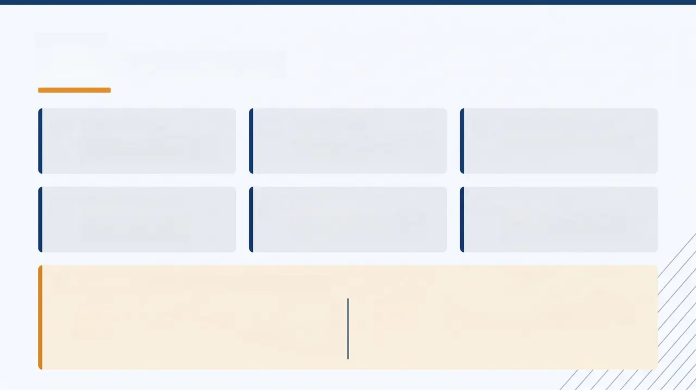







SECTION 4
Pharmacokinetics
BIOAVAILABILITY
Variable — significant
first-pass metabolism
LIPOPHILICITY
High — readily crosses
the blood-brain barrier
PEAK PLASMA LEVEL
4-8 hours post-dose
PLASMA HALF-LIFE
~15 hours (range
10-28 hours)
ACTIVE METABOLITE
Nortriptyline — major
active metabolite
ELIMINATION
Primarily hepatic; renal
contribution
Therapeutic Lag — Key Clinical Distinction
DEPRESSION
PAIN RELIEF
Therapeutic lag: days to weeks
Higher doses required (75-200mg)
Gradual receptor adaptation needed
Effect may be faster — different mechanism
Lower doses effective (10-75mg noce)
Not dependent on receptor downregulation

Slide 5





SECTION 4
Therapeutic Uses and BNF 2023 Doses
Neuropathic Pain
Depression
Off-label use · NICE CG173 First-Line
Licensed use · Higher doses required
10–75 mg nocte
75–200 mg/day
Start 10–25 mg, increase every 3–7 days
Initially 75 mg; increase gradually
Typical range 25–75 mg · Max 75 mg nocte for pain
Hospitalised: up to 300 mg/day · Much higher than pain doses
Nocturnal Enuresis
Licensed use · Paediatric
Migraine Prophylaxis
Off-label use
10–50 mg nocte
10–75 mg nocte
Age 7–10 yrs: 10–20 mg · Age 11–16 yrs: 25–50 mg
Start 10 mg; increase to 50–75 mg maintenance
Max 3 months without review · ECG if clinically indicated
Lower doses effective than for antidepressant use
⚠️ Dose reminder: Pain doses (10–75 mg) are significantly lower than antidepressant doses (75–200 mg) — do not confuse the
two ranges in clinical practice or exams.
Bradford VTS · Amitriptyline in Primary Care · BNF 2023

Slide 6




SECTION 5
Adverse Effects
Side effects arise from receptor blockade — understanding the mechanism predicts the effect
Anticholinergic
Cardiovascular
CNS & Other
Muscarinic blockade
Na⁺ channel + α₁ blockade
H₁ blockade + anticholinergic load
- Sedation (useful noce;
problematic daytime)
- Weight gain
- Cognitive impairment
- Delirium risk in elderly
- Sexual dysfunction
- Seizure threshold ↓
- Dry mouth (xerostomia — very
common)
- Constipation
- Urinary retention (caution: BPH)
- Blurred vision
- Tachycardia
⚠️ Narrow-angle glaucoma risk
- Orthostatic hypotension
- Dizziness + reflex tachycardia
- QTc prolongation
⚠️ Arrhythmias in overdose
- Falls risk in elderly
⚠️ Potentially fatal in overdose
Anticholinergic burden — especially
significant in elderly patients
www.bradfordvts.co.uk

Slide 7

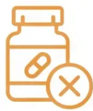


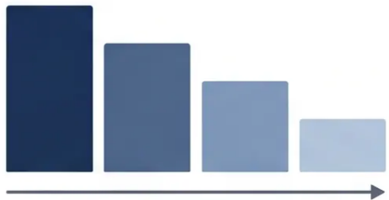
SECTION 7
Discontinuation Syndrome
Why It Happens
Symptoms to Expect
What To Do
- Abrupt stop or rapid dose
reduction
- TCAs have active metabolites —
half-life variation creates
rebound effects
- Higher risk with shorter half-life
agents
- Anxiety & insomnia
- Headache & nausea
- Malaise & general unwellness
- Motor disturbance
- Taper slowly over 2-4 weeks
minimum
- Reduce dose in small steps
- If not tolerated → switch to
nortriptyline (longer half-life,
smoother taper)
*Gradual dose reduction over weeks
www.bradfordvts.co.uk
7 / 16

Slide 8
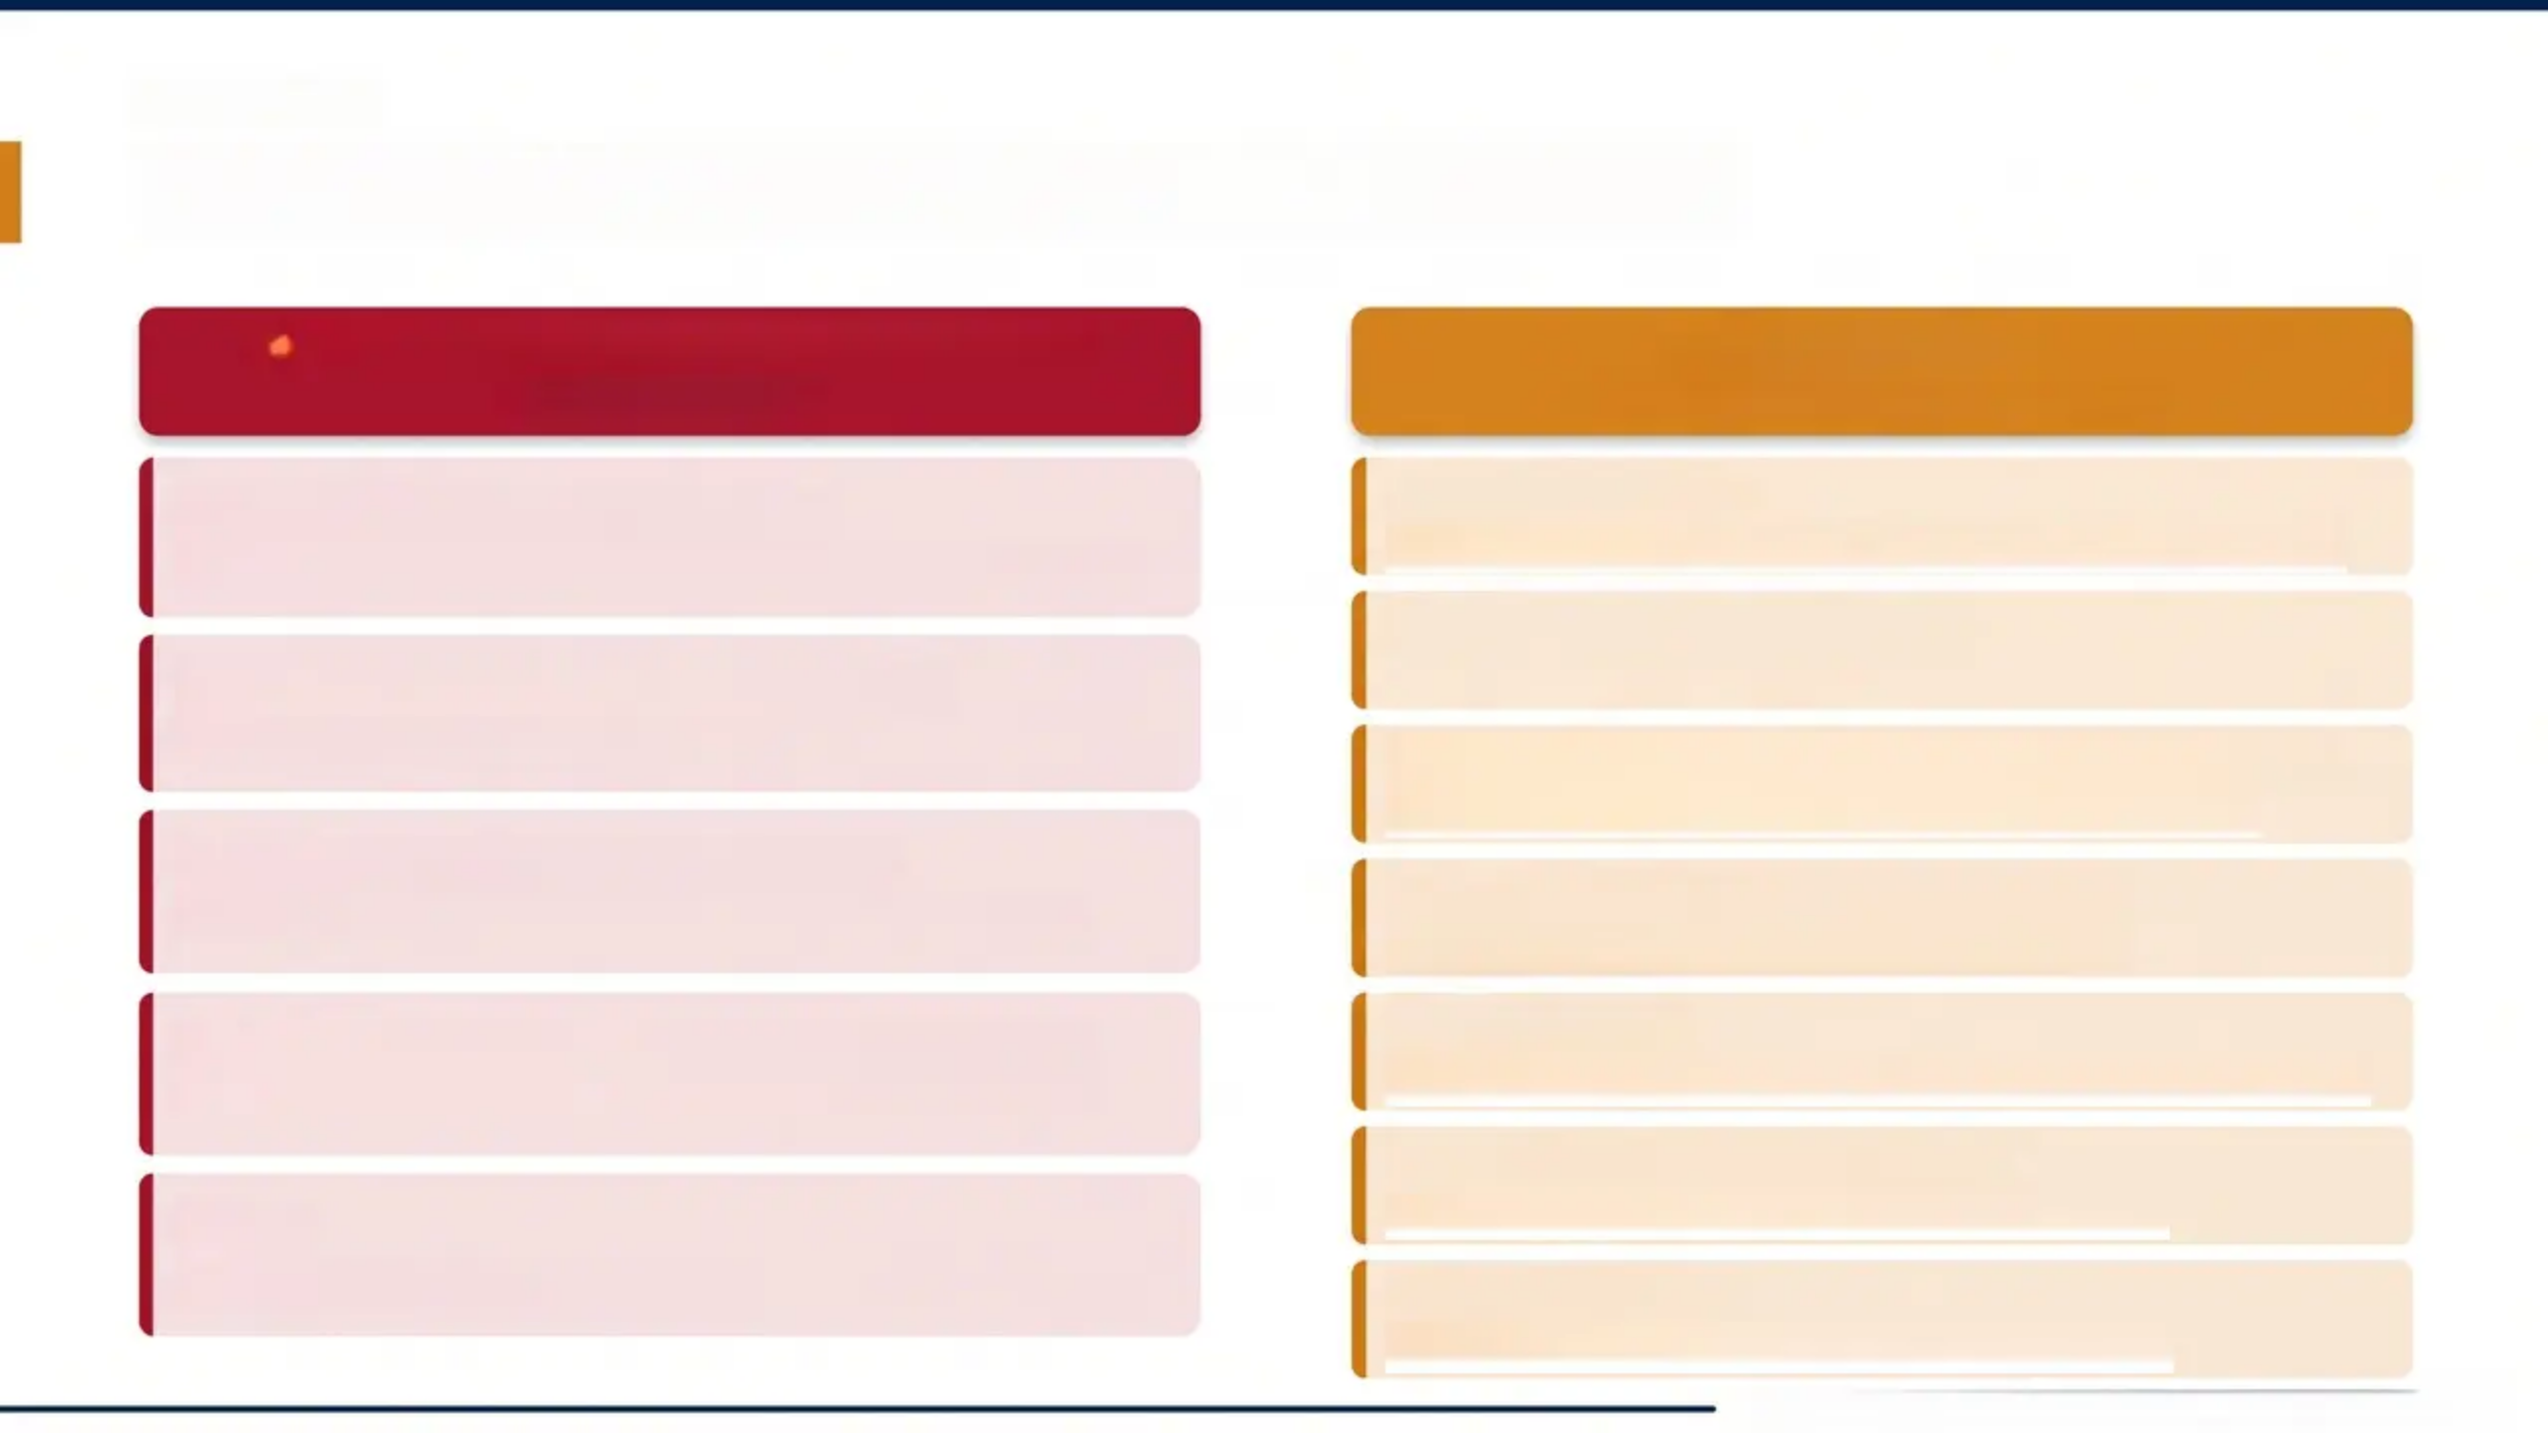

SECTION 7
Contraindications and Precautions
ABSOLUTE CONTRAINDICATIONS
PRECAUTIONS
*Do not prescribe*
*Use with caution — assess risk
Recent Myocardial Infarction
Elderly Patients
*Anticholinergic load, falls risk, cognitive impairment
*Sodium channel blockade increases arrhythmia risk
Epilepsy / Seizure History
Serious Arrhythmias / Heart Block
*Lowers seizure threshold
*QTc prolongation — potentially fatal
Prostatic Hypertrophy / Urinary Retention
*Anticholinergic — worsens outflow obstruction
Acute Angle-Closure Glaucoma
Bipolar Disorder / Schizophrenia
*Anticholinergic effect raises intraocular pressure
*May unmask psychosis or trigger mania
Liver Disease
MAOI Use (concurrent or within 14 days)
*Reduced hepatic metabolism — higher plasma levels
*Fatal — serotonin syndrome / hypertensive crisis
Pregnancy & Breastfeeding
Mania
*Limited safety data — specialist guidance
*May precipitate manic episode
Suicidal Ideation
*Monitor closely; limit quantities dispensed
*Bradford VTS Teaching Deck — Amitriptyline in Primary Care

Slide 9
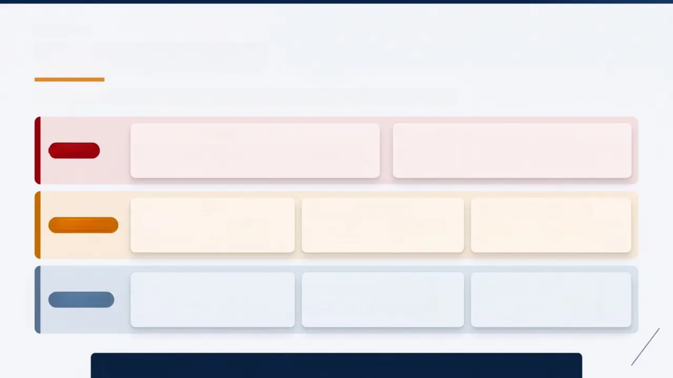
SECTION 9
Drug Interactions
Key interactions by risk level — always check current BNF before prescribing
A. MAO Inhibitors
B. MAOIs + Serotonergic Agents
FATAL
Hypertensive crisis, hyperpyrexia, convulsions, coma
Absolute contraindication — 14-day washout required
Mutual potentiation — fatal serotonin syndrome risk
Never co-prescribe
A. SSRIs / SNRIs
B. Antiarrhythmics
C. CYP2D6 Inhibitors
HIGH RISK
Serotonin syndrome risk
Agitation, tremor, hyperthermia
Amiodarone, quinidine
Additive QTc prolongation → arrhythmia
Fluoxetine, paroxetine
↑ Amitriptyline plasma levels → toxicity
A. CNS Depressants
B. Direct Adrenergics
C. Indirect Adrenergics
CAUTION
Alcohol, opioids, benzodiazepines
Enhanced sedation — toxic sedation risk
e.g. Adrenaline
Potentiated vasopressor effect
e.g. Ephedrine
Blocked — reduced effect
All TCAs lower seizure threshold • Grapefruit juice may inhibit hepatic metabolism • Always verify interactions via BNF

Slide 10
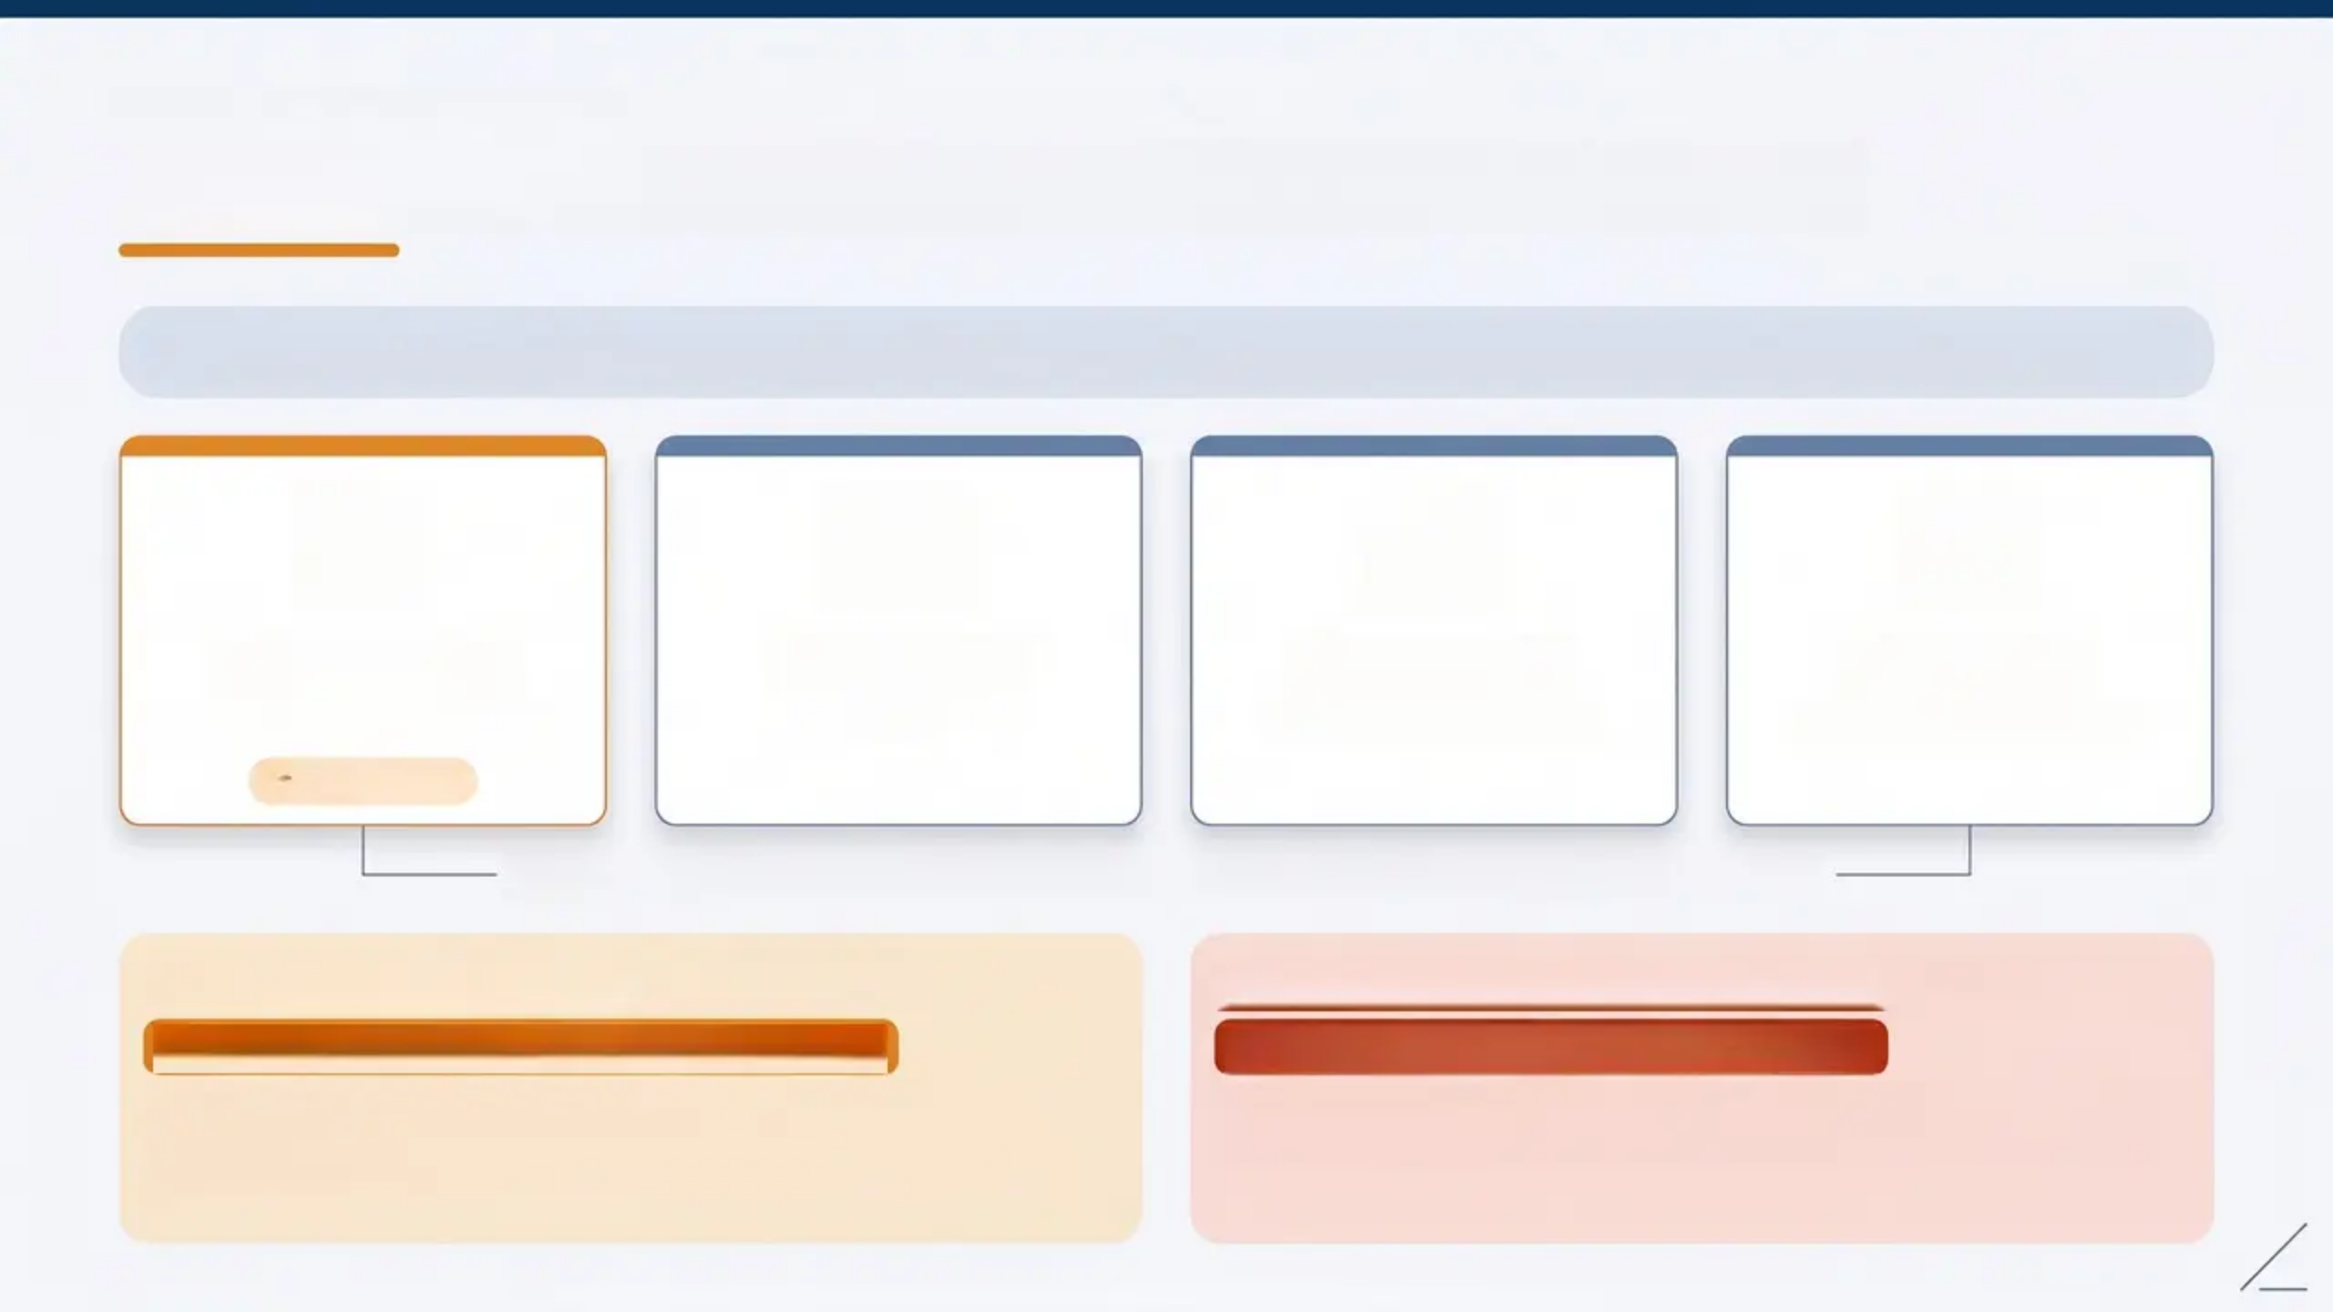

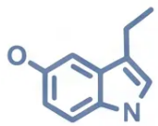


SECTION 9 — NICE GUIDANCE
NICE CG173 — First-Line for Neuropathic Pain
NICE CG173 (Updated September 2020) — Offer a choice of initial treatment for neuropathic pain (except trigeminal neuralgia):
Amitriptyline
Duloxetine
Gabapentin
Pregabalin
TCA — 10–75mg nocte
SNRI
Alpha-2-delta ligand
Alpha-2-delta ligand
⭐ Focus Drug
All four are co-equal first-line choices — shared decision-making guides selection
Left Box — Switch Option
Right Box — Trigeminal Neuralgia Exception
If Amitriptyline Side Effects Intolerable:
⚠️ Exception — Trigeminal Neuralgia:
Consider switching to nortriptyline or imipramine —
same TCA class, generally fewer side effects. Switch at
equivalent dose; no need to restart titration.
Amitriptyline is NOT first-line. Specialist pathway applies
— use carbamazepine or oxcarbazepine.
⚠️ Always verify doses against current BNF/NICE guidance. For educational use only. www.bradfordvts.co.uk

Slide 11
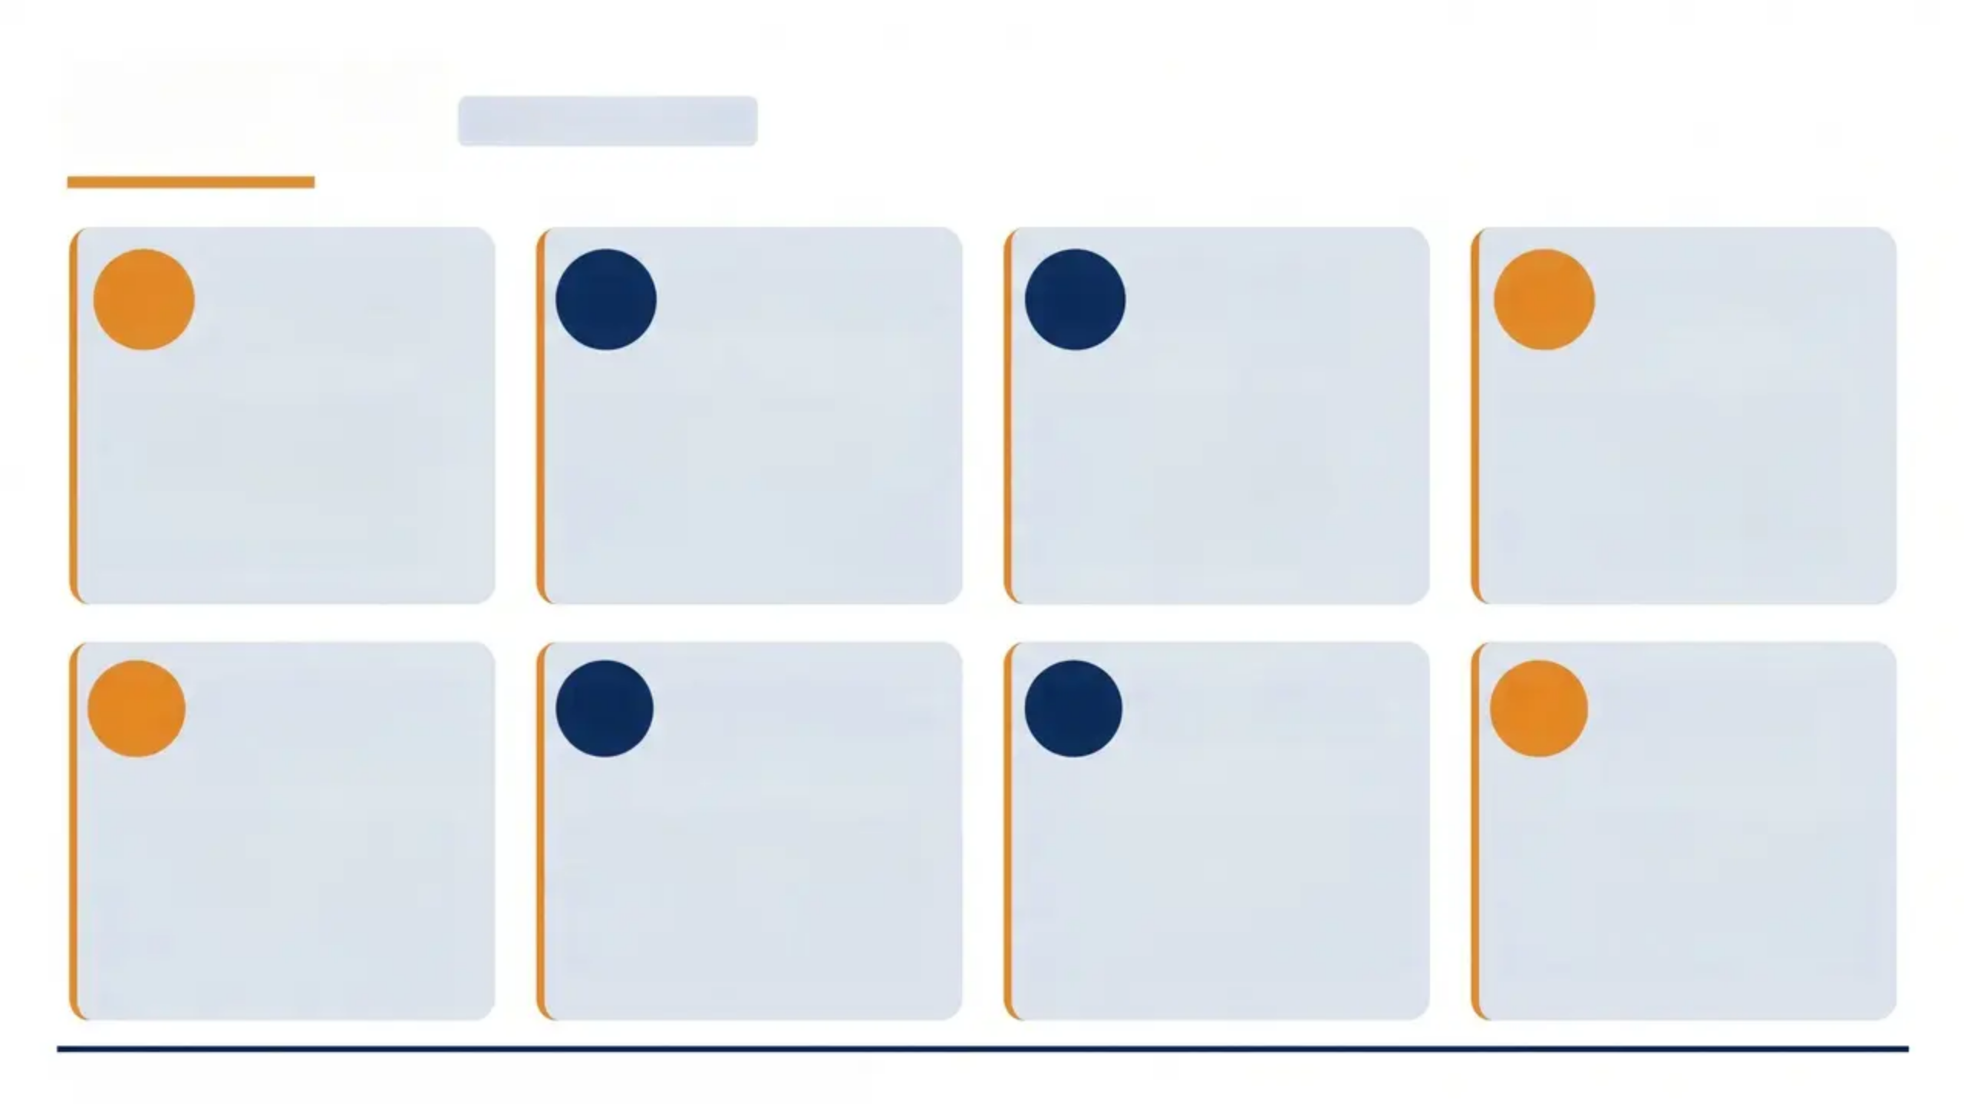
'Top Tips'
CLINICAL PRACTICE
Know Your
Doses
Start at Night
01
02
03
Caution in
Elderly
04
Give It Time
Pain: 10–75 mg nocte.
Antidepressant: 75–200
mg.
Never confuse the two.
Use sedation as an
advantage — nocte dosing
improves sleep and
reduces daytime
drowsiness.
High anticholinergic
burden — consider
nortriptyline instead.
Avoid in dementia.
Allow 4–6 weeks before
declaring treatment
failure in neuropathic
pain.
05
Four First-Line
Options
06
Switch, Don't
Restart
07
08
Taper Slowly
Falls Risk
Every Visit
NICE CG173 (2020):
nortriptyline, duloxetine,
gabapentin, and
pregabalin are co-equal
first-line choices.
Side effects? Switch to
nortriptyline at the same
dose — no need to start
from scratch.
Never stop abruptly —
reduce over 2–4 weeks
minimum to avoid
discontinuation syndrome.
Orthostatic hypotension +
sedation = high falls risk
in elderly. Review at every
consultation.
Bradford VTS Teaching Deck — Amitriptyline in Primary Care — www.bradfordvts.co.uk

Slide 12
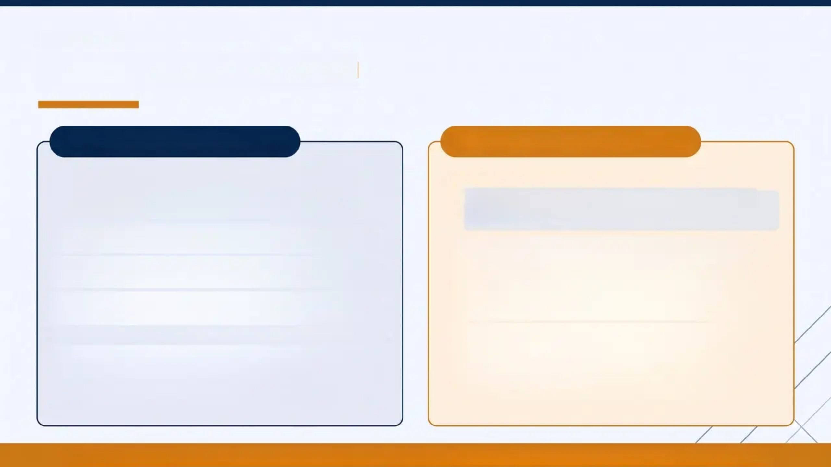


SECTION 11
Exam Pearls
AKT / SCA
AKT — Applied Knowledge
SCA — Clinical Consultation
NICE CG173 (2020): four first-line options for
neuropathic pain — amitriptyline, duloxetine,
gabapentin, pregabalin
BNF 2023 pain dose: start 10–25mg nocte, usual
range 25–75mg nocte
Amitriptyline is NOT licensed for pain — off-label
use
Overdose mechanism: sodium channel blockade
→ QRS widening → fatal arrhythmia
MAOIs + amitriptyline = absolute contraindication
Antidepressant dose 75–200mg vs analgesic dose
10–75mg — key distinction
Anticholinergic effects: dry mouth, urinary
retention, constipation, blurred vision
Explain off-label use clearly: “This medication
was originally for depression — we use it at
much lower doses for nerve pain”
Warn about nocturnal sedation when starting —
many patients stop on day one without warning
Discuss anticholinergic side effects (dry mouth,
constipation) proactively — and how to manage
them
Safety-net: if side effects troublesome, return to
discuss alternatives — nortriptyline, duloxetine,
gabapentin
Taper messaging: never stop abruptly — explain
discontinuation syndrome in lay terms
Pain dose ≠ antidepressant dose • Off-label • 4 first-line options (NICE CG173) • MAOIs = absolute contraindication

Slide 13


















SECTION 13
Red Flags
Critical safety concerns in amitriptyline prescribing — act immediately
Amitriptyline Overdose
Potentially fatal — sodium channel blockade causes QRS widening and life-threatening cardiac arrhythmias. Toxicology emergency.
Suicidal Ideation
Limit quantities dispensed. Close monitoring required — especially in the first weeks of treatment.
Concurrent MAOI Use
Absolute contraindication — fatal interaction causing hypertensive crisis, hyperpyrexia, and serotonin syndrome.
New or Worsening Mania
Stop amitriptyline immediately and refer — TCA may precipitate or unmask manic episode.
Acute Angle-Closure
Glaucoma
Absolute contraindication — anticholinergic effect raises intraocular pressure. Ophthalmology emergency.
www.bradfordvts.co.uk

Slide 14
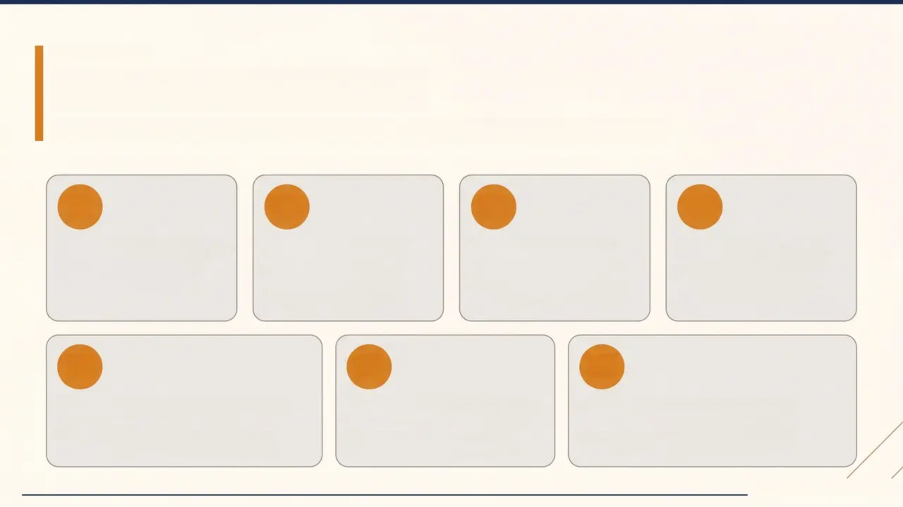
SECTION 14
Common Pitfalls
*Frequent clinical errors to recognise and avoid in amitriptyline prescribing
01
02
03
04
Elderly Prescribing
Dose Confusion
Not One of Four
Abrupt Stopping
Anticholinergic load +
falls risk overlooked
Pain dose 10–75mg ≠
antidepressant dose
75–200mg
NICE CG173: four equal
first-line options, not
amitriptyline alone
Always taper over 2–4
weeks — discontinuation
syndrome
05
06
07
Sedation Warning Missed
MAOI Check Skipped
Off-Label Not Explained
Many patients stop on day one —
always counsel upfront
Fatal interaction — always
screen before prescribing
Pain use is unlicensed — patients
must be informed
www.bradfordvts.co.uk

Slide 15


SECTION 14
Quick Recall
Classification
Mechanism
Pain Dosing (BNF 2023)
- TCA — tertiary amine
- Introduced 1961
- Alongside imipramine,
clomipramine, doxepin
- 5-HT + noradrenaline reuptake
inhibition
- Muscarinic, alpha-1, H1, Na+
channel blockade
- Receptor blockade = side effects
- Start: 10–25 mg nocte
- Usual range: 25–75 mg nocte
- Max: 75 mg nocte
- ⚠️ NOT licensed for pain —
off-label use
NICE CG173 (2020)
Safety — Avoid / Caution
Switch Strategy
- One of 4 equal first-line options
- Amitriptyline / duloxetine /
gabapentin / pregabalin
- Not the only first-line choice
- Not for trigeminal neuralgia
- Avoid: MAOIs, recent MI,
arrhythmias
- Caution: elderly (falls +
anticholinergic load)
- Overdose → Na+ channel blockade
→ fatal arrhythmia
- Taper slowly — 2–4 weeks minimum
- Side effects intolerable → switch
to nortriptyline
- Same dose — do not restart from
scratch
- Nortriptyline: fewer anticholinergic
effects
- Preferred in elderly
⚠️ Always double check doses with the latest NICE/BNF guidance. For educational purposes only.
www.bradfordvts.co.uk

Slide 16
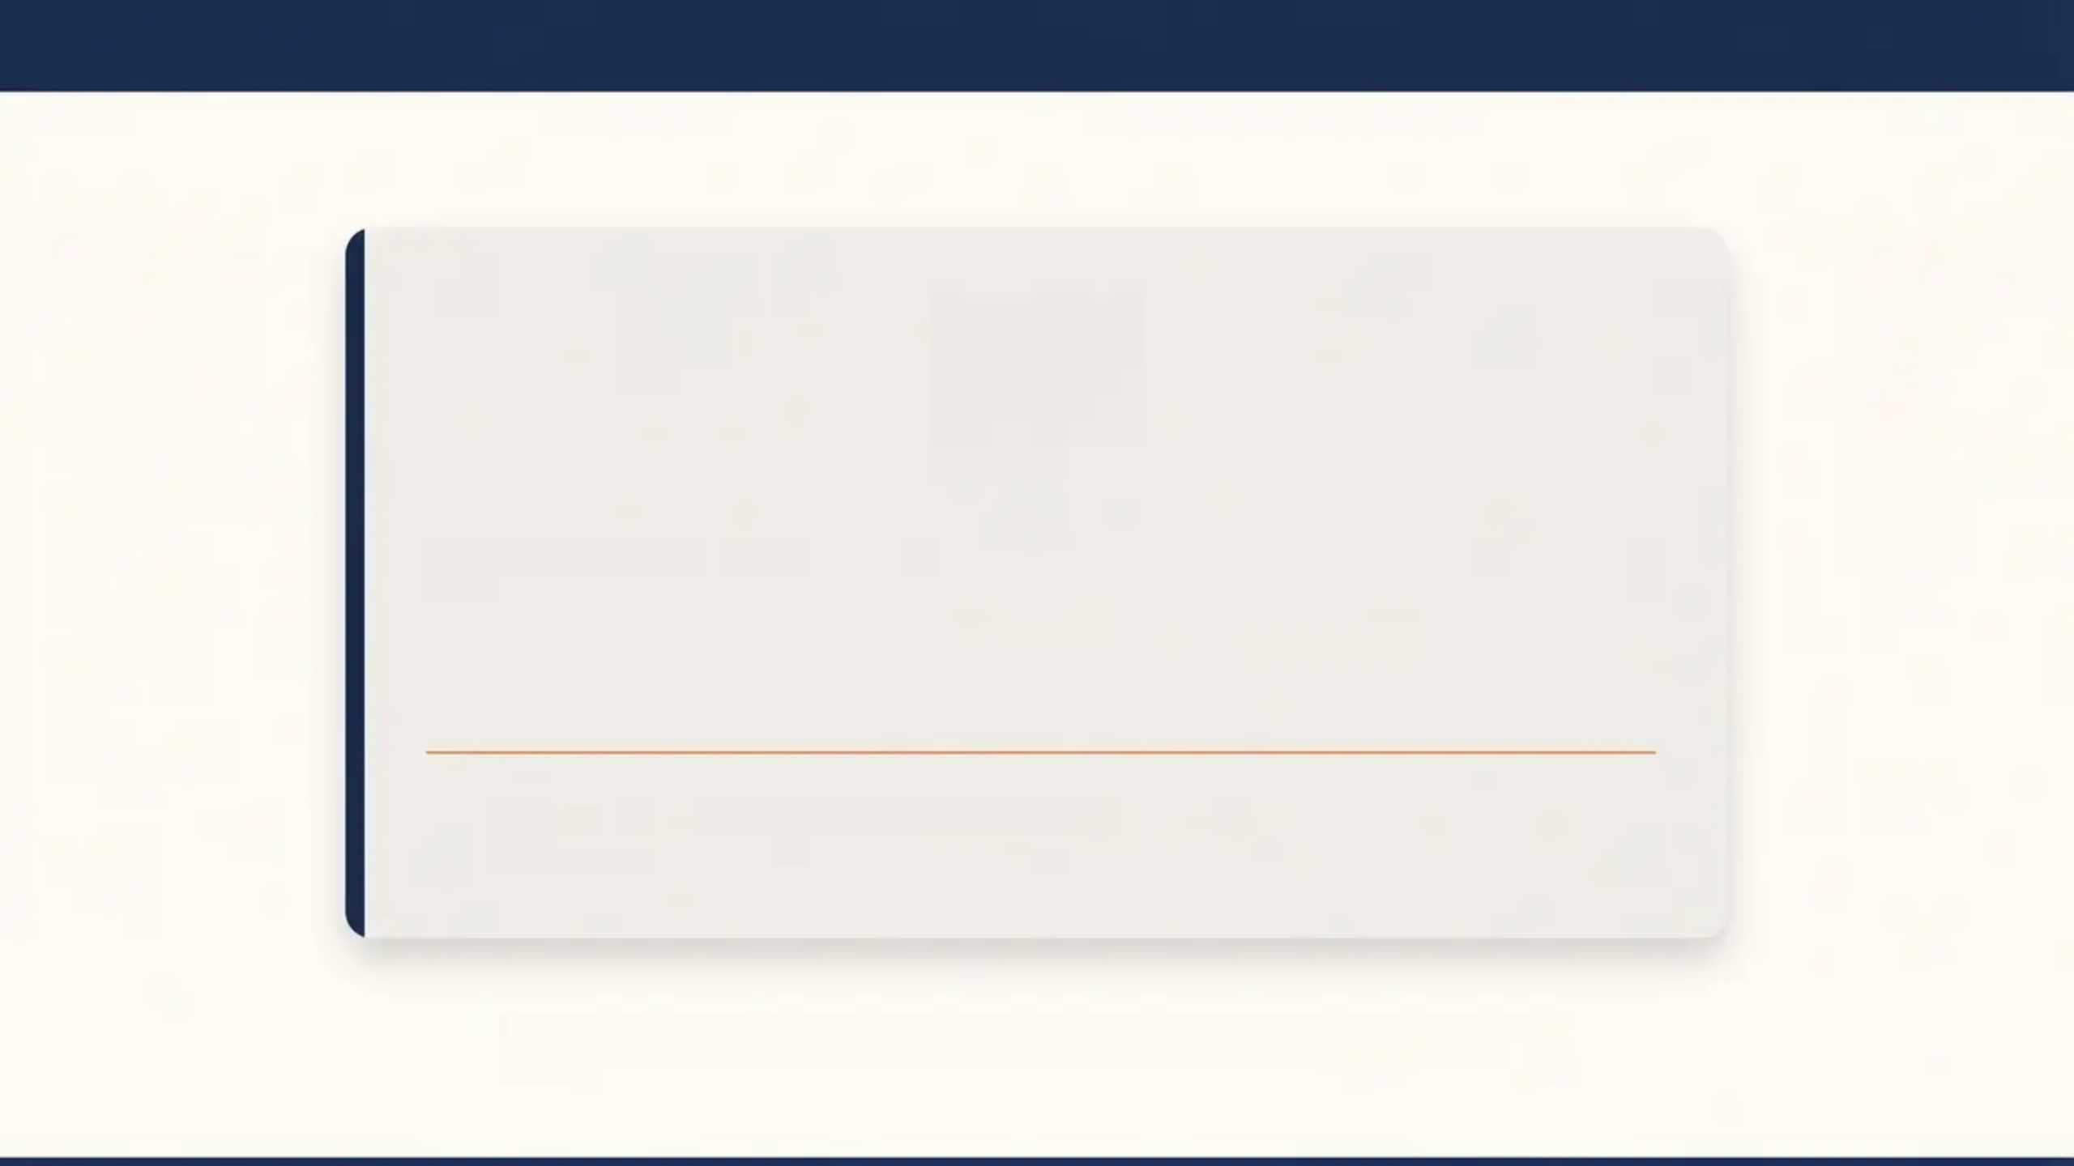

BRADFORD VTS TEACHING DECK
www.bradfordvts.co.uk
Always double check this advice and drug
doses with the latest NICE/BNF guidance
This document is for educational purposes only.
Bradford VTS Teaching Deck — Amitriptyline in Primary Care
Created May 2026 | Updated to NICE CG173 (2020) & BNF 2023 Standards

