Slide 1
BRADFORD VTS TEACHING DECK
Pain Management
Analgesic Ladder, Opioids & Neuropathic Pain
Analgesic Ladder & Drug Selection
Opioid Prescribing: Weak & Strong
Side Effects, Risks & Long-Term Use
Opioid Equivalences & Stopping
Neuropathic Pain Management
May 2026

Slide 2
DISCLAIMER
⚠ Educational Use Only
This presentation is provided exclusively for educational and training purposes as a teaching aid. It does not constitute formal clinical guidance.
Clinicians must independently verify all medical information, prescribing guidance, procedural protocols, and legal requirements against current national guidance, local policies, and relevant regulatory bodies before applying in practice.
Primary sources: NICE guidelines, BNF, RCGP, GMC, NHS England, MHRA, British Pain Society.

Slide 3
What Analgesics Are Available?
A structured overview of analgesic drug classes used in UK primary care
STEP 1 — NON-OPIOID
STEP 2 — WEAK OPIOIDS
Paracetamol
Codeine
NSAIDs (ibuprofen, naproxen, diclofenac)
Dihydrocodeine
Aspirin
Tramadol
Nefopam
Low-dose buprenorphine (patch)
TOPICAL AGENTS
STEP 3 — STRONG OPIOIDS
Capsaicin 0.075% cream
Morphine
Rubifacients
Oxycodone
Topical NSAIDs (diclofenac gel)
Fentanyl patch
Topical local anaesthetics
High-dose buprenorphine
ADJUVANTS / ADD-ONS
Amitriptyline / nortriptyline (TCA)
Muscle relaxants (diazepam, methocarbamol)
Gabapentin / pregabalin
TENS machine, physio, osteopathy, acupuncture
Duloxetine
Use analgesics as part of a multimodal pain management plan. Treat the underlying cause where possible.

Slide 4
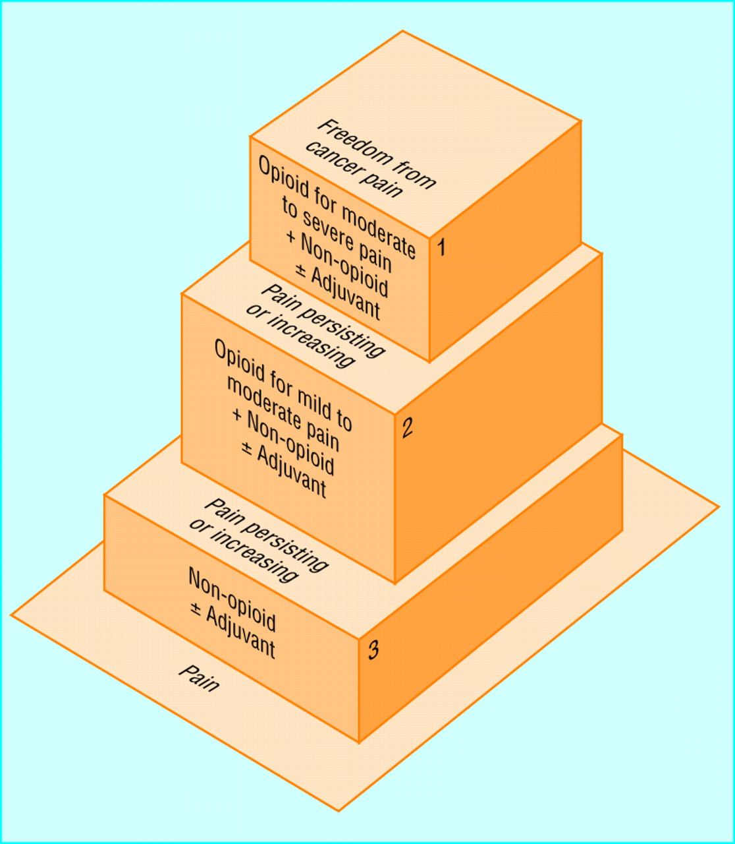
The WHO Analgesic Ladder
Three-step framework for structured analgesic prescribing — NICE endorsed
Step 1
Mild Pain
Non-opioid ± Adjuvant
Paracetamol (1g QDS), NSAID (with PPI if indicated), or nefopam
Step 2
Moderate Pain
Weak opioid + Non-opioid ± Adjuvant
Codeine, dihydrocodeine, tramadol, or low-dose buprenorphine patch
Step 3
Severe Pain
Strong opioid + Non-opioid ± Adjuvant
Morphine (preferred), oxycodone, or fentanyl patch
Move up the ladder when pain persists or increases. Adjuvants can be added at any step.
WHO analgesic ladder: who.int/cancer/palliative/painladder

Slide 5
Weak Opioids — Dosing & Equivalences
For use when non-opioid analgesia is insufficient (WHO Step 2)
Drug | Usual Dose | Max Daily Dose | Oral Morphine Equivalent | Notes
Codeine | 30–60 mg QDS | 240 mg/day | ~40 mg/day | Poor metabolisers get no benefit; significant constipation
Dihydrocodeine | 30–60 mg QDS | 240 mg/day | ~50 mg/day | Similar profile to codeine; less nausea in some patients
Tramadol | 50–100 mg QDS or SR formulation | 400 mg/day | ~40–80 mg/day | Dual mechanism (opioid + SNRI); unpredictable; serotonin syndrome risk; ↑ seizure risk
Buprenorphine patch (Butrans) | 5–20 mcg/hr patch 7-day patch | 70 mcg/hr patch | ~10–120 mg/day morphine | Partial agonist; ceiling effect; do NOT confuse with Transtec (72-hr patch)
⚠ Tramadol must NOT be combined with SSRIs/SNRIs/MAOIs — risk of serotonin syndrome. Tramadol lowers seizure threshold — use with caution in epilepsy.

Slide 6
Strong Opioids — Dosing & Equivalences
For use when weak opioids are insufficient (WHO Step 3)
Drug | Usual Starting Dose | Oral Morphine Equivalent | Key Notes
Morphine (preferred 1st-line strong opioid) | 5–10 mg IR 4-hourly or 30 mg MR BD | Reference standard | Use IR for titration; switch to MR once stable. Renally cleared — caution in renal impairment.
Oxycodone | 5 mg IR 4-hourly or 10 mg MR BD | Oxycodone 10 mg ≈ Morphine 20 mg | ~1.5–2× potency of oral morphine. Fewer opioid-induced respiratory side effects in some patients.
Fentanyl patch (Durogesic/generic) | 12 mcg/hr patch (72-hr patch) | 25 mcg/hr ≈ Morphine 60–100 mg/day 100 mcg/hr ≈ Morphine 360 mg/day | Only use in STABLE, opioid-tolerant patients. Not suitable for opioid-naïve patients or acute pain.
Buprenorphine patch (Transtec — 96-hr) | 35 mcg/hr patch | 35 mcg/hr ≈ Morphine ~84 mg/day | Do NOT confuse Transtec (96-hr, higher dose) with Butrans (7-day, lower dose weak opioid).
⚠ Fentanyl patches are contraindicated in opioid-naïve patients and acute pain.
Also, strong opioids must NOT be started without clear documented clinical indication, informed consent, and a monitoring plan.

Slide 7
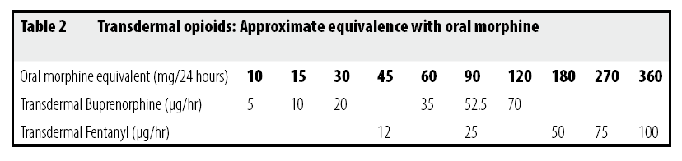
Transdermal Opioid Equivalences
Critical prescribing reference — do NOT confuse Butrans with Transtec
Butrans (Buprenorphine)
Transtec (Buprenorphine)
Fentanyl Patch (Durogesic)
7-day patch
96-hour (4-day) patch
72-hour (3-day) patch
Strengths: 5 mcg/hr, 10 mcg/hr, 15 mcg/hr, 20 mcg/hr
Strengths: 35 mcg/hr, 52.5 mcg/hr, 70 mcg/hr
Strengths: 12 mcg/hr, 25 mcg/hr, 50 mcg/hr, 75 mcg/hr, 100 mcg/hr
5 mcg/hr ≈ 10 mg/day oral morphine
35 mcg/hr ≈ 84 mg/day oral morphine
25 mcg/hr ≈ 60–100 mg/day oral morphine
Weak opioid — WHO Step 2
Strong opioid — WHO Step 3
Strong opioid — opioid-tolerant patients only
⚠ NEVER interchange Butrans and Transtec patches without full opioid dose conversion — the strengths are NOT equivalent. Verify all conversions using a validated opioid conversion tool or specialist advice.

Slide 8
Side Effects of Opioids
Counsel ALL patients before initiating opioid therapy
Common Side Effects
Serious / Serious Risks
Constipation — does NOT resolve with tolerance; prescribe laxatives (e.g. macrogol) routinely
Respiratory depression — risk ↑ with: dose escalation, co-prescribing sedatives, OSA, elderly
Nausea and vomiting — tolerance usually develops within a few days; treat with cyclizine if needed
Falls risk — especially in elderly; review all CNS depressants
Somnolence and dizziness — tolerance usually develops; warn re driving
Dependence and misuse — screen before initiating
Itching — treat with antihistamine; tolerance may occur
Tolerance to most side effects within 1–2 weeks, except constipation and itch
Accidental overdose — commonest serious event; co-prescribe naloxone in high-risk patients
Managing Side Effects
Nausea:
Cyclizine 50mg TDS or prochlorperazine — usually needed only for first 1–2 weeks
Itch:
Chlorphenamine or loratadine
Constipation:
Macrogol (Movicol) first-line; lactulose alternative — prescribe ROUTINELY
Resp depression:
Naloxone 400 mcg IV/IM — have emergency plan for high-risk patients

Slide 9
Long-Term Adverse Effects of Opioids
Educate patients before starting chronic opioid therapy — and monitor regularly
Endocrine Dysfunction
Opioid-Induced Hyperalgesia
Suppression of hypothalamic-pituitary-adrenal and gonadal axes
Paradoxical increase in pain sensitivity with prolonged use
Men: erectile dysfunction, reduced libido, infertility, gynaecomastia
Suspect if pain worsens despite dose increases
Women: amenorrhoea, infertility, reduced libido
Management: reduce opioid dose; consider opioid rotation
Both: depression, fatigue, osteoporosis
Distinguishing from tolerance can be clinically challenging
Immunological Effects
Pregnancy & Neonatal Effects
Suppression of antimicrobial immune response (evidence mainly animal studies)
Opioids cross the placenta
Possible impaired tumour surveillance
Risk of neonatal abstinence syndrome (NAS)
Clinical significance in humans still under research
Respiratory depression in neonate
Do NOT use strong opioids in pregnancy without specialist input
Educate all patients about long-term effects BEFORE initiating opioids. Document this discussion in the clinical record.

Slide 10
Stopping Strong Opioids Safely
Opioid withdrawal — planned dose reduction in primary care
Key Principles
Withdrawal Symptoms
Susceptibility to withdrawal varies significantly between individuals
• Yawning, lacrimation, rhinorrhoea
• Sweating, piloerection, chills
Symptoms typically peak within 24–72 hours and may last up to 2 weeks
• Abdominal cramps, nausea, diarrhoea
• Anxiety, restlessness, insomnia
Reduce dose incrementally: 10–25% decrements
• Muscle aching and cramps
• Tachycardia, hypertension
Pace reductions according to patient tolerance and the half-life of the preparation
Important Prescribing Notes
Review at each dose reduction — adjust pace if symptomatic
⚠ Even short courses of tramadol can cause withdrawal
⚠ Modified-release formulations take longer to reduce due to prolonged half-life
Consider psychology support or specialist pain service for complex cases
⚠ Do not abruptly stop opioids — always taper

Slide 11
Opioid Prescribing — Key Recommendations
British Pain Society consensus, NICE NG193 — UK primary care guidance
1
Duration of Benefit
2
Goal Setting
Opioids provide useful analgesia in the short and medium term. Current evidence does NOT support long-term benefit for chronic non-cancer pain. Set a clear time-limited trial with a defined review date.
Complete pain relief is rarely achievable. The clinical goal is sufficient reduction in pain to enable rehabilitation and restoration of function. Opioids must form part of a wider, integrated management plan.
3
Neuropathic Pain
4
Patient Selection
Opioids can be useful in neuropathic pain when first-line agents (amitriptyline, duloxetine, pregabalin, gabapentin) have failed or are not tolerated. They are not first-line treatment for neuropathic pain.
Carefully assess risk of dependence, misuse, and addiction before initiating. Consider using a validated tool (e.g. ORT). Document your decision and the discussion with the patient.
Ref: NICE NG193 (Chronic primary pain), British Pain Society 'Opioids for Persistent Pain: Good Practice' consensus statement

Slide 12
Opioid Prescribing — Safety Rules
Mandatory considerations before and during opioid prescribing
Pre-treatment Counselling
Contraindications
80% of opioid users experience at least one adverse effect. You MUST counsel patients before starting treatment — document the discussion. Discuss: side effects, driving restrictions, dependence risk, and monitoring plan.
Do NOT prescribe opioids in pregnancy without specialist input. Do NOT use strong opioids in children without specialist advice. Use with caution in the elderly — risk of falls, respiratory depression, and cognitive impairment is significantly increased.
Respiratory Depression Risk
Withdrawal Warning
Risk is highest in: elderly patients, those with OSA or other respiratory disorders, polypharmacy with CNS depressants (benzodiazepines, Z-drugs, gabapentinoids). Accidental overdose is the most common serious event — consider co-prescribing naloxone.
Even short courses of tramadol can cause withdrawal on stopping — including yawning, sweating, and abdominal cramps. Always taper. Never stop opioids abruptly without a planned reduction schedule.

Slide 13
Opioid Prescribing — Long-Term Monitoring
Ongoing responsibilities when prescribing opioids chronically
Educate Re: Long-Term Effects
Do NOT Use as First Line
Inform patients about endocrine effects (reduced libido, infertility, erectile dysfunction, osteoporosis) and immunological effects before long-term use. Document in the record.
Opioids are NOT first-line treatment for chronic non-cancer pain. Exhaust non-pharmacological options and appropriate non-opioid analgesia first. Document the rationale for opioid initiation.
Review Before Long-Term Prescribing
Use Modified-Release Formulations
Before committing to long-term opioid therapy, clearly document the indication, agreed goals, a monitoring plan, and a review timeline. Shared decision-making is mandatory.
For long-term regular opioid use, prescribe modified-release (MR) preparations to provide consistent analgesia and reduce euphoric peaks that drive misuse risk.
Monitor for Opioid-Induced Hyperalgesia
Long-Term Monitoring Schedule
Warn patients about opioid-induced hyperalgesia. If pain worsens despite dose escalation, suspect OIH — reduce dose rather than increase, and consider opioid rotation.
Review at regular intervals: pain level and functional improvement, side effects, signs of misuse or diversion, driving ability, need for continuation. Annual medication review minimum.

Slide 14
Opioids: Driving & Addiction
Legal responsibilities and addiction awareness
🚗 Driving & Opioids
⚠ Addiction & Dependence
Patients MUST NOT drive at the start of opioid therapy or following any major dose change
Addiction Definition:
Characterised by impaired control over use, craving, and continued use despite harm — distinct from physical dependence or tolerance
It is the patient's legal responsibility to notify DVLA that they are taking opioid medication
Prevalence:
Driving under the influence of opioids is a criminal offence — even when prescribed
Problematic opioid use affects a significant proportion of chronic pain patients — screen ALL patients before initiating
Risk Factors:
Patients may resume driving once they are stable, the drug is having no adverse effects on their driving, and driving is not otherwise inadvisable
Personal or family history of addiction, mental health comorbidity, history of trauma or abuse, younger age
Detection:
DVLA notified — a medical standard licence may be issued for stable, compliant patients
Regular review for aberrant drug-related behaviour, unsanctioned dose escalation, multiple lost prescriptions, early requests
You MUST document the driving advice given at every relevant consultation
Management:
Involve addiction services early. Do not abruptly stop. Seek specialist advice for suspected opioid use disorder.
Document DVLA advice given and any addiction screening performed at every opioid review consultation.

Slide 15
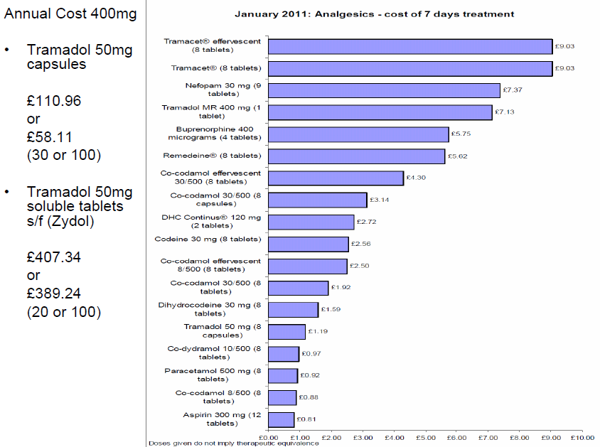
Cost of Analgesics in UK Primary Care
Prescribing costs — choose cost-effective options where clinically appropriate
Note: Chart shows relative cost comparisons — verify current costs against the BNF or Drug Tariff before prescribing.
Cost data for illustrative comparison only. Always verify prescribing costs against current BNF Drug Tariff prices.

Slide 16
Opioid Prescribing — Quick Reference Summary
Key rules and clinical safety checklist for UK primary care
Before Starting
When Prescribing
Ongoing Monitoring
✓
Exhaust non-opioid analgesia first
✓
Start low, titrate slowly
✓
Review at regular intervals (minimum annually)
✓
Document clear indication and agreed goals
✓
Use IR for titration, switch to MR for maintenance
✓
Assess: pain, function, side effects, misuse risk, driving
✓
Screen for addiction risk
✓
Co-prescribe laxative routinely
✓
Opioid passports / monitoring tools where available
✓
Counsel re: side effects, driving, dependence
✓
Check drug interactions (esp. CNS depressants, SSRIs with tramadol)
✓
Taper and stop if no functional benefit
✓
Check for contraindications (pregnancy, respiratory impairment)
✓
Avoid combining two opioids
✓
Document every review clearly
Ref: NICE NG193, NICE NG173, BPS Opioids for Persistent Pain, RCGP Guidance on Opioid Prescribing

