Slide 1

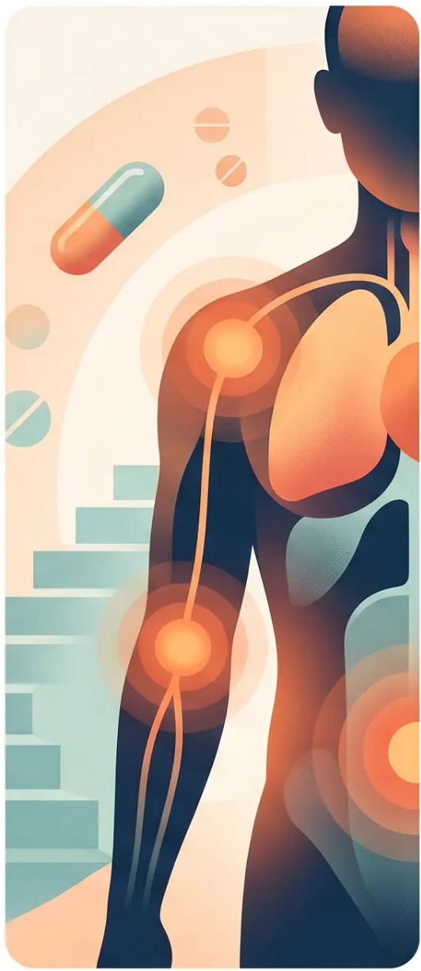
BRADFORD VTS
TEACHING DECK
Analgesics & Opioids
in Primary Care
Bradford VTS Teaching Deck — May 2026
Updated to NICE NG193 (2021) & BNF 2023 standards
www.bradfordvts.co.uk
⚠️ Always double check this advice and drug doses with the latest NICE/BNF
guidance. This document is for educational purposes only.
Bradford VTS | May 2026

Slide 2

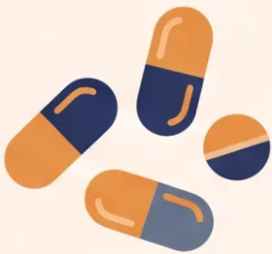
Analgesic Classes & Adjuvants
An overview for primary care — NICE NG193 (2021) & BNF 2023
Non-Opioid Analgesics
Adjuvants —
Neuropathic Pain
Topical Agents
Other Approaches
• Paracetamol — Step 1;
safe first choice
• Amitriptyline (TCA) —
10–25mg nocte; titrate to
25–75mg nocte
• Capsaicin 0.075% cream —
post-herpetic neuralgia;
apply 3-4× daily
• TENS — transcutaneous
electrical nerve stimulation
• Aspirin — anti-
inflammatory; GI risks
• Methocarbamol — muscle
relaxant; short-term only
• Duloxetine (SNRI) — 30mg
od × 1 wk → 60mg od; max
120mg/day
• Lidocaine 5% plasters
(Versatis) — PHN; 1 plaster
12h/day; max 3 for large
areas
• NSAIDs (ibuprofen,
naproxen) — effective for
inflammatory pain; PPI if
long-term
• Diazepam — short-term
muscle spasm only;
dependence risk
• Gabapentin — 300mg
nocte → bd → tds; max
3600mg/day
• Topical NSAIDs
(diclofenac gel) — localised
musculoskeletal pain
• Nefopam — centrally
acting; useful when
NSAIDs/opioids
contraindicated
• Non-pharmacological
approaches —
recommended by NICE
NG193 for chronic primary
• Pregabalin — 75mg bd →
150mg bd; max 600mg/day
• Rube facients — limited
evidence; symptomatic use
NICE NG193: supervised exercise &
psychological therapy recommended
for chronic primary pain
NICE NG193: Paracetamol not
recommended for chronic primary pain
Gabapentin & Pregabalin: Class C
Controlled Drugs since April 2019
Bradford VTS | Analgesics & Opioids in Primary Care
www.bradfordvts.co.uk

Slide 3

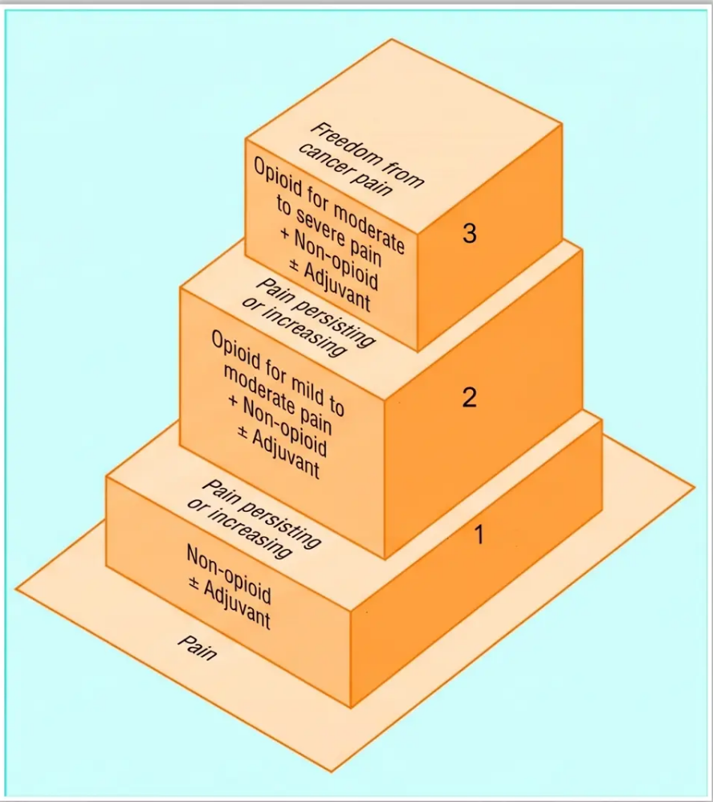
WHO Analgesic Ladder
& NICE Guidance
Originally designed for cancer pain — critical caveats apply in 2026
1
Non-opioid analgesia
Paracetamol ± NSAID ± adjuvants
2
Add a weak opioid
Codeine, dihydrocodeine, or tramadol ± non-opioid ± adjuvants
3
Substitute strong opioid
Morphine, oxycodone, or fentanyl ± non-opioid ± adjuvants
Escalate when pain persists or increases at each step
!
NICE NG193 (2021) — Key Restriction
✔ Ladder remains appropriate for:
Opioids should NOT be offered for chronic primary pain
at any step of the ladder.
Cancer pain · Palliative care · Acute pain management
WHO Ladder originally designed for cancer pain – not validated for chronic non-cancer pain.
The ladder does not incorporate non-pharmacological approaches or neuropathic adjuvants.
Bradford VTS | Analgesics & Opioids | Slide 3

Slide 4
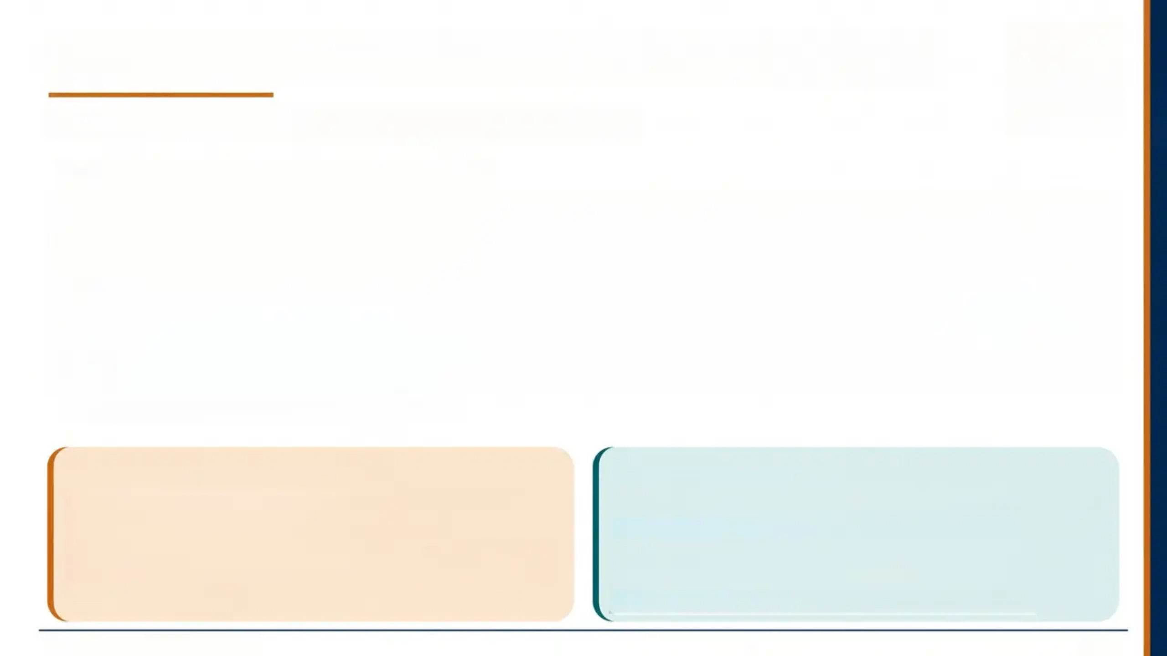




Weak Opioids and Morphine Equivalence
BNF 2023 / Faculty of Pain Medicine — reviewed March 2023
DOSE REFERENCE & ORAL MORPHINE EQUIVALENCE
Drug
Typical Dose
Max / 24h
Morphine Equivalence
Codeine phosphate
30–60 mg every 4–6h
240 mg
100 mg codeine = 10 mg morphine (ratio 0.1)
Dihydrocodeine
30–60 mg every 4–6h
240 mg
100 mg DHC = 10 mg morphine (ratio 0.1)
Tramadol
50–100 mg every 4–6h (or SR)
400 mg
100 mg tramadol = 10 mg morphine (ratio 0.1)
Codeine 30 mg single dose
—
—
= 3 mg morphine equivalent
Codeine 240 mg/day = 24 mg oral morphine equivalent
⚠️ CYP2D6 — CODEINE METABOLISM
⚠️ TRAMADOL — SEROTONIN SYNDROME RISK
Codeine is a prodrug converted to morphine by CYP2D6.
• Poor metabolisers (10%): no analgesic benefit
• Ultra-rapid metabolisers: dangerously high morphine levels
MHRA warning: avoid in children and breastfeeding
Tramadol has dual opioid AND serotonergic (SNRI-like) action.
• Risk of serotonin syndrome with SSRIs, SNRIs, MAOIs
• Also: Class C controlled drug — prescribe with appropriate
vigilance
Comparable morphine-equivalent potency to codeine
Bradford VTS | Analgesics & Opioids
4 / 10

Slide 5








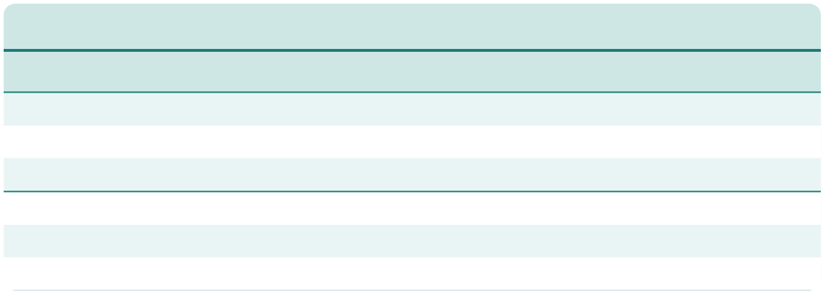



Strong Opioids & Transdermal Conversions
BNF 2023 & Faculty of Pain Medicine — verified equi-analgesic values
Oral Strong Opioids
Transdermal Patches — BNF 2023
Drug
Typical Dose
Oral Morphine Equivalence
Fentanyl (change every 72 hours)
Patch Strength (mcg/hr)
Oral Morphine Equivalent (mg/24h)
Morphine (oral IR)
5–10 mg every 4h
Reference: 1:1
12 mcg/hr
30 mg/24h
Oxycodone (oral)
5–10 mg every 4–6h
10 mg oxycodone =
15 mg morphine (1.5x)
25 mcg/hr
60 mg/24h *
50 mcg/hr
120 mg/24h
75 mcg/hr
180 mg/24h
100 mcg/hr
240 mg/24h
Hydromorphone
(oral)
1.3–2.6 mg every 4h
2 mg hydromorphone
= 10 mg morphine (5x)
* BNF 2023: 25 mcg/hr = 60 mg/24h — NOT 60–100 mg as in older references
Buprenorphine — Weekly & Twice-Weekly
Patch Strength (mcg/hr)
Oral Morphine Equivalent (mg/24h)
Morphine (SC)
Oral dose ÷ 2
SC 5 mg = oral 10 mg
(Weekly patches) 5 mcg/hr
12 mg/24h
Diamorphine (SC)
Oral morphine ÷ 3
SC 3.3 mg =
oral 10 mg
10 mcg/hr
24 mg/24h
20 mcg/hr
48 mg/24h
35 mcg/hr
84 mg/24h
52.5 mcg/hr
126 mg/24h
70 mcg/hr
168 mg/24h
Oxycodone is 1.5× more potent than oral morphine —
a common AKT exam point
⚠️ Do NOT confuse fentanyl and buprenorphine patch strengths — they are entirely different scales
Conversion ratios are approximate — always reduce calculated equi-analgesic dose by 25–50% when switching opioids (incomplete cross-tolerance) | BNF 2023

Slide 6
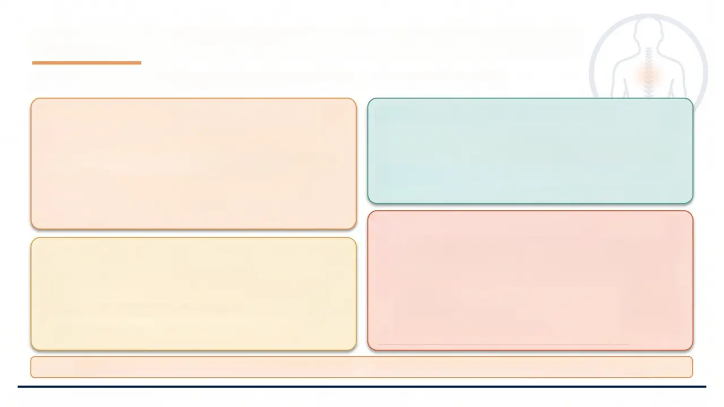




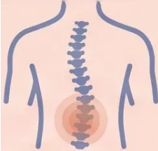
Adverse Effects & Opioid-Induced Hyperalgesia
Know the side effects — and when worsening pain means LESS opioid, not more
Common Side Effects
Long-Term Endocrine & Other Effects
• Constipation — never resolves; prescribe stimulant + osmotic
laxative from Day 1 (e.g. senna + macrogol)
• Nausea & vomiting — usually settles within days; antiemetic for
first week (cyclizine, metoclopramide, or haloperidol)
• Sedation / drowsiness — settles once dose is stable; DVLA
notification required
• Itching — antihistamine if troublesome
• Affects approximately 80% of patients (at least one side effect)
• GnRH suppression → reduced FSH / LH
• Consequences: amenorrhea, reduced libido, erectile dysfunction,
infertility, low mood / depression
• Respiratory depression — risk elevated in: elderly, OSA, COPD,
concurrent CNS depressants
• Immunological effects — emerging evidence (mainly animal studies)
Opioid-Induced Hyperalgesia (OIH)
DVLA & Driving
• What it is: Paradoxical increase in pain sensitivity caused by opioid
exposure — opposite of the expected effect
• How to recognise: Pain worsens despite dose escalation; spreads
beyond original area; allodynia may develop
• Management:
- ↓ Reduce opioid dose
- Consider opioid rotation
- Introduce non-opioid strategies
• ⚠️ Do NOT escalate the dose — this makes OIH worse
• All patients starting opioids must notify DVLA
• Advise to avoid driving at start of therapy and after any major
dose change
• Sedation risk is highest in the titration phase
• Clinician responsibility: document DVLA advice given in notes
“Document DVLA advice in every consultation”
⚠️ Laxative Rule: Prescribe stimulant + osmotic laxative from Day 1 of any opioid — constipation NEVER develops tolerance
Bradford VTS | Analgesics & Opioids
www.bradfordvts.co.uk
Slide 6 of 10

Slide 7




Opioid Prescribing & Titration Principles
Initiation · Titration · Safe Tapering — NICE NG193 / BNF 2023
① Before Starting
② Titration
③ Safe Stopping
• Full pain assessment — type,
duration, prior treatments
• Start: oral morphine 5–10mg every
4h (immediate release)
• Taper slowly: reduce by 10–25%
every 2–4 weeks
• Clarify indication: cancer /
neuropathic / chronic primary pain?
• Breakthrough dose: one-sixth of
total 24h dose, as required
• Never stop abruptly — always wean
• Once stable → convert to 12-hourly
modified-release preparation
• Withdrawal symptoms: yawning,
sweating, abdominal cramps,
restlessness, nausea
• 🚨 Chronic primary pain: do NOT
start opioids (NICE NG193)
• Dose increases: no more than
25–50% of previous dose
• Agree goals and wider management
plan
• Symptoms can occur even after
short tramadol courses
• Discuss risks, benefits, and adverse
effects
• Prescribe stimulant + osmotic
laxative from Day 1
• Symptoms last up to 72h after each
dose reduction
• Consider antiemetic for first week
• Opioid risk assessment: prior
addiction, mental health, social
factors
• Support patient through the process
— psychological as well as physical
• Review at 1–2 weeks initially, then
monthly
⚠️ One prescriber ideally — avoid multiple sources. Consider a prescribing agreement for long-term opioid prescriptions.
Bradford VTS | Analgesics & Opioids | Slide 7 of 10

Slide 8
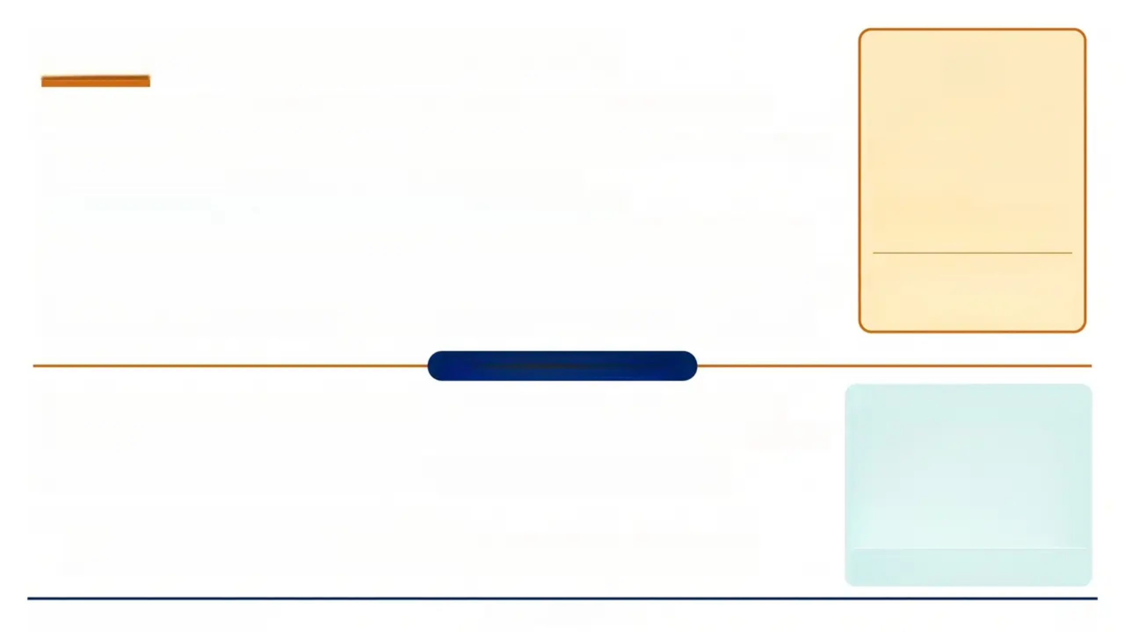













Fentanyl Patches & Cancer Pain
Practical application, titration, heat warnings, and first-line cancer pain prescribing
Heat Warning
◆ Application: Apply to dry, non-inflamed, hairless skin — upper arm or trunk. Clip hair, do not shave. Tape edges if needed.
◆ Timing: Change every 72 hours. Rotate sites — rest each area for 3–6 days.
◆ Onset: Systemic effect ~12h after first application. Steady-state only after 36–48h.
◆ Converting from morphine: From 4-hourly IR morphine: continue regular morphine for 12h after first patch.
From 12-hourly SR morphine: apply patch when giving last SR dose.
Fentanyl absorption ↑ with
fever or external heat.
✔ Shower: OK
✘ Hot bath, electric blanket,
hot water bottle: AVOID
◆ Rescue doses during titration: Use rescue doses liberally for first 3 days. Rescue dose = one-third of 12-hourly
morphine dose. After 48h: if ≥2 rescue doses needed → increase patch by 25 mcg/hr. Unused patches container.
◆ Disposal: Fold adhesive-side inwards. Home: household waste. Hospital: → return to pharmacy. Wash hands.
Patch + fever → risk of opioid
toxicity → remove patch and
seek advice.
Cancer Pain: First-Line Morphine
◆ Starting dose: Oral morphine IR: 5–10mg every 4 hours. Elderly / frail / renal impairment: start at 2.5mg
◆ Breakthrough dose: One-sixth of total daily dose, as required. Can be taken as often as hourly during titration
◆ Titration: Review total daily dose daily during active titration. Adjust regular dose to account for
breakthrough doses used. Give 30 min before procedures or movements likely to cause pain
BNF 2023 Key Conversions
Route
Conversion
Oral → SC morphine
÷ 2
Oral → SC diamorphine
÷ 3
Fentanyl 25 mcg/hr
= 60mg oral/24h
Fentanyl 50 mcg/hr
= 120mg oral/24h
◆ When oral morphine unsuitable (10–30% of patients):
Switch to: oxycodone (1.5× more potent) | hydromorphone (5× more potent) | transdermal fentanyl
When switching: reduce calculated equi-analgesic dose by 25–50% (incomplete cross-tolerance)
Fentanyl 100 mcg/hr
= 240mg oral/24h
Always reduce by 25–50% when switching
opioids — incomplete cross-tolerance.
Bradford VTS | Analgesics & Opioids
www.bradfordvts.co.uk
8 / 10

Slide 9




Exam Pearls & Clinical Red Flags
AKT / SCA
Safety Critical
Essential recall facts and danger signs every GP trainee must know
Exam Pearls — AKT / SCA
Clinical Red Flags
NICE NG193 (2021): Opioids NOT recommended for chronic
primary pain
⚠️ Opioid toxicity triad: Drowsiness + respiratory rate <8/min +
pinpoint pupils → give Naloxone immediately
Tramadol ratio (BNF 2023): 100mg tramadol = 10mg oral
morphine (ratio 0.1)
⚠️ Fentanyl patch + fever or external heat → rapid toxicity risk
→ remove patch, reduce dose
Fentanyl patch (BNF 2023): 25 mcg/hr = 60mg oral
morphine/24hr
⚠️ Pain NOT controlled by morphine will NOT be controlled by
fentanyl — do NOT switch without specialist advice
Oxycodone: 1.5× more potent than oral morphine mg for mg
⚠️ Respiratory depression risk: Elderly, OSA, COPD, concurrent
benzodiazepines or CNS depressants
Codeine: CYP2D6 prodrug — poor metabolisers (10%) get no
benefit; ultra-rapid metabolisers → toxicity risk
⚠️ Opioid misuse signs: Craving, impaired control, continued
use despite harm
Gabapentin & Pregabalin: Class C controlled drugs since
April 2019
⚠️ Opioid withdrawal: Yawning, sweating, abdominal cramps,
pileorection — NEVER stop abruptly — always taper
Tramadol: Serotonin syndrome risk with SSRIs / SNRIs / MAOIs
OIH: Opioid-induced hyperalgesia → reduce dose, do NOT
escalate
⚠️ OIH mismanagement: Escalating opioid dose when
OIH is the cause is the cause → worsens pain
SCA pearl: Before starting opioids — full assessment, agree
goals, discuss risks, explore biopsychosocial factors
⚠️ Abrupt opioid cessation → withdrawal crisis — taper by
10-25% every 2-4 weeks
Driving: All opioid patients must notify DVLA
Naloxone reverses opioid toxicity — 400 mcg IV/IM/SC; repeat every 2-3 min as needed. Short half-life — monitor closely for re-sedation.
Bradford VTS | Analgesics & Opioids in Primary Care
Slide 9 of 10 | www.bradfordvts.co.uk

Slide 10


Top Tips & Common Pitfalls
Clinical essentials for safe opioid prescribing
01
Always use
BNF 2023
02
No opioids for
chronic
primary pain
03
Laxative from
Day 1
04
Fentanyl 25
mcg/hr = 60
mg morphine
Never rely on old
conversion charts —
doses have been revised
NICE NG193 (2021) — this
is a landmark change from
prior guidance
Stimulant + osmotic —
constipation never
resolves with opioids
BNF 2023 — not 60–100
mg as older charts stated
05
Tramadol 400
mg ≈ 40 mg
morphine
06
OIH: reduce
don't escalate
07
Gabapentinoids
are Class C
08
Reduce by 25–
50% on
switching
Weak opioid + serotonin
syndrome risk with
SSRIs/SNRIs
Worsening pain on opioids
→ opioid-induced
hyperalgesia
Gabapentin & pregabalin
— controlled drugs since
April 2019
Incomplete cross-tolerance
— always reduce equi-
analgesic dose
Always double-check this advice and drug doses with the latest NICE/BNF guidance.
This document is for educational purposes only. | www.bradfordvts.co.uk | Bradford VTS Teaching Deck, May 2026

