Slide 1
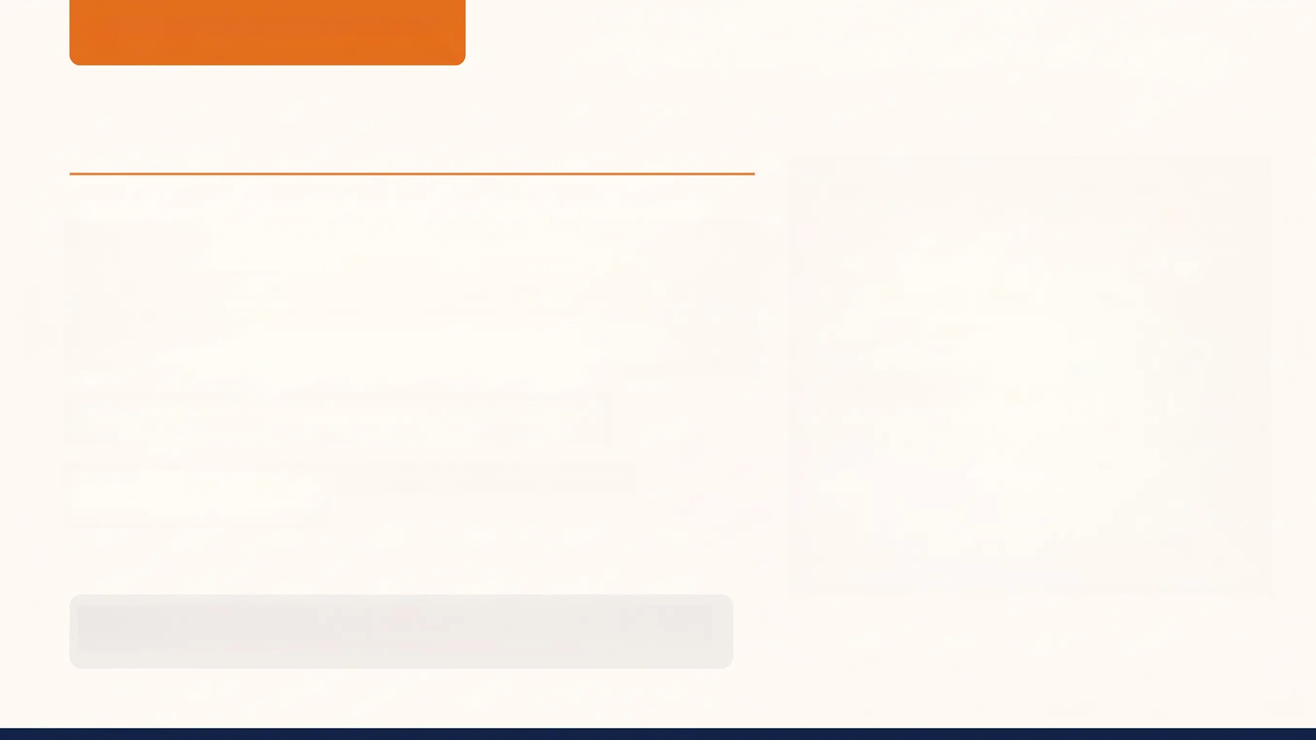
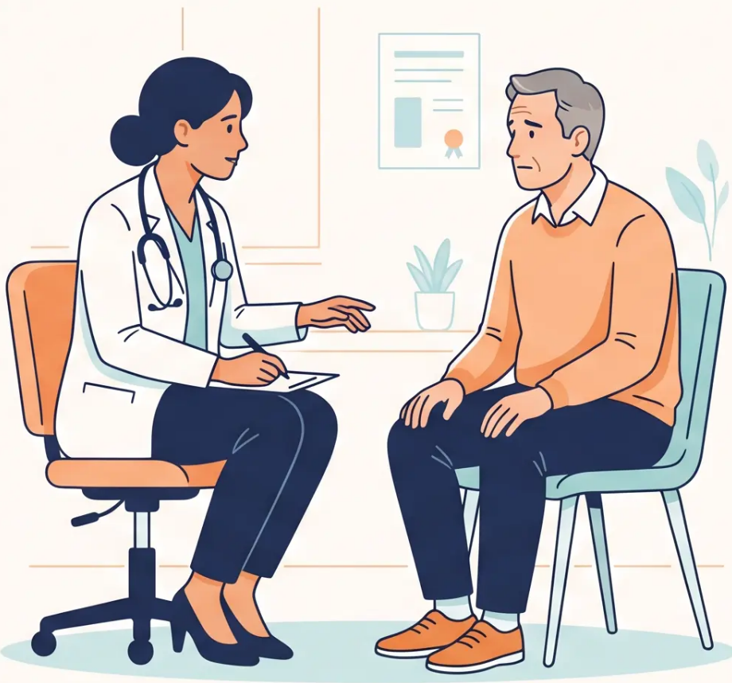
BRADFORD VTS TEACHING DECK
Chronic Pain: Pacing
and Self-Management
Created May 2026 · Updated to NICE NG193 (2021)
www.bradfordvts.co.uk
Always double check this advice and drug doses with the latest
NICE/BNF guidance. This document is for educational purposes only.

Slide 2
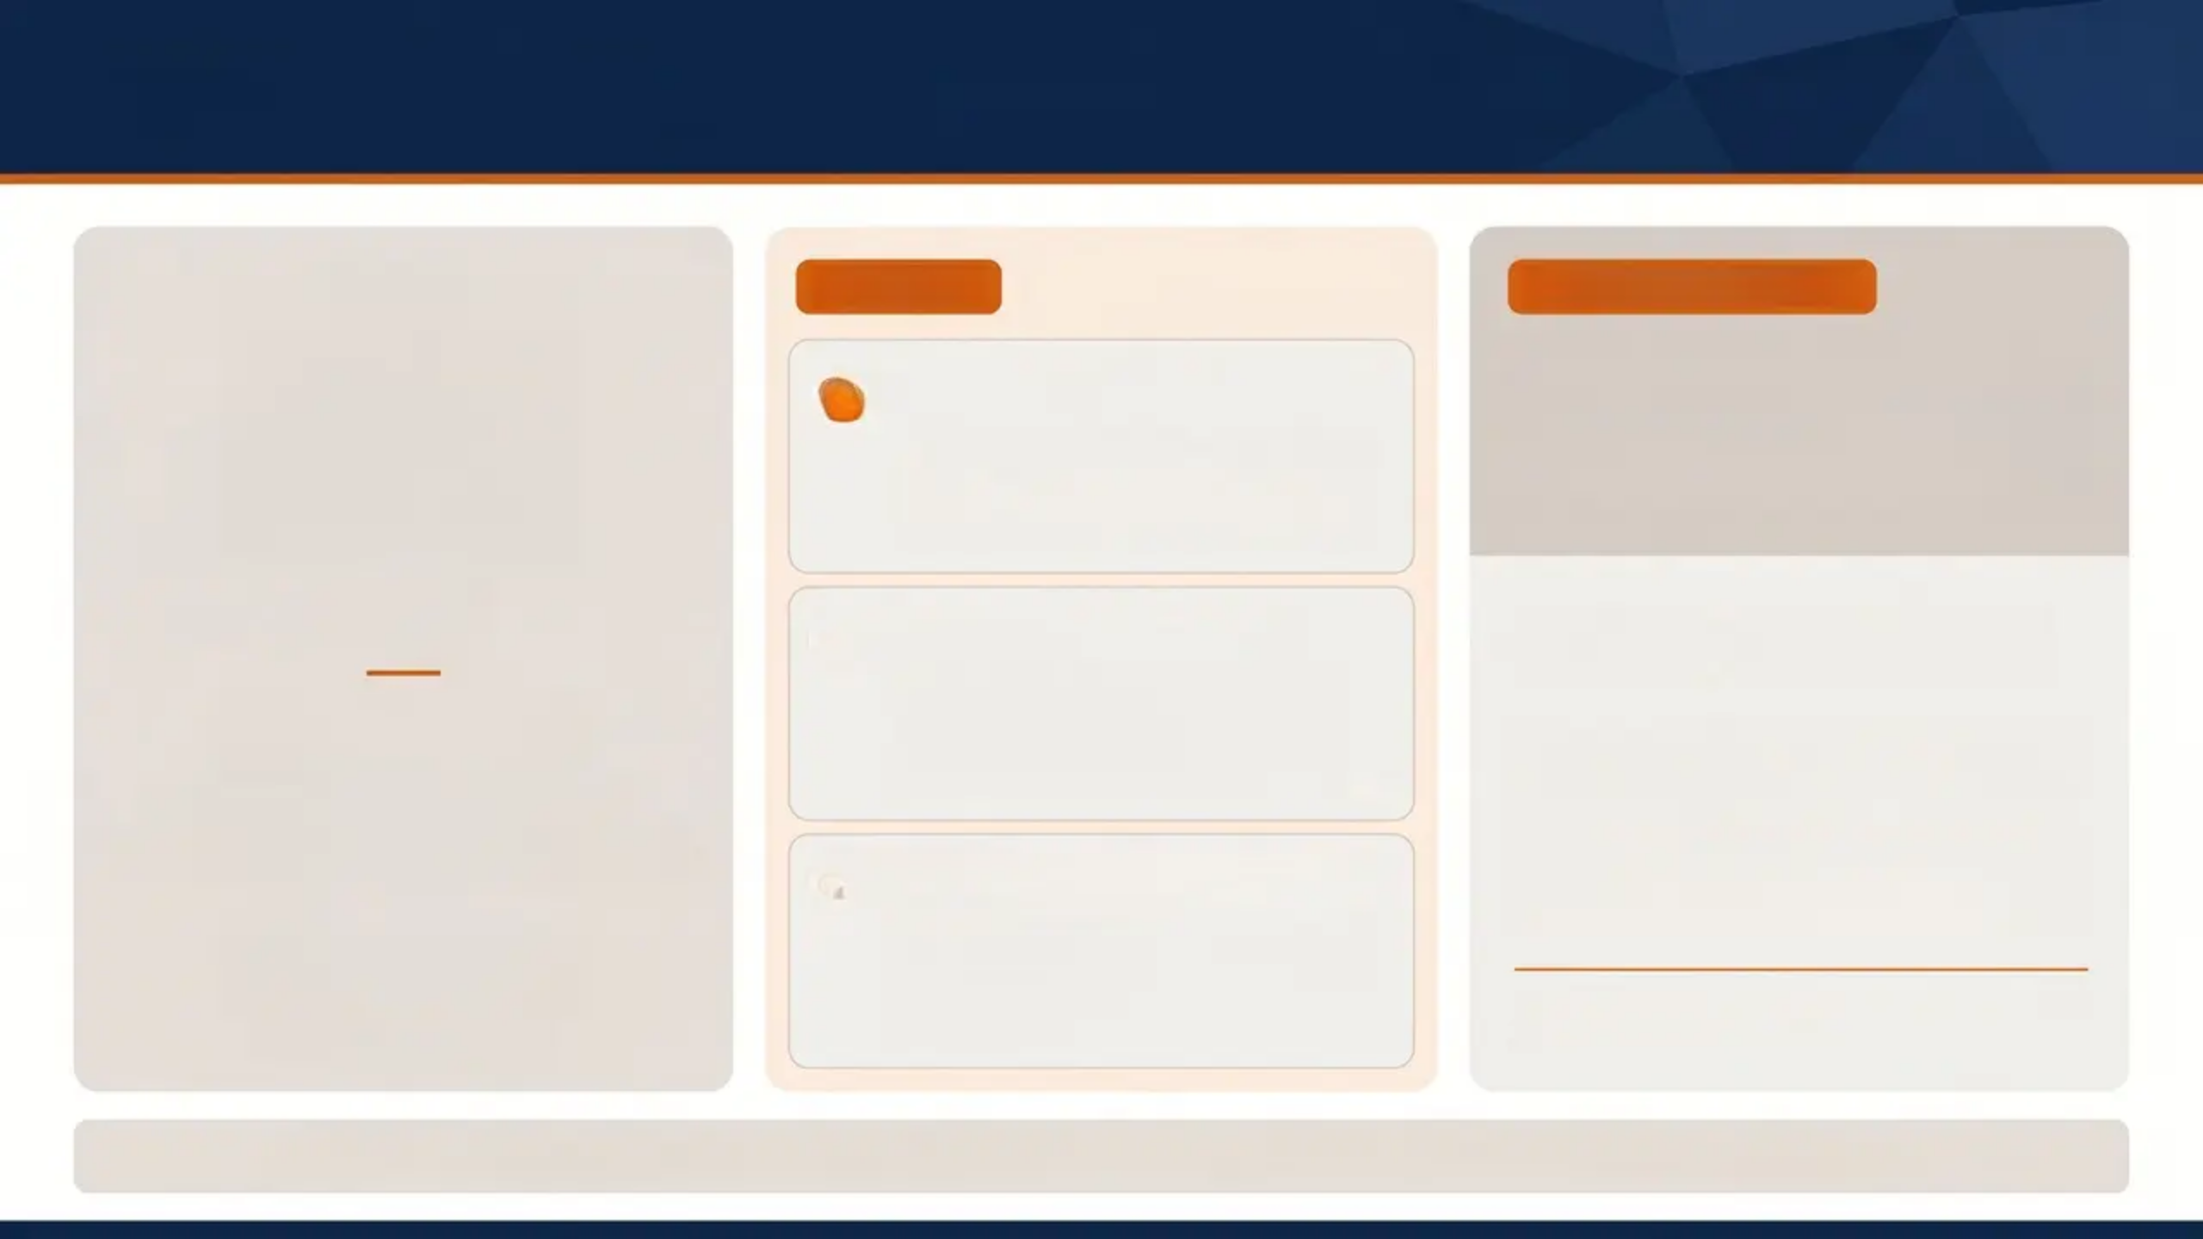
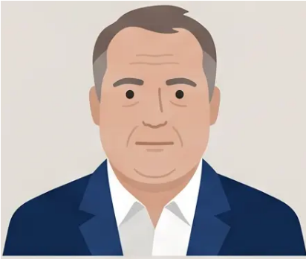
The Chronic Pain Challenge: Case Study Mr JF
ICE MODEL
KEY TEACHING POINT
1
Block 1 — Ideas
What is the greatest
challenge here?
“I have OA. Walking makes pain
worse. When pain worsens, I’m
destroying my joints.”
Mr JF
Not the pain itself.
2
Block 2 — Concerns
Age 54 · Museum Guide
Obese · Type 2 Diabetes
Knee pain × 3 months — bilateral
X-ray: early degenerative changes only
3 weeks sick leave
Upcoming meeting with
unsupportive employer
Possible depression
“I’m time-expired. My working
life is over. I can’t support my
family.”
The real challenge is the ICE —
the patient's beliefs, fears, and
expectations — alongside the
psychosocial context.
3
Block 3 — Expectations
“The doctor can't do anything.
I don't want surgery, painkillers,
or physio.”
Address ICE before prescribing.
NICE NG193 Principle: Psychosocial factors are stronger predictors of chronicity than pathology.

Slide 3
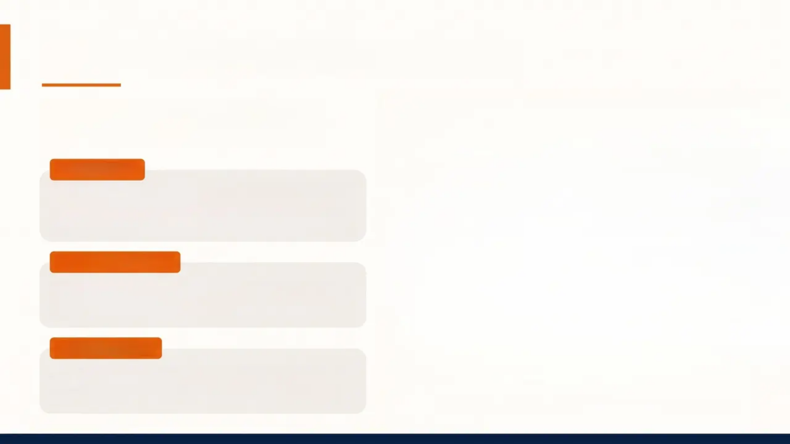
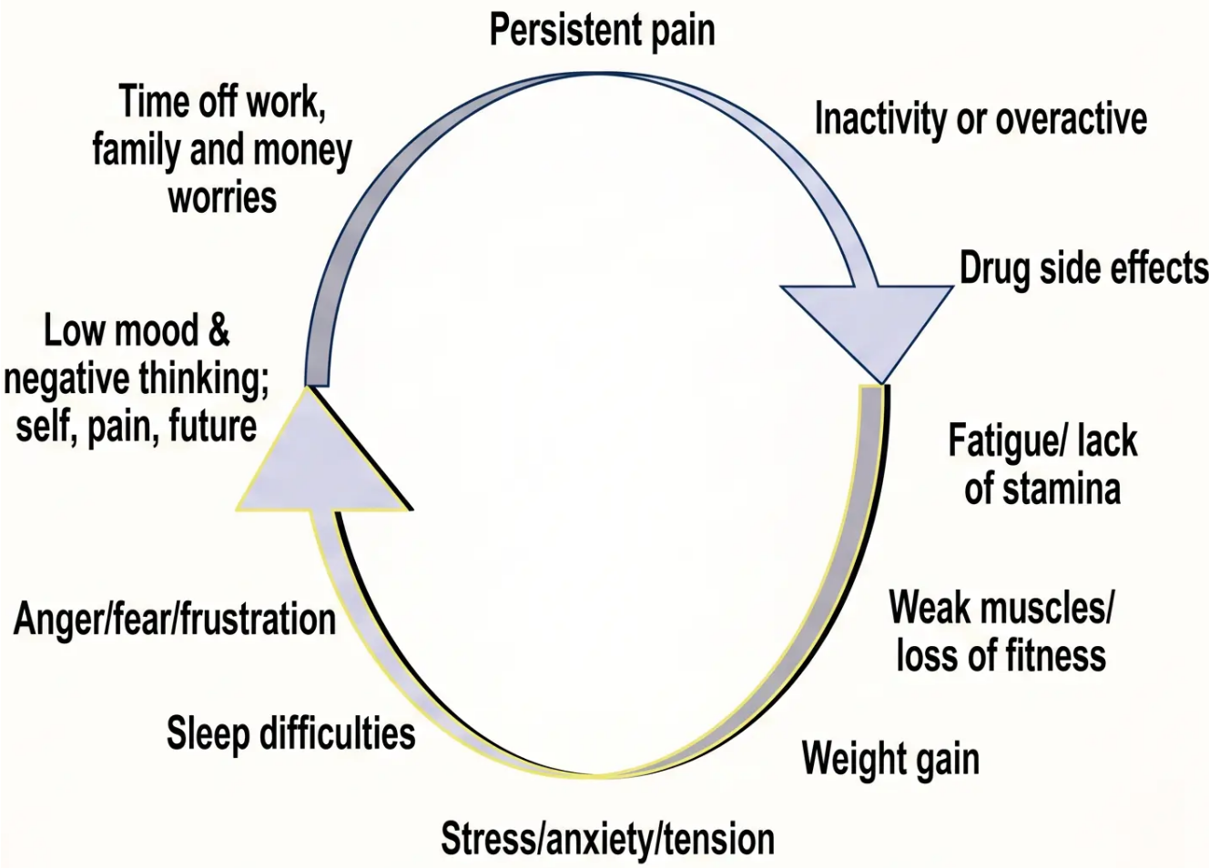

CBT Approach to Chronic Pain
Breaking the negative spiral through
thought and belief change
THE CBT CYCLE
Sensations ⇔ Emotions ⇔ Thoughts/
Beliefs ⇔ Activity
Each element reinforces the others – change one to break the cycle.
THE NEGATIVE SPIRAL
Pain → Reduced Activity → Deconditioning →
More Pain → Catastrophisation → Helplessness
NICE NG193 (2021)
Supervised group exercise + CBT or ACT –
first-line for chronic primary pain.
The persistent pain cycle – Pete Moore / Expert Patients Programme.

Slide 4
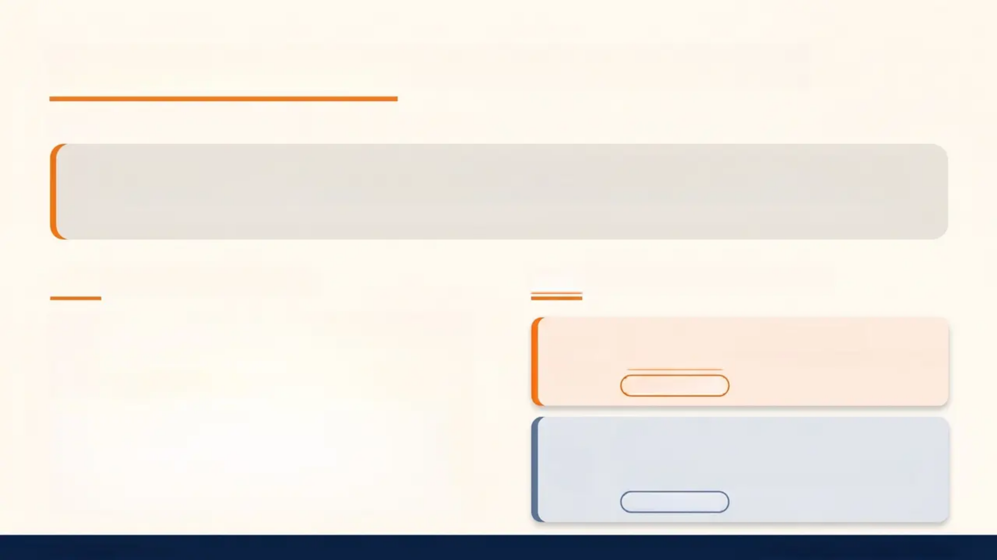
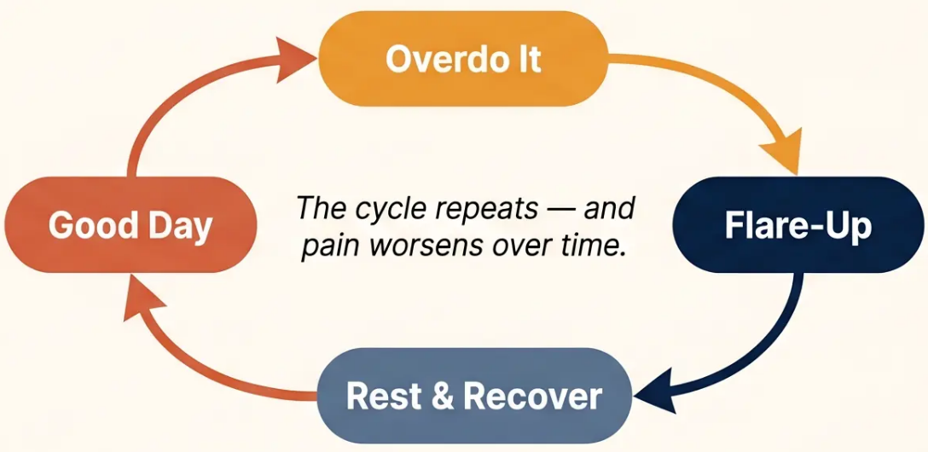


Understanding Pacing and the Pain Cycle
Self-Management Foundations
Pacing - A self-management skill that helps people maintain a consistent daily activity level despite
chronic pain — avoiding the 'boom and bust' cycle.
“On good days I do everything I can to catch up — never sure when the next good day will be.” — Pete Moore, Expert Patients Programme
The Boom and Bust Cycle
Two Unhelpful Pacing Styles
Overactive — The Overdoer
Fits everything into good days → suffers afterwards
Boom and Bust
Underactive — The Underdoer
Spends most of the day resting to avoid pain →
weak muscles, stiffer joints
Deconditioning
Bradford VTS Teaching Deck
Chronic Pain: Pacing and Self-Management

Slide 5

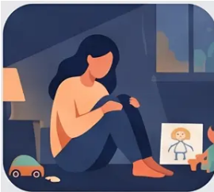
CASE STUDY
Sally and Pacing in Practice
ADVANTAGES
Sally, 34 years — Single
mother, 2 children
• Gets lots of help from family
• Reduces immediate pain sensation
• Reduces perceived risk of injury
• Pain feels “validated” by others
• May qualify for benefits/DLA
• Slipped at work 9 months ago — back pain since
• Waiting 6 months for scan; X-ray: no abnormality detected
• Taking 8 paracetamol/day — “only takes the edge off”
• Family doing ALL household tasks, childcare, school runs
• Spending whole days in bed
DISADVANTAGES
• Family collusion reinforces avoidance
• Catastrophisation and fear-avoidance beliefs
• Deconditioning and increasing obesity
• Learned helplessness; loss of control
• Social isolation and guilt about children
• No forward planning; living day to day
Pacing Style: Underactive (Underdoer)
*Allowing family to take over; minimal activity; avoiding all pain
“The blocks to recovery are not the pain itself — they are fear of harm, unhelpful beliefs, and family collusion.”
Bradford VTS Teaching Deck — Chronic Pain: Pacing and Self-Management
www.bradfordvts.co.uk
5 / 10

Slide 6
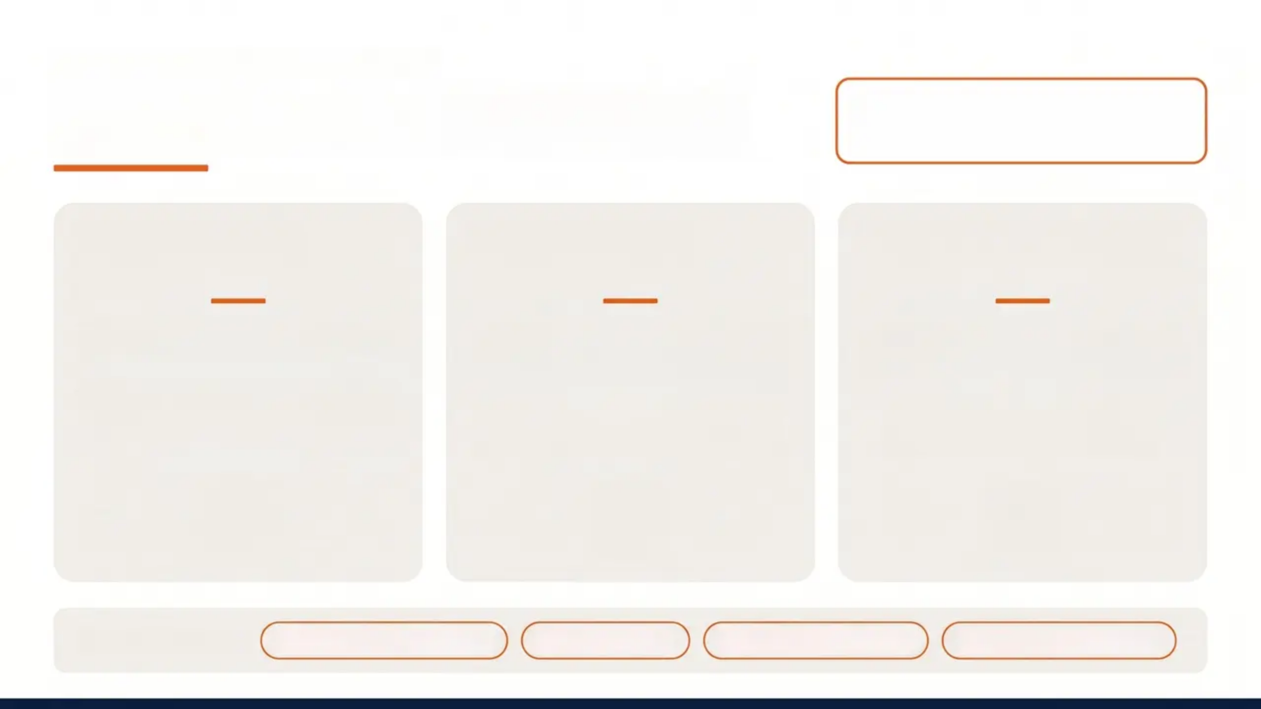

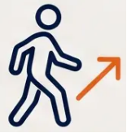
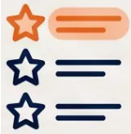
SELF-MANAGEMENT STRATEGIES
Practical Pacing: The 3 Ps
Pacing is NOT about doing less
— it's about doing consistently.
1
2
3
PLAN
PACE
PRIORITISE
Set a consistent daily baseline
Gradual graded activity — like
marathon training
Focus energy on what matters
most to recovery
Start below your comfort level
— don't push on good days
Time-contingent rest breaks,
not pain-contingent
Social activity and work >
household tasks
Also essential:
Relaxation & breathing
Sleep hygiene
SMART goal-setting
Communication skills

Slide 7




NICE NG193 · 2021
Management Guidelines
Chronic Primary Pain —
Evidence-Based Recommendations
Recommended
Not Recommended for Pain Alone
• Supervised group exercise programme
• Opioids (any route)
First-Line
• CBT or ACT
Recommended
• Paracetamol alone
• Acupuncture / dry needling
• NSAIDs
Consider
• Antidepressants for pain specifically
• Social prescribing and supported self-management
• Gabapentinoids
• Interdisciplinary pain management programme
Complex cases
Note: Comorbid depression/anxiety may still warrant
antidepressants. Neuropathic features need specific treatment.
The goal of treatment is to reduce disability and improve quality of life — not necessarily to eliminate pain.
— NICE NG193 (2021)
www.bradfordvts.co.uk
7 / 10

Slide 8
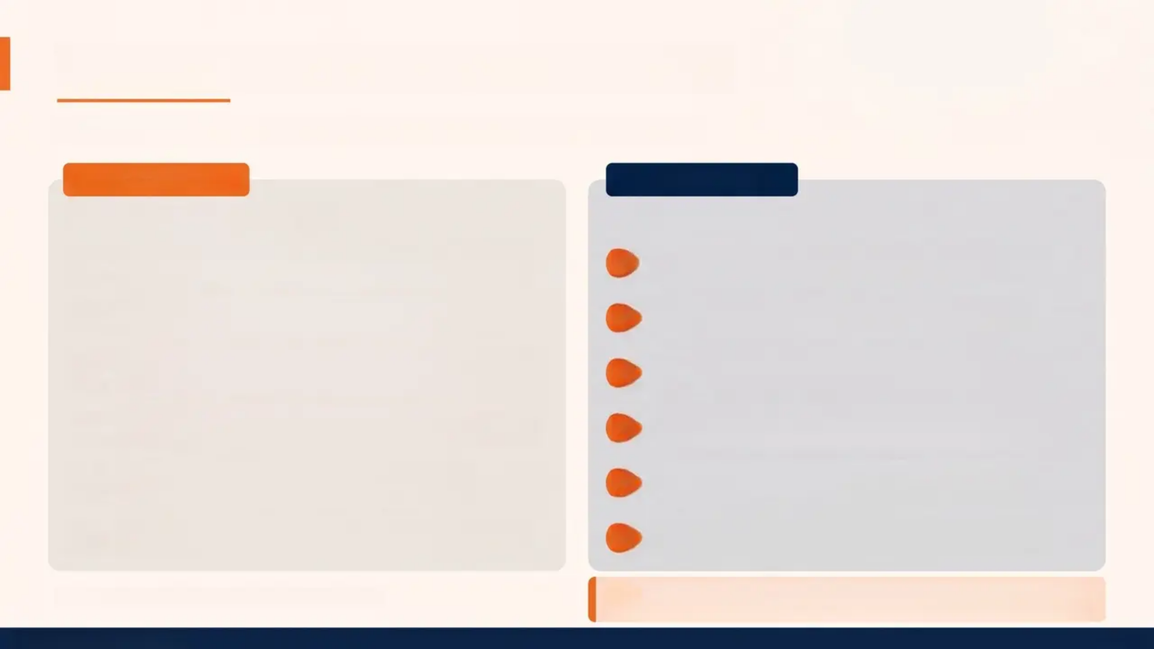












The Pain Toolkit & Clinical Top Tips
Self-management strategies and clinical practice essentials
THE PAIN TOOLKIT
CLINICAL TOP TIPS
For patients with chronic pain
For the consulting GP
Accept the pain — It is real. It is not ‘all in your
your head.’
Explore ICE before prescribing — Unhelpful
beliefs must be addressed first.
Hurt ≠ Harm — Pain does not always mean
damage is occurring.
Exercise is first-line (NICE NG193) — Not
analgesics; supervised group exercise.
Graded activity — Start small, build slowly and
consistently.
Validate the pain — Dismissal reinforces fear-
avoidance and causes harm.
Pace yourself — Consistent daily routine; avoid
boom-and-bust.
Pacing = consistent activity — Not doing less;
doing consistently despite pain.
Relax and manage stress — Breathing,
progressive muscle relaxation.
Address family collusion — Enabling avoidance
significantly delays recovery.
Set goals — ‘What could I do if pain were 2/10
instead of 8/10?’
Screen for depression — Underdiagnosed in
chronic pain; treat if present.
Based on Pete Moore's Expert Patients Programme
'The goal of treatment is to reduce disability and improve quality
of life — not necessarily to eliminate pain.' — 'NICE NG193 (2021)'
Bradford VTS Teaching Deck
8 / 10

Slide 9





GP TRAINING · EXAM REVISION
Exam Pearls: AKT and SCA
Key recall points for GP licensing exams — know these cold.
AKT — Knowledge Recall
SCA — Consultation Skills
NICE NG193: supervised exercise is
recommended first-line for chronic primary pain
Explore ICE fully before making any
management plan — don't jump to prescribing
Opioids, NSAIDs, paracetamol — NOT
recommended for chronic primary pain
Acknowledge distress — never minimise;
dismissal reinforces fear-avoidance
Pacing = time-contingent activity, not pain-
contingent
Show biopsychosocial awareness: 'I can see this
is affecting your work and family...'
CBT and ACT are NICE-recommended
psychological therapies
Offer an exercise programme as part of your
plan — don't just issue a sick note
Fear avoidance + catastrophisation =
psychosocial yellow flags predicting chronicity
Safety net — check for depression, social
support, DLA/benefits needs
“The goal is to reduce disability and improve quality of life — not necessarily to eliminate pain.” (NICE NG193)
Bradford VTS Teaching Deck · www.bradfordvts.co.uk
9 / 10

Slide 10



Red Flags, Pitfalls & Quick Recall
Critical safety checks, clinical errors to avoid, and final key principles.
⚠️ RED FLAGS — ACT NOW
COMMON PITFALLS — AVOID THESE
QUICK RECALL — KEY PRINCIPLES
New neurological symptoms in
known chronic pain patient
Chronic primary pain: no clear cause;
avoid opioids
Prescribing before exploring ICE
Recommending rest — reinforces
fear-avoidance
NICE NG193: supervised exercise =
first-line
Sudden unexplained worsening —
exclude infection, fracture,
malignancy
CBT / ACT = recommended
psychological therapies
Over-investigating — repeated
scans entrench illness behaviour
Pacing = consistent activity; avoid
boom-and-bust
Suicidal ideation — significant risk
in chronic pain
Signing indefinite sick notes without
a graded return-to-work plan
Three Ps: Plan • Pace • Prioritise
ICE: always explore before prescribing
Severe depression complicating
management
Yellow flags: catastrophisation, fear-
avoidance, low mood
Missing depression —
underdiagnosed in chronic pain
Family collusion = barrier to recovery
Safeguarding concern — patient
unable to care for self or
dependants
Goal: reduce disability and improve QOL
Ignoring family dynamic —
collusion delays recovery
Opioids NOT recommended for chronic
primary pain
Always double check this advice and drug doses with the latest NICE/BNF guidance. This document is for educational purposes only.

