Slide 1
BRADFORD VTS TEACHING DECK
Neuropathic Pain
Management in Primary Care
Drug Management Pathways
Cost Comparisons
PHN & Diabetic Neuropathy Algorithms
Patient Resources

Slide 2
DISCLAIMER
⚠ Educational Use Only
This presentation is provided exclusively for educational and training purposes as a teaching aid. It does not constitute formal clinical guidance.
Clinicians must independently verify all medical information, prescribing guidance, procedural protocols, and legal requirements against current national guidance, local policies, and relevant regulatory bodies before applying in practice.
Primary sources: NICE guidelines, BNF, RCGP, GMC, NHS England, MHRA, British Pain Society.

Slide 3
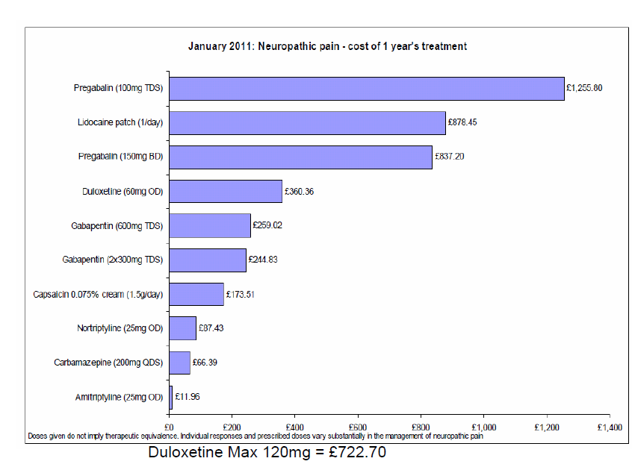
Neuropathic Pain — Drug Costs
Cost comparisons for commonly used agents (relative, illustrative)
Note: Cost comparisons are illustrative. Amitriptyline remains the most cost-effective first-line agent. Pregabalin and gabapentin now have generic pricing. Verify costs against current BNF Drug Tariff.
Amitriptyline remains the most affordable first-line agent for neuropathic pain. Duloxetine now also recommended as first-line by NICE NG173.

Slide 4
Managing Neuropathic Pain in Primary Care
NICE NG173 — first-line to third-line pharmacological management
NICE NG173 (Neuropathic Pain in Adults, 2013, updated 2023) recommends a structured stepwise approach. The choice of agent should be guided by comorbidities, patient preference, and contraindications.
FIRST LINE
Amitriptyline
Duloxetine
Gabapentin
Pregabalin
10–75mg nocte. TCA. Caution: cardiac, elderly, glaucoma. First-line except trigeminal neuralgia.
30–120mg OD. SNRI. Effective for diabetic neuropathy and mixed anxiety/depression. Monitor BP.
Start 300mg OD, titrate to 1.8g/day in 3 divided doses. Class C (misuse potential).
Start 75mg BD, titrate to 300–600mg/day. Class C (misuse potential). Schedule 3 CD.
SECOND LINE
Tramadol
Capsaicin 0.075% cream
50–100mg QDS. Opioid adjuvant. Short-term use only. Serotonin syndrome risk with SSRIs.
Apply TDS–QDS to affected area. For localised neuropathic pain. Burning sensation initially.
THIRD LINE / SPECIALIST
Capsaicin 8% patch (Qutenza)
IV lidocaine
Specialist referral
Single application; specialist use only. Licensed for post-herpetic neuralgia.
Specialist initiation only. For severe refractory neuropathic pain.
Consider if 2 adequate drug trials have failed. Refer to pain clinic or relevant specialist.
Gabapentin and pregabalin are Class C controlled drugs (Schedule 3 CD). Follow current prescribing regulations. Do not prescribe both simultaneously.

Slide 5
Post-Herpetic Neuralgia — Management Algorithm
Stepwise pharmacological management in primary care
Clinical Notes (NICE NG173)
1st Line:
Amitriptyline 10mg nocte; titrate to 25–75mg. Alternative: gabapentin or pregabalin if TCA not tolerated.
Capsaicin:
Capsaicin 0.075% cream TDS–QDS (Axsain). Warn about burning sensation — improves with repeated use.
3rd Line:
Lidocaine 5% medicated plaster (Versatis) for localised PHN — limited to 12 hrs/day. Specialist guidance advised.
Capsaicin 8%:
Qutenza patch — single specialist application; licensed for PHN. Refer to pain clinic.
Review:
Review at 8–12 weeks. If <30% improvement and dose adequately trialled — switch or escalate.
Referral:
Refer to pain specialist if 2 adequate drug trials have failed or significant functional impairment persists.
Prevent PHN: ensure prompt antiviral treatment (within 72 hrs of rash onset) for herpes zoster in at-risk patients.

Slide 6
Patient Information — Pregabalin
Slow titration approach for drug-sensitive or comorbid patients
⚠ Pregabalin is a Schedule 3 Controlled Drug (Class C). Follow controlled drug prescribing regulations. Monitor for misuse, dependence, and diversion.
Prescribing Notes — Pregabalin
Starting dose:
75 mg BD (or 25–50 mg BD in elderly/renally impaired)
Titration:
Increase by 75mg BD at weekly intervals as tolerated
Therapeutic range:
150–300 mg BD (max 600 mg/day)
Side effects:
Dizziness, drowsiness, weight gain, peripheral oedema, visual disturbance
Renal dosing:
Dose reduction required if eGFR <60 — see BNF for exact adjustments
Driving:
Advise not to drive until stable dose established and unaffected
Stopping:
Taper slowly over at least 1 week — do NOT stop abruptly
Controlled drug:
Schedule 3 CD — 30-day max supply on single prescription. No repeat prescriptions.
Slow titration:
Use slow-titration patient leaflet for drug-sensitive patients (see left)

Slide 7
Key Points
Key Points
NICE NG173 Summary
If a drug causes intolerable side effects, switch to another in the same class before escalating
Diabetic neuropathy
Amitriptyline, duloxetine, gabapentin, or pregabalin (in any order)
E.g. if amitriptyline poorly tolerated, try nortriptyline before escalating
Post-herpetic neuralgia
Use patient information leaflets to improve adherence
Amitriptyline, pregabalin, or gabapentin. Add capsaicin 0.075% for localised pain.
Trigeminal neuralgia
All drugs in this pathway can cause significant adverse effects
Carbamazepine is FIRST LINE. Refer to neurology if refractory.
Opioids are adjunctive — use in conjunction with other treatments
Central sensitisation / mixed
Duloxetine preferred where depression/anxiety coexist
Consider referral if 2 adequate trials have failed
All causes
Review at 8–12 weeks. Continue if ≥30% pain reduction. Withdraw if no benefit.

Slide 8
Patient Resources & Pathway Tools
High-quality patient-facing resources for neuropathic pain
Recommended Resources
Pain Toolkit
www.paintoolkit.org — self-management resource
NHS Pain Toolkit
NHS-endorsed patient guide
Understanding Neuropathic Pain
Patient education booklet (NICE endorsed)
Neurotransmitters charity
www.neurotransmitters.co.uk
Patient leaflets
Available via NICE, PCDS, local formulary
Pain Concern
www.painconcern.org.uk — helpline and resources
BPS Pain Patient Page
www.britishpainsociety.org/people-with-pain
Local formulary tools
Check local ICC/ICB for neuropathic pathway

