Slide 1
BRADFORD VTS TEACHING DECK
Understanding Pain in 6 Slides
May 2026
Covering
Biopsychosocial Model
The Pain Cycle
Classification of Pain
Neuropathic Pain
Assessing Pain & SOCRATES
Some Pain Cases

Slide 2


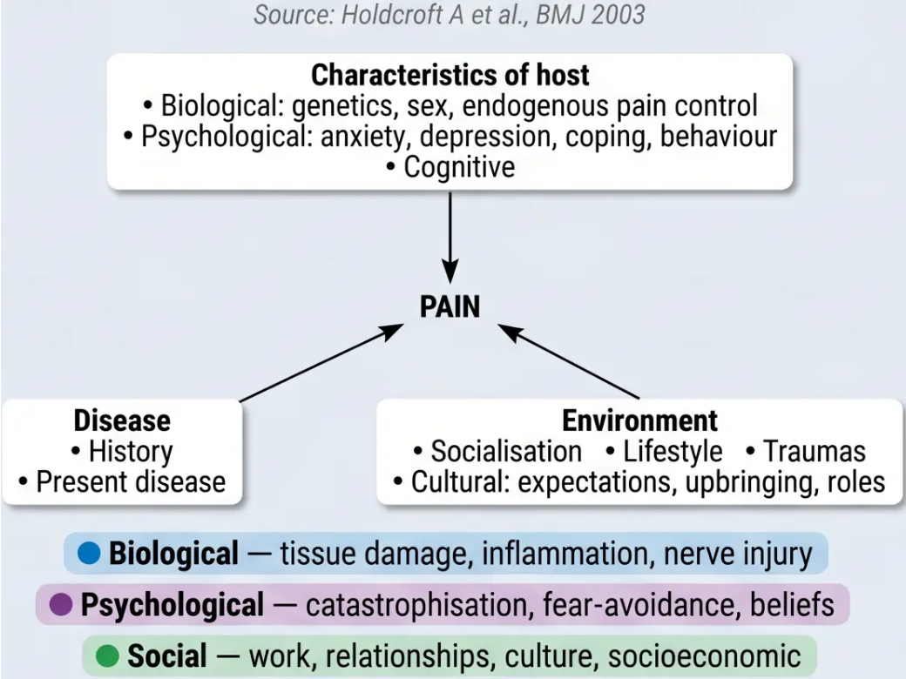
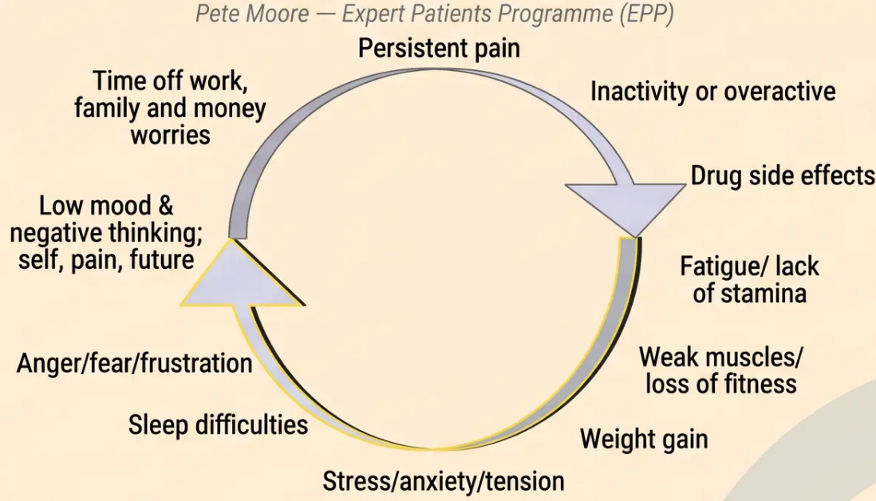
Biopsychosocial Model & the Pain Cycle
*Pain is a sensory, emotional, cognitive, and behavioural experience — not just tissue damage*
“Two patients with identical injuries may have vastly different pain experiences – the biopsychiscial model explains why.”
The Biopsychosocial Model – factors that interact
and modulate the experience of pain
The Persistent Pain Cycle
Negative spiral: Pain → inactivity → deconditioning → more pain
Breaking the cycle: Pacing · CBT · graded activity · social engagement
Bradford VTS · Understanding Pain · Slide 5 of 7

Slide 3




Classification of Pain
Acute Pain
Chronic Pain
Neuropathic Pain
- Protective and time-limited
- Biological signal of tissue
damage
- Resolves with healing
Persists beyond 3 months
Caused by a lesion or disease
of the somatosensory system
(IASP definition)
Primary
Secondary
- Burning, shooting, electric-
shock quality
- Allodynia • Hyperalgesia
- Affects 2-4% of general population
- Up to 25% of diabetic patients
No clear
underlying
cause, or pain
disproportionate
to injury
e.g. fibromyalgia,
IBS, non-specific
low back pain
Pain as
symptom of an
underlying
condition
e.g. OA, RA,
cancer pain,
endometriosis
Nociceptive • Short-term
Treat differently from nociceptive pain
⚠️ NICE NG193 (2021) — Landmark Shift
Common AKT exam topic
For chronic PRIMARY pain — do NOT offer opioids, paracetamol, or NSAIDs.
Offer: supervised exercise • psychological therapy (CBT/ACT) • social prescribing

Slide 4
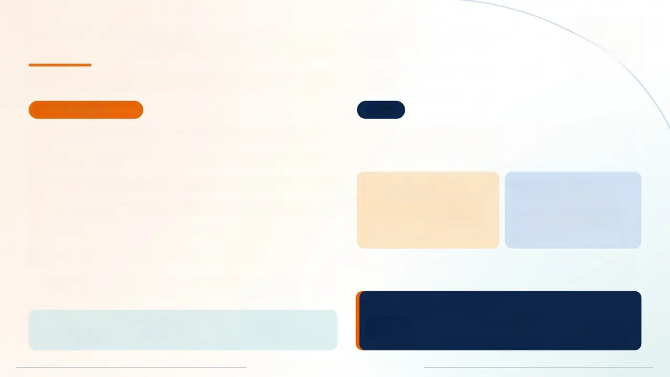
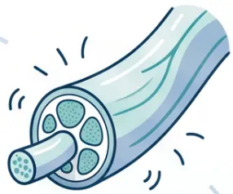







Neuropathic Pain and CRPS
Recognising the features — and knowing when to refer
NEUROPATHIC PAIN
CRPS
Burning / Shooting / Electric shock pain — ongoing, spontaneous
Segmental limb pain following (usually) minor injury —
disproportionately severe and prolonged. Involves nerves, skin,
muscles, blood vessels, and bone.
Numbness & pins and needles — sensory loss in affected area
Allodynia — pain from a normally non-painful stimulus (e.g. light touch)
Card A — CRPS Type I
Card B — CRPS Type II
• Former name: Reflex
Sympathetic Dystrophy (RSD)
• No identifiable nerve injury
• More common
• Former name: Causalgia
• Follows injury to a major
peripheral nerve
• Less common
Hyperalgesia — exaggerated pain response to a painful stimulus
Dysaesthesia — unpleasant abnormal sensation
Hypaesthesia — heightened sensitivity to touch
Sympathetic nervous system dysregulation. Can arise without injury.
Occasionally affects non-limb areas.
Poor nerve regeneration → abnormal fibres → cross-talk →
ectopic discharges from injured axons
GP ACTION — REFER EARLY
2-4%
20-25%
35-70
If CRPS is suspected → refer promptly to a specialist pain team.
Do not delay. Early intervention significantly improves outcomes.
general population
of diabetic patients
patients per average GP list
Bradford VTS - Understanding Pain - Slide 4 of 7

Slide 5
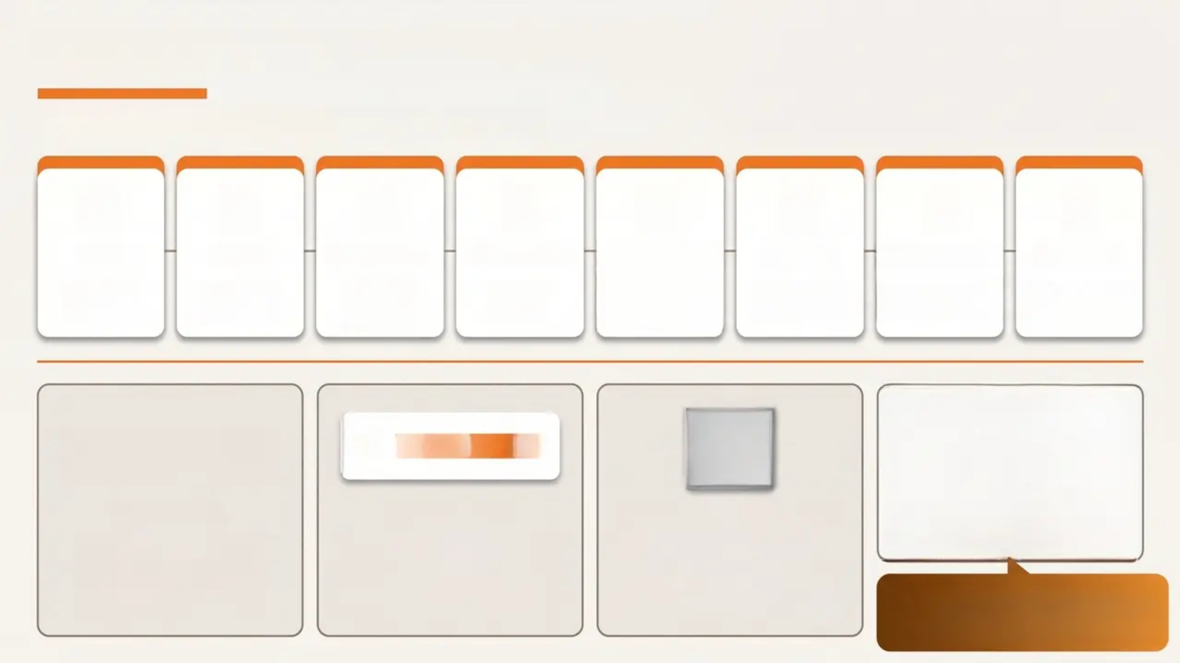
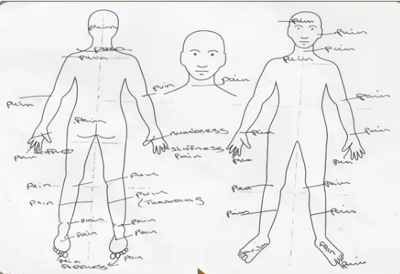
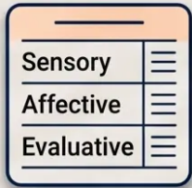



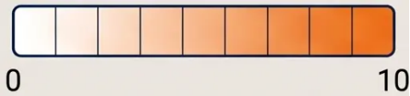

Pain Assessment & SOCRATES
A structured approach to every pain history
S
O
C
R
A
T
E
S
Site
Onset
Character
Radiation
Associated
Timing
Exacerbating
Severity
Where is
the pain?
Sudden or
gradual?
Burning,
shooting,
aching?
Does it
spread?
Nausea,
weakness,
sensory change?
Constant or
intermittent?
What makes it
worse or better?
Score 0-10.
Impact on life?
VAS / NRS
Faces Scale
McGill Questionnaire
0-10 scale. Simple,
validated, widely used.
Limited in cognitive
impairment.
Facial expressions mapped
to NRS 0-10. Useful in
children and
communication difficulties.
Multidimensional – captures
quality, not just severity.
Tracks change over time in
chronic pain.
A body chart takes 2 minutes
and gives invaluable information
about pain distribution.

Slide 6
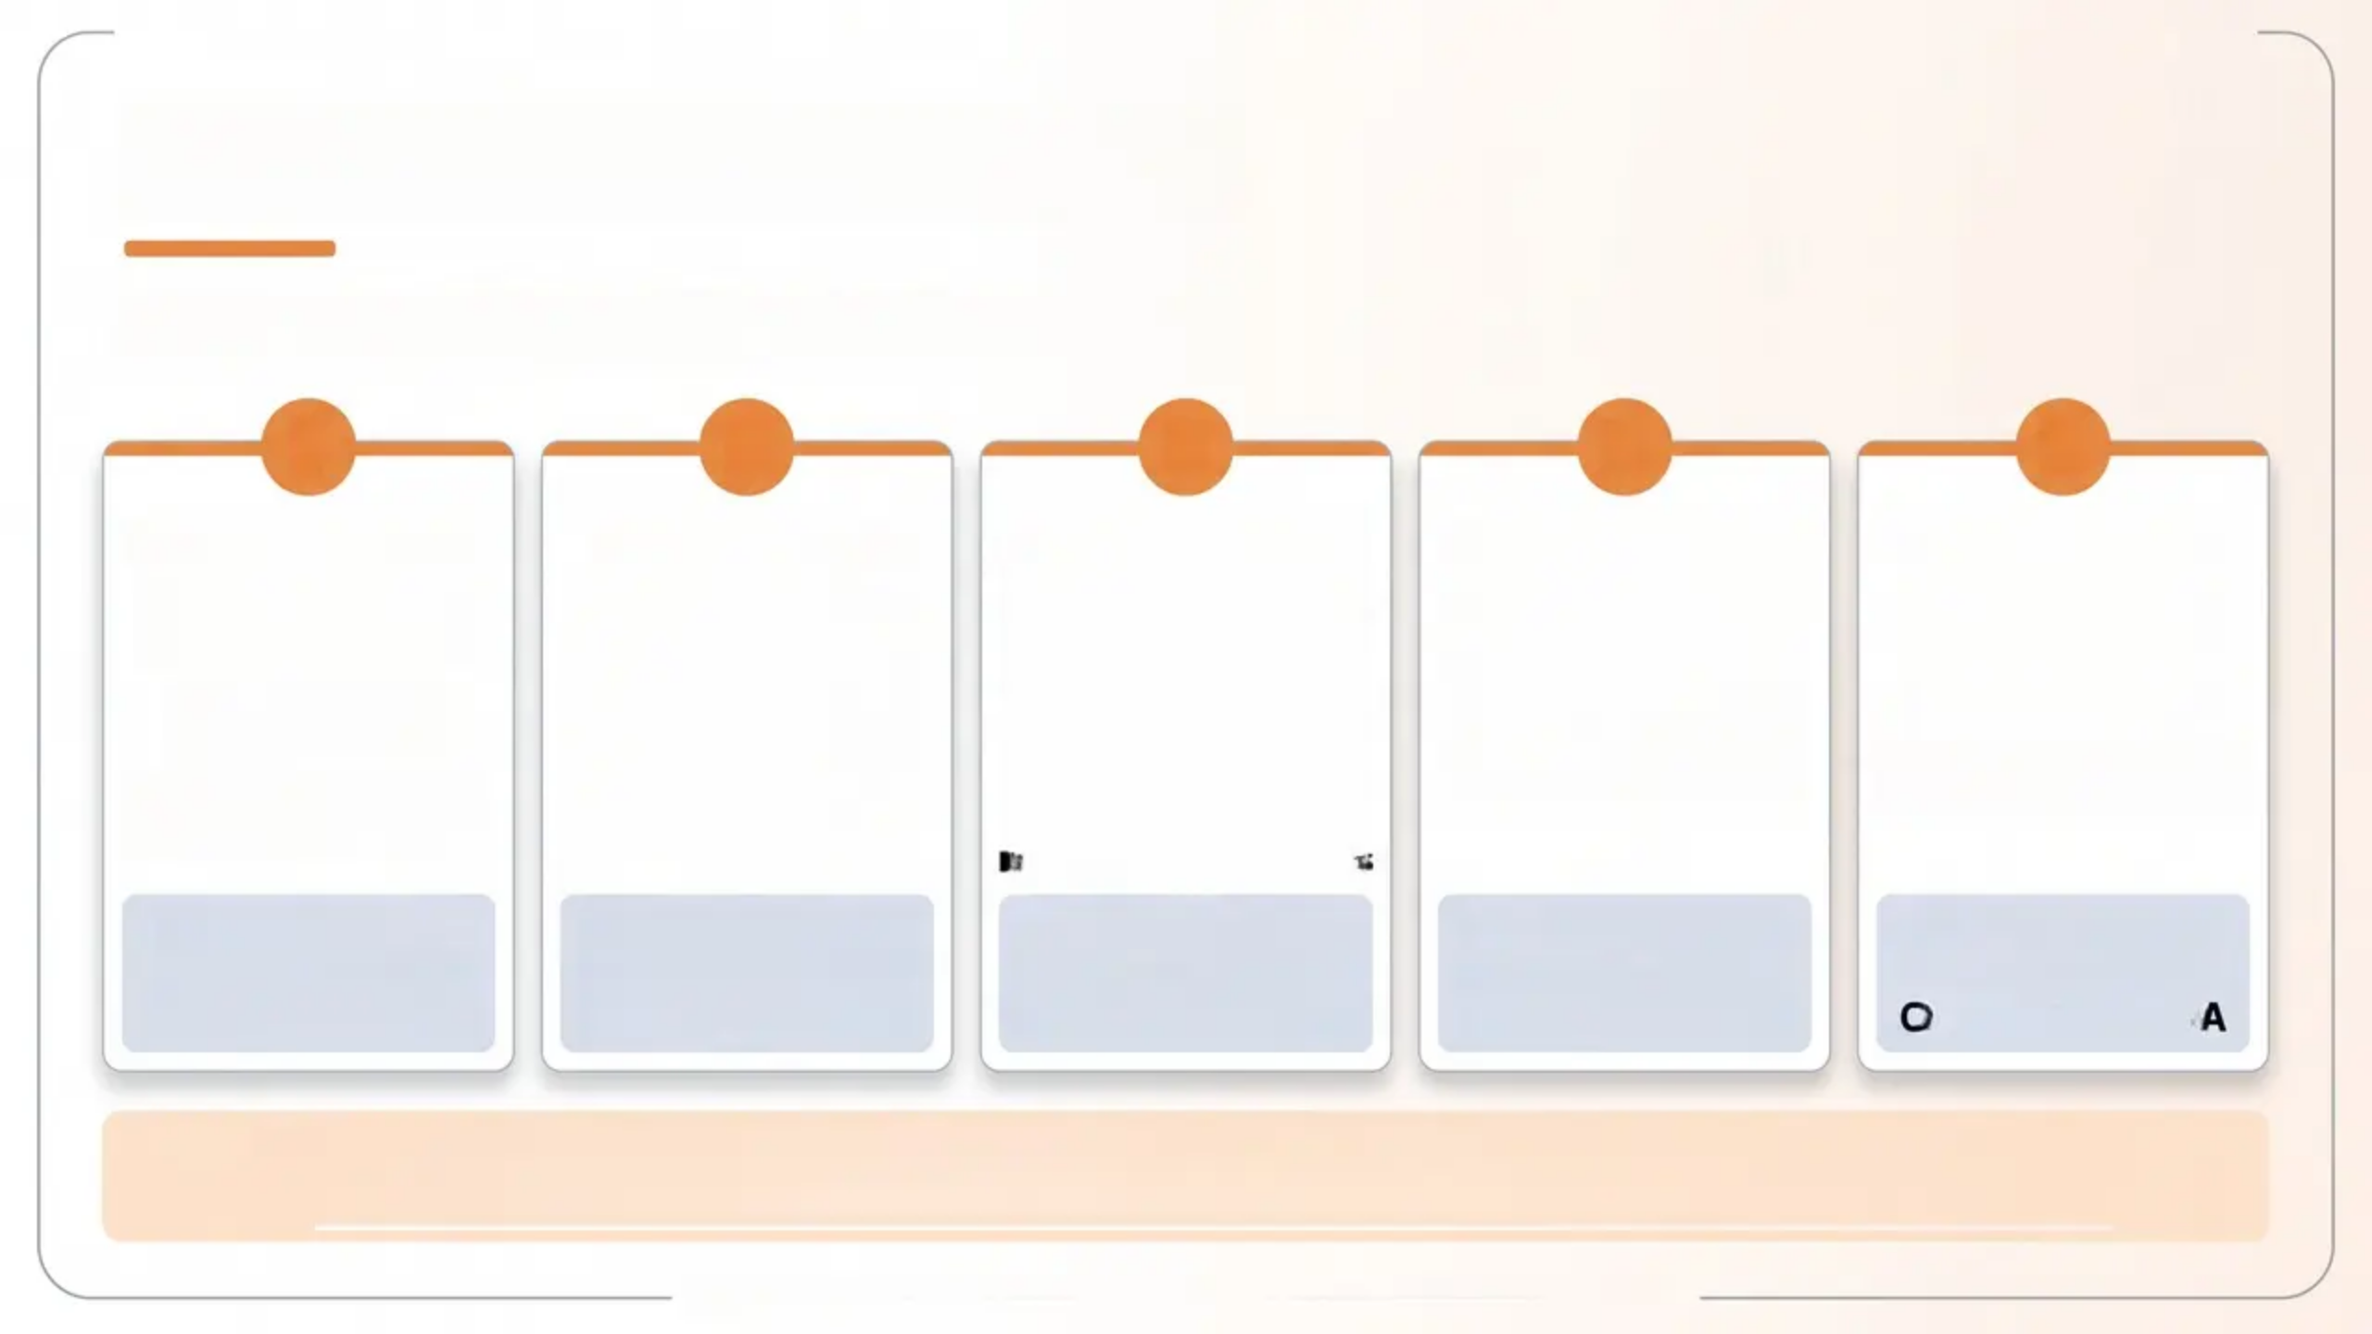






Clinical Case Vignettes
Five presentations — what’s the diagnosis?
1
2
3
4
5
👩‍🦰 67-year-old woman
Pain in backs of both
legs
Worsening over 6
months
History: severe RTA as
child
👨‍🦱 19-year-old male
Minor horse riding
accident, 5 years ago
Struggles with work
Atypical pain
distribution on body
map
👩‍🦰 35-year-old woman
Fibromyalgia-type pain,
5 years
Significantly worsened
after viral illness (6
months ago)
Unhelpful pain
management behaviours
👩‍🦰 54-year-old woman
Scald injury to left
hand (NHS workplace,
5 years ago)
Mild CRPS affecting
left arm
👨‍🦱 46-year-old male
Gradual onset pain,
now 18 months
Manual occupation
Pain chart: L5/S1 nerve
root + OA of thumb
Diagnosis: Spinal
Stenosis + OA of
Spine
Diagnosis: CRPS
(Complex Regional
Pain Syndrome)
Diagnosis:
Fibromyalgia
(Chronic Primary Pain)
Diagnosis:
Neuropathic Pain /
CRPS
Diagnosis: L5/S1
Nerve Root
Compression + OA
🎯 Teaching point: Each case illustrates a different pain classification — always consider the full
biopsychosocial picture and screen for CRPS, neuropathic features, and yellow flags.
Bradford VTS • Understanding Pain • May 2026 • www.bradfordvts.co.uk

