Slide 1
BRADFORD VTS TEACHING AIDS
VAS Pain Charts & Cases
Adapted from an original presentation from Dr Jonathan Dixon, Bradford

Slide 2

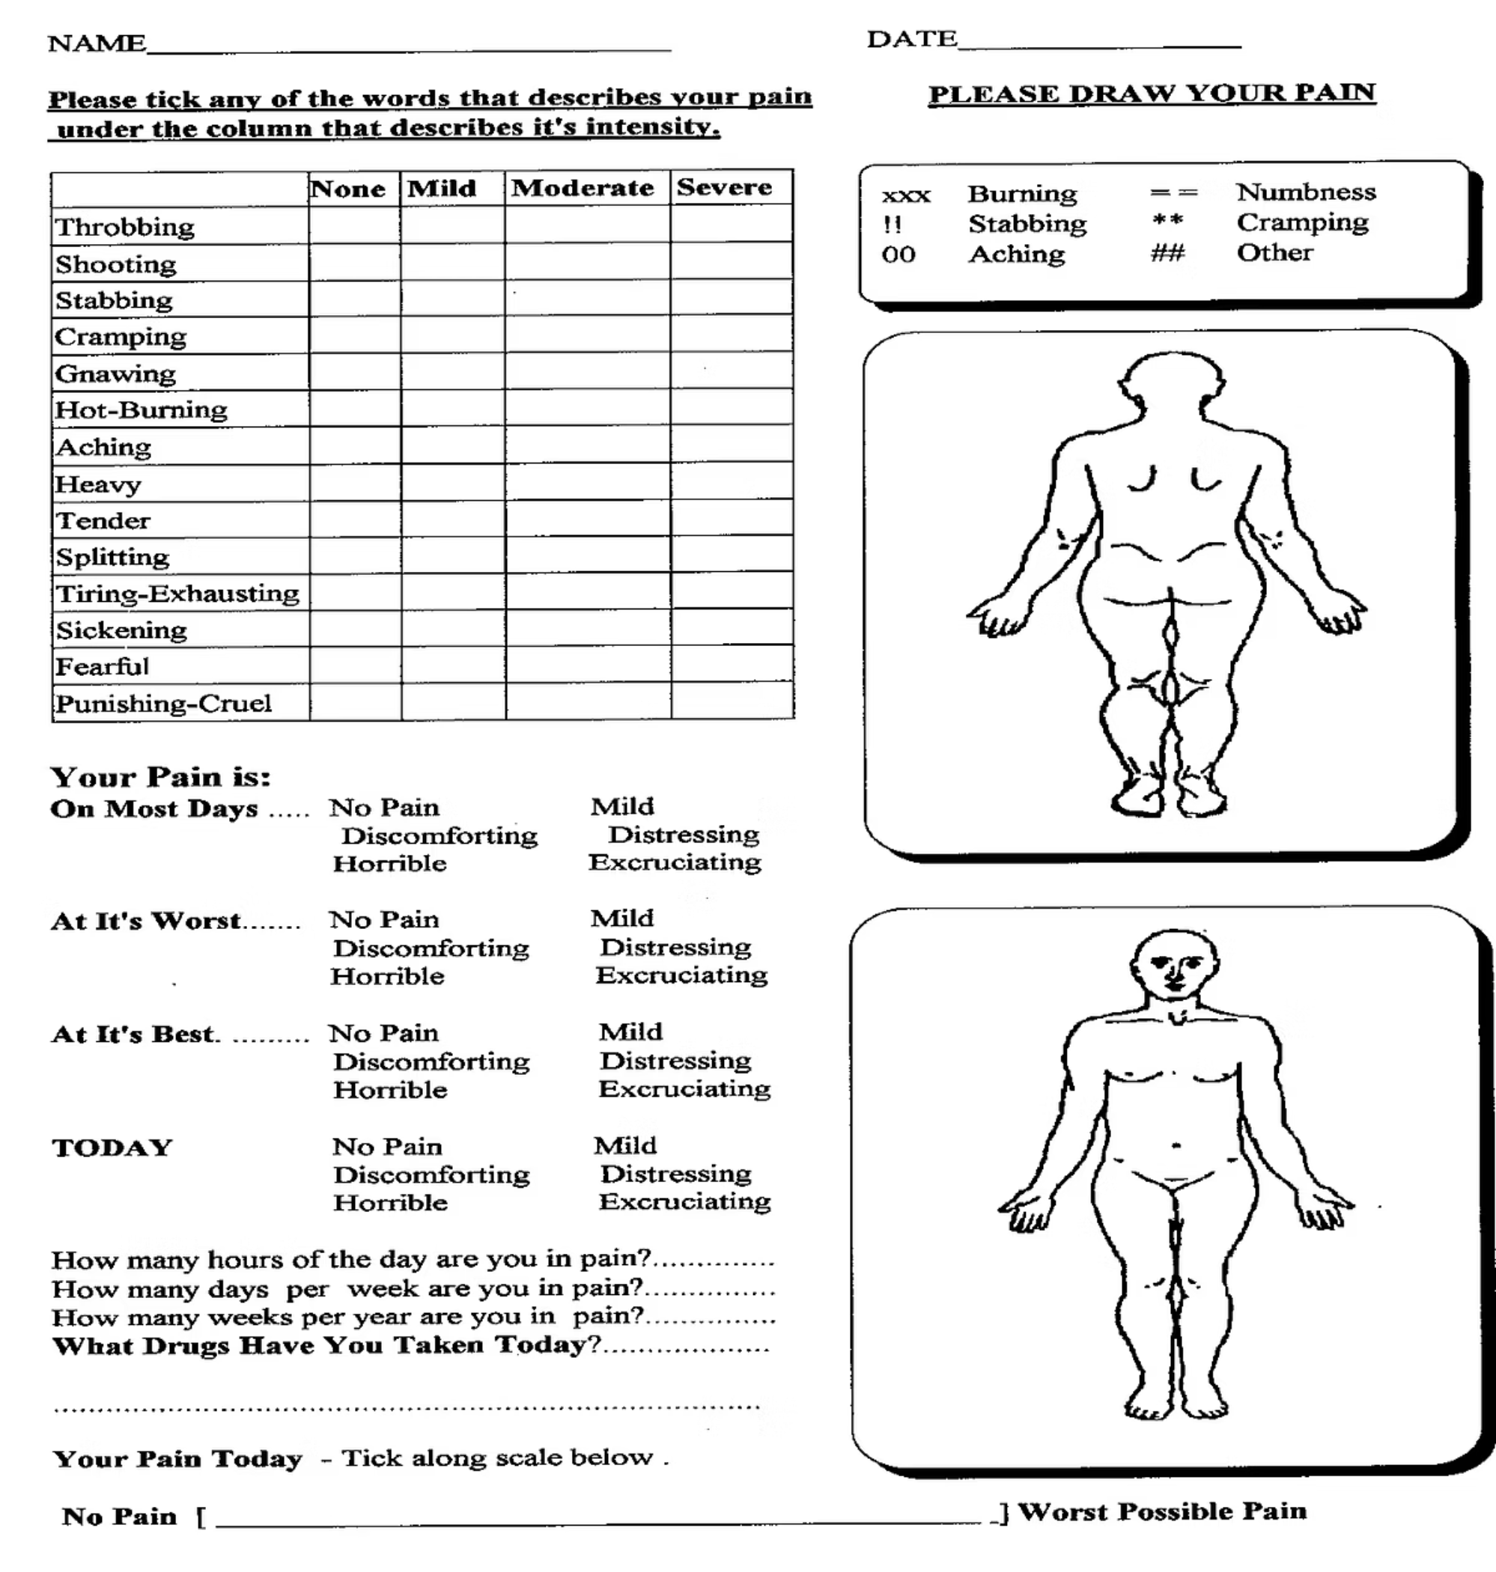
VAS Chart
Really good for helping you get a true understanding of the patient's experience of pain

Slide 3

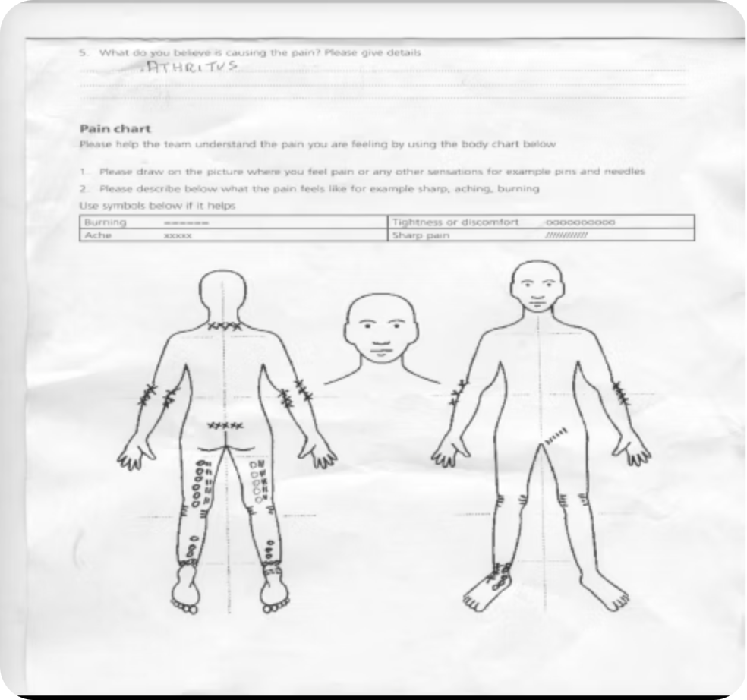
VAS Chart 1
67 year old female pain backs of legs getting worse last 6 months.
Severe RTA as a child as pedestrian.
What is diagnosis?

Slide 4
VAS Chart 1
Answer
Spinal Stenosis & OA Spine

Slide 5
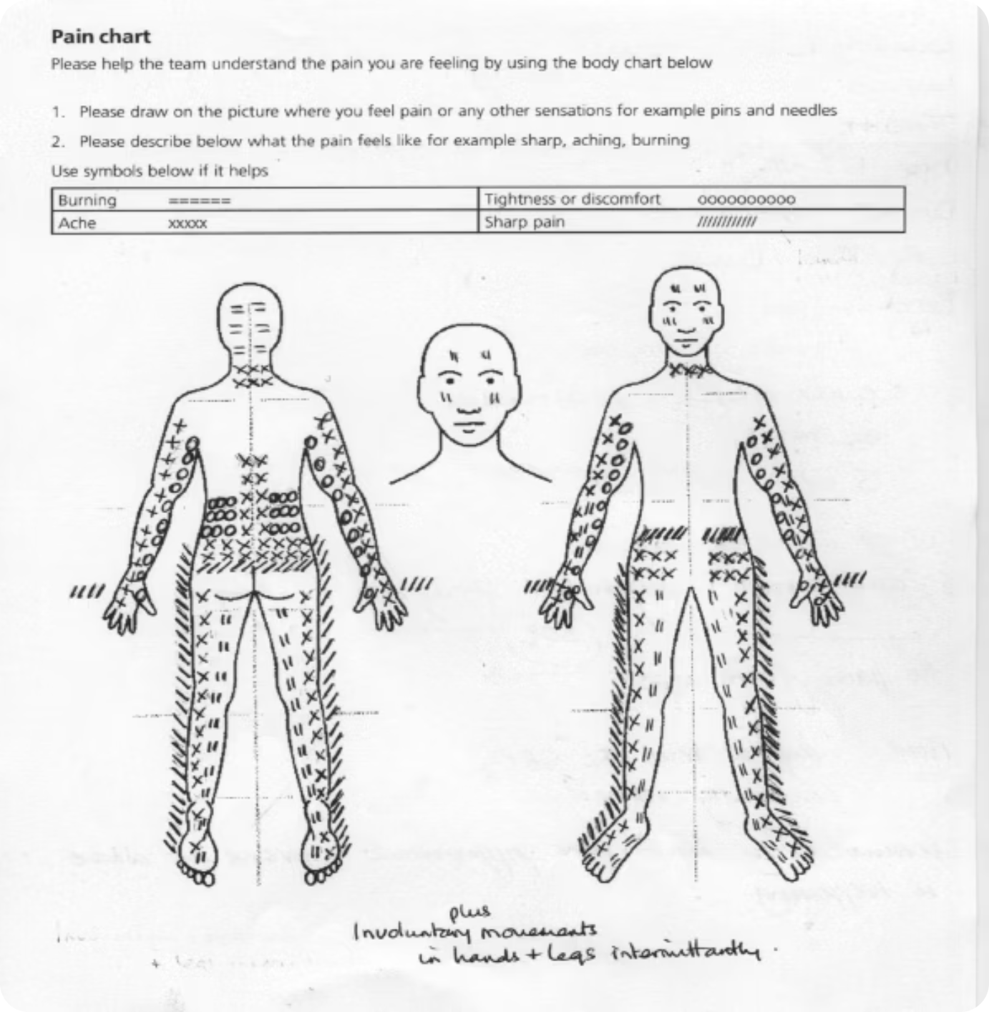
VAS chart 2
Male 19 years old, after minor horse riding accident 5 years ago. Struggles with work due to symptoms.

Slide 6
VAS Chart 2
Answer
Chronic Regional Pain Syndrome (CRPS)

Slide 7
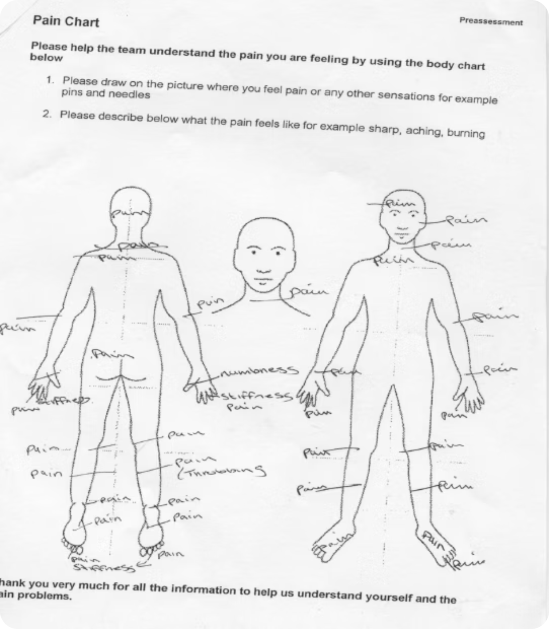
VAS chart 3
Female, 35 years. Pain affecting her for 5 years much worse after recent viral illness in last 6 months. Unhelpful pain management behaviours.

Slide 8
VAS chart 3
Answer
Fibromyalgia

Slide 9

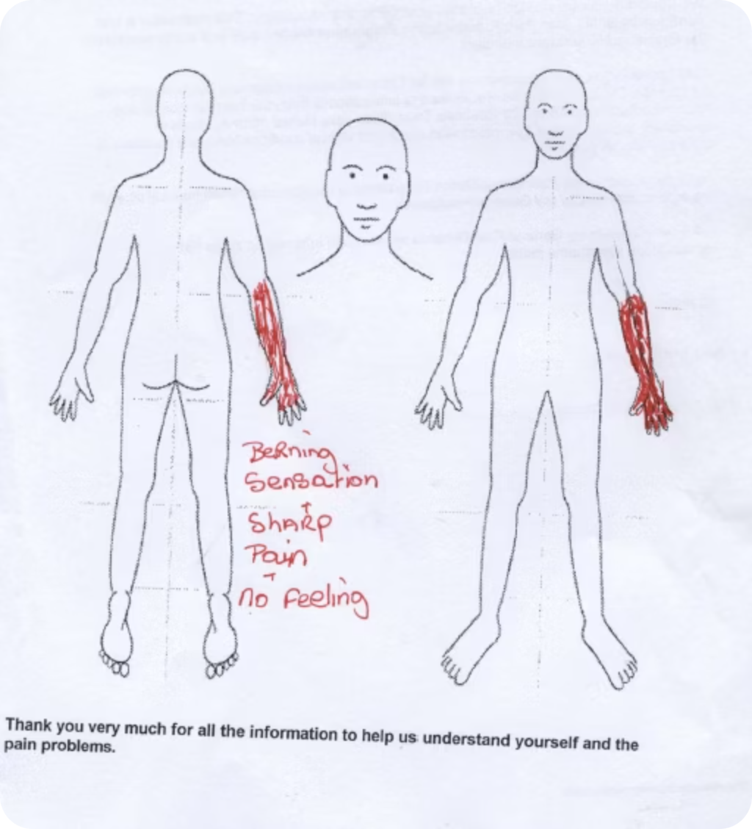
VAS Chart 4
Female 54 years old. Scald injury to left hand in NHS workplace 5 years ago. Mild CP affecting left arm.

Slide 10
VAS chart 4
Answer
Neuropathic Pain/CRPS

Slide 11
CRPS
Complex regional pain syndrome (CRPS) is a complex and poorly understood condition.
It is typically characterised by segmental limb pain after a (usually) relatively minor injury to a limb but is more severe and lasts much longer than would normally be expected given the injury. It may also encompass a range of problems involving one or more of the nerves, skin, muscles, blood vessels and bone. Occasionally, it affects parts of the body other than the limbs and it may also arise in the absence of injury.
It is thought to arise as a result of abnormal sympathetic nerve healing following trauma, although the exact pathophysiology still remains very much a mystery. In theory, it can be divided into two disease entities of differing aetiologies:
CRPS I
CRPS II
Formerly known as reflex sympathetic dystrophy (RSD), this is pain which develops in the absence of identifiable nerve injury.
Formerly known as causalgia (literally meaning 'hot pain'), this develops after injury to a major peripheral nerve.

Slide 12
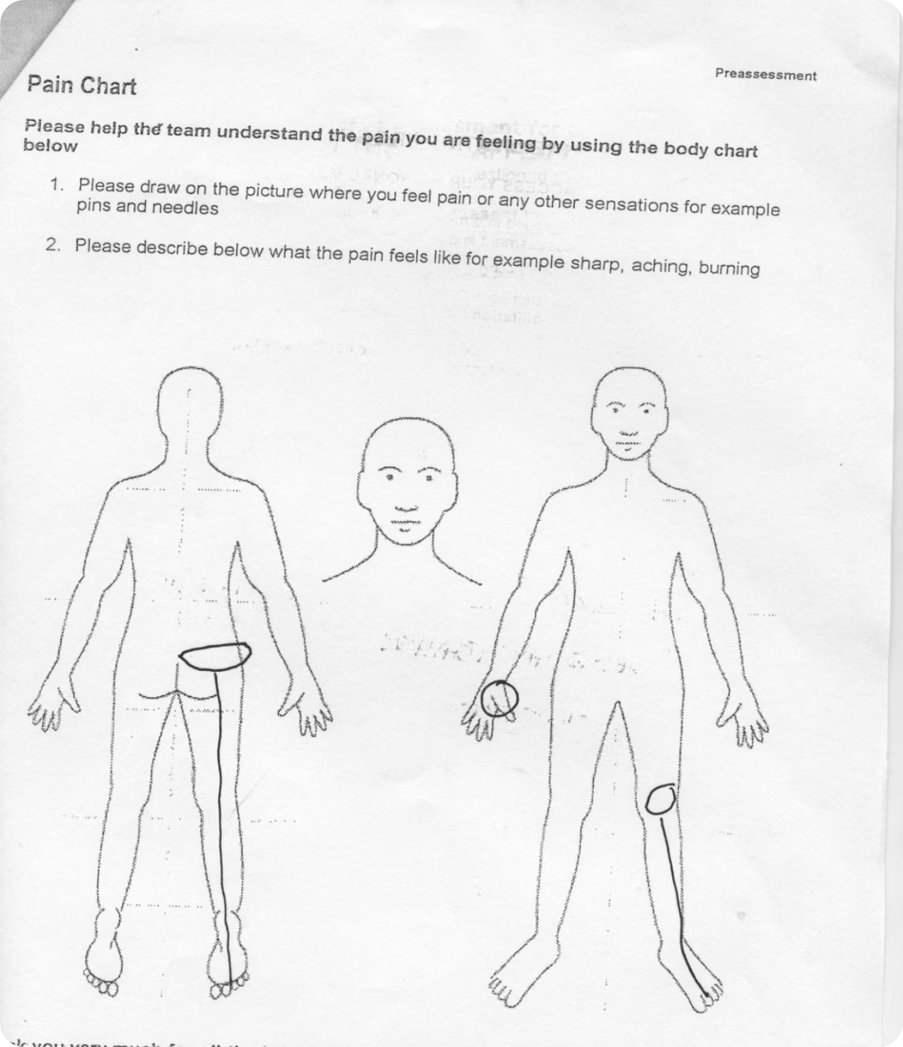
VAS Chart 5
Male 46 gradual onset of pain over several weeks present now for 18 months –manual job.

Slide 13
VAS Chart 5
Answer
Nerve Root Compression L5/S1
PLUS
OA Thumb

