Slide 1




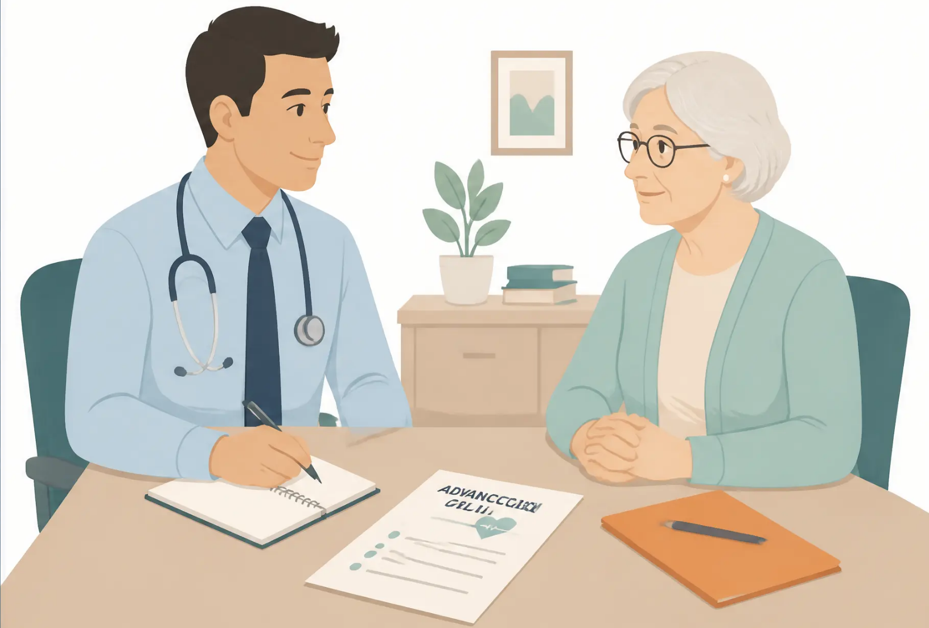
BRADFORD VTS TEACHING DECK
Advance Care Planning,
LPA & ReSPECT
A Teaching Presentation for UK GP Trainees
(ST1–ST3 & IMGs)
Created: June 2026
www.bradfordvts.co.uk
For educational purposes only. Content reflects guidance current at time of publication.
Always refer to current national guidance and local policies.
www.bradfordvts.co.uk

Slide 2











Presentation Overview
What we'll cover today — for GP trainees ST1–ST3 and IMGs
What is ACP?
Legal Documents
ReSPECT Process
Definition, principles & who benefits
ADRT, LPA & Powers of
Attorney Act 2023
Emergency care planning &
form sections
Mental Capacity Act
The Conversation
Exam & Practice Pearls
Five principles, TREAT
assessment & best interests
How to initiate, navigate &
document ACP talks
AKT boxes, SCA tips, red
flags & quick recall
30–35 slides · Nano-style teaching format · Sources: NHS England 2022, MCA 2005, Resuscitation Council UK
For educational purposes only. Content reflects guidance current at time of publication.
Always refer to current national guidance and local policies.
www.bradfordvts.co.uk

Slide 3







Defining Advance Care Planning
What is ACP and why does it matter?
“A voluntary process of person-centred discussion
between an individual and their care providers about
their preferences and priorities for their future care,
while they have the mental capacity for
meaningful conversation.”
— NHS England Universal Principles for ACP, 2022
VOLUNTARY
PERSON-CENTRED
CAPACITY-REQUIRED
Cannot be forced or rushed
Starts with “what matters to you”
Done while mental capacity is intact
For educational purposes only. Content reflects guidance current at time of publication.
Always refer to current national guidance and local policies.
www.bradfordvts.co.uk

Slide 4











Key Principles of ACP
What makes Advance Care Planning different from other clinical decisions
Voluntary
Person-Centred
Capacity Required
Multiple
Conversations
Any Professional
Cannot be forced or
demanded. Can be
declined at any time.
Starts with "What
matters to you?" —
not what matters to us.
Conversations happen
while the person has
mental capacity.
Not just doctors —
nurses, allied health,
and social care can
lead ACP.
A process over time —
not a single one-off
discussion.
"ACP is not about predicting the future — it's about making sure
the person's voice is heard when they can no longer speak for themselves."
For educational purposes only. Content reflects guidance current at time of publication.
Always refer to current national guidance and local policies.
www.bradfordvts.co.uk

Slide 5
















Components of Advance Care Planning
Five key tools — from informal wishes to legally binding decisions
Advance Statement
Informal
Informal wishes, values, and preferences — NOT legally binding, but must be considered
Advance Decision to Refuse Treatment (ADRT)
Legally binding refusal of specific treatment — must be written,
signed, and witnessed for life-sustaining treatment
Legally Binding
Lasting Power of Attorney (LPA)
Legal authority for another person to make health or financial
decisions — only when registered with OPG
Legally Binding
ReSPECT / Emergency Care Plan
Clinician-completed summary of emergency treatment preferences —
not legally binding but carries professional weight
Informal
DNACPR
Clinical Decision
Specific clinical decision about CPR only — individual,
patient-centred, never a blanket decision
For educational purposes only. Content reflects guidance current at time of publication.
Always refer to current national guidance and local policies.
www.bradfordvts.co.uk

Slide 6


















Informal vs Formal Documents
Not all ACP documents carry the same legal weight — knowing the difference matters
INFORMAL
FORMAL
(Not Legally Binding)
(Legally Binding if Valid)
Advance Statement
Advance Decision to Refuse Treatment (ADRT)
Records wishes, values, and preferences for
future care. Must be considered in best
interests decisions — but cannot be enforced.
Legally binding if valid and applicable. Must be
written, signed, and witnessed for life-sustaining
treatment refusal.
VS
Lasting Power of Attorney — Health & Welfare
Named Spokesperson
Legally binding once registered with the Office of
the Public Guardian (OPG). Only active when the
person lacks capacity.
A person the patient wishes to be consulted.
Has no legal decision-making authority unless
they hold a registered LPA.
LPA — Property & Financial Affairs
Covers finances and property. Does not cover
health decisions.
"Must be considered — but cannot override clinical judgement"
Key point: Next-of-kin has NO automatic legal authority to make health decisions for an adult
lacking capacity — only a registered Health & Welfare LPA confers this right.
For educational purposes only. Content reflects guidance current at time of publication.
Always refer to current national guidance and local policies.
www.bradfordvts.co.uk

Slide 7













Who Benefits from ACP?
ACP is not only for the dying — it is for anyone who wants to plan ahead
Progressive Illness
Risk of Losing Capacity
Declining Function or High Frailty
Cancer, COPD, heart failure,
liver or kidney failure
Dementia, MND,
learning disability
Declining functional status
or high frailty score
Key Care Transitions
Major Surgery or High-Risk Treatment
Anyone Who Wishes to Plan
Care home admission,
multiple hospital admissions
Facing significant procedures
or interventions
Not just the dying — future
care matters to everyone
> People with dementia (71% die within 6 months of >6-month prognosis)
Priority Groups
to Identify:
> Severe frailty (25% die each year)
> Residents in care homes
> Patients on the palliative care register
> Housebound patients
For educational purposes only. Content reflects guidance current at time of publication.
Always refer to current national guidance and local policies.
www.bradfordvts.co.uk

Slide 8














Triggers for Initiating ACP
When should we start the conversation?
Patient Initiates
New Diagnosis
Deterioration
Patient raises the topic themselves
Progressive or life-limiting illness confirmed
Change or decline in condition or function
Care Transition
Routine Review
High Frailty Score
Regular clinical appointment or
EOL register review
Care home admission or major life change
Severe frailty — 25% die each year
The Gold Standards Framework "Surprise Question"
"Would I be surprised if this patient died in the next 12 months?"
If the answer is No. → initiate the ACP conversation now.
→ See Slide 9
For educational purposes only. Content reflects guidance current at time of publication.
Always refer to current national guidance and local policies.
www.bradfordvts.co.uk

Slide 9





The Surprise Question
A simple clinical trigger for identifying ACP needs
“Would I be surprised if this patient
died in the next 12 months?”
— Gold Standards Framework
NO
YES
Initiate an ACP conversation
Add to palliative/EOL register
Identify missing ACP elements
Continue routine care
Remain alert to change
Revisit at next deterioration
Part of the Gold Standards Framework — used in primary care to
identify patients who may benefit from proactive ACP.
For educational purposes only. Content reflects guidance current at time of publication.
Always refer to current national guidance and local policies.
www.bradfordvts.co.uk

Slide 10







UNIVERSAL PRINCIPLES FOR ACP — NHS ENGLAND 2022
Universal Principles for ACP
Principles 1–3
Published March 2022 · Arising from CQC ‘Protect, Connect, Respect’ report (2021)
The Person is Central
The person is central to developing and agreeing their advance care plan,
including deciding who else should be involved.
This is their plan — not ours. We support and facilitate; we do not dictate.
Personalised Conversations
The person has personalised conversations about their future care
focused on what matters to them and their needs.
Start with “What matters to you?” — not “What’s wrong with you?”
Shared Decision-Making
The person agrees the outcomes through a shared decision-making
process in partnership with relevant professionals.
Agreement, not prescription. Decisions made with the person, never for them.
For educational purposes only. Content reflects guidance current at time of publication.
Always refer to current national guidance and local policies.
www.bradfordvts.co.uk

Slide 11










Universal Principles for ACP
Part 2 of 2
Principles 4 – 6 | NHS England, March 2022
4
A Shareable, Personalised Care Plan
The person has a shareable advance care plan that
records what matters to them — their preferences
and decisions about future care and treatment.
5
Opportunity to Review and Revise
The person has the opportunity, and is encouraged,
to review and revise their advance care plan as
circumstances or wishes change.
6
Anyone Can Speak Up
Anyone involved in ACP is able to speak up if
they feel the universal principles are not being
followed.
These principles arose from COVID-19
concerns about unlawful blanket DNACPR
notices being applied without individual
discussion.
For educational purposes only. Content reflects guidance current
at time of publication. Always refer to current national guidance
and local policies.
Slide 11 of 35
www.bradfordvts.co.uk

Slide 12










Advance Decision to Refuse Treatment (ADRT)
KEY FACTS
A legally binding decision made in advance — but only active when capacity is lost
Who can make one?
What is an ADRT?
Any adult (18+) with mental capacity
A decision made while the person has mental capacity
to refuse a specific treatment in specific future
circumstances.
When does it activate?
Only when person lacks capacity
Is it legally binding?
Yes — if valid and applicable
■ Only comes into force when the person lacks capacity
to make that decision
Can it be withdrawn?
Yes — verbally or in writing, at any
time while capacity remains
■ Must be respected by all healthcare professionals
if valid and applicable
Clinicians must follow a valid and applicable ADRT —
even if they disagree with the decision.
■ Can be verbal for non-life-sustaining
treatment refusals
■ Must be written, signed and witnessed for
life-sustaining treatment refusals
For educational purposes only. Content reflects guidance current at time of publication.
Always refer to current national guidance and local policies.
www.bradfordvts.co.uk
12 / 35

Slide 13










ADRT Validity for Life-Sustaining Treatment
Four requirements — ALL must be met for the ADRT to be legally binding
01
02
03
04
In Writing
Signed
Witnessed
States Life May
Be at Risk
The ADRT must be a written
document — verbal refusal
is NOT sufficient for
life-sustaining treatment
Signed by the person
themselves, or by someone
else in their presence and
at their direction
The signature must be
witnessed by another
person, who also signs
the document
Must contain an explicit
statement that the decision
applies even if life is
at risk
All four requirements must be present simultaneously. Missing even ONE
means the ADRT is NOT legally binding for life-sustaining treatment refusal.
For educational purposes only. Content reflects guidance current at time of publication.
Always refer to current national guidance and local policies.
www.bradfordvts.co.uk

Slide 14



14 / 35
ADRT Validity Checklist
11 steps to confirm the ADRT is current, specific, and legally binding
GENERAL VALIDITY — ALL ADRTS
LIFE-SUSTAINING TREATMENT — ADDITIONAL STEPS
1 Does the person currently have capacity?
If YES → ADRT is not applicable yet
7 Do all specified circumstances exist right now?
The clinical situation must match what was written
2 Has the person withdrawn the ADRT?
Verbally or in writing — if withdrawn, it is no longer valid
8 Is the ADRT in writing?
Verbal refusal is NOT binding for life-sustaining treatment
3 Has a subsequent LPA been made covering this treatment?
A later LPA may supersede the ADRT
9 Is it signed by the person (or on their behalf)?
Signature of the donor is required
4 Have circumstances changed unexpectedly?
Changes the person didn't anticipate when writing it
10 Is it witnessed?
Must be signed by a witness — cannot be self-witnessed
5 Has the person acted inconsistently with the ADRT?
Actions suggesting a change of mind may invalidate it
11 Does it contain the explicit statement?
Must state: “This applies even if my life is at risk”
— This exact form of words (or equivalent) is legally required
6 Does the ADRT specify the treatment AND circumstances?
Must name the specific treatment and the specific situation
If ALL relevant steps are satisfied → the ADRT is valid and applicable. You MUST respect it.
If ANY step fails → seek senior advice and document your reasoning.
For educational purposes only. Content reflects guidance current at time of publication.
Always refer to current national guidance and local policies.
www.bradfordvts.co.uk

Slide 15






Lasting Power of Attorney (LPA)
Legal authority given to an attorney to make decisions on behalf of the donor
KEY DEFINITION
"An LPA gives a trusted person (the attorney) legal authority to make
decisions on behalf of the donor — but only once the donor has lost
mental capacity, or as specified."
Mental Capacity Act 2005 | Powers of Attorney Act 2023
Property & Financial Affairs
Health & Welfare
Type 1 LPA
Type 2 LPA
• Covers medical treatment, care, where person lives
• Covers finances, property, bills, bank accounts
• ONLY activates when the donor lacks capacity
• Can be used while donor still has capacity
(unless restricted)
• Life-sustaining treatment: only if explicitly stated
• Registered with the Office of the Public
Guardian (OPG)
• Must be registered with the OPG before use
Does NOT cover health or care decisions
This is the LPA most relevant to clinical practice
Always check: 1. Is the LPA registered with OPG? 2. Does it cover health AND welfare? 3. Does it include life-sustaining treatment decisions?
For educational purposes only. Content reflects guidance current at time of publication.
Always refer to current national guidance and local policies.
www.bradfordvts.co.uk

Slide 16





Two Types of LPA
Health & Welfare vs Property & Financial Affairs
Health & Welfare LPA
Property & Financial Affairs LPA
For care and treatment decisions
For financial and property decisions
Day-to-day care and wellbeing
Bank accounts and bills
Medical treatment decisions
Property and mortgage decisions
Where the person lives
Investments and savings
Managing day-to-day finances
Life-sustaining treatment (only if explicitly stated)
Only activates when the person lacks capacity
Cannot be used while the donor still has capacity
Can be used while donor still has capacity
(unless the donor has restricted this)
Life-sustaining treatment must be explicitly included —
it is NOT automatic
Does NOT cover health or care decisions —
a separate Health & Welfare LPA is needed for that
Always check: which type of LPA does this patient have — and is it registered with the OPG?
An unregistered LPA has no legal force
For educational purposes only. Content reflects guidance current at time of publication.
Always refer to current national guidance and local policies.
www.bradfordvts.co.uk

Slide 17









NHS
Powers of Attorney Act 2023
England
What Changed — and Why It Matters for Clinicians
The Powers of Attorney Act 2023 updated the Lasting Powers of Attorney framework
in England & Wales, modernising registration and strengthening protections for vulnerable donors.
Digital LPA Registration
Enhanced Fraud Safeguards
Online application and registration now
available via the Office of the Public
Guardian (OPG) portal — reducing paper
burden and processing time.
Attorneys must now formally confirm they
understand their legal duties. Stronger
identity checks and notification requirements
reduce risk of financial or welfare abuse.
Streamlined Registration Process
Still Registered with OPG
Simplified forms and faster processing
times. Digital tracking allows donors
and attorneys to monitor registration
progress online.
All LPAs — digital or paper — must still be
registered with the Office of the Public
Guardian before they can be used.
Registration remains a legal requirement.
Clinician reminder: Always verify that an LPA has been registered with OPG
before acting on it — a signed but unregistered LPA has no legal force.
For educational purposes only. Content reflects guidance current
at time of publication. Always refer to current national guidance
and local policies.
Slide 17 of 35
www.bradfordvts.co.uk

Slide 18









Practical Tips for Clinicians Checking LPAs
What to verify before acting on an LPA in clinical practice
Is it Registered with the OPG?
Does it Cover Health & Welfare?
Does it Include Life-Sustaining
Treatment?
An LPA is not legally valid until
registered with the Office of the
Public Guardian.
There are two separate LPA types –
property & financial affairs, and
health & welfare.
Authority over life-sustaining treatment
decisions is not automatic – it must be
explicitly stated within the LPA document.
Ask to see a physical copy – look
for the OPG registration stamp.
A financial LPA gives no authority
over medical decisions.
Read the specific clauses carefully.
If not stated → attorney cannot make
that decision.
You can verify online:
Confirm the document clearly states
it is a Health & Welfare LPA.
www.gov.uk/find-someones-attorney
CHECK FIRST
DON'T ASSUME
READ THE SMALL PRINT
• Check whether the donor still has capacity — Health & Welfare LPA only activates
when they lack capacity
Also Remember
• Check for a more recent version or revocation registered with OPG
• If the attorney's decision seems inconsistent with the patient's known wishes —
document your concerns and consider escalation
For educational purposes only. Content reflects guidance current at time of publication.
Always refer to current national guidance and local policies.
www.bradfordvts.co.uk

Slide 19











19 / 35
Best Interests When No LPA Exists
Who decides when no one has legal authority?
Everyday Decisions
No one has automatic legal authority to make health decisions
for an adult who lacks capacity — not even a next of kin.
• Clinicians make best interests decisions
• Family and carers are consulted — they advise, they do not decide
• Consider the person's past wishes, values, and beliefs
• Use the least restrictive option
Serious or Complex Decisions
Consider referring to an Independent Mental Capacity Advocate (IMCA)
• Statutory right to IMCA when: no family/friends to consult AND
decision involves serious medical treatment or a change of residence
• IMCA represents and supports the person — not the family
• IMCA involvement is a legal requirement in qualifying cases
Highly Contested or Very Serious Cases
Refer to the Court of Protection
• Withdrawal of life-sustaining treatment (e.g., CANH) in prolonged
disorders of consciousness
• Disputes between clinicians and family
• Court makes a best interests determination
Key principle: The goal is always to make the decision the person would have made —
not the decision the family or clinician prefers.
For educational purposes only. Content reflects guidance current at time of publication.
Always refer to current national guidance and local policies.
www.bradfordvts.co.uk

Slide 20
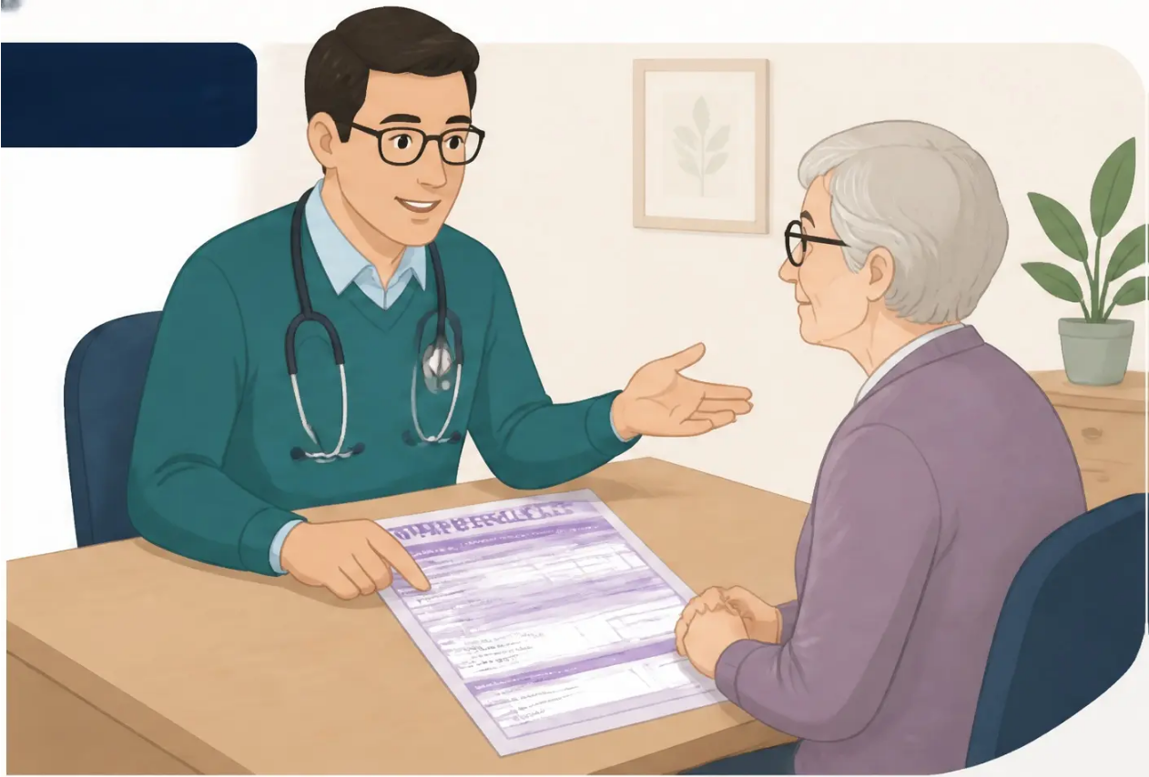








Section 5 · Emergency Care Planning
The ReSPECT Process
Recommended Summary Plan for Emergency Care and Treatment
Recommended Summary Plan for Emergency Care and Treatment
Clinician-completed document — not patient-completed,
but jointly discussed
Focuses on emergency and crisis
treatment decisions specifically
Not legally binding — but carries
significant professional and moral weight
Patient keeps the form at home —
for use by any clinician in a crisis
Introduced by Resuscitation Council UK,
launched 2017
“The ReSPECT form takes approximately 10 minutes
to complete — but the conversations behind it
take longer and matter more.”
For educational purposes only. Content reflects guidance current at time of publication.
Always refer to current national guidance and local policies.
www.bradfordvts.co.uk

Slide 21












ReSPECT vs Full ACP
Two related but distinct tools — knowing the difference matters
ReSPECT / ECP
Emergency Care Plan
Full ACP
Advance Care Planning
Focus
Focus
Emergency and crisis treatment decisions
Broader future care preferences, values and wishes
Completed by
Completed by
Clinician — with patient input and discussion
Patient — often with professional support
Legally binding?
Legally binding?
No — but carries significant professional weight
ADRT and LPA elements are legally binding
Speed of access
Speed of access
Rapid — designed for crisis use
Detailed — not designed for immediate crisis use
CPR discussion
CPR discussion
Always included and explicitly addressed
May be included as part of wider planning
Key point: ReSPECT is a subset of ACP — it focuses specifically on what happens in a medical emergency.
A full ACP conversation should ideally happen first, informing what goes on the ReSPECT form.
For educational purposes only. Content reflects guidance current at time of publication.
Always refer to current national guidance and local policies.
www.bradfordvts.co.uk

Slide 22










ReSPECT Form: Sections 1–3
Understanding what gets recorded – and why each section matters
SECTION 1
Personal Details & Clinical Summary
• Personal details, date of completion
• Summary of the person's current conditions
• Communication needs and preferences noted
• Other planning documents recorded here (e.g., existing ADRT or LPA noted)
SECTION 2
Person's Preferences & Priorities
"What matters to me is..."
• What matters most to the person — values, goals, fears
• Their priorities: quality of life vs length of life
• A priority scale is recorded here — from "focus on life-sustaining treatment"
to "focus on comfort and symptom relief"
• Completed with the person, in their own words where possible
SECTION 3
Specific Treatments: Try or Avoid
• Lists individual treatments to attempt or not attempt (e.g., IV fluids, antibiotics, hospital admission)
• Distinct from the CPR decision — this is about broader treatment preferences
• Completed jointly by clinician and patient during the conversation
• Should reflect the person's values from Section 2
For educational purposes only. Content reflects guidance current at time of publication.
Always refer to current national guidance and local policies.
www.bradfordvts.co.uk

Slide 23













ReSPECT Form: Sections 4-6
Clinical Recommendations, CPR Decisions & Who Was Involved
ResuscitatCt Coion UK — ReSPECT Process
SECTION 4
Clinical Recommendations for Emergency Care
DNACPR must be
INDIVIDUAL —
never a blanket decision
• Overall focus of care — comfort, active treatment, or both
• CPR recommendation — one of three options:
CPR attempts NOT recommended —
must be individually discussed
CPR attempts recommended
Modified CPR (children only)
• Specific treatment decisions (e.g. hospital admission, ventilation, IV fluids)
SECTION 5
Details of Those Involved in the Discussion
• Who was present — patient, family member, carer, named professional
• Date of discussion and name/role of clinician completing the form
The form belongs to the patient — they keep it at home
SECTION 6
Emergency Contacts & Key Professionals
• Emergency contact details (next of kin, carer, named person)
• Key professionals involved in care (GP, specialist, district nurse, care home)
Ensures any clinician responding in a crisis can quickly identify who to contact
For educational purposes only. Content reflects guidance current at time of publication.
23 / 35
www.bradfordvts.co.uk
Always refer to current national guidance and local policies.

Slide 24







Mental Capacity Act 2005
Five Statutory Principles — Every Clinician Must Know These
1
2
3
4
5
Presume Capacity
Maximise Capacity
Right to Unwise
Decisions
Best Interests
Least Restrictive
Option
Always assume a person
has capacity unless
proven otherwise
Take all practical steps to
help the person make
their own decision
A person may make a
decision others disagree
with — this alone does
not mean they lack capacity
Any act or decision
made for someone
lacking capacity must be
in their best interests
Consider whether a less
restrictive alternative can
achieve the same outcome
Capacity is decision-specific and time-specific — always assess for the
decision in front of you, at the time it needs to be made.
For educational purposes only. Content reflects guidance current at time of publication.
www.bradfordvts.co.uk
Always refer to current national guidance and local policies.

Slide 25







Capacity Assessment: TREA(T) Mnemonic
All four elements must be present. Capacity is decision-specific and time-specific.
Take In (Understand)
Can the person understand the information relevant to the decision?
Retain
Can they hold the information in mind long enough to make a decision?
Evaluate (Use or Weigh)
Can they use and weigh up the information to arrive at a decision?
Articulate (Communicate)
Can they communicate their decision — by any means
(speech, writing, gesture, eye movement)?
All four must be present for capacity. If any one element is absent —
the person lacks capacity for that specific decision at that time.
For educational purposes only. Content reflects guidance current at time of publication.
www.bradfordvts.co.uk
Always refer to current national guidance and local policies.
25 / 35

Slide 26
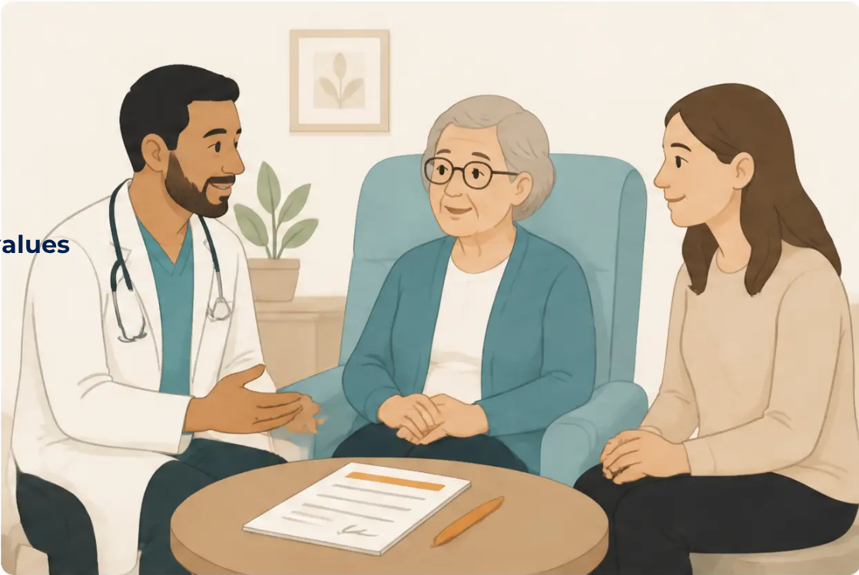














Best Interests Decision Making
When a patient lacks capacity — how do we decide?
Involve the person as much as possible
Even without full capacity, the person may still express
preferences, emotions, or reactions — these matter.
Consider past and present wishes, feelings, beliefs and values
What did they say when they had capacity? What is written
in their advance statement or ACP?
Consult people important to the person
Family, carers, friends — they advise, they do not decide.
Their role is to inform the best interests discussion.
Consider what the person would likely want
“If they could tell us, what would they say?” — use
everything known about their values and character.
Family members advise — they do not have
legal authority to decide (unless they hold a
registered Health & Welfare LPA)
Choose the least restrictive option
If two options achieve the same goal, always choose the one
that limits the person's rights and freedom the least.
For educational purposes only. Content reflects guidance current at time of publication.
Always refer to current national guidance and local policies.
www.bradfordvts.co.uk

Slide 27




DNACPR: Legal and Ethical Framework
Individual decisions. Patient-centred. Never blanket.
What DNACPR Is
What DNACPR Is NOT
Legal Framework
• A medical decision not to attempt CPR if
the heart stops or breathing ceases
• Clinicians are not legally obliged to offer
CPR if unlikely to succeed or not in best
interests
• NOT a withdrawal of all treatment
• NOT a "do not treat" order
• Part of a wider care plan — NOT the
whole care plan
• Must be an individual clinical decision
• NOT a blanket group decision
• Family may be consulted but cannot
override clinical judgement
• Made by the responsible clinician
• NOT based on age, disability, frailty
score, or care setting alone
• Must be communicated to the patient
(unless causing serious harm)
• CQC Report 2021: blanket DNACPR
orders during COVID-19 were found
unlawful and unethical
• NOT something that can be applied
without individual assessment
• Can be initiated by the patient
themselves
• Universal Principles for ACP (NHS
England 2022) published directly
in response
Red Flag: A DNACPR notice applied to a patient without any documented individual discussion
may be unlawful. Every decision must be individually assessed, documented, and where
appropriate, discussed with the patient.
For educational purposes only. Content reflects guidance current at time of publication.
27 / 35
www.bradfordvts.co.uk
Always refer to current national guidance and local policies.

Slide 28








DNACPR and CPR Success Rates
What the evidence tells us — and why it matters for every DNACPR conversation
< 5%
40–50%
10–15%
15–20%
Frailty, advanced cancer,
multi-organ failure
Community cardiac arrest
Overall CPR survival
In-hospital cardiac arrest
Shockable rhythm +
bystander CPR + early
defibrillation
Survival to discharge
To hospital discharge,
all settings
Survival very low; quality of
survival often poor
40–50%
15–20%
10–15%
< 5%
Community — best case
All settings average
Frailty /
Advanced disease
Illustrative comparison — not exact data; reflects typical outcomes.
🔑 Clinical Insight: CPR survival figures are frequently overestimated by patients and families. Studies suggest
the public believes survival rates are 3–4× higher than reality. Sharing accurate, compassionate information
is part of an ethical, individualised DNACPR conversation — not a reason to withhold CPR,
but a reason to discuss it honestly.
For educational purposes only. Content reflects guidance current at time of publication.
www.bradfordvts.co.uk
Always refer to current national guidance and local policies.
28 / 35

Slide 29
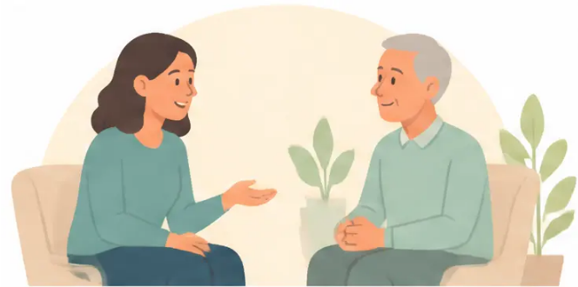







Initiating the ACP Conversation
Starting well — open questions that open doors
The best ACP conversations begin with curiosity — not a checklist.
Coping & Illness
Future Hopes
Quality of Life & Worries
“How have you been coping
with your illness recently?”
“When you think about the
future, what do you hope for?”
“What does quality of life
mean to you?”
“What does a good day look
like for you at the moment?”
“Do you like to think about or
plan ahead for your care?”
“When you think about the
future, what worries you most?”
REMEMBER
It is OK not to resolve everything today — one question can open a conversation
that continues over many appointments.
For educational purposes only. Content reflects guidance current at time of publication.
Always refer to current national guidance and local policies.
www.bradfordvts.co.uk
29 / 35

Slide 30









Communication Skills & Ending the Conversation
Practical skills for during and closing an ACP discussion
During the Conversation
Ending the Conversation
• Use plain language — avoid medical jargon
• Summarise what was discussed — or ask the patient to do so
• Give information in manageable chunks
• Screen for other concerns:
• Clarify vague statements:
"Is there anything else you'd like to discuss?"
"I don't want heroics" → "What do you mean by heroics?"
• Plan follow-up if needed — not everything must be resolved today
• Respect the person's pace — don't rush
• Document the conversation clearly in the clinical notes
• Use interpreters, not family members, when needed
• Share (with consent) with:
• Acknowledge emotions and allow silence
• GP out-of-hours service
• It is OK to have multiple conversations — not everything today
• Ambulance / 111
• District nurses
• Care home staff
Cultural consideration: Some communities prefer family-centred decision-making — respect this while upholding individual patient rights.
Always use culturally appropriate resources and professional interpreters.
• ICE framework:
• Safety-netting:
SCA Exam Pearl
"What are your ideas about what's
happening? What concerns you most?
What were you hoping we could do?"
"We'll review this together if things change —
please come back if you want to discuss
anything further."
For educational purposes only. Content reflects guidance current at time of publication.
Always refer to current national guidance and local policies.
www.bradfordvts.co.uk

Slide 31









AKT Exam Pearls
AKT
Key facts you are expected to know — written answer precision required
ADRT — Life-Sustaining Treatment
ADRT — When It Applies
Must be: written + signed + witnessed
and explicitly state “this applies even
if life is at risk”
Only activates when the person
lacks capacity to make that
specific decision at that time
LPA — Health & Welfare
MCA 2005 — Five Principles
Must be registered with the OPG before use.
Only activates when the donor lacks capacity.
Life-sustaining treatment covered only if
explicitly stated
Presume capacity · Maximise capacity ·
Right to unwise decisions · Best interests ·
Least restrictive option
Capacity Assessment
Powers of Attorney Act 2023
Decision-specific and time-specific.
Four abilities: understand · retain ·
weigh/use · communicate
Introduced digital LPA options and
enhanced safeguards against fraud.
Still registered with OPG
Remember: LPA for property & finances does NOT cover health decisions.
Next-of-kin has NO automatic legal authority.
For educational purposes only. Content reflects guidance
current at time of publication. Always refer to current
national guidance and local policies.
31 / 35
www.bradfordvts.co.uk

Slide 32













SCA EXAM PEARLS
SCA Exam Pearls
Communication, Consultation Skills & Clinical Reasoning
The SCA tests your ability to consult, communicate, and navigate complex clinical and ethical situations — not just recall facts.
ICE Framework
Opening the ACP Dialogue
Ideas: “What are your thoughts about what’s
happening to you?”
“Would you like to talk about what you’d like to happen
if you became very unwell?”
Concerns: “What worries you most about the future?”
“Do you ever think about the future and what your
care might look like?”
Expectations: “What were you hoping we could do today?”
“Is there anything you’d want us to know if you
couldn’t speak for yourself?”
Use ICE to open ACP conversations naturally — it feels
patient-led, not clinician-imposed.
Open-ended, non-threatening, and patient-paced — never rushed.
Safety-Netting in ACP
Navigating Family Concerns & Collusion
“I understand your family wants to protect you — let’s talk
about what would help most.”
“We’ll review this again together if things change.”
“Please come back if you want to discuss anything
further — there’s no pressure to decide today.”
Explore the family’s fears — often fear of distress, not malice.
“I’ll make sure your wishes are documented so
the whole team knows.”
Reassure: DNACPR ≠ withdrawal of all care.
Gently uphold the patient’s right to know — family
cannot override this.
Safety-netting signals ongoing partnership —
ACP is a process, not a single event.
Acknowledge, explore, reassure — then return to the
patient’s own voice.
In the SCA, marks come from how you communicate — not just what you know.
For educational purposes only. Content reflects guidance current at time of publication.
Always refer to current national guidance and local policies.
www.bradfordvts.co.uk

Slide 33












Red Flags & Common Pitfalls
Avoid these errors in ACP, ADRT, LPA, and DNACPR practice
Red Flags
Common Pitfalls
● DNACPR without documented discussion
● Confusing advance statement with ADRT
This may be unlawful — every decision must be
individual and patient-centred
Advance statements are NOT legally binding —
ADRTs are, if valid and applicable
● LPA not registered with OPG
● Assuming next-of-kin has legal authority
An unregistered LPA has no legal validity —
always ask to see the registered copy
They do NOT — unless they hold a registered
Health & Welfare LPA
● ADRT for life-sustaining treatment —
unwitnessed or unsigned
● Thinking DNACPR means "do not treat"
DNACPR applies to CPR only — all other
appropriate care continues
Not legally binding — treat as an advance
statement only
● Blanket DNACPR applied to a population group
● Assuming property & finance LPA covers health decisions
It does NOT — only a registered Health & Welfare LPA
covers medical decisions
Unlawful — confirmed by CQC 2021 COVID-19 findings
● Family demanding CPR against clear
clinical judgement
● Completing ReSPECT without having the
Educate, support, and document — but do not
override clinical best interests
conversation first
The form follows the discussion — never the other way around
For educational purposes only. Content reflects guidance current at time of publication.
33 / 35
www.bradfordvts.co.uk
Always refer to current national guidance and local policies.

Slide 34




Top Tips & Quick Recall
Eight pearls for practice — and rapid-fire recall for ACP, ADRT, LPA & ReSPECT
Universal Principles : 6 principles · 2022
QUICK RECALL
TOP TIPS FOR PRACTICE
Max 6 words each
Would I be surprised if this patient died in the next 12
months?" — if No → start ACP now
ACP : Voluntary · person-centred · capacity-required
ADRT : Specific refusal · binding if valid
ACP is a process — revisit at every deterioration,
not just once
ADRT life-sustaining : Written · signed · witnessed
ADRT for life-sustaining treatment: must be
written + signed + witnessed
LPA : Registered with OPG first
Health & Welfare LPA only activates when
the person lacks capacity
Health LPA : Only when lacking capacity
Life-sustaining treatment via LPA: only if
explicitly stated in the document
ReSPECT : Emergency plan · not legally binding
ReSPECT is not legally binding — but follow it as
part of best interests
DNACPR : Individual decision · never blanket
DNACPR must always be an individual decision —
never blanket
SurPECT Question : No? → Start ACP
Always check if an LPA exists — it takes precedence
over family members
MCA : Presume capacity · best interests · least restrictive
For educational purposes only. Content reflects guidance current at time of publication.
34 / 35
www.bradfordvts.co.uk
Always refer to current national guidance and local policies.

Slide 35



Thank You
End of Teaching Session — Advance Care Planning, LPA & ReSPECT
Core Messages to Take Away
● ACP is a voluntary, ongoing, person-centred process — not a one-off form
● ADRT for life-sustaining treatment must be written, signed, and witnessed
● LPA health and welfare only activates when capacity is lost — check OPG registration
● ReSPECT guides emergency care decisions — not legally binding, but professionally weighty
● DNACPR is always an individual clinical decision — never blanket, never coercive
● MCA 2005: presume capacity, best interests, least restrictive option
Disclaimer
This presentation is for educational purposes only.
It does not constitute clinical, legal, or professional advice.
Clinical judgement must always be applied in individual patient care.
Content reflects guidance current at time of publication (June 2026).
Always refer to current national guidelines, local policies, and relevant legislation.
Created by Bradford VTS | June 2026
www.bradfordvts.co.uk
For educational purposes only. Content reflects guidance current at time of publication.
Always refer to current national guidance and local policies.
www.bradfordvts.co.uk

