Slide 1

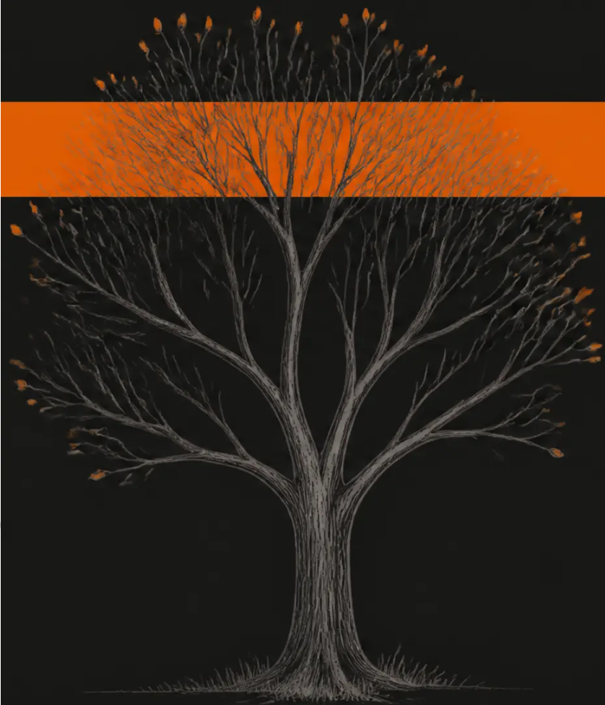


BRADFORD VTS TEACHING DECK
BEREAVEMENT
Bereavement
Understanding Grief and How to Help
Normal grief · Risk assessment · Clinical support · Compassionate practice
Updated to ICD-11 2022 · NHS Bereavement Care Standards · NICE NG31
Created June 2026
www.bradfordvts.co.uk
DISCLAIMER
This teaching deck is for educational purposes only.
All clinical decisions should be based on individual
patient assessment and current national guidelines.
Bradford VTS GP Training Programme
Bradford VTS Teaching Deck · Bereavement · June 2026 · www.bradvts.co.uk

Slide 2

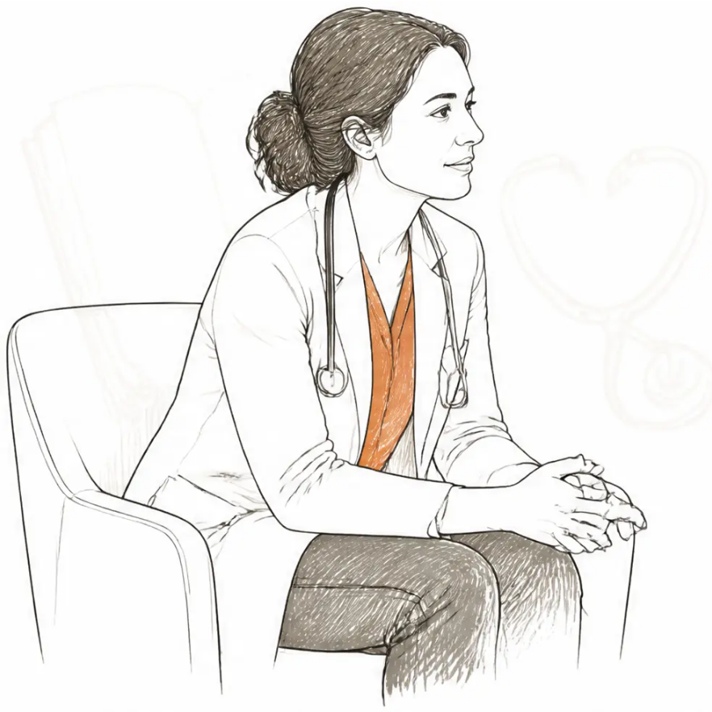
LEARNING OBJECTIVES • Bradford VTS • Bereavement
By the end of this session,
you will be able to...
1 Define bereavement, grief, and mourning —
and understand their differences
2 Describe models of normal grief —
Worden's Tasks and the Dual Process Model
3 Identify risk factors for Prolonged Grief Disorder
(ICD-11, 2022)
4 Implement a structured bereavement
protocol in primary care
5 Know when and how to refer for specialist
bereavement support
6 Support bereaved patients and families
effectively in general practice
Session length: approx. 45–60 minutes • Interactive case discussion included
Bradford VTS Teaching Deck • Bereavement • June 2026 • www.bradfordvts.co.uk
Slide 2 of 32

Slide 3




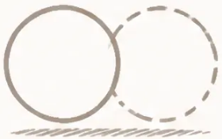


BRADFORD VTS — BEREAVEMENT
3 / 32
Definitions — Key Terms
Understanding the language of loss before we explore the experience
BEREAVEMENT
GRIEF
MOURNING
From Old English 'berafian' — to rob or plunder
Rando (1984)
The outward expression of grief
The objective situation of having
lost a significant person through
death.
The internal, subjective experience
of loss — emotional, psychological,
physical, and spiritual.
The social, cultural, and behavioural
practices through which grief is
expressed externally.
Being deprived of a continuing
relationship — the external, factual
reality of loss.
Grief is universal. It crosses all
socioeconomic and cultural boundaries.
It cannot be predicted, controlled, or
scheduled.
Shaped by culture, religion, and social
norms. Mourning is grief made visible —
it varies enormously between individuals
and communities.
Grief reactions are individual and variable — they may last weeks, months, or years. No two people grieve identically.
Bradford VTS Teaching Deck · Bereavement · June 2026 · www.bradfordvts.co.uk

Slide 4

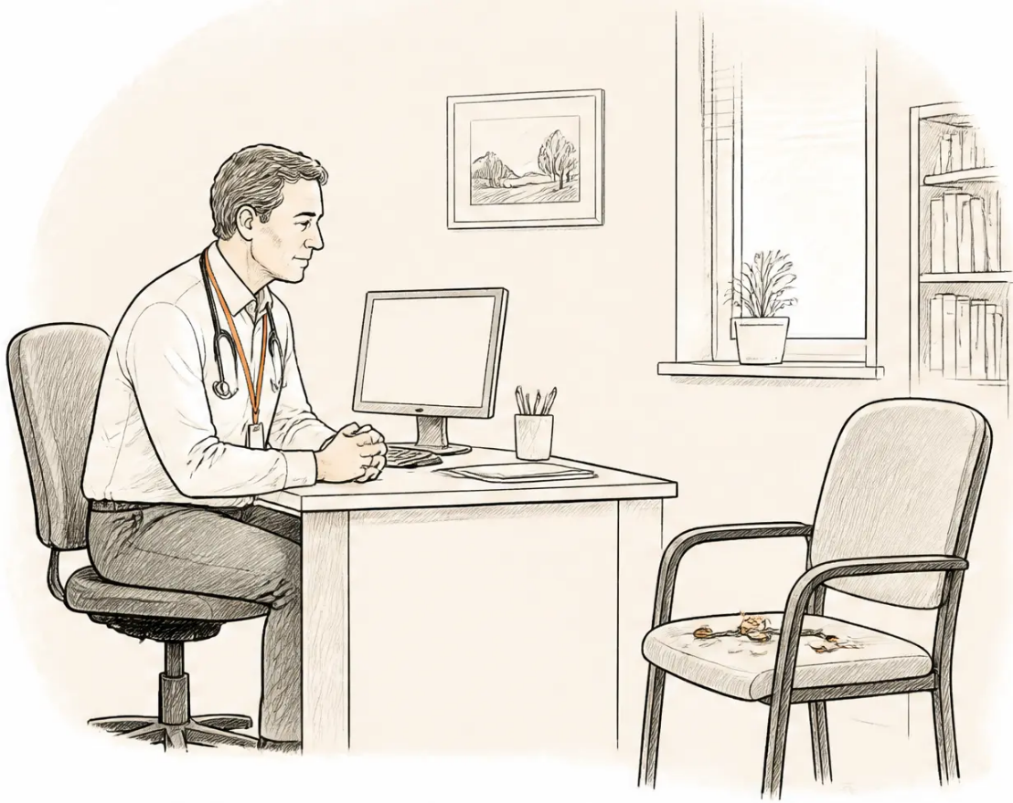







THE SCALE OF BEREAVEMENT IN PRIMARY CARE ● Slide 4 of 32
The Scale of Bereavement
in Primary Care
Every GP practice carries a significant, often invisible, bereavement caseload.
600,000
deaths per year in the UK (ONS)
5–10
bereaved individuals affected by each death
20–30
bereavements per year on an average GP list of 2,000 patients
...meaning up to 100–200 bereaved individuals actively affected at any one time
KEY INSIGHT
↑ GP Consultations
↑ Physical & Mental Illness
↑ Mortality Risk
Bereavement is one of the most common life events
presenting to primary care — yet it is often
under-recognised and under-supported.
Bereaved patients
consult more frequently
Depression, anxiety, PTSD,
physical illness
Elevated death risk in
bereaved spouses —
especially first 6 months
Bradford VTS Teaching Deck · Bereavement · June 2026 · www.bradfordvts.co.uk

Slide 5




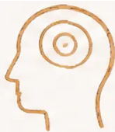
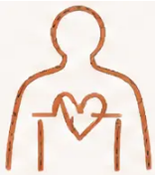




BRADFORD VTS · BEREAVEMENT · SLIDE 5 OF 32
Normal Grief Reactions
What to Expect — and What to Reassure
Emotional
Cognitive
Behavioural
Physical
Perceptual
Sadness · Yearning
Illusions of seeing
the deceased
Preoccupation with
the deceased
Tearfulness · Restlessness
Fatigue · Sleep disturbance
Anger · Guilt
Social withdrawal
Appetite changes
Hearing their voice
Confusion · Forgetfulness
Poor concentration
Anxiety · Relief
Searching behaviours
“Grief waves” ·
Chest tightness
Sensing their presence
(Common and normal —
not psychosis)
Grief reactions are normal. Many feel frightening to the bereaved person.
Your role: normalise, reassure, and accompany — not diagnose or fix.
Bradford VTS Teaching Deck · Bereavement · www.bradfordvts.co.uk · June 2026

Slide 6

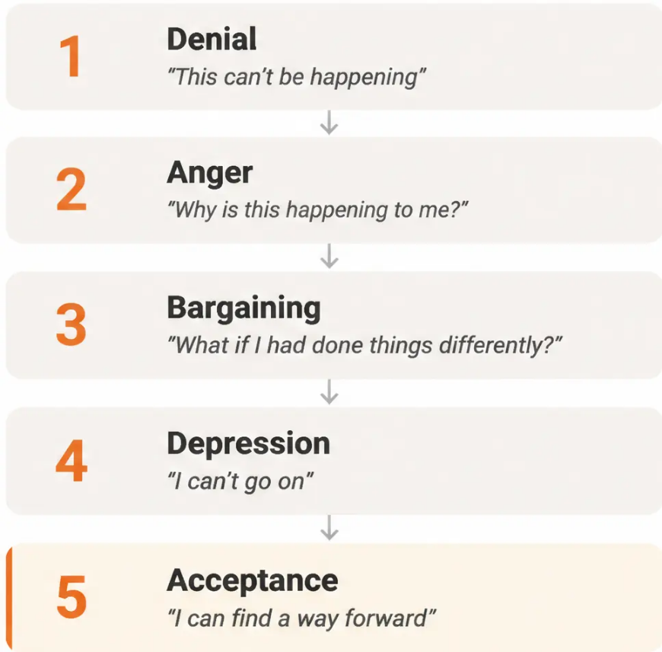

BRADFORD VTS · BEREAVEMENT
6 / 32
Kübler-Ross — 5 Stages of Grief
Historical Context
⚠ CLINICAL CONTEXT — 2026
◆ Originally observed in dying patients —
not bereaved family members
◆ Not a linear sequence — people cycle,
skip, and revisit stages unpredictably
◆ Not everyone experiences all five —
grief is individual, not formulaic
◆ Modern evidence has moved beyond this model —
Worden's Tasks and the Dual Process Model
are more clinically accurate
Use Kübler-Ross as a starting point for
normalising grief — never as a prescription
for how someone should grieve.
Elisabeth Kübler-Ross, On Death and Dying, 1969
Bradford VTS Teaching Deck · Bereavement · June 2026 · www.bradfordvts.co.uk

Slide 7








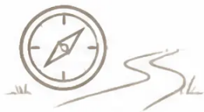

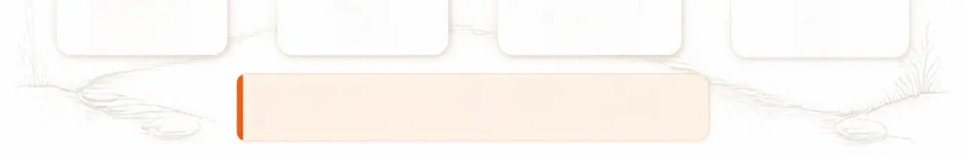

WORDEN'S FOUR TASKS OF MOURNING
Slide 7 / 32
Worden's Four Tasks of Mourning
Grief as an active process — not a passive experience
William Worden, 1992
1
2
3
4
Accept the Reality
of the Loss
Work Through
the Pain of Grief
Adjust to an Environment
Without the Deceased
Emotionally Relocate
the Deceased
Intellectual then emotional
recognition that the person
is gone — and is not
coming back. Initial denial
is normal and protective.
Allow difficult emotions
to be felt — not
suppressed or avoided.
Grief that is bypassed
does not dissippear;
it resurfaces later.
Practical and emotional
adaptation — new roles,
responsibilities, and identity.
May involve learning entirely
new skills and redefining
oneself.
Not forgetting — but finding
a new internal place for the
deceased that allows
continued living. Letting go
of the presence while
keeping the bond.
Clinical use: More flexible and less prescriptive than Kübler-Ross.
Tasks can be revisited — grief is not a one-way street.
Tasks framework is widely used in grief therapy and counselling.
Bradford VTS Teaching Deck · Bereavement · June 2026 · www.bradfordvts.co.uk

Slide 8


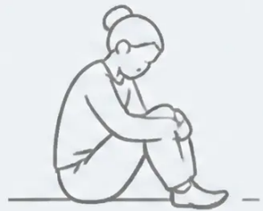


THE DUAL PROCESS MODEL
Stroebe & Schut, 1999 · Updated 2010
The Dual Process Model
Healthy grieving = active oscillation between two orientations
Loss Orientation
Restoration Orientation
OSCILLATION
• Yearning for the deceased
• Adjusting to new roles
Normal, healthy grieving
moves fluidly between
both orientations
• Processing grief emotions
• Learning new skills
• Revisiting memories
• Rebuilding social identity
• Intrusive thoughts about the loss
• Distraction from grief
Feeling the loss
Rebuilding life
● Only Loss-Oriented
● Only Restoration-Oriented
Risk of rumination and complicated grief
Risk of avoided or delayed grief
Bradford VTS Teaching Deck · Bereavement · June 2026 · www.bradfordvts.co.uk

Slide 9


BRADFORD VTS • BEREAVEMENT • SLIDE 9 OF 32
Continuing Bonds Theory
Klass, Silverman & Nickman, 1996 — a modern reframing of healthy grief
“Grief is not about severing ties with the
deceased — it is about transforming
the relationship.”
● Maintain the bond
The relationship continues internally — as memory, meaning, and identity.
● Transform the connection
From physical presence → to inner presence.
The deceased remains part of who we are.
● This is healthy, not pathological
Talking to the deceased, keeping meaningful objects,
asking "what would they have wanted?" —
all normal and healthy.
The relationship transforms — it does not end.
Do not pathologise continuing bonds — they are a sign of healthy adaptation.
Bradford VTS Teaching Deck • Bereavement • www.bradfordvts.co.uk • June 2026

Slide 10

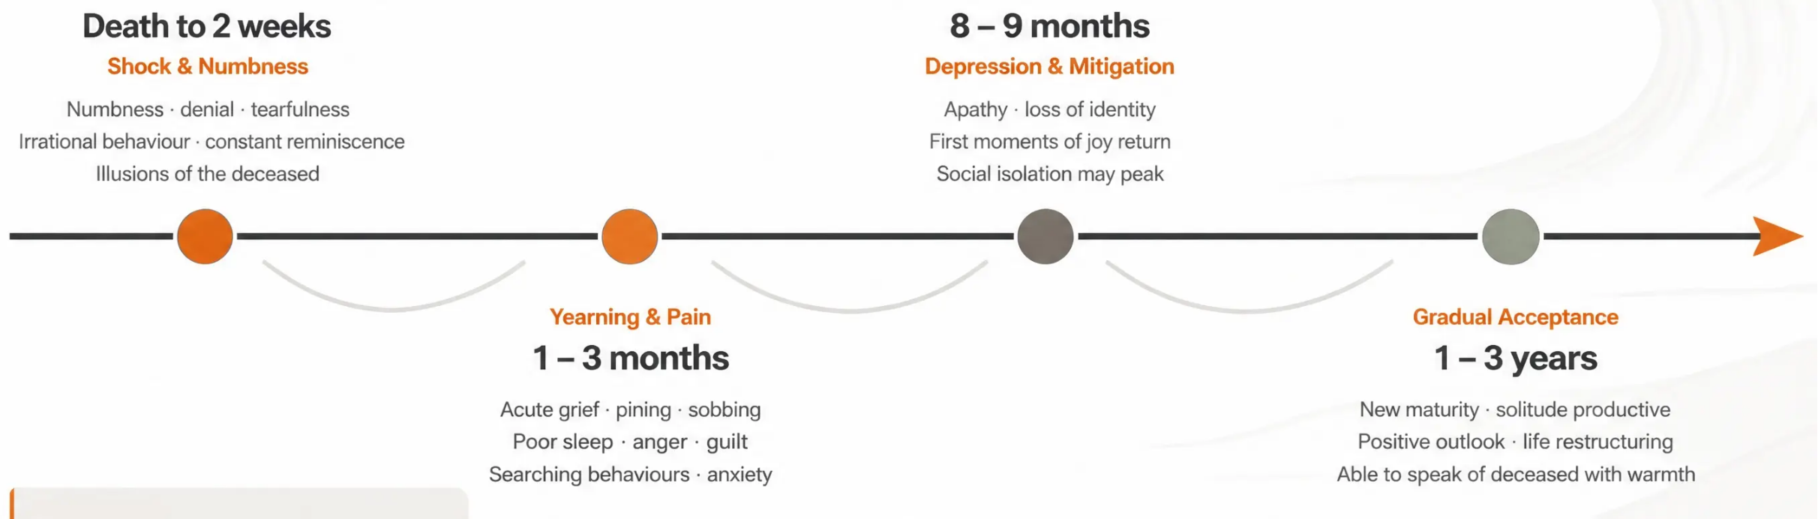

BRADFORD VTS · BEREAVEMENT · DECK 7
Parkes' Phases of Grief Timeline
Colin Murray Parkes (1972) — a guide to typical grief progression. Individual variation is wide.
Clinical note
Depression may persist longer in older adults.
This timeline is a guide — never a prescription.
Always follow the individual.
Bradford VTS Teaching Deck · Bereavement · June 2026 · www.bradfordvts.co.uk
10 / 32

Slide 11















BRADFORD VTS • BEREAVEMENT • DECK 7
11 / 32
Risk Assessment
in Bereavement
BEREAVEMENT CAN LEAD TO:
Physical Illness
Mental Illness
Why identifying high-risk individuals matters
Increased cardiovascular risk;
immune suppression
Depression, anxiety, PTSD
Bereavement is not simply sadness.
It is a recognised risk factor for physical illness,
mental illness, and premature death —
particularly in the first six months.
Substance Misuse
Increased GP Visits
Increased alcohol and
drug use
Somatic presentations;
repeated consultations
The primary care team’s role: proactively identify
high-risk individuals before crisis develops.
GP Responsibility: It is impossible to predict exactly
how someone will respond to loss — but structured
risk assessment allows earlier, targeted support.
Premature Death
Prolonged Grief Disorder
Widowhood effect — elevated
mortality, especially first 6 months
~10% of bereaved; ICD-11
diagnosis; needs specialist care
Bradford VTS Teaching Deck • Bereavement • www.bradfordvts.co.uk • June 2026

Slide 12









RISK FACTORS FOR COMPLICATED GRIEF
12 / 32
Risk Factors for Complicated Grief
Identifying who is at higher risk — so we can support them proactively
No single factor predicts outcome — but combinations significantly raise risk.
MODE OF DEATH
NATURE OF THE RELATIONSHIP
• Sudden, unexpected, or traumatic death
(accident, cardiac arrest)
• Highly ambivalent relationship → guilt and
unresolved feelings
• Violent death or suicide
• Highly dependent relationship → overwhelming
sense of loss
• Prolonged suffering or disfiguring illness
• Loss of a child (any age) → typically the most
severe grief
Terminal illness death can still feel sudden to the bereaved.
SOCIAL & SITUATIONAL FACTORS
PERSONAL & MEDICAL HISTORY
• Perceived isolation — lack of family or friends
• Previous mental illness, especially depression
• Grief actively discouraged by social environment
• Substance misuse (alcohol, drugs)
• Concurrent life crises: financial stress,
redundancy, other losses
• Physical ill health in the bereaved person
• Anticipatory denial before death → harder to
grieve after
• Prior unresolved losses resurfacing
Combinations of risk factors — not single factors — best predict complicated grief.
Use clinical judgement alongside screening tools.
Bradford VTS Teaching Deck • Bereavement
www.bradfordvts.co.uk • June 2026

Slide 13











BRADFORD VTS • BEREAVEMENT • DECK 7
The Kirkwood Hospice
Vulnerability Questionnaire
Validated screening tool • Identify at-risk bereaved individuals • Score ≥13 = High Risk
Relationship to patient
Widow / Widower / Partner / Parent of adult child
Family unable to share feelings openly
Patient has children at home
Age 0–5 or 13–16 scores highest
Heavy alcohol or drug use
Main carer unusually dependent or insecure
Lacks caring family or friends
Concurrent life crisis
Financial stress, redundancy, other losses
Unusually angry or bitter
Unusually self-reproachful or guilt-ridden
Pre-existing mental illness, cardiac
problems, or prior suicide attempt
Score ≥ 13
Proactive GP contact and bereavement referral recommended
= HIGH RISK
Use alongside clinical judgement — not as a standalone tool
Bradford VTS Teaching Deck • Bereavement • June 2026
13 / 32 • www.bradfordvts.co.uk

Slide 14

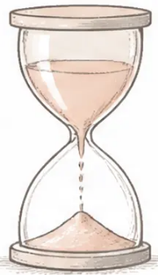





PROLONGED GRIEF DISORDER
Slide 14 of 32
Prolonged Grief Disorder
ICD-11 (2022) · DSM-5-TR (2022)
Diagnostic Features (ICD-11)
Previously called: complicated grief · pathological grief · chronic grief
Persistent & Pervasive Response
AT A GLANCE
Grief not diminishing with time — beyond what is culturally expected
● Timeframe: Persistent grief NOT diminishing
after ≥ 6 months from bereavement
Core Symptom
Persistent yearning for the deceased OR persistent preoccupation with them
● Prevalence: Affects approximately ~10%
of bereaved individuals
Intense Emotional Pain
Sadness · guilt · anger · denial · difficulty accepting the death ·
loneliness · loss of identity
● Core feature: Persistent yearning OR
preoccupation with the deceased
Functional Impairment
● Impact: Significantly impairs daily functioning —
personal, social, occupational
Significantly disrupts personal, family, social, educational,
or occupational life
This IS a clinical diagnosis —
it requires active treatment
Risk Factors for PGD
Sudden death
Suicide
bereavement
Loss of
a child
Prior
attachment
difficulties
Limited
social support
NOT standard antidepressants unless comorbid MDD
Bradford VTS Teaching Deck · Bereavement · June 2026 · www.bradfordvts.co.uk

Slide 15






BRADFORD VTS TEACHING DECK • BEREAVEMENT
Slide 15 / 32
The Bereavement Support Spectrum
NHS 3-Tier Model
Complex / Prolonged Grief Disorder
TIER 3
Specialist
Specialist psychological therapy • Grief-focused CBT •
Psychiatric assessment • Psychosexual assessment
Delivered by: NHS Talking Therapies (IAPT) • Specialist
counsellors • Psychiatry
TIER 2
Higher-risk individuals
Structured bereavement support • Group and individual sessions
Selective
Delivered by: Macmillan • Hospice bereavement services •
Cruse • Samaritans
TIER 1
ALL bereaved people
Information about the normality of grief • Practical support • Signposting
Universal
Delivered by: GP • Practice nurse • District nurse • Community teams
GP ROLE
Triage to appropriate tier • Monitor for Prolonged Grief Disorder • Make timely referrals
Bradford VTS Teaching Deck • Bereavement • June 2026 • www.bradfordvts.co.uk

Slide 16

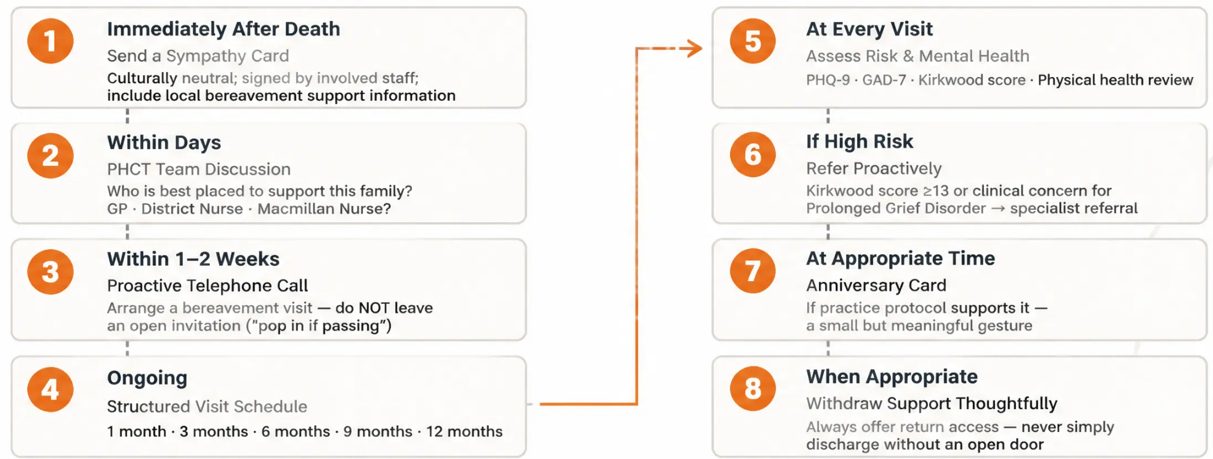


BRADFORD VTS TEACHING DECK • BEREAVEMENT
Slide 16 of 32
The Bereavement Protocol
in Primary Care
A structured step-by-step approach — adapted from Yorkshire Cancer Network, updated to current practice
KEY PRINCIPLE
Bereaved people rarely self-refer. Proactive, scheduled
contact is the single most important thing a practice can do.
Bradford VTS Teaching Deck • Bereavement • June 2026 • www.bradfordvts.co.uk

Slide 17
















BRADFORD VTS • BEREAVEMENT
Slide 17 of 32
Telephone Checklist
for Bereaved Relatives
Cover these seven areas during every follow-up call — document in clinical records
1 Sleep
5 Family & Friends
Disturbed sleep is common — if severe,
consider active management
Social support is the single most
protective factor in bereavement
2 Appetite
Significant change (up or down) →
consider physical assessment
6 Anger or Guilt
Explore and normalise — excessive guilt
may indicate complicated grief
3 General Health
Somatic symptoms are common —
don't dismiss physical complaints
7 Thoughts of Self-Harm
Ask directly if any concern arises —
never assume absence of ideation
4 Going Out
Social isolation is a key risk factor for
Prolonged Grief Disorder
Always document bereavement support conversations in clinical records.
Bradford VTS Teaching Deck • Bereavement • June 2026 • www.bradfordvts.co.uk

Slide 18
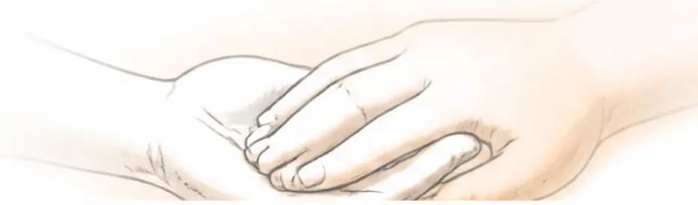





TEN WAYS TO HELP THE BEREAVED
18 / 32
Ten Ways to Help the Bereaved
Source: Goodall, Drage & Bell — therapeutic presence over problem-solving
01 • Be There
06 • Know Your Own Feelings About Loss
Presence alone is therapeutic — showing up matters
Self-awareness prevents projection and burnout
02 • Listen Without Judgement
07 • Offer Reassurance
“What you’re feeling is completely normal”
Accept what they say without correcting or advising
03 • Show You Are Listening
08 • Don’t Take Anger Personally
Eye contact, nods, paraphrasing — signal your attention
Anger is a normal part of grief — you are a safe target
04 • Encourage Them to Talk About the Deceased
09 • Recognise Vicarious Grief
Allow memories — don’t steer away from the person who died
Your feelings may reflect theirs — that is natural
05 • Tolerate Silences
10 • Accept You Cannot Fix This
Grief needs space — resist the urge to fill the quiet
Your role is to accompany — not to cure the loss
Your role is to accompany, not to fix.
Bradford VTS Teaching Deck • Bereavement • June 2026 • www.bradfordvts.co.uk

Slide 19
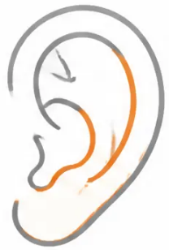

















KEYS TO GOOD LISTENING IN BEREAVEMENT SUPPORT
19 / 32
Keys to Good Listening
Adapted from Ward & Associates (1994) 'Good Grief' —
Core communication skills for bereavement support
Source: Ward & Associates, 1994 • Good Grief
You cannot listen while you are talking.
Warmth and Caring
Open Questions
Genuinely concerned, accepting, and friendly —
not performed warmth, but real human presence.
Ask questions that cannot be answered with yes or no.
'How have you been feeling?' not 'Are you feeling better?'
Empathy
Tolerate Silence
Try to understand from their perspective — not sympathy
('I feel sorry for you') but empathy ('I am trying to
understand how this feels for you').
Don't rush to fill pauses. A long silence often means
the person is still processing — not that conversation
has failed.
Non-Judgemental Acceptance
Clarify and Summarise
Accept the person and their feelings — whatever
those feelings are. There are no wrong emotions in grief.
Check you have understood: 'It sounds like you're
saying... is that right?' Summarising shows you have
truly heard them.
Respect and Genuineness
Listen for Feelings — and What is NOT Said
Honour their right to feel any emotion and make
free choices. Be real — not playing a role.
People sense inauthenticity.
Listen for emotional undertones, not just facts.
What is left unsaid is often as important as what is spoken.
Limit your own talking • Don't interrupt • Don't assume • Never complete their sentences
The most powerful thing you can offer a bereaved person is your full, unhurried attention.
Bradford VTS Teaching Deck • Bereavement • www.bradfordvts.co.uk • June 2026

Slide 20


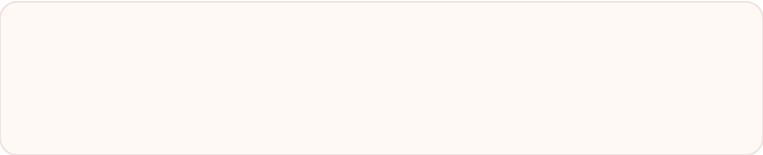



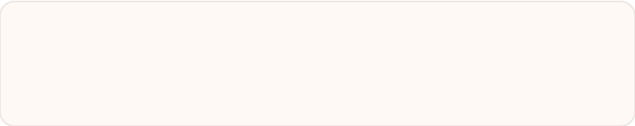


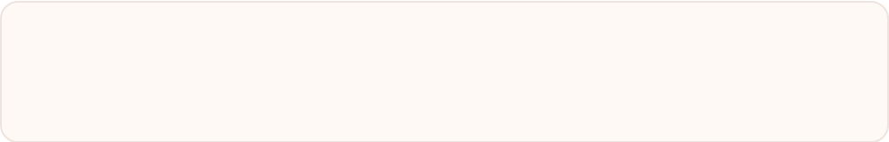
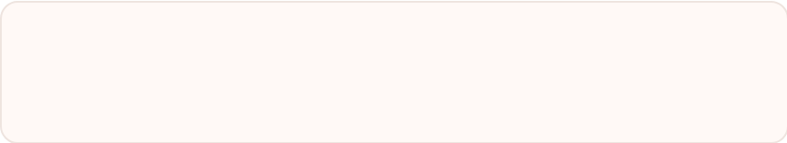






BRADFORD VTS TEACHING DECK — BEREAVEMENT
Page 20 of 32
What Not to Say
Common phrases that minimise loss or judge the grieving process — and why they land badly
“I know how you feel”
“At least they’re not suffering anymore”
Unless you’ve experienced the same loss —
you almost certainly don’t.
The bereaved person is — don’t rush
to reframe their pain.
“You should be feeling better by now”
“Try not to dwell on it”
Implies their grief is running on
the wrong schedule.
Avoidance worsens grief —
this is the opposite of helpful.
“Everything happens for a reason”
“At least you still have your other children”
Minimises the reality and
randomness of loss.
Every relationship is irreplaceable.
Never compare losses.
“You can always have another...”
“Changing the subject or avoiding the person”
Never say this about any loss —
a child, a partner, a pet.
Signals their grief is too uncomfortable for you —
isolation deepens grief.
KEY PRINCIPLE
The bereaved person hasn’t forgotten their loss — you don’t need to protect them
from being reminded. Your role is to accompany, not to fix.
Bradford VTS Teaching Deck · Bereavement · June 2026 · www.bradfordvts.co.uk

Slide 21
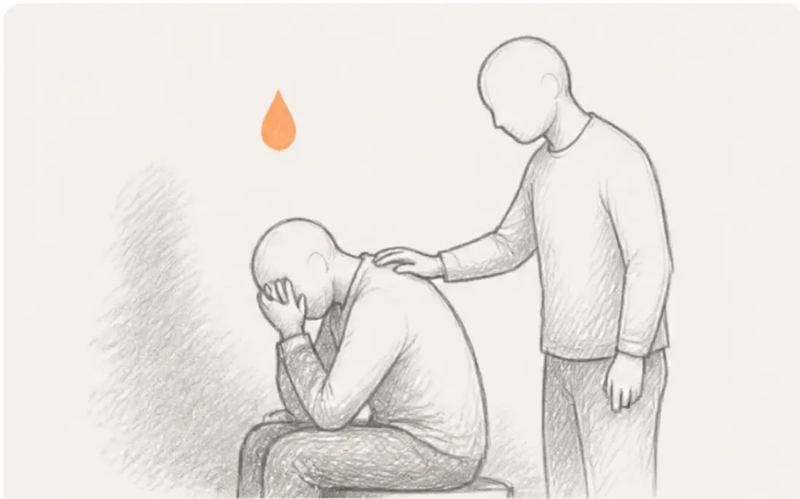



SUICIDE BEREAVEMENT
Slide 21 of 32
Suicide Bereavement
Special Case
A qualitatively different bereavement — proactive, compassionate, and specific GP response required.
What Makes This Different
■ Guilt & responsibility — “Did I miss the signs?” is almost universal
■ Stigma — survivors often receive less social support due to social taboo
■ Contagion risk — elevated suicide risk in close social networks
■ Higher PGD & PTSD rates — compared with other bereavement types
GP Actions
→ Contact within days — not weeks — of the bereavement
→ Acknowledge the specific nature of this loss directly and compassionately
→ Screen for depression and suicidal ideation in survivors — ask directly
→ Consider safeguarding for dependent children in the household
Grief after suicide carries a unique weight —
guilt, stigma, and unanswered questions.
→ Refer to: SOBS (Survivors of Bereavement by Suicide) and
SASP (Support After Suicide Partnership)
HIGH RISK
Suicide bereavement: always proactive contact · always ask about mental health · never assume the family is coping.
Bradford VTS Teaching Deck · Bereavement · June 2026 · www.bradfordvts.co.uk

Slide 22
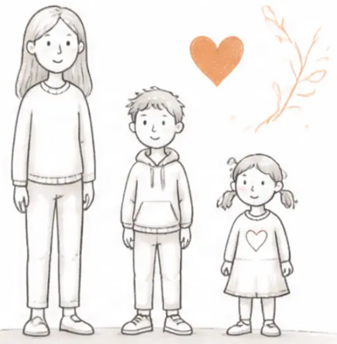








CHILDREN AND YOUNG PEOPLE
22 / 32
Children and Young People
Grief is different in children — but equally important to recognise and support
AGE-APPROPRIATE RESPONSES
KEY PRINCIPLES
Be honest — Use clear language. Say “has died” —
not “gone to sleep” or “passed away.”
May not understand the permanence of death.
Under 5
May ask when the person is coming back.
Euphemisms cause confusion and anxiety.
Play continues normally — this is healthy, not uncaring.
Maintain routines — Security and predictability
are protective. Keep school, meals, and bedtimes
as normal as possible.
Understands death is permanent. Grief may
5-12
appear as anger, school problems, or physical
complaints rather than open sadness.
Allow involvement — Let children attend
funerals or memorial rituals if they wish.
Often masks grief. Peer group becomes
Choice and agency matter.
Watch for warning signs — Persistent regression,
school refusal, prolonged withdrawal, or suicidal
thoughts → urgent CAMHS referral.
Adolescents
primary support. Risk of risk-taking behaviour.
May grieve in private.
SPECIALIST REFERRAL RESOURCES
Winston's Wish
Child Bereavement UK
childbereavementuk.org
winstonswish.org · 08088 020 021
Bradford VTS Teaching Deck · Bereavement · June 2026 · www.bradfordvts.co.uk

Slide 23














BRADFORD VTS • BEREAVEMENT • SLIDE 23 OF 32
Cultural Diversity
in Bereavement
Practices vary — always ask, never assume
Muslim
Hindu
Jewish
Sikh
Christian
Janazah prayer - burial within 24 hours
Akhand Path — continuous
scripture reading
Cremation - Antim Sanskar ritual
Shiva — 7-day mourning period
Wide variation across denominations
Iddah — 3-month mourning for widow
13-day mourning period
Simple burial within 24 hours
Burial or cremation; vigils
Cremation - Bhog ceremony
Belief in divine will guides expression
Shraddha memorial ceremonies
Kaddish prayers - mirrors covered
Anniversary remembrance common
Community mourning and prayer
Always ask — never assume
Ask: ‘What traditions or rituals are important to you and your family at this time?’
Never assume cultural practices based on ethnicity or appearance.
Bradford VTS Teaching Deck • Bereavement • www.bradfordvts.co.uk • June 2026

Slide 24



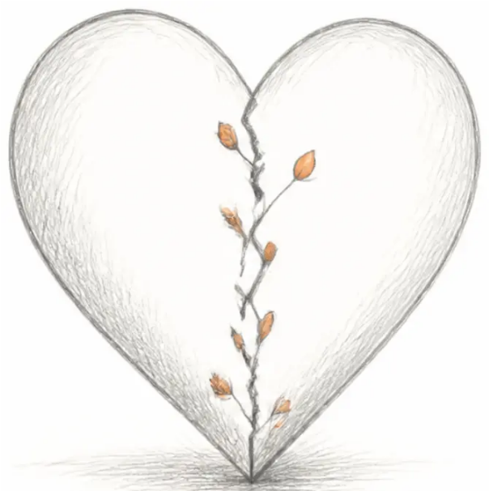


BRADFORD VTS · BEREAVEMENT
24 / 32
Bereavement and
Physical Health
THE WIDOWHOOD EFFECT
Bereaved spouses face significantly increased mortality —
especially in the first 3–6 months. Risk is highest in older men.
Proactive GP contact in this window is essential.
The GP's responsibility — monitoring, assessing, and acting
CARDIOVASCULAR RISK
Acute grief can trigger Takotsubo cardiomyopathy ('broken heart
syndrome'). Bereaved patients presenting with chest pain or
breathlessness → ECG and troponin urgently. Immune function
is also reduced in acute grief.
ALCOHOL · SUBSTANCE USE · SELF-NEGLECT
Alcohol and substance use commonly increase after bereavement.
Screen proactively with AUDIT at every bereavement visit. Monitor
for poor nutrition, missed medications, and sleep deprivation — all
have compounding health consequences.
GP ACTIONS AT BEREAVEMENT VISITS
● Review medication adherence
'Broken heart syndrome' (Takotsubo cardiomyopathy)
— a real clinical entity in acute grief
● Screen for alcohol use (AUDIT)
● Physical health check at 6–12 months
● Be alert: new somatic symptoms may be grief seeking expression
Bradford VTS Teaching Deck · Bereavement · June 2026 · www.bradfordvts.co.uk

Slide 25






BRADFORD VTS · BEREAVEMENT
Bereavement Support Resources
General Support
Child & Family Support
Suicide Bereavement
● Cruse Bereavement Care
● Winston's Wish
● Survivors of Bereavement by
Suicide (SOBS)
cruse.org.uk
winstonswish.org
Helpline: 0808 808 1677
uksobs.org
08088 020 021
Peer support for those bereaved
by suicide
● Macmillan Cancer Support
For bereaved children and families
macmillan.org.uk
● Support After Suicide Partnership (SASP)
Cancer-related bereavement
● Child Bereavement UK
supportaftersuicide.org.uk
childbereavementuk.org
National coordination and resources
● Marie Curie Bereavement Support
mariecurie.org.uk
Support for children, young people
and families
● Samaritans
● Samaritans
116 123 — 24 hours
samaritans.org
Also supports those bereaved by suicide
116 123 — 24 hours
● Mind Bradford
Local mental health support
including bereavement
● Bradford Hospice Bereavement Services
● NHS Talking Therapies (IAPT)
Local specialist support
Self-referral for grief-related
depression and anxiety
GP tip: Frame referrals as additional support — not a hand-off. 'I'd like you to have Cruse alongside us, not instead of us.'
Bradford VTS Teaching Deck · Bereavement
www.bradfordvts.co.uk · June 2026 · Slide 25 of 32

Slide 26


















BRADFORD VTS — BEREAVEMENT
Top Tips in General Practice
Practical essentials for every primary care team
Name a Bereavement Lead
Recognise Prolonged Grief Disorder
Every practice needs a named bereavement lead
and a written protocol — not ad hoc.
PGD (ICD-11 2022): ≥6 months of severe,
impairing grief → specialist referral, not just reassurance.
Schedule Follow-Up Proactively
Use the Kirkwood Score
Never leave support open-ended.
Book: 1 month · 3 months · 6 months · 9 months · 12 months.
Score ≥13 → proactive GP contact and
bereavement support referral. Don't wait for the patient to ask.
Use Kübler-Ross Carefully
Always Assess the Children
Useful introductory framework — NOT a linear
roadmap. Don't use it prescriptively with patients.
Children in the bereaved family need separate
assessment. Refer to Winston's Wish when needed.
Act Fast After Sudden Death
Ask About Alcohol Every Time
Sudden, violent, or suicide bereavement →
proactive contact within days, not weeks.
Screen for alcohol use (AUDIT) and medication adherence
at every bereavement visit — both commonly overlooked.
Bradford VTS Teaching Deck · Bereavement
26 / 32 · www.bradfordvts.co.uk

Slide 27















BRADFORD VTS · BEREAVEMENT
27 / 32
AKT Exam Pearls
Key clinical facts for the Applied Knowledge Test — know these cold
Prolonged Grief Disorder
Worden's 4 Tasks
ICD-11 (2022) & DSM-5-TR (2022) · ≥ 6 months ·
~10% of bereaved · specialist treatment required
Accept reality → Work through pain → Adjust to
environment → Emotionally relocate deceased
Dual Process Model
PGD Risk Factors
Oscillate between Loss-Orientation and
Restoration-Orientation · neither pole alone is healthy
Sudden/violent death · suicide · loss of child ·
poor social support · prior mental illness
Widowhood Effect
Kirkwood Score ≥ 13
↑ mortality in bereaved spouses · greatest risk in
first 6 months after bereavement
High risk → proactive GP contact and
specialist bereavement support referral
NHS 3-Tier Model
Kübler-Ross Caveat
Universal → Selective → Specialist
Historical model · NOT a linear prescription ·
not based on bereaved family research
Bradford VTS Teaching Deck · Bereavement · June 2026 · www.bradfordvts.co.uk

Slide 28









BRADFORD VTS TEACHING DECK • BEREAVEMENT
SCA EXAM PEARLS
SCA Exam Pearls
Consultation skills • Communication • Mental health screening
Opening the Consultation
Children in the Bereaved Family
“I’m so sorry for your loss. How have you been
getting on since...?”
“How are the children doing? Do you need any
support for them?”
Always ask — children are often overlooked in bereavement visits.
Open with warmth — never rush to the clinical agenda.
Normalising Grief
Suicide Bereavement Consultation
“What you’re feeling is completely normal — grief
can feel overwhelming and unexpected.”
“Acknowledge the specific difficulty. Ask directly
about the patient’s own mental health. Offer
rapid follow-up.”
Reassurance is a clinical intervention in itself.
Don’t avoid the word suicide — it does not increase risk.
Somatic Presentations
Referring to Cruse or Macmillan
“When a patient presents with a new physical
symptom — consider whether this is grief
presenting physically.”
“Frame as additional support — not a hand-off.
I’d like you to also have access to....”
Depression vs normal grief: PHQ-9 ≥10 at 3+ months
with functional impairment → treatment needed.
Ask gently about recent losses if not already documented.
SCA TIP: Your role is to accompany — not to fix.
Bradford VTS Teaching Deck • Bereavement • June 2026 • www.bradfordvts.co.uk • Slide 28 of 32

Slide 29

















BRADFORD VTS TEACHING DECK · DECK 7 — BEREAVEMENT
29 / 32
Red Flags in Bereavement
Critical indicators requiring urgent clinical action
Active Suicidal Ideation
Takotsubo Cardiomyopathy
Acute chest pain in bereaved person →
ECG and troponin urgently
Urgent same-day mental health assessment — do not defer
Prolonged Grief Disorder
Suicide Bereavement —
Children in Household
≥ 6 months, significant functional impairment → specialist referral
Safeguarding assessment required;
proactive contact within days
Bereaved Children Not Assessed
Always evaluate children separately — refer to Winston's Wish if needed
Prior Mental Illness
Rapidly Deteriorating
Marked Alcohol or Substance Increase
Dual diagnosis assessment; AUDIT screening;
safeguarding if children present
Urgent psychiatric review; do not manage
alone in primary care
When in doubt — act early. Bereaved patients rarely self-escalate.
Bradford VTS Teaching Deck · Bereavement · June 2026 · www.bradfordvts.co.uk

Slide 30













COMMON PITFALLS
30 / 32
Common Pitfalls
Errors in bereavement care that are common — and avoidable
Medicalising Normal Grief
Open-Ended Support Only
Prescribing antidepressants immediately
for sadness in acute bereavement
“Come back anytime” — bereaved people
rarely self-refer; always schedule proactively
Kübler-Ross as a Checklist
Not Assessing Children
“You should be at acceptance by now” —
stages are not a prescriptive timeline
Children in bereaved families must
always be evaluated separately
Missing Prolonged Grief Disorder
Assuming Cultural Practices
PGD at 6+ months is commonly overlooked —
always review at that milestone
Never assume rituals or beliefs based
on appearance — always ask
Not asking about suicide in suicide bereavement survivors out of fear of causing offence is itself a clinical error.
Bradford VTS Teaching Deck • Bereavement • June 2026 • www.bradfordvts.co.uk

Slide 31









QUICK RECALL
Slide 31 of 32
Quick Recall
Key concepts, models, and contact numbers — at a glance
WORDEN — TASK 4
DUAL PROCESS MODEL
PGD — ICD-11 (2022)
KIRKWOOD SCORE
Emotionally relocate
the deceased and
move on — not 'forget'
Oscillate between
LOSS orientation and
RESTORATION
orientation
≥ 6 months · significant
impairment · ~10%
bereaved · specialist
treatment
Score ≥ 13 = high risk
→ proactive GP
contact and referral
WIDOWHOOD EFFECT
NHS 3-TIER MODEL
CRUSE HELPLINE
WINSTON'S WISH
↑ mortality in
bereaved spouse —
especially in
first 6 months
Universal
↓
Selective
↓
Specialist
0808 808 1677
08088 020 021
Cruse Bereavement Care
Child bereavement support
Kübler-Ross stages: a useful starting point — never a prescriptive sequence
Bradford VTS Teaching Deck · Bereavement · June 2026 · www.bradfordvts.co.uk

Slide 32

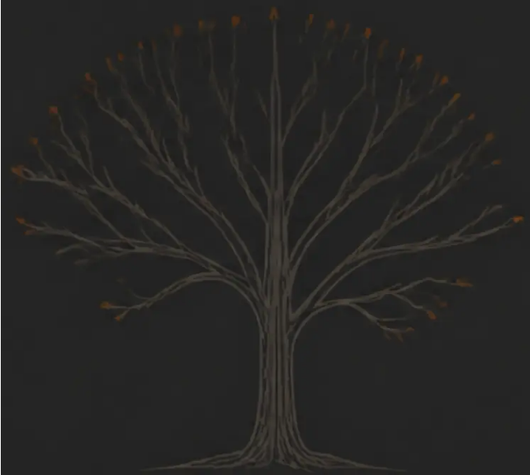

BRADFORD VTS TEACHING DECK · BEREAVEMENT · JUNE 2026
DISCLAIMER
This teaching deck is for educational purposes only.
All clinical decisions should be based on individual patient assessment
and current national guidelines.
Content reflects evidence available at June 2026.
KEY REFERENCES
Worden WJ (2018) Grief Counselling and Grief Therapy, 5th Edition
Stroebe & Schut (1999; updated 2010) — Dual Process Model of Coping with Bereavement
ICD-11 (2022) — Prolonged Grief Disorder classification
www.bradfordvts.co.uk
DSM-5-TR (2022) — Prolonged Grief Disorder formal diagnosis
NICE NG31 — Care of Dying Adults in the Last Days of Life (2015)
Bradford VTS GP Training Programme
NHS England — Bereavement Care Standards (2022)
Bradford, West Yorkshire
RCGP Bereavement Guidance
Original source material: Yorkshire Cancer Network Bereavement Guidance
(Bown, Stearn, 2003); Goodall, Drage & Bell — Ten Ways to Help the Bereaved (Winslow Press)
Bradford VTS Teaching Deck · Bereavement · Created June 2026 · www.bradfordvts.co.uk
32 / 32

