Slide 1

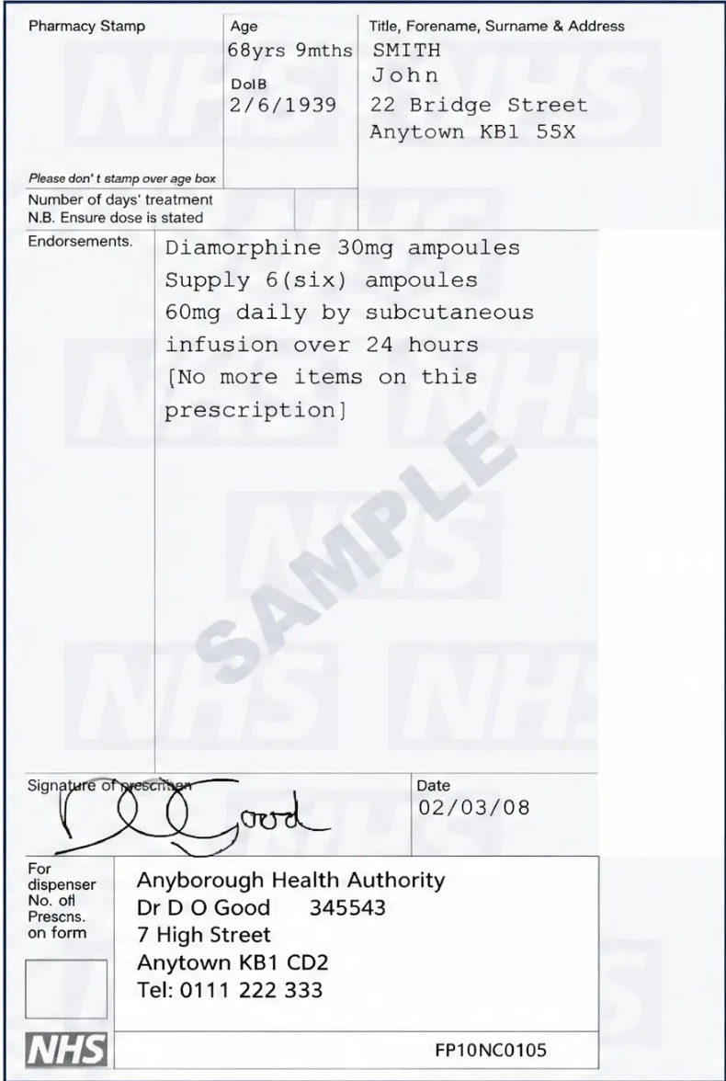









Section 5 — Prescribing
FP10 Legal Requirements for Schedule 2 CDs
Schedule 2 CDs — Morphine, Oxycodone, Diamorphine, Fentanyl
Patient full name and address
Full address required — not just name
Drug name (prescribe by brand where clinically relevant)
e.g., MST Continus, OxyContin — not just 'morphine MR'
Formulation and strength
e.g., Tablets, 30mg
Quantity in WORDS AND FIGURES
e.g., 'Sixty (60) tablets' — legal requirement
Clear dosage instructions
e.g., 'Take ONE tablet every 12 hours'
Prescriber's signature — handwritten
Computer-generated body; wet signature required — check local policy
Oramorph 10mg/5ml oral solution is NO LONGER Schedule 2 —
prescribe on standard FP10
If dose requires two tablet strengths (e.g., 45mg = 15mg + 30mg),
prescribe each on a separate line
Sample FP10 prescription — note quantity in words and figures
www.bradfordvts.co.uk
Pain Management & Opioid Conversion | Bradford VTS 2026

