Slide 1



BRADFORD VTS TEACHING DECK |
www.bradfordvts.co.uk | June 2026
GP TRAINING | QUALITY IMPROVEMENT
Early Detection of
Cancer
in Primary Care
A Quality Improvement Framework for GP Practice
Source: RCGP / Cancer Research UK QI Toolkit for Early Diagnosis of Cancer
NICE NG12 (last updated April 2026) | Scottish Referral Guidelines 2025
Stage at diagnosis is the
#1 predictor of survival
Bradford VTS | Educational use only | Content based on NICE NG12 and RCGP QI Toolkit | Not for clinical decision-making without reference to current guidelines

Slide 2








BRADFORD VTS TEACHING DECK
www.bradfordvts.co.uk
WHY THIS MATTERS TO YOU AS A GP
Why Early Detection
Matters
~20%
Stage at diagnosis is the single strongest
predictor of cancer survival
5-year survival rate for
Stage IV cancer
UK cancer outcomes lag behind comparable
countries — earlier detection closes the gap
Most patients present to their GP first —
you are the gatekeeper
~90%
Emergency cancer diagnosis = worse stage,
worse survival, avoidable harm
5-year survival rate for
Stage I cancer
The goal: shift more cancers to Stages 0–II
diagnosis via the 2-Week Wait pathway
Source: NICE NG12 / Cancer Research UK
Bradford VTS | Educational use only | Based on NICE NG12 (April 2026) and RCGP/Cancer Research UK QI Toolkit

Slide 3






BRADFORD VTS TEACHING DECK
www.bradfordvts.co.uk
| June 2026
GP TRAINING | SESSION OBJECTIVES
Learning Objectives
By the end of this session, you will be able to:
01
04
Explain Stage & Survival
Use PDSA Cycles
Describe why stage at diagnosis is the key predictor
of cancer survival outcomes
Design and test small-scale improvements using
process mapping and PDSA methodology
02
05
Recognise Red Flag Symptoms
Implement Safety Netting
Apply NICE NG12 (April 2026) criteria to identify
2-week wait referral triggers by cancer site
Apply robust, documented safety netting for
patients with possible cancer symptoms
03
06
Apply the NCDA QI Framework
Build a Detection Culture
Use audit data to identify and address delays in
cancer diagnosis at practice level
Engage patients and the whole practice team in
a culture of early cancer detection
Bradford VTS | Educational use only | Based on NICE NG12 (April 2026) & RCGP/Cancer Research UK QI Toolkit | Not for clinical decision-making without reference to current guidelines

Slide 4
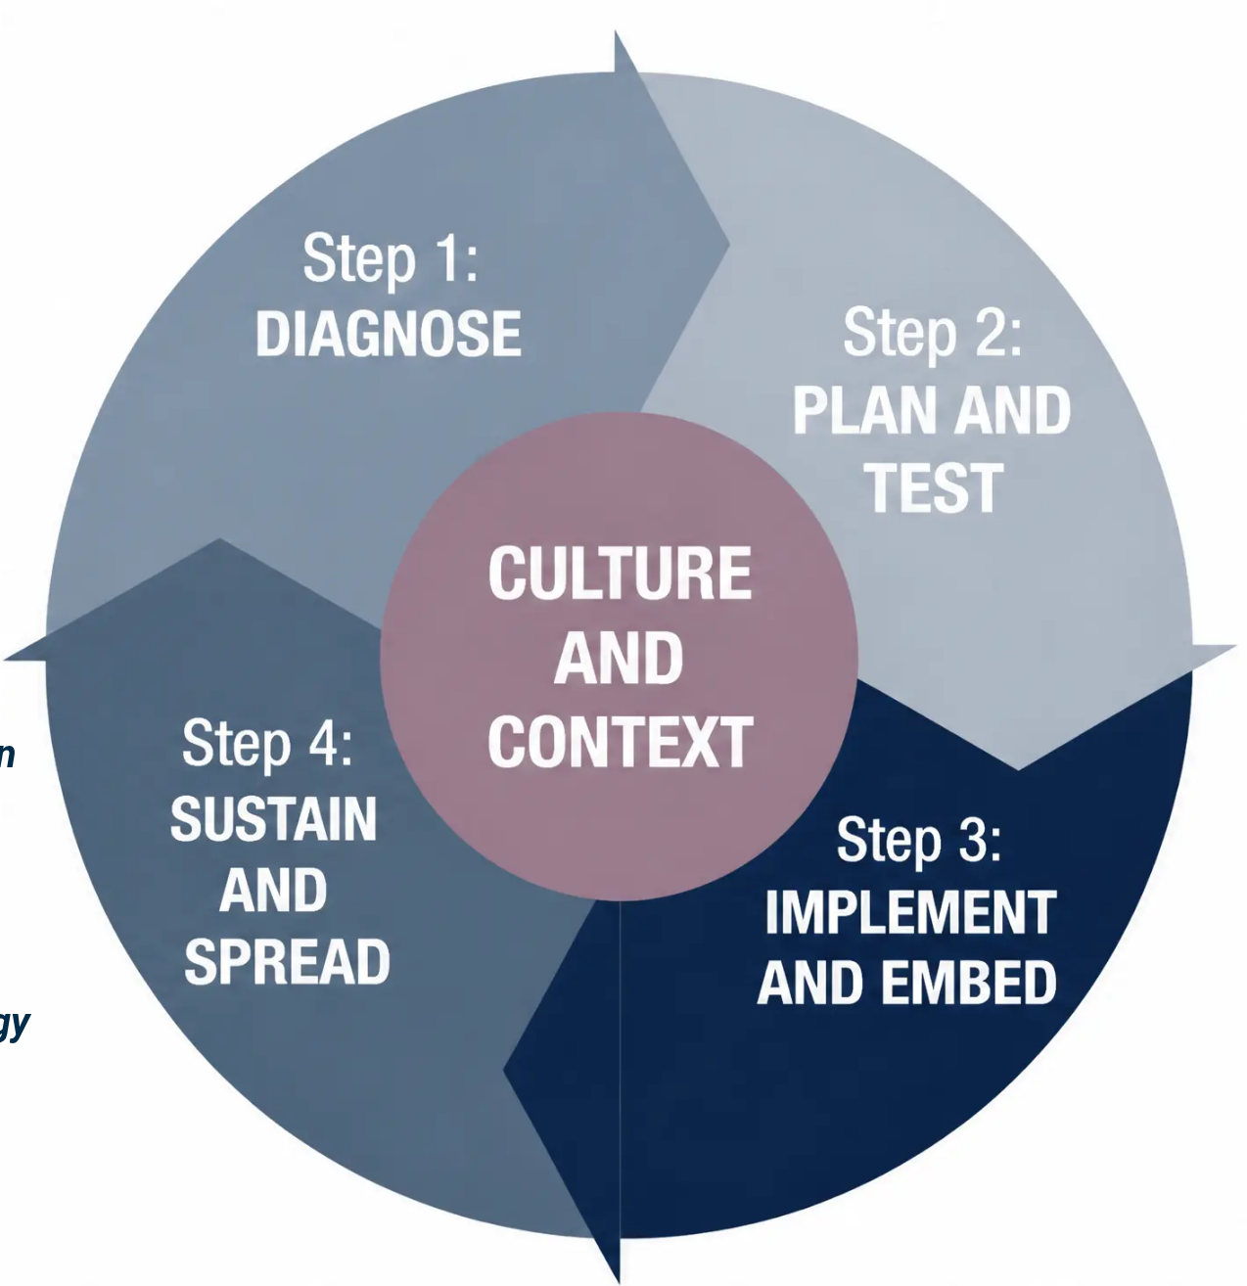

RCGP QI TOOLKIT
The QI Wheel:
A Framework for Change
A continuous roadmap for improving
cancer detection — from culture to evidence.
● Centre — Culture & Context • the foundation of all change
● Ring 2 — QI Cycle • Diagnose → Plan → Implement → Sustain
● Ring 3 — Patient Involvement • revealing blind spots
● Ring 4 — Engagement • whole team and stakeholders
● Ring 5 — Improvement Science • evidence-based methodology
QI is not audit alone — it's a continuous
cycle of small, tested changes.
Source: RCGP / Cancer Research UK QI Toolkit for Early Diagnosis of Cancer
Bradford VTS | www.bradfordvts.co.uk | June 2026

Slide 5
















BRADFORD VTS TEACHING DECK
www.bradfordvts.co.uk | June 2026
NICE NG12 | APRIL 2026 UPDATE
Cancer Red Flags: Know When to Act
Refer when risk meets NICE threshold — many 2WW referrals will NOT result in cancer diagnosis. This is expected.
COLORECTAL
LUNG
BREAST
OVARIAN
• Unexplained rectal bleeding,
age ≥40 + bowel habit change
• CXR findings suggestive of
lung cancer (any age)
• CA125 ≥35 IU/mL
• Unexplained breast lump
(any age)
• Age ≥40: unexplained
haemoptysis
• Persistent: bloating, pelvic
pain, urinary symptoms,
appetite loss
• FIT-positive result (any age)
• Age ≥60: weight loss +
abdominal pain / diarrhoea
• Skin changes or nipple
changes / discharge ≥50
• Smoker/ex-smoker: 2+ of
cough, fatigue, SOB, chest
pain, weight loss
PROSTATE
HAEMATOLOGICAL
UROLOGICAL
UPPER GI
• PSA raised for age
• Unexplained splenomegaly
• Visible haematuria (any
age, any cause)
• Dysphagia (any age)
• Hard or irregular prostate
on DRE
• Lymphadenopathy >1cm
for >6 weeks
• Age ≥55: unexplained
upper GI symptoms +
weight loss / anaemia
• Renal mass on imaging
• Unexplained anaemia (Hb
<110 men / <100 women)
Source: NICE NG12 (last updated 15 April 2026) | Scottish Referral Guidelines 2025
Bradford VTS | Educational use only

Slide 6
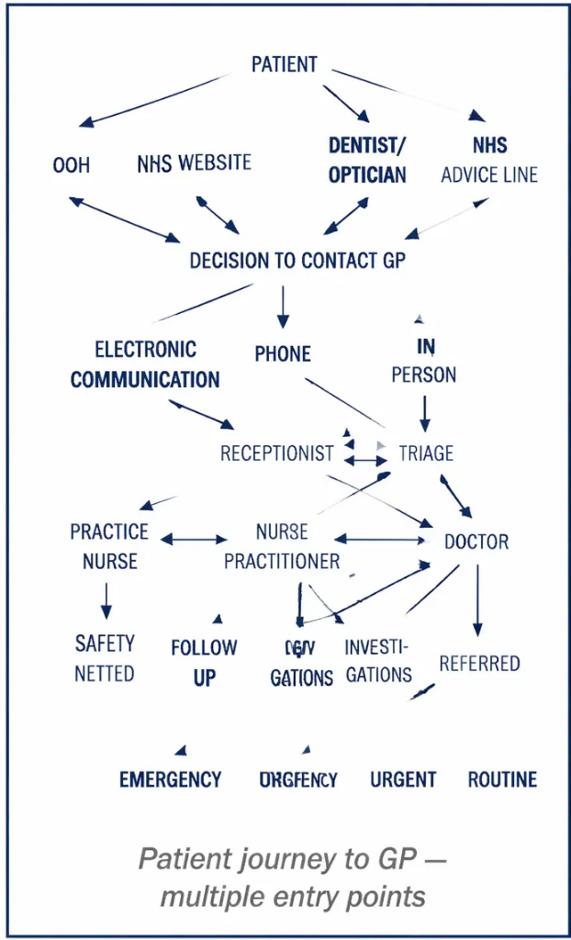
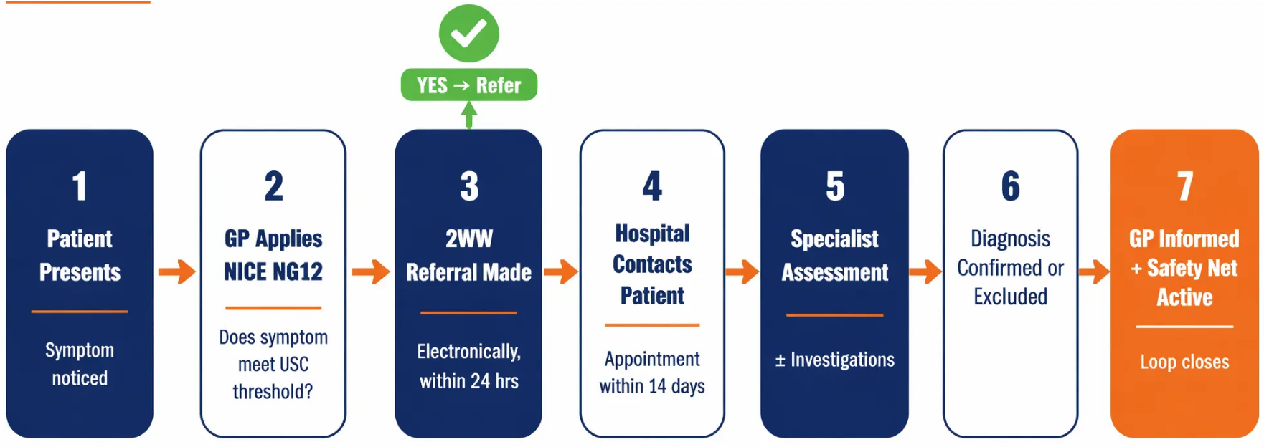





USC PATHWAY | NICE NG12
The 2-Week Wait Pathway
From Symptom to Specialist
Common Bottlenecks
Multiple consultations
before referral
Missed abnormal
test follow-up
Long primary
care interval
Emergency
A&E presentation
(NCDA Data)
Source: NICE NG12 (April 2026) | Scottish Referral Guidelines 2025 | Bradford VTS | www.bradfordvts.co.uk

Slide 7















BRADFORD VTS TEACHING DECK
www.bradfordvts.co.uk | June 2026
PATIENT SAFETY | CLINICAL SYSTEMS
Safety Netting:
Your Most Powerful Tool
Tell & Write
Set a Deadline
Red Flag Leaflet
Code It
Book Follow-Up
Verify Contact
"Come back if X happens"
4-week return rule
Patient takes it home
Safety net advice
documented
Don't wait for patient
to call
Phone number
confirmed
The NCDA revealed: many practices did NOT document
safety netting — leaving patients unclear on
when to re-present.
TOP TIP
Ask your PPG to co-design your
safety net leaflet — plain language,
patient-tested.
Bradford VTS | Educational use only | Based on RCGP/Cancer Research UK QI Toolkit & NICE NG12 (April 2026) | Not for clinical decision-making

Slide 8



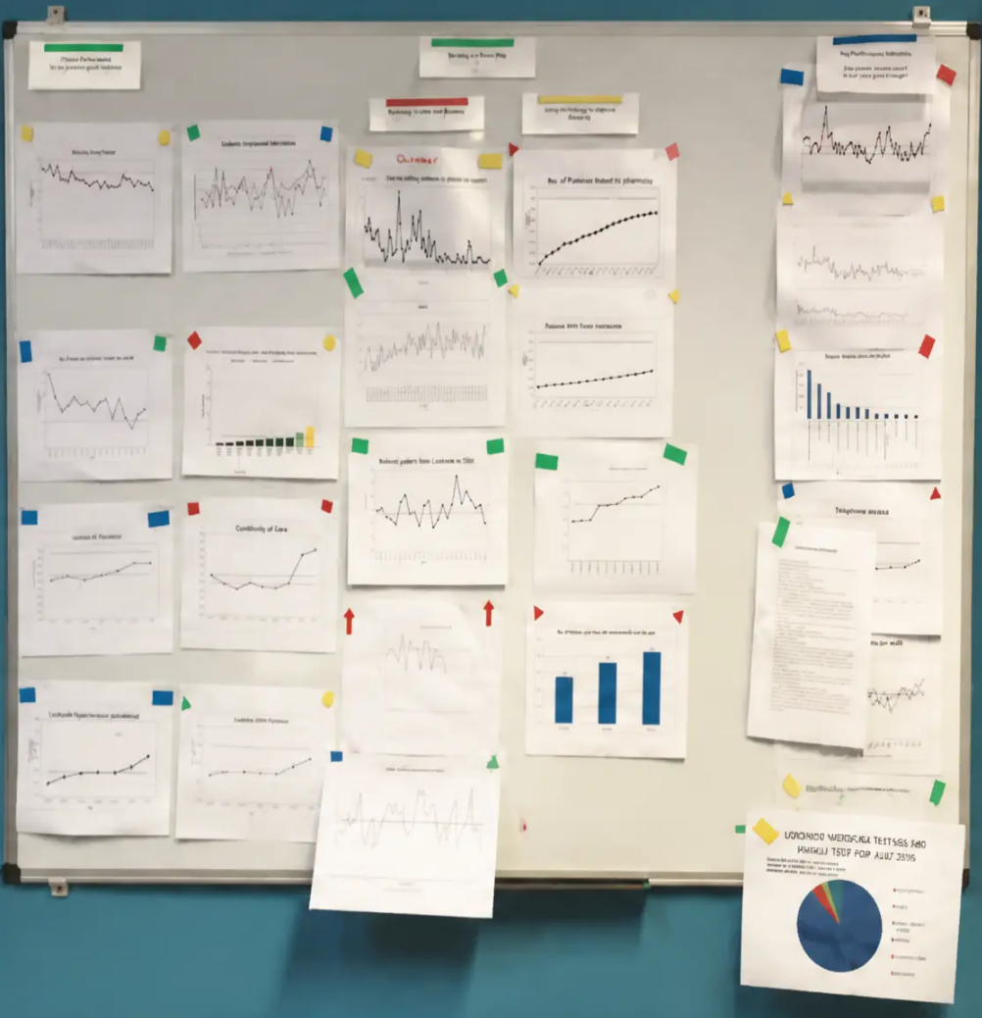





QUALITY IMPROVEMENT · AUDIT
Using NCDA Data: Know Your Practice Performance
WHAT NCDA MEASURES AT PRACTICE LEVEL
Stage at diagnosis for your patients
Number of consultations
before referral
Primary care interval — days
from first symptom to referral
Avoidable delays — location
and reason identified
Route to diagnosis — 2WW /
emergency / screening / other
TURN DATA INTO ACTION
Compare your data to national and peer-practice benchmarks
Ask: Are we above/below average for emergency presentations?
Ask: Is our primary care interval longer than the median?
Use Pareto charts to identify most common causes of delay
Note: NCDA data is typically 12–18 months old at publication —
supplement with real-time practice data.
Know your numbers.
England: Primary Care Webtool ·
GP Patient Survey · PHE Fingertips
Scotland: Scottish Public
Health Observatory
Wales: QOF Database ·
Public Health Wales Observatory
England · Scotland · Wales — regional data sources available
Bradford VTS | Educational use only | RCGP/Cancer Research UK QI Toolkit · NICE NG12 (April 2026
www.bradfordvts.co.uk | June 2026

Slide 9











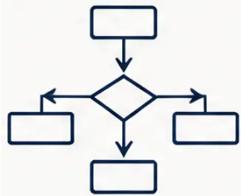
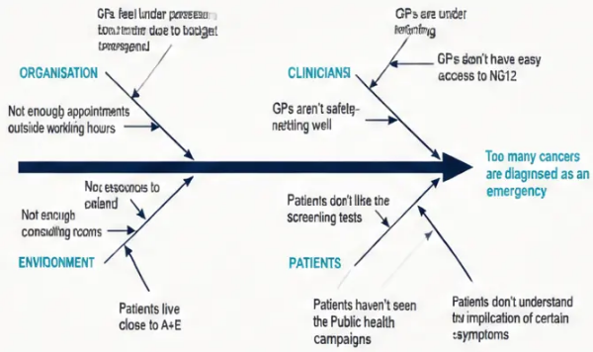



QUALITY IMPROVEMENT
Diagnose Your Improvement Needs
5 Key Tools
01
02
03
04
05
Process Mapping
Significant Event
Analysis
Clinical Audit
Diagnostic Survey
Fishbone Diagram
Visualise every step from
symptom to specialist.
Reveals bottlenecks
instantly using sticky-note
workshops.
Measure against NICE NG12
standards. Target: 60% via
USC pathway; 80% with
CA125 before ovarian
referral.
Survey your team and
patients: Do staff know
2WW criteria? Do
patients recognise red
flag symptoms?
Identify root causes of delayed
diagnosis across six branches:
People, Process, Environment,
Equipment, Time, Organisation.
Review real cases
retrospectively. Six
structured questions. No-
blame culture essential. Use
RCGP Cancer SEA Toolkit.
Source: RCGP/Cancer Research UK QI Toolkit for Early Diagnosis of Cancer | NICE NG12 (April 2026)
Bradford VTS | www.bradfordvts.co.uk | June 2026

Slide 10
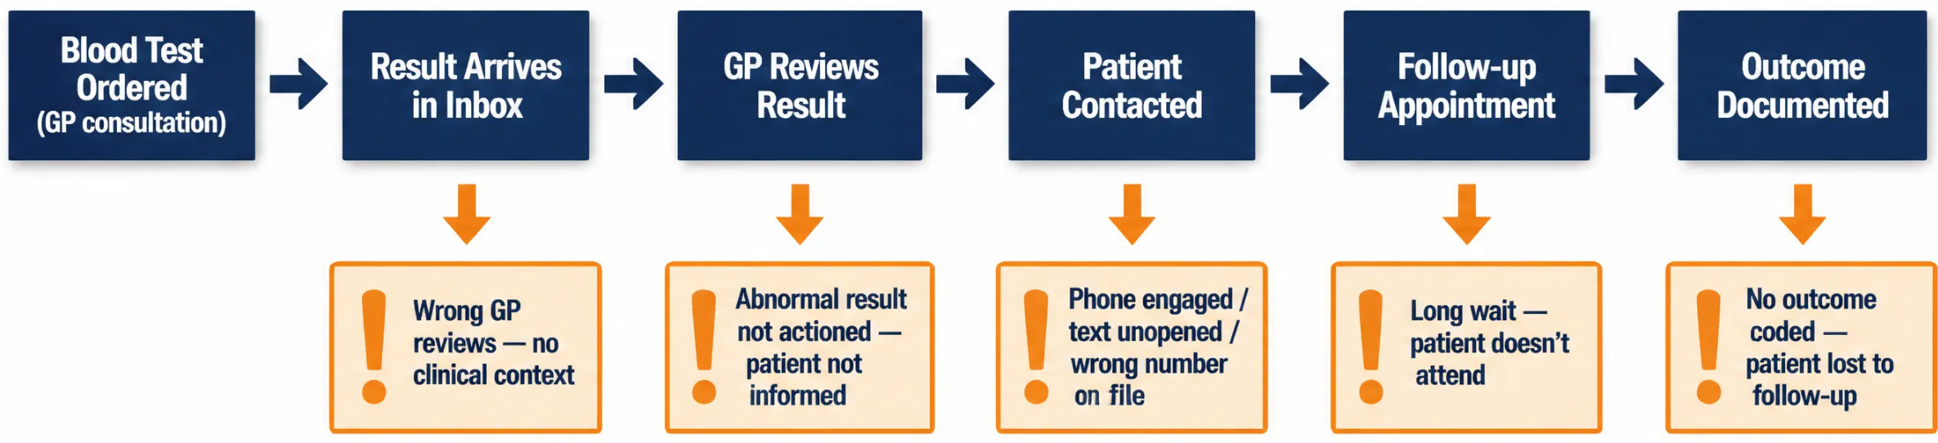

BRADFORD VTS TEACHING DECK
www.bradfordvts.co.uk
June 2026
PROCESS MAPPING | SLIDE 10 OF 20
Process Map: Handling Abnormal Blood Results
Where does the system break down — and how do we fix it?
DESIGNATE
AUTOMATE
AUDIT
Named GP reviews all
cancer-related results
IT alerts for coded 'suspected cancer'
patient with no follow-up
Check every suspected cancer patient
has a documented outcome
Source: NCDA / RCGP QI Toolkit | NICE NG12 (April 2026) | Bradford VTS — Educational use only

Slide 11





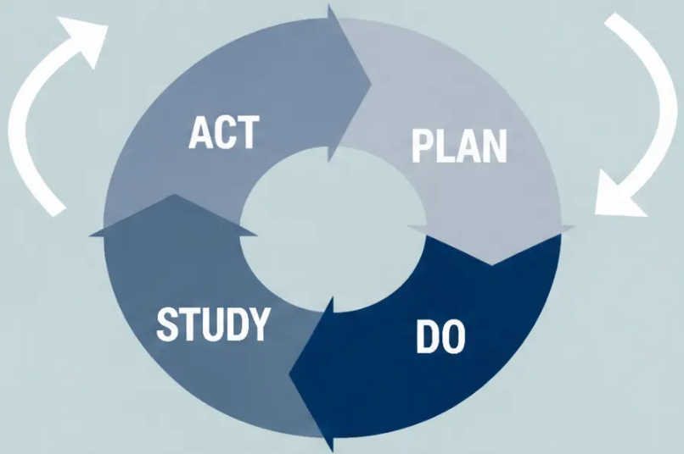




QUALITY IMPROVEMENT METHODOLOGY
PDSA Cycle: Test Changes Before You Commit
What are we trying
to accomplish?
Identify: patients not attending follow-up.
PLAN
Test: (1) code suspected cancer patients, (2) improve
return instructions, (3) verify contact details.
How will we know that a
change is an improvement?
What changes can we make that
will result in improvement?
Run fortnightly search for coded suspected
cancer patients.
DO
Trial coding change first — small scale, one GP.
Did coding improve attendance?
STUDY
Analyse data + gather team feedback.
Look for patterns in non-attenders.
Keep what works. Stop what doesn’t.
ACT
Layer next change.
Cascade success across the practice.
◆ Each PDSA cycle builds confidence. Small tested changes beat grand plans that never happen.

Slide 12
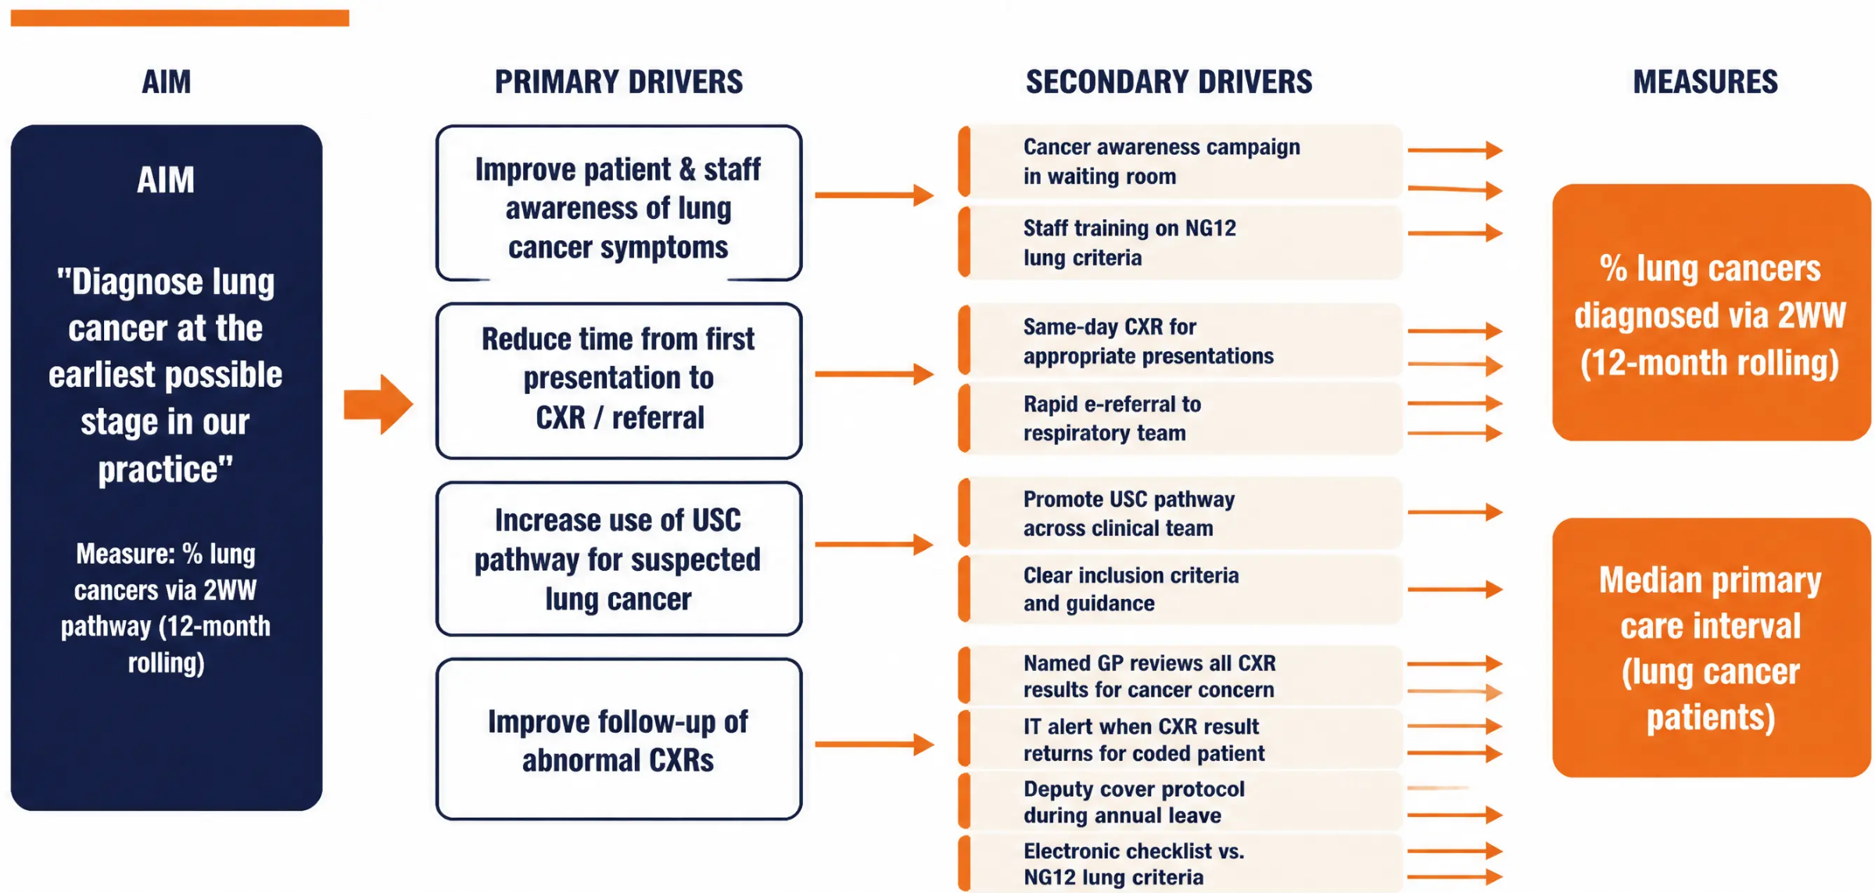
QI METHODOLOGY | LUNG CANCER
Driver Diagram: Diagnosing Lung Cancer Earlier
Bradford VTS | www.bradfordvts.co.uk | June 2026
Source: RCGP/Cancer Research UK QI Toolkit | NICE NG12 (April 2026)

Slide 13



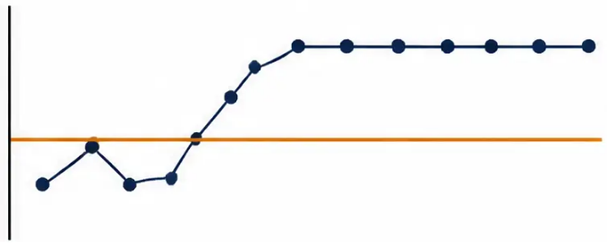
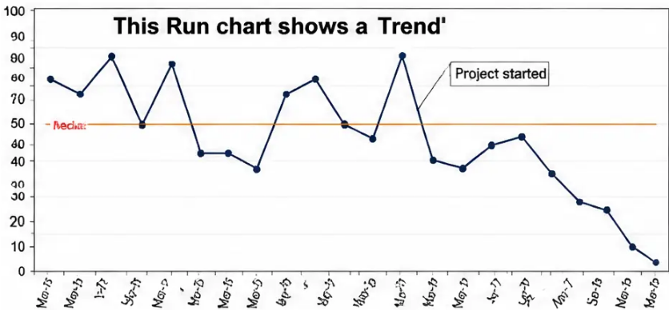
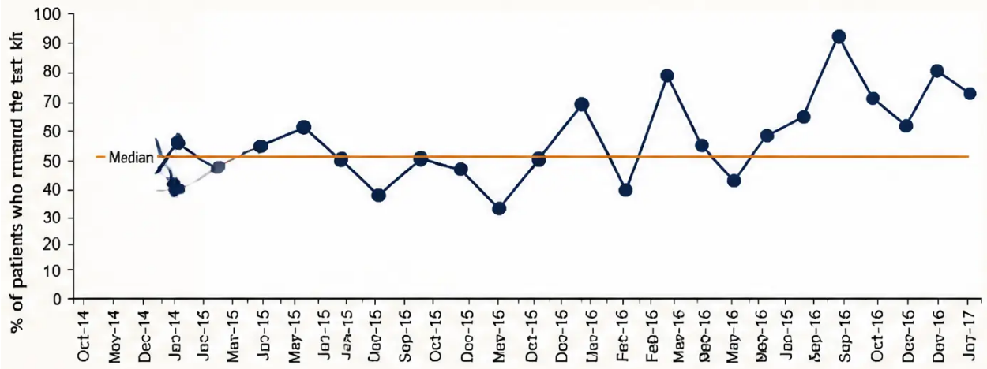

QI METHODOLOGY
Run Charts: Tracking Real Improvement Over Time
RANDOM VARIATION
SHIFT = REAL CHANGE
TREND = DIRECTION
• Line crosses median frequently
• 6+ consecutive points on one side of median
• No consistent pattern — normal noise.
• Confirms a genuine, sustained change.
No action needed.
• 5+ points all moving in same direction
Investigate — celebrate or correct.
• Real directional improvement underway.
Bowel Screening Uptake Example
Baseline median: 57% per month.
After IT alert intervention — all post-intervention
points fell above the median.
SHIFT confirmed → Real improvement achieved.
Use IHI Run Chart Excel Template (free at ihi.org)
Bradford VTS | Source: RCGP/Cancer Research UK QI Toolkit | NICE NG12 (April 2026) | www.bradfordvts.co.uk | June 2026 | Educational use only

Slide 14







BRADFORD VTS TEACHING DECK
www.bradfordvts.co.uk | June 2026
QI METHODOLOGY · SLIDE 14
Care Bundles: All-or-Nothing Quality
Every action must be completed — for every patient, every time
EXAMPLE: Breast Cancer Referral Bundle
1 Patient with suspicious breast lump seen
within 48 hours
WHAT IS A CARE BUNDLE?
A care bundle is 3–5 evidence-based
actions that must ALL be completed
together to improve outcomes.
Completing 3 out of 4 = incomplete bundle.
2 Referral made via USC (2-Week Wait) pathway
3 Referral submitted within 24 hours of decision
WHY ALL-OR-NOTHING?
4 Patient's up-to-date phone number
included on referral
Individual item rates will always look
higher than the bundle rate.
The bundle rate reveals the true gap —
and drives real improvement.
0% — Incomplete
100% — Bundle Complete ✓
All 4 must be achieved for the bundle to count.
Bradford VTS | Educational use only | Source: RCGP/Cancer Research UK QI Toolkit | NICE NG12 (April 2026)

Slide 15
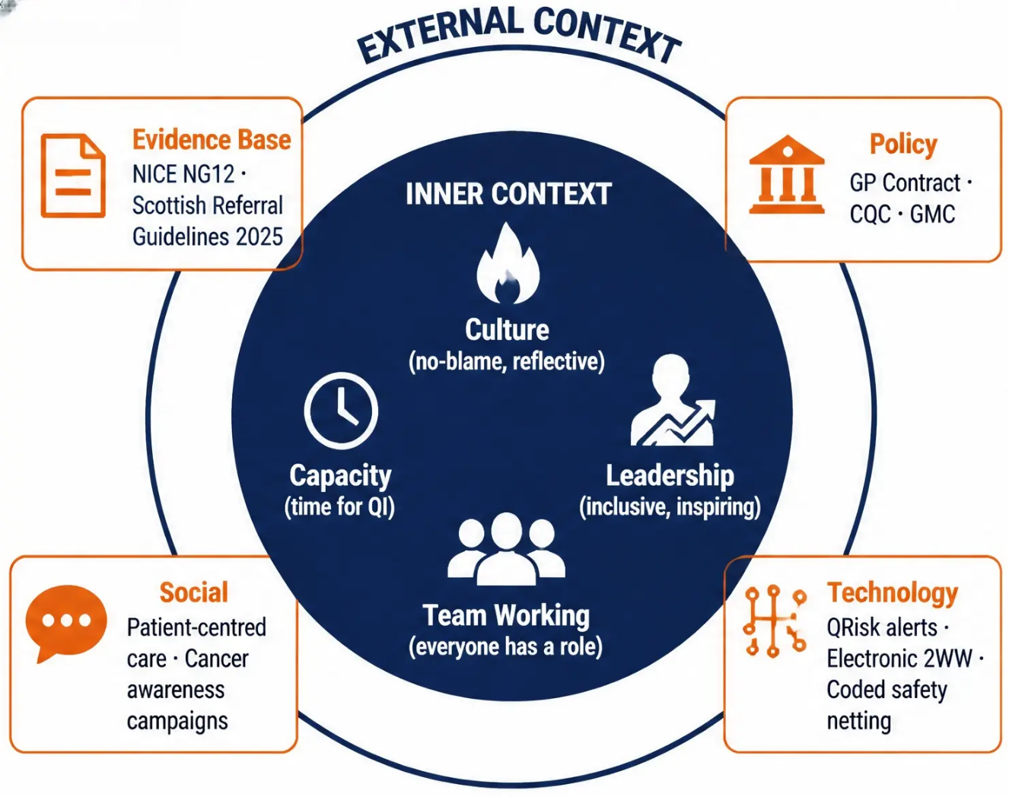

QUALITY IMPROVEMENT FRAMEWORK
Culture and Context:
The Invisible Engine
Without the right culture, no
improvement sticks — no
matter how good the plan.
DIAGNOSTIC TOOLS
Context Checklist
Force-Field Analysis
SWOT Analysis
Staff & Patient Questionnaires
Bradford VTS | Educational use only | RCGP/Cancer Research UK QI Toolkit | NICE NG12 (April 2026)
www.bradfordvts.co.uk | June 2026

Slide 16






PATIENT PARTNERSHIP
“See Your Practice Through Their Eyes”
01
02
Process Mapping with PPG
Waiting Room Survey
Invite patients to map your referral
journey — they spot what clinicians miss.
Ask patients: Do you know the warning
signs of cancer? Results reveal
awareness gaps.
03
04
Patient Stories
Co-Design Safety Net Leaflets
Share real early-diagnosis success
stories to motivate others to
attend screening.
Plain language, patient-tested. Ask
your PPG to write and review them.
05
06
Social Media & Newsletters
Review Results Protocols
“A busy, stressed practice makes patients feel
they’re wasting the doctor’s time — they delay
reporting symptoms.”
PPG-led cancer awareness posts
reach patients who never attend
the surgery.
Ask PPG to sense-check your results-
handling process from the patient’s
perspective.
— NCDA Research Finding
RCGP Patient Groups: PCPG (England) · P3 (Scotland) · PiP (Northern Ireland) · PPiP (Wales)
Bradford VTS | Educational use only | RCGP/Cancer Research UK QI Toolkit | NICE NG12 April 2026
www.bradfordvts.co.uk | June 2026

Slide 17










BRADFORD VTS TEACHING DECK
www.bradfordvts.co.uk | June 2026
TEAM LEADERSHIP & QI CULTURE
Engagement & Motivation: Getting Buy-In
EXPECTANCY
INSTRUMENTALITY
VALENCE
MOTIVATION
"Will my effort
make a difference?"
"Will good work
achieve the goal?"
"Is the outcome
worth it?"
Vroom's Expectancy Theory
01
02
03
04
Share a Patient Story
Display Run Charts
Celebrate Quick Wins
Use Belbin Roles
Real cases where early detection
changed the outcome — nothing
motivates like a human story
Visible data on the wall motivates
the whole team — progress seen
is progress made
Loudly acknowledge every
improvement — builds momentum
and psychological safety
Match QI tasks to team strengths —
pair quieter members in small
groups first
Bradford VTS | Educational use only | Based on RCGP/Cancer Research UK QI Toolkit & NICE NG12 (April 2026) | Not for clinical decision-making

Slide 18








BRADFORD VTS TEACHING DECK
www.bradfordvts.co.uk | June 2026
CLINICAL PRACTICE
Top Tips for Early Cancer Detection
in General Practice
01
02
03
04
05
Think Cancer
Stage = Survival
Safety Net Every Time
Know Your NICE NG12
Chase Abnormal Tests
When in doubt, refer.
Every stage advanced
at referral may cost a life.
Document it. Code it.
Book the follow-up.
Updated April 2026 —
keep it on your desktop.
Don't wait for the patient
to call back.
Most won't have cancer —
that's expected.
06
07
08
09
10
Use Your NCDA Data
Check Contact Details
Make Access Easy
Use the Whole Team
No Blame, All Learn
Your blind spots are
already visible in the data.
A referral fails if the
hospital can't reach
the patient.
Hard appointments → A&E
→ emergency diagnosis →
worse survival.
Receptionists and nurses
can spot cancer
symptoms too.
SEA is powerful.
Psychological safety
saves lives.
Bradford VTS | Educational use only | Based on RCGP/Cancer Research UK QI Toolkit & NICE NG12 (April 2026) | Not for clinical decision-making without reference to current guidelines

Slide 19






EXAM PREPARATION
In the Exam: AKT & SCA Hints
AKT — KNOWLEDGE
SCA — CONSULTATION SKILLS
■ Safety net every consultation —
vague or persistent symptoms always need a documented plan
■ NICE NG12 thresholds — know 2WW criteria by cancer site
■ Primary care interval — days from first presentation to referral
■ Verbalise your thinking —
say "I want to make sure we don't miss anything serious..."
■ USC vs. non-urgent referral — understand the distinction
■ Shared decision-making — explain 2WW benefits
AND the expected high non-cancer rate
■ CA125 ≥35 IU/mL — required before ovarian cancer referral
■ Code it — document suspected cancer
in the medical record for follow-up
■ FIT testing thresholds — colorectal cancer trigger values
■ PDSA — Plan, Do, Study, Act (expect QI methodology questions)
■ Address anxiety — reassure: "Most people referred
do not have cancer"
Know it. Say it. Document it. — Three habits that protect your patients and your exam score.
Bradford VTS | www.bradfordvts.co.uk | June 2026 | Educational use only
Source: NICE NG12 (April 2026) | RCGP/Cancer Research UK QI Toolkit

Slide 20


BRADFORD VTS TEACHING DECK
www.bradfordvts.co.uk | June 2026
KEY TAKEAWAYS
YOUR NEXT ACTIONS
01 Review your NCDA data with your
Cancer Research UK facilitator
Stage at diagnosis is the #1 factor in cancer survival
Know NICE NG12 (April 2026) — your referral bible
02 Map one cancer referral process at
your next practice meeting
Use the 2WW pathway liberally and without fear
03 Run one SEA on a recent
cancer diagnosis case
Safety net every time — document, code, book it
04 Activate QRisk cancer alerts
in your IT system
QI is a team sport: small PDSA cycles beat grand plans
05 Audit 2WW referral documentation
against NICE NG12
Patients are your most powerful allies — involve them
Small changes, tested well, spread widely —
that’s how we save lives earlier.
Source: RCGP/Cancer Research UK QI Toolkit |
NICE NG12 (April 2026) | Scottish Referral Guidelines 2025
Bradford VTS | Educational use only | Content based on NICE NG12 and RCGP/Cancer Research UK QI Toolkit | Not for clinical decision-making without reference to current guidelines

