Slide 1


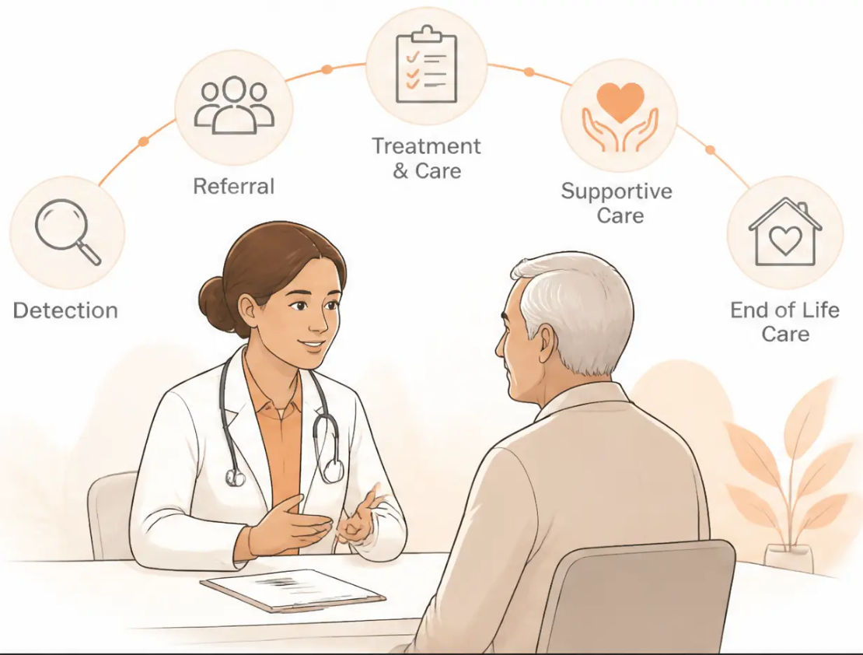


Everything in Cancer Care
From Detection to End of Life
Recognition · Referral · Coordination · Compassionate Care
A GP's Complete Guide — Updated to NICE NG12 (2026)
Bradford VTS Teaching Deck
Created June 2026
For educational purposes only. All clinical decisions should be based
on individual patient assessment and current national guidelines.
www.bradfordvts.co.uk
Bradford VTS | Improving Cancer Care
June 2026

Slide 2


Learning Objectives
By the end of this session, you will be able to:
Recognise the key features that trigger urgent cancer referral – NICE NG12 (2026)
Understand the 2-week wait (2WW) / urgent suspected cancer pathway
Apply the Gold Standards Framework (GSF) to improve cancer care in primary care
Coordinate cancer care across the primary–secondary interface
Support patients and carers through diagnosis, treatment, and end of life
Recognise the survivorship needs of patients living beyond cancer treatment
www.bradfordvts.co.uk
Bradford VTS | Improving Cancer Care
Slide 2 of 29

Slide 3

The Scale of Cancer in Primary Care
Why early recognition matters — the numbers behind your daily practice
375,000
25–30
new cancer diagnoses in the UK per year
new cancers expected per year on an
average GP list of 2,000 patients
Cancer Research UK, 2024
80%
50%
of cancer diagnoses originate
from a GP consultation
of people diagnosed with cancer
now survive 10 years or more
UK, 2024
Cancer is the second most common cause of death in the UK — but late-stage
diagnosis remains the key driver of poor outcomes. GPs are the gateway.
www.bradfordvts.co.uk
Bradford VTS | Improving Cancer Care
June 2026

Slide 4
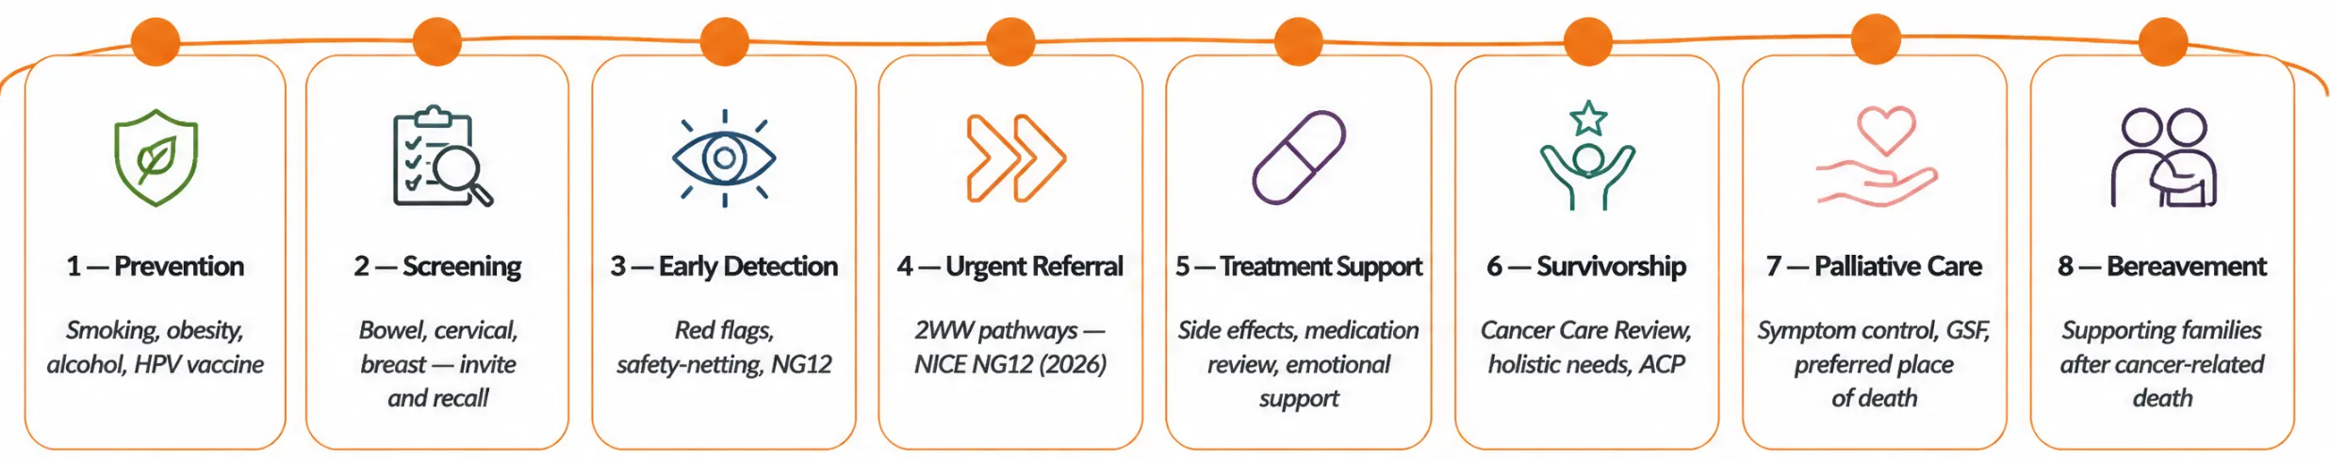


The GP's Role in Cancer Care
Across the Pathway
GPs are involved at every stage —
from the first consultation to
bereavement support.
www.bradfordvts.co.uk
Bradford VTS | Improving Cancer Care
Page 4 of 29

Slide 5








NICE NG12 (2026)
Suspected Cancer: Key Principles
Primary guidance for GP referral decisions — updated 2026
Urgent Suspected
Cancer (2WW)
Urgent Routine
Referral
What's New in 2026
• Features could indicate cancer but less
immediately suspicious
• FIT now central to colorectal referral
decisions
• Patient seen by specialist within 14 days
• Features that strongly suggest cancer
• Not a 2WW — seen within weeks,
not 14 days
• Low-dose CT recommended for
high-risk lung cancer patients
• Positive Predictive Value threshold: ≥ 3%
• Triggered by specific symptom
combinations per cancer site
• Requires clinical judgement alongside
investigation results
• PPV ≥ 3% threshold clarified across
cancer types
• May follow initial investigation
(e.g., FIT result)
• Expanded FIT indications; lower
referral threshold
Clinical judgement always applies — a negative test does not exclude cancer if suspicion remains high.
Bradford VTS | Improving Cancer Care
www.bradfordvts.co.uk
Slide 5 of 29

Slide 6


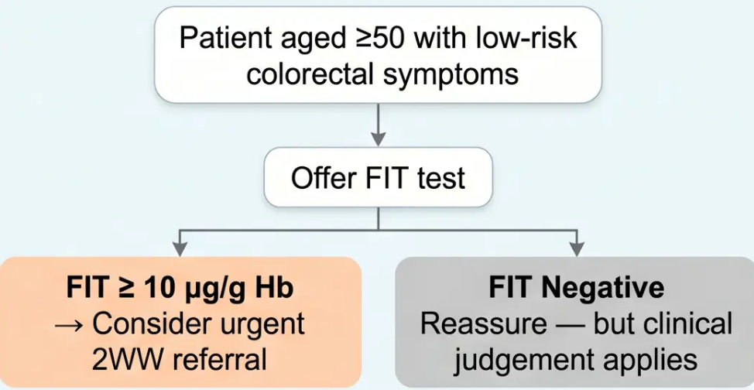

NICE NG12 — Colorectal Cancer Referrals (2026)
Urgent 2-Week Wait criteria and the central role of FIT testing
Refer Urgently (2WW) if...
FIT Test (Faecal Immunochemical Test)
➔ Age ≥40 — unexplained weight loss +
abdominal pain
➔ Age ≥50 — unexplained rectal bleeding
➔ Age ≥60 — iron deficiency anaemia OR
change in bowel habit
Key 2026 update: Expanded FIT indications; lower referral
threshold based on FIT result. FIT negative does NOT
exclude cancer if clinical concern remains.
➔ Any age — tests suggest bowel obstruction
www.bradfordvts.co.uk
Bradford VTS | Improving Cancer Care
Slide 6 of 29

Slide 7



NICE NG12 — Lung Cancer Referrals
Urgent Suspected Cancer (2WW) | Updated 2026
Refer Urgently (2WW)
Consider Urgent Referral
(2WW)
PPV THRESHOLD
• Chest X-ray findings suggestive of lung
cancer (any age)
• Positive predictive value
≥ 3% triggers direct
2WW referral
• Haemoptysis (any age)
• Aged ≥40 with two or more of: persistent
cough · fatigue · weight loss · breathlessness ·
chest pain · haemoptysis · anorexia
• New-onset clubbing
• Superior vena cava
obstruction (SVCO)
• Clinical judgement always
applies alongside
thresholds
• Aged ≥40 with persistent or recurrent
chest infection
NICE NG12 (2026): Chest X-ray alone is NOT sufficient to rule out lung cancer
when clinical suspicion is high — CT chest is preferred.
www.bradfordvts.co.uk
Bradford VTS | Improving Cancer Care
Slide 7 of 29

Slide 8






NICE NG12 — Upper GI, Breast & Haematological Cancers
2WW urgent referral criteria — NICE NG12 (2026)
Upper GI Cancer
Breast Cancer
Haematological Cancer
• Age ≥55 with weight loss + upper
abdominal pain, reflux, or dyspepsia
→ 2WW
• Unexplained breast lump at any
age → 2WW
• Unexplained lymphadenopathy ≥ 6 weeks
• Splenomegaly (unexplained)
• Skin tethering, nipple retraction,
or bloody discharge → 2WW
• B symptoms: fever, night sweats,
weight loss >10% in 6 months
• Dysphagia at any age → 2WW
• Unilateral axillary lymphadenopathy
→ consider referral
• Unexplained blood count abnormality
→ urgent FBC + haematology review
• Haematemesis at any age → 2WW
Clinical judgement always applies — these criteria are triggers, not limits.
Bradford VTS | Improving Cancer Care
www.bradfordvts.co.uk
Slide 8 of 29 | June 2026

Slide 9




Safety-netting in Cancer Presentations
Non-specific presentations need clear plans — document everything.
When You Refer
When You Don't Refer
• Explain what you're concerned about and
why you're referring
• “If symptoms persist beyond X weeks, please
come back” — give a specific timeframe
• Give the patient a clear timeframe for
referral acceptance
• Document your clinical reasoning AND your
safety-net advice in full
• Provide a return instruction: “If you haven't
heard within X days, contact the practice”
• Revisit at next consultation: “How are those
symptoms I was monitoring?”
• Document clearly in the notes: “Referred for
2WW — possible colorectal cancer”
Legal Principle
Missed cancer diagnosis is the second most common cause of clinical negligence
claims in UK general practice. Clear documentation of your safety-netting is your best protection.
www.bradfordvts.co.uk
Bradford VTS | Improving Cancer Care
Slide 9 of 29

Slide 10






The Gold Standards Framework (GSF)
A systematic approach to quality cancer care in primary care
IDENTIFY
Place all advanced cancer patients on the Palliative Care Register.
Ask the Surprise Question.
ASSESS
Holistic needs assessment using PEPSI-COLA.
Include carer needs. Review regularly.
PLAN
Proactive, coordinated care across the Primary Health Care Team.
Anticipate, don't react.
Developed by Dr Keri Thomas —
widely adopted across UK primary care
Reduces crisis admissions · Improves preferred place of death · Supports carers
www.bradfordvts.co.uk
Bradford VTS | Improving Cancer Care
Slide 10 of 29

Slide 11






GSF — The 7 C's Applied to Cancer Care
A systematic framework for proactive cancer care in primary care
C1
C2
C3
C4
Communication
Coordination
Control of Symptoms
Continuity
Supportive Care Register ·
Named GP · Coordinator ·
Holistic assessment ·
OOH handover · EPaCCS ·
Monthly PHCT meeting
District Nurse per patient
PEPSI-COLA · Symptom scores
Home care pack
C5
C6
C7
Continued Learning
Carer Support
Care of the Dying Phase
SEA · Audit · Education ·
Carer needs assessment ·
Terminal care protocol ·
GSF accreditation
Benefits · Marie Curie
SR1 form · Gold Standards
DS1500 replaced by SR1 form (August 2021) — SR1 does not require a 6-month prognosis
www.bradfordvts.co.uk
Bradford VTS | Improving Cancer Care
Slide 11 of 29

Slide 12

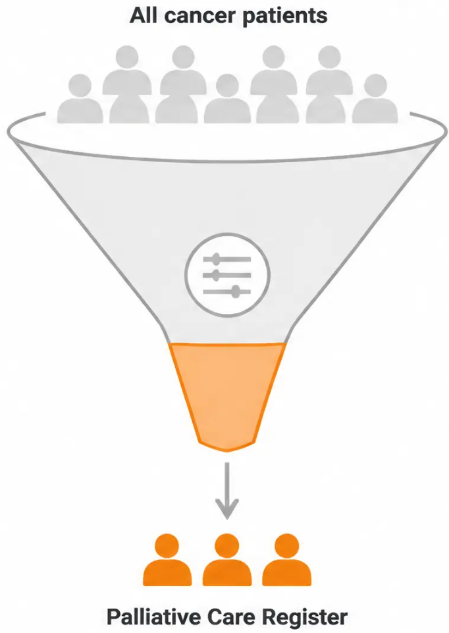










The Supportive Care Register
Cancer Patients
Who belongs on the register — and why it matters
WHO TO INCLUDE
All patients with metastatic or advanced cancer
Any cancer patient triggering a positive “Surprise Question”
(Would you be surprised if this patient died in the next 12 months?)
Patients completing active treatment with significant symptom burden
Patients told the cancer is “no longer curable”
GSF PROGNOSTIC INDICATORS
Metastatic disease confirmed on staging
Karnofsky Performance Status below 50%
Weight loss greater than 10% in the last 6 months
Patient has declined further active treatment
Repeated hospital admissions in the last 3 months
Add SNOMED/Read codes · Link to care plan · Share with Out-of-Hours service
www.bradfordvts.co.uk
Bradford VTS | Improving Cancer Care
Slide 12 of 29

Slide 13


















Holistic Assessment in Cancer Care
The PEPSI-COLA Framework
Cancer patients have needs across every domain — not just physical.
Physical
Emotional
Personal / Spiritual
Pain, nausea, fatigue,
breathlessness, constipation,
lymphoedema
Anxiety, depression,
fear of dying, existential
distress
Meaning, faith, life review,
sense of purpose
Social
Information
Control / ACP
Financial concerns,
carer burden, housing,
isolation
What they know · What they
want to know · Family needs
Preferred place of care and
death · DNACPR · ADRT · LPA
Out-of-Hours
Late / Dying Phase
Afterlife / Bereavement
Emergency contacts · Crisis
medication availability
Terminal care planning ·
Family preparation
Carer support post-death ·
Follow-up plan
www.bradfordvts.co.uk
Bradford VTS | Improving Cancer Care
Slide 13 of 29

Slide 14
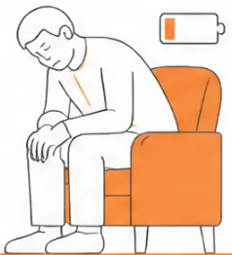




Cancer-Related Fatigue
The most common symptom in cancer patients — affects over 75% | NICE NG214 (2023)
Assessment
Management (NICE NG214, 2023)
Treat reversible causes first
Anaemia, hypothyroidism, depression, sleep disturbance
● Multifactorial causes — disease, treatment, comorbidities
Graded activity & rehabilitation
Evidence-based; refer to physiotherapy or cancer rehab programme
● Disease-related: cytokines, anaemia, hypercalcaemia
● Treatment-related: chemotherapy, radiotherapy, surgery
Sleep hygiene
Consistent routine; address insomnia directly
● Use ESAS (Edmonton Symptom Assessment System)
for physical component
Energy conservation / pacing
Prioritise activities; avoid boom-and-bust cycles
Psychological support
CBT-based fatigue management; refer if needed
● Use PHQ-9 for psychological / depression component
Always screen for treatable underlying causes
before escalating management.
Medication review
Review oncology drugs for fatigue as side effect
NOT recommended: Methylphenidate — insufficient evidence
Avoid: Opioids prescribed for fatigue alone
www.bradfordvts.co.uk
Bradford VTS | Improving Cancer Care
Slide 14 of 29

Slide 15

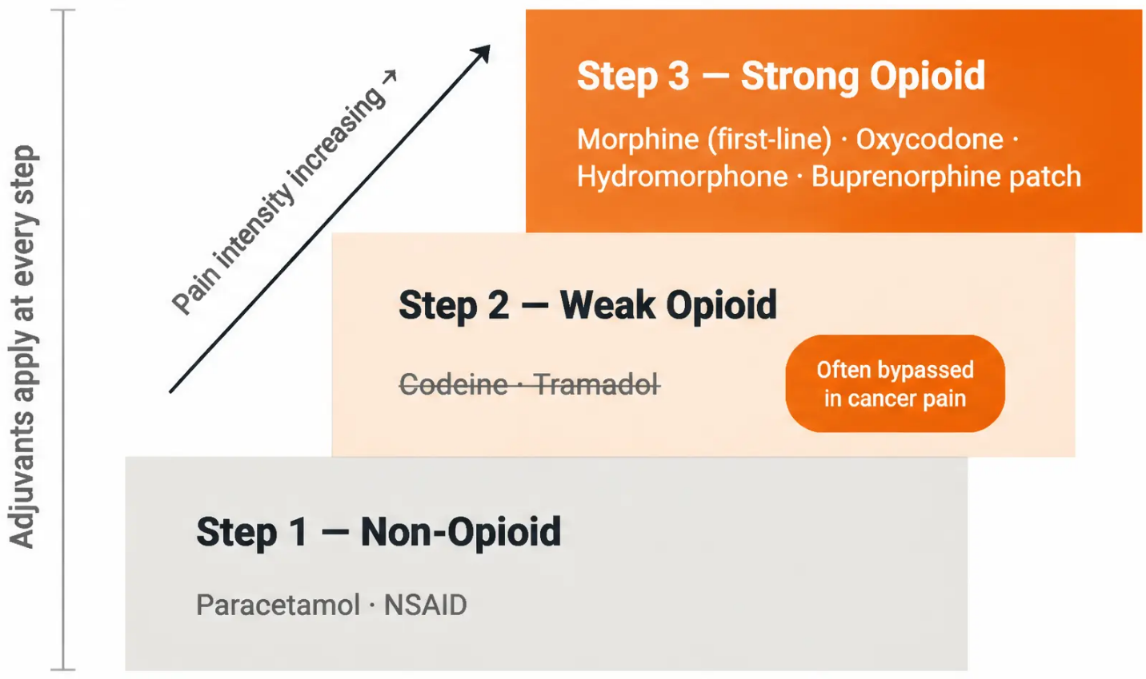
Cancer-Related Pain Management
WHO Analgesic Ladder · Updated BNF/NICE Guidance 2024–2026
Adjuvant Therapies
Bone Pain
NSAID + strong opioid · Bisphosphonates ·
Orthopaedic review
Neuropathic Pain
Amitriptyline · Duloxetine ·
Gabapentin / Pregabalin
(Gabapentinoids: controlled drug status 2024)
Liver Capsule Pain
Dexamethasone 4–8 mg daily
Raised ICP / Headache
Dexamethasone 16 mg daily (initial dose)
● Always prescribe laxatives with opioids
● Review for nausea and respiratory depression
● Anticipatory prescribing — consider syringe driver early
www.bradfordvts.co.uk
Bradford VTS | Improving Cancer Care
15 / 29

Slide 16




Cancer-Related Breathlessness
Common in lung cancer, mesothelioma, lymphoma, and advanced cancer — often undertreated
ASSESS
MANAGE
• ESAS breathlessness score —
quantify and track over time
● Low-dose oral/SC morphine — 2.5–5 mg 4-hourly;
evidence-based even without hypoxia
• SpO₂ and respiratory rate —
baseline observations
● Benzodiazepines — lorazepam 0.5–1 mg sublingual
or SC midazolam for anxiety component
• Exclude reversible causes —
PE (Wells score + CTPA),
pleural effusion (ultrasound)
● Fan therapy — cool air directed to face;
proven effective, simple, and free
● Treat reversible causes — drain effusion, correct
anaemia, relieve bronchospasm
• Anxiety component —
breathlessness and panic are
closely linked; assess together
● Physiotherapy — breathing retraining techniques;
pacing and positioning advice
Oxygen rule:
Oxygen is only indicated if SpO₂ is below 92%. It does NOT relieve breathlessness
in normoxic cancer patients — fan therapy is more effective and less distressing.
www.bradfordvts.co.uk
Bradford VTS | Improving Cancer Care
Page 16 of 29

Slide 17








Coordinating Cancer Care
The GP as Care Coordinator
Cancer care spans many teams — the GP holds the thread.
Primary–Secondary Interface
Communication Tools
Cancer Care Review
• Keep GP record updated with
oncology decisions
• EPaCCS — share care preferences
electronically across teams
• Offer within 12 months of diagnosis
(QOF indicator)
• OOH handover form — updated
whenever clinical status changes
• Cover: symptoms, psychological wellbeing,
benefits, ACP, return to work
• Review MDT outcomes where accessible
• Shared care protocols: tamoxifen,
bisphosphonates, steroids
• Anticipatory prescribing — community
pharmacy supply
• Record in structured template
• Refer to Macmillan or local cancer
support as needed
• Cancer Care Review: QOF requirement
at 12 months post-diagnosis and
annually thereafter
• Macmillan Care Coordinator —
information prescriptions; Living with
and Beyond Cancer programme
• Repeat annually for all patients
living with cancer
Bradford VTS | Improving Cancer Care
www.bradfordvts.co.uk
Slide 17 of 29

Slide 18








Cancer Survivorship
Living with and beyond cancer — the GP's role continues
Cancer Care Review
Long-Term Effects
Psychological Wellbeing
QOF Requirement
Know What to Watch For
Fear of Recurrence is Universal
• Offer within 12 months of diagnosis
• Chemo: neuropathy, cardiac toxicity,
premature menopause
• Fear of recurrence (FoR) — normalise
and provide information
• Cover: symptoms, psychological
wellbeing, benefits, ACP, return to work
• Radiotherapy: fibrosis, lymphoedema,
bowel/bladder symptoms
• Anxiety and depression: screen with
PHQ-9 / GAD-7
• Refer to Macmillan / local
cancer support
• Surgery: body image, sexual function,
stoma care
• Refer to cancer psychology if severe
or persistent
• Record in template; repeat annually
• Endocrine therapy: bone density →
DEXA scanning
• Social reintegration: work, relationships,
identity
More patients are living with and beyond cancer — survivorship is now a core GP competency.
www.bradfordvts.co.uk
Bradford VTS | Improving Cancer Care
Slide 18 of 29 | June 2026

Slide 19









Cancer Screening
19 / 29
GP Responsibilities
Know the programmes. Recall your patients. Close the gap.
Cervical Screening
Breast Screening
Bowel Screening
Lung Screening
• HPV primary testing
• Mammography
• FIT test (ages 50–75)
• Low-dose CT (LDCT)
• Ages 25–64
• Ages 50–71
• Colonoscopy if FIT positive
• Ages 55–74 with smoking history
• Every 3 years (ages 25–49)
• Automatic national invitation
• Home self-sampling kit
• NHS Targeted Lung Health Check
• Every 5 years (ages 50–64)
• GP role: re-invite non-attenders
• Results communicated directly
• Eligible patients actively invited
GP role: re-invite non-attenders
Address screening hesitancy
sensitively
FIT ≥10 µg/g Hb → urgent 2WW
GP role: identify and
encourage uptake
GP Actions
Review non-attenders • Address hesitancy sensitively
• Document and code results appropriately
www.bradfordvts.co.uk
Bradford VTS | Improving Cancer Care
June 2026

Slide 20














Cancer Prevention in Primary Care
Key modifiable risk factors — evidence-based GP actions
Tobacco
Obesity
Alcohol
Refer to NHS Stop Smoking services
Weight management referral —
linked to 13 cancer types
AUDIT screening + brief intervention
NICE NG209 (Feb 2025)
NICE NG246
NICE CG115 — linked to 7 cancer types
HPV Vaccination
UV Exposure
Radon Gas
NHS programme: ages 12–13;
catch-up to 25
Skin awareness advice;
promote sunscreen use
High-risk areas: SW England,
Derbyshire, parts of Yorkshire
Prevents cervical, oropharyngeal & anal cancers
Melanoma prevention
PHE radon mapping — lung cancer risk
www.bradfordvts.co.uk
Bradford VTS | Improving Cancer Care
Slide 20 of 29 | June 2026

Slide 21




Breaking a Cancer Diagnosis — The GP Approach
Most diagnoses are delivered in secondary care — but the GP's role begins immediately after
The GP's Role in This Moment
The GP often has the first conversation about worrying features before referral
After secondary care breaks the news, the GP becomes the anchor of continuity
Patients frequently return to their GP to re-process, clarify, and seek emotional support
Proactive GP Contact After Diagnosis
Proactive telephone call or appointment invitation within 2–4 weeks of diagnosis
Check understanding of what secondary care communicated
Assess emotional response and immediate support needs
Clarify the GP's ongoing role and who to contact with concerns
SPIKES Framework — A Structured Approach
S Setting · Private, seated, unhurried — never in a corridor
P Perception · "What have you been told so far?"
I Invitation · "How much detail would you like right now?"
K Knowledge · Give information honestly, in plain language, in chunks
E Emotions · Acknowledge and sit with the emotional response
S Strategy & Summary · Agree next steps; confirm who is doing what
www.bradfordvts.co.uk
Bradford VTS | Improving Cancer Care
Page 21 of 29

Slide 22





Supporting Carers of Cancer Patients
Carers carry an enormous burden — often unrecognised. The GP's role is to see them too.
Carer Needs Assessment
Offer under the Care Act 2014 — carers have a legal right to
assessment. Ask: 'How are YOU coping?' — the most
important question in any carer consultation.
Benefits & Practical Help
• Carer's Allowance for eligible carers
• PIP for the patient; Attendance Allowance (aged 65+)
• SR1 form — fast-track DWP benefits; does not require
6-month prognosis
• Marie Curie nursing — overnight and weekend home support
Community Support
Macmillan carer support — online and telephone resources.
HEAL programme where locally available. Signpost early —
don't wait for crisis.
Preparing for Bereavement
Prepare carers for what happens after death — practical steps,
who to call, what to expect. Schedule a follow-up bereavement
visit before the patient dies.
www.bradfordvts.co.uk
Bradford VTS | Improving Cancer Care
Slide 22 of 29

Slide 23








Top Tips — Improving Cancer Care
Practical pearls for everyday GP cancer care
FIT ≥10 μg/g → Urgent 2WW Referral
Safety-Netting in Writing
Document your safety-net advice every time
A missed cancer is the 2nd most common GP negligence claim
But FIT negative does NOT exclude cancer
if clinical concern is high
DS1500 is gone — use the SR1 form
No 6-month prognosis needed; fast-tracks
patient benefits (since Aug 2021)
Cancer Care Review is a QOF requirement
Schedule proactively within 12 months of diagnosis
Low-dose morphine is evidence-based
for breathlessness
Discuss every cancer patient at the monthly PHCT meeting
GSF register + proactive review
reduces crisis admissions
Effective even without hypoxia —
start 2.5–5mg orally
Fan therapy works for breathlessness —
simple and free
Oxygen only if SpO2 <92%
Does NOT relieve breathlessness in normoxic cancer patients
Cool air to the face; proven effective;
recommend to all patients
www.bradfordvts.co.uk
Bradford VTS | Improving Cancer Care
Slide 23 of 29

Slide 24



AKT Exam Pearls
AKT
Key facts, thresholds, and rules to know cold
♦ GSF 7 C's: Communication, Coordination,
Control of symptoms, Continuity, Continued
learning, Carer support, Care of dying
♦ NICE NG12 (2026): FIT ≥ 10 μg/g → 2WW referral
♦ 2WW threshold: Positive predictive value ≥ 3%
♦ First-line strong opioid: Morphine (oral MR) —
NICE CG140
♦ 2WW pathway: Patient seen by specialist
within 14 days
♦ Morphine for breathlessness: Evidence-based
even without hypoxia
♦ Oxygen in breathlessness: Only if SpO2 < 92% —
NOT for normoxic patients
♦ DS1500: Withdrawn August 2021 →
replaced by SR1 form
♦ Cancer Care Review: QOF indicator — due within
12 months of diagnosis
♦ GSF 3 steps: Identify → Assess (PEPSI-COLA) → Plan
♦ HPV vaccine: Prevents cervical, oropharyngeal,
and anal cancers
All thresholds based on NICE NG12 (2026) and current BNF/NICE guidance
www.bradfordvts.co.uk
Bradford VTS | Improving Cancer Care — Slide 24 of 29
June 2026

Slide 25









SCA Exam Pearls
SCA
Communication · Clinical Scenarios · Consulting Skills
ACP DISCUSSION
BREAKING BAD NEWS
Opening line: 'I'd like to make sure
we're thinking ahead together...'
Never standing. Never in a corridor.
Never by letter without a follow-up plan.
CANCER FATIGUE
CARER CONSULTATION
Validate it as real. Explore PHQ-9
for depression. Refer to rehab and exercise.
Key opening: 'How are YOU coping?'
— not just 'How is the patient?'
SR1 FORM
SURVIVORSHIP REVIEW
'This form helps you access benefits
more quickly — you don't need
a 6-month prognosis.'
Cover: symptoms · wellbeing · lifestyle ·
ACP · return to work · follow-up schedule
When a patient asks: 'Am I going to die from this?' — acknowledge, check how much
they want to know, then give an honest, compassionate answer.
www.bradfordvts.co.uk
Bradford VTS | Improving Cancer Care
25 / 29

Slide 26

















Red Flags
Symptoms and scenarios demanding immediate action
Haemoptysis — Any Age
Dysphagia — Any Age
2WW referral immediately — upper GI cancer
until proven otherwise
Urgent chest X-ray plus 2WW consideration immediately
FIT Result ≥10 μg/g
Unexplained Iron-Deficiency Anaemia — Age ≥60
Urgent referral regardless of bowel
symptom severity
2WW colorectal referral without delay
Unexplained Lymphadenopathy ≥6 Weeks
Patient Declines 2WW Appointment
Consider haematological malignancy —
urgent FBC and haematology review
Safety-net in writing, document clearly,
consider safeguarding implications
High Clinical Suspicion + FIT Negative
Opioids Prescribed Without Laxatives
Constipation is universal with opioids —
always co-prescribe a laxative
FIT does NOT exclude cancer — refer on
clinical grounds regardless
www.bradfordvts.co.uk
Bradford VTS | Improving Cancer Care
26 / 29

Slide 27

















Common Pitfalls
Errors that affect patient safety — know them, avoid them
Misinterpreting FIT as a rule-out test
Delaying the SR1 form
FIT negative does not exclude cancer when clinical
suspicion is high — always apply clinical judgement
The SR1 unlocks fast-track financial support —
delay causes real hardship for patients and families
Opioids without laxatives
Skipping the Cancer Care Review
Constipation is universal with opioids —
always co-prescribe a stimulant laxative from day one
Missed QOF points and — more importantly —
a missed opportunity to support the whole patient
Oxygen for normoxic breathlessness
Assessing patient but not carer
Oxygen does not relieve breathlessness unless
SpO₂ is below 92% — fan therapy is better evidence
Carer burnout is common and serious — every
palliative review must include “How are YOU coping?”
Reassuring a FIT-positive patient without urgent referral
NICE NG12 is unambiguous: FIT ≥ 10 µg/g → urgent 2WW referral regardless of symptom severity.
Reassurance without referral is a patient safety failure.
www.bradfordvts.co.uk
Bradford VTS | Improving Cancer Care
27 / 29

Slide 28

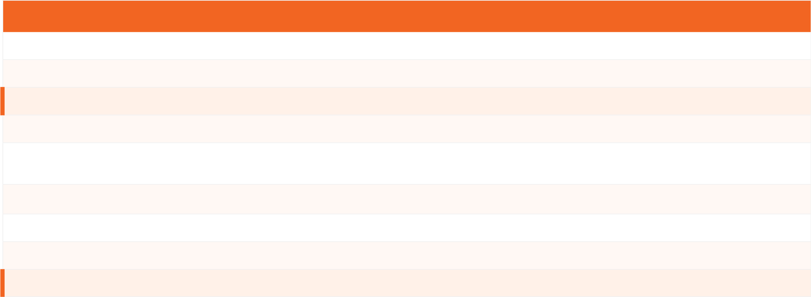









Quick Recall
Cancer Care in Primary Care
Key facts, thresholds, and guidelines at a glance
Topic
Key Fact
2WW Threshold
PPV ≥3% — patient seen by specialist within 14 days
FIT Threshold
≥10 μg/g Hb → urgent 2WW referral
DS1500
Withdrawn August 2021 → replaced by SR1 form
GSF Steps
Identify → Assess → Plan
GSF 7 C's
Communication, Coordination, Control of symptoms, Continuity, Continued learning, Carer support, Care of dying
Cancer Breathlessness
Low-dose morphine + fan therapy; oxygen only if SpO2 <92%
Cancer Fatigue
Graded activity; treat reversible causes; NOT methylphenidate
Cancer Care Review
QOF indicator — due within 12 months of diagnosis
Key Guideline
NICE NG12 (2026) — Suspected Cancer: Recognition and Referral
All thresholds based on NICE NG12 (2026) and current BNF/NICE guidance
www.bradfordvts.co.uk
Bradford VTS | Improving Cancer Care
28 / 29

Slide 29


Disclaimer & Key Resources
This teaching deck is for educational purposes only. All clinical decisions should be
based on individual patient assessment and current national guidelines. Content is
correct at time of publication — June 2026.
Key Resources
■ NICE NG12 (2026) — Suspected Cancer: Recognition and Referral
www.nice.org.uk/ng12
■ Cancer Research UK
www.cancerresearchuk.org
■ NICE CG140 — Opioids in Palliative Care
www.nice.org.uk/cg140
■ Macmillan Cancer Support
www.macmillan.org.uk
■ NICE NG31 — Care of Dying Adults in the Last Days of Life
www.nice.org.uk/ng31
■ Gold Standards Framework
www.goldstandardsframework.org.uk
www.bradfordvts.co.uk
Bradford VTS | Improving Cancer Care — Deck 6
Created June 2026

