Slide 1




Bradford VTS Teaching Deck
www.bradfordvts.co.uk
PRIMARY PALLIATIVE CARE SERIES
GSF – The UK Primary
Palliative Care Model
For GPs & Trainees
Bradford Vocational Training Scheme
Created: June 2026 • Updated to NICE NG142 (2019) Standards • Bradford VTS
Sources: NICE NG142 · Gold Standards Framework · RCGP Daffodil Standards 2019 · NICE QS13
Bradford VTS | Primary Palliative Care Teaching Series | June 2026

Slide 2












What is Primary Palliative Care?
FOUNDATIONS OF THE MODEL
Most people with life-limiting illness spend the
majority of their last year at home.
DEFINITION
Primary palliative care is the end-of-life and
serious illness care delivered by generalist teams —
GPs, district nurses, practice nurses, and community
pharmacists — as the core providers in the community.
GPs and community nurses are the backbone
of end-of-life care in the community.
~75% of patients prefer to die at home —
yet only ~40–45% actually do.
Good primary palliative care can close this gap.
“Not specialist palliative care — this is the everyday,
relationship-based care that generalists already provide.”
NICE NG142 (2019): GP practices must maintain a register
and take a proactive approach to end-of-life care.
● Bradford VTS | Primary Palliative Care Teaching Series
2

Slide 3







THE CASE FOR PRIMARY PALLIATIVE CARE
Why GPs are Central to Palliative Care
GAP
75%
~40-45%
of patients wish to die
at home or in a familiar setting
actually die at home
— the reality falls short
Good primary palliative care can close this gap — and GPs are the key.
● Most people with life-limiting illness spend the majority of their last year at home
● GPs and district nurses are the backbone of community end-of-life care
● NICE NG142 (2019): GP practices must maintain a register and take a proactive approach
● Bradford VTS | Primary Palliative Care Teaching Series
Slide 3 of 35

Slide 4












THE PRIMARY PALLIATIVE CARE MODEL
The Three Core Pillars
A systematic approach to proactive, person-centred end-of-life care
STEP 1
STEP 2
STEP 3
IDENTIFY
ASSESS
PLAN
Find and register patients proactively
using the Surprise Question and
clinical triggers
Review physical, psychological, social,
and spiritual needs at every MDT
meeting
Coordinate proactive care to prevent
crises and honour each patient's
preferences
Palliative Care Register
PEPSI-COLA Framework
ACP • OOH Handover • MDT
The GSF-aligned framework for every patient in the last year of life
“ The goal is not to react to crises — it is to prevent them. ”
Bradford VTS | Primary Palliative Care
Slide 4 of 35

Slide 5

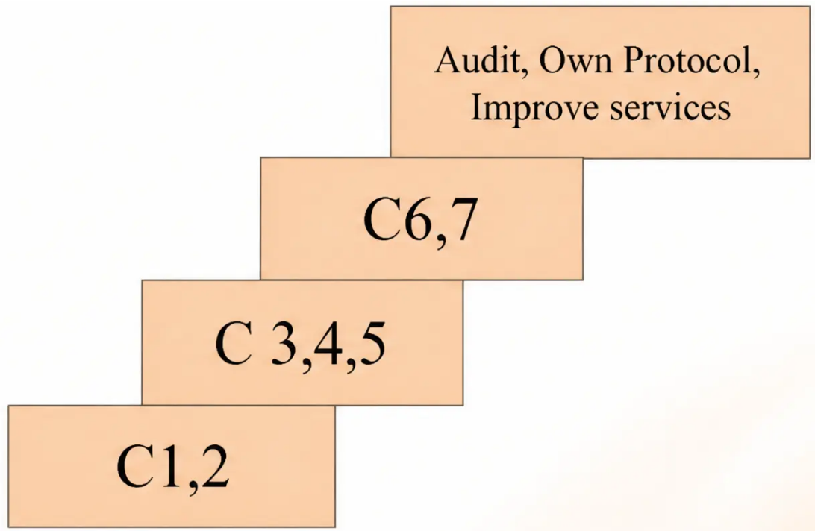




SECTION 2 — THE FRAMEWORK
The Gold Standards Framework (GSF)
A systematic, evidence-based approach to primary palliative care
WHAT IS IT?
A systematic, evidence-based approach for primary
care teams to improve the organisation and quality of
palliative care in the community.
ORIGIN
Developed by Dr Keri Thomas in the early 2000s.
Now a national accreditation programme for GP
practices, care homes, and hospitals.
WHY IT MATTERS
The most widely used model for organising primary
palliative care in the UK — built around 7 core
standards known as the 7 C's.
KEY FACT
GSF is structured around 7 C's — each representing a
core standard of care. The next three slides explore all seven.
GSF progression model — from basic communication
through to service improvement
Bradford VTS | Primary Palliative Care Teaching Series
Slide 5 of 35

Slide 6











GOLD STANDARDS FRAMEWORK — 7 C's
C1 · C2 · C3 · C4 · C5 · C6 · C7
Communication & Coordination
C1 and C2 — the organisational backbone of primary palliative care
C1
C2
C1
Communication
C2
Coordination
Supportive Care Register
Named Coordinator + GP Lead
• A live, maintained list of all patients in the last
12 months of life
• A named Palliative Care Coordinator for every practice
• Usually a District Nurse or Practice Manager
• Reviewed at every MDT meeting
• Maintains the register, organises MDT meetings,
ensures paperwork is complete
• Coded on EMIS Web or SystmOne
• GP Lead holds clinical responsibility and acts
as point of reference
• Shared digitally with community nurses and OOH
The Register is the foundation — you cannot
coordinate care for patients you haven't identified.
The Coordinator is the conductor of
the orchestra — keeping every player in time.
Monthly MDT Meeting
10–20 minutes carved from existing PHCT meetings · GPs, District Nurses,
Macmillan nurses, Practice Manager · Review every patient on the register
Bradford VTS | Primary Palliative Care
Slide 6 of 35
NICE NG142 · GSF

Slide 7






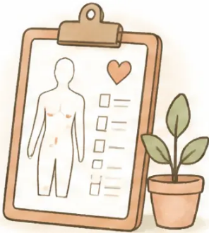


GOLD STANDARDS FRAMEWORK · 7 C's
GSF 7 Cs: Symptom Control and Continuity
Standards C3 and C4 — holistic assessment, out-of-hours planning, and anticipatory prescribing
C3
C4
Control of Symptoms
Continuity — Out of Hours
Holistic assessment at every review
Seamless care when the usual GP isn't available
● PEPSI-COLA checklist — assess all 9 domains
of need at MDT reviews
Paired Standards
● OOH Handover Form — sent to out-of-hours
provider when patient enters last weeks of life
● Pain body chart — map pain location and
character visually
● Updated at least twice weekly — kept current
as condition changes
● PACA scale — functional status and
palliative care needs rating
● Contains: diagnosis, prognosis, medications,
ACP/DNACPR status, preferred place of care,
Key GP/DNA contact, emergency plan
● VAS scales — visual analogue tools for
symptom intensity
● Anticipatory prescribing — "Just in Case"
medicines written up and placed in the home
before the terminal phase
● PHQ-2 / PHQ-9 — depression screening
● GAD-2 / GAD-7 — anxiety screening
● EPaCCS — Electronic Palliative Care
Coordination Systems; digital sharing of
preferences across all care settings
● Bradford VTS | Primary Palliative Care Teaching Series
Slide 7 of 35

Slide 8







GOLD STANDARDS FRAMEWORK — 7 C's
Learning, Carers, and Dying Phase
Standards C5, C6 & C7 — completing the GSF framework
• Significant Event Analysis (SEA) after every death
• Invite Macmillan nurses to MDT for case-based education
C5
• RCGP Daffodil Standards — voluntary quality accreditation for GP practices
Continued Learning
• Home Care Pack — contact details, medication card, crisis information
• Marie Curie nursing nights — free night-sitting service
C6
• Bereavement support — planned before and after the patient's death
Carer Support
• Agreed terminal care protocol — recognise the dying phase early
• Anticipatory prescribing — "Just in Case" box in the home
C7
• Preferred place of death discussed, recorded, and honoured where possible
Care in the Dying Phase
GSF 7 C's — Framework Complete
Gold Standards Framework — Primary Palliative Care
Slide 8 of 35 | Bradford VTS 2026
8

Slide 9







STEP 1 — IDENTIFY
The Palliative Care Register
A live, maintained list of patients in their last 12 months of life
NICE NG142 & QOF REQUIREMENT
■ All GP practices must maintain a Palliative Care Register —
a live, updated list of patients expected to be in their
last 12 months of life.
THE SURPRISE QUESTION
“Would I be surprised if this patient
died in the next 12 months?”
If NO → Add to register and begin proactive planning
KEY FACTS
● Coded on EMIS Web / SystmOne with SNOMED/CTV3
palliative care codes
● SR1 form completion (replacing DS1500, since 2021)
is a minimum trigger for entry
Every practice in England is required to maintain this register (NICE NG142, 2019)
Bradford VTS | Primary Palliative Care
Step 1 of 5 — Identify
Slide 9 of 35

Slide 10





STEP 1 — IDENTIFY
Triggers for Register Inclusion
Who belongs on the Palliative Care Register — and how do you know?
THE SURPRISE QUESTION
“Would I be surprised if this
patient died in the next 12 months?”
If the answer is NO → add to the register and start
proactive planning
● Progressive cancer (any)
● Advanced dementia
● Advanced heart failure
● Chronic kidney disease (advanced)
● Severe COPD
● Motor neurone disease
Life-limiting conditions — think beyond cancer
Also: advanced liver failure, frailty with predictable decline,
any serious illness with a foreseeable trajectory
● Bradford VTS | Primary Palliative Care
Slide 10 of 35

Slide 11




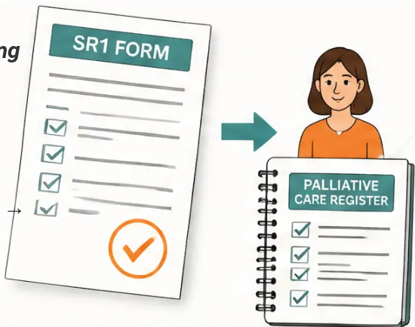


STEP 1: IDENTIFY — THE REGISTER
The SR1 Form
Replacing the DS1500 — what GPs need to know
WHAT IS IT?
● Replaces the DS1500 as the fast-track benefits form for
people with a life-limiting illness
IMPORTANT CHANGE — 2021
● Completed by a GP or specialist — confirms the patient
has a progressive life-limiting condition with a prognosis
likely less than 12 months
DS1500 was replaced
by the SR1 form in 2021
● Enables fast-track access to Universal Credit, PIP, and
ESA without the usual waiting period
REGISTER LINK
All references to DS1500 in older guidance
are now outdated.
● Completing an SR1 form is a key trigger for adding
a patient to the Palliative Care Register
● If you are writing an SR1, the patient almost
certainly meets the "Surprise Question" threshold
Use SR1 in clinical practice and in exam answers.
● Prompt SR1 completion → prompt register entry →
proactive care begins
AKT Pearl: DS1500 → SR1 (2021)
➔ SR1 = fast-track benefits trigger AND a prompt to start proactive palliative care planning
●
Bradford VTS | Primary Palliative Care
Slide 11 of 35
www.bradfordvts.co.uk

Slide 12



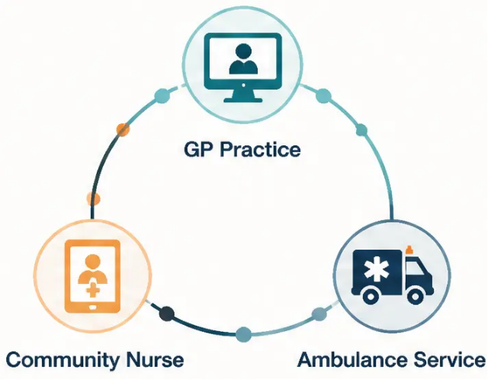








STEP 1: IDENTIFY
Managing the Electronic Register
Coding, care plan linkage, and cross-service record sharing
Clinical System Coding
Maintained on EMIS Web or SystmOne · Coded using CTV3 or
SNOMED palliative care codes · Enables automatic identification
and flagging across the practice system
Linked Electronic Care Plans
Each patient on the register is linked to their ACP and ReSPECT form ·
DNACPR status visible directly from the patient record · Anticipatory
prescribing notes and preferred place of death documented in-system
Shared with Community and Emergency Services
Record shared digitally with District Nurses, OOH provider, and ambulance service ·
EPaCCS (Electronic Palliative Care Coordination Systems) — also known as
Coordinate My Care in some regions · Enables any clinician at any hour to access
the patient’s end-of-life preferences
Active Register Maintenance
Reviewed at every monthly MDT meeting · Patients moved between active and
inactive sections as condition changes · “Poorlies and Pendings” — a holding
section for patients not yet confirmed but being monitored
Bradford VTS | Primary Palliative Care Teaching Series
Slide 12 of 35

Slide 13














STEP 2 · ASSESS
PEPSI-COLA: Holistic Assessment
Part 1 of 3 — Physical · Emotional · Personal
P · E · P | S · I · C · O · L · A
Physical Symptoms
Emotional & Psychological
Personal & Spiritual
• Pain
• Depression
• Spiritual & existential needs
• Breathlessness
• Anxiety
• Sense of meaning & purpose
• Nausea & vomiting
• Adjustment to illness
• Religious beliefs & practices
• Constipation
• Fear of dying
• Cultural needs & values
• Fatigue
• Mood & wellbeing
• What matters most to them
PHQ-2/PHQ-9 · GAD-2/GAD-7
“What symptoms are
troubling you most right now?”
“How have you been
feeling in yourself?”
“What gives you strength or
comfort at difficult times?”
PEPSI-COLA is used at monthly MDT meetings to review every patient on the palliative care register holistically
Bradford VTS · Primary Palliative Care Teaching Series · Slide 13 of 35

Slide 14











STEP 2: ASSESS — PEPSI-COLA
Social · Information · Control
P E P S I C O L A
Domains S, I, and C — holistic needs beyond the physical
S
I
C
• Family support network — who is at home?
• What does the patient understand
about their illness?
• Preferred place of care and death —
discussed?
• Caring responsibilities and carer burden
• What do they want to know — and
how much?
• Advance Care Plan (ACP) or ReSPECT
form completed?
• Social isolation or loneliness
• Housing and practical needs
• What has the family been told?
• DNACPR decision documented?
• Is there a language or literacy barrier?
• Financial pressures and welfare entitlements
• Lasting Power of Attorney (LPA) in place?
• Are written resources available in the
right format?
• Patient’s wishes known to family and OOH?
“Who is looking after this patient –
and who is looking after the carer?”
“Never assume — ask what they know,
then ask what they want to know.”
“ACP is not a single conversation —
it is an ongoing, evolving dialogue.”
Bradford VTS | Primary Palliative Care Teaching Series
Slide 14 of 35

Slide 15










STEP 2: ASSESS
Part 3 of 3
PEPSI-COLA: O • L • A
Out-of-hours • Late/dying phase • Afterlife/bereavement
Out-of-Hours
Afterlife / Bereavement
Late / Dying Phase
Crisis Prevention
Terminal Care Planning
Carer & Family Support
• OOH handover form completed and
shared
• Preferred place of death recorded
• Carer needs assessed separately
• Bereavement support planned in
advance
• ACP / ReSPECT completed
• Anticipatory medicines in the home
• DNACPR discussed and documented
• Crisis plan documented
• GP follow-up after death arranged
• Syringe driver protocol agreed
• Named contacts for OOH provider
• Signpost to bereavement services
• Family prepared for dying process
• EPaCCS record updated
• Death certificate and admin support
GSF C4 — Continuity
GSF C7 — Care in Dying Phase
GSF C6 — Carer Support
PEPSI-COLA
P E P S I C O L A
Bradford VTS | Primary Palliative Care Teaching Series | June 2026
15

Slide 16




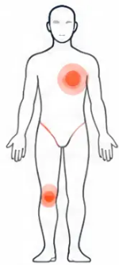
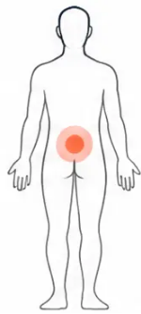












STEP 2 — ASSESS
Practical Assessment Tools
Four tools used in holistic palliative care assessment
PACA Scale
Pain Body Chart
Palliative Care Assessment Scale
Location and Character of Pain
Rates functional status — how well is
the patient coping day-to-day?
Patient marks pain sites on a body
diagram — type, severity, radiation
Independent
Needs
some help
Needs
significant
help
Mostly
dependent
Fully
dependent
PHQ-2 / PHQ-9
GAD-2 / GAD-7
Patient Health Questionnaire —
Generalised Anxiety Disorder Scale
Depression Screening
PHQ-2 as initial screen; PHQ-9 for
GAD-2 as initial screen; GAD-7 for
fuller assessment of depressive symptoms
fuller anxiety assessment
“Little interest or pleasure in doing things?”
“Feeling nervous, anxious, or on edge?”
“Feeling down, depressed, or hopeless?”
“Not being able to stop or control worrying?”
Score 0–3 each · PHQ-2 ≥3 → proceed to PHQ-9
Score 0–3 each · GAD-2 ≥3 → proceed to GAD-7
Visual Analogue Scales (VAS) — also used for symptom intensity (pain, breathlessness, nausea) · Simple 0–10 patient-rated scale
Bradford VTS | Primary Palliative Care
Slide 16 of 35
NICE NG142 · GSF · Daffodil Standards 2019

Slide 17








Traffic Light RAG Rating System
Categorising patients by stability to prioritise proactive care
GOLD STANDARDS FRAMEWORK · PATIENT RISK STRATIFICATION
GREEN
AMBER
RED
Stable
Unstable / Declining
Terminal Phase
Well-managed symptoms
Deteriorating condition
Last days or hours of life
No immediate concerns
Increasing support needs
Active dying recognised
Routine review at MDT
May need urgent review
Immediate care activation
Maintain current plan
Increase monitoring & input
Initiate terminal care protocol
RAG status reviewed at every monthly MDT palliative care meeting
Gold Standards Framework · Traffic Light Tool
Bradford VTS | Primary Palliative Care Teaching Series | June 2026

Slide 18
















STEP 3 OF 5
Plan — Proactive Coordinated Care
Shifting from reactive crisis response to anticipatory, coordinated care
REACTIVE
PROACTIVE
Crisis-driven
Anticipatory planning
Unplanned admissions
mindset shift
Preferences documented
Symptom surprises
Crises prevented
Document
Coordinate
Anticipate
Support
ACP, DNACPR, preferences
MDT, roles, OOH handover
Just in Case medicines
Carers, Home Care Pack
Bradford VTS | Primary Palliative Care Teaching Series | Slide 18 of 35
18

Slide 19















STEP 3 · PLAN
Monthly MDT Palliative Care Meetings
Structure · Attendees · Agenda · PEPSI-COLA in practice
PEPSI-COLA
ATTENDEES
Per-Patient Checklist
· Essential: GP Lead, District Nurses,
Macmillan Nurse, Practice Manager
P Physical symptoms
· As required: Social Worker, OT,
Physiotherapist
E Emotional / psychological
REGISTER REVIEW
P Personal / spiritual
· Review all patients on Palliative Care Register
· Flag: new patients, deteriorating patients,
recent admissions
· Assign or confirm RAG status
(Green / Amber / Red)
S Social support
I Information & communication
PER-PATIENT REVIEW
PEPSI-
COLA
C Control / ACP
· Use PEPSI-COLA checklist as aide-mémoire
· Confirm: Key GP, Key Nurse, current action plan
· Update OOH handover if status has changed
O Out-of-hours plan
6-MONTHLY SEA
L Late / dying phase
"10–20 minutes — not a new meeting"
· Significant Event Analysis of all deaths
· What went well? What could be improved?
· Use Traffic Lights framework to assess
care quality
A Afterlife / bereavement
●
Bradford VTS | Primary Palliative Care Teaching Series | June 2026 · NICE NG142

Slide 20







STEP 3: PLAN — NOMINATED ROLES
Nominated Roles in Primary Care
Every practice needs four clearly defined people — the "orchestra" of palliative care
GP Lead
Palliative Care
Coordinator
Key GP
Key Nurse
Clinical Responsibility
"Conductor of the Orchestra"
Named Clinician + Deputy
Named Nurse + Deputy
Overall clinical responsibility for
palliative care in the practice
Primary clinical GP for
that individual patient
Usually the District Nurse
responsible for that patient
Maintains the Supportive Care Register
Point of reference for complex
clinical decisions
Organises monthly MDT meetings
Continuity of care and
clinical relationship
Coordinates community nursing
care and home visits
Ensures paperwork and
OOH handovers are complete
Champions palliative care
standards at practice level
Deputy named to cover absence
Deputy named to ensure continuity
Usually a District Nurse or Practice Manager
Maximum 4 core contacts per patient — reducing the "revolving door" of 75+ different clinicians
Bradford VTS | Primary Palliative Care Teaching Series | June 2026

Slide 21












STEP 3: PLAN — PROACTIVE CARE
Part 1 of 2
Proactive Planning Checklist
Part 1 — Documentation and Decisions
Preferred Place of Care and Death — Discussed and Recorded
Ask proactively: "Have you given any thought to where you'd like to be cared for?"
ACP / ReSPECT Form — Completed and Filed
Advance Care Plan documents patient's wishes, values, and future treatment preferences
DNACPR — Decision Discussed and Documented
Sensitively explored; decision recorded in notes and on ReSPECT form; patient/family informed
Clinical System Coded — Palliative Care Status Active
SNOMED/CTV3 code applied in EMIS Web or SystmOne; linked to care plan and OOH records
Key GP and Key Nurse Nominated and Recorded
Named contacts documented; deputy named; maximum 4 core professionals per patient
Why this matters:
Starting these conversations early — before crisis — means patients retain
control over their care. Reactive planning almost always means unmet preferences.
Bradford VTS | Primary Palliative Care Teaching Series | June 2026
21 / 35

Slide 22

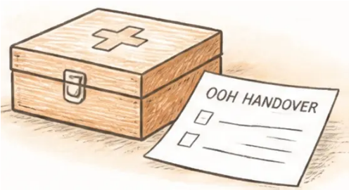



STEP 3: PLAN — PROACTIVE CARE
22 / 35
Proactive Planning Checklist
Part 2: Practical Arrangements
Anticipatory Medicines Written Up
EPaCCS Record Updated
“Just in Case” box prescribed and in the
home before the terminal phase
Digital end-of-life preferences shared across
all care settings — OOH, ambulance, hospital
Syringe Driver Protocol Agreed
Carer Support Package in Place
Care pathway documented; community
nursing aware of setup plan
Marie Curie nights booked; community nursing
package confirmed; respite arranged if needed
Equipment in the Home
Home Care Pack Given
Hospital bed, pressure mattress, catheter
pack, commode — ordered proactively
Contact details, medication card, crisis plan, and
“what to expect” information handed to patient
and carer
OOH Handover Form Completed
Bereavement Support Planned
Sent electronically to OOH provider; updated
at least twice weekly when in terminal phase
Support identified for family before and after death;
follow-up appointment scheduled post-bereavement
Timing is everything:
Anticipatory medicines, equipment, and the OOH handover should all be in place BEFORE
the crisis — not during it. If the family is calling 999 at midnight, the planning has come too late.
Bradford VTS | Primary Palliative Care Teaching Series | June 2026

Slide 23

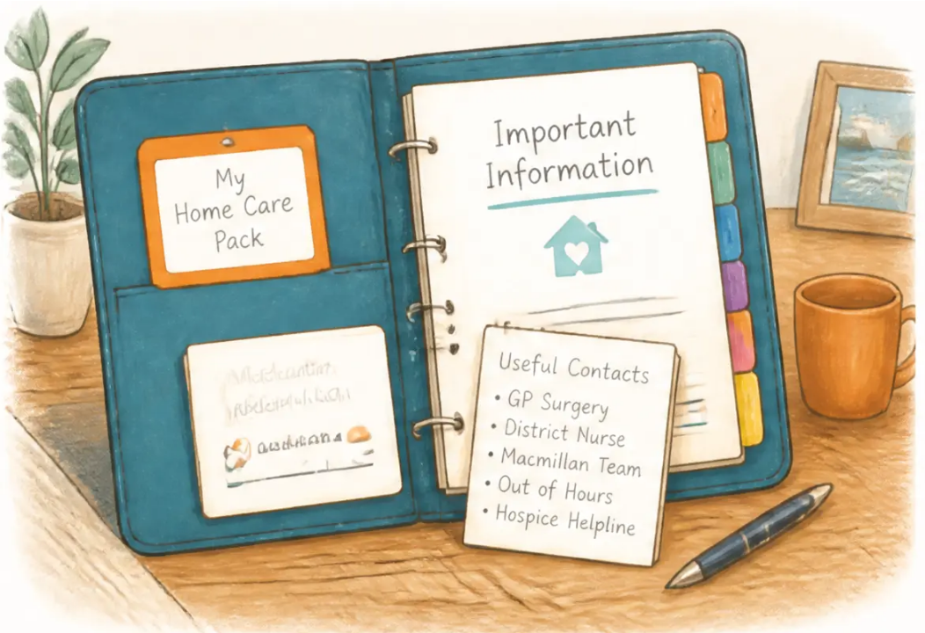














The Home Care Pack
Essential support for patients and carers at home
Contact Details
Medication Record Card
All relevant services: GP, District Nurse,
Macmillan, OOH, hospice helpline
Kept in the home; taken to every
appointment and hospital admission
Crisis Care Information
Weekly Review Sheet
What to do out of hours — and when
NOT to call 999
Patient and carer feedback on symptoms,
comfort, and concerns
What to Expect
Carer Support Information
Information on illness progression and
signs of the dying phase
Respite options, Marie Curie nights,
bereavement contacts
Given to every patient approaching end of life
Give the Home Care Pack BEFORE a crisis — information in a calm moment is far more valuable than information during one
Bradford VTS | Primary Palliative Care Teaching Series | June 2026

Slide 24












Out of Hours Handover and EPaCCS
Ensuring continuity when your patient needs you most — and you're not there
THE PROBLEM
THE SOLUTION
Dying patients deteriorate on evenings
and weekends — when their usual GP
is unavailable
OOH Handover Form + EPaCCS
Shared records ensure any clinician can
provide appropriate, preference-led care
OOH Handover Form
EPaCCS
Electronic Palliative Care
Coordination Systems
● Sent electronically to OOH provider when patient
enters last weeks of life
GP Practice
● Updated at least twice weekly as condition changes
● Contains: diagnosis · prognosis · current medications
● ACP and DNACPR status clearly documented
EPaCCS / Coordinate My Care
● Preferred place of care and death recorded
● Key GP and District Nurse contact details
● Emergency management plan for likely scenarios
OOH · Ambulance · Hospital · Community Nursing
Send BEFORE the crisis —
a phone call at 11pm is too late
■ Enables real-time sharing of EOL preferences across ALL care settings
■ Reduces inappropriate hospital admissions at end of life
■ Now standard in many areas — "Coordinate My Care" is one live example
Bradford VTS | Primary Palliative Care Teaching Series
Slide 24 of 35
●

Slide 25









Bradford VTS Teaching Deck
www.bradfordvts.co.uk
STEP 4 OF 5
Terminal Care Protocol
Managing the last days of life — recognition, symptom control, and family support
When the terminal phase is recognised — act proactively, not reactively
Recognise the Terminal Phase
Stop Non-Essential Medications
Use NICE NG31 criteria — patient bed-bound, minimal
oral intake, semi-conscious, mottled skin. Communicate
clearly with family that the dying phase has begun.
Review and stop statins, antihypertensives, vitamins,
and preventive medications. Continue only comfort-
focused medicines. Reduces burden on patient and family.
Prepare the Family
Anticipatory Prescribing — "Just in Case" Box
Prescribe SC morphine, midazolam, hyoscine, and
haloperidol before they are needed. Medicines must be
in the home before the crisis — not ordered during it.
Explain what to expect — changes in breathing, reduced
consciousness, mottling. Offer Marie Curie night nursing.
Provide Home Care Pack crisis information.
Chaplaincy/spiritual care if requested.
Syringe Driver and Route Switch
Preferred Place of Death
If oral route lost — switch to subcutaneous. Set up
continuous syringe driver for pain, secretions, agitation.
District Nurse initiates and monitors.
Review ACP/ReSPECT. If patient wishes to die at home —
mobilise rapid response community nursing, hospice-at-
home, and equipment. Avoid unnecessary hospital admission.
After Death:
• Notify OOH to remove handover form
• Inform all relevant services
• Initiate bereavement support for family
Bradford VTS | Primary Palliative Care Teaching Series | June 2026
25 // 35

Slide 26








STEP 5 — C5: CONTINUED LEARNING
Continued Learning & Significant Event Analysis
Reflecting on care quality • Team education • Daffodil Standards
Significant Event Analysis (SEA)
RCGP Daffodil Standards (2019)
Conducted for every patient death —
a structured team reflection
Voluntary quality accreditation for GP practices
(RCGP & Marie Curie)
Key questions: What went well? What could
be improved? What will we change?
Covers: identification, assessment, coordination,
carer support, after-death care
Use the Traffic Light framework to rate
quality of care at 6-monthly reviews
Used in CQC inspections as evidence of
good palliative care practice
Invite Macmillan nurses to MDT meetings
for case-based education
Demonstrates team-wide commitment to
end-of-life care quality
"Every death is a learning opportunity
for the whole team"
Also: HEE e-learning for End of Life Care — free to all NHS staff
Bradford VTS | Primary Palliative Care Teaching Series
Slide 26 of 35

Slide 27













STEP 5 — CARER SUPPORT · C6
Carer Support and Benefits
Caring for carers — before and after the death
Carer Needs Assessment
Every carer is entitled to their own needs assessment — separate
from the patient’s.
Assess: emotional burden, physical strain, social isolation, and
financial impact.
Assess independently
Marie Curie Nursing and Practical Services
Free Marie Curie night-sitting service — allows carers to sleep
while a nurse stays overnight.
Refer early; demand is high. Also: hospice-at-home, respite care,
and bereavement support.
Refer proactively
Benefits Carers May Not Know About
Carer’s Allowance · Attendance Allowance · Universal Credit ·
Personal Independence Payment (PIP)
Many carers are unaware of entitlements — a brief mention in
consultation can transform financial pressure.
Don’t assume they know
Bradford VTS | Primary Palliative Care Teaching Series
27 / 35

Slide 28







NICE NG142 and Daffodil Standards
Current national guidance and GP practice accreditation
NICE GUIDELINE
RCGP & MARIE CURIE
NG142
Daffodil Standards
End of Life Care for Adults: Service Delivery
2019 · Voluntary Accreditation
October 2019 · CURRENT
■ GP practices must identify adults likely to be in the last
12 months of life
What Daffodil Standards Cover
🌼 Identification of patients
🌼 Preferred place of death
■ Practices must have a process for coordinating and planning
end-of-life care
🌼 Holistic needs assessment
🌼 Carer support
🌼 Communication skills
🌼 After-death care
■ End-of-life care must be available 24 hours a day, 7 days a week
🌼 Care coordination
🌼 Team education
■ Needs and preferences must be assessed and documented
■ Care should be coordinated using digital systems where
possible (EPaCCS)
“ Demonstrates commitment to high-quality palliative care —
recognised in CQC inspections as evidence of good practice. ”
■ Fast-track continuing healthcare for those who wish to die at home
Replaces previous EOL guidance. Applicable to all GP practices in England.
Voluntary — not mandatory. Shows quality above baseline.
Both NG142 and the Daffodil Standards point to the same goal: proactive, coordinated,
person-centred end-of-life care delivered in the community.
Bradford VTS Teaching Deck • Primary Palliative Care
28 / 35

Slide 29












CLINICAL PRACTICE
Top Tips
8 Pearls of Practice
Ask the Surprise Question
Assign the Coordinator
“Would I be surprised if this patient died in
the next 12 months?” — if No, add to the
register immediately.
Every practice needs a "conductor of the
orchestra" — the Palliative Care Coordinator
role is essential.
Use PEPSI-COLA
Send OOH Handover Early
Review all 9 domains at every MDT —
don't just focus on physical symptoms.
Don't wait for a crisis — a phone call at
11pm is too late. Send before deterioration.
"Just in Case" Medicines First
Give Carers a Home Care Pack
Anticipatory prescribing must be in the home
before the terminal phase begins.
Information before a crisis is far better
than information during one.
Keep MDT Meetings Short
SR1 = Register Trigger
10–20 minutes carved from an existing PHCT
meeting is all that's needed — consistency
matters more than length.
SR1 form (replacing DS1500 since 2021) triggers
fast-track benefits and should prompt
immediate register entry.
Bradford VTS | Primary Palliative Care Teaching Series
●
Slide 29 of 35

Slide 30













EXAM PREPARATION
AKT Exam Pearls
Key facts and high-yield recall points for the Applied Knowledge Test
NICE GUIDELINE
NICE NG142 (2019): GP practices must maintain a palliative care register and proactively coordinate end-of-life care
GSF FRAMEWORK
GSF 7 C's: Communication · Coordination · Control of symptoms · Continuity · Continued learning · Carer support · Care in the dying phase
AKT
IDENTIFICATION TOOL
"Surprise Question" (Gold Standards Framework): if you would NOT be surprised if the patient died within 12 months → add to register
ASSESSMENT TOOL
PEPSI-COLA = holistic 9-domain checklist: Physical · Emotional · Personal · Social · Information · Control · Out-of-hours · Late/dying · Afterlife
APPLIED KNOWLEDGE TEST
RAG SYSTEM
Traffic light rating: Green = stable · Amber = unstable/declining · Red = terminal phase (last days/hours)
FORM UPDATE
DS1500 was REPLACED by the SR1 form in 2021 for fast-track benefits (Universal Credit, PIP, ESA) — do not reference DS1500
ACCREDITATION
Daffodil Standards (RCGP/Marie Curie, 2019): voluntary GP practice accreditation for end-of-life care quality — used as evidence in CQC inspections
Bradford VTS | Primary Palliative Care Teaching Series | June 2026
30 / 35

Slide 31













EXAM PREPARATION • SCA
SCA Exam Pearls
Communication strategies for the consultation
SCA: Simulated Consultation Assessment — What you say matters as much as what you know
Exploring ICE in End-of-Life Consultations
Discussing Prognosis Sensitively
“What do you understand about where things are heading?”
“It’s hard to be certain about timing, but we’re
thinking in terms of weeks to months rather
than years.”
“What concerns you most at the moment?”
“What would matter most to you if you became very unwell?”
Ideas · Concerns · Expectations — ask all three
Acknowledge uncertainty · Avoid false precision ·
Give a frame, not a date
Safety-Netting at End of Life
Preferred Place of Death Discussion
“Here’s how to reach us day or night — please
don’t call 999 unless [specific scenario], because
our team can respond in the community.”
“Many people have thoughts about where they’d
like to be cared for — have you given that any
thought?”
Empower · Prevent panic · Reduce inappropriate admissions
Open question · Non-directive · Document the answer
SCA tip: Silence is not failure — a pause after a difficult question shows you are listening
Bradford VTS | Primary Palliative Care Teaching Series
Slide 31 of 35

Slide 32






Bradford VTS Teaching Deck
www.bradfordvts.co.uk
CLINICAL SAFETY
Red Flag Boxes
Warning signs that must not be missed in primary palliative care
Patient in Last Months of Life —
NOT on Register
No OOH Handover Form Sent
If the patient deteriorates on a Friday evening,
the out-of-hours team is flying blind. Send the
handover before the crisis — not during it.
Risk of reactive crisis care and avoidable hospital
admission. Every dying patient needs proactive planning.
No Anticipatory Medicines in the Home
Carer Showing Signs of Burnout,
Depression, or Isolation
Family cannot manage acute symptoms at home
without a "Just in Case" box. Absence risks distressing
terminal agitation, pain, or breathlessness managed
by ambulance instead.
Carer collapse = patient crisis. Assess carers separately.
Ask directly: "How are you coping?" Refer to
Marie Curie, respite, carer's assessment.
Patient Unaware of Preferred Place of Death Options
Patients cannot exercise choice if the conversation has never happened.
Ask proactively — do not wait for the crisis moment. Document the
preference and act on it.
● Any one of these flags in your practice = immediate action required
●
Bradford VTS | Primary Palliative Care Teaching Series | June 2026

Slide 33













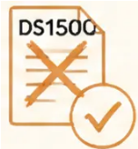


Bradford VTS Teaching Deck
www.bradfordvts.co.uk
REFLECTIVE PRACTICE
Common Pitfalls in Palliative Care
Six mistakes to recognise — and avoid — in everyday practice
Reactive Rather
Than Proactive
Starting ACP
Too Late
Overlooking Non-
Cancer Patients
Waiting for a crisis to act — instead
of anticipating needs and planning
ahead
Leaving advance care planning until
the patient is actively dying — when
it is too late for meaningful discussion
Heart failure, COPD, dementia,
and CKD patients have equal need —
but are often missed from the register
GPs Working
Alone
Outdated OOH
Handover
Citing DS1500
Instead of SR1
Failing to use the full MDT —
district nurses, Macmillan nurses,
social workers, and coordinators
are essential partners
Sending the handover once and
never updating it — a patient's
condition changes; so must the
handover form
The DS1500 was replaced by the
SR1 form in 2021 — outdated
references cause confusion and
delay fast-track benefits
Most pitfalls share a common root: acting too late. Proactive care is the antidote.
Slide 33 of 35
Bradford VTS | Primary Palliative Care Teaching Series | June 2026

Slide 34










Bradford VTS Teaching Deck
www.bradfordvts.co.uk
SLIDE 34 OF 35
Quick Recall
Key acronyms, frameworks, and facts — know these cold
GSF
PEPSI-COLA
RAG Rating
Gold Standards Framework
Holistic Assessment Tool
Traffic Light System
• 7 C's organising framework
P Physical
E Emotional
Green — Stable, well-managed
• Communication · Coordination
P Personal
S Social
• Control of symptoms · Continuity
Amber — Unstable, declining
I Information
C Control
• Continued learning · Carer support
O Out-of-hours
L Late/dying
Red — Terminal phase, last days/hours
• Care in the dying phase
A Afterlife (bereavement)
Developed by Dr Keri Thomas
9-domain checklist — use at every MDT
Reviewed at every MDT meeting
SR1 Form
Surprise Question
Must-Know Facts
Replaced DS1500 in 2021
GSF Identification Tool
NICE NG142 · Core Standards
“Would I be surprised if this patient
died in the next 12 months?”
• NICE NG142 (2019) — current guidance
• Fast-track benefits: Universal Credit, PIP, ESA
• Completion = prompt register entry
• GP practices must maintain a register
• ~75% prefer to die at home
• DS1500 is obsolete — never use it
• Only ~40–45% actually do → close the gap
NO → Add to palliative care register
YES → Monitor; reassess regularly
• Triggers proactive care planning
• Coordinator = “conductor of the orchestra”
• OOH handover → send BEFORE the crisis
NICE NG142 · Benefits trigger
Ask at every case review
Bradford VTS · June 2026
●
Bradford VTS | Primary Palliative Care Teaching Series | June 2026

Slide 35












Bradford VTS Teaching Deck
www.bradfordvts.co.uk
Disclaimer & Resources
DISCLAIMER
This teaching resource has been produced for educational purposes
for GP trainees and International Medical Graduates within Bradford VTS.
It is intended as a learning aid and does not replace clinical judgement,
local protocols, or current national guidance.
Always refer to up-to-date NICE guidelines and local trust/PCN policies
when making clinical decisions.
Content reflects NICE NG142 (2019) standards as of June 2026.
Guidance may be updated — check NICE.org.uk for the latest version.
Key References & Further Reading
NICE NG142
Gold Standards Framework
Daffodil Standards
NICE QS13
End of Life Care for Adults:
GSF National Programme —
RCGP & Marie Curie —
End of Life Care for Adults —
Service Delivery (October 2019)
GP Practice Accreditation
GP Practice Quality Standards (2019)
Quality Standard
www.nice.org.uk
www.goldstandardsframework.org.uk
www.rcgp.org.uk
www.nice.org.uk
Bradford VTS | Primary Palliative Care Teaching Series | Created June 2026 | Updated to NICE NG142 2019 Standards
© Bradford VTS 2026 — For Educational Use Only

