Slide 1



BRADFORD VTS TEACHING DECK
One Chance
to Get It Right
Mastering the Art of a Good Death
in General Practice
Bradford VTS Teaching Deck · GP Palliative Care
NICE NG31 · NG142 · NHS Ambitions 2021–2026
Created June 2026
How people die remains in the
memory of those who live on.
— Dame Cicely Saunders
⚠ Always verify drug doses with current BNF/NICE guidance.
Educational use only.
www.bradfordvts.co.uk
⚠ For educational purposes only — verify all doses with current BNF/NICE guidance

Slide 2




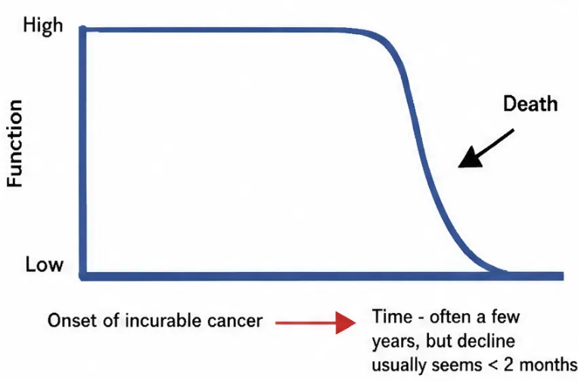
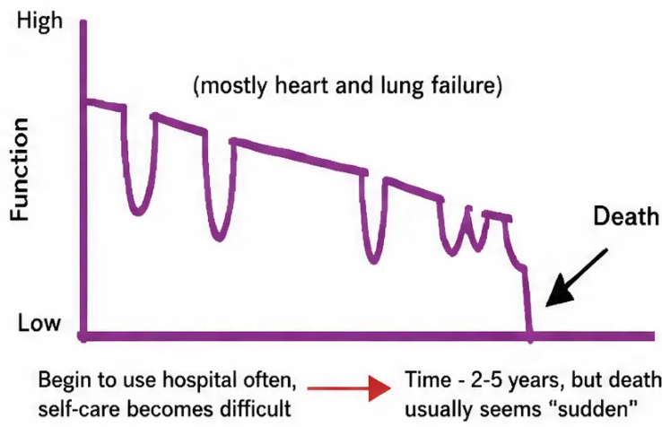
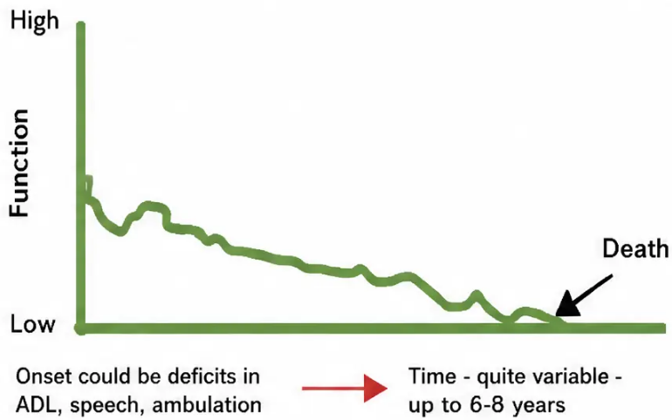
Why It Matters: The Three Trajectories of Dying
www.bradfordvts.co.uk
GPs manage approximately 20 deaths per year.
Every trajectory looks different — knowing which path your patient is on changes everything.
Cancer Trajectory
Organ Failure Trajectory
Frailty / Dementia Trajectory
Maintained function, then rapid decline
Palliative care: start when curative
treatment ends
Gradual decline with acute exacerbations
Each crisis may be the last — plan early
Slow, prolonged, hard to recognise
The hardest to identify — use the
Surprise Question
Palliative care ≠ end of life care — it can begin alongside curative treatment.
BRADFORD VTS TEACHING DECK · Palliative Care
www.bradfordvts.co.uk

Slide 3





BRADFORD VTS TEACHING DECK
www.bradfordvts.co.uk
Proactive Identification
GSF PIG v7 (2022) — THREE STEPS
The Surprise Question & GSF PIG
The Surprise Question
THE SURPRISE QUESTION
Would you be surprised if they died in 6–12 months?
“Would you be SURPRISED
if this patient died
in the next 6–12 months?”
General Clinical Indicators
• Declining performance status (ECOG ≥3)
• Weight loss >10% over 6 months
• Repeated unplanned admissions (2+ in 6 months)
If NO → add to Palliative Care Register
Begin active care planning now
Disease-Specific Indicators
• Cancer: deteriorating despite oncology
The single most powerful screening tool in GP practice
Use at every significant review for patients with serious illness
• Heart Failure: NYHA III–IV, cardiac cachexia
• Dementia: unable to dress, eat, or communicate
AKT PEARL
GSF PIG v7 (2022): Surprise Question → General Indicators → Disease-Specific Indicators
www.bradfordvts.co.uk
⚠ Educational use only — verify with current NICE/BNF guidance

Slide 4













Diagnosing Dying: NICE NG31 and the Last Days of Life
Bradford
VTS
Ask Four Questions
Clinical Signs of Dying
1 Could this patient be in
the last days of life?
Bedbound · Unable
to self-care
Drowsy /
semi-comatose
Not tolerating
fluids
Mottled /
discoloured skin
Cheyne-Stokes
breathing
Cool extremities /
↓ urine
2 Was this deterioration
expected?
NICE NG31 Key Actions
3 Is further life-prolonging
treatment inappropriate?
Recognise dying — multi-disciplinary assessment; review regularly
Communicate sensitively and honestly with patient and family
4 Have reversible causes
been excluded?
Hydration: individualised decision — assess benefits and burdens
Anticipatory prescribing for pain, breathlessness, nausea,
agitation, secretions
Infection · Electrolytes · Medication toxicity · Dehydration
www.bradfordvts.co.uk
Verify all doses with current BNF/NICE guidance.

Slide 5











The Good Death: Holistic and Spiritual Care
NHS Ambitions Framework 2021–2026 · One Chance to Get It Right, 2014
Physical
Pain · Breathlessness · Nausea · Fatigue · Comfort
Psychological
Anxiety · Fear of dying · Fear of pain · Emotional peace
Social
Family · Carers · Isolation · Financial · Housing
Six NHS Ambitions
Spiritual & Existential
● Each person seen as an individual
Meaning · Purpose · Faith · Legacy · Reconciliation
● Fair access for all
● Maximise comfort and wellbeing
● Coordinated care, right time, right place
“What gives your life meaning?”
● All staff prepared to care
— The most powerful question a GP can ask
● Community prepared to help
www.bradfordvts.co.uk
BRADFORD VTS TEACHING DECK · Palliative Care

Slide 6












BRADFORD VTS TEACHING DECK
www.bradfordvts.co.uk
Advance Care Planning and the ReSPECT Process
Planning ahead • Legal frameworks • Person-centred emergency care
ReSPECT replaces standalone DNACPR
— it's about what CAN be done, not just what won't be.
Resuscitation Council UK • v3 Current Standard
1 ReSPECT
2 ADRT
3
LPA — Health & Welfare
Recommended Summary Plan for
Emergency Care and Treatment
Advance Decision to Refuse Treatment
Lasting Power of Attorney
• Legally binding under Mental Capacity Act 2005
• Covers full range of emergency care — not just CPR
• Only activates when person LACKS capacity
• Must be registered with Office of the
Public Guardian
• Must be: written • signed • witnessed
• Section 5: CPR decision (yes / no / uncertain)
• Must state 'even if my life is at risk' for
life-sustaining treatment
• Signed by clinician + person or representative
• Donee can decide on life-sustaining
treatment only if explicitly granted
• Travels across all care settings
• Cannot demand treatment — only refuse it
• Person's goals and values at its heart
• Separate from Financial LPA
• Must have capacity when made
• Must be in place before capacity is lost
Current NHS Standard
Legally Binding
Register with OPG first
CPR in end-stage disease: survival to discharge <5% • Frame conversations around ‘What matters most to you?’ — not ‘Do you want us to try?’
AKT PEARL • ADRT: written + signed + witnessed = legally binding • LPA only active when capacity lost
www.bradfordvts.co.uk
Educational use only — verify with current BNF/NICE/MCA guidance

Slide 7













BRADFORD VTS
GSF Coordination and Anticipatory Prescribing
Proactive planning for a good death at home
The GSF 7 Cs
‘Just in Case’ Box — Core Medications
● C Communication — Palliative register · Surprise Question · MDT
Pain / Breathlessness Morphine sulfate SC · 2.5–5mg PRN
● C Co-ordination — Named lead · GSF meetings · 24/7 access
Agitation Midazolam SC · 2.5–5mg PRN
● C Control of symptoms — Regular review · Anticipatory Rx
Nausea / Vomiting Cyclizine SC · 25–50mg PRN
(or Haloperidol 0.5–1.5mg)
● C Continuity — OOH handover · Shared emergency plan
● C Continued learning — Death audit · Team reflection
Respiratory Secretions Hyoscine butylbromide
SC · 20mg PRN
● C Carer support — Needs assessment · Bereavement risk
‘Prescribe early — don’t wait for a crisis.
Leave at home. Share plan with district nurses.’
● C Care in dying phase — Comfort · Dignity · Last Days plan
GSF PIG v7 · 2022
Verify all doses — current BNF
www.bradfordvts.co.uk
● NICE NG31 · GSF PIG v7 2022

Slide 8









Communication Skills & Specialist Referrals
SPIKES Framework · When to Refer · Hospice & Macmillan Pathways
The SPIKES Framework — Difficult Conversations
When to Refer to Specialist Palliative Care
Setting
Active, progressive, advanced disease PLUS one or more of:
Private space · Sit down · Unhurried · All key people present
◆ Uncontrolled or complex symptoms despite optimal GP management
Perception
◆ Complex psychological, emotional, or existential distress
“What do you understand about your illness right now?”
◆ Difficult decisions about future care or treatment
Invitation
◆ Complex family or social dynamics
“Would it help to talk about what we might expect in the coming weeks?”
◆ Patient or family requesting specialist input
Knowledge
Small chunks · Pause · Check understanding · Avoid jargon
Macmillan CNS Referral
Urgent: 2 working days
Empathy
Routine: 5 working days
Acknowledge emotion before continuing · Silence is powerful
Summary
Hospice Inpatient /
Day Services
Marie Curie Nurses
(overnight home care)
Fast Track CHC —
GP can initiate
Summarise · Write it down · Plan next steps · Follow-up booked
SCA Pearl: Use ‘What matters most to you?’ — respond to
emotion before giving information. Address ICE before clinical plan.
Red Flag: Do not wait for crisis — refer early, Fast Track
CHC should be used proactively, not in the final 24 hours.
www.bradfordvts.co.uk
BRADFORD VTS · Palliative Care

Slide 9










BRADFORD VTS TEACHING DECK
Carer Support, Red Flags & Top Tips
Supporting the Carer
Red Flags — Act Now
Top Tips
Safety-critical — do not delay
High-yield clinical pearls
The invisible backbone of community palliative care
● Uncontrolled pain or distressing symptoms →
immediate review + anticipatory Rx
● Start palliative conversations early —
it is not giving up
● Always ask: "How are YOU coping?"
● Carer needs assessment via local authority
● Surprise Question at every significant review
● Wish to hasten death → urgent psychological
+ spiritual assessment
● Respite: Marie Curie nurses, hospice breaks
● ReSPECT, not just DNACPR — frame
around what you WILL do
● Bereavement risk assessment —
start before death
● Carer burnout or neglect signs →
safeguarding + urgent respite
● Prescribe 'just in case' box before the crisis
● Watch for burnout: physical +
mental health impact
● Delirium in dying patient → review meds,
exclude reversible causes (NICE NG31)
● Ask: "What gives your life meaning?"
● Family blocking honest communication →
patient's rights take precedence
● Know your referral pathways: Macmillan CNS,
hospice, Fast Track CHC
● Signpost: Cruse Bereavement Care, MIND,
hospice services
● ADRT not found in emergency → act in best
interests; cannot assume it exists
● Document ACP — share with OOH
and ambulance
● After the death: personal letter or call
means everything
● Dying in hospital against wishes → audit
trigger; review what failed
● A personal letter after death costs nothing;
means everything
"Bereavement problems
begin before the death."
"No anticipatory Rx at home =
avoidable suffering at 3am"
"One conversation at the right time
changes everything.."
www.bradfordvts.co.uk
Educational use only — verify all guidance with current NICE/BNF

Slide 10







BRADFORD VTS TEACHING DECK
www.bradfordvts.co.uk
Exam Pearls & Quick Recall
AKT · SCA · High-Yield Summary
AKT Exam Pearls
Quick Recall
◆ NICE NG31 = last days of life care · NG142 = service delivery
1. Surprise Question → palliative
care register
◆ Anticipatory Rx: morphine · midazolam · cyclizine · hyoscine butylbromide
2. NICE NG31: last 2–3 days
◆ ADRT: written + signed + witnessed = legally binding refusal
3. ReSPECT replaces standalone
DNACPR
◆ Hyoscine butylbromide does NOT cross blood-brain barrier — preferred for secretions
4. LPA only active when capacity
SCA Consultation Pearls
5. GSF 7 Cs: coordinate proactive
care
● ‘What matters most to you?’ — anchor phrase for every EoL consultation
6. Hospice ≠ giving up
● Use SPIKES framework · respond to emotion before information
7. Ask: holistic — physical,
psychological, social, spiritual
● Address ICE before explaining clinical plan — always
8. One chance — make every
death count
● Show comfort with uncertainty · silence is a clinical skill
“How people die remains in the memory of those who live on.” — Dame Cicely Saunders
www.bradfordvts.co.uk
⚠ Educational use only — verify all doses with current BNF/NICE guidance

