Slide 1



BRADFORD VTS TEACHING DECK
Pain Management and Opioid Conversion
in Palliative Care
A Bradford VTS Teaching Resource for GPs & Trainees
June 2026
www.bradfordvts.co.uk
⚠ Disclaimer: Always double-check drug doses and clinical guidance
with the latest NICE/BNF resources. This presentation is for
educational purposes only and does not replace clinical judgement
or local protocols.
www.bradfordvts.co.uk
June 2026 | Bradford VTS Teaching Deck

Slide 2
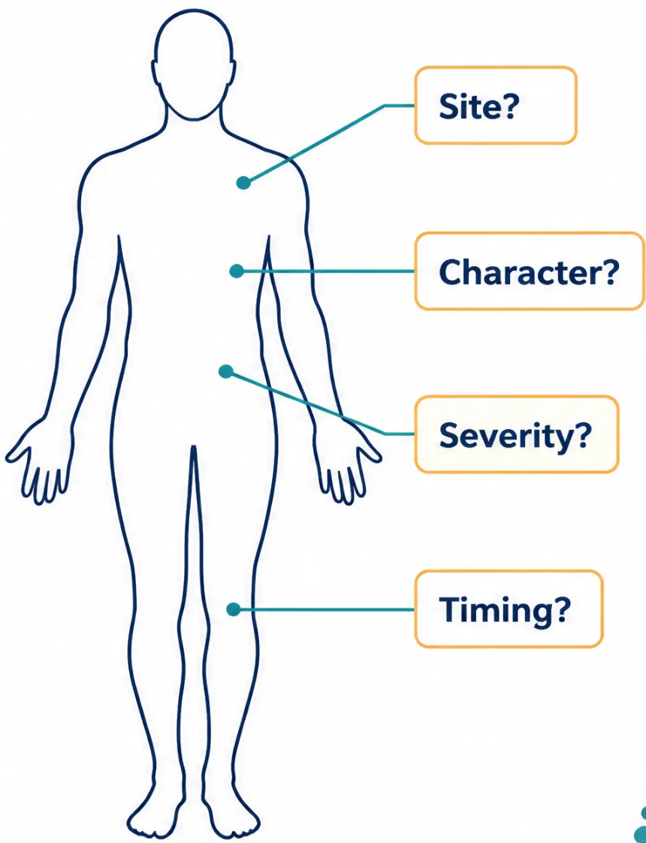




Section 1 — Pain Assessment
The Foundation of Care
Comprehensive Pain Assessment
A thorough pain history is VITAL —
without it, effective treatment is impossible.
Key Questions in a Pain History
● Site(s) — where exactly is the pain?
● Character — aching, burning, or shooting?
● Severity — rate it 0–10 on a numeric scale
● Timing — constant, intermittent, or nocturnal?
● Aggravating and relieving factors
● Current analgesia response and functional impact
Cancer pain is NOT always cancer-related —
always exclude musculoskeletal, visceral, neuropathic,
and other causes before assuming malignant origin.
www.bradfordvts.co.uk
Pain Management & Opioid Conversion | Bradford VTS 2026

Slide 3






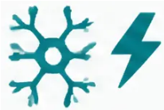

Section 1 — Pain Assessment
Key Pain Assessment Principles
Multiple Pain Sites
Partial Opioid
Responsiveness
Non-Drug Treatments
Assess each pain site separately —
a patient may have more than one
distinct pain, each with a different
cause, character, and treatment.
Neuropathic and bone pain respond
only partially to opioids. Adjuvant
medicines are often essential —
not optional — for adequate control.
Always consider: radiotherapy, nerve
blocks, TENS, physiotherapy, and
surgery. These are not last resorts —
they are first-line options for many
pain types.
Treat the CAUSE, not just the symptom — and remember, pain in a
cancer patient is not always cancer-related.
Pain Management & Opioid Conversion in Palliative Care
www.bradfordvts.co.uk
Slide 3 of 35

Slide 4


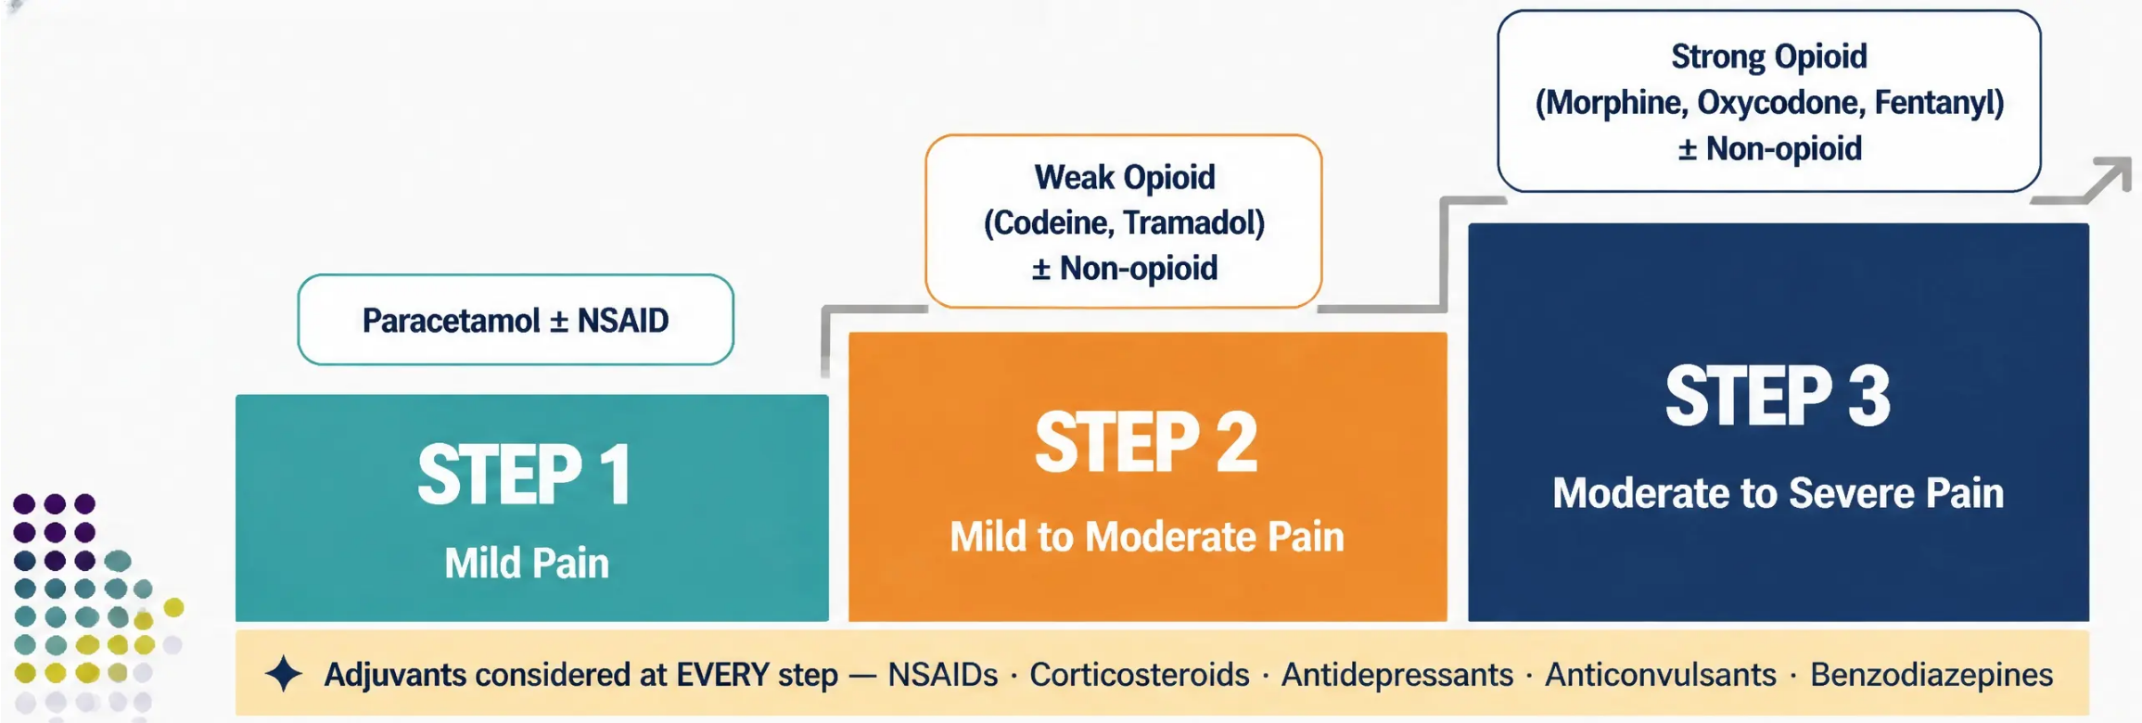
Section 2 — Analgesic Approach
Sept 2024
NICE CG140 Update
The WHO Analgesic Ladder
For moderate-to-severe cancer pain,
it is acceptable to move directly
from Step 1 to Step 3 —
bypassing weak opioids.
for GP Practice
Choose your step based on pain severity — not disease stage.
www.bradfordvts.co.uk
Bradford VTS Teaching Deck | Pain Management & Opioid Conversion

Slide 5

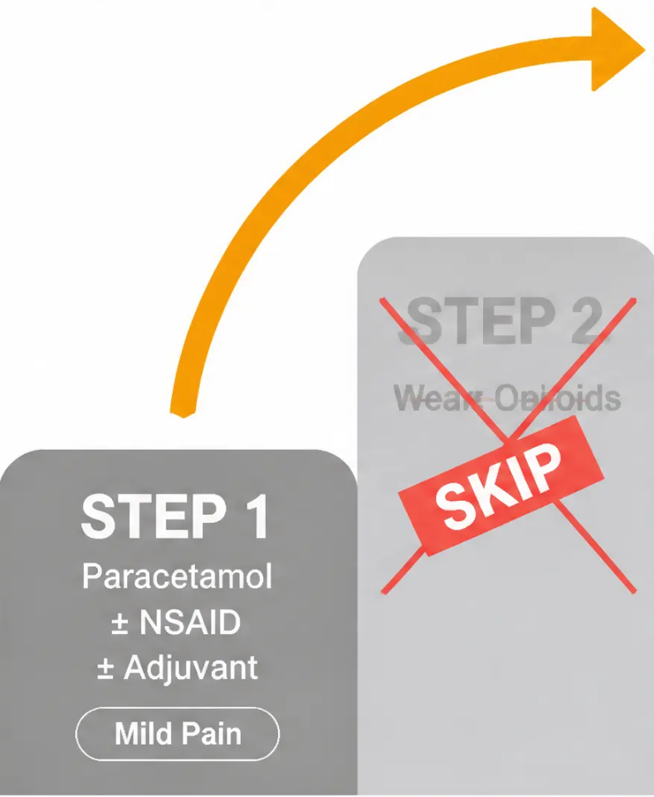




Section 2 — WHO Analgesic Ladder
NICE CG140 Update: Direct Move to Step 3
NICE CG140 — September 2024
STEP 3
For moderate-to-severe cancer pain, it is now
acceptable to move DIRECTLY from Step 1 to
Step 3 — bypassing weak opioids entirely.
Strong Opioids
(Morphine,
Oxycodone,
Fentanyl)
● Weak opioids have a dose ceiling —
limited benefit at higher pain levels
Moderate-Severe Pain
● Low-dose strong opioids are often more
effective and better tolerated
● Step 2 can cause unnecessary delay in
achieving adequate pain control
When in doubt about cancer pain severity
→ → start low-dose strong opioid
www.bradfordvts.co.uk
Bradford VTS Teaching Deck | Pain Management & Opioid Conversion

Slide 6
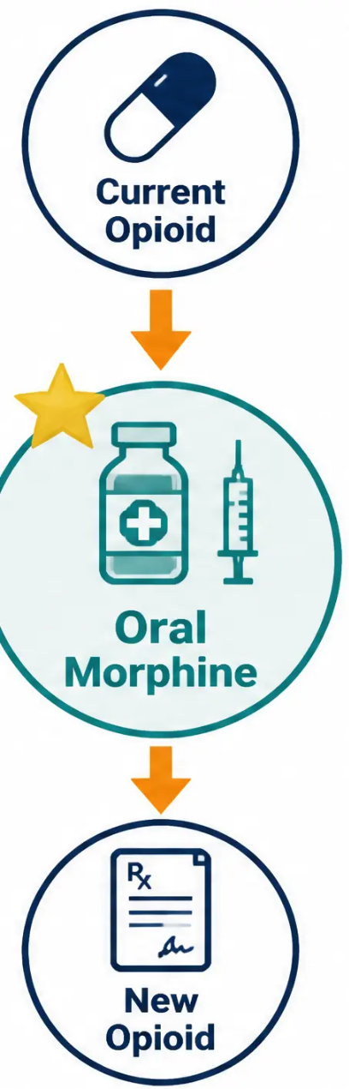












Section 3 — Opioids
Safe Opioid Prescribing Principles
Gold Standard: Oral Morphine
Oral morphine is the first-line strong opioid for cancer pain.
When oral route is unavailable — use SC morphine or SC diamorphine.
Always Convert Via Oral Morphine
Step 1: Convert current opioid → oral morphine equivalent.
Step 2: Convert oral morphine → new opioid.
Oral morphine is the universal reference point — never convert
directly between two non-morphine opioids.
Double-Check Every Calculation
Always verify opioid calculations with a colleague.
Errors carry serious, potentially fatal consequences.
www.palliativedrugs.com — drug compatibility & dose checking
www.bradfordvts.co.uk
Pain Management & Opioid Conversion | Bradford VTS 2026

Slide 7
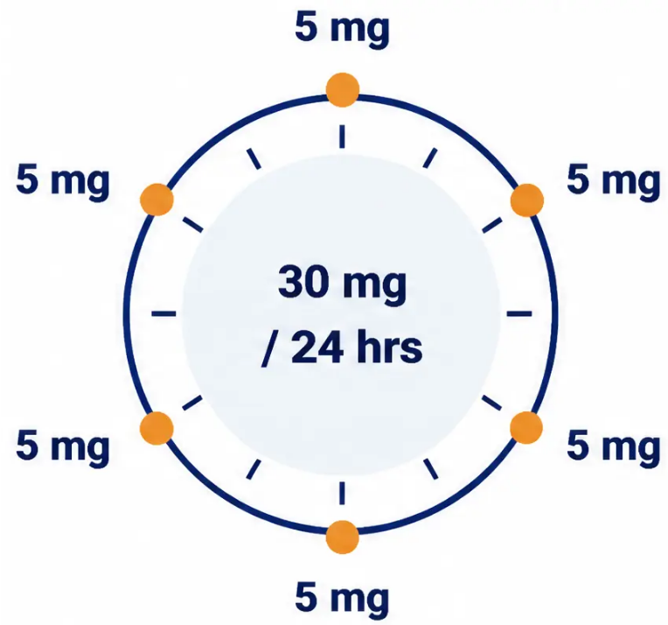
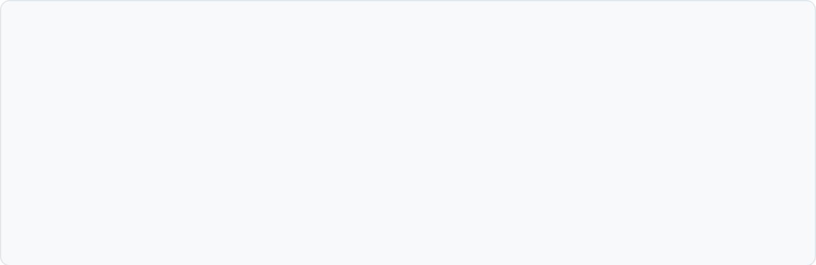





Section 4 — Morphine Prescribing
Starting Morphine in Opioid-Naïve Patients
Standard Adult Starting Dose
Immediate-release morphine 5 mg every 4 hours
= 30 mg total per 24 hours
Prescribe the SAME dose as PRN breakthrough –
available every hour if needed
⚠ Dose Adjustment Required
Elderly patients: start 2.5 mg every 4 hours
Renal impairment: start 2.5 mg every 4 hours — monitor closely
When in doubt, start low and titrate up carefully
Breakthrough PRN = same dose as regular 4-hourly dose
Available every 1 hour as needed
Reassess and recalculate total daily dose after 24–48 hours
Once pain is stable, convert to modified-release (BD) preparation
www.bradfordvts.co.uk
Pain Management & Opioid Conversion | Bradford VTS 2026
7 / 35

Slide 8











Section 4 — Morphine Prescribing
Managing Breakthrough Pain
The 1/6th Rule
Example
30 mg/day
The Breakthrough Dose Formula
Breakthrough dose = Total 24-hour opioid dose ÷ 6
Recalculate every time the background dose changes —
the breakthrough dose must always reflect the current total daily dose.
How Often Can It Be Taken?
Short-acting morphine lasts approximately 4 hours.
• Available every 1–2 hours if needed
per breakthrough dose
• Advise patients: ‘Keep it nearby — use it when the pain comes on’
• If needed more than 3–4 times per day, contact the team —
the background dose likely needs increasing
Background: MST 15 mg BD
When to Reassess the Background Dose
Breakthrough: Oramorph 5 mg PRN
Reassess after 24–48 hours. Add up all doses taken
(background + all PRN doses used) to calculate the new total daily dose.
New background dose = Total daily dose used ÷ 2
(for BD modified-release)
www.bradfordvts.co.uk
Pain Management & Opioid Conversion | Bradford VTS 2026

Slide 9





Section 2 — Morphine Prescribing
Oramorph Prescribing and Safety
The Standard Preparation
Schedule 2 CD Status — Important Update
Oramorph 10 mg / 5 ml
Oramorph 10 mg/5 ml oral solution is NO LONGER
classified as a Schedule 2 Controlled Drug.
This is the standard strength oral morphine solution used in
community palliative care.
It can be prescribed on a standard FP10 — no need for a
handwritten CD prescription with quantity in words and figures.
⚠ The Critical Dosing Rule
Note: This applies to the oral solution only. Morphine
tablets and injections remain Schedule 2 CDs.
To give a dose of 5 mg — measure out 2.5 ml
Always prescribe using BOTH the milligram dose AND
the millilitre volume in your instructions.
Clinical Safety
Write: 'Morphine sulphate oral solution —
give 5 mg (2.5 ml) every four hours'
Two concentrations exist
Higher-concentration Oramorph solutions (e.g., 100 mg/5 ml)
are available. Always confirm which concentration is being
dispensed. A tenfold dosing error is possible if concentration
is assumed.
Never write mg only or ml only. Specifying both prevents
dangerous dosing errors, especially when liquid preparations
of different concentrations exist.
www.bradfordvts.co.uk
Slide 9 of 35
Pain Management & Opioid Conversion | Bradford VTS 2026

Slide 10





Section 2 — Opioid Prescribing
Converting from Weak to Strong Opioids
When co-codamol reaches its ceiling — it’s time to step up safely.
BEFORE
AFTER — TWO OPTIONS
Option A
MST 10–20mg twice daily (BD)
Co-codamol 30/500
Four times daily (QDS)
Modified-release morphine —
sustained background cover
Codeine content: 30mg × 4 = 120mg/day
≡ approximately 12mg oral morphine/day
CONVERT
Option B
Oramorph 5–10mg every 4 hours
Codeine has a dose ceiling — further
increases give no extra analgesia.
Immediate-release morphine —
flexible, easy to titrate
Always prescribe a breakthrough dose — whichever option you choose.
Breakthrough dose = 1/6 of total 24-hour morphine dose |
Immediate-release morphine | Available every 1–2 hours as needed
www.bradfordvts.co.uk
10 / 35
Pain Management & Opioid Conversion | Bradford VTS 2026

Slide 11











Section 2 — Morphine Prescribing
Dose Titration: Case Study
Case 1 — Ovarian Cancer, 76-year-old Female
Clinical Scenario: Started on MST 15mg BD (total 30mg/day). Pain partially controlled but patient using
regular PRN doses. After 24 hours: 3 × 10mg PRN doses used on top of background MST 30mg BD.
Starting Doses
PRN Usage Recorded
Recalculated Doses
• MST: 15mg BD
• Background used: 60mg
(MST 30mg BD)
• New MST: 90 ÷ 2 = 45mg BD
• Total background: 30mg/day
• New breakthrough: 90 ÷ 6 = 15mg PRN
• Breakthrough (1/6 rule):
30 ÷ 6 = 5mg PRN
• PRN doses taken: 3 × 10mg = 30mg
• Prescribe as: MST 15mg + 30mg =
45mg ✓
• Total dose in 24hr: 90mg
The Rule: New background dose = total 24hr dose ÷ 2 (for BD). New breakthrough = total 24hr dose ÷ 6.
Recalculate every time the background dose changes.
MST available in 5mg, 10mg, 15mg, 30mg, 60mg, 100mg, 200mg tablets. Combine two strengths if exact dose unavailable.
www.bradfordvts.co.uk
Bradford VTS Teaching Deck | June 2026

Slide 12
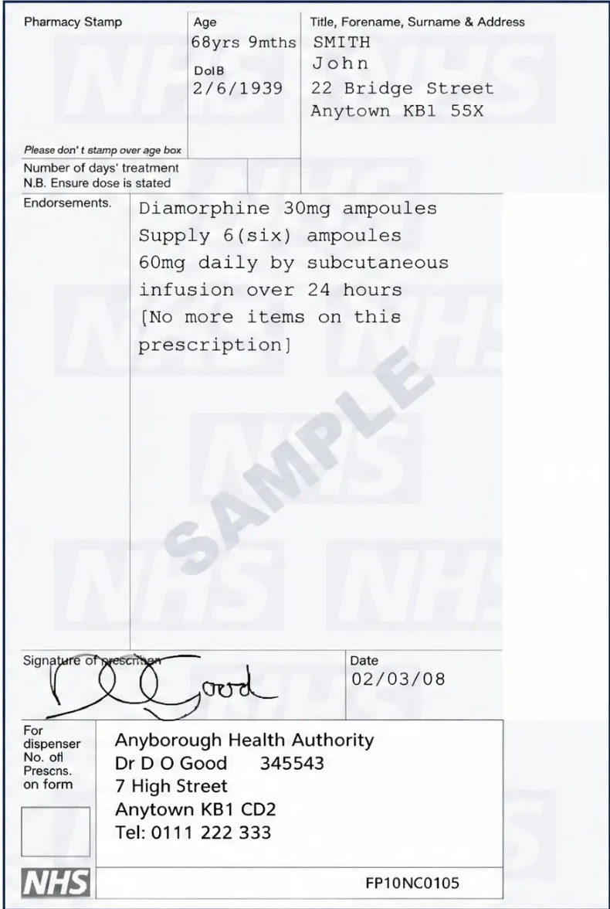









Section 5 — Prescribing
FP10 Legal Requirements for Schedule 2 CDs
Schedule 2 CDs — Morphine, Oxycodone, Diamorphine, Fentanyl
Patient full name and address
Full address required — not just name
Drug name (prescribe by brand where clinically relevant)
e.g., MST Continus, OxyContin — not just 'morphine MR'
Formulation and strength
e.g., Tablets, 30mg
Quantity in WORDS AND FIGURES
e.g., 'Sixty (60) tablets' — legal requirement
Clear dosage instructions
e.g., 'Take ONE tablet every 12 hours'
Prescriber's signature — handwritten
Computer-generated body; wet signature required — check local policy
Oramorph 10mg/5ml oral solution is NO LONGER Schedule 2 —
prescribe on standard FP10
If dose requires two tablet strengths (e.g., 45mg = 15mg + 30mg),
prescribe each on a separate line
Sample FP10 prescription — note quantity in words and figures
www.bradfordvts.co.uk
Pain Management & Opioid Conversion | Bradford VTS 2026

Slide 13
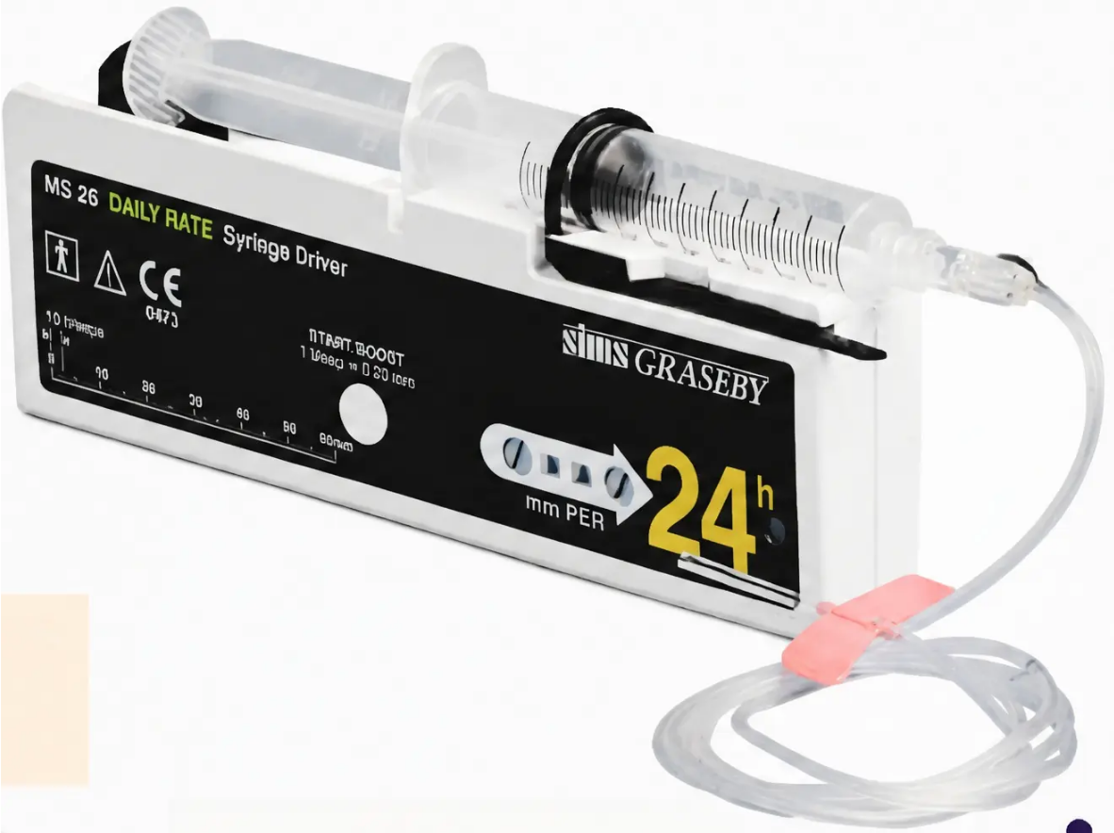








Section 6 — Syringe Driver
Syringe Driver: Indications & Management
When is a Syringe Driver (CSCI) Appropriate?
Persistent vomiting
Unable to keep oral medications down
Dysphagia
Difficulty or inability to swallow tablets or liquids
Unconscious or unresponsive
Oral route no longer safe or feasible
Poor gastrointestinal absorption
Malabsorption, bowel obstruction, or severe weakness
Uncontrolled pain alone is NOT an indication for a syringe driver
Titrate oral opioids first. Only convert to CSCI when the oral
route is genuinely unsuitable.
Graseby MS26 — 24-hour syringe driver (CSCI)
— Syringe changed every 24 hours by District Nurses or Hospice at Home team
— Takes several hours to reach therapeutic levels —
consider an initial SC bolus dose at start
www.bradfordvts.co.uk
Pain Management & Opioid Conversion | Bradford VTS 2026

Slide 14








Section 6 — Syringe Driver
Converting Oral Opioids to Syringe Driver
The Golden Rule: Convert via Oral Morphine — Always
Calculate total 24-hour oral morphine dose → then apply conversion ratio
Oral Morphine
SC Morphine
SC Diamorphine
Total 24-hr dose
24-hr CSCI dose
24-hr CSCI dose
e.g. 180mg/day
= 90mg / 24hr
= 60mg / 24hr
÷ 2
÷ 3
SC Morphine
SC Diamorphine
Diamorphine preferred — more soluble, smaller injection volume
CASE 2 — Worked Example
68F, Breast Cancer — Unable to Take Oral Tablets
Starting Point
Calculated CSCI Doses
• MST 90mg twice daily
• SC Morphine: 180 ÷ 2 = 90mg / 24hr
• Total oral morphine = 180mg / 24 hours
• SC Diamorphine: 180 ÷ 3 = 60mg / 24hr
• Oral route no longer viable
• Prescribe EITHER — not both
Always prescribe SC PRN breakthrough dose alongside CSCI — same drug as driver
www.bradfordvts.co.uk
Pain Management & Opioid Conversion | Bradford VTS 2026

Slide 15




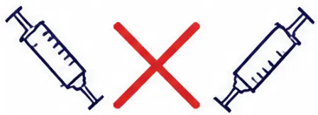


Section 6 — Syringe Driver
CSCI Drug Compatibility and Safety
Not all drugs can be mixed in a syringe driver — always verify before combining.
Always Check First
Verification Resources
Always Consult
• www.palliativedrugs.com — Syringe Driver
Survey Database (SDSD): the UK gold
standard reference
• Never assume two drugs are compatible
• Discuss with your pharmacist before
prescribing any new drug combination
• Physical incompatibility may not be visible —
chemical reactions can occur without cloudiness
or precipitation
• Check drug combinations, concentrations,
and diluents
• Contact the palliative care specialist team
for complex multi-drug drivers
• Even familiar combinations must be verified
each time
• District Nurses and Hospice at Home teams
are experienced — involve them early
• Free to access; regularly updated
• Incompatible mixes can cause drug inactivation
or patient harm
• Your local palliative care team can advise on
complex or unusual combinations
• If in doubt: use separate syringe drivers
rather than combine
• Hospital or community pharmacist — always
a valid first call
KEY RESOURCE
Syringe Driver Survey Database: www.palliativedrugs.com/syringe-driver-survey-database —
check drug compatibility, concentrations, and diluent choices before every new combination.
Bookmark this site.
www.bradfordvts.co.uk
Pain Management & Opioid Conversion | Bradford VTS 2026

Slide 16

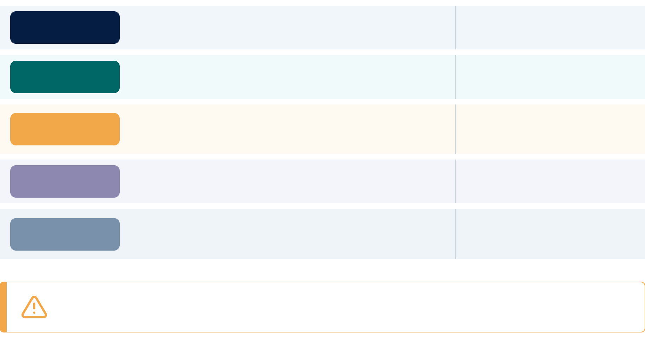










Section 7 — End of Life Care
Anticipatory Medications for End of Life
The five standard 'just-in-case' medicines — prescribed in advance for the last days of life (NICE NG31)
PAIN
Match the drug already
in the syringe driver
Prescribe ALL FIVE
anticipatory medicines
in advance —
not just when needed
Morphine SC or Diamorphine SC
PRN dose = 1/6 of total 24-hour opioid dose
NAUSEA
Haloperidol SC
Preferred antiemetic at end of life —
non-sedating at standard doses
1.5–3 mg SC PRN | Up to 5 mg/24hr CSCI
SECRETIONS
Reduces secretion production —
does not cross blood-brain
barrier (non-sedating)
Hyoscine Butylbromide (Buscopan) SC
20 mg SC PRN | Up to 120 mg/24hr CSCI
Anticipatory prescribing
prevents distressing
delays at end of life
AGITATION
Midazolam SC
Seek specialist input if
>20 mg/24hr needed
2.5–5 mg SC PRN | 10–20 mg/24hr starting dose CSCI
BREATHLESSNESS
Low-dose opioids reduce the
sensation of breathlessness —
safe and evidence-based
Morphine or Diamorphine SC
Same drug and dose as for pain
NICE NG31 recommends midazolam 2.5–5 mg SC PRN for agitation.
Doses above 20 mg/24hr require specialist palliative care input.
www.bradfordvts.co.uk
Slide 16 of 35 | Bradford VTS Teaching Deck
Anticipatory Medications for End of Life

Slide 17






Section 7 — Anticipatory Medications
Dosing for Anticipatory Medications
PRN and CSCI dose ranges per NICE NG31 — for the last days of life
Morphine or Diamorphine
Haloperidol
Pain / Breathlessness
Nausea and Vomiting
• PRN SC dose: 1.5–3 mg SC PRN
• PRN SC dose: 1/6 of total 24-hour opioid dose
• CSCI 24hr: Based on total daily opioid requirement
• CSCI 24hr: Up to 5 mg/24hr (max 10 mg in
exceptional cases)
Match drug already in syringe driver. Reacclulate after
every background dose change.
First-line antiemetic in palliative CSCI. Avoid in
Parkinson's disease.
Hyoscine Butylbromide
Midazolam
Respiratory Secretions
Agitation / Distress
• PRN SC dose: 20 mg SC PRN
• PRN SC dose: 2.5–5 mg SC PRN
• CSCI 24hr: Up to 120 mg/24hr
• CSCI 24hr: 10–20 mg/24hr starting range
(Buscopan) — repositioning and reassurance for
family equally important.
Seek specialist palliative care input if >20–30 mg/24hr
needed for refractory agitation.
Always prescribe PRN anticipatory medications alongside any CSCI —
patients must not be left without access to breakthrough doses
www.bradfordvts.co.uk
Dosing for Anticipatory Medications — NICE NG31
Slide 17 of 35

Slide 18
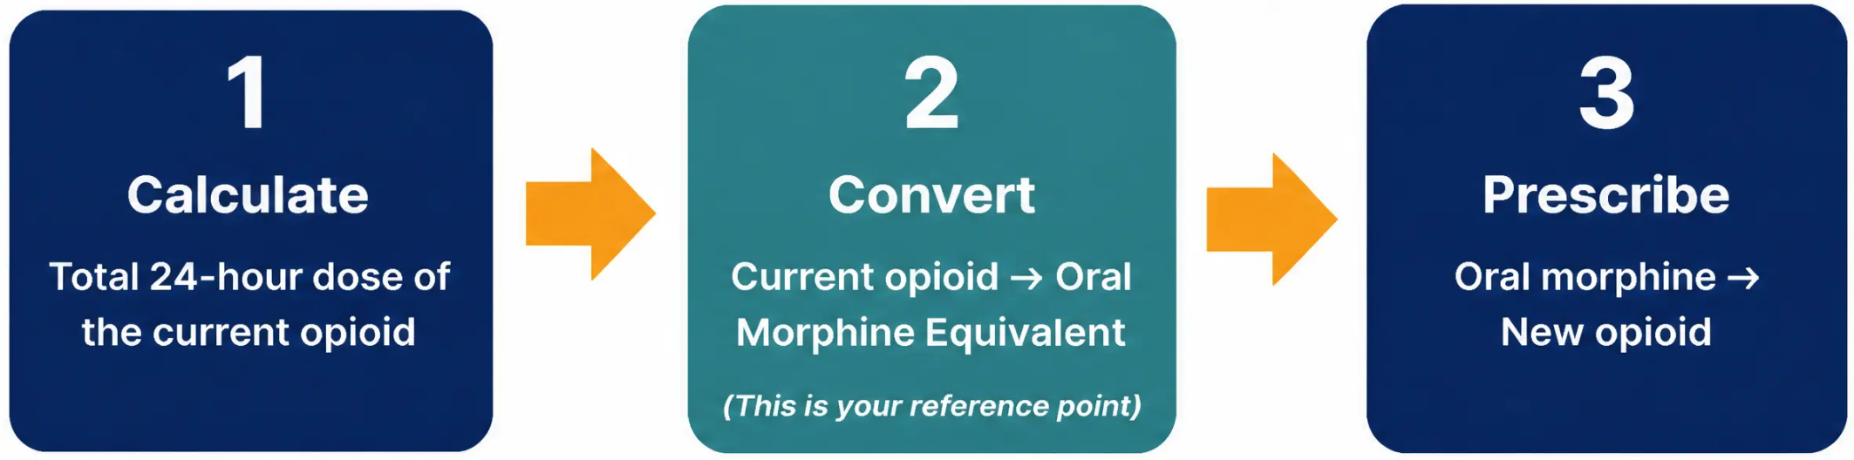




Section 8 — Opioid Conversion
Opioid Conversion: The Universal Reference
Always convert via oral morphine — it is the universal reference point.
Convert TO oral morphine first — then convert OUT to the new opioid.
Always double-check calculations with a colleague before prescribing.
www.bradfordvts.co.uk
18 / 35
Pain Management & Opioid Conversion | Bradford VTS 2026

Slide 19
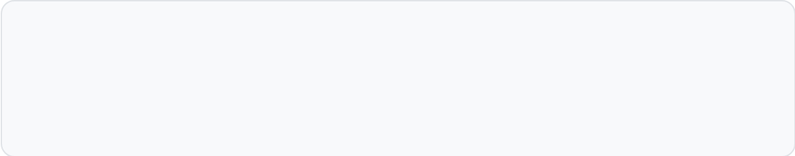
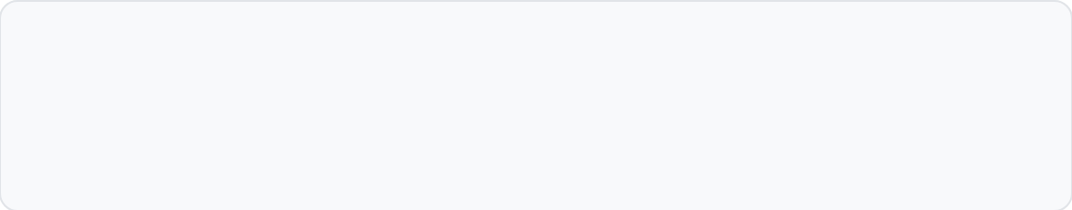


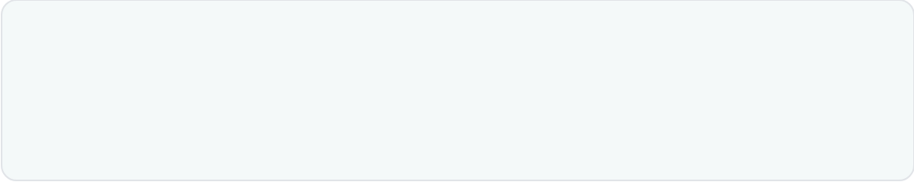
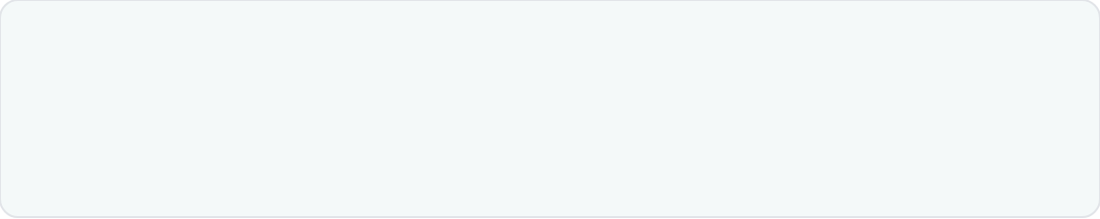


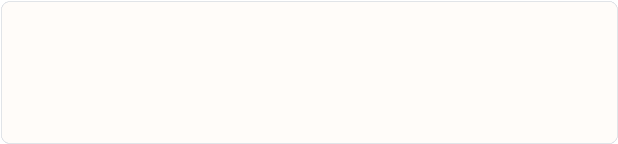
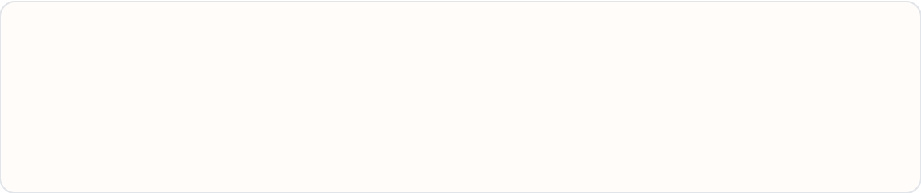



Section 8 — Opioid Conversion
Opioid Conversion & Key Ratios
BNF-aligned reference factors — always convert via oral morphine.
For example, lets look at converting sc morphine and sc diamorphine to oxycodode
SC MORPHINE → ORAL MORPHINE
SC DIAMORPHINE → ORAL MORPHINE
Always convert to
oral morphine first
x 3
30 mg SC morphine = 60 mg oral
20 mg SC diamorphine = 60 mg oral
ORAL MORPHINE → OXYCODONE
ORAL MORPHINE → OXYCODONE
60 mg oral morphine = 30 mg oxycodone
60 mg oral morphine = 30mg oxycodone
FENTANYL PATCH (mcg/hr) → ORAL MORPHINE
BUPRENORPHINE PATCH → ORAL MORPHINE
10 mcg/hr ≈ 24 mg/day
25 mcg/hr patch ≈ 60 mg oral morphine/24 hr
Range ×2–3 — see local palliative care chart
BuTrans / Transtec — moderate pain range only
AKT Tip: The most-tested ratios are
Oral morphine ÷ 2 = oral oxycodone
Oral morphine ÷ 2 = SC morphine
Oral morphine ÷ 3 = SC diamorphine
Fentanyl patch25 mcg/hr ≈ 60–90 mg oral morphine/24h
Buprenorphine patch:
5 mcg/hr ≈ 12 mg oral morphine/24h
10 mcg/hr ≈ 24 mg oral morphine/24h KNOW THESE COLD
www.bradfordvts.co.uk
Pain Management & Opioid Conversion in Palliative Care
Slide 19 of 35

Slide 20






Section 8 — Opioid Conversion
Fentanyl Conversion: Clinical Variations
Conversion factors for fentanyl patches vary between sources — knowing why matters clinically.
BNF / NICE Current Guidance
Palliative Care Formulary (PCF 7th Ed.)
× 2.4
× 3.6
vs
Range accepted: × 2 to × 3
Some specialist teams use this factor
• Fentanyl 25 mcg/hr patch ≈ 60 mg oral morphine/day
• Fentanyl 150 mcg/hr ≈ 540 mg oral morphine/day
• Recommended for routine clinical use
• Reflects Twycross / PCF methodology
• Consistent with current BNF and NICE CG140
• Used by some palliative care specialists
Clinical Safety Rule:
For high-dose fentanyl conversions, NEVER rely on a single conversion factor. Always use your
local palliative care team's conversion chart and seek specialist review. Genuine inter-expert
variation exists — the safest approach is to involve your palliative care team.
Reference: BNF current edition; Twycross PCF 7th edition; NICE CG140 (Sept 2024)
www.bradfordvts.co.uk
Pain Management & Opioid Conversion | Bradford VTS 2026

Slide 21










Section 8 — Opioid Conversion
Incomplete Cross Tolerance
The mandatory dose reduction rule when switching opioids
When switching opioids — always reduce the calculated new dose by 25–50%
Tolerance to one opioid does NOT fully transfer to another. The new opioid will be
relatively more potent than the calculation suggests.
Calculate equivalent dose
Reduce by 25–50%
Prescribe reduced dose
Convert to oral morphine,
then to new opioid
Apply cross-tolerance
reduction
Titrate up if needed —
safer to start low
Use the 50% reduction especially when:
• Dose exceeds 1g oral morphine equivalent per 24 hours
• Patient is elderly or frail
• Signs of delirium or opioid-induced hyperalgesia present
• Rapid prior opioid escalation has occurred
Always double-check with a colleague.
Patient Safety
Errors in opioid switching have serious consequences.
www.bradfordvts.co.uk
Incomplete Cross Tolerance — Safety Rule
Slide 21 of 35

Slide 22





Section 8 — Opioid Conversion
Complex Opioid Conversion
Case Study — Case 3
Case 3
Fentanyl 150 mcg/hr patch in situ
31-year-old male
Ketorolac 90 mg/24hr CSCI
Spindle cell carcinoma — complex high-dose opioid requirements
PRN: 120 mg diamorphine/24hr extra
WHAT’S IN SITU?
HOW TO MANAGE THIS
• Fentanyl patches 150 mcg/hr — transdermal,
ongoing background analgesia
1. Leave fentanyl patches in situ
Allow time for patch levels to stabilise
• Ketorolac 90 mg/24hr — NSAID via syringe
driver for bone/soft tissue component
2. Start a syringe driver to cover the EXTRA analgesia only
Cover the 120 mg diamorphine PRN used in 24 hours
• 120 mg diamorphine PRN — used over
the past 24 hours for breakthrough pain
3. Calculate breakthrough dose
Sum ALL opioids → convert to oral morphine equivalent →
divide by 6 → convert back to SC diamorphine
Patches will take 12–24 hrs to settle after
removal — do not remove abruptly
4. Reassess frequently
This is a rapidly changing, high-complexity case
◆ This is a highly complex case — ALWAYS involve your specialist palliative care team
High-dose conversions carry significant risk. Do not rely on a single conversion factor. Use your local
palliative care team's chart and seek specialist review before making changes.
Pain Management & Opioid Conversion
www.bradfordvts.co.uk
Bradford VTS 2026

Slide 23

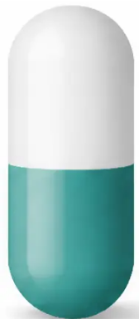
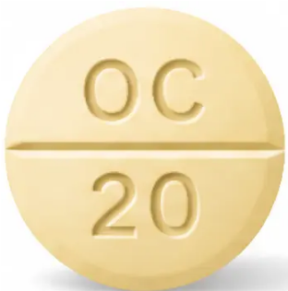





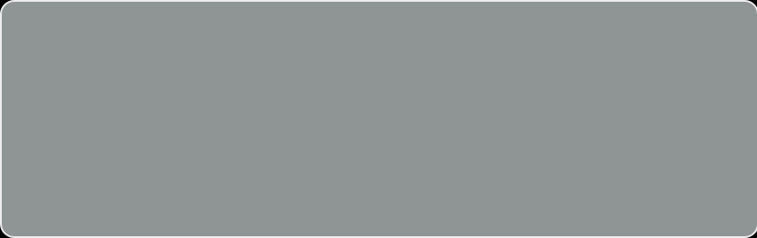
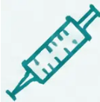

Section 9 — Alternative Strong Opioids
Oxycodone: Second-Line Strong Opioid
INDICATION
Second-line strong opioid — use when morphine causes
intolerable side effects (e.g., nausea, hallucinations, confusion)
Also consider when renal function is a concern — see below
RENAL FAILURE — KEY ADVANTAGE
Oxycodone accumulates LESS than morphine in renal impairment
OxyNorm —
Immediate Release
OxyContin —
Modified Release
(BD)
Preferred strong opioid when eGFR is reduced or unstable.
Metabolites less likely to cause toxic accumulation compared
to morphine-6-glucuronide.
(oral liquid & capsules)
POTENCY RATIO — EXAM PEARL
SC Route Available
Oral Oxycodone : Oral Morphine = 1 : 2
Prescribe as SC oxycodone —
do NOT convert to SC
morphine/diamorphine
10 mg oral oxycodone ≡ 20 mg oral morphine
30 mg oral oxycodone ≡ 60 mg oral morphine
Always convert via oral morphine as the universal reference point
When switching FROM morphine TO oxycodone — divide morphine dose by 2,
then reduce by a further 25–50% for incomplete cross-tolerance
www.bradfordvts.co.uk
Pain Management & Opioid Conversion in Palliative Care
Slide 23 of 35

Slide 24
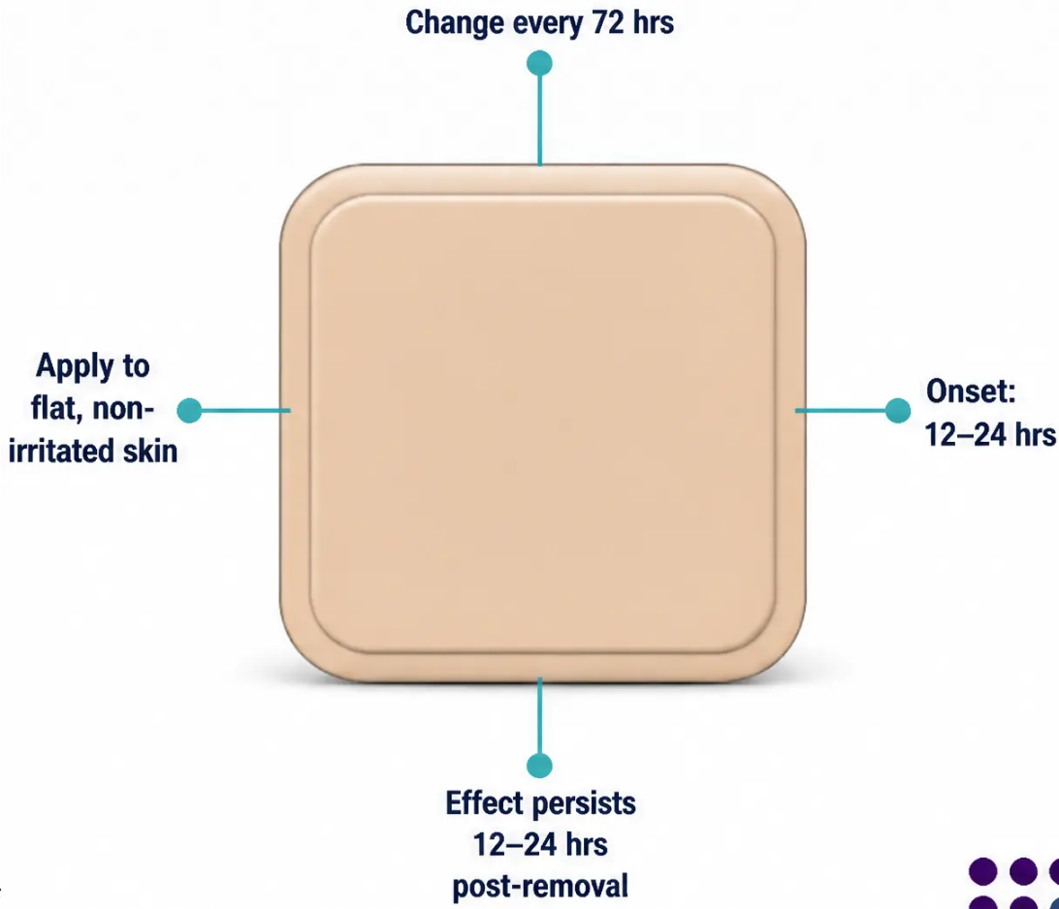










Section 9 — Alternative Strong Opioids
Fentanyl Patches for Stable Pain
Transdermal Fentanyl — The Basics
• Changed every 72 hours (3 days)
• Takes 12–24 hours to reach steady-state blood levels
• Effects persist 12–24 hours after patch removal
• Available strengths: 12, 25, 50, 75, 100 mcg/hr
• Multiple patches can be combined — e.g., 12 + 25 = 37 mcg/hr
Suitable For — and Not Suitable For
USE FOR:
NOT FOR:
• Stable, chronic background pain
• Acute, unstable, or rapidly
escalating pain
• Morphine-intolerant patients
(less constipation, less nausea)
• Opioid-naive patients
(risk of overdose)
• Patients who struggle with
oral medication
• When rapid titration is needed
Managing Breakthrough Pain with Patches
• Use oral Oramorph (immediate-release morphine) for breakthrough doses
• Short-acting fentanyl lozenges or intranasal fentanyl: specialist
palliative care advice only
Stable pain only — never for acute titration
• Breakthrough dose = 1/6 of total 24-hour oral morphine equivalent
• Fentanyl 25 mcg/hr ≈ 60 mg oral morphine/day (BNF ×2.4 factor)
www.bradfordvts.co.uk
Pain Management & Opioid Conversion
Bradford VTS 2026

Slide 25



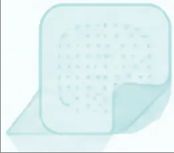
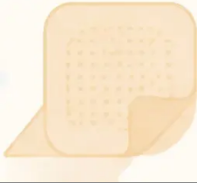

Section 9 — Alternative Strong Opioids
Buprenorphine Patches and Partial Agonists
Transdermal buprenorphine — two formulations, different change frequencies, moderate pain range
BuTrans
Transtec
7-day patch
4 day patch (96-hour)
• Available strengths: 5, 10, 20 mcg/hr
• Available strengths: 35, 52.5, 70 mcg/hr
• Changed every 7 days
• Changed every 96 hours (every 4 days)
• Full effect takes up to 72 hours after application
• Full effect takes up to 24 hours after application
• 10 mcg/hr ≈ 24 mg/day oral morphine
• Higher-strength formulation than BuTrans
• Suitable for: moderate, stable chronic pain
• Suitable for: moderate-to-moderately-severe stable pain
• Less constipation and nausea than oral morphine
• Multiple patches can be used if needed
Key Equivalence: Buprenorphine 10 mcg/hr patch ≈ 24 mg oral morphine per day
Partial Agonist —
Ceiling Effect
Buprenorphine is a partial mu-opioid agonist. At higher doses, analgesic effect plateaus —
it is generally used for moderate pain only. Not suitable for severe or rapidly escalating pain.
Does not fully displace full agonists — consider carefully when switching.
www.bradfordvts.co.uk
25
Pain Management & Opioid Conversion | Bradford VTS 2026

Slide 26





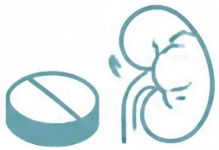
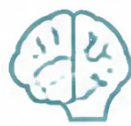



Section 10 — Adjuvant Analgesics
Adjuvant Analgesics: NSAIDs and Steroids
NSAIDs
Dexamethasone
Anti-inflammatory Analgesia
Corticosteroid Adjuvant
Best For:
Indications and Doses:
• Bone pain
Raised ICP
• Musculoskeletal pain
8–16 mg/day — taper after response
• Liver capsule pain
Nerve / Spinal Cord Compression
• Soft tissue infiltration
8–16 mg/day — urgent referral simultaneously
Subcutaneous Option:
Liver Capsule Pain
• Ketorolac 30 mg SC PRN
2–4 mg/day
• Or 60–120 mg/24 hr CSCI in syringe driver
Appetite & Energy
2–4 mg/day
Safety Reminders:
• Always co-prescribe a PPI
Also Useful For:
• Check renal function before starting
• Breathlessness in lymphangitis
• Consider cardiovascular risk
• Superior vena cava obstruction
Both NSAIDs and dexamethasone work alongside opioids — they target the
underlying mechanism of pain, not just the perception of it.
Adjuvant Analgesics — NSAIDs and Steroids
www.bradfordvts.co.uk
Slide 26 of 35

Slide 27







Section 10 — Adjuvant Analgesics
Adjuvants for Neuropathic Pain & Anxiety
Neuropathic Pain
Anxiety & Pain Amplification
● Amitriptyline
Anxiety significantly amplifies pain perception —
treat both together.
Tricyclic Antidepressant
Start 10–25 mg at night. Titrate slowly upward.
Especially useful when low mood or poor sleep
accompanies neuropathic pain.
● Lorazepam
0.5–1 mg sublingual as needed.
Bonus: improves sleep quality.
Rapid onset — useful for acute anxiety episodes.
● Gabapentin
● Diazepam
Anticonvulsant
Start 300 mg once daily. Titrate to 300 mg
three times daily.
2–5 mg twice to three times daily.
Longer-acting — useful for background anxiety.
First-line for neuropathic pain — well evidenced.
● Midazolam
● Pregabalin
Anticonvulsant
2.5 mg SC as needed.
Start 75 mg twice daily.
Used in community syringe driver context.
Faster titration than gabapentin. Similar efficacy.
Also covers agitation in last days of life.
Treat anxiety as a co-diagnosis — uncontrolled anxiety makes opioid titration harder and pain control worse.
www.bradfordvts.co.uk
Pain Management & Opioid Conversion | Slide 27 of 35

Slide 28














Section 11 — Top Tips
Top Tips for Palliative Pain Management
Eight clinical pearls every GP trainee must know
Always convert via oral morphine
Reduce dose by 25–50% when switching opioids
It is the universal reference point — convect TO it
first, then OUT from it.
Incomplete cross-tolerance means the calculated
dose is always too high. Reduce it.
Breakthrough = 1/6 of total 24-hour dose
Fentanyl patches are for stable pain only
Recalculate every single time you change
the background dose.
Never use for rapid titration — onset takes 12–24
hours, effects persist after removal.
Always prescribe laxatives with any opioid
Double-check all syringe driver calculations
Always verify with a colleague. Use
www.palliativedrugs.com for drug compatibility.
Constipation does not resolve on its own.
Prescribe from day one, every time.
Use your local palliative care team's fentanyl chart
Undertreated pain is a patient safety concern
Pain control at end of life is both a clinical
and legal obligation.
Conversion factors vary from ×2.4 to ×3.6 — never
rely on a single figure at high doses.
www.bradfordvts.co.uk
Pain Management & Opioid Conversion in Palliative Care
Slide 28 of 35

Slide 29


















Section 12 — Exam Preparation
Exam Pearls: AKT Focus
High-yield facts — know these cold for the AKT
Renal failure preference: Oxycodone accumulates less than morphine — preferred strong opioid in renal impairment
1. Oral morphine ÷ 2 = SC morphine
2. Oral morphine ÷ 3 = SC diamorphine
e.g. 60 mg oral morphine → 30 mg SC morphine / 24 hr
e.g. 60 mg oral morphine → 20 mg SC diamorphine / 24 hr
3. Oxycodone is twice as potent as morphine
4. Incomplete cross-tolerance: reduce by 25–50%
10 mg oral oxycodone ≡ 20 mg oral morphine
Always reduce the calculated new opioid dose when switching
5. Fentanyl 25 mcg/hr patch ≈ 60 mg oral morphine/day
6. Buprenorphine 10 mcg/hr ≈ 24 mg oral morphine/day
Using BNF × 2.4 factor — check local chart at high doses
Partial agonist — ceiling effect; moderate pain only
7. FP10 Schedule 2 CD: quantity in WORDS AND FIGURES
8. Oramorph 10 mg/5 ml — 5 mg dose = 2.5 ml
⚠ Always specify both mg AND ml to avoid dosing errors
Legal requirement — morphine, oxycodone, diamorphine, fentanyl
www.bradfordvts.co.uk
Exam Pearls — AKT Focus | Bradford VTS Teaching Deck

Slide 30






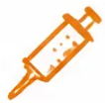



Section 12 — SCA Exam Preparation
Exam Pearls: SCA Communication
Saying the right thing — in the right way
💬 SCA Focus — Communication & Consultation Skills
Explaining Opioids
Breakthrough Pain
Syringe Driver
‘Think of it like insulin for a
diabetic — your body needs it
to manage pain normally. It
won’t make you addicted when
used correctly for pain.’
‘Keep the quick-acting medicine
nearby. Use it when pain comes
on. If you need it more than
3–4 times a day, call us — that’s
our sign to adjust your regular dose.’
‘This is just a better way to get your
medicines in, since tablets are
getting difficult. It goes under the
skin and the nurses will change it
every day — same medicines, just
delivered differently.’
Normalise. Reassure. Use analogy.
Empower. Give a clear action threshold.
Demystify. Avoid alarming language.
🛡️ Safety-Netting Script:
‘If the pain is suddenly much worse, or feels different from usual — please call us straight away.
That’s a sign we need to see you urgently.’
— Red flag awareness; patient empowerment
Slide 30 of 35
Bradford VTS Teaching Deck
www.bradfordsvts.co.uk
June 2026

Slide 31











Section 13 — Red Flags
Red Flags: Urgent Palliative Concerns
Recognise these presentations immediately → act without delay
Sudden Dramatic
Pain Increase
New Back Pain +
Neurology
Opioid Toxicity Signs
Bone metastases + acute pain spike →
suspect pathological fracture. Urgent
assessment required.
Leg weakness, paraesthesia, or
bladder/bowel change in cancer →
SCC until proven otherwise. Same-day
emergency MRI + dexamethasone.
Confusion, myoclonic jerks,
hallucinations, pinpoint pupils,
RR <8 → reduce opioid. Do NOT
increase dose.
Syringe Driver Running
Abornmally
Respiratory Depression
Running faster or slower than
expected → drug delivery error.
Check urgently. Do not leave
unreviewed.
RR <8, falling O₂ sats, unarousable
after opioid inititation → emergency.
Call senior/hospice/999 immediately.
www.bradfordvts.co.uk
June 2026 | Bradford VTS Teaching Deck

Slide 32













Section 14 — Clinical Safety
Common Pitfalls to Avoid
Skipping dose reduction when
switching opioids
Fentanyl patch for unstable pain
Patches take 12–24 hrs to work —
never use for acute uncontrolled pain
Incomplete cross-tolerance = overdose risk —
always reduce new opioid by 25–50%
Forgetting laxatives with
every opioid
Mixing incompatible drugs in
syringe driver
Opioid-induced constipation does not
resolve on its own — prescribe routinely
Always check compatibility at
www.palliativedrugs.com before mixing
Confusing mg and ml for
Oramorph liquid
Opioids alone for bone or
neuropathic pain
Standard strength 10mg/5ml —
5mg = 2.5ml. Always specify BOTH units
Adjuvants are essential — NSAIDs for bone
pain, gabapentin for neuropathic
www.bradfordvts.co.uk
Pain Management & Opioid Conversion | Bradford VTS 2026

Slide 33


















Section 15 — Quick Recall
Quick Recall: Palliative Essentials
Pain History
WHO Ladder
• Site · Character · Severity (0–10)
• Step 1: Mild → Paracetamol ± NSAID
• Timing · Aggravating/relieving factors
• Step 2: Moderate → Weak opioid
• Response to current analgesia
• Step 3: Severe → Strong opioid
• Functional impact
• ✓ Can skip Step 2 (NICE CG140)
Conversion Ratios
Breakthrough Rule
• Oral morphine ÷ 2 = SC morphine
• Always = 1/6 of total 24-hour dose
• Oral morphine ÷ 3 = SC diamorphine
• Reacalculate every time background dose changes
• Oral oxycodone × 2 = oral morphine
• Oramorph 10 mg/5 ml: 5 mg = 2.5 ml
• Fentanyl 25 mcg/hr ≈ 60 mg oral morphine
• Specify both mg AND ml on prescription
• Buprenorphine 10 mcg/hr ≈ 24 mg/day
Anticipatory Meds
FP10 Legal & Safety
• Pain: Morphine or Diamorphine (1/6 rule)
• CD quantity: words AND figures (legal)
• Nausea: Haloperidol 1.5–3 mg SC PRN
• Switch opioids → reduce new dose 25–50%
• Secretions: Hyoscine butylbromide 20 mg SC PRN
• Always prescribe laxatives with opioids
• Agitation: Midazolam 2.5–5 mg SC PRN
• Check compatibility: palliativedrugs.com
Quick Recall: Palliative Essentials
www.bradfordvts.co.uk
Slide 33 of 35 | June 2026

Slide 34




Section 14 — Summary
Summary and Key Resources
Key Resources
What We’ve Covered Today
Clinical Guidelines
NICE CG140 & NG31
● Pain assessment is the essential first step — always treat the cause
Cancer pain management (CG140, updated Sept 2024)
and care of dying adults (NG31, 2015)
● Use the WHO ladder guided by pain severity, not disease stage
www.nice.org.uk
● Oral morphine is the gold standard — always convert via oral morphine
Drug Doses & Conversions
● Breakthrough dose = 1/6 of total 24-hour dose — recalculate every time
British National Formulary
Current opioid dosing, conversion ratios, renal impairment
guidance, and controlled drug regulations
● Switch opioids? Reduce the new dose by 25–50% for cross-tolerance
www.bnf.nice.org.uk
● Fentanyl patches are for stable pain only — never for acute titration
Syringe Driver Compatibility
● Always prescribe laxatives with any opioid — always
palliativedrugs.com
● Anticipatory medications save suffering at end of life —
prescribe proactively
Syringe Driver Survey Database — essential for
checking drug compatibility before mixing
www.palliativedrugs.com
"Good pain management is a clinical obligation — and a mark of excellent palliative care."
www.bradfordvts.co.uk
Bradford VTS Teaching Deck — Pain Management & Opioid Conversion
Slide 34 of 35 | June 2026

Slide 35
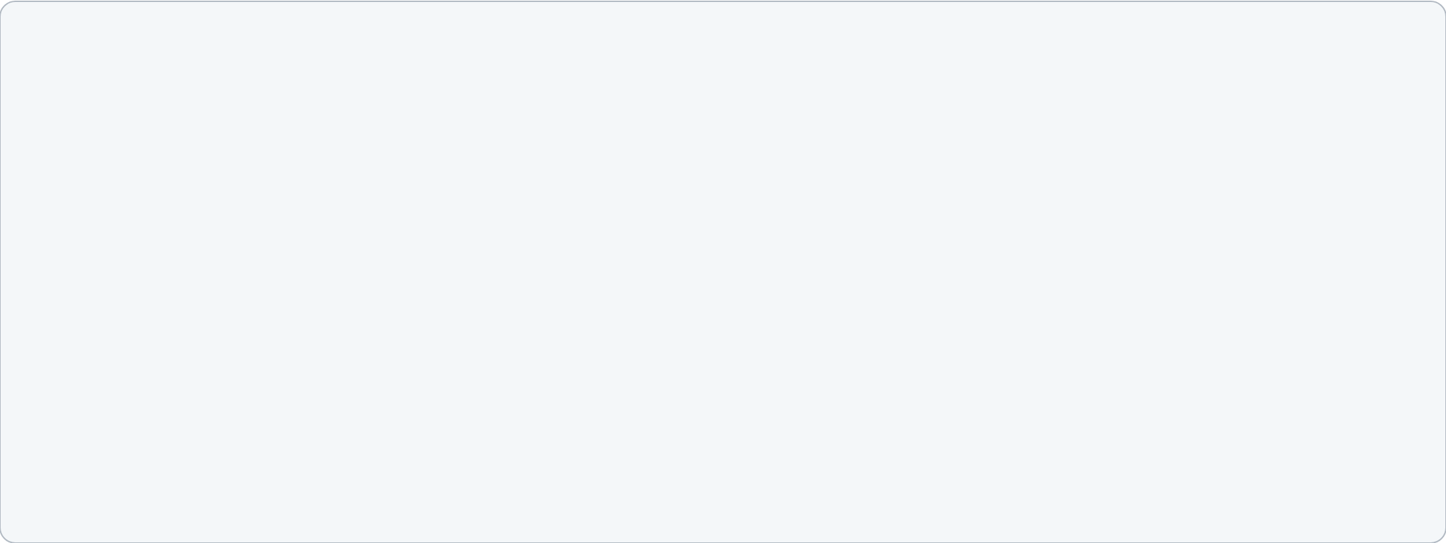

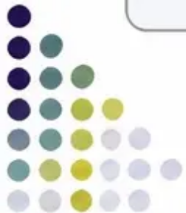
Important Disclaimer
This presentation is for educational purposes only.
Always double-check all drug doses, conversion factors, and clinical guidance against
the latest editions of the BNF and NICE guidelines before applying to clinical practice.
Drug doses, guidance, and clinical recommendations are subject to change —
the responsibility for safe prescribing remains with the individual clinician.
Sources referenced in this teaching deck include:
• NICE CG140 — Cancer Pain Management (last reviewed September 2024)
• NICE NG31 — Care of Dying Adults in the Last Days of Life (2015)
• British National Formulary (BNF) — current edition
• BAWC Palliative Care MCN Opioid Conversion Chart (January 2021, reviewed January 2024)
• palliativedrugs.com — Syringe Driver Survey Database
When in doubt — contact your local Palliative Care team.
Specialist support is always available and always appropriate.
www.bradfordvts.co.uk
Bradford VTS Teaching Deck — Pain Management & Opioid Conversion in Palliative Care
June 2026 | Slide 35 of 35

