Slide 1






BRADFORD VTS TEACHING DECK
PALLIATIVE CARE
Overview &
Practicalities
Bradford VTS Teaching Deck for GPs & Trainees
Created June 2026 · Updated to current NICE CG140 / NG31 standards
www.bradfordvts.co.uk
Always double check this advice and drug doses with
the latest NICE/BNF guidance. This document is for
educational purposes only.
www.bradfordvts.co.uk
Palliative Care — Overview & Practicalities

Slide 2






SECTION 1 — WHAT IS PALLIATIVE CARE?
Defining Palliative Care
“The active total care of patients whose disease is
not responsive to curative treatment — with the
goal of achieving the best quality of life for
patients and their families.”
WHO Definition (updated 2022)
Not just cancer
Active & holistic
Runs in parallel
Heart failure, COPD,
renal disease,
neurological
conditions, dementia —
any life-limiting illness
Controls pain, other
symptoms, and
psychological, social
and spiritual
problems
Palliative care can
begin at diagnosis —
alongside curative or
disease-modifying
treatment
www.bradfordvts.co.uk
Palliative Care — Overview & Practicalities
Slide 3

Slide 3




CORE COMPONENTS
The Seven Pillars of Palliative Care
01
02
03
04
Symptom Control
Communication
Rehabilitation
Continuity of Care
Effective management of
pain and physical symptoms
Honest, compassionate,
and timely conversations
Maximising independence
and functional ability
Seamless care across
settings and over time
05
06
07
Terminal Care
Bereavement Support
Coordination of Services
Joined-up working across
teams and agencies
Comfort and dignity in the
last days and hours
Supporting families before
and after death
www.bradfordvts.co.uk
Palliative Care — Overview & Practicalities

Slide 4








SECTION 1 — WHAT IS PALLIATIVE CARE?
Funding & Charity Context in the UK
~80%
of palliative care inpatient units are funded partly by the voluntary sector
The remainder receives NHS funding — but charity support is essential to the system
Macmillan Cancer Support
Marie Curie
Sue Ryder Foundation
Cancer-focused support, nursing, and
financial guidance
Nursing care at home and in hospices
for people with terminal illness
Hospice and neurological care
across the UK
Macmillan nurses provide specialist
palliative care at home and in clinics
Source of the Practicalities of Palliative
Care teaching (Dr Sarah Holmes)
Provides inpatient, day therapy, and
community palliative services
GP trainees should know what is available locally — voluntary sector provision varies significantly by region.
www.bradfordvts.co.uk
Palliative Care — Bradford VTS Teaching Deck | June 2026

Slide 5





SECTION 2 — IDENTIFYING PATIENTS FOR PALLIATIVE CARE
Identifying Patients: The Surprise Question
Gold Standards Framework — Validated Clinical Trigger
“Would you be surprised if this patient
were to die in the next 6–12 months?”
— Gold Standards Framework Surprise Question
NO
YES
No, I would not be surprised
Yes, I would be surprised
➔ This patient should be considered for palliative care planning
➔ Continue routine review
➔ Add to GSF register
➔ Reassess at each significant clinical change
➔ Begin Advance Care Planning discussions
➔ Keep the question in mind as disease progresses
➔ Review symptom management and support needs
Clinical Pearl: If in doubt — the answer is probably “No”. Act early, not late.
www.bradfordvts.co.uk
Slide 6 of 40

Slide 6






SECTION 2 — IDENTIFYING PATIENTS
Triggers for Supportive & Palliative Care
The SPICT tool identifies three routes into palliative care — any ONE is sufficient to trigger a review.
01
02
03
The Surprise Question
Patient Choice
Clinical Indicators
“Would you be surprised if this patient
died in the next 6–12 months?”
Patient with advanced disease makes
an informed choice for comfort care only.
Specific indicators based on the patient's
condition — cancer, organ failure, frailty,
or dementia.
If the answer is NO — you would NOT
be surprised — the patient should be
considered for palliative care planning.
Examples: declining dialysis, refusing
transplant, opting for symptom
management over life-prolonging
treatment.
Requires at least 2 disease-specific
indicators alongside general
deterioration markers.
Gold Standards Framework — validated trigger
Respects patient autonomy — document clearly
Detailed in following slides →
www.bradfordvts.co.uk
Slide 7 of 40

Slide 7



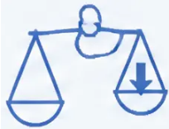




SECTION 2 — IDENTIFYING PATIENTS
General Clinical Indicators for Review
Any ONE of these four indicators should trigger a palliative care review
Declining Performance Status
Significant Weight Loss
ECOG grade 3–4 — limited self-care,
confined to bed or chair more than 50%
of waking hours, or deteriorating functional
ability due to progressive disease
Greater than 10% unintentional body
weight lost over the preceding six
months — a marker of advanced disease
and catabolic state
Frequent Unplanned Admissions
Increasing Care Needs
Two or more unplanned hospital
admissions in the past six months —
indicates disease instability and an
opportunity for proactive planning
Resident in a nursing or care home, or
requiring significantly increasing levels
of care and support at home to manage
daily activities
Clinical Tip: If ANY ONE of these applies — ask the Surprise Question. If you wouldn't be surprised by death in 12 months, initiate ACP.
www.bradfordvts.co.uk
Palliative Care — Overview & Practicalities
June 2026

Slide 8







SECTION 2 · IDENTIFYING PATIENTS
Disease-Specific Indicators
Cancer · Heart Disease · Renal Disease
Requires at least 2 of the following indicators per disease category — alongside the surprise question
Cancer
Heart Disease
Renal Disease
• Performance status deteriorating
due to metastatic disease
• NYHA Class IV symptoms
• Stage 5 CKD — eGFR <15 ml/min
• Persistent breathlessness or chest
pain at rest or minimal exertion
• Conservative renal management
chosen due to multi-morbidity
• Persistent symptoms despite
optimal palliative oncology
treatment
• Refractory symptoms despite
optimal therapy
• Deteriorating on renal replacement
therapy
• Systolic BP <100 or pulse >100
• Too frail for further oncology
treatment
• New life-limiting condition as
a complication
• Cardiac cachexia
• 2+ acute episodes requiring IV
treatment in past 6 months
Clinical reminder: These indicators are used alongside the Surprise Question and SPICT tool — not in isolation
www.bradfordvts.co.uk
Palliative Care — Overview & Practicalities
9 / 40

Slide 9










SECTION 2 — IDENTIFYING PATIENTS
Disease-Specific Indicators
Respiratory • Neurological • Dementia
Needs at least 2 indicators present (alongside the Surprise Question)
Respiratory Disease
Neurological Disease
Dementia
Severe COPD / Restrictive lung disease
MND • MS • Advanced Parkinson's
Advanced / End-stage
● Severe COPD: FEV₁ < 30% predicted
● Progressive physical or cognitive
decline despite optimal therapy
● Unable to dress, walk, or eat
without assistance
● Restrictive deficit: VC < 60%, TLCO < 40%
● Unable to communicate meaningfully
● On long-term oxygen therapy (LTOT)
● Speech problems or progressive dysphagia
● Recurrent aspiration pneumonia
● Breathless at rest between exacerbations
● Recurrent febrile infections
● BMI < 21
● Increasing dependence for
daily activities
● Urinary or faecal incontinence
● Significant weight loss or failure to thrive
● Persistent severe symptoms despite
optimal therapy
● Significant carer burden
www.bradfordvts.co.uk
10 / 40
Bradford VTS Teaching Deck — Palliative Care

Slide 10











CLINICAL INDICATORS FOR THE LAST DAYS OF LIFE
NICE NG31 · Recognising Imminent Death
RECOGNISE THESE SIGNS
THREE CLINICAL QUESTIONS TO ASK
Confined to bed — unable to self-care
or reposition independently
1) Was this deterioration expected?
Does it fit the known disease trajectory?
Difficulty taking oral fluids — not
tolerating artificial nutrition or hydration
2) Is further life-prolonging treatment
inappropriate?
Unable to take oral medication — route
of administration must be reviewed
Have goals of care been reviewed?
3) Have reversible causes been excluded?
Increasingly drowsy or unresponsive —
reduced level of consciousness
Pain, infection, dehydration,
medication toxicity?
Rapid, expected deterioration —
consistent with disease trajectory
If all three answers point to the dying phase —
initiate personalised end-of-life care planning
www.bradfordvts.co.uk
NICE NG31 (2015) · Bradford VTS Teaching Deck · June 2026

Slide 11












SECTION 3 — TOTAL PAIN
The Concept of Total Pain
Cicely Saunders — founder of the modern hospice movement
Physical
Psychological
Disease • Treatment • Comorbidities
Fear • Anxiety • Depression
• Pain from tumour invasion or metastases
• Fear of pain, death, and loss of control
• Side effects of treatment
• Anxiety about family and finances
• Comorbid conditions amplifying symptoms
• Depression amplifying physical suffering
TOTAL
PAIN
Social
Spiritual
Family • Finances • Future
Meaning • Purpose • Existential Distress
• Worry about being a burden to loved ones
• "Why is this happening to me?"
• Financial concerns and loss of role
• Loss of meaning and purpose
• Isolation and relationship strain
• Unresolved existential or religious questions
Key insight: All four dimensions interact and amplify each other.
Physical pain cannot be fully controlled without addressing psychological, social and spiritual suffering.
www.bradfordvts.co.uk

Slide 12
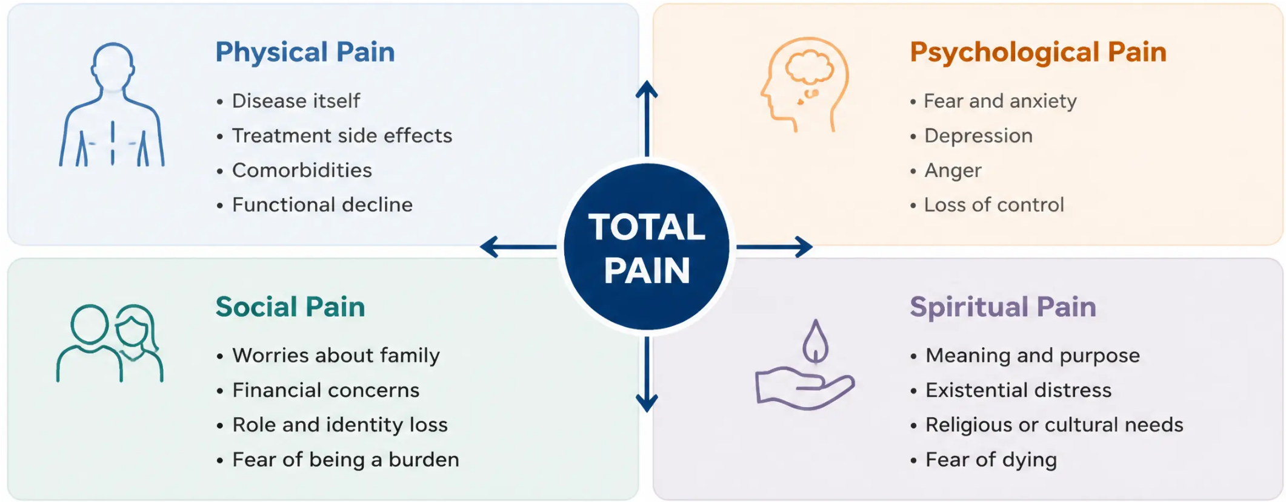


CICELY SAUNDERS · TOTAL PAIN FRAMEWORK
Dimensions of Total Pain
All four dimensions interact — you cannot treat physical pain without addressing the others
90% of cancer pain can be controlled with oral drugs —
but only when ALL four dimensions are assessed and addressed.
www.bradfordvts.co.uk
Bradford VTS Teaching Deck · Palliative Care

Slide 13



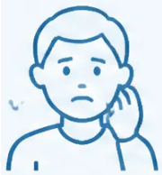
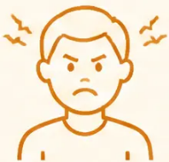


SECTION 3 — TOTAL PAIN
Managing Anxiety and Anger
Understanding the emotional dimensions of palliative care
All four dimensions of total pain interact — emotional distress directly amplifies physical pain perception.
ANXIETY
ANGER
Common fears patients carry
Common sources of frustration
● Fear of pain and the process of dying
● Delays in reaching a diagnosis
● Fear of hospital or nursing home admission
● Poor or inadequate communication from clinicians
● Worries about family and finances
● Failure of treatments or unmet expectations
● Fear of being a burden to loved ones
● Bureaucratic obstacles and system failures
● Feeling abandoned by friends, family or healthcare
● Spiritual distress and uncertainty about meaning
Anxiety amplifies pain perception —
address fears directly in every consultation
Anger is often displaced —
explore the underlying fear or loss behind it
www.bradfordvts.co.uk
Palliative Care — Overview & Practicalities | Bradford VTS 2026

Slide 14
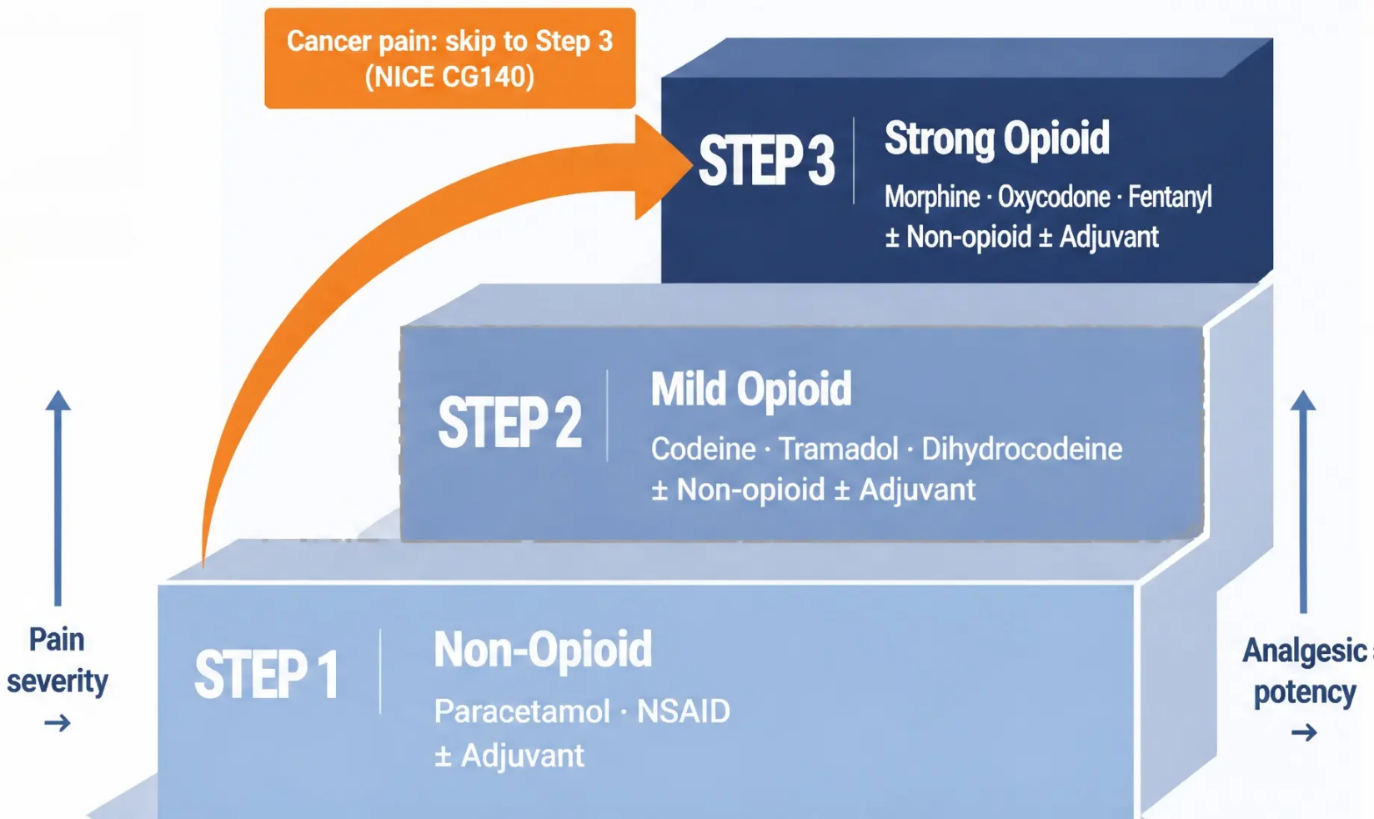



SECTION 4 — WHO ANALGESIC LADDER
The WHO Analgesic Ladder
(Updated — NICE CG140)
By mouth • By the clock • By the ladder • For the individual
NICE CG140 UPDATE
For adults with moderate-to-severe
cancer pain, it is acceptable to move
directly from Step 1 to Step 3 —
bypassing weak opioids entirely.
• Weak opioids have a dose ceiling,
unpredictable efficacy, and high
side-effect burden.
• Strong opioids have NO arbitrary
dose ceiling.
Adjuvant analgesics (e.g. amitriptyline, gabapentin, dexamethasone, NSAIDs) can be
added at any step of the ladder
www.bradfordsvts.co.uk
Palliative Care — Bradford VTS Teaching Deck | June 2026

Slide 15










WHO ANALGESIC LADDER — STEPS 1 & 2
Non-Opioid & Weak Opioid Options
Paracetamol · NSAIDs · Codeine · Tramadol · Dihydrocodeine
STEP 1 — NON-OPIOIDS
STEP 2 — WEAK OPIOIDS
Paracetamol
Codeine — 30-60 mg every 4-6 hours
(max 240 mg/day)
1 g four times daily
Useful adjunct throughout opioid titration —
do not stop when escalating the ladder
Predictable prodrug; ~10% population are poor metabolisers
Tramadol — 50-100 mg every 6 hours
(max 400 mg/day)
NSAIDs (ibuprofen, naproxen, diclofenac)
Particularly effective for:
• Bone pain
Weak mu-agonist + serotonin/noradrenaline
reuptake inhibitor
Less constipation than codeine
• Soft tissue infiltration
• Hepatomegaly
Always add PPI cover
Dihydrocodeine — 30-60 mg every 4-6 hours
(max 240 mg/day)
Caution: renal, cardiovascular, GI risk
NICE CG140 UPDATE (2024): For moderate-to-severe cancer pain, it is acceptable to move
directly from Step 1 to Step 3 — bypassing weak opioids entirely.
Weak opioids have a dose ceiling, unpredictable efficacy, and high side-effect burden.
NICE
CG140
Co-proxamol (dextropropoxyphene) — PERMANENTLY WITHDRAWN from UK market 2005. Do not prescribe.
www.bradfordvts.co.uk | Slide 16 of 40

Slide 16















MORPHINE: FIRST-LINE STRONG OPIOID
NICE CG140 | Reviewed September 2024
WHY ORAL MORPHINE?
First-Line by NICE Guidance
Oral morphine is the recommended first-line strong
opioid for adults with moderate-to-severe cancer pain
No Arbitrary Dose Ceiling
Titrate upward until pain is controlled — there is no
maximum dose; the right dose is the one that works
Predictable Pharmacokinetics
Well-understood absorption and metabolism when
dosed correctly; consistent and reliable in clinical practice
NICE CG140 (2024)
Low Cost, Wide Availability
“Oral morphine is the first-line strong opioid
for adults with cancer pain”
Inexpensive and universally available in UK primary care
and community pharmacy
No upper dose limit — titrate to response
Decades of Clinical Evidence
Extensive global experience; the most studied opioid
in palliative care worldwide
Key Principle:
By mouth · By the clock · By the ladder · For the individual
www.bradfordvts.co.uk

Slide 17









SECTION 5 — MORPHINE & STRONG OPIOIDS
NICE CG140
Initiating Morphine in Opioid-Naive Adults
Immediate-release oral morphine — starting safely
STANDARD ADULT
ELDERLY / RENAL IMPAIRMENT
5 mg
every 4 hours
2.5 mg
every 4 hours
(= 30 mg per 24 hours total)
(= 15 mg per 24 hours total)
• Immediate-release (IR) oral morphine
• Reduce starting dose by half
• Regular dosing — every 4 hours around the clock
• Review MORE frequently — at least every 24 hours
• Monitor for accumulation of active metabolites
• Review and titrate after 24–48 hours
• Provide breakthrough dose alongside (see below)
• Titrate cautiously upward based on response
BREAKTHROUGH DOSE PRINCIPLE
Always prescribe a PRN breakthrough dose alongside regular morphine.
Breakthrough dose = 1/6 of total daily dose — same IR morphine formulation.
Available approximately every hour if needed. Reacculate every time the regular dose changes.
Example: 5 mg every 4 hours (= 30 mg/day) → breakthrough dose = 5 mg IR morphine PRN
www.bradfordvts.co.uk

Slide 18












NICE CG140
Dose Titration & Breakthrough Pain
Review total usage every 24–48 hours and recalculate accordingly
STEP 1
STEP 2
STEP 3
STEP 4
Review 24-hour usage
Calculate new total
Prescribe new regular dose
Recalculate breakthrough
New breakthrough = 1/6
of the NEW total daily dose
Always update when
regular dose changes
Add all regular doses +
all PRN doses taken in
the past 24 hours
This sum becomes the
new total daily
morphine requirement
Divide total by 6 for
4-hourly dosing – or
convert to twice-daily
SR preparation
The Breakthrough Dose Rule
Breakthrough dose = 1/6 of the total 24-hour opioid dose
Prescribe as immediate-release (IR) morphine
Available approximately every hour if needed – do NOT restrict frequency
Example: Total daily dose = 120 mg oral morphine → Breakthrough = 20 mg IR morphine PRN
Once pain is stable on 4-hourly IR morphine, convert to twice-daily
modified-release (SR) preparation. Always maintain an IR formulation
for breakthrough alongside any SR prescription.
www.bradfordvts.co.uk
Bradford VTS Teaching Deck — Palliative Care | Slide 19 of 40

Slide 19














NICE CG140 | UK FORMULARY
Morphine Products and Formulations
Immediate-release vs modified-release preparations — know which to use and when
IMMEDIATE-RELEASE (IR)
MODIFIED-RELEASE (SR)
For breakthrough pain & initial titration
For regular background analgesia once stable
Oramorph
MST Continus
Every 4 hours
Every 12 hours
Oral solution (10 mg/5 ml)
Tablets (various strengths)
Zomorph
Sevredol
Every 12 hours
Every 4 hours
Capsules (can open and sprinkle)
Tablets (10 mg, 20 mg, 50 mg)
MXL
Every 24 hours
Capsules (once-daily preparation)
Use IR formulations for dose titration and all breakthrough doses
Convert from 4-hourly IR to SR once pain is stable over 24–48 hours
ALWAYS prescribe an IR breakthrough formulation alongside any SR preparation
Breakthrough dose = 1/6 of total daily morphine dose | Available as often as needed (approx. every hour if required)
www.bradfordvts.co.uk

Slide 20











CASE STUDY
Morphine Dose Titration
Mrs M — 56 years old — Breast cancer with bone metastases
CURRENT MEDICATIONS
24-HOUR TOTAL
NEW REGULAR DOSE
BREAKTHROUGH DOSE
• MST Continus 60 mg
twice daily
Always = 1/6 of total daily dose
Total daily dose = 180 mg
MST 60 mg × 2 = 120 mg
• Oramorph (IR) PRN —
20 mg per dose
180 mg ÷ 6 = 30 mg
PRN: 3 × 20 mg = 60 mg
New MST =
90 mg twice daily
• Paracetamol 1 g
four times daily
New PRN =
30 mg Oramorph (IR)
• Diclofenac SR 75 mg
twice daily
Total =
180 mg / 24 hours
180 mg ÷ 2 = 90 mg BD
(modified-release)
Available as often as needed
(approx. hourly if required)
Using 3 PRN doses per day
Rule: Every time you adjust the regular dose — recalculate the breakthrough dose. They move together.
www.bradfordvts.co.uk

Slide 21













NICE CG140 • SYRINGE DRIVER
Subcutaneous Morphine & Syringe Drivers
WHEN TO SWITCH TO SC ROUTE
ORAL MORPHINE → SC MORPHINE
Oral morphine dose ÷ 2 =
SC morphine dose / 24 hrs
Persistent vomiting — oral
absorption unreliable
e.g. Oral morphine 60 mg/24 hrs →
SC morphine 30 mg/24 hrs via syringe driver
Dysphagia — unable to swallow
tablets or liquid
Unconscious or semi-conscious —
last days of life
ORAL MORPHINE → SC DIAMORPHINE
Oral morphine dose ÷ 3 =
SC diamorphine dose / 24 hrs
Severe nausea — oral route
not tolerated
e.g. Oral morphine 60 mg/24 hrs →
SC diamorphine 20 mg/24 hrs via syringe driver
The syringe driver delivers medication
continuously over 24 hours via a small
SC needle — comfortable and effective
for home and hospice use.
Why diamorphine? More soluble
than morphine — smaller volume
needed in syringe driver. Preferred
in UK palliative practice.
Always provide a separate SC PRN
breakthrough dose alongside the
syringe driver — 1/6 of total 24-hour
opioid dose.
www.bradfordvts.co.uk
Palliative Care — Overview & Practicalities | Bradford VTS 2026

Slide 22



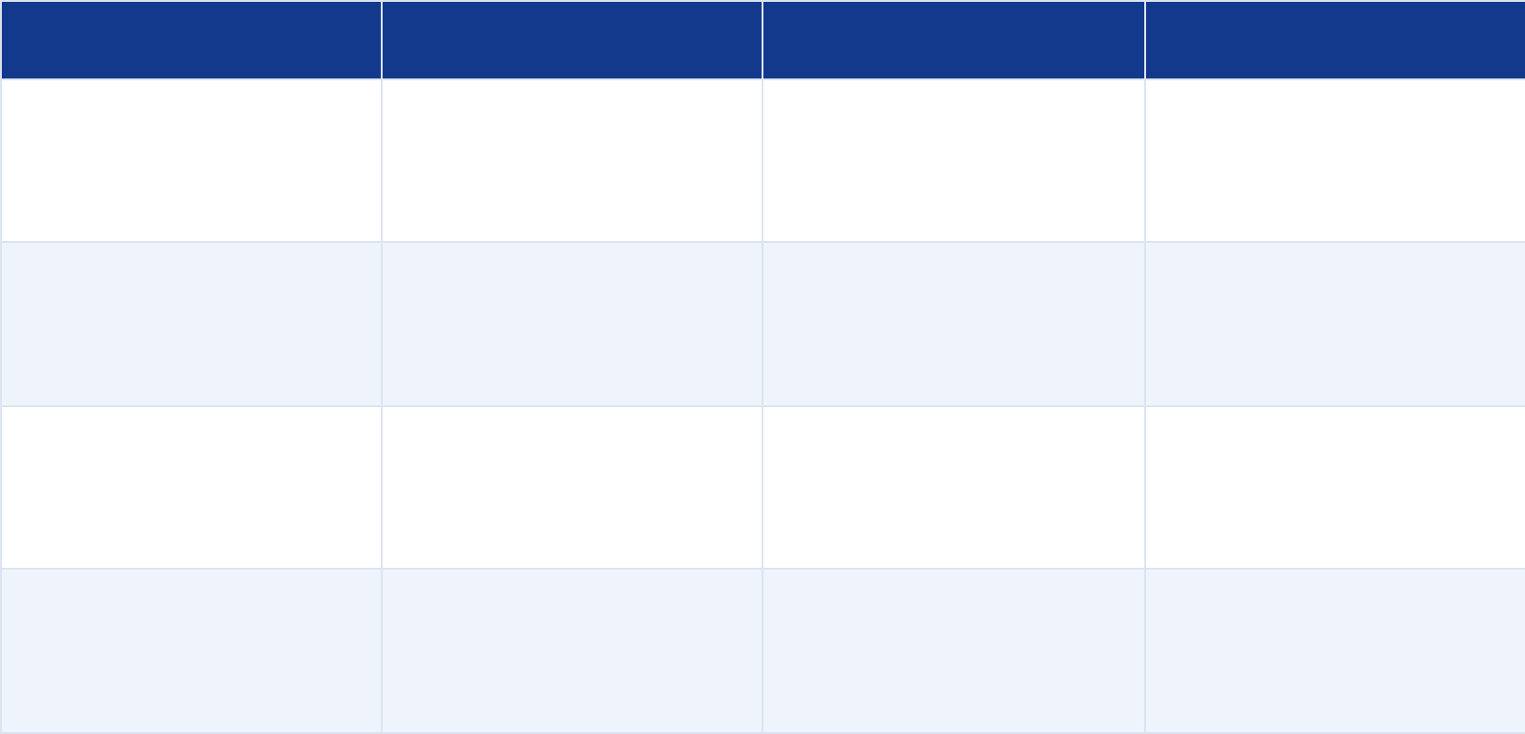























OPIOID CONVERSION RATIOS
BNF Current | NICE CG140
Use these ratios every time you convert between routes or opioids — recalculate breakthrough dose after every change
CONVERSION REFERENCE TABLE
KEY RULE
FROM
TO
CONVERSION RULE
EXAMPLE
Oral → SC morphine: ÷ 2
Oral → SC diamorphine: ÷ 3
Oral morphine
SC morphine
÷ 2
30 mg oral → 15 mg SC
POTENCY NOTE
Oral morphine
SC diamorphine
÷ 3
30 mg oral → 10 mg SC
Oxycodone is 2× more potent
than morphine orally
Hydromorphone is ~7.5× more
potent than morphine orally
Oral morphine
Oral oxycodone
÷ 2
10 mg morphine →
5 mg oxycodone
Oral morphine
Oral hydromorphone
÷ 7.5
30 mg morphine →
4 mg hydromorphone
ALWAYS
Recalculate breakthrough dose
= 1/6 of NEW total daily dose
after any conversion
Diamorphine preferred for UK syringe drivers — more soluble than morphine.
Fentanyl patch conversion: always seek specialist palliative care advice or use validated conversion chart.
www.bradfordvts.co.uk

Slide 23









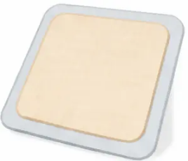

ALTERNATIVE STRONG OPIOIDS
NICE CG140 ✓
When morphine is not the right choice
OXYCODONE
FENTANYL PATCH
Formulations:
Formulation:
• Transdermal patch — changed every 72 hours
• OxyContin — modified-release, taken every 12 hours
• No oral immediate-release fentanyl patch exists
• OxyNorm — immediate-release capsules and liquid
When to use:
10 mg oral oxycodone ≡ 20 mg oral morphine
Oxycodone is approximately TWICE as potent orally
• Chronic, STABLE, well-established opioid requirements
• Patients with swallowing difficulties or poor oral absorption
• Fewer GI side effects — less constipation, less nausea
than oral morphine
When to use:
• Morphine causing troublesome side effects
(e.g. excessive sedation, itch, hallucinations)
Takes 24–48 hours to reach steady state
NOT suitable for acute pain titration
NOT for opioid-naive patients with unstable pain
• Patient preference or tolerability issues
• Renal impairment (use with caution —
seek specialist advice)
Breakthrough pain cover:
Always prescribe an IR morphine or oxycodone
alongside the patch for breakthrough doses
Dose conversion: use validated charts or seek
specialist palliative care advice
Always recaculate breakthrough dose after switching
AKT PEARL: Fentanyl patch = stable chronic pain only. Oxycodone = 2× oral morphine potency.
www.bradfordvts.co.uk
Slide 24 of 40

Slide 24














PRESCRIBING LAW
Legal Requirements for Controlled Drugs
Schedule 2 — Mandatory Prescription Elements
What Must Appear on Every CD Prescription
Computer-Generated Prescriptions (Post-2019)
1
Patient Name and Address
Schedule 2 prescriptions may be computer-printed in
some circumstances — but always verify current
local policy. A handwritten signature remains
mandatory.
Full name and home address — not just date of birth
2
Drug Name, Form and Strength
e.g. Morphine sulfate modified-release tablets 30 mg
3
Total Quantity — Words AND Figures
Oramorph 10 mg/5 ml Solution
e.g. Sixty (60) tablets — both formats legally required
Oramorph oral solution at this concentration is
no longer a controlled drug — standard
prescription rules apply. Higher concentrations
remain Schedule 2.
4
Dose Instructions
Clear dosing directions — e.g. "One tablet every 12 hours"
5
Prescriber's Name and Address
Must include the prescriber's registered address
AKT Tip
6
Signature
The total quantity in BOTH words and figures is
the most commonly tested legal requirement.
Missing either invalidates the prescription.
Handwritten signature of the prescriber
www.bradfordvts.co.uk

Slide 25









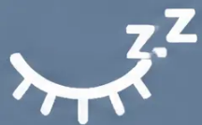




NICE CG140 · OPIOID MANAGEMENT
Managing Common Opioid Side Effects
Anticipate, prevent, and manage — most side effects are predictable and treatable
Sedation / Drowsiness
Constipation
Nausea & Vomiting
Dry Mouth (Xerostomia)
UNIVERSAL · DOES NOT RESOLVE
COMMON · USUALLY TEMPORARY
COMMON INITIALLY · USUALLY RESOLVES
OFTEN MOST TROUBLESOME LONG-TERM
• Common in first 1–2 weeks of
opioid initiation
• Often the most persistent and
distressing long-term symptom
• Occurs in nearly ALL patients on opioids
• Common in first week — usually
settles with dose stabilisation
• Unlike nausea/sedation — does NOT
improve over time
• Simple measures first:
— Frequent small sips of cold water
— Suck ice cubes or frozen fruit
segments (pineapple, melon)
— Sugarless chewing gum
• Usually resolves spontaneously —
warn patients in advance
• Distinguish from disease-related fatigue
• ⚠ Sedation RECURRING after dose
change → consider opioid toxicity
• Start laxatives BEFORE constipation develops
• First-line: Metoclopramide 10 mg
every 8 hours (oral or SC)
• Prescribe BOTH: stimulant + softener
— Senna (stimulant)
• Do NOT automatically increase opioid
dose if patient becomes confused
or sedated
• Alternative: Haloperidol 1.5 mg
nocte (opioid-induced or
metabolic nausea)
• ⚠ Avoid sugary drinks — dental caries
risk in long-term opioid patients
— Docusate or lactulose (softener)
• Prescribe regularly — NOT as PRN
• Review: Has dose changed recently?
Any renal impairment? New
medications?
• Ensure good oral hygiene and
regular mouth care
• BNF note: avoid haloperidol BD in
frail patients — excess sedation risk
MANDATORY PROPHYLAXIS —
prescribe from day one
Frozen pineapple or melon segments
are surprisingly effective
and well-tolerated
Warn patients early — most stop
opioids unnecessarily due to nausea
Recurrent sedation after titration =
toxicity until proven otherwise
www.bradfordvts.co.uk

Slide 26














Mandatory Laxative Prophylaxis
NICE CG140 Supported
Start laxatives BEFORE constipation develops — do not wait for symptoms
NICE-Supported Prescribing Regimen
Why Laxatives Are Non-Negotiable
• Constipation occurs in nearly ALL patients
on opioids
Senna
Stimulant laxative
Regular oral dosing — not PRN. Start at
standard dose; titrate as needed.
Stimulates bowel muscle contractions
• Unlike nausea and sedation, it does
NOT diminish with time
• Untreated constipation causes distress,
nausea, and reduces opioid adherence
Docusate (or lactulose as alternative)
Stool softener
Regular oral dosing — not PRN. Use
alongside stimulant.
Softens stool by increasing water content
• Prophylaxis is far easier than treating
established constipation
If you start morphine, you start
laxatives. Always.
Prescribe BOTH: stimulant + softener —
routinely, regularly, from day one
Review and titrate with
opioid dose changes
Prescribe regularly — not PRN
Do not substitute with diet alone
www.bradfordvts.co.uk

Slide 27






RED FLAG: Agitated confusion in a patient on opioids = CONSIDER OPIOID TOXICITY FIRST –
do NOT increase the opioid dose
Recognising and Managing Opioid Toxicity
NICE CG140 | BNF Current Guidance
Warning Signs — Recognise These
Management — Act on This
● Subtle agitation or restlessness — often the earliest sign
1. Reduce opioid dose by 30–50%
● Visual & tactile hallucinations — shadows/insects/object/
people at the periphery of visual field
Do not stop abruptly — reduce and reassess
2. Ensure adequate hydration
● Vivid, disturbing dreams
Promotes renal clearance of active opioid
metabolites (morphine-6-glucuronide)
● Confusion and cognitive changes
3. Haloperidol 0.5–1 mg SC every 2–4 hours PRN
● Myoclonic jerks — muscle twitching, especially at night
For agitation and hallucinations — BNF current dose
● Respiratory depression — late sign; rare with
correct titration
4. Seek specialist palliative care advice
Consider opioid rotation if toxicity persists
Clinical note: Escalating opioid requirements indicate disease progression or tolerance — NOT addiction.
Reassure patients and families explicitly. Psychological dependence is rare in cancer pain management.
www.bradfordvts.co.uk
Palliative Care — Overview & Practicalities
Slide 28 of 40

Slide 28



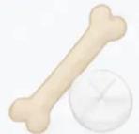
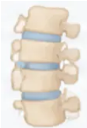








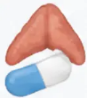



Adjuvant Analgesics in Palliative Care
Used at ANY step of the analgesic ladder — when opioids alone are insufficient
NSAIDs
Bone Pain — Multi-Modal Strategy
(ibuprofen · naproxen · diclofenac)
• Especially effective for bone pain, soft tissue
infiltration, hepatomegaly
Morphine
Bisphosphonates
Paracetamol
Radiotherapy
NSAID
• Use alongside morphine — additive effect
Single-fraction radiotherapy is highly effective for bone metastases.
• Always co-prescribe a PPI for gastric protection
• Caution: renal impairment, cardiovascular risk,
bleeding risk
Zoledronic acid (bisphosphonate) for bone mets.
When Are Adjuvants Used?
Corticosteroids
(dexamethasone 2–8 mg daily)
• At any step of the WHO analgesic ladder
• When opioids alone do not control pain adequately
• For pain types opioids address poorly:
Bone pain → NSAID + radiotherapy + bisphosphonate
⚡ Neuropathic pain → amitriptyline / gabapentin / pregabalin
(see next slide)
• Nerve compression and raised intracranial pressure
• Soft tissue infiltration and hepatomegaly
• Also improves appetite, energy and nausea
• Rapid onset — useful in acute symptom crises
🧠 Raised ICP — dexamethasone (rapid effect)
• Always cover with PPI if also using NSAIDs
🌀 Bowel colic — hyoscine butylbromide (antispasmodic)
PPI Protection: Always prescribe a proton pump inhibitor when combining NSAIDs and corticosteroids together —
combined GI risk is significantly increased.
www.bradfordvts.co.uk

Slide 29









MANAGEMENT OF NEUROPATHIC PAIN
Adjuvant Analgesia · NICE-Aligned
First-Line Options
1st LINE
Features of Neuropathic Pain
Amitriptyline
Duloxetine
10-25 mg nocte, titrate up
30-60 mg once daily
• Burning sensation
Gabapentin
Pregabalin
300 mg OD → titrate to 300 mg TDS
• Shooting or stabbing pain
75 mg twice daily
RECOGNISE
Choose based on comorbidities and tolerability — all are NICE-aligned first-line
• Tingling / pins and needles
• Allodynia — pain from normally
non-painful stimuli
ADJUVANT
Adjuvant Options
• Dexamethasone 4-8 mg OD — nerve compression, rapid onset
• NSAIDs — soft tissue and bone pain component
• Dysaesthesia — unpleasant
abnormal sensation
• Combine with opioid titration if needed
• Dermatomal distribution
When to Escalate
SPECIALIST
• Ketamine infusion
Think: nerve compression, post-surgical,
diabetic, cancer-related
• Anaesthetic nerve blocks
• Spinal analgesia
• TENS, acupuncture, counselling (evidence-based adjuncts)
Refer to specialist palliative care team for complex or refractory neuropathic pain
Clinical Note (NICE-corrected): Sodium valproate and mexiletine are NOT recommended first-line
for cancer neuropathic pain. Use amitriptyline, duloxetine, gabapentin or pregabalin as per current NICE guidance.
www.bradfordvts.co.uk
30

Slide 30
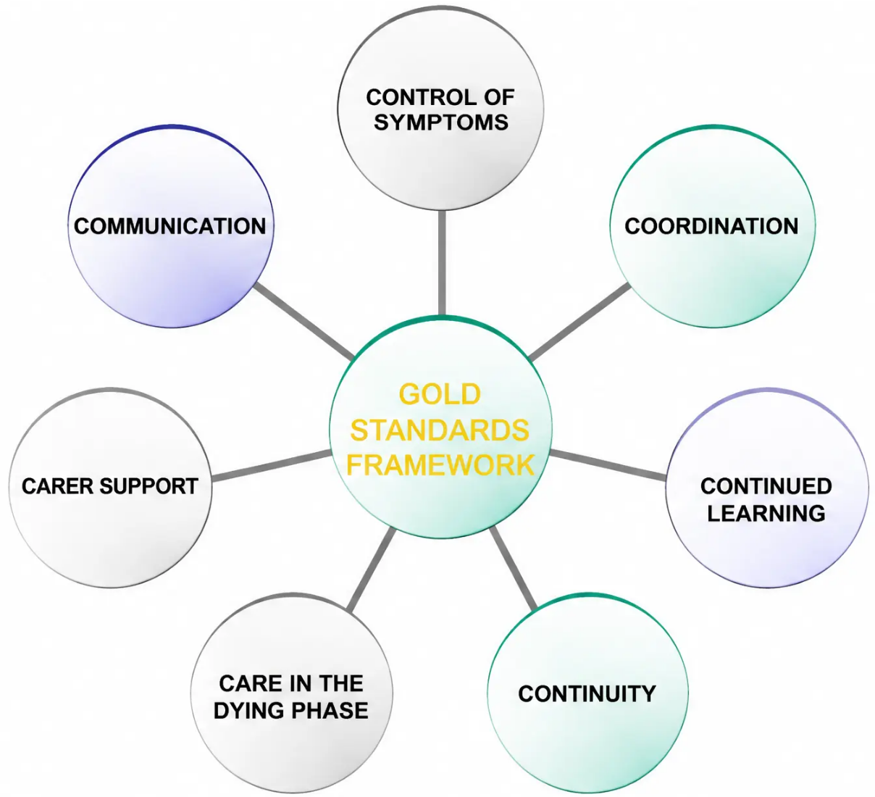

THE GOLD STANDARDS FRAMEWORK
www.bradfordvts.co.uk
What is the GSF?
A validated tool for improving coordination
and delivery of palliative care in primary care
Endorsed by NICE (2004) and the
End of Life Care Strategy (2008)
Still widely used and recommended
across UK primary care
GP Workload Context
Average GP manages approximately
20 deaths per year — a mix of cancer,
organ failure, frailty and dementia
Goals — "A Good Death"
● Symptoms controlled
● Preferred place of care achieved
● Fewer crises and emergency admissions
● Carers feel supported and involved
● Staff confidence and communication improve
GSF radial model — six domains surrounding the central coordination goal
www.bradfordvts.co.uk
Bradford VTS Teaching Deck | Palliative Care
31 / 40

Slide 31














THE GOLD STANDARDS FRAMEWORK
The 7 Cs of GSF
Communication
Co-ordination
Control of Symptoms
Continuity
GSF register, surprise
question, traffic light
(RAG) system, ACP
discussions
Named GSF coordinator;
patients aware they are
on the register
Education, assessment
tools, anticipatory care,
specialist links
Out-of-hours handover;
resuscitation status
communicated across
settings
Continued Learning
Carer Support
Care in the Dying Phase
Critical events review;
preferred vs actual place
of death audit
National Carers' Strategy;
bereavement risk
assessment; ACP support
Anticipatory prescribing;
personalised care plans
for the last days
www.bradfordvts.co.uk

Slide 32











SECTION 9 — ADVANCE CARE PLANNING
Advance Care Planning
An ongoing conversation — not a one-time form
ACP is an ongoing process of discussion between a patient, their family, and healthcare
professionals about wishes and preferences for future care — particularly important when
decision-making capacity may be lost in the future.
Triggered by life-limiting illness or deteriorating trajectory
1
2
3
Discuss
Document
Communicate
• Explore values, priorities and fears
• Advance Statement (not legally binding)
• Share with GP, out-of-hours, hospital team
• ADRT — Advance Decision to Refuse
Treatment
• What matters most to the patient?
• Ambulance service must be informed
• Preferred place of care and death
• Family/carers aware of patient's wishes
• Lasting Power of Attorney
(Health & Welfare)
• Who should be involved in decisions?
• Review and update as condition changes
• ReSPECT form
Ongoing — revisit regularly
Must travel with the patient
Across ALL care settings
SCA PROMPT
"I’d like to talk about planning ahead so we can make sure things go the way you’d want — would that be OK?"
www.bradfordvts.co.uk
Palliative Care — Overview & Practicalities
33 / 40

Slide 33


















ADVANCE CARE PLANNING
Legal Documents in Advance Care Planning
LEGALLY BINDING
MUST BE REGISTERED
Advance Decision to Refuse Treatment
ADRT
Lasting Power of Attorney
Health & Welfare LPA
What it is:
What it is:
A written, signed, witnessed document in which a person
aged 18+ refuses a specific treatment in advance
A legal document appointing a named person to make health
and welfare decisions on behalf of someone who lacks capacity
Legal basis:
Legal basis:
Mental Capacity Act 2005
Mental Capacity Act 2005
Validity criteria — ALL must be met:
Key requirement:
• Written and signed by the patient
Must be REGISTERED with the Office of the Public Guardian
before it can be used — an unregistered LPA has NO legal force
• Witnessed and signed
• Patient was 18 or over at time of signing
What the LPA holder can decide:
• Explicitly states it applies even if life is at risk
(for life-sustaining treatment)
Care arrangements, medical treatment decisions, place of care —
IF the patient lacks capacity at the time
• Has not been withdrawn
• Not contradicted by a subsequently made
Lasting Power of Attorney
Important distinction:
Key clinical point:
The LPA holder can only act when the patient lacks capacity.
They cannot override a patient who still has capacity.
A valid ADRT is legally binding even if the clinician disagrees.
It must be followed.
GP action:
GP action:
Check registration status before acting on LPA instructions.
Ask to see the registered document.
Communicate to ALL relevant care settings — out-of-hours,
hospital, ambulance service. Ensure it travels with the patient.
Advance Statement (not shown above) — records preferences and wishes but is NOT legally binding.
However, it must be taken into account in best interests decisions.
www.bradfordvts.co.uk

Slide 34







SECTION 10 — ADVANCE CARE PLANNING
DNACPR and ReSPECT Documentation
DNACPR
ReSPECT
• A clinical decision — not a patient request
• Now widely used across England — replacing
local DNACPR forms
• Made by the responsible clinician
• A single, portable document recording personalised
recommendations for emergency care
• Must be discussed with the patient if they have capacity
• If discussion would cause unnecessary distress
(e.g. actively dying), document the reason for not
discussing
• Covers CPR decisions AND broader emergency
care preferences
• Follows the patient across all care settings (home,
hospital, care home, ambulance)
• Must be communicated across ALL care settings:
GP, hospital, out-of-hours, ambulance service
• Includes two sections:
- Clinical Recommendation — clinician's view
- Patient Preferences — patient's own wishes
• Both professionals and the public consistently
overestimate CPR success rates
The decision to not attempt CPR does not mean
withdrawal of other care.
Designed to be taken to every care setting —
including by ambulance crews.
LEGAL POINT: A valid ADRT refusing CPR is legally binding under the Mental Capacity Act 2005 —
even if found in a drawer by paramedics. It supersedes the clinician's decision if valid and applicable.
www.bradfordvts.co.uk
Bradford VTS Teaching Deck — Palliative Care
For educational purposes only — verify all doses against current NICE/BNF guidance

Slide 35

















SECTION 11 — REFERRAL
Specialist Palliative Care Referral
REFER WHEN THE PATIENT HAS BOTH:
Macmillan Nurse
1 Active, progressive, usually advanced disease —
prognosis limited and focus of care is quality of life
• Urgent referral: seen within 2 working days
• Non-urgent: within 5 working days
• Assesses at home or outpatient clinic
2 AND at least one unmet need:
• Advice on symptom management (may prescribe)
• Psychosocial support and counselling
• Can refer to: lymphoedema, benefits, psychology,
Hospice at Home, Marie Curie, Fast Track discharge
Uncontrolled or
complex symptoms
Specialised nursing
or therapy needs
Hospice Services
Complex psychological
or emotional issues
Complex social or
family issues
• Inpatient beds — complex symptom control
(not only end-of-life)
• Day therapy centre
• Outpatient clinics
• Condition-specific groups (COPD, heart failure)
Difficult decisions about future care
• Art, complementary and creative therapies
• Bereavement service
Hospice is not just for dying — inpatient beds are used for complex symptom control at any stage
www.bradfordvts.co.uk | Palliative Care — Overview & Practicalities | Bradford VTS Teaching Deck | June 2026

Slide 36








BRADFORD VTS — TOP TIPS
Palliative Care: Overview & Practicalities
8 Tips to Get Right Every Time
Use the Surprise Question proactively
Warn patients about temporary side effects
At every GSF register review — "Would you be
surprised if this patient died in the next 6–12 months?"
If no, start ACP conversations now.
Opioid-induced nausea and sedation usually resolve
in 1–2 weeks. Tell patients in advance — otherwise
they stop their opioids.
Start laxatives BEFORE opioids
Always check for reversible causes before
labelling agitation
Constipation is universal and does NOT improve
with time. Prescribe stimulant + softener from
day one — not PRN.
Urine retention, constipation, uncontrolled pain,
metabolic disturbance, drug toxicity — all common
and all fixable.
An ADRT refusing CPR is legally binding —
even in a drawer
Breakthrough dose = always 1/6 of total daily dose
Recalculate every single time you adjust the regular
dose. Don't forget to update the PRN
prescription too.
Ensure all documentation travels with the patient.
Communicate to GP, hospital, out-of-hours, and
ambulance service.
Syringe driver conversions — know these cold
Start palliative care conversations early
Oral morphine ÷ 2 = SC morphine. Oral morphine ÷ 3
= SC diamorphine. Write them on your hand if you
need to.
Not just in the last days. Most patients with life-limiting
illness benefit from ACP discussions at diagnosis
of advanced disease.
www.bradfordvts.co.uk
Slide 37 of 40

Slide 37






BRADFORD VTS — EXAM PREPARATION
Exam Pearls
Key facts for the AKT and communication strategies for the SCA
AKT
SCA
Knowledge & Prescribing Facts
Consultation & Communication
● NICE CG140 (Sept 2024): oral morphine is first-line
strong opioid for cancer pain
● ICE opener: “What do you understand about your illness
at the moment?”
● Start morphine: 5 mg every 4 hours opioid-naive adults;
2.5 mg elderly/renal impairment
● Exploring concerns: “What worries you most about
what’s happening?”
● Breakthrough dose = 1/6 of total daily dose —
recaclulate every time you titrate
● Eliciting priorities: “What would be most important to you
in the weeks ahead?”
● Breaking bad news: use SPIKES — Signal → Perception →
Invitation → Knowledge → Emotion → Summary
● Oral morphine ÷ 2 = SC morphine; ÷ 3 = SC diamorphine
● Fentanyl patches take 24-48 hours to reach steady-state —
NOT for acute titration
● Safety-netting: “If pain or breathlessness worsens before your
review, contact us — we can arrange medication quickly
to keep you comfortable”
● Co-proxamol (dextropropoxyphene) WITHDRAWN
from UK market 2005
● Starting ACP: “I’d like to talk about planning ahead so things
go the way you’d want — would that be OK?”
● A valid ADRT is legally binding under the Mental Capacity Act 2005
● Addressing addiction fear: “Using morphine for genuine pain
relief does not cause addiction — your body needs it medically,
just as a diabetic needs insulin”
● ReSPECT = current portable emergency care planning
form across England
● Constipation from opioids: prescribe stimulant + softener
routinely from day one — does NOT resolve spontoneously
● Explaining laxatives: “These are a must — constipation from
morphine doesn’t go away on its own, unlike the drowsiness
which usually settles”
● GSF “surprise question” = validated trigger
for palliative care identification
● Acknowledge emotion before information — pause after
delivering difficult news
www.bradfordvts.co.uk
Palliative Care — Overview & Practicalities | Bradford VTS Teaching Deck | June 2026

Slide 38




BRADFORD VTS | PALLIATIVE CARE
Red Flags & Common Pitfalls
RED FLAGS — ACT NOW
COMMON PITFALLS — AVOID THESE
● Agitated confusion on opioids
● Multiple pain sites
→ Consider opioid toxicity first — do NOT increase the dose
→ Assess each site independently — patients may have more than one pain
● RR <8/min + sedation + pinpoint pupils
● Reducing dose interval instead of increasing dose
→ Opioid overdose — urgent senior/specialist help immediately
→ Does not work for MR opioids; increases side effects
● Sudden severe pain + bone mets
● Fentanyl patch in opioid-naive patient with unstable pain
→ Pathological fracture until proven otherwise
→ Patches are for stable, established requirements only
● New limb weakness / back pain / incontinence
in metastatic cancer
● Failing to educate patient/family on opioid side effects
→ Spinal cord compression
→ Leads to premature abandonment of effective analgesia
— same-day MRI
● DNACPR documented but not communicated
● Headache + vomiting + visual changes in brain mets
to OOH/family
→ Raised ICP — immediate dexamethasone + oncology review
→ Creates dangerous gaps in care at the critical moment
● Using the Liverpool Care Pathway (LCP)
● Valid ADRT not communicated to OOH/ambulance
→ Patient safety failure — ensure documentation
travels with the patient
→ WITHDRAWN after Neuberger Review 2013 —
use individualised personalised care plans
www.bradfordvts.co.uk
NICE CG140 | NICE NG31
Slide 39 of 40

Slide 39
















BRADFORD VTS TEACHING DECK
www.bradfordvts.co.uk
Quick Recall
Core principles to take away — Palliative Care Overview & Practicalities
WHO definition: active total care — quality of life focus
Constipation: laxatives from day one — stimulant + softener
Opioid toxicity: agitation · myoclonus · hallucinations
Surprise question → GSF register → begin ACP
WHO ladder: by mouth · by the clock · by the ladder
ADRT = legally binding under Mental Capacity Act 2005
ReSPECT = portable, cross-setting EOL care plan
Start morphine: 5 mg every 4 hours (2.5 mg elderly/renal)
Breakthrough dose = 1/6 of total 24-hour dose — always
Refer Macmillan: uncontrolled symptoms or complex needs
Oral → SC morphine: ÷ 2 · Oral → SC diamorphine: ÷ 3
Co-proxamol WITHDRAWN from UK market 2005
Disclaimer
Always double-check this advice and all drug doses against the latest NICE and BNF guidance before clinical use.
This document is for educational purposes only and does not constitute clinical advice.
NICE CG140 (reviewed September 2024) · NICE NG31 (2015) · Bradford VTS Teaching Deck, June 2026
www.bradfordvts.co.uk | Palliative Care: Overview & Practicalities | Bradford VTS Teaching Deck | June 2026

