Slide 1



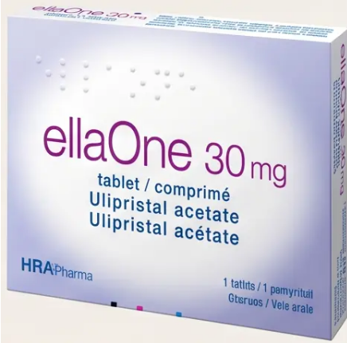
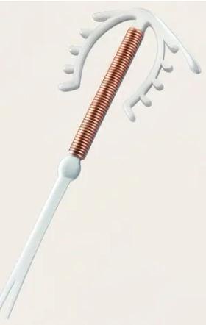

BRADFORD VTS TEACHING DECK
EMERGENCY CONTRACEPTION
Bradford VTS
Teaching Deck
Emergency Contraception for GP Trainees
Created May 2026 — Updated to current NICE CKS 2024 / FSRH Standards
⚠ Disclaimer: Always double check this advice and drug doses with the latest
NICE/BNF guidance. This document is for educational purposes only.
www.bradfordvts.co.uk
May 2026

Slide 2


















BRADFORD VTS TEACHING DECK — EMERGENCY CONTRACEPTION
Overview and Indications for EC
NICE CKS 2024
What is Emergency Contraception?
Emergency contraception (EC) prevents pregnancy after unprotected sexual intercourse (UPSI) or
contraceptive failure. It is not intended as a regular contraceptive method.
INDICATIONS FOR EC
1 🔴 Unprotected Sexual Intercourse (UPSI)
2 🔴 Condom Failure
Any episode of unprotected vaginal intercourse
Breakage or slippage during intercourse
3 🔴 Missed Combined Pill
4 🔴 Missed Progestogen-Only Pill
≥24h late (30/35mcg pill); ≥12h late (20mcg pill)
>3h late (traditional POP); >12h late (desogestrel)
5 🔴 Late Injectable Contraception
6 🔴 Expelled or Failed IUS/IUD
>14 weeks since Depo-Provera; >13 weeks since
Sayana Press
Expelled device or vomiting within 2h of oral EC
dose
www.bradfordvts.co.uk
May 2026

Slide 3







OVERVIEW
The Three Primary Methods of Emergency Contraception
*Choose the most appropriate method based on timing, weight, and clinical context
METHOD 01
METHOD 02
METHOD 03
Ulipristal Acetate
Levonorgestrel
Copper IUD
Levonelle 1500mcg
ellaOne 30mg
Cu-IUD — Intrauterine Device
72 hrs
120 hrs
5 days
Standard time window after UPSI
Extended time window after UPSI
Post-UPSI OR 5 days post-ovulation
~85%
Better maintained
>99.9%
Prevention of expected pregnancies
Efficacy at higher BMI vs LNG-EC
Most effective EC method available
GOLD STANDARD
*Available over the counter. Less effective
at higher BMI or weight >70kg.
*Requires prescription. Do not co-administer
with progestogen for 5 days post-dose.
*Effective regardless of weight or enzyme
inducers. Can be retained as ongoing
contraception.
🔑 Always offer all three methods — including the copper IUD — at every EC consultation (NICE CKS 2024)
www.bradfordvts.co.uk
May 2026

Slide 4




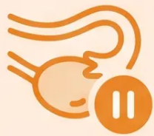


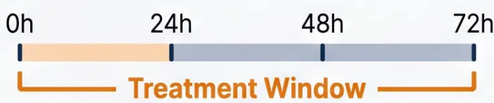



BRADFORD VTS TEACHING DECK
Levonorgestrel EC (Levonelle 1500mcg)
Mechanism · Dosing · Enzyme Inducers
How It Works
Standard Dose
Enzyme Inducers ⚠
- Primarily inhibits or delays
ovulation
1500 mcg
Examples: - Rifampicin
- Carbamazepine, Phenytoin
Single tablet — take as soon as possible
- Most effective when given before
the LH surge
- St John’s Wort
If enzyme inducers are being used:
- Does NOT cause abortion — no
effect after fertilisation
➔ Double dose: 3mg LNG
(2 × 1500mcg tablets) — off-licence
Take immediately — every hour counts
- Works best the earlier it is taken
➔ Preferred: Copper IUD (most
effective, unaffected by enzyme inducers)
- If vomiting within 2 hours ➔ repeat dose
- Available over the counter (OTC)
Not an abortifacient — reassure patients
Do NOT give UPA with enzyme inducers
www.bradfordvts.co.uk
May 2026

Slide 5















LNG-EC Efficacy and Weight Considerations
Levonelle 1500mcg — Time and Body Weight Matter
EFFICACY OVER TIME
WEIGHT AND BMI IMPACT
Time After UPSI
Estimated Pregnancy Prevention
LNG-EC is LESS Effective at Higher Weights
< 24 hours
~95%
◆ BMI > 26 kg/m² — Reduced efficacy; offer UPA 30mg
or copper IUD preferentially
24 – 48 hours
~85%
◆ Weight > 70 kg — LNG-EC significantly less effective;
prefer UPA 30mg or copper IUD (FSRH guidance)
48 – 72 hours
~58%
◆ Double-dosing LNG-EC for high BMI is NO longer
recommended — UPA 30mg is the preferred alternative
Efficacy declines significantly with time — take as soon as
possible after UPSI.
If High BMI or Weight > 70 kg — Prefer:
→ UPA (ellaOne) 30mg — better maintained efficacy across
weight ranges
< 24h
24–48h
48–72h
→ Copper IUD — most effective, unaffected by weight or BMI
www.bradfordvts.co.uk
May 2026

Slide 6

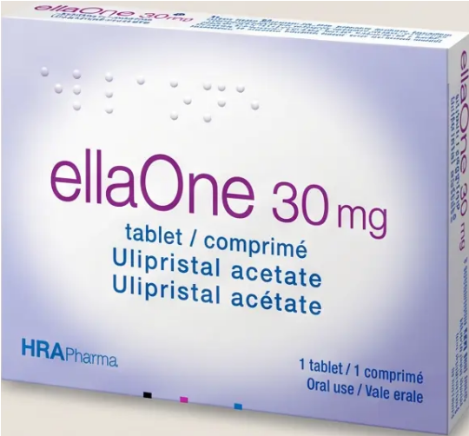

BRADFORD VTS TEACHING DECK
Ulipristal Acetate (ellaOne 30mg)
*Section 3 — Oral EC Methods
DRUG CLASS
Selective Progesterone Receptor Modulator (SPRM)
HOW IT WORKS
• Binds competitively to progesterone receptors in the pituitary and ovary
• Inhibits or delays ovulation — crucially, even after the LH surge has already begun
• This is its key advantage over LNG-EC, which loses effectiveness once the LH
surge starts
EFFECTIVE WINDOW
ellaOne® 30mg — Ulipristal acetate
UPSI
120 hours (5 days)
More effective than LNG-EC especially in the 72–120 hour window (3-5 days)
Key Advantage
DOSE
Works even after the LH surge
has started — unlike LNG-EC
Single tablet — 30mg — taken as soon as possible after UPSI
Available on NHS prescription; also available OTC in pharmacies
www.bradfordvts.co.uk
Emergency Contraception
May 2026

Slide 7








BRADFORD VTS TEACHING DECK
UPA Key Clinical Points and Interactions
ellaOne 30mg — Critical prescribing rules every GP trainee must know
HORMONAL CONTRACEPTION — WAIT 5 DAYS
BREASTFEEDING PRECAUTION
Do NOT start regular hormonal contraception for 5 days
after taking UPA. Progestins competitively bind
progesterone receptors and reduce UPA efficacy.
UPA is excreted in breast milk. Women who are
breastfeeding should express and discard milk for 24
hours after taking UPA.
After 5 days → start CHC/POP/implant + use condoms for 7
more days; IUS/IUD requires 5 more days of condom use.
Contrast with LNG-EC — no interruption to breastfeeding
required with levonorgestrel.
SEVERE ASTHMA — AVOID UPA
PRIOR PROGESTOGEN USE — REDUCED EFFICACY
Do NOT give UPA to women with severe asthma
controlled by oral or systemic corticosteroids.
If the patient has taken a progestogen-only pill in the
last 7 days, UPA may be less effective due to receptor
saturation.
Theoretical concern — progesterone receptor
modulation may affect airway response.
In this scenario → consider copper IUD as preferred EC
method.
Offer LNG-EC or copper IUD instead in this group.
Quick Rule: UPA after progestogen = reduced effect → prefer copper IUD. UPA before hormones = wait 5 days.
www.bradfordvts.co.uk
May 2026
| Slide 7 of 20

Slide 8



















BRADFORD VTS TEACHING DECK
Comparison: UPA vs. LNG-EC
Oral emergency contraception — key clinical differences at a glance
💊 UPA — ellaOne 30mg
💊 LNG-EC — Levonelle 1500mcg
Selective Progesterone Receptor Modulator
Progestogen — ovulation inhibitor
🕒 Time Window
120 hours (5 days)
72 hours (3 days)
✓ Longer window
Up to 5 days after UPSI
Standard; up to 96h off-licence
⚖️ High BMI /
Weight >70kg
Better maintained efficacy
Reduced efficacy
⚠️
Preferred over LNG-EC when BMI >26 or weight >70kg
Significantly less effective; avoid as first choice at high BMI
🤱 Breastfeeding
Express and discard milk for 24 hours
Safe — no interruption needed
✅
Resume breastfeeding after 24h
Can breastfeed immediately after dose
⚠️ Prior Progestogen Use
⚠️
Reduced efficacy
⚠️
No significant interaction noted
If progestogen taken in last 7 days — consider copper IUD instead
🔄 Starting Hormonal
Contraception After EC
Wait 5 days
Same day (quick-start)
✅
Then start hormonal contraception + condoms for 7 more days
Use condoms for 7 days (CHC) or 2 days (POP)
Both oral methods are valuable — UPA offers a longer window and better BMI efficacy;
LNG-EC allows immediate hormonal contraception and is safe in breastfeeding without interruption
www.bradfodvts.co.uk
May 2026 | Slide 8 of 20

Slide 9



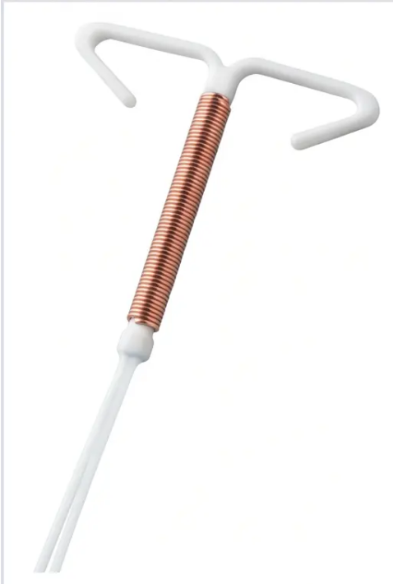
BRADFORD VTS TEACHING DECK
Copper IUD: The Gold Standard EC
MOST EFFECTIVE
>99.9%
Effective — regardless of weight or BMI
Compared to ~85% for LNG-EC
How It Works
◆ Copper ion toxicity impairs sperm motility and function — preventing fertilisation
◆ Prevents implantation — additional barrier if fertilisation occurs
Works at multiple points in the reproductive process — not dependent on hormonal pathways
Key Advantages
✓ Most effective EC available — >99.9% regardless of weight
✓ Works regardless of enzyme inducers — rifampicin, anti-epileptics: no problem
Copper IUD (Cu-IUD)
✓ Can be retained as ongoing long-term contraception (up to 10 years)
T-shaped device with copper coil
⚠ Always offer the copper IUD — even if the patient only asks for “the morning after pill”
Copper toxicity to sperm is the primary mechanism
www.bradfordvts.co.uk
May 2026

Slide 10







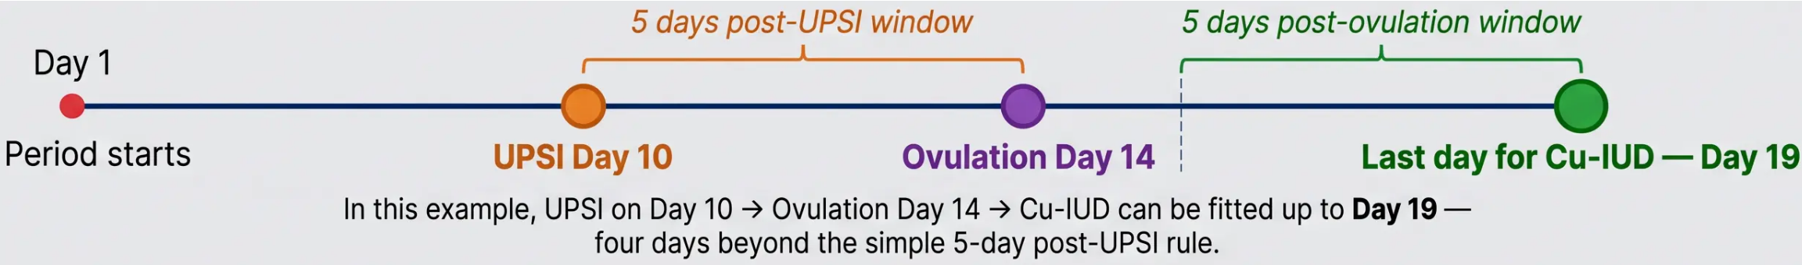

BRADFORD VTS TEACHING DECK
Copper IUD Timing and the Ovulation Rule
Understanding the extended insertion window — a key AKT exam point
RULE 1
RULE 2 — KEY EXAM POINT
Up to 5 days after UPSI
Up to 5 days after earliest estimated ovulation
The straightforward rule — copper IUD can be fitted within 5
days (120 hours) of any episode of unprotected sexual
intercourse.
Even if more than 5 days have passed since UPSI — if ovulation has
not yet occurred, the window may still be open. This can extend the
effective fitting window significantly beyond the simple 5-day rule.
Worked Example — 28-Day Cycle
The copper IUD window is always calculated to whichever date is LATER — post-UPSI or post-ovulation. Always calculate
both before deciding the window has closed.
www.bradfordvts.co.uk
May 2026

Slide 11







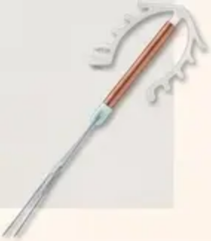

BRADFORD VTS TEACHING DECK
Practical Points for Copper IUD Insertion
Prophylactic
Antibiotics
STI Screening
Pain Management
• Offer STI screen to all women
requesting EC
• Offer if high STI risk (age <25, new
or multiple partners)
• Offer ibuprofen 400mg orally
30–60 minutes before procedure
• Swab for chlamydia and
gonorrhoea before insertion when
possible
• Azithromycin 1g — single oral
dose (chlamydia cover)
• Warm pack to lower abdomen
post-insertion
• Doxycycline 100mg BD × 7 days
(gonorrhoea cover)
• Encourage patient to void bladder
before procedure
• Age under 25 or multiple partners
→ higher STI risk
• Alternatively: test and treat if
results available quickly
• Warn of cramping during and after
insertion — usually short-lived
• If low risk and willing to wait: test
first, insert when results clear
• Do not use prophylaxis as a
substitute for STI testing
• Paracetamol 1g as alternative if
NSAIDs contraindicated
• Do not routinely delay insertion if
the window is closing
• Local anaesthetic (lidocaine)
may be considered for
anxious patients
*If frank PID or purulent cervicitis is present
— do NOT insert. Treat infection first.
Copper IUD —
T-shaped,
copper-wound
www.bradfordvts.co.uk
May 2026

Slide 12








BRADFORD VTS TEACHING DECK
Contraindications to Copper IUD Use
*UKMEC 2025 — Absolute Contraindications (Category 4)*
Confirmed Intrauterine Pregnancy
Current PID or Purulent Cervicitis
Insertion will not terminate an established
pregnancy.
Active pelvic inflammatory disease or purulent
cervicitis is a UKMEC 4 absolute
contraindication. Treat infection fully before
any IUD insertion is considered.
Always confirm LMP and assess
pregnancy risk before fitting.
Uterine Cavity Distortion
Copper Allergy or Wilson's Disease
Fibroids, congenital anomalies, or any structural
distortion preventing safe placement of the IUD.
Confirm cavity dimensions before insertion
attempt.
Systemic copper metabolism disorder (Wilson's
disease) or confirmed allergy to copper
components is an absolute contraindication to
the copper IUD.
Remember: Nulliparity is NOT a contraindication — copper IUD is safe and highly effective in nulliparous women. Do not withhold it.
www.bradfordvts.co.uk
Emergency Contraception — Bradford VTS Teaching Deck
12 / 20

Slide 13













BRADFORD VTS TEACHING DECK
Consultation Framework: History Taking
*Systematically assess every EC request using this 8-point framework*
1 Date & Time of UPSI
Medical History & Medications
5
*Enzyme inducers reduce LNG-EC efficacy;
severe asthma on steroids — avoid UPA*
*Calculate exact hours elapsed — determines
which EC methods are still within window*
Weight & BMI
2 Last Menstrual Period (LMP)
*Assess pregnancy risk — was UPSI after the
fertile window? Estimate ovulation date*
6
*BMI >26 or weight >70 kg — LNG-EC less
effective; prefer UPA or copper IUD*
3 Other UPSI This Cycle
STI Risk Assessment
7
*Offer STI screen with every EC request;
consider prophylaxis if fitting copper IUD*
Multiple episodes increase risk — each
unprotected act must be considered*
4 Current Contraception
Safeguarding
What failed? Identify the gap — and plan ongoing
contraception going forward*
8
*Under-16? Assess Fraser / Gillick competency —
consider safeguarding referral*
Always close the loop: Discuss regular ongoing contraception at every EC consultation — EC is not a routine contraceptive method.
www.bradfordvts.co.uk
Emergency Contraception — Bradford VTS Teaching Deck
May 2026

Slide 14

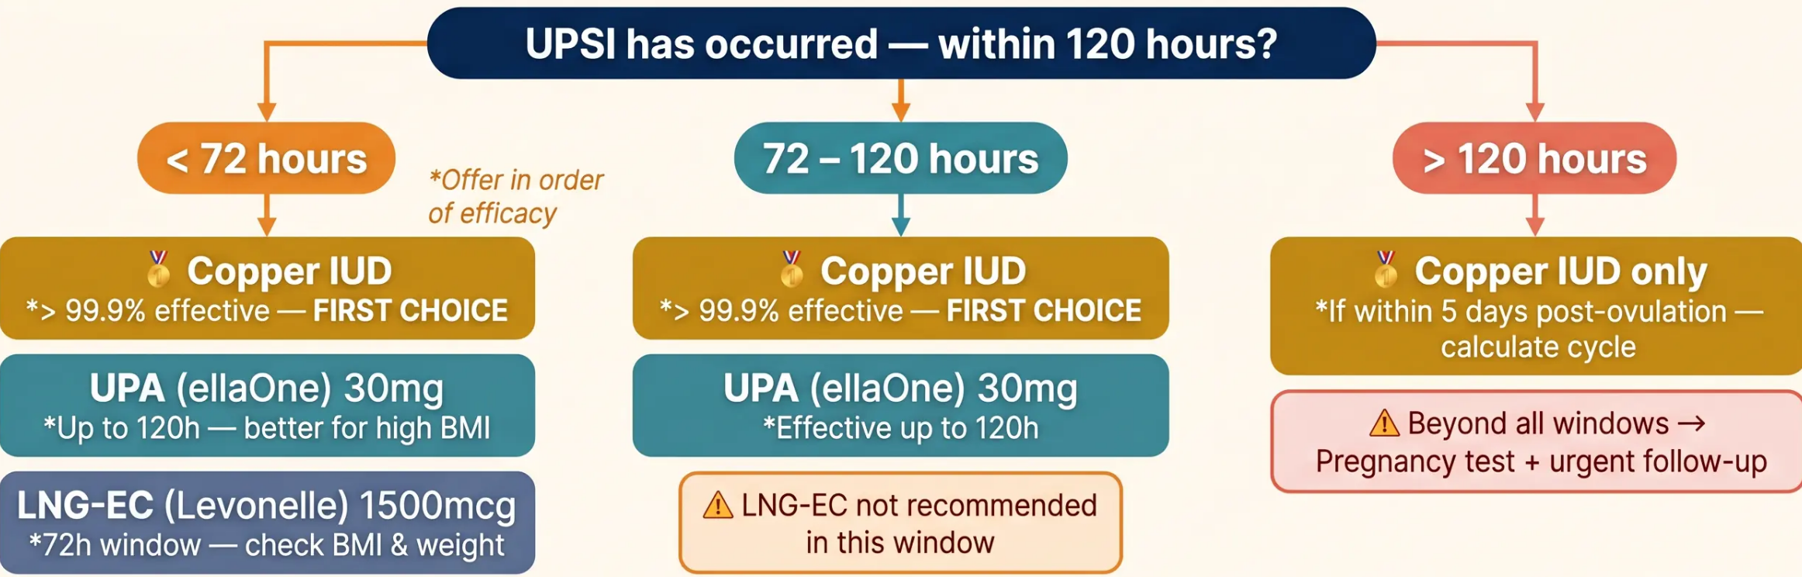

BRADFORD VTS TEACHING DECK
Emergency Contraception Decision Tree
*Selecting the right method based on time since UPSI*
🌟 Key Rule: Copper IUD window = 5 days post-UPSI OR 5 days post-ovulation — whichever is later.
This may extend the window beyond 5 days from UPSI.
www.bradfordvts.co.uk
Emergency Contraception — Decision Tree
May 2026

Slide 15










Ongoing Contraception After EC
Quick-start protocols and additional
barrier protection guidance
After LNG-EC
After UPA
After Copper IUD
(Levonelle 1500mcg)
(ellaOne 30mg)
• Start hormonal contraception the
same day — quick-start
immediately after taking LNG-EC
• Wait 5 full days before starting
hormonal contraception —
progestins competitively reduce
UPA efficacy if given sooner
• Immediately effective as ongoing
contraception — no additional
barrier method required if
retained
• Use condoms for 7 days after
starting combined hormonal
contraception (CHC), patch, or
ring — or 2 days for progestogen-
only pill (POP)
• Use condoms during those 5 days
AND for 7 days after starting CHC,
patch, ring, or implant — or 5
days after starting an IUS
• Option 1: Retain as long-term
contraception — copper IUD is
licensed for up to 10 years
• Option 2: Remove at next period
after confirming pregnancy has
been excluded — if the patient
does not wish to continue with IUD
• Pregnancy test if period is more
than 7 days late, or if the next
period is lighter than usual
• Pregnancy test if period is more
than 7 days late, or if lighter than
usual
✓ No waiting required —
quick-start on same day
! Do NOT quick-start hormonal
contraception — wait 5 days
✓ Most effective option — instant
and ongoing protection
Key rule: LNG-EC → start same day · UPA → wait 5 days · Copper IUD → already protected
www.bradfordvts.co.uk
May 2026

Slide 16




BRADFORD VTS TEACHING DECK
Top Tips for EC Management
Critical practice reminders for every EC consultation
01 Always Offer All Three Methods
02 Copper IUD First
Let the patient choose with informed consent — always discuss
the copper IUD even if she only asks for 'the morning after pill.'
Most effective EC at >99.9% — should always be offered and
discussed as the preferred option regardless of's initial request.
03 High BMI? → UPA or Copper IUD
04 Copper IUD Window Extends Beyond 5 Days
LNG-EC is significantly less effective above BMI 26 or weight
>70 kg. Switch to UPA 30mg or copper IUD.
The window is 5 days after UPSI OR 5 days after earliest
estimated ovulation — whichever is later. Key exam point.
05 UPA + Progestogen: Wait 5 Days
06 Always Offer STI Screen
Do not start hormonal contraception for 5 days after UPA —
progesterone competes at the receptor and reduces UPA efficacy.
Every EC consultation is an opportunity to screen for sexually
transmitted infections — do not skip this step.
07 Advance-Prescribe Regular Contraception
08 Safeguarding Under-16s
EC is not a regular contraceptive method — always discuss and
initiate ongoing contraception at the same appointment.
All patients under 16 presenting for EC require a safeguarding
assessment — Fraser/Gillick competency must be documented.
www.bradfordvts.co.uk
Emergency Contraception — Bradford VTS Teaching Deck
May 2026 | Slide 16 of 20

Slide 17



BRADFORD VTS TEACHING DECK
SLIDE 17 OF 20
AKT Exam Pearls
High-yield facts for the Applied Knowledge Test — timing windows, UKMEC 2025 updates, and enzyme inducer management
★ 1 — LNG-EC Timing Window
★ 5 — Enzyme Inducers & LNG-EC
Standard window: 72 hours after UPSI
Rifampicin, anti-epileptics reduce LNG-EC efficacy
Options: double-dose LNG (3mg, off-licence) OR — preferably — copper IUD
Off-licence extension: up to 96 hours if UPA declined and IUD unsuitable
Do NOT give UPA with enzyme inducers
★ 2 — UPA Timing Window
★ 6 — UPA + Progestogen Interaction
Effective up to 120 hours (5 days) after UPSI
Do NOT start hormonal contraception for 5 days after UPA
More effective than LNG-EC especially in the 72–120h window
Progestins competitively bind progesterone receptors → reduce UPA efficacy
★ 3 — Copper IUD — Extended Window
★ 7 — High BMI / Weight >70kg
Up to 5 days post-UPSI OR 5 days after earliest estimated ovulation
— whichever is LATER
LNG-EC significantly less effective above BMI 26 or weight >70kg
Prefer UPA 30mg or copper IUD — do not simply double-dose LNG-EC
This can extend the window well beyond day 5 — key AKT exam point ⚡
★ 4 — UKMEC 2025 Update
★ 8 — Vomiting After Oral EC
If vomiting within 2 hours of LNG-EC dose → repeat the dose
NO absolute contraindications to oral EC (LNG-EC or UPA)
Even previous VTE history = UKMEC 2 only
Antiemetic optional; if persistent vomiting, consider copper IUD instead
💡 Copper IUD remains effective regardless of weight, enzyme inducers, or time since UPSI (within window) — always offer it.
www.bradfordvts.co.uk
May 2026 | NICE CKS 2024 / FSRH Standards

Slide 18




Bradford VTS Medical Education
Clinical teaching
Red Flags and Safety Netting
Identifying urgent clinical concerns after emergency contraception
🚩 RED FLAGS — ACT NOW
🔵 SAFETY NETTING — ADVISE ALL PATIENTS
⚠️ Missed period after EC:
✔️ Pregnancy test if period is >7 days late:
Pregnancy test urgently — do not wait and watch
Or if next period is lighter or shorter than expected
⚠️ Abdominal pain after copper IUD insertion:
✔️ Return if any lower abdominal pain develops:
Exclude uterine perforation, ectopic pregnancy, or PID
Especially within days of copper IUD insertion
⚠️ Heavy or prolonged bleeding post-IUD:
✔️ Copper IUD: follow-up at 3–6 weeks:
Confirm threads, exclude expulsion or infection
Review for perforation or expulsion — urgent assessment
⚠️ Signs of PID: Fever, pelvic pain, offensive discharge
✔️ UPA users: express and discard milk for 24 hours:
discharge — do NOT insert IUD; treat PID first
If breastfeeding — specific safety advice required
⚠️ Under-16 presenting repeatedly for EC:
✔️ All EC users: discuss regular contraception: EC is not a
Safeguarding referral — do not manage in isolation
regular method — advance-prescribe ongoing contraception
Key principle: Every EC consultation is an opportunity for ongoing contraception planning and safeguarding review.
www.bradfordvts.co.uk
Bradford VTS Teaching Deck — Emergency Contraception
18 / 20

Slide 19



BRADFORD VTS TEACHING DECK
Common Pitfalls & Quick Recall
Avoiding errors — and locking in the essentials
⚠ Common Pitfalls
✓ Quick Recall
⚠ Not offering copper IUD — oral EC only is not enough;
Cu-IUD must always be discussed
✓ ① 3 EC options — LNG-EC · UPA · Copper IUD
✓ ② Copper IUD — most effective (>99.9%), up to 5 days
⚠ LNG-EC in high BMI — still prescribing Levonelle when
BMI >26 or weight >70 kg without considering UPA or
Cu-IUD
✓ ③ LNG-EC — 72h window; less effective if BMI >26 or
weight >70 kg
⚠ Hormonal contraception immediately after UPA —
reduces efficacy; always wait 5 days
✓ ④ UPA — 120h window; wait 5 days before hormonal
contraception
⚠ Calculating window from UPSI only — Cu-IUD window
extends to 5 days post-ovulation, not just 5 days
post-UPSI
✓ ⑤ Cu-IUD window — 5 days post-UPSI OR 5 days
post-ovulation
✓ ⑥ Always offer Cu-IUD — even if patient asks only for
"the pill"
⚠ Skipping STI screen — mandatory with every EC request
⚠ Assuming Cu-IUD unsuitable for nulliparous women —
nulliparity is NOT a contraindication
✓ ⑦ STI screen — with every EC consultation
✓ ⑧ Fraser/Gillick — required for all under-16s
Key rule: Copper IUD window = 5 days post-UPSI OR 5 days post-ovulation — whichever gives the longer window.
www.bradfordvts.co.uk
May 2026 · Slide 19 of 20

Slide 20


















BRADFORD VTS TEACHING DECK
Final Summary & Disclaimer
| Method
Time Window
Efficacy
| Key Consideration |
LNG-EC (Levonelle)
Up to 72 hours
~85%
Less effective if BMI >26 or weight >70 kg
UPA (ellaOne)
Up to 120 hours
Better than LNG-EC
Wait 5 days before hormonal contraception
5 days post-UPSI or
5 days post-ovulation
>99.9%
Most effective — always offer
Copper IUD
● Always offer the Copper IUD
● STI screen with every EC request
● Fraser / Gillick assessment if under 16
⚠️ IMPORTANT DISCLAIMER
Always double check this advice and all drug doses with the latest NICE CKS, FSRH, and BNF guidance before
clinical application. Drug guidelines and recommendations are subject to change. This presentation is for
educational purposes only and does not replace individual clinical judgement or current national guidance.
Created May 2026 — Updated to NICE CKS 2024 / FSRH Standards
www.bradfordvts.co.uk
Emergency Contraception — Bradford VTS Teaching Deck
May 2026

