Slide 1






BRADFORD VTS TEACHING DECK
Contraception for GPs
A Comprehensive Clinical Teaching Deck
*Created May 2026 — Updated to UKMEC 2025 and FSRH 2026 Standards*
Disclaimer: Always double check this advice and drug doses with the latest
NICE/BNF guidance. This document is for educational purposes only.
www.bradfordvts.co.uk
*Contraception for GP Trainees | May 2026

Slide 2








Learning Objectives for GP Registrars
By the end of this session, you will be able to:
Counsel on All Methods
Apply UKMEC 2025 Criteria
01
02
Explain efficacy, side effects, and suitability
of every contraceptive method
Safely prescribe contraception in women
with complex medical conditions
Missed Pills and Interactions
Initiate and Follow Up LARC
03
04
Give accurate missed pill and drug
interaction advice per FSRH 2026 guidelines
Manage implants, IUS, and IUDs including
insertion timing and complications
Special Circumstances
AKT and SCA Confidence
05
06
Address postnatal, perimenopausal, and
post-abortion contraception needs
Navigate exam scenarios with accurate,
up-to-date clinical knowledge
*Contraception for GP Trainees
www.bradfordvts.co.uk
| May 2026

Slide 3



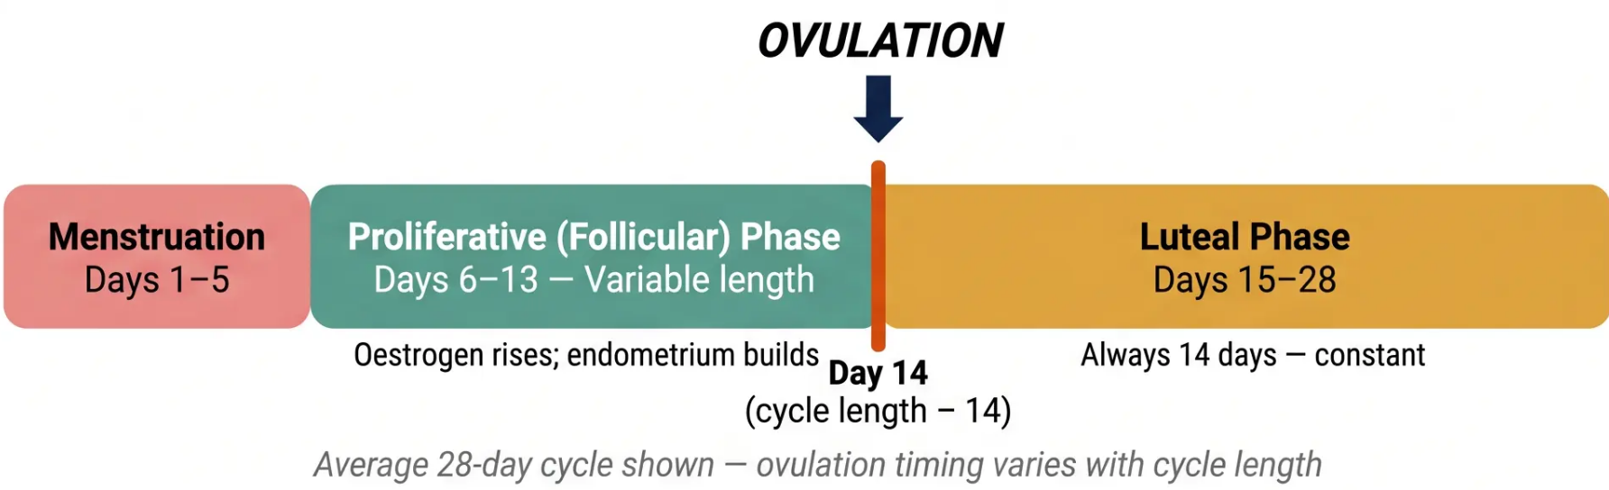





The Menstrual Cycle and Fertility Window
Sperm Survival
Understanding cycle phases and the fertile window for patient counselling
Up to 7 days
in fertile cervical mucus
Egg Survival
12–24 hours
(allow 48 hours for safety)
◆ Fertile Window: Days 8–19
Peak risk: Days 11–16 | 30% conception chance on day of ovulation
Peak Conception
30% chance on
Clinical tip: Counsel patients that the fertile window is longer than most assume — sperm can
survive nearly a week, making early-cycle unprotected sex a real risk.
day of ovulation
www.bradfordvts.co.uk
3 / 35
Contraception for GP Trainees | May 2026

Slide 4


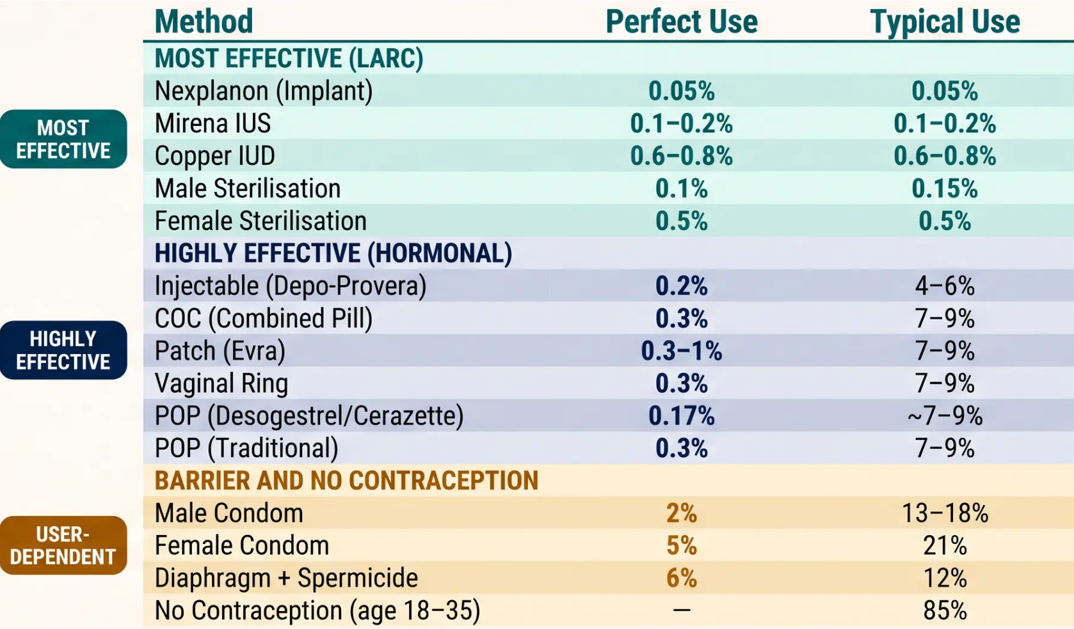


Contraceptive Efficacy: Pearl Index and Failure Rates
*Failure rates shown as percentage of women experiencing unintended pregnancy per year
KEY MESSAGE
LARC methods are
the most effective
Implant, IUS, and copper IUD
do not rely on user compliance
— efficacy in perfect and
typical use is identical
Nexplanon: 0.05% failure rate
— the most effective reversible
method available
www.bradfordvts.co.uk
Contraception for GP Trainees | May 2026 | Slide 4 of 35

Slide 5




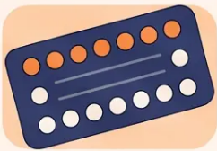
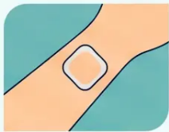
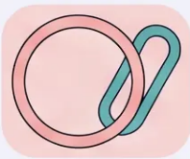




Combined Hormonal Contraception (CHC): Types and Formats
Three delivery formats — one shared mechanism
Combined Oral Contraceptive
COC Pill
Transdermal Patch
Evra
Vaginal Ring
NuvaRing & Feanolla
• Ethinyloestradiol (EE) 20–35 mcg +
progestogen
• 20 mcg EE + 150 mcg
norelgestromin per day
• NuvaRing: 15 mcg EE + 120 mcg
etonogestrel daily → In for 3 weeks,
out for 1 week
• Taken daily for 21 days, then 7-day
pill-free interval
• Applied to skin; changed weekly x
3 weeks
• Feanolla (new): Estradiol +
nomegestrol → 4 weeks continuous
use, then 7-day break → Oestradiol-
based (not ethinyloestradiol)
• First-line example: Microgynon 30
(levonorgestrel 150mcg + EE 30mcg)
• Followed by 1 patch-free week
• Good option for those who struggle
with daily pills
• Lowest VTE risk progestogen group
• Discreet, monthly management
• Same VTE risk profile as COC
Most commonly prescribed
Weekly application
Monthly / 4-weekly
Shared Mechanism:
Inhibits ovulation · Thickens cervical mucus · Thins endometrial lining
www.bradfordvts.co.uk
*Contraception for GP Trainees | May 2026

Slide 6



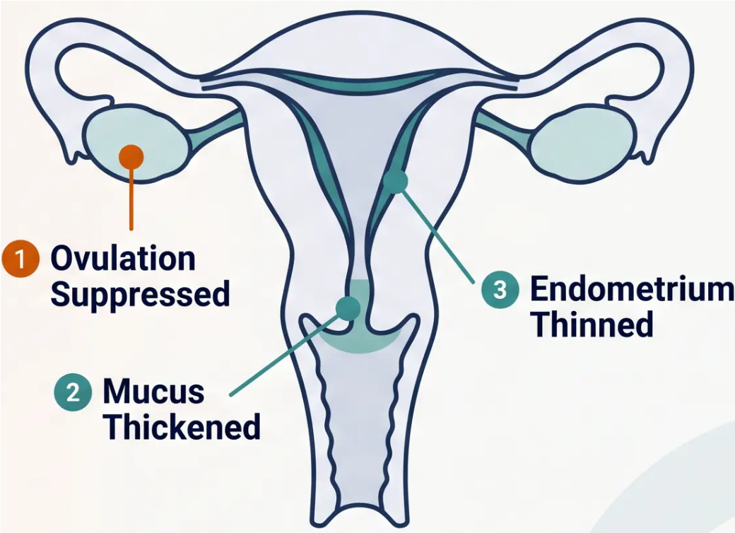





CHC Mechanism of Action
How combined hormonal contraception prevents pregnancy at three levels
PRIMARY MECHANISM
➊ Inhibits Ovulation
Suppresses LH and FSH surges via synthetic oestrogen and
progestogen — prevents follicle maturation and egg release
SECONDARY MECHANISM
➋ Thickens Cervical Mucus
Progestogen thickens mucus at the cervical os — creates a
physical barrier impeding sperm penetration
SECONDARY MECHANISM
➌ Thins Endometrial Lining
Progestogen thins the endometrium — reduces receptivity
to implantation should fertilisation occur
Key message: Ovulation inhibition is the primary and most reliable mechanism — secondary effects provide additional protection
www.bradfordvts.co.uk
*Contraception for GP Trainees | May 2026

Slide 7


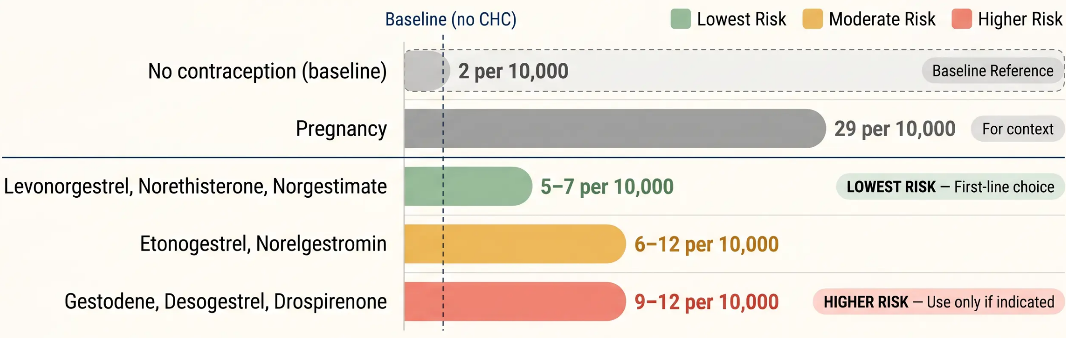

VTE Risk Stratification by Progestogen Type
Venous thromboembolism risk per 10,000 women per year — FSRH / UKMEC 2025
First-Line Recommendation: Microgynon 30 (levonorgestrel + EE 30mcg) carries the lowest
VTE risk among COCs. Prescribe Yasmin (drospirenone) only when clinically indicated.
www.bradfordvts.co.uk
Contraception for GP Trainees | May 2026 | Slide 7 of 35

Slide 8












FSRH 2026: Starting Rules for CHC
When you start matters — and the rules have been updated
1
2–5
Any
Day
Day 1 Start
Day 2–5 Start
Quick Start
- Start on day 1 of period
- Start on days 2–5 of the cycle
- Start on any day if pregnancy
excluded
- Immediate contraceptive
protection
- No additional precautions
needed
- Use condoms for 7 days
- No additional precautions
needed
- (Updated FSRH 2026 — previously
“day 1–5” defined differently)
- Pregnancy test at 3 weeks
after starting
- No condoms required from
day one
- Protection is considered
immediate
- Consider emergency
contraception if recent UPSI
✓ Immediate protection
⚠ Condoms × 7 days +
test at 3 weeks
✓ No extra precautions
Postpartum (not breastfeeding): Start from day 21
Breastfeeding: Avoid CHC if under 6 weeks
postpartum (UKMEC 4) — use POP or LARC instead
(UKMEC 1) — avoid days 0–20 due to elevated VTE risk
*Contraception for GP Trainees
May 2026
www.bradfordvts.co.uk
Slide 8 of 35

Slide 9






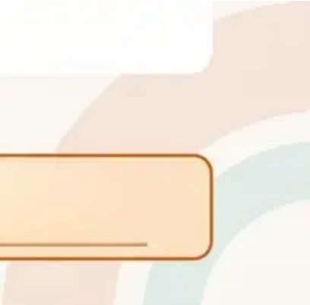
Tailored Regimens and Flexible CHC Use
FSRH 2026 — Reducing Hormone-Free Interval Risks
Traditional Approach
Standard
21 Days Active + 7-Day Pill-Free Interval
The 7-day hormone-free interval (HFI) is associated with follicular
development, headaches, and breakthrough bleeding — particularly
in women with hormone-sensitive conditions.
Shortened HFI
FSRH 2026 Recommended
Shortened HFI: 4-Day Pill-Free Interval
Reducing the pill-free interval to just 4 days suppresses follicular
activity more effectively. Recommended for women with menstrual
migraines, heavy withdrawal bleeds, or endometriosis.
Extended
Flexible Option
Extended or Tricycling Regimens
Take 2–3 packs consecutively before a shortened break. Continuous
use (no break) is an option for some women. Reduces frequency of
withdrawal bleeds and hormone-dip symptoms.
🔑 Clinical Pearl: The hormone-free interval is the most vulnerable time for contraceptive failure — shortening or eliminating it
improves efficacy and reduces withdrawal symptoms. FSRH 2026 actively encourages offering tailored regimens to all CHC users.
www.bradfordvts.co.uk
Contraception for GP Trainees |
May 2026

Slide 10










Missed Pill Advice: 30mcg and 35mcg CHC
FSRH 2026 Updated Guidelines — Standard-Strength Pills (e.g. Microgynon 30, Rigevidon)
🕒 Key Threshold: A pill is “missed” if taken ≥24 hours late
This is the FSRH 2026 update — previously ≥12 hours in older guidance
⚠️ ≥ 24 Hours Late — 1 or More
Pills Missed
🚨 ≥ 24 Hours + Unprotected Sex
✅ < 24 Hours Late
(Less than one full day)
(One or more days)
- Week 1 missed + UPSI occurred:
- Take the missed pill immediately
→ Consider emergency contraception
- Week 3 missed:
- Take the most recent missed pill now
- Continue remaining pills as normal
- No extra precautions needed
→ Omit the pill-free interval
- Leave any earlier missed pills
- No emergency contraception required
→ Run straight into next pack
- Continue remaining pills as normal
- Week 2 missed:
- Use condoms for the next 7 days
→ 7-day condom rule applies; EC
usually not needed
Safe — no action beyond taking the pill
Check which week — see below
Week position determines EC need
🎯 AKT Exam Pearl: For 30/35mcg pills — the missed pill threshold is ≥24 hours (FSRH 2026). For 20mcg pills, the threshold
drops to ≥12 hours. This distinction is a frequent AKT exam question. See Slide 11 for 20mcg guidance.
www.bradfordvts.co.uk
Contraception for GP Trainees | May 2026 | Slide 10 of 35

Slide 11










Missed Pill Advice: 20mcg CHC
★ AKT EXAM POINT
Low-Dose Pills Require Extra Vigilance — and Feature Heavily in AKT Exams
20mcg pills:
12-hour window
WHICH PILLS ARE 20MCG?
- Loestrin 20
- Mercilon
30/35mcg pills:
24-hour window
- Femodette
*Lower oestrogen dose = narrower missed-pill tolerance
THE 12-HOUR THRESHOLD RULE
This distinction is a frequent AKT
question. Many candidates
incorrectly apply the 24-hour rule
to all pills.
Missed by < 12 hours
Take the pill as soon as remembered. No extra precautions needed.
Continue pack as normal.
◆ FSRH 2026 Update:
Missed by ≥ 12 hours
The 24-hour threshold now
applies to standard-dose pills
(previously 12 hours). The 12-hour
rule remains specific to 20mcg pills
only.
Take the most recent missed pill immediately. Use condoms for 7 days.
If missed in Week 1 and unprotected sex occurred → consider emergency contraception.
If missed in Week 3 → omit the pill-free interval.
www.bradfordvts.co.uk |
Contraception for GP Trainees | May 2026 | Slide 11 of 35

Slide 12







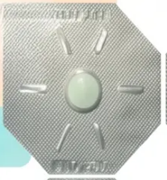
Progestogen-Only Pill (POP): Traditional and Desogestrel
*No oestrogen. No pill-free interval. Taken every day.
Traditional POP
Desogestrel POP
*3-Hour Window
*12-Hour Window
● Brands: Micronor, Norgeston
● Brands: Cerazette, Cerelle, Hana, Lovima, Zelleta
● Active ingredient: Norethisterone 350mcg /
Levonorgestrel 30mcg
● Active ingredient: Desogestrel 75mcg
● Mechanism: Inhibits ovulation (primary) AND
thickens cervical mucus — dual action
● Mechanism: Primarily thickens cervical mucus —
does NOT reliably inhibit ovulation
● Missed pill rule: If more than 12 hours late → take
immediately + 2 days extra precaution
● Missed pill rule: If more than 3 hours late → take
immediately + 2 days extra precaution
● Suitable for: Women who cannot use oestrogen;
those who prefer a larger safety window;
breastfeeding women
● Suitable for: Women who cannot use oestrogen;
breastfeeding women
✓ 12-hour window — more forgiving for daily life
⚠ 3-hour window — strict timing needed
Both POPs: No pill-free interval · Taken continuously every day · Safe in breastfeeding · Affected by enzyme inducers · NOT affected by broad-spectrum antibiotics (FSRH 2026)
www.bradfordvts.co.uk
*Contraception for GP Trainees | May 2026
| Slide 12

Slide 13











POP Clinical Management: Starting and Missing
Progestogen-Only Pill — Protocol for Protection and Missed Doses
STARTING RULES
MISSED PILL RULES
When to Start the POP
What to Do When a POP is Missed
Day 1 of Period → Immediate protection
A — Traditional POP
3-HOUR WINDOW
No additional contraception needed. Start on the first day of
menstrual bleeding.
(Micronor / Norgeston — norethisterone or levonorgestrel)
– If taken ≤3 hours late → Take as usual. No extra precaution needed.
– If taken >3 hours late → Take the missed pill immediately. Use
condoms for 2 days. If unprotected sex occurred → consider
emergency contraception.
Any Other Day → Not immediately protected
Use condoms or abstain for 2 days extra precaution. Consider pregnancy
exclusion before starting.
B — Desogestrel POP
12-HOUR WINDOW
Quick Start (Any Time) → Pregnancy excluded clinically
(Cerazette / Cerelle / Hana / Lovima / Zelleta — desogestrel 75mcg)
Use condoms for 2 days. Pregnancy test at 3 weeks if UPSI has occurred.
– If taken ≤12 hours late → Take as usual. No extra precaution needed.
– If taken >12 hours late → Take the missed pill immediately. Use
condoms for 2 days. If unprotected sex occurred → consider
emergency contraception.
Postpartum → Safe to start from 3 weeks postpartum
No restriction (UKMEC 1–2). Safe in breastfeeding — no effect on milk supply.
Clinical Reminder: Both traditional and desogestrel POPs require only 2 days extra precaution after a missed
dose — not 7 days. The key difference is the window: 3 hours vs 12 hours.
www.bradfordvts.co.uk
*Contraception for GP Trainees | May 2026 | Slide 13 of 35

Slide 14















14 / 35
Injectable Contraception
Depo-Provera and Sayana Press
Two injectable progestogen options — same hormone, different routes and intervals
Depo-Provera
Sayana Press
Drug Medroxyprogesterone acetate (MPA)
Drug Medroxyprogesterone acetate (MPA)
Dose 150 mg
Dose 104 mg
Route Deep intramuscular injection (IM)
Route Subcutaneous injection (SC)
Site Deltoid or gluteal muscle
Site Abdomen or anterior thigh
Interval Every 12 weeks
Interval Every 13 weeks
Given by Healthcare professional
Given by Patient (self-administered) or clinician
Efficacy Greater than 99% with perfect use
Efficacy Equivalent to Depo-Provera
Mechanism of Action — Inhibits ovulation · Thickens cervical mucus · Thins the endometrial lining
🕒 12 vs 13 weeks
🏠 Self-injection available
⚠ Cannot be reversed
Different intervals — do not confuse
Once given, effect lasts full interval
Sayana Press only
www.bradfordvts.co.uk
*Contraception for GP Trainees | Bradford VTS | May 2026

Slide 15








Injectables: Side Effects and Bone Mineral Density
Understanding the clinical profile of Depo-Provera and Sayana Press — UKMEC 2025
Irregular Bleeding
Weight Gain
Bone Mineral Density (BMD)
- Common, especially in the first few
months
- Average gain of 2–3 kg per year in some
users
- Depo-Provera causes a reversible reduction
in BMD
- Amenorrhoea develops in around 50% of
users by one year
- Not universal — significant individual
variation
- BMD recovers after stopping — not permanent
- Avoid in adolescents (peak bone mass still
developing)
- Counsel patients before starting — this is
expected, not alarming
- Acknowledge patient concerns openly
- Offer reassurance alongside evidence-based
discussion
- Avoid in women with osteoporosis risk
factors (UKMEC 2025)
- Does not indicate loss of contraceptive
effect
- Consider alternative method if weight gain is
a significant concern
- No requirement for routine DEXA scanning
in healthy adults
*Counsel proactively — set expectations early
*Acknowledge concerns — then discuss evidence
*Reversible — but avoid in high-risk groups
DMPA is UKMEC 2 for most women. Caution (UKMEC 2–3) in adolescents and women with significant osteoporosis
risk. Delayed return of fertility up to 12–18 months after stopping — always counsel before initiating.
UKMEC 2025 Guidance
www.bradfordvts.co.uk
*Contraception for GP Trainees | May 2026

Slide 16




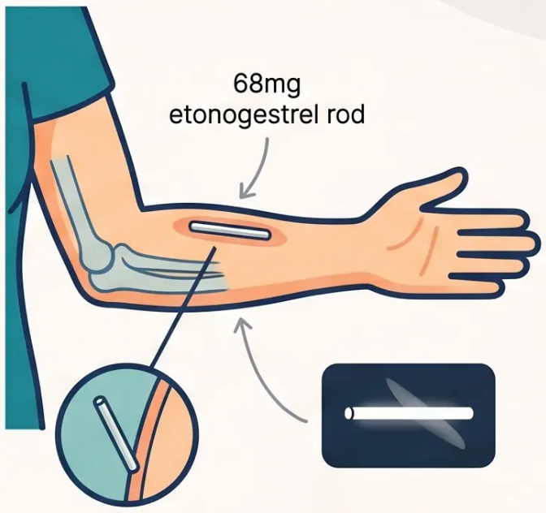


Nexplanon: The Most Effective Reversible Method
Etonogestrel 68mg subdermal implant — licensed for 3 years
0.05%
Device Specifications
Single flexible rod, approximately 4cm long
Contains 68mg etonogestrel (ENG)
Releases hormone slowly over 3 years
Failure Rate
Pearl Index <1 per 1,000 woman-
years — the most effective
reversible contraceptive available
Insertion Location
Radiopaque Property
Non-dominant arm, inner aspect
8–10cm above the medial epicondyle
Requires trained clinician for insertion
and removal
Visible on X-ray if impalpable
If not found on X-ray → ultrasound first
If still not located → MRI scan
Radiopaque —
visible on X-ray
★ Nexplanon has a failure rate of just 0.05% — comparable to surgical sterilisation,
but fully reversible with rapid return of fertility after removal.
May 2026
Contraception for GP Trainees
www.bradfordvts.co.uk
Slide 16 of 35

Slide 17
















Management of Unscheduled Bleeding with Nexplanon
Irregular bleeding affects ~20% of implant users in year one — the most common reason for removal. Manage proactively.
Before Any Treatment — Exclude First:
Infection / STI
Pregnancy
Gynaecological Pathology
Step 1
Step 2
Step 3
Step 4
Combined Oral
Contraceptive (COC)
Mefenamic Acid
Tranexamic Acid
If COC Contraindicated
- 1g three times daily (not
500mg)
- Norethisterone 5mg three
times daily
- Prescribe cyclically for 2–3
months
- 500mg three times daily
- For 5 days during bleeding
episode
- For 5 days during bleeding
episode
- Best available evidence for
bleeding control
- For 5 days
- Prostaglandin inhibitor —
reduces bleeding
- Progestogen-only alternative
- Use if oestrogen not
contraindicated
- Antifibrinolytic — reduces flow
⚠️ Correct dose: 1g TDS —
BNF confirmed
*First-line treatment
Counsel Before Insertion
- Warn all patients: irregular bleeding
is common
Remove the implant and offer an alternative contraceptive method.
Discuss all options — do not leave the patient without contraception.
- Most improves after 3–6 months
If Bleeding Remains Intolerable
- Setting expectations prevents early
removal
- Document counselling in notes
www.bradfordvts.co.uk
Contraception for GP Trainees | May 2026 | Slide 17 of 35

Slide 18


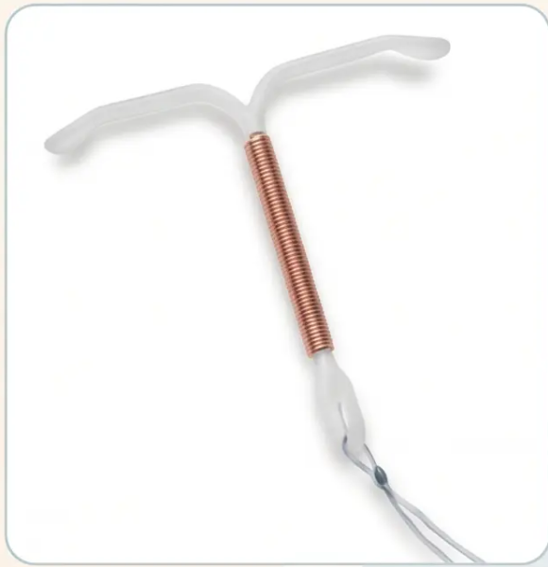







18 / 35
Copper Intrauterine Device (IUD): Non-Hormonal LARC
Hormone-free, highly effective, and long-lasting
Copper IUD (T-Safe Cu 380A type)
— actual device
How It Works
• Copper ions are toxic to sperm — primary mechanism; prevents fertilisation
• Also alters cervical mucus and may prevent implantation
Available Devices
T-Safe Cu 380A
Nova-T 380
Flexi-T 300
duration: 10 years
duration: 5 years
duration: 5 years
Most effective copper IUD
Can be retained post-
menopause if inserted ≥ age 40
Suitable alternative
option
Smaller profile,
option for nulliparous
women
Efficacy
• Failure rate: 0.6–0.8% typical use — over 99% effective
• Efficacy is immediate on insertion — no hormonal loading period
Key Point: T-Safe Cu 380A is licensed for 10 years — if inserted at age 40 or older, it can be left in place until after the menopause
www.bradfordvts.co.uk
Contraception for GP Trainees | Bradford VTS | May 2026

Slide 19







Copper IUD: Clinical Considerations and Emergency Use
Risks, ectopic awareness, and the gold standard for emergency contraception
Insertion Risks & Clinical Points
Emergency Contraception: Gold Standard
• Insertion pain — especially in nulliparous women;
consider misoprostol or NSAID pre-medication
• Most effective EC available: >99.9% effective
• Works up to 5 days after unprotected sex (UPSI)
• PID risk at insertion: approximately 1 in 100 —
higher if STI present; screen beforehand
• Also effective up to 5 days after estimated ovulation
— extends beyond the simple 5-day window
• Perforation risk: 1–2 per 1,000 insertions — rare
but serious
• Preferred when BMI >26 kg/m² or weight >70 kg —
oral EC less reliable at higher weight
• Ectopic pregnancy: if pregnancy occurs with IUD
in situ, 1 in 20 chance of ectopic — always exclude
• Preferred when patient is on enzyme inducers (e.g.
rifampicin, antiepileptics) — oral EC unreliable
• Heavier, more painful periods — especially in the
first few months; usually settles
• Effective regardless of cycle timing when used within
the ovulation window rule
• Expulsion — can occur silently; teach patients to
check strings monthly
• Provides ongoing contraception after insertion —
dual benefit
🔑 AKT PEARL: Copper IUD works up to 5 days post-UPSI — OR 5 days after calculated ovulation.
This extends its window beyond the 5-day rule in late-cycle unprotected sex.
www.bradfordvts.co.uk
Contraception for GP Trainees | May 2026 | Slide 19 of 35

Slide 20





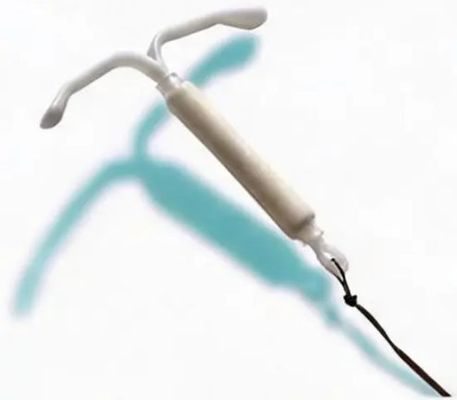



Intrauterine System (IUS): Mirena 8-Year Ligoace Update
FSRH 2024 Lpdated Guidance — Gey Clastical Change for GP Practice
CLINICAL UPDATE: Mirena is now licensed for 8 years for controception
YEARS
What Has Changed
• Previously licensed for 5 years* for contraception — many women were bering replaced too serrly
New licensed duration
for controception
• Now licensed for 8 years* for contraception (FSPH 2024 update) — do not routinely replace at 5 years
Previouiic 5 years
If Instert at Age >45
• Mirena insterted at age 45 or older* cesn be p3tired unsil menopase — no need replace at 8 years
Fonn adating suggellaon tbsome mpeads
Why Minerk Maants: Fore Kee Uevs
Cantroception
Endomreniam
Sipe endomıttoilt
Tray vingi efle
Bloaurtigriti HRT
hyperphaiah fvls
f+lingt hei 95 lfi rindafrem
desve: odinrown r ıeıoouın
during ostoporias
wommnr
Fnzaligriete setitnel.czlumro
Salconning therory.
• Neivy Mencren BИebnua (HMB)
• Firaty flaiiye te snaatment
Anrentishe Qamın haooşmh daira
Frs:lieiaupsreatmert to heory pedods
Mirena IUS — levnorgestrel-releasing intrauterit system
May 2026
www.bradfordvts.co.um
Silde 20 of 35
Contraception for GP Traintes

Slide 21






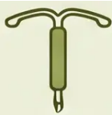
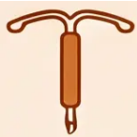









IUS Options: Kyleena, Jaydess, and Levosert
Comparing LNG-IUS devices — hormone dose, release rate, and licensed duration
Mirena
Kyleena
Jaydess
Levosert
(Reference Anchor)
Reference Standard
Lower dose option
Shortest duration
Mid-duration option
● LNG Content: 52 mg
● LNG Content: 19.5 mg
● LNG Content: 13.5 mg
● LNG Content: 52 mg
● Daily Release: 20 mcg/day
● Daily Release: 9 mcg/day
● Daily Release: 6 mcg/day
● Daily Release: 20 mcg/day
● Licensed Duration: 8 years
(FSRH 2024 update)
● Licensed Duration: 5 years
● Licensed Duration: 3 years
● Licensed Duration: 6 years
If inserted ≥45 yrs: retain
until menopause
Suitable for those preferring
lower hormonal dose
Smaller frame — may suit
nulliparous women
Same LNG dose as Mirena;
shorter licensed period
💡 Clinical note: All LNG-IUS devices thicken cervical mucus and thin the endometrium. Higher-dose devices are more likely to
cause amenorrhoea. Choice depends on duration needed, patient preference, and clinical indication.
www.bradfordvts.co.uk
Contraception for GP Trainees | May 2026 | Slide 21 of 35

Slide 22













UKMEC 2025: The Clinical Safety Framework
UK Medical Eligibility Criteria — Published by CoSRH, replacing the 2016 edition
1
2
3
4
No Restriction
Advantages
Outweigh Risks
Risks Outweigh
Advantages
Absolute
Contraindication
Method can be used
safely. No clinical
concern.
Generally suitable.
Benefits exceed
theoretical concerns.
Not usually
recommended. Specialist
advice advised.
Method must NOT be
used. Risk is
unacceptable.
Key Clinical Rule:
Two UKMEC Category 3 conditions together = treat as Category 4
Always assess the cumulative risk picture — multiple moderate risks can create an absolute contraindication.
CoSRH (formerly FSRH) — replaces UKMEC 2016
www.bradfordvts.co.uk
Slide 22 of 35
Contraception for GP Trainees | May 2026

Slide 23








UKMEC 2025: Migraine and Smoking Categories
Category 3 and Category 4 conditions for Combined Hormonal Contraception
UKMEC CATEGORY 4 — ABSOLUTE CONTRAINDICATION
UKMEC CATEGORY 3 & 4
Migraine WITH Aura
Smoking and Age
Migraine with aura at any age → CHC is absolutely contraindicated
Tier 1 — UKMEC 2: ● Age under 35, any smoking
*Advantages generally outweigh risks — CHC acceptable
Applies to COC, transdermal patch, and vaginal ring equally
Risk: significantly increased stroke risk due to oestrogen’s
prothrombotic effect
Tier 2 — UKMEC 3: ●
Age 35 or older, fewer than 15 cigarettes per day
Aura features: visual disturbance, sensory symptoms, speech
disturbance lasting 5–60 minutes
*Risks generally outweigh advantages — not usually recommended
Tier 3 — UKMEC 4: ●
Age 35 or older, 15 or more cigarettes per day
UKMEC 2 — Migraine WITHOUT Aura (initiation)
*Absolute contraindication — do NOT prescribe CHC
UKMEC 3 — Migraine WITHOUT Aura (continuation)
Simple headache without neurological aura symptoms — CHC
may be used with caution initially, reviewed on continuation
*Cardiovascular and VTE risk compounds significantly with age and
smoking volume — the combination is particularly hazardous
⚠ Key Rule: Two UKMEC 3 conditions together = treat as UKMEC 4
*Example: A 36-year-old smoker with migraine without aura — combined risk escalates to absolute contraindication level
www.bradfordvts.co.uk
UKMEC 2025
| Slide 23 of 35

Slide 24



















UKMEC 2025: BMI, Hypertension, and VTE History
Assessing cardiovascular and thrombotic risk when prescribing CHC
UKMEC Category Legend Strip UKMEC 1 — No restriction UKMEC 2 — Advantages outweigh risks UKMEC 3 — Risks outweigh advantages UKMEC 4 — Absolute contraindication
COLUMN 1 — BMI / OBESITY
COLUMN 2 — HYPERTENSION
COLUMN 3 — VTE HISTORY & THROMBOPHILIA
BMI & Obesity
Blood Pressure
VTE & Clotting Risk
BMI 30–34 kg/m²
BP 140–159 / 90–94 mmHg
UKMEC 2
UKMEC 3
History of VTE
UKMEC 4
BMI ≥35 kg/m²
UKMEC 3
BP ≥160 / 95 mmHg
Current VTE on anticoagulants
UKMEC 4
UKMEC 4
Family history VTE
Well-controlled hypertension
UKMEC 3
UKMEC 3
(1st degree, under 45)
Known thrombophilia
UKMEC 4
Obesity increases VTE and cardiovascular risk —
higher BMI warrants caution with CHC.
Severe hypertension with CHC significantly raises
stroke and MI risk. Stop CHC and manage BP first.
Any personal history of VTE is an absolute
contraindication to CHC. Family history alone = UKMEC.
Key Rule: Two UKMEC 3 conditions together = treat as UKMEC 4
Example: BMI ≥35 + family history of VTE = combined risk treated as absolute
contraindication. Always assess multiple risk factors together, not in isolation.
www.bradfordvts.co.uk
UKMEC 2025 | Bradford VTS Teaching Deck
24 / 35

Slide 25







UKMEC 2025: Postpartum and Breastfeeding Rules
Timing of contraception initiation after childbirth — based on VTE risk and infant safety
Postpartum — Not Breastfeeding
Breastfeeding
Days 0–20 – CHC (COC / patch / ring):
UKMEC 3 – Elevated VTE risk – avoid
Less than 6 weeks postpartum – CHC
UKMEC 4 – Absolute contraindication – affects milk supply
and neonatal exposure
Day 21 onwards – CHC
UKMEC 1 – VTE risk normalised – can start
6 weeks to 6 months – CHC
UKMEC 3 – Use with caution – risks generally outweigh
advantages
Day 21 onwards – POP
UKMEC 1 – No restriction
Immediately postpartum – Injectable (Depo-Provera)
UKMEC 1 – Can start straight away
6 months or more – CHC
UKMEC 2 – Usually acceptable – advantages outweigh risks
Immediately postpartum – Implant (Nexplanon)
UKMEC 1 – Can start straight away
From 3 weeks postpartum – POP / Injectable / Implant
UKMEC 1-2 – Safe – progestogen-only methods preferred
From 4 weeks postpartum – IUD / IUS
UKMEC 1 – Safe to insert – no hormonal concerns
48 hours to 4 weeks – IUD / IUS insertion
UKMEC 3 – Avoid this window – uterine involution risk
From 28 days (4 weeks) – IUD / IUS
UKMEC 1 – Safe to insert
Key Rule: Two UKMEC 3s = Treat as UKMEC 4 — If a patient has two separate UKMEC 3 conditions, the combined risk is treated as an absolute contraindication
www.bradfordvts.co.uk
Contraception for GP Trainees | May 2026

Slide 26
















Contraception in Special Circumstances: Postpartum
When can each method safely start after delivery?
Not Breastfeeding
Breastfeeding
Immediate
(Day 0–1)
Injectable (Depo-Provera / Sayana Press),
Implant (Nexplanon)
UKMEC 1 – no restriction
From 3–6
Weeks
POP (progestogen-only pill), Implant
(Nexplanon), Injectable (Depo-Provera)
UKMEC 1–2 – safe, no effect on milk supply
Combined Hormonal Contraception (CHC),
COC, patch, vaginal ring
UKMEC 1 from day 21 – VTE risk if started earlier
From Day 21
Before 6
Weeks: CHC
Avoid
Combined pill, patch, ring
UKMEC 4 – oestrogen suppresses milk and
neonatal exposure risk
Days 0–20:
UKMEC 3
CHC not recommended before day 21
Elevated postpartum VTE risk
6 Weeks to
6 Months:
CHC Caution
CHC may be considered with caution
UKMEC 3 – use only if no suitable alternative
From Day 28
(4 weeks)
Copper IUD / Levonorgestrel IUS
UKMEC 1 at ≥4 weeks
UKMEC 3 between 48 hours and 4 weeks
After 6 Months CHC generally acceptable
Breastfeeding UKMEC 2 – advantages outweigh risks
Key Clinical Rule: “LARC methods (implant and injectable) can be started immediately postpartum –
they do not rely on patient compliance and are ideal in the postnatal period.”
www.bradfordvts.co.uk
Slide 26 of 35
Contraception for GP Trainees | May 2026

Slide 27











Perimenopausal Contraception and Stopping Criteria
When to stop, what to use, and how to advise your patient confidently
Age-Based Stopping Rule
Universal Rule
- Women can be advised to stop all contraception at age 55 — natural loss of fertility is
assumed by this point, regardless of method used
- This applies even without confirmed menopause or FSH testing
- A simple, reassuring rule for patients and clinicians alike
Amenorrhoea Duration Criteria
If aged ≥ 50 years: Stop non-hormonal contraception after 1 year of amenorrhoea
If aged < 50 years: Stop non-hormonal contraception after 2 years of amenorrhoea
Hormonal methods (POP, implant, Mirena) may mask periods — amenorrhoea criteria apply to non-hormonal or barrier methods
FSH Testing — Useful but Limited
- FSH > 30 IU/L on two occasions, 1–2 months apart → suggests ovarian failure
- However: FSH is unreliable in women using hormonal contraception — levels are masked
- Do not rely on FSH alone to stop contraception in women on the pill, implant, or injection
→ POP / Implant: can continue until age 55
→ Mirena IUS: if inserted aged ≥ 45, retain until menopause is confirmed or age 55
Key Rule: Two UKMEC 3 conditions together = treat as UKMEC 4 — escalate caution accordingly
www.bradfordvts.co.uk
Contraception for GP Trainees | May 2026 | Slide 27 of 35

Slide 28




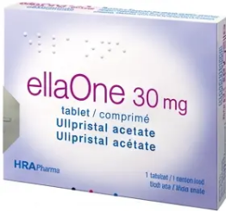
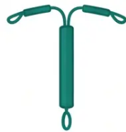


Emergency Contraception: Oral and IUD Options
*Compare options by time window, efficacy, and patient factors — FSRH 2026*
Levonelle
Copper IUD
ellaOne
Most Effective Emergency Contraception
Levonorgestrel 1500mcg
Ulipristal Acetate 30mg
- Window: Up to 5 days after UPSI OR up to
5 days after estimated ovulation (extends
beyond simple 5-day rule)
- Window: Within 72 hours of UPSI
- Efficacy: Reduces risk by ~85% if taken
within 24 hrs; decreases with time
- Window: Within 120 hours (5 days) of UPSI
- Efficacy: More effective than Levonelle,
especially days 3–5
- Efficacy: >99.9% — unaffected by weight or
enzyme inducers
- Weight caution: ⚠️ Less effective if BMI
>26 kg/m² or weight >70kg
- Weight: Better than LNG in higher BMI —
but copper IUD still preferred if very high BMI
- Preferred if: BMI high, on enzyme inducers,
or wants ongoing contraception
- If overweight: Consider double dose
(unlicensed) or switch to ellaOne or copper
IUD
- ⚠️ Do NOT give regular progestogen for 5
days after — reduces efficacy
- Ongoing contraception: Provides long-term
contraception after insertion
- Enzyme inducers: Reduced efficacy — use
copper IUD instead
- Enzyme inducers: Reduced efficacy — use
copper IUD
- Ectopic note: If pregnancy occurs, 1:20 risk
of ectopic — counsel accordingly
- Availability: Over the counter; pharmacy /
GP
- Availability: Prescription only (or pharmacy
in some settings)
- ✅ Gold standard for emergency
contraception in most clinical scenarios
Key Rule: Copper IUD > ellaOne > Levonelle in terms of efficacy — always discuss all three options with the patient.
www.bradfordinvts.co.uk
Slide 28 of 35
*Emergency Contraception |

Slide 29














Drug Interactions: Enzyme Inducers
Understanding which drugs reduce contraceptive efficacy — and what to do
ENZYME INDUCERS
METHODS AFFECTED
MANAGEMENT
These drugs accelerate liver metabolism
— reducing hormone levels in CHC, POP,
and implant
First choice: Use Depo-Provera
(DMPA) or Copper IUD — not affected
by enzyme inducers
Combined pill (COC/patch/ring)
Efficacy significantly reduced
• Rifampicin (strongest inducer)
If CHC must be used: Use ≥50mcg EE
pill (off-label) + additional contraception
for duration of enzyme inducer AND 28
days after stopping
• Rifabutin
Progestogen-only pill (POP)
Efficacy reduced — not reliable
• Carbamazepine
• Oxcarbazepine
• Phenytoin
Implant (Nexplanon)
Efficacy reduced — not reliable
Duration rule: Continue extra
precautions for 28 days after enzyme
inducer is stopped (4 weeks — not 7 days)
• Phenobarbital
• Primidone
Note: Copper IUD and Depo-
Provera (DMPA) are NOT affected
by enzyme inducers
⚠ Lamotrigine Special Case: CHC and
POP REDUCE lamotrigine levels →
increased seizure risk. Seek specialist
neurology/epilepsy advice before prescribing.
• Topiramate (>200mg/day)
• St John's Wort (herbal — often
forgotten!)
www.bradfordvts.co.uk
Contraception for GP Trainees | May 2026 | Slide 29 of 35

Slide 30










Slide 30 of 35 — FSRH 2026 Update: Broad-Spectrum Antibiotics
Contraception for GP Trainees | May 2026 | Slide 30 of 35
FSRH 2026 Update: Broad-Spectrum Antibiotics
A major clinical guideline change affecting everyday GP prescribing
🔔 GUIDELINE UPDATE — FSRH 2026
Broad-spectrum antibiotics do NOT reduce CHC efficacy.
No additional contraception is required.
OLD ADVICE — Now Incorrect
CURRENT ADVICE — FSRH 2026
“Use condoms for the duration of antibiotics plus 7 days”
Broad-spectrum antibiotics (amoxicillin, tetracyclines,
metronidazole, erythromycin, etc.) do not interfere with CHC
absorption or efficacy. No extra precautions needed.
(Pre-FSRH 2019/2026 guidance — no longer applicable)
⚠️ Important Exception — Enzyme Inducers
🎯 AKT EXAM POINT
Rifampicin and IE enzyme inducers — these DO significantly reduce CHC efficacy.
Extra precautions ARE required. Consider DMPA or copper IUD instead.
The old “7-day antibiotic rule” is
now outdated and incorrect
www.bradfordvts.co.uk
Contraception for GP Trainees | May 2026 | Slide 30 of 35

Slide 31








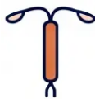



Clinical Top Tips for GP Trainees
Eight essential pearls for confident contraception practice
01
02
03
04
Offer LARC First
Migraine + Aura =
No CHC
Mirena Lasts 8 Years
Antibiotics Don't
Affect CHC
Always discuss LARC before
prescribing pills — NICE recommends
all women requesting contraception.
Migraine with aura is UKMEC 4 —
absolute contraindication for all
combined hormonal contraception.
Updated FSRH 2024 guidance —
do not replace Mirena at 5 years if
inserted before age 45.
FSRH 2026: broad-spectrum
antibiotics no longer reduce CHC
efficacy. No extra precautions needed.
05
06
07
08
Copper IUD:
Best EC Option
Know Your
POP Windows
Quick-Start
Confidently
Counsel on
DMPA Delay
Over 99.9% effective up to 5 days
post-UPSI — works regardless of
weight or enzyme inducers.
Desogestrel POP: 12-hour window.
Traditional POP: 3-hour window.
Critical for missed pill advice.
Start contraception any day if
pregnancy excluded — use condoms
for 7 days and test at 3 weeks.
Return of fertility after Depo-
Provera can take 12-18 months —
always counsel before starting.

Slide 32














AKT
Exam Focus
AKT Exam Pearls: High-Yield Knowledge
Master these key facts to excel in your AKT contraception questions
VTE Risk — Lowest
VTE Risk — Higher
Levonorgestrel, norethisterone, norgestimate COCs carry the
lowest VTE risk — 5 to 7 per 10,000 women per year. Always
first-line choice.
Gestodene, desogestrel, and drospirenone (Yasmin) carry
higher VTE risk — 9 to 12 per 10,000. Only prescribe if
clinically indicated.
UKMEC 4 — Absolute Contraindications for CHC
Missed Pill Thresholds
Migraine with aura · Smoking ≥15 cigarettes/day aged ≥35 ·
BP ≥160/95 · History of VTE · Breastfeeding under 6 weeks ·
Active viral hepatitis · Current breast cancer
30/35 mcg pills: missed if ≥24 hours late → 7-day rule applies.
20 mcg pills: missed if ≥12 hours late → same 7-day rule. This
distinction is a frequent AKT question.
FSRH 2026 — Antibiotics Update
Key Efficacy Facts
Broad-spectrum antibiotics (amoxicillin, tetracyclines,
metronidazole) do NOT reduce CHC efficacy. No extra
contraception needed. Exception: rifampicin and rifabutin
ARE enzyme inducers.
Nexplanon failure rate: 0.05% — most effective reversible
method. Copper IUD as EC: effective up to 5 days post-UPSI
or 5 days after ovulation.
Depo-Provera: fertility may not return for up to 18 months.
www.bradfordvts.co.uk
Contraception for GP Trainees | May 2026 | Slide 32 of 35

Slide 33


















SCA Communication and Consultation Pearls
Consulting with confidence, compassion, and safety
Safeguarding Under-16s
Language and Framing
Safety-Netting and Follow-Up
🗣️ Use "pregnancy chances" —
not "Pearl Index"
📋 Apply Fraser Guidelines
before prescribing
When to return — and what
symptoms to watch for
🤝 Acknowledge weight/mood
concerns before giving evidence
🔒 Gillick competence: can the
young person understand fully?
Pregnancy test timing after
quick-start or EC
🚫 Document clearly — do not
prescribe if not competent
Offer STI screen when giving
emergency contraception
✅ Always offer LARC with
balanced pros and cons
👥 Consider referral if any
safeguarding concern arises
Advise on irregular bleeding
before LARC insertion
🔄 Respect patient choice even if
not your preference
Fraser Guidelines apply to all
contraception requests under age 16
Set expectations early — reduces
unnecessary re-attendance
💡 SCA Tip: The examiner is assessing your process, not just your facts — listen, acknowledge, then inform.
www.bradfordvts.co.uk
Contraception for GP Trainees | May 2026 | Slide 33 of 35

Slide 34




Red Flags and Common Clinical Pitfalls
*Know when to act urgently — and avoid carrying outdated advice into practice*
⚠️ RED FLAGS — STOP AND ACT
⚡ COMMON PITFALLS — DON’T GET CAUGHT
◆ New migraine with aura on CHC → Stop
immediately, urgent review
✖ Prescribing COC with migraine + aura — UKMEC 4;
absolutely contraindicated
◆ BP ≥160/95 on CHC → Stop, manage BP, do not
restart CHC
✖ Telling patients to use condoms with antibiotics —
Outdated since FSRH 2026; broad-spectrum
antibiotics do NOT affect CHC
◆ Sudden severe headache on CHC → Stop,
emergency assessment
✖ Replacing Mirena at 5 years — Mirena is now licensed
for 8 years; early replacement is unnecessary
◆ Calf pain / chest pain / breathlessness → Possible
VTE — emergency assessment
✖ Refusing IUD/IUS to nulliparous women — Safe and
effective; a common misconception
◆ Abdominal pain with IUD/IUS in situ → Exclude
ectopic pregnancy and PID
✖ Confusing Depo and Sayana Press intervals — Depo
every 12 weeks (IM); Sayana Press every 13 weeks (SC)
◆ Lost IUD/IUS strings → Arrange USS — do not
assume expulsion
✖ Stopping contraception based on FSH alone — FSH
unreliable in women using hormonal contraception
www.bradfordvts.co.uk
*Contraception for GP Trainees | May 2026

Slide 35






















Quick Recall
Ten things to remember before you leave
01 LARC = most effective contraception
02 Migraine + aura → NO combined pill
03 Mirena lasts 8 years (updated)
04 Antibiotics don’t reduce CHC efficacy
06 Nexplanon: 3 years, most reliable method
05 Copper IUD: best emergency contraception
07 Depo: 12-weekly, fertility delayed 12-18 months
08 UKMEC 4 = absolute contraindication
09 20mcg pill: 12-hour missed threshold
10 Quick-start: condoms 7 days + test at 3 weeks
⚠️ Disclaimer
Always double check this advice and drug doses with the latest NICE/BNF guidance. This document is for educational purposes only.
BRADFORD VTS TEACHING DECK
www.bradfordvts.co.uk
*Contraception for GP Trainees | May 2026 | UKMEC 2025 / FSRH 2026
*Slide 35 of 35

