Slide 1

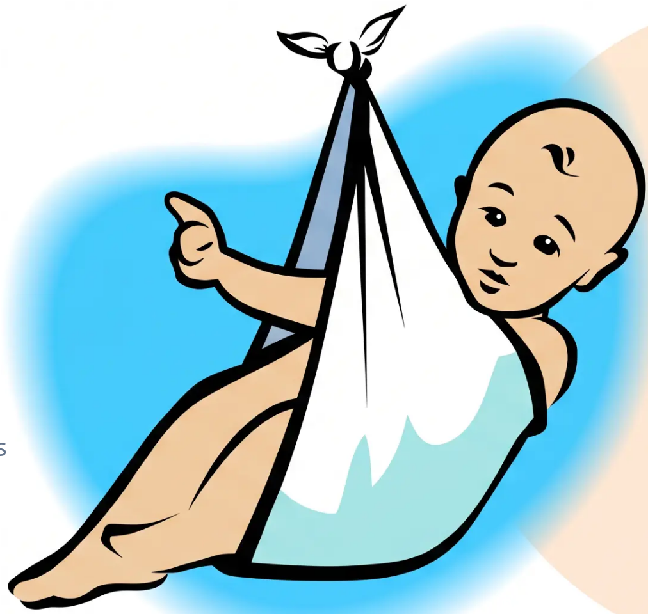


BRADFORD VTS TEACHING DECK
Primary Care Education Series
Infertility in
Primary Care
Bradford VTS Teaching Deck
Created May 2026 · Updated to NICE NG257 March 2026 standards
www.bradfordvts.co.uk
⚠ Disclaimer: This deck is for educational purposes only.
Always verify advice and drug doses against the latest NICE
and BNF guidance before clinical application.
Bradford VTS · www.bradfordvts.co.uk · May 2026

Slide 2














BRADFORD VTS TEACHING DECK
Definitions and IVF Criteria
NICE NG257 · Foundational Concepts
Infertility
Primary
Infertility
Secondary
Infertility
Subfertility
"Failure to conceive
after 12 months of
regular unprotected
sexual intercourse"
"Reduced ability to
conceive — used
interchangeably with
infertility in clinical
practice"
"No previous
pregnancy has
occurred"
"Previous pregnancy
has occurred — even
if it did not result in a
live birth"
NICE NG257
NICE NG257
NICE NG257
IVF Criteria Trigger
NICE NG257 2026
12 months of regular unprotected sexual intercourse without conception OR
6 cycles of artificial insemination without success
Bradford VTS · www.bradfordvts.co.uk · May 2026

Slide 3











BRADFORD VTS TEACHING DECK
When to Refer Earlier than 12 Months
NICE NG257 2026 — Expedited Referral Criteria
Woman Aged ≥36 Years
Known Cause of Infertility
Previous Pelvic Surgery
Refer after 6 months of UPSI, not 12
Endometriosis, PCOS, anovulation, previous PID
Including salpingectomy or adhesion history
Previous Chemotherapy or
Radiotherapy
Irregular or Absent Periods
History of STI with PID
Oligomenorrhoea, secondary amenorrhoea
Pelvic radiotherapy especially relevant
Chlamydia-related tubal damage risk
🕒 Key Rule: Refer women aged ≥36 after just 6 months — time and ovarian reserve are critical
NICE NG257 2026
www.bradfordvts.co.uk · May 2026

Slide 4





BRADFORD VTS TEACHING DECK
Epidemiology of Infertility
UK prevalence · conception rates · long-term prognosis
1 in 7 couples in the UK experience difficulty conceiving
Approximately 3.5 million people affected
12 months
24 months
3 years
~84% of couples conceive
~92% of couples conceive
~50% remaining
with regular unprotected intercourse
cumulative conception rate
may need investigation or treatment
Approximate distribution of causes — often multifactorial = 45% female cause, 30% male cause, 20% unexplained
~30%
~25%
~20%
~20%
~5%
Male Factor
Ovulatory Disorders
Unexplained
Tubal Damage
Uterine / Other
Bradford VTS · www.bradfordvts.co.uk · May 2026 · Based on NICE NG257 March 2026

Slide 5

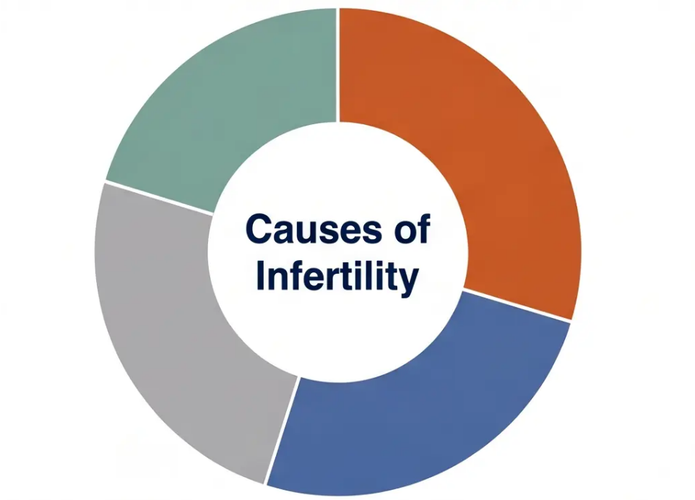





BRADFORD VTS TEACHING DECK
www.bradfordvts.co.uk
Common Causes of Infertility
Understanding the distribution helps guide your initial assessment
Male Factor — 30%
*Most common single cause · OAT syndrome most frequent · Always
investigate both partners
Ovulatory Disorders — 25%
*PCOS is the leading cause · Letrozole now first-line per NICE NG257 2026
Unexplained — 20%
*No identifiable cause after full investigation · IVF may be recommended
Tubal Damage — 20%
PID / Chlamydia most common cause · Endometriosis contributes
significantly
■ Male Factor — 30%
■ Ovulatory Disorders — 25%
⚠ Endometriosis — not a separate category but a significant
contributor across ovulatory, tubal, and unexplained groups.
Consider in any woman with dysmenorrhoea or pelvic pain.
■ Unexplained — 25%
■ Tubal Damage — 20%
Bradford VTS · www.bradfordvts.co.uk · May 2026 · Based on NICE NG257 March 2026

Slide 6





BRADFORD VTS TEACHING DECK
Initial GP Assessment: Female History
Ask the right questions from the very first consultation
Cycle & Reproductive History
Medications
- Menstrual cycle: length, regularity, dysmenorrhoea,
intermenstrual bleeding
- NSAIDs — can impair ovulation; review timing of use
- Antipsychotics — cause hyperprolactinaemia and
anovulation
- Previous pregnancies: outcomes including miscarriages,
terminations, ectopic
- Anti-epileptics — interact with folate; require 5mg folic acid
- Duration of trying to conceive — and with current or
previous partner
Lifestyle Factors
- Sexual history: frequency of intercourse, STI history,
previous PID
- BMI: obesity reduces conception rates and IVF success
- Smoking and alcohol — both impair fertility; advise
reduction
Medical & Surgical History
- Known conditions: PCOS, endometriosis, thyroid disease,
diabetes
- Excessive exercise at low body weight → anovulation
- Occupational exposures — toxins, radiation, chemicals
- Previous pelvic surgery, radiotherapy, or chemotherapy
- Previous chlamydia or PID — raises tubal factor suspicion
- Irregular or absent periods — suggest anovulation; refer earlier
⚠ Key Reminder: Investigate both partners simultaneously from the very first appointment — never investigate the woman in isolation.
Bradford VTS · www.bradfordvts.co.uk · May 2026
6 / 25

Slide 7






BRADFORD VTS TEACHING DECK
Initial GP Assessment: Male History
What to ask every male partner — from the first consultation
Reproductive & Sexual
Testicular & Surgical
Medications & Lifestyle
- Previous paternity?
- Undescended testes (childhood)
- Anabolic steroids / finasteride
- Erectile or ejaculatory
dysfunction
- Orchitis or mumps orchitis
- Sulfasalazine, anti-hypertensives
- Varicocele, torsion, or trauma
- Smoking, alcohol, cannabis
- Frequency of intercourse
- Varicocele, torsion, or trauma
- Heat exposure — tight
underwear, hot baths, saunas
- Past STI or epididymitis
- Previous groin or scrotal surgery
- Libido changes
- Systemic illness: diabetes, cystic
fibrosis
- Chemotherapy or radiotherapy
- BMI and occupation (toxins, heat)
⚠ Don’t forget: Investigate both partners simultaneously from day one — semen analysis
is non-invasive and frequently diagnostic.
www.bradfordvts.co.uk · May 2026 · Based on NICE NG257 March 2026

Slide 8










BRADFORD VTS TEACHING DECK ·
www.bradfordvts.co.uk
Physical Examination in Primary Care —
Assess both partners from the very first appointment
BMI — Both Partners
Ideal BMI 19–30 for both partners · Obesity reduces fertility and IVF success rates
Female
Male
Signs to Assess
Signs to Assess
◆ PCOS signs — hirsutism, acne, acanthosis
nigricans (dark velvety skin at neck/axillae)
◆ Hypogonadism signs — reduced facial/body
hair, gynaecomastia, small testes
◆ Thyroid — goitre, tremor, dry skin, bradycardia
◆ Testicular assessment — volume, consistency,
presence of varicocele
◆ Pelvic examination — only if clinically indicated;
assess for tenderness, adnexal masses, uterine
abnormality
◆ Epididymis — tenderness or swelling
suggesting previous infection
◆ Galactorrhoea — check if hyperprolactinaemia
suspected
◆ BMI and body habitus — obesity, anabolic
steroid use signs
Clinical Pearl: Examination findings rarely make the diagnosis alone — but they guide targeted investigation and avoid missing reversible causes.
Bradford VTS · www.bradfordvts.co.uk · May 2026 · NICE NG257

Slide 9

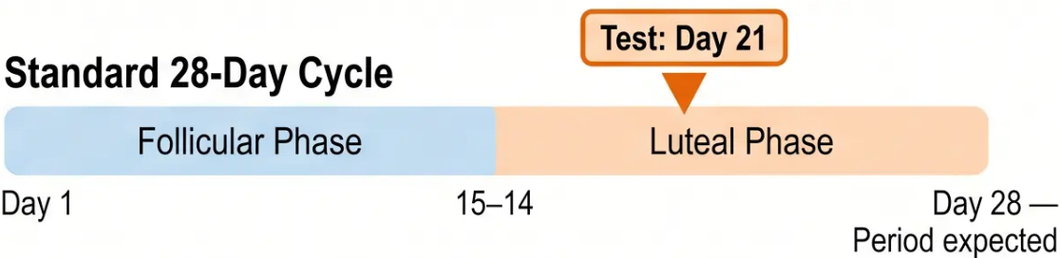
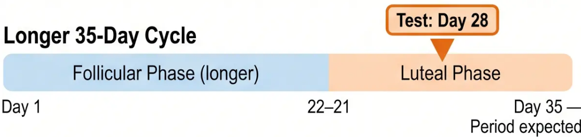
BRADFORD VTS TEACHING DECK · www.bradfordvts.co.uk
Female Investigations: Ovulatory Assessment
Day 21 Progesterone — The Rule and the Nuance
The Core Rule
The Adjustment Rule Length
Always test 7 days before the expected next period
CONFIRMS OVULATION
Day 21 Progesterone ≥ 30 nmol/L
Taken in the mid-luteal phase of a standard 28-day cycle
Rule: Cycle length – 7 = Day to test
What does the result mean?
● ≥ 30 nmol/L — Ovulation confirmed
● < 30 nmol/L — Suggests anovulation; repeat or investigate further
⚠ AKT Tip: “Day 21” is a misnomer in longer cycles — always calculate 7 days before the expected next period. This is a common exam and clinical pitfall.
Bradford VTS · www.bradfordvts.co.uk · May 2026 · Based on NICE NG257 March 2026

Slide 10





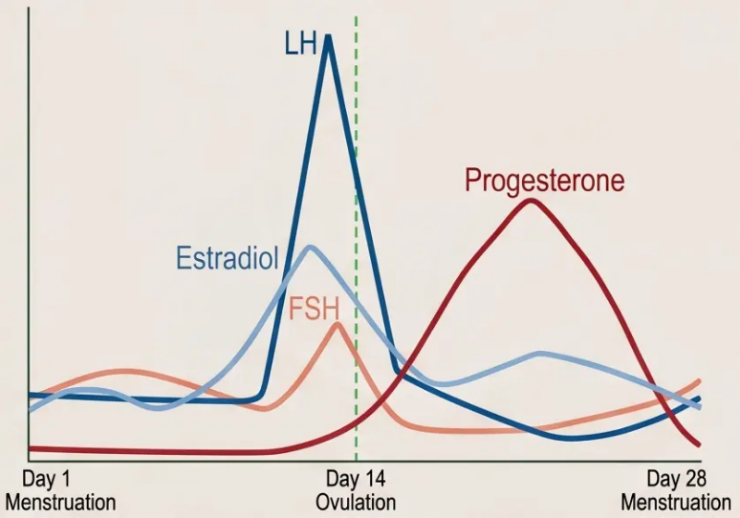



BRADFORD VTS TEACHING DECK · www.bradfordvts.co.uk
Female Investigations: Hormonal Profile
Interpreting Day 2–5 and anovulation screening tests
Day 2–5 Blood Tests — Ovarian Reserve & PCOS Screen
Menstrual cycle hormone levels — Day 2–5
represents the early follicular baseline used for testing
FSH
LH
Oestradiol
3–10 IU/L
2–12 IU/L
(low at baseline)
✅ Normal = adequate
reserve
✅ Normal = balanced
✅ Low Day 2–5 = expected
⚠ Elevated LH + low FSH =
PCOS pattern (LH:FSH
ratio >2:1)
⚠ Elevated early = poor
reserve signal; can
suppress FSH falsely
⚠ >10 IU/L = reduced
ovarian reserve
Anovulation Cause Screening
Prolactin — < 500 mIU/L
TSH — 0.4–4.0 mIU/L
⚠ >1000 mIU/L = significant hyperprolactinaemia
⚠ Any abnormality (high or low) →
treat before fertility treatment
Both hypo- and hyperthyroidism
impair ovulation
Follicular Phase
Luteal Phase
Causes: prolactinoma, antipsychotics,
metoclopramide, hypothyroidism
Features: galactorrhoea, amenorrhoea → MRI pituitary
Bradford VTS · www.bradfordvts.co.uk · NICE NG257 March 2026 · May 2026

Slide 11









BRADFORD VTS TEACHING DECK · www.bradfordvts.co.uk
Screening and Ovarian Reserve
Female Investigations — Part 2
ROUTINE SCREENING
OVARIAN RESERVE
Rubella Immunity
Anti-Müllerian Hormone (AMH)
Check serology — vaccinate if not immune. Avoid
conception for 1 month post-vaccination.
— Reflects the size of the remaining follicle pool — a
marker of ovarian reserve
— Low AMH (below 7 pmol/L) → reduced ovarian
reserve — poorer response to stimulation
Chlamydia NAAT Screen
Treat if positive before any intrauterine procedure.
Prevent tubal damage.
— Elevated AMH → possible PCOS — large follicle pool
but disordered ovulation
Cervical Smear
REFERENCE RANGE
Normal AMH
10–50 pmol/L
Confirm screening is up to date per national programme.
Low reserve
< 7 pmol/L
Sickle Cell / Haemoglobin
Not routinely requested in primary care — increasingly used
pre-referral to guide fertility clinic planning.
Screen if at risk based on ethnicity and family history.
⚠ Key Point: Vaccinate for rubella if not immune — and advise the patient to avoid pregnancy for at least one month after vaccination.
Bradford VTS · www.bradfordvts.co.uk · May 2026 · Based on NICE NG257 March 2026

Slide 12











BRADFORD VTS TEACHING DECK
www.bradfordvts.co.uk
Male Investigations: Semen Analysis
WHO 2021 Reference Values · Two analyses recommended if first is abnormal
≥ 1.4 ml
≥ 16 million/ml
≥ 42%
≥ 4%
Volume
Concentration
Total Motility
Morphology
Per ejaculate
Sperm per millilitre
Moving sperm
Normal forms (Kruger strict)
⚠ IMPORTANT
SOURCE
Two semen analyses are recommended at least 3 months
apart if the initial result is abnormal — sperm take
approximately 2½ months to mature.
WHO Laboratory Manual for the Examination and
Processing of Human Semen, 6th Edition (2021).
Reference values represent the 5th centile of fertile men.
Bradford VTS · www.bradfordvts.co.uk · May 2026 · Based on NICE NG257 (March 2026) and WHO 2021

Slide 13





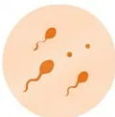





BRADFORD VTS TEACHING DECK
Semen Analysis: Terminology
and Repeats
Understanding abnormal results and what to do next
Two Tests Required
If the first semen analysis is
abnormal, a second test must
be requested
Azoospermia
Oligospermia
No sperm present in
the ejaculate
Low sperm count (below
reference threshold)
≥ 12 Weeks Apart
Sperm take approximately 74 days
to mature (spermatogenesis
cycle) — a single abnormal result
may not be representative
Asthenospermia
Teratospermia
Poor sperm motility —
reduced forward movement
Abnormal sperm morphology
— irregular shape
Do not refer on a single abnormal
result alone — repeat before escalating
OAT Syndrome — Oligoasthenoteratospermia: all three
parameters abnormal simultaneously
NICE NG257 2026
Bradford VTS · www.bradfordvts.co.uk · May 2026
13 / 25

Slide 14











BRADFORD VTS TEACHING DECK
www.bradfordvts.co.uk
Lifestyle Advice: Folic Acid and BMI
NICE NG257 2026 · Pre-conception and fertility advice
FOLIC ACID
HEALTHY BMI
400 mcg daily
Target Range
Standard dose — all women trying to conceive
Begin before conception · Continue for first 12 weeks
Underweight
19 – 30
Obese
5 mg daily
Ideal: 20 – 25
High-risk dose — prescribe if any of the following:
- Obesity (BMI >30) → reduces conception rates and IVF success
- BMI above 30
- Low BMI (BMI <19) → anovulation, menstrual irregularity
- Previous pregnancy with neural tube defect
- On anti-epileptic medication
Even modest weight loss (5%) can
restore ovulation in PCOS
- Diabetes (type 1 or type 2)
- Sickle cell disease or malabsorption
💡 Discuss weight sensitively and supportively
💡 Ask at every pre-conception consultation
Bradford VTS · www.bradfordvts.co.uk · May 2026 · Based on NICE NG257 March 2026

Slide 15




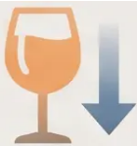

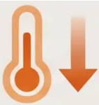



BRADFORD VTS TEACHING DECK
Lifestyle Advice: Smoking, Alcohol & Environment
For both partners — applies from the moment of trying to conceive
Stop Smoking
Limit Alcohol
Avoid Recreational Drugs
Reduce Scrotal Heat
Smoking reduces fertility in
both partners. It lowers
ovarian reserve, impairs
sperm DNA integrity, and
IVF success rates. Refer to
smoking cessation services.
NICE NG257: ≤14 units per
week for both partners.
Ideally avoid alcohol altogether
when actively trying to conceive.
Excess alcohol impairs
sperm quality and ovulation.
Cannabis, anabolic steroids,
and other recreational drugs
impair sperm production and
ovulation. Anabolic steroids
can cause prolonged
azoospermia.
Tight underwear, hot baths,
saunas, and prolonged sitting
increase scrotal temperature
and impair sperm production.
Advise loose-fitting avoiding
prolonged heat exposure.
≤14 units/week
Especially cannabis & steroids
Both partners
Male partner
⚠️ Key Point: Lifestyle changes are free, effective, and should be discussed at
the very first consultation — before any investigation or referral.
Bradford VTS · www.bradfordvts.co.uk · May 2026

Slide 16












BRADFORD VTS TEACHING DECK
Timing of Intercourse and Lubricants
NICE NG257 2026 · Lifestyle Advice
Frequency
Lubricants
Every 2–3 days throughout the cycle
Most lubricants impair sperm motility
Not just at mid-cycle
Avoid standard commercial lubricants
Use fertility-friendly alternatives if needed
Scheduling sex increases anxiety and reduces spontaneity
NICE NG257 does NOT recommend ovulation prediction kits
routinely — they add pressure without proven benefit
e.g. Pre-Seed — a fertility-friendly lubricant option
Tip: Encourage regular, relaxed intercourse — not regimented scheduling. Spontaneity supports wellbeing and adherence.
Bradford VTS · www.bradfordvts.co.uk · May 2026 · Based on NICE NG257 March 2026

Slide 17
















BRADFORD VTS TEACHING DECK · www.bradfordvts.co.uk
Referral Criteria
NICE NG257 2026
Both partners under 36 · 12 months of UPSI
without conception
Anovulatory cycles — irregular or absent
periods
→ Refer to fertility services
→ Gynaecology
🕒 Woman aged 36 or over · 6 months of UPSI
without conception
Suspected tubal damage — previous PID,
ectopic, salpingectomy
→ Expedited referral to fertility services
→ Gynaecology
KEY: Refer at 6 months, NOT 12
Abnormal semen analysis on repeat testing
Known endometriosis or previous pelvic surgery
→ Gynaecology — refer earlier, do not wait 12 months
→ Urology / Andrology
Fertility Services · Gynaecology · Urology / Andrology
Bradford VTS · www.bradfordvts.co.uk · May 2026 · Based on NICE NG257 March 2026

Slide 18














BRADFORD VTS TEACHING DECK
www.bradfordvts.co.uk
NHS IVF Eligibility
NICE NG257 · Updated March 2026
Female Age
Duration of Trying
Pre-treatment Screening
Woman must be under 40 years
at the start of treatment
2 years of regular unprotected sex
(UPSI) without conception — OR —
12 unsuccessful cycles of
intrauterine insemination (IUI)
Normal uterine cavity confirmed
· Semen analysis reviewed
· Ovarian reserve assessed
NICE Recommends: 3 Cycles of IVF
For women aged under 40 with an identified cause or unexplained infertility after 2 years of unsuccessful UPSI.
LOCAL VARIATION
KNOW FOR AKT
IVF eligibility and number of cycles offered varies by
Integrated Care Board (ICB). Most areas offer 1 to 3 cycles
— always check local ICB policy before advising patients.
NICE recommends 3 cycles — but local commissioning
decisions may restrict this. Patients may need to self-fund
additional cycles beyond locally commissioned provision.
Bradford VTS · www.bradfordvts.co.uk · May 2026 · NICE NG257

Slide 19













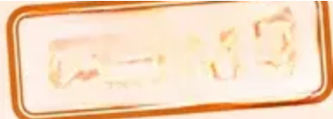
BRADFORD VTS TEACHING DECK
Polycystic Ovary Syndrome (PCOS)
Most common cause of anovulatory infertility
DIAGNOSIS — ROTTERDAM CRITERIA
2 out of 3 criteria required for diagnosis
01
02
Clinical or Biochemical
Hyperandrogenism
03
Polycystic Ovaries
on Ultrasound
Oligo- or Anovulation
Irregular or absent periods
≥20 follicles per ovary or
increased ovarian volume
Hirsutism, acne, or elevated
androgens
Exclude other causes: thyroid disease, hyperprolactinaemia, CAH
MANAGEMENT LADDER
FIRST LINE
SECOND LINE
ALTERNATIVE
Lifestyle Modification
Letrozole
Clomifene Citrate
Weight loss (even 5%) can restore
ovulation · BMI 19–30
Aromatase inhibitor · Ovulation induction
Monitor for multiple pregnancy risk
NICE NG257
2026 UPDATE
Letrozole is now the first-line drug for ovulation induction in PCOS
Replaces clomifene as preferred agent · Previously clomifene was first-line (CG156 2013) · Know this for AKT
Bradford VTS · www.bradfordvts.co.uk · May 2026
19 / 25

Slide 20








BRADFORD VTS TEACHING DECK
www.bradfordvts.co.uk
Hyperprolactinaemia and Tubal Factors
Causes, investigation, and management of two key infertility pathways
Hyperprolactinaemia
Tubal Factor Infertility
Elevated prolactin → anovulation and amenorrhoea
Tubal damage → impaired egg transport and fertilisation
◆ Causes: Prolactinoma (pituitary adenoma), antipsychotics,
metoclopramide, domperidone, cimetidine,
hypothyroidism
◆ Causes: Pelvic inflammatory disease (PID — chlamydia most
common),, endometriosis, previous ectopic pregnancy,
post-surgical adhesions
◆ Symptoms: Galactorrhoea, amenorrhoea, headache, visual
field defects
◆ Investigations: HSG (hysterosalpingography) — first-line
tubal imaging; HyCoSy — ultrasound alternative;
Laparoscopy — gold standard if suspected severe damage
◆ Investigate: MRI pituitary (if prolactin significantly elevated
or symptoms suggest adenoma)
◆ Management: IVF preferred over tubal surgery if damage is
severe or bilateral
◆ Treatment: Cabergoline — first-line dopamine agonist
(BNF); bromocriptine — alternative. Always review and stop
offending medications.
◆ Screening: Chlamydia NAAT screen before any intrauterine
procedure
Prolactin >1000 mIU/L → MRI pituitary urgently
Previous PID or ectopic → refer early for tubal assessment
Slide 20 of 25 · Bradford VTS · May 2026 · Based on NICE NG257 2026 & BNF 2025/2026

Slide 21











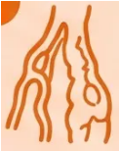








BRADFORD VTS TEACHING DECK
Male Factor Infertility
~30% of infertility cases — always investigate both partners
MOST COMMON PRESENTATION
‘Terato’ — abnormal morphology
OAT Syndrome
‘Astheno’ — poor motility
‘Oligo’ — low count
Oligoasthenoteratospermia — low count + poor motility + abnormal morphology
REVERSIBLE CAUSES — ACT NOW
1
Varicocele
2
Drugs
3
Heat & Lifestyle
Anabolic steroids · Finasteride
Surgical repair may improve
sperm parameters — refer urology
Tight underwear · Hot baths
· Sulfasalazine · Chemotherapy
· Smoking · Cannabis
· Excessive alcohol
— review and stop if possible
AZOOSPERMIA — NO SPERM DETECTED
· Normal FSH and testosterone
· Elevated FSH → primary testicular failure
Obstructive
· Blockage in vas deferens or epididymis
Non-Obstructive
· Low testosterone possible
· Surgical retrieval possible (PESA/TESA)
· Karyotype (Klinefelter’s 47,XXY)
*Potentially Treatable
*Requires Full Work-up
· Causes: vasectomy, infection, congenital
absence of vas deferens (CF-related)
· CF gene testing (CFTR mutations)
· Refer urology/andrology urgently
Azoospermia investigations: FSH · Testosterone · Karyotype · CF gene (CFTR) · Refer urology/andrology
Bradford VTS · www.bradfordvts.co.uk
21 / 25
May 2026 · NICE NG257

Slide 22







BRADFORD VTS TEACHING DECK
Top Tips for Primary Care
Eight evidence-based pearls from NICE NG257 2026
01
Investigate Both
Together
02
Refer ≥36 After
6 Months
03
Letrozole First in
PCOS
04
Adjust Day 21
Timing
Always request semen
analysis and female bloods
simultaneously — never
investigate one partner in
isolation.
Women aged 36 or over
should be referred after only
six months of trying — not
twelve. Time is ovarian
reserve.
NICE NG257 2026 now
recommends letrozole as
first-line ovulation induction
— clomifene is no longer
preferred.
Day 21 progesterone only
applies to 28-day cycles. For
longer cycles, test seven
days before the expected
next period.
05
Right Folic Acid
Dose
06
Don’t Schedule Sex
07
Check Rubella
Immunity
08
Lifestyle Before
Medication
Advise intercourse every two
to three days throughout the
cycle — not just mid-cycle.
Scheduling increases anxiety
and reduces spontaneity.
400 mcg for most women;
5 mg daily if BMI over 30, on
anti-epileptics, previous
NTD, or diabetes.
Vaccinate if not immune.
Advise the couple to avoid
conception for one full
month after vaccination.
Even 5% weight loss in
women with PCOS can restore
ovulation naturally — always
try lifestyle modification first.
Bradford VTS · www.bradfordvts.co.uk · May 2026 · Based on NICE NG257 March 2026

Slide 23

















BRADFORD VTS TEACHING DECK · www.bradfordvts.co.uk
AKT Exam Pearls
High-yield facts for the Applied Knowledge Test — NICE NG257 2026
PEARL 01 · GUIDELINE UPDATE
PEARL 02 · OVULATION INDUCTION
NICE NG257 (March 2026) replaces
Letrozole is now first-line for PCOS —
CG156 (2013) Know the update for AKT
not clomifene
PEARL 03 · PROGESTERONE TIMING
PEARL 04 · WHO 2021 SEMEN VALUES
Day 21 progesterone ≥30 nmol/L =
ovulation confirmed
Volume ≥1.4 ml
Concentration ≥16 million/ml
Motility ≥42%
*Adjust: test 7 days before expected next period
Morphology ≥4%
PEARL 05 · SEMEN ANALYSIS REPEATS
PEARL 06 · EARLY REFERRAL
Two semen analyses required at least
12 weeks apart if first result is abnormal
Women ≥36 years → refer after only
6 months of UPSI (not 12 months)
*Sperm maturation takes ~74 days
Bradford VTS · www.bradfordvts.co.uk · May 2026 · Slide 23 of 25

Slide 24
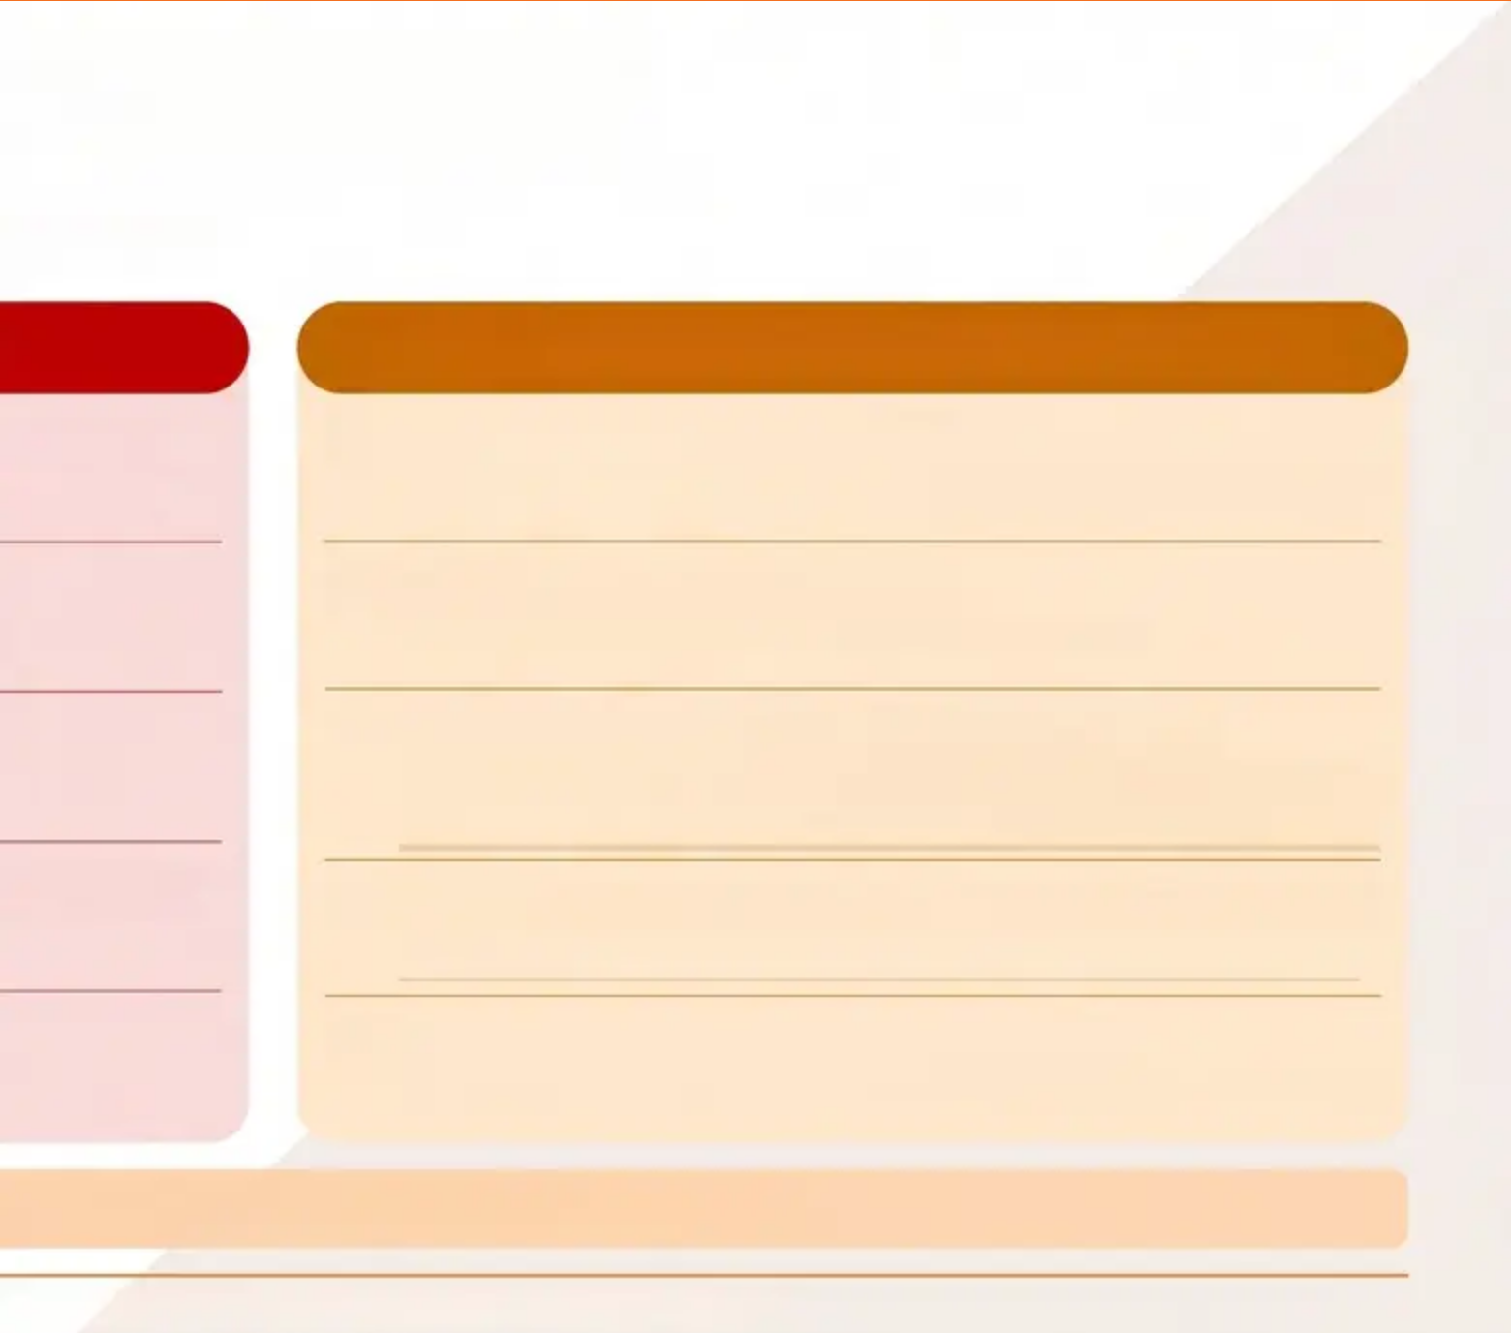



BRADFORD VTS TEACHING DECK · www.bradfordvts.co.uk
Red Flags and Common Pitfalls
Know when to act urgently — and what not to miss
RED FLAGS — Act Urgently
⚠ COMMON PITFALLS — Don't Get Caught Out
⚠ Investigating only the woman
⚠ Amenorrhoea + hot flushes + ↑FSH in woman <40
→ Premature Ovarian Insufficiency (POI) — urgent referral
→ Always investigate both partners simultaneously from day one
⚠ Galactorrhoea + amenorrhoea
⚠ Using clomifene first in PCOS
→ NICE NG257 2026: Letrozole is now first-line
→ Hyperprolactinaemia — MRI pituitary urgently
⚠ Azoospermia
⚠ Always testing Day 21 progesterone literally
→ Urgent urology / andrology referral
→ Adjust: test 7 days before expected next period (e.g. Day 28
in a 35-day cycle)
⚠ Severe pelvic pain + suspected deep endometriosis
⚠ Prescribing 400mcg folic acid when 5mg is indicated
→ Urgent gynaecology
→ Obesity (BMI >30), anti-epileptics, previous NTD, diabetes
⚠ Previous ectopic pregnancy
⚠ Waiting 12 months to refer women ≥36
→ Earlier tubal assessment — refer sooner
→ Refer after only 6 months — ovarian reserve is time-critical
💡 These are high-yield AKT topics — know them cold.
Bradford VTS · www.bradfordvts.co.uk · May 2026 · Based on NICE NG257 March 2026

Slide 25

















BRADFORD VTS TEACHING DECK · www.bradfordvts.co.uk
Quick Recall
Essential facts to take away from this session
Both Partners
12 months / 6 months
1 in 7
Prog ≥30 nmol/L
Couples affected by
infertility in the UK
Investigate male and
female simultaneously
from day one
UPSI threshold; refer
women ≥36 after only 6
months
Day 21 progesterone
confirms ovulation
(adjust for cycle length)
≥16 million/ml
Letrozole First
Folic Acid
Every 2–3 Days
WHO 2021 sperm
concentration lower
reference limit
NICE NG257 2026 —
first-line ovulation
induction in PCOS
400 mcg standard · 5 mg
if high risk (BMI >30,
anti-epileptics, prev NTD)
Avoid scheduling
intercourse — regular
frequency throughout cycle
⚠ Important Disclaimer
This teaching deck is for educational purposes only and is intended for GP trainees and qualified healthcare professionals.
Always verify clinical advice, drug doses, and eligibility criteria against the latest NICE guidelines, BNF, and local ICB/CCG protocols
before clinical application. Guidelines may ge — check NICE NG257 and relevant CKS pages for the most current recommendations.
Bradford VTS Teaching Deck · Infertility in Primary Care · Created May 2026 · NICE NG257 March 2026
Slide 25 of 25

