Slide 1
Obstetric Abdominal Palpation
Angela Laughton
Clinical Education Manager/Midwife
Bradford Teaching Hospital NHS Trust

Slide 2

Aims
To be able to:
Measure fundal height & calculate approx gestation
Understand the process of examination
Use a Pinard stethoscope

Slide 3
Inspection
The 6 'S' + UF
Shape and asymmetry
Tense stretching
'Stripe'
Striae gravidarium
Scars
Superficial dilated veins
?Umbilical Inversion
?Foetal movements

Slide 4
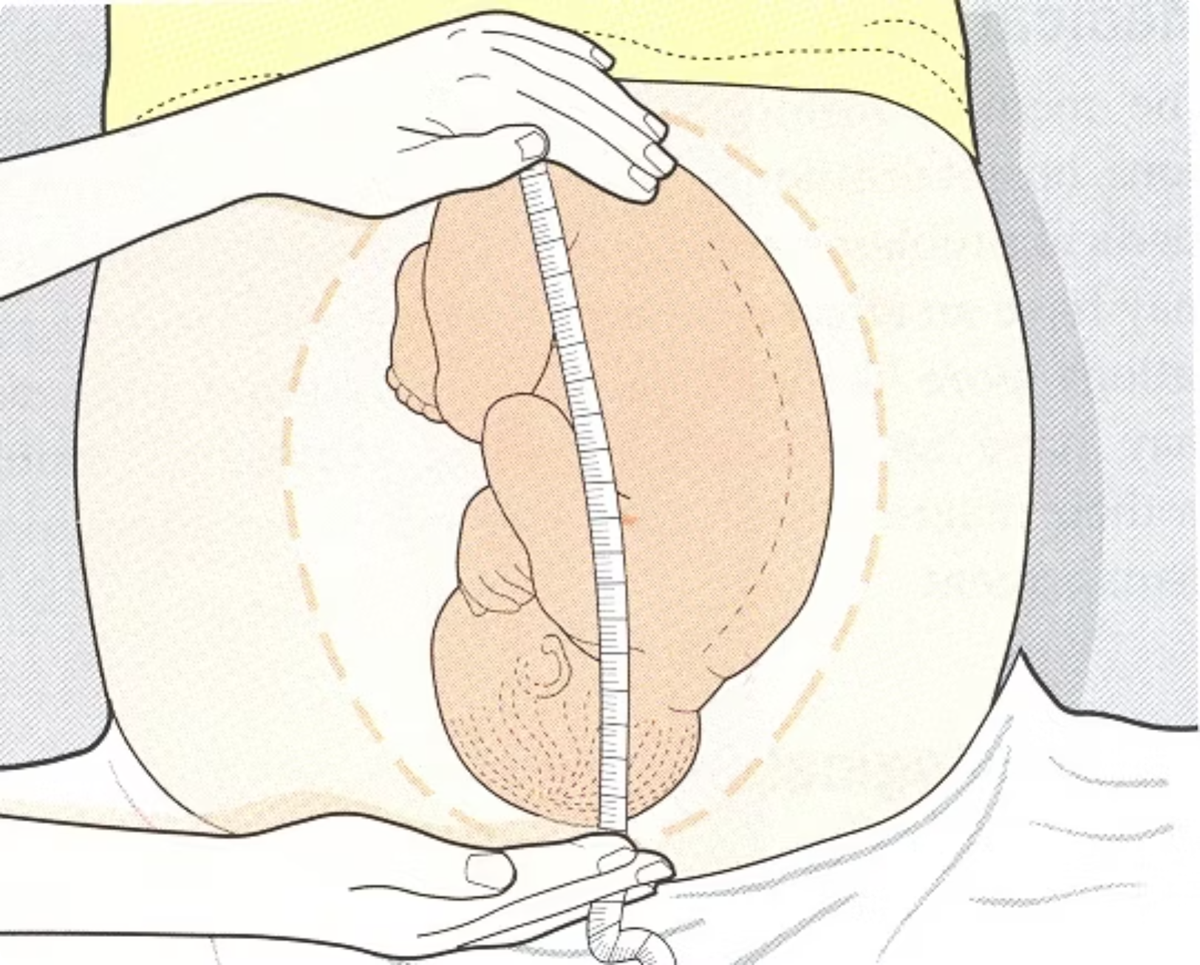
Symphysiofundal Height
Palpate uterus with left hand
To find fundus press, there is a 'give' at the fundus
Measure from here with a straight tape down to the pubic symphysis

Slide 5

Fetal Poles & axis
The fetal poles refer to the head and bottom of the fetus.
In Twins at least three fetal poles should be felt.
From finding the 2 poles you can determine the 'lie/axis' of the baby e.g. longitudinal, transverse or oblique.

Slide 6
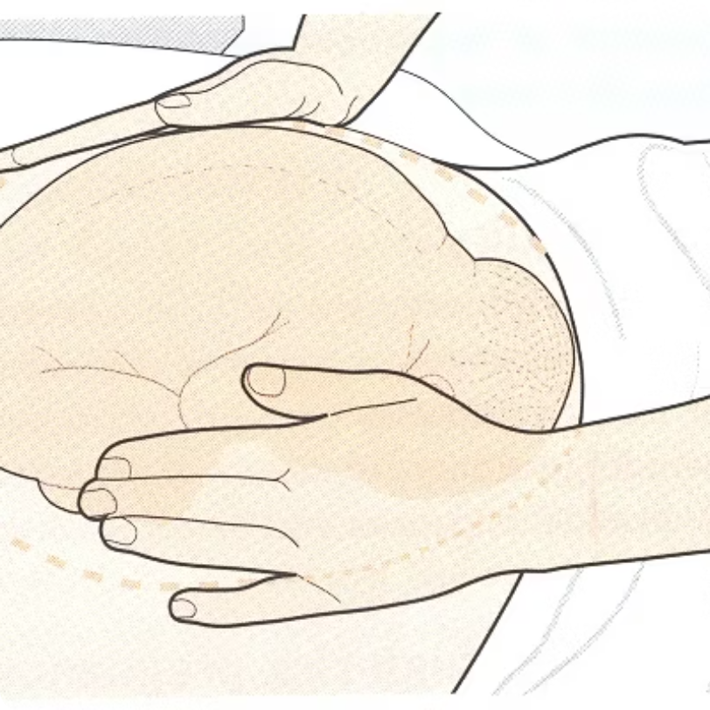
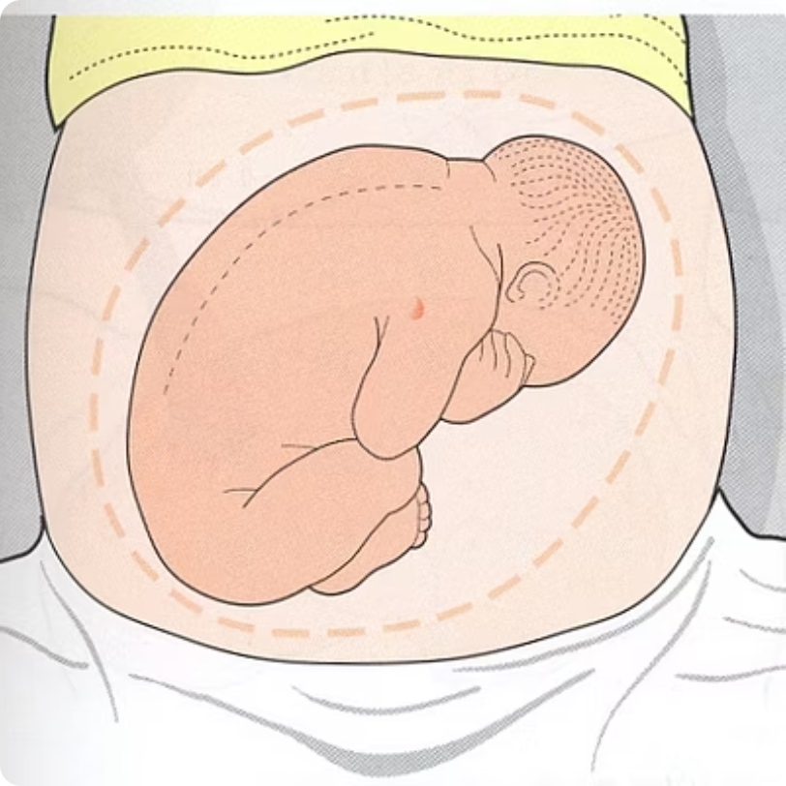
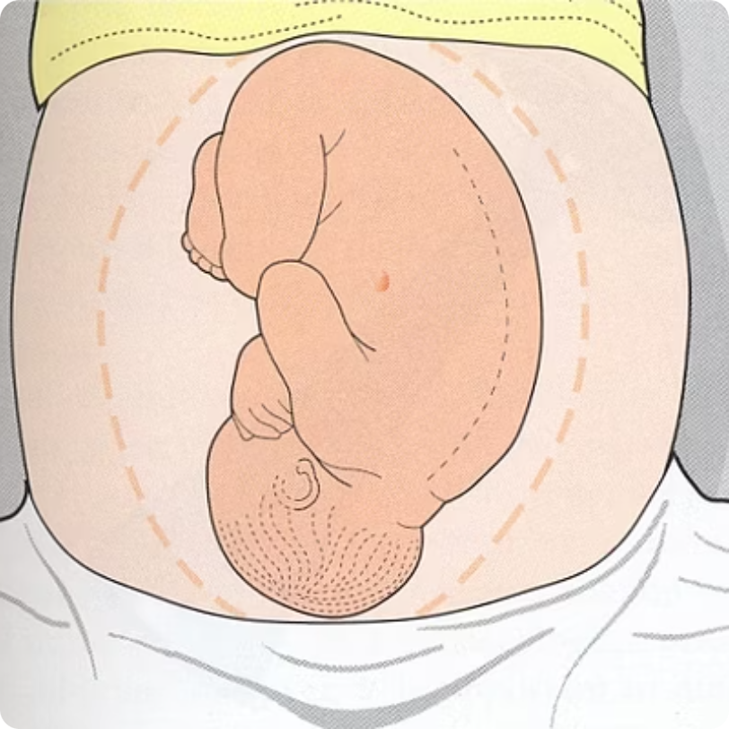
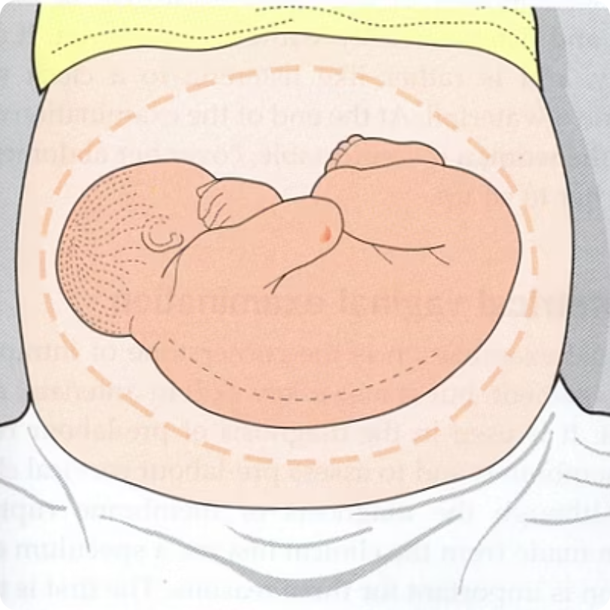
Axis

Slide 7

Presentation
Turn to face the pelvis and press the fingers of both hands firmly downwards just above the symphysis pubis
Head = cephalic
Bottom = Breech
Any other part of the body = compact presentation e.g. shoulder, arm.

Slide 8

Breech or cephalic??

Slide 9
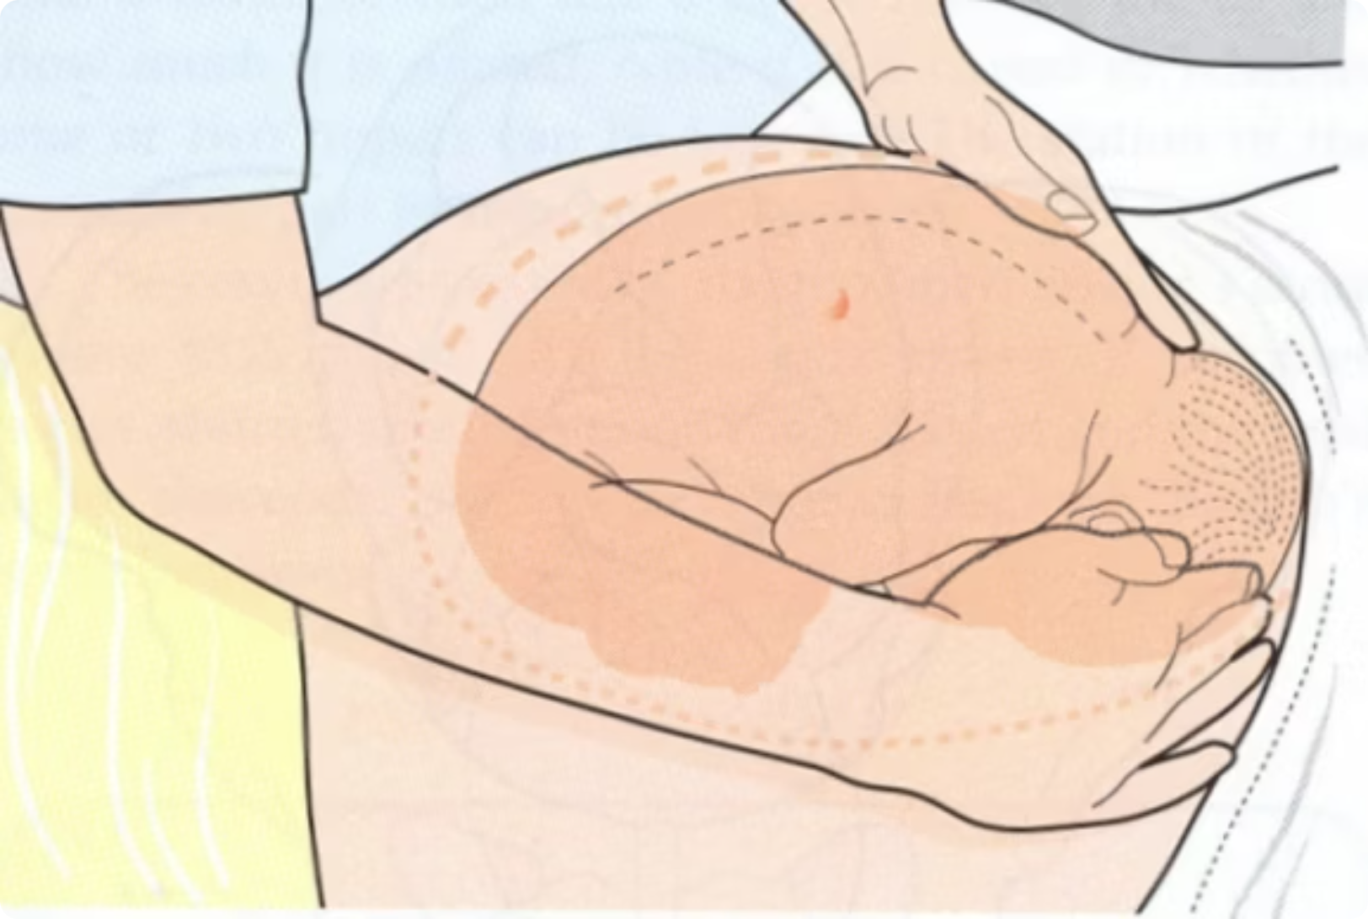
Head engagement
Ballot head between fingers
Record in fifths palpable
Head engaged at 2/5 palpable or less
Free at 3/5 palpable or more

Slide 10
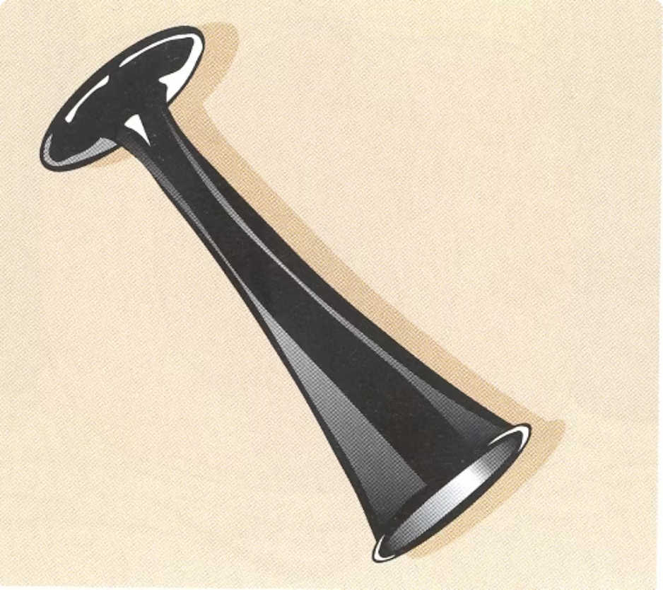
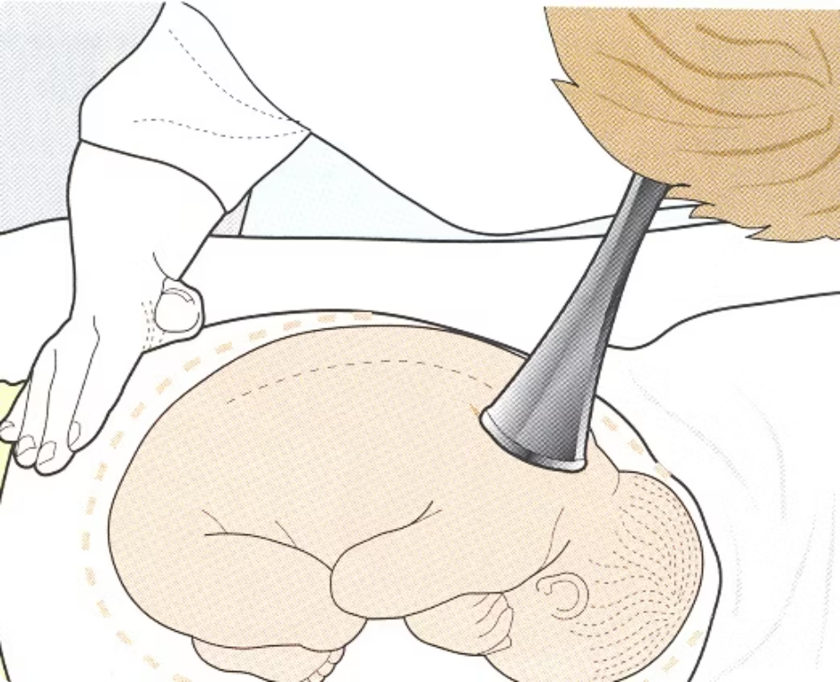
Auscultation with the Pinard Stethoscope
Place funnel end over the left anterior shoulder of the fetus and press ear to other end
Difficult technique / skill
Should always be done prior to using sonic-aid

