Slide 1




BRADFORD VTS TEACHING DECK
Obstetric Examination
A Comprehensive Teaching Resource
Created May 2026 | Updated to current NICE/RCOG 2024/2025 standards
⚠ Disclaimer: This resource is for educational purposes only. Always verify
drug doses and clinical guidance against the latest NICE/BNF guidelines
before clinical application.
www.bradfordvts.co.uk
www.bradfordvts.co.uk
Slide 1 of 30

Slide 2


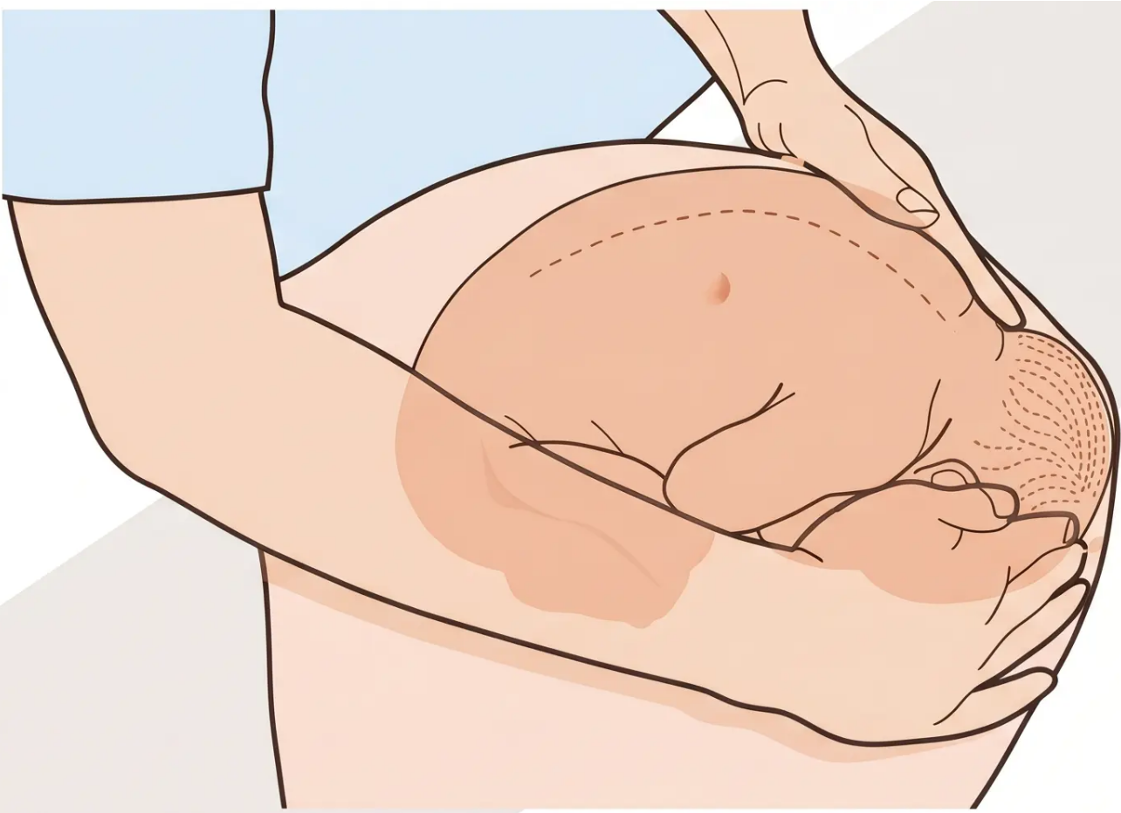





BRADFORD VTS TEACHING DECK
SECTION
01
Obstetric
Abdominal
Palpation
'Clinical assessment of fetal
growth, position, and wellbeing'
[ Inspection ]
[ SFH Measurement ]
[ Fetal Lie & Presentation ]
[ ECV ]
www.bradfordvts.co.uk
Slide 2 of 30

Slide 3







BRADFORD VTS TEACHING DECK
“Purpose of Abdominal Palpation”
Why do we examine the pregnant abdomen?
Assess Gestational
Age & Fetal Growth
Identify Fetal
Presentation & Lie
Symphysis-fundal height (SFH)
measurement estimates
gestational age and monitors growth
Determine if the fetus is cephalic,
breech, or transverse — and its
orientation within the uterus
Determine Fetal
Head Engagement
Assess Liquor Volume
Clinical assessment of amniotic
fluid — oligohydramnios or
polyhydramnios may indicate fetal
compromise
Assess how much of the fetal
head is palpable above the pelvic
brim — reported in fifths
www.bradfordvts.co.uk
Slide 3 of 30

Slide 4



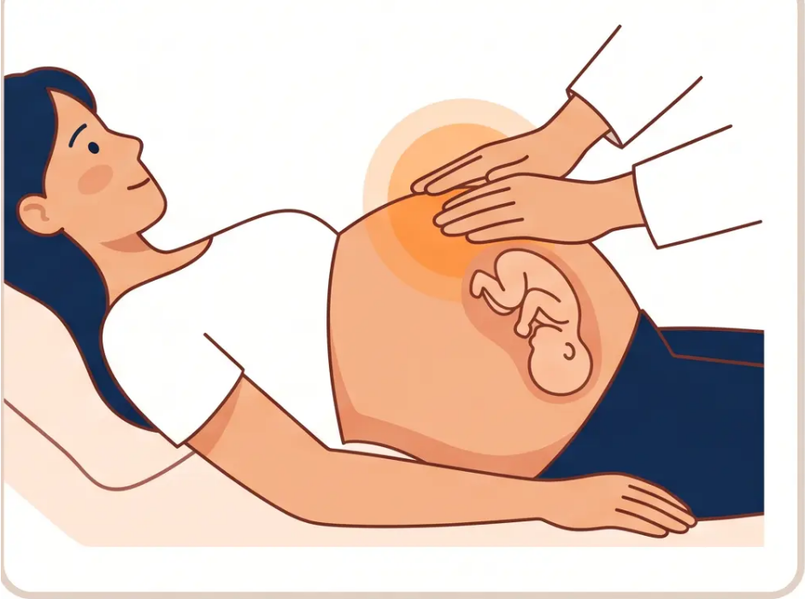






BRADFORD VTS TEACHING DECK
“Examination Technique”
Step 1: Inspection & Step 2: Fundal Palpation
Inspection & Patient Positioning
1
Ask the woman to empty her bladder before examination.
Position supine or semi-recumbent, abdomen fully exposed.
Fundal Palpation
2
Both hands placed firmly on the upper uterus.
Identify the fetal part in the fundus:
● Breech — soft, irregular, not ballotable
● Head — hard, round, ballotable
Clinical Pearl: In a cephalic presentation, the head is felt in the
lower uterus — the fundus contains the softer, bulkier breech.
Fundal palpation — identifying the fetal pole in
the upper uterus
www.bradfordvts.co.uk
Slide 4 of 30 | Section 1: Obstetric Abdominal Palpation

Slide 5

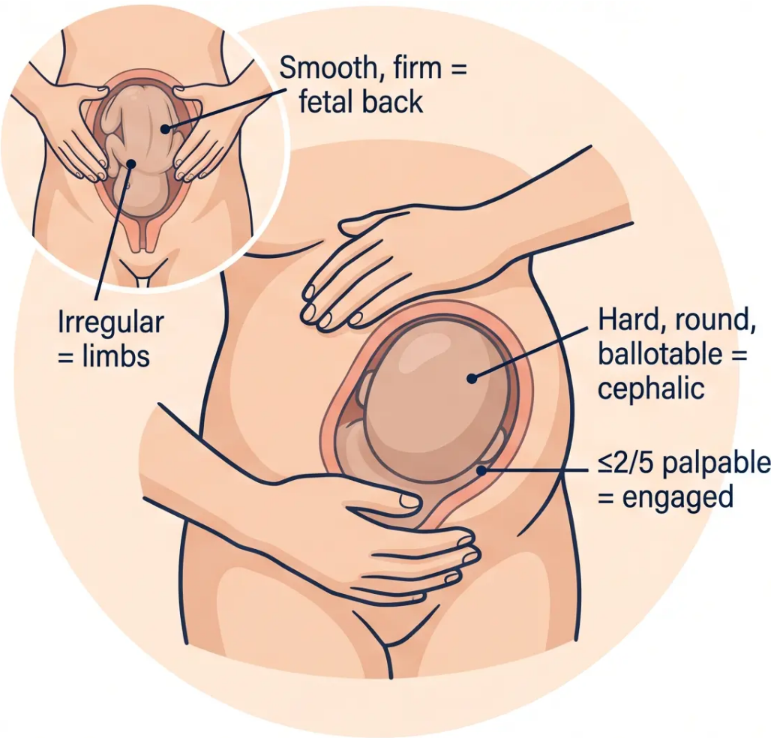



BRADFORD VTS TEACHING DECK
Lateral Palpation & Pelvic Pole Assessment
Identifying the fetal back, presenting part, and engagement using Pawlik's grip
Lateral Palpation
What are you feeling for?
• Fetal back — smooth, firm, continuous, curved surface →
lies on one side
• Fetal limbs — irregular, knobbly, variable resistance →
opposite side
The back identifies fetal position — useful for auscultation placement
Pelvic Pole Assessment — Pawlik's Grip
What is presenting?
• Cephalic (head): Hard, round, smooth, ballotable — can be
gently bounced between fingers
• Breech: Soft, irregular, not ballotable — cannot be bounced
“Engagement:” Head is engaged when less than half is
palpable above the pelvic brim (≤2/5 palpable above brim)
In primigravidae: normally engages around 36 weeks
Pawlik's grip: one hand cradles the lower uterus above the symphysis pubis
www.bradfordvts.co.uk
Slide 5 of 30

Slide 6

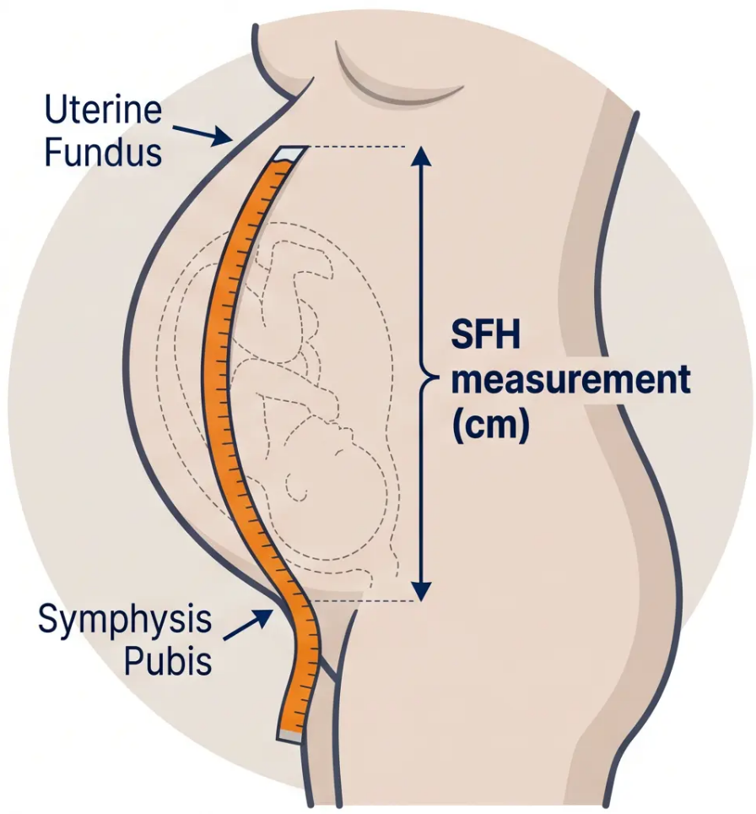

BRADFORD VTS TEACHING DECK
“Symphysis-Fundal Height (SFH) Measurement”
“Section 1 — Obstetric Abdominal Palpation”
How to Measure
① Ask the woman to empty her bladder — ensures accuracy
② Position supine, semi-recumbent — uterus relaxed and accessible
③ Identify the symphysis pubis — lower fixed landmark
④ Identify the uterine fundus — upper landmark (palpate gently)
⑤ Place tape measure from symphysis pubis to fundal height —
tape measure inverted (blank side up) to avoid bias
⑥ Read the measurement in centimetres
📏 SFH (cm) ≈ Gestational Age (weeks)
Normal range: ±2 cm
Measured from 24 weeks gestation onwards
www.bradfordvts.co.uk
Slide 6 of 30

Slide 7

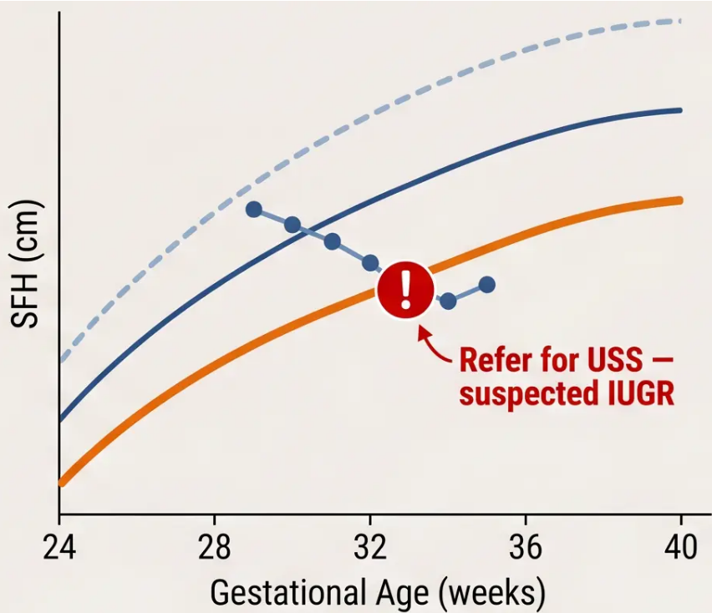




BRADFORD VTS TEACHING DECK
“SFH Referral Criteria & Growth Charts”
Section 1 — Obstetric Abdominal Palpation
1. GROWTH CHART PRINCIPLES
• SFH (cm) plotted at each antenatal visit from 24 weeks onwards
• Measurements plotted on customised centile charts (adjusted for
maternal height, weight, ethnicity, and parity)
• Serial measurements are more informative than a single reading –
look for crossing centiles as well as absolute values
2. WHEN TO REFER FOR ULTRASOUND
◆ SFH below the 10th centile → Refer for USS (suspected IUGR)
◆ SFH crossing centiles downward → Refer for USS even if above 10th
“Ultrasound assesses: fetal biometry, liquor volume (AFI), umbilical artery
Dopplers, and estimated fetal weight.”
= 50th centile
= 90th centile = 10th centile
Do not reassure without imaging if SFH < 10th centile
= 10th centile
alert: refer for USS
www.bradfordvts.co.uk
Slide 7 of 30

Slide 8



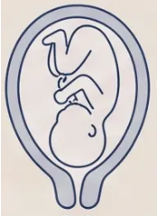

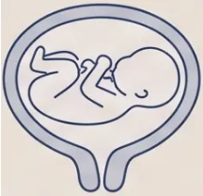

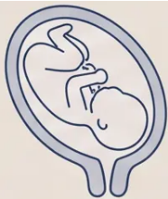




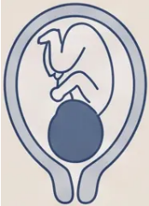

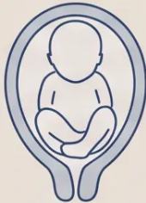

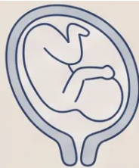


BRADFORD VTS TEACHING DECK
Fetal Lie and Presentation
Section 1 — Obstetric Abdominal Palpation
FETAL LIE
✓ Normal
Abnormal
Unstable
Longitudinal
Transverse
Oblique
Fetal spine parallel to maternal spine —
the expected lie
Fetal spine perpendicular to maternal
spine — shoulder may present
Diagonal — often converts to longitudinal
or transverse in labour
FETAL PRESENTATION
✓ Normal
Abnormal
Rare / Urgent
Cephalic
Breech
Shoulder
Head presenting — palpated as hard,
round, ballotable mass at pelvic pole
Buttocks or feet presenting — soft, irregular
at pelvic pole; hard head at fundus
Associated with transverse lie — cannot
deliver vaginally
💡 Clinical Tip: At fundal palpation — breech feels soft and irregular; head feels hard, round, and ballotable. At pelvic pole — the reverse applies.
www.bradfordsvts.co.uk
Slide 8 of 30

Slide 9

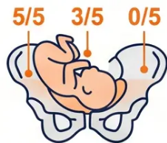







BRADFORD VTS TEACHING DECK
Fetal Engagement and External Cephalic Version
Assessing engagement by palpation | Managing breech at 36 weeks
Head Engagement
External Cephalic Version (ECV)
Offer ECV to all women with uncomplicated breech
presentation at 36 weeks gestation
Head engaged when ≤2/5 palpable above the pelvic brim
● 5/5 above brim — completely unengaged; freely
mobile
✓ Who: Offered to all women with breech presentation
at 36 weeks
✓ Success rate: Approximately 50% overall
● 4/5 above brim — head just dipping into pelvis
✓ Setting: Hospital setting with CTG monitoring before
and after
● 3/5 above brim — entering engagement
● 2/5 above brim — engaged (majority of head below
brim)
✓ Contraindications: Placenta praevia, previous uterine
surgery (relative), fetal compromise, ruptured membranes
● 0/5 above brim — deeply engaged; not palpable
abdominally
✓ If unsuccessful: Planned caesarean section or vaginal
breech delivery (specialist unit)
In primigravidae, engagement normally occurs around 36 weeks.
In multigravidae, engagement may not occur until labour begins.
AKT Pearl: ECV should be proactively offered — not
waiting for the woman to ask. Success rate ~50%.
www.bradfordvts.co.uk
Slide 9 of 30 | Section 1: Obstetric Abdominal Palpation

Slide 10

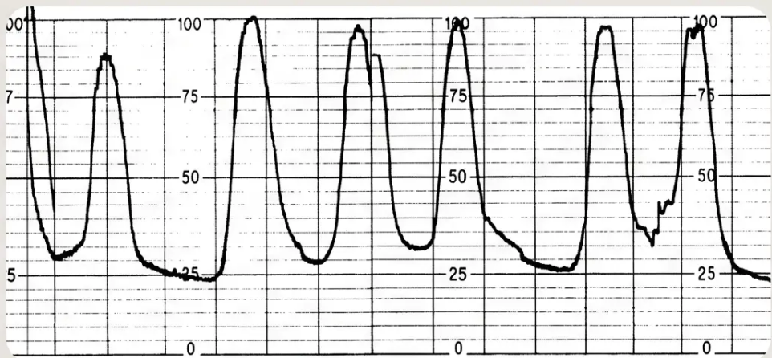
BRADFORD VTS TEACHING DECK
SECTION
02
FETAL HEART RATE TRACE
Cardiotocography
(CTG) Interpretation
Continuous electronic fetal monitoring
combining fetal heart rate (FHR) patterns with
uterine contractions — a core skill for safe
intrapartum care.
4 CTG features
Deceleration Types
CTG Classification
Numbers
www.bradfordvts.co.uk
Slide 2 of 30

Slide 11





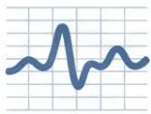








BRADFORD VTS TEACHING DECK
The Four Features of CTG Assessment
NICE NG229 / FIGO 2015 — assessed for every CTG trace
Baseline FHR
Variability
Normal: 110–160 bpm
Normal: 5–25 bpm
The average fetal heart rate over a 10-minute
window, excluding accelerations and
decelerations
Beat-to-beat fluctuation in the fetal heart rate —
reflects a healthy, responsive autonomic
nervous system
Accelerations
Decelerations
≥15 bpm for ≥15 seconds
Timing + shape = key to classification
Transient rises in FHR — a reassuring sign of fetal
wellbeing and an active, responsive fetus
Transient falls in FHR — classified by timing
relative to contractions: early, variable, or late
Assessment based on NICE NG229 Intrapartum Care and FIGO 2015 CTG Guidelines
www.bradfordvts.co.uk
Slide 11 of 30

Slide 12


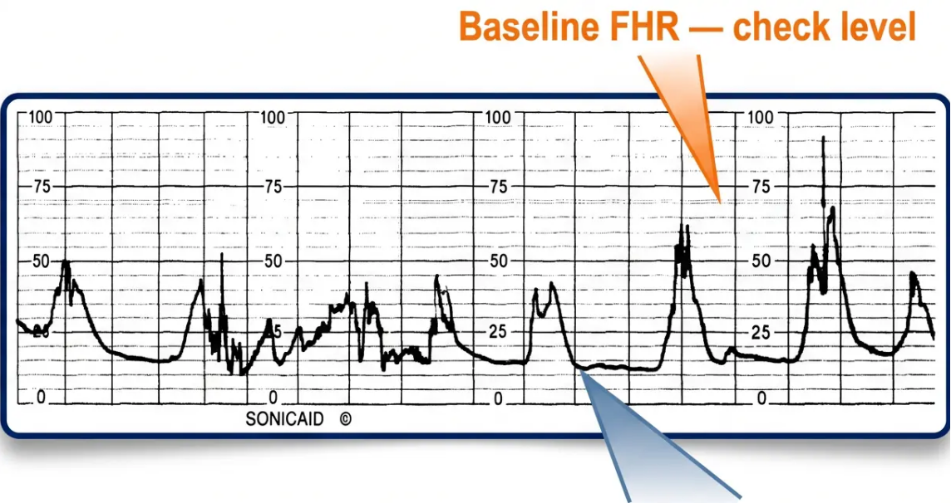







BRADFORD VTS TEACHING DECK
Baseline Fetal Heart Rate and Variability
Two of the four key CTG features — the foundation of fetal wellbeing assessment
Baseline FHR 110 – 160 bpm
• Measured over a 10-minute window, excluding
accelerations and decelerations
• Tachycardia >160 bpm; Bradycardia <110 bpm — both
non-reassuring or abnormal depending on duration
Variability (Beat-to-Beat) 5 – 25 bpm
• Reflects the interplay between the sympathetic and
parasympathetic nervous systems
Variability —
check amplitude
• Reduced variability (<5 bpm for ≥30 min) = non-
reassuring; may indicate fetal sleep or compromise
• Absent/minimal variability (<3 bpm for ≥30 min) =
abnormal — escalate
Example CTG trace — note the baseline level
and beat-to-beat oscillation pattern
www.bradfordvts.co.uk
Slide 12 of 30

Slide 13








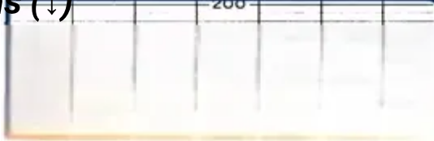

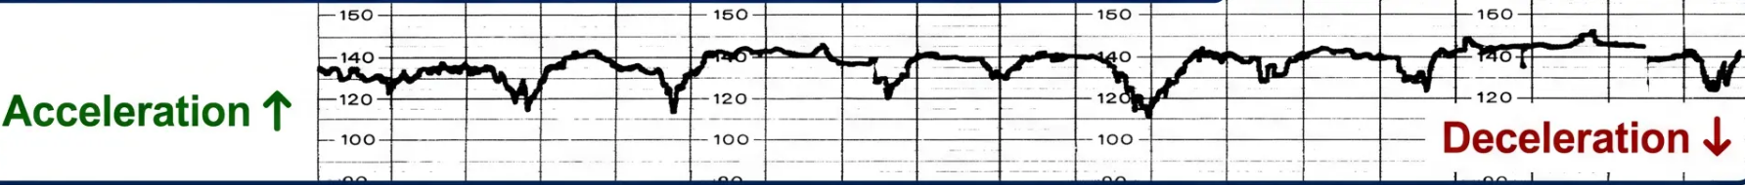

BRADFORD VTS TEACHING DECK
‘Accelerations & Decelerations’
‘Recognising reassuring and concerning transient changes in fetal heart rate’
↑ ‘Accelerations’
↓ ‘Decelerations’
✅ REASSURING
⚠️ MAY BE CONCERNING
What is it?
What is it?
A transient increase in fetal heart rate of ≥15 bpm
above baseline, lasting ≥15 seconds’
A transient decrease in fetal heart rate of ≥15 bpm
below baseline, lasting ≥15 seconds’
Clinical meaning
Preview types
● Indicates fetal wellbeing
● Early — Normal (head compression)
● Sign of an active, non-acidotic fetus
● Variable — Cord compression (monitor)
● Presence is strongly reassuring
● Late — Pathological (placental insufficiency)
⚠️ Absence of accelerations alone is not abnormal — but note the clinical context
‘Full classification on next slide →
Example CTG trace — identify accelerations (↑) and decelerations (↓)
💡 Accelerations = active
fetus. Decelerations =
investigate the cause.
www.bradfordvts.co.uk
Slide 13 of 30 | Section 2: CTG Interpretation

Slide 14







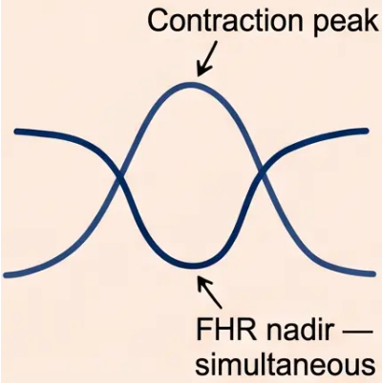
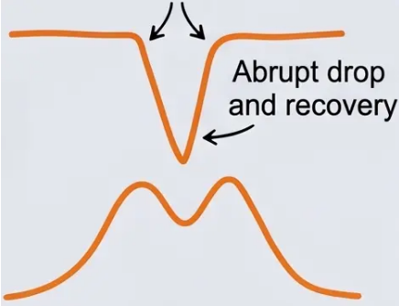

BRADFORD VTS TEACHING DECK
Classification of Decelerations
Section 2 — CTG Interpretation
Early vs Variable — Recognising the Pattern
CTG trace reference — identify the pattern
Early Decelerations
Variable Decelerations
Usually Normal
May Be Concerning
● Shape: Uniform, smooth, mirror-image of the contraction
● Shape: V-shaped (sometimes W-shaped),
abrupt onset and recovery
● Timing: Nadir (lowest point)
coincides exactly with the peak of
the contraction
Variable timing
● Timing: Variable — no fixed
relationship to contractions
● Cause: Fetal head compression
→ vagal stimulation
● Cause: Umbilical cord compression
→ rapid vagal stimulation
● Significance: Normal finding in
active labour — no action
required
● Significance: Non-reassuring if
prolonged, deep, or slow to
recover
✅ Reassuring — no intervention needed
⚠️ Non-reassuring if prolonged, deep, or repetitive — escalate
www.bradfordvts.co.uk
Slide 14 of 30

Slide 15





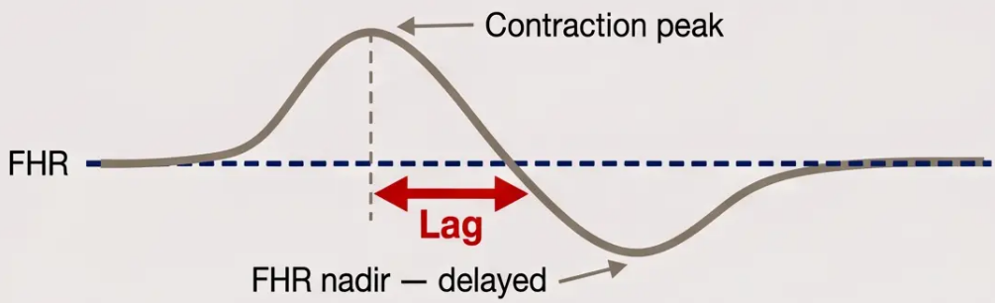


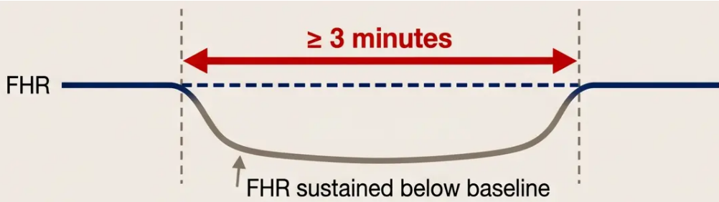



BRADFORD VTS TEACHING DECK
“Pathological Decelerations”
PATHOLOGICAL
Late & Prolonged — Know When to Act
Late Decelerations
Prolonged Decelerations
Onset after contraction peak
Duration ≥ 3 minutes
• Mechanism: Uteroplacental insufficiency — reduced
oxygen delivery during contractions
• Definition: FHR drop lasting ≥ 3 minutes (some define
significant if ≥ 5 min)
• Appearance: Smooth, uniform shape; mirrors
contraction but delayed; slow return to baseline
• Causes: Cord prolapse, abruption, maternal
hypotension, uterine hyperstimulation
• Significance: ALWAYS pathological — never ignore;
escalate immediately
• Action: Urgent assessment — may require emergency
delivery depending on clinical context
PLACENTAL INSUFFICIENCY
URGENT — ESCALATE NOW
Remember: Late decelerations = placental insufficiency. Even a single late deceleration warrants clinical review.
www.bradfordvts.co.uk
Slide 15 of 30

Slide 16










BRADFORD VTS TEACHING DECK
CTG Classification
Section 2 — CTG Interpretation
“Normal · Suspicious · Pathological”
NORMAL
SUSPICIOUS
PATHOLOGICAL
All 4 features reassuring
1 non-reassuring feature
≥2 non-reassuring OR
≥1 abnormal feature
- ⚠ Baseline 100–109 or 161–180 bpm
- ✔ Baseline 110–160 bpm
- ● Baseline <100 or >180 bpm
- ✔ Variability ≥5 bpm
- ⚠ Variability 3–4 bpm for ≥30 min
- ● Variability <3 bpm for ≥30 min
- ✔ Accelerations present
- ⚠ Variable decelerations present
- ● Late decelerations
- ✔ All other features reassuring
- ✔ No concerning decelerations
- ● Sinusoidal pattern
Continue monitoring
Increase surveillance · Senior review
FBS or emergency delivery
www.bradfordsvts.co.uk
Slide 16 of 30

Slide 17

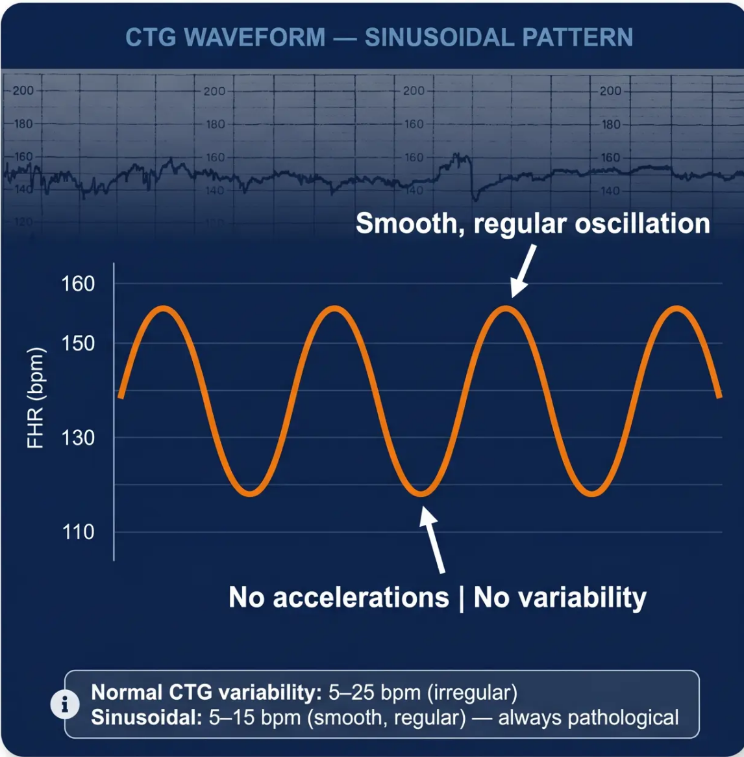





BRADFORD VTS TEACHING DECK
Sinusoidal Pattern
& Fetal Anaemia
ALWAYS ABNORMAL
WHAT IS THE SINUSOIDAL PATTERN?
A smooth, regular, undulating waveform
resembling a sine wave
2–5 cycles per minute | Amplitude 5–15 bpm | Persists for ≥20 minutes
CAUSES — SEVERE FETAL ANAEMIA
● Anti-D alloimmunisation (rhesus haemolytic disease)
● Fetal haemorrhage (fetomaternal or feto-fetal)
● Hydrops fetalis
CLINICAL ACTION
Sinusoidal CTG → Urgent senior obstetric review
Do not delay — this is a medical emergency
www.bradfordvts.co.uk
Slide 17 of 30 | Section 2: CTG Interpretation

