Slide 1



BRADFORD VTS TEACHING DECK
Postnatal Care
for GP Trainees
📅 Created May 2026 — Updated to current NICE NG194 / CKS February 2026 standards
🌐 www.bradfordvts.co.uk
⚠️ Disclaimer: This deck is for educational purposes only. Always verify drug doses and guidance against the latest NICE/BNF publications before clinical application.

Slide 2


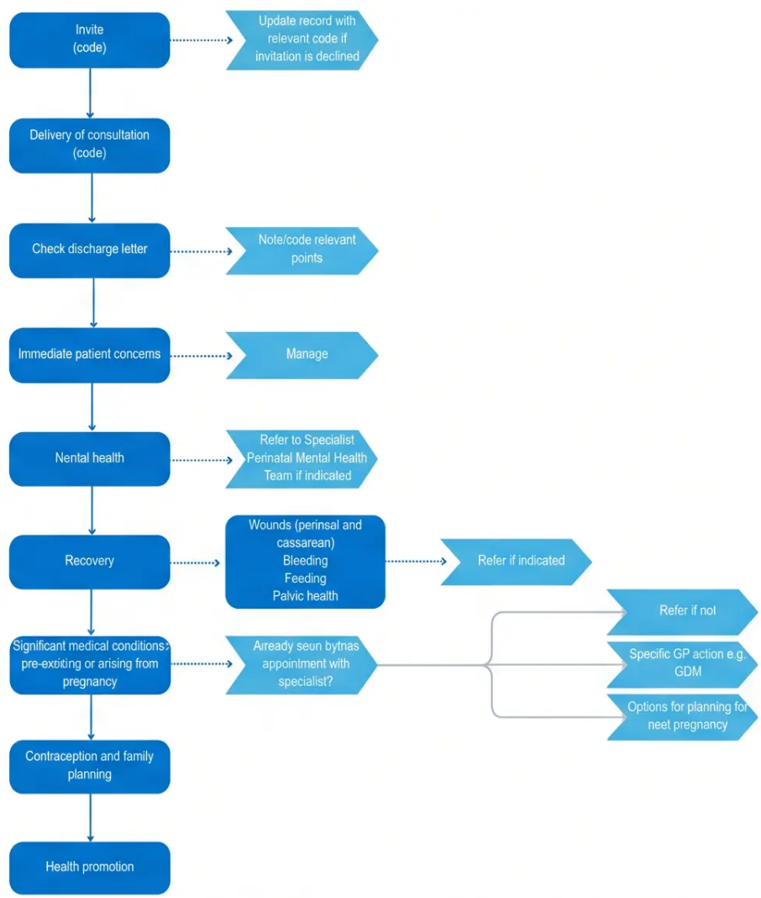



Consultation Structure
The 6-Week Postnatal Check
GP Contractual Obligation — GMS Contract
Offered to ALL women
At 6–8 weeks following delivery — regardless of
delivery type or complexity.
GMS Contract Obligation
A mandatory component of GP services — not
optional. Document the offer and outcome in
the patient record.
Physical + Psychological Recovery
Reviews both physical healing and perinatal mental
health — the baby’s 6–8 week check runs
simultaneously as a separate clinical assessment.
www.bradfordvts.co.uk
Postnatal Care — Bradford VTS Teaching Deck | NICE NG194 / CKS Feb 2026

Slide 3









Purpose of the Assessment
The 6-Week Postnatal Check — What Are We Actually Doing?
Perinatal Mental Health
Contraception Needs
Infant Feeding
Screen for depression and
anxiety using EPDS
Assess suitability and
counsel on safe options
Support breastfeeding;
address formula feeding
Immunisations
Physical Recovery
Check infant and maternal
vaccination status
Identify wounds, anaemia,
pelvic floor issues
www.bradfordvts.co.uk

Slide 4








Clinical History: Delivery and Recovery
Section 2 — History Taking
Nature of Delivery
- SVD, instrumental (forceps / ventouse), or caesarean section
- Complications during labour: PPH, prolonged labour, shoulder dystocia
- Perineal tears: degree (1st–4th), episiotomy, wound healing
Complications and Recovery
- Postpartum haemorrhage — estimated blood loss; any transfusion?
- Wound concerns: CS scar or perineal wound — signs of infection, dehiscence
- Anaemia symptoms: fatigue, breathlessness, pallor — check FBC if indicated
Return of Function
- Return of menstruation — date, cycle regularity
- Sexual intercourse — when resumed; any dyspareunia or discomfort
- Contraception discussed? (Link forward to slide 8)
www.bradfordvts.co.uk
NICE NG194 / CKS February 2026

Slide 5











Clinical History: Physical Wellbeing
What to ask at the 6-week check — beyond the delivery
HISTORY TAKING · PHYSICAL DOMAINS
Breastfeeding
Sleep
– Any difficulties latching or pain?
– Hours of sleep per night (fragmented)?
– Nipple soreness or damage?
– Daytime fatigue — severity?
– Signs of mastitis (fever, hard red area)?
– Who supports overnight care?
– Expressing or mixed feeding?
– Exhaustion affecting mood or function?
Urinary & Bowel Symptoms
Emotional Wellbeing
– Current mood — low, anxious, irritable?
– Stress or urge urinary incontinence?
– Frequency or urgency?
– Feeling bonded with baby?
– Constipation — ongoing?
– Support network at home (partner, family)?
– Faecal incontinence or urgency?
– Partner relationship — any concerns?
– Any history of mental health problems?
NICE NG194 · CKS Postnatal Care (February 2026)
www.bradfordvts.co.uk

Slide 6








Physical Examination Components
Targeted assessment at the 6-week postnatal check
Blood Pressure
BMI and Weight
Routine measurement at every
postnatal contact. Postpartum
hypertension and eclampsia can
present up to 6 weeks after delivery
— always check.
Document BMI. Discuss healthy
weight management and signpost
to support services if indicated.
Sensitive, non-judgmental
approach.
⚠ Red flag: headache + high BP → emergency
Targeted Exam —
If Symptomatic
Abdominal Examination
Inspect and palpate CS scar if
applicable — check for healing,
tenderness, or signs of infection.
Assess uterine involution if clinically
indicated.
• Pelvic floor / perineum — assess
wound healing, incontinence,
prolapse symptoms
• Breast exam — only if mastitis,
abscess, or lump reported
CS scar: swab + antibiotics if infected; refer if dehiscence
Examination is not routine — guided by history
www.bradfordvts.co.uk

Slide 7



















Managing Common Physical Issues
Postnatal physical complications — investigation and management
Urinary
Incontinence
Anaemia
Wound Problems
Suspect if Hb <100 g/L postnatal
CS scar or perineal wound
Stress or urge incontinence
post-delivery
Investigate: FBC if
symptomatic (fatigue, pallor,
breathlessness)
Infected wound: Swab +
antibiotics
First-line: Pelvic floor
exercises — advise
immediately
Treat: Oral iron
supplementation
Dehiscence: Refer urgently
Refer: Physiotherapy if not
improving
Assess: Redness,
discharge, breakdown
Review: Recheck FBC to
confirm response
Persistent: Urology/
urogynaecology referral
Always screen for symptoms proactively — many women will not volunteer these concerns without direct questioning.
7 / 28
www.bradfordvts.co.uk
BRADFORD VTS TEACHING DECK

Slide 8













Contraception at the 6-Week Check
Know when each method can safely start — and why timing matters before intercourse resumes.
⚠️ Women can ovulate from Day 28 postnatal — contraception must be in place before the 6-week check if
intercourse has resumed.
Combined Hormonal
Contraception (CHC)
Progestogen-Only
Pill (POP)
Injectable
(Depo-Provera)
Implant
(Nexplanon)
IUD / IUS
(Coil)
Combined Pill /
Patch / Ring
Progestogen-Only
Pill
Injectable
Implant
Any time postpartum
IUD / IUS
From Day 21 (non-BF);
from Week 3 if
breastfeeding
Any time postpartum
From Day 28
(4 weeks) postpartum
Day 21+ if not
breastfeeding
🟡 May increase
bleeding if given
under 6 weeks
🔴 Avoid if breastfeeding
6 weeks (UKMEC 4)
🟢 Safe in breastfeeding
(UKMEC 1-2)
🟢 Safe immediately
(UKMEC 1)
🟢 UKMEC 1
at ≥4 weeks
Always document the contraception discussion at the 6-week check — and confirm the plan before discharge.
www.bradfordvts.co.uk
Postnatal Care — Bradford VTS Teaching Deck | NICE NG194 / CKS Feb 2026

Slide 9
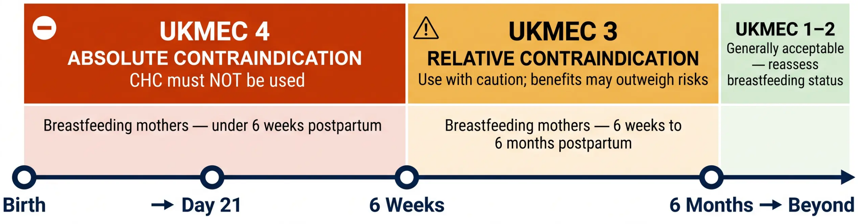





Combined Hormonal Contraception Rules
UKMEC Categories in the Postnatal Period
Combined Oral Contraceptive (COC)
Vaginal Ring
Contraceptive Patch
Non-breastfeeding mothers: CHC can start from
Reason for restriction: Oestrogen suppresses milk
supply and increases VTE risk in early postnatal period
Day 21 postpartum (UKMEC 1)
www.bradfordvts.co.uk

Slide 10








CONTRACEPTION AT 6 WEEKS — PART 2
Progestogen-Only and LARC Options
Postpartum contraception timing — safe starts for every method
Progestogen-Only Pill (POP)
Injectable (Depo-Provera)
e.g. Cerazette, Noriday
Medroxyprogesterone acetate
✓ Start from Day 21 postpartum
✓ Can start any time postpartum (UKMEC 1)
✓ Safe while breastfeeding (UKMEC 1–2)
✓ If given before 6 weeks — may increase bleeding
✓ Can start at 3 weeks even if breastfeeding
✓ Safe in breastfeeding
✓ No effect on milk supply
✓ 12-week duration — consider if compliance concern
● UKMEC 1–2 — Generally safe
● UKMEC 1 — Any time postpartum
Implant (Nexplanon)
IUD / IUS
Etonogestrel subdermal implant
Copper IUD or Levonorgestrel IUS (e.g. Mirena)
✓ Can be inserted any time postpartum (UKMEC 1)
✓ Insert from Day 28 (4 weeks) postpartum (UKMEC 1)
✓ Highly effective — 3 years duration
✓ Can be inserted immediately postpartum or at 4+ weeks
✓ Safe in breastfeeding
✓ Safe in breastfeeding
✓ Ideal if immediate long-term contraception desired
✓ IUS also reduces heavy periods — dual benefit
● UKMEC 1 — Any time postpartum
● UKMEC 1 from Day 28 postpartum
POSTPARTUM TIMING REFERENCE
Day 0 (Birth) →
● Day 21
● ● ● Day 28 (4 weeks)
● 6 weeks
6 months
www.bradfordvts.co.uk
Slide 10 of 28

Slide 11




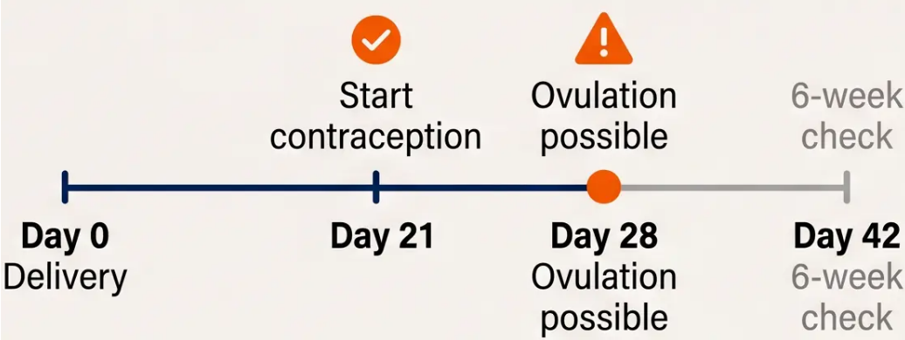




Contraception: Key Counselling Points
What every woman must be told at the 6-week check
Ovulation from Day 28
Lactational Amenorrhoea Method (LAM)
LAM is only reliable if ALL THREE conditions are
simultaneously met:
1 — Fully breastfeeding (no supplementary
feeds or formula)
2 — Amenorrhoeic (periods have not returned)
- Women who are not breastfeeding can ovulate from
day 28 postnatally
3 — Baby is less than 6 months old
- Contraception should be started from day 21 if
intercourse has resumed — before the 6-week check
If any one condition fails → LAM is no longer reliable
→ advise additional contraception immediately
Don’t wait for the 6-week check — it may be too late
www.bradfordvts.co.uk

Slide 12






Section 4 of 8 — Perinatal Mental Health
Perinatal Mental Illness
Overview of Prevalence and Urgency
50–80%
10–15%
of new mothers
1–2 per 1,000
deliveries
of new mothers
● Baby Blues
● Postnatal Depression
● Puerperal Psychosis
Onset: Days 3–5 after delivery
Tearfulness, emotional lability
Self-limiting — reassurance only
Onset: 2 weeks to 12 months
Low mood, poor bonding, anxiety
Screen with EPDS — treat actively
Onset: Within 2 weeks of delivery
Hallucinations, delusions, confusion
Psychiatric EMERGENCY — admit
urgently
⚠ Severity increases as prevalence decreases — always rule out psychosis first in acute presentations
www.bradfordvts.co.uk
Postnatal Care for GP Trainees — Bradford VTS 2026

Slide 13






Screening with the EPDS Tool
Edinburgh Postnatal Depression Scale — NICE NG194 (2021)
Booking Visit
4–6 Weeks Postnatal
3–4 Months Postnatal
(Antenatal)
(6-Week Check — GP)
(Health Visitor)
First opportunity to detect
antenatal depression and anxiety
Performed at the mandatory
GP postnatal review
Continued monitoring beyond
the 6-week check
10 Questions
Validated Screening Tool
Self-report questionnaire. Each item scored 0–3.
Maximum total score: 30
Validated for use both antenatally and postnatally.
Not diagnostic — guides clinical assessment.
www.bradfordvts.co.uk
Postnatal Care for GP Trainees | Bradford VTS 2026

Slide 14





EPDS Scoring and Interpretation
Edinburgh Postnatal Depression Scale — 10 questions, maximum score 30
Low risk — no significant concern
0 – 8
Reassurance. Follow up at next routine contact.
✔
Possible depression — borderline
9 – 11
Monitor closely. Repeat EPDS at next visit. Explore further in consultation.
⚠
Clinical assessment required.
Offer psychological support (CBT / IPT).
Consider antidepressant therapy.
≥ 12
Probable depression
❶
Q10 ≥ 3
URGENT — Immediate risk assessment.
Do not leave unattended. Refer same-day.
Suicidal ideation present
⚠
⚠ Always review Question 10 first, regardless of total score.
www.bradfordvts.co.uk |
Slide 14 of 28 — Bradford VTS Teaching Deck

Slide 15









EPDS Question 10: Suicide Risk
EPDS — Question 10 of 10
The thought of harming myself has
occurred to me.
0 — Never
1 — Hardly ever
2 — Sometimes
3 — Yes, quite often
Score of 3 = ‘Yes, quite often’ — the highest severity response
⚠ Score ≥ 3 on Q10
Requires IMMEDIATE
urgent risk assessment
Regardless of total EPDS score
• Do not leave the patient unattended
• Conduct a full suicide and self-harm
risk assessment
• Escalate urgently — involve mental
health services or crisis team
www.bradfordvts.co.uk

Slide 16












Baby Blues vs. Postnatal Depression
Knowing when to reassure — and when to act
Baby Blues
Postnatal Depression
Days 3–5 Postpartum
From 2 Weeks Postpartum Onward
• Affects 50–80% of women
• Affects 10–15% of women
• Tearfulness, emotional lability, mood swings
• Persistent low mood, tearfulness, poor bonding
VS
• Triggered by rapid hormonal shift after delivery
• Anxiety, cognitive impairment, fatigue
• Self-limiting — resolves without treatment
• Can persist for months without treatment
• No impact on bonding or function (transient)
• Risk factors: previous PMI, poor social support
Management: Reassurance and support only
Management: Clinical assessment required
No pharmacological treatment needed
EPDS screening → CBT / antidepressants (sertraline)
Key Teaching Point: Baby blues peaks at day 3–5 and resolves spontaneously.
If tearfulness persists beyond 2 weeks → assess for PND with EPDS.
www.bradfordvts.co.uk
Postnatal Care for GP Trainees — Bradford VTS 2026

Slide 17










Management of Postnatal Depression
First-line approaches for mild-to-moderate PND
Cognitive
Behavioural
Therapy (CBT)
Guided
Self-Help
Listening
Visits
- Individual structured
psychotherapy
- CBT-based self-help resources
- Delivered by health visitor
- Workbooks or online
programmes
- Non-directive, supportive
approach
- Challenges negative thought
patterns
- Facilitated by a practitioner
- Regular home-based contact
- Recommended by NICE NG194
- Accessible and low-intensity
first step
- Particularly valuable in early
weeks
- Delivered by trained practitioner
💊 Pharmacological treatment (sertraline — see next slide) is considered alongside or after psychological
approaches, particularly in moderate-to-severe PND or when psychological therapy is declined or unavailable.
www.bradfordvts.co.uk

Slide 18








18 of 28
Pharmacological Treatment: Sertraline
Choosing the right antidepressant in breastfeeding mothers
FIRST-LINE SSRI IN BREASTFEEDING: SERTRALINE
1
Lowest transfer into breast milk — widely used and well evidenced (BNF / NICE 2025)
Preferred
Second-line
Avoid
Sertraline
Paroxetine
Fluoxetine
First-line choice
Second-line option
Avoid in breastfeeding
2
Lowest breast milk transfer
Well-tolerated by infant
Start at standard dose
Also low breast milk transfer
Acceptable if sertraline not
tolerated
Long half-life — accumulates
in infant
Risk of infant side effects
Continue antidepressant for at least 6 months after symptom resolution —
same as non-postnatal depression
3
www.bradfordvts.co.uk

Slide 19





Puerperal Psychosis: Emergency Care
Perinatal Mental Illness — Section 5 of 5
⚠ PSYCHIATRIC EMERGENCY — Onset within 2 weeks of delivery — Admit urgently
🔍 Recognise It
⚡ Act Now
1. Urgent risk assessment — suicidal ideation
AND infanticide risk
• Onset within 2 weeks of delivery
• Hallucinations (auditory or visual)
2. Do not leave mother unattended with the baby
• Delusions (often related to the baby)
3. Admit to Mother and Baby Unit (MBU) — keeps
mother and baby together
• Rapid, dramatic mood shifts
• Severe confusion or disorientation
4. If MBU unavailable → psychiatric ward admission
• Agitation, bizarre or disorganised behaviour
5. Medications: olanzapine, quetiapine
(antipsychotics); lithium may be used — monitor
levels; discuss breastfeeding implications
• Insomnia (not explained by baby’s needs)
Prevalence: 1–2 per 1,000 deliveries;
Rare — but life-threatening if missed
⚠ High risk of suicide and infanticide —
never underestimate
NICE NG194 (2021) | NICE CKS Postnatal Care (February 2026)
www.bradfordvts.co.uk

Slide 20










Breastfeeding: Benefits and Support
Maternal and infant advantages — and managing common challenges
Why Breastfeed?
Common Challenges
For the Mother:
Engorgement
- Reduced risk of breast and ovarian cancer
Frequent feeding · cool packs · express if needed
- Lower risk of type 2 diabetes
- Faster uterine involution
Nipple Pain / Damage
- Reduced risk of postnatal depression
Check latch · lanolin cream · consider
breast shields
- Natural child spacing (with LAM — caveats apply)
For the Baby:
- Fewer GI and respiratory infections
Insufficient Milk Supply
- Reduced risk of SIDS
Reassure · frequent feeding · refer to
lactation consultant · monitor infant weight
- Lower obesity risk in later life
- Optimal nutrition — uniquely tailored
- Reduced ear infection risk
*For mastitis and breast abscess — see next slide
www.bradfordvts.co.uk

Slide 21
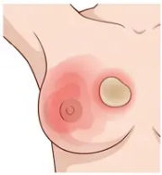







Bradford VTS
Managing Mastitis and Abscesses
Breastfeeding Complications — Recognition and Treatment
◆ MASTITIS
● BREAST ABSCESS
Infection of breast tissue — usually unilateral
Localised collection of pus — requires drainage
Symptoms to Recognise:
How to Identify:
- Red, hot, tender area of breast
- Fluctuant, tender breast mass
- Fever, flu-like symptoms
- Fever not settling on antibiotics
⚠ If not resolving
→ suspect abscess
- Usually 2–4 weeks postnatally
- May have pointing or visible skin changes
Management:
Management steps:
Flucloxacillin 500 mg QDS
🔬 Ultrasound (USS) — confirm diagnosis and guide drainage
Duration: 10 days
Fluctuant mass +
fever persisting
💉 Aspiration or surgical drainage — definitive treatment
(BNF — first-line antibiotic)
💊 Continue antibiotics — flucloxacillin (or co-amoxiclav if
MRSA risk)
Continue breastfeeding — do not stop
🤱 Breastfeeding from unaffected side — continue if possible
Warm compress + frequent feeding
🏥 Refer to secondary care if large, multi-loculated, or
systemically unwell
Review if no improvement at 48–72 hours
💡 Key Pearl: Always continue breastfeeding in mastitis — stopping increases abscess risk. Flucloxacillin is BNF first-line; not erythromycin.
www.bradfordvts.co.uk
Created May 2026 | NICE NG194 / CKS February 2026

Slide 22






Postpartum Thyroiditis Assessment
An often-missed diagnosis — screen at 1–4 months if symptomatic
What Is It?
Clinical Phases
Postpartum thyroiditis is an autoimmune inflammation of
the thyroid gland occurring in the first year after delivery. It
typically presents in two phases — an initial hyperthyroid
phase followed by a hypothyroid phase — though either
phase may occur alone.
Phase 1 — Hyperthyroid
Phase 2 — Hypothyroid
Weeks 1–4 months postpartum
Months 4–8 postpartum
Palpitations
Fatigue, low energy
🕒 Timing: Symptoms typically emerge between 1 and 4
months postpartum
Cold intolerance
Anxiety, irritability
Weight loss
Weight gain
🔬 Action: Check TFTs if the woman is symptomatic at any
postnatal contact in this window
Heat intolerance
Low mood (may mimic
Tremor
PND)
Higher Risk In:
Constipation
• Women with pre-existing thyroid antibodies (anti-TPO positive)
*Most women recover normal thyroid function by 12 months.
• Personal or family history of autoimmune thyroid disease
• Type 1 diabetes mellitus
~20–30% develop permanent hypothyroidism.
🩺 Check TFTs at any postnatal contact between 1–4 months if the woman reports relevant
symptoms — do not dismiss as PND without excluding thyroid dysfunction first.
www.bradfordvts.co.uk

Slide 23










Top Tips for Postnatal Care
Key clinical advice for the 6-week check and beyond
EPDS
Sertraline
Contraception
Baby Blues
01
02
03
04
Question 10
First-Line
Timing
vs PND
Always review Q10 first
— score ≥3 means
urgent risk assessment,
regardless of total score
In breastfeeding mothers
— NOT fluoxetine
(accumulates in infant)
Ovulation from day 28 —
discuss contraception
before resuming
intercourse; don't assume
breastfeeding is protective
Baby blues peaks days
3–5, self-limiting — PND
starts from 2 weeks
onward; reassess if
mood persists
Puerperal
Mastitis
Postpartum
05
06
07
Psychosis
Treatment
Thyroiditis
Onset within 2 weeks —
psychiatric emergency; admit
urgently to Mother and Baby
Unit
Flucloxacillin 500mg QDS 10
days — continue
breastfeeding throughout (BNF)
Check TFTs if symptoms
appear at 1–4 months
postnatally — commonly
missed
www.bradfordvts.co.uk
Slide 23 of 28

Slide 24













AKT Exam Pearls: High-Yield Facts
Know these cold — they come up repeatedly
EPDS Scoring
First-Line SSRI in Breastfeeding
Score ≥12 = probable depression — offer clinical assessment
and psychological support
Sertraline — lowest breast milk transfer; preferred first-line
✘ Fluoxetine — long half-life; accumulates in infant — avoid
Score ≥3 on Question 10 = urgent suicide risk assessment —
do not delay
CHC and Breastfeeding (UKMEC)
PMI Prevalence Figures
< 6 weeks postpartum + breastfeeding = UKMEC 4 (do not use)
6 weeks – 6 months postpartum + breastfeeding = UKMEC 3
(caution)
Baby blues: 50–80% — days 3–5, self-limiting — reassure only
PND: 10–15% — from 2 weeks onward — screen with EPDS
Puerperal psychosis: < 1–2 per 1,000 — psychiatric emergency
Contraception Timing Rules
Mastitis Treatment
Ovulation possible from day 28 — contraception needed from
day 21+
Flucloxacillin 500 mg QDS for 10 days (BNF)
Continue breastfeeding — stopping increases abscess risk
Abscess → USS + aspiration/drainage
Implant / injectable: can start immediately postpartum
IUD / IUS: from 4 weeks (28 days) postpartum
www.bradfordvts.co.uk
Slide 24 of 28

Slide 25













Red Flags: Urgent Identification
Conditions requiring immediate action — do not delay
> EPDS Question 10
Score ≥ 3
> Confusion,
Hallucinations, Rapid
Mood Shift
> Severe Headache +
Hypertension
- Suicidal ideation present
- Can occur up to 6 weeks
postnatally
- Immediate risk assessment —
do not leave alone
- Onset within 2 weeks of delivery
- Psychiatric emergency
- Check BP immediately
- Urgent same-day referral or
crisis team
- Admit urgently to Mother and
Baby Unit
- Emergency admission — 999
if severe
> Heavy or Persistent
Bleeding
> Fever + Breast Pain +
Fluctuant Mass
> Positional Headache
After Epidural or Spinal
- Blood loss greater than 500 ml
- Do not delay — risk of sepsis
- Worse on sitting or standing,
relieved lying flat
- Ongoing or worsening bleeding
- Urgent ultrasound
- Urgent referral or emergency
admission
- Surgical aspiration or drainage
needed
- Anaesthetic review urgently
- Blood patch may be required
Bradford VTS Teaching Deck — Postnatal Care for GP Trainees
www.bradfordvts.co.uk

Slide 26












Common Pitfalls in Postnatal Care
Errors to recognise — and correct — in clinical practice
⚠ AVOID THESE MISTAKES
Prescribing fluoxetine to
breastfeeding mothers
Not screening for PND at
the 6-week check
Neglecting contraception
discussion
→ Use sertraline — lowest breast
milk transfer; first-line SSRI
→ EPDS screening is mandatory per
NICE NG194 at every postnatal contact
→ Ovulation from day 28 — discuss
and document contraception plan
Reassuring all tearfulness
as baby blues
Missing postpartum thyroiditis
Stopping antidepressants
too early
→ Baby blues: days 3–5 only. Persistent
tearfulness → assess for PND
→ Check TFTs at 1–4 months if symptoms
(fatigue, palpitations, weight change)
→ Continue for at least 6 months
after symptom resolution
www.bradfordvts.co.uk

Slide 27












Quick Recall: Essential Summary
High-yield facts — know these cold before your AKT
EPDS
PND vs Baby Blues
Puerperal Psychosis
Baby blues: days 3–5, self-limiting,
50–80%
10 questions — max score 30
Onset <2 weeks post-delivery
Score ≥12 → probable depression
Prevalence: 1–2 per 1,000
Score ≥3 on Q10 → urgent suicide risk
assessment
PND: from 2 weeks onward, 10–15%
Features: hallucinations, delusions,
confusion
Persistent tearfulness beyond day 5 →
assess for PND
Q10 = suicidal ideation — check this first
Admit urgently → Mother and Baby Unit
Mastitis
Key Medications
Contraception
Flucloxacillin 500mg QDS × 10 days
(BNF)
PND in breastfeeding → Sertraline (first-line)
Not fluoxetine — long half-life, accumulates
in infant
Ovulation from day 28 — act before 6-week
check
Continue breastfeeding — do not stop
CHC: UKMEC 4 if breastfeeding <6 weeks
Antidepressant: continue ≥6 months after
resolution
POP: safe from day 21 (breastfeeding: 3
weeks)
Abscess → USS + aspiration/drainage
Not erythromycin
Puerperal psychosis → olanzapine /
quetiapine
Implant / injectable: immediately postpartum
IUD/IUS: from 4 weeks postpartum
www.bradfordvts.co.uk

Slide 28






Final Disclaimer & Resources
Bradford VTS Teaching Deck — Postnatal Care for GP Trainees
Educational Use Only
This teaching deck has been created for educational purposes for GP trainees within the
Bradford VTS programme. It is not intended as clinical guidance and does not replace
individual clinical judgement. Always verify all drug doses, contraindications, and clinical
recommendations against the latest versions of:
- NICE Guidelines (including NG194 and CKS Postnatal Care, updated February 2026)
- British National Formulary (BNF) 2025/2026
- Local trust and ICB protocols
🌐 Further resources and updated decks: www.bradfordvts.co.uk
Slide 28 of 28 · Created May 2026
www.bradfordvts.co.uk · Bradford VTS Teaching Deck · Postnatal Care for GP Trainees · May 2026

