Slide 1


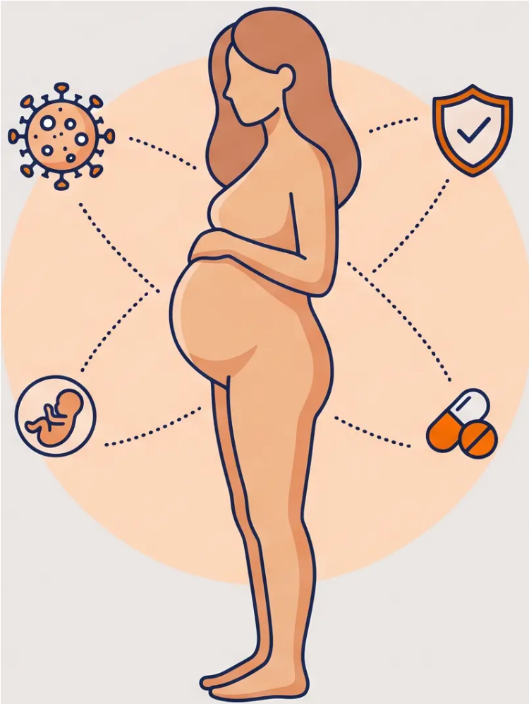






BRADFORD VTS TEACHING DECK
June 2026
Chickenpox in Pregnancy
Varicella-Zoster Virus (VZV) — Maternal & Fetal Risks,
Exposure Management, and Treatment in Pregnancy
Maternal Risks
Fetal Risks
Management
www.bradfordvts.co.uk
Slide 24 of 30

Slide 2

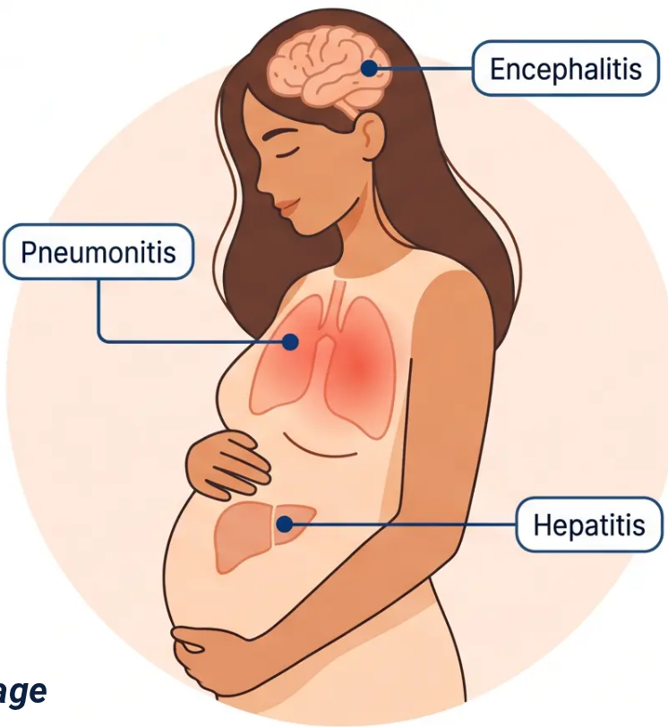








BRADFORD VTS TEACHING DECK
Section 4 — Chickenpox in Pregnancy
“Maternal Risks and Varicella Pneumonitis”
“Chickenpox in pregnancy carries significantly greater risk than in the general population”
Complications Panel
10x
Varicella Pneumonitis
- Most serious complication
- Risk highest in 2nd and 3rd trimesters
- Can be life-threatening — requires hospital
admission
“Increased Risk
of Varicella
Pneumonitis”
Encephalitis
- Rare but severe neurological complication
- Altered consciousness, seizures
“Compared to non-pregnant
adults of the same age”
Hepatitis
- Liver inflammation
- Monitor LFTs if suspected
⚠ Risk is highest in the 2nd and 3rd trimesters — severity increases with gestational age
www.bradfordvts.co.uk
25 / 30

Slide 3


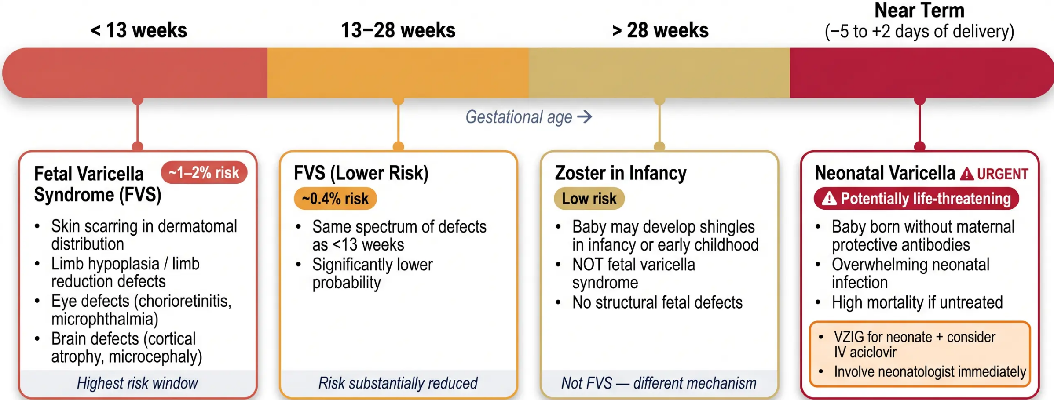


BRADFORD VTS TEACHING DECK
Section 4 — Chickenpox in Pregnancy
Fetal Varicella Syndrome & Neonatal Risks
Risk to the baby depends critically on the timing of maternal infection
www.bradfordvts.co.uk
Slide 26 of 30

Slide 4
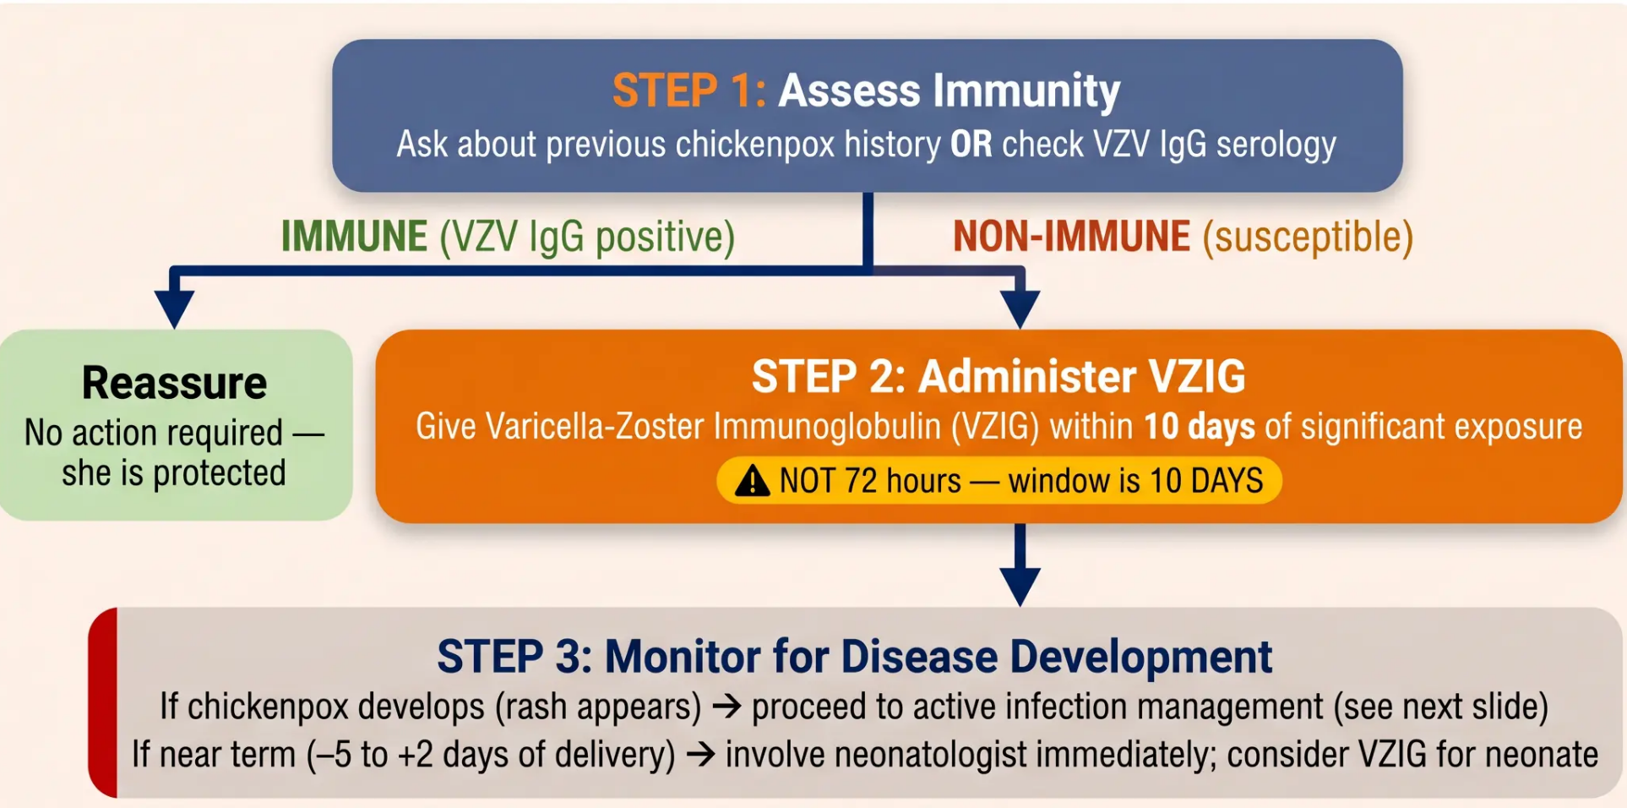



BRADFORD VTS TEACHING DECK
Management of Exposure & VZIG
Chickenpox in Pregnancy — Section 4
Key Fact
VZIG window =
10 days
Not 72 hours.
This is a frequent
AKT exam trap.
www.bradfordvts.co.uk
Slide 27 of 30

Slide 5












BRADFORD VTS TEACHING DECK
Section 4 — Chickenpox in Pregnancy
Management of Active Chickenpox Infection
ACICLOVIR — FIRST-LINE ANTIVIRAL
➔ Indication: Chickenpox developing in the 2nd or 3rd trimester
Admit to Hospital If:
Pneumonia or respiratory symptoms
Severe or haemorrhagic rash
Neurological symptoms (encephalitis)
Immunocompromised patient
Near term (±5 days of delivery)
➔ Dose: 800 mg orally, 5 times daily
➔ Duration: 7 days
➔ Timing: Must be started within 24 hours of rash onset —
efficacy significantly reduced after this window
*Also consider in 1st trimester if severe disease — senior obstetric review
*IV aciclovir required for hospitalised cases
USE — Paracetamol
AVOID — Ibuprofen & Aspirin
*Safe for fever and pain relief in pregnancy
*Ibuprofen: contraindicated in pregnancy
Standard adult dosing applies
Aspirin: risk of Reye’s syndrome in neonate
www.bradfordvts.co.uk
Slide 28 of 30

