Slide 1




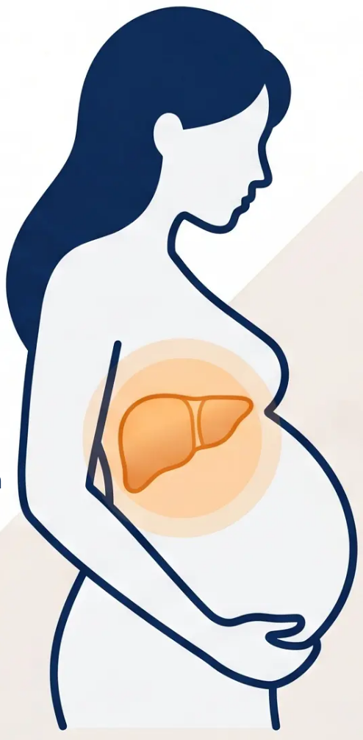





BRADFORD VTS TEACHING DECK
Obstetric
Cholestasis
Intrahepatic Cholestasis
of Pregnancy (ICP)
Generalised
Pruritus
Bile Acid
Accumulation
A liver disorder unique to pregnancy —
characterised by pruritus and elevated bile acids
Pruritus (no rash)
Bile Acids ≥19 µmol/L
Third Trimester
Affects ~0.5–1.5% of pregnancies in the UK | Higher in South Asian populations
www.bradfordvts.co.uk
Slide 18 of 30

Slide 2

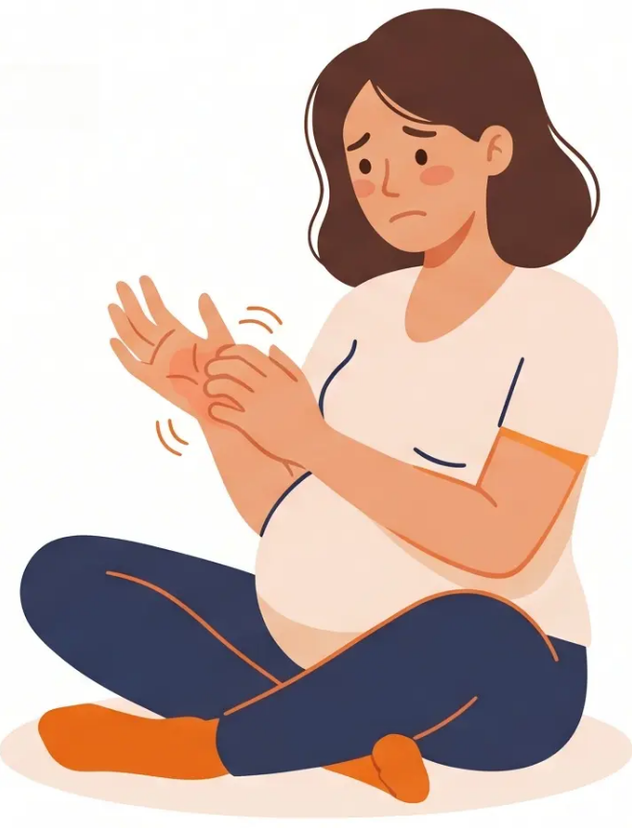








BRADFORD VTS TEACHING DECK
SECTION 3 — OBSTETRIC CHOLESTASIS
Clinical Presentation of ICP
Intrahepatic Cholestasis of Pregnancy — Recognising the Classic Picture
Generalised Pruritus
Intense itching — worst on the palms of the hands and soles of the
feet. Characteristically worse at night. No primary skin rash.
No rash — the itch IS the symptom
No Primary Rash
Unlike other causes of pruritus in pregnancy (e.g. PUPPP, eczema),
ICP produces no primary skin lesion. Scratch marks (excoriations)
may be visible — but these are secondary to the itch, not a rash.
Jaundice and Other Features
Jaundice occurs in approximately 20% of cases. When present:
dark urine and pale stools may also appear. Symptoms worsen as
pregnancy progresses and resolve dramatically after delivery.
Symptoms typically begin in the third
trimester and resolve within days of delivery.
www.bradfordvts.co.uk
Slide 19 of 30

Slide 3


















BRADFORD VTS TEACHING DECK
Diagnostic Investigations for ICP
Section 3 — Obstetric Cholestasis
Intrahepatic Cholestasis of Pregnancy — Key Laboratory Tests
Serum Bile Acids
LFTs — ALT & AST
Bilirubin
Prothrombin Time (PT)
≥19 µmol/L = ICP
confirmed
Raised — typically 2–3×
upper limit of normal
May be mildly raised;
jaundice in ~20% of
cases
Prolonged if severe —
fat-soluble vitamin
malabsorption
PRIMARY DIAGNOSTIC TEST
Gamma-GT
Ultrasound Abdomen
Hepatitis Serology
May be mildly raised
Exclude biliary obstruction
Exclude viral hepatitis
⚠ Key Threshold: Serum Bile Acids ≥19 µmol/L = Diagnostic for ICP
*Bile acids ≥40 µmol/L → offer delivery from 35 weeks | ≥100 µmol/L → consider earlier delivery*
www.bradfordvts.co.uk
Slide 20 of 30

Slide 4










**BRADFORD VTS TEACHING DECK**
Medical Management of ICP
Ursodeoxycholic Acid · Symptomatic Relief · Vitamin K
UDCA (First-Line Treatment)
Symptomatic Relief
Vitamin K
FIRST-LINE
ADJUNCT THERAPY
IF COAGULOPATHY
• Dose: 10–15 mg/kg/day in divided doses
• Chlorphenamine (chlorpheniramine):
• Indicated if ‘prothrombin time (PT) is
prolonged’
• Reduces pruritus and may improve fetal
outcomes
• Antihistamine for itch relief
• Caused by fat-soluble vitamin
malabsorption
• Safe in pregnancy (BNF confirmed)
• BNF: Licensed for cholestatic liver disease
• Aqueous cream with menthol:
• Use ‘water-soluble form (menadiol)’
• Monitor response with weekly bile acids
and LFTs
• Topical application for skin relief
• Check PT as part of monitoring bloods
• Cooling effect on palms and soles
Start as soon as ICP is confirmed
Do not use as sole treatment — always add UDCA
Fat-soluble vitamin absorption impaired in severe ICP
AKT Pearl
UDCA is first-line for ICP — antihistamines alone are insufficient. Always monitor with weekly bile acids and LFTs.
www.bradfordvts.co.uk
Slide 21 of 30 | Section 3 — Obstetric Cholestasis (ICP)

Slide 5















BRADFORD VTS TEACHING DECK
Fetal Risks and Timing of Delivery
Obstetric Cholestasis (ICP)
Preterm Birth
Meconium-Stained Liquor
Stillbirth
Risk increases with rising
bile acid levels
Fetal distress risk in labour
Risk rises sharply when bile
acids ≥ 40 µmol/L
Zone 2
Zone 3
Zone 1
≥ 100 µmol/L
≥ 19 µmol/L
≥ 40 µmol/L
CONSIDER EARLIER
DELIVERY
DIAGNOSTIC
OFFER DELIVERY
ICP confirmed — begin
monitoring and treatment
From 35 weeks gestation —
increased stillbirth risk
Senior obstetric review —
discuss immediate delivery
⚠ Weekly monitoring of bile acids and LFTs throughout — escalate promptly if thresholds reached
www.bradfordvts.co.uk
Slide 22 of 30

Slide 6







BRADFORD VTS TEACHING DECK
Postnatal Care and Future Risks
Obstetric Cholestasis (ICP)
After Delivery
Postnatal Follow-Up
Future Considerations
• Pruritus resolves within days of
delivery
• Reassess LFTs and bile acids at 6–12
weeks postnatally
• Avoid combined oral contraceptive
pill (COC) — oestrogen may trigger ICP
recurrence
• Bile acids normalise within days to
weeks
• Confirm full normalisation of liver
function
• Progesterone-only pill (POP) or barrier
methods preferred
• LFTs return to normal
• If LFTs remain elevated → investigate
for underlying liver disease
• Recurrence risk in future pregnancies:
45–90%
• Symptoms dramatically improve
post-delivery
• Consider referral to hepatology if
persistent abnormality
• Counsel patient before next pregnancy
• Early bile acid monitoring in subsequent
pregnancies
Delivery is curative
Don’t discharge without postnatal bloods
⚠ COC contraindicated post-ICP
ICP resolves after delivery — but postnatal follow-up and contraception counselling are essential
www.bradfordvts.co.uk
Slide 23 of 30

