Slide 1





BRADFORD VTS TEACHING DECK
www.bradfordvts.co.uk
Antenatal Care
and Monitoring
A Comprehensive Guide for GP Trainees
Based on NICE NG201 (2021, updated 2024 standards)
🗓️ Created: June 2026 — Updated to NICE NG201 2024 Standards
🌐 www.bradfordvts.co.uk
Sources: NICE NG201 · NICE CKS · BNF 2025/2026
⚠ Disclaimer: This presentation is for educational purposes only. Always verify drug doses and clinical guidance against the latest NICE and BNF publications before applying to clinical practice.

Slide 2













BRADFORD VTS TEACHING DECK
Overview: Purpose of Antenatal Care
*NICE NG201 · 2024
Why antenatal care matters — the five core goals
Identify &
Manage Risks
Identify
Additional Needs
Detect conditions
threatening mother
or baby's health
Detect conditions
threatening mother
or baby's health
Monitor Fetal
Wellbeing
Education &
Support
Prepare for
Labour
Additional
Needs
Track progress of
pregnancy and fetal
development
Provide information,
psychological and
emotional support
Plan for delivery,
postnatal care and
breastfeeding
Refer women needing
specialist or
additional care
www.bradfordvts.co.k

Slide 3








BRADFORD VTS TEACHING DECK
First GP Contact: Timing and Booking
What to do when a woman first presents in primary care
Confirm Pregnancy
Book Midwifery Care
Care Pathway
- Positive home pregnancy test
or missed period
- Refer to midwife promptly at
first contact
Provider
Role
- Establish Last Menstrual Period
(LMP)
- Booking appointment must be in
place by 10 weeks
Initial booking,
shared care, problem
management
GP
- NICE NG201 standard — GP
responsibility to ensure this
happens
- Confirm gestational age
Midwife
Routine antenatal
care (uncomplicated)
- Calculate Estimated Due Date
(EDD)
- Uncomplicated pregnancies:
midwife-led care
High-risk
EDD = LMP + 280 days (40 weeks)
Adjusted by dating USS at 10–14 weeks
Obstetrician
pregnancies,
referrals
Target: Booking by 10 weeks gestation
www.bradfordvts.co.uk
NICE NG201 · 2024 Standards

Slide 4





BRADFORD VTS TEACHING DECK
Supplements: Folic Acid and Vitamin D
NICE NG201 · BNF 2025/2026 · Updated 2024 Standards
Folic Acid
Vitamin D
• Standard dose: 400 mcg daily
• Dose: 10 mcg (400 IU) daily
• High-risk dose: 5 mg daily
• Duration: Throughout entire pregnancy
• When to start: Ideally before conception
• Also recommended: During breastfeeding
• Guideline: NICE 2024 update
• Duration: Continue until end of week 12
💡 Note: Vitamin D is particularly important
for women with limited sun exposure, darker
skin tones, or those who cover their skin.
⚠️ High-Risk Indications for 5mg:
Obesity · Epilepsy · Previous NTD ·
Diabetes · Malabsorption
www.bradfordvts.co.uk
Slide 4 of 28

Slide 5
















BRADFORD VTS TEACHING DECK
www.bradfordvts.co.uk
Lifestyle Advice and Initial Risk Assessment
*First GP Contact — What to discuss and screen for
LIFESTYLE ADVICE
INITIAL RISK ASSESSMENT
Smoking Cessation
Domestic Violence and Abuse
Refer to NHS Stop Smoking Service; offer NRT if needed;
document smoking status
Ask at EVERY first contact — alone, without partner present
• Ask directly and sensitively in a private setting
• Use MARAC referral pathway if high risk identified
Alcohol — Advise Complete Avoidance
• Document carefully; follow safeguarding protocols
No safe level established in pregnancy; risk of fetal
alcohol spectrum disorder
Depression Risk Screening
Diet and Food Safety
Use Whooley questions or EPDS at booking
• Identify prior mental health history, current mood, support
network
Avoid unpasteurised cheese, raw eggs, liver, high-
mercury fish; eat well-balanced diet rich in iron and folate
• Refer to perinatal mental health team if concerns identified
Exercise and Rest
Moderate activity encouraged; avoid contact sports and
high-risk activities
Always ask about domestic violence in
private — never with the partner in the room.
www.bradfordvts.co.uk

Slide 6
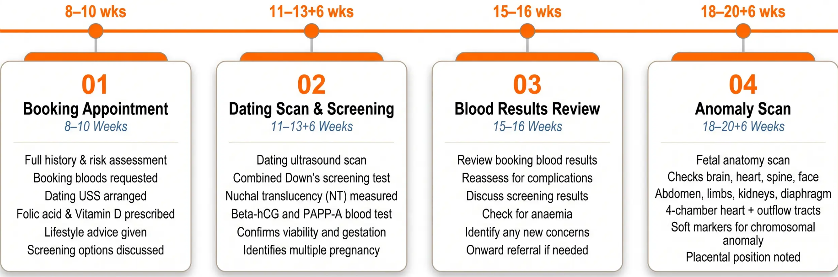

BRADFORD VTS TEACHING DECK
www.bradfordvts.co.uk
Appointment Schedule: Nulliparous Women
*First Four Appointments — Weeks 8 to 20 — NICE NG201
💡 NICE NG201: Nulliparous women have 10 antenatal appointments in total.
These first four appointments establish baseline health, screening, and fetal anatomy.
www.bradfordvts.co.uk

Slide 7











BRADFORD VTS TEACHING DECK
www.bradfordvts.co.uk
Appointment Schedule: Nulliparous Women
Appointments 5–10 · 25 to 38 Weeks Gestation
⟳ Recurring at every visit from 25 weeks: Symphysis-fundal height (SFH) · Blood pressure · Urine dipstick
Appointment 5
25 weeks
Appointment 6
28 weeks
– Symphysis-fundal height (SFH) measurement
– SFH, BP, urine
– Blood pressure check
– Bloods: Hb, antibodies, glucose challenge (if risk factors)
– Urine dipstick
– Anti-D prophylaxis if Rhesus D negative
Appointment 7
31 weeks
Appointment 8
34 weeks
– SFH, BP, urine
– SFH, BP, urine
– Review 28-week blood results
– Second dose anti-D (if Rh negative — 500 IU regimen)
– Address concerns and questions
– Review fetal growth and wellbeing
Appointment 9
36 weeks
Appointment 10
38 weeks
– SFH, BP, urine
– SFH, BP, urine
– Check fetal presentation
– Plan for management of post-dates pregnancy
– Discuss birth plan and labour preferences
– Discuss options if pregnancy continues beyond
41 weeks
– Breastfeeding discussion
www.bradfordvts.co.uk · Bradford VTS Teaching Deck · Antenatal Care and Monitoring · May 2026

Slide 8









BRADFORD VTS TEACHING DECK
www.bradfordvts.co.uk
Appointment Schedule: Parous Women
7
Appointments
vs 10 for nulliparous
Uncomplicated subsequent pregnancies – streamlined to 7 appointments (NICE NG201)
Appt 1 • 8–10 wks
Appt 2 • 11–13+6 wks
Appt 3 • 18–20+6 wks
Appt 4 • 28 wks
Full history, bloods,
USS booking, lifestyle,
screening offer
Dating USS + Down’s
combined screening
test
Fetal anatomy scan;
structural anomaly
check
Bloods (Hb,
antibodies); anti-D if
Rh negative
Appt 5 • 34 wks
Appt 6 • 36 wks
Appt 7 • 38 wks
Anti-D (Rh neg);
SFH, BP, urine
Presentation check;
birth plan; breastfeeding
discussion
SFH, BP, urine; plan
for post-dates
Parous women with uncomplicated previous pregnancies require fewer appointments. Additional visits are arranged if complications arise.
www.bradfordvts.co.uk · Bradford VTS Teaching Deck · Antenatal Care and Monitoring

Slide 9







BRADFORD VTS TEACHING DECK
Antenatal Care and Monitoring
Routine Investigations: Booking Bloods
Part 1 of 2 — Performed at 8–10 Weeks Gestation
Full Blood Count (FBC)
Detects anaemia (Hb <110 g/L in first trimester) and thrombocytopenia — essential baseline for monitoring
monitoring throughout pregnancy
Blood Group and Antibodies (Group & Save)
ABO and Rhesus typing; screens for alloantibodies that could cause haemolytic disease of the fetus and
newborn (HDFN)
Rhesus D (RhD) Status
Identifies RhD-negative women who will require anti-D prophylaxis — critical for planning RAADP at 28
weeks and after sensitising events
Haemoglobin Electrophoresis
Offered to women at risk of sickle cell disease or thalassaemia based on family origin or clinical history —
enables counselling and fetal testing if carrier detected
www.bradfordvts.co.uk
Source: NICE NG201 · BNF 2025/2026

Slide 10



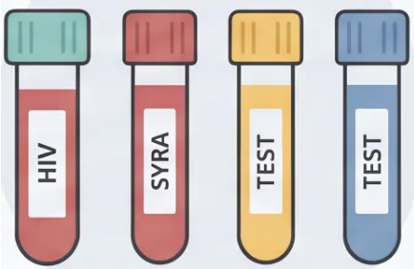

BRADFORD VTS TEACHING DECK
www.bradfordvts.co.uk
ROUTINE INVESTIGATIONS · BOOKING BLOODS
Booking Bloods — Part 2
Mandatory screening offers at 8–10 weeks for ALL pregnant women
HIV Test
Offered to ALL pregnant women regardless of risk
Reduces mother-to-child transmission to less than 1% with treatment
Syphilis Serology (VDRL / TPHA)
Screens for active or past syphilis infection
Congenital syphilis is preventable with early treatment
Rubella Immunity
Checks antibody status — not a treatment screen but informs post-natal MMR
Non-immune women offered MMR vaccination after delivery — NOT in pregnancy
*All four tests are universally
offered — not risk-stratified
HBsAg — Hepatitis B Surface Antigen
Identifies women with Hepatitis B infection
Positive result → neonatal vaccination and immunoglobulin at birth
www.bradfordvts.co.uk · Antenatal Care and Monitoring · Bradford VTS 2026

Slide 11






BRADFORD VTS TEACHING DECK
Routine Investigations: Urine and Other Tests
*Booking appointment · 8–10 weeks · NICE NG201*
Midstream Urine (MSU)
Urine Dipstick
Chlamydia Screening
Culture at Booking
Every Appointment
Women Under 25
– Screens for asymptomatic bacteriuria
– Protein → possible pre-eclampsia or
UTI
– Offered via National Chlamydia
Screening Programme (NCSP)
– Present in up to 5% of pregnant
women
– Glucose → possible gestational
diabetes; refer for OGTT if persistent
– Women aged under 25 at booking
– Must be treated — risk of
pyelonephritis if missed
– Asymptomatic infection common —
important to screen
– Blood → haematuria; investigate if
persistent
– Repeat if symptomatic at any point
– Treat with azithromycin (BNF — safe
in pregnancy)
Treat if positive — do not observe
Routine at every antenatal visit
Offer to all women under 25 at booking
Carbon Monoxide Testing — Offered at booking to assess smoking status. Refer to stop-smoking services if elevated reading.
www.bradfordvts.co.uk
Slide 11 of 28

Slide 12














BRADFORD VTS TEACHING DECK
www.bradfordvts.co.uk
Antenatal Screening: First
Trimester Combined Test
How the Combined Test Works
Nuchal Translucency (NT)
Ultrasound measurement of fluid at back of
baby's neck
USS at 11–13+6 weeks
*Offered at 11–13+6 weeks gestation*
Down’s Syndrome
T21
Blood Tests
*Most common trisomy; 1 in 700 live births*
Beta-hCG — Human chorionic gonadotrophin
PAPP-A — Pregnancy-associated plasma protein A
Edwards’ Syndrome
T18
*Severe; most pregnancies do not survive to term*
Combined Risk Score
Patau’s Syndrome
Individual risk calculated — reported as e.g. 1 in 150
T13
*Severe structural abnormalities; very poor prognosis*
*High risk result → offered diagnostic testing (CVS or amniocentesis)*
🔑 Key Point: The combined test is more accurate than any single test alone — — sensitivity for T21 approximately
85–90% with a 5% false-positive rate. It does not diagnose — a high-risk result triggers an offer of diagnostic testing.
www.bradfordvts.co.uk · Bradford VTS Teaching Deck · Antenatal Care and Monitoring · May 2026

Slide 13
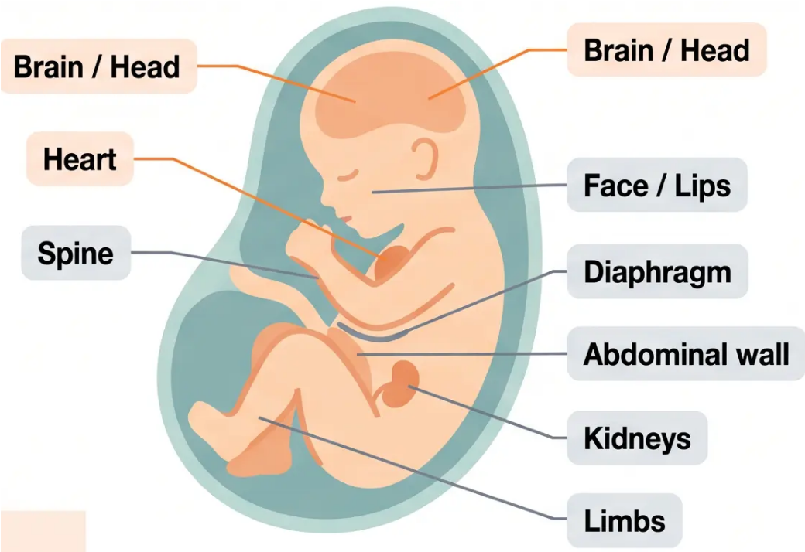

BRADFORD VTS TEACHING DECK
www.bradfordvts.co.uk
Antenatal Screening: Second Trimester Anomaly Scan
Fetal anatomy scan — offered at 18 to 20+6 weeks gestation
What Is Checked?
• 🧠 Brain — ventricles, cerebellum, posterior fossa
• 🫀 Heart — 4-chamber view + outflow tracts
• 🦴 Spine — neural tube defects
• 👁️ Face — cleft lip detection
• 🫁 Diaphragm — diaphragmatic hernia
• 🩸 Abdominal wall — gastroschisis, exomphalos
• 🫘 Kidneys — renal agenesis, pelviectasis
• 🦵 Limbs — long bone measurement, skeletal dysplasia
🔍 Soft Markers
Soft markers (e.g., echogenic bowel, choroid plexus cysts) may indicate
chromosomal anomaly — discuss with specialist if identified.
www.bradfordvts.co.uk
Source: NICE NG201 · NICE CKS Antenatal Care (202)

Slide 14


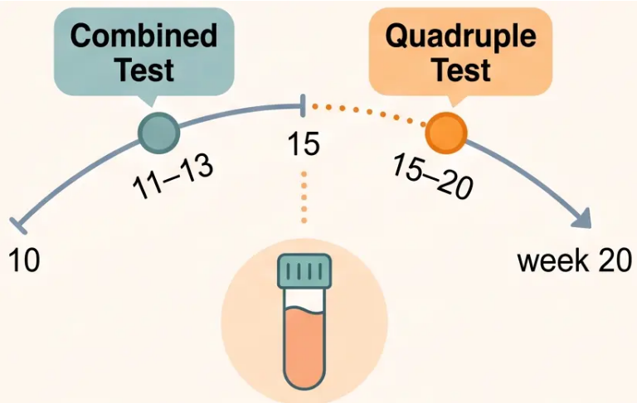



BRADFORD VTS TEACHING DECK
www.bradfordvts.co.uk
Antenatal Screening: Quadruple Test
Second-line screening for Down’s syndrome — offered 15–20 weeks if combined test was missed
When Is It Offered?
- Offered between 15 and 20 weeks of pregnancy
- Only if the first trimester combined test was missed or could not be performed
What Does It Measure?
🔬 AFP — Alpha-fetoprotein
🔬 hCG — Human chorionic gonadotrophin
🔬 uE3 — Unconjugated oestriol
🔬 Inhibin A
Combined to calculate a risk score for Trisomy 21 (Down’s syndrome) only
Important Limitations
- Screens for T21 (Down’s syndrome) only — does not screen for T18 or T13
4 4 blood markers
- Less accurate than the first trimester combined test — higher false-positive rate
- Should only be used when the combined test window has passed
⚠️ Preferred test remains the combined test at 11–13+6 weeks.
The quadruple test is a fallback — not a first choice.
www.bradfordvts.co.uk
NICE NG201 · NICE CKS · BNF 2025/2026 · Slide 14 of 28

Slide 15






BRADFORD VTS TEACHING DECK
www.bradfordvts.co.uk
Pre-Eclampsia Prevention: Low-Dose Aspirin
NICE NG133 — Hypertension in Pregnancy (2024 Update)
Prescribe Aspirin 75–150 mg once daily From 12 weeks gestation until delivery
Offer to women with ≥1 high-risk factor OR ≥2 moderate-risk factors
HIGH RISK
MODERATE RISK
One factor alone qualifies for aspirin
Two or more factors together qualify for aspirin
• Previous pre-eclampsia
• First pregnancy (nulliparous)
• Multifetal pregnancy (twins/triplets)
• Age 40 years or older
• Chronic hypertension
• BMI ≥ 35 kg/m² at booking
• Type 1 or Type 2 Diabetes Mellitus
• Family history of pre-eclampsia (first-degree relative)
• Chronic kidney disease (CKD)
• Interpregnancy interval > 10 years
• Low birthweight or SGA in previous pregnancy
• Autoimmune disease (SLE, antiphospholipid syndrome)
⚠ Always verify doses with current BNF. Educational use only.
www.bradfordvts.co.uk

Slide 16













BRADFORD VTS TEACHING DECK
www.bradfordvts.co.uk
Iron Deficiency Anaemia in Pregnancy
NICE NG201 · BNF 2025/2026
Diagnostic Thresholds
Treatment Pathway
Hb levels defining anaemia in pregnancy
Oral iron replacement — BNF first-line
FIRST TRIMESTER
1
Ferrous Sulphate 200mg — Three Times Daily
Haemoglobin below this
level = anaemia
First-line oral iron — take on an empty stomach where tolerated
2
Vitamin C Enhances Absorption
Take with orange juice or ascorbic acid to maximise iron uptake
SECOND & THIRD TRIMESTER
Monitor FBC at 2–4 Weeks
Most common threshold
during pregnancy
3
Check response — Hb should rise by approximately 20 g/L per month
4
Alternatives if Oral Not Tolerated
POSTPARTUM
Ferrous fumarate 210mg TDS · Ferrous gluconate · IV iron if oral fails
Postnatal anaemia threshold
Avoid tea, coffee, and dairy within 1 hour
of taking iron — they inhibit absorption
www.bradfordvts.co.uk
23 / 28

Slide 17
















BRADFORD VTS TEACHING DECK
www.bradfordvts.co.uk
Anti-D Prophylaxis (RAADP)
*For Rhesus D Negative Women — NICE NG25
Routine Prophylaxis (RAADP)
Sensitising Events
Miscarriage or threatened miscarriage > 12 weeks
Timing: Within 72 hours
Option A (Single Dose Regimen)
28
1500 IU anti-D IM at 28 weeks
Amniocentesis or CVS
(single dose)
Timing: Within 72 hours
Antepartum haemorrhage (APH) Timing: Within 72 hours
Option B (Two Dose Regimen)
Rh
External cephalic version (ECV) Timing: Within 72 hours
28
34
500 IU at 28 weeks +
500 IU at 34 weeks
Abdominal trauma
Timing: Within 72 hours
Delivery (any gestation)
Timing: Within 72 hours
Either regimen is acceptable per NICE NG25
Kleihauer Test: Required after large fetomaternal
haemorrhage (FMH) to calculate additional anti-D dose needed
Offer both options and document choice in notes
Exam Pearl: Anti-D must be given within 72 hours of any sensitising event. RAADP is given at 28 weeks
(and 34 weeks if two-dose regimen). Rhesus D status checked at booking — plan prophylaxis early.
www.bradfordvts.co.uk
24 / 28

Slide 18










BRADFORD VTS TEACHING DECK
www.bradfordvts.co.uk
Safeguarding and Psychosocial Assessment
Routine screening, EPDS, and appropriate referral pathways
Domestic Violence & Abuse
Depression Screening — EPDS
- Edinburgh Postnatal Depression Scale (EPDS)
used in pregnancy
- Screen at every antenatal appointment
- Ask in private — never with partner present
- Administer at booking appointment
- Use direct, non-judgemental language
- Repeat at 4-6 weeks postnatal
- Refer to MARAC if high-risk domestic violence
identified
- Score ≥13 suggests significant depressive
symptoms — refer appropriately
"Routine enquiry must happen at every visit —
not just at booking."
"Perinatal mental health problems are common
— early identification improves outcomes."
Child Protection Concern
MARAC Referral
Perinatal Mental Health Team
Refer to social services immediately
High-risk domestic violence cases
Complex mental health needs in pregnancy
www.bradfordvts.co.uk · Slide 25 of 28 · Bradford VTS Teaching Deck: Antenatal Care and Monitoring

Slide 19











BRADFORD VTS TEACHING DECK
Top Tips & AKT Exam Pearls
High-yield facts for the Applied Knowledge Test — NICE NG201 · BNF 2025/2026
TOP TIPS
AKT EXAM PEARLS
Folic Acid Dosing
Appointment Counts
400 mcg standard · 5 mg if high risk (obesity, epilepsy, previous
NTD, diabetes)
Nulliparous = 10 appointments · Parous = 7 appointments
(NICE NG201)
Vitamin D Throughout
GDM Thresholds (OGTT)
Fasting ≥ 5.6 mmol/L OR 2-hour ≥ 7.8 mmol/L → diagnose GDM
10 mcg (400 IU) daily — entire pregnancy, not just first trimester
First-Line Antihypertensive
Book by 10 Weeks
Labetalol — first-line in pregnancy; methyldopa or nifedipine as
alternatives
GP refers promptly to midwife — booking appointment must
happen by 10 weeks gestation
Avoid in Pregnancy
Aspirin from Week 12
ACE inhibitors and ARBs — teratogenic (renal dysgenesis,
oligohydramnios)
75–150 mg once daily for high-risk pre-eclampsia women —
continue until delivery
First-Line Antiemetic
Cyclizine 50 mg TDS — BNF first-line for nausea and vomiting
in pregnancy
Anti-D at 28 Weeks
RAADP — 1500 IU single dose OR 500 IU at 28 and 34 weeks
for Rh-negative women
Anaemia Thresholds
Hb < 110 g/L (T1) · < 105 g/L (T2/T3) · < 100 g/L (postnatal)
www.bradfordvts.co.uk

Slide 20





BRADFORD VTS TEACHING DECK
Red Flags & Common Pitfalls
Clinical Safety — Know Before You Go
⚠ RED FLAGS
⚠ COMMON PITFALLS
Immediate Emergency Action Required
Avoidable Errors in Antenatal Practice
→ BP ≥ 160/110 → Immediate hospital assessment —
severe pre-eclampsia
◆ Missing high-dose folic acid — 5mg not prescribed
when indicated (obesity, epilepsy, previous NTD,
diabetes)
→ Headache + visual disturbance + epigastric pain →
Pre-eclampsia until proven otherwise
◆ Not offering aspirin — 75–150mg from 12 weeks in
high-risk pre-eclampsia women is now standard care
→ Reduced fetal movements → Advise immediate
attendance — do NOT use home Doppler
◆ Prescribing ACE inhibitors or ARBs — Teratogenic;
check ALL medications at booking
→ Antepartum haemorrhage → Any vaginal bleeding
after 24 weeks → emergency hospital
→ Severe vomiting + weight loss + ketosis →
Hyperemesis gravidarum → hospital admission
◆ Not sending MSU at booking — Asymptomatic
bacteriuria must be treated (risk of pyelonephritis)
→ Fever + rigors + flank pain → Pyelonephritis →
hospital + IV antibiotics
◆ Dismissing reduced fetal movements — Never
reassure without formal assessment
www.bradfordvts.co.uk
27 / 28

Slide 21







BRADFORD VTS TEACHING DECK
www.bradfordvts.co.uk
Quick Recall
Essential numbers and drug choices — commit these to memory
400 mcg daily · 5 mg if high risk
(obesity, epilepsy, previous NTD, diabetes)
75–150 mg from week 12
(high-risk pre-eclampsia women)
Folic Acid
Aspirin
10 mcg (400 IU) daily
throughout pregnancy
Labetalol — first-line ·
Avoid ACE inhibitors & ARBs
Vitamin D
Antihypertensive
10 visits — nulliparous ·
7 visits — parous
1500 IU at 28 weeks ·
or 500 IU at 28 & 34 weeks
Appointments
Anti-D (RAADP)
Fasting ≥5.6 mmol/L ·
2-hour ≥7.8 mmol/L
Cyclizine 50 mg three times
daily (BNF safe in pregnancy)
GDM Thresholds
First Antiemetic
⚠ Final Disclaimer
This teaching deck is for educational purposes only. Clinical decisions should always be based on the most current NICE guidelines, BNF recommendations,
and individual patient assessment. Drug doses and thresholds may change — always verify with up-to-date sources before applying to clinical practice.
*Sources: NICE NG201 (2021, 2024 update) · NICE CKS Antenatal Care · NICE CKS Nausea/Vomiting in Pregnancy (Nov 2025) · BNF 2025/2026
*Created May 2026 · Bradford VTS · www.bradfordvts.co.uk

