Slide 1


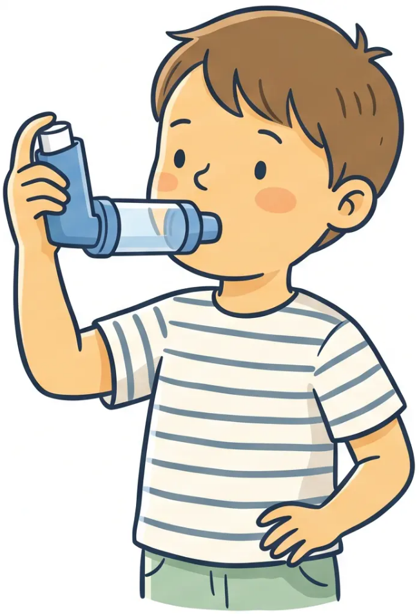
BRADFORD VTS TEACHING DECK
Asthma & Wheeze
in Children
A Comprehensive Guide for GP Registrars
AKT and SCA Exam Preparation · May 2026 Clinical Standards
NICE NG245 · SIGN 158 · BNFC 2025–2026
May 2026
Bradford VTS · Paediatric Respiratory Series

Slide 2







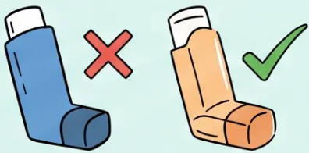
CLINICAL CURRENCY • MAY 2026
Clinical Currency and Key Changes
NICE NG245
⚠ KEY CHANGE
BTS/NICE/SIGN Joint Guideline
SABA-only therapy is no
longer recommended for
children aged 5 and over.
November 2024, updated November 2025 • Children 5–16 years
NICE CKS ASTHMA
Clinical Knowledge Summary
Last revised March 2026 • Includes under-5s
AIR Therapy (as-needed
ICS/formoterol) replaces blue
inhaler alone
SIGN 158
Acute Asthma Management
MART applies from age 5+ —
same structural shift as adults
Amended May 2025 • Paediatric and adult
BNFC 2025–2026
British National Formulary for Children
Paediatric drug doses referenced throughout
Bradford VTS · Paediatric Respiratory Series
Slide 2 of 34

Slide 3






RECOGNITION · UNDER 5 YEARS
Recognition Under 5 Years:
Wheeze not Asthma
Children under 5 cannot perform reliable spirometry — do not label, describe.
Episodic Viral Wheeze
Multi-Trigger Wheeze
• Wheeze occurs only during viral URTI
• Wheeze with viral infections AND other triggers
• No symptoms between episodes
• Triggers include exercise, allergens, cold air, smoke
• Most common type in toddlers
• Symptoms may occur between episodes
• Often resolves by school age
• Higher risk of persistent asthma
Lower risk of persistent asthma
Monitor closely — may evolve into asthma
⚠ Do NOT use the word ‘asthma’ for any child under 5 years — use ‘wheeze’ and treat empirically
NICE CKS Asthma · March 2026 · Bradford VTS Teaching Deck
3 / 34

Slide 4



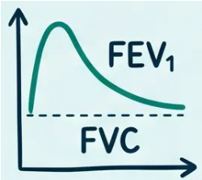

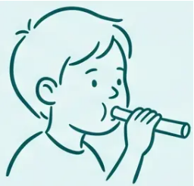


RECOGNITION · AGE 5–16
Recognition 5 to 16 Years: Objective Testing
Asthma diagnosis from age 5 requires objective evidence — clinical impression alone is not sufficient.
Spirometry
Bronchodilator
Reversibility
FeNO Testing
Serial Peak Flow
FEV₁/FVC ratio
Obstructive pattern
confirms airflow
limitation
Post-salbutamol FEV₁
improvement
≥12% increase
supports diagnosis
Fractional exhaled
nitric oxide
Monitor over 2–4
weeks
Threshold: ≥35 ppb
in children
Diurnal variability
>20% is significant
EXAM PEARL
FeNO threshold in children is ≥35 ppb — lower than the adult threshold of 40 ppb. A commonly tested distinction in AKT.

Slide 5

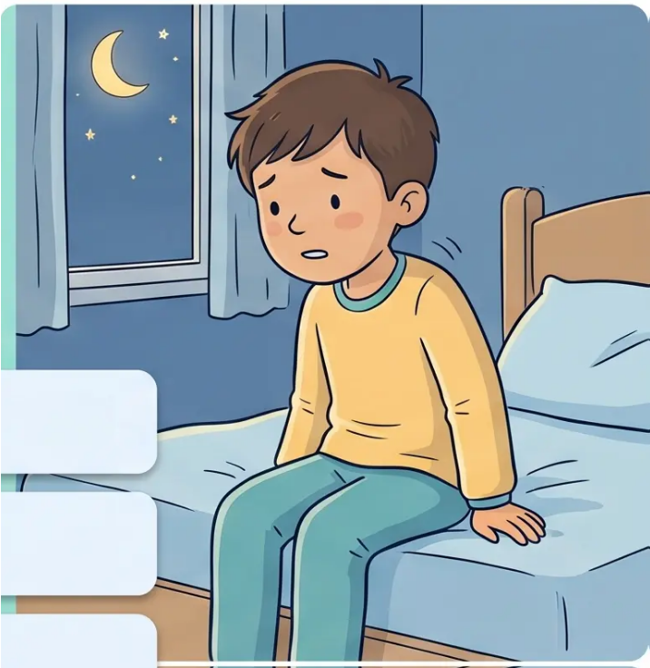










Recognition
Clinical Features Suggesting Asthma
Variable, episodic symptoms — the hallmark pattern
Wheeze — Expiratory, polyphonic; variable and episodic in nature
Cough — Persistent or recurrent; often worse at night or early morning
Breathlessness — Episodic; may limit exercise or play
Chest Tightness — Reported in older children; often underreported in young children
Nocturnal Pattern — Symptoms classically worse at night and on waking
Trigger Pattern — Exercise · Cold air · Viral URTI · Allergens · Smoke
Atopy link: Personal or family history of eczema, allergic rhinitis, or food allergy strengthens the diagnosis
NICE NG245 · NICE CKS Asthma (March 2026)
5 / 34

Slide 6














Differential Diagnosis
Differentiating Asthma from Other Conditions
Not every childhood wheeze is asthma — keep the differential wide.
Inhaled Foreign Body
Pertussis (Whooping Cough)
Sudden onset; unilateral wheeze in a toddler —
refer urgently
Paroxysmal cough with inspiratory whoop —
check immunisation history
Cystic Fibrosis
Croup / Laryngotracheitis
Failure to thrive, steatorrhoea, recurrent chest
infections — sweat test
Stridor, barking cough — upper airway, not lower
Bronchiolitis
Congenital Abnormalities
Vascular ring, tracheal stenosis, tracheomala-
cia — persistent or positional wheeze
RSV in infants under 2 years; wheeze plus crackles
Bradford VTS · Asthma and Wheeze in Children · Slide 6 of 34
NICE NG245 · SIGN 158

Slide 7



Differential Diagnosis
Pointers Against an Asthma Diagnosis
Consider alternative pathologies when these features are present
Onset under 1 year
Wheeze in infants under 1 year — refer; likely bronchiolitis in RSV season, not asthma
No family or personal atopy
Absence of eczema, allergic rhinitis, or family atopic history weakens asthma probability
Failure to thrive + loose stools
Consider cystic fibrosis — urgent sweat test indicated
Unilateral wheeze
When the picture doesn't fit —
think beyond asthma
Especially sudden onset in a toddler — inhaled foreign body until proven otherwise
Chronic moist productive cough
Suggests bronchiectasis or suppurative lung disease — not typical asthma
Stridor rather than wheeze
Upper airway pathology — croup, tracheomalacia, vascular ring
Bradford VTS · Paediatric Asthma Series
Slide 7 of 34

Slide 8



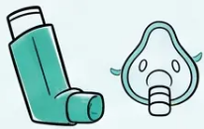
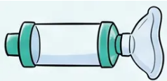

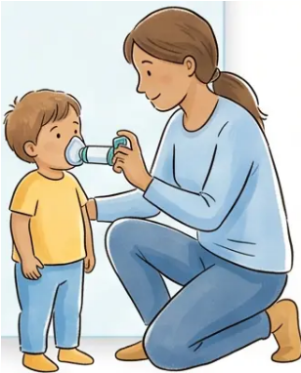



Under 5 Years · Acute Management
Acute Episodic Wheeze
Management in Children Under 5 Years
No formal NICE step algorithm for under-5s — trial and observe approach
SABA — Salbutamol
Spacer + Mask — Essential
OCS — Prednisolone
• Salbutamol 100 mcg/puff
• Large-volume spacer (750 mL)
required for all under-5s
• Reserve for severe episodes only
• 2–10 puffs via large-volume spacer
• Dose: 1–2 mg/kg/day
• Face mask for under-3s;
mouthpiece if cooperative from
~3 years
• MDI alone is not effective in this
age group
• Maximum: 20 mg/day
• Mask must form a good seal —
no gaps
• Duration: 3–5 days
• Repeat every 20 minutes during
acute attack if needed
• Oral liquid preparation
for young children
• Clean spacer monthly with water;
air dry only — never wipe inside
First-line relief
Always required with MDI
Severe episodes only
BNFC 2025–2026 · NICE CKS Asthma (March 2026)
Bradford VTS · Slide 8 of 34

Slide 9







Under 5 Years
Management Under 5 Years: Preventive Options
For multi-trigger wheeze — trial one option for 8–12 weeks, then review for clinical benefit.
Low-Dose Inhaled Corticosteroid (ICS)
Leukotriene Receptor Antagonist (LTRA)
First-line preventive option
Montelukast — especially for multi-trigger wheeze
Trial duration: 8–12 weeks
Trial duration: 8–12 weeks
Example: Beclometasone 100 mcg twice daily
Dose: 4 mg once daily (granules or chewable tablet)
Delivery: MDI via large-volume spacer + face mask
Age range: 6 months to 5 years
Standard-particle inhaler only in this age group
No inhaler technique required — oral administration
Stop if no benefit after 8 weeks — avoid unnecessary
ICS exposure.
Dual benefit if co-existing allergic rhinitis — LTRA
addresses both.
⚠ No formal NICE step-wise algorithm for under-5s — trial and observe approach
NICE CKS Asthma (March 2026) · BNFC 2025–2026

Slide 10



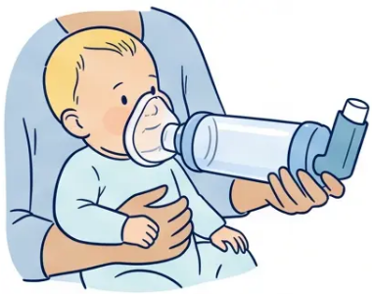
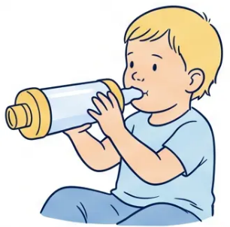
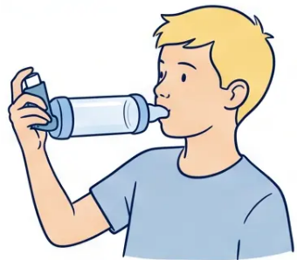




Inhaler Technique
Inhaler Delivery: Spacers and Masks
Correct device selection is as important as the prescription itself.
Under 3 Years
Age 3–5 Years
Age 5–16 Years
Large-Volume Spacer + Face Mask
Spacer + Mouthpiece (if cooperative)
Spacer + Mouthpiece
Mask seals over nose and mouth
750 mL spacer recommended
Transition from mask when child can seal lips
Encourage slow, steady breaths
MDI always via spacer — never dry
Observe technique at every review
Never use MDI without a spacer in children — dramatically reduces lung deposition if used alone
Clean spacer monthly — wash with water, air dry, never wipe inside (reduces static charge)
DPI not suitable for under-5s — requires inspiratory effort children cannot reliably produce
Spacer + mask = essential for ALL under-5s using MDI inhalers
BNFC 2025–2026 · NICE NG245

Slide 11








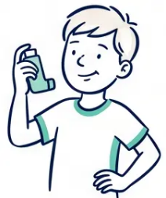
NICE NG245 · KEY CHANGE
Management 5 to 16 Years:
The AIR Therapy Shift
PREVIOUSLY
SABA-only therapy
Salbutamol as the sole reliever — no regular ICS
*Paradigm shift
Paradigm shift — May 2024 / NG245
NOW RECOMMENDED
✓ AIR Therapy — ICS/Formoterol as-needed
Anti-inflammatory reliever: low-dose ICS/formoterol used
as the reliever from first step
Budesonide/formoterol 100/6 Turbohaler — licensed from age 6+
NICE NG245 (Nov 2024, updated Nov 2025) · Same structural shift as adult guidance
11 / 34

Slide 12









NICE NG245 · Age 5–16
Step-wise Management: Steps 1 and 2
Moving away from SABA-only — the new standard for children aged 5 and above
STEP 1
As-Needed Relief
STEP 2
Regular Maintenance + Relief
AIR Therapy
Low-Dose MART
Anti-Inflammatory Reliever
Maintenance and Reliever Therapy
• As-needed low-dose ICS/formoterol — used only
when symptoms occur
• Daily low-dose ICS/formoterol — regular
maintenance dose each morning
• Same inhaler used as reliever — no second
inhaler needed
• Replaces SABA-only — no standalone blue inhaler
Escalate if
uncontrolled
• Ages 5–16 — licensed from age 6
(Symbicort Turbohaler 100/6 mcg)
• Budesonide/formoterol 100/6 Turbohaler —
licensed for age 6 and above
If ICS/formoterol not suitable: interim
low-dose ICS + SABA while transitioning
One inhaler. Two roles. Simplifies adherence
for families and children.
NICE NG245, 2024
NICE NG245, 2024 · BNFC 2025–2026
Bradford VTS · Paediatric Asthma
Slide 12 of 34
May 2026

Slide 13









Step-wise Management
Steps 3 and 4: Escalation and Add-on Therapy
NICE NG245 · For children aged 5–16 years
3
4
Moderate-Dose MART
Add-on Therapies
Regular moderate-dose ICS/formoterol
as both daily maintenance and reliever
LTRA (Montelukast):
Trial for 8–12 weeks
Age 6–14 years: 5mg OD chewable tablet
Age 15+: 10mg OD tablet
Inhaler: Budesonide/formoterol 100/6
Turbohaler — licensed from age 6+
Especially useful if allergic rhinitis co-exists
Not
controlled?
LABA Addition:
Age 12+ years only
Step up from Step 2 if symptoms remain
uncontrolled on low-dose MART
Not routinely used below age 12 without specialist advice
Specialist Referral:
Consider if still uncontrolled — refer to paediatric respiratory team
Still same inhaler — MART principle maintained
Stop LTRA if no benefit at 8 weeks
Bradford VTS · Paediatric Asthma · NICE NG245 (2024)
Slide 13 of 34

Slide 14



Step-wise Management • Step 5
Step 5: Specialist Care
Paediatric Respiratory Referral • Biologics • Refractory Asthma
When to Refer to Paediatric Respiratory
• Asthma uncontrolled despite Step 4 optimisation
• Diagnostic uncertainty — consider alternative diagnoses
• Suspected severe or difficult asthma requiring specialist workup
Specialist-Led Interventions
• Comprehensive phenotyping — identify treatable traits
• Biologics initiated by paediatric teams (not GP)
• High-dose ICS management with safety monitoring
Biologics in Children
Generally initiated and monitored by specialist paediatric
respiratory teams — not routinely started in primary care.
NICE NG245 • Step 5 • Specialist Referral
Bradford VTS • May 2026

Slide 15




























BNFC 2025–2026
Paediatric ICS Dose Equivalence
Children 5–11 years · Daily inhaled corticosteroid dose ranges by drug
Drug
Low Dose
Moderate Dose
High Dose
Beclometasone
Standard Particle
100–200 mcg/day
300–400 mcg/day
500–800 mcg/day
Beclometasone
standard particle
Beclometasone
Extrafine
50–100 mcg/day
150–200 mcg/day
300–400 mcg/day
Beclometasone
extrafine
Budesonide
Budesonide
100–200 mcg/day
300–400 mcg/day
500–800 mcg/day
Fluticasone
Propionate
Fluticasone
propionate
50–100 mcg/day
150–200 mcg/day
250–400 mcg/day
Mometasone discontinued in the UK — February 2026
Switch children currently prescribed mometasone to budesonide or beclometasone equivalents
Bradford VTS · Paediatric Asthma · BNFC 2025–2026
15 / 34

Slide 16





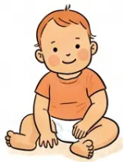
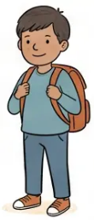
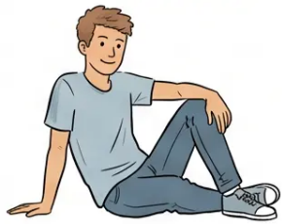

PRESCRIBING REFERENCE
LTRA Dosing by Age Group
Montelukast — once daily dosing (BNFC 2025–2026)
6 months – 5 years
6 – 14 years
≥ 15 years
4 mg
5 mg
10 mg
Once daily
Once daily
Once daily
Granules or chewable tablet
Chewable tablet
Standard tablet
⚠ Montelukast: counsel on neuropsychiatric side effects
Bradford VTS · Paediatric Asthma Series
Slide 16 of 34

Slide 17

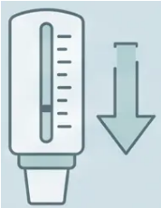







SIGN 158, May 2025 | Bradford VTS Teaching Deck
SIGN 158 • Acute Severity
Acute Severe Asthma 5–12 Years: Classification
Classify severity before you treat — every parameter counts
MODERATE
SEVERE
LIFE-THREATENING
● PEF 50–75% of best or
predicted
● PEF <50% of best or predicted
● PEF <33% of best or predicted
● SpO₂ <92%
● RR >30 breaths/min
● Able to talk in full sentences
● Silent chest
● HR >125 beats/min
● Symptoms present but not
distressed
● Cyanosis
● Too breathless to complete
sentences
● Poor respiratory effort
● SpO₂ ≥95%
● Exhaustion or altered
consciousness
● SpO₂ 92–94%
Treat in community / GP
Urgent treatment — consider 999
Call 999 — immediate transfer
SpO₂ <92% in any child with wheeze = immediate hospital transfer regardless of PEF

Slide 18



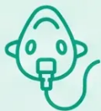
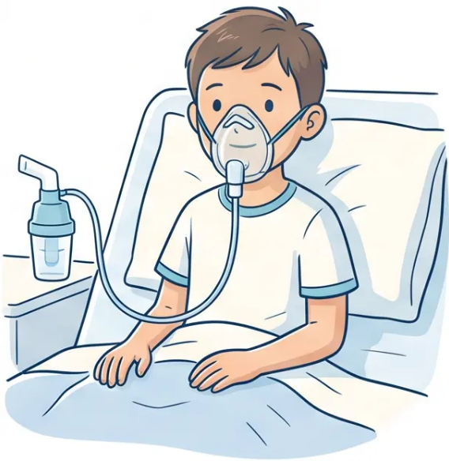












SIGN 158 · May 2025
Acute Severe Asthma: Immediate Treatment
Children aged 5–12 years
Oxygen
High-flow oxygen to maintain SpO₂ 94–98%
Nebulised Salbutamol
2.5 mg if small child · 5 mg if ≥5 years
Severe / life-threatening: continuous nebulisation or back-to-back every 20 minutes
Add Ipratropium 0.25 mg nebulised Add-on
For severe or life-threatening episodes only
Prednisolone + IV Magnesium
> ⚠️ IV Magnesium only if
life-threatening or poor
response to initial treatment
Prednisolone 1–2 mg/kg/day (max 40 mg) orally · 3–5 days
IV Magnesium sulfate 40 mg/kg (max 2 g) over 20 min — life-threatening or poor response
Bradford VTS · Paediatric Respiratory Series
18 / 34

Slide 19








Acute Care · SIGN 158
Hospital Admission Criteria
Acute Severe Asthma · Children 5–12 Years
Life-Threatening Features
Failure to Respond
Persistent Low SpO₂
• Silent chest
• No improvement after initial
bronchodilator treatment
• SpO₂ remains below 92%
• Cyanosis
• Despite supplemental
high-flow oxygen
• Persisting severe features
despite salbutamol +
ipratropium
• Altered consciousness
• Poor respiratory effort
• Very young child or
additional clinician concern
• PEF < 33% · SpO₂ < 92%
• Clinician concern at any point
If in doubt — call 999 and transfer immediately. Do not delay.

Slide 20

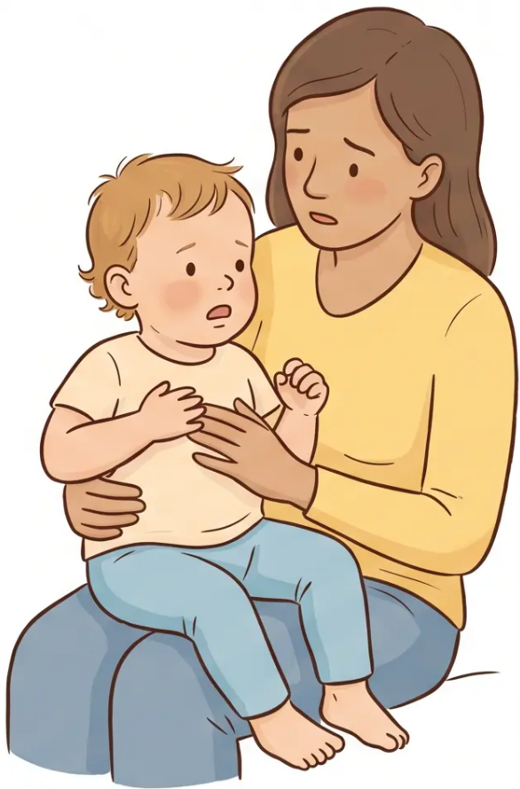












RED FLAG RECOGNITION
Acute Severe Wheeze Under 5 Years
Recognising Severity in Infants and Toddlers
SpO₂ below 92%
Most important single marker of severity — act immediately
Unable to Feed (infants) · Unable to Speak (toddlers)
Respiratory distress overriding basic function
Cyanosis
Central cyanosis — lips, tongue, or fingertips — critical sign
Silent Chest
No wheeze heard = airflow critically reduced — pre-arrest sign
Infants and toddlers cannot report symptoms
— observe behaviour and work of breathing
Additional markers: RR >40 (age 2–5) · HR >140 (age 2–5) · Cyanosis · Exhaustion
Bradford VTS · Paediatric Respiratory Series
Slide 20 of 34
SIGN 158 · May 2025

Slide 21







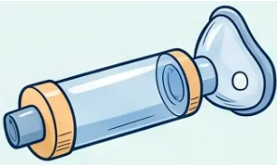
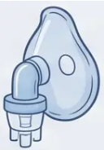






ACUTE MANAGEMENT
Acute Severe Wheeze: Management Under 5 Years
SIGN 158 (May 2025) · Salbutamol via Spacer or Nebuliser · Prednisolone 3 Days
First-Line: Salbutamol via Spacer
Alternative: Nebulised Salbutamol
Steroid Course: Prednisolone
Salbutamol via Spacer + Mask
Nebulised Salbutamol
Oral Prednisolone
100 mcg/puff — 6 to 10 puffs
2.5 mg nebulised
1–2 mg/kg/day
Large-volume spacer with face mask
Use if spacer not tolerated or
response inadequate
Maximum 20 mg per day
Repeat every 20 minutes during
acute attack
Duration: 3 days
Continuous nebulisation if not
responding
Preferred first-line route
If spacer not tolerated
Severe episode only
Admit to hospital if: SpO₂ <92% · Not responding to repeated salbutamol · Cyanosis · Silent chest · Unable to feed
Bradford VTS · Paediatric Respiratory Series
Slide 21 of 34
SIGN 158 · May 2025 · BNFC 2025–2026

Slide 22






ANNUAL REVIEW
School-Age Asthma Monitoring
Every child with asthma needs a structured annual review — minimum once yearly, more if poorly controlled.
Symptom Frequency
Inhaler Technique
Action Plan and School
• Daytime symptoms per week
• Always observe technique
directly
• Written asthma action plan —
every child
• Nocturnal waking episodes
• Copy shared with school nurse
and class teacher
• Activity limitation or exercise
symptoms
• Check spacer use and condition
• Remind about spacer cleaning
— monthly wash, air dry
• Anaphylaxis plan if food allergy
co-exists
• Reliever use in past month
• Reassess device choice as
child grows
• Review understanding with
parent and child
⚠ Also check: growth (height plotted regularly), adrenal suppression risk in high-dose ICS, and whether the child still needs their current treatment step.

Slide 23

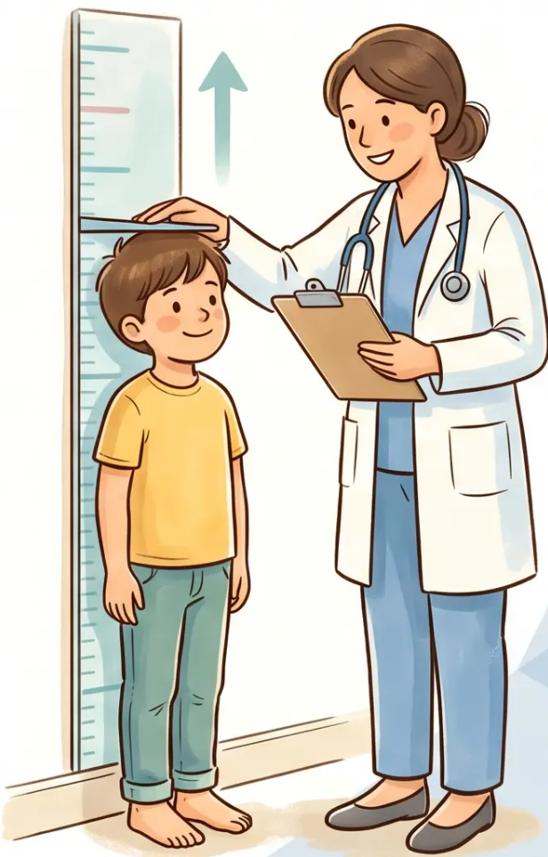



ICS Safety · Monitoring
Growth Monitoring and Safety
Children on ICS need proactive long-term safety checks — not just
symptom control reviews.
Height Monitoring
• Measure height at every routine asthma review — at minimum every 6 months for children
on moderate or high-dose ICS
• Use a calibrated stadiometer and plot on a UK-WHO growth chart each time
• A consistent downward centile crossing warrants review and possible dose reduction
Adrenal Suppression Risk
• Risk increases with high-dose ICS — particularly above 400 mcg/day budesonide equivalent
in children
• Symptoms: fatigue, hypoglycaemia, poor weight gain, recurrent illness, early morning lethargy
• If symptomatic: check morning cortisol; refer to paediatric endocrinology if low or borderline
Prescribing Reminder: Always use the lowest effective ICS dose. Step down when
control is stable for 3 months. Document dose reviews at every consultation.
Bradford VTS · Paediatric Asthma Series
23 / 34
BNFC 2025–2026 · NICE NG245

Slide 24

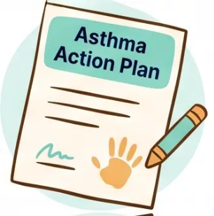

Monitoring & Safety
Written Asthma Action Plans
Every child with asthma must have one — and it must leave the consulting room with them.
What the Plan Includes
Who Gets a Copy
● Daily medication — inhaler name, device, dose,
and timing written out clearly
The Child and Family — primary copy; review at every
asthma appointment; update when treatment changes
● Trigger awareness — personal triggers identified
for this child (exercise, pets, viral illness)
School Nurse or Class Teacher — legal and practical
necessity; enables safe management during school hours
● Worsening signs — what to look for: increased
cough, night waking, reliever use increasing
GP Record — scanned or filed; shared with out-of-
hours services and A&E if needed
● Emergency steps — when and how to use
reliever, when to call 999, when to go to A&E
Review and reissue at every
annual review — an outdated plan
is as dangerous as no plan.
Bradford VTS · Paediatric Asthma
Slide 24 of 34

Slide 25









Top Tips
Top Tips for Paediatric Asthma
Part 1 of 2
TIP 1
Don’t diagnose asthma under age 5
Use “wheeze” or “pre-school wheeze” — asthma label requires objective testing from age 5 onwards.
TIP 2
SABA-only is no longer recommended from age 5
Transition to AIR therapy (as-needed ICS/formoterol) or MART — in line with NICE NG245 and adult guidance.
TIP 3
Always use a spacer with MDI in children
Spacer use vastly improves lung deposition — essential for all children using a metered-dose inhaler, regardless of age.
Bradford VTS · Paediatric Asthma
Top Tips · Part 1
May 2026

Slide 26



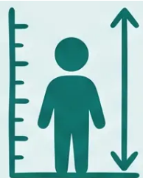
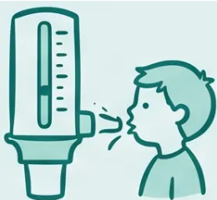






Top Tips
Top Tips for Paediatric Asthma: Part 2
26 / 34
Tip 5
Tip 6
Tip 7
Montelukast: Dual Benefit
Monitor Growth 6-Monthly
Peak Flow Diaries Support
If a child has both asthma and
allergic rhinitis — montelukast
treats both conditions with a single
daily tablet. A valuable combination
therapy choice.
All children on ICS need height
measured every 6 months. High-
dose ICS carries a real risk of growth
suppression — document and act
early.
When spirometry is normal but
asthma is suspected, a 2–4 week
peak flow diary showing diurnal
variation greater than 20% provides
objective diagnostic support.
LTRA · Allergic Rhinitis
ICS Safety · Growth
Diagnosis · Monitoring
Bradford VTS · Paediatric Respiratory Series
NICE NG245 · BNFC 2025–2026

Slide 27


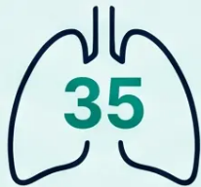








EXAM PEARLS • AKT
AKT Diagnosis and Thresholds
High-yield diagnostic facts for the AKT — know these cold
THE CRITICAL THRESHOLD
FeNO ≥ 35 ppb in children
Lower than the adult threshold of ≥ 40 ppb — a common AKT trap
Diagnosis Rules
Thresholds and Traps
No asthma diagnosis under 5
FeNO: children vs adults
01
04
Use 'wheeze' or 'pre-school wheeze' — episodic viral
wheeze vs multi-trigger wheeze
Children ≥35 ppb • Adults ≥40 ppb — do not confuse
these in the AKT
Objective testing from age 5
Cough-variant asthma — caution
02
05
Spirometry + bronchodilator reversibility required —
clinical impression alone is not sufficient (NICE NG245)
Cough as the sole symptom — possible but commonly
over-diagnosed; always seek objective evidence
Serial peak flow monitoring
Multi-trigger wheeze = higher risk
03
06
2-4 weeks; diurnal variability >20% supports diagnosis
diagnosis when spirometry is normal
Wheeze with viral AND other triggers (exercise,
allergens) — higher likelihood of persistent asthma
Bradford VTS • Paediatric Asthma Series
NICE NG245 • SIGN 158 • May 2026
27 / 34

Slide 28













Exam Pearls • AKT
AKT Management and Doses
High-yield doses and thresholds — memorise these cold
LTRA DOSING — MONTELUKAST (BNFC 2025–2026)
MONTELUKAST
MONTELUKAST
MONTELUKAST
Under 6 Years
6 to 14 Years
15 Years and Over
4 mg OD
5 mg OD
10 mg OD
Granules or chewable tablet
Chewable tablet
Standard tablet
From 6 months
Life-Threatening Asthma — Key Thresholds (Children 5–12 Years)
PEF
SpO₂
CLINICAL FEATURES
< 33%
< 92%
• Silent chest
• Cyanosis or altered consciousness
of predicted
despite oxygen
• Poor respiratory effort or exhaustion
Any ONE of these features = Life-threatening. Call 999.
SIGN 158 (May 2025) • NICE NG245 • BNFC 2025–2026
28 / 34 • Bradford VTS

Slide 29










Exam Pearls • SCA
SCA Communication Scenarios
What the examiner wants to hear — and how to say it.
SCA Scenario 1
SCA Scenario 2
Parent worried about the ‘blue inhaler’
Creating a School Asthma Action Plan
WHAT THEY SAY
WHAT TO ASSESS
• Does the family understand the child’s trigger pattern?
He’s always needed his blue inhaler — why are you taking it away?
• Can the child (or parent) demonstrate inhaler technique?
WHAT YOU EXPLAIN
• Does the school have a named person responsible for the plan?
• Using only a blue inhaler means no daily protection for the airways
KEY CONSULTATION TASKS
• Agree green / amber / red zones with the family in plain language
• The new inhaler (ICS/formoterol) does both jobs — relieves AND protects
• It is used the same way — only when needed — but is safer long-term
• Provide written plan — copy to school nurse and class teacher
• Record plan in clinical notes and set review date
SCA Scenario 3
Child with cough — parent expects an asthma diagnosis
Don’t rush to diagnose
Examiner wants to see
Cough alone is not enough — ask about variability, triggers, night symptoms
• Safety-netting: when to return, what to watch for
Request a peak flow diary (2–4 weeks) before labelling
• Shared decision-making — involve the parent and child
Explore parental concern — what does the family fear most?
• Avoiding premature closure — keep differential open (pertussis, habit cough, GORD)
Examiner tip: Use ‘I want to make sure we get the right diagnosis’ — shows patient-centred thinking and clinical caution.
Bradford VTS · Paediatric Asthma
29 / 34

Slide 30












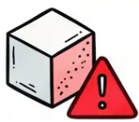
RED FLAGS
Urgent Clinical Concerns
SpO₂ < 92%
Silent Chest
Immediate hospital transfer — any child
with wheeze or asthma
Life-threatening feature — call 999
immediately
Unilateral Wheeze
Infant Under 1 Year
Suspect inhaled foreign body — urgent
referral, especially in toddlers
Wheeze in infants — refer; bronchiolitis
likely in RSV season, not asthma
SIGN 158 · May 2025 — Acute Severe Asthma in Children.
Bradford VTS · Slide 30 of 34

Slide 31


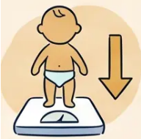
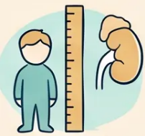

RED FLAGS
Red Flags: Long-term Monitoring Risks
Two long-term risks that must not be missed in children with asthma
Failure to Thrive + Wheeze
High-dose ICS — Adrenal Risk
• Persistent wheeze + poor weight gain +
loose, fatty stools
• High-dose ICS long-term (above 400 mcg
budesonide equivalent per day)
• Consider cystic fibrosis — urgent sweat
test referral
• Risk of adrenal suppression — check
morning cortisol if symptomatic
• Do not label as asthma until CF excluded
• Symptoms: fatigue, hypoglycaemia, collapse
under stress or illness
Refer urgently — do not delay with empirical asthma treatment
Check morning cortisol — consider endocrine referral if concerned
SIGN 158 · NICE NG245 · BNFC 2025–2026 · Bradford VTS Teaching Deck — May 2026
31 / 34

Slide 32




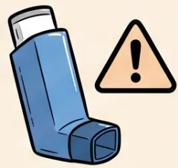




Common Pitfalls
Common Pitfalls: Diagnosis and Treatment
1
2
Diagnosing Asthma Under 5 Years
SABA Without ICS in Children Aged 5+
• Children under 5 cannot perform reliable
spirometry
• SABA-only prescribing is no longer recommended
from age 5
• Asthma label should NOT be applied — use
“wheeze”
• NICE NG245 (2024): move to AIR therapy or MART
• Distinguish: episodic viral wheeze vs multi-trigger
wheeze
• SABA alone leaves airways unprotected from
inflammation
• Treat empirically; review regularly; avoid premature
diagnosis
• Risk of over-reliance and under-treatment of
underlying disease
“Label the symptom, not the disease — until
objective testing is possible.”
“Every child aged 5+ with confirmed asthma needs
an anti-inflammatory — not just a reliever.”
Bradford VTS · Paediatric Asthma
Slide 32 of 34
NICE NG245 · SIGN 158 · May 2026

Slide 33




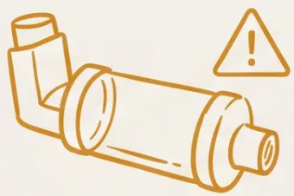
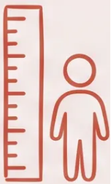
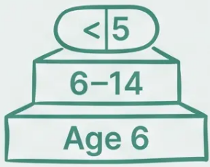




COMMON PITFALLS
Delivery and Monitoring
Errors that affect treatment efficacy and child safety
Confusing Montelukast
Doses by Age
Neglecting Spacer Cleaning
Ignoring Growth Monitoring
Spacers should be washed monthly
in warm water and left to air dry.
Never wipe the inside — wiping
creates static, reducing drug delivery
Children on ICS must have height
measured regularly. High-dose ICS
(>400 mcg budesonide equivalent)
warrants 6-monthly growth checks
and consideration of morning cortisol.
Dose is strictly age-dependent: 4 mg
for under 6 years · 5 mg for 6–14
years · 10 mg for 15 years and over.
Prescribing the wrong tier is a
common and avoidable error.
Technique Error
Safety Monitoring
Prescribing Accuracy
Bradford VTS · Paediatric Respiratory Series
NICE NG245 · SIGN 158 · BNFC 2025–2026
33 / 34

Slide 34









QUICK RECALL
Quick Recall Summary
Key thresholds · Age-specific treatment · Emergency protocols
Diagnosis & Age Rules
Treatment by Age
Acute Severity & Emergency
Under 5: Use “wheeze” — NOT
asthma diagnosis
Under 5: SABA via large-volume
spacer + mask; trial ICS or
montelukast 4mg OD
Moderate (5-12y): PEF 50–75%;
talking normally
5+ years: Spirometry +
bronchodilator reversibility
required
Severe (5-12y): PEF <50%;
RR >30; HR >125; SpO₂ 92–94%
Age 5+: AIR therapy — as-needed
ICS/formoterol replaces SABA-only
Life-threatening: PEF <33%;
SpO₂ <92%; silent chest; cyanosis
FeNO threshold (children):
≥35 ppb (adults: 40 ppb)
MART: Low-dose then moderate-dose
ICS/formoterol (Symbicort 100/6, age 6+)
IV Magnesium (children):
40 mg/kg, max 2g over 20 min
Peak flow variability: >20%
diurnal variation over 2–4 weeks
supports diagnosis
Montelukast doses:
< 6 years → 4 mg OD,
6–14 years → 5 mg OD,
≥15 years → 10 mg OD
Under 5 severe marker:
SpO₂ <92% — most critical sign
Episodic viral wheeze vs
multi-trigger wheeze — key
pre-school distinction
Admit if: SpO₂ <92%,
life-threatening features,
or clinician concern
Mometasone: Discontinued UK —
switch to budesonide or beclometasone
RED FLAGS
SpO₂ <92% · Silent chest · Unilateral wheeze ·
Failure to thrive → act immediately
BRADFORD VTS · · May 2026

