Slide 1





BRADFORD VTS TEACHING DECK
ADULT ASTHMA · MAY 2026
Asthma
in Adults
A comprehensive guide to adult asthma management
for GP registrars, incorporating the latest NICE NG245
and SIGN 158 guidelines.
For GP Registrars preparing for RCGP AKT & SCA
Clinical Currency: May 2026 | NICE NG245 · SIGN 158 · BNF 91
Incorporating NICE NG245 · SIGN 158 · BNF 91

Slide 2











GUIDELINES UPDATE
Clinical Currency and Key Updates
May 2026
NICE NG245
SIGN 158
BNF 91 • NICE CKS
JOINT BTS/NICE/SIGN GUIDELINE
ACUTE ASTHMA MANAGEMENT
DRUG DOSES & PRIMARY CARE
*Published November 2024 · Updated
November 2025
*Amended May 2025
*BNF 91 — March 2026 (all drug doses)
*Governs acute severe asthma
treatment in hospital and emergency
settings
*NICE CKS Asthma — revised March
2026
*Replaces NG80 (2021) and old
BTS/SIGN 153
*⚠️ Mometasone (Asmanex)
*Primary reference for adult asthma
diagnosis and management
discontinued UK — Feb 2026
MAJOR 2024 CHANGE
SABA-only treatment is NO LONGER recommended
*Salbutamol as-needed alone at Step 1 is abolished. All adults with asthma must
now use ICS/formoterol as their reliever — AIR therapy.

Slide 3


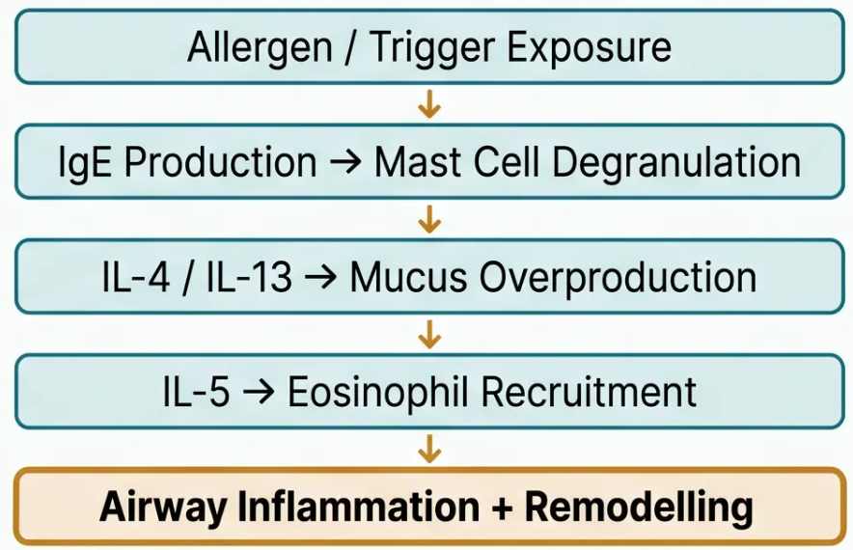



PATHOPHYSIOLOGY
Definition and Pathophysiology
Type 2 Inflammatory Pathway
What is Asthma?
A heterogeneous disease characterised by chronic
airway inflammation, variable airflow obstruction,
and bronchial hyperresponsiveness — typically
reversible spontaneously or with treatment.
Common Triggers
Allergens — house dust mite, pollen, animal dander
Exercise — cold air, exertion
Drugs — NSAIDs, aspirin
FeNO Significance
Infections — viral respiratory illness
FeNO ≥ 40 ppb indicates eosinophilic / Type 2
inflammation — supports asthma diagnosis and
predicts ICS response.
Occupational — flour, isocyanates, latex, wood dust
NICE NG245 • 2024

Slide 4




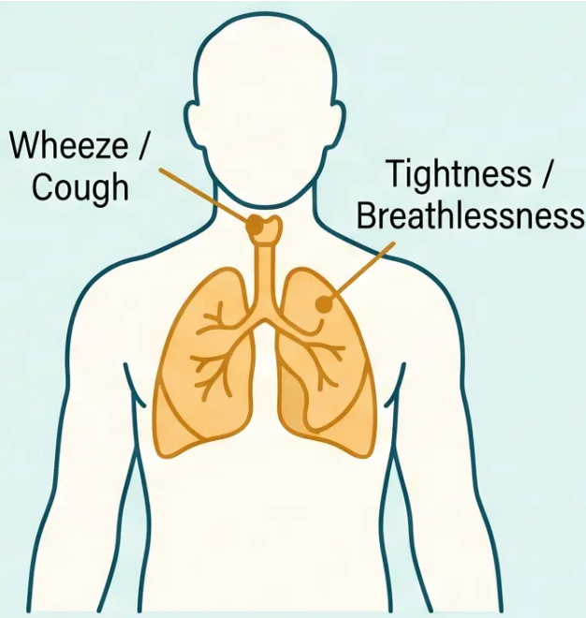



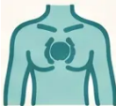



DIAGNOSIS
Diagnosis: Clinical Features
TYPICAL SYMPTOMS
Wheeze
Breathlessness
Cough
Chest Tightness
Symptoms are variable, episodic — not constant. Worse at night and early morning.
KEY CLINICAL POINTERS
• Symptoms worsen at night or early morning
• Identifiable triggers — exercise, allergens, cold air, viral infections, NSAIDs
Variable & Episodic
• Personal history of atopy — eczema, allergic rhinitis, food allergy
• Family history of atopy or asthma
Symptoms may be absent
between episodes
Normal examination between episodes does NOT exclude asthma

Slide 5





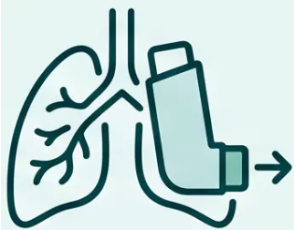
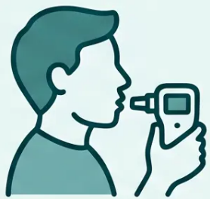






DIAGNOSIS
Objective Testing Requirements
NICE NG245 (2024) requires objective confirmation — clinical features alone are insufficient for diagnosis.
Spirometry + BDR
FeNO Measurement
Serial Peak Flow
Measure FEV1 before and after
salbutamol
Fractional exhaled nitric oxide —
marker of eosinophilic inflammation
Home monitoring over 2–4 weeks
✓ FEV1 >12% AND >200 mL
post-salbutamol
✓ ≥40 ppb = High
(supports diagnosis)
✓ >20% diurnal variability
⚠ Normal spirometry does NOT exclude asthma — testing between attacks may be entirely
normal. Use FeNO and serial peak flow to support diagnosis when spirometry is unhelpful.
*NICE NG245 · Nov 2024 | Also consider: blood eosinophils ≥0.3 × 10⁹/L · bronchial challenge (PC20 <8 mg/mL)

Slide 6





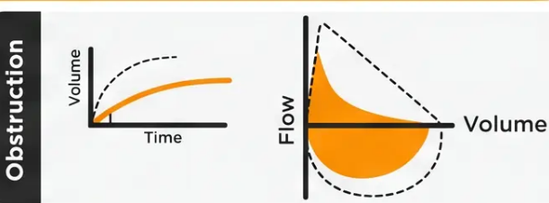

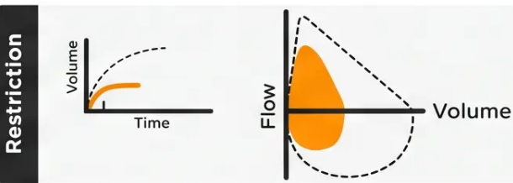
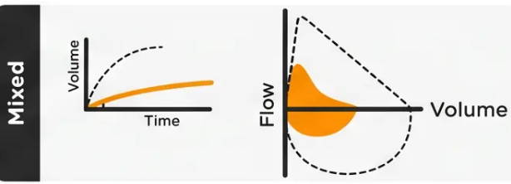

DIAGNOSIS
Spirometry and Bronchodilator Reversibility
What is a Positive BDR Result?
Spirometry Performed
Abnormal Ventilatory Function
>12%
AND
>200 mL
increase in FEV₁ post-salbutamol 400mcg
*Both criteria must be met — percentage alone is insufficient
• Measure FEV₁ at baseline, then administer salbutamol 400mcg
via spacer, wait 15–20 minutes, repeat spirometry
• A normal spirometry result does NOT exclude asthma — test
between exacerbations may be entirely normal
⚠️ AKT Pearl
*BDR requires BOTH >12% AND >200 mL — not just percentage
improvement. This is a common exam trap.
Spirometry patterns: obstruction,
restriction, and mixed
Slide 6 · Bradford VTS · Asthma in Adults 2026

Slide 7

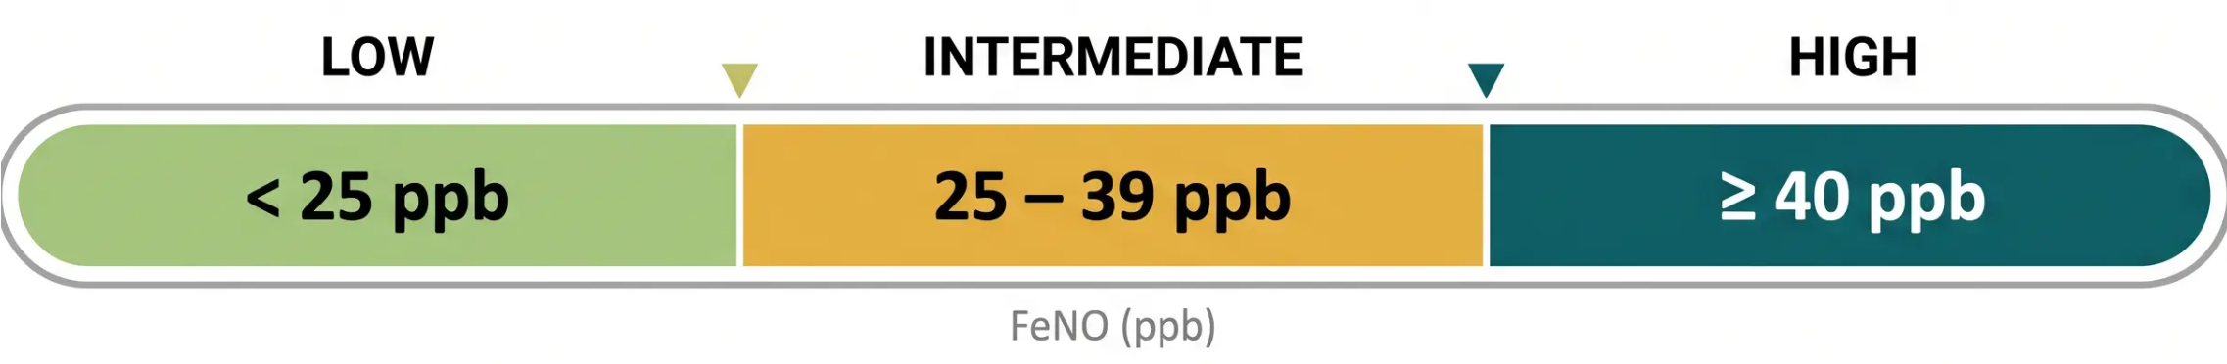
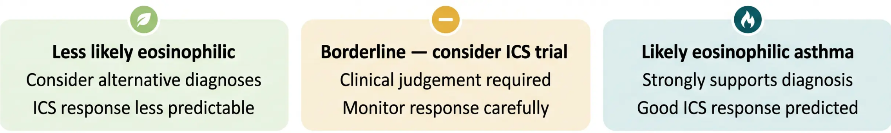


DIAGNOSIS
FeNO Thresholds and Interpretation
⚠ FeNO ≥ 40 ppb in an adult = HIGH probability of type 2 eosinophilic asthma — supports
diagnosis and predicts strong response to ICS
NICE NG245, 2024

Slide 8



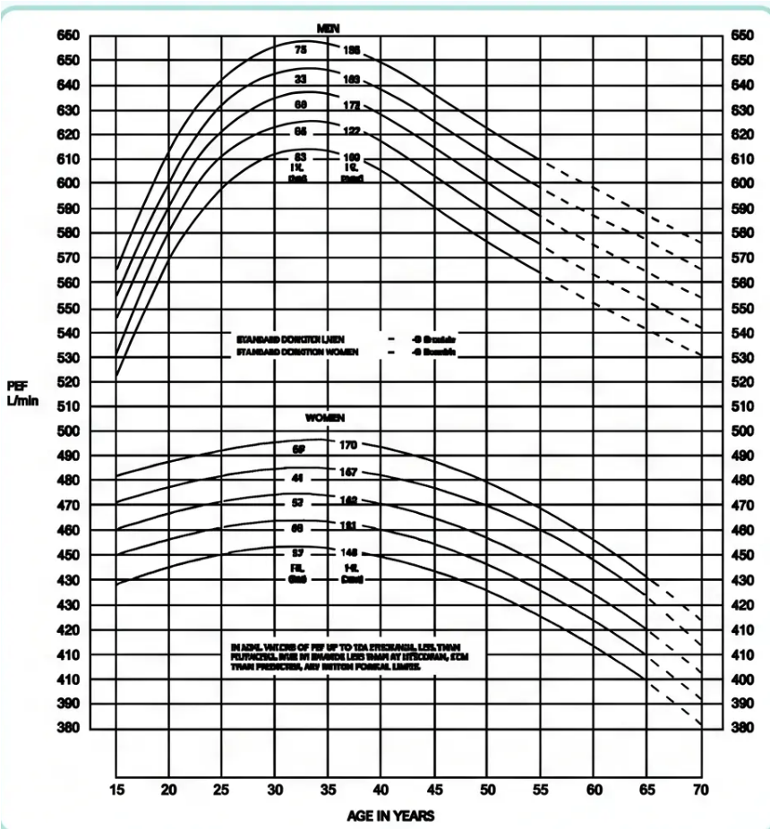





DIAGNOSIS · OBJECTIVE TESTING
Peak Flow Variability
Normal PEF Reference Values
> 20%
Diurnal Variation = Positive Result
Measured over at least 2 weeks of serial monitoring
How to Calculate
(Highest PEF – Lowest PEF) ÷ Highest PEF × 100
*Record morning and evening peak flow readings daily for 2–4 weeks*
Normal spirometry does NOT exclude asthma
*Peak flow monitoring captures variability that spirometry between attacks misses
*Source: Standard PEF normative chart – used to determine % predicted
NICE NG245 · 2024
8 / 32

Slide 9




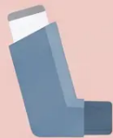





MANAGEMENT • NICE NG245 • 2024
Management: The Major 2024 Change
❌ BEFORE — Step 1 Under Old Guidance
Why this failed:
• Treats symptoms — not the underlying inflammation
• Leaves airway inflammation untreated between doses
Salbutamol (SABA) alone
• Associated with increased exacerbation risk and
asthma deaths
Used as needed for symptom relief only
NG245 CHANGE • NOV 2024
✅ NOW — Step 1 Under NICE NG245
Why this works:
ICS/Formoterol as needed
• Treats inflammation AND relieves symptoms in one inhaler
e.g. Budesonide/formoterol 200/6 mcg Turbohaler
OR Beclometasone/formoterol 100/6 mcg Fostair
• Reduces exacerbation risk even in mild asthma
ICS + LABA
• Provides background ICS protection with every use
⚠️ SABA-only prescribing at Step 1 is no longer recommended for any adult with asthma — NICE NG245, November 2024

Slide 10



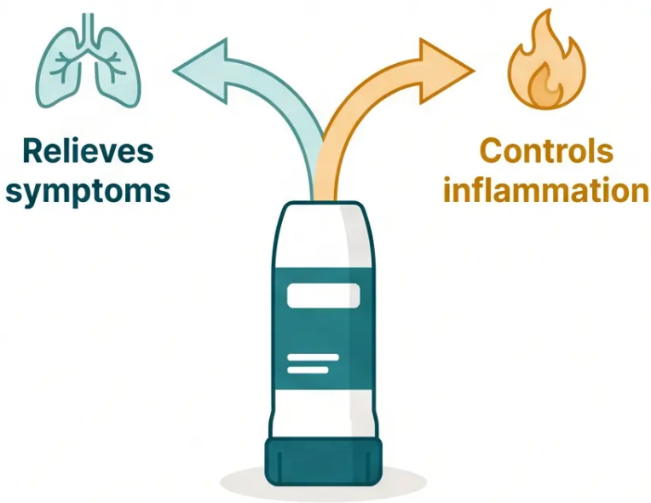


MANAGEMENT · STEP 1 OF 5
Step 1: Anti-inflammatory Reliever (AIR) Therapy
⚠ SABA-only at Step 1 is ABOLISHED
Salbutamol alone no longer recommended at any step
WHAT IS AIR THERAPY?
As-needed low-dose ICS/formoterol — used as both reliever and
inflammation controller in one inhaler.
Budesonide/formoterol 200/6 mcg Turbohaler
Beclometasone/formoterol 100/6 mcg Fostair
• Used as needed only — no separate daily maintenance ICS at this step
• Each puff delivers both bronchodilation and anti-inflammatory dose
• Suitable for mild or infrequent symptoms
WHY THE CHANGE?
SABA alone treats symptoms but ignores underlying airway inflammation —
ICS/formoterol as-needed reduces exacerbation risk even in mild asthma.
One inhaler. One action. Two benefits.
NICE NG245 · 2024

Slide 11














MANAGEMENT • STEP-WISE THERAPY
Step 2: Low-dose MART
Daily
Morning
Dose
Maintenance and Reliever Therapy — one inhaler, two roles
WHAT IS MART?
The same ICS/formoterol inhaler is used for both regular daily maintenance
AND as a reliever when symptoms occur. One inhaler. Two jobs.
Maintenance — 1 puff BD
Symptoms
Occur?
Regular Dose
As-Needed Relief
Once or twice daily — every day
Take extra puff(s) as reliever
Extra puffs when symptoms occur
EXAMPLE REGIMEN
Inflammation
Treated
Budesonide/Formoterol 200/6 mcg Turbohaler
1 puff twice daily (maintenance)
ICS component addresses the cause
+ extra puffs as needed (reliever)
Maximum 8 puffs per day total
Same inhaler throughout
Do NOT add a separate SABA reliever
Bradford VTS • Asthma in Adults • May 2026
11 / 32

Slide 12









MANAGEMENT · STEP 3 OF 5
Step 3: Moderate-dose MART
For patients whose symptoms remain uncontrolled on low-dose MART — escalate the
ICS/formoterol dose, keep the same inhaler as reliever.
WHAT ESCALATES
Regular Moderate-dose ICS/Formoterol — MART
– Maintenance dose increases to moderate-dose
ICS/formoterol — taken once or twice daily as
regular preventer
Example:
Budesonide/formoterol 400/12 mcg Turbohaler
— 1 puff twice daily as maintenance
– Same inhaler continues to be used as the reliever
when symptoms occur
— Additional puffs as needed for symptom relief
— Total daily limit: up to 8 puffs per day
WHO NEEDS STEP 3?
WHAT STAYS THE SAME
● Symptoms not controlled on low-dose MART
(Step 2) after adequate trial
● MART principle unchanged — one inhaler for both
maintenance and relief
● ICS/formoterol device stays consistent (don't switch
inhaler type mid-MART)
● Frequent reliever use persisting despite Step 2
● Consider after checking: adherence, inhaler
technique, and triggers first
● Continue stepping down once controlled for 3 months
Bradford VTS · Asthma in Adults
Slide 12 · Step-wise Management

Slide 13

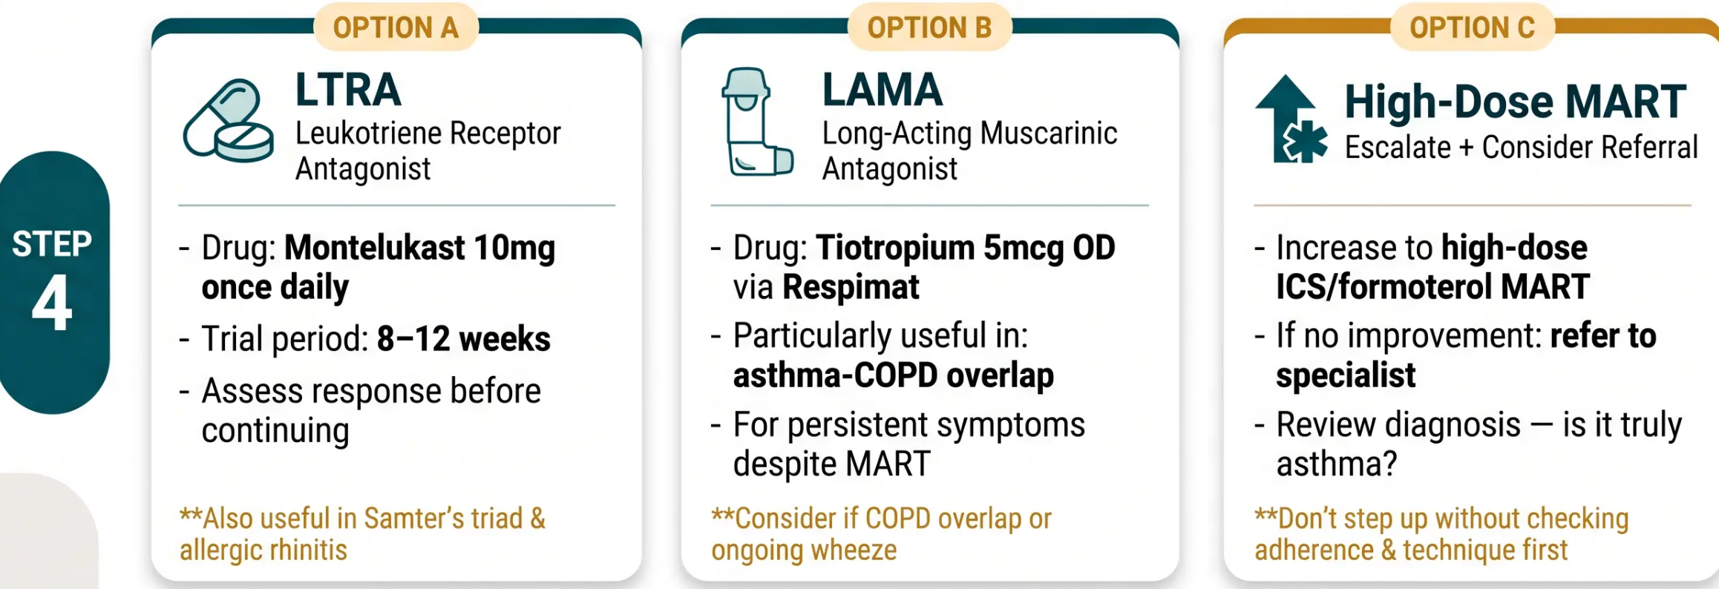


MANAGEMENT · STEP 4
Step 4: Add-on Therapies
For patients with persistent symptoms despite moderate-dose MART — before considering specialist referral.
⚠️ Before stepping up to Step 4 — confirm adherence, inhaler technique, and trigger avoidance are optimised

Slide 14



















MANAGEMENT · STEP 5
Biologic Therapies
Overview
*Specialist-initiated · Severe Refractory Asthma Only
All biologics are initiated by specialist teams. Consider referral when Step 4 is optimised and asthma remains uncontrolled.
Dual
Biomarker
Broadest
Omalizumab
Mepolizumab
Dupilumab
Benralizumab
Tezepelumab
ANTI-IgE
ANTI-IL-5
ANTI-IL-4/IL-13
ANTI-IL-5Rα
ANTI-TSLP
Severe allergic asthma
Severe eosinophilic asthma
Eosinophils ≥150 AND
Eosinophils ≥300 cells/µL
≥3 exacerbations/year
IgE ≥30 IU/mL
Eosinophils ≥300 cells/µL
FeNO ≥25
≥3 exacerbations/year
Any eosinophil count
Perennial allergen
sensitisation
≥3 exacerbations/year
≥4 exacerbations/year
Broadest eligibility
Dual biomarker required
*Thermoplasty: considered in highly selected severe refractory asthma patients — specialist centres only.
*NICE NG245 · Step 5 · Specialist Referral Required

Slide 15









STEP 5 · BIOLOGIC THERAPIES
Biologics: Specific Criteria
Omalizumab
Mepolizumab
Benralizumab
ANTI-IgE
ANTI-IL-5
ANTI-IL-5Rα
● Severe allergic asthma
● Blood eosinophils ≥300 cells/μL
● Severe eosinophilic asthma
● IgE ≥30 IU/mL
● Blood eosinophils ≥300 cells/μL
● ≥3 exacerbations/year
● Sensitised to perennial allergen
● ≥3 exacerbations in past year
● Severe eosinophilic asthma
● ≥4 exacerbations/year or
continuous OCS
Dupilumab
Tezepelumab
Broadest biologic
ANTI-IL-4/IL-13
ANTI-TSLP
● Blood eosinophils ≥150 cells/μL AND
FeNO ≥25 ppb (dual biomarker)
● Severe asthma
● ≥3 exacerbations/year OR continuous OCS
● ≥4 exacerbations/year
● No eosinophil threshold required
● Broadest eligibility of all biologics
All biologics are specialist-initiated. Refer to severe asthma service before considering any biologic therapy.
NICE NG245 · SIGN 158 · Bradford VTS 2026

Slide 16




















MANAGEMENT · ICS DOSES
ICS Dose Equivalence
BNF 91
Mometasone (Asmanex) DISCONTINUED — Feb 2026
Drug(Brand)
Low Dose
Moderate Dose
High Dose
mcg/day
mcg/day
mcg/day
200–500
600–800
1000–2000
Beclometasone standard
(Clenil)
100–200
300–400
500–800
Beclometasone extrafine
(Qvar / Fostair)
Budesonide
200–400
600–800
1000–1600
(Pulmicort)
100–250
300–500
600–1000
Fluticasone propionate
(Flixotide)
Ciclesonide
80–160
240–320
400–640
(Alvesco)
Fluticasone furoate
N/A solo
100 OD
200 OD
(Relvar)
★ Key Equivalence Note: Extrafine beclometasone (Qvar / Fostair) 100 mcg ≈ Standard beclometasone
(Clenil) 250 mcg — extrafine is approximately 2.5× more potent. Always check formulation before dosing.

Slide 17



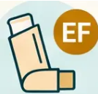







PHARMACOLOGY · ICS DOSING
Beclometasone: Standard vs Extrafine
Same drug, very different potency — knowing the difference prevents dangerous dosing errors.
Standard Beclometasone
Extrafine Beclometasone
CLENIL MODULITE · CFC-FREE MDI
QVAR · FOSTAIR · HFA MDI
• Particle size: Large particles (~3–4 μm)
• Particle size: Very fine particles (~1–1.5 μm)
• Deposition: Upper airways and large bronchi
• Deposition: Small airways and peripheral lung
÷ 2.5
• Low dose: 200–500 mcg/day
• Low dose: 100–200 mcg/day
Extrafine
dose
• Moderate dose: 600–800 mcg/day
• Moderate dose: 300–400 mcg/day
• High dose: 1000–2000 mcg/day
• High dose: 500–800 mcg/day
Standard
Extrafine
mcg
Reference standard for ICS dose comparisons
~2.5× more potent than standard beclometasone
Widely used; established safety profile
Half the dose achieves equivalent effect
Dosing Alert: 100 mcg Fostair/Qvar ≈ 250 mcg Clenil. Never substitute at the same dose — always recalculate.
Mometasone (Asmanex) discontinued in UK, February 2026 — switch patients to alternative ICS

Slide 18














MONITORING
Monitoring and Asthma Control
Control Level
Asthma is well-controlled when ALL four markers are absent
Well-Controlled
Reliever Use
Daytime Symptoms
All 4 markers absent
Using reliever more than
3 times per week indicates
poor control
Symptoms on more than
2 days per week
Partially Controlled
1–2 markers present
Uncontrolled
Nocturnal Waking
Activity Limitation
3–4 markers present — step up
Waking at night due to
asthma symptoms
Any restriction of normal
daily activities
Annual review: inhaler technique,
adherence, action plan, smoking status

Slide 19




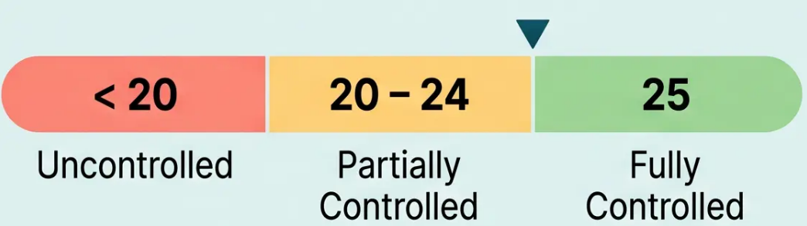






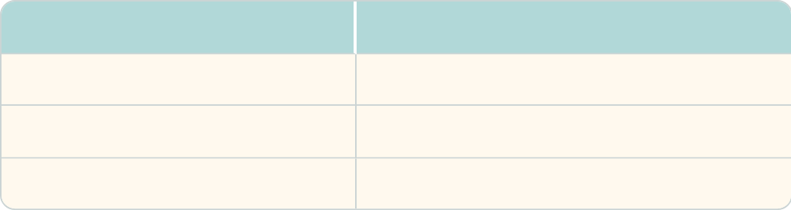











MONITORING
Assessment Tools: ACT and RCP 3 Questions
Asthma Control Test (ACT)
RCP ‘3 Questions’
In the last week / month, have you had difficulty
sleeping because of your asthma symptoms?
Have you had your usual asthma symptoms
during the day?
Has your asthma interfered with your usual
activities?
• Score 25 – Fully controlled; no action needed
• Score 20–24 – Partially controlled; review
triggers and technique
Positive answers
Interpretation
0
Well controlled
1
Borderline — review
• Score < 20 – Uncontrolled; step up treatment
2–3
Poorly controlled — act
*5 patient-reported questions covering the past 4 weeks
*Widely used in UK primary care; quick and validated
Annual Review Essentials:
● Written Action Plan
● Smoking Status
● Inhaler Technique
● FeNO if available
● Adherence

Slide 20












ACUTE CARE · SIGN 158 (MAY 2025)
Acute Severe Asthma: Severity Classification
MODERATE
SEVERE
LIFE-THREATENING
NEAR-FATAL
- PEF 50–75% best or
predicted
- PEF 33–50% best or
predicted
- PEF < 33% best or
predicted
- Raised PaCO₂
- Requiring mechanical
ventilation
- Worsening symptoms
- SpO₂ < 92%
- RR ≥ 25/min
- Able to talk in
sentences
- HR ≥ 110 bpm
- Silent chest
- ICU-level care needed
- Unable to complete
sentences
- Cyanosis
- No alarming features
- Exhaustion / altered
consciousness
- Arrhythmia /
hypotension
*Increasing severity →
Bradford VTS
SIGN 158 · May 2025

Slide 21


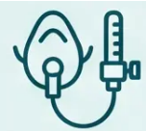













ACUTE CARE · SIGN 158 · MAY 2025
Acute Severe Asthma: Immediate Management
Oxygen
24–28% Venturi mask or high-flow oxygen — target SpO₂ 94–98%
Nebulised Salbutamol
5 mg nebulised — repeat as needed. Continuous 5–10 mg/hr if life-threatening.
Ipratropium Bromide
ADD-ON
0.5 mg nebulised — add for severe or life-threatening attack
Corticosteroids
Prednisolone 40–50 mg oral — OR IV hydrocortisone 100 mg if unable to swallow
IV Magnesium Sulfate
IV Salbutamol
REFRACTORY
Only if nebulised route
is impractical
1.2–2 g IV over 20 minutes — single dose for refractory severe asthma
21 / 32

Slide 22













ACUTE CARE
Hospital Admission and Discharge Planning
Admit to Hospital
Discharge Planning
Life-threatening features present
Step up maintenance treatment
● Silent chest, cyanosis, SpO₂ <92%, exhaustion, altered
consciousness, arrhythmia, hypotension
Review and escalate inhaler therapy before discharge
Prednisolone 40–50mg for 5 days
● Severe attack not responding
Minimum 3 days; oral route preferred
No improvement after 15–30 minutes of initial treatment
Written personalised action plan
Traffic light framework — green, yellow, red zones
● SpO₂ <92% despite treatment
GP review within 2 working days
Persistent hypoxia after oxygen and bronchodilator therapy
Urgent follow-up to reassess control and treatment
● Previous near-fatal attack
Outpatient review within 4 weeks
High-risk patient — lower threshold for admission
Specialist or GP asthma clinic follow-up
⚠️ A written action plan must be provided at every discharge — this is a NICE NG245 mandatory recommendation.
Bradford VTS · Asthma in Adults
22 / 32

Slide 23





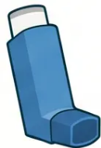






INHALER TECHNIQUE
Inhaler Technique Principles
Poor inhaler technique is the most common cause of treatment failure
CARD 1 — MDI (Pressurised Metered-Dose Inhaler)
CARD 2 — DPI (Dry Powder Inhaler)
CARD 3 — SMI (Soft Mist Inhaler) + Spacer Note
MDI
DPI
SMI
Pressurised Metered-
Dose Inhaler
Dry Powder Inhaler
Soft Mist Inhaler
(e.g. Respimat)
- Slow, deep breath — similar to MDI
- No spacer needed
- Requires coordination of actuation and
inhalation
- Fast, forceful inhalation required
- Slower aerosol cloud — easier to inhale
- No spacer needed or suitable
- Longer actuation time than MDI
- Slow, steady, deep breath in
- Keep device horizontal or upright as
directed
- Example: Tiotropium Respimat (Step 4)
- Hold breath for 10 seconds after
- Always use with a spacer at Step 2 and
above
Spacer Reminder
- Do not exhale into device before use
Spacer Devices
- Reduces oropharyngeal deposition
- Breath-actuated — no coordination needed
- Use with all MDIs at Step 2+
- Increases lung deposition significantly
- Examples: Turbohaler, Accuhaler, Ellipta
- Reduces steroid deposition in mouth/throat
- Essential for patients with poor coordination
⚠ Coordination required
✓ No coordination needed
✓ No spacer required
Check and observe inhaler technique at every clinical review — do not assume correct use

Slide 24














SELF-MANAGEMENT
Personalised Self-Management Plans
NICE NG245 Recommendation
Every patient with asthma should receive a written, personalised action plan at diagnosis and
at every annual review.
GREEN
YELLOW
RED
Well Controlled
Caution — Worsening
Danger — Seek Help Now
Continue regular treatment as prescribed
Use reliever only when needed
Maintain usual activity levels
No changes required
Increase reliever use (ICS/formoterol)
Start oral prednisolone immediately
Consider starting oral prednisolone
Use reliever frequently
Monitor symptoms closely
Call 999 or go to A&E
Contact GP if no improvement in 48 hrs
Do not wait — act now
STAY THE COURSE
TAKE ACTION
EMERGENCY ACTION
Plans should include: patient's personal best PEF · trigger identification · reliever and maintenance inhaler names · emergency contacts

Slide 25






OCCUPATIONAL HEALTH · DIAGNOSIS
Occupational Asthma
Think work. Think weekends. Think holidays.
CLINICAL SCENARIO
“Do your symptoms improve on weekends or holidays?”
— The single most important screening question in the consultation
WHEN TO SUSPECT
- Adult-onset asthma, or worsening asthma in a working adult
- Symptoms consistently worse on workdays; better at weekends or on leave
- Specific triggers identifiable at the workplace
COMMON OCCUPATIONAL SENSITISERS
“35-year-old baker. Wheeze and
cough for 8 months. Symptoms
worse Monday–Friday.
• 🌾 Flour / grain dust — Bakers, millers
• 🎨 Isocyanates — Paint sprayers, foam
manufacturers
Completely resolved during
two-week holiday.”
Also: latex (healthcare), colophony (electronics soldering), hairdressing chemicals
CLINICAL APPROACH
→ Suspect occupational
1. Take an occupational history — job type, specific exposures, symptom timing
asthma — serial peak flows
2. Serial peak flow monitoring — at work AND away from work (≥2 weeks each)
+ specialist referral
3. Refer to specialist — respiratory or occupational medicine
⚠️ Early removal from exposure is essential — delay worsens long-term prognosis significantly

Slide 26








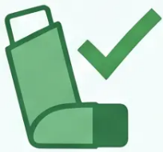


CLINICAL PRACTICE · MUST-KNOW REMINDERS
Top Tips
Part 1 of 2
SABA-only therapy is no longer recommended at any step
MAJOR 2024 CHANGE
TIP 1
Salbutamol alone fails to treat underlying airway inflammation. All adults with asthma
must use ICS/formoterol as their reliever — even for mild, infrequent symptoms.
DIAGNOSIS
Objective evidence is mandatory before diagnosing asthma
DIAGNOSIS
NICE NG245 requires spirometry with bronchodilator reversibility AND/OR FeNO AND/OR
serial peak flow. Clinical features alone are insufficient.
NORMAL TESTS
Normal spirometry between attacks does NOT exclude asthma
NORMAL
TESTS
Tests performed when asymptomatic may be entirely normal. Diagnose in context — serial peak flow
monitoring or bronchial challenge may be needed.
AIR THERAPY
Step 1 = ICS/formoterol as-needed — treats inflammation AND symptoms together
AIR
THERAPY
AIR (Anti-inflammatory Reliever) therapy provides low-dose ICS with every use. It reduces exacerbation
risk even in mild asthma — something SABA alone never achieved.
26 / 32
Bradford VTS · Asthma in Adults · May 2026

Slide 27















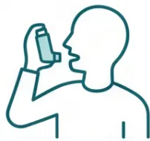

CLINICAL PRACTICE · TOP TIPS
27 / 32
Top Tips (Part 2)
≈
Qvar/Fostair
100 mcg
Extrafine Beclometasone is 2.5× More Potent
Qvar and Fostair (extrafine) deliver smaller particles with greater lung
deposition — 100 mcg extrafine ≈ 250 mcg standard beclometasone (Clenil).
Never substitute dose-for-dose.
Clenil
250 mcg
Same effect — half the dose
Mometasone (Asmanex) Discontinued in UK — February 2026
Any patient currently prescribed Asmanex must be switched to an alternative
ICS. Do not re-prescribe. Budesonide or fluticasone propionate are appropriate
substitutes — check dose equivalence before switching.
ASMANEX X
Feb 2026 — UK withdrawal
Check Inhaler Technique at Every Single Review
Most treatment failures are technique failures — not pharmacological failures.
Ask the patient to demonstrate their inhaler before stepping up therapy.
Technique deteriorates silently over time.
Observe. Don't just ask.
Bradford VTS · Asthma in Adults · May 2026
NICE NG245 · BNF 91

Slide 28







EXAM PEARLS · AKT
AKT Key Facts
High-yield facts for the Applied Knowledge Test — know these cold.
Guidelines & Diagnosis
Acute & Biologics
Management
● NG245 (Nov 2024) replaced NG80 —
know this
● Step 1 = AIR therapy — ICS/formoterol
as-needed; SABA-only abolished
ACUTE SEVERITY
Severe
● BDR positive: FEV1 >12% AND >200
mL (both criteria required — not just
>12%)
● Step 2 = Low-dose MART — regular +
reliever same inhaler
Life-threatening
Magnesium
● Step 3 = Moderate-dose MART
● Normal spirometry does NOT exclude
asthma
● Step 4 = Add LTRA (montelukast) or
LAMA (tiotropium)
● FeNO ≥40 ppb → type 2 eosinophilic
asthma; predicts ICS response
BIOLOGIC THRESHOLDS
● Step 5 = Biologics (specialist)
Mepolizumab: Eos ≥300 cells/µL
● FeNO <25 ppb → consider alternative
diagnoses
● Extrafine beclometasone = 2.5× more
potent than standard beclometasone
Dupilumab: Eos ≥150 AND FeNO ≥25
(dual biomarker)
● Serial peak flow: >20% diurnal
variability over ≥2 weeks
● Mometasone (Asmanex) discontinued
UK — Feb 2026
Tezepelumab: Any type — no eosinophil
threshold (broadest)
⚠ Both BDR criteria must be met
Omalizumab: IgE ≥30 + perennial
allergen sensitisation
💡 Extrafine dose + 2.5 = standard equivalent
⚠ AKT TRAP: BDR requires BOTH >12% AND >200 mL — the absolute value is commonly omitted and commonly examined
28 / 32

Slide 29









EXAM PEARLS · SCA
Exam Pearls: SCA Scenarios
SCENARIO 1
SCENARIO 2
Why Salbutamol Alone Isn’t Enough
Addressing Steroid Fears
Explain that salbutamol relieves symptoms but does not
treat underlying airway inflammation. ICS/formoterol
addresses both — reducing exacerbation risk even
in mild asthma.
Acknowledge concerns empathically. Explain inhaled
steroids have minimal systemic absorption, are not the
same as anabolic steroids, and are essential for
preventing serious attacks.
SCENARIO 3
SCENARIO 4
Poorly Controlled Asthma: Before
Stepping Up
Identifying Occupational Asthma
Ask: ‘Do your symptoms improve at weekends or on
holiday?’ A positive answer is a red flag. Consider
serial peak flows at work vs away, and refer to a
specialist promptly.
Always check adherence, inhaler technique, and trigger
avoidance first. Stepping up treatment without
addressing these is a common and avoidable error.
SCA TIP: In all scenarios — listen first, acknowledge concerns, then explain clearly using plain language.
29 / 32
Bradford VTS

Slide 30








CLINICAL SAFETY · HIGH-RISK FEATURES
Red Flags in Asthma
Immediate action or specialist referral required
⚠ SpO₂ Below 92%
⚠ Silent Chest
Life-threatening feature in acute attack — immediate
999 / hospital transfer. Do not wait.
Absence of wheeze in severe attack signals near-
complete airflow obstruction — extremely dangerous.
⚠ PEF Below 33% of Best
⚠ Previous Near-Fatal Attack
Life-threatening severity threshold — requires
emergency treatment and urgent hospital admission.
History of ICU admission or intubation — high-risk
patient. Consider asthma passport and specialist referral.
⚠ Samter's Triad
⚠ Raised Eosinophils (>1.0 × 10⁹/L) + Asthma
May indicate EGPA (eosinophilic granulomatosis with
polyangiitis) — refer for specialist workup.
ASTHMA + RHINITIS + ASPIRIN/NSAID sensitivity —
Avoid NSAIDs; leukotriene antagonist preferred.
⚠ "Increasing reliever use despite step-up treatment → Review diagnosis · Consider Difficult Asthma Referral"

Slide 31


CLINICAL PRACTICE · QUALITY & SAFETY
Common Pitfalls to Avoid
Prescribing SABA alone
Ignoring inhaler technique
01
05
Salbutamol-only is no longer standard at any
step — always add ICS
Fix technique before stepping up — most
failures are technique failures
Diagnosing without objective tests
Confusing beclometasone doses
02
06
NG245 requires spirometry, FeNO, or serial
peak flow — not symptoms alone
Extrafine (Qvar/Fostair) is 2.5× more potent
than standard Clenil
Stopping ICS when well
No written action plan
03
07
ICS is maintenance therapy — stopping risks
relapse and exacerbations
Every patient needs a personalised written
plan — NICE NG245 requirement
Forgetting to step down
Using theophylline first-line
04
08
Once controlled for 3 months, consider
stepping down treatment
Rarely first-line now — significant drug
interactions and toxicity risk
Before stepping up: always check adherence, inhaler technique, and triggers first
Bradford VTS · Asthma in Adults · May 2026
31 / 32

Slide 32












FINAL REVIEW
32 / 32
Quick Recall Summary
Step-wise Management
Diagnosis Markers
• Step 1: ICS/formoterol as-needed (AIR) — no SABA-only
• Spirometry: FEV1 >12% AND >200 mL post-BD
• Step 2: Low-dose MART
• FeNO ≥40 ppb → type 2 eosinophilic asthma
• Step 3: Moderate-dose MART
• FeNO <25 ppb → consider alternatives
• Step 4: Add LTRA or LAMA
• Peak flow variability >20% over 2–4 weeks
• Step 5: Biologics (specialist)
• Normal spirometry does NOT exclude asthma
Acute Severe Asthma
Key Exam Facts
• Severe: PEF 33–50%; RR ≥25; unable to speak
• SABA-only abolished at all steps (NG245, 2024)
• Life-threatening: PEF <33%; SpO₂ <92%
• Extrafine beclometasone = 2.5× standard beclometasone
• Mometasone (Asmanex) discontinued UK Feb 2026
• O₂ → nebulised salbutamol → ipratropium
• Prednisolone 40–50 mg oral
• Tezepelumab: any eosinophil count or FeNO level
• IV magnesium sulfate 1.2–2 g for refractory attack
• Dupilumab: eosinophils ≥150 AND FeNO ≥25
Bradford VTS GP Training Programme
NICE NG245 · SIGN 158 · BNF 91 · May 2026
Slide 32 of 32

