Slide 1


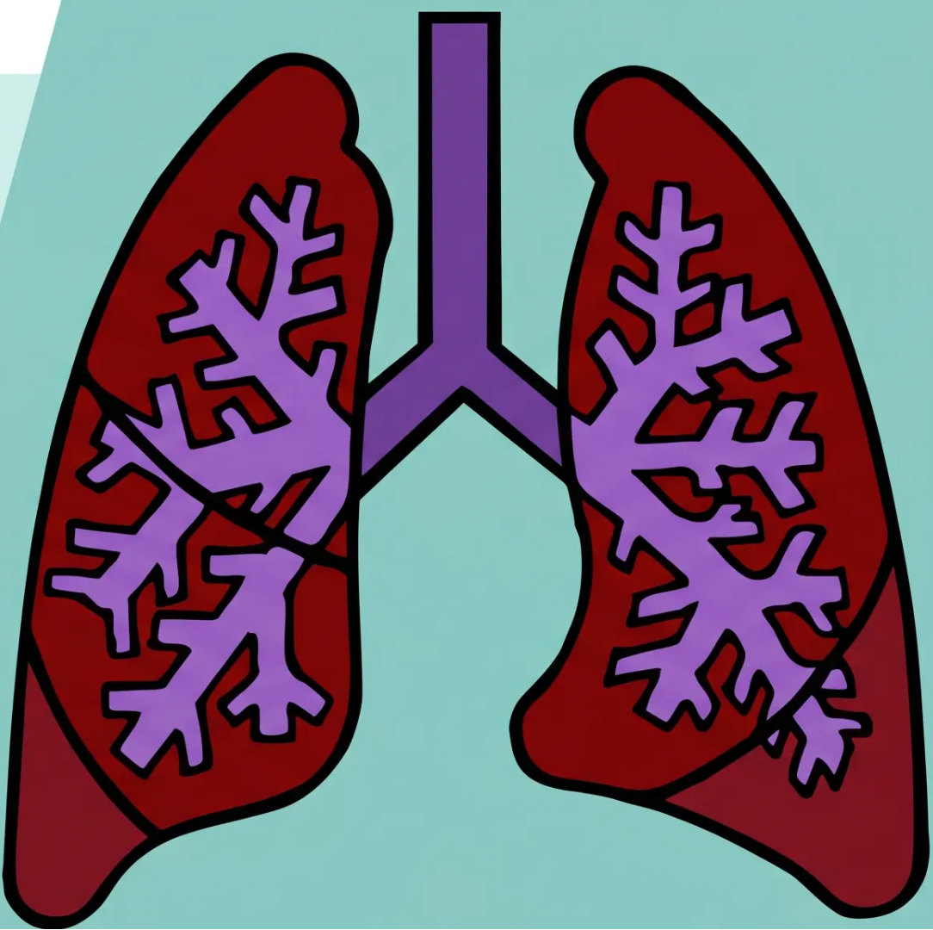

BRADFORD VTS TEACHING DECK
COPD
Bradford VTS Teaching Deck
Comprehensive GP training guide for
Chronic Obstructive Pulmonary Disease
Updated to May 2026 · RCGP AKT and SCA Preparation
NICE NG115 · GOLD 2026 · BNF 91
Bradford Vocational Training Scheme · General Practice · 2026

Slide 2









Clinical Currency and Guidelines
*All content reflects guidelines current as of May 2026
NICE NG115
GOLD 2026
BNF 91
COPD in Over 16s
Global Initiative for
COPD
British National
Formulary
Updated March 26, 2026
January 2026
March 2026
• Integrated TA1142 —
Dupilumab for COPD
• ABE classification retained
• Source for all drug doses
in this deck
• Primary reference for UK
clinical management
• Cardiovascular risk chapter
added (from GOLD 2025)
• Roflumilast dosing:
250mcg → 500mcg
*Ensifentrine introduced in GOLD 2025
niceguidelines.org.uk
goldcopd.org
bnf.nice.org.uk
‘This teaching deck integrates NICE NG115, GOLD 2026, and BNF 91 — use alongside current guidelines in clinical practice.’
Bradford VTS · COPD Teaching Deck · May 2026

Slide 3










03 / 36
Definition and Key Features
NICE NG115 · Updated March 2026
“COPD is a common, preventable and treatable disease characterised by persistent
respiratory symptoms and airflow limitation due to airway and/or alveolar
abnormalities, usually caused by significant exposure to noxious particles or gases.”
— NICE NG115 DEFINITION
Not Fully Reversible
Progressive in Most
>90% Caused by Smoking
~3.2 Million Affected
Unlike asthma — obstruction
persists post-bronchodilator
FEV₁ declines over time;
rate slowed by cessation
In the UK; occupational dusts
and gases also implicated
~1.2M diagnosed in UK;
~2M more undiagnosed
Bradford VTS · COPD Teaching Deck · 2026

Slide 4



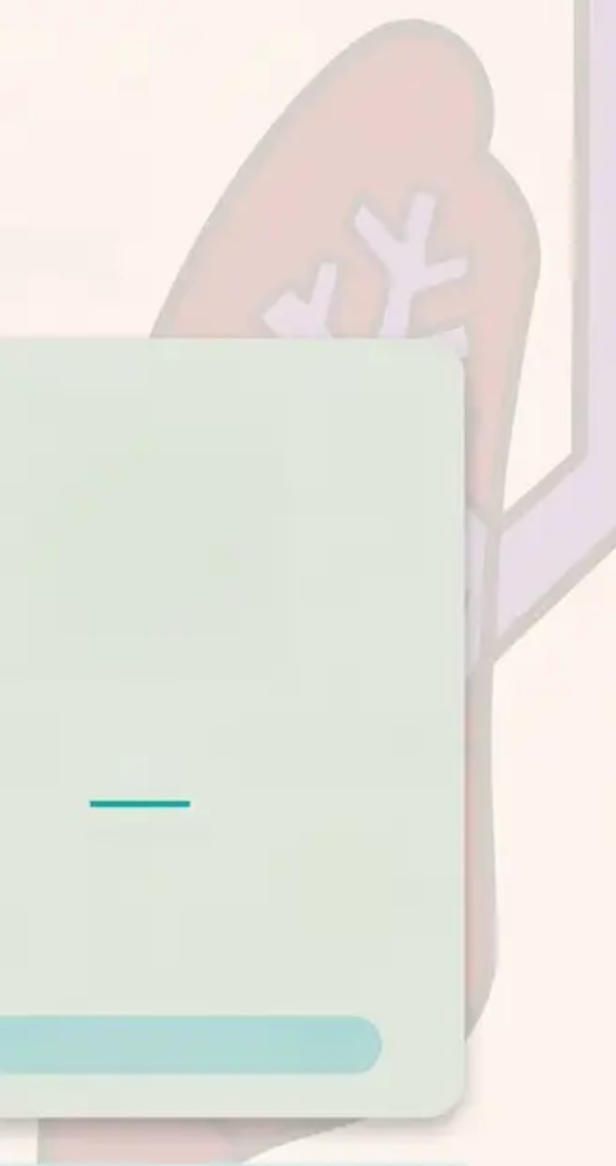



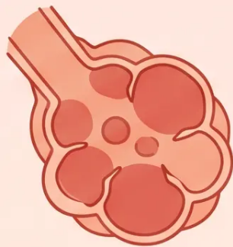
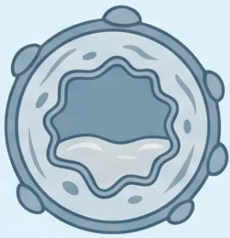
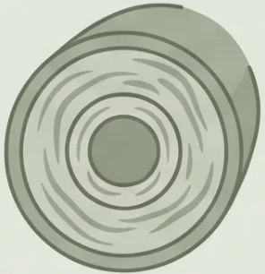


Pathological Changes in COPD
*Three distinct processes — each contributing to airflow limitation
Emphysema
Chronic Bronchitis
Small Airways Disease
- Destruction of alveolar walls
- Excess mucus production
- Fibrosis of small airway walls
- Loss of elastic recoil
- Cough ≥ 3 months/year
- Narrowing of bronchiolar lumen
- Air trapping → hyperinflation
- For ≥ 2 consecutive years
- Increased airflow resistance
*Barrel chest, reduced breath sounds
*Clinical definition — a
diagnosis of exclusion
*Main driver of FEV1 decline
**All three processes combine to produce irreversible, progressive airflow obstruction — the hallmark of COPD**

Slide 5














DIAGNOSIS
Clinical Diagnosis: Features and History
Who should you suspect has COPD?
TYPICAL PATIENT PROFILE
Age >35–40 years
>20 pack-year smoking history
Gradual, progressive onset
Progressive Breathlessness
Frequent Chest Infections
Recurrent lower respiratory tract infections; often
under-reported
Exertional initially, then at rest as disease advances
Chronic Cough
Occupational Exposure
Productive or dry; often dismissed by patient as
'smoker's cough'
Dusts, gases, fumes — always ask even in non-smokers
Insidious Onset
Wheeze
CLINICAL ALERT
Symptoms often attributed
to ageing; years may pass
before diagnosis
~2 million people in the UK
remain undiagnosed —
COPD is significantly under-
detected in primary care
May be present; does not exclude COPD diagnosis

Slide 6















Diagnostic Spirometry and Investigations
*NICE NG115 · Required for all suspected COPD*
INITIAL INVESTIGATIONS
Administer Bronchodilator
Chest X-Ray (CXR)
Salbutamol 400 mcg via spacer
At initial assessment · Exclude
other pathology · May show
hyperinflation or bullae
Wait 15–20 Minutes
Allow full bronchodilator effect
Full Blood Count (FBC)
Polycythaemia (chronic
hypoxia) · Anaemia exclusion ·
Eosinophil count
Perform Spirometry
Measure FEV1 and FVC post-bronchodilator
Consider Alpha-1-
Antitrypsin
Post-BD FEV1/FVC < 0.70
Must be POST-bronchodilator
because pre-BD
Age <40 · Minimal smoking
history · Family history of COPD
overestimates by ~25%
Confirms airflow obstruction → COPD diagnosis
Bradford VTS · COPD Teaching Deck · NICE NG115 Updated March 2026

Slide 7






















07 / 36
Differentiating COPD from Asthma
Key clinical features for diagnosis and exam
Feature
COPD
Asthma
Onset
Usually over 35–40 years
Often childhood or young adult
Smoking history
Nearly always present
Variable
Chronic productive cough
Common
Uncommon
Breathlessness
Progressive, daily
Variable, episodic
Nocturnal waking
Uncommon
Common ✓
Day-to-day variation
Uncommon
Common ✓
Bronchodilator reversibility
Minimal — less than 12%
Often significant — more than 12% AND more than 200 mL
Exam tip: BDR in COPD is minimal — post-BD FEV₁/FVC remains below 0.70. In asthma, reversibility is
significant: FEV₁ increases more than 12% AND more than 200 mL.
Bradford VTS · COPD Teaching Deck · 2026

Slide 8


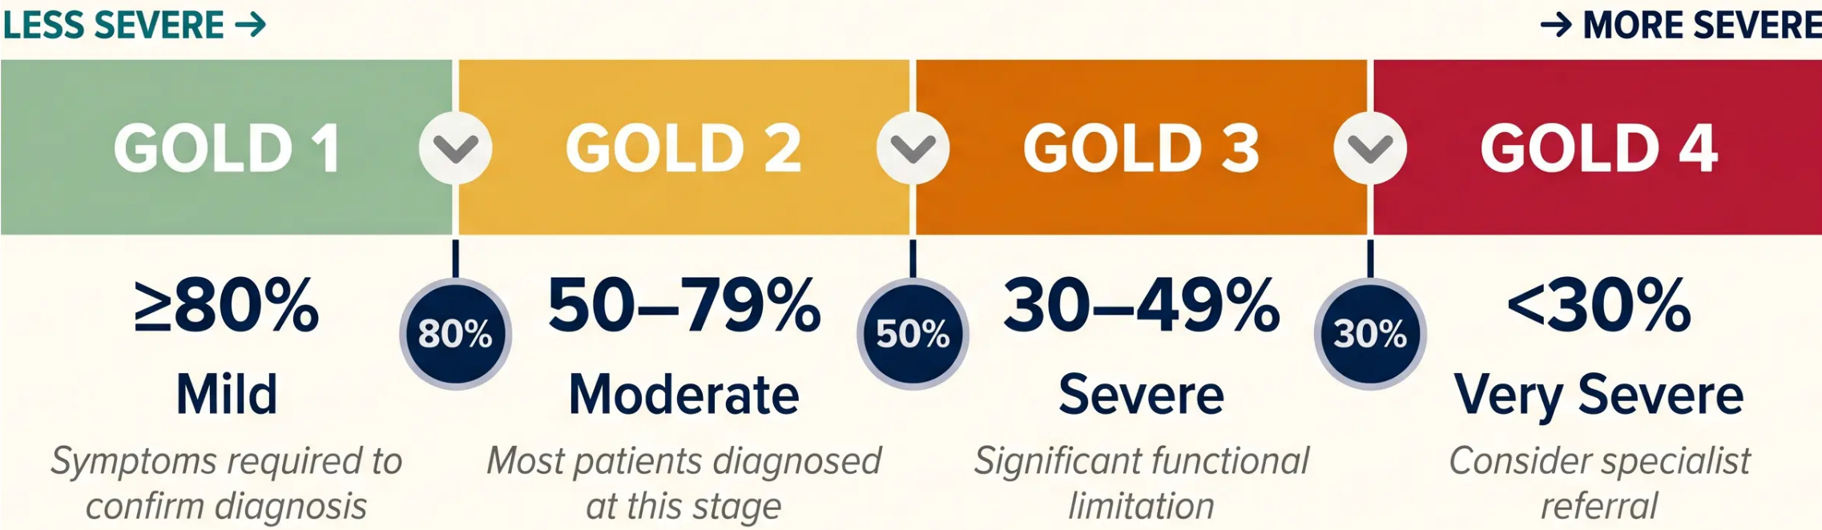
08 / 36
Spirometric Severity Grading (GOLD 1–4)
Post-bronchodilator FEV1 % predicted — with FEV1/FVC <0.70 confirmed
★ Exam Recall: The three cut-offs are 80 / 50 / 30 — remember these for GOLD 1, 2, 3, 4
All stages require post-bronchodilator FEV1/FVC <0.70 to confirm obstruction first

Slide 9













GOLD ABE Classification (2026)
Symptom burden × Exacerbation risk — categorise every COPD patient
A
B
E
Group A
Group B
Group E
High symptoms · Low risk
Low symptoms · Low risk
High exacerbation risk
• CAT score < 10 OR mMRC grade 0–1
• CAT score ≥ 10 OR mMRC grade ≥ 2
• ≥ 2 moderate exacerbations in past
year, OR
• 0 or 1 moderate exacerbation in past
year
• 0 or 1 moderate exacerbation in past
year
• ≥ 1 exacerbation requiring hospitalisation
• No hospitalisations
• No hospitalisations
• Regardless of symptom score
Start: SABA or SAMA (PRN)
Start: LAMA + LABA
Start: LAMA (preferred) or LABA
(consider ICS if eosinophils ≥0.3)
Why “E” not “C”? GOLD retired Groups C and D. in 2023. Group E captures all patients with frequent exacerbations regardless of
symptom burden — simplifying the framework.
SYMPTOM ASSESSMENT TOOLS
CAT score — threshold ≥10
9 / 36
mMRC scale — threshold ≥2

Slide 10

























SLIDE 10 · SYMPTOM ASSESSMENT
MRC Dyspnoea Scale
Modified Medical Research Council (mMRC) — 5-point breathlessness grading
1
STRENUOUS EXERCISE
Only breathless with strenuous exercise
Clinical
Thresholds
2
HURRYING / INCLINES
Breathless when hurrying on the level or up a slight hill
mMRC ≥ 2 → High
symptom burden
(GOLD Group B or E)
3
WALKING ON LEVEL
Walks slower than contemporaries, or stops after walking about 1 mile on the level
Grade ≥ 3 → Offer
Pulmonary
Rehabilitation
(NICE NG115)
4
100 METRES / MINUTES
Stops after walking about 100 metres or after a few minutes on the level
AT REST / DRESSING
Too breathless to leave the house, or breathless when dressing
Grade 3-4 with
disability → PR
even if MRC 2
5
Bradford VTS · COPD Teaching Deck · 2026
10 / 36

Slide 11



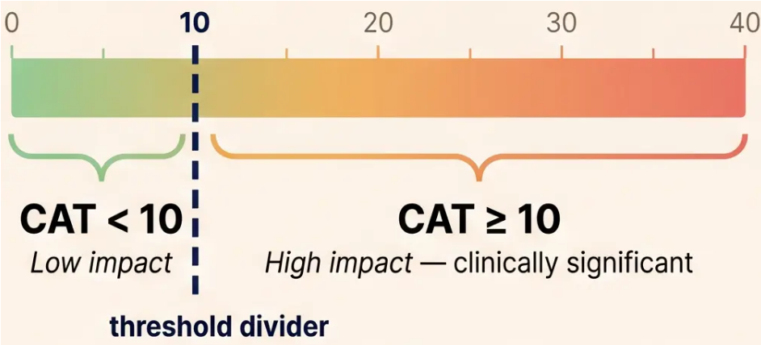
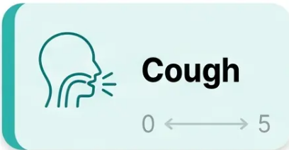

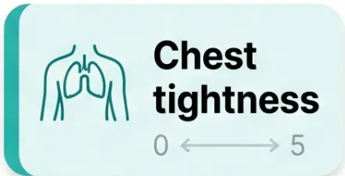






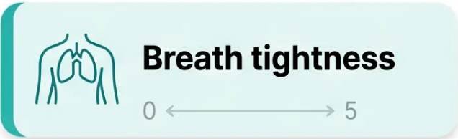
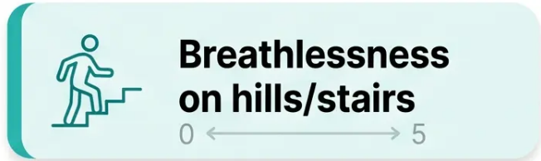




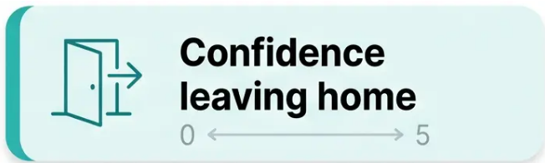


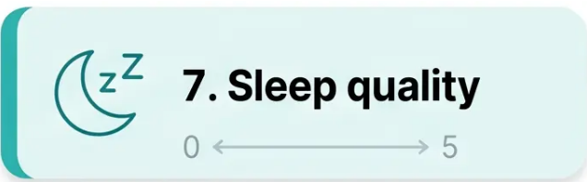
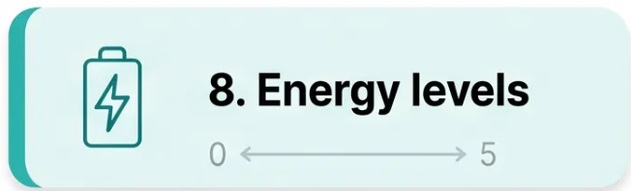






11 / 36
threshold divider
COPD Assessment Test (CAT)
*8-item patient-reported outcome measure · scored 0–40*
CAT < 10
CAT ≥ 10
High symptom burden
Low symptom burden
• Group A classification
Group B or E classification
• Less urgent treatment
escalation
• Drives treatment decisions
• Triggers LABA/LAMA
escalation
CLINICAL PEARL
“CAT ≥ 10 = “high symptoms” in GOLD ABE classification
— determines whether patient is Group B or E”
Bradford VTS · COPD Teaching Deck · May 2026 · NICE NG115 · GOLD 2026

Slide 12















Pharmacological Management: Step 1 & 2
*NICE NG115 · All patients start here
Short-Acting Bronchodilator (PRN Relief)
STEP
1
For ALL patients with COPD — as-needed symptom relief
SABA
SAMA
Salbutamol 100mcg MDI
OR
Ipratropium 20mcg MDI
2 puffs PRN
2 puffs QDS
Regular Long-Acting Bronchodilator
STEP
2
Based on clinical features — choose pathway
No Asthmatic
LAMA alone
Asthmatic
LABA + ICS
Features
Tiotropium 18mcg OD or
Umeclidinium 55mcg OD
Features Present
Salmeterol/Fluticasone
combination
Eosinophils <0.3 × 10⁹/L
Or eosinophils ≥0.3 × 10⁹/L
“Asthmatic features” = history of asthma/atopy, significant BDR >400mL, or eosinophilia
→ See next slide: The Management Fork — Asthmatic Features in Detail

Slide 13













The Management Fork: Asthmatic Features
Step 2 decision pathway — choosing the right long-acting bronchodilator strategy
Does the patient have asthmatic features
OR blood eosinophils ≥ 0.3 × 10⁹/L?
"Asthmatic features" = history of asthma/atopy · significant BDR (>400 mL) · eosinophilia
NO
YES
No asthmatic features · Eosinophils < 0.3 × 10⁹/L
Asthmatic features present
OR Eosinophils ≥ 0.3 × 10⁹/L
LAMA Alone
LABA + ICS
Long-acting muscarinic antagonist
monotherapy
Long-acting beta-agonist combined
with inhaled corticosteroid
- Tiotropium 18 mcg OD (HandiHaler)
- Salmeterol / Fluticasone (Seretide)
- Umeclidinium 55 mcg OD (Ellipta)
- Formoterol / Budesonide (Symbicort)
- Glycopyrronium 44 mcg OD (Breezhaler)
Group A or B · No ICS needed
Asthma-COPD overlap · ICS indicated
⚠ Prescribing ICS without eosinophil count in non-asthmatic COPD increases pneumonia risk — always check before initiating

Slide 14



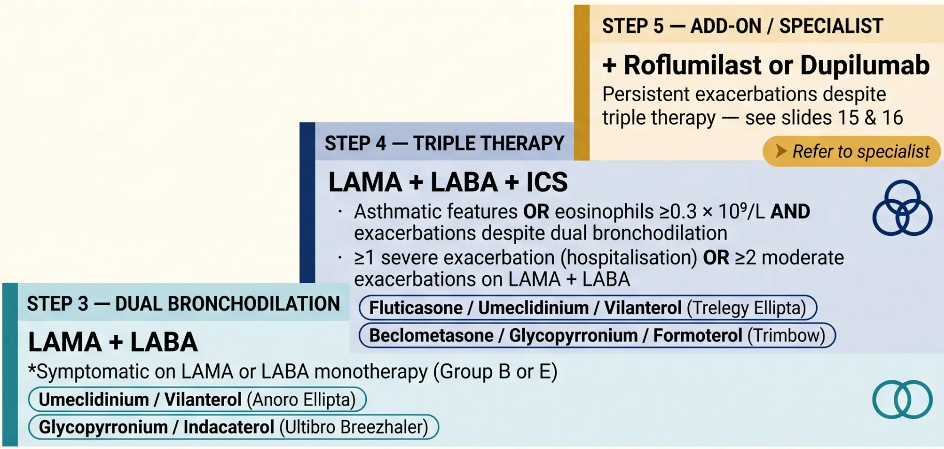



14 / 36
Dual and Triple Therapy Escalation
*When bronchodilator monotherapy is no longer enough
ESCALATION TRIGGERS
✓ Still symptomatic
on current therapy
✓ CAT ≥10 or mMRC
≥2 persisting
✓ ≥2 moderate
exacerbations in
past year
✓ ≥1 hospitalised
exacerbation
Review eosinophil
count before adding ICS
NICE NG115 (March 2026) · GOLD 2026 · Bradford VTS

Slide 15




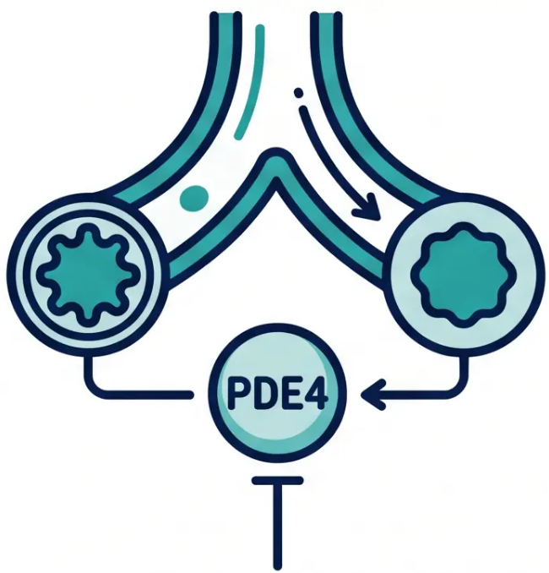






Phosphodiesterase-4 Inhibitors: Roflumilast
Add-on therapy for severe COPD with chronic bronchitis · BNF 91
INDICATIONS — ALL FOUR CRITERIA REQUIRED
• FEV₁ <50% predicted (post-bronchodilator)
• Chronic bronchitis (productive cough ≥3 months/year,
≥2 consecutive years)
• ≥2 moderate exacerbations in the past year
• Already on triple therapy (LAMA + LABA + ICS) — all four
criteria must be met
DOSING SCHEDULE (BNF 91)
Weeks 1–4 (initiation)
250 mcg once daily
Week 5 onwards (maintenance)
500 mcg once daily
↓ cAMP breakdown → ↓ inflammation
*Start low to reduce GI side effects — nausea and weight loss are common early
Mechanism: selective PDE4 inhibition
Roflumilast is an oral tablet — NOT an inhaler
→ anti-inflammatory
Bradford VTS · COPD Teaching Deck · May 2026
Slide 15 / 36

Slide 16










PHARMACOLOGICAL MANAGEMENT • STEP 5
New Biologic Therapy: Dupilumab (TA1142)
First biologic approved for COPD • NICE TA1142 • March 2026
😮 NEW — March 2026
MECHANISM
Who Qualifies?
Monoclonal antibody — blocks IL-4 and
IL-13 signalling pathways, reducing
type-2 eosinophilic airway inflammation
✔ Adults only
✔ Severe uncontrolled COPD
INITIATION
Specialist-initiated only — not
prescribed in primary care. Refer to
secondary care respiratory team.
✔ Blood eosinophils ≥ 0.3 × 10⁹/L
✔ Already on optimised triple
therapy (LAMA + LABA + ICS)
EXAM ALERT
*All four criteria must be met
simultaneously
First and only NICE-approved biologic
for COPD. High-yield AKT topic — know
the TA number: TA1142.
Dupilumab — subcutaneous injection
NICE TA1142 (March 2026) · Integrated into NICE NG115 March 2026 · Bradford VTS COPD Teaching Deck

Slide 17



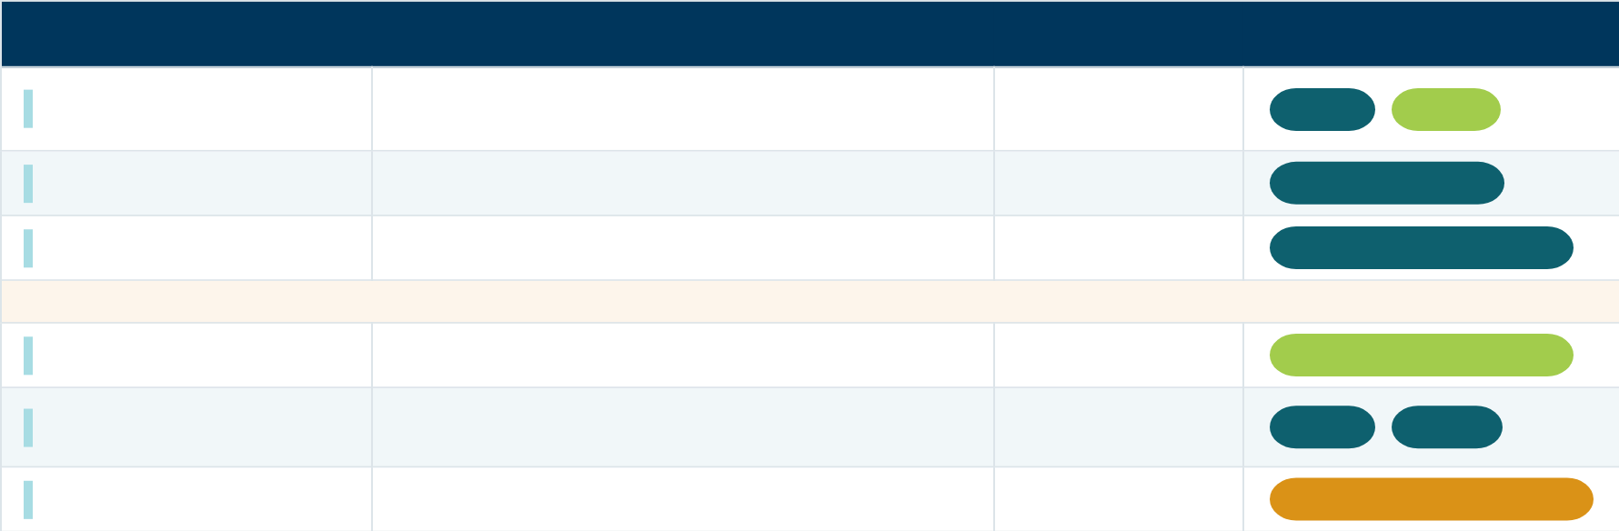






























17 / 36
BNC Drug Doses and Inhaler Types
BNF 91 • March 2026 reference
LAMA
Drug
Dose
Frequency
Inhaler Type
18 mcg (HandHaler) • 5 mcg (Respimat)
Once daily
Tiotomium
DPI
SMI
55 mcg
Once daily
Umeecidniurn
DPI (Ellopta
44 mcg
Once daily
DPI (Breezhaler)
Glycchavironium
LABA
Indacetotol
150 mcg
Once daily
DPI (Breezhaler)
500 mcg
PDE4 INHBITOR
Twice daily
Salmlperol
DPI
MDI
250 mcg × 4 weeks → 500 mcg
Roflumiliot
Once daily
Oral tabet
Roflumilest: Start at 250 mcg for 4 weeks to
reduce GI side effects, then step up to 500 mcg

Slide 18



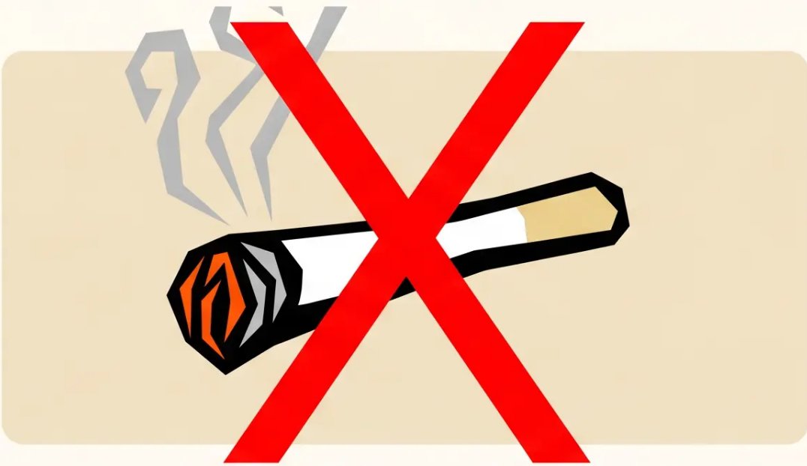






Smoking Cessation: The Key Intervention
The single most effective treatment in COPD management
50–80 mL/year
25–30 mL/year
FEV1 decline — after cessation
FEV1 decline — continuing smoker
Smoking cessation halves the rate of lung function decline
How to Help Patients Stop
1. Refer
NHS Stop Smoking Service — evidence-based structured support
2. Pharmacotherapy Options
Varenicline
NRT
Bupropion
Patches / gum / spray
First-line
Second-line
3. Approach
Non-judgmental, motivational, revisit at every contact
Smoking accounts for >90% of COPD cases in the UK
Bradford VTS · COPD Teaching Deck · 2026
Slide 18 of 36

Slide 19


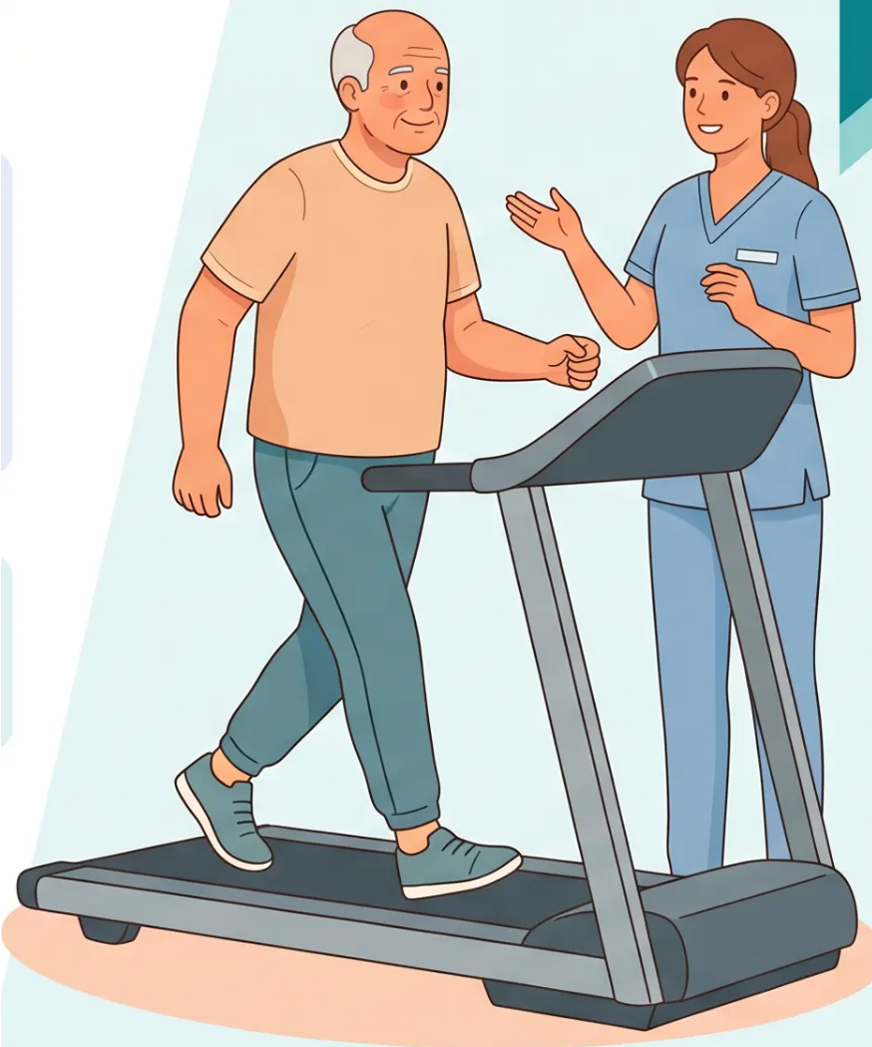
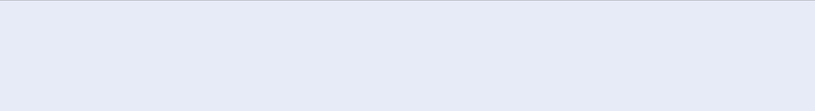





NON-PHARMACOLOGICAL MANAGEMENT
Pulmonary Rehabilitation
The intervention with the strongest evidence base for improving quality of life
Who Should Be Referred?
✓ MRC Grade 3 or 4 — offer pulmonary rehabilitation
✓ MRC Grade 2 — offer if functionally limited or disabled by breathlessness
✓ Any patient with COPD who remains symptomatic or deconditioned
despite optimal medical therapy
*NICE NG115 recommendation — do not wait for maximum pharmacological treatment first
6 weeks
2x/week
MDT
Minimum programme
duration
Supervised sessions
per week
Multidisciplinary
team approach
What Does It Deliver?
● ↑ Exercise capacity — improved walking distance and endurance
● ↑ Quality of life — reduced breathlessness, better daily function
● ↓ Hospital admissions — fewer and shorter inpatient stays
● ↑ Confidence — self-efficacy and understanding of the condition
Bradford VTS · COPD Teaching Deck · May 2026
Slide 19 of 36

Slide 20











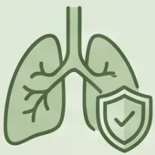
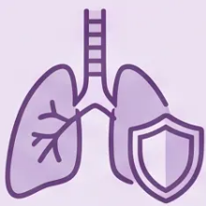


20 / 36
Vaccination and Preventative Care
Reduce exacerbation risk and respiratory complications in COPD patients
All COPD patients should be up to date with the following vaccinations — record status at every annual review
Influenza
COVID-19
*Annual*
*Booster*
- Offered every autumn
- Follow current national schedule
- All COPD patients, regardless of severity
- COPD patients are in priority group
Every year
Per national guidance
Pneumococcal
RSV
*PPV23*
*Respiratory Syncytial Virus*
- One-off dose for most patients
- Offer if eligible per national programme
- RSV is a significant exacerbation trigger in
COPD
- Repeat based on individual risk assessment
- Protects against Streptococcus pneumoniae
One-off + review
If eligible
Bradford VTS · COPD Teaching Deck · May 2026 · NICE NG115 · GOLD 2026

Slide 21


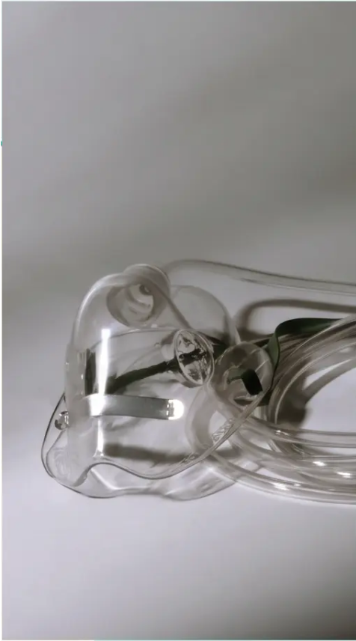






Long-Term Oxygen Therapy
(LTOT) Criteria
PaO₂ thresholds · Assessment process · Usage requirements
PRIMARY CRITERION
SECONDARY CRITERION
PaO₂ < 7.3 kPa
PaO₂ 7.3 – 8.0 kPa
When stable (not during exacerbation)
With one or more of the following:
→ Qualifies for LTOT regardless of
other conditions
· Cor pulmonale
· Secondary polycythaemia
· Pulmonary hypertension
Two arterial blood gases (ABGs) taken 3 weeks apart, when patient is stable and on
optimal't. Never prescribe LTOT on a single result or during an acute exacerbation.
Assessment Required
Minimum Daily Use
Must be used for at least 15 hours per day to demonstrate survival benefit.
More hours = greater benefit.
Bradford VTS · COPD Teaching Deck · May 2026

Slide 22



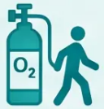



22 / 36
Oxygen Administration and SBOT
Ambulatory oxygen criteria and the evidence against short-burst therapy
Ambulatory Oxygen
Short-Burst Oxygen Therapy (SBOT)
Who qualifies?
NOT recommended for COPD breathlessness
• Qualifies for LTOT and remains ambulatory
→ Assessed and prescribed alongside LTOT
• No evidence of benefit for non-hypoxaemic
breathlessness in COPD
• Exercise desaturation ≥4% on walking
assessment → Even if not meeting full LTOT
threshold at rest
• Does not relieve dyspnoea in patients with
normal oxygen saturations
• Risk of dependency and false reassurance
• Only NICE-approved use for SBOT: cluster
headache — not COPD
Formal walking assessment required — typically
6-minute walk test with oximetry monitoring.
Prescribed by specialist respiratory team.
NOT RECOMMENDED
If a patient is requesting home oxygen for breathlessness
alone, explore the evidence together — and consider
referral to pulmonary rehabilitation instead.
Requires formal assessment · Specialist-led
Ambulatory O₂ = evidence-based, formally assessed · SBOT for breathlessness = no evidence, not recommended

Slide 23



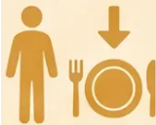
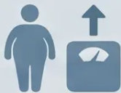






23 / 36
Nutrition and Weight Management
*Managing BMI to optimise COPD outcomes
BMI < 20
BMI ≥ 30
Underweight — Nutritional Support
Overweight — Weight Management
- Refer for dietary assessment
- Refer to structured weight management programme
- High-calorie nutritional supplements (e.g. oral
nutritional drinks)
BMI
- Obesity increases breathlessness and worsens
exercise tolerance
- Weight loss in COPD worsens prognosis — muscle
wasting reduces respiratory muscle strength
- Cardiovascular risk is elevated in obese COPD
patients
- Monitor weight at every review
- Encourage physical activity within patient's capability
Low BMI is an independent predictor of poor
outcomes in COPD
Obesity compounds dyspnoea — even modest
weight loss improves symptoms
Bradford Vocational Training Scheme · General Practice · 2026

Slide 24






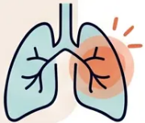



EXACERBATION MANAGEMENT · SLIDE 24
Defining and Identifying Exacerbations
Recognising acute worsening — and what's driving it
NICE NG115 DEFINITION
“Acute worsening of respiratory symptoms beyond normal day-to-day variation,
requiring a change in treatment”
This is a clinical diagnosis — no single test confirms it
Viral Triggers
Bacterial Triggers
Less common but important
~80%
— Rhinovirus (common cold)
— Haemophilus influenzae
— Influenza
— Streptococcus pneumoniae
● RSV
of all exacerbations
— Moraxella catarrhalis
● Parainfluenza
Also consider: air pollution, environmental irritants
HOW TO RECOGNISE AN EXACERBATION
● Increased breathlessness
● Change in sputum colour or volume
● More frequent coughing

Slide 25










Management of Mild-Moderate Exacerbations
Home treatment protocol – NICE NG115
Prednisolone 30mg OD
Increase SABA
Antibiotic if Indicated
STEP 1 – IMMEDIATE
STEP 2 – 5-DAY COURSE
STEP 3 – IF PURULENT SPUTUM OR
RAISED CRP
- Increase frequency of short-acting
bronchodilator
- Oral prednisolone 30mg once daily
- Duration: 5 days (as effective as
14-day course)
First line:
- Salbutamol 100mcg MDI – up to
every 4 hours
Amoxicillin 500mg TDS × 5 days
- Reduces inflammation and speeds
recovery
Penicillin allergy:
- Use with spacer for best delivery
Doxycycline 200mg day 1, then 100mg OD
- Review if no improvement within
24 hours
- No need to taper after short course
Second line:
Co-amoxiclav or clarithromycin
SABA · PRN escalation
5 days · no taper needed
Purulent sputum · raised CRP
⚠ Admit if: SpO₂ <90% · severe breathlessness · cyanosis ·
altered consciousness · failure of home management
📋 Causes: Viral URTI ~80% · Bacterial (H. influenzae,
S. pneumoniae, Moraxella) · Air pollution

Slide 26




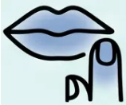






26 / 36
Criteria for Hospital Admission
*Recognising when a COPD exacerbation requires urgent inpatient care*
Severe Breathlessness
SpO₂ <90% on Air
Central Cyanosis
Use of accessory muscles;
unable to complete sentences
Persistent hypoxaemia despite
initial treatment
Blue discolouration of lips or
fingertips
Altered Consciousness
Failed Home Treatment
Rapid Clinical Deterioration
Confusion, drowsiness, or
reduced GCS
No improvement after initiating
rescue medication
Sudden or severe worsening
beyond normal variation
Exam tip: SpO₂ <90% on air = hospital threshold — distinct from LTOT criteria (PaO₂ <7.3 kPa)

Slide 27



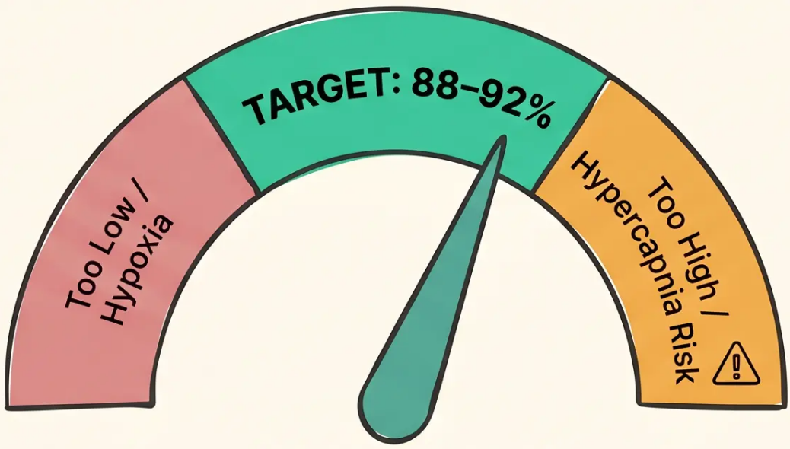


Controlled Oxygen Therapy in Hospital
COPD Exacerbation · Acute Setting · Safety-Critical
OXYGEN TARGET
SpO₂ 88–92%
Use Venturi mask — 24% (blue) or 28% (white) — to
deliver precise, controlled flow rates
CRITICAL REASON
Risk of Hypercapnic Respiratory Failure
In COPD, hypoxic drive may be blunted. High-flow
uncontrolled oxygen suppresses respiratory drive → rising
CO₂ → respiratory acidosis → reduced consciousness
AVOID
Do NOT target 94–98% in COPD
Not the same as asthma
This is the standard target for asthma and most other
conditions — but it is dangerous in COPD exacerbation.
Never use uncontrolled high-flow oxygen.
Asthma target: 94–98% · COPD target: 88–92%
Bradford VTS · COPD Teaching Deck · 2026
27 / 36

Slide 28









SECTION 9 · SELF-MANAGEMENT
Self-Management and Rescue Packs
Empowering patients with agreed protocols for starting steroids and antibiotics at home
Rescue Pack Contents
When to Start the Pack
When to Call for Help
stable
worsening
start pack now
– Increased breathlessness beyond
normal
– No improvement after 48 hours of
rescue pack
– 💊 Prednisolone 30mg OD × 5 days
– 💊 Antibiotic — amoxicillin 500mg
TDS or doxycycline (if penicillin
allergy)
– Change in sputum colour
(yellow/green) or volume
– SpO2 dropping or severe
breathlessness
– Symptoms clearly worse than usual
day-to-day
– Confusion, cyanosis, or unable to
manage at home
“Rescue packs work best when the patient knows exactly when and how to use them.”
Agreed written protocol with GP essential — review annually
SCA
TIP
Rescue pack discussion = key SCA scenario
— demonstrate shared decision-making

Slide 29






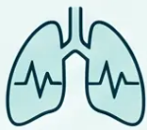
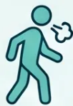












29 / 36
The Annual Review Checklist
*Essential components of a comprehensive yearly COPD review in primary care
Spirometry
MRC Dyspnoea Grade
Inhaler Technique
CAT Score
Repeat if clinical change;
confirm severity grade
Record grade 1–5;
identify deterioration
Score 0–40; CAT ≥10 =
high symptom impact
Observe and correct at
every review
Vaccination Status
Nutrition & BMI
Rescue Pack
Smoking Cessation
Review prednisolone +
antibiotic supply and plan
Flu, COVID, pneumococcal,
RSV if eligible
Assess status; refer to
Stop Smoking Service
BMI <20 → support; BMI
>30 → weight management
Bradford VTS · COPD Teaching Deck · May 2026
NICE NG115 · Annual Review

Slide 30










BRADFORD VTS • TOP TIPS
Tips
Top Tips Part 1 of 2 — Diagnosis, the Fork, and New Biologics
01 Post-BD Spirometry — Always
02 The Fork in the Road
Use post-bronchodilator FEV1/FVC <0.70 to diagnose
COPD.
Asthmatic features OR eosinophils ≥0.3 × 10⁹/L →
start LABA + ICS
No asthmatic features → LAMA only (avoid
unnecessary ICS)
Pre-BD spirometry overestimates obstruction by ~25%.
DIAGNOSIS
TREATMENT
03 Dupilumab — Now NICE Approved
04 LTOT: Two ABGs Required
First biologic for COPD. TA1142, March 2026.
Two arterial blood gases, 3 weeks apart, when patient is
stable.
For severe uncontrolled COPD + eosinophils ≥0.3 × 10⁹/L
on triple therapy. Specialist-initiated.
Never prescribe on a single result or during an
exacerbation.
NEW 2026
OXYGEN
Continued on next slide →
30 / 36

Slide 31









BRADFORD VTS · COPD TEACHING DECK
Top Tips (Part 2)
5–8
*Essential advice on oxygen, steroids, and pulmonary rehabilitation*
5
6
Oxygen Target in COPD: 88–92%
Short Steroid Courses Work
Not the same as asthma. Avoid uncontrolled high-
flow oxygen — risk of hypercapnic respiratory
failure. Use Venturi mask 24–28% in hospital.
5 days of prednisolone 30mg is as effective as
14 days for exacerbations — and causes fewer
side effects. Don’t default to longer courses.
7
8
Pulmonary Rehab: Underused but Powerful
Roflumilast: Start Low, Go Slow
Improves exercise tolerance and quality of life
more than any single drug. Offer to MRC grade
3–4, or grade 2 if functionally disabled. Minimum
Minimum 6 weeks.
Begin at 250mcg OD for 4 weeks to reduce GI side
effects, then step up to 500mcg OD. Only for
FEV1 <50% + chronic bronchitis + ≥2
exacerbations despite triple therapy.
Bradford VTS GP Training · COPD 2026
Slide 31 of 36

Slide 32
























PAGE 32 · EXAM PREPARATION
Exam Pearls: AKT Focus
High-yield facts — know these cold for the written exam
DIAGNOSIS
GOLD GRADING
ABE GROUPS
GOLD 1
≥ 80%
Mild
A — Low symptoms + low exacerbation risk
B — High symptoms + low exacerbation risk
E — ≥2 moderate OR ≥1 hospitalised
exacerbation
FEV₁/FVC < 0.70
GOLD 2
50-79%
Moderate
Post-bronchodilator — always. Pre-BD
overestimates obstruction by ~25%
GOLD 3
30-49%
Severe
GOLD 4
< 30%
Very Severe
CAT ≥10 / mMRC ≥2 = high symptoms
All require FEV₁/FVC < 0.70
TRIPLE THERAPY
LTOT CRITERIA
EXACERBATION Rx
LAMA + LABA + ICS
→ PaO₂ < 7.3 kPa when stable
→ Prednisolone 30mg OD × 5 days (not 14)
→ Asthmatic features OR eosinophils
≥ 0.3 × 10⁹/L + exacerbations
→ Two ABGs, 3 weeks apart,
after optimal Rx
→ Antibiotic if purulent sputum or
raised CRP
→ ≥1 severe exacerbation OR ≥2
moderate on dual therapy
Roflumilast: add if FEV₁ <50% + chronic
bronchitis + ≥2 exacerbations despite triple
→ Use ≥ 15 hours/day
→ O₂ target: 88–92% (NOT 94–98%)
PaO₂ 7.3–8.0 kPa → LTOT if cor
pulmonale / polycythaemia / PHT
→ Controlled O₂ via Venturi 24–28%
⚠ High-flow O₂ → hypercapnic respiratory failure
Bradford VTS · COPD Teaching Deck · 2026
32 / 36

Slide 33














EXAM PEARLS · SCA
Exam Pearls: SCA Scenarios
Practical consultation frameworks — what the examiner is looking for
💬 SCA tests communication, clinical reasoning, and safety-netting — not just knowledge
Oxygen at Home
Smoking Cessation
Acute Exacerbation
Patient still smoking with established COPD
Patient asking about home oxygen
Patient calling with worsening symptoms
• Acknowledge the patient's breathlessness
and concern
• Non-judgmental, curious opener — explore
readiness to change
• Assess severity: SpO2, accessory muscle
use, confusion
• Explain: oxygen only helps if blood oxygen
is genuinely low
• Validate: "It's incredibly hard to stop —
you're not alone"
• If managing at home: prednisolone 30mg
OD for 5 days
• LTOT requires formal assessment — two
ABGs, three weeks apart, when stable
• Explain impact clearly: slows FEV1 decline
from ~80mL/yr to ~30mL/yr
• Antibiotic if purulent sputum: amoxicillin
500mg TDS × 5 days
• "We need to check your oxygen levels
properly before prescribing"
• Offer options: NRT, varenicline (Champix),
bupropion, NHS Stop Smoking Service
• Review rescue pack — has the patient got
one? Does it need replenishing?
• No benefit shown for non-hypoxaemic
COPD
• Motivational interviewing tone — avoid
lecturing
• Clear safety-netting: SpO2 <90%, no
improvement in 48h → hospital
• Safety-net: when to return, what to expect
from assessment
• Safety-net: follow-up appointment, written
information
• Arrange follow-up within 2 weeks post-
exacerbation
Key phrase: "Oxygen is a treatment, not a
comfort measure — it needs to be right for you"
Key phrase: "This single change will do more for
your lungs than any inhaler I can prescribe"
Key phrase: "Five days of steroids is as effective
as fourteen — and much kinder to the patient"
Bradford VTS · COPD Teaching Deck · 2026
Slide 33 of 36

Slide 34













⚠ SAFETY-NETTING · URGENT REVIEW
Red Flags in COPD
*Critical signs requiring urgent investigation or referral*
Haemoptysis
Rapid FEV1 Decline
Any blood in sputum in a COPD patient
Decline >100 mL/year
→ Urgent CXR + consider CT — exclude malignancy
→ Review diagnosis · CT chest · Alpha-1-antitrypsin screen
Age <40 + COPD Features
SpO₂ <88% at Rest (Stable)
Minimal or no smoking history
When stable and not in exacerbation
→ Screen for Alpha-1-antitrypsin deficiency
→ Urgent LTOT assessment (two ABGs, 3 weeks apart)
SpO₂ <90% in Exacerbation
Cor Pulmonale
Acute deterioration with low saturations
Peripheral oedema + COPD features
→ Consider hospital admission
→ LTOT assessment · Diuretics · Specialist referral
Bradford VTS · COPD Teaching Deck · 2026
Slide 34 of 36

Slide 35









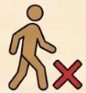


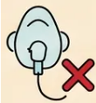
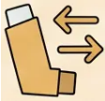



35 / 36
Common Pitfalls to Avoid
Frequent clinical errors in spirometry, oxygen targeting, and prescribing
PITFALL 1
PITFALL 5
Pre-bronchodilator spirometry used
for diagnosis
Missing alpha-1-antitrypsin deficiency
Screen if age <40, minimal smoking history, or family history of COPD
Pre-BD overestimates obstruction by ~25% — always use post-BD FEV1/FVC
PITFALL 2
PITFALL 6
ICS prescribed without asthmatic features or
eosinophil check
Not referring for pulmonary rehabilitation
Massive evidence base — improves QOL more than any single drug
Unnecessary ICS increases pneumonia risk — check eosinophils first
PITFALL 3
PITFALL 7
Not distinguishing asthmatic from
non-asthmatic COPD
Targeting SpO₂ 94–98% in COPD exacerbation
Too high — risks hypercapnic respiratory failure; target 88–92%
Asthmatic features → LABA+ICS; no features → LAMA first
PITFALL 4
PITFALL 8
Prescribing SBOT for breathlessness in
non-hypoxaemic COPD
Prescribing 14-day prednisolone courses
5-day courses are equally effective with fewer side effects
No evidence of benefit — SBOT is not indicated here
Bradford VTS · COPD Teaching Deck · 2026
⚠ Pitfalls · Slide 35

Slide 36








SLIDE 36 · FINAL SUMMARY
Quick Recall Summary
Diagnostic cut-offs · Treatment steps · Emergency targets
DIAGNOSIS
GOLD SEVERITY
TREATMENT STEPS
Post-BD FEV1/FVC <0.70 = COPD confirmed
Step 1: SABA or SAMA (all patients)
GOLD 1: FEV1 ≥80% — Mild
Always use post-bronchodilator spirometry
Step 2: LAMA (no asthmatic features) or
LABA+ICS (asthmatic/eosinophilia ≥0.3)
GOLD 2: FEV1 50-79% — Moderate
CXR + FBC at initial assessment
GOLD 3: FEV1 30-49% — Severe
Alpha-1-antitrypsin if age <40 or minimal
smoking
Step 3: LAMA + LABA dual bronchodilation
GOLD 4: FEV1 <30% — Very Severe
Step 4: Triple therapy — LAMA + LABA + ICS
ABE: A low/low · B high/low · E high exacerbations
Roflumilast: FEV1 <50% + chronic bronchitis +
≥2 exacerbations despite triple
LTOT CRITERIA
EXACERBATION
NEW & KEY DRUGS
PaO2 <7.3 kPa when stable → LTOT indicated
Prednisolone 30mg OD × 5 days (not 14)
Dupilumab (TA1142, March 2026) — first biologic
for COPD
OR PaO2 7.3–8.0 kPa + cor pulmonale /
Antibiotic if purulent sputum: amoxicillin 500mg
polycythaemia
TDS × 5 days
Criteria: severe uncontrolled + eosinophils ≥0.3 on
triple therapy
Two ABGs 3 weeks apart — never on single result
Penicillin allergy: doxycycline 200mg → 100mg OD
Never assess during exacerbation
Specialist-initiated only
Hospital O2 target: 88–92% via Venturi 24–28%
Must use ≥15 hours/day
Roflumilast: start 250mcg × 4 weeks, then 500mcg OD
Avoid uncontrolled high-flow O2 — risk of hypercapnia
O2 target: 88–92% (not 94–98%)
Tiotropium: 18mcg OD (HandiHaler) or 5mcg OD
(Respimat)
Rescue pack: prednisolone + antibiotic + patient plan
Bradford VTS · COPD Teaching Deck · May 2026
END OF DECK
NICE NG115 · GOLD 2026 · BNF 91

