Slide 1




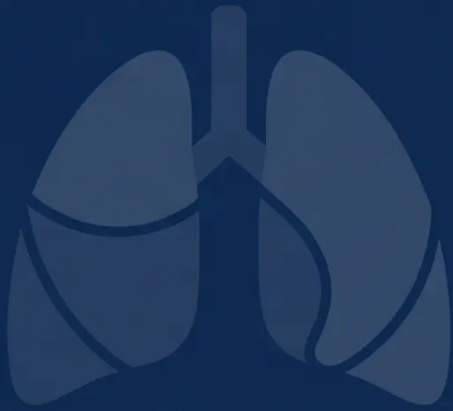





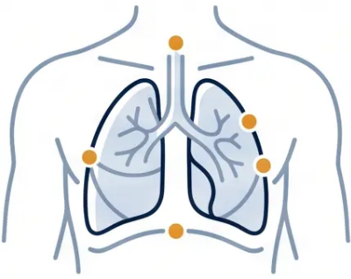

Chest Infections
in Primary Care
BRADFORD VTS TEACHING DECK
A comprehensive guide for GP registrars
on managing chest infections — updated
NICE guidelines and preparation for RCGP
AKT and SCA exams.
Clinical Practice
NICE NG250 · NG120 · NG117
AKT & SCA Prep
Bradford VTS — GP Registrar Teaching Series.
May 2026

Slide 2










Session 1 · Clinical Foundation
Clinical Currency & Guidelines Update
May 2026
NICE NG250
Pneumonia: Diagnosis and Management
⚡ NEW — Replaces NG138
Published September 2025 · Replaces NG138 (July 2019)
NICE NG120
Acute Cough / Acute Bronchitis
Current · No new update
Antibiotics not routinely recommended · Remains current
NICE NG117
Bronchiectasis
Surveillance confirmed 2026
Published 2019 · Confirmed current through 2026 surveillance
BNF 91
Antibiotic Dosing Reference
March 2026
All antibiotic doses in this deck referenced to BNF 91
⚠️ Know your guidelines — NG250 (Sept 2025) replaces NG138 and is directly examinable in the RCGP AKT.

Slide 3







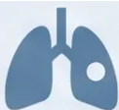
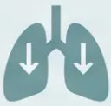






Section 1 · Classification
Classification of Common Chest Infections
Community-
Acquired Pneumonia
Aspiration
Pneumonia
Acute Bronchitis
Viral · Self-limiting · No
routine antibiotics
Consolidation · Fever ·
CRB-65 guided
Swallowing difficulty ·
Reduced consciousness
Hospital-Acquired
Pneumonia
Bronchiectasis
Exacerbation
Influenza
Onset >48 hrs post-admission
· Different organisms
Structural lung disease ·
Recurrent infections
Sudden onset · Systemic
illness · Antivirals if at-risk
Primary care focus: Acute Bronchitis · CAP · Bronchiectasis · Influenza — covered in full in this deck

Slide 4
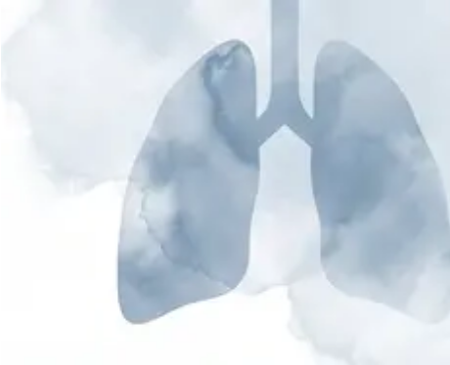




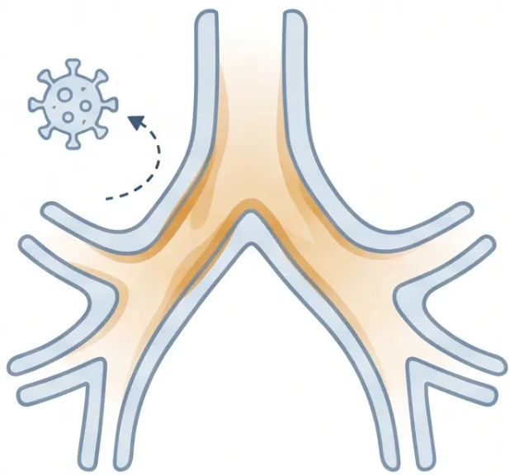


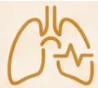





ACUTE BRONCHITIS • SECTION 2
Acute Bronchitis: Diagnosis and Viral Aetiology
Usually viral • Self-limiting • Cough lasts 3–4 weeks • No routine antibiotics
PRESENTING SYMPTOM
Productive or dry cough — typically lasting 3 to 4 weeks
ASSOCIATED FEATURES
Wheeze and breathlessness may be present
ON EXAMINATION
No crackles — no signs of consolidation
AETIOLOGY
Viral inflammation of the bronchi —
self-limiting in healthy adults
Usually viral — antibiotics are not indicated routinely
NICE NG120 • Bradford VTS 2026

Slide 5











ACUTE BRONCHITIS · NICE NG120
Management of Acute Bronchitis
No Routine Antibiotics
Symptom Relief
Delayed Prescribing Strategy
NICE NG120 recommends against
routine antibiotic prescribing for
acute bronchitis. Antibiotics do
not shorten illness duration and
increase resistance risk.
• Honey — adults and children
over 1 year
May be appropriate for patients
with higher risk or patient anxiety.
• Paracetamol or ibuprofen for
fever and discomfort
Issue a prescription to use only if
symptoms worsen or do not
improve after 2–3 days.
• Reassure: cough typically
resolves in 3–4 weeks
Strong NICE Recommendation
Expected illness duration: cough lasts 3–4 weeks — set patient expectations early.

Slide 6
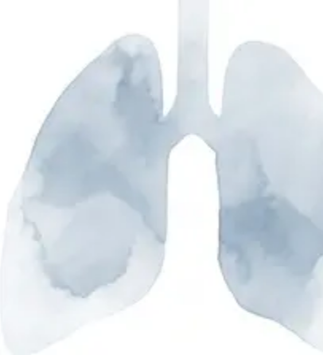






Acute Bronchitis · NICE NG120
When to Consider Antibiotics for Bronchitis
• CRP-Guided Prescribing •
Consider antibiotics if patient has:
Antibiotics likely
not needed
< 20 mg/L
• COPD or significant respiratory disease
• Elderly patients (especially frail)
Bacterial cause unlikely
• Immunocompromised
Consider delayed
prescription
20–100 mg/L
• Diabetes mellitus
Uncertain — clinical judgement required
• Heart failure or significant cardiac disease
Prescribe antibiotics
immediately
> 100 mg/L
• Multiple or serious comorbidities
Likely bacterial infection
*Also consider if systemically very unwell
Always use CRP alongside clinical assessment — never in isolation

Slide 7


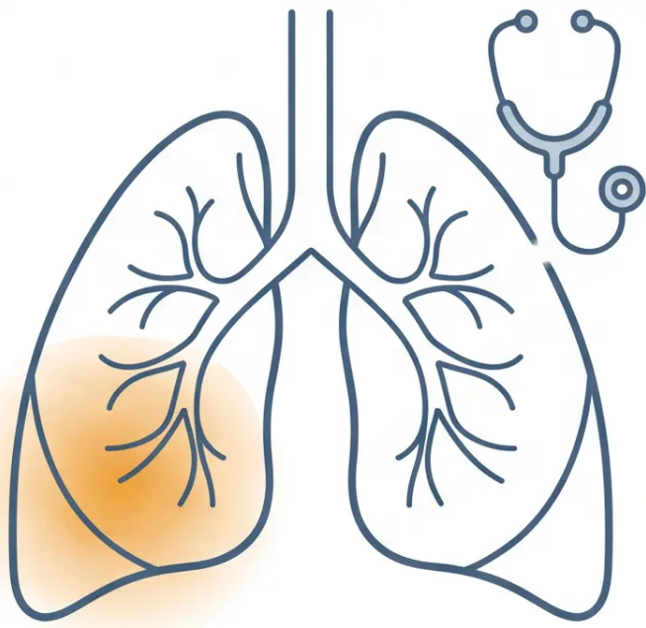











NICE NG250 · September 2025
Community-Acquired Pneumonia
Diagnosis
DIAGNOSE WHEN ≥2 OF THESE SYMPTOMS ARE PRESENT
Pleuritic
Fever
New Cough
Chest Pain
Breathlessness
>38°C
acute onset
sharp, worse on
breathing
new or worsening
EXAMINATION FINDINGS
New focal chest signs — crackles or consolidation on auscultation
CXR is NOT routinely required to diagnose CAP in the community —
this is a CLINICAL diagnosis
*Focal consolidation — key
examination finding in CAP
*CXR is useful when: diagnosis is uncertain · poor response to treatment · considering hospital admission*
Bradford VTS · Chest Infections in Primary Care
07 / 24

Slide 8
























Community-Acquired Pneumonia
Assessment Using the CRB-65 Score
C
R
B
65
Confusion
Respiratory Rate
Blood Pressure
Age
New onset
disorientation in
person, place, or time
≥ 30 breaths
per minute
Systolic < 90 mmHg or
Diastolic ≤ 60 mmHg
Age 65 years
or older
+1 point
+1 point
+1 point
+1 point
Score 0 – Low Risk – < 1% mortality
Score 1-2 – Moderate Risk – 1-10%
Score 3-4 – High Risk – > 10%
– Treat at Home
mortality – Consider Hospital
mortality – Urgent Admission
CRB-65 is designed for community use — no blood tests required. CURB-65 (hospital version) adds urea ≥ 7 mmol/L.

Slide 9
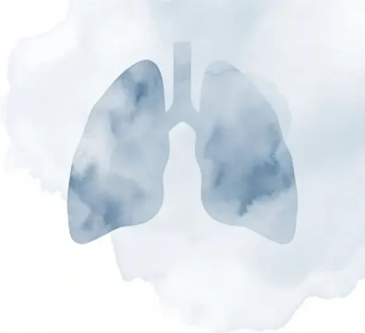






Community-Acquired Pneumonia · CRB-65
CRB-65 Management Thresholds
Three risk tiers — each with a clear action. Mortality risk guides your decision.
0
1-2
3-4
Low Risk
Moderate Risk
High Risk
Mortality < 1%
Mortality 1–10%
Mortality > 10%
Manage at home
Consider hospital referral
Urgent hospital admission
Prescribe antibiotics if CAP
diagnosis confirmed. Arrange
follow-up. Safety-net clearly.
Assess individually. Discuss
with patient. Close follow-up
if managing at home.
Do not delay. Arrange
emergency transfer. Consider
sepsis protocol.
⚠ CRB-65 is for community use only — no blood urea required. CURB-65 is the hospital equivalent (adds urea ≥ 7 mmol/L).

Slide 10











Community-Acquired Pneumonia · NICE NG250
Antibiotic Treatment for Low-Severity CAP
CRB-65 = 0 · Treating at home · 5-day course for adults (NG250, Sept 2025)
FIRST LINE
PENICILLIN ALLERGY
ATYPICAL COVER
Amoxicillin
Doxycycline
Clarithromycin
500 mg · Three times
daily · 5 days
200 mg Day 1 · then 100 mg
once daily · Days 2–5
500 mg · Twice daily
· 5 days
Suitable for most patients
with low-severity CAP
Total 5-day course ·
Take with food or milk
Use if Mycoplasma or
atypical organism suspected
NG250 Key Change: 5-day course for adults — previously often 7 days. Shorter courses are equally effective.

Slide 11
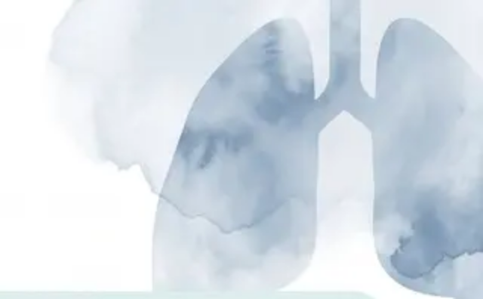













Antibiotic Treatment
Antibiotic Dosing & Dual Therapy
BNF 91 · NICE NG250 (Sept 2025)
Amoxicillin
Doxycycline
Clarithromycin
First-line · Low-severity CAP
Penicillin allergy alternative
Atypical cover · Mycoplasma
500 mg three times daily
Day 1: 200 mg (loading dose)
500 mg twice daily
Duration: 5 days
Days 2–5: 100 mg once daily
Duration: 5 days
Severe: 1 g three times daily
Duration: 5 days total
Used alone or in dual therapy
Oral · Adults
Oral · Adults
Oral · Adults
Amoxicillin + Clarithromycin
Dual Therapy — Moderate to High Severity CAP
Switch to IV if patient unable to swallow orally
Reassess at 48 hours · de-escalate where possible
Hospital setting · covers both typical and atypical organisms
NICE NG250
Bradford VTS · GP Registrar Teaching Series
11 / 24

Slide 12














GUIDELINE UPDATE
NEW
🗓️
Key Changes in NICE NG250
September 2025 — Replaces NG138 (July 2019)
BEFORE • NG138 • 2019
NOW • NG250 • SEPT 2025
5
Adults with CAP: 7-day
antibiotic course (standard)
Adults with CAP: 5-day
antibiotic course
Children (3 months–11 years),
non-severe CAP: 3-day course
Children: variable course lengths
Shorter courses are equally effective — and reduce antibiotic resistance
⚠️ AKT Examable: NG250 published September 2025 — know the new course lengths

Slide 13








Antibiotic Stewardship · NICE Guidance
Point-of-Care CRP Testing
Use CRP alongside clinical assessment — never in isolation.
< 20
20–100
> 100
mg/L
mg/L
mg/L
No Antibiotics
Delayed Prescription
Prescribe Immediately
Unlikely bacterial infection
Consider back-up antibiotic script
Likely bacterial; start antibiotics now
⬅ Lower CRP — Less likely bacterial.
Higher CRP — More likely bacterial. ➡
Always combine with clinical history & examination
Not a standalone diagnostic tool
Slide 13 / 24

Slide 14




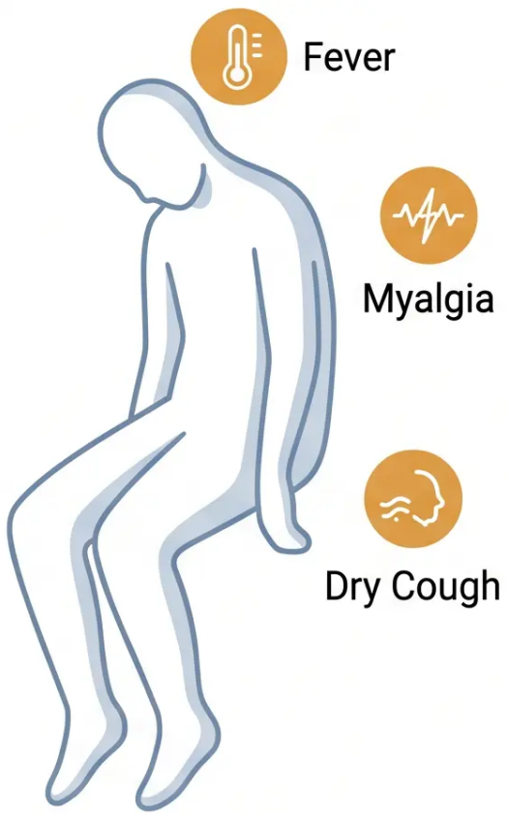
Section 6 · Viral Infections
Influenza and Viral Respiratory Infections
Sudden-onset, systemic, self-limiting — recognise the pattern.
CLASSIC FLU PRESENTATION
NATURAL COURSE
● Sudden high fever — abrupt onset,
often >38.5°C
● Healthy adults: typically
resolves in 5–7 days
● Severe myalgia — muscle aches,
feeling "knocked down"
● Cough and fatigue may linger
for 1–2 weeks
● Headache and fatigue —
prominent, early
● Self-limiting — no antivirals
needed in healthy, low-risk
adults
● Dry cough — respiratory symptoms
follow systemic illness
Systemic symptoms dominate first —
unlike a cold or bronchitis
Reassurance and symptom relief are
the mainstay of management
Flu ≠ a bad cold — the sudden systemic onset is the diagnostic clue.
Bradford VTS · Chest Infections in Primary Care
Slide 14 / 24

Slide 15






















INFLUENZA • SLIDE 15 OF 24
Influenza Management & At-Risk Groups
Antiviral Treatment
At-Risk Groups for Complications
Within 48 hours of symptom onset
Age ≥ 65 years
COPD / Asthma
Not recommended routinely for healthy adults — targeted use only.
Antivirals are only effective if started early — delay
reduces benefit significantly.
Chronic Heart Disease
Diabetes Mellitus
— Oseltamivir (Tamiflu)
Liver Disease
Chronic Kidney Disease
Oral capsule • 75mg BD • 5 days
(dose adjust for renal impairment)
Immunocompromised
Pregnancy
— Zanamivir (Relenza)
Inhaled • 10mg BD • 5 days
Morbid Obesity (BMI ≥ 40)
(use if oseltamivir not tolerated or resistance suspected)
Healthy adults: self-limiting illness — 5 to 7 days. Reassure and support, no antivirals needed.

Slide 16
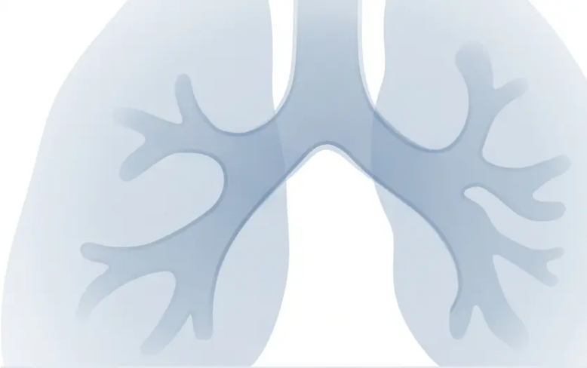






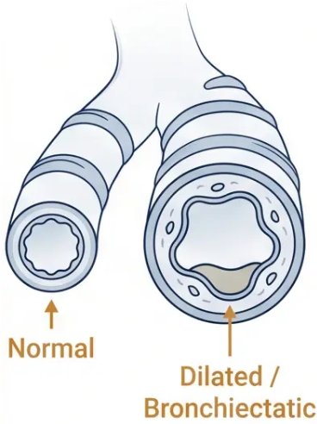
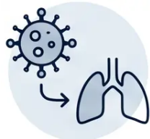









Bronchiectasis · Section 7
Bronchiectasis
Definition and Aetiology
Permanent, abnormal dilatation of the bronchi — leading to impaired
mucus clearance and a cycle of recurrent infection and inflammation.
Post-
Infectious
Cystic
Fibrosis
Ciliary
Dyskinesia
Immuno-
deficiency
ABPA
Idiopathic
Childhood whooping
cough, measles, TB,
pneumonia
Most common
cause in children
Impaired
mucociliary
clearance
Hypogammaglo-
bulinaemia
Allergic
bronchopulmonary
aspergillosis
~50% of cases —
no cause
identified
NICE NG117 · 2019 (Confirmed current 2026)
16 / 24.

Slide 17




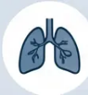






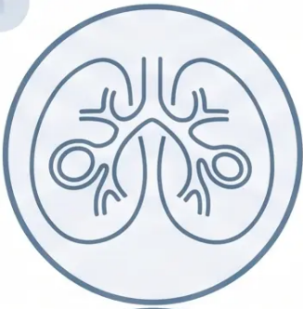





SLIDE 17 OF 24
Bronchiectasis · Part 2 of 3
Bronchiectasis: Symptoms & Investigations
● Clinical Features
● Investigations
Chronic Productive Cough
HRCT Chest
GOLD STANDARD
Daily cough with large volumes of sputum
Most prominent and persistent symptom
Definitive diagnosis — shows dilated, thickened
bronchi. Preferred over plain CXR.
Recurrent Chest Infections
Sputum Culture
Frequent infective exacerbations
Often same organisms (e.g. Haemophilus, Pseudomonas)
Identifies causative organisms. Pseudomonas
colonisation = worse prognosis — refer to respiratory.
Haemoptysis
Spirometry
Blood-streaked sputum is common
Frank haemoptysis warrants urgent investigation
Usually shows obstructive pattern. Quantifies
functional impairment.
Breathlessness
Immunoglobulins + CF Screen
Progressive in advanced disease
Associated with obstructive spirometry pattern
HRCT: "signet ring sign" —
bronchial diameter wider than
adjacent pulmonary artery
Rule out hypogammaglobulinaemia, cystic
fibrosis, ciliary dyskinesia.

Slide 18
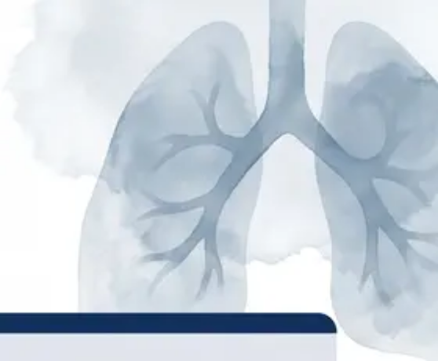










SLIDE 18 OF 24 — Management Strategies for Bronchiectasis
BRONCHIECTASIS · NICE NG117
Management Strategies for Bronchiectasis
Physiotherapy &
Airway Clearance
Antibiotic Treatment
— Exacerbations
Prophylaxis &
Specialist Care
• Daily airway clearance is the
cornerstone of management
• Azithromycin 250mg OD — 3 days per
week
Amoxicillin 500mg TDS × 7–14 days
Doxycycline 200mg day 1, then 100mg
OD × 7–14 days (penicillin allergy)
• Selected patients only — specialist-
initiated
• Flutter valve / Acapella device —
oscillating PEP therapy
Guided by previous sputum cultures
where available
• Reduces exacerbation frequency in
eligible patients
• Active Cycle of Breathing Technique
(ACBT)
• Monitor for hearing, cardiac (QTc),
and resistance
Longer courses than CAP — 7 to 14
days standard
• Annual sputum culture and
spirometry review
• Postural drainage where appropriate
• Refer if: Pseudomonas colonisation,
frequent exacerbations (≥3/year),
haemoptysis
• Referral to respiratory
physiotherapist
Pseudomonas aeruginosa
Ciprofloxacin orally or IV antibiotics.
Indicates worse prognosis. Refer to
respiratory specialist.
Consistent daily technique reduces
exacerbation frequency
Macrolide prophylaxis:
always specialist-led
Slide 18 · Bradford VTS · NICE NG117

Slide 19
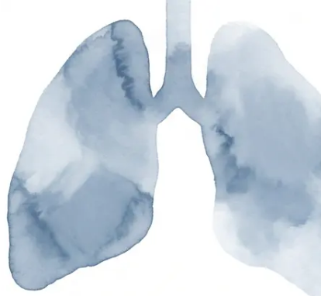






Clinical Safety · Primary Care
Safety-Netting and Urgent Reassessment
Know when to act — and what to tell your patient
Urgent Red Flags
Advise Patients to Return If...
SpO₂ below 92% — Possible respiratory failure;
consider urgent admission
Symptoms worsen or do not improve within
48–72 hours
CRB-65 score ≥ 2 — High mortality risk; discuss
hospital referral
Breathlessness significantly worsens
Blood appears in sputum (haemoptysis)
Haemoptysis — Urgent CXR; if >3 weeks +
smoking history → 2-week wait lung cancer referral
Cough persists beyond 3 weeks without
improvement — Consider investigation; possible
2-week wait referral if malignancy risk
Sepsis features — HR >100, hypotension,
confusion, fever >39°C → emergency admission
“Document your safety-netting advice in every
consultation — it is a medicolegal requirement
and a core SCA competency.”
No improvement after 48 hours on antibiotics
— Reassess diagnosis; consider admission or
alternative cause
Bradford VTS · Chest Infections · Slide 19 of 24

Slide 20











Bradford
VTS
Bradford VTS · Clinical Pearls
Top Tips
TOP TIPS
01
02
03
04
NG138 is gone —
know NG250
Bronchitis?
No antibiotics.
CRB-65 is for
primary care
CRP guides your
decision
NICE NG250 (Sept 2025)
replaced NG138. The new
5-day adult CAP course is
examinable.
Viral LRTI is self-limiting.
Cough lasts 3–4 weeks —
reassure patients
confidently.
CURB-65 adds urea —
that’s for hospital. In the
community, use CRB-65
only.
<20 = no antibiotics ·
20–100 = delayed · >100 =
prescribe immediately
Slide 20 of 24 · Bradford VTS Teaching Series.
05
06
07
08
CAP is a clinical
diagnosis
5 days is enough
for CAP
Haemoptysis
demands action
Pseudomonas =
refer on
CXR is NOT required in the
community. Diagnose on
symptoms and examination.
Shorter courses are equally
effective. Amoxicillin 500mg
TDS × 5 days in adults.
Cough >3 weeks + smoker +
haemoptysis → 2-week wait
chest referral (NICE NG12).
Bronchiectasis with
Pseudomonas colonisation
carries worse prognosis.
Refer to respiratory.

Slide 21












EXAM PREPARATION
Exam Pearls
AKT Focus
GUIDELINE UPDATE
CRB-65 SCORING
C · R · B · 65 — each scores 1 point
NG250 (Sept 2025) replaces NG138
— C = New confusion
This is examinable — know the new guidance
replaced the 2019 version.
— R = Respiratory rate ≥30/min
— B = BP systolic <90 or diastolic ≤60 mmHg
— 65 = Age ≥65 years
MANAGEMENT THRESHOLDS
FIRST-LINE ANTIBIOTICS
Score 0 → Home · 1–2 → Consider
hospital · 3–4 → Urgent admission
Amoxicillin 500mg TDS — 5 days
Penicillin allergy → Doxycycline 200mg day 1, then
100mg OD × 4 days
Atypical cover → Clarithromycin 500mg BD × 5 days
CRB-65 is for community use only — no blood urea
required.
⚡ AKT TIP: CXR is NOT required to diagnose CAP in the community — it is a clinical diagnosis.
Bradford VTS — GP Registrar Teaching Series
21 / 24

Slide 22
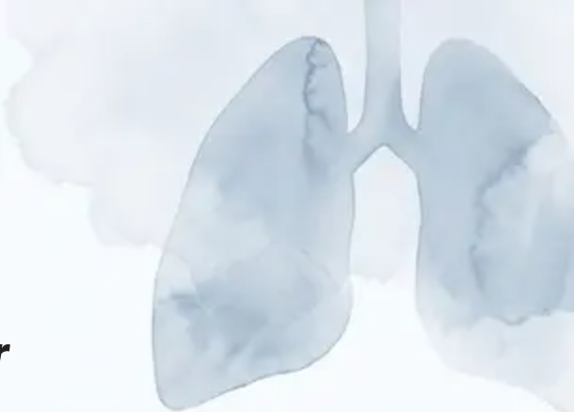








Exam Pearls · SCA Focus
SCA Scenarios
Communication strategies for the RCGP SCA — what the examiner wants to hear
SCA 01
SCA 02
Patient Demanding Antibiotics for a Cough
Moderate-Risk Pneumonia — CRB-65 = 1
This looks like a viral chest infection. Antibiotics won't
help against viruses, and they can cause side effects
like diarrhoea and thrush. I'd expect the cough to clear
up in about 3 to 4 weeks — that's completely normal for
this type of infection.
Your score suggests a moderate risk with this chest
infection. I want to be honest with you — there's a small
but real chance this could become more serious. We
need to decide together whether it's safer to treat you at
home with close monitoring, or whether a hospital
assessment would give us more reassurance.
• Acknowledge the patient's concern before explaining
• Shared decision-making — involve the patient in the
admission vs home care discussion
• Offer a clear safety net: "Please come back if you're not
improving after 48-72 hours, or if you develop a fever or
feel much worse"
• Document safety-netting clearly: follow-up within 24
hours if managed at home
NG120 — No routine antibiotics for acute bronchitis
CRB-65 = 1–2 → Consider hospital referral
Explain — Use plain language, no jargon
Acknowledge — Validate the patient's worry first
Safety-net — Always give clear return criteria
22 / 24

Slide 23

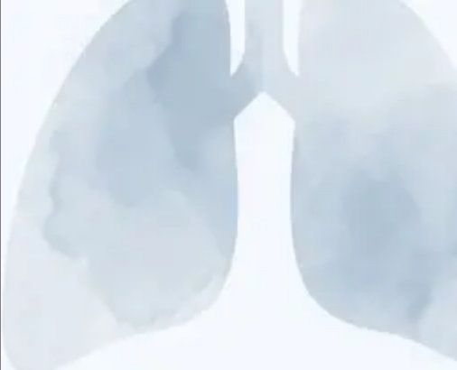









BRADFORD VTS • CLINICAL PRACTICE
Common Pitfalls in Primary Care
Mistakes that cost marks — and matter to patients.
Antibiotics for Viral Bronchitis
Skipping CRP Where Available
Routine antibiotics are not recommended for acute
bronchitis — NICE NG120 is clear. Reassure, don’t prescribe.
Point-of-care CRP guides antibiotic decisions. Not using it where
available is a missed opportunity to reduce over-prescribing.
CRB-65 vs CURB-65 Confusion
Missing Bronchiectasis
CRB-65 is for community use — no urea needed.
CURB-65 adds urea and is used in hospital only.
Ask about daily sputum volume in recurrent chest infections.
HRCT is the gold standard — don’t delay referral.
7-Day Course for Mild CAP
No Safety-Netting Advice
NG250 (Sept 2025) mandates 5 days for adults.
Longer courses are no longer evidence-based.
Always give clear return criteria. “Come back if no
improvement in 48–72 hours” is essential, not optional.
Ignoring Haemoptysis
Diagnosing CAP Without Alternatives
Always investigate. Cough >3 weeks + smoking history +
haemoptysis → 2-week wait lung cancer referral.
Consider PE, cardiac failure, and lung malignancy before
labelling every consolidation as pneumonia.
If in doubt — safety-net, investigate, refer.

Slide 24


















BVTS · Chest Infections · Final Slide
Quick Recall Summary
Everything you need — at a glance.
NG250 · CAP Antibiotics
CRB-65 · Score & Action
NEW
First-line:
Amoxicillin 500mg TDS — 5 days
0
Treat at home
Doxycycline 200mg day 1, then 100mg
OD — 5 days total
1–2
Consider hospital
Penicillin allergy:
3–4
Urgent admission
Atypical cover:
Clarithromycin 500mg BD — 5 days
CRB-65 = community use only (no urea measurement)
CRP · Point-of-Care Interpretation
Bronchiectasis · Key Facts
< 20 mg/L
→ No antibiotics
♦ HRCT chest — gold standard for diagnosis
20–100 mg/L
♦ Pseudomonas colonisation = worse prognosis
→ Delayed prescription
> 100 mg/L
→ Prescribe immediately
♦ Physiotherapy + airway clearance = cornerstone of management
♦ Macrolide prophylaxis (azithromycin) — specialist-initiated only
Always use alongside full clinical assessment.
Don’t Forget
Bronchitis → NO routine antibiotics | CAP → Clinical diagnosis, no CXR needed | Always investigate | NG138 → Replaced by NG250 (Sept 2025)
Bradford VTS · GP Registrar Teaching Series · May 2026 · Based on NICE NG250, NG120, NG117 · BNF 91
24 / 24

