Slide 1



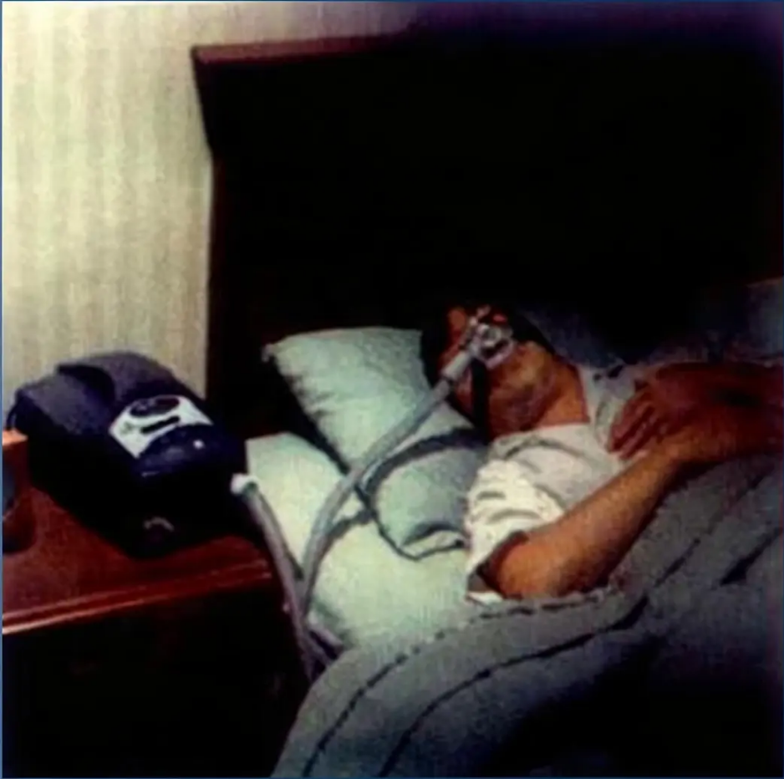


Bradford VTS
GP Registrator Teaching Series
Obstructive Sleep Apnoea
(OSA)
Bradford VTS Teaching Deck
May 2026
NICE NG2020
DVLA 2025 Guidetines
For GP Registrars preparing for AKT and SCA Examinations.
May 2026 Edition • RSGP AKT • SCA

Slide 2










Bradford VTS
OSA Teaching Deck
Section 1 — Foundations
Definition and
AHI Severity
Apnoea
Hypopnoea
Complete cessation of
airflow lasting 10 seconds or
more during sleep.
≥30% reduction in airflow
for ≥10 seconds, with ≥3%
oxygen desaturation.
AHI = Apnoea-Hypopnoea Index — events per hour of sleep
MILD
MODERATE
SEVERE
AHI 5–14 / hour
AHI 15–29 / hour
AHI ≥30 / hour
Symptoms may be subtle;
lifestyle measures first.
CPAP indicated;
significant QOL impact.
CPAP first-line; DVLA and
driving assessment essential.
AHI <5/hour = normal in adults | Simple snoring: no apnoeas, no daytime sleepiness — not routinely treated on NHS

Slide 3







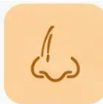


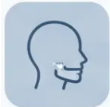




Bradford VTS | Obstructive Sleep Apnoea
03 / 25
— Clinical Background
Key Risk Factors for OSA
Modifiable
Non-Modifiable
Obesity —
BMI >25 increases risk; BMI >35 high risk — most
important modifiable factor
Male Sex —
2–3× more common in males
Alcohol & Sedatives —
Age 40–60 —
Worsen upper airway muscle tone during sleep
Peak prevalence in middle age; present at all ages
Nasal Obstruction —
Neck Circumference —
Deviated septum, chronic rhinitis
>43 cm (men), >40 cm (women)
Hypothyroidism —
Craniofacial Anatomy —
Always exclude before referral — check TFTs
Retrognathia, micrognathia — narrow upper airway
Menopause —
Family History —
Oestrogen loss increases OSA risk
Positive family history increases risk
“Obesity is the single most important modifiable risk factor — weight loss may be curative in mild-to-moderate OSA”
Bradford VTS • OSA Teaching Deck • May 2026
NICE NG202

Slide 4



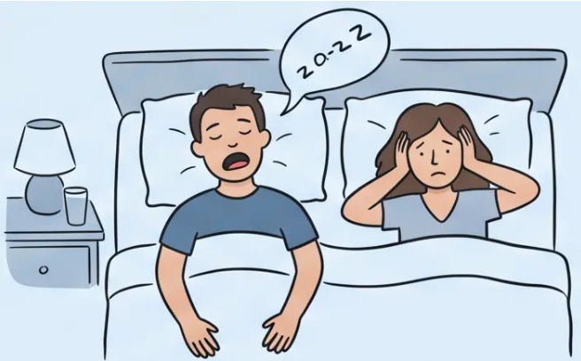











Bradford VTS
4 / 25
Obstructive Sleep Apnoea
SYMPTOMS
Nocturnal Symptoms
Often first reported by a bed partner — not the
patient themselves.
Loud Snoring
Witnessed Apnoeas
Gasping / Choking
Restless Sleep / Waking
Often disruptive —
reported by partner.
Partner notices
breathing stops.
Sudden arousal to
resume breathing.
Frequent micro-arousals
through the night.
Simple snoring ≠ OSA
Key diagnostic indicator
May wake patient briefly
Patient often unaware
⚠ Clinical note: Many patients are unaware of their nocturnal symptoms — always ask the bed partner.

Slide 5














Clinical Presentation
Daytime Symptoms and Impact
Excessive Daytime Sleepiness
Morning Headaches
Unrefreshing Sleep
Hallmark symptom — falling
asleep inappropriately
On waking — may indicate
overnight hypercapnia
Waking exhausted despite
adequate hours in bed
Poor Concentration & Memory
Mood Changes
Reduced Libido
Cognitive impairment affecting
work and daily tasks
Irritability, low mood — often
mistaken for depression
Commonly under-reported;
ask sensitively
Excessive Daytime Sleepiness (EDS) is the hallmark symptom — but NOT all OSA
patients are sleepy. Do not use ESS alone to rule out OSA.

Slide 6







Clinical Assessment Tool
Epworth Sleepiness Scale (ESS)
Score range: 0 – 24
Rate likelihood of dozing in each situation: 0 = would never doze · 3 = high chance of dozing
1 Sitting and reading 0 – 3
5 Lying down in the afternoon 0 – 3
6 Sitting and talking to someone 0 – 3
2 Watching television 0 – 3
3 Sitting inactive in a public space 0 - 3
7 Sitting quietly after lunch (no alcohol) 0 – 3
4 Passenger in a car for one hour 0 – 3
8 Stopped briefly in traffic while driving 0 – 3
≥11 = Abnormal
0 – 10
11 – 15
16 – 24
NICE NG202: Do NOT use ESS
alone — combine with STOP-BANG
Normal Range
Mild – Moderate EDS
Severe EDS
Bradford VTS · OSA Teaching Deck
6 / 25

Slide 7






Screening Tool
STOP-BANG Questionnaire
S Snore Do you snore loudly?
T Tired Do you often feel tired, fatigued, or
sleepy during the day?
NICE NG202 recommends using STOP-
BANG alongside the ESS — not ESS alone.
The Epworth Sleepiness Scale (ESS) misses the actual
obstructive sleep apnoea risk factors. It only measures
daytime sleepiness, not whether someone is likely to have
apnoea during sleep. So use with a tool like STOP-BANG,
which checks things ESS does not.
O Observed Has anyone observed you stop
breathing during sleep?
P Pressure Do you have or are you being
treated for high blood pressure?
≥ 3
B BMI > 35?
= High Risk for OSA
A Age > 50?
Score 0–2 = lower risk
N Neck circumference > 40 cm?
G Gender Male?
Each YES = 1 point. Maximum score: 8.
Bradford VTS — OSA Teaching Deck
NICE NG202 · May 2026

Slide 8





NICE NG202 — Primary Care
Assessment in Primary Care
➊ Exclude Hypothyroidism — Check TFTs before referring; hypothyroidism mimics and worsens OSA
➋ Assess BMI — BMI >25 increases risk; BMI >35 = high risk; document and address
➌ Cardiovascular Risk — Assess and document BP, lipid profile, diabetes status
➍ Alcohol and Sedative Use — Evening alcohol and benzodiazepines worsen upper airway tone
➎ Document ESS Score — Record Epworth Sleepiness Scale result (threshold ≥11)
➏ Document STOP-BANG Score — Record STOP-BANG result (high risk ≥3); use BOTH tools together
⚠ NICE NG202: Do NOT rely on ESS alone — many patients with OSAHS are NOT excessively sleepy.

Slide 9















Bradford VTS
Primary Care Assessment · NICE NG202
Referral Criteria
When to Refer to Sleep Services
Refer if 2 or more of these are present:
snoring
waking headaches
witnessed apnoeas
excessive daytime sleepiness
unrefreshing sleep
nocturia
Do NOT use ESS alone as a gatekeeper
Many patients with OSAHS are NOT excessively sleepy — a normal ESS score does not rule
out significant OSA. Always consider STOP-BANG and symptom clusters together.
NICE NG202 · May 2026
9 / 25

Slide 10















Section 7 of 25 — Referral
Urgent Referral Pathways
NICE NG202 — protecting patients and the public
4-Week Urgent Referral
Same-Day Assessment
Refer urgently if ESS ≥11 AND any of the following:
Arrange same-day assessment if:
Severe EDS + driving risk —
Vocational driver — HGV, PSV, or taxi driver
ESS high + active driving risk — immediate
safety concern
Safety-critical occupation —
Pilots, heavy machinery operators
Suspected respiratory failure —
Significantly impaired quality of life —
Features of CO₂ retention — possible obesity
hypoventilation
Clinically meaningful QOL impact
Document ESS + STOP-BANG scores before referral.
Do not delay — these patients must not drive.
Duty of Care — If a patient refuses to stop driving despite advice, consider
DVLA notification after appropriate discussion.
DVLA
2025

Slide 11











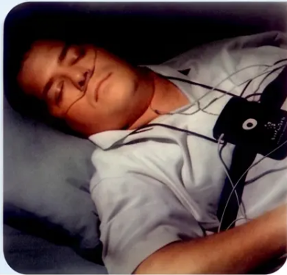
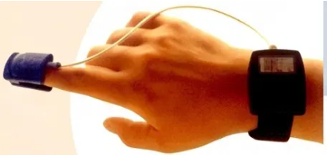


Bradford VTS • Diagnostic Sleep Studies
Diagnostic Sleep Studies
Arranged by specialist services — understanding what happens after referral.
Level 3
Level 1
Home-Based Polygraphy
Polysomnography (PSG)
What it measures
What it measures
All Level 3 parameters ✓
Airflow
Respiratory effort
EEG (brainwave activity)
EMG (muscle activity)
Heart rate
VS
Full sleep staging
SpO₂ (oxygen saturation)
EOG (eye movements)
Most commonly used in UK practice
Gold standard — most detailed
Patient-friendly: worn at home
Cost-effective and accessible
Laboratory/hospital setting
Reserved for complex or uncertain cases
Standard Pathway
Gold Standard
Specialist service arranges sleep studies post-referral —
GP role is to refer, not to diagnose
Oximetry alone is NOT recommended as a sole diagnostic tool — NICE NG202

Slide 12





Section 4 — Treatment
Lifestyle Measures and Weight Loss
Obesity is the single most important modifiable risk factor for OSA
Weight loss alone may be curative in mild-to-moderate disease
Alcohol and
Sedatives
Other Lifestyle
Measures
Weight Management
• BMI >25 increases OSA risk;
BMI >35 = high risk
• Avoid alcohol especially in the
evening
• Treat nasal obstruction (rhinitis,
deviated septum)
• Target weight loss for all overweight
patients
• Sedatives worsen upper airway
muscle tone
• Sleep position: lying on the side may
reduce symptoms in positional OSA
• Avoid zopiclone and benzodiazepines
in OSA — they deepen obstruction
• Refer to weight management services
• Consistent sleep schedule and sleep
hygiene
• Bariatric surgery: consider if BMI
>35 + moderate-severe OSA
• Review all sedating medications
• Smoking cessation (reduces upper
airway inflammation)
Lifestyle measures apply to ALL patients — regardless of whether CPAP or MADs are also prescribed.
NICE NG202
Bradford VTS · OSA Teaching Deck · May 2026
12 / 25

Slide 13


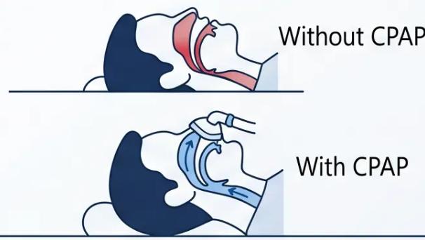






Treatment — NICE NG202
CPAP: First-line Treatment
First-line treatment for moderate and severe OSAHS (AHI ≥ 15/hour)
*Also offered for mild OSAHS (AHI 5–14) when symptoms significantly impact quality of life.*
How CPAP Works
Clinical Benefits
Eliminates apnoeas and hypopnoeas — restores normal sleep architecture
Reduces excessive daytime sleepiness — significant improvement in ESS scores
Lowers cardiovascular risk — evidence for reduced hypertension, AF risk, and stroke
Improves mood, cognition, and quality of life — measurable functional gains
Practical Considerations
Adherence Threshold
Mask Types
Philips Recall Awareness
≥ 4 hours per night considered
therapeutically effective. CPAP devices
record usage data for clinical review.
Nasal or oronasal masks available.
Fit is critical — poor mask fit is the
leading cause of non-adherence.
Philips CPAP recall (June 2021) —
patients on older devices should
have been reviewed and re-issued.
NICE NG202 · CKS OSA Nov 2025
Slide 13 of 25 · Bradford VTS

Slide 14


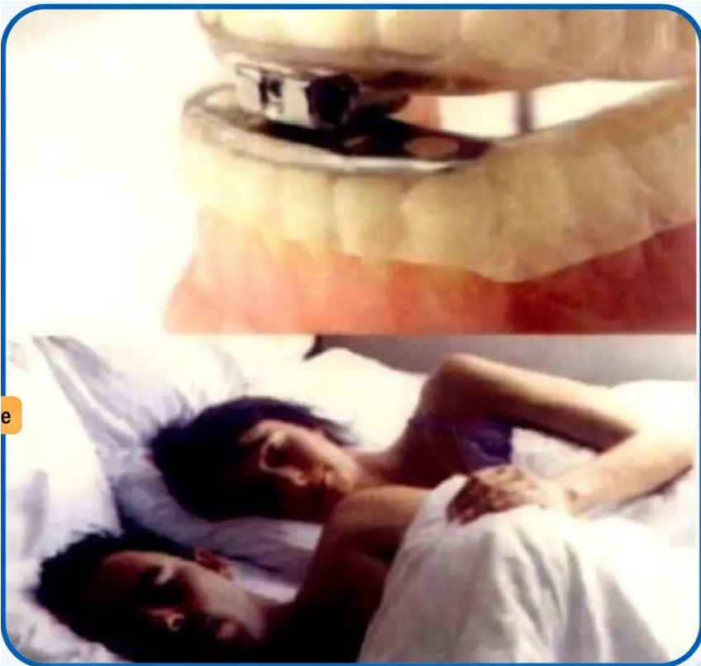




Treatment Options
Mandibular Advancement Devices (MADs)
Custom-fitted devices for mild to moderate OSA when CPAP is not suitable.
When to Use MADs
Indicated for:
— Mild to moderate OSAHS (AHI 5–29)
— When CPAP is not tolerated or not preferred by the patient
Device Requirements
Must be:
— Custom-fitted or semi-customised by a dental specialist
— NOT over-the-counter devices — OTC devices are not adequate
Evidence and Limitations
Clinical evidence:
— Good evidence for symptom relief and quality-of-life improvement
— Less effective than CPAP for severe OSAHS (AHI ≥30)
Custom mandibular advancement device (top); patient
and partner at rest (bottom).
— Useful adjunct when patient preference guides treatment choice
MADs are a valid NICE-recommended alternative — but customisation is non-negotiable.

Slide 15











Treatment Options
Positional Therapy and Surgery
Adjunctive and escalation strategies — know when to use them.
Positional Therapy
Weight Loss Surgery
What it does: Prevents sleeping in the supine position,
which worsens upper airway collapse.
Criteria
■ BMI >35
Evidence: Limited evidence base. May benefit patients
whose OSA is predominantly positional recommoanty whose
OSA is predominantly positional (worse when lying on back).
■ Moderate-to-severe OSA (AHI ≥15)
Why it works: Significant weight reduction reduces
pharyngeal fat deposition, improving airway patency. May be
curative in selected patients.
NOT first-line
Not recommended as a standalone
primary treatment (NICE NG202).
NICE position: Consider bariatric surgery where BMI and
OSA severity criteria are met and other interventions have
not achieved adequate weight loss.
Role: Adjunctive only — may be combined with CPAP or
MADs in selected patients.
May be curative
Key principle: Neither positional therapy nor surgery replaces CPAP as first-line treatment — they are adjuncts or escalation pathways.

Slide 16








DVLA Guidance · 2025
DVLA Driving Rules: Group 1
Standard car and motorcycle licence holders (Category A & B)
Moderate or Severe OSA — AHI ≥ 15
Must stop driving immediately.
Must notify DVLA.
STOP DRIVING
Mild OSA — Symptomatic
STOP IF SYMPTOMATIC
Must stop driving if symptoms are present and affecting driving.
Notify DVLA only if symptoms are not controlled within 3 months.
Treated and Controlled OSA
May resume driving once a healthcare professional confirms satisfactory treatment response.
CPAP adherence and symptom resolution must be documented.
MAY DRIVE
Group 1 licence: DVLA review every 3 years once relicensed.
Duty of Care — If a patient refuses to stop driving despite clinical advice, consider DVLA notification afterappropriate discussion. Document all conversations.

Slide 17












DVLA Regulations · Group 2 Drivers
DVLA Driving Rules: Group 2
⚠ Stricter Standards Apply — HGV · PSV · Vocational Licence Holders
Group 2 drivers face more rigorous DVLA requirements — annual review, mandatory notification, and confirmed treatment
adherence before relicensing.
Must Stop Driving
Notify DVLA
Annual Review
Moderate or severe OSA (AHI ≥15)
Mandatory notification for
moderate/severe OSA
Annual DVLA medical review required
Until treatment confirmed effective
Relicensing requires confirmed
treatment adherence
Immediate cessation required on
diagnosis
Patient must inform DVLA directly
GP supports with medical evidence
when requested
CPAP compliance data (≥4 hrs/night)
reviewed
Healthcare professional confirmation
needed
Immediate Action
Mandatory
Every Year
Group 2 vs Group 1: Group 2 licences require annual review; Group 1 requires review every 3 years once relicensed.
Bradford VTS · OSA Teaching Deck · May 2026
NICE NG202 · DVLA 2025 · Slide 17 of 25

Slide 18








Bradford VTS | GP Registrar Teaching Series
Bradford VTS | GP Registrar Teaching Series
18 / 25
★ Top Tips
Top Tips for GPs
Part 1 of 2
Don't use ESS alone as a gatekeeper
01
Many OSA patients are NOT excessively sleepy — always combine ESS with STOP-BANG
(NICE NG202).
OSA is far more than a snoring problem
02
Untreated OSA significantly raises risk of hypertension, atrial fibrillation, type 2 diabetes,
and stroke.
Use STOP-BANG: score ≥3 means high risk
03
Eight yes/no questions — quick to complete in consultation. Flags risk independently of
daytime sleepiness.
● Top Tips · Part 1 of 2
Continued on next slide →

Slide 19













Bradford VTS · Obstructive Sleep Apnoea
Top Tips for GPs
Part 2 — Treatment, Investigation & Devices
CPAP is first-line for
moderate/severe OSA
MADs must be
customised — not OTC
AHI ≥15 — offer CPAP promptly; delays
increase cardiovascular and driving risk.
Over-the-counter devices are not adequate.
Refer to a dental specialist for custom-fitted
or semi-customised MADs.
Always exclude hypothyroidism
before referring
Weight loss may be curative
in mild OSA
Check TFTs in every suspected OSA patient
before onward referral — hypothyroidism is a
reversible cause.
The most important modifiable risk factor.
Refer to weight management services; significant
loss can eliminate mild-moderate disease.
Based on NICE NG202 · NICE CKS OSA (revised November 2025)
Bradford VTS · May 2026

Slide 20








Bradford VTS | GP Registrar Teaching Series
Exam Pearls
✎ AKT Revision
Exam Pearls: AKT Focus
Key numbers, thresholds, and NICE-recommended tools — tested frequently in the AKT.
AHI Severity Thresholds
ESS Threshold
STOP-BANG Threshold
Epworth Sleepiness Scale
Mild: 5–14 events/hour
STOP-BANG
ESS ≥11 = Excessive Daytime Sleepiness
Moderate: 15–29 events/hour
Score ≥3 = High risk for OSA
Scale range: 0–24 (8 situations, 0–3 each)
Severe: ≥30 events/hour
NICE recommends BOTH ESS and
STOP-BANG
Do NOT use ESS alone to rule out OSA
CPAP Indication
MADs Indication
DVLA Rule
CPAP — First-line
Mandibular Advancement Devices
DVLA Driving Rule
AHI ≥15 (moderate/severe)
Mild/moderate OSA if CPAP not
tolerated
⚠ Moderate/severe OSA →
must stop driving
Conditional offer for mild OSA
(AHI 5–14) if QOL significantly
impaired
Must be customised — OTC devices
are NOT adequate
Notify DVLA; relicensing requires
confirmed treatment response
Positional therapy is NOT first-line standalone treatment — frequently tested distinction.

Slide 21





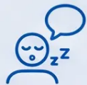





Bradford VTS
GP Registrar Teaching Series
21 / 25
SCA PREPARATION
Exam Pearls: SCA Scenarios
Three high-yield consultation scenarios — practise your structure, safety-netting, and shared decision-making.
SCENARIO 1
SCENARIO 2
SCENARIO 3
The Witnessed Apnoea
The HGV Driver
CPAP Refusal
Patient snores loudly; partner
witnesses breathing pauses. ESS = 14.
No driving concerns raised yet.
Vocational driver, ESS = 15. Referred
urgently. Has not stopped driving.
Aware of fatigue but dismisses it.
Moderate OSA confirmed. Patient
refuses CPAP — finds mask
claustrophobic. Wants alternatives.
● Explain the OSA diagnostic journey
and sleep study process
● Explain the legal duty to stop
driving immediately
● Explore concerns empathetically;
validate the experience
● Advise on DVLA obligations
proactively
● Communicate DVLA notification
obligation sensitively but clearly
● Offer MADs as evidence-based
alternative (customised, not OTC)
● Discuss CPAP and what to expect
● Reinforce cardiovascular risk of
untreated OSA; discuss weight loss
● Arrange urgent 4-week referral;
document the conversation
AHI context · Sleep study · CPAP intro
DVLA duty · Urgent ref · Safety
Shared decision · MADs · CVD risk
💡 SCA Tip: In all three scenarios — safety-net driving, document clearly, and demonstrate patient-centred communication.

Slide 22









Bradford VTS | Obstructive Sleep Apnoea
Slide 22 of 25
CLINICAL SAFETY
Clinical Red Flags
Critical signs requiring urgent action — know these cold.
Vocational Driver with Excessive Daytime Sleepiness
ESS ≥11 in HGV/PSV/taxi driver — urgent referral within 4 weeks; must stop driving immediately.
Suspected Respiratory Failure / CO₂ Retention
Morning headaches + severe EDS (ESS >16) — consider hypercapnia; same-day assessment.
Nocturnal Desaturation Below 88%
On sleep study — may indicate obesity hypoventilation syndrome (OHS); consider NIV referral.
Cor Pulmonale Features with OSA
Peripheral oedema, raised JVP, right heart strain — urgent respiratory referral.
Patient Refusing to Stop Driving
After clinical advice given — consider DVLA notification; document discussions carefully.
NICE NG202 · DVLA 2025
⚠ Document all driving risk discussions in the medical record

Slide 23













Bradford VTS | Common Pitfalls · Part 1
23 / 25
CLINICAL PITFALLS
Common Pitfalls (Part 1)
Avoiding diagnostic errors and missed diagnoses in primary care.
01
02
Sedatives prescribed
in undiagnosed OSA
03
Atypical presentations in women
Over-reliance on ESS alone
Sedatives prescribed in
ESS can be normal even in moderate or
severe OSA. NICE NG202 is clear —
never use ESS alone to rule out
OSA. Always pair with STOP-BANG.
Women with OSA often present with fatigue,
low mood, and poor concentration — not
classic snoring. OSA is frequently missed or
misdiagnosed as depression or hypothyroidism.
Zopiclone and benzodiazepines
worsen upper airway obstruction during
sleep. Avoid in any patient with
suspected or confirmed OSA.
04
Not Excluding Hypothyroidism Before Referral
Hypothyroidism is a reversible cause of OSA-like symptoms and worsens existing OSA. NICE NG202 recommends checking
TFTs before referring. Missing this delays the correct diagnosis and may lead to unnecessary sleep studies.
NICE NG202 · RCGP AKT & SCA
See Part 2 for further pitfalls →

Slide 24









Bradford VTS | GP Registrar Teaching Series
Common Pitfalls • Part 2
Management Errors
Common Pitfalls (Part 2)
Avoidable errors in OSA management — know these for SCA and safe practice.
Failing to Advise on Driving
Prescribing Sedatives in OSA
Zopiclone and benzodiazepines worsen upper
airway obstruction — avoid in any patient with
known or suspected OSA.
Patients with moderate/severe OSA must be
told to stop driving. Not explaining DVLA
obligations leaves both patient and GP exposed.
Missing OSA in Women
Underestimating OSA in Obesity
Women present atypically — less snoring, more
fatigue and mood symptoms. OSA is frequently
frequently under-diagnosed in female patients.
Any obese patient with daytime sleepiness
warrants OSA assessment. High BMI + tiredness
should always prompt ESS and STOP-BANG.
⚠ Prescribing sedatives in OSA is a patient safety issue — always check before prescribing.
Slide 24 of 25

Slide 25






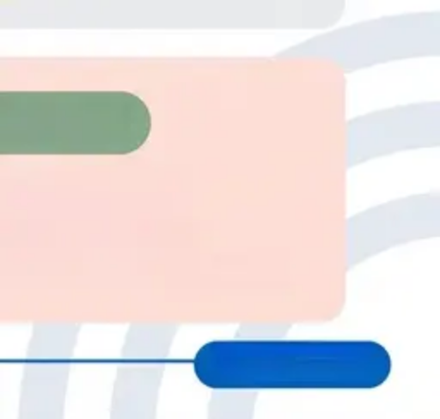





FINAL RECAP
Quick Recall Summary
AHI thresholds · CPAP indications · DVLA rules — know these cold.
AHI SEVERITY
5–14 / hour
15–29 / hour
≥ 30 / hour
AHI Severity Thresholds
Mild OSA
Moderate OSA
Severe OSA
TREATMENT
CPAP
MADs
Treatment Indications
First-line for AHI ≥ 15
Mild to Moderate OSA
Moderate or Severe OSA
If CPAP not tolerated or declined
Also consider in Mild OSA if QOL significantly impaired
Must be custom-fitted — not OTC devices
DVLA DRIVING RULES
STOP DRIVING
STOP DRIVING
MAY DRIVE
DVLA Rules
Moderate/Severe OSA
Once HCP confirms
Mild OSA — if symptomatic
(AHI ≥ 15)
treatment response
Notify DVLA if symptomalliy
Group 2 (HGV/PSV): annual DVLA review
Notify DVLA if uncontrolled after 3 months
Notify DVLA immediately
Slide 25 / 25
Bradford VTS · OSA Teaching Deck · May 2026

