Slide 1


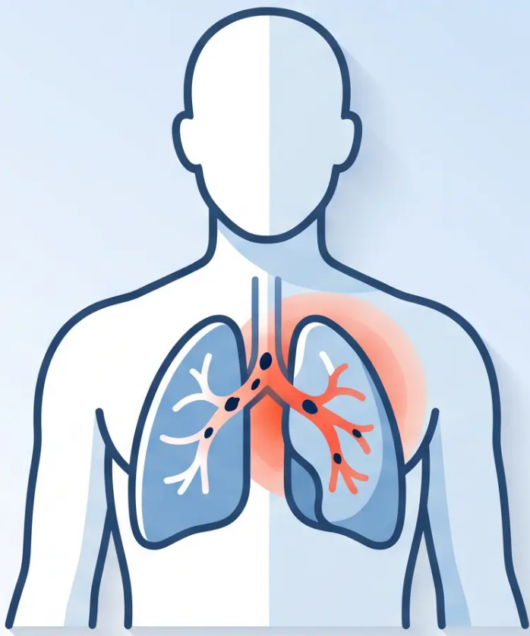


BRADFORD VTS TEACHING DECK
Pulmonary
Embolism & VTE
Comprehensive guide for GP registrars preparing
for AKT and SCA exams, covering the latest NICE
NG158 and BNF 91 updates as of May 2026.
Bradford VTS · May 2026 · NICE NG158 Confirmed Current
Bradford VTS
GP Registrar Training · AKT & SCA Preparation

Slide 2




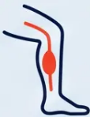
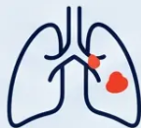
‘Definitions and Epidemiology’
“Understanding VTE: DVT, PE, and why it matters in primary care.”
‘VTE’
‘DVT’
‘PE’
Venous Thromboembolism
Deep Vein Thrombosis
Pulmonary Embolism
Umbrella term encompassing both
DVT and PE — the two major
manifestations of venous clot disease.
Thrombus forming in a deep vein —
most commonly the leg or pelvis. The
origin of most pulmonary emboli.
Thrombus lodging in the pulmonary
artery, usually arising from a DVT. Can
be life-threatening within minutes.
1–2
10%
30%
per 1,000
fatal within 1 hour
10-year recurrence
people per year develop VTE
of untreated pulmonary embolism cases
risk if VTE was unprovoked
Bradford VTS · PE and VTE Teaching Deck
Slide 2 of 21

Slide 3




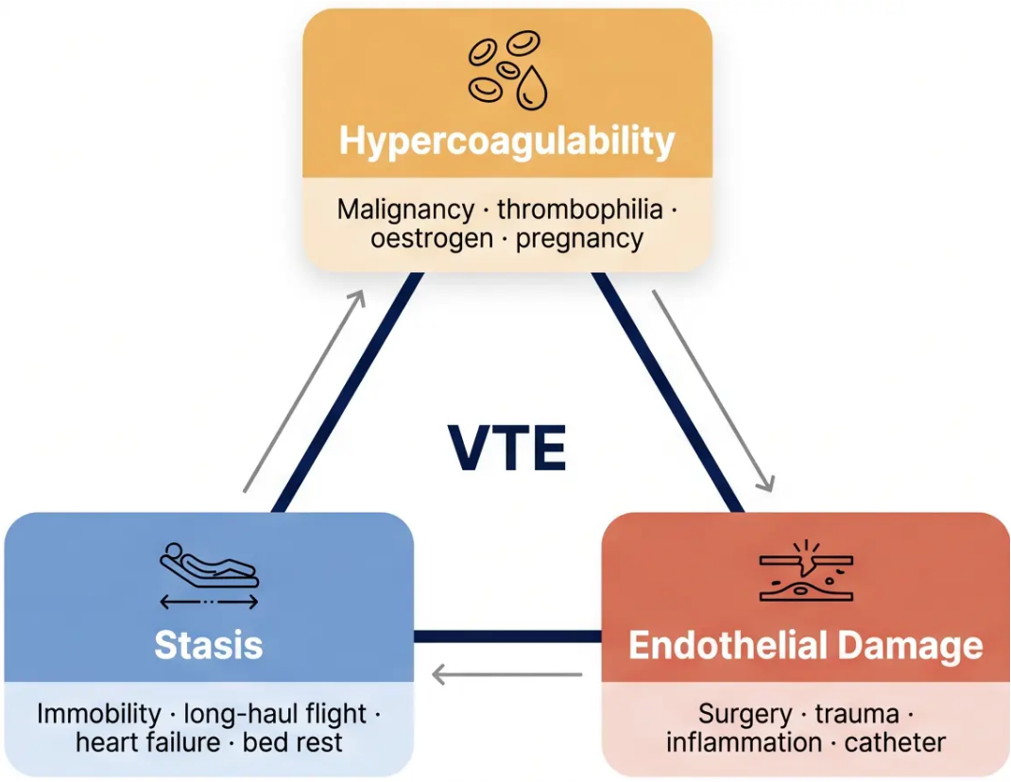
Risk Factors and Virchow's Triad
Understanding why clots form
Surgical / Procedural:
Medical Conditions:
• Recent surgery (especially
orthopaedic, pelvic)
• Active malignancy
• Heart failure
• Trauma or fracture
• Nephrotic syndrome
• Inflammatory conditions
Lifestyle / Situational:
• Prolonged immobility (long-
haul flight, hospitalisation)
Hormonal / Reproductive:
• COC pill or HRT
(oestrogen-containing)
• Obesity (BMI >30)
• Age over 60
• Pregnancy and puerperium
Personal / Genetic History:
• Previous VTE
• Thrombophilia (Factor V Leiden,
APS, protein C/S deficiency)
Bradford VTS · PE and VTE Teaching Deck
Slide 3 of 21

Slide 4


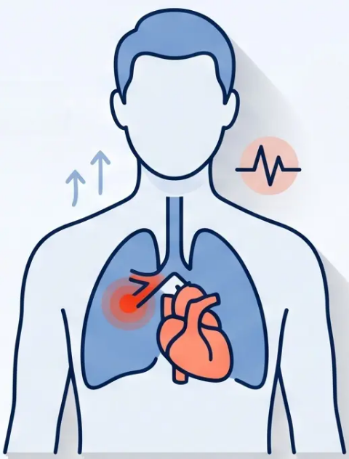


Clinical Presentation of PE
Know what to look for — symptoms and signs
● Symptoms
● Signs
● Breathlessness — most common
presenting symptom
● Tachycardia — most common sign
● Tachypnoea
● Pleuritic chest pain — sharp, worse
on inspiration; lateral or anterior
● Hypoxia — SpO₂ <95%
● Low-grade fever
● Haemoptysis — suggests pulmonary
infarction; less common
● Hypotension — massive PE
● Palpitations / Pre-syncope /
Syncope
● Raised JVP + RV heave —
massive PE
● Cough
● Signs of DVT — unilateral calf
swelling, warmth, redness
Bradford VTS · PE & VTE Teaching Deck
Slide 4 of 21

Slide 5


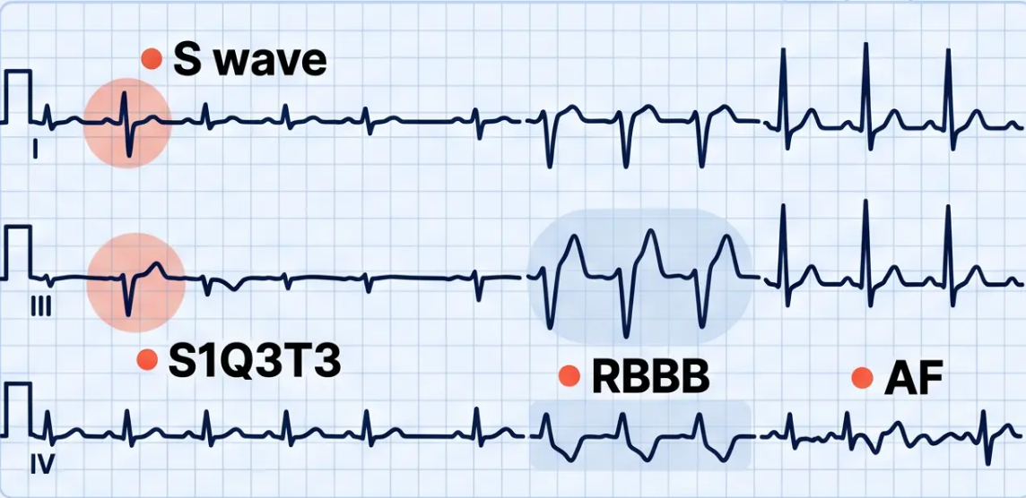












ECG Changes in
Pulmonary Embolism
Most findings reflect right heart strain —
none are diagnostic alone
Sinus Tachycardia
S1Q3T3 Pattern
Right Bundle Branch Block
New-Onset AF
MOST COMMON
CLASSIC — BUT RARE
RIGHT HEART STRAIN
LESS COMMON
HR >100 bpm. Present in the
majority of PE cases.
Non-specific but important
in context.
Deep S in Lead I, Q wave and
inverted T in Lead III. Suggests
acute right heart strain. Seen
in minority of cases.
New RBBB pattern. Broad
QRS with RSR' in V1. Indicates
acute pressure overload on
the right ventricle.
Irregularly irregular rhythm
without P waves. Can be
triggered by right atrial
stretch from PE.
Bradford VTS · PE & VTE Teaching Deck
Slide 5 of 21

Slide 6









DIAGNOSTIC TOOLS
2-Level Wells Score for PE
NICE NG158 — Confirmed Current May 2026
Clinical Feature
Score
Clinical signs and symptoms of DVT
3
Alternative diagnosis less likely than PE
3
Heart rate greater than 100 bpm
1.5
TOTAL
/ 13
Immobilisation ≥3 days OR surgery in past 4 weeks
1.5
Previous DVT or PE
1.5
Haemoptysis
1
Malignancy (active, treated in last 6 months, or palliative)
1
SCORE ≤ 4 POINTS
SCORE > 4 POINTS
PE Unlikely
PE Likely
Perform quantitative D-dimer first
Proceed to immediate CTPA
Bradford VTS
NICE NG158 • Wells Score for PE

Slide 7


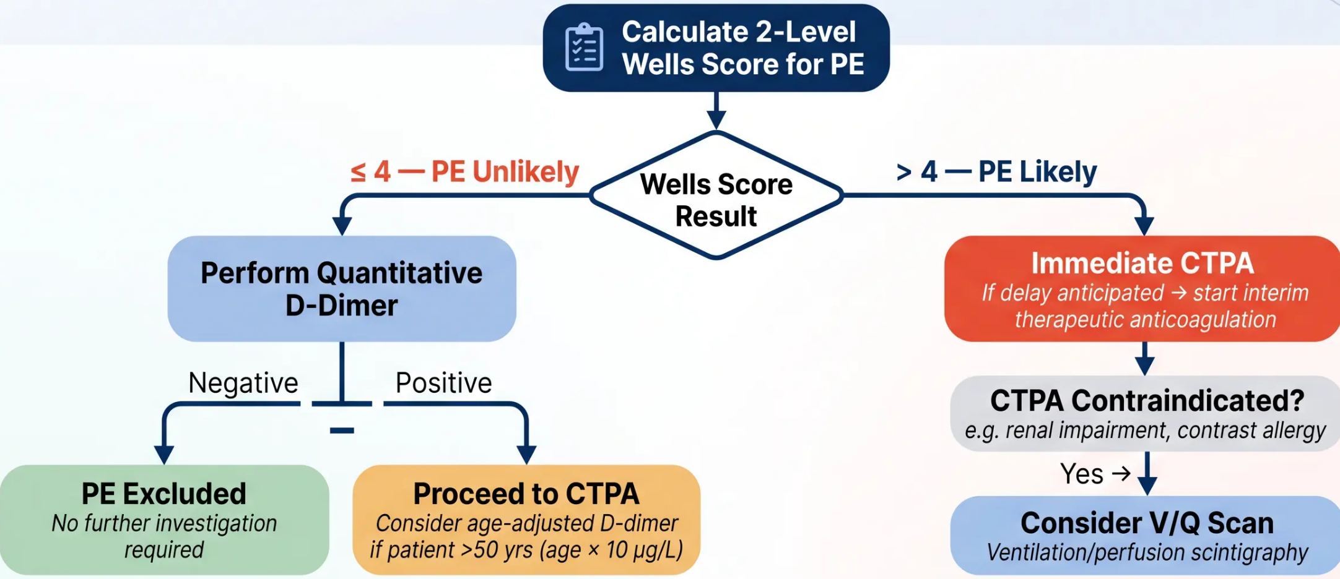





Diagnostic Algorithm
NICE NG158 · Confirmed Current May 2026
CTPA = CT Pulmonary Angiography · V/Q = Ventilation/Perfusion Scan · D-dimer threshold: 500 µg/L (or age × 10 µg/L if >50 years)
Decision / Action
Investigation
PE Excluded
Further Imaging Required

Slide 8












PERC Rule and Age-Adjusted D-dimer
*Two tools for safely excluding PE without over-investigating
PERC Rule
Age-Adjusted D-dimer
All 8 must be negative — low clinical suspicion only
For patients aged over 50 years — raises the
threshold, reduces false positives
○ Age under 50
○ Heart rate under 100 bpm
Standard threshold: Fixed 500 μg/L
Age-adjusted threshold: Age × 10 μg/L
○ SpO₂ 95% or above
○ No unilateral leg swelling
○ No haemoptysis
Example 1:
Example 2:
○ No prior VTE
Patient aged 65
Patient aged 78
○ No recent surgery or trauma (within 4 weeks)
65 × 10 = 650 μg/L threshold
78 × 10 = 780 μg/L threshold
○ No oestrogen use
Standard 500 cut-off would
over-investigate
Higher threshold — fewer
unnecessary CTPAs
If ALL 8 negative → PE excluded. No D-dimer needed.
*Only apply when Wells score ≤4 (PE Unlikely) and D-dimer is being used
Bradford VTS · PE and VTE Teaching Deck
NICE NG158 — Confirmed Current May 2026 · Slide 8 of 21

Slide 9











First-Line Treatment: DOACs
Apixaban and rivaroxaban — no LMWH bridge required
Apixaban
Rivaroxaban
Eliquis — Preferred First-Line
Xarelto — First-Line Alternative
ACUTE PHASE
ACUTE PHASE
10 mg twice daily
15 mg twice daily
× 7 days
× 21 days
MAINTENANCE
MAINTENANCE
5 mg twice daily
20 mg once daily
Ongoing — review at 3 months
Ongoing — review at 3 months
Start immediately at diagnosis. No food restriction.
Must be taken WITH food for adequate absorption.
⚡ No LMWH bridge needed for apixaban or rivaroxaban
✓ NICE NG158 confirmed current — May 2026
Bradford VTS • Slide 9 of 21 • PE & VTE Teaching Deck

Slide 10










Alternative Anticoagulation
and Warfarin
*When DOACs are not the right choice — three situations you must know*
Antiphospholipid
Syndrome
Pregnancy & Puerperium
Severe Renal
Impairment / Other
– Use: WARFARIN
– Use: LMWH (e.g. dalteparin,
tinzaparin)
– eGFR <15: use LMWH (DOACs
renally cleared — accumulation risk)
– Target INR: 2–3
– ⚠ DOACs are associated with
higher recurrence risk in APS
– Continue throughout pregnancy
and for ≥6 weeks postpartum
– Edoxaban / Dabigatran: require
5–10 days LMWH first, then switch
– ⚠ DOACs: contraindicated (cross
placenta)
– Significant drug interactions:
consider LMWH or warfarin
– Do NOT use apixaban or
rivaroxaban in confirmed triple-
positive APS
– ⚠ Warfarin: contraindicated in 1st
trimester (teratogenic) and near
delivery
– Warfarin: used when DOACs not
tolerated or contraindicated
WARFARIN — not DOAC
LMWH ONLY
Check eGFR before prescribing
*Edoxaban and dabigatran both require an initial 5–10 day LMWH lead-in — unlike apixaban and rivaroxaban which can be started immediately.
Bradford VTS · PE and VTE Teaching Deck
Slide 10 of 21 · NICE NG158 · BNF 91

Slide 11














Duration of Anticoagulation
*How long is long enough? Tailored to VTE type and clinical risk.
Provoked VTE
Unprovoked VTE
Identifiable reversible trigger — surgery,
fracture, long flight
No clear identifiable cause found
3 Months
≥ 3 Months
Minimum. Review at 3 months and stop if
trigger resolved.
Consider extending to 6 months or long-term.
Discuss bleeding vs. recurrence risk annually.
Cancer-Associated VTE
Recurrent Unprovoked VTE
Active malignancy driving hypercoagulable state
Second or further unprovoked event
≥ 6 Months
Long-Term
While cancer is active. DOACs preferred
(apixaban, rivaroxaban, edoxaban) or LMWH.
Indefinite anticoagulation. Annual risk-benefit
review. Discuss patient preference.
Key principle: Provoked = defined endpoint. Unprovoked = ongoing shared decision-making.
Bradford VTS · PE & VTE Teaching Deck
Slide 11 · NICE NG158 · May 2026

Slide 12

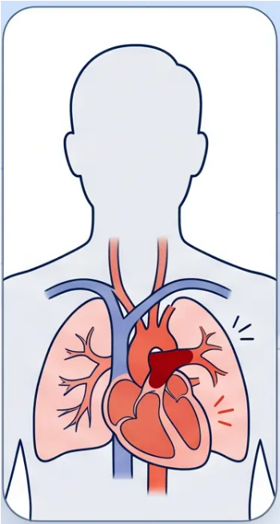




Massive Pulmonary Embolism
EMERGENCY
Haemodynamic instability · Emergency management
RECOGNISE IT
TREAT IT
● Systolic BP <90 mmHg — or a drop of >40 mmHg
from baseline
① Call 999 immediately
Do not delay transfer from primary care
② Systemic thrombolysis
● Cardiac arrest or peri-arrest — loss of output, PEA
Alteplase — 10 mg IV bolus, then
90 mg over 2 hours
● Severe hypoxia — SpO₂ unresponsive to oxygen
③ Anticoagulation in parallel
● Altered consciousness — syncope, agitation,
collapse
Heparin alongside thrombolysis
④ ITU / Resuscitation team
● Signs of right heart strain — raised JVP, RV
heave, shock
Surgical embolectomy if thrombolysis
fails or is contraindicated
Bradford VTS · PE and VTE Teaching Deck
Slide 12 of 21
NICE NG158 · May 2026

Slide 13













DVT Diagnosis and Management
2-level Wells score · Ultrasound · Anticoagulation principles
DVT Likely — Score ≥ 2
Proximal Leg Ultrasound
If negative and clinical suspicion remains high
Calculate DVT Wells Score
→ repeat ultrasound in 6–8 days
Score ≥ 2 → DVT Likely
Confirmed DVT
Score < 2 → DVT Unlikely
DVT Unlikely — Score < 2
D-dimer Test
If positive → proceed to proximal leg ultrasound
If negative → DVT excluded
Anticoagulation
Duration
Special Situations
DOACs First-Line
Treatment Duration
Exceptions
Apixaban: 10mg BD × 7 days → 5mg BD
Antiphospholipid syndrome → Warfarin,
not DOAC
Provoked DVT: 3 months minimum
Rivaroxaban: 15mg BD × 21 days → 20mg OD
Unprovoked DVT: ≥ 3 months
Pregnancy → LMWH only
No LMWH bridge required
Consider extending — discuss risks and
benefits with patient
Cancer-associated DVT → DOAC or LMWH,
≥ 6 months
Bradford VTS · GP Registrar Training
13 / 21
NICE NG158 · May 2026

Slide 14














Thrombophilia Testing
When to screen, what to test, and the golden rule of timing
WHEN TO TEST
Age < 50 +
Mesenteric /
Family History
of VTE
Unexplained
Unprovoked
Recurrent
VTE
Cerebral /
Miscarriage +
VTE
Hepatic Veins
VTE
Unprovoked VTE under 50
Unusual sites
Strong family history
APS suspicion
Inherited Thrombophilias
Acquired / Autoimmune
• Factor V Leiden (most common inherited thrombophilia)
• Anticardiolipin antibodies
• Prothrombin gene mutation
• Lupus anticoagulant
• Protein C deficiency
• Anti-β₂-glycoprotein I antibodies
• Protein S deficiency
• Antithrombin deficiency
Antiphospholipid antibody panel — confirm on repeat testing ≥12 weeks apart
Do NOT test during acute VTE or while on anticoagulation
Results will be unreliable — anticoagulants interfere with thrombophilia assays.
Wait at least 3 months after stopping anticoagulation before testing.
Bradford VTS · PE and VTE Teaching Deck
Slide 14 of 21 · NICE NG158

Slide 15








Special Considerations
Pregnancy · Antiphospholipid Syndrome
Pregnancy + VTE
Antiphospholipid Syndrome (APS)
● LMWH is the only safe anticoagulant in pregnancy
DOACs cross the placenta — contraindicated in all trimesters
● Warfarin is the preferred anticoagulant in APS
Target INR 2–3 for VTE; INR 3–4 for arterial thrombosis
(specialist-led)
● Warfarin is also contraindicated
Teratogenic in first trimester; risk of fetal haemorrhage in
third trimester
● DOACs are associated with higher recurrence
rates in APS
Particularly in triple-positive APS — avoid DOACs in this group
● Continue LMWH throughout pregnancy and for at
least 6 weeks postpartum
Minimum total duration: 3 months
● Diagnosis: anticardiolipin, lupus anticoagulant,
anti-β2-glycoprotein antibodies
Two positive tests ≥12 weeks apart required for diagnosis
⚠ DOACs + Warfarin = CONTRAINDICATED in pregnancy
⚠ APS + VTE = WARFARIN, not DOAC
Bradford VTS · PE and VTE Teaching Deck
Slide 15 of 21 · NICE NG158 · BNF 91 · May 2026

Slide 16









BRADFORD VTS
Top Tips for GP Training
8 clinical pearls you must know cold
01
02
03
04
Wells ≤4 = PE Unlikely
Wells >4 = PE Likely
DOACs are FIRST LINE
Apixaban: 10mg BD × 7
days
then 5mg BD maintenance
→ D-dimer first
→ Immediate CTPA
No LMWH bridge needed
for apixaban or rivaroxaban
05
06
07
08
Rivaroxaban:
Age-adjusted D-dimer
in >50 years
Antiphospholipid
syndrome:
Pregnancy + VTE:
15mg BD × 21 days
LMWH only — DOACs and
warfarin contraindicated
then 20mg OD — MUST
Threshold = age × 10 µg/L
WARFARIN — not DOACs
take with food
(not fixed 500)
Bradford VTS · PE and VTE Teaching Deck
Slide 16 of 21

Slide 17













EXAM PREPARATION
Exam Pearls: AKT Focus
High-yield facts for the Applied Knowledge Test — know these well
Wells Score Cut-offs
PERC Rule
≤4 = PE Unlikely → D-dimer first
All 8 criteria negative + low clinical suspicion
>4 = PE Likely → Immediate CTPA
→ PE excluded without D-dimer
Apixaban (First-line)
Rivaroxaban (First-line)
10 mg twice daily → 7 days
15 mg twice daily → 21 days (with food)
→ then 5 mg twice daily
→ then 20 mg once daily (with food)
Duration Rules
Critical Exceptions
Provoked VTE → 3 months minimum
Antiphospholipid syndrome → Warfarin, NOT DOACs
Unprovoked VTE → ≥3 months, consider longer
Pregnancy → LMWH only, no DOAC or warfarin
Bradford VTS • PE and VTE Teaching Pack
NICE NG158 • BNF 91 • May 2026
Slide 17 of 21

Slide 18

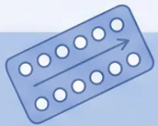
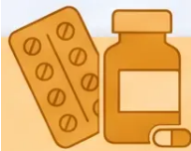







EXAM PEARLS
SCA Scenarios
Three consultation vignettes — think through your approach before reading the key points
SCA tests you tests your clinical reasoning, communication, and safety-netting — not just your knowledge.
Scenario A
Scenario B
Scenario C
Young woman on COC, presents with
breathlessness and pleuritic chest pain
Patient asks: ‘Do I really need to take these
blood-thinning tablets for 3 months?’
Elderly patient with haemoptysis and
unilateral leg swelling
• calculate 2-level Wells score at the
consultation
• Explain provoked vs unprovoked VTE in
plain language
• Haemoptysis + leg swelling = high clinical
suspicion for PE with DVT
• Breathlessness + pleuritic pain + COC use =
PE must be excluded
• Provoked (e.g., after surgery or long flight):
3 months is appropriate minimum
• Calculate Wells score — likely PE
Likely (>4) → arrange immediate CTPA
• Arrange same-day urgent investigation
(D-dimer or CTPA depending on Wells)
• Unprovoked: at least 3 months — discuss
extending; involves shared decision
• Consider interim therapeutic anticoagulation
if CTPA will be delayed
• Advise to stop COC immediately — do not
wait for diagnosis confirmation
• Explain bleeding risk honestly alongside clot
recurrence risk
• Age-adjusted D-dimer applies if Wells ≤4:
threshold = age × 10 µg/L
• Discuss what to watch for: unusual bleeding,
bruising, dark stools
• Consider underlying malignancy as a trigger
— unprovoked VTE in elderly
• Safety-net clearly: if worsening, call 999
• Document shared decision-making around
contraception alternatives
• Agree a review date — do not just say ‘stop at
3 months’ without reassessment
• Arrange urgent hospital referral; do not
manage in community without imaging
Stop COC · Investigate urgently · Safety-net
Wells >4 → CTPA · Age-adjusted D-dimer · Exclude malignancy
Provoked vs unprovoked · Shared decision · Review date
Bradford VTS · PE and VTE Teaching Deck
Slide 18 of 21 · NICE NG158 · May 2026

Slide 19










Red Flags in VTE
Critical warning signs requiring immediate action
01
02
03
Haemodynamic Instability
Severe Hypoxia
Massive or Bilateral Leg Swelling
Systolic BP <90 mmHg or drop >40
mmHg with suspected PE →
Massive PE. Call 999 immediately.
SpO₂ <90% with suspected PE →
urgent hospital transfer. Do not delay
for investigations.
Bilateral swelling → consider IVC
thrombosis or underlying
malignancy. Unilateral massive
swelling → phlegmasia.
04
05
06
PE with Known Malignancy
Unprovoked VTE in Young
Patient
Recurrent VTE Despite
Anticoagulation
Cancer-associated VTE — extended
anticoagulation minimum 6 months.
Consider DOACs or LMWH.
Age <50 with no clear trigger →
thrombophilia screen after
completing anticoagulation course.
Consider antiphospholipid
syndrome or occult malignancy.
Urgent specialist review.
When in doubt — act fast. Most red flags require same-day hospital assessment or 999.
Bradford VTS · PE and VTE Teaching Deck
Slide 19 of 21

Slide 20







Common Pitfalls
*Frequent clinical errors to avoid in VTE assessment and management
● 01
● 02
● 03
● 04
DOACs in
antiphospholipid
syndrome
D-dimer in high-
risk patients
No age-adjusted
D-dimer
DOACs in
pregnancy
Wells >4 → go straight to
CTPA, not D-dimer
In patients >50 yrs: use
age × 10 μg/L, not fixed
500 μg/L
APS requires warfarin —
DOACs carry higher
recurrence risk
LMWH only — DOACs and
warfarin are both
contraindicated
● 05
● 06
● 07
● 08
Stopping at exactly
3 months
Thrombophilia
testing too early
Rivaroxaban
without food
Missing underlying
malignancy
Always ask: was this VTE
provoked or unprovoked?
Unprovoked may need longer
Test at least 3 months after
anticoagulation is stopped
— not during acute VTE
Must be taken with food —
absorption is significantly
reduced if fasting
Unprovoked VTE → always
consider occult cancer as
the driving cause
Bradford VTS · Pulmonary Embolism and VTE
Slide 20 of 21

Slide 21














Quick Recall Summary
Everything you need to know — at a glance
Wells Score (PE)
Apixaban (Eliquis)
Rivaroxaban (Xarelto)
– ≤ 4 points → PE Unlikely → D-dimer first
– Acute: 15 mg twice daily × 21 days (with
food)
– Acute: 10 mg twice daily × 7 days
– > 4 points → PE Likely → Immediate CTPA
– Maintenance: 5 mg twice daily
– Maintenance: 20 mg once daily (with
food)
– If CTPA delayed → start interim
anticoagulation
– No LMWH bridge needed
– No LMWH bridge needed
Treatment Duration
DOACs: When NOT to Use
D-dimer & PERC
– Provoked VTE → 3 months minimum
– Antiphospholipid syndrome → Warfarin only
– PERC: all 8 criteria negative → no D-dimer
needed
– Unprovoked VTE → ≥ 3 months, consider
longer
– Pregnancy → LMWH only
– Severe renal impairment (eGFR < 15) →
LMWH
– Age-adjusted D-dimer (age > 50):
threshold = age × 10 μg/L
– Cancer-associated → ≥ 6 months
– Edoxaban / Dabigatran → needs 5–10 day
LMWH lead-in
– Thrombophilia testing: wait ≥ 3 months
after anticoagulation stopped
– Recurrent unprovoked → long-term
Bradford VTS · May 2026
NICE NG158 Confirmed Current · BNF 91
End of Deck

