Slide 1



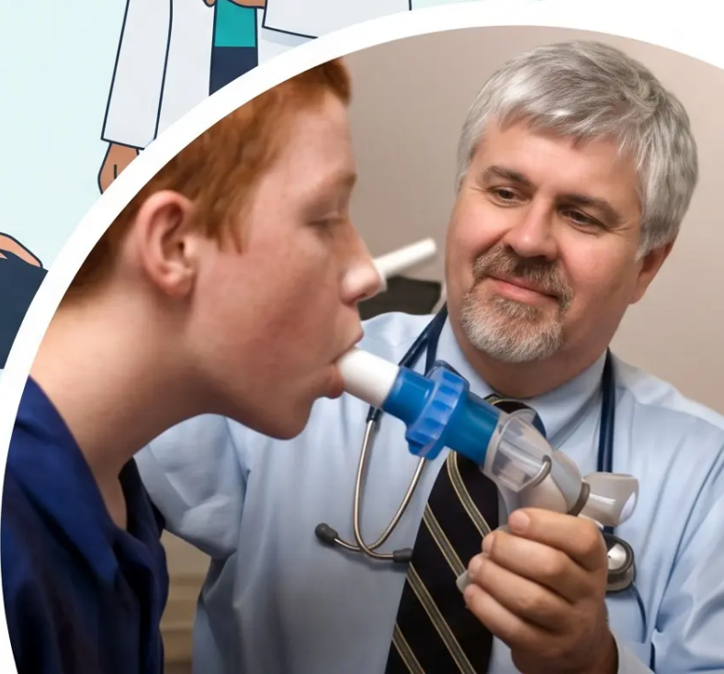
Spirometry: Performing
and Interpreting
Bradford VTS Teaching Deck
*A comprehensive guide for GP registrars on spirometry
standards, interpretation, and exam preparation for
AKT and SCA, updated to May 2026 clinical standards.*
May 2026 Edition · ARTP v6.5 · NICE NG115 / NG245 · GLI 2022

Slide 2




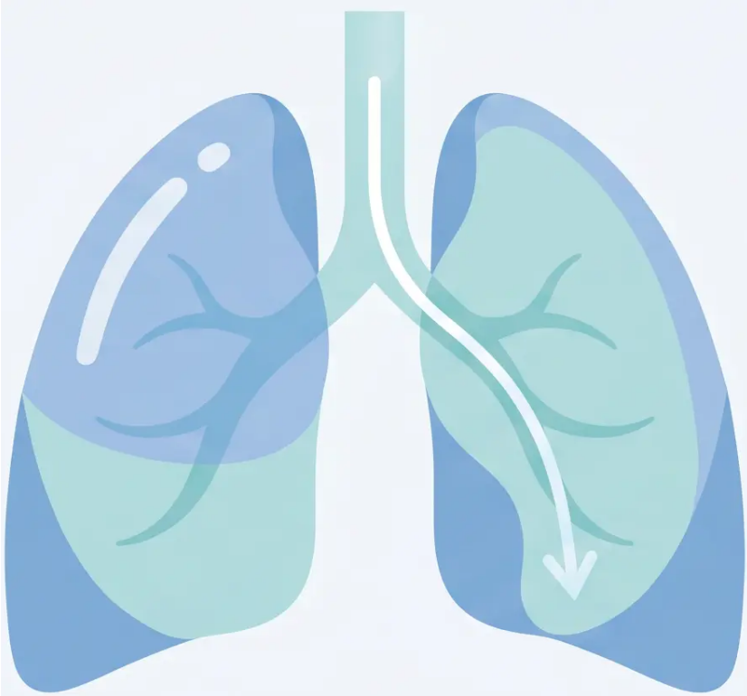


What is Spirometry?
FOUNDATIONS
Spirometry measures the volume of air a
patient can forcibly expel from the lungs
after a maximal inspiration — assessing
how well the lungs move air.
Why we do it in primary care
● Confirm diagnosis of COPD, asthma, or
interstitial lung disease
Grade COPD severity and monitor progression
● Assess bronchodilator response
● Pre-operative lung function assessment
● QOF targets and health promotion checks
2

Slide 3






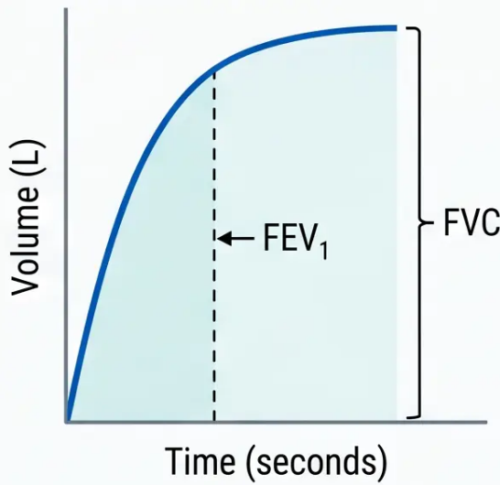






Key Spirometry Parameters
*Understanding what each measurement tells us about airway function*
FEV₁
FVC
Forced Expiratory Volume in 1 second
Forced Vital Capacity
Volume of air forcibly expelled in the first
second of exhalation. Reflects large airway
flow. Reduced in obstructive disease.
Maximum volume of air forcibly expelled in
one complete breath from full inspiration.
Represents total exhalation capacity.
↓ in obstruction
↓ in restriction
VC / RVC
FEV₁/FVC
Vital Capacity / Relaxed (Expiratory) Vital Capacity
Forced Expiratory Ratio (FER)
Volume expelled during a slow, relaxed exhalation.
May exceed FVC in obstructive disease due to air
trapping — use RVC for ratio if RVC > FVC.
Proportion of total air expelled in the first second.
The KEY diagnostic ratio. Normal ≥0.70. Below
0.70 (post-bronchodilator) indicates obstruction.
FEV₁/FVC = proportion of total
volume expelled in 1 sec
Use if RVC > FVC
KEY diagnostic ratio
Bradford VTS · Spirometry Teaching Deck
3 / 37

Slide 4





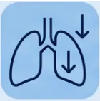
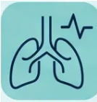









INDICATIONS
When to Perform Spirometry
*Key clinical scenarios for GP practice*
Suspected
Asthma
Unexplained
Breathlessness
Suspected COPD
*Smoker or ex-smoker with
breathlessness or chronic cough
*Variable symptoms, wheeze,
nocturnal waking
*Exclude respiratory cause
when aetiology unclear
Monitoring
Chronic Disease
Pre-operative
Assessment
Occupational
Lung Disease
*Track disease progression;
annual COPD review
*Assess respiratory reserve
before surgery
*Screening in dusty or chemical
exposure environments
Bradford VTS
Respiratory
Services
4 / 37

Slide 5













Contraindications to Spirometry
*Know before you blow — safety first*
ABSOLUTE
RELATIVE
● Recent eye surgery — within 3 months
● Haemoptysis of unknown origin
● Pneumothorax (unresolved)
● Recent thoracic or abdominal surgery
— within 3 months
● Unstable cardiovascular status
● Pregnancy (1st trimester — avoid;
2nd/3rd — results may be affected)
● Myocardial infarction — within last
3 months
● Active respiratory exacerbation
● Thoracic, abdominal or cerebral
aneurysm
● Acute illness (e.g., vomiting, diarrhoea,
acute infection)
“Poorly controlled symptoms or active exacerbation? Reschedule — results will be falsely abnormal.”

Slide 6
















Patient Preparation
& Pre-test Procedures
What to tell your patient before they attend
BEFORE ATTENDING
DURING THE TEST
No alcohol
Accurate height
Avoid for at least 4 hours before the test
Essential — used to calculate predicted values
Light eating only
Record age and sex
Avoid a substantial meal for 2 hours before
Required for reference equation calculations
No vigorous exercise
Comfortable room temperature
Avoid for at least 30 minutes before
Stable conditions improve result reliability
Loose-fitting clothing
Seated correctly
Tight clothing restricts chest expansion
Hard-backed chair, feet flat on floor, nose clip applied
● Verbal consent must be obtained and accurate height recorded before every test — this directly affects predicted values.
Bradford VTS
6 / 37

Slide 7










Inhaler Withholding Times for Reversibility
*Ensure bronchodilators are withheld before testing to avoid false results*
4 hours
SABA
Salbutamol (blue inhaler) · Ipratropium (Atrovent)
LABA
24 hours
Salmeterol · Formoterol (green inhaler)
24 hours
LAMA
Tiotropium · Umeclidinium · Glycopyrronium
12 hours
Theophyllines
Aminophylline · Theophylline (oral)
No smoking for at least 1 hour before testing
*Withholding times apply when bronchodilator reversibility testing is planned. Standard diagnostic spirometry does not require withholding.

Slide 8



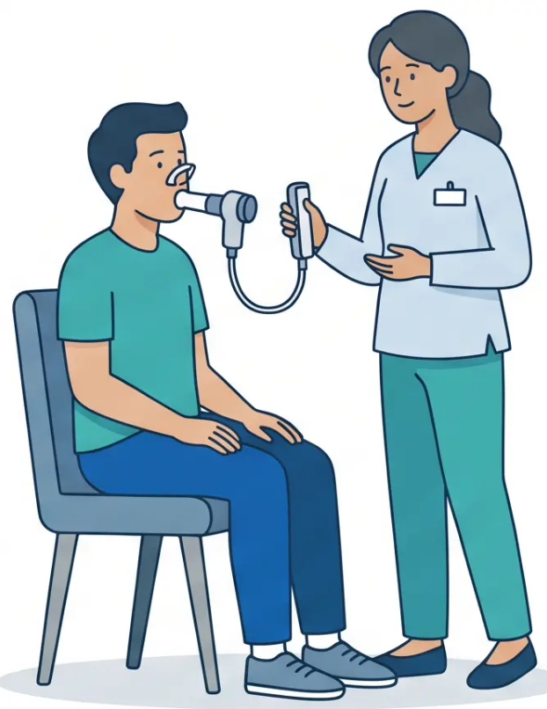





Technique: Relaxed Vital Capacity (RVC)
Also known as EVC (Expiratory Vital Capacity) — measures total exhalable volume without forced effort
1 Maximal Inspiration
Ask the patient to take the deepest possible breath in before beginning.
2 Apply Nose Clip
Fit the nose clip securely to prevent any air escaping through the nose during exhalation.
3 Insert Mouthpiece
Patient seals lips firmly around the mouthpiece — check for no gaps or leaks around the seal.
4 Breathe Out Slowly and Completely
Patient exhales at their own comfortable pace — NOT forced. Continue until no more air can
be expelled. This is the key distinction from FVC technique.
5 Achieve Reproducibility
Repeat until two best results are within 150mL of each other. Minimum two acceptable
blows required.
💡 Why RVC matters in obstruction: In obstructive disease, RVC (relaxed) is often
greater than FVC (forced) due to air trapping. When RVC > FVC, use RVC for the
FEV1/FVC ratio calculation — this gives a more accurate result.
Patient seated, nose clip applied,
relaxed exhalation in progress
Bradford VTS
8 / 37

Slide 9

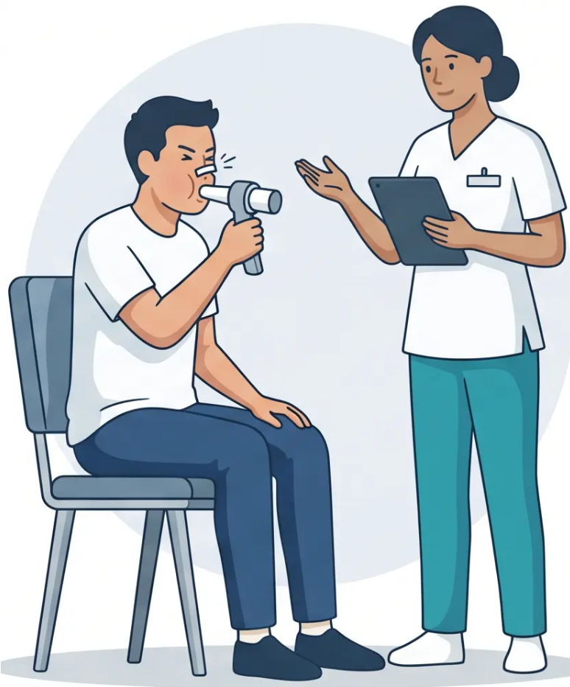



Technique: Forced Vital Capacity (FVC)
*The ‘blast’ technique — maximum effort, sustained exhalation
1 Take a maximal breath in
Fully inflate the lungs before the mouthpiece is inserted
2 Insert mouthpiece, seal lips firmly
No gaps — air leaks will underestimate FVC
3 Apply nose clip
Prevents nasal air escape during the forced blow
4 ‘Blast’ out — as hard and fast as possible
Sharp, explosive start — no hesitation or slow ramp-up
5 Continue blowing for at least 6 seconds
3 seconds minimum in children · Do not stop early
6 Repeat — minimum 3 acceptable blows
Best two results must be within 5% or 150mL of each other
! Acceptability Check
- Sharp start · No cough in first second · No early termination
- Best FEV1 + Best FVC taken separately — may be from different blows
Seated · Upright · Feet flat · Nose clip applied
Bradford VTS · Spirometry Teaching Deck
9 / 37

Slide 10



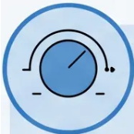






Calibration and Quality Control
*Ensuring your spirometer gives accurate, reliable results before every session*
Verification
Calibration
3L Syringe
• Adjusts the spirometer's signal to produce a known
output
• Checks the spirometer is reading correctly
• Uses a 3-litre calibration syringe as the known
standard
• Most pneumotachograph equipment requires daily
calibration
• Acceptable tolerance: reading must be within ±3%
of 3.00L
• Follow manufacturer's guidelines for frequency and
method
• Perform daily before the first patient session
• Record calibration results in the equipment log
Verification checks accuracy. Calibration corrects it.
Biological Quality Control (Biological QC)
• A known, healthy individual (e.g., a staff member)
performs spirometry regularly
• Detects equipment drift or malfunction over time
• Results logged and compared at each session — flag
any significant deviation
• Their results should not vary by more than ±10%
from their own established baseline
Infection control: Use disposable cardboard mouthpieces as minimum. In high TB-prevalence
areas, use bacterial filters. Clean flow heads per manufacturer guidance after every session.
Bradford VTS · Spirometry Teaching Deck · May 2026

Slide 11
















QUALITY STANDARDS
ARTP v6.5: Acceptability Criteria
Each blow must meet ALL of the following criteria to be considered acceptable
ARTP v6.5 · Sept 2025
Good Start
No Hesitation
No Cough in
First Second
≥ 6 Seconds
Duration
No Leaks or
Glottis Closure
Back-extrapolated
volume less than 5% of
FVC or less than 150 mL
— whichever is greater
Exhalation must begin
immediately and
continue without pause
or restart
Any cough during the
first second invalidates
the FEV₁ measurement
Blow must last at least 6
seconds in adults (or
reach a clear volume
plateau); 3 seconds in
children
Mouthpiece must be
sealed; no sudden
glottis closure or
obstruction during blow
⚠ Poorly performed spirometry is worse than no spirometry
Reject any blow that fails acceptability criteria — do not include in the final reported values
Bradford VTS · Spirometry Teaching Deck
Slide 11 of 37

Slide 12











ARTP v6.5 Quality Standards: Reproducibility
*Ensuring consistency between acceptable blows — Sept 2025 standards
The Core Reproducibility Rule
Taking the Best Values
- Take the highest FEV1 from all acceptable blows
The best two acceptable FEV1 readings
must be within 150 mL or 5% of each
other. Same rule applies to FVC.
- Take the highest FVC from all acceptable blows
- These may come from different blows — this is
correct and expected
- If relaxed VC (RVC) > FVC, use RVC for the ratio
calculation
Minimum 3 acceptable blows required
Up to 8 attempts permitted
Apply rule separately to FEV1 and FVC
⚠ Important
Never average the values — always take the highest.
Step 1: Blow 1
Step 2: Blow 2
Step 3: Blow 3
Difference: 70 mL ✓
*Best two selected:
Within 150 mL —
Reproducible
Blows 1 & 3
FEV1: 2.45 L
FEV1: 2.38 L
FEV1: 2.41 L
ARTP Spirometry Standards v6.5 - Sept 2025 - Bradford VTS 2026
12

Slide 13







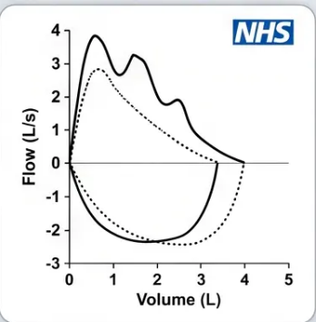




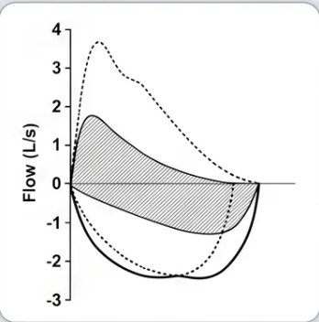



Visual Patterns and Technique Problems
Recognising poor technique on the flow-volume loop —
before it misleads your diagnosis
Problem name
What you see
Effect on results
Normal vs. Abnormal Loop
Cough During Test
Irregular peaks and troughs throughout curve
Affects FVC
⚠
Poor Effort
Rounded, blunt peak — not sharp or explosive
Reduces FEV1
⚠
Slow Start
Peak appears mid-curve, not at the beginning
Reduces FEV1
⚠
Baseline Reference Curve
Inspiration at Start
Negative curve deflection at the start
Affects all readings
⚠
Premature Termination
Curve ends abruptly; no plateau reached
Underestimates FVC
⚠
Air Leak
Lower overall volumes throughout the curve
Underestimates all values
⚠
Bradford VTS · Spirometry Teaching Deck
Slide 13 of 37

Slide 14







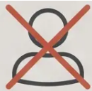







GLI Global 2022 Race-Neutral Equations
*The new UK standard for spirometry reference values — adopted June 2025*
WHAT CHANGED
The ARTP issued a position statement in June 2025
formally adopting GLI Global 2022 race-neutral
reference equations for UK spirometry practice.
OLD APPROACH
CURRENT STANDARD
VARIABLES USED
ECCS / BTS Equations
Age
Height
Sex
GLI Global 2022
Race-neutral equations
+ Ethnic correction factors
*No racial or ethnic adjustment. No correction factors.
Afro-Caribbean: -13%
OBSOLETE
Age · Height · Sex only
Z-scores & LLN reporting
Asian: -7%
CLINICAL IMPORTANCE
Eliminates systematic bias against non-white patients.
Ensures equitable diagnosis across all ethnic backgrounds.
**Race-specific correction factors are no longer recommended in UK practice — ARTP, June 2025**
Bradford VTS · Spirometry Teaching Deck
Slide 14 of 37

Slide 15







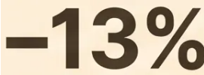


Obsolete Ethnic Correction Factors
*These corrections are no longer recommended in UK practice*
The Old Approach
SUPERSEDED
OLD APPROACH — NOW SUPERSEDED
ARTP Position Statement
OUTDATED
June 2025
Applied to Afro-Caribbean patients
Applied to Asian patients
*Predicted values were manually reduced by these fixed percentages based on
assumed racial lung volume differences.
REPLACED BY
GLI Global 2022
Race-Neutral Reference
The Problem
Equations
▪ Scientifically unjustified — based on population data that did not account for
socioeconomic, environmental, or measurement confounders
Uses age, height, and sex only.
No racial adjustment. Eliminates
systematic bias.
▪ Systematically biased — reduced predicted values for non-white patients,
potentially masking true lung disease
▪ Clinically harmful — could lead to under-diagnosis of respiratory conditions
in ethnic minority patients
*ARTP Position Statement on Ethnicity and
Spirometry Reference Equations, June 2025
Bradford VTS · Spirometry Teaching Deck · May 2026

Slide 16





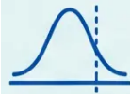






Reporting Results: Z-scores and LLN
How we define ‘normal’ — and why it matters clinically
Three ways to report spirometry results: % predicted · Z-score · Lower Limit of Normal (LLN)
% Predicted
Z-score and LLN
• Most commonly used in community and GP settings
• Z-score = number of standard deviations from the
predicted mean for that individual
• Compares patient result to the average predicted
value for their age, height, and sex
• LLN (Lower Limit of Normal) = Z-score below –1.64
(5th percentile of healthy reference population)
• Traditional cut-off: <80% predicted = abnormal
vs
• Statistically more rigorous — accounts for variability
across age, height, and sex
• Easy to communicate to patients
• Limitation: Fixed 80% threshold does not account
for natural variation across age groups — tends to
over-diagnose in elderly patients and under-
diagnose in younger patients
• Reduces over-diagnosis of COPD in patients over 70
• Reduces under-diagnosis in younger patients
• Used with GLI Global 2022 race-neutral equations
• Preferred by GLI 2026 joint statement for defining
physiological abnormality
Simpler · Less precise
More precise · Recommended
FEV1/FVC <0.70 used for COPD diagnosis
(GOLD 2026, NICE NG115)
Z-score <-1.64 preferred for defining physiological
abnormality and reducing over-diagnosis
FIXED RATIO RULE
LLN RULE
16 / 37
Bradford VTS · Spirometry 2026

Slide 17













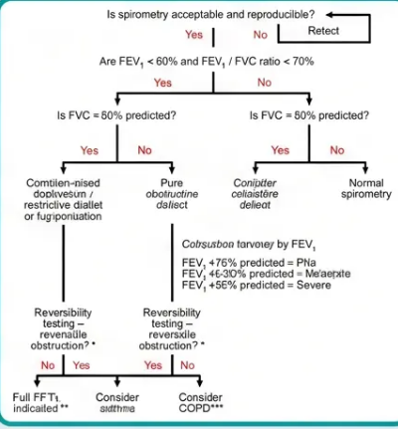







Step-by-Step Interpretation Algorithm
Three logical steps to classify any spirometry result
FEV1/FVC ratio < 0.70?
YES → Obstructive pattern
NO → Proceed to Step 2
(Post-bronchodilator – GOLD 2026, NICE NG115)
If ratio is normal – FVC below LLN?
YES → Restrictive pattern
NO → Normal spirometry
(LLN = Z-score below -1.64; or <80% predicted)
(LLN = Z-score below -1.64; or <80% predicted)
Confirm with TLC (full lung function)
STEP
Reference: Full diagnostic algorithm
3
YES → Mixed / Combined pattern
If obstructive – FVC also below LLN?
(Look for combined obstruction + restriction)
NO → Pure obstruction
STEP
⚠ KEY NOTE: Fixed ratio <0.70 preferred for
COPD diagnosis. LLN preferred for reducing
over-diagnosis in patients over 70.
Bradford VTS - Spirometry Teaching Deck
Slide 17 of 37

Slide 18











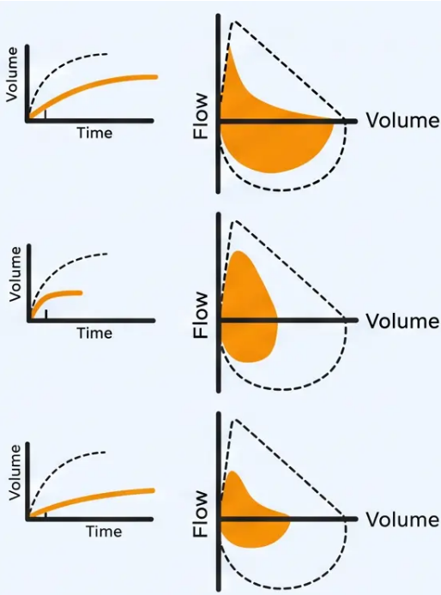












Summary of Spirometry Patterns
Pattern
FVC
FEV1
FEV1/FVC
Ratio
Normal
>80%
predicted
>80%
predicted
>0.70
(or above LLN)
Obstructive
Normal or
reduced
↓ Reduced
<0.70
Restrictive
↓ Reduced
(below LLN)
↓ Reduced
Normal or
elevated
Mixed /
Combined
↓ Reduced
(below LLN)
↓ Reduced
<0.70
*Post-bronchodilator values required for COPD diagnosis (NICE NG115). Confirm restriction
with full lung function (TLC) if clinically indicated.
*Flow-volume and volume-time
curve patterns

Slide 19

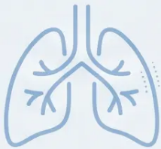








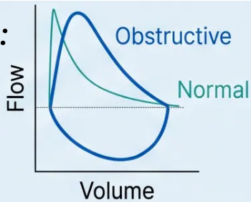



Obstructive Pattern and Common Causes
*FEV1/FVC < 0.70 post-bronchodilator — the defining feature*
COPD
WHAT THE NUMBERS SHOW
Most common cause in adults with smoking history.
Fixed airflow obstruction, post-BD FEV1/FVC <0.70.
■ FEV1/FVC ratio — Reduced: below 0.70 (post-BD)
Asthma
■ FEV1 — Reduced (reflects large airway narrowing)
Variable, reversible airflow obstruction. FEV1/FVC may normalise
between attacks. BDR >12% AND >200mL.
■ FVC — Normal or reduced (air trapping may reduce it)
> Remember: If FVC is also below LLN, consider a
mixed obstructive + restrictive pattern — don't miss it.
Bronchiectasis
Chronic airway inflammation and dilation. Persistent obstructive pattern;
productive cough.
Tumour / Foreign Body
Flow-volume loop appearance:
Large airway obstruction. Fixed obstruction pattern; consider if atypical
presentation.
Scooped, concave expiratory
curve — characteristic of airflow
obstruction
Large Airway Obstruction
Tracheal stenosis, vocal cord dysfunction. Flattening of inspiratory loop on
flow-volume curve.
Bradford VTS · Spirometry Teaching Deck
19 / 37

Slide 20













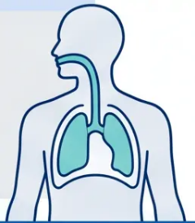



Restrictive Pattern and Common Causes
*Spirometry Interpretation · Pattern Recognition*
RESTRICTIVE PATTERN
SIGNATURE
FEV₁/FVC Ratio
FVC
FEV₁
Normal or Elevated (≥0.70)
Reduced (below LLN)
Reduced (proportionally)
Spirometric Characteristics
Common Causes
Spirometric Features
Lung Parenchyma
Chest Wall & Skeletal
FVC reduced — Total exhalable volume is below the
lower limit of normal
– Interstitial lung disease
(IPF, sarcoidosis)
– Kyphoscoliosis
– Obesity (severe)
FEV1 reduced — Proportionally reduced alongside FVC
– Drug-induced pulmonary
fibrosis
Ratio preserved or elevated — Key distinguishing
feature from obstruction; ratio ≥0.70
Small lung volumes — Both parameters fall together; the
“shrinking lung” picture
Neuromuscular
Pleural & Surgical
– Muscular dystrophy
– Pleural effusion,
mesothelioma,
pleural thickening
Important: Spirometry alone cannot confirm restriction —
full lung function testing (TLC measurement) is required for
definitive diagnosis. Refer if restrictive pattern found.
– Neuromuscular disease
(e.g., MND, myasthenia)
– Pneumonectomy
Bradford VTS · Spirometry Teaching Deck
20 / 37

Slide 21





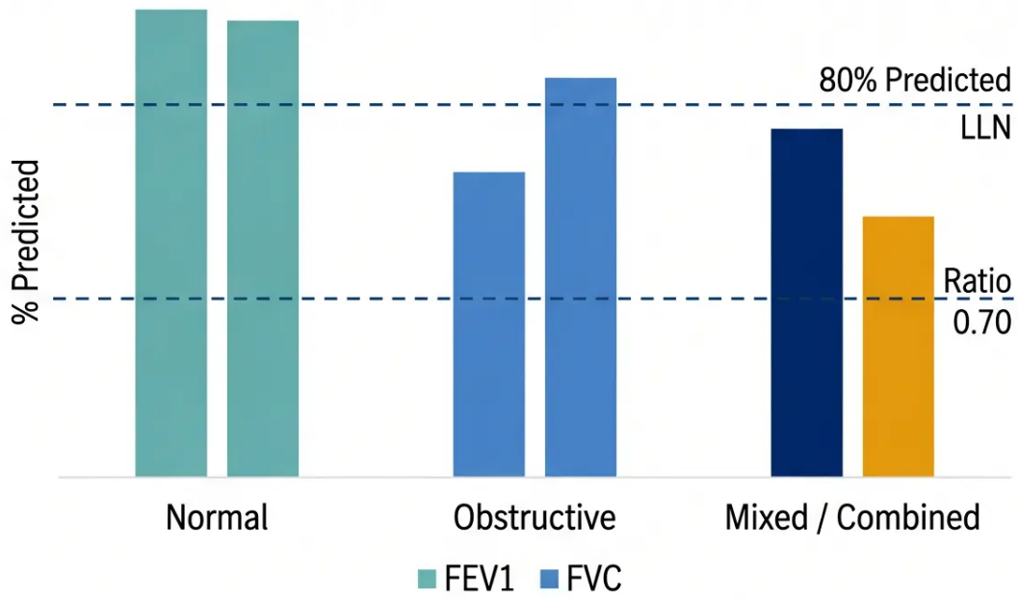




INTERPRETATION
Mixed / Combined Pattern
Obstruction + Restriction together — when the picture is more complex
How to Identify It
Spirometry Profiles: Normal vs Obstructive vs Mixed
• FEV1/FVC ratio < 0.70 (obstructive component present)
• FVC also below LLN (< 80% predicted) (restrictive component present)
• Both criteria must be met simultaneously
Common Clinical Scenarios
• Severe COPD with significant air trapping
• COPD co-existing with kyphoscoliosis
• COPD co-existing with pulmonary fibrosis
• Tumour alongside underlying obstructive disease
• Obesity with underlying COPD
Important Note
A truly restrictive component should be confirmed with full lung
function testing (TLC measurement). Spirometry alone cannot
definitively exclude air trapping as the cause of reduced FVC.
Mixed pattern = FEV1/FVC < 0.70 AND FVC below LLN —
always consider full lung function testing to confirm.
Bradford VTS · Spirometry Teaching Deck · May 2026
21 / 37

Slide 22









COPD Severity Grading
NICE NG115 · GOLD 2026 · Post-bronchodilator FEV₁ % predicted
All stages require: post-bronchodilator FEV₁/FVC < 0.70 confirmed
GOLD 1
≥ 80%
Mild
FEV1 ≥ 80%
predicted
GOLD 2
50 – 79%
Moderate
FEV1 50–79%
predicted
GOLD 3
30 – 49%
Severe
FEV1 30–49%
predicted
GOLD 4
< 30%
Very Severe
FEV1 < 30%
predicted
⚠ GOLD 1 (Mild): Symptoms must be present to diagnose COPD — do not diagnose on ratio alone.
22 / 37

Slide 23












GOLD ABE Classification (2026)
Categorising COPD patients by symptoms and exacerbation risk
All patients must first have confirmed airflow obstruction (post-BD FEV1/FVC <0.70). Groups are assigned
using symptom burden and exacerbation history.
A
B
E
Low Symptoms · Low Risk
High Symptoms · Low Risk
High Exacerbation Risk
• CAT score < 10
• CAT score ≥ 10
• ≥ 2 moderate exacerbations
per year, OR
• mMRC grade 0–1
• mMRC grade ≥ 2
• 0–1 moderate exacerbations
per year
• 0–1 moderate exacerbations
per year
• ≥ 1 exacerbation requiring
hospitalisation
(Regardless of symptom burden)
• No hospitalisations
• No hospitalisations
Optimise bronchodilation
Maximise symptom control
Escalate: LABA + LAMA ± ICS
Respiratory
*"E" stands for Exacerbator — the former Group C was removed in GOLD 2023 and the ABE model retained in 2026.
Services

Slide 24



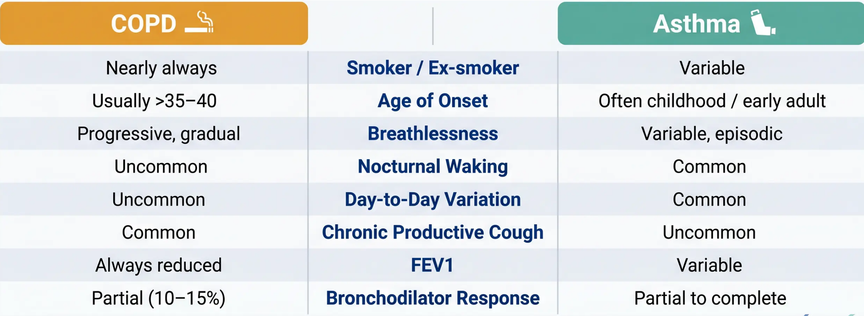

Distinguishing Asthma from COPD
Clinical and spirometric features — side by side
ASTHMA KEY CRITERION
COPD KEY CRITERION
Reversibility: >12% AND >200mL → suggests asthma (NICE NG245)
Post-BD FEV1/FVC <0.70 → confirms COPD (NICE NG115)
Bradford VTS · Spirometry Teaching Deck · May 2026
24 / 37

Slide 25






















Slide 25 of 37
Bronchodilator Reversibility (BDR) Testing
*Step-by-step clinical procedure
1
2
3
4
Baseline
Spirometry
Administer
Salbutamol
Repeat
Spirometry
Wait
400 mcg via large-
volume spacer
15–30 minutes
Perform standard
FEV1 and FVC
measurement
Measure post-
bronchodilator
FEV1 and FVC
(4 puffs × 100 mcg)
Allow bronchodilator
to take full effect
OR: Salbutamol 2.5 mg
nebulised
Before the Test
Why It Matters
• Withhold SABA ≥ 4 hours before
• Withhold LABA ≥ 24 hours before
Post-bronchodilator values are required to confirm
COPD (NICE NG115). Using pre-BD values
overestimates COPD prevalence by approximately 25%.
• Withhold LAMA ≥ 24 hours before
• No smoking ≥ 1 hour before
Bradford VTS · Spirometry Teaching Deck · May 2026

Slide 26


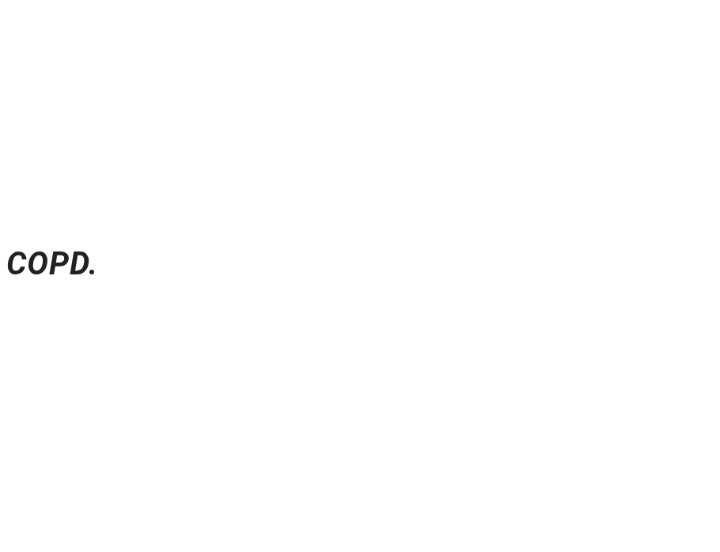
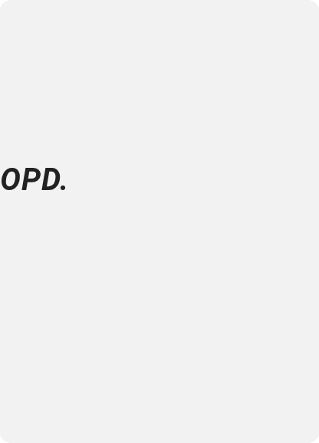

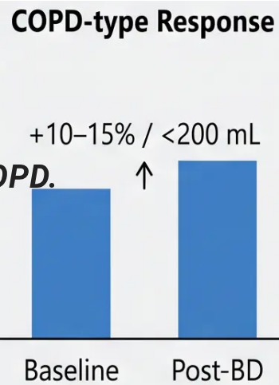
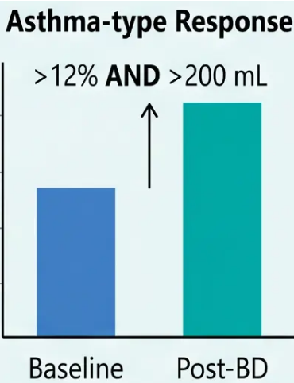
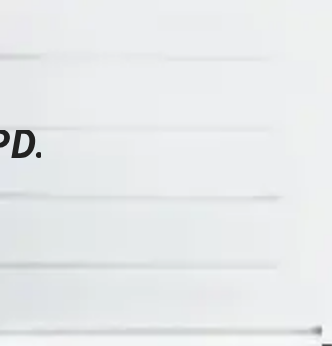



Interpreting Reversibility (NICE NG245)
Bronchodilator Reversibility — Diagnostic Threshold for Asthma
FEV1 increase of > 12% AND > 200 mL from baseline = Significant Reversibility
BOTH CRITERIA REQUIRED
Before and After Bronchodilator
The Two-Part Rule ✔ FEV1 increase > 12% from baseline
✔ FEV1 increase > 200 mL in absolute volume
Meeting only one criterion is not sufficient for diagnosis
CLINICAL SIGNIFICANCE
What It Suggests Significant reversibility points toward asthma rather than
However, reversibility tests can be inconsistent — serial peak flow monitoring
(14 days, >20% diurnal variation) is often more reliable for confirming asthma.
IMPORTANT NOTE
What It Does NOT Mean Partial reversibility (10–15%) is common in COPD and
is NOT diagnostically significant. The old threshold of >400 mL to distinguish COPD from
asthma is no longer recommended by NICE. “>400 mL threshold” → OBSOLETE
Baseline Post-BD
Baseline Post-BD
Bradford VTS · Spirometry Teaching Deck
26 / 37

Slide 27






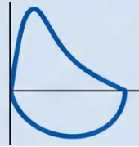
Case Study 1: Clive
*47-year-old male · 30 pack-year smoking history · Breathlessness and productive cough
INTERPRETATION
Spirometry Results
Obstructive Pattern
0.85 L
Why?
FEV₁
percentage
predicted
41%
• FEV₁/FVC ratio 43% — well below 0.70 threshold
• FVC near normal (79%) — air trapping not dominant here
1.97 L
FVC
percentage
predicted
79%
• FEV₁ markedly reduced at 41% predicted
43%
COPD SEVERITY (GOLD / NICE NG115)
FEV₁/FVC
GOLD Stage 3 — Severe
*Post-bronchodilator values — use for COPD diagnosis (NICE NG115)
*FEV₁ 30–49% predicted with FEV₁/FVC <0.70 post-bronchodilator
Symptoms present — productive cough, breathlessness —
consistent with COPD diagnosis at this severity.
Obstructive curve
AKT PEARL
Always use post-bronchodilator FEV₁/FVC to confirm COPD.
Pre-BD spirometry overestimates COPD prevalence by ~25%.
27 / 37
Bradford VTS

Slide 28






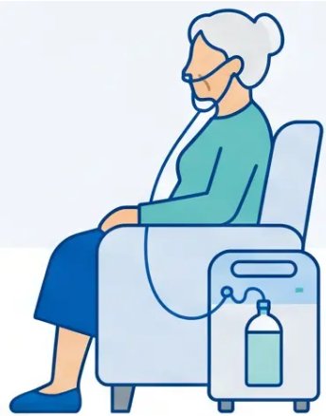

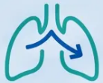


Case Study 2: Carol
*69-year-old female · Frequent admissions · Home oxygen*
AGE
69 years
0.94 L
2.39 L
39%
SEX
Female
56% predicted
115% predicted
Fixed ratio
threshold: <0.70
SMOKING
HISTORY
10 cigarettes/day
since age 21
FEV1 — Forced
Expiratory
Volume in 1 sec
FVC — Forced
Vital Capacity
FEV1/FVC
Ratio (FER)
CLINICAL
CONTEXT
Frequent hospital
admissions · Home
oxygen user
↓ Reduced
→ Normal / above
predicted
↓↓ Significantly
reduced
Home oxygen user —
consider clinical context
when interpreting values
SPIROMETRY PATTERN
DIAGNOSIS
GOLD SEVERITY
Obstructive
COPD — Moderate
GOLD 2
Post-bronchodilator FEV1/FVC <0.70 · NICE NG115
FEV1 50–79% predicted
Bradford VTS
28 / 37

Slide 29







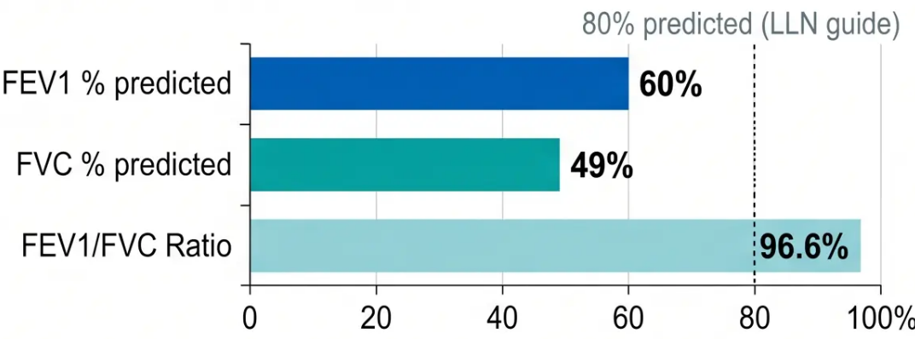

















Case Study 4: Sam
RESTRICTIVE
Restrictive Pattern — Preserved Ratio, Markedly Reduced FVC
Sam
20 pack-year smoking history
Breathless for 6 months
Restrictive result
Spirometry Results
Measurement
Value
% Predicted
FEV1
1.99 L
60%
FVC
2.06 L
49% Below LLN
FEV1/FVC Ratio
-
96.6% ✔
Clinical Interpretation
Pattern: Restrictive
● FEV1/FVC ratio is preserved at 96.6% — obstruction is NOT present
● FVC is markedly reduced at 49% predicted — well below LLN
📋 Normal ratio + reduced FVC = Restrictive pattern → refer for full lung function tests (TLC measurement) to confirm
Clinical Action: Refer for full lung function / TLC

Slide 30











CASE STUDY 08
Case Study 8: Paul
25 pack-year smoker · Dusty warehouse work · Breathless on exertion
Occupation: Dusty warehouse environment
Smoking: 25 pack years
Presentation: Breathlessness, 6 months
Pre-Bronchodilator
Post-Bronchodilator
Baseline
+ 34%
After Salbutamol
1.54 L · FEV1 (50% predicted)
2.06 L · FEV1 (67% predicted)
+520 mL
2.72 L · FVC (69% predicted)
3.35 L · FVC (85% predicted)
57% · FEV1/FVC (Obstructive)
62% · FEV1/FVC (Improved)
Post salbutamol 400mcg
(4 puffs via spacer, 20 min wait)
Obstructive Pattern
Significant Reversibility
★ AKT Pearl: >12% AND >200 mL = significant reversibility (NICE NG245)
FEV1 rose by 520 mL (+34%) — exceeds the NICE NG245 threshold of >12% AND >200 mL. Significant reversibility suggests
an asthma component, even in a long-term smoker. Post-bronchodilator is essential before confirming a COPD-only diagnosis.
Clinical Verdict
Bradford VTS
Respiratory
Services

Slide 31





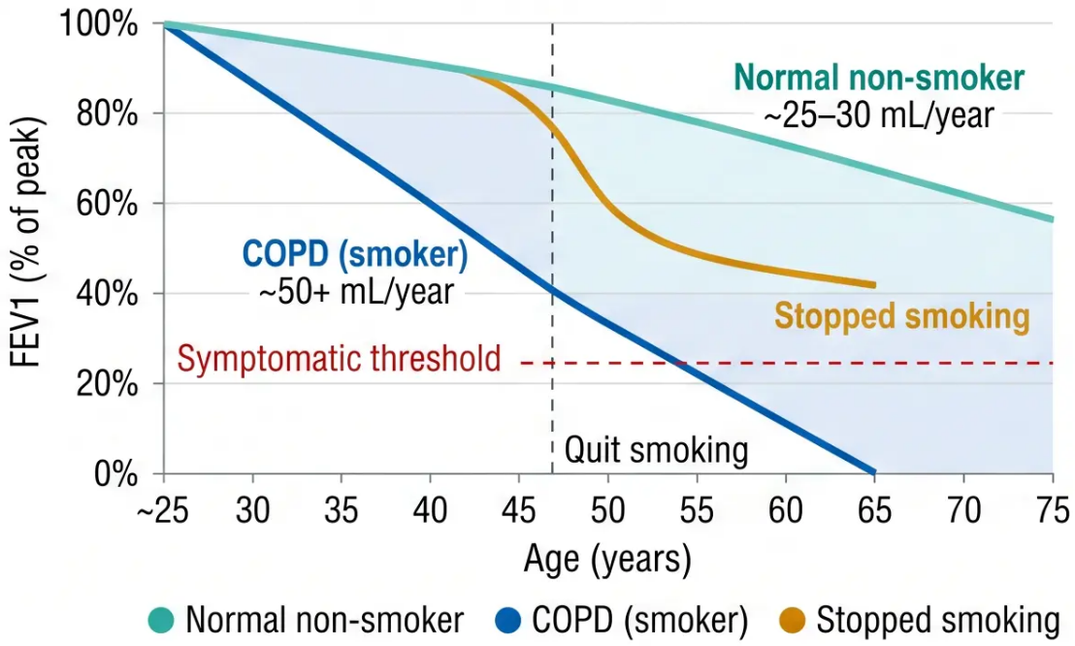







Annual FEV1 Monitoring
Tracking lung function decline over time in COPD
FEV1 declines with age — but in COPD, the decline accelerates. Annual spirometry
detects this early.
FEV1 Decline Over Time
Normal rate of FEV1 decline
~25–30 mL per year in healthy non-smokers
Accelerated decline in COPD
~50 mL/year or more — often doubles or triples
normal rate
Action threshold
Marked deterioration (>80 mL/year) — review
management urgently
Clinical note: Annual spirometry is a QOF requirement for
patients with COPD. Document trend, not just single
readings. A sudden drop between years is more significant
than absolute values.
31 / 37

Slide 32















Top Tips for Spirometry
PRACTICAL GUIDANCE
Use the
Highest Values
RVC Beats FVC
in Air Trapping
Post-BD
Spirometry is
Essential
Ditch Old Ethnic
Corrections
01
02
03
04
Take the highest FEV1 AND
highest FVC separately —
they may come from different
blows.
If relaxed VC exceeds FVC,
use RVC for ratio calculation
— more accurate result.
GLI Global 2022 race-neutral
equations are now standard —
Afro-Caribbean/Asian
adjustments are obsolete.
Always use post-bronchodilator
values to confirm COPD — pre-
BD overestimates by ~25%.
Reject Invalid
Traces
Symptoms
Required for
GOLD 1
Reversibility:
Both Criteria
Must Be Met
Low FVC +
Normal Ratio =
Restrictive
05
06
07
08
Poorly performed spirometry
is worse than no spirometry —
do not interpret suboptimal
blows.
Don't diagnose COPD on ratio
alone — GOLD stage 1 (FEV1
≥80%) requires symptoms to
be present.
Significant reversibility = FEV1
increase of >12% AND >200mL
— not just percentage alone
(NICE NG245).
Don't miss restriction — refer
for full lung function tests (TLC
measurement) to confirm.
Bradford VTS · Spirometry Teaching Deck
32 / 37

Slide 33
















AKT
Exam Pearls: AKT Focus
*Key diagnostic thresholds, COPD severity stages, and contraindications frequently tested in the RCGP AKT exam*
COPD Diagnosis
COPD Severity
Post-bronchodilator FEV1/FVC <0.70 confirms
COPD — always post-BD, never pre-BD alone
(NICE NG115)
FEV1 % predicted cut-offs: ≥80% Mild (GOLD 1)
· 50–79% Moderate (GOLD · Moderate (GOLD 2)
· 30-9% Severe (GOLD 3) · <30% Very Severe (GOLD 4)
RCGP AKT
Asthma Reversibility
Restrictive Pattern
Significant bronchodilator response = FEV1 >12%
AND >200 mL from baseline (NICE NG245,
2024) — both criteria must be met
Normal or elevated FEV1/FVC ratio + reduced FVC
= restrictive — refer for full lung function (TLC) to
confirm
Contraindications
Reference Equations
Recent MI (within 3 months), active
pneumothorax, unexplained haemoptysis,
unstable cardiac status, recent eye surgery
Old ethnic correction factors (Afro-Caribbean –13%,
Asian –7%) are obsolete — replaced by GLI Global
2022 race-neutral equations (ARTP, June 2025)
Bradford VTS · Spirometry Teaching Deck
Slide 33 of 37

Slide 34








EXAM PEARLS
SCA Focus
In the SCA, spirometry questions test how you communicate findings,
prepare patients, and document limitations — not just what you know.
Explaining Spirometry to Patients
Safety-Netting the Test
Communicating Results Clearly
· ‘I’m going to ask you to take the deepest
breath you can, then blow out as hard and
fast as possible into this tube — keep
blowing until I say stop.”
· Do not perform during an exacerbation
— reschedule when clinically stable
· Plain language: “Your breathing test shows
your lungs don’t empty as quickly as
expected — this can be a sign of a
condition called COPD”
· “If your breathing is worse than usual on
the day, let us know and we’ll rebook”
· Warn about dizziness or light-headedness
— reassure it is brief and normal
· If result is borderline or unexpected,
arrange repeat rather than acting on a
single test
· Avoid jargon: explain FEV1 as “the amount
of air you can push out in one second”
· Explain the need for 3 attempts: “We need
a few goes to get a reliable result”
· If technique was suboptimal: document
clearly — “Result limited by poor
effort/cough — repeat advised”
· Serial peak flows over 14 days (>20%
diurnal variation) more reliable for
asthma than a single reversibility test
· Mention inhaler withholding in advance:
“Please don’t use your blue inhaler for 4
hours before”
· Never act on a technically inadequate
trace without noting the limitation
SCA Examiner Insight: Marks are awarded for patient-centred communication, appropriate safety-netting, and honest
acknowledgement of test limitations — not just clinical accuracy.
Bradford VTS — Spirometry Teaching Deck
34 / 37

Slide 35




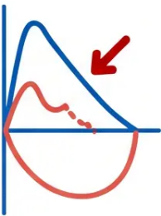





CLINICAL SAFETY
Red Flags in Spirometry
*Critical findings requiring urgent investigation or referral*
Isolated low FVC with normal FEV1/FVC ratio
Restrictive pattern — do not dismiss. Refer for full lung function testing including TLC measurement to
confirm restriction and investigate cause.
Rapid annual FEV1 decline (>80 mL/year)
Accelerated deterioration beyond expected COPD trajectory. Revend expected COPD trajectory. Review
management urgently — consider adherence, smoking status, alternative diagnosis, or comorbidity.
Haemoptysis in a patient with COPD
Spirometry is contraindicated. Do not proceed with the test.
Investigate urgently for malignancy — arrange CXR and urgent respiratory referral.
FEV1/FVC <0.70 in a symptomatic patient
Obstructive pattern confirmed — initiate COPD diagnostic pathway per NICE NG115.
Post-bronchodilator spirometry required before diagnosis is confirmed.
Unexpected result inconsistent with clinical picture
Consider suboptimal technique, artefact, or alternative diagnosis.
Do not interpret in isolation — repeat with optimal technique or refer for specialist lung function assessment.
Bradford VTS · Spirometry Teaching Deck
35 / 37

Slide 36











Common Pitfalls to Avoid
8 frequent errors in spirometry practice — know these for AKT and SCA
Using pre-bronchodilator values for
COPD diagnosis
Not using highest FEV1 and FVC separately
Overestimates COPD prevalence by ~25% — always
use post-BD spirometry
Best FEV1 and best FVC may come from different
blows — never take one blow only
Applying old ethnic correction factors
Diagnosing COPD on ratio alone in elderly
Fixed ratio <0.70 over-diagnoses COPD in patients
over 70 — symptoms must be present
Afro-Caribbean –13%, Asian –7% are obsolete — use
GLI Global 2022 race-neutral equations
Missing a restrictive pattern
Normal or elevated ratio with reduced FVC = restric-
tive — refer for full lung function (TLC)
Performing spirometry during exacerbation
Results will be falsely abnormal — reschedule when
patient is clinically stable
Ignoring suboptimal technique when
interpreting
Using 400mL threshold to distinguish
COPD from asthma
Always note technical quality — poorly performed
spirometry is worse than none
Current NICE NG245 standard: >12% AND >200mL
— not the old 400mL criterion
Respiratory
Services
Bradford VTS · Spirometry Teaching Deck · May 2026
36 / 37

Slide 37


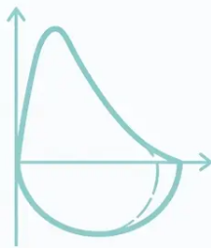














Quick Recall Summary
*Essential cut-offs, quality standards, and reference equations — revision-ready*
Obstructive Pattern
Restrictive Pattern
COPD Severity (GOLD 2026)
- FEV1/FVC < 0.70 post-bronchodilator
- Normal or elevated FEV1/FVC ratio
- GOLD 1: FEV1 ≥ 80% — Mild
- FEV1 reduced, FVC normal or reduced
- FVC reduced (below LLN)
- GOLD 2: FEV1 50–79% — Moderate
- Causes: ILD, kyphoscoliosis, obesity,
pleural disease
- GOLD 3: FEV1 30–49% — Severe
- Causes: COPD, asthma, bronchiectasis
- GOLD 4: FEV1 < 30% — Very Severe
- Confirm with TLC measurement
- (Post-BD FEV1/FVC < 0.70 required)
Bronchodilator Reversibility
Quality Standards (ARTP v6.5)
GLI 2022 Race-Neutral Equations
- Significant: FEV1 > 12% AND > 200 mL
- Min. 3 acceptable blows; up to 8 attempts
- Uses age, height, sex only — no race
adjustment
- Suggests asthma (NICE NG245, 2024)
- Reproducibility: FEV1 and FVC within 150 mL or 5%
- Replaces old Afro-Caribbean –13% / Asian –7%
- Blow duration: ≥ 6 seconds (adults)
- Not just 12% alone — both criteria required
- LLN = Z-score below –1.64 (5th percentile)
- COPD: partial response (10–15%), not
diagnostic
- Use HIGHEST FEV1 + HIGHEST FVC separately
- ARTP endorsed June 2025 for UK practice
- If RVC > FVC, use RVC for ratio
Bradford VTS · Spirometry Teaching Deck · May 2026 · ARTP v6.5 · NICE NG115 / NG245 · GLI 2022

