Slide 1
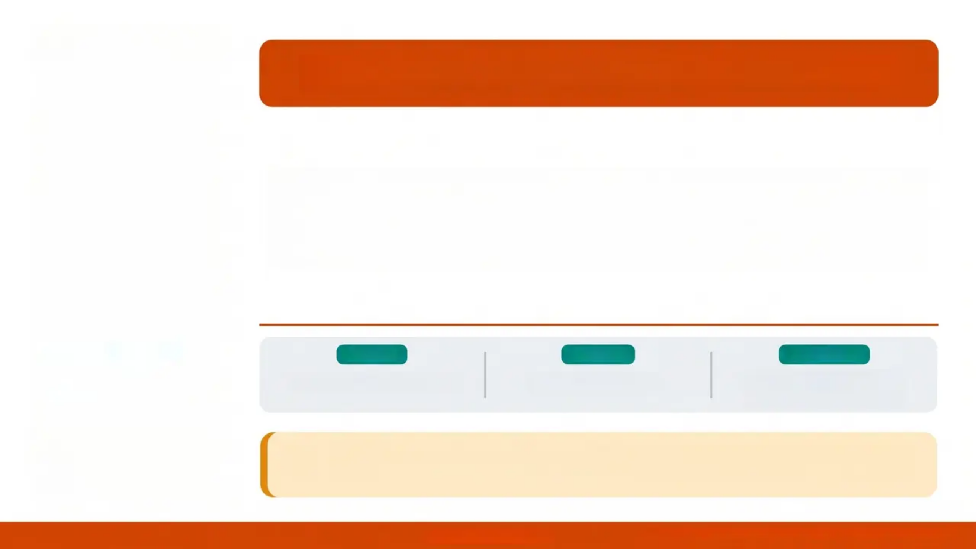

BRADFORD VTS TEACHING DECK
Child Protection & maltreatment
in General Practice
WEBSITE
UPDATED
STANDARDS
www.bradfordvts.co.uk
Created May 2026
NICE CG89 (Dec 2025) &
Working Together 2026
Disclaimer: Always double check this advice and drug doses with the
latest NICE/BNF guidance. This document is for educational purposes only.
Child Protection & Maltreatment • Bradford VTS • May 2026
www.bradfordvts.co.uk

Slide 2







Colour key:
💜 Purple = AKT focus
teal = SCA focus
🟠 Orange = Core clinical
Learning Objectives
By the end of this session, you will be able to...
Recognise Maltreatment
Apply the New Definition
Identify physical, emotional, sexual abuse
and neglect using NICE CG89 (December
2025) criteria
Use the updated NICE 2025 definition of
'independently mobile' correctly in clinical
assessment
Navigate SCA Scenarios
Excel in the AKT
Demonstrate professional curiosity, voice of
the child, and safe information sharing in
SCA consultations
Apply knowledge of Working Together 2026,
Section 47, FGM reporting, and FII
terminology to AKT questions
Understand the Framework
Document and Refer Safely
Describe the statutory and multi-agency
safeguarding framework under Working
Together 2026
Know when and how to refer, document, and
share information — without waiting for
certainty
Bradford VTS Teaching Deck • Child Protection & Maltreatment
www.bradfordvts.co.uk
Slide 3

Slide 3
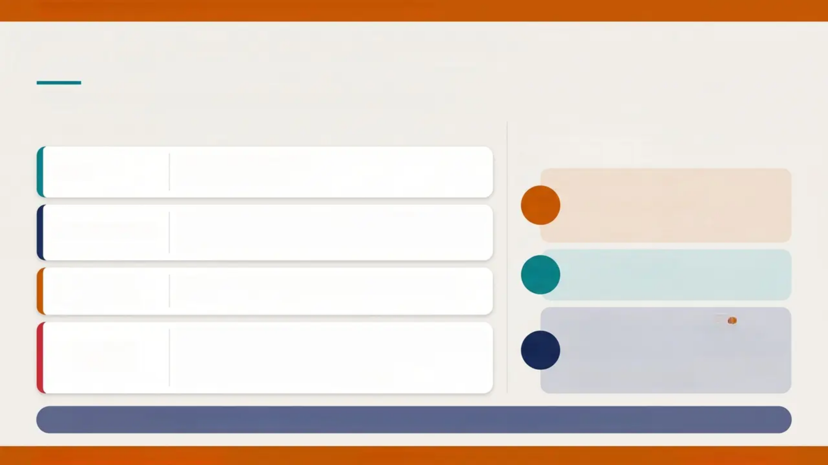
Definitions & Statutory Framework
Children Act 1989 & 2004 · Working Together to Safeguard Children 2026
Key Definitions
Legislative Pillars
Statutory Framework
CHILD
Any person under 18 years
Children Act 1989 & 2004
Children Act 1989
1989
• Child's welfare is paramount
• Section 17: children in need
• Section 47: duty to investigate
• Section 31: care & supervision orders
Protecting children from maltreatment; preventing impairment
of health or development; ensuring children grow up in safe,
effective care; taking action to enable optimal outcomes.
SAFEGUARDING
2004
Children Act 2004
CHILD
PROTECTION
Activity undertaken to protect specific children who are
suffering, or at risk of, significant harm.
Established Local Safeguarding Children Boards
(now replaced by Safeguarding Partnerships)
Working Together 2026
The threshold for compulsory intervention. Includes ill-
treatment and impairment of health or development. May be a
single severe incident or accumulation of concerns.
• Current statutory guidance (replaces 2023)
• Multi-Agency Safeguarding Arrangements (MASA)
• Safeguarding Partners: Local Authority, NHS ICB,
Police
• Child's welfare is paramount
SIGNIFICANT
HARM
2026
⚠️ This is the legal trigger for Section 47 enquiry
💡 Key Principle: The child's welfare is the paramount consideration — Children Act 1989, s.1
Slide 4 · Definitions & Statutory Framework
www.bradfordvts.co.uk
Bradford VTS · May 2026

Slide 4







CATEGORIES OF MALTREATMENT
NICE CG89 · Updated December 2025
Recognising all forms of harm — know these for AKT and SCA
AKT + SCA
Physical Abuse
Emotional Abuse
Hitting, shaking, throwing, burning, scalding, poisoning, suffocating
Includes Fabricated or Induced Illness (FII) — updated term
Persistent ill-treatment causing severe adverse effects on development
Includes witnessing domestic abuse · threats · making child feel worthless
FII replaces Munchausen by Proxy
AKT: Most common with neglect
Sexual Abuse
Neglect
Contact and non-contact acts · grooming · online exploitation
Under 13: MUST report — no capacity to consent in law
Persistent failure to meet basic physical and psychological needs
Most common category in England — includes medical neglect
SCA: direct disclosure = immediate action
Pitfall: DNA pattern = safeguarding concern
Child Sexual Exploitation (CSE)
CCE / County Lines
Coerced or manipulated in exchange for gifts, money, affection, drugs
Always abuse — regardless of apparent consent
Coercion into criminal activity · cuckooing · drug running
Home Office 2018 definition — look for unexplained absences
⚠️ FGM — Mandatory reporting for ALL healthcare professionals · Girls under 18 · Must report to Police
Bradford VTS Teaching Deck · Child Protection & Maltreatment in General Practice
www.bradfordvts.co.uk
Slide 5 · NICE CG89 December 2025

Slide 5





BRADFORD VTS • CHILD PROTECTION & MALTREATMENT IN GENERAL PRACTICE
SECTION 2 — EPIDEMIOLOGY
🎯 AKT
Prevalence & Epidemiology
These figures may
appear in SBA questions
~50,000
~180,000
1 in 5
children currently on Child
Protection Plans in England
Section 47 enquiries per
year in England
children in the UK have
experienced abuse (NSPCC)
Child Protection Plans by Category (England, 2024–25)
Neglect
Emotional Abuse
Physical Abuse
Sexual Abuse
Multiple / Other
Most common category
Second most common
~9% of CPPs
~5% of CPPs
Combined remainder
Source: NICE CG89 (December 2025) • Working Together to Safeguard Children 2026 • NSPCC
www.bradfordvts.co.uk
Prevalence & Epidemiology
Slide 6 of 36 • Bradford VTS 2026

Slide 6
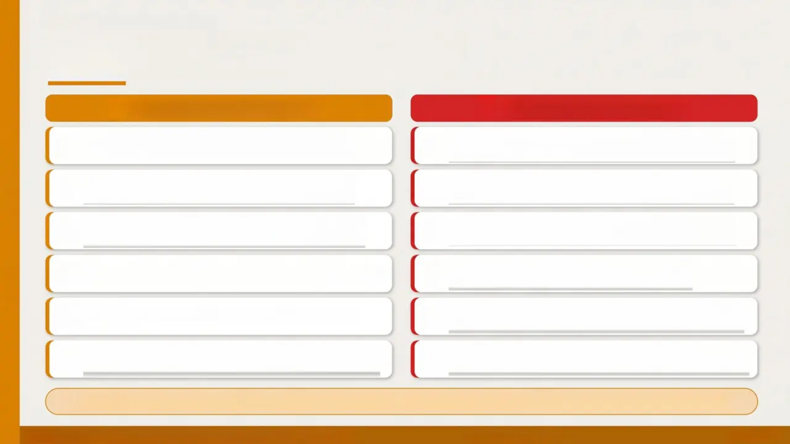














SAFEGUARDING AWARENESS
Risk Factors & High-Risk Situations
Knowing who is at risk helps you ask the right questions
High-Risk Family Factors
High-Risk Clinical Flags
Domestic abuse – co-occurs in 30–60% of child
maltreatment cases
Previous child on CPP or care proceedings –
strongest predictor
Parental substance misuse – alcohol or drug
dependency
Schedule 1 offender in household – automatic
heightened concern
Parental mental illness – especially severe and
enduring conditions
Previous domestic abuse incidents – police or
GP records
Parent who was themselves abused –
intergenerational pattern
Social exclusion / poverty – isolation amplifies risk
Severe and enduring parental mental illness –
risk to supervision
History of abuse in parent's own childhood
Young, isolated, or concealed pregnancy – late
booking a warning sign
Parental learning disability – may need additional
support, not automatic risk
'Think Family' – When seeing any adult with substance misuse, mental illness, or domestic abuse: 'Are there children at home?'
Bradford VTS Teaching Deck • Child Protection & Maltreatment in General Practice
www.bradfordvts.co.uk
Slide 7 of 36

Slide 7





BRADFORD VTS TEACHING DECK · Child Protection & Maltreatment in General Practice
CONTEXTUAL RISK
Sources of Stress for Families
Understanding the context — stress does not cause abuse, but increases vulnerability
Social & Economic
Parental Factors
Family & Relationship
• Poverty and financial
hardship
• Poor or overcrowded
housing
• Social exclusion and
isolation
• Unemployment or
precarious work
• Mental illness or depression
• Substance misuse /
alcohol dependency
• History of abuse in parent's
own childhood
• Young or single parenthood
• Learning disability
• Domestic abuse in the
household
• Relationship breakdown
or conflict
• Lack of social support
network
• Concealed pregnancy /
late booking
Stressors accumulate — no single
factor predicts maltreatment
⚠️ Professional Curiosity: When you see these stressors in an adult patient — always ask: ‘Are there children in this household?’
Bradford VTS Teaching Deck · Child Protection & Maltreatment
www.bradfordvts.co.uk
Slide 8 of 36

Slide 8


RECOGNITION — GENERAL CLINICAL FEATURES
NICE CG89 · December 2025
Consider maltreatment in any child where one or more of the following apply
HISTORY & PRESENTATION
INJURY & BEHAVIOUR
Delayed presentation — days or weeks after
injury
Unusual injury site — ears, neck, abdomen,
buttocks, genitalia
Changing or inconsistent history — story
changes between contacts
Bruises of different ages or shapes — suggests
repeated incidents
History incompatible with developmental
stage — e.g., 'he rolled off the sofa' for a 6-week-old
Previous suspicion or record of abuse —
check cumulative records
Signs of domestic violence in household —
co-occurrence is common
Injury inconsistent with described mechanism
— force or pattern doesn't match story
Child appears fearful or overly compliant —
trust your instinct
KEY SIGN
AKT EXAM PEARL
Frozen Watchfulness
Frozen watchfulness is a highly testable clinical sign.
Also watch for: carer with unrealistic expectations, child
giving their own disclosure, and injury patterns that
change across consultations.
Child becomes hypervigilant — unnaturally still,
scanning the environment for threats.
Classic sign of chronic, repeated abuse. Trust this sign.
Child Protection & Maltreatment in General Practice
www.bradfordvts.co.uk
Slide 9 of 36

Slide 9

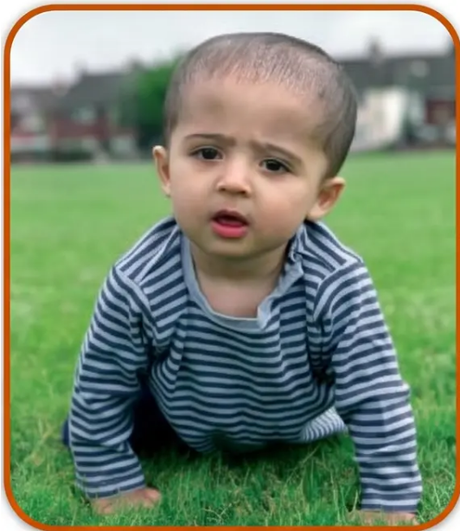


NICE CG89 — DECEMBER 2025 KEY UPDATE
‘Independently Mobile’ — New Formal Definition
NICE CG89 updated 3 December 2025 · Consensus-based definition
A child IS ‘independently mobile’ if they can do ANY of the following:
✔ Crawl
✔ Bottom shuffle
✔ Pull to stand using furniture
✔ Stand unaided
✔ Cruise (move holding an object)
✔ Climb
✔ Walk using a push-along walker
✔ Walk unaided
Crawling = independently mobile (NICE 2025)
AKT Exam Focus
If a child is NOT independently mobile → bruising,
abrasions, or thermal injuries are far more likely to
represent maltreatment.
Document specific motor skills present — not just ‘mobile’ or
‘non-mobile’. Required for clinical and legal defensibility.
Relevant to NICE CG89 Recommendations 1.1.2, 1.1.5, and 1.1.6
Document exactly: e.g., ‘Can roll but cannot crawl, bottom shuffle, or pull to stand’ — vague terms are no longer acceptable.
NICE CG89 · December 2025 Update
www.bradfordvts.co.uk
Slide 10 of 36 · Bradford VTS Teaching Deck

Slide 10
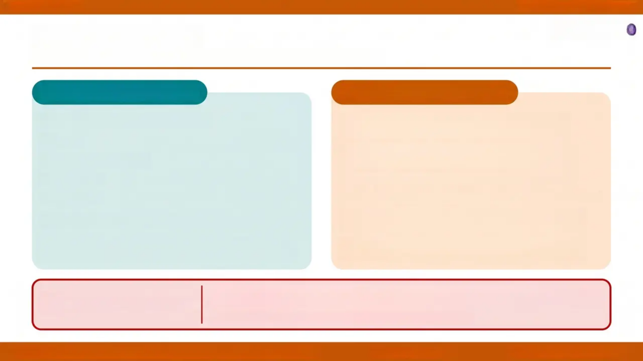

NICE CG89 · December 2025
Bruising Patterns
AKT Focus
When should bruising raise concern for maltreatment?
WHERE is the bruise?
WHAT does it look like?
Face, ears, or behind the ears
Patterned bruising — hand-print, belt mark,
ligature mark, loop mark
Neck
Multiple bruises of different ages — implies
repeated events
Abdomen or back
Buttocks
Bruises in clusters — grouped, not scattered
Genitalia
Petechiae — without adequate medical explanation
Bruises of unusual shape — geometric, linear,
object-shaped
Frenulum (inner upper lip — infant)
Accidental bruises typically occur on bony prominences —
shins, forehead, knees.
Bruising in a child NOT independently mobile
(see Slide 12)
Any bruise in a child who is NOT independently mobile requires immediate
escalation — document specific motor milestones, not just ‘mobile’ or ‘non-mobile’.
KEY CLINICAL RULE
NICE CG89 updated December 2025 · Recs 1.1.2, 1.1.5, 1.1.6
Bradford VTS Teaching Deck · Child Protection & Maltreatment in General Practice
www.bradfordvts.co.uk
Slide 11 · NICE CG89 Dec 2025

Slide 11
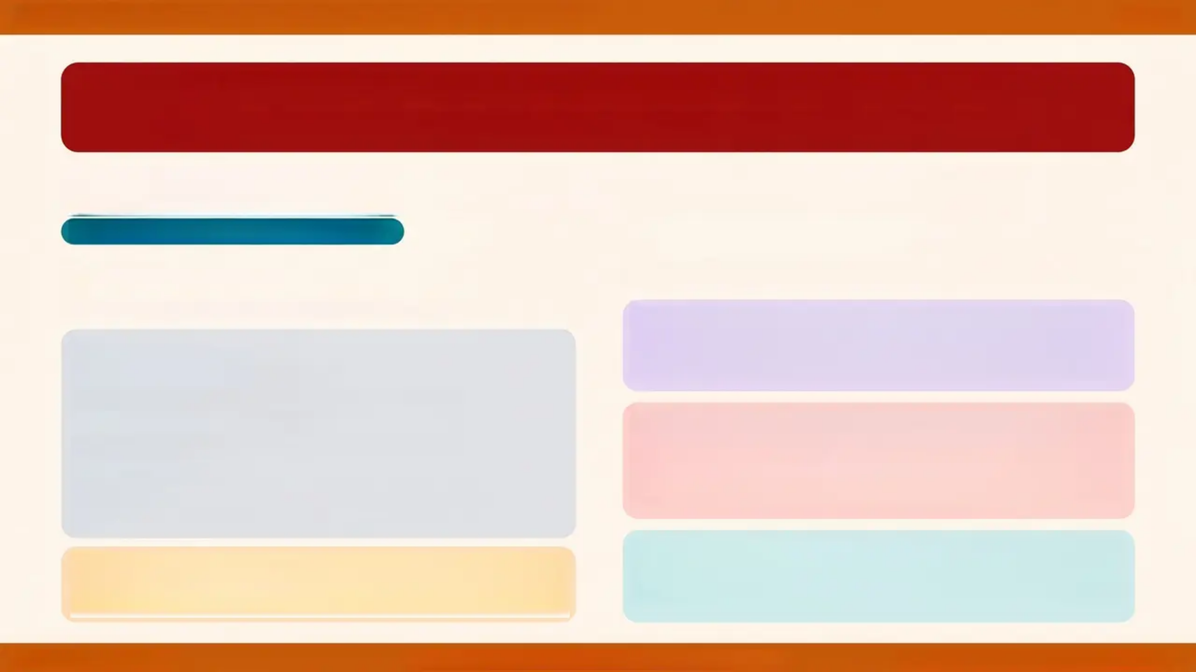



BRADFORD VTS · Child Protection & Maltreatment in General Practice
Slide 12
ANY BRUISE IN A PRE-MOBILE INFANT = RED FLAG
Refer same day to Children's Social Care. Do not wait for certainty.
Bruising in Non-Independently Mobile Infants
NICE CG89 · Updated December 2025
DOCUMENT SPECIFICALLY
AKT EXAM FOCUS
Not just 'mobile' or 'non-mobile' — be precise
**Clinical Significance** A pre-mobile infant with any
bruise has no plausible accidental mechanism.
Bruising = maltreatment until proven otherwise.
Can the infant crawl?
Can they bottom shuffle?
Can they pull to stand using furniture?
Can they stand unaided?
Can they cruise (hold object to move)?
Can they climb?
Can they walk with a push-along walker?
Can they walk unaided?
**Legal Defensibility** Vague terms like 'non-mobile'
are no longer acceptable. NICE Dec 2025 requires
specific motor skill documentation for CG89
recommendations 1.1.2, 1.1.5, and 1.1.6.
If NONE of the above — child is NOT independently
mobile. Document the specific skills present, e.g.: 'Can roll
but cannot crawl, bottom shuffle, or pull to stand.'
**SCA Pearl** In the consultation, directly observe
and record what the infant can do. Ask the carer to
demonstrate. Note the verbatim in the record.
www.bradfordvts.co.uk
NICE CG89 (December 2025) · Working Together 2026
Bradford VTS Teaching Deck · May 2026

Slide 12






Burns, Scalds, Bites & Fractures
Non-Accidental Injury — Key Clinical Patterns
Burns & Scalds
Bites
Fractures
Key Principles
'Glove or stocking'
distribution
• Symmetrical burns on
hands / feet / buttocks
• 'Hole in doughnut' scald
• Clear-edged contact
burns – e.g.
(cigarette, iron)
• Burns at unusual sites
• Any burn in a pre-mobile
infant without clear
accidental cause
• Human bites: crescent-
shaped double arches
with crushing injury
• Rarely break skin, but
leaving a clear patter
• Adult bites larger than
child, forensic significance
• Animal bites, different
patterns
• Bite locations to like
torso, genitalia, buttocks
• Photograph and refer
urgently for forensic
• Posterior rib fractures:
HIGH specificity for abuse
• Classic metaphyseal
'corner' fractures
• Spiral fractures in
pre-mobile infants
• Multiple fractures of
different ages
• Presents as limp,
reluctance to move, or
unexplained swelling
• Require urgent paediatric
assessment
• Delayed presentation
• Changing history
between contacts, red flag
• Document specific
erectic motor skills
• Any injury in pre-mobile
infant requires same-day
paediatric referral
• Ring named/designated
doctor if uncertain (do not
investigate alone)
• Photograph injuries where
possible with consent
Pre-mobile infant + any burn
= immediate referral
Adult bite on a child =
forensic referral
Posterior rib fractures = non-
accidental until proven otherwise
Ring named doctor first —
refer, don't investigate
Red = Red Flag • Purple = AKT Focus • Teal = SCA Focus • Amber = Pitfall
Bradford VTS Teaching Deck — Child Protection & Maltreatment
www.bradfordvts.co.uk
Slide 13 · NICE CG89 Dec 2025

Slide 13





PHYSICAL ABUSE · SLIDE 14 OF 36
Fabricated or Induced Illness (FII)
Formerly known as Munchausen Syndrome by Proxy
AKT EXAM FOCUS
TERMINOLOGY UPDATE
'Munchausen Syndrome by Proxy' is now obsolete. The correct and current term is Fabricated or Induced Illness (FII). Use FII
in clinical records, referrals, and AKT/SCA answers.
How to Recognise FII
What To Do
Recognition Features
Management Approach
— Repeated unexplained symptoms or illnesses
— Multiple A&E attendances with no clear diagnosis
— Symptoms present only when the carer is with the child
— Signs and symptoms improve when child is separated from carer
— Carer appears over-concerned — or unusually calm despite serious
presentations
— Investigations repeatedly normal
— Child has been seen by many specialists without resolution
— Carer has medical knowledge or healthcare background (sometimes)
— Do NOT confront the carer directly — this may cause harm
— Discuss with Named/Designated Doctor for Child Protection first
— Refer to Children's Social Care — multi-agency approach
essential
— Paediatric admission may be needed for observation
— Covert inpatient observation may be required in some cases
— All agencies must share information carefully and coordinately
— Document all presentations, attendances, and concerns
chronologically
AKT Pearl: FII comes to light after multiple unexplained presentations — not
usually after a single visit. Think pattern, not episode.
NICE CG89 / Intercollegiate 2025
Bradford VTS Teaching Deck · Child Protection & Maltreatment in General Practice
www.bradfordvts.co.uk
Slide 14 of
36

Slide 14

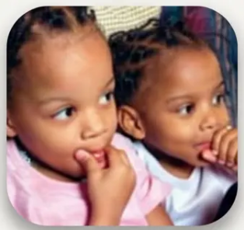







BRADFORD VTS · CHILD PROTECTION & MALTREATMENT
Slide 15 of 36
Emotional Abuse — Features by Age Group
NICE CG89 | Indicators vary by developmental stage — know all four
INFANTS
PRE-SCHOOL
SCHOOL AGE
TEENAGERS
• Failure to thrive (FTT)
• Poor attachment to
carer
• Multiple A&E
attendances
• Developmental delay
• Short or light for age
• Language delay
• Overactive or
aggressive behaviour
• Indiscriminate
friendliness
• Learning difficulties
• Low self-esteem
• Soiling / enuresis
• Poor peer
relationships
• Destructive behaviour
• Truancy and running
away
• Self-harm
• Substance misuse
• Sexual risk-taking
behaviour
• School failure
⚠️ Pitfall: Emotional abuse is rarely the sole presenting complaint — it manifests as a pattern across multiple contacts.
Look at the cumulative picture.
www.bradfordvts.co.uk
Child Protection & Maltreatment in General Practice
Bradford VTS · May 2026

Slide 15
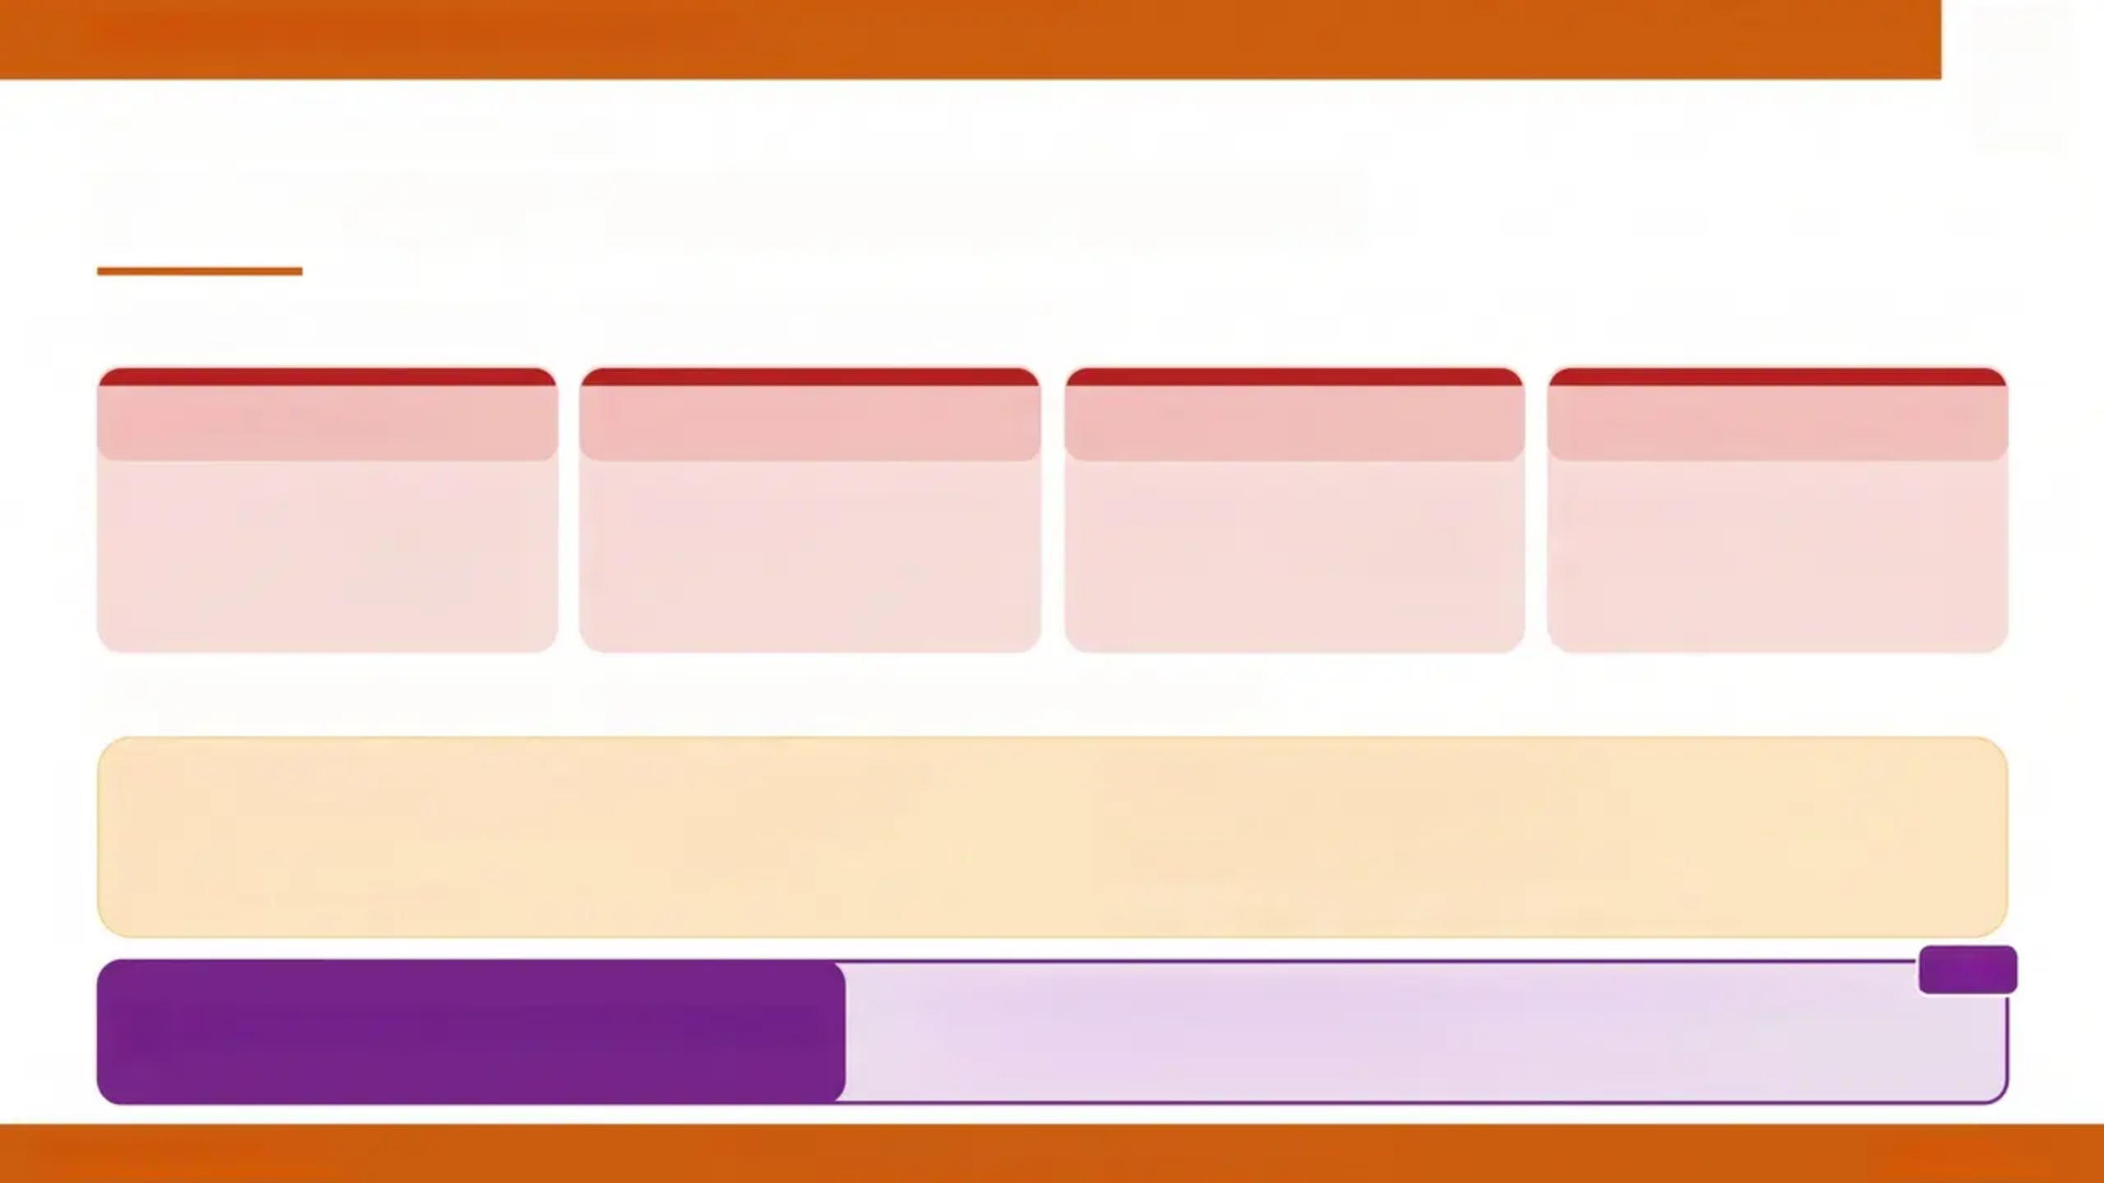





BRADFORD VTS TEACHING DECK
SEXUAL ABUSE • RECOGNITION
Sexual Abuse — Recognition Features
STRONG INDICATORS — Consider Maltreatment
Direct Disclosure
STI in Prepubertal Child
Pregnancy
Sexualised Behaviour
Child states abuse has
occurred — take seriously,
document verbatim, do not
probe
Any sexually transmitted
infection in a child who has
not reached puberty requires
urgent investigation
Pregnancy in any child,
especially under 13 — must
be reported regardless of
circumstances
Age-inappropriate
sexualised language, play, or
behaviour beyond normal
developmental curiosity
ASSOCIATED FEATURES — Less Specific, Require Context
• Genital or anal trauma or unexplained infection
• Enuresis or encopresis (especially new onset)
• Sleep disturbance, nightmares, bedwetting
• Somatic complaints — headaches, abdominal pain
• Self-harm or suicidal ideation
• Withdrawal or sudden behavioural change
• Depression or anxiety in a child
• Running away from home or truancy
Under 13: Sexual activity MUST be reported — no legal capacity to consent.
Age 13–16: Apply Fraser competence and GMC 0–18 guidance.
You CANNOT promise absolute confidentiality to a parent or carer.
AKT
AKT PEARL — Confidentiality Rule
www.bradfordvts.co.uk
Child Protection & Maltreatment in General Practice
Slide 16 of 36

Slide 16
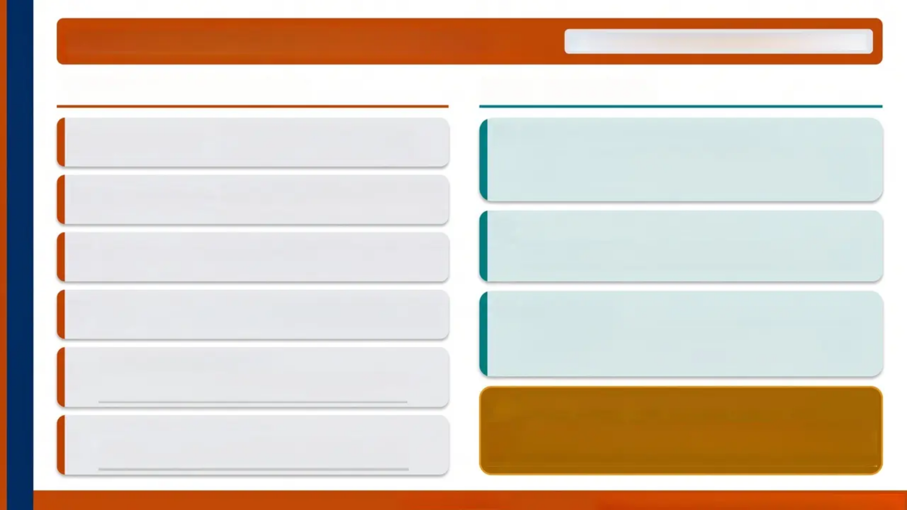











Neglect — Features and GP Role
NICE CG89 - Most Common Category in England
Recognising Neglect
The GP's Role
Poor Hygiene
Consistently dirty, unwashed, or
inadequately clothed for weather
Persistent Non-Attendance (DNA)
Repeated 'Did Not Attend' entries for a child are a
safeguarding pattern — not just an admin issue. Review the
cumulative record, not isolated appointments.
Dental Neglect
Untreated dental caries — one of the
most visible indicators in primary care
Immunisation & Health Checks
Persistent FTT without organic cause
— weight and height consistently low
Failure to Thrive
Persistent failure to attend immunisation or developmental
checks — flag and escalate. Do not just rebook passively.
Withheld Medication
Think Family
Essential medications not given
— e.g., insulin, inhalers, prescribed treatments
When seeing adults with substance misuse, mental illness,
or domestic abuse — always ask: Are there children at
home? Are their basic needs being met?
Deprivation Hands/Feet
Cold, red, swollen extremities from chronic
Exposure and inadequate shelter
Common Pitfall — Don't Just Code ‘DNA’
Preventable Accidents
Persistent non-attendance IS a safeguarding concern. Every repeated
DNA for a child should prompt a safeguarding review — not just a rebooked
appointment. Document the pattern explicitly in the clinical record.
Injury patterns suggesting inadequate
supervision — repeated A&E attendances
www.bradfordvts.co.uk
Bradford VTS Teaching Deck • Child Protection & Maltreatment

Slide 17
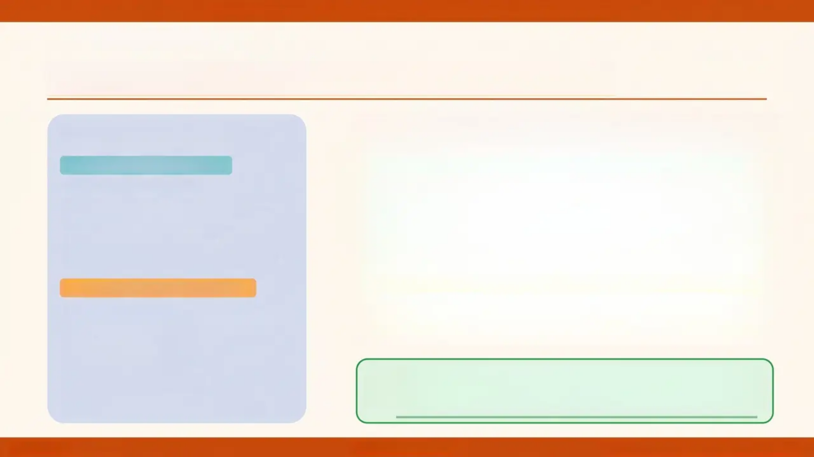
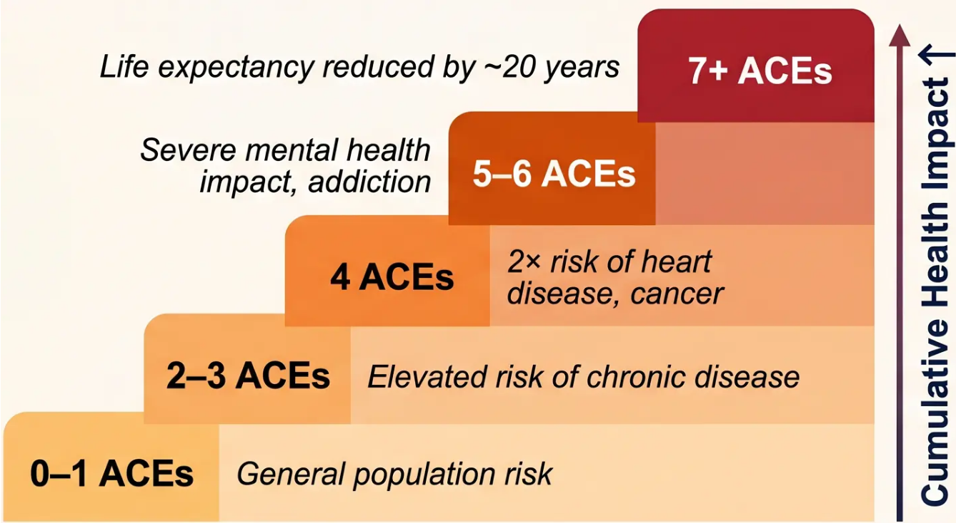

BRADFORD VTS • CHILD PROTECTION & MALTREATMENT IN GENERAL PRACTICE
LONG-TERM IMPACT
Adverse Childhood Experiences (ACEs)
The 10 ACE Categories
HOUSEHOLD CHALLENGES
• Domestic abuse
• Parental substance misuse
• Parental mental illness
• Parental separation
• Household member in prison
DIRECT CHILD MALTREATMENT
• Physical abuse
• Emotional abuse
• Sexual abuse
• Physical neglect
• Emotional neglect
GP opportunity: ACEs are not destiny — early
intervention, trauma-informed care, and strong social
support can significantly buffer long-term harm.
Source: Felitti et al. (1998) — ACE Study
Slide 18
www.bradfordvts.co.uk
Bradford VTS Teaching Deck • May 2026

Slide 18








THE GP'S ROLE · WORKING TOGETHER 2026
www.bradfordvts.co.uk
SAFEGUARDING RESPONSIBILITIES
The GP's Role in Safeguarding
Longitudinal Family
Knowledge
Well-Child &
Immunisation Contacts
First Point of Contact
Families turn to their GP before any
other service — often the earliest
opportunity to identify concern
Continuous awareness of family
dynamics, history, and patterns
across multiple contacts and siblings
Routine appointments are active
safeguarding opportunities —
observe, assess, and document
Home Visits
Attend Case
Conferences
Respond to Section 47
Enquiries
HV and district nurse contacts
reveal home environment — living
conditions, supervision, family
dynamics
Your longitudinal view is invaluable.
If unable to attend — send a written
report. Non-engagement is not
acceptable
Local authority has a duty to
investigate suspected significant
harm — GPs must contribute
promptly and fully
Do not take situations at face value. Look beyond the
presenting complaint. Think Family with every contact.
Professional Curiosity Principle
Bradford VTS Teaching Deck · Child Protection & Maltreatment in General Practice
www.bradfordvts.co.uk
Slide 19 · Working Together 2026

Slide 19








What does it look like in practice?
Look beyond the presenting problem
The injury, the symptom — what is the context behind it?
PROFESSIONAL
CURIOSITY
Ask direct questions despite discomfort
Silence or avoidance is not professional curiosity
Challenge inconsistent or implausible explanations
A changing history is a red flag, not a minor discrepancy
Looking beyond the
presenting complaint
Consider the child's perspective
Even when the adult is your patient — always think: what is the child's experience?
A core safeguarding principle
Think about impact on children in the household
Adult mental illness, substance misuse, domestic abuse — who else is at home?
THINK FAMILY PRINCIPLE
When seeing adults with mental illness, substance misuse, or domestic abuse —
always ask: Are there children in this household?
www.bradfordvts.co.uk
Child Protection & Malreatment in General Practice
Slide 20 of 36

Slide 20
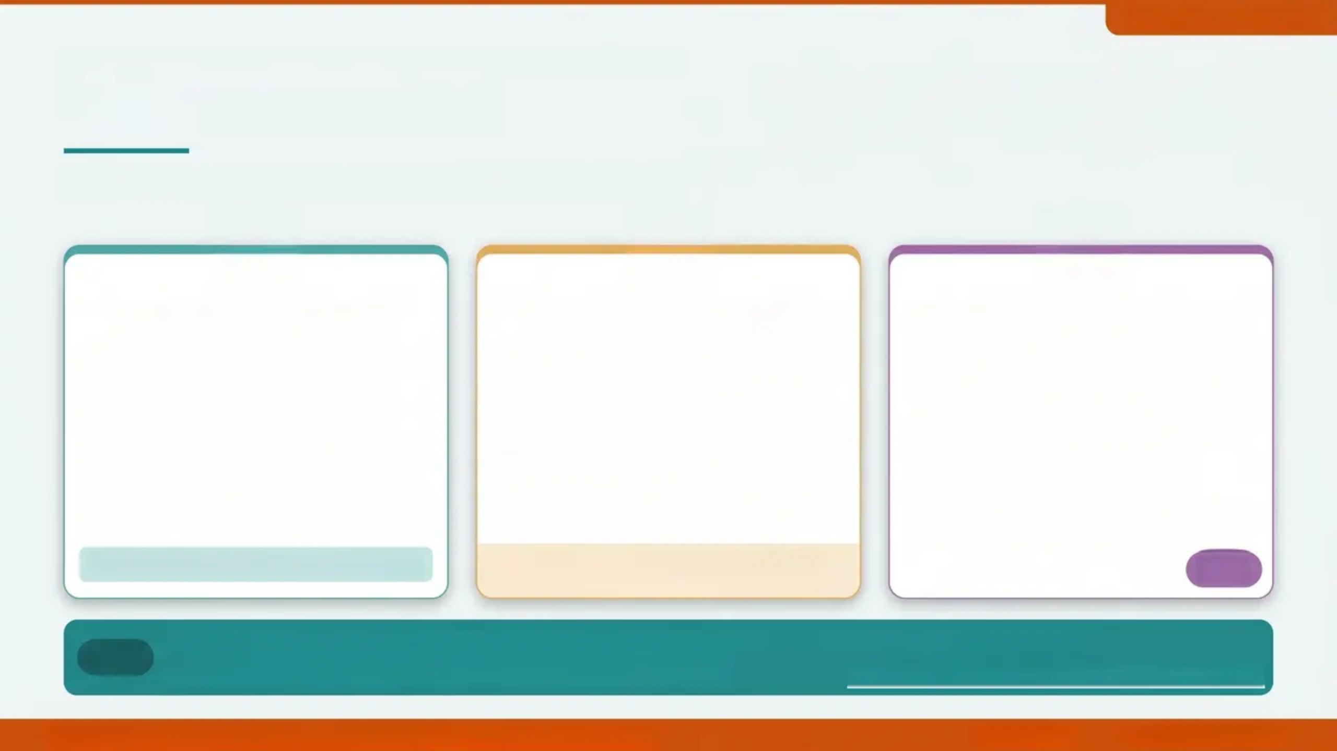



www.bradfordvts.co.uk
SAFEGUARDING COMPETENCY • RPCCH INTERCOLLEGIATE 2025
Voice of the Child
Hearing, recording, and respecting what children tell us
Capture Their Words
Ask Without Leading
Observe Non-Verbal Cues
Use direct verbatim quotes in clinical records
Write exactly what the child said, in
quotation marks
Note the child's own language — do not
paraphrase
Record who was present during the
conversation
Use open-ended questions only
'Can you tell me more about that?' not
'Did someone hurt you?'
Do not coach, suggest, or prompt answers
See the child alone where age-appropriate
Do not promise absolute confidentiality
Child's demeanour entering the room
Interaction with the accompanying carer
Eye contact, flinching, or withdrawal
Does the carer speak for the child
throughout?
Frozen watchfulness — unnaturally still,
hypervigilant
Closed or leading questions can compromise
later legal proceedings
“She said: ‘Daddy hits me when he’s cross.’”
AKT
SCA
In the SCA: Document the child's account verbatim. Note if the parent answers every question.
Show professional curiosity — ask to see the child alone.
RPCCH Intercollegiate Document 2025 — Core Competency
Bradford VTS Teaching Deck • Child Protection & Maltreatment in General Practice
Slide 21 of 36
www.bradfordvts.co.uk

Slide 21
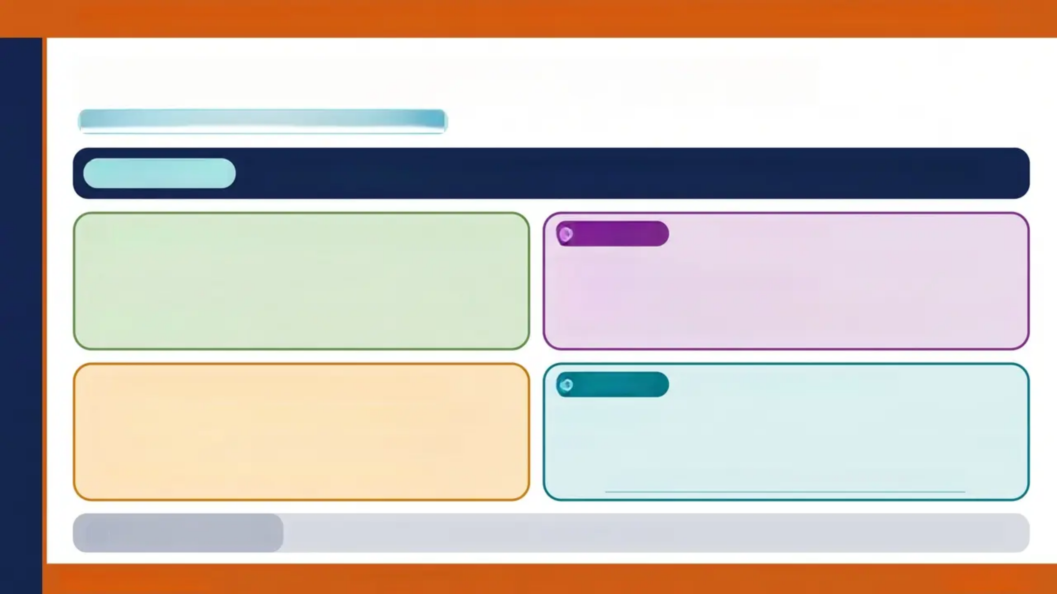





BRADFORD VTS TEACHING DECK • CHILD PROTECTION & MALTREATMENT IN GENERAL PRACTICE
Confidentiality and Information Sharing
Legal & Ethical Framework • GDPR • GMC Guidance
CORE PRINCIPLE
AKT FOCUS
Legal Basis
Information CAN & SHOULD be shared when:
• Child is at risk of significant harm
• Child is suffering abuse
• Public interest in preventing serious crime
• Data Protection Act 2018 / GDPR — safeguarding provisions
• GMC 0-18 guidance — duty to share
• Under-13s: sexual activity MUST be reported (no capacity to consent)
• Ages 13-16: clinical judgment + Fraser competence
Parental Consent NOT Required when:
SCA FOCUS
What to Say to the Carer
• Seeking consent would put child at further risk
• Consent-seeking would impede the enquiry
• Case involves potential significant harm
“I have a legal duty to share this information to keep [child's name] safe.”
“I cannot promise absolute confidentiality when a child’s safety is at risk.”
Never apologise for sharing — you have a legal duty.
ALWAYS DOCUMENT:
Record your reasoning — whether you disclosed or decided not to, and why. Date, time, who was informed.
www.bradfordvts.co.uk
Child Protection & Maltreatment in General Practice
Slide 22 of 36

Slide 22



BRADFORD VTS TEACHING DECK · Child Protection & Maltreatment in General Practice
When to Refer — Thresholds
AKT FOCUS
Know the difference:
S.17 vs S.47
REFERRAL DECISION FRAMEWORK · WORKING TOGETHER 2026
SAME-DAY REFERRAL
CONSULT FIRST
Children's Social Care — do not delay
Named / Designated Doctor — then decide
• Any suspicion of significant harm
• Child in immediate danger
• Unexplained injury in a pre-mobile infant
• Child's direct disclosure of abuse
• FGM identified or suspected — girl under 18
• Pregnancy or STI in a child under 13
• Any case where delay could increase risk
• Posterior rib fractures identified
• Ambiguous presentations — no clear pattern
• Single concern without cumulative context
• Complex family situations
• Uncertain whether threshold is met
• Need for specialist paediatric opinion
• Clarifying whether Section 17 or Section 47
applies
Refer if concerned. Children's Social Care investigate — not the GP.
Document the advice received — date, time, clinician name.
Child unlikely to achieve reasonable health/development without LA
services — refer to Children's Social Care for support, not investigation.
LOWER THRESHOLD — Section 17 (Child in Need)
BRADFORD VTS · Child Protection & Maltreatment in General Practice
www.bradfordvts.co.uk
Slide 23 of 36

Slide 23



BRADFORD VTS · CHILD PROTECTION & MALTREATMENT IN GENERAL PRACTICE
STATUTORY DUTIES
Section 47 Enquiries & Child Protection Conferences
Section 47 — What Is It?
CP Case Conferences — Your Role
• Triggered when local authority has reasonable cause to
suspect a child is suffering or likely to suffer significant
harm
• Initial CP Conference: convened within 15 working days of
Section 47 strategy discussion
• Review CP Conference: at least every 6 months while
child is on a Child Protection Plan
• Local authority has a statutory duty to investigate
• GP's role: respond promptly to requests for information
• Provide factual written information from clinical records
• Attend strategy discussions if invited
• GP should attend or send a comprehensive written report
• Your longitudinal family knowledge is legally required –
non-engagement must be explained in writing
• Conference decides whether to place child on a Child
Protection Plan (CPP)
AKT FOCUS
Section 47 = “significant harm” threshold.
Section 17 = “child in need” (lower threshold).
Know the difference for SBA questions.
SCA FOCUS
In SCA: never say “I’ll just refer and let them deal with it.”
Know you will contribute a written report and stay involved.
COMMON PITFALL
KEY PRINCIPLE
Not attending or sending a written report is not acceptable. Your
input is a legal requirement – document why if you cannot attend.
You investigate nothing – Children’s Social Care investigates.
Your role is to inform, contribute, and safeguard.
www.bradfordvts.co.uk
Child Protection & Maltreatment in General Practice
Slide 24 of 36

Slide 24







Child Protection & Maltreatment in General Practice
STATUTORY FRAMEWORK
Working Together 2026
AKT FOCUS
Multi-Agency Safeguarding Framework
Child's welfare is paramount
Children Act 1989, s.1 — core legal principle
Three Safeguarding Partners
Local Authority
NHS Integrated Care Board
Police
• Lead agency for child protection
• Conducts Section 47 enquiries
• Chairs safeguarding arrangements
• Coordinates health sector response
• Includes GP, hospital & community
services
• Replaces NHS England local role
• Joint responsibility for child safety
• Investigates criminal aspects
• Supports Section 47 enquiries
REPLACED
NOW CURRENT
Local Safeguarding Children Boards (LSCBs)
Multi-Agency Safeguarding Arrangements (MASA)
Children Act 2004 model — now abolished
Working Together 2026 — statutory framework
www.bradfordvts.co.uk
Slide 25 of 36
Working Together to Safeguard Children 2026

Slide 25


Domestic Abuse & Safeguarding Children
RED FLAG TOPIC
Think Family — Always Ask
30–60%
When seeing adults with alcohol misuse, drug dependency, mental illness, or domestic
abuse — always ask:
of child maltreatment
cases occur in
households with
domestic abuse
“Are there children living in this household?”
SCA PEARL
Routine Screening Tools (NICE-recommended)
HARK
HITS
Humiliation · Afraid · Rape · Kick
Four-question validated tool for domestic abuse in
clinical settings
Hurt · Insult · Threaten · Scream
Brief screening tool; useful in primary care consultations
Co-occurrence is the rule,
not the exception
AKT — Know both tools by name
Witnessing
domestic abuse =
emotional abuse
Clare's Law
Safe Spaces in Primary Care
Domestic Violence Disclosure Scheme —
patients can request information from police
about a partner's history of domestic abuse.
GPs should be aware and signpost.
Create opportunity for private disclosure.
See patient alone during consultation.
Reception and waiting areas can display DA
resources discreetly.
— Working Together 2026
“Children do not need to be directly harmed to be significantly harmed — witnessing abuse is harm.”
Domestic Abuse & Safeguarding · Slide 26
www.bradfordvts.co.uk
Bradford VTS Teaching Deck · May 2026

Slide 26
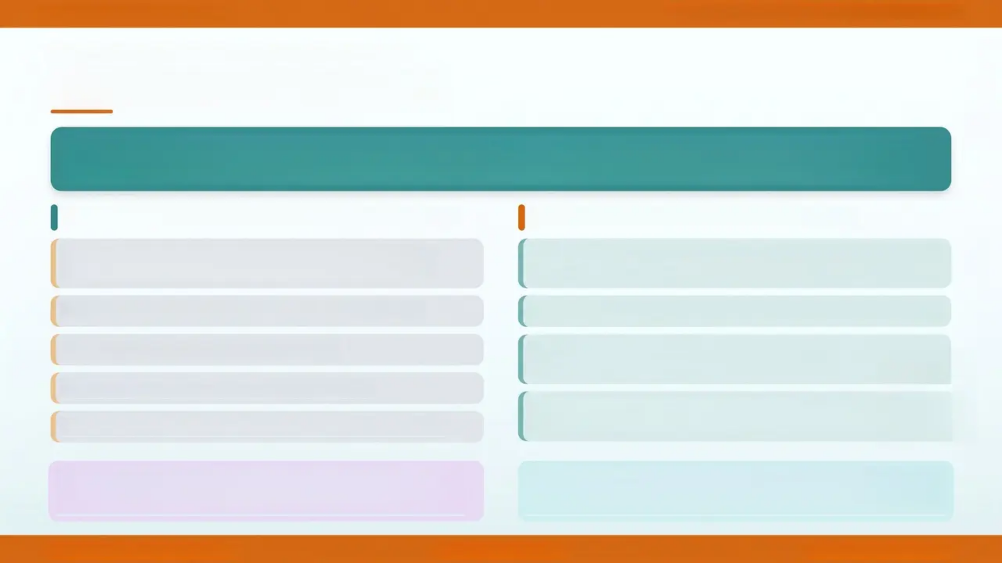

Child Protection & Maltreatment in General Practice
WORKING TOGETHER 2026 • ANTENATAL CARE
Perinatal Safeguarding
“Pre-birth assessments should begin from 12 weeks gestation for all at-risk pregnancies —
mandated by Working Together 2026”
When to Consider a Pre-Birth Assessment
GP's Role in Perinatal Safeguarding
Previous child on a Child Protection Plan or removed
from family
Identify risk factors at first antenatal contact — ask
routinely about domestic abuse, substance use, mental health
Parental substance misuse or alcohol dependency
Refer to Children's Social Care early — don't wait until birth
Domestic abuse — current or historical
Liase with midwifery, health visiting, and
MARAC where relevant
Parental mental illness (severe or enduring)
Document all concerns in clinical records — flag
unborn child's future record if system allows
Concealed pregnancy or late booking (after 20 weeks)
AKT Pearl: Pre-birth assessments from 12 weeks gestation —
Working Together 2026 mandate. “Concealed pregnancy” and “late
booking” are recognised risk flags.
SCA Tip: When seeing a pregnant patient with known risk factors,
always ask: “Is there anything at home that’s making things harder for you
right now?” — open, non-threatening professional curiosity language.
Slide 27 • Perinatal Safeguarding
www.bradfordvts.co.uk
Bradford VTS
May 2026

Slide 27
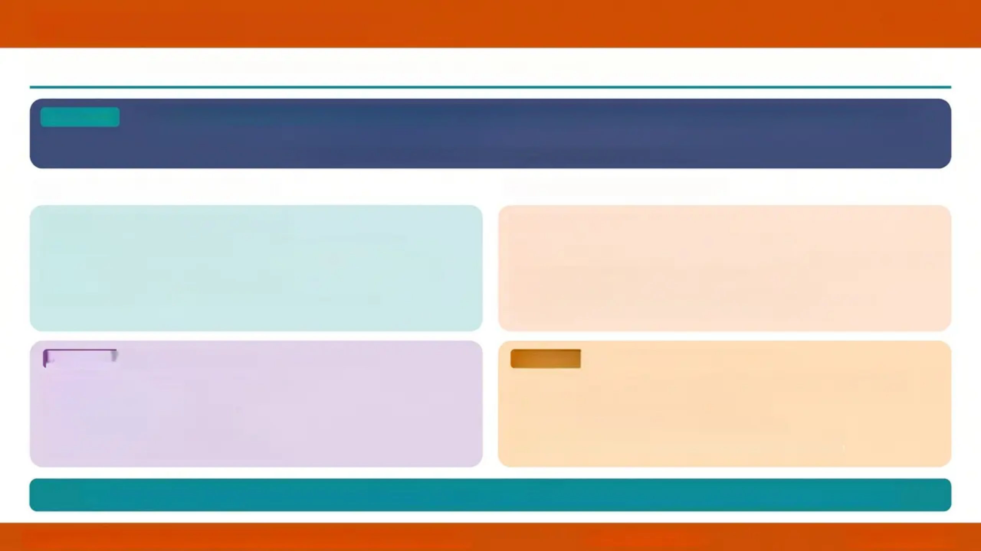


LOOKED AFTER CHILDREN (LAC)
Slide 28 of 36
Children in local authority care have complex health needs — the GP plays a vital ongoing role
DEFINITION
A Looked After Child is any child in the care of the local authority for more than 24 hours — includes
foster care, residential care, and kinship care placements
Also includes children on remand and those subject to care orders (Children Act 1989)
Health Needs & Assessments
GP Role & Responsibilities
Statutory Health Assessments
Primary Care Responsibilities
– Initial health assessment within 20 working days of becoming LAC
– Review health assessments every 6 months (under 5s) or annually (5 and
over)
– Completed by a registered medical practitioner
– Includes developmental, emotional, and physical health review
– Maintain up-to-date and accessible medical records
– Share information with the child’s designated health professional when requested
– Ensure immunisations are up to date — check and act on gaps
– Provide medical reports for statutory health assessments
– Prescribe and review medication in collaboration with the care team
– Be aware of the child’s placement status and any changes
AKT FOCUS
Health Needs — Higher Prevalence
Common GP Errors with LAC
FALLITALL
– Mental health difficulties (up to 45% of LAC)
– Developmental delay and learning difficulties
– Incomplete immunisation histories
– Dental neglect and poor oral health
– Unmet emotional and attachment needs
– Higher rates of substance misuse in older LAC
– Assuming someone else is managing their health — LAC often fall through
– Not updating records when placement changes
– Failing to flag incomplete immunisation schedules
– Not recognising that placement instability itself is a health risk
– Missing mental health needs because the child appears “fine”
💡 Think LAC: Every child in care deserves the same standard of health care as any other child — proactive, not reactive
Bradford VTS Teaching Deck · Child Protection & Maltreatment in General Practice
www.bradfordvts.co.uk
Slide 28 · May 2026

Slide 28
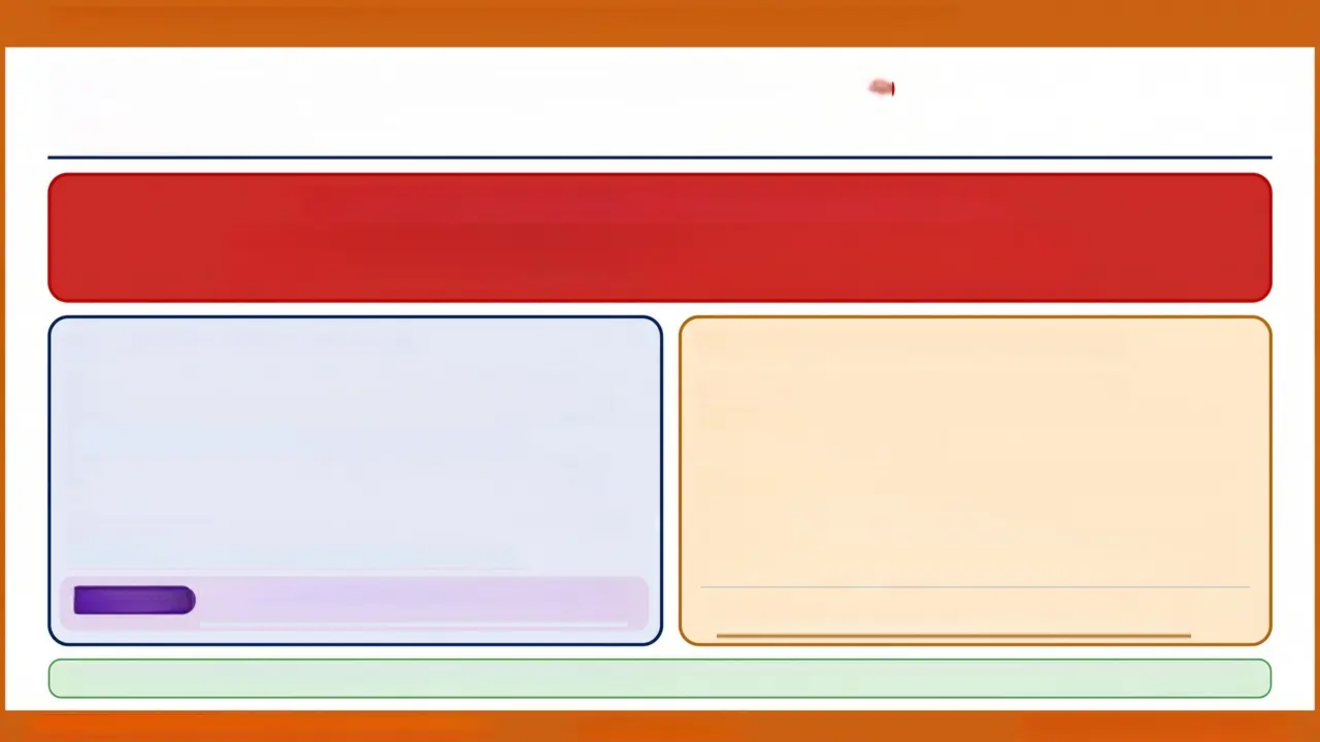

BRADFORD VTS TEACHING DECK · Child Protection & Maltreatment in General Practice
FGM — Mandatory Reporting
LEGAL DUTY
Female Genital Mutilation Act 2003 · Mandatory since April 2015
⚠️ ALL HEALTHCARE PROFESSIONALS MUST REPORT
A girl under 18 has FGM identified clinically → Report to POLICE
A girl under 18 is at risk of FGM → Report to POLICE + Children's Social Care
REPORTING REQUIREMENTS
⚠️ RISK INDICATORS — THINK FGM
▪ Who must report: All healthcare professionals (GPs, nurses,
midwives, HVs, A&E staff)
▪ Since: April 2015 — mandatory, not discretionary
▪ Report to: Police (999 or 101) AND NHS Digital mandatory
data collection
▪ Timescale: As soon as reasonably practicable after identification
▪ Parental consent: NOT required before reporting
• Girl from a community where FGM is practised
• Travelling to country of origin (especially school holidays)
• Older sister has had FGM
• Girl asks about FGM or shows anxiety about a trip abroad
• Mother or female relative has had FGM
• Girl presents with urinary symptoms, menstrual problems,
or perineal scarring
🎓 AKT PEARL
FGM mandatory reporting — since April 2015, all HCPs
must report to police. A favourite AKT single best answer.
WHO Classification: Type I (clitoridectomy) · Type II (excision) ·
Type III (infibulation) · Type IV (other)
✅ FGM has no health benefits. It is internationally recognised as a violation of human rights and is illegal in the UK. You are protected when reporting in good faith.
Slide 29 of 36 · Bradford VTS · Child Protection & Maltreatment
www.bradfordvts.co.uk
NICE CG89 · Working Together 2026

Slide 29
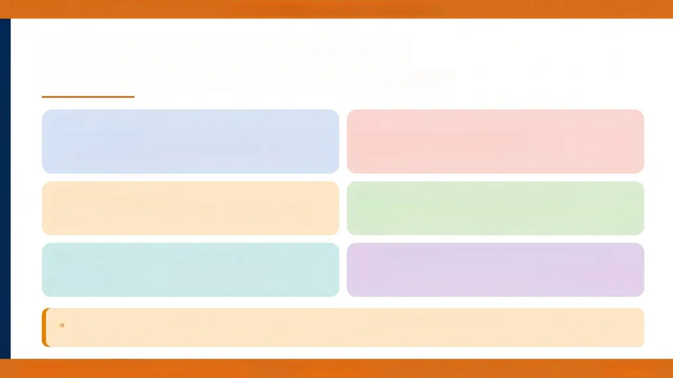







NOTE-KEEPING & DOCUMENTATION • BRADFORD VTS
Note-keeping & Documentation
Every entry matters — documentation is your legal defence
Flag the Record
DNA Is a Safeguarding Pattern
Use the safeguarding node in SystmOne (or equivalent). Every
child with a safeguarding concern must be flagged in the clinical
system.
Code persistent non-attendance accurately. A pattern of missed
appointments is a safeguarding concern — not just an admin
issue.
Tag Sibling Records
Record the Child's Words Verbatim
Risk within a household applies to ALL children. Link and tag
records of siblings — not just the presenting child.
Use direct quotes in the notes. Document who spoke — note if
the parent answered for the child. Never paraphrase a disclosure.
Remove from Online Access
Document Information-Sharing Decisions
Sensitive safeguarding entries must be hidden from patient-
facing apps (e.g., NHS App). Do this immediately after entry.
Always record your reasoning — whether you shared
information or decided not to, and why. This is a legal requirement.
Pitfall to Avoid: 'Coding 'DNA' without safeguarding concern is a common error. Also — always record who
brought the child to the appointment, their name, relationship, and whether they hold parental responsibility.'
Bradford VTS Teaching Deck • Child Protection & Maltreatment
www.bradfordvts.co.uk
Slide 30 of 36

Slide 30


TOP TIPS
High-Yield Clinical Pearls for GP Practice
01
02
03
04
Pre-Mobile Bruise = Red Flag
FTT + Dirty + DNA = Neglect
Think Family Always
Don't Accept a Changing History
Any bruise in a child who
cannot crawl, bottom shuffle,
or pull to stand requires
immediate action.
Document specific motor
skills — not just ‘non-mobile.’
Persistent failure to thrive,
poor hygiene, and repeated
non-attendance is a
safeguarding pattern — not
just an admin problem.
When seeing adults with
alcohol, drugs, or mental
illness — always ask: ‘Are
there children at home?’
If the mechanism of injury
changes between contacts,
this is a strong indicator of
maltreatment — regardless of
plausible each story sounds.
05
06
07
08
Frozen Watchfulness
Use Your Named Doctor
Consider FII Early
Attend Case Conferences
A child who is unnaturally
still, hypervigilant, and
scanning the environment has
almost certainly experienced
repeated traumatic events.
Classic AKT exam sign.
Ring the named/designated
doctor when uncertain. You
don’t have to decide alone
— document the advice
given.
Repeated unexplained
symptoms, multiple A&E
attendances, and a carer who
is over-concerned or
strangely calm = think
Fabricated or Induced Illness.
Your longitudinal family
knowledge is invaluable. If
you cannot attend, send a
written report.
Non-engagement must be
formally explained.
Bradford VTS Teaching Deck · Child Protection & Maltreatment in General Practice
www.bradfordvts.co.uk
Slide 31 of 36

Slide 31
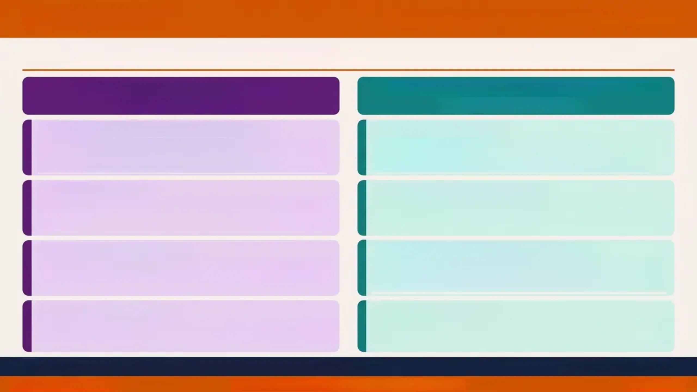






EXAM PEARLS
✦ AKT + SCA · High-Yield Revision
Know these cold before your exam — these topics come up repeatedly
AKT — Knowledge & Recall
SCA — Communication & Consultation
Single Best Answer focus
Role-play & consultation skills
Independently Mobile — NICE Dec 2025
Opening with Concern
New consensus definition: crawl, bottom shuffle, pull to stand,
cruise, walk. Any bruise in a non-mobile infant = red flag.
Document specific motor skills.
Use: 'I'm concerned about [child's name] — can you help me
understand what happened?' — child-centred language, not
accusatory.
Terminology Update
Never Promise Confidentiality
Munchausen by Proxy → now Fabricated or Induced Illness (FII).
Child Protection Register → now Child Protection Plan.
Never use old terms in exam answers.
Never say 'This stays between us.' Say: 'I may need to share
this with others to keep your child safe — that's my duty.'
FGM Mandatory Reporting
Professional Curiosity in Consultation
Since April 2015 — ALL healthcare professionals must report to
police. Any girl under 18 with FGM or at risk. No exceptions.
Show it: 'I notice [child] has been seen five times in two months
for injuries — I want to make sure we're giving the best care.'
Curious, not accusatory.
Working Together 2026
If You Suspect Abuse
Current statutory guidance — not 2018 or 2023. MASA replaces
LSCB. Safeguarding Partners: Local Authority + NHS ICB + Police.
Involve named doctor. Document everything. Refer — do not
investigate yourself. Show this process clearly in the SCA station.
Remember: Refer if concerned — Children's Social Care investigate, not GPs
Colour key: ✅ AKT 🟢 SCA
www.bradfordvts.co.uk
Child Protection & Maltreatment in General Practice
Slide 32 of 36

Slide 32
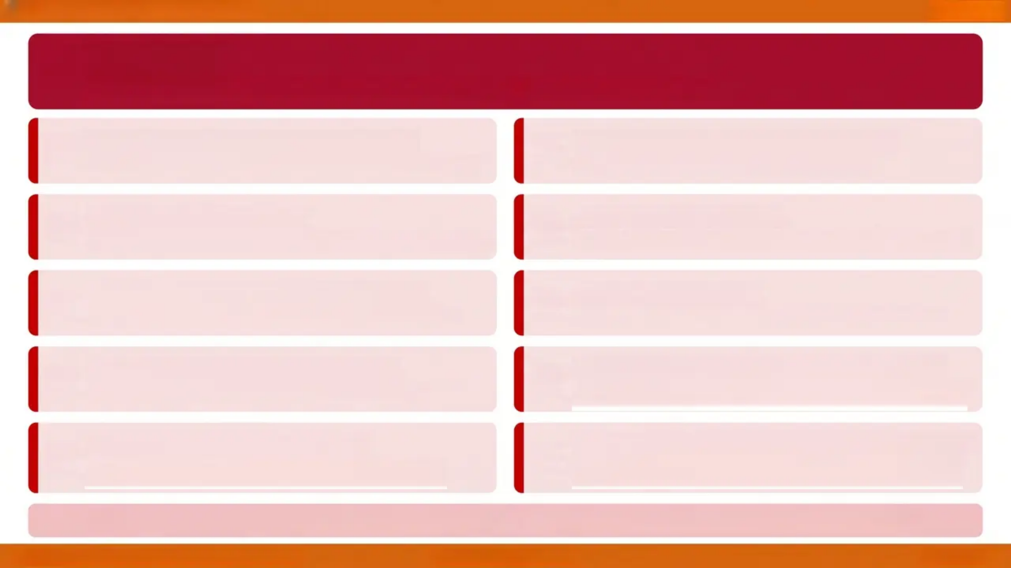











Red Flags
Red Flags
Urgent safety-netting criteria — act immediately, do not delay referral
Any bruise in a pre-mobile infant
FGM identified in a girl under 18
Cannot crawl, bottom shuffle, pull to stand, or walk — NICE Dec 2025
Mandatory police report — also report to NHS Digital
Posterior rib fractures
Frozen watchfulness
Unnaturally still, hypervigilant child — sign of chronic repeated trauma
Highly specific for non-accidental injury — caused by forceful squeezing
Child's direct disclosure of abuse
Patterned bruising
Document verbatim — do not coach or suggest; refer immediately
Hand-print, belt mark, ligature mark — never accidental in pattern
Pregnancy or STI under age 13
Repeated unexplained presentations
No capacity to consent in law — mandatory reporting applies
Consider Fabricated or Induced Illness (FII) — multi-agency response
needed
Frenulum bruising in a baby
Domestic abuse with dependent children
Strong indicator of physical abuse — requires urgent paediatric
assessment
Witnessing DA = emotional abuse; co-occurrence with maltreatment
maltreatment 30–60%
⚡ If any red flag is present — refer to Children's Social Care the same day. Do not wait for certainty.
Child Protection & Maltreatment in General Practice
www.bradfordvts.co.uk
Slide 33 of 36

Slide 33









COMMON PITFALLS
Bradford VTS · Slide 34
Frequent GP trainee errors in child protection.
Recognising your own blind spots is part of being a safe clinician.
Promising Absolute Confidentiality
Using ‘Munchausen by Proxy’
You CANNOT guarantee confidentiality in safeguarding.
Explain your legal duty clearly — never apologise for it.
Outdated term. Correct term is Fabricated or Induced
Illness (FII). Wrong terminology in exams costs marks.
Coding DNA Without Concern
Forgetting Sibling Records
Persistent ‘Did Not Attend’ is a safeguarding pattern —
not just an admin issue. Flag it.
Risk extends to ALL children in the household. Tag
sibling records — household risk is shared risk.
Waiting for Certainty to Refer
Missing Child Protection Conferences
GPs investigate nothing — Children’s Social Care does.
Refer if concerned. Uncertainty is not a reason to delay.
Your longitudinal family knowledge is legally required
input. If you can't attend, send a written report.
One pitfall missed = one child unprotected
Common Pitfalls
www.bradfordvts.co.uk
Bradford VTS Teaching Deck · May 2026

Slide 34
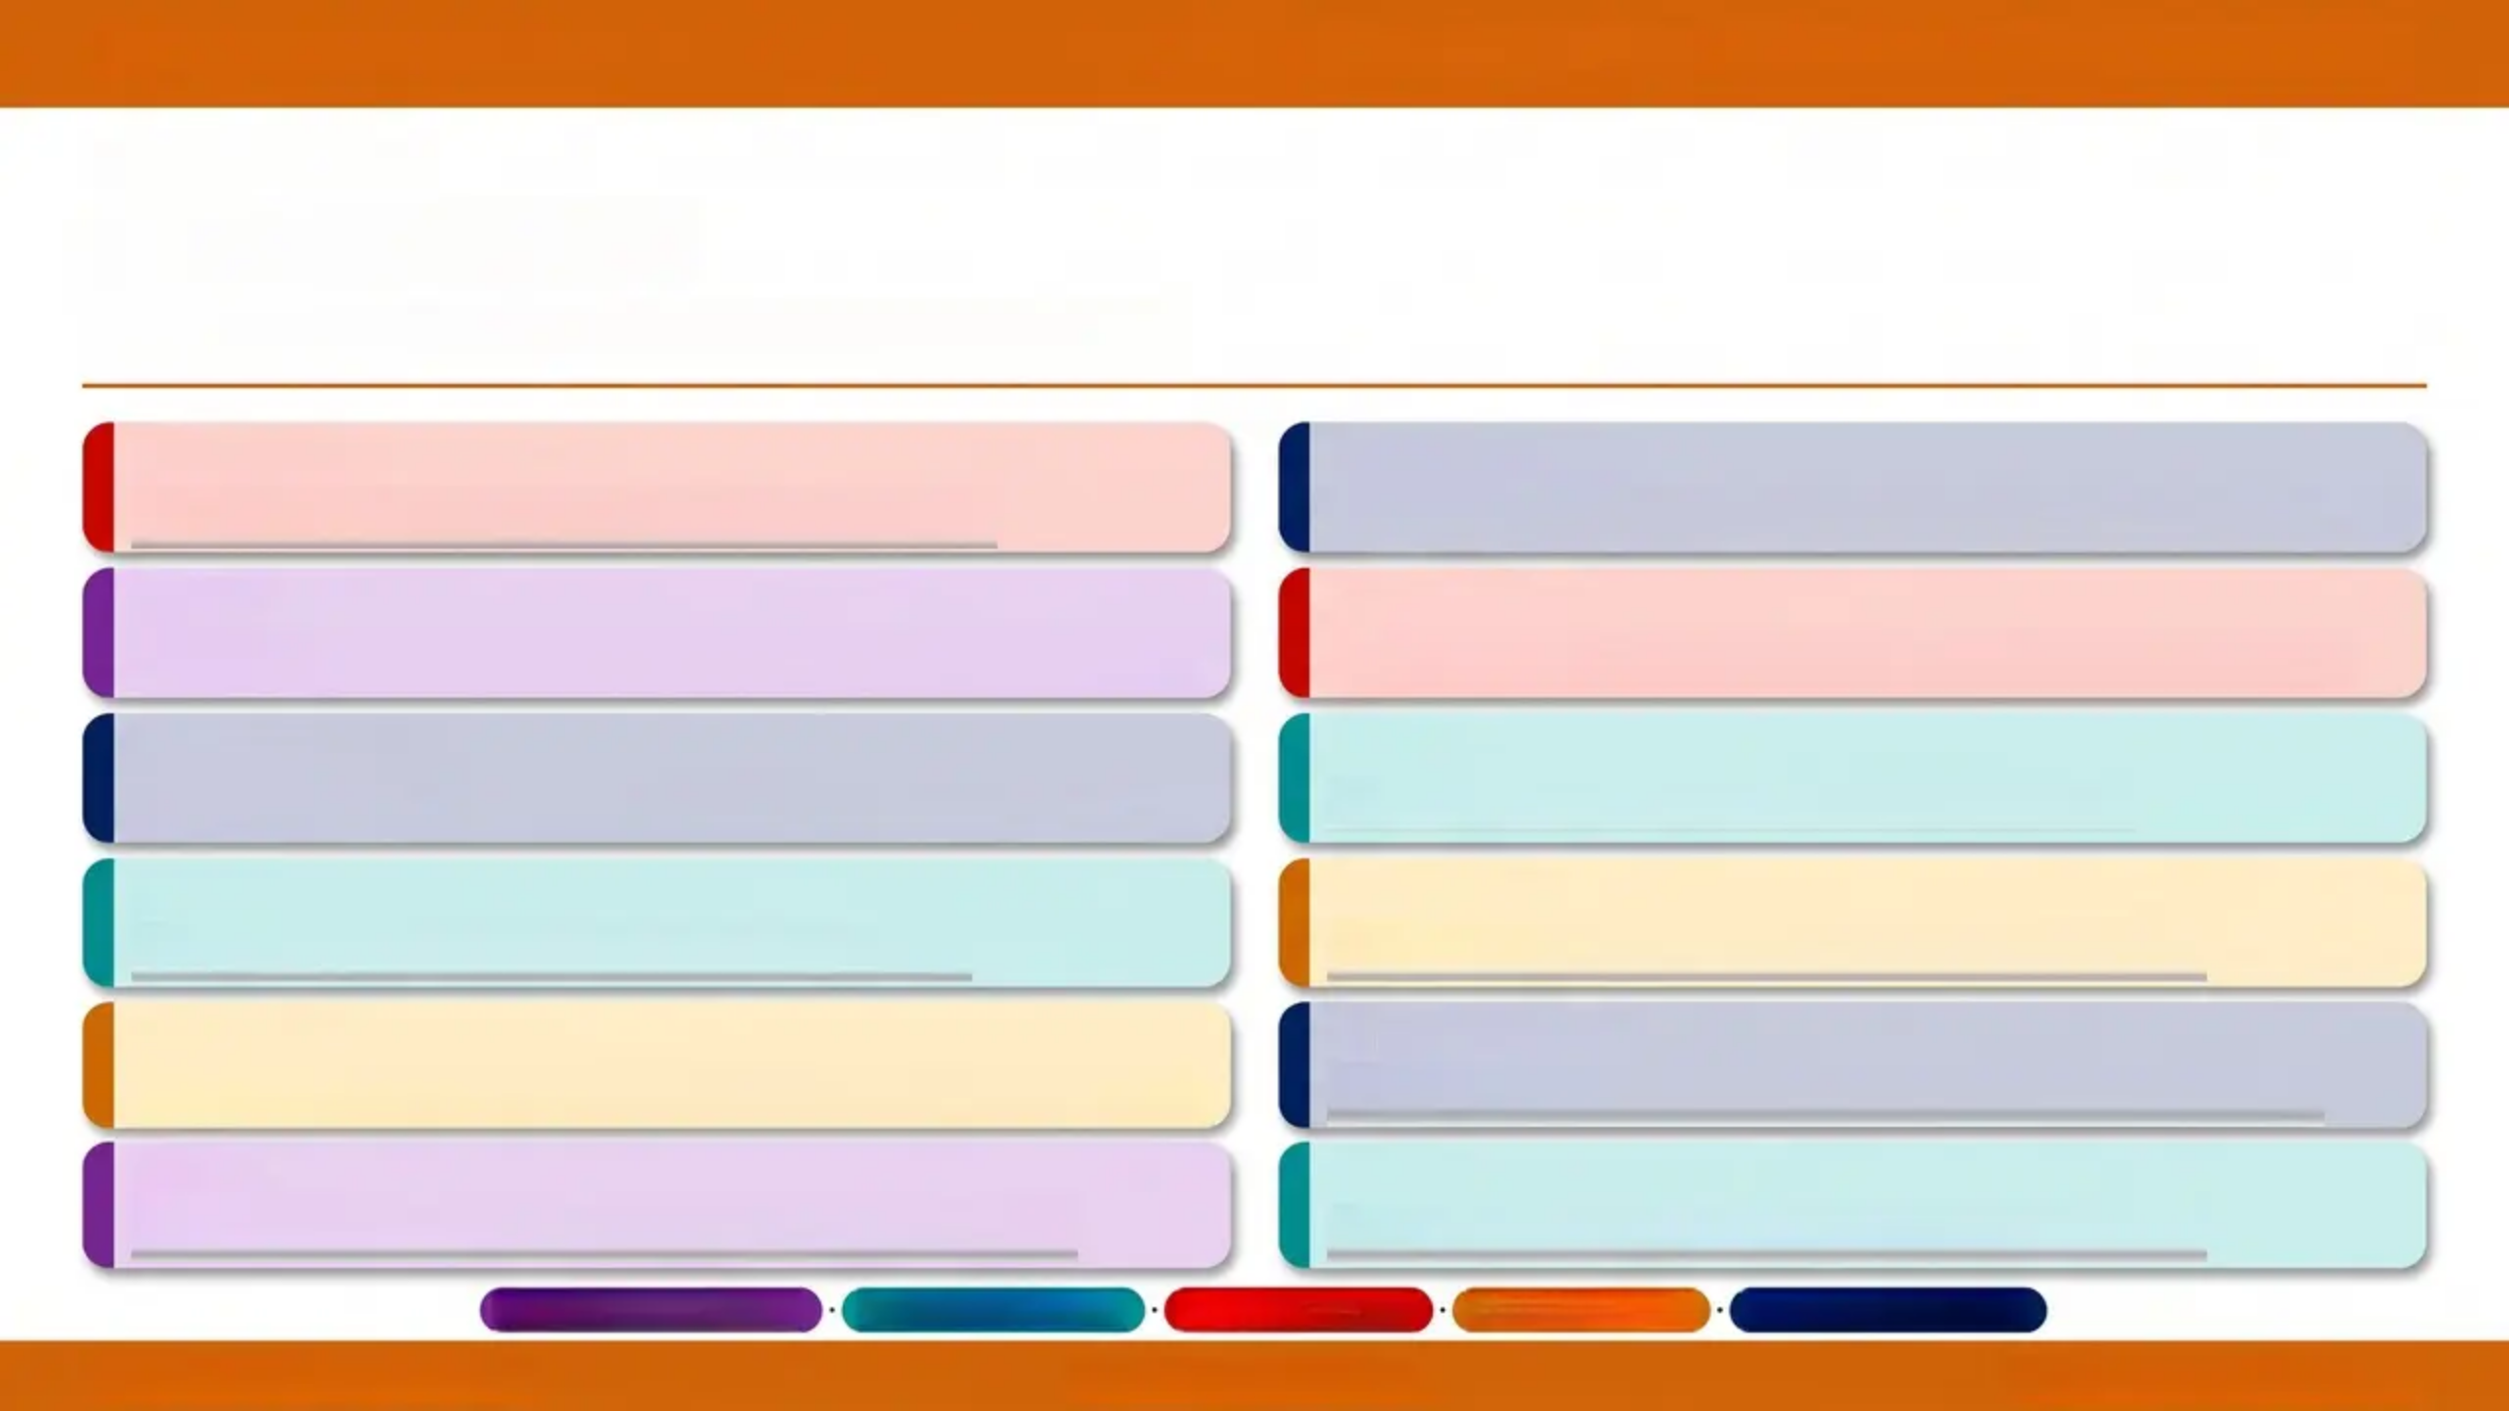













BRADFORD VTS TEACHING DECK • CHILD PROTECTION & MALTREATMENT IN GENERAL PRACTICE
FINAL REVIEW
Quick Recall
8–12 key points • max 6 words each • read fast
RED FLAG
FRAMEWORK
Pre-mobile bruise = red flag always
Four categories: physical, emotional, sexual, neglect
AKT
RED FLAG
NICE Dec 2025: independently mobile defined
Frozen watchfulness = chronic abuse sign
Framework
Working Together 2026 — statutory framework
SCA
SCA
Voice of child: document verbatim
PITFALL
Fill replaces Munchausen by Proxy
PITFALL
Tag sibling records — household risk
FRAMEWORK
Refer if concerned — don’t investigate yourself
AKT
Section 47: local authority must investigate
FGM: mandatory police report, under 18
SCA
Think Children with every adult patient
(
When adults present with worrying stuff, eg alcohol, think
about their children.
Purple = AKT Focus
Teal = SCA Focus
Red = Red Flag
Amber = Pitfall
Navy = Framework
Slide 35 of 36 • Quick Recall
www.bradfordvts.co.uk
Bradford VTS • May 2026

Slide 35


BRADFORD VTS TEACHING DECK • CHILD PROTECTION & MALTREATMENT IN GENERAL PRACTICE
Important Disclaimer
Always verify clinical advice, drug doses, and thresholds against the latest NICE guidelines,
BNF, and local Trust/ICB protocols before acting on information in this resource.
This teaching deck is produced for educational purposes only, specifically for GP trainees undertaking
Bradford VTS training. It does not constitute clinical advice and should not replace individual clinical
judgment or current statutory guidance.
Content reflects NICE CG89 (updated December 2025) and Working Together to Safeguard Children 2026 standards at time of creation.
Created May 2026 · Subject to update as guidance evolves
www.bradfordvts.co.uk
Slide 36 of 36
www.bradfordvts.co.uk • Bradford VTS Teaching Deck • Created May 2026
Educational Use Only

