Slide 1





BRADFORD VTS TEACHING DECK
SAFEGUARDING SERIES | GP TRAINING RESOURCE
Safeguarding Children
Perinatal Mental Health, Child Exploitation
& Adverse Childhood Experiences
Website: www.bradfordvts.co.uk
Date:
Created May 2026, updated to current NICE NG193 (2023)
and Working Together 2026 standards
Clinical Currency:
NICE NG193 (Perinatal Mental Health, 2020 — reviewed 2023)
• NICE CG89 (December 2025) • Working Together 2026
Protecting our youngest patients
A Disclaimer: Always double check this advice and drug doses with the
latest NICE/BNF guidance. This document is for educational purposes only.
www.bradfordvts.co.uk

Slide 2





www.bradfordvts.co.uk
Learning Objectives
By the end of this session, you will be able to:
PERINATAL MENTAL HEALTH
CHILD EXPLOITATION
Recognise prevalence, risk factors, and
safeguarding implications of perinatal
mental illness — including when to refer
urgently
Identify indicators of CSE and CCE,
understand County Lines, and apply the
CSERQ15 screening framework
ADVERSE CHILDHOOD EXPERIENCES
SAFEGUARDING FRAMEWORK
Understand ACE scoring, cumulative
health risk, and the GP's role in trauma-
informed care and early intervention
Apply the 2025 Intercollegiate Document
standards, training levels, and Working
Together 2026 principles in primary care
AKT Relevant
SCA Relevant
Colour coding used throughout this deck
www.bradfordvts.co.uk

Slide 3

INTERCOLLEGIATE DOCUMENT — 5TH EDITION 2025
Safeguarding Training Framework
Replaces 2019 (4th edition) — Next review: November 2028
Training Requirements by Role
KEY CHANGES 2019 → 2025
Contextual safeguarding —
stronger emphasis
Voice of the Child — now explicit
Level 3 competency
Trafficked children & modern
slavery — expanded
Children in care / care leavers —
new dedicated section
Online safety & tech-facilitated
abuse — new content
Mandatory FGM reporting —
reinforced
LEVEL 3
LEVEL 3+
GP Trainees & GPs
12 hours every 3 years
GP Leads
16 hours every 3 years
YOUR REQUIREMENT
LEVEL 3
LEVEL 2
Practice Nurses
Practice Managers /
Reception Managers /
Safeguarding
Administrators
Upgraded from Level 2 in
previous edition
“Voice of the Child is now a
core competency at all levels ”
ICD 5th Edition, 2025
*Named/Designated Doctors and Nurses: Level 4/5 — specialist requirements apply
www.bradfordvts.co.uk

Slide 4
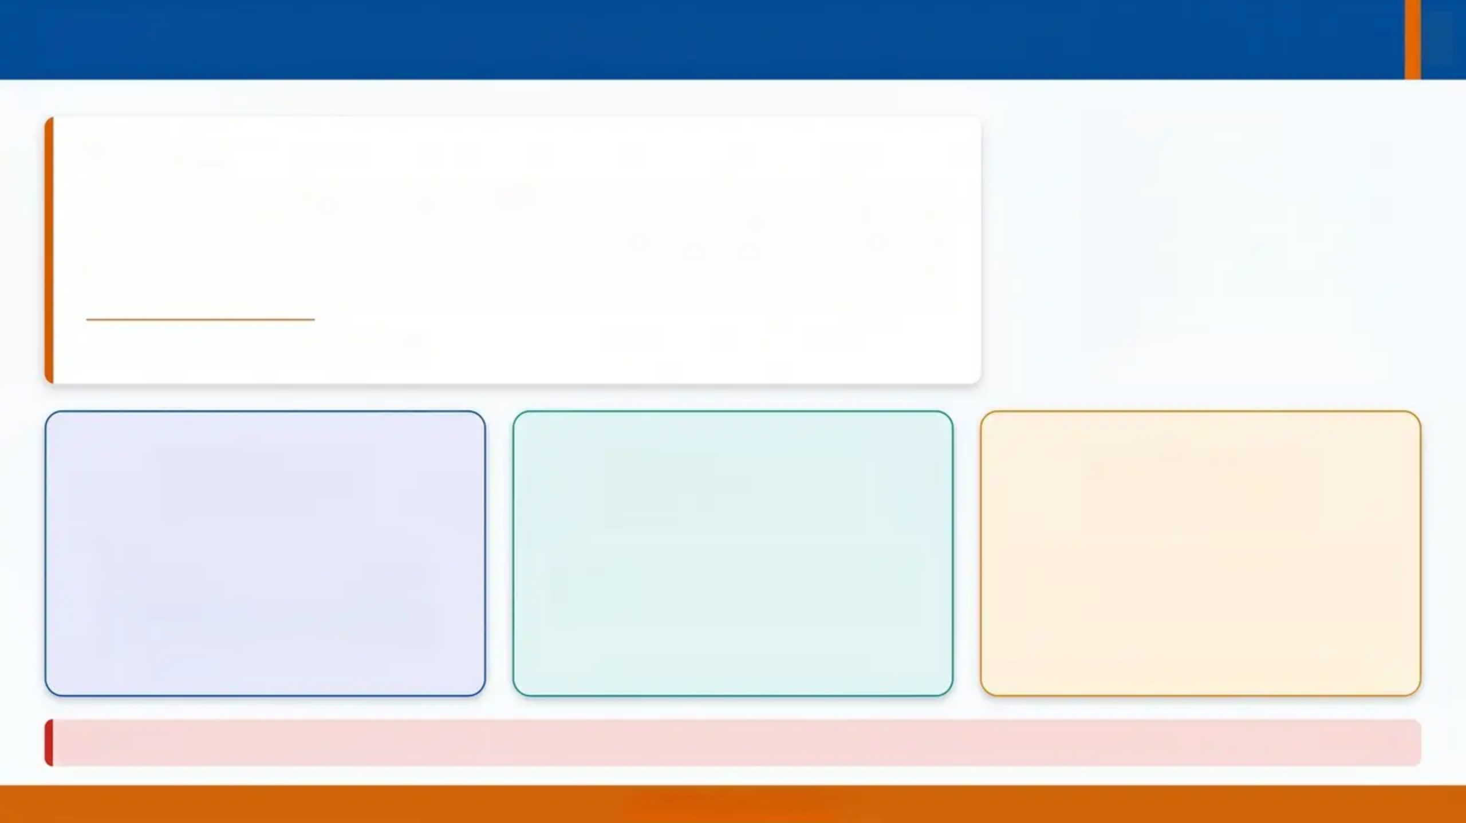
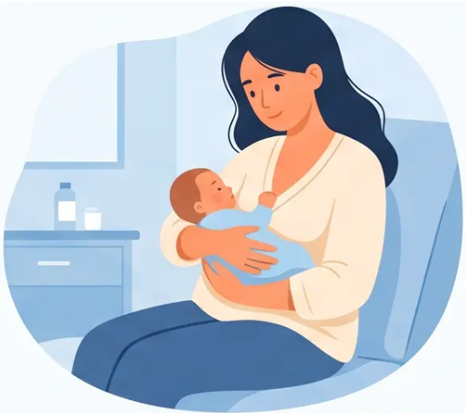
Perinatal Mental Health: Definition & Prevalence
DEFINITION
the first 12 months following birth
Mental health problems arising during pregnancy or within
the first 12 months following birth — including anxiety,
depression, PTSD, bipolar disorder, and postpartum psychosis.
Source: NICE NG193 (updated 2023)
1 in 5
1 in 10
~50%
women affected during
pregnancy or first year
postpartum
men experience perinatal
mental health difficulties
detected — and only half of
those receive treatment
Up to 20% — NICE NG193
Often unasked, often missed
Significant under-recognition in primary care
⚠️ ~25% of maternal deaths between 6 weeks and 1 year postpartum are related to mental health — MBRRACE-UK. Suicide is a leading cause.
www.bradfordvts.co.uk

Slide 5
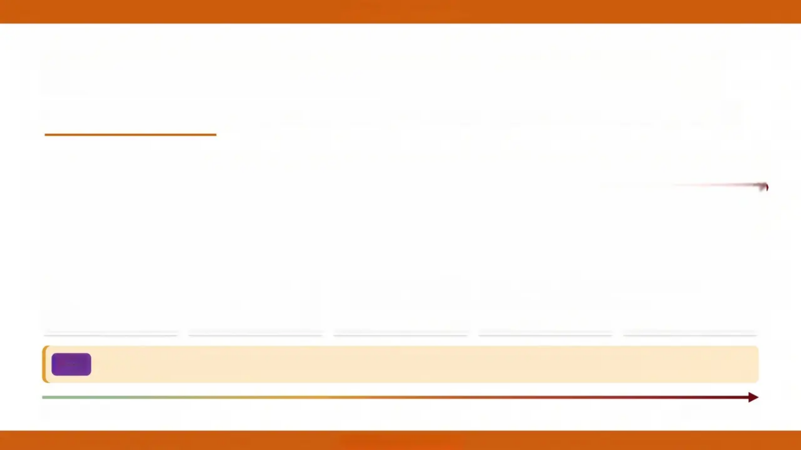











www.bradfordvts.co.uk
Spectrum of Perinatal Mental Illness
*From common distress to rare psychiatric emergency — all require GP awareness
Adjustment Disorders & Distress
Mild–Moderate Depression & Anxiety
Severe Depression & PTSD
Chronic Serious Mental Illness
Postpartum Psychosis
Prevalence:
Prevalence:
Prevalence:
Prevalence:
Prevalence:
150–300 per 1,000 births
100–150 per 1,000 births
30 per 1,000 births each
2 per 1,000 births
2 per 1,000 births
Annual UK cases:
Annual UK cases:
Annual UK cases:
Annual UK cases:
Annual UK cases:
Up to 210,000/year
~105,000/year
~21,000/year each
~1,400/year
~1,400/year
*Most common — often self-limiting
*Frequently under-detected
*Specialist input often needed
*Requires preconception planning
*⚠ EMERGENCY — admit to MBU
AKT
Only ~50% of cases are detected — and only 50% of those detected receive treatment.
*More common
*More severe
www.bradfordvts.co.uk

Slide 6



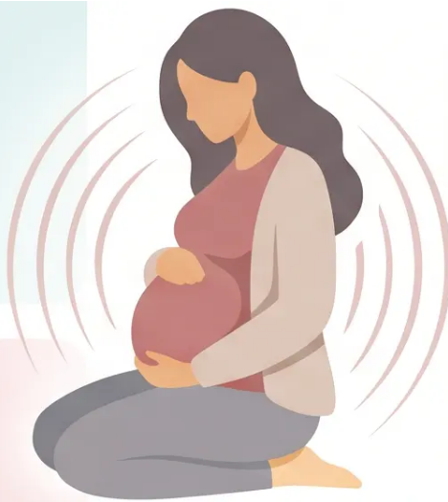



Section 2: Perinatal Mental Health
Risk Factors for Perinatal Mental Illness
Personal & Psychiatric History
Social & Relational Factors
• Personal history of mental health problems
• Family or personal history of bipolar disorder
• Bereavement or pregnancy loss
• Alcohol or drug misuse
• Domestic abuse 🚩
• Interpersonal conflict
• Inadequate social support
• Migration status
Obstetric &
Pregnancy Factors
Childhood &
Contextual Factors
• Unplanned or unwanted pregnancy
• History of perinatal loss
• Preterm birth or neonatal complications
• Experience of childhood abuse and neglect
• Looked After Child (LAC) history
• Socioeconomic deprivation
⚠️ Domestic abuse is the single most important modifiable risk factor — always ask at booking and every contact.
www.bradfordvts.co.uk

Slide 7

PERINATAL MENTAL HEALTH
Specific Risks: Women with Bipolar Disorder
HIGH RISK
Bipolar disorder significantly elevates the risk of postpartum psychosis and severe postnatal depression.
>1 in 5
1 in 2
1 in 2
~1 in 2
Postnatal
Psychosis Risk
Postnatal
Psychosis Risk
Postnatal
Psychosis Risk
Severe Postnatal
Depression
Women with bipolar
disorder
Previous postnatal
psychosis
Bipolar + family history
of postnatal psychosis
Women with bipolar
disorder
Clinical Action: Women with bipolar disorder planning pregnancy or newly pregnant must have a pre-
conception or early antenatal psychiatric review. Refer proactively — do not wait for symptoms.
www.bradfordvts.co.uk

Slide 8



www.bradfordvts.co.uk
PERINATAL MENTAL HEALTH
Barriers to Detection
Only ~50% of perinatal mental illness is detected — and only 50% of those detected receive treatment.
“Detection failure begins long before the consultation.”
— stigma, fear, and system pressures combine
“Maternal Factors”
“GP Factors”
• Stigma around mental illness in new mothers
• “Putting on a brave face”—not wanting to seem weak
• Fear of being judged as a bad mother
• Fear that baby will be taken away
• Uncertainty about what is “normal” after birth
• Not knowing whether treatment will actually help
• Not asking about mental wellbeing routinely
• Time pressure—the 10-minute appointment
• Lack of training or confidence in perinatal MH
• Normalising or dismissing symptoms as “baby blues”
• Assuming midwives or health visitors will pick it up
• Discomfort with emotional or psychiatric topics
“She may be suffering in silence — and smiling at the appointment.”
“Professional curiosity is not optional — it is a clinical skill.”
GP Reflection: “When did I last ask a new mother how she was really feeling?”
www.bradfordvts.co.uk

Slide 9
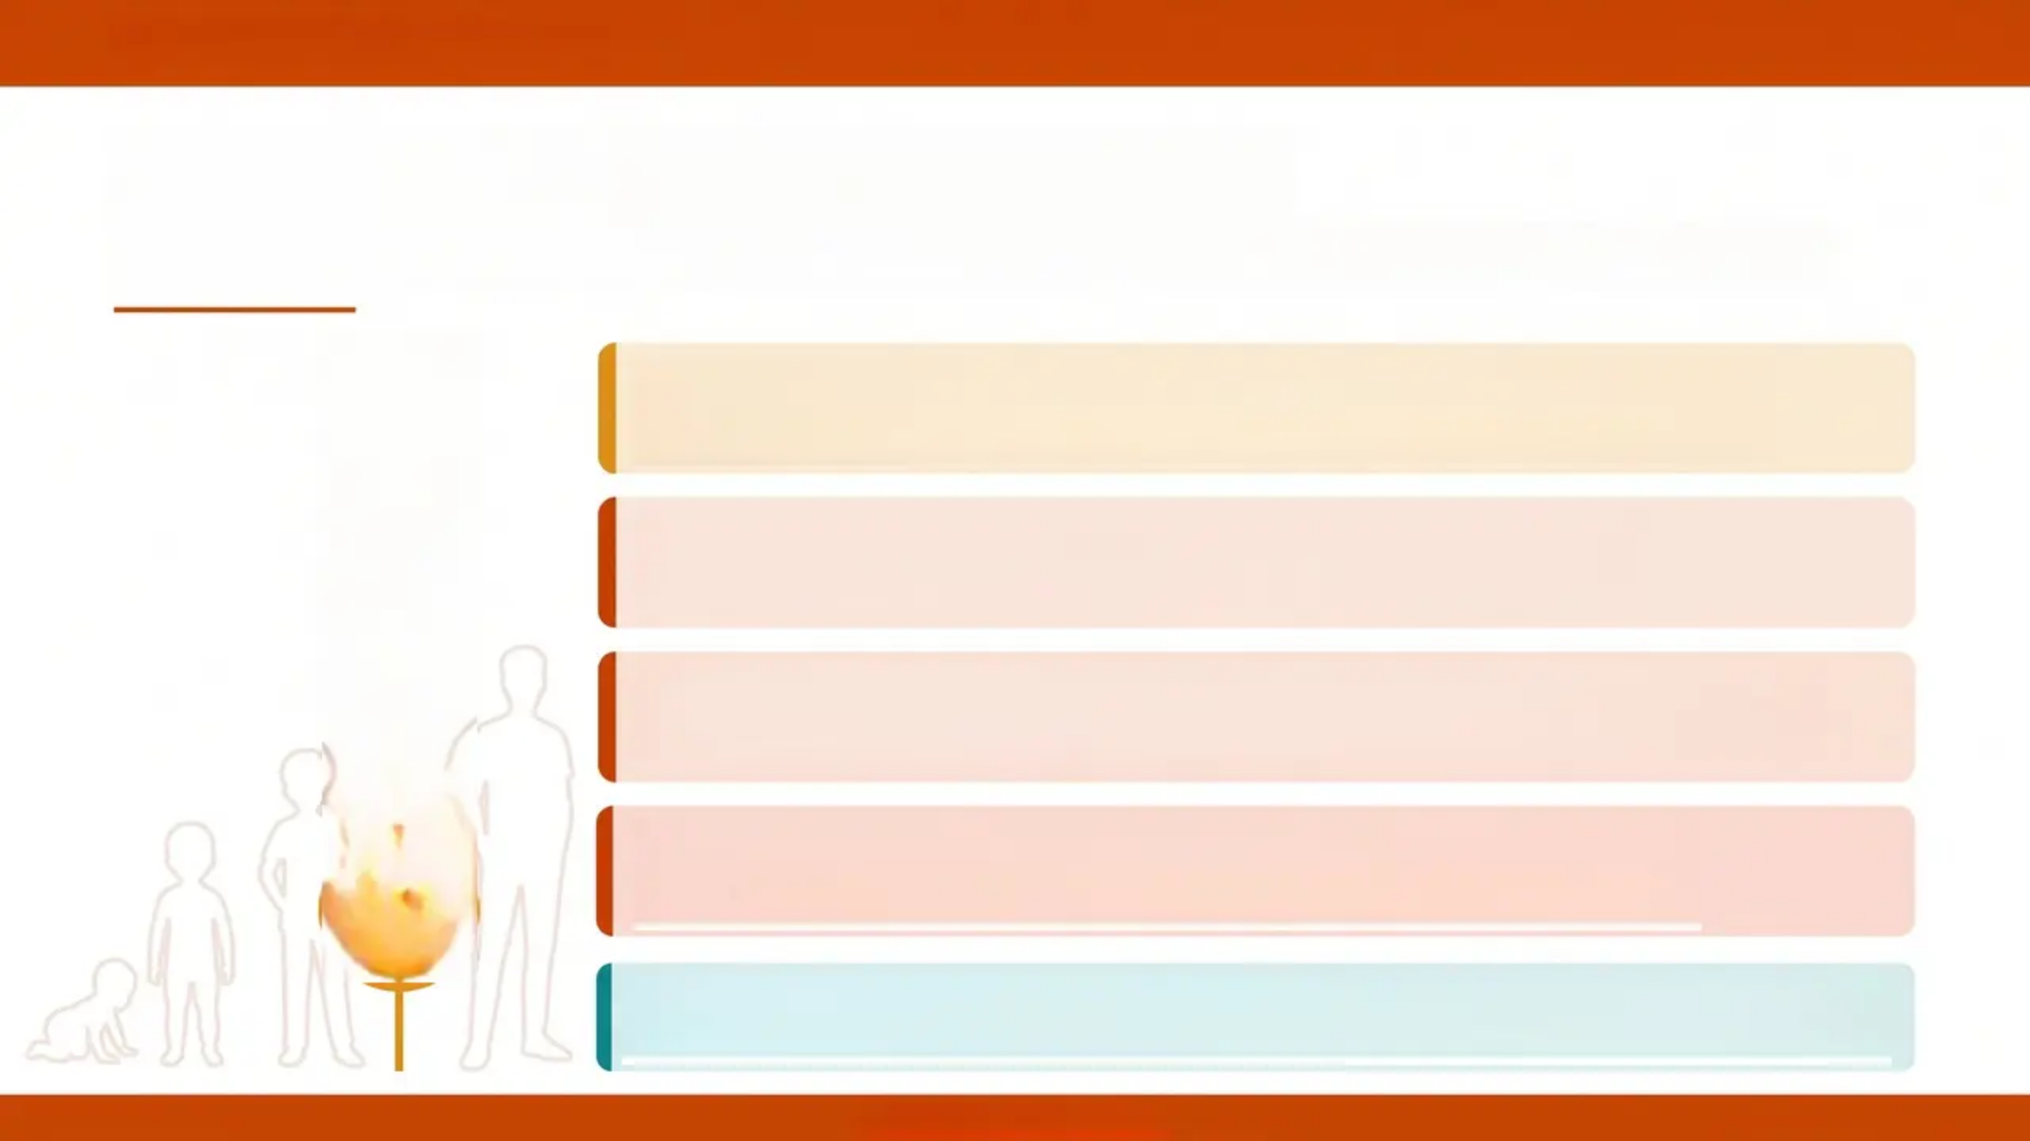

PERINATAL MENTAL HEALTH
Impact on Child Development
When perinatal mental illness goes untreated — the cascade of harm
>2× risk
Behavioural problems at 12 months
(if maternal disengagement at 3 months)
>2× risk
Anti-social behaviour by age 2
>2× risk
Depression and behavioural difficulties
in adolescence
>2× risk
Depression before age 18 — with
recurrence by age 25
SCA INSIGHT: "Two-thirds of the £8.1 billion cost of untreated perinatal mental
illness is linked to long-term problems for the child — not the mother."
www.bradfordvts.co.uk

Slide 10








‘The GP Role in Perinatal Mental Health’
SCA Relevant
CORE GP RESPONSIBILITIES
REFER URGENTLY IF...
Ask everyone — Enquire about mental wellbeing with every pregnant
woman, new mother, and father at every contact. Don’t wait to be told.
• Rapidly changing mental state
• Suicidal ideation — especially
violent ideation
• Pervasive guilt or hopelessness
Maintain the postnatal appointment — Resurrect and protect the
maternal 6-week postnatal check. Use EPDS (score ≥13 = depression).
Code correctly — Depression within 1 year of birth = Postnatal
Depression. Code it. It matters for risk stratification.
• Significant estrangement from
infant
• Persistent beliefs of
inadequacy as a mother
Communicate with the MDT — Clear, timely communication with
midwives and health visitors. Don’t work in isolation.
Suicide awareness — Most perinatal suicides use violent methods. Ask
directly. Don’t avoid the question.
• Evidence of psychosis
Watch the mother-infant relationship — Significant estrangement
from infant is a red flag requiring urgent review.
Do NOT discharge without a
crisis plan.
SCA tip: Use open questions — 'How are you finding things at home?' and 'How is baby feeding/sleeping?' — before moving to structured screening.
www.bradfordvts.co.uk
Slide 11 of 33

Slide 11

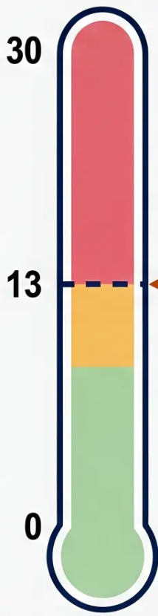



SECTION 2: PERINATAL MENTAL HEALTH
Edinburgh Postnatal Depression Scale (EPDS)
*A validated screening tool for perinatal depression — know the threshold, know the action
THE TOOL
– 10-item self-report questionnaire
– Validated for use in pregnancy AND postnatal period
– Each item scored 0–3; maximum score = 30
– Completed by the mother (or father — validated for paternal use)
– Takes approximately 5 minutes to complete
≥13: Suggests depression
*Act now — refer or manage
THRESHOLD = 13
WHEN TO USE
*Score ≥13 = clinical action required
Antenatal contacts — at booking and mid-pregnancy
10-12: Borderline
6-week postnatal check — GP responsibility
*Repeat in 2 weeks; discuss with HV
0-9: Low concern
*Use at every opportunity with new mothers and fathers — not just at scheduled checks
*Reassure, monitor, support
SCA PRACTICE
Open with: ‘As part of our routine check, I’d like to ask you a few
questions about how you’ve been feeling — is that okay?’
Never rush the EPDS. Create space for honesty.
AKT
FACT
EPDS ≥13 suggests postnatal
depression — a common SBA topic
www.bradfordvts.co.uk
Slide 12 of 33

Slide 12


Pre-birth Assessment and Referral
SAFEGUARDING ACTION
Do not wait until birth — refer to Children’s Social Care from 12 weeks gestation
When is Pre-birth
Referral Required?
The SOS Framework
High-Risk Groups:
Don't Miss
SCA
PITFALL
Unborn child may be at risk
of significant harm
• Mother was previously a
Looked After Child (LAC)
• Concerns identified at any
antenatal contact — do not
wait for confirmation
S
O
S
State your concern
“I am worried that…”
Mothers who were previously
Looked After Children (LAC)
• Women with severe perinatal
mental illness
• Women with active substance
misuse
• Domestic abuse in current
relationship
• Previous child removed from care
Observable evidence
“I have noticed that…”
So what for the baby?
“This may affect the
baby by…”
Referral from 12 weeks gestation —
not at birth, not at 20 weeks.
Use the SOS framework to articulate
concerns clearly to Children’s Social Care.
SysmOne note: Child safeguarding node entries are NOT visible to patients via online access. Use this for pre-birth safeguarding
records. Remove sensitive data from standard journal entries using the 'world' icon.
www.bradfordvts.co.uk
Bradford VTS Teaching Deck | Safeguarding Children
Slide 13 of 33

Slide 13



RED FLAG TOPIC — PERINATAL SUICIDE
MBRRACE-UK 2022-24
THE EVIDENCE
SCA — WHAT TO DO
Suicide is a leading cause
of maternal death
Your direct clinical actions
Ask directly — “Are you having any thoughts of harming
yourself or ending your life?” Do not soften or avoid — direct
questioning does not increase risk
In the year after birth — MBRRACE-UK 2022-24
~25%
of maternal deaths between 6 weeks
and 1 year postpartum are related to
mental health
Use EPDS — Score ≥13 suggests depression; any suicidal
ideation on Question 10 = urgent action regardless of total score
Violent methods
Assess for violent intent — If ideation involves violent
methods (hanging, jumping), treat as psychiatric emergency
Hanging and jumping are the most common
methods — NOT overdose
“This distinguishes perinatal suicide from general population patterns.”
Do NOT discharge without a crisis plan — Same-day
liaison with crisis team, midwife, health visitor; consider
emergency MH referral or 999
AKT PEARL
Only ~50% detected; only 50% of those treated
Under-recognition is a systemic failure
⚠️ Common Pitfall: “Depression is under-recognised as a
cause of perinatal suicide. Do not assume a smiling,
functioning mother is not at risk. Ask at every contact.”
www.bradfordvts.co.uk

Slide 14




CASE STUDY
www.bradfordvts.co.uk
Case Study: Perinatal Mental Health in General Practice
SCA Relevant
THE SCENARIO
Sarah, 29, attends her 6-week postnatal check. She had an
uncomplicated vaginal delivery. She mentions she's “fine” but seems flat,
avoids eye contact, and says she's “not sleeping much.” Her partner has
returned to work. She has no family nearby. She was treated for
depression aged 22.
⚠️ What are the red flags in this history?
SCA APPROACH — WHAT TO SAY
KEY LEARNING POINTS
Orange Use EPDS — score ≥13 suggests depression
💡“I’m glad you came in today — how are you really feeling in yourself?”
💡“How are you finding things at home? Is there anyone around to
support you?”
Red Ask directly about suicidal thoughts — do
not avoid
Green Involve health visitor — shared care is
essential
💡“Sometimes new mums feel low or overwhelmed — is that something
you’ve been experiencing?”
Purple Code as postnatal depression — not just
“depression”
Open questions, normalising language, avoiding assumptions.
www.bradfordvts.co.uk

Slide 15

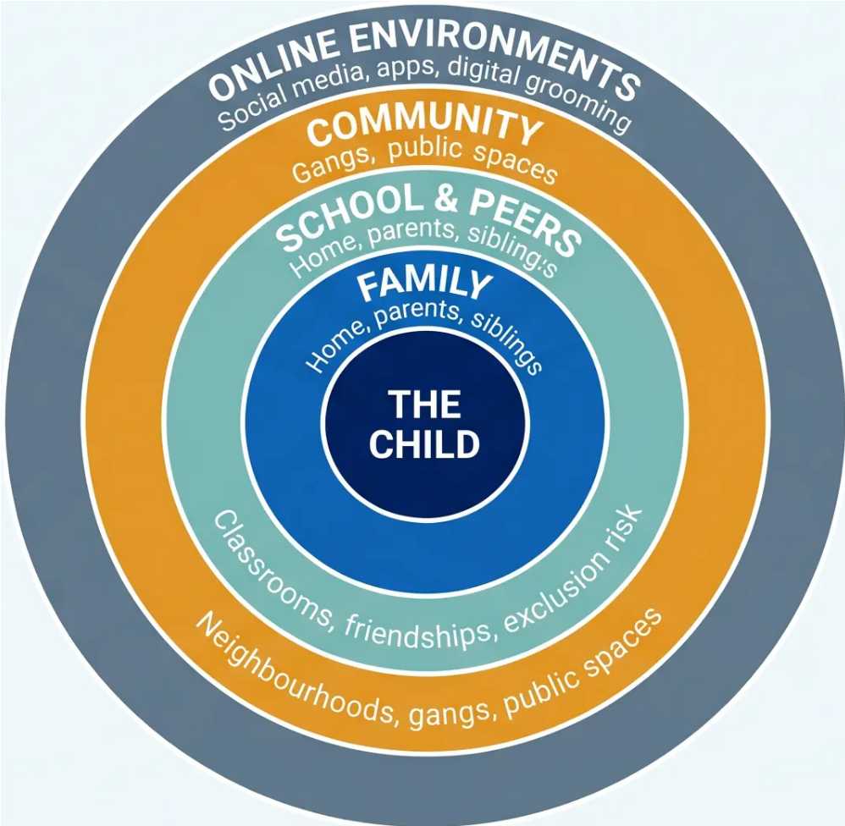
Contextual Safeguarding Framework
Section 3
FIRMIN, 2013
“An approach to understanding
and responding to young
people's experiences of
significant harm beyond their
families.” — Carlene Firmin, 2013
■ Goes beyond the home environment
■ Adolescents face harm where parents
have limited influence
■ Multi-agency response is essential
Working Together 2026 incorporates contextual safeguarding principles —
harm extends into all of these rings.
SCA: Professional curiosity in wider contexts
www.bradfordvts.co.uk

Slide 16




CHILD CRIMINAL EXPLOITATION (CCE) & COUNTY LINES
Section 4: Child Exploitation
AKT ★ DEFINITION
COUNTY LINES
Child Criminal Exploitation
How It Works
Home Office 2018 | Working Together 2026
HM Government | NCA
Occurs where an individual or group takes
advantage of an imbalance of power to
coerce, control, manipulate or deceive a child
or young person under the age of 18.
Grooming — Young people recruited
through deception, gifts, and false friendship
Cuckooing — Taking over a vulnerable
person's home as a drugs base
May appear consensual — still abuse
Debt Bondage — Victims trapped through
manufactured debts they cannot repay
Does not require physical contact
4,600+ serious organised
crime groups in the UK
£37 billion+ annual cost of
serious/organised crime
27,000 young people self-
identify as gang members
www.bradfordvts.co.uk
Slide 17 of 33

Slide 17

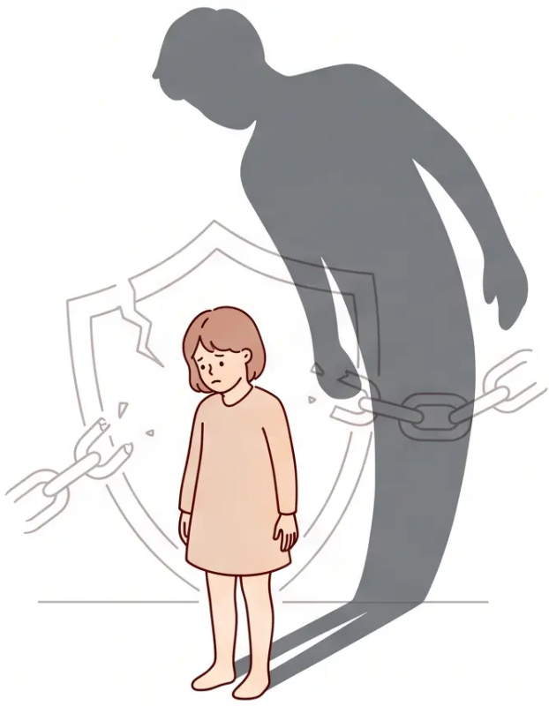



SECTION 4 — CHILD EXPLOITATION
SCA
Child Sexual Exploitation (CSE)
FORMAL DEFINITION — DCFS 2017 / WORKING TOGETHER 2026
"Sexual exploitation of children where an individual or group takes
advantage of an imbalance of power to coerce, manipulate, or
deceive a child into sexual activity — which may be in exchange for
something the child needs or wants."
It is abuse — whether or not the child appears to consent.
Children cannot give meaningful consent when there is an imbalance of
power. Apparent willingness does not negate the abusive nature of the act.
Power Imbalance
Coercion & Deception
The 'Consent' Myth
Exploiters use age, status, money,
drugs, or belonging to control
Grooming disguises abuse as
a relationship or exchange
A child manipulated into
activity cannot freely consent
Power imbalance is the defining
feature of CSE
www.bradforddvs.co.uk

Slide 18





VULNERABILITY FACTORS: WHO IS AT RISK?
Child Exploitation
Risk exists at three levels – understanding context helps GPs identify and act earlier.
Child Level
Family Level
Community Level
Individual vulnerabilities
Home environment risks
Environmental context
• School exclusion
• Special educational needs
• Mental health difficulties
• Experience of bullying
• Substance misuse
• Poverty and deprivation
• Domestic abuse
• Neglect or abuse at home
• Parental substance misuse
• Family members in gangs
• Gang-affected neighbourhood
• Disenfranchised communities
• Lack of opportunity
• Poor institutional response
• Online exposure and peer
pressure
No single factor determines risk – it is the accumulation and interaction of factors across all three levels that escalates vulnerability.
www.bradfordvts.co.uk

Slide 19





GP Risk Indicators for Exploitation
www.bradfordvts.co.uk
“Professional curiosity is not optional — look beyond the presenting complaint”
Behavioural Signs
Clinical Presentations
Social & Material Signs
• frequent missing episodes
• found in distant locations
• sudden extreme behaviour changes
• obsession with mobile phone(s)
• multiple phones / secretive calls
• school exclusion or truancy
• new older friends with nicknames
• vague somatic complaints
• secondary enuresis
• drug use / carrying drugs or weapons
• physical injuries including knife wounds
• sexual health concerns / STI
• mental health impacts
• “train track” injuries (needle marks)
• unexplained money or goods
• clothing from unknown source
• parents with mental health impacts
• living away from parents
• pushing away from usual peers
• debt to unknown persons
• withdrawal from family
Always ask – never assume accidental
REMEMBER
“Any single indicator may have an innocent explanation. It is the pattern and combination that
demands professional curiosity and action. Refer to MASH at lower threshold if other concerns exist.”
www.bradfordvts.co.uk

Slide 20






THE 5 WARNING SIGNS OF COUNTY LINES
CCE | COUNTY LINES
Every GP should know these – each sign is a potential referral trigger
Home Office 2018 / Children's Society 2019
1
2
3
Unexplained Items
Going Missing
Older Friends
New clothing, phones, money
— no credible explanation
Found in distant locations —
repeated missing episodes
New associates with nicknames
— unknown to family
4
5
Withdrawing
from Peers
Behaviour Change
Dropping old friendships —
changing interests suddenly
Secretive, says ‘others have their
back’ — guarded and evasive
Any ONE of these signs in a teenager = professional curiosity required. Refer to MASH if two or more are present.
www.bradfordvts.co.uk

Slide 21
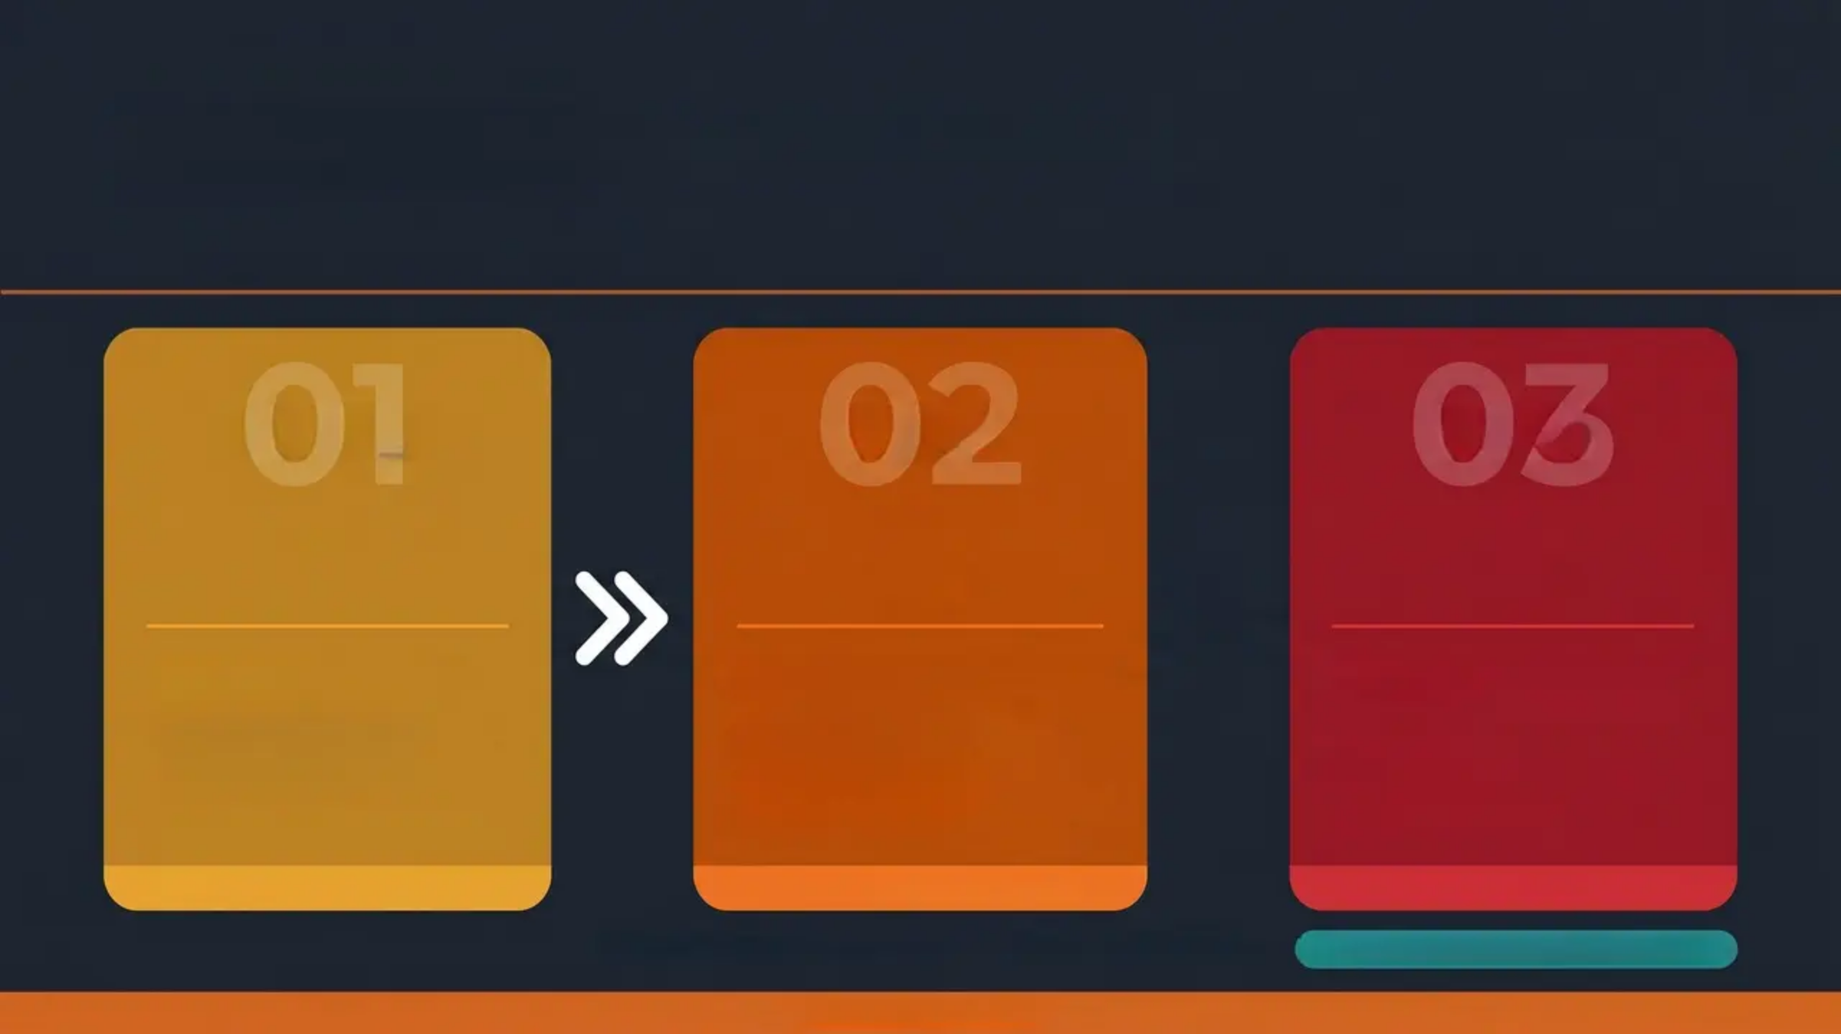




CHILD CRIMINAL EXPLOITATION
The Journey Through CCE
Target → Test → Trap
TARGET
TEST
TRAP
• Observe vulnerabilities
• Gain trust gradually
• Manipulate and befriend
• Mark for recruitment
• Test loyalty and compliance
• Create dependency
• Introduce to established
members
• Ask for “favours”
• Physical & psychological
violence
• Trafficking
• Blackmail & debt bondage
• Isolation from family
Source: Children's Society 2019 – Target → Test → Trap model
SCA: Ask open questions at any stage of this journey
www.bradfordvts.co.uk

Slide 22

Assessment of Exploitation Risk: CSERQ15
AKT
CSERQ15
Key Screening Areas (CSERQ15 Domains)
Child Sexual Exploitation Risk
Questionnaire — 15-item validated
screening tool
Controlling
relationship
STI, pregnancy or
termination (females)
Missing episodes
5 or more positive responses
= Action Required
Living away from
parents
Unsafe locations
frequented
Self-harm
Refer at lower threshold if other
concerns exist — holistic
approach always applies
School exclusion
Low self-esteem
Alcohol use
Older partner
(age gap ≥4 years)
Parental substance
misuse or mental
Unexplained
injuries
MASH
Early Help
Full tool has given 15 items
Specialist Exploitation Teams
AKT Pearl: CSERQ15 — 5+ positive responses = mandatory action.
Always refer at lower threshold if holistic concern exists.
Always document voice of the child
www.bradfordvts.co.uk
23 / 33

Slide 23








GP Approach to Risk Assessment
SCA
*Professional curiosity is not optional — look beyond the presenting complaint
Give Space to Speak
Professional Curiosity
Explain Confidentiality
Limits
Offer the young person a chance to
talk alone. Use open, non-leading
questions: “Can you tell me more
about what’s been happening?”
Look beyond the presenting complaint.
If something feels wrong, probe
deeper. Use the 5 Whys approach —
don’t accept the first explanation.
Be honest: “I can’t promise to keep
this secret if I’m worried about your
safety.” Never promise full
confidentiality in a safeguarding context.
Think Family
Record Voice of the Child
Share Information — MDT
Consider the wider family context. A
parent’s own ACES, mental health,
or substance misuse directly affects
the child’s risk.
Document what the child said in
their own words. Use quotation
marks. This is a core competency at
Level 3 (ICD 2025).
Involve school nurse, health visitor,
school, social worker as appropriate.
Information sharing is a professional
duty, not a breach of confidentiality.
Pitfall to avoid: Accepting the first story. If a teenager says “I just fell”—ask again, differently. Professional
curiosity is a safeguarding duty, not optional.
www.bradfordvts.co.uk

Slide 24

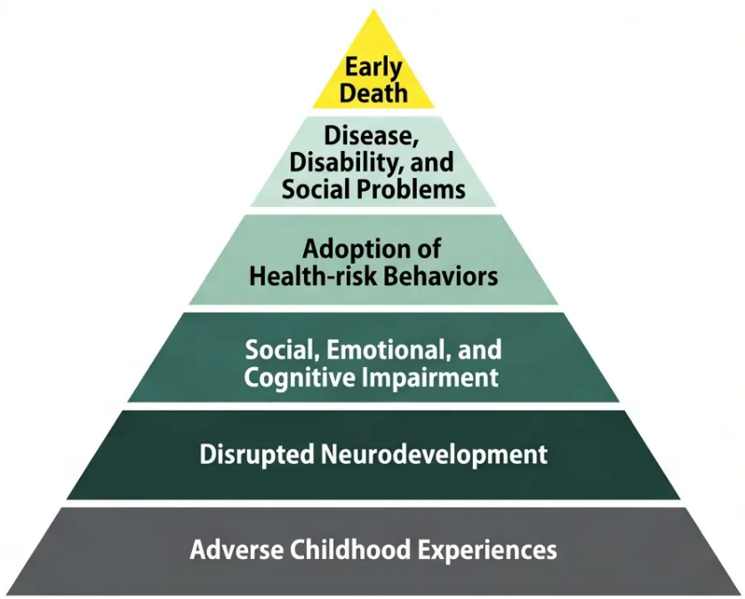
SECTION 5
ADVERSE CHILDHOOD EXPERIENCES (ACEs)
What Are ACEs?
“Stressful or traumatic events in childhood with lasting negative effects on health and wellbeing.”
CDC-Kaiser ACE Study, 1998
CHILD MALTREATMENT
HOUSEHOLD ACEs
Verbal abuse
Alcohol abuse in household
Parental separation or divorce
Physical abuse
Mental illness in household
Sexual abuse
Domestic violence
Emotional neglect
Incarceration of a family
member
Physical neglect
Drug use in household
Each ACE adds cumulative risk
ACE score 4+ = significantly increased risk of multiple adverse health outcomes across the life course
www.bradfordvts.co.uk

Slide 25
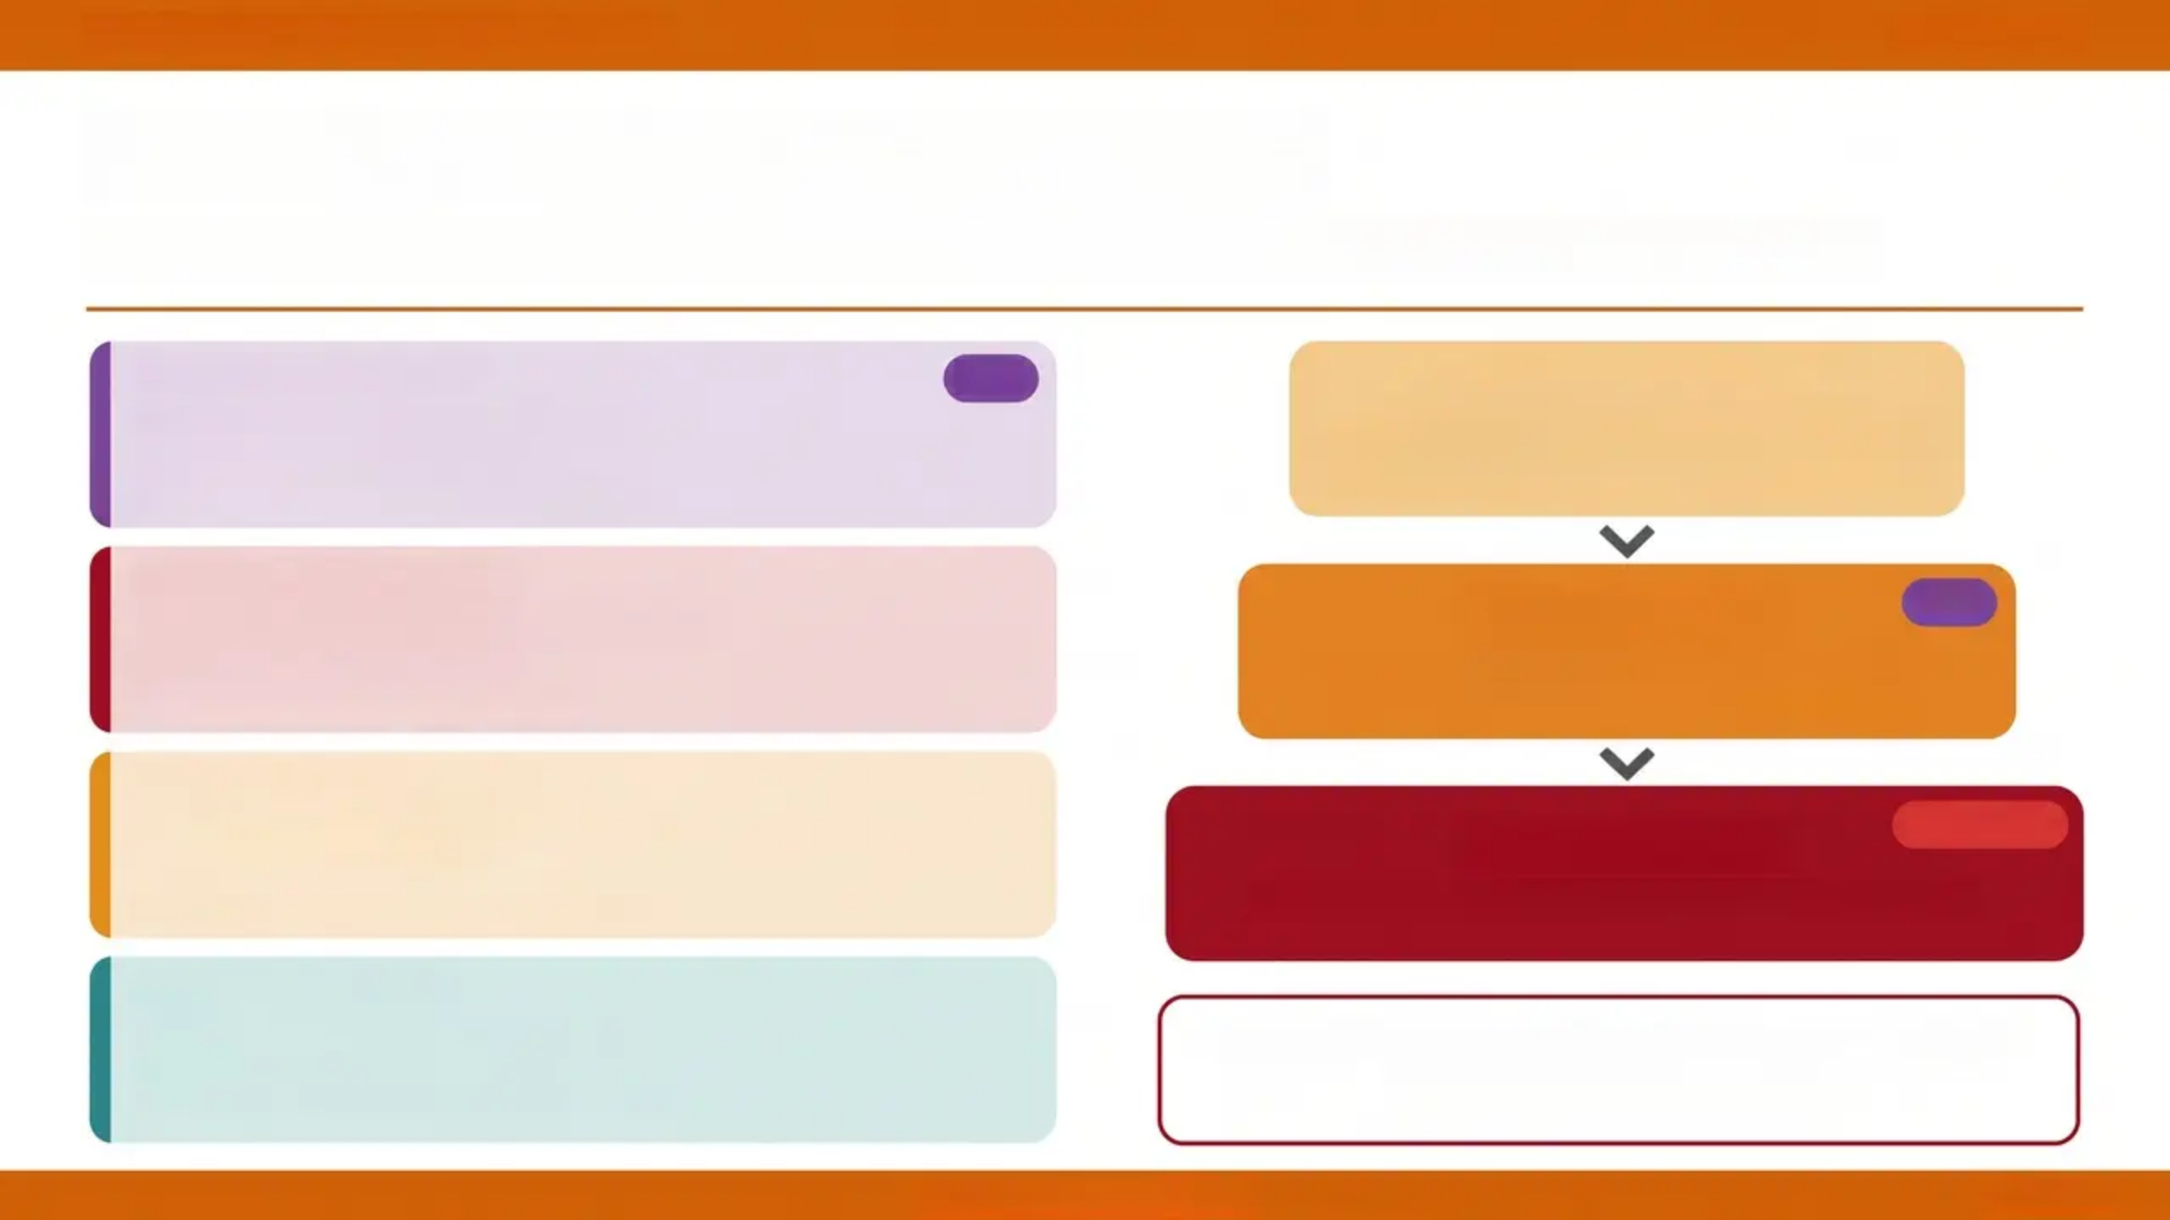
Section 5 of 5
ACEs and Health Outcomes
Each additional ACE increases cumulative risk across the life course
MENTAL HEALTH
AKT
ACE Score 1–3
• Depression, anxiety, PTSD
• Suicidity and self-harm
• Substance misuse as coping
Elevated risk begins — mental health
and behavioural impacts
PHYSICAL HEALTH
ACE Score 4+
AKT
• Heart disease, diabetes, obesity
• Cancer risk elevated
• Chronic pain syndromes
Significantly increased risk of multiple
adverse health outcomes
BEHAVIOURAL RISK
• Smoking, alcohol, drug misuse
• Sexual risk-taking
• Poor help-seeking behaviour
ACE Score 6+
20-year reduction in life expectancy
SOCIAL IMPACT
• Unemployment and poverty
• Relationship difficulties
• Perpetuation across generations
ACE score 6+ = 20 fewer years of life
Source: CDC-Kaiser ACE Study
www.bradfordvts.co.uk
Slide 26 of 33

Slide 26






ADVERSE CHILDHOOD EXPERIENCES GP Safeguarding Role
27 / 33
ACEs and the GP Safeguarding Role
Trauma-informed care — breaking the cycle across generations
AWARENESS
Think about your adult patients' own ACEs
Resilience Factors
A parent's unresolved trauma directly shapes their parenting
capacity — ask about their childhood when relevant.
These can buffer ACE impact — identify and strengthen them
Supportive adult relationship
IDENTIFICATION
At least one trusted, stable adult in the child's life
Recognise children with multiple ACE stressors
Multiple safeguarding concerns = high ACE burden. Consider
cumulative risk — not just the presenting issue.
Positive school engagement
Attendance, belonging, and achievement at school
ACTION
Community support
Signpost to Early Help early
Access to youth services, faith groups, local networks
Early Help can be as effective as formal referral for mild-to-
moderate risk. Don't wait for crisis.
"Trauma-informed care means
asking 'What happened to you?' —
not 'What's wrong with you?'
⚠️ Pitfall to avoid: Focusing only on the child — the whole
family system carries ACE burden.
www.bradfordvts.co.uk

Slide 27
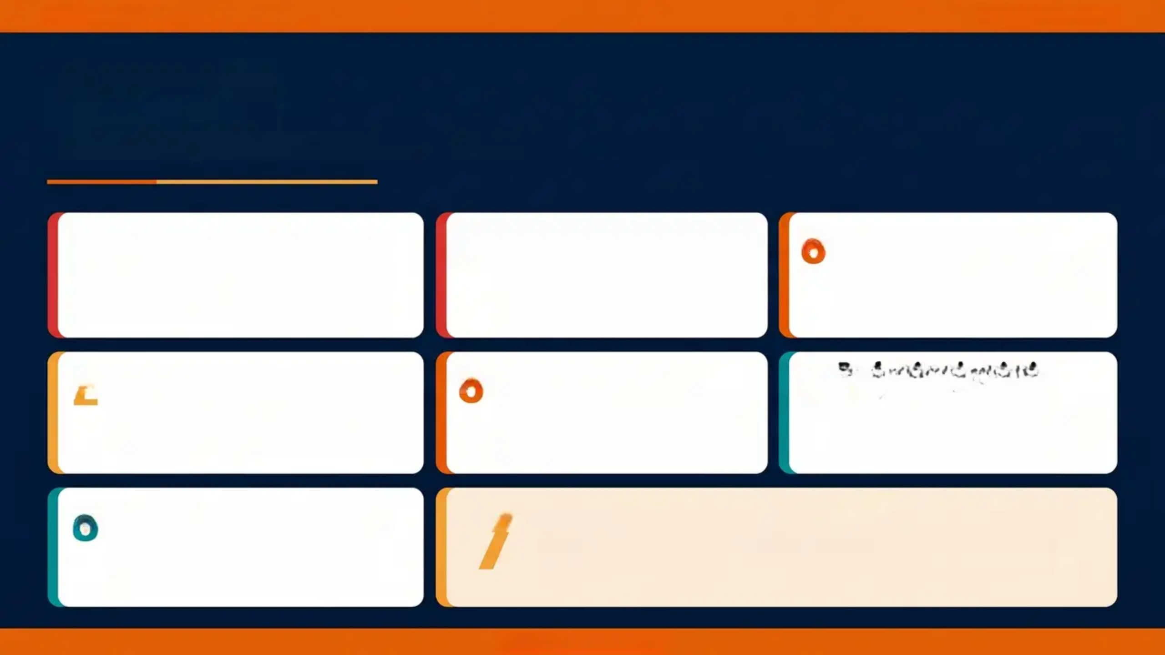
BRADFORD VTS TEACHING DECK
www.bradfordvts.co.uk
Top Tips
7 things every GP trainee must know
1
4
“Train track” injuries and
knife wounds
5
PND coding matters
Perinatal mental health kills
Ask directly. Most perinatal suicides use
violent methods. Use EPDS at postnatal
check. Refer urgently if in any doubt.
Depression within 1 year of birth IS
postnatal depression. Code it correctly,
note safeguarding implications, involve
health visitor.
Always ask about gang involvement and
document carefully. These are not just
accidental injuries.
2
5
PND coding matters
Professional curiosity
is not optional
County Lines = modern slavery
6
Unexplained gifts, going missing, new
older friends with nicknames → refer to
MASH immediately.
Depression within 1 year of birth IS
postnatal depression. Code it correctly,
note safeguarding implications,
involve health visitor.
Look beyond the presenting complaint.
Use the 5 Whys technique to probe
deeper when something feels wrong.
3
7
ACE score 4+ is a GP priority
Pre-birth referral at 12 weeks
Not just a social issue. Significantly
increased risk of mental and physical
illness throughout life.
Safeguarding concerns about an unborn baby? Do not wait until birth.
Refer to Children's Social Care from 12 weeks gestation.
www.bradfordvts.co.uk

Slide 28
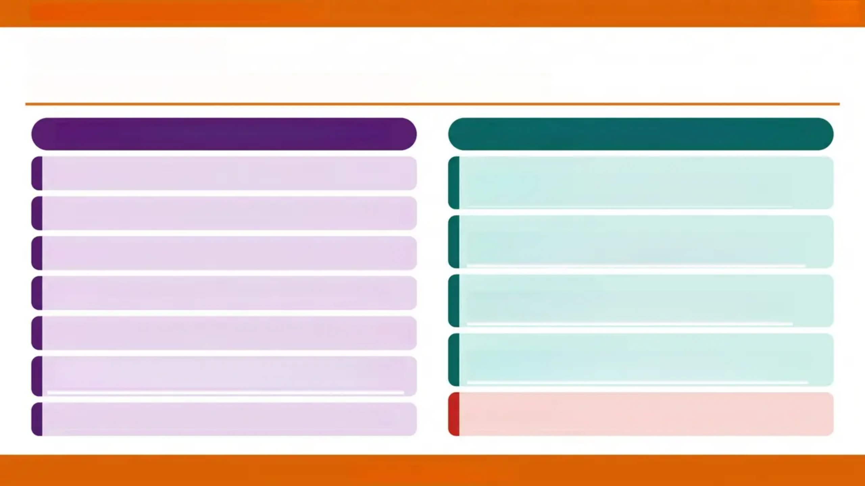
Bradford VTS Teaching Deck — Safeguarding Children
Exam Pearls
High-yield facts for your AKT and SCA — know these cold
AKT — KNOWLEDGE & STATISTICS
SCA — COMMUNICATION SKILLS
NEW MOTHER — MOOD
Perinatal mental illness affects up to 1 in 5 women
“I’m worried about how you’re feeling — can you tell me
more about how things are at home?”
Postpartum psychosis: 2 per 1,000 births — severe, admit to MBU
BABY WELLBEING CHECK
“How are you finding things with the baby? How is feeding
and sleeping going?”
EPDS ≥ 13 suggests postnatal depression — validated screening tool
EXPLOITATION CONCERN
Current standard: Intercollegiate Document 2025 (not 2019)
“I’m concerned some of what you’ve described might be
putting you at risk. I’d like to talk about this with you…”
GPs require 12 hours safeguarding training every 3 years (Level 3)
CONFIDENTIALITY BOUNDARY
“I want to be open with you — there are some things I may
need to share with others to keep you safe.”
CCE definition (Home Office 2018) — ‘does not always involve
physical contact’
NEVER SAY THIS
CSERQ15: 5+ positive responses = mandatory action required
Never promise confidentiality in any safeguarding context.
www.bradfordvts.co.uk

Slide 29
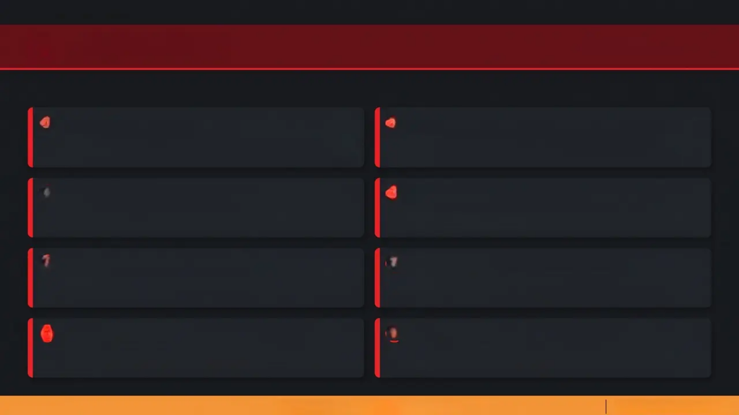

Slide 30 of 33 — Red Flags
RED FLAGS
Immediate Action Required
THE FOLLOWING SIGNS REQUIRE URGENT CLINICAL RESPONSE – DO NOT DELAY
1
Postpartum Psychosis
2
Violent Suicidal Ideation — Perinatal Period
Rapidly changing mental state, delusions or hallucinations after
birth — EMERGENCY: admit to Mother and Baby Unit immediately
Do NOT discharge without crisis plan. Hanging and jumping
are commonest methods — ask directly
Significant Estrangement from Infant
3
Infant
4
Knife Wounds / "Train Track" Injuries in Teenagers
Mother unable to bond with baby despite opportunity —
urgent review; safeguarding referral
Strong indicator of gang or County Lines exploitation —
document, ask about gang involvement
5
Child Repeatedly Going Missing
Pregnancy or STI in Child Under 13
6
Each episode = CSE/CCE until proven otherwise — refer to
MASH immediately
Mandatory immediate report to Children's Social Care —
no exceptions
7
ACE Score 6+
8
Perinatal Period + Domestic Abuse
20-year life expectancy reduction — intensive early support
and multi-agency involvement required
Highest risk period for escalation — safeguarding referral
and safety planning essential
Red = Immediate Action Required
www.bradfordvts.co.uk

Slide 30



‘Amber = Pitfall to Avoid’
'COMMON PITFALLS'
Not asking fathers about mental wellbeing
AVOID THESE ERRORS
Not coding postnatal depression correctly
Perinatal mental illness affects 1 in 10 men —
routinely include fathers
Depression within 1 year of birth IS PND — code it
correctly for risk stratification
Missing suicidal ideation in perinatal women
Using outdated 2019 ICD thresholds
Depression is under-recognised; perinatal suicides
often use violent methods — ask directly
Training requirements have changed — use 2025
ICD standards (12 hrs/3 yrs, Level 3)
Accepting ‘he just fell’ for knife wounds
Assuming exploitation requires physical
Professional curiosity is not optional — probe
beyond the presenting story
CCE ‘does not always involve physical contact’ —
Home Office 2018
Not referring pre-birth when concerns exist
Safeguarding concerns about unborn babies should be referred from 12 weeks — do NOT wait until delivery
www.bradfordvts.co.uk
31 / 33

Slide 31
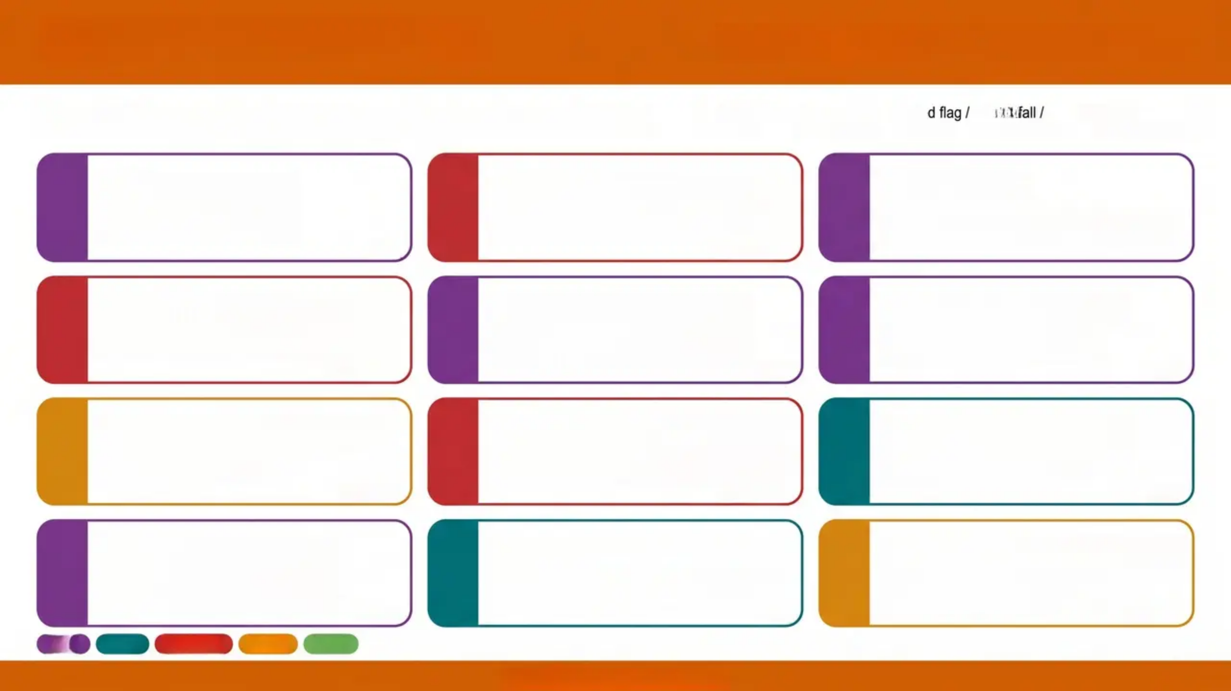



QUICK RECALL
Key facts — 6 words or fewer
Read each card. If you hesitate — revise that section.
1 in 5 women:
perinatal MH
Postpartum psychosis:
2/1,000 births
EPDS ≥13:
postnatal depression
Perinatal suicide: violent
methods commonest
ACE score 4+:
lifelong health risk
CCE: no physical
contact needed
CSERQ15: 5 positives
= refer now
County Lines:
cuckooing, debt bondage
Pre-birth referral:
from 12 weeks
GPs: 12 hrs
training / 3 years
Think Family:
parent's ACEs matter
Exploitation: professional
curiosity essential
www.bradfordvts.co.uk

Slide 32

BRADFORD VTS TEACHING DECK
SLIDE 33 OF 33 — CLOSING DISCLAIMER
Important Disclaimer
This teaching deck has been produced for educational purposes only, as part of the
Bradford VTS GP Training Programme.
Always verify clinical information, drug doses, and safeguarding thresholds against the
most current guidance, including:
- NICE guidelines (including NG193, CG89)
- British National BNF
- Working Together to Safeguard Children (2026)
- RCPCH Intercollegiate Safeguarding Document (2025, 5th edition)
Clinical guidance is subject to change. It is the responsibility of each clinician to ensure they
are practising in accordance with current, locally agreed protocols and national standards.
This document does not constitute medical or legal advice.
Created May 2026 | Updated to NICE NG193 (2023) & Working Together 2026 standards | Source file: safeguarding training – children – 2019.pptx
www.bradfordvts.co.uk

