Slide 1


BRADFORD VTS TEACHING DECK
Safeguarding Adolescents
in General Practice
www.bradfordvts.co.uk
Created May 2026, updated to current Working Together 2026
and GMC 0-18 guidance standards
For GP Trainees — SCA/AKT Exam Preparation
Disclaimer: Always double check this advice and drug doses with the latest NICE/BNF guidance.
This document is for educational purposes only.
www.bradfordvts.co.uk

Slide 2
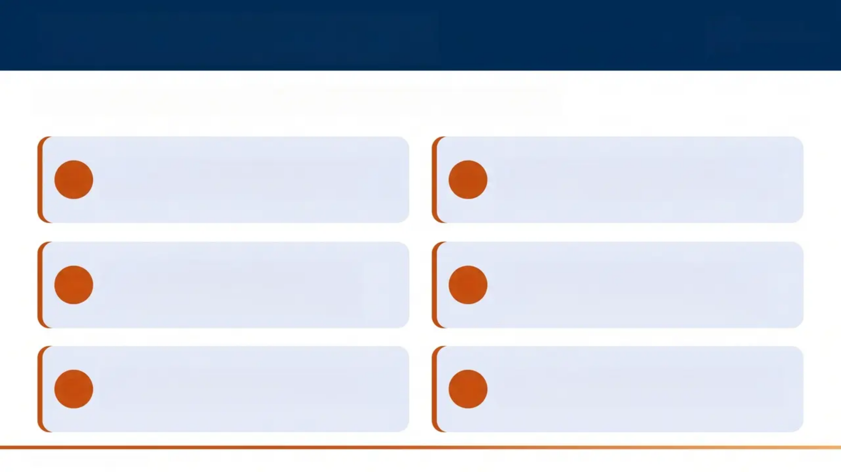
Learning Objectives
RC
GP
Royal College of
General Practitioners
By the end of this session, GP trainees will be able to:
— Describe adolescent development and
why it creates unique safeguarding risk
— Apply Gillick competence and Fraser
guidelines correctly in clinical practice
01
02
— Identify red flags for Child Sexual
Exploitation using the SAFEGUARD
mnemonic
— Navigate confidentiality and
information sharing under GMC 0-18
guidance
03
04
— Understand the legal framework
around under-13s, capacity, and consent
— Prepare confidently for AKT and SCA
questions on adolescent safeguarding
05
06
www.bradfordvts.co.uk

Slide 3





Adolescent Development Overview
Ages 10-25 | WHO · AYPH · UNICEF definition
Young Adolescent — 10-14 yrs
Middle Adolescent — 15-17 yrs
Late Adolescent — 18-24 yrs
Physical
Brain
Cognitive
Emotional & Social
• Growth spurt &
reproductive maturation
• Girls: peak puberty
~12-13 yrs
• Boys: peak puberty
~13-14 yrs
• Muscle strength
develops into the 20s
• Development
continues to age 25
• Reward systems
mature before
regulation
• Explains risk-taking &
sensation-seeking
• Analytical thinking
develops
• Weighing risk &
learning from
experience
• Forming own values &
ethics
• Identity & self-esteem
forming
• Peer influence
becomes paramount
• Seeking
independence from
family
www.bradfordvts.co.uk
Safeguarding Adolescents in General Practice | Bradford VTS

Slide 4

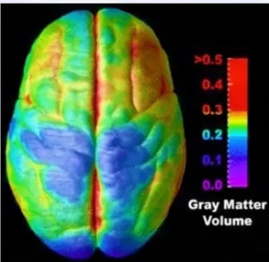
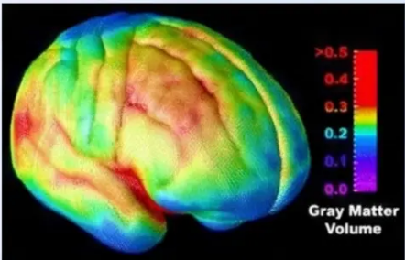

Brain Development & Risk-Taking
*Why adolescents are wired differently — and why it matters clinically
1
MRI EVIDENCE
Brain development continues until age 25
Major reorganisation and fine-tuning throughout adolescent years
THE KEY IMBALANCE
2
THE KEY IMBALANCE
‘Reward system’ (dopaminergic pathways) → develops early and fast
— Sensation-seeking, motivation, social sensitivity
‘Regulatory system’ (prefrontal cortex) → develops slowly and late
— Impulse control, risk assessment, consequence weighing
Gray matter volume changes across adolescent
development (MRI evidence)
This gap explains adolescent risk-taking behaviour
3
> “The social brain undergoes profound
change during adolescence — understanding
this is essential for safeguarding practice.”
WHY IT MATTERS
Behaviour that looks like a “lifestyle choice” may reflect
neurological immaturity — not moral failing
www.bradfordvts.co.uk

Slide 5
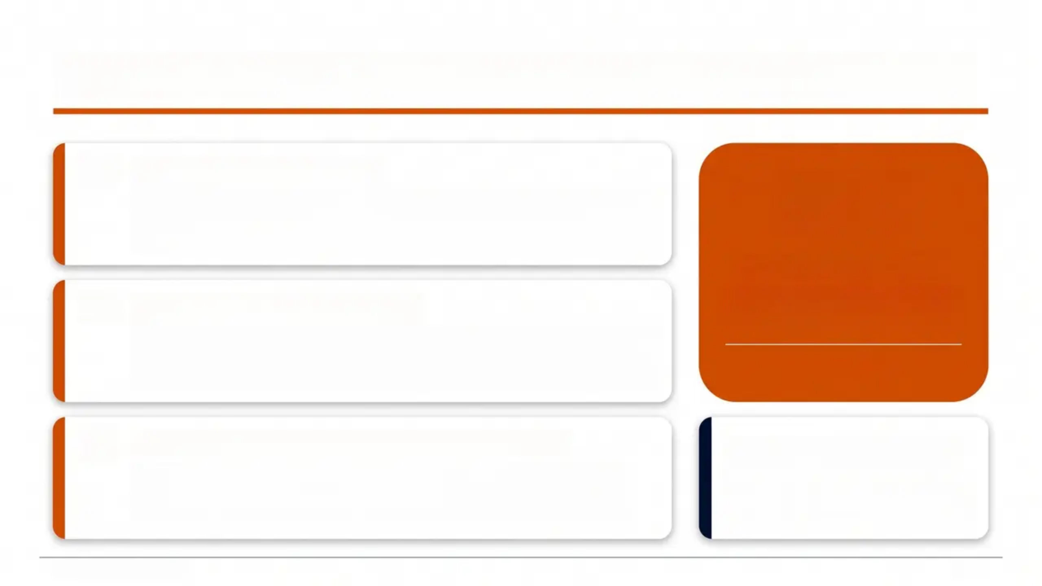



Why Adolescence is Particularly Risky for Safeguarding
The Normalisation Trap
10%
Behaviour that would be clearly abusive in younger children may be
dismissed as ‘typical teenage behaviour’ by professionals — this is
one of the most dangerous pitfalls in adolescent safeguarding.
of 11-17 year-olds
Polyvictimisation at Age 14
have experienced 12+ forms
of maltreatment simultaneously
Age 14 is peak risk for polyvictimisation — being victim of many
types of maltreatment simultaneously. 10% of 11-17 year-olds in the
UK have experienced 12 or more forms of maltreatment (NSPCC).
Source: NSPCC
Professional & Cultural Bias Can Be Fatal
“Lifestyle choice is not
a clinical diagnosis.”
Rochdale SCR (2013): Girls repeatedly raped were dismissed as
making a ‘lifestyle choice.’ Cultural and professional bias actively
prevented identification of abuse.
Bradford VTS Teaching Principle
www.bradfordvts.co.uk
6 / 31

Slide 6
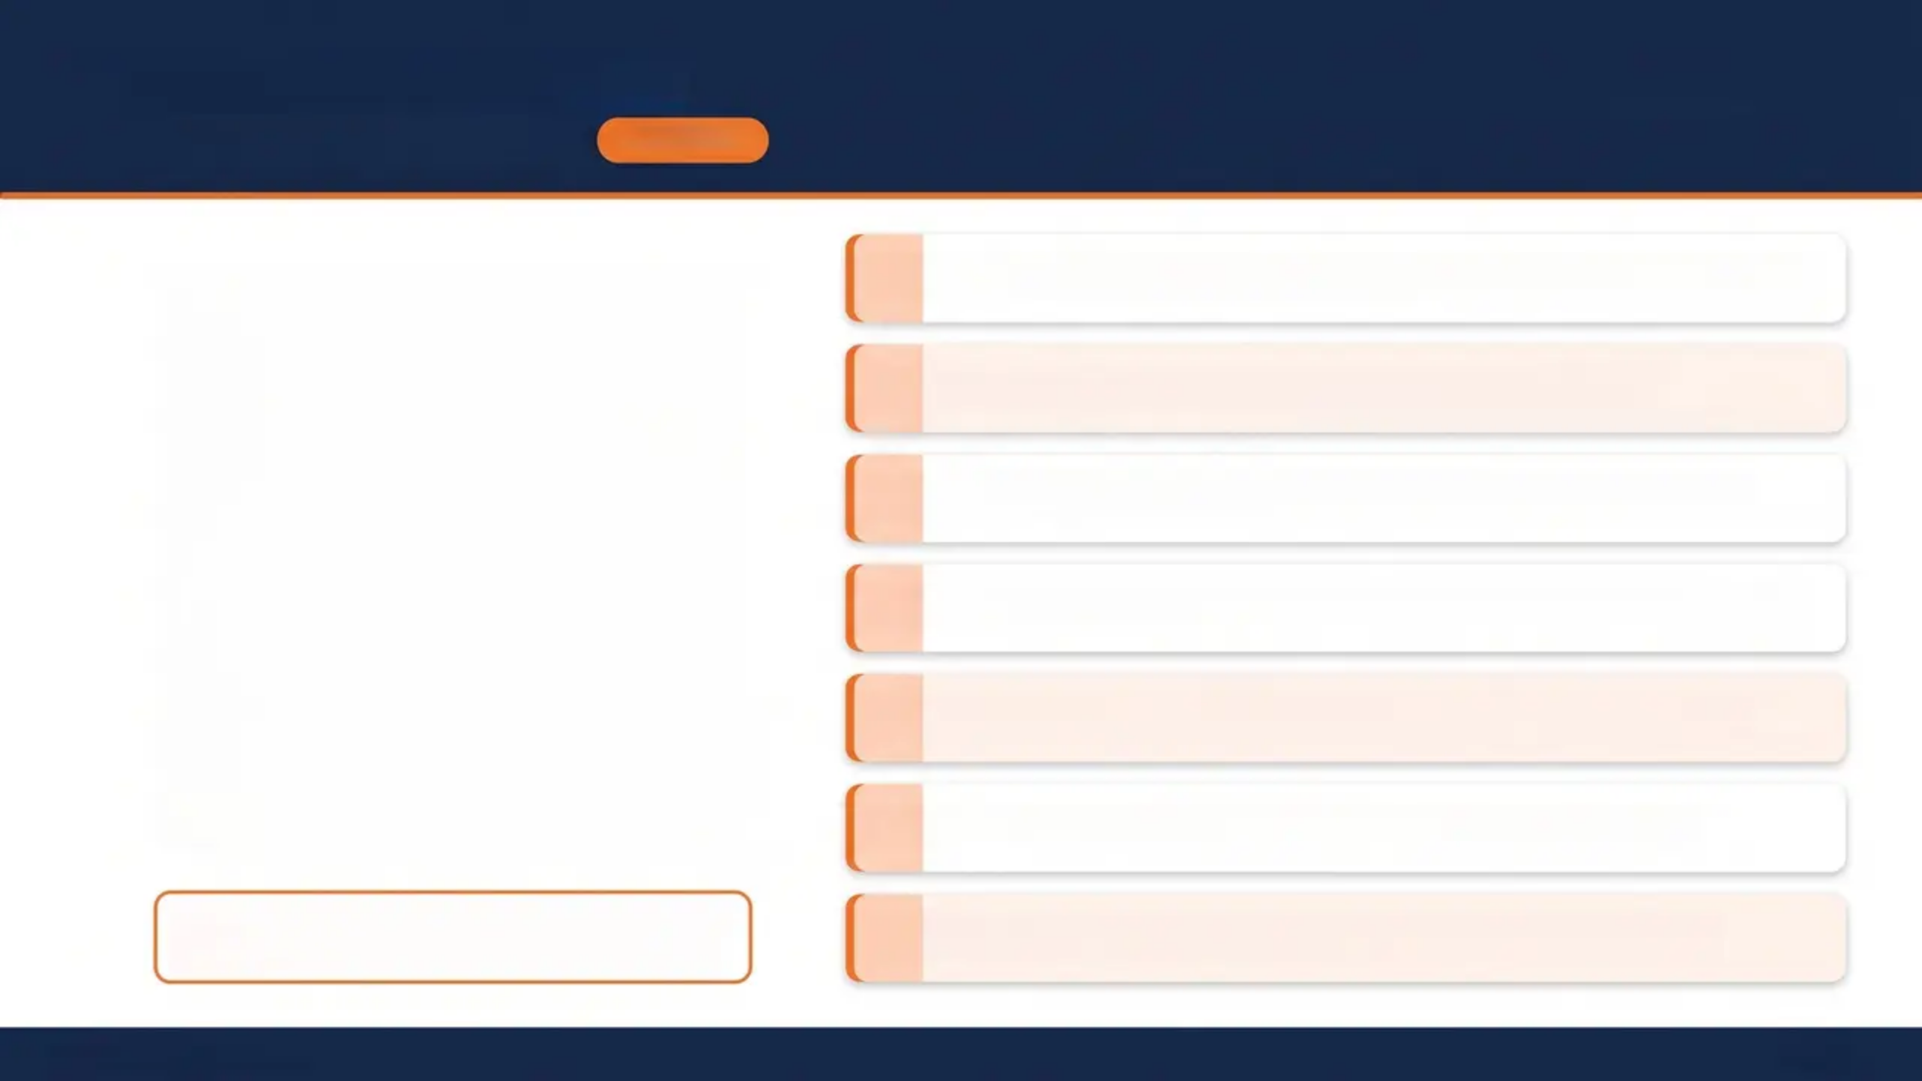
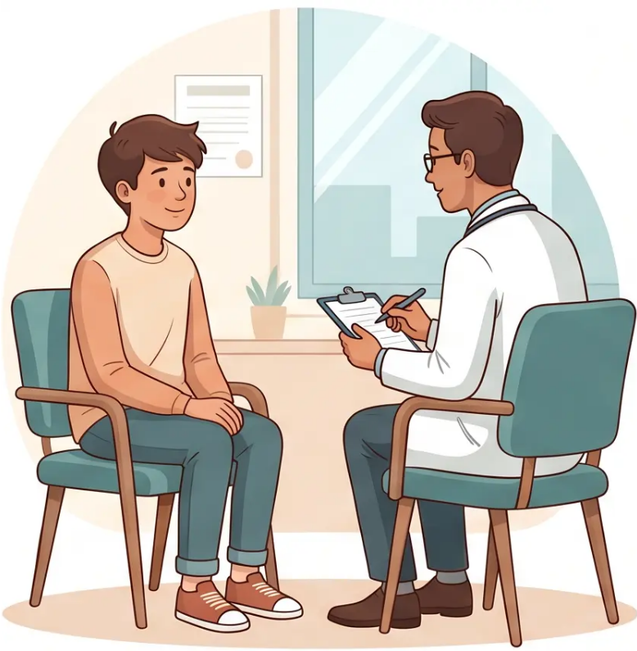
Gillick Competence &
Fraser Guidelines
For under-16s • Assessed every consultation
UNDER 16s
1
Understands the nature & purpose – of the proposed intervention
2
Understands the alternatives – and their associated risks
3
Understands there is a choice – and that choices have consequences
4
Understands risks & side effects – of the proposed treatment
5
Can weigh information – to arrive at a reasoned decision
6
Willing to make a choice – including deferring to another person
*Must be assessed fresh at every consultation –
capacity can fluctuate.
7
Free from undue pressure – decision must be truly voluntary
www.bradfordvts.co.uk
7 / 31

Slide 7
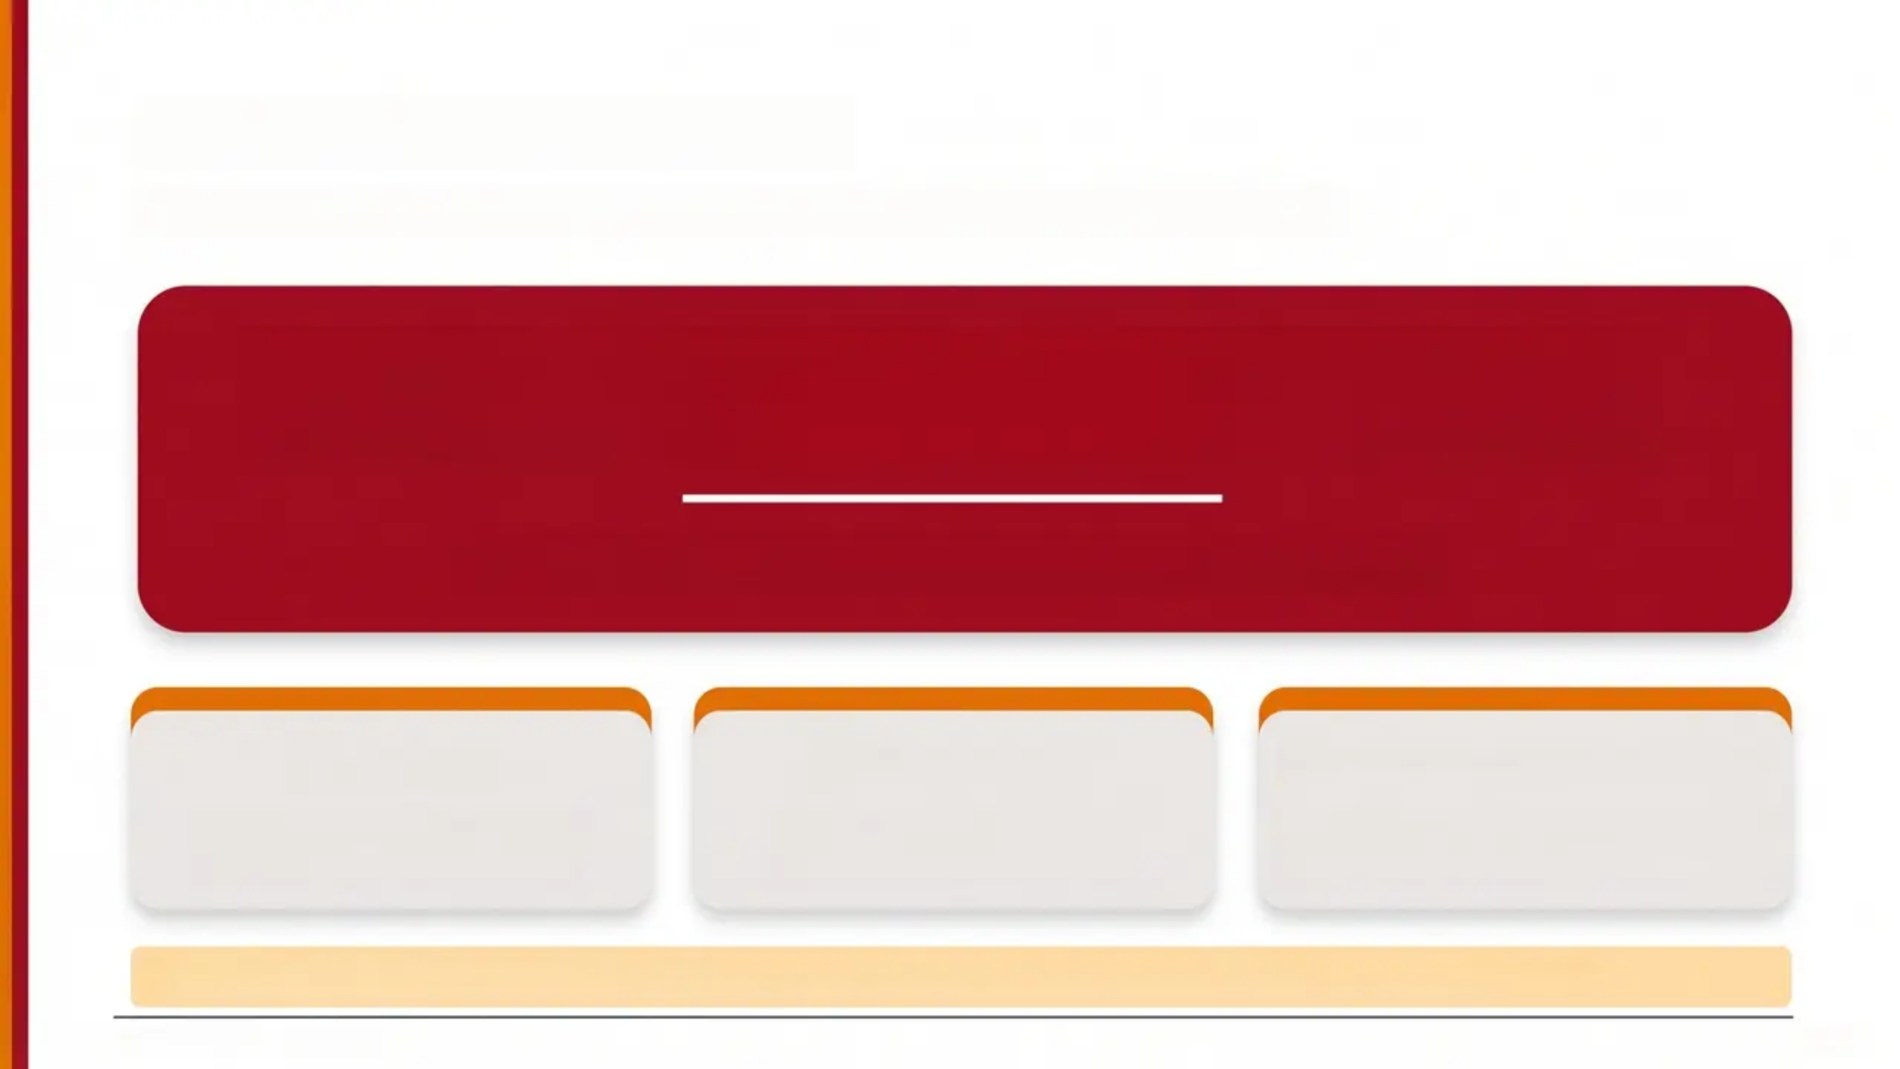



Under 13s: The Rule
*The most important legal line in adolescent safeguarding*
A child under 13 CANNOT legally consent to sexual activity.
Any sexual activity involving an under-13 is a crime.
You MUST usually share this information.
Report
Document
Do NOT assess Fraser
Consult named/designated
doctor for child protection
Record your decision and
reasoning clearly
Fraser competence does not apply
to under-13s for sexual activity
🎓 AKT Pearl: “Under 13 = no Fraser assessment needed. Report directly. No exceptions.”
www.bradfordvts.co.uk
8 / 31

Slide 8







09
16-18 Years: Capacity & GMC Guidance
Mental Capacity Act 2005 + GMC 0-18 Guidance
Public Interest: Grounds for Disclosure
Presumed to Have Capacity
GMC 0-18 — Even with capacity, you may share when...
Young people aged 16-18 are
presumed to have capacity under
the Mental Capacity Act 2005
Serious Harm or Death
Serious Crime
To protect the young person or
someone else from death or
serious harm
To prevent, detect, or prosecute
a serious criminal offence
Capacity must still be assessed at every
consultation — it can fluctuate
Neglect or Abuse
Serious Risk Behaviour
When a child is at risk of
neglect or abuse
Behaviour putting self or others
at serious risk — e.g., serious
addiction, self-harm, joy-riding
Having capacity does NOT mean information can never be shared — public interest can override.
www.bradfordvts.co.uk
Safeguarding Adolescents in General Practice

Slide 9




Confidentiality in
Adolescent
Consultations
Always tell first
Tell the Young Person First
Before sharing information, always inform the young
person — unless doing so would put them at further risk.
GMC 0-18 Guidance
When you MUST share
When You Must Share Information
• Partner in position of trust (teacher, coach, care worker)
• Force, threat, bribery, or payment involved
• Drugs or alcohol used to influence sexual activity
• Large age or power difference between partners
• Person known to authorities for abusive relationships
"Explain the consultation is
confidential — but if there
are serious concerns about
safety, you MUST act."
The golden rule
— GMC 0-18
Never Promise Absolute Confidentiality
Say instead: 'Consultations are usually confidential, but
if I'm worried about your safety I would need to tell
someone — and I'd tell you first.'
www.bradfordvts.co.uk
Safeguarding Adolescents in General Practice
10

Slide 10




CONSULTING ALONE WITH YOUNG PEOPLE
Practical strategies for creating a safe, private consultation space.
Creating the Space
Useful Phrases
Make it clear young people can see you alone —
display a visible “Talk to Us” leaflet in the waiting room
“It’s great that Amy has come to get things sorted
and has you to help her. As she’ll be using the
contraception I’ll have a chat with her first by
herself and then we can fill you in at the end.”
Never imply they must bring a parent to access
services
Consider end-of-surgery or longer appointments for
sensitive conversations
— Opening a private consultation
Think carefully about chaperones — they can deter
young people from being honest
“It’s really helpful you’re here. I’d like to have 5
minutes with [name] by myself as part of my
routine check — I’ll make sure to include you at
the end.”
Can my 14 year
old see the doctor
without me?
Yes, the under-16s
can see us alone,
with a parent,
carer or friend
— SCA-ready phrasing
Never give the impression that young people cannot
access services without a parent present.
www.bradforddpts.co.uk

Slide 11
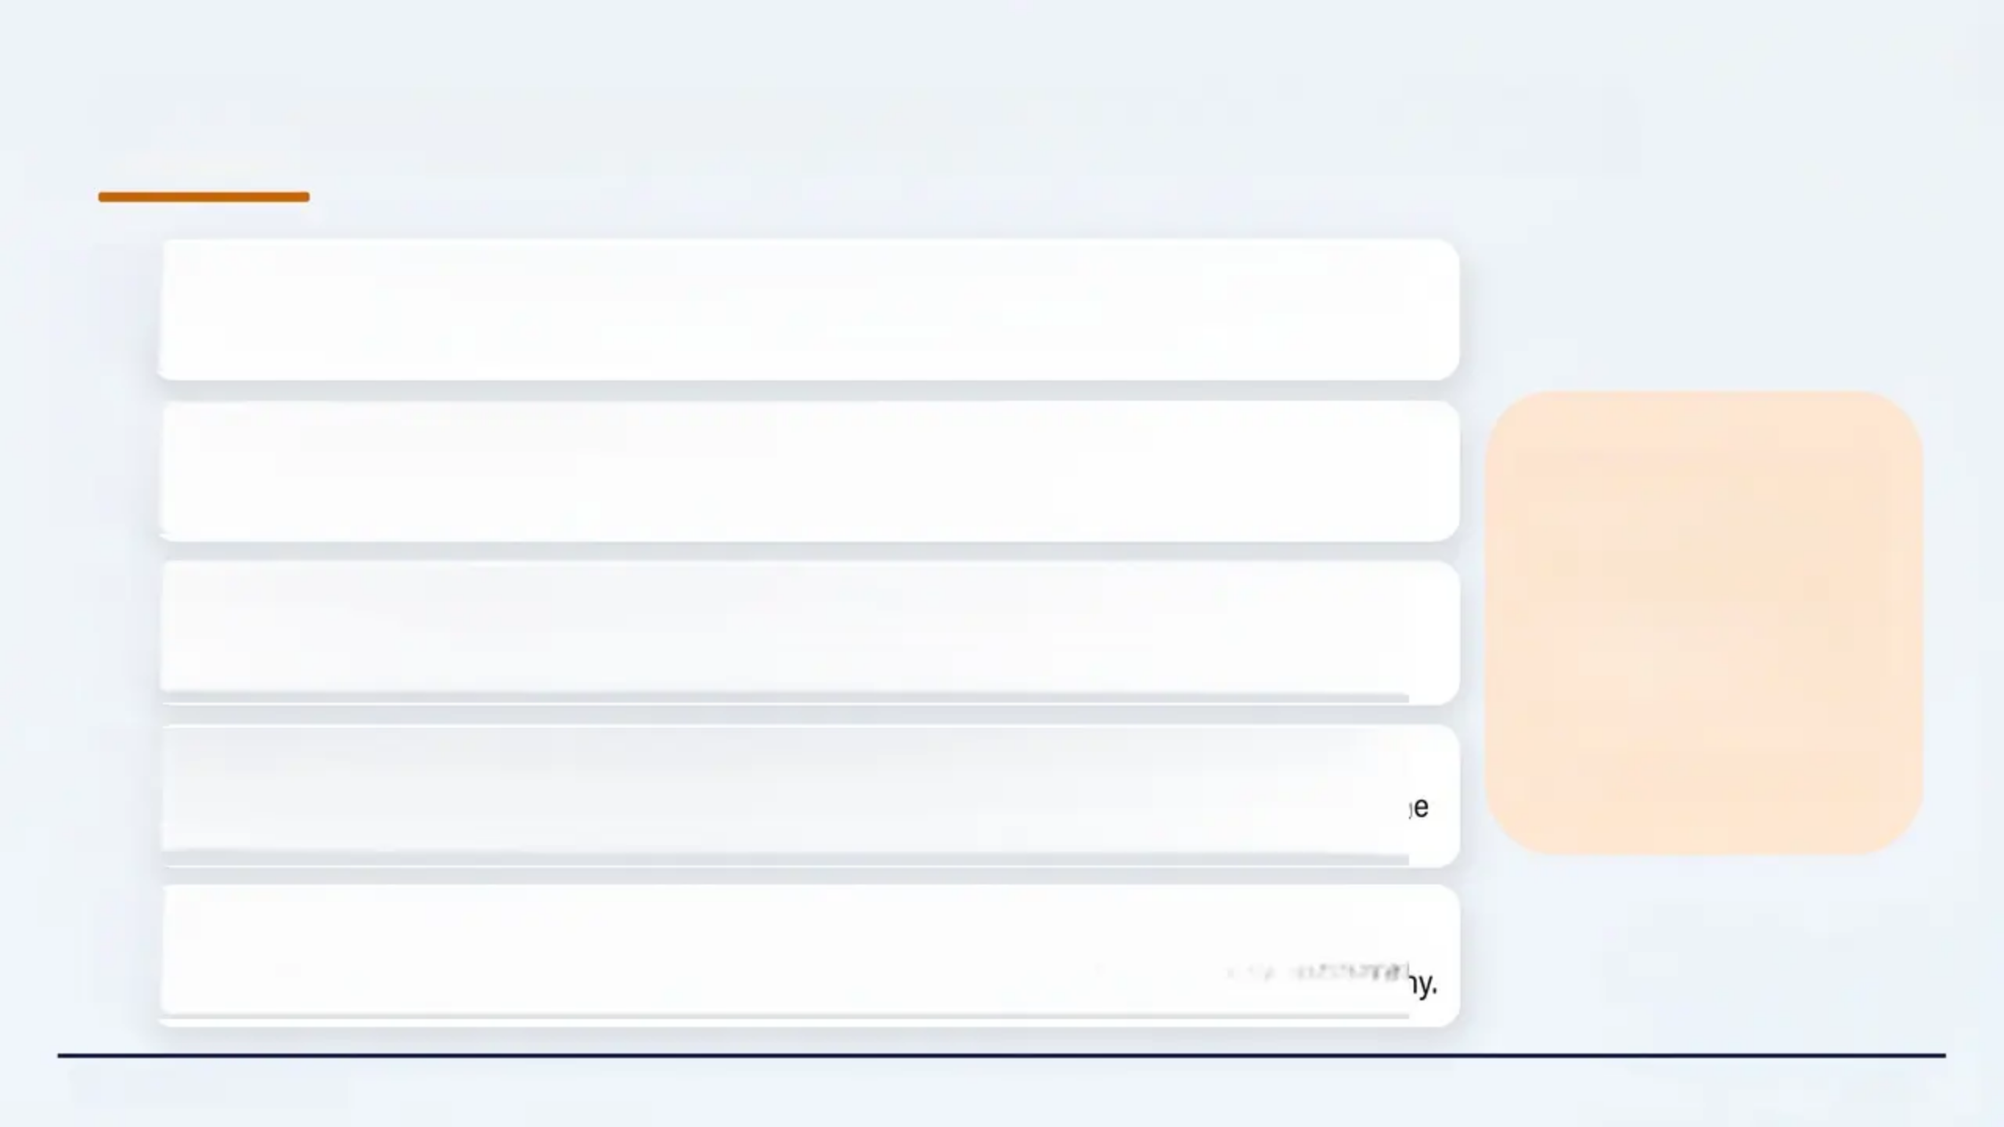
Handling Disclosure: A Practical Approach
1
Create Safety First
Act in the best interest of the young person. Ensure immediate safety before anything else.
2
Stay Calm and Acknowledge
“We need to make sure
you are safe. I’m going
to speak to another
professional about this
— and I’ll let you know
what happens.”
“Thank you for telling me — that took courage.” Validate their trust without over-reacting.
3
Be Honest About Next Steps
‘Tell them you will need to share information. Do not promise absolute confidentiality.
Explain who you will speak to.
4
Make a Prompt Referral
Patient-facing language
Refer to social services or police without delay. Do not wait for consent if disclosure is in the
public interest.
5
Document Everything
Record your decision, reasoning, and actions clearly. Note if you chose not to share and why.
www.bradfordvts.co.uk
12 / 31

Slide 12


CSE: Definition & Key Statistics
WORKING TOGETHER 2026
WORKING TOGETHER 2026 DEFINITION
A form of sexual abuse where a child is sexually exploited in exchange for
something they need or want, and/or by the perpetrator through a power
imbalance.
May appear consensual — but is ALWAYS abuse. Online or offline.
1,400
9,000+
12–15 yrs
Children exploited in
Rotherham over 16 years
Children at risk of CSE
identified by police across
England & Wales in one year
Average age when CSE
concerns are first identified
(Jay, 2014)
(NSPCC)
(Beckett, Holmes & Walker, 2017)
Majority of victims are girls — but boys are also exploited, often with less visibility.
www.bradforddfts.co.uk
13 / 31

Slide 13
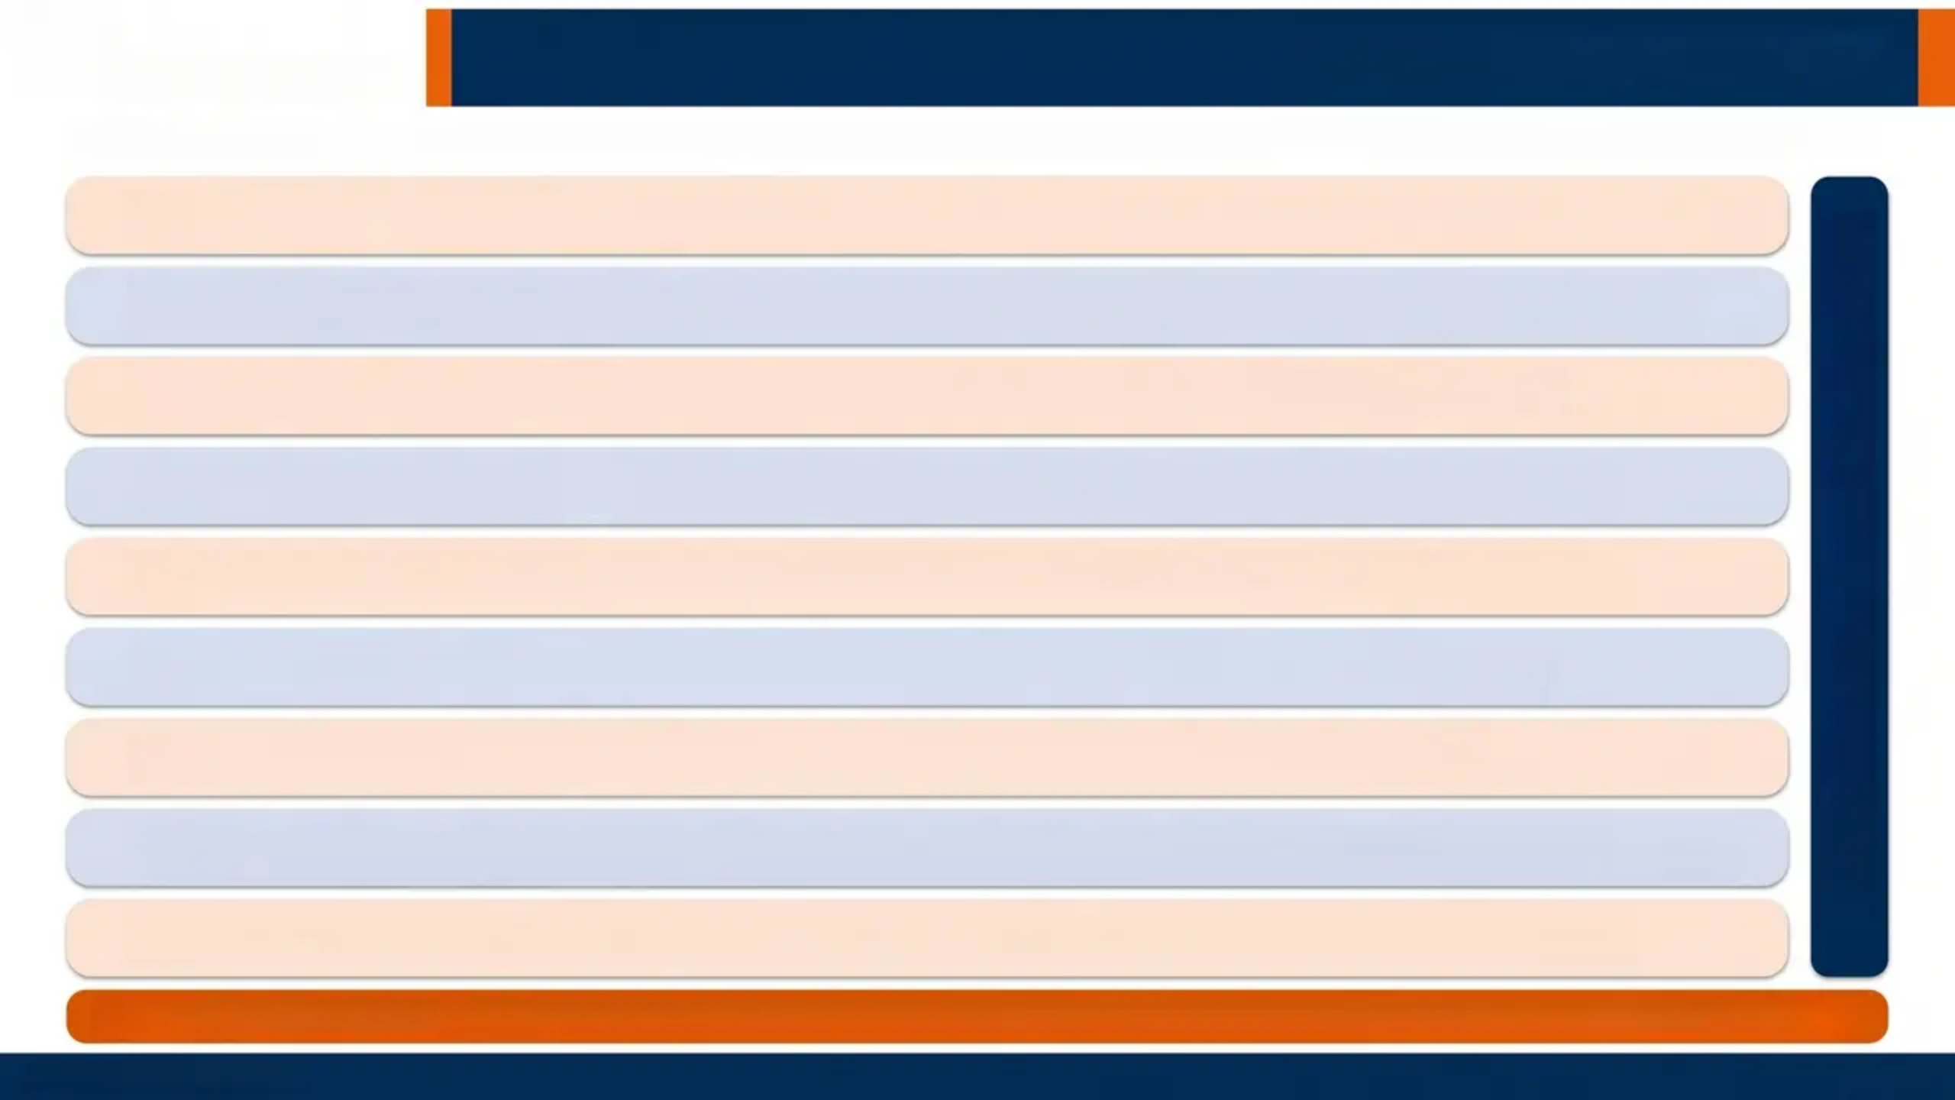

The SAFEGUARD Mnemonic
CSE Risk Indicator Screening Tool — use systematically with any teenager presenting with vague, sexual health, or mental health concerns
S
Sexual health & behaviour
STIs, pregnancy, terminations, sexualised behaviour
SAFEGUARD
A
Absent from school
Repeatedly missing school or running away
F
Familial abuse
Problems or abuse within the home
E
Emotional & physical condition
Poor mental health, learning disability
G
Gangs & older peer groups
Involvement in crime, older associates
U
Use of technology
Online exploitation, sexual bullying
A
Alcohol & drug misuse
Substance use as risk indicator
Receipt of unexplained gifts
R
Money, phones, clothes from unknown source
D
Distrust of authority
Avoidance of professionals, withdrawal
Use SAFEGUARD with ANY teenager presenting with vague symptoms, recurrent attendances, or unexplained concerns
www.bradfordvts.co.uk
14 / 31

Slide 14
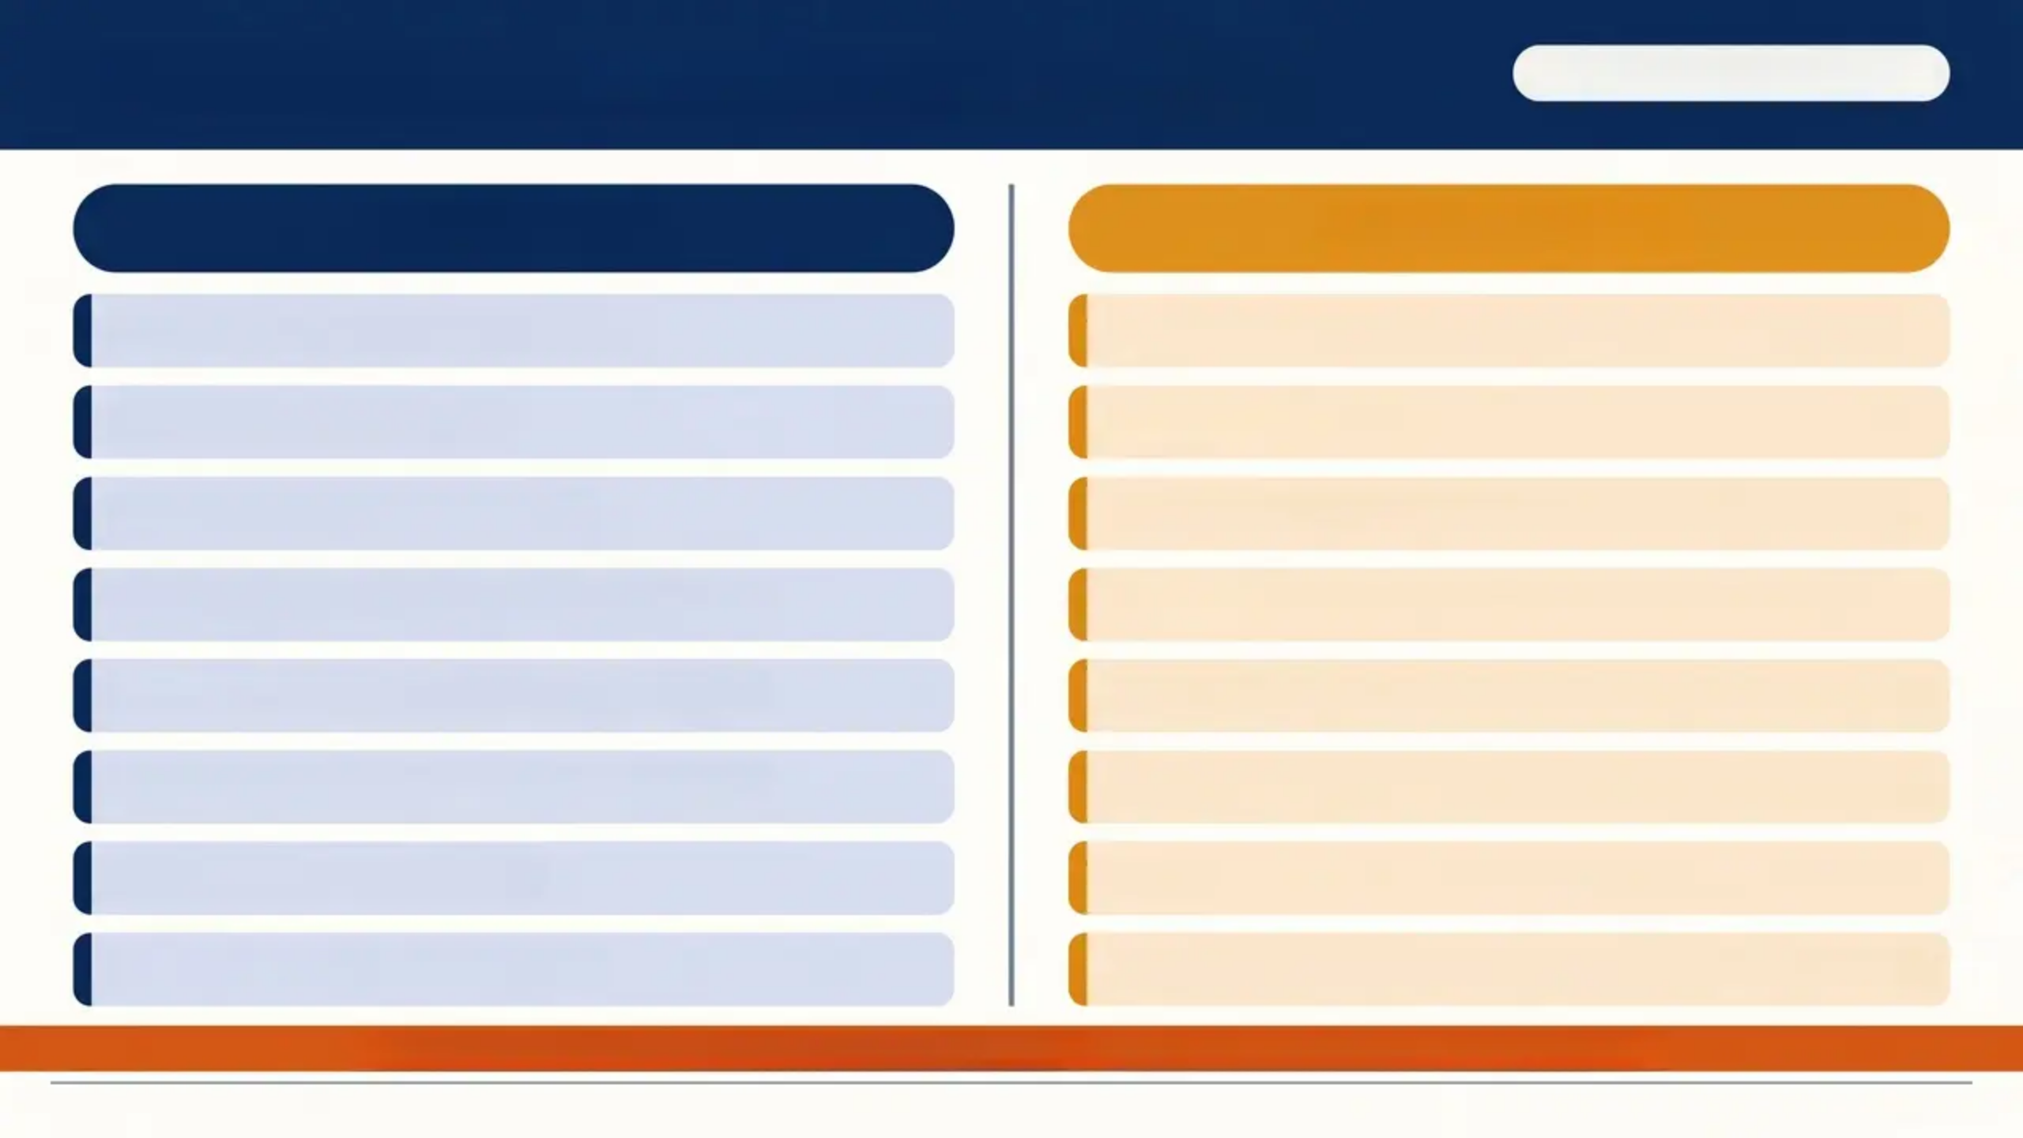
CSE Risk Factors & Warning Signs
Real Love Rocks — Barnardo's
Risk Factors
Warning Signs
Migrant / refugee / asylum seeker
Excessive/strange messages from unknown people
Financially unsupported
Returning home under influence of alcohol or drugs
Sudden changes in behaviour
Unexplained new gifts — phones, jewellery, trainers
Death, loss, or illness of significant person
Being picked up/dropped off by unknown people
Staying out overnight without explanation
Associating with adults over 18; invited to adult activities
Substance misuse (child, parent, or carer)
Mood changes — secretive, withdrawn, or aggressive
Experiencing homophobia
Marks or injuries concealed on body
Disappearing from 'the system'
Sudden change in friends, music, clothes, school attendance
*Disclosure and retraction of a statement is itself a red flag — not a reason to close the case.*
www.bradfordvts.co.uk
15 / 31

Slide 15
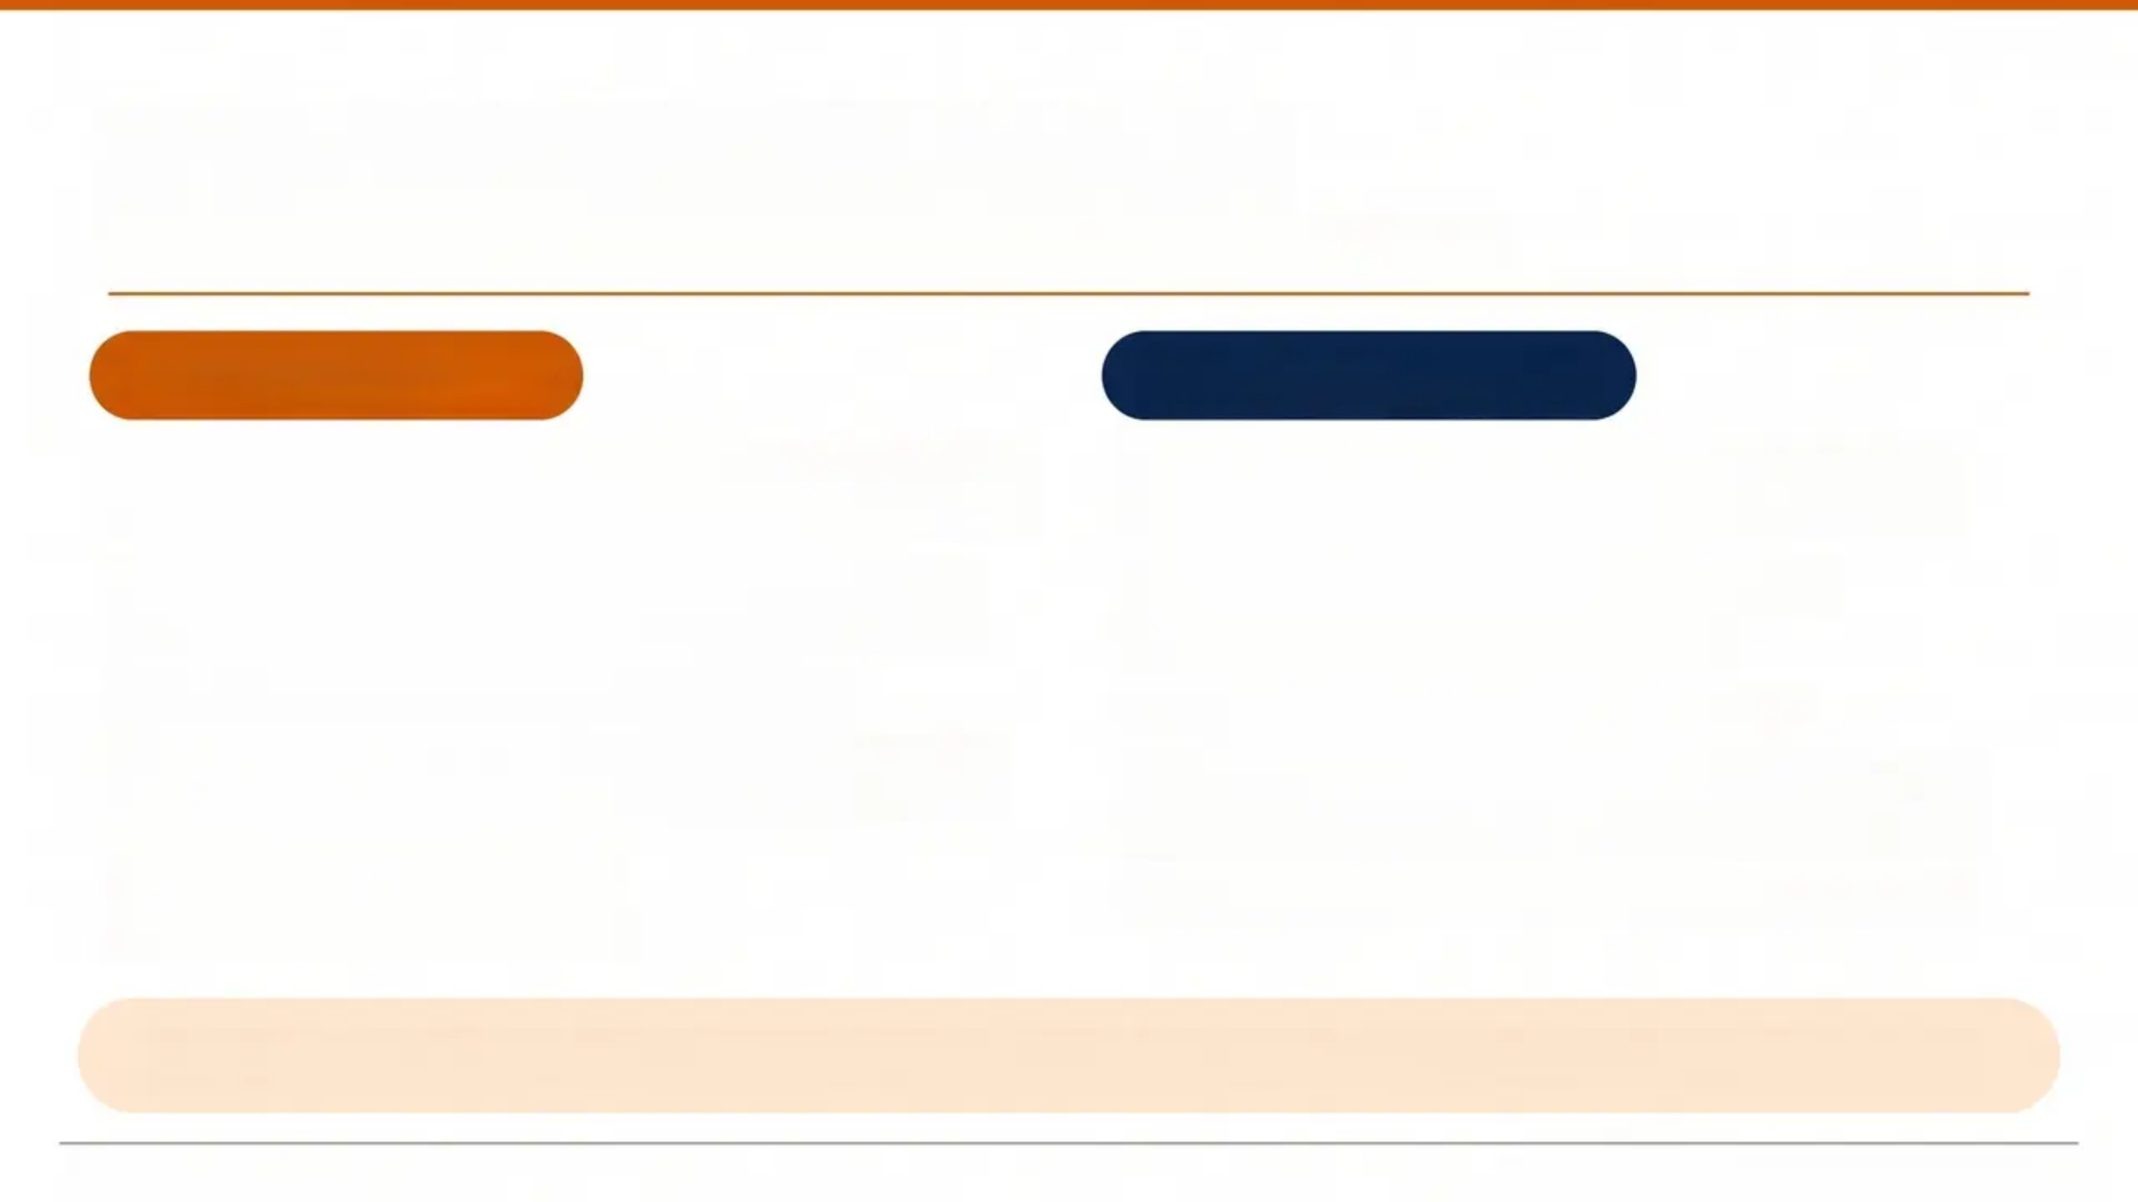
Asking the Right Questions
Screening for coercion, consent, and unsafe relationships
Consent & Safety
Relationship Check
Have you ever felt scared or uncomfortable
with someone you've had sexual contact with?
Have you ever been made to do something
sexual you didn't want to?
Do you feel you could say no to sex?
Has anyone given you gifts, money, drugs or
alcohol for sex?
Where do you have sex?
Who else is or was there?
Are you in a relationship? Can you tell me
about it?
Are you happy? What’s going well?
How were things at the start?
Do you feel good about yourself?
Has anything changed in how your partner
treats you?
Are you happy with the sex you're having?
It may take several appointments to build trust — these questions don’t need to be asked all at once.
www.bradfordvts.co.uk
Safeguarding Adolescents in General Practice

Slide 16
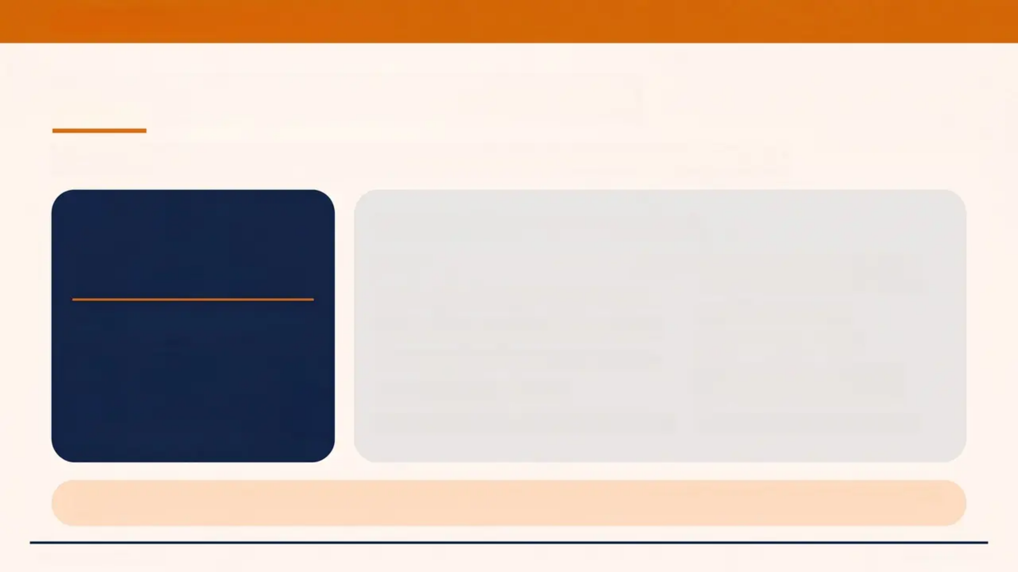
BRADFORD VTS TEACHING DECK
'The CSERQ15 Screening Tool'
Validated 15-item tool for Child Sexual Exploitation risk screening
15
CSERQ15 — Key Items Include:
Missing overnight without explanation
Parental substance misuse
or issues
screening items
Age gap of ≥4 years with partner
Self-harm history
Threshold for Action
Controlling or coercive relationship
Alcohol or drug use
5+
Sexual activity in unsafe locations
School exclusion or non-
attendance
Not living with parents
positive responses =
mandatory safeguarding action
Parental substance misuse or issues
STI or pregnancy under 16
Short on time? Use the CSERQ4 — a 4-item validated version for time-limited consultations.
www.bradfordvts.co.uk
Page 17 of 31

Slide 17


BRADFORD VTS TEACHING DECK
www.bradfordvts.co.uk
Virginity Testing and Hymenoplasty
Legal Update — Health and Care Act 2022
What is now illegal?
• Performing virginity testing on a woman of any age
• Performing hymenoplasty on a woman of any age
• Assisting or enabling either procedure
ILLEGAL
Applies regardless of consent
Since October 2022
Your Duty as a GP
• Refuse any request — explain the law clearly
• If patient is under 18 or appears coerced → consider
safeguarding referral
• If evidence of coercion → report to police
Health and Care Act 2022
England and Wales
Both are forms of honour-based abuse
⚠️ Key Exam Pearl: “Virginity testing and hymenoplasty are illegal in England and Wales since October
2022 — never perform either; always consider safeguarding if a patient under 18 is being pressured.”
www.bradfordvts.co.uk
Page 18 of 31

Slide 18




ADOLESCENT SEXUAL HEALTH DATA
NATSAL-3 Survey Data
“Understanding what is typical helps identify what is concerning”
16 years
16 years
— Age at first intercourse
— Age at first intercourse
30.9%
29.2%
— Had intercourse before age 16
— Had intercourse before age 16
6.5
5.2
— Average lifetime sexual partners
— Average lifetime sexual partners
46.0%
38.3%
— Had ≥1 new partner in last year
— Had ≥1 new partner in last year
“Average age when CSE concerns are first identified: 15–17 years — overlapping directly with peak sexual activity data”
www.bradfordvts.co.uk

Slide 19
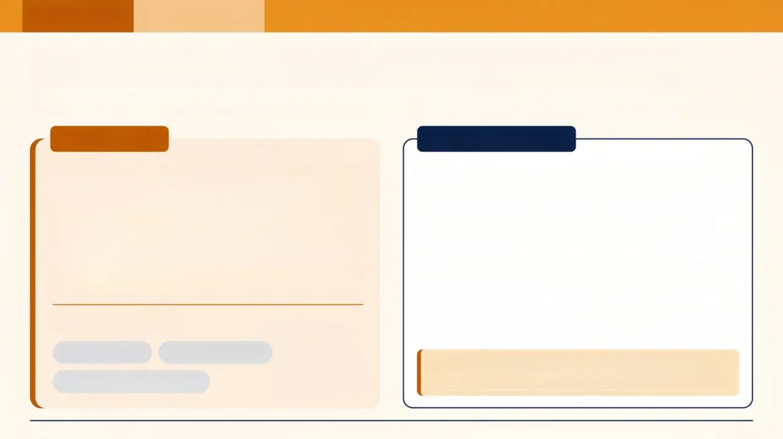



CASE STUDY
SCA Preparation
17-Year-Old Presenting for Contraception
What are you really being asked to assess?
The Scenario
Key Considerations
Amy, 17, comes in asking for the contraceptive
pill. Her mother is in the waiting room. Amy
seems quiet and avoids eye contact. She
mentions her boyfriend is 24. She says
everything is “fine” but hesitates when asked if
she’s happy in the relationship.
Capacity: Presume capacity at 17 (MCA 2005)—
but still assess Fraser competence for contraception
Age gap: Partner is 24 — a ≥4-year age gap is a
CSE red flag (CSERQ15)
Coercion check: Does she feel she could say no to
sex? Is the relationship her choice?
Confidentiality: Explain confidentiality clearly — not
absolute if safety is at risk
What do you do first?
See her alone
Assess capacity
A 24-year-old partner + quiet affect +
hesitation = don't just prescribe and move on.
Explore the relationship
www.bradfordvts.co.uk

Slide 20

BRADFORD VTS TEACHING DECK
Case Study: The 15-Year-Old
Alcohol, Missing Episodes & Safeguarding Risk
Clinical Thinking Prompts
Red Flag Check
THE SCENARIO
- Repeated missing episodes + alcohol
- Silent, withdrawn in consultation
- Parent dominating the room
- School non-attendance (6 weeks)
“Kayleigh is 15. Her mum brings her in after she
was found drunk in the park at midnight on a
school night — the third time this month. Mum is
angry and wants ‘something done.’
SAFEGUARD Triggers
- A — Alcohol misuse ✓
- A — Absent from school ✓
- G — Gang/older group? — ask
- R — Unexplained gifts/money? — ask
Kayleigh is silent, staring at the floor. When asked,
she says she was just ‘with mates.” She has
Your Next Steps
- Ask mum to step out — routine practice
- Use open, non-judgemental questions
- Consider CSERQ4 screening
- Discuss with named GP; consider MASH referral
Her mum answers every question directed at Kayleigh.
Bottom Anchor — Key Clinical Pearl
“Alcohol + missing + school absence in a 15-year-old = CSE until proven otherwise.”
www.bradfordvts.co.uk

Slide 21

CASE STUDY
Case Study: Vague Presentations
When the symptom isn't the real story
THE PATIENT
Think SAFEGUARD
> Jade, 15, attends for the 4th time in 3
months. Previous visits: headaches,
abdominal pain, low mood. No organic
cause found.
Apply the mnemonic systematically. Vague or recurrent
presentations are a trigger — not a reassurance.
Create the space
“Is there anything else going on that you’d like to
talk about — maybe something at home or with
friends?”
She comes alone today. She is quiet and
avoids eye contact.
Offer a longer or end-of-surgery appointment.
WHAT MIGHT YOU BE MISSING?
Document & act
Recurrent unexplained symptoms in a teenager are
a safeguarding signal until proven otherwise.
Record all attendances, symptoms, and safeguarding
considerations. If concerned, discuss with named GP
for child protection. Do not wait for a “clear” disclosure.
Polyvictimisation peak: age 14. Recurrent attendance + vague symptoms = safeguarding until ruled out.
www.bradfordvts.co.uk

Slide 22
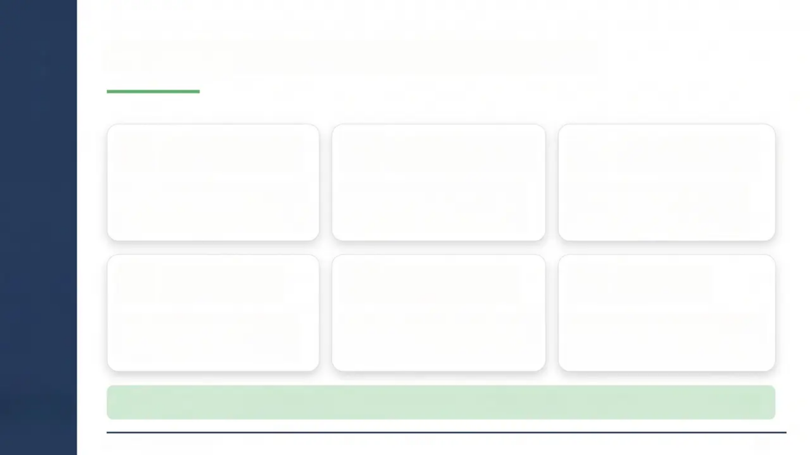







CORE SKILLS
The GP's Role: Practical Skills
Create a Safe, Non-
Judgemental Space
Assess Fraser/Gillick
Competence
Apply GMC 0–18
Confidentiality Rules
Young people must feel able to
disclose freely — tone and
setting matter as much as words
Assess at every consultation —
not once, not assumed —
capacity can fluctuate
Know when you must share —
safety overrides confidentiality
when there is serious risk
Use the Brook
Traffic Light Tool
Know When — and
Act Promptly
Involve the
Young Person
Guides your response to sexual
behaviours — green / amber /
red framework for action
Delays in sharing information can
cause serious harm; refer to
MASH or police without hesitation
Where safe to do so, include them
in decisions — never promise
absolute confidentiality
23
Have a 'Talk to Us' leaflet visible. Know your local MASH, Early Help, and sexual health pathways.
www.bradfordvts.co.uk
23 / 31

Slide 23
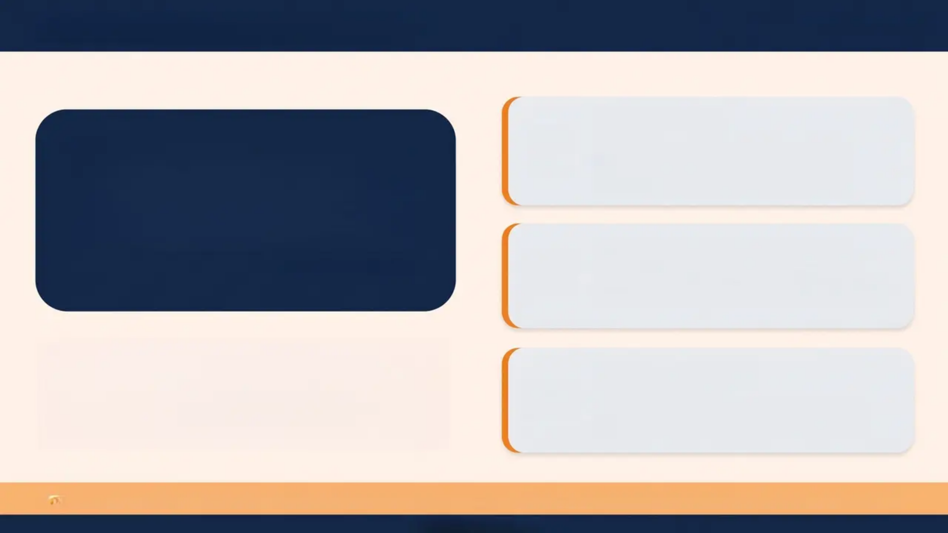




“Contextual Safeguarding”
www.bradfordvts.co.uk
Peer Groups
“Harm to adolescents
often occurs OUTSIDE
the family home.”
Gang involvement, peer pressure,
exploitation by older peers, criminal
exploitation
Schools & Public Spaces
— Firmin, 2013
Bullying, sexual harassment, county lines
recruitment, knife crime exposure
Traditional safeguarding frameworks focus on the
home. Contextual Safeguarding recognises that
adolescents face risks in wider social
environments — and that these contexts must be
assessed and addressed.
Online & Digital
Grooming, sexual bullying, sextortion,
exploitation via social media and apps
AKT Pearl: “Contextual Safeguarding” — Firmin 2013 — harm beyond the family home. A named concept in the Working Together 2026 framework.
www.bradfordvts.co.uk

Slide 24






SAFEGUARDING PRACTICE
Voice of the Child in Adolescents
Ask directly
Always speak to the young person alone, at some
point, without the parent or carer present.
Listen actively
Believe what they tell you. Validate their experience
before problem-solving. Avoid leading questions.
Document their words
Record the young person's exact words in the notes —
not a paraphrased adult interpretation.
“What does this young person
think, feel, and want?”
Feed back to them
Tell the young person what you're going to do and why.
Their voice must be heard in referrals and assessments.
Clinical reminder: Working Together 2026: The child's lived experience must be
central — not an afterthought — in every safeguarding assessment.
www.bradfordvts.co.uk

Slide 25



TOP TIPS
www.bradfordvts.co.uk
Top Tips
1
Lifestyle choice 'I NOT a
diagnoses
4
Under 13 = Regort. Always.
A 14-year-old repeatedly having sex with a 25-year-old
is CSE — not a lifestyle choice. Name it.
No Fraser assessment needed. No capacity to consent.
Consult named doctor and refer promptly.
2
Never promise absolute
confidentiality
5
The 5 Whys Technique
Say, ‘Consultations are usually confidential — but if I'm
worried about your safety, I’d need to tell someone,
and I’d tell you first.’
In difficult cases, ask ‘why?’ five times in succession
to probe beneath the surface and uncover the true
safeguarding picture.
3
Use SAFEGUARD systematically
Think Contextual Safeguarding
6
Apply the mnemonic for any teenager with vague,
recurrent, or unexplained presentations — not just
obvious cases.
Harm the adolescents often happens outside the
home — peer groups, schools, online. Don't only look
at the family.
www.bradfordvts.co.uk

Slide 26
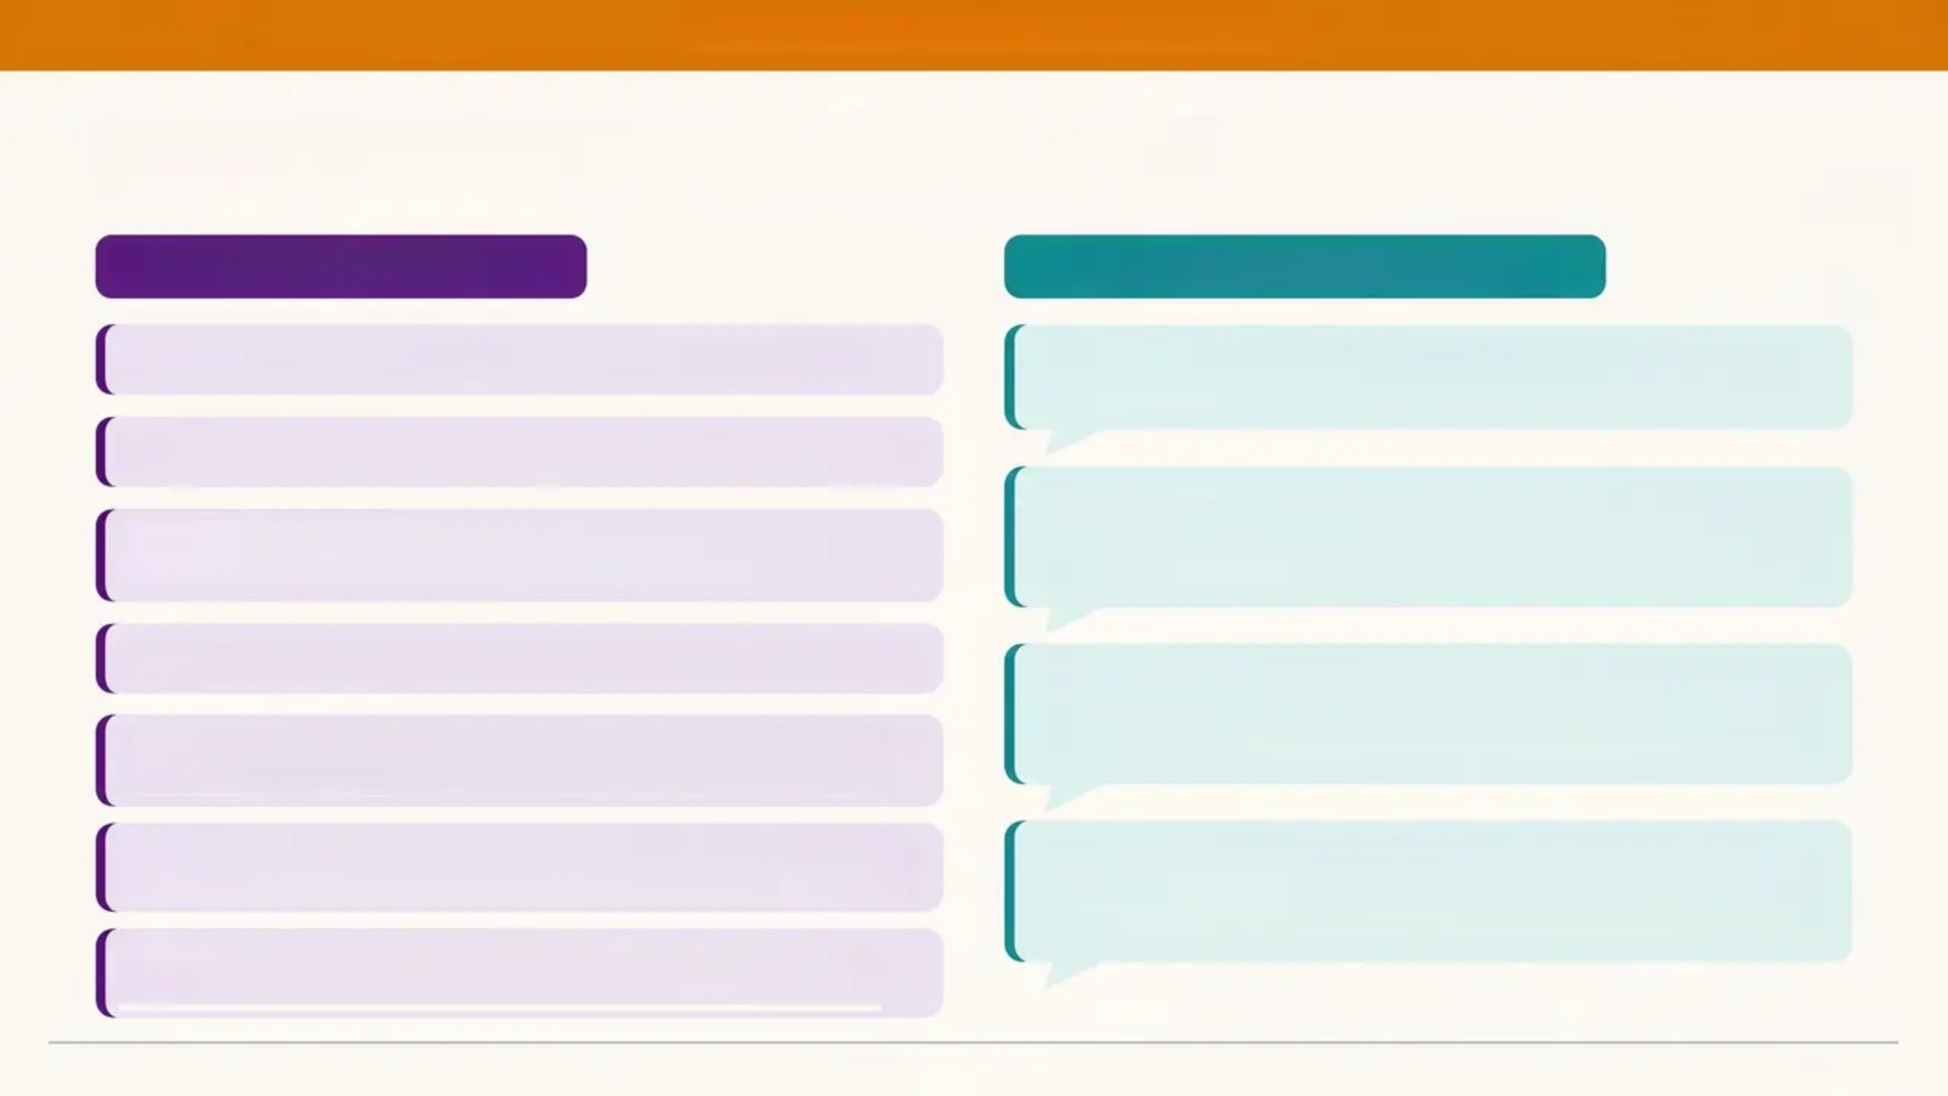
BRADFORD VTS TEACHING DECK
Exam Pearls AKT + SCA — Know This Cold
AKT — Knowledge Facts
SCA — Communication Scripts
“I want to make sure you know that this is your appointment.
Is there anything you’d like to tell me on your own today?”
Gillick / Fraser: 7 criteria — ALL must be met for competence
Under 13: Cannot consent to sexual activity in law — MUST report
“It's really helpful you're here. I’d like 5 minutes with [name] by
myself as part of my routine check — I'll include you at the end.”
(When a parent won't leave)
Virginity testing & hymenoplasty: Illegal in England & Wales
since October 2022
CSERQ15: Validated tool — 5+ positive responses = mandatory
“Everything you tell me stays between us, unless I'm concerned
your safety is at serious risk — and if that happens, I'd always
let you know first.” (Confidentiality explanation)
Working Together 2026: CSE is always abuse — regardless of
apparent consent
Intercollegiate Document 2025: GPs require Level 3 — 12 hours
per 3 years
“Thank you for telling me that — it took courage. I want to make
sure you're safe, so I'm going to need to speak to someone else
about what you've told me.” (Disclosure response)
Contextual safeguarding: Firmin 2013 — harm occurs beyond
the family
www.bradfordvts.co.uk
27 / 31

Slide 27


“Red Flags”
Act on these — do not rationalise them away
www.bradfordvts.co.uk
Under 13 + any sexual activity
Pregnancy or STI under 16
Assess Fraser competence; under 13 = report immediately
Always report — no capacity to consent, no exceptions
Knife wounds / unexplained injuries
In any teenager — contextual safeguarding concern
Age gap ≥4 years with older partner
Significant power imbalance — CSE risk
Disclosure then retraction
Young person at risk of repercussions — act anyway
Unexplained expensive gifts
Phones, jewellery, trainers from unknown source
Parent speaks for withdrawn teenager
Answers all questions — young person appears fearful or silent
Repeatedly missing from home
Coercion re: virginity testing / hymenoplasty
Multiple episodes — not a one-off teenage phase
Illegal since 2022 — safeguarding referral if under 18
www.bradfordvts.co.uk

Slide 28
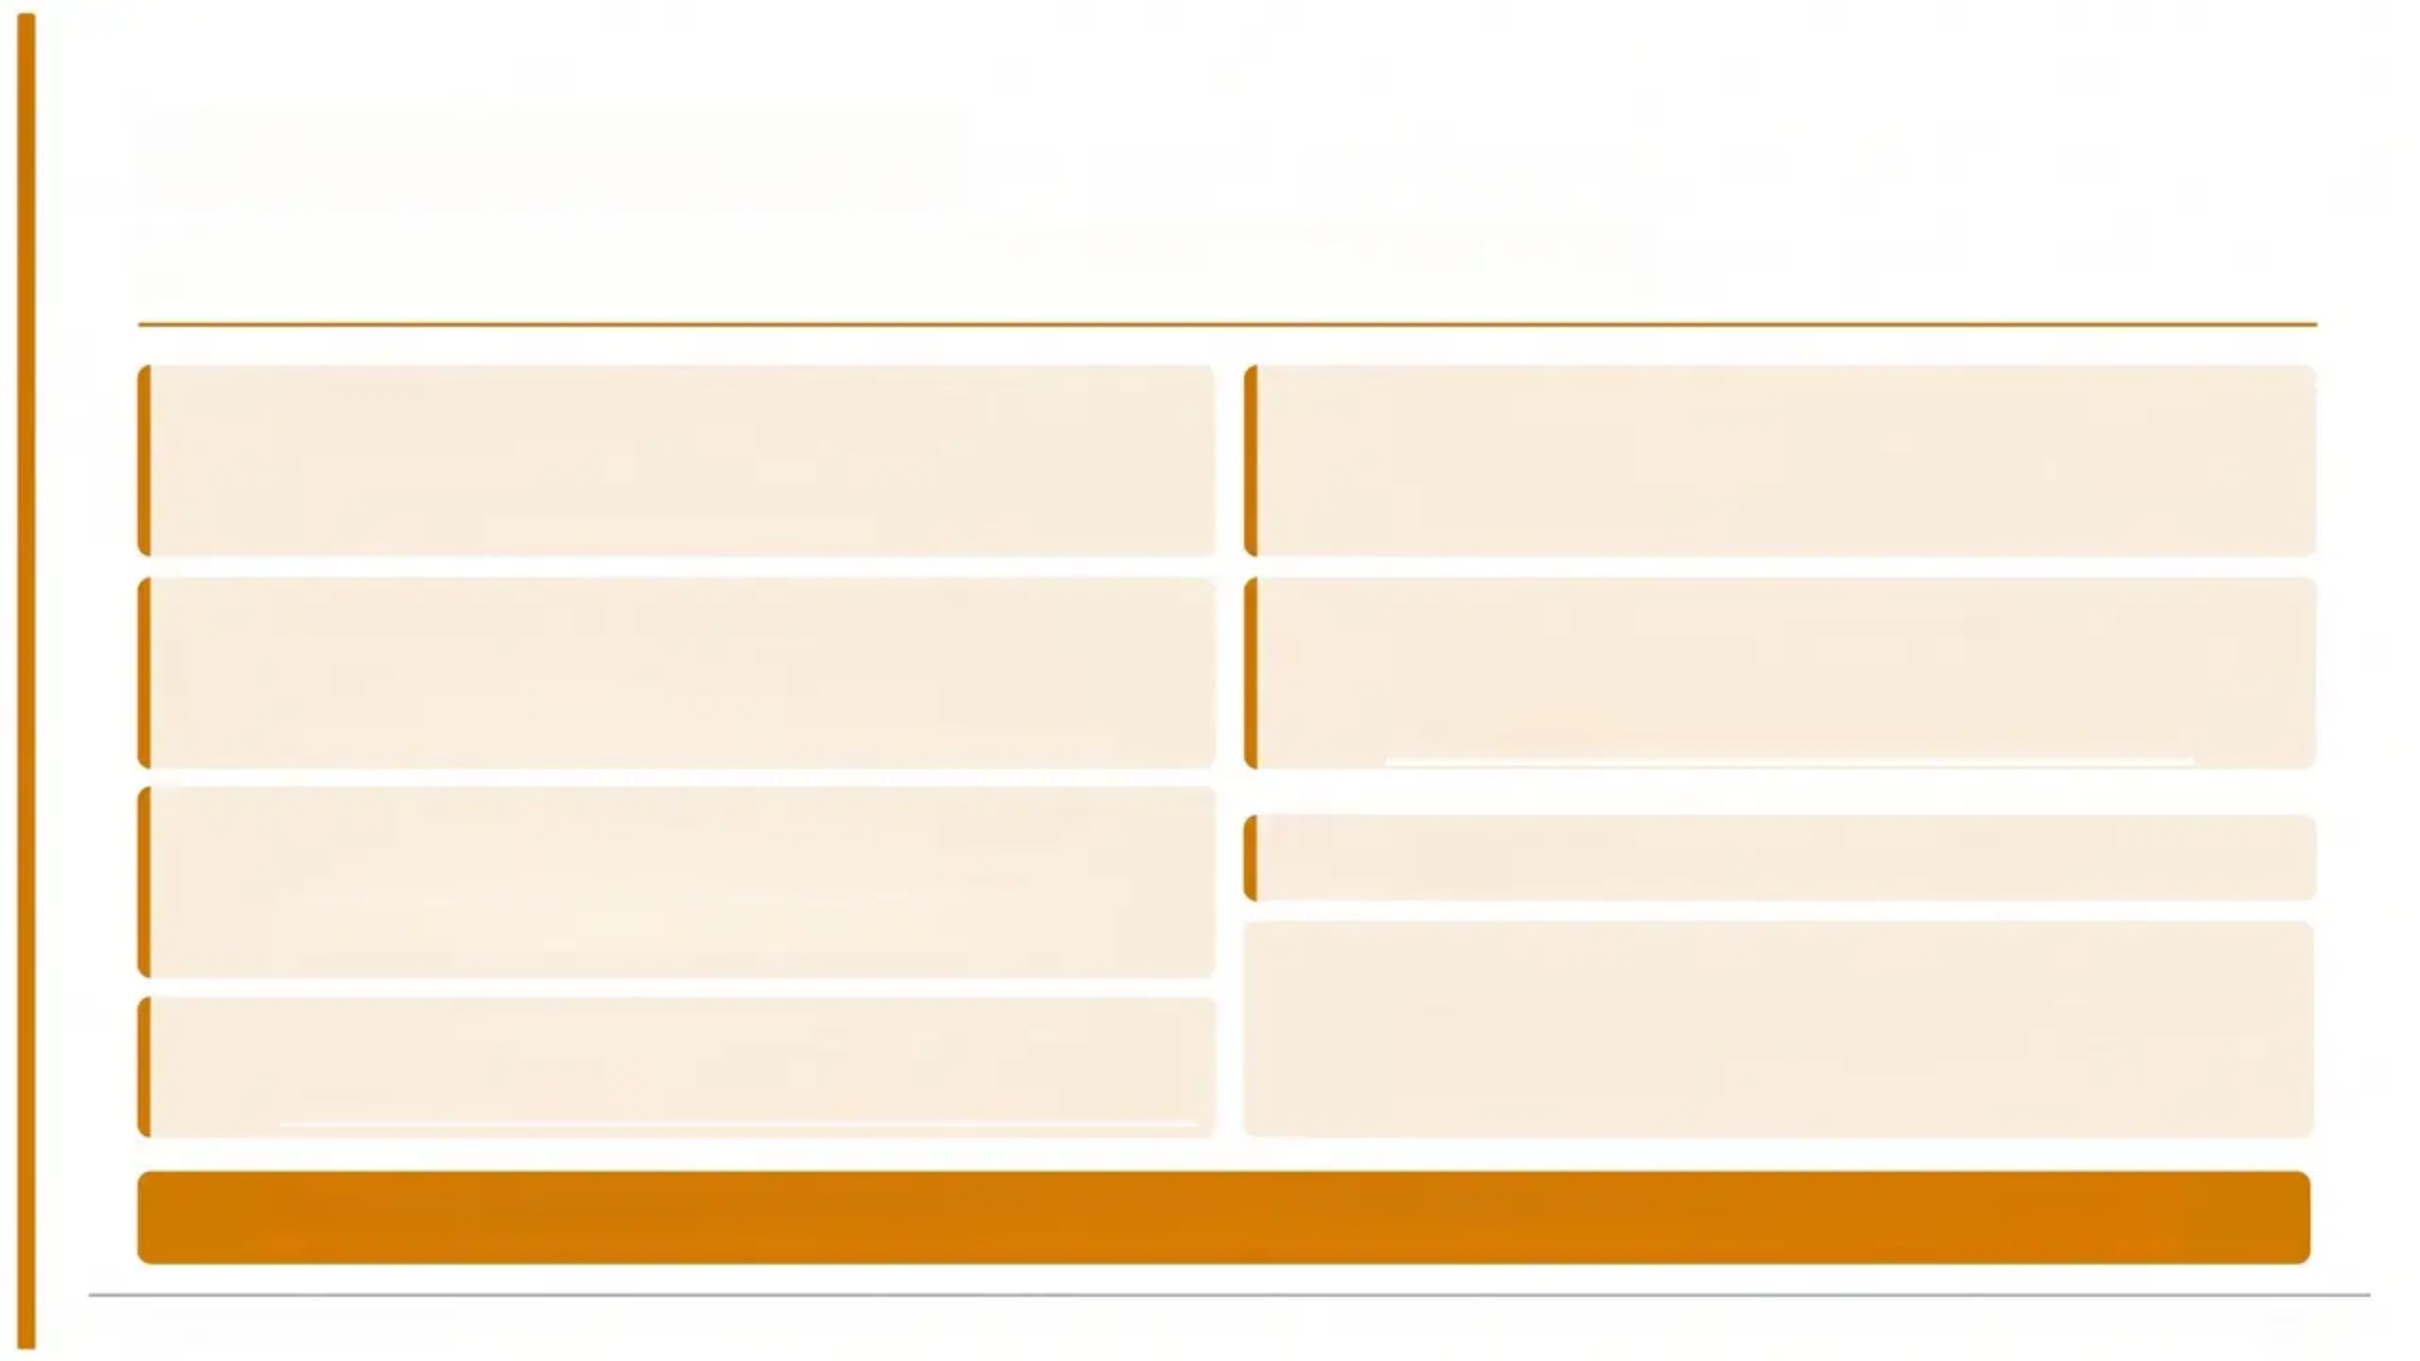







Common Pitfalls
Mistakes that put young patients at risk — all avoidable.
Normalising abusive behaviour
Not using SAFEGUARD systematically
Calling CSE a “lifestyle choice”—the most
dangerous pitfall of all
Use for any teenager with vague, recurrent or
unexplained presentations
Promising absolute confidentiality
Forgetting the 2022 virginity testing law
You cannot—and must not—ever make this
promise
Both virginity testing and hymenoplasty are
illegal since October 2022
Applying Fraser criteria to under-13s
Assuming CSE only affects girls
Under 13 cannot consent to sexual activity—do
not assess Fraser competence
Letting a parent dominate the consultation
Boys are exploited too—often through criminal
routes, less recognised
Always create space to see the young person alone
If in doubt — consult your named GP for child protection. Document everything.
www.bradfordvts.co.uk
29 / 31

Slide 29
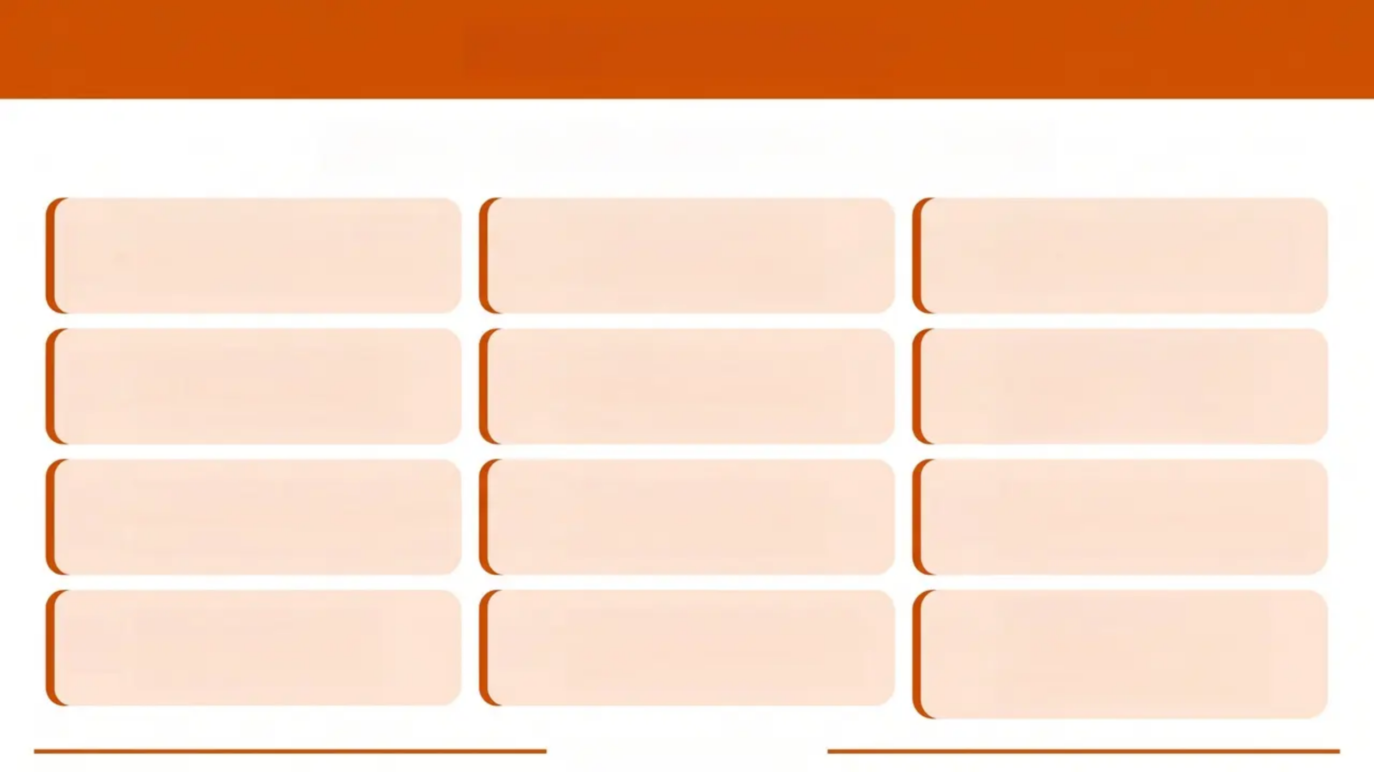












QUICK RECALL
Key facts — commit these to memory
Under 13: report —
no consent
SAFEGUARD
mnemonic:
CSE risk screen
Age gap ≥4 years:
CSE risk
Fraser: 7 criteria
for competence
Virginity testing:
illegal since 2022
Confidentiality:
not absolute in
safeguarding
CSE: always abuse,
regardless consent
CSERQ15: 5
positives = refer
10% teens: 12+
maltreatment types
Brain develops
until age 25
See young people
alone routinely
Think contextual
safeguarding
beyond home
www.bradfordvts.co.uk

Slide 30


BRADFORD VTS TEACHING DECK
Important Disclaimer
This teaching deck is for educational purposes only. It has been created to support GP
trainees preparing for the AKT and SCA examinations.
Always verify clinical advice, drug doses, and safeguarding thresholds against the latest
NICE guidelines, BNF, and current GMC/RCGP guidance before applying in practice.
Clinical guidance evolves. This deck reflects standards current at the time of creation
(May 2026), including Working Together 2026 and GMC 0-18 guidance.
Created by Bradford VTS | www.bradfordvts.co.uk | May 2026
www.bradfordvts.co.uk

