Slide 1

Level 3 Children Safeguarding Training
Safeguarding team :
Dr Kirsty King
Dr Emma Savin

Slide 2

Agenda
Safeguarding training recommendations
Perinatal maternal health
Child exploitation
Adverse childhood experiences

Slide 3
Learning Objectives
Better understanding of how to achieve and maintain level 3 competencies.
Improve recognition of perinatal mental health problems, child exploitation and adverse childhood experiences.
Understand the impact of these on children and families
and society.
Be able to respond effectively: signpost / refer to support services.
Any other objectives from the group?

Slide 4
Acknowledgements
Child Exploitation Gangs and County Lines
Faye McAllister – Child Sexual Exploitation Specialist Nurse
Adverse childhood experiences
Dr Laura Wood BM MA MRCPCH
ESRC PhD Researcher, Lancaster University

Slide 5
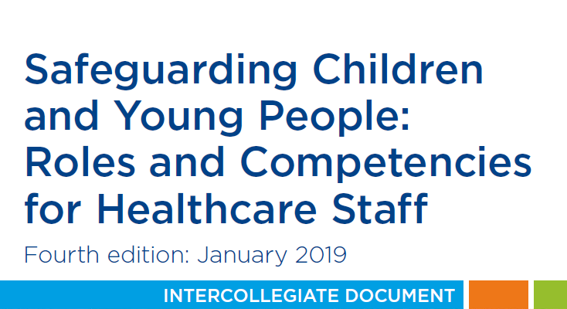
Changes to safeguarding training recommendations
https://www.rcn.org.uk/professional-development/publications/pub-007366

Slide 6
Changes
The training recommendation for GPs has increased to 12 hrs every 3 yrs.
For GP Leads the recommendation is now stated as 16 hrs over 3 yrs.
Practice Managers, Reception managers and Safeguarding Administrators are now specified as requiring Level 2 training. (2014: Level 1).
Practice Nurses now require Level 3 training (2014:Level 2).

Slide 7
Case study
Anne, aged 27 has attended alone. She is a new patient, having recently moved to Bradford from Lincoln. She wants to be referred to the midwife as she thinks she is 20 weeks pregnant.
What would you ask about/do during the consultation?
What else might you need to consider?
From where might you gather more information?

Slide 8
Case study continued
Anne tells you that she has left Lincoln after being re-housed, as she was fleeing an abusive relationship. She has moved to Bradford as it had available accommodation. Her family and friends are still in Lincoln.
She had an abusive childhood and spent periods of time in foster care.
This is her first pregnancy. She says that although she doesn’t want to be pregnant she has no choice but to have the baby. She states that she didn’t initially realise she was pregnant as she has irregular periods.
What would you do next?
What and where would you record the information?

Slide 9

Removing information from online viewing in SystmOne
Bradford, Airedale, Wharfedale and Craven CCG safeguarding team
2019

Slide 10
Child safeguarding node entries are not visible for online viewing
Adult safeguarding template entries are always visible for online viewing unless you make changes to ‘other details’ (see next slide)
New journal entries can also be removed from online viewing by clicking the ‘world’ icon

Slide 11
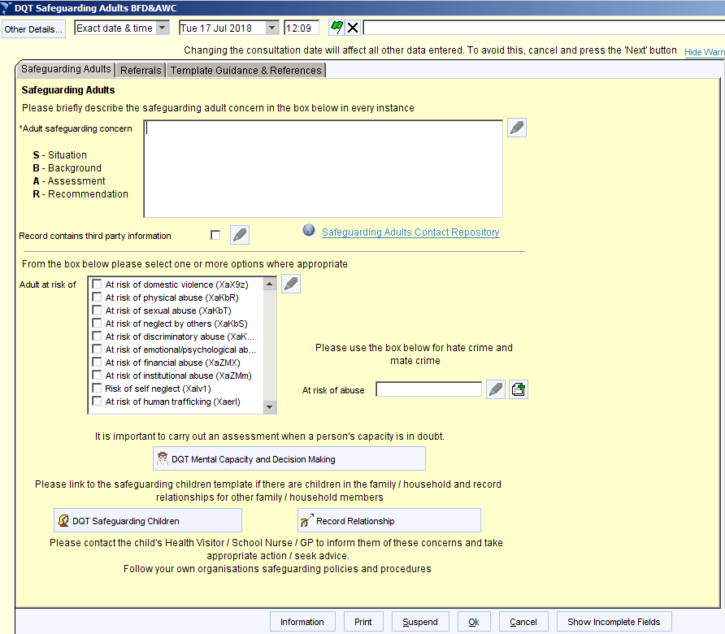

Slide 12
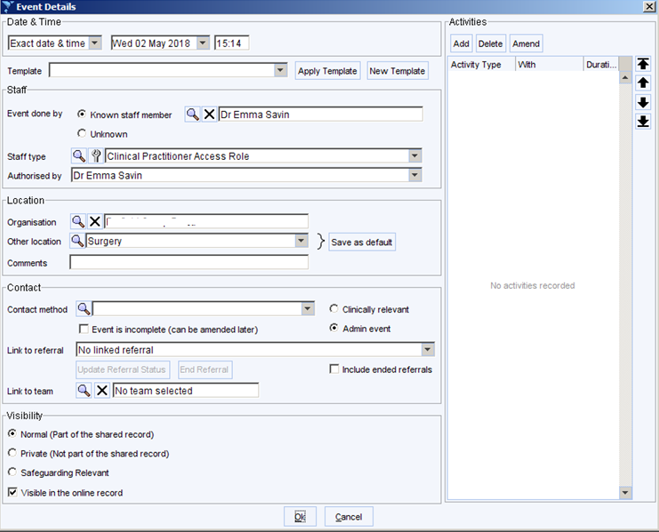
Untick this box

Slide 13
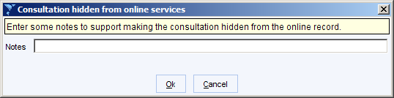
Eg. domestic abuse, safeguarding, contains 3rd party information

Slide 14
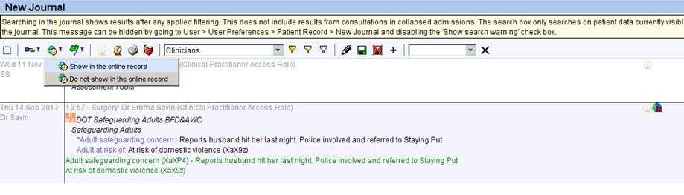
Removing information from the new journal
First click on new journal entry then click on ‘world’ icon
Select ‘do not show in the online record’
A crossed out world icon shows you this has been removed from online viewing

Slide 15
Pre-birth assessment
If it is considered that an unborn child may be at risk of Significant Harm, a Referral to Children’s Social Care must be made ASAP from 12 weeks gestation.
Using the SOS framework, state your concerns in terms of how the parents’ circumstances and/or behaviours may impact on the baby and what risks are predicted.
Applies to all pregnant women who were previously LAC

Slide 16
Case study continued
You refer to the midwife urgently, including the additional information around her home circumstances and her current state of mind.
All goes well during the remainder of the pregnancy and Anne gives birth to a healthy baby boy at full term.
During the first 3 days, mother and child remained in hospital and the hospital staff noted no concerns and mother responded well to her baby’s needs.
The midwife visited two days after the discharge and again three days later. It was noted that all was well and there were no concerns.
Anne decides to stay in Bradford as she feels safe here and started to make friends.

Slide 17
Case study continued
Anne comes to see you for the ‘8 week baby check’, after missing 2 appointments. Baby Jake is now 4 months old.
Health visitors have expressed concerns that Jake has dropped two centiles on the weight growth charts. The HV has discussed supplementing breast feeding with formula feeds to which Anne has agreed.
Anne appears well-kempt, although she looks tired. Jake is in his pram and asleep initially. Anne reports she is well and expresses no concerns when asked how she and Jake are doing. She doesn’t feel his weight is an issue and says he is feeding fine.
Although Jake wakes and starts crying, Anne doesn’t appear to make any attempts to soothe/settle him.
Thoughts?

Slide 18
Case study continued
When asked directly about her feelings for Jake, Anne says of course she loves him as he is her son. She says she is ‘getting on with things’ and has found a new partner who is ‘good to her’.
She appears to handle Jake fine when undressing him for his examination.
The examination of Jake shows no physical problems although Jake does visibly appear underweight. Anne agrees to see a paediatrician to monitor/assess Jake’s weight
What support/services can you access?
Any additional information you would want to ask Anne?

Slide 19
Case study continued
3 months later you receive a letter from the Lilac clinic to state that Anne has had a medical termination of pregnancy.
A few weeks later the Health visitor contacts you as when she visited Anne she was very tearful and said her partner had died and that she was being accused of murder. The HV said that Anne appeared on edge and when questioned around her partner’s death was vague about the details.
Anne told the HV that she was worried someone would try to kill her baby to make her confess. The HV said that Jake was playing happily and appeared well cared for.
What are you worried about?
What would you do next?

Slide 20
Perinatal Mental Illness
Mental health problems occuring during pregnancy or in the first 12 months following birth
Range of mental health problems including anxiety, depression, trauma, loss and psychotic disorders
Up to one in five (20%) of women and one in ten men are affected by mental health problems during pregnancy and the first year after birth.
Only 50% are detected, only 50% of these are treated.
≈ 25% of maternal deaths between 6 weeks and a year after childbirth are related to mental health problems (RCOG)

Slide 21
Perinatal mental health disorders
Postpartum psychosis
2/1000 births (1,400 cases per annum)
Chronic serious mental illness
2/1000 births (1,400 cases per annum)
Severe depressive illness
30/1000 births (21,000 cases per annum)
Post-traumatic stress disorder
30/1000 births (21,000 cases per annum)
Mild - moderate depressive illness and anxiety states
100-150/1000 births (105,000 cases per annum)
Adjustment disorders and distress
150-300/1000 births (up to 210,000 cases per annum)

Slide 22
Reasons for low detection rate
Maternal factors
GP factors
Stigma
Putting on a brave face
Fear of being thought a ‘bad mother’
Fear the baby may be taken away
Not knowing what is ‘normal’
Not knowing if treatment will help
Not asking
Time constraints
Lack of training or confidence
Lack of access to SMABS
Normalising or dismissing symptoms

Slide 23
Impact of perinatal mental illness
Untreated this costs society £8.1 billion for each one-year cohort of births in the UK ¹
  two-thirds of the cost being linked to short and long term problems for the child.
Increased risk of:
Early delivery
Smaller size/lower weight at birth
Negative impact on family relationships
1. Maternal mental health alliance

Slide 24
Impact of perinatal mental illness
Adverse impact on the early development of the child leading to behavioural, social or cognitive difficulties:
> 2x risk of:
  Behavioural problems at 12 months if there is disengagement at 3 months
  anti-social behavioural issues by the age of 2
  behavioural issues and depression during adolescence
  depression prior to age 18 with recurrence by age 25

Slide 25
Risk factors for post-partum depression
History of mental health problems
  Family or personal history of bipolar disorder significantly increases the risk of developing postpartum psychosis
Experience of childhood abuse and neglect
Alcohol or drug abuse
Bereavement/pregnancy loss
Domestic Abuse
Interpersonal conflict
Inadequate social support
Unplanned or unwanted pregnancy
Migration status

Slide 26
Women with bipolar – increased risks
More than one in five risk of postnatal psychosis.
One in two for women with a history of previous postnatal psychosis
One in two with bipolar disorder and a family history of postnatal psychosis
Almost one in two risk of experiencing severe postnatal depression

Slide 27
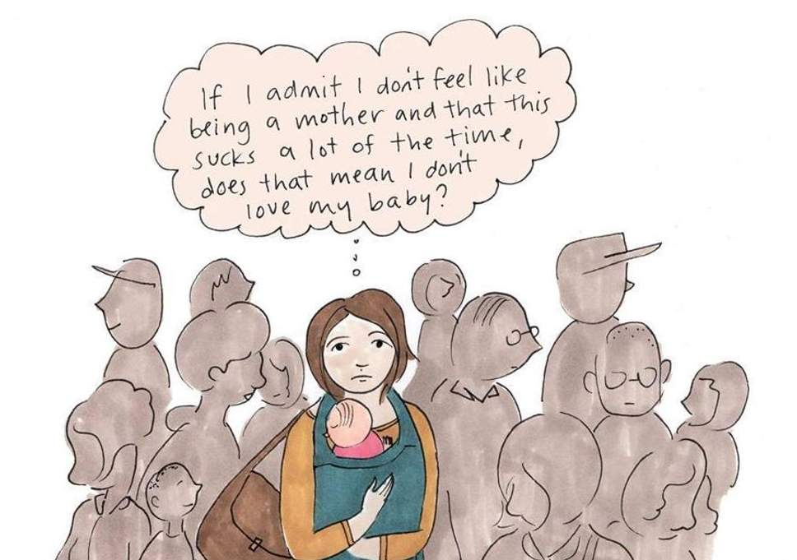
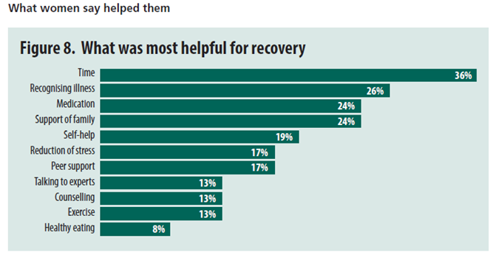
Women’s viewpoint

Slide 28
The importance of the postnatal check
Almost half (47%) of new mothers get less than three minutes or no time to discuss their mental and physical health at the routine six week postnatal check-up, according to a survey by the National Childbirth Trust (NCT).
The NCT is calling for government funding for a full postnatal check-up so GPs have sufficient time to talk to a new mother about her health and wellbeing.
The Royal College of General Practitioners (RCGP) has backed the charity’s Hidden Half campaign (www.nct.org.uk/hiddenhalf).

Slide 29
Suicide in perinatal and non-perinatal women in contact with psychiatric services: 15 year findings from a UK national inquiry
Most women who died by suicide in the perinatal period used a violent method, mainly by hanging or jumping
Women who died by suicide within the perinatal period were more likely to be younger, married, and living with a partner than were those who died outside that period
Depression was the most common diagnosis in all women who died by suicide, occurring in about half of postnatal suicides and a third of pregnancy and non-perinatal suicides.

Slide 30
Symptoms at the patients’ last contact with a mental health professional were:
Emotional distress and depressed mood were most common.
Recent self-harm, suicidal ideas, hopelessness also relatively common.
Delusions or hallucinations were relatively rare
Depression is arguably under-recognised as a leading cause of perinatal suicide,

Slide 31
The GP’s role
Ask
Listen without judgment
Respond
Support

Slide 32
The GP’s role
Ask pregnant women and new mothers and fathers about their mental wellbeing at every opportunity.
Maintain / resurrect the maternal postnatal appointment.
Consider hosting a mother and baby group in your building.
Remember that depression within 1 year of giving birth is Postnatal depression. Code it as such, recognise the risks and utilise appropriate referral pathways.
Suicide awareness and skills training.
Clear communication with Midwives and Health Visitors.
Knowledge of referral pathways.
Signpost to support organisations.

Slide 33
National support and helplines
Association for postpartum psychosis
https://www.app-network.org/what-is-pp/getting-help/
Family Lives (prev ParentLine) (has a helpline)
https://www.familylives.org.uk/how-we-can-help/confidential-helpline/
Association for perinatal illness (has a helpline)
https://apni.org/
Tommy’s
https://www.tommys.org/pregnancy-information/im-pregnant/mental-health-during-and-after-pregnancy

Slide 34
Specialist Perinatal Mental Health Services

Slide 35
Specialist Mother and Baby Mental Health Service (SMABS)
Support women with a range of mental health problems who are considering having a baby, are pregnant or have a baby under the age of one and have a GP within the Bradford, Airedale, Wharfedale or Craven area.
Women who meet the service’s criteria will be offered an assessment and where appropriate a personalised package of care.
The service cannot work with mothers after 12 months postpartum.

Slide 36
Specialist Mother and Baby Mental Health Service (SMABS)
The range of mental health the team can help with includes:
bipolar disorder
post-partum psychosis
schizophrenia
depression or anxiety (OCD, panic, phobia, birth trauma)
if the woman has a first degree relative with bipolar disorder or postpartum psychosis, and/or the woman has a significant change in mental state in late pregnancy or early after birth
eating disorders
personality disorders
severe fear of pregnancy and childbirth

Slide 37
Specialist Mother and Baby Mental Health Service (SMABS)
Provide advice and support for women who are at high risk during the perinatal period because they have a history of, or current, severe mental health problems.
Pre-conception advice about risks and treatments when considering a future pregnancy.
Focus on preventing problems and intervening early to promote early recovery.

Slide 38
Who is in the team?
Perinatal mental health nurses,
nursery nurses,
perinatal consultant psychiatrist,
occupational therapist,
psychological therapist,
parent infant therapist

Slide 39
How to refer
Complete an Adult Mental Health referral form.
Urgent referrals if any red flags - Please call the First Response team for an urgent assessment on telephone: 01274 221181
Admission to a mother and baby unit should always be considered where a woman has any of the following:
rapidly changing mental state,
suicidal ideation (particularly of a violent nature),
pervasive guilt or hopelessness,
significant estrangement from the infant,
new or persistent beliefs of inadequacy as a mother,
evidence of psychosis
For advice ring 01274 251010. The team is available from 8.30am -12.30pm Mondays, Tuesdays, Wednesdays and Fridays and can provide general advice on potential referrals

Slide 40
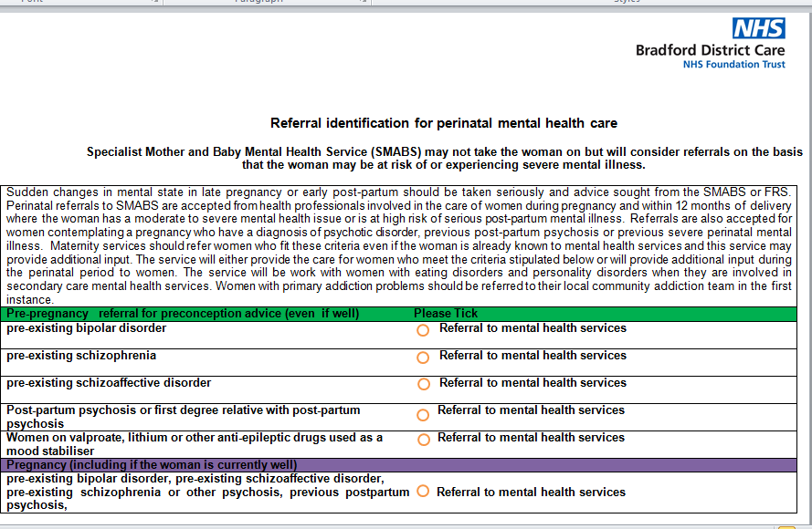

Slide 41
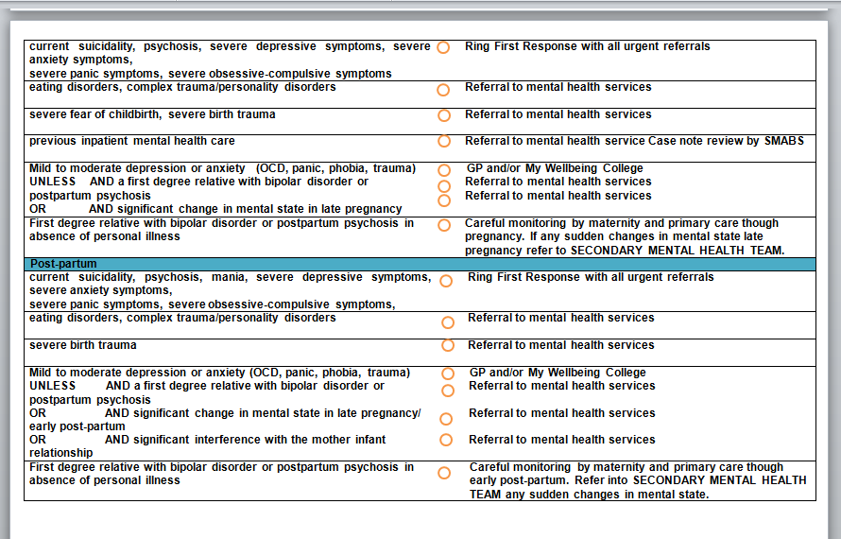

Slide 42
Support offered
Triage of referrals within two working days
Joint psychiatric / obstetric clinics within antenatal clinics
Joint work for women currently within secondary mental health services
Telephone advice for professionals
Specialist psychological and occupational therapies
Pre-conception advice and perinatal care plans
Parent-infant assessment, interventions and therapy
Signposting and referral to appropriate interventions and services including Leeds Mother and Baby Unit where appropriate.

Slide 43
Pre-conception advice
Women of child-bearing age who are at risk of developing significant mental health difficulties during pregnancy or postnatally and are considering a pregnancy.
Referral in by FRS/CMHT. If no CMHT involvement then GP can refer.
Clinic appt within 28 days. Perinatal service, BRI Maternity.
90 mins with a senior psychiatrist.
Consultation, information and advice. Not ongoing care.

Slide 44
SMABS, further information
https://www.bdct.nhs.uk/services/specialist-mother-baby-mental-health-service/
perinatalspecialistt@bdct.nhs.uk

Slide 45
Case discussion
Fast forward 12 years……
You are about to see Anne to review her medication, she is now 40 years old and was recently started on sertraline for anxiety a month ago by your colleague. The notes reference ‘work related stress and behavioural issues child.’
Anne reports that she is not feeling much better
What questions do you want to ask Anne?

Slide 46
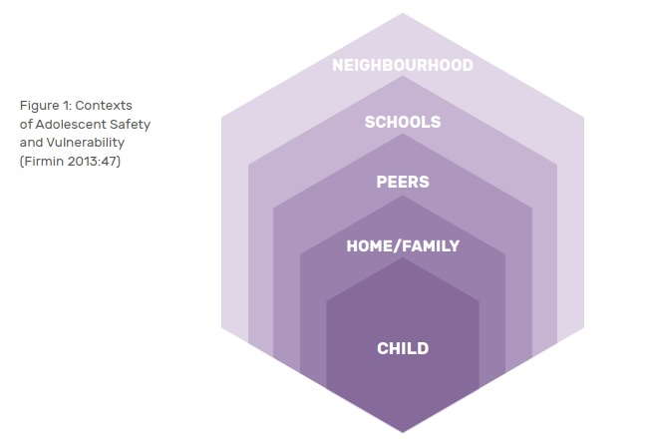
Contextual safeguarding
Contextual Safeguarding is an approach to understanding, and responding to, young people’s experiences of significant harm beyond their families.

Slide 47
Child Exploitation
Encompasses sexual exploitation, criminal exploitation modern slavery and trafficking [often overlap]
Identified as a serious and growing public health threat
Close links with serious and organised crime, drugs and profit
More than 4600 serious and organised crime groups in UK
Serious and Organised Crime :
- cost to UK in excess of £37 billion per annum
- kills more UK citizens each year than all other national security threats, war and natural disasters combined
HM Government (2018)
DOH (2012)
Notes:
Multiagency CE protocol launching bradford start december

Slide 48
Child Criminal Exploitation
‘Child Criminal Exploitation… occurs where an individual or group takes advantage of an imbalance of power to coerce, control, manipulate or deceive a child or young person under the age of 18. The victim may have been criminally exploited even if the activity appears consensual. Child Criminal Exploitation does not always involve physical contact; it can also occur through the use of technology. ‘
Home Office (2018)

Slide 49
What is a Gang?
“A relatively durable, predominantly street-based group of young people who:
See themselves as a discernable group
Engage in a range of criminal activity
Identify or lay claim over territory
Have some form of identifying structural feature
Are in conflict with other, similar, gangs”
(Centre for Social Justice 2009)

Slide 50
Who is at risk of gang-related harm?
Young people who are:
Gang involved
Not gang involved but living in an area where gangs are active
Not gang involved but at risk of being a victim of gangs
Not gang involved but family members/friends are gang members

Slide 51
Children at risk in numbers
313,000 – know someone who is a gang member
Of whom:
33,000 – siblings of a gang member
34,000 – victims of a violent crime
6560 – identified as gang members by agencies
(Office of Children’s Commissioner 2019)
27,000 – self identify as gang members – (British Crime survey, 2018)

Slide 52
Local statistics
51 identified organised crime gangs in Bradford.
471 children who are connected either through committing criminal acts on behalf of the gangs, or being closely related to active gang members.
2 of the organised crime gangs in Bradford have been linked to county lines.
W Y Police, Oct 2018

Slide 53
County Lines
County Lines typically involves a gang from a large urban area travelling to locations such as county or coastal towns to sell class A drugs.
Users are contacted via a mobile phone line used by the gang.
Couriers travel between the gang’s urban base and the county locations on a regular basis to collect cash and deliver drugs.
Young people groomed to act as couriers and deliver drugs to customers out of their areas – this often involves deception, intimidation, violence, debt bondage and/or grooming.
(Home Office 2018)

Slide 54
Gang as ‘Family’
Esteem
Needs
Safety Needs
Physiological Needs
Pinkney, 2018

Slide 55
Practices Used in Gangs and County Lines
Sophisticated business models able to evolve and respond quickly to avoid police disruption – drill music, branding
Use of mass marketing techniques
Recruiting younger children – ‘tinies’
Recruiting ‘clean skins’
Constant surveillance of runners through ‘find my iphone’
Move towards partnership rather than conflict with rival gangs
Debt bondage
‘Pop up’ brothels next to traphouses
Cuckooing
Use of budget hotels and Air BnB
Use of app based taxi companies to transport exploited young people.
Giving children guidelines on behaviour to avoid police or professional notice.
Threats of extreme violence –knife crime is a significant feature

Slide 56
Children At Risk
Child Level Vulnerability
School exclusion/off-rolling
Family Level Vulnerability
Poverty
Family members associated with gangs
Community Level vulnerability
Gang neighbourhood
Mental health
Bullying
Substance misuse
Neglect or abuse
Parental substance misuse
Disenfranchised communities
Lack of opportunity
Special educational needs
Domestic abuse
Poor institutional response
PUSH AND PULL FACTORS
Office of the Children's Commissioner (2019)
Early Intervention Foundation (2015)

Slide 57
Vulnerability
2.3 million children living in vulnerable families
Increase in drug use in 10-15 years olds Home Office (2018)
Increase in children living in poverty
Increase in children living in temporary accommodation
Increase in permanent exclusions
Increase in Children in Care
Increase in mental health difficulties in children
Office of Children’s Commissioner (2019)

Slide 58
A Child’s Journey Through Child Criminal Exploitation
From The Children’s Society (2019)
Observe children
Identifying vulnerabilities, needs and wants
Gaining and developing trust
Sharing information with others in the group
Manipulating them to recruit them
Marking them as someone to watch
Test loyalty
Offer protection
Provide a sense of belonging
Introduce them to more established members
Create a dependency
Ask for favours
Ask to recruit others
Experiences of physical, psychological and sexual violence
Trafficking
Humiliation and control
Reinforced dependency
Blackmail
Debt bondage – fake robbery
Isolation from friends and family
Target
Test
Trap
Continued vulnerability
Injury/
Death
Youth Justice system

Slide 59
CSE in Gangs
Sexual exploitation is used in gangs to:
exert power and control over members
initiate young people into the gang
exchange sexual activity for status or protection
entrap rival gang members by exploiting girls and young women
inflict sexual assault as a weapon in conflict.
Inflict sexual assault as a punishment.

Slide 60
CE Risk Indicators
Frequent missing episodes
Being found in distant locations
Poor behaviour in school/ school exclusion/truanting
Drug use
Found carrying drugs or weapons
Money/goods from an unknown source
Sudden and extreme changes in behaviour at home
Obsession with mobile phone/multiple phones.

Slide 61
5 warning signs:
Does your child have items of clothing, have mobile phones and/or money that they cannot explain how they came by?
Are they going missing and being found in locations far from home?
Are they making friends with older individuals and calling them by a nickname?
Are they pushing away from their peers and changing interests?
Has there been a change in behaviour - for example saying “others have their back” and are they being secretive?

Slide 62
Health –specific Risk Indicators
Expressions of despair – self harm, overdose, challenging behaviour
Mental health impacts
Sexual health impacts, secondary enuresis
Vague somatic complaints
Physical injury including knife wounds
Parents presenting with mental health impacts
Parents seeking mental health/ADHD diagnosis for their adolescent

Slide 63
Making an Assessment of RISK
Give the young person the ‘opportunity to tell’
Professional curiosity
Think family
Explain limits of confidentiality
Information sharing – MDT, school nurse, health visitor, school, social worker
Record voice of the child
USE PROFESSIONAL JUDGMENT – is the child at risk of significant harm/a child in need?
Seek expert advice – Safeguarding leads, Specialist Teams
Thresholds and pathways and specific risk exploitation toolkits in your local area
Referral onwards – MASH, Specialist Teams, Early Help etc

Slide 64
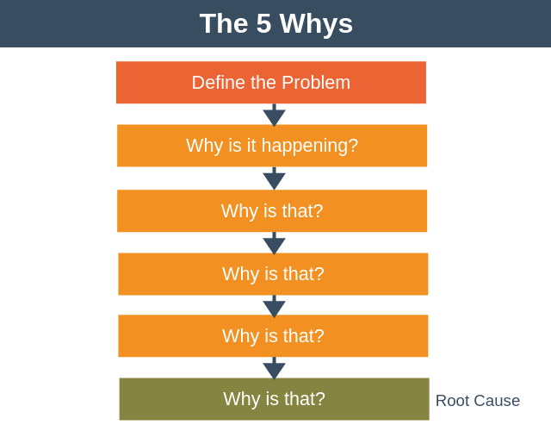

Slide 65

Look beyond the presenting issue…..

Slide 66
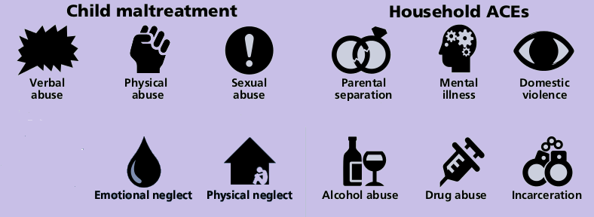

Adverse Childhood Experiences
A short video explaining ACE’s and their impact

Slide 67
The 10 ACE Categories
There are 10 types of childhood trauma measured in the Adverse Childhood Experiences studies.
Five are personal:
physical abuse
verbal abuse
sexual abuse
physical neglect
emotional neglect
Five are related to other family members:
a parent who’s an alcoholic
a mother who’s a victim of domestic abuse
a family member in jail
a family member diagnosed with a mental illness
the disappearance of a parent through divorce, death or abandonment

Slide 68
Thinking back to Jake – what is his ACE score?
Background:
Anne is suffering from anxiety and is a single parent of 13 year old Jake
Jakes father Bob is alcohol dependent and was the perpetrator of domestic abuse
Jake used to witness the domestic abuse between her and Bob and once was physically injured trying to protect her. Bob always belittled Jake.
Anne ended the relationship 2 years ago
Anne works long hours, has financial problems – sometimes she struggles to be able to buy enough food for the week

Slide 69
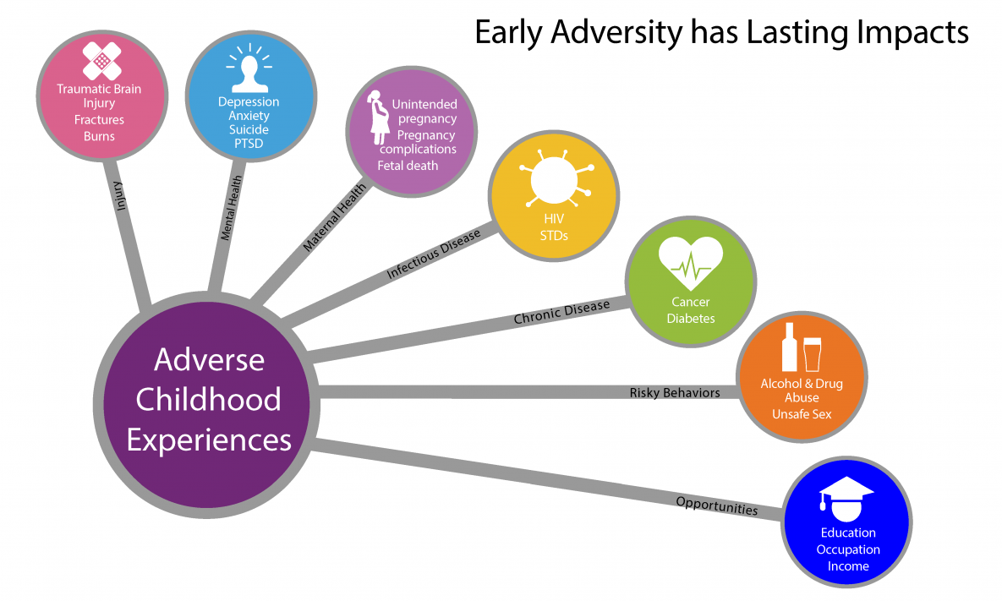
Why worry about ACEs?

Slide 70
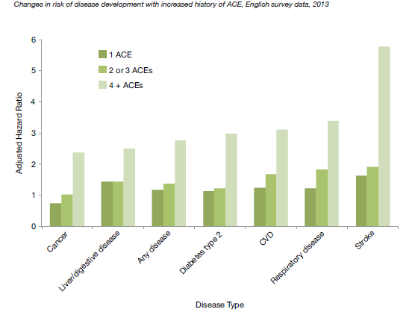
ACE’s Outcomes: The Data
Source: Reproduced from UCL Institute of Health Equity (2015). The impact of adverse experiences in the home on the health of children and young people, and inequalities in prevalence and effects. The UCL Institute of Health Equity paper.3 Crown copyright 2015

Slide 71
Childhood adversity and mental health
Using data from the World Health Organisation World Mental Health Surveys, Kessler et al estimated that eradicating childhood adversities would lead to a:
22.9% reduction in mood disorders;
31.0% reduction in anxiety disorders;
41.6% reduction in behaviour disorders;
27.5% reduction in substance disorders

Slide 72
How does being exposed to Adverse Childhood Experiences cause harm?
Three mechanisms for how ACEs cause harm have been suggested:
health-harming behaviours;
social determinants of health e.g. education, employment and income
neurobiological and genetic pathways.

Slide 73
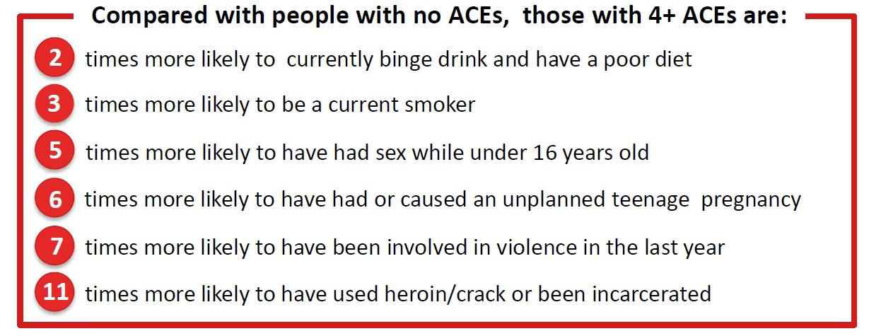
Links to health-harming behaviours
English ACE Study Data
Centre for Public Health at Liverpool John Moores University

Slide 74
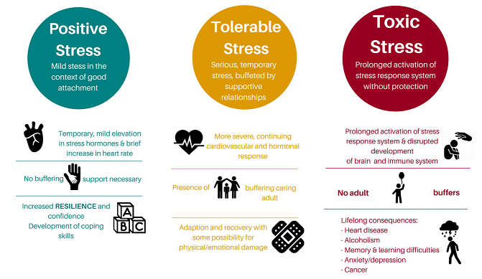
Stress in childhood
ACEs

Slide 75
Trauma
Fear + Powerlessness = trauma
Type 3 trauma:
Multiple pervasive traumas from an early age that continue over a length of time.

Slide 76
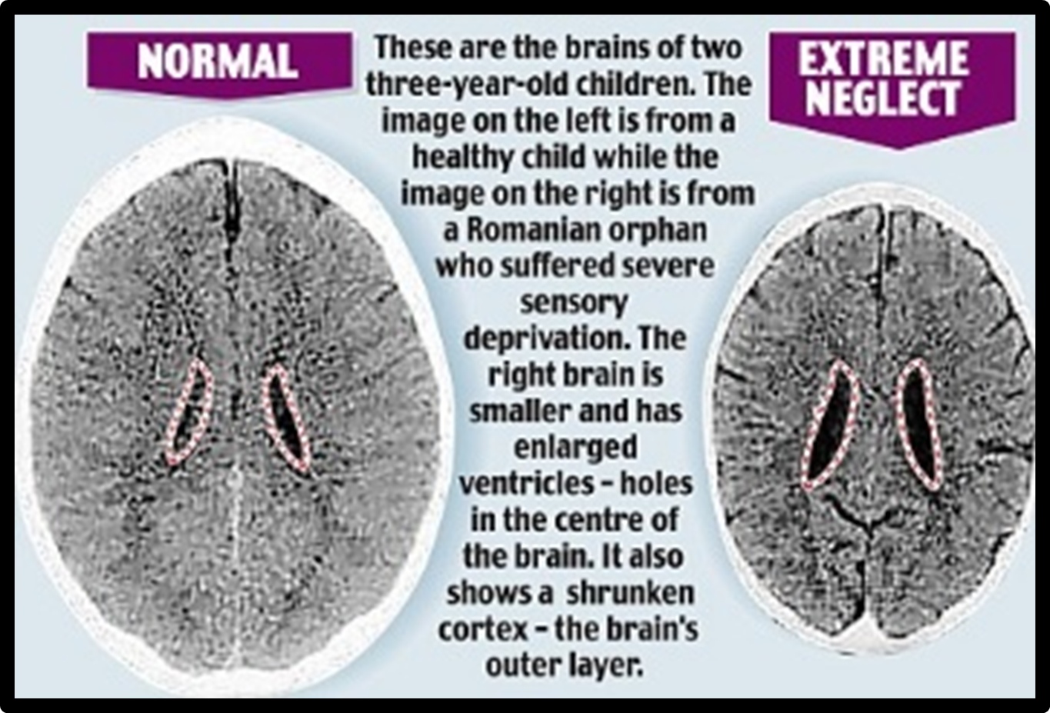

Slide 77
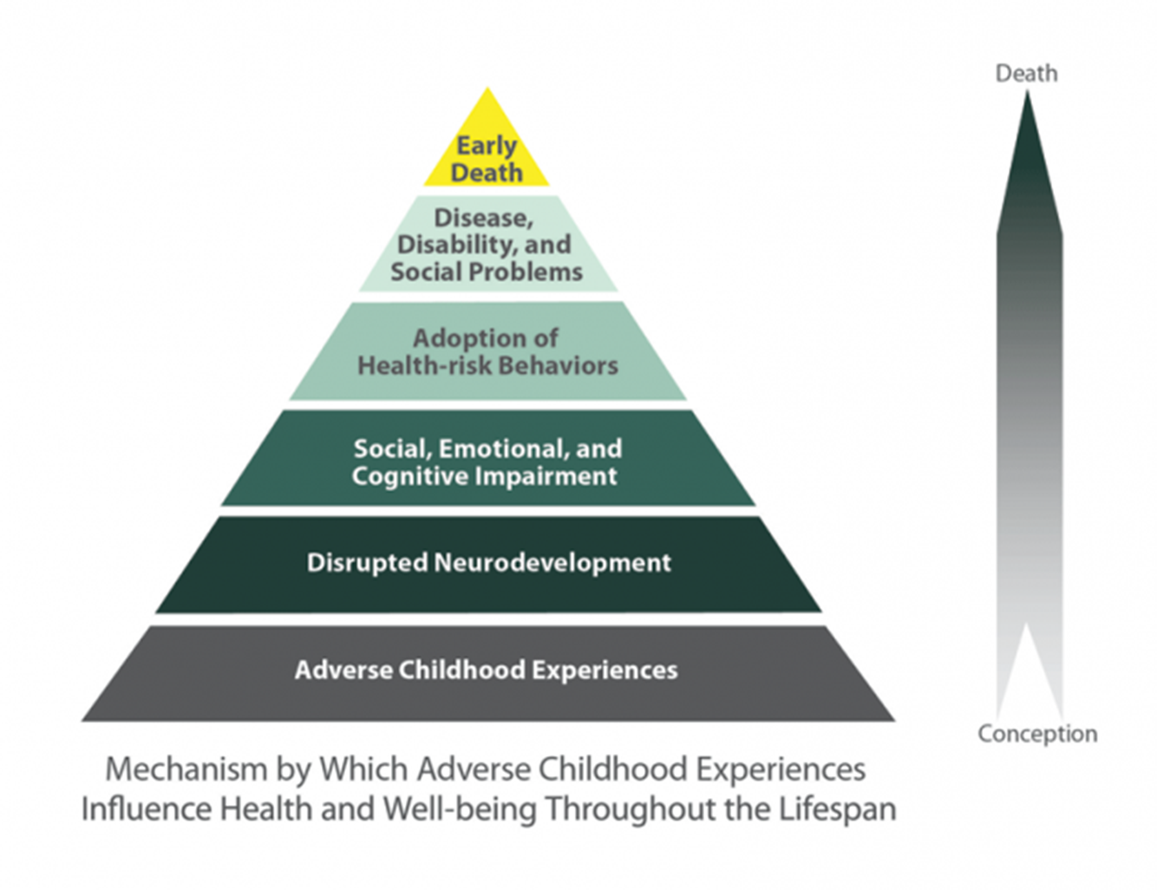
ACE’s Pyramid

Slide 78
Who has ACES?
National ACE study was undertaken in England in 2013.
This found that almost half of the general population reported at least one ACE and over 8% reported four or more (Bellis et al, 2014bc).

Slide 79
Resilience
Each child’s experiences of early adversity and any resultant intervention treatment will be different.
Many children go on to live successful, happy, healthy lives despite their negative experiences demonstrating resilience
Adversity-exposed children who go on to have positive outcomes may have internal (and external) systems in place to adapt and thrive in the context of adversity and in response to stress

Slide 80
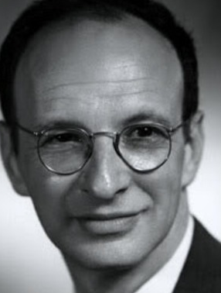
Urie Bronfenbrenner (1917-2005)
“In order to develop normally,
a child requires progressively more complex joint activity with one or more adults...
Every child needs at least one adult who is irrationally crazy about him or her.
That's number one.
First, last and always”

Slide 81
Building resilience
Looking at individual and wider community factors e.g.
Relationship with a trusted adult
Ability to develop additional skills e.g. through sport participation
Attendance at school – fostering feeling of belonging and interest in education
Sources of support within the community

Slide 82
Food for thought
How often do we ask about ACEs when assessing adults with the following:
Mental health issues
Substance misuse
New parents who are struggling
Looked after children are likely to have experienced multiple ACEs
In Looked After girls:
  3 x risk of teenage pregnancy.
  More likely to continue their pregnancies.
  Nearly half are mothers by age of 24yrs

Slide 83
The GP role
GPs have an established role in identifying children at risk of, or experiencing ACEs. This enables us to:
Facilitate other agency involvement if appropriate
Address parental problems such as mental health or substance misuse before they impact on the child.
Recognise that ACEs:
Damage health across the life course
Negatively impact on the future parenting abilities of adults who have experienced ACEs (perpetuating the cycle)

Slide 84
Community & relationships are healing
The National Association for People Abused in Childhood (NAPAC) is the UK’s leading national charity offering support to adult survivors of all types of childhood abuse, including physical, sexual and emotional abuse and neglect.
https://napac.org.uk/
May need trauma therapies (not generic counselling)
PTSD self help resources: www.mind.org.uk

Slide 85
Trauma informed care
Help our patients to feel safe:
Choice
Control
Empower
Collaborate
Trust

Slide 86
Intercollegiate guidance competencies
Knowledge and awareness as appropriate to role of the importance of perinatal mental health and the potential negative life-long consequences for children if maternal and paternal mental health problems go untreated in the perinatal period. RCGP
Able to recognise that severe mental health difficulties in pregnancy and postpartum can adversely affect parenting capacity, with potential long-term consequences for children.
Able to recognise that severe postnatal depression might adversely affect maternal atunement to her infant that, without specific intervention, will give rise to maternal-infant attachment difficulties and child maltreatment.

Slide 87
Intercollegiate guidance competencies
Able to recognise that severe postnatal depression and other mental health difficulties might be the result of adverse childhood experiences and ongoing domestic violence and abuse.
Able to recognise that trauma from adverse childhood experiences (ACEs) is cumulative and that building individual resilience and coping strategies might militate a good outcome.
Able to recognise that adult mental health conditions such as depression, self-harm, attempted suicide and psychosis are manifestations of cumulative trauma from adverse childhood experiences (ACEs) that can be intergenerational, thus affecting the patient’s children

Slide 88
Intercollegiate guidance competencies
Able to recognise that children with challenging behaviour (eg, ADHD, ASD) can be signs of emotional dysregulation/ attachment difficulties that, in turn are manifestations of previous or ongoing maltreatment.
Able to recognise that self-harm can be a manifestation of maltreatment, particularly CSA/CSE.
To know how to assess training requirements and contribute to departmental updates where relevant to role. This can be undertaken in various ways, such as through audit, case discussion, peer review, and supervision and as a component of refresher training.

Slide 89
Intercollegiate guidance competencies
To be able to identify, drawing on professional and clinical expertise, possible signs of sexual, physical, or emotional abuse or neglect including domestic abuse, sexual exploitation, grooming and exploitation to support and/or commit acts of terrorism (known as radicalisation), FGM, modern slavery, gang and electronic media abuse using child and family-focused approach

Slide 90
Feedback forms please
Thank you for your participation

