Slide 1


Bradford VTS Teaching Deck
www.bradfordvts.co.uk
HIV in Primary Care:
Testing, Counselling and PEPSE
GP Trainee Teaching Resource
Updated to BHIVA / BASHH 2024-2025 Standards · May 2026
For educational purposes only · Always verify with current NICE/BNF guidance · www.bradfordvts.co.uk

Slide 2








Bradford VTS Teaching Deck
www.bradfordvts.co.uk
Learning Outcomes
When and how to offer an HIV test
Conduct a sensitive pre-test discussion
Including opt-out approach and indicator conditions
Informed consent, risk assessment, non-judgemental approach
Interpret HIV test results correctly
Understand HIV natural history and ART
Positive, negative, and window period management
Updated BHIVA 2025: ART for all regardless of CD4
U=U and its clinical implications
Prescribe and counsel on PEPSE
Undetectable = Untransmittable — PARTNER study evidence
BASHH 2024 regimen, 72-hour window, adherence
Navigate confidentiality and GMC guidance
Partner notification and limits of confidentiality
For educational purposes only · Always verify with current NICE/BNF guidance · www.bradfordvts.co.uk

Slide 3


Bradford VTS Teaching Deck
www.bradfordvts.co.uk
The Case for Testing in Primary Care
new HIV diagnoses in
the UK in 2024
Why Testing Matters
3,043
Early treatment → near-normal life expectancy
4% decrease from 2023 — but the challenge remains
Prevents onward transmission (U=U principle)
Enables vertical transmission prevention in
pregnancy
~7%
of people with HIV
remain undiagnosed
Opt-Out Testing Highlight
Bradford & High-Prevalence Areas
Every undiagnosed case is a missed treatment opportunity
43%
still present late — CD4
below 350 at diagnosis
BHIVA/BASHH/RCEM 2024: Opt-out BBV testing
now recommended in Emergency Departments in
areas with HIV prevalence above 2 per 1,000
population — this includes Bradford.
Late presentation = worse outcomes, higher mortality
For educational purposes only • Always verify with current NICE/BNF guidance • www.bradfordvts.co.uk

Slide 4












Who to Offer an HIV Test
www.bradfordvts.co.uk
Offer to Everyone In
Proactively Offer to High-Risk Groups
New patient registration — especially
in high-prevalence areas
MSM — at least annually; every 3 months
if high risk
Sexual health consultations — any STI
or contraception visit
People who inject drugs (PWID) — and
their sexual partners
Sub-Saharan Africa / endemic regions —
and other high-prevalence countries
Antenatal care — routine opt-out
screening
Partners of known HIV-positive
individuals
Blood donations — routine
HIV indicator conditions —
(see next slide)
Trans women who have sex with men
Sex workers
Bradford is a high-prevalence area — HIV testing should be offered at every new patient registration.
For educational purposes only · Always verify with current NICE/BNF guidance · www.bradfordvts.co.uk

Slide 5










Bradford VTS Teaching Deck · www.bradfordvts.co.uk
HIV Indicator Conditions
Think HIV — These Conditions Always Require an HIV Test
Dermatology
Respiratory
Neurology
Gastroenterology
Seborrhoeic dermatitis (severe)
Molluscum contagiosum
(extensive)
Herpes zoster
(multidermatomal / recurrent)
Recurrent pneumonia
Tuberculosis (TB)
PCP — Pneumocystis
jirovecii pneumonia
Aseptic meningitis
Peripheral neuropathy
Unexplained dementia
Unexplained weight loss
Oral candidiasis
(unexplained)
Cryptosporidiosis
Haematology / Oncology
Oral / ENT
Genitourinary
General / Other
Non-Hodgkin lymphoma
Unexplained lymphadenopathy
Thrombocytopenia
Oral hairy leukoplakia
(virtually pathognomonic
for HIV)
Any STI
Recurrent genital herpes
Cervical cancer
Unexplained persistent
fever
Kaposi's sarcoma
Wasting syndrome
AKT TIP: Oral hairy leukoplakia → think HIV unless proven otherwise.
Kaposi's sarcoma = AIDS-defining illness. Both are high-yield AKT topics.
For educational purposes only · Always verify with current NICE/BNF guidance · www.bradfordvts.co.uk

Slide 6


www.bradfordvts.co.uk
HIV Pre-Test Discussion in Primary Care
Brief · Focused · Non-judgemental — BHIVA Guidance
1
Why this test is being offered
Normalise it — “We offer this as part of routine care”
2
What HIV is and how it is transmitted
Brief, factual, non-stigmatising explanation
3
The window period
4th-gen test reliable at 45 days post-exposure
4
The benefits of knowing your status
Early treatment = near-normal life expectancy; U=U
SCA Tip:
5
Confidentiality
“If a patient seems
reluctant — explore their
fears gently. Fear of a
positive result is the
most common barrier.”
Explain what goes in the notes; limits of confidentiality
6
What happens if positive
Basic outline only — referral to specialist; support available
7
Consent
Verbal consent is sufficient — written not required
For educational purposes only · Always verify with current NICE/BNF guidance · www.bradfordvts.co.uk

Slide 7


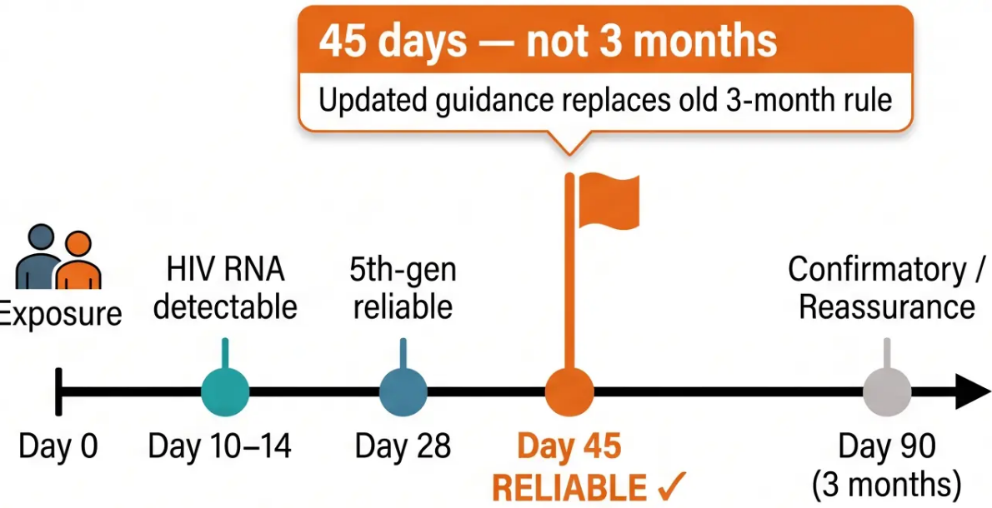
Bradford VTS Teaching Deck • www.bradfordvts.co.uk
HIV Tests: Types and Window Periods
4th-Generation Ag/Ab Combo
UK Standard
2024
Detects: HIV antibodies + p24 antigen
Reliable at 45 days • Confirmatory at 3 months
5th-Generation Test
Detects: Ag/Ab + type differentiation
~28 days (lab dependent)
HIV RNA (Viral Load)
Detects: HIV genetic material directly
~10–14 days • Used in suspected acute seroconversion
Days Post-Exposure
Antibody-Only Test
Detects: HIV antibodies only
Standard UK HIV test (2024): 4th-generation Ag/Ab
combo — reliable result at 45 days post-exposure.
3 months • No longer first-line; largely replaced
For educational purposes only • Always verify with current NICE/BNF guidance • www.bradfordvts.co.uk

Slide 8



Bradford VTS Teaching Deck
www.bradfordvts.co.uk
Interpreting HIV Test Results
Negative Result
Positive Result — Initial Steps
- Reassure the patient clearly and warmly
- If tested within the window period → re-test
at 45 days post-exposure
- Discuss ongoing risk reduction and consider
PrEP referral if high-risk
- Opportunity for: hepatitis B vaccination, STI
screen, condom counselling
- Give the result clearly and calmly — state it first
- Keep information minimal at this first
consultation — focus on the next 24-48 hours
- Arrange confirmatory testing via GUM / ID clinic
- Do NOT start ART in primary care — refer
urgently to HIV specialist clinic
- Safety net: assess risk of self-harm; arrange
follow-up within 48-72 hours
Window period reminder: 4th-gen test reliable
at 45 days — not 3 months
AKT Tip: Do not counsel about ART at this first
visit — focus on coping and support
For educational purposes only · Always verify with current NICE/BNF guidance · www.bradfordvts.co.uk

Slide 9

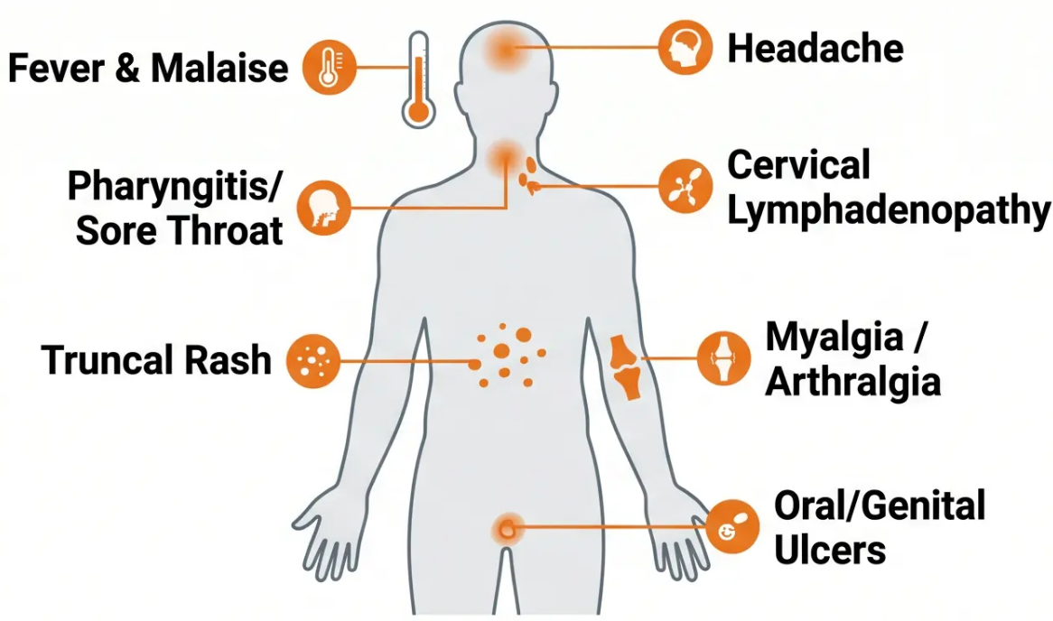
Bradford VTS Teaching Deck
www.bradfordvts.co.uk
HIV Seroconversion Illness
Recognising the window when antibody tests can mislead
CLINICAL ALERT
HIV antibody tests may be negative during
seroconversion — the patient is highly infectious
but the standard test appears reassuring.
CORRECT TEST
If seroconversion is suspected → request HIV
RNA (viral load) or a 5th-generation test
HIV RNA detects infection from ~10-14 days post-exposure
RED FLAG
Recent high-risk exposure + seroconversion
symptoms → Urgent HIV RNA + consider PEPSE
if within 72 hours
Onset: 2-6 weeks post-exposure · Duration: 1-2 weeks (self-limiting)
AKT
TIP
A negative HIV antibody test does NOT rule out acute HIV
infection during the seroconversion window.
For educational purposes only · Always verify with current NICE/BNF guidance · www.bradfordvts.co.uk

Slide 10



Bradford VTS Teaching Deck • www.bradfordvts.co.uk
HIV Pathophysiology and Natural History
Disease progression • Updated BHIVA 2025 ART guidance
⚡️ BHIVA 2025 UPDATE
Acute Infection / Seroconversion
ART for ALL
Weeks 2-6 • Viraemia peaks • CD4 temporarily falls then recovers •
May cause seroconversion illness
Regardless of CD4 count
Asymptomatic HIV Infection
Previous guidance: start ART if
CD4 above 200
Median 10 years untreated • CD4 gradually declines •
Viral load persists • Patient feels well
Current guidance: offer ART to
every person with HIV
Earlier treatment = better outcomes
+ prevents transmission (U=U)
HIV-Related Illness
CD4 200-350 • Recurrent infections • Constitutional symptoms •
Increasing immune compromise
First-line regimen: dolutegravir /
lamivudine (dual therapy)
AIDS
CD4 count still matters for:
• PCP prophylaxis (below 200)
• Vaccine decisions
• Monitoring AIDS-defining illness risk
CD4 below 200 • AIDS-defining illnesses • PCP, Kaposi's
sarcoma, cerebral toxoplasmosis
For educational purposes only • Always verify with current NICE/BNF guidance • www.bradfordvts.co.uk

Slide 11

Bradford VTS Teaching Deck • www.bradfordvts.co.uk
11 / 24
HIV-Associated Conditions: The GP Role
Patients with HIV need more than specialist care – the GP is central to long-term health
Annual Health Review
Bone Health
In addition to specialist HIV clinic – holistic GP-led review
Elevated osteoporosis risk – monitor DEXA where indicated
Cardiovascular Risk
Renal Monitoring
HIV + ART both increase CV risk – assess and manage
proactively; smoking cessation is especially important
Tenofovir (TDF) nephrotoxicity – monitor eGFR and urine
protein regularly
Mental Health Support
Vaccinations
Stigma, depression, and anxiety are common – screen
regularly and offer appropriate referral
Annual influenza • Pneumococcal • Hepatitis A/B • HPV – all
recommended
Cervical Screening
STI Screening
Increased frequency if HIV positive – annually (not
standard 3-yearly interval)
At least annually – more frequently if ongoing high-risk
behaviour
Drug Interactions with ART – Always Check Before Prescribing
St John's Wort – Contraindicated
with ALL antiretrovirals
Rifampicin – Significantly reduces
most ART drug levels
Some Statins / PPIs – Check individual
ART regimen before prescribing
*AKT TIP: ALWAYS check HIV drug interactions before prescribing any new medication to a patient on ART
For educational purposes only • Always verify with current NICE/BNF guidance • www.bradfordvts.co.uk

Slide 12





Bradford VTS Teaching Deck · www.bradfordvts.co.uk
U=U
Undetectable = Untransmittable
WHAT DOES U=U MEAN?
A person on effective ART with an undetectable viral load
(VL below 200 copies/mL) cannot sexually transmit HIV.
PARTNER 1 & PARTNER 2 Studies
Zero transmissions recorded in serodiscordant couples where the
HIV-positive partner had an undetectable viral load
Applies To
Does Not Apply When
Clinical Implications
Vaginal sex • Anal sex • Oral sex
Requires sustained undetectable VL
on ART
Viral load is detectable
During acute seroconversion
ART adherence is poor
Reduces stigma and psychological burden
Informs partner notification discussions
Does not protect against other STIs
SCA TIP
If a patient with HIV asks about risk to their partner — U=U is the key evidence-based message.
Reassure, but remind that ART adherence and regular VL monitoring are essential.
For educational purposes only · Always verify with current NICE/BNF guidance · www.bradfordvts.co.uk

Slide 13

Bradford VTS Teaching Deck
www.bradfordvts.co.uk
PrEP: Pre-Exposure Prophylaxis
BASHH / BHIVA 2025 Guidelines
Who Should Be Offered PrEP?
Current Regimens
MSM
Daily PrEP: TDF/FTC (Truvada) – one tablet once daily
Standard first-line option
Recent STI or multiple partners
Trans women who have sex with men
Alternative Daily PrEP: TAF/FTC – one tablet once daily
Preferred for women; bone or renal concerns
Elevated acquisition risk
Heterosexual men and women
Event-Based PrEP (MSM only):
2-1-1 Dosing
MSM ONLY — not for women
HIV-positive partner not on ART
2 tablets 2-24h before; 1 tablet at 24h; 1 tablet at 48h
People who inject drugs
Sharing equipment
3-Monthly Monitoring
Serodiscordant couples
HIV test
Renal function
STI screen
Blood pressure
Where HIV-positive partner has detectable viral load
Over 111,000 people accessed PrEP in England in 2024 — free on NHS via sexual health clinics
For educational purposes only • Always verify with current NICE/BNF guidance
www.bradfordvts.co.uk

Slide 14




PEPSE: Post-Exposure Prophylaxis Following Sexual Exposure
www.bradfordvts.co.uk
Must start within 72 HOURS of exposure — ideally within 24 hours
The earlier PEPSE is started, the greater the efficacy. Every hour matters.
WHAT IS PEPSE?
WHO SHOULD RECEIVE PEPSE?
Antiretroviral medication taken after a potential
HIV exposure to prevent infection from taking
hold. It is not a cure — it is a prevention window.
• Receptive anal or vaginal sex with HIV-positive
partner (unknown or detectable viral load)
• Needle-sharing with HIV-positive person
• Sexual assault (any route)
• High-risk exposure in serodiscordant couple
If HIV-positive source is on ART with
undetectable VL → PEPSE generally
not indicated (U=U)
Start within 72h
28-day full course
Risk assessment: useBASHH PEPSE tool – consider route of exposure, partner VL status, partner HIV status, and local prevalence.
For educational purposes only · Always verify with current NICE/BNF guidance · www.bradfordvts.co.uk

Slide 15






Bradford VTS Teaching Deck
www.bradfordvts.co.uk
PEPSE: Current BASHH 2024 Regimen
Preferred regimen • Duration • Follow-up • Adherence
FIRST-LINE REGIMEN — BASHH 2024
Truvada (TDF 300mg / FTC 200mg) — one tablet once daily
➕ Dolutegravir 50mg — once daily
28 DAYS — COMPLETE THE FULL COURSE
*Simpler once-daily dosing preferred over raltegravir-based regimen (BASHH 2024)
Side Effects to Counsel
Follow-Up Testing Schedule
Adherence Counselling
Follow-Up HIV Tests
Common Side Effects
Adherence Matters
- Baseline: at PEPSE start
- Day 28: on completion
- Day 45: main result
- 3 months: confirmatory reassurance
- Nausea, headache, fatigue
- Diarrhoea — usually first week
- Usually self-limiting
- Advise: take with food
- Set daily alarms
- Carry tablets — do not miss doses
- Missing doses reduces efficacy
- PEPSE is not 100% effective
⚠️ PEPSE is not a substitute for PrEP. Continue condom use during and after the course.
*For educational purposes only • Always verify with current NICE/BNF guidance • www.bradfordvts.co.uk

Slide 16







Bradford VTS Teaching Deck
www.bradfordvts.co.uk
HIV and Pregnancy
Preventing vertical transmission — what every GP trainee needs to know
Antenatal Testing
Starting ART in Pregnancy
- Routine opt-out HIV test offered to ALL pregnant women
- Repeat in third trimester if high-risk or initial test declined
- Goal: identify and treat before delivery
- ART started immediately regardless of CD4 count or viral load
- Goal: achieve undetectable viral load before delivery
- Transmission risk with undetectable VL at delivery: <0.5%
- Without treatment: up to 15–25% transmission risk
Mode of Delivery
Infant Feeding & Neonatal Prophylaxis
- Vaginal delivery: recommended if VL undetectable at term
- Caesarean section: if VL detectable or unknown at delivery
- Decision made jointly with HIV specialist and obstetric team
- Breastfeeding: NOT recommended in UK (formula feeding
preferred)
- Small but non-zero transmission risk via breast milk even on ART
- Neonatal ARV prophylaxis given based on maternal VL at delivery
Urgent referral if HIV-positive woman has no viral suppression near delivery — involve obstetric and HIV specialist teams immediately.
For educational purposes only - Always verify with current NICE/BNF guidance - www.bradfordvts.co.uk

Slide 17
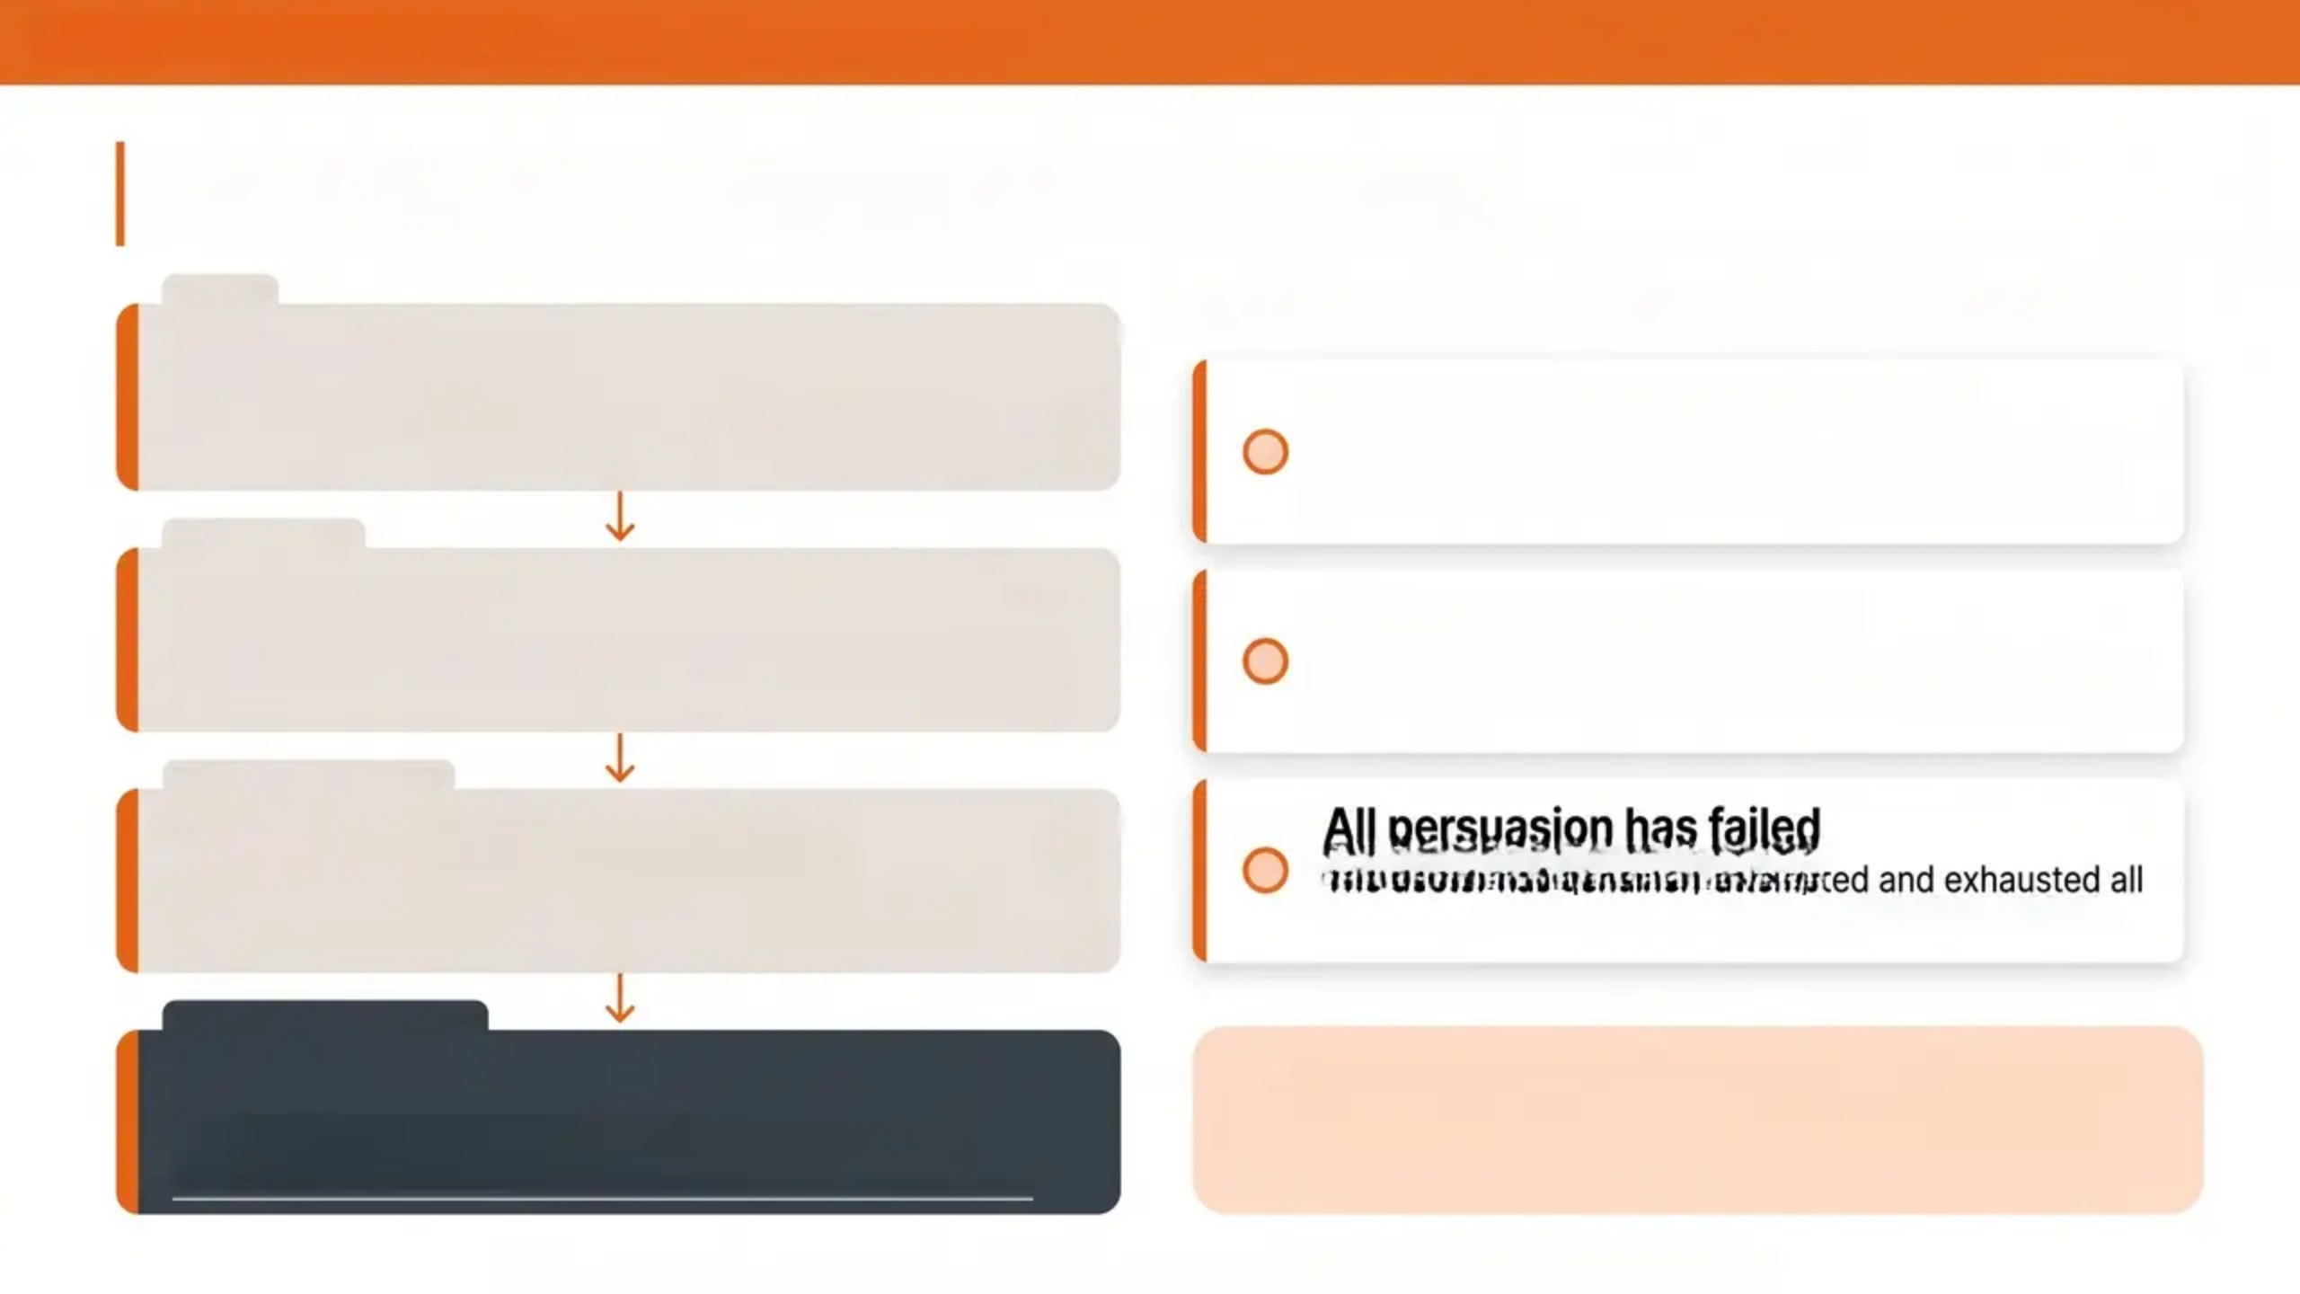

Bradford VTS Teaching Deck
www.bradfordvts.co.uk
Confidentiality and HIV: GMC Guidance
FIRST
WHEN DISCLOSURE WITHOUT CONSENT IS PERMITTED
Counsel the patient
Explain the importance of informing their partner. Offer
support — GUM clinic or counsellor can assist with disclosure.
Serious risk of HIV transmission
An identifiable person faces a real and significant risk
of harm.
IF REFUSED
Try to persuade
Patient refuses to disclose
Make further attempts to encourage patient-led disclosure.
Document all conversations carefully.
The patient declines to inform their partner and will not
allow the doctor to do so.
IF STILL REFUSED
Consult senior colleague or MDO
All persuasion has failed
Seek advice from a senior clinician or medical defence
organisation before taking any further action.
The doctor has genuinely attempted and exhausted all
reasonable efforts to encourage voluntary disclosure.
LAST RESORT ONLY
Disclose minimum necessary
AKT TIP: GMC guidance permits disclosure WITHOUT
consent only as a last resort. Always attempt patient-
led disclosure first — and document every step.
Inform only the identifiable person at serious risk. Do not
disclose beyond what is strictly necessary.
For educational purposes only · Always verify with current NICE/BNF guidance ·
www.bradfordvts.co.uk

Slide 18

Bradford VTS Teaching Deck • www.bradfordvts.co.uk
TOP TIPS
HIV in Primary Care
Offer HIV Tests Proactively
PEPSE: 72 Hours Maximum
01
06
New registrations, STI screens, and indicator
conditions — don't wait to be asked.
Ideally within 24 hours. Send to GUM or ED
out of hours — never delay.
02
Use Opt-Out Language
Always Check Drug Interactions
07
“We test everyone for HIV as part of our
standard checks”— reduces stigma and refusals.
ART has extensive interactions. Check before
prescribing anything new.
4th-Gen Test: 45 Days
PrEP Is Widely Accessible
03
08
Reliable result at 45 days post-exposure —
not 3 months as older guidance states.
Over 111,000 accessed PrEP in England in
2024. Refer via sexual health clinic.
04
U=U Changes Everything
Serconversion: Antibody May Be Negative
09
Undetectable viral load = cannot sexually
transmit HIV. Use this to reduce stigma.
If serconversion suspected, use HIV RNA —
not antibody test alone.
05
ART for ALL — Any CD4
Confidentiality: Patient Disclosure First
10
BHIVA 2025: start antiretroviral therapy
regardless of CD4 count.
GMC permits breach only as a last resort.
Always try patient-led disclosure first.
For educational purposes only • Always verify with current NICE/BNF guidance • www.bradfordvts.co.uk

Slide 19


Bradford VTS Teaching Deck
www.bradfordvts.co.uk
EXAM PEARLS
AKT — Applied Knowledge Test
Q: Window period — 4th-gen Ag/Ab test?
Reliable result at 45 days post-exposure — not 3
months as older guidance states. Repeat at 3
months for reassurance only.
Q: When to start ART?
ALL people with HIV regardless of CD4 count —
BHIVA 2025 interim update. No threshold applies.
Q: Classic HIV indicator condition?
Oral hairy leukoplakia = think HIV unless proven
otherwise. Also: recurrent zoster, PCP, unexplained
lymphadenopathy.
Q: PEPSE timing?
Must start within 72 hours of exposure — ideally
within 24 hours. Efficacy declines with delay.
Q: GMC — can you breach HIV confidentiality?
Only as a last resort — patient disclosure must be
attempted first. Follow GMC process strictly.
Q: U=U evidence base?
PARTNER 1 and PARTNER 2 studies — zero
transmissions where HIV+ partner had undetectable
viral load.
Q: Key ART drug interaction?
St John's Wort — contraindicated with ALL ART.
Rifampicin significantly reduces most ART levels.
Q: HIV in pregnancy — mode of delivery?
Vaginal delivery acceptable if viral load is undetect
at term. Caesarean if VL detectable or unknown.
For educational purposes only · Always verify with current NICE/BNF guidance · www.bradfordvts.co.uk

Slide 20







Bradford VTS Teaching Deck - www.bradfordvts.co.uk
EXAM PEARLS: SCA
SCA Skills
Communication skills that examiners are looking for — HIV in the consultation room
Delivering a Positive HIV Result
Addressing Stigma and Fear
• Stay calm — give the result clearly and early
• Acknowledge shock; keep information minimal
• Focus on the next 24-48 hours only
• Arrange follow-up within 48-72 hours
• Safety net for mental health crisis
• Normalise testing — ‘We offer this to everyone’
• Avoid stigmatising language at all times
• Explore the patient’s fears gently if reluctant
• Frame HIV as a manageable long-term condition
• Use U=U to reduce fear around transmission
PEPSE Counselling
Partner Notification
• Explain the 72-hour window clearly
• Stress: the sooner, the better
• Outline the 28-day course and adherence importance
• Address side effects honestly — nausea, fatigue common
• PEPSE is not 100% effective — condoms still needed
• Explore patient's feelings before advising
• Offer GUM clinic support for disclosure
• Explain the GMC process — patient disclosure first
• Avoid being threatening about confidentiality limits
• Reassure: support is available throughout
Explaining U=U
Confidentiality Conversations
• Undetectable viral load = cannot sexually transmit HIV
• Cite PARTNER studies — zero transmissions
• Stress ART adherence is what maintains U=U
• Clarify: does not protect against other STIs
• Powerful tool for reducing patient anxiety
• Explain confidentiality clearly and reassuringly
• Outline limits calmly — not as a threat
• GMC allows disclosure only as an absolute last resort
• Offer to help the patient disclose with support
• Always try patient-led disclosure first
For educational purposes only • Always verify with current NICE/BNF guidance • www.bradfordvts.co.uk

Slide 21







Bradford VTS Teaching Deck · www.bradfordvts.co.uk
RED FLAGS: HIV in Primary Care
These scenarios require urgent action — do not delay
Serconversion Illness + Recent
High-Risk Exposure
New AIDS-Defining Illness
Urgent HIV RNA test • Consider PEPSE if within 72
hours • Antibody test may be falsely negative
Kaposi's sarcoma, PCP, cerebral toxoplasmosis •
Urgent referral to HIV specialist
New HIV Positive Diagnosis
Late PEPSE Request — Check the Clock
Urgent HIV specialist referral • Safety-net for
mental health crisis • Follow up within 48-72 hours
If >72 hours post-exposure → PEPSE not indicated •
Offer STI screen + PrEP discussion instead
HIV Positive Pregnancy Without Viral
Suppression
Unexplained CD4 <200 or Suspected
HIV Lymphoma
Urgent joint obstetric and HIV specialist team
referral • Start ART immediately
Start PCP prophylaxis • Urgent specialist review •
Consider haematology if lymphoma suspected
For educational purposes only • Always verify with current NICE/BNF guidance • www.bradfordvts.co.uk

Slide 22












Bradford VTS Teaching Deck
www.bradfordvts.co.uk
COMMON PITFALLS:
GP Trainee Errors to Avoid
ART only if CD4 drops below 200
Undetectable VL means cured
Now: ART for ALL patients regardless of CD4 count — BHIVA 2025
HIV is lifelong — undetectable means well-managed, not cured
3-month window period
PEPSE not available after hours
Now: 4th-generation Ag/Ab test reliable at 45 days post-exposure
Direct to ED for 24/7 PEPSE access if out of hours
Using the term HAART
Breaching HIV confidentiality without process
Correct terminology: ART (antiretroviral therapy)
Follow GMC steps — patient disclosure first; breach only as last resort
Pneumocystis carinii pneumonia
Missing indicator conditions
Correct: Pneumocystis jirovecii pneumonia (PJP)
Always offer HIV test with oral hairy leukoplakia, recurrent zoster, PCP
Skipping drug interaction checks
PrEP is only for MSM
Always check ART interactions before any new prescription
PrEP is offered to all high-risk groups — not MSM exclusively
For educational purposes only • Always verify with current NICE/BNF guidance • www.bradfordvts.co.uk

Slide 23










Bradford VTS Teaching Deck
www.bradfordvts.co.uk
Quick Recall
HIV in Primary Care
*Core concepts — commit these to memory
Offer HIV Tests
4th-Gen Test
Undetectable = Untransmittable
New registrations • indicator
conditions • STI screens • antenatal care
Reliable result at 45 days
post-exposure — not 3 months
Undetectable viral load → cannot
sexually transmit HIV (PARTNER studies)
ART — BHIVA 2025
PEPSE Window
Seroconversion Illness
Start ART regardless of CD4 count
— no threshold
Within 72 hours • ideally within 24h •
TDF/FTC + dolutegravir • 28 days
HIV antibody may be negative —
use HIV RNA if acute HIV suspected
Check ART Interactions
GMC Guidance
PrEP Access
ALWAYS check before prescribing •
St John’s Wort contraindicated
Patient disclosure first • breach only
as last resort after full GMC process
111,000+ accessed in 2024 • free via
sexual health clinics • refer proactively
For educational purposes only • Always verify with current NICE/BNF guidance • www.bradfordvts.co.uk

Slide 24


Bradford VTS Teaching Deck
www.bradfordvts.co.uk
Final Disclaimer
Important Notice
Always verify all clinical advice, drug doses, and treatment
recommendations with the latest NICE guidelines and BNF before
applying in clinical practice.
This resource is for educational purposes only and does not constitute
clinical advice. Guidelines change — check current sources.
Bradford VTS Teaching Resource · May 2026
www.bradfordvts.co.uk
HIV in Primary Care: Testing, Counselling and PEPSE · Bradford VTS · Updated to BHIVA/BASHH 2024-2025 Standards

