Slide 1
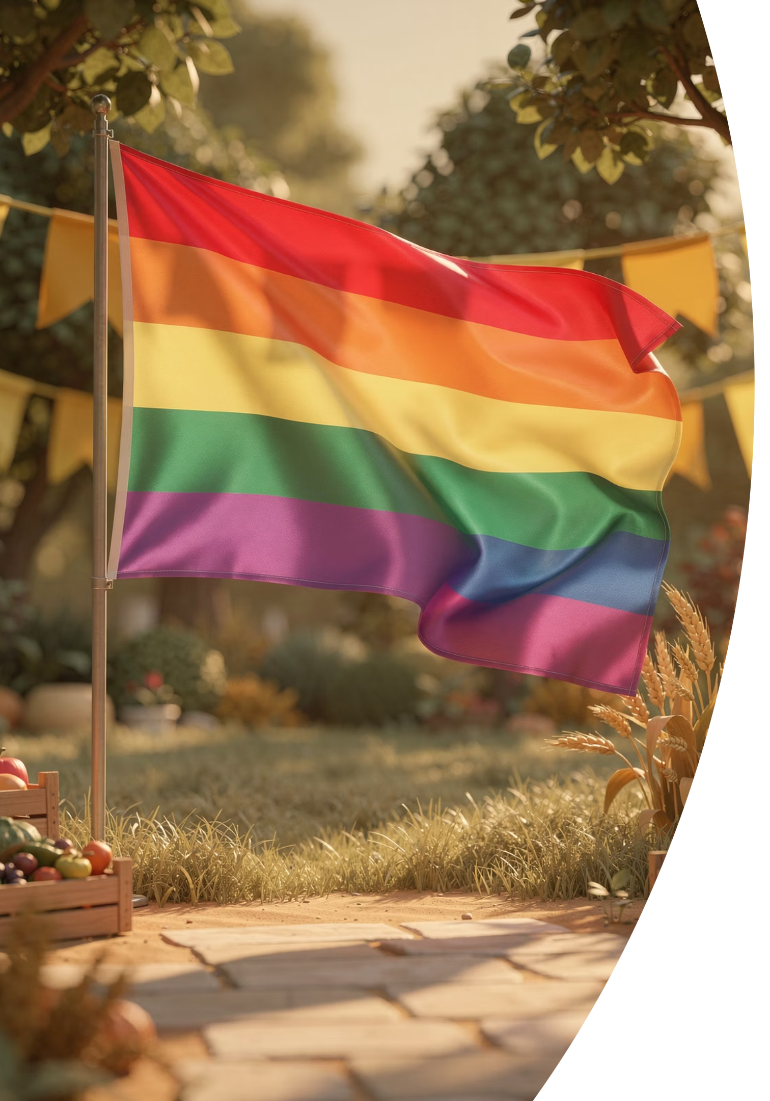
BRADFORD VTS TEACHING DECK
LGBT slang
The wonderful diversity within gay people — an educational resource for healthcare professionals and trainees.
LGBT+ INCLUSIVE CARE

Slide 2

Aims…
Understanding Terminology
Understand the distinction between the terms "gay" and "men who have sex with men" (MSM) — two terms that are related but carry different clinical and social meanings.
Gay-Friendly Practice
Appreciate why gay men are often reluctant to use primary care services, and consider practical steps you can take to make your practice more welcoming and inclusive.
Key Health Issues
Know what health issues are particularly important to men who have sex with men, including sexual health, mental wellbeing, and preventive care.
Sensitive Communication
Consider how to tackle difficult or sensitive issues without prejudice, using non-judgmental language and an inclusive, patient-centred approach.

Slide 3

Sexual Practices of Gay Men
An important reminder: many of the practices below are not exclusive to gay men — they are also common in heterosexual relationships, often less openly discussed.
Common Sexual Practices
Social & Cultural Context
Oral sex
Anal / thigh intercourse
Rimming (licking the anus)
Fisting (fist in the anus)
S&M — sadomasochism
Sex toys
Water sports (urine play) / scat (poo play)
Such practices are common in straight communities in the UK too. Just not as widely discussed!
Gay men meet partners through bars, clubs, saunas, cruising parks, laybys, and increasingly online (e.g. gay.com, Gaydar, Grindr). Understanding these social spaces helps clinicians ask relevant questions and provide appropriate, non-judgmental care.
Older cultural shorthand — such as handkerchief codes — is now largely outdated. The concept of "clones" (men who adopt a similar aesthetic) has evolved with each generation of gay culture.

Slide 4

Woman-to-Woman Sexual Health
Woman-to-woman sexual activity is not risk free. Healthcare professionals should never assume that lesbian or bisexual women are exempt from sexually transmitted infections. Many STIs can be transmitted through skin-to-skin contact, shared sex toys, and oral-genital contact.
Common Conditions
STIs to Screen For
Serious Conditions
Allergic Vaginitis
Bacterial Vaginosis (BV)
Trichomoniasis
Yeast Infections (Thrush)
Pubic Lice (Crabs)
Chlamydia
Gonorrhoea
Genital Warts
Herpes
Syphilis
Pelvic Inflammatory Disease (PID)
Hepatitis (A, B, C)
HIV / AIDS
Do not assume low risk based on sexual orientation alone. Always take a thorough sexual history in a non-judgmental way.

Slide 5

Useful Resources & Links
The following organisations provide high-quality, evidence-based information on LGBT+ sexual health. Signposting patients to trusted resources can support self-management and encourage engagement with services.
Terrence Higgins Trust
Playing Safely
The UK's leading HIV and sexual health charity. Offers guidance on HIV prevention, testing, treatment, and support for those living with HIV.
www.tht.org.uk
A dedicated resource providing practical safer sex information for gay and bisexual men, covering a range of practices and risk-reduction strategies.
www.playingsafely.co.uk
Encourage patients to explore these resources in their own time. Having printed leaflets or visible signage in your waiting room also signals a welcoming, inclusive practice.

Slide 6

LGBT Slang
How well do you know the language of the gay community? The following slides present common terms used within gay culture. Understanding this vocabulary helps build rapport, demonstrate cultural competence, and communicate more effectively with your patients.

Slide 7
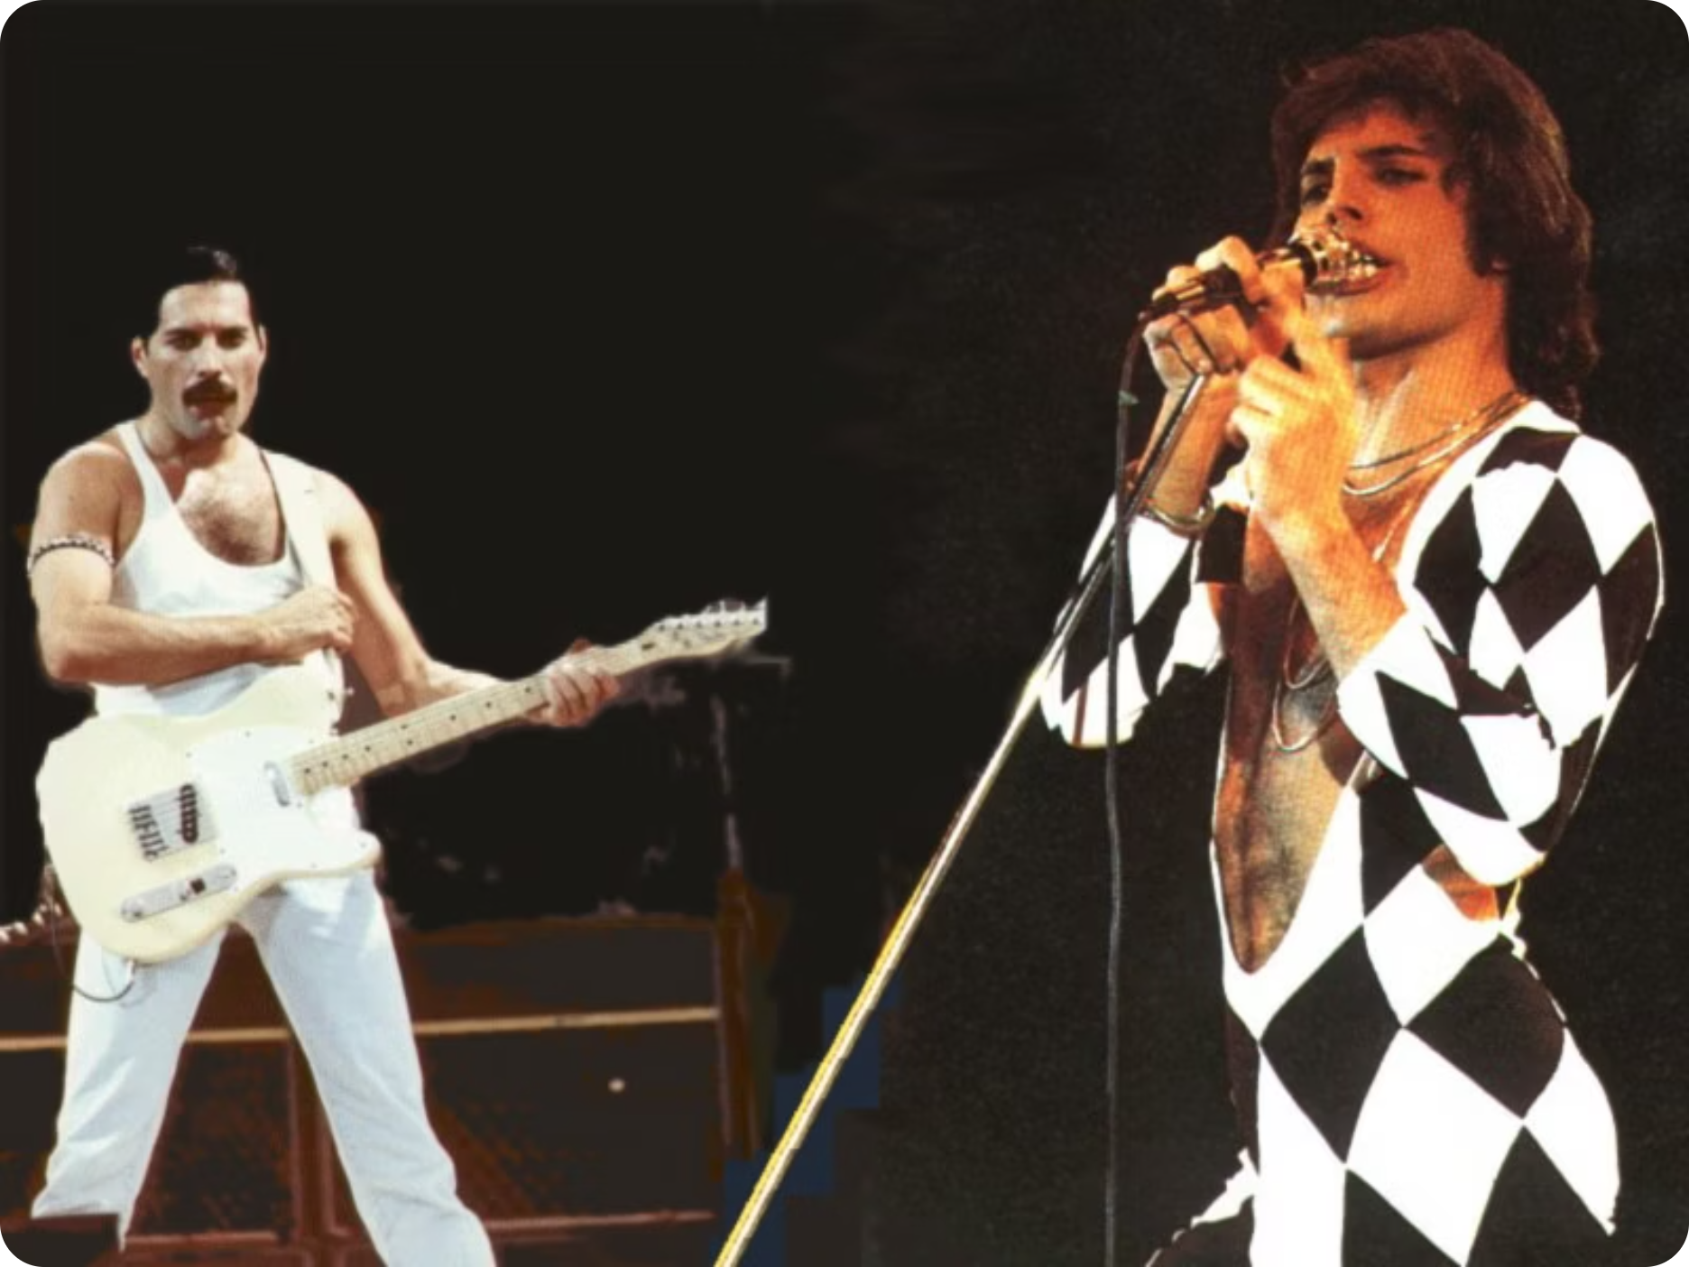
Clone
A "clone" is an older gay slang term, typically referring to men — often with moustaches and short hair — who adopted a very similar aesthetic to one another in the 1970s and 1980s. The look was so ubiquitous within certain gay communities that men were said to look like copies of each other.
The term has largely fallen out of everyday use, though the concept of recurring style archetypes within gay communities remains culturally relevant. Each generation tends to develop its own version of the "clone."

Slide 8
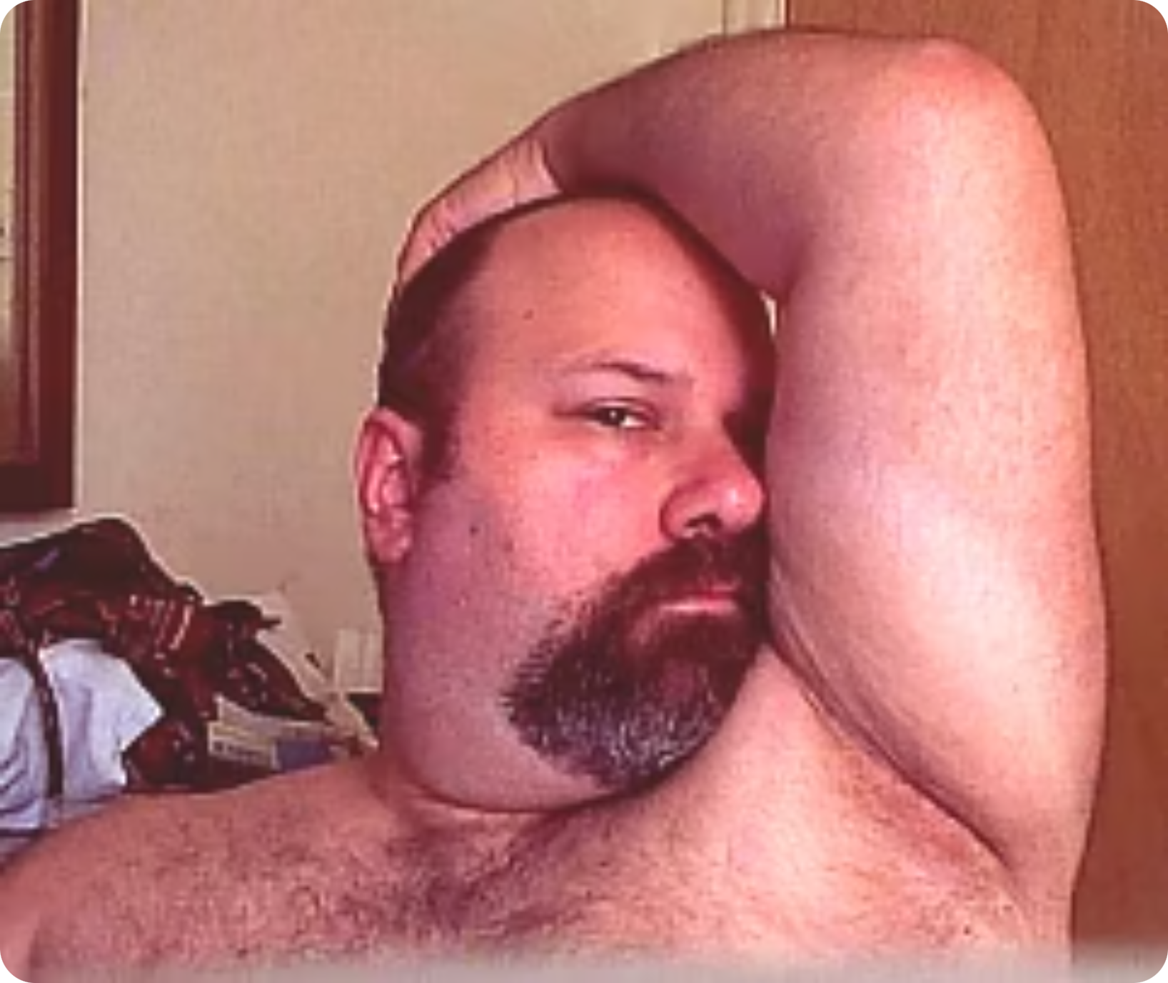
Bear
A "bear" is a term used within gay culture to describe a man who is typically larger, stockier, and hairy — often with a beard. Bears are celebrated for rejecting mainstream ideals of body image and instead embracing a more traditionally masculine, rugged aesthetic.
There is an established "bear community" with its own social events, bars, and online spaces. Many gay men specifically identify as bears or are attracted to them, making it an important subcultural identity to be aware of in a clinical context.

Slide 9


Cub
A "cub" is essentially a younger, typically slimmer or less hirsute version of a bear. Cubs often share the bear community's values — warmth, body positivity, and a rejection of conventional gay beauty standards — but present with a more youthful or less heavily built appearance.
Cubs often socialise within the bear community and may be romantically or sexually attracted to bears, though this is not universal. The term reflects the diversity of body types and identities celebrated within gay culture.

Slide 10
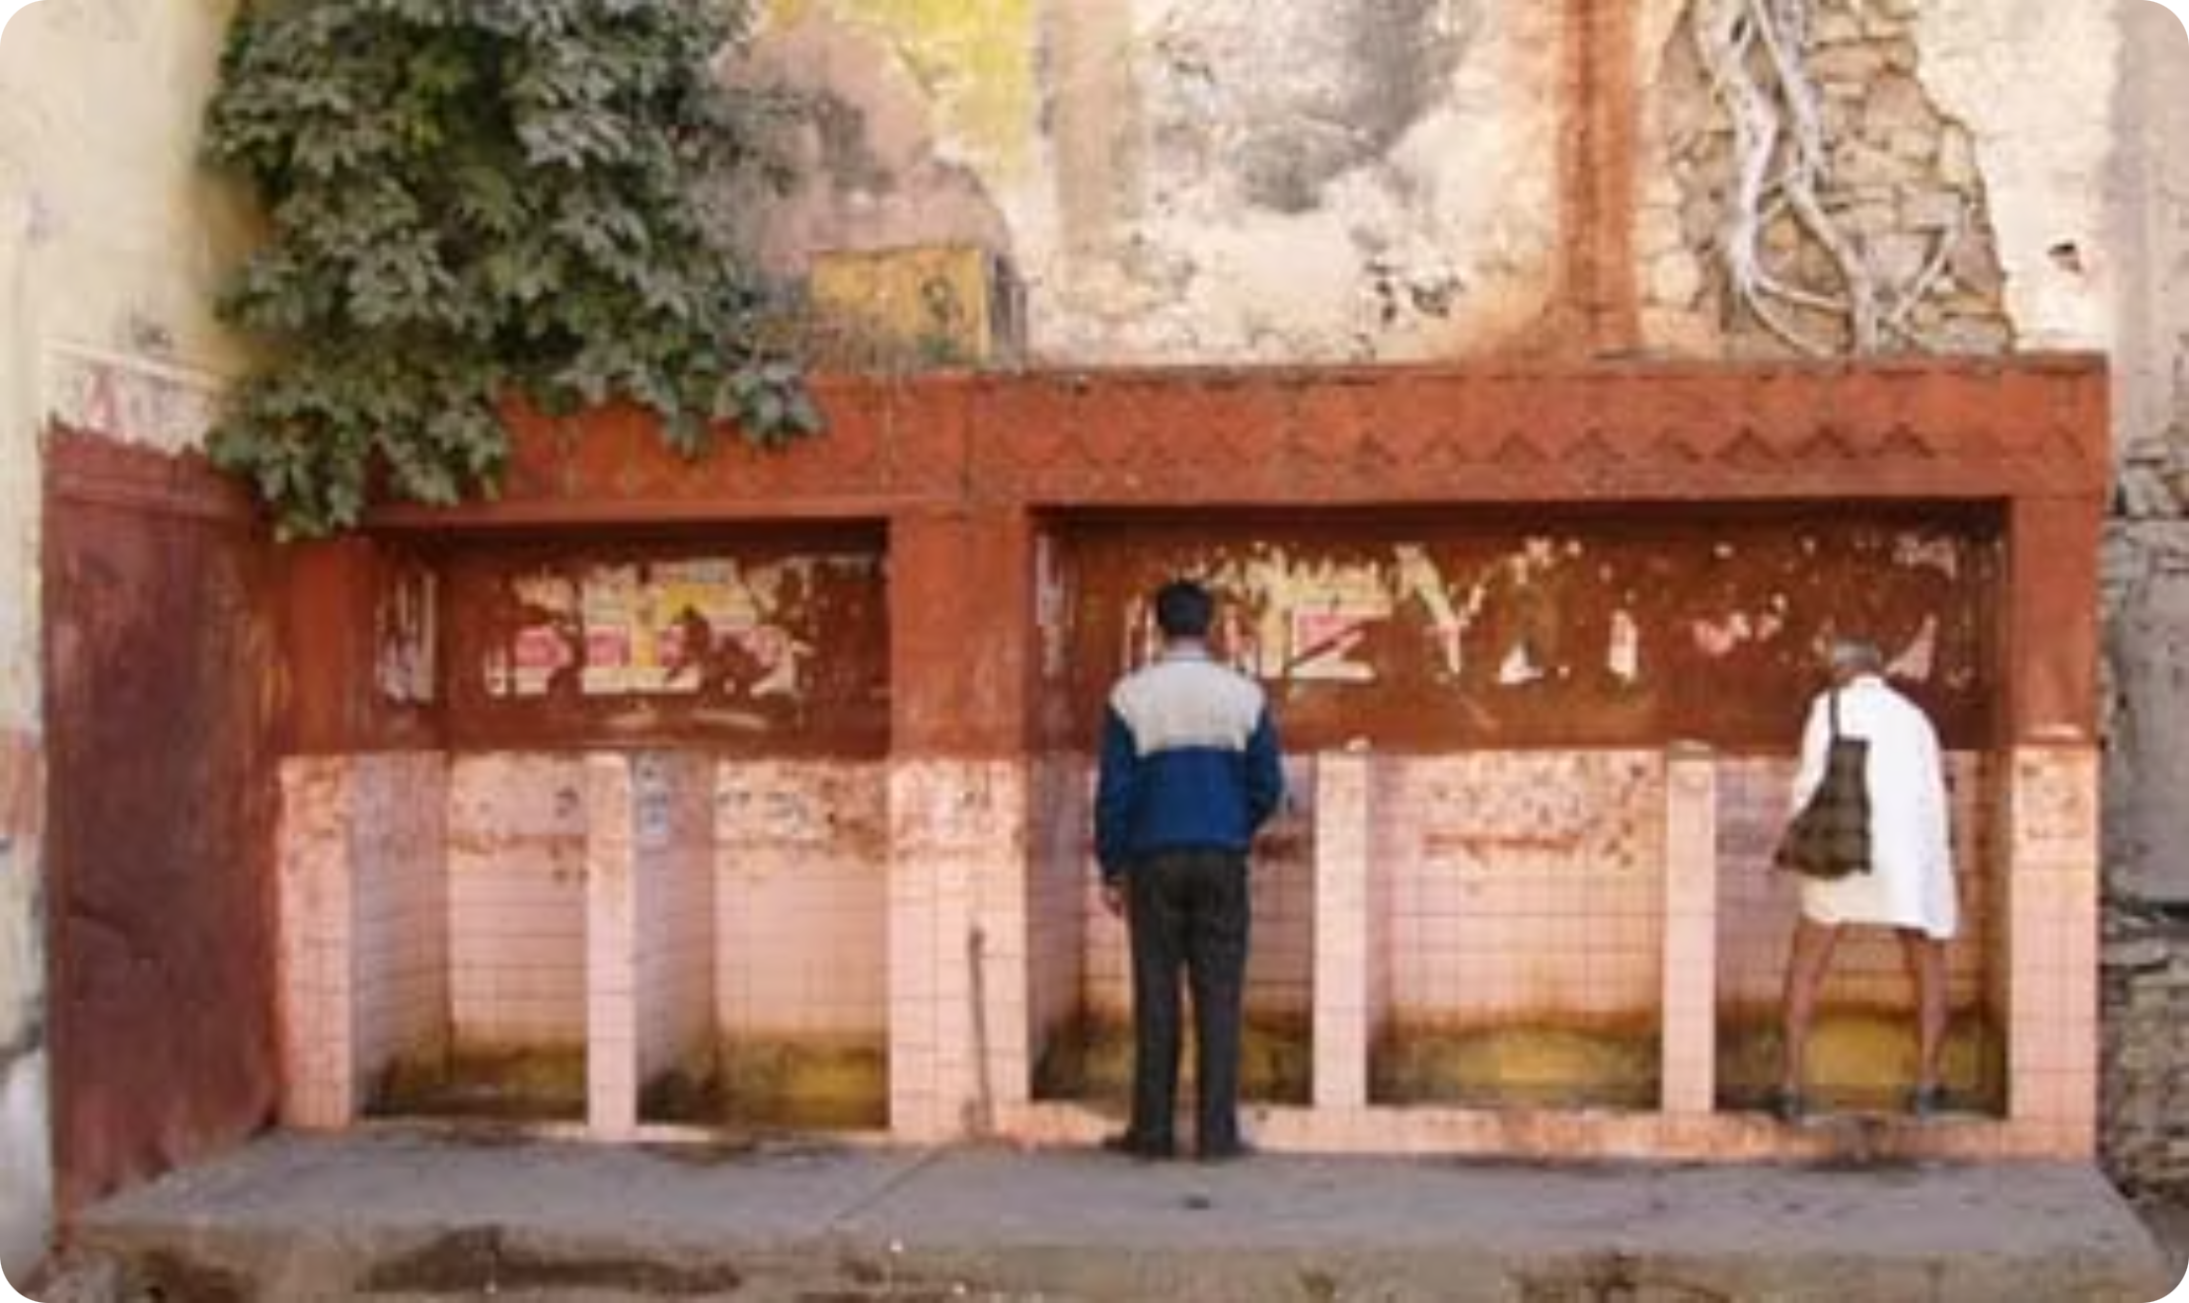
Cottage = Toilet
"Cottaging" refers to the practice of seeking or engaging in casual sex in public toilets. The term originates from British slang and has historically been associated with gay men, partly as a result of the criminalisation of homosexuality which forced sexual encounters into covert, semi-public spaces.
From a clinical perspective, it is useful to understand cottaging as a social behaviour that may still occur, particularly among men who do not openly identify as gay or who lack access to other social spaces. Non-judgmental enquiry is essential.

Slide 11

Cruising in Parks
"Cruising" refers to seeking casual sexual encounters in public outdoor spaces — typically parks, woodland areas, laybys, and other semi-secluded locations. These spaces are often well-known within the local gay community, even if they remain invisible to the general public.
As with cottaging, cruising is more common among men who may not openly identify as gay or bisexual, or who do not feel safe or comfortable in more visible gay social spaces. Understanding this behaviour helps clinicians provide appropriate sexual health screening and harm reduction advice.

Slide 12
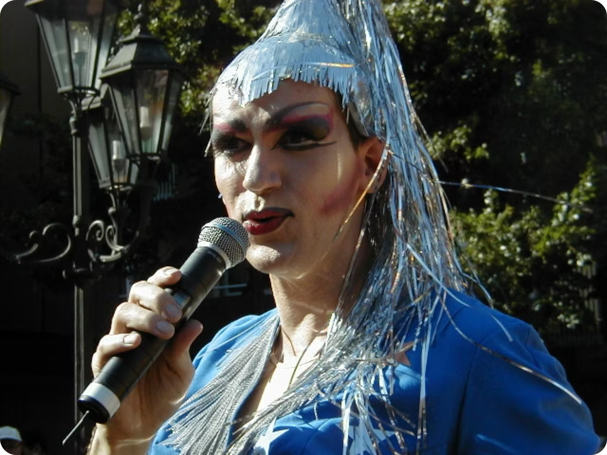
Diva
In gay culture, a "diva" is a female performer — often a powerful, glamorous, and emotionally expressive singer or entertainer — who holds particular cultural significance and admiration within the gay community.
Classic divas include Shirley Bassey, Edith Piaf, and Liza Minnelli. More recent figures include Madonna, Kylie Minogue, and Beyoncé. The connection between gay men and divas often relates to themes of resilience, flamboyance, and emotional authenticity — values that resonate deeply within gay cultural identity.

Slide 13
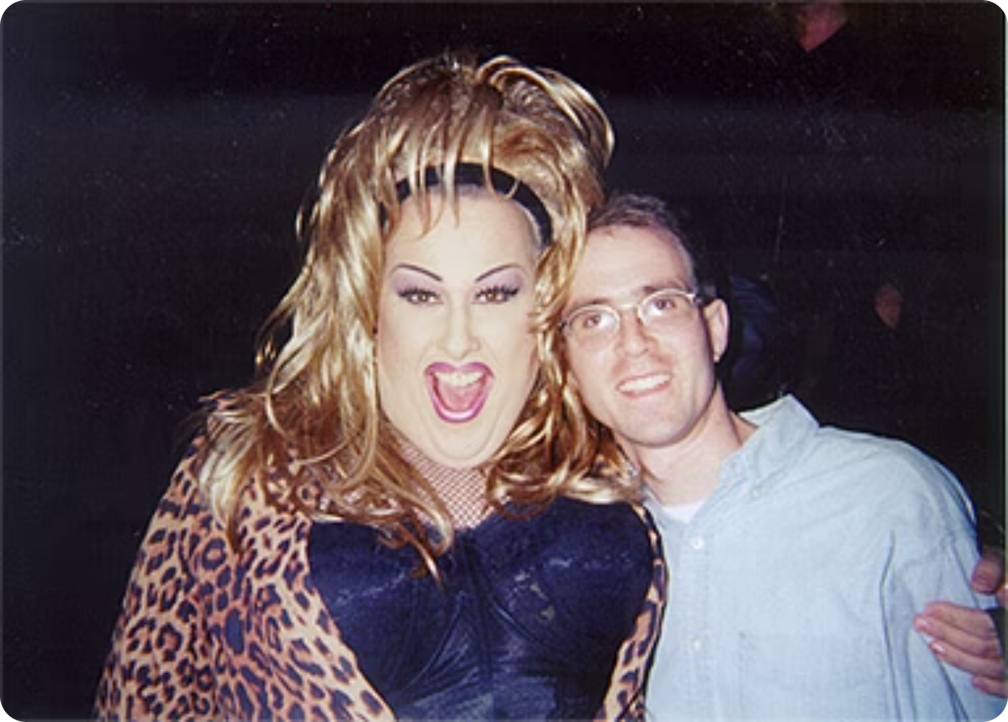
Drag Queen
A drag queen is typically a person — usually male — who performs in exaggerated feminine dress, make-up, and persona, often for entertainment purposes. Drag is a celebrated art form within gay culture, involving elaborate costumes, lip-syncing, comedy, and theatrical performance.
It is important to distinguish drag performance from gender identity: drag queens are not necessarily transgender, and being a drag performer does not define someone's sexual orientation. Drag culture has gained mainstream visibility through shows such as RuPaul's Drag Race.

Slide 14
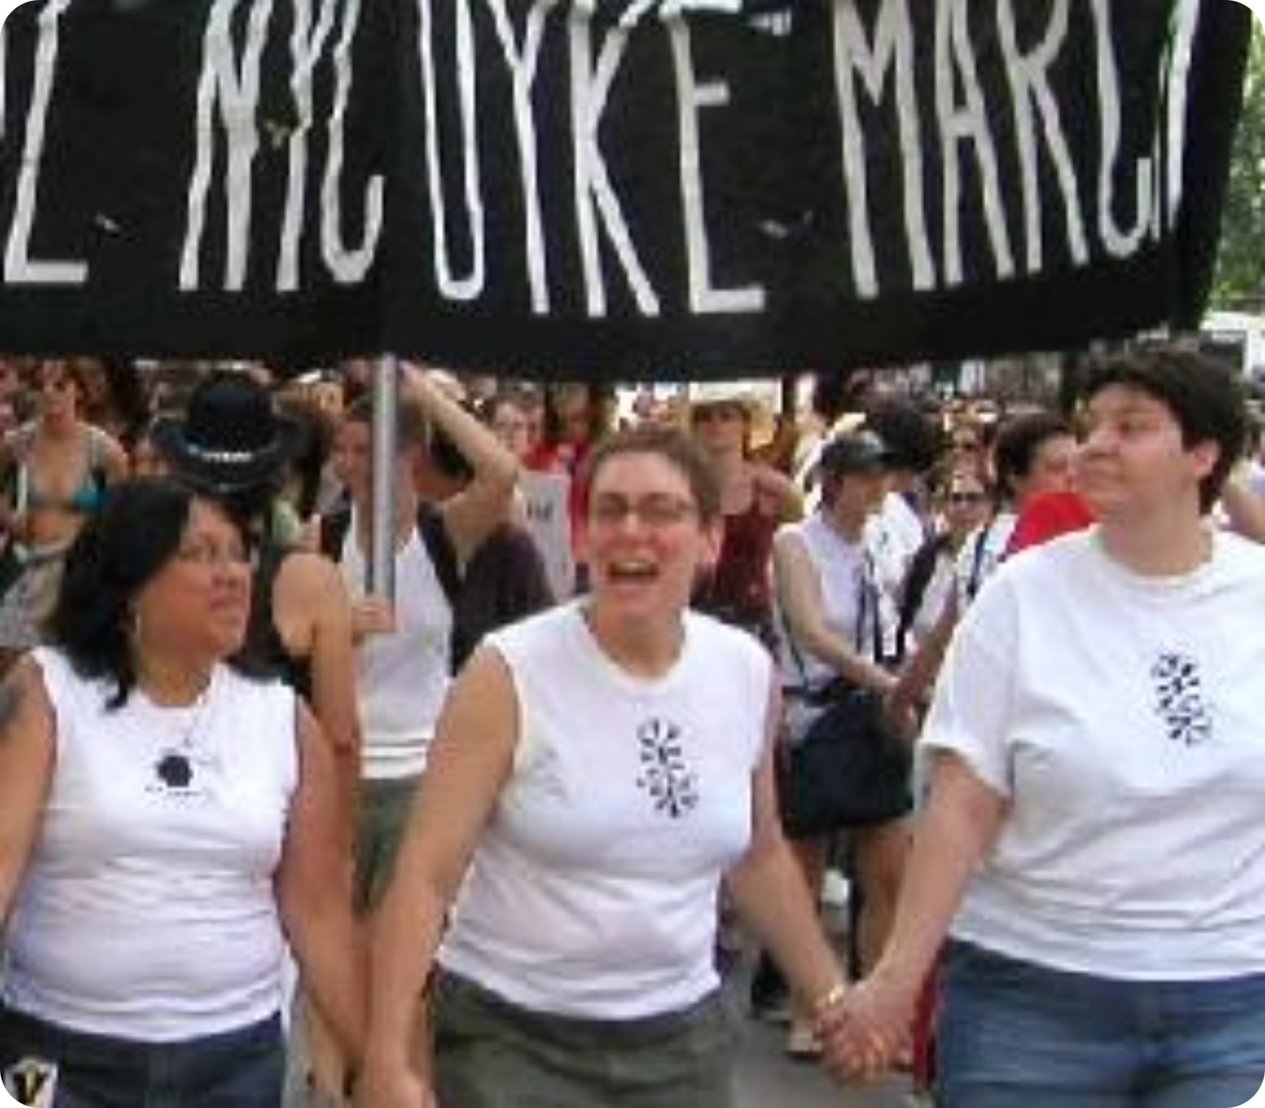

Drag King / Butch / Dyke
A drag king is a performer — typically female or non-binary — who dresses in an exaggerated masculine style for entertainment. "Butch" describes a lesbian or queer woman who presents in a more masculine way, while "dyke" is a term for a lesbian that has historically been used as a slur but has been widely reclaimed by the community.
The term "dyke" can be offensive when used by those outside the community, or without invitation. Always take your cue from the patient's own language and self-identification.

Slide 15

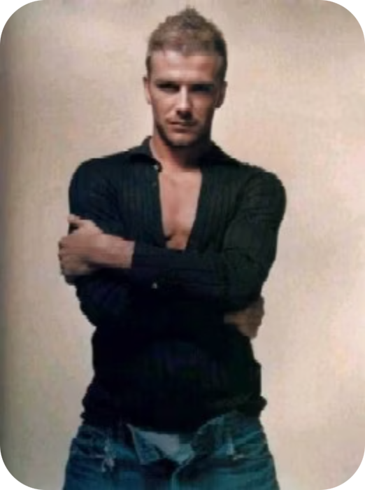
Metrosexual
A metrosexual is a heterosexual man who takes significant interest in his personal grooming, appearance, and fashion — traits that have culturally been associated with gay men. The term gained widespread popularity in the early 2000s, with David Beckham frequently cited as the archetypal example.
From a clinical perspective, this term is a useful reminder that appearance, style, and behaviour are not reliable indicators of sexual orientation. Assumptions based on how a patient presents can lead to missed opportunities for appropriate sexual health care.

Slide 16

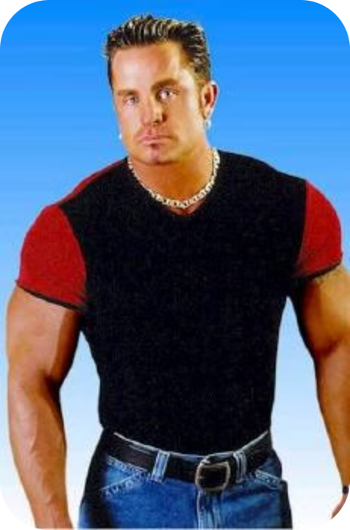
Muscle Mary
A "Muscle Mary" is gay slang for a gay man who is very muscular or bodybuilder-like in physique. The term is generally used affectionately or humorously within the community.
Body image is a particularly significant issue for many gay men. Research suggests gay and bisexual men are at higher risk of body dysmorphia, eating disorders, and steroid or performance-enhancing drug use compared to heterosexual men. Healthcare professionals should be aware of these risks and consider them when reviewing patients who present with related concerns.

Slide 17

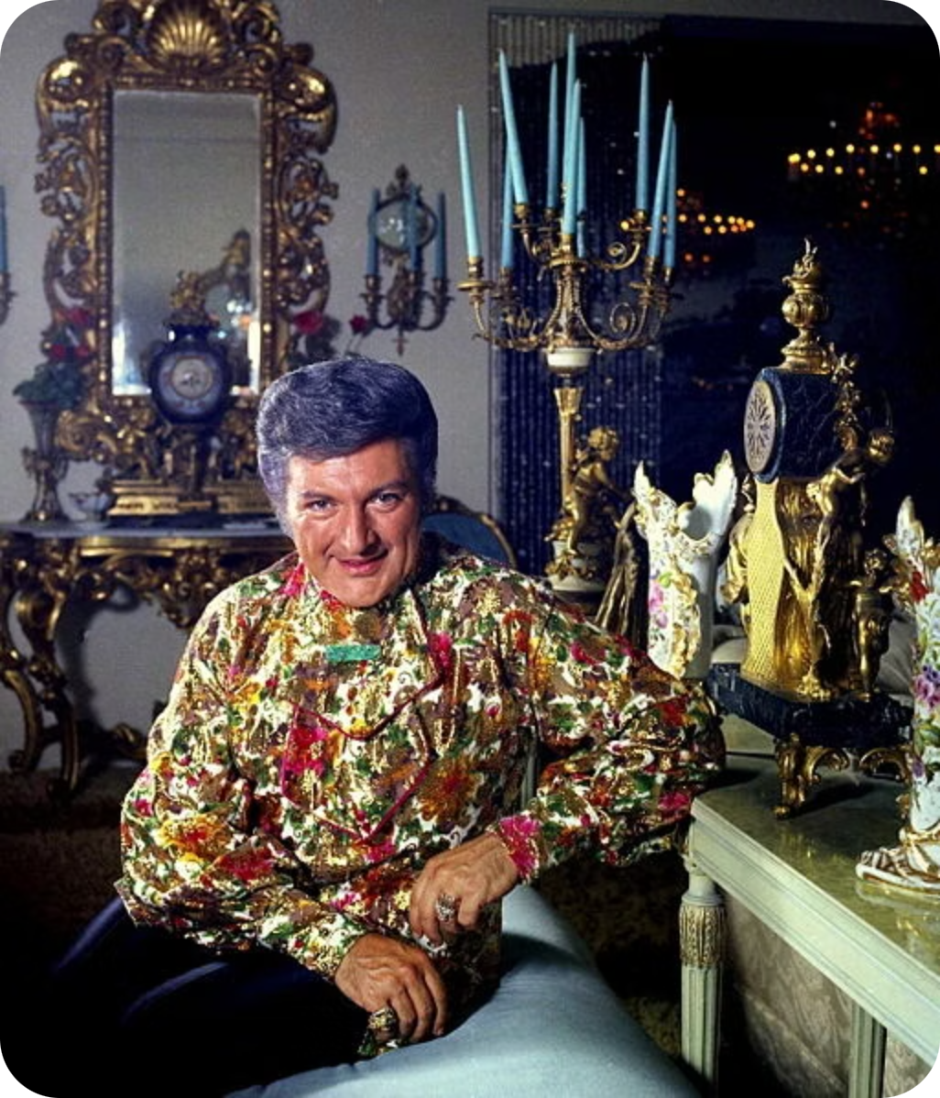
Queen
A "queen" is a term used to describe a very effeminate and camp gay man. It can be used affectionately within the community as a form of self-identification or playful banter, though it may be perceived as derogatory if used by someone outside the community.
Being "camp" — characterised by theatricality, irony, and exaggerated femininity — is an important and celebrated aspect of gay cultural expression for many men. Healthcare professionals should never conflate effeminate presentation with assumptions about a patient's health behaviours or sexual practices.

Slide 18

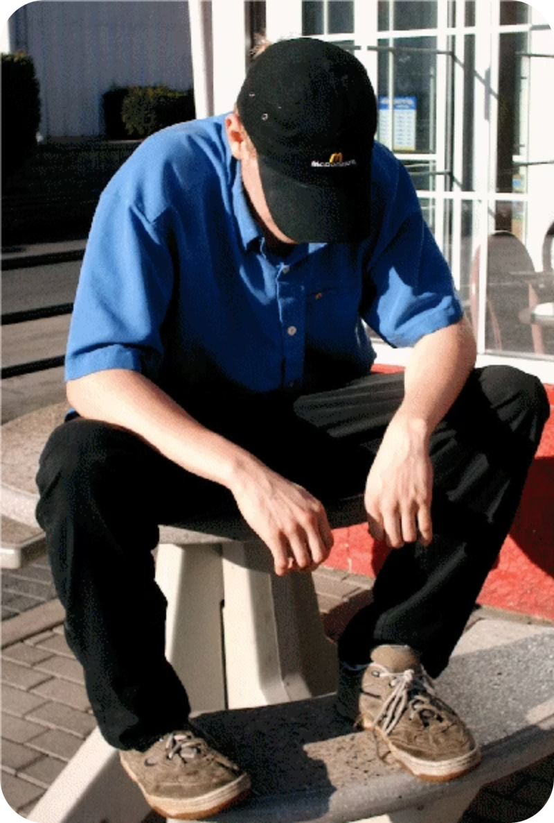
Stromo
A "stromo" is a gay man who acts and dresses in a conventionally straight manner — sometimes described as "straight-acting" or "straight-looking." The term is a blend of "straight" and "homo."
This term is clinically significant: a man who presents in a conventionally masculine way may not be recognised as gay by healthcare providers, potentially leading to missed sexual health conversations. It reinforces the importance of not assuming heterosexuality and of creating an environment where patients feel safe to disclose their sexual orientation and practices.

Slide 19

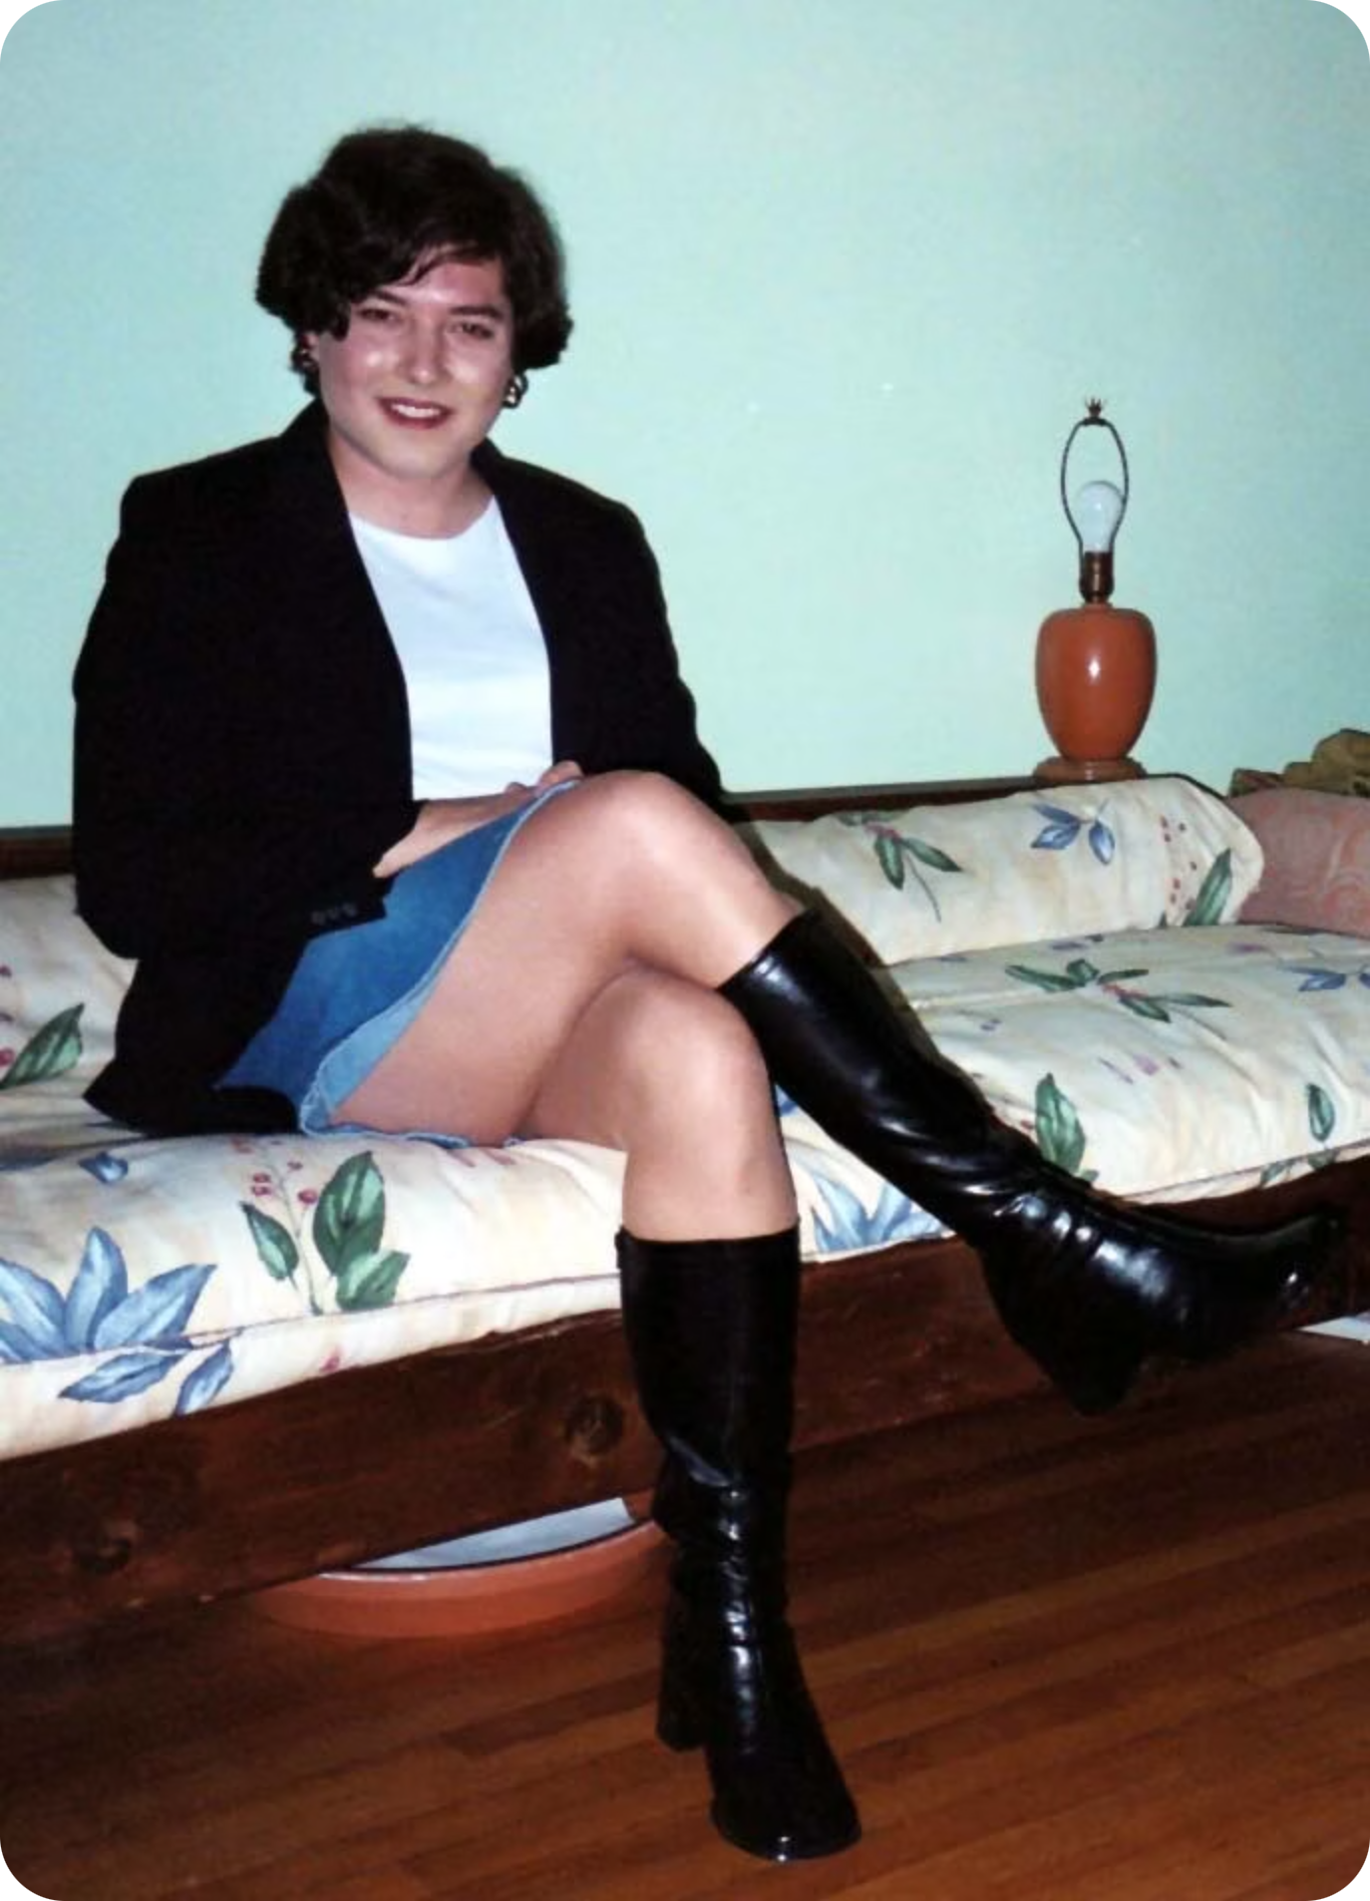
Tranny / Transvestite
"Tranny" is a shortened, informal form of transvestite — a person who wears clothing typically associated with the opposite gender. It is important to note that transvestism is distinct from being transgender: a transvestite does not necessarily identify as a different gender, and being a transvestite does not determine sexual orientation.
The term "tranny" is increasingly considered offensive and should be avoided by healthcare professionals. Use "transvestite" or, better still, ask the individual how they prefer to be described.

Slide 20

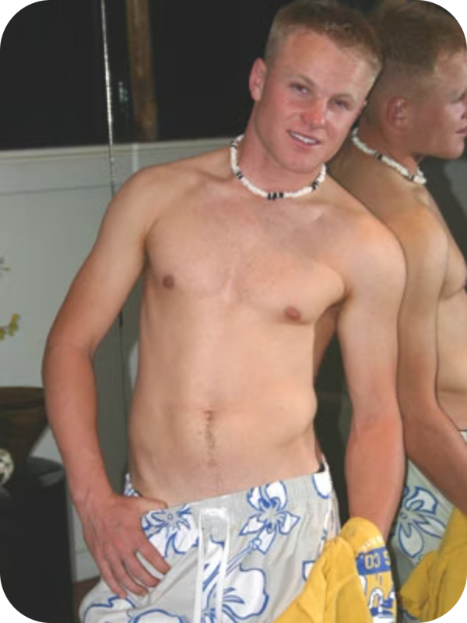
Twink
A "twink" is gay slang for a young, slim, often conventionally attractive gay man, typically with little body hair. The term generally refers to men of legal age (16 and above in the UK) who conform to a particular youthful aesthetic.
Twinks and "daddies" (older men attracted to younger partners) represent a well-recognised dynamic within gay culture. These generational pairings are consensual adult relationships and should not be confused with any form of inappropriate attraction. Understanding these terms helps clinicians communicate naturally and without confusion.

Slide 21
Gay Slang Glossary — Part 1
Bear & Cub
Bottom / Top
A bear is a gay man with a beard and/or significant body hair — celebrated for a masculine, rugged look. A cub is a younger, typically slimmer bear who often socialises within the same community.
Equivalent to passive/active. A bottom is the receptive partner; a top is the penetrative partner. Some men identify as versatile, taking either role depending on context or preference.
Bug Chaser
Closeted / Coming Out
A term for individuals who deliberately seek unprotected sex with the goal — or thrill — of potentially acquiring HIV. A rare but clinically important behaviour requiring sensitive, non-judgmental exploration if disclosed.
Closeted means not open to friends or family about being gay. Coming out is the ongoing process of disclosing one's sexual orientation — to oneself and to others. It is a deeply personal journey with significant implications for mental health and wellbeing.

Slide 22
Gay Slang Glossary — Part 2
Cottage & Cruising
Cut
A cottage is a public toilet used for casual sex. Cruising refers to seeking sexual partners in public spaces such as parks or laybys. Both behaviours may indicate a patient who does not openly identify as gay and may not access mainstream sexual health services.
Refers to circumcision. Many gay men and their partners have preferences regarding circumcision. This may be relevant in sexual health consultations, particularly when discussing STI risk and hygiene.
Daddy
Diva
An older gay man, often attracted to younger men (twinks) of legal age. This is a consensual adult dynamic rooted in generational attraction — not to be confused with paedophilia. Understanding this term prevents misinterpretation in clinical settings.
A female cultural icon — often a singer or entertainer — held in particularly high regard by the gay community. Examples include Shirley Bassey, Kylie Minogue, and Madonna. Cultural knowledge of divas can build rapport in consultations.

Slide 23
Gay Slang Glossary — Part 3
Fag Hag & Fag Stag
Friend of Dorothy
A fag hag is a straight woman who socialises primarily with gay men; a fag stag is a straight man in the same position. Both terms, though informal, describe genuine social dynamics in gay communities. Some find the terms affectionate; others may not.
A coded, historically used phrase meaning someone is gay — originating from The Wizard of Oz. Used during times when it was unsafe to be openly gay. Now largely a cultural reference, though occasionally still used with irony or affection.
Gay Curious
Gaydar & Gaybourhood
Someone who is interested in exploring homosexual acts but does not identify as gay. This group may not seek sexual health care through gay-specific services — making inclusive, non-assumptive care in primary care settings especially important.
Gaydar is the informal "radar" some people have for detecting whether others are gay. A gaybourhood is a neighbourhood with a high concentration of LGBT+ residents, businesses, and social spaces — such as Soho in London or the Gay Village in Manchester.

Slide 24
Gay Slang Glossary — Part 4
Metrosexual
Muscle Mary & Prince Albert
A heterosexual man who takes great care over grooming and appearance in ways culturally associated with gay men. Often cited example: David Beckham. A reminder that appearance should never be used to infer sexual orientation.
A Muscle Mary is a very muscular gay man — relevant to body image discussions. A Prince Albert is a penile piercing through the glans, which some men report increases sexual pleasure. Be aware this exists; it may be relevant in physical examination or smear conversations.
Queen & Rimming
Gay Pride
A queen is a very effeminate, camp gay man — often used affectionately. Rimming refers to anilingus (oral-anal stimulation) — a common sexual practice with specific STI transmission risks including hepatitis A, shigella, and intestinal parasites.
The annual celebration of LGBT+ identity, culture, and rights, held in cities worldwide at various times of year. Pride events can be important for community belonging and mental health. Many patients will attend or identify strongly with Pride as a cultural event.

Slide 25
Gay Slang Glossary — Part 5
Size Queen
Stromo
A gay man whose sexual preferences are strongly influenced by the size of a partner's penis. An informal term, used within the community, that reflects how sexual preferences vary widely — just as they do in heterosexual relationships.
A gay man who acts and presents in a stereotypically straight manner. Clinically important: do not assume heterosexuality based on presentation. A stromo may not be identifiable as gay to health professionals and may avoid disclosing his sexuality without reassurance of confidentiality and non-judgment.
Twink & Tranny
Water Sports & Yestergay
A twink is a young, slim gay man (of legal age). Tranny is a now largely outdated and potentially offensive shortening of transvestite — professionals should avoid the term and use respectful, patient-led language instead.
Water sports refers to sexual activity involving urination. A yestergay is slang for someone who previously identified as gay but no longer does. Both terms reflect the fluidity and diversity of sexual expression and identity.

Slide 26
An Important Reminder
Many of the sexual acts discussed in this presentation are not limited to the gay population. They are equally common — though more covertly practised — in the heterosexual community.
The Gay Community's Openness
What This Means for You
The gay community tends to be considerably more open and frank about sexual matters than many heterosexual communities. This openness is a cultural strength — not a cause for judgement — and often means gay patients are well-informed about their sexual health.
As a healthcare professional, you may encounter language, practices, or relationship structures that are unfamiliar. The appropriate response is curiosity without judgement — ask, listen, and learn. Never assume a behaviour is problematic simply because it is unfamiliar.
Normalising conversations about sexual health — regardless of orientation — improves outcomes for all patients.

Slide 27
Popular Gay Cities Around the World
Gay communities thrive in many cities globally. Knowing where your patients may holiday, socialise, or seek community can support more contextually relevant sexual health conversations.
🇬🇧 UK Cities
🌍 European Destinations
🌎 Global Hotspots
Brighton — estimated 1 in 3 men are gay; the national average is approximately 1 in 10
Manchester — home to the famous Canal Street Gay Village
London — Soho remains a hub of LGBT+ culture
Birmingham & Blackpool
Sitges, Spain — a popular gay resort town near Barcelona
Amsterdam, Netherlands — internationally renowned for LGBT+ culture
Brussels, Belgium
Gran Canaria — particularly Maspalomas beach
San Francisco — the Castro district is iconic
Fort Lauderdale, Florida
…and many more worldwide!
Patients who visit these destinations may have higher sexual health screening needs. Consider proactively offering STI testing and PrEP/PEP information following holidays to major gay resorts.

