Slide 1



Bradford VTS • www.bradfordvts.co.uk
BRADFORD VTS TEACHING DECK
LGBTQ+ Health
in Primary Care
Bradford VTS Teaching Resource
May 2026
Updated to NHS England 2025 Standards
Equality Act 2010 • GMC Good Medical Practice 2024
BASHH 2024 • Gender Recognition Act 2004
Inclusive Care for Every Patient
*Always verify against current NICE/BNF guidance. Educational purposes only.
LGBTQ+ Health in Primary Care • Bradford VTS
www.bradfordvts.co.uk
Slide 2 of 21

Slide 2




Bradford VTS
www.bradfordvts.co.uk
Learning Outcomes
*By the end of this session, you will be able to...
01
— Understand key terminology for
LGBTQ+ identities
05
— Understand care for trans patients
in primary care
02
— Recognise specific health needs of
LGBTQ+ patients
06
— Address sexual health needs of gay
and bisexual men
03
— Apply inclusive, non-heteronormative
consultation skills
07
— Respond sensitively to disclosure of
LGBTQ+ identity
04
— Know the relevant legislation: Equality
Act 2010 and GRA 2004
08
— Recognise and respond to LGBTQ+
mental health disparities
Bradford VTS Teaching Deck — LGBTQ+ Health in Primary Care
Slide 3 of 21

Slide 3

Bradford VTS
www.bradfordvts.co.uk
LGBTQ+ Terminology: Getting It Right
Use these terms confidently in clinical practice
Sex
Gender Identity
Sexual Orientation
Biological characteristics —
chromosomes, hormones, anatomy.
Categories: male, female, intersex.
A person's internal, deeply held sense of
their own gender. May or may not align
with sex assigned at birth.
Who a person is attracted to —
emotionally, romantically, and/or
sexually.
Cisgender
Transgender / Trans
Non-Binary / Gender Dysphoria
Gender identity aligns with the sex
assigned at birth.
Umbrella term — gender identity differs
from sex assigned at birth. Includes trans
men, trans women, non-binary people.
Non-binary: identity outside male/female
Gender dysphoria: distress from mismatch
between identity and sex assigned at birth.
⚠️ AVOID IN CLINICAL SETTINGS
AKT TIP
X 'Transsexual'
X 'Homosexual'
X 'Biological sex'
'Homosexual' carries historical
pathologising connotations — always
use patient-preferred language in
clinical records.
Outdated — use trans/transgender
Feels clinical/pathologising —
use gay, lesbian, bisexual
Preferred: 'sex assigned at birth'
Bradford VTS Teaching Deck — LGBTQ+ Health in Primary Care
Slide 4 of 21

Slide 4




Bradford VTS
www.bradfordvts.co.uk
The Legal Framework in England
Key legislation every GP trainee must know
EQUALITY ACT 2010
GENDER RECOGNITION ACT 2004
9 Protected Characteristics
Gender Recognition Certificate (GRC)
• Prohibits discrimination in health & social care
• Relevant to GP practice: Sexual orientation + Gender reassign
• Also covers: age, disability, race, religion/belief, sex,
marriage/civil partnership, pregnancy
• Legally changes gender for all purposes
• Requires: gender dysphoria diagnosis + 2 years living in
acquired gender
• Birth certificate can be amended
Legal Duty to Treat Without Discrimination
⚠️ Disclosing trans history without consent = Criminal Offence
MARRIAGE ACT 2013
CONVERSION THERAPY
Same-Sex Marriage Legal Since 2014
Harmful & Unethical — Never Recommend
• Marriage (Same Sex Couples) Act 2013
• England & Wales — same-sex couples have equal marriage rights
• Civil partnerships also remain available
• NHS England (2024) & BMA: any attempt to change sexual
orientation or gender identity is harmful
• GMC Good Medical Practice 2024: explicit professional duty
• Gillick competence applies to young LGBTQ+ people
Equal Rights in Law
⛔️ Never Refer — Professional & Ethical Violation
AKT TIP: Know the Equality Act 2010 protected characteristics — sexual orientation and gender reassignment are both explicitly protected.
Bradford VTS Teaching Deck — LGBTQ+ Health in Primary Care
Slide 5 of 21

Slide 5



Bradford VTS
www.bradfordvts.co.uk
LGBTQ+ Health Inequalities: The Evidence
*Sources: Stonewall 2017, 2018 | NHS England Data
2×
1 in 4
1 in 8
more likely to experience
depression & anxiety
LGBTQ+ people avoided
seeking care
trans people had unmet
mental health needs
LGB people vs general population
due to fear of discrimination
in the past 12 months
Stonewall 2018
Stonewall 2017
NHS England Data
Gay & Bisexual Men
Lesbian & Bisexual Women
Trans People
• Higher rates of STIs and HIV risk
• Chemsex — significant community
health issue
• Hepatitis B and HPV exposure
• Lower cervical smear uptake
• Higher rates of obesity and alcohol use
• Barriers to recognising HPV
transmission risk
• Barriers to cancer screening access
• Significantly elevated self-harm and
suicidality
• Long GIC waiting lists compound distress
KEY MESSAGE
Health inequalities are driven by stigma, discrimination, and
healthcare avoidance — not by LGBTQ+ identities themselves.
Bradford VTS Teaching Deck — LGBTQ+ Health in Primary Care
Slide 6 of 21

Slide 6








Bradford VTS
www.bradfordvts.co.uk
Creating an Inclusive Consultation
Practical steps for every GP consultation
Open Without Assumptions
Ask About Pronouns
'Ask 'Do you have a partner?' —
not 'Are you married?' or 'Do you
have a boyfriend?'
'What pronouns do you use?' —
ask respectfully, not intrusively.
Normalise it as routine.
Record It Properly
Never Out a Patient
Log preferred name and pronouns
on the clinical system — not just in
the consultation note.
Do not reveal LGBTQ+ status to
family, friends, or colleagues
without explicit consent.
SCA TIP
Making heteronormative
assumptions in an SCA station —
e.g. asking 'Do you have a
boyfriend?' in a sexual health
scenario — will cost marks. Practice
inclusive language actively.
Respond With Warmth
No Appearance Assumptions
If a patient discloses their identity,
say: 'Thank you for telling me —
this helps me provide better care.'
Never assume sexual orientation
from how a patient looks, dresses,
or presents.
Bradford VTS Teaching Deck — LGBTQ+ Health in Primary Care
Slide 7 of 21

Slide 7




Bradford VTS
www.bradfordvts.co.uk
Language to Use and Avoid
Professional clinical language promotes dignity and reduces harm
AKT TIP: The key principle is to use terms that do not imply pathology or choice — avoid language with historical stigmatising connotations.
USE THESE TERMS
AVOID THESE TERMS
'partner'
Not ‘husband/wife’ until
patient establishes this
'homosexual'
Pathologising connotations in
clinical settings — use gay/lesbian
'trans man / trans woman'
Person-first language always
Outdated clinical term — use
trans/transgender
'transsexual'
'assigned female/male at birth
AFAB/AMAB — use where
anatomy is clinically relevant
'lifestyle choice'
Sexual orientation and gender
identity are not choices
'sexual orientation'
Not ‘sexual preference’ —
preference implies choice
'he-she / it'
Highly offensive — never use
'gay / lesbian / bisexual'
Patient-preferred identity
terms
'born a man / born a woman'
Use 'assigned male/female
at birth' instead
'preferred name & pronouns'
Always — on records and
in conversation
'sexual preference'
Implies choice — use
'sexual orientation'
Bradford VTS Teaching Deck — LGBTQ+ Health in Primary Care
Slide 8 of 21

Slide 8





Bradford VTS
www.bradfordvts.co.uk
Working With Trans Patients in Primary Care
CORE PRINCIPLES
Dignity First
Name & Pronouns
Confidentiality
Equal Rights
Treat in presented
gender role at all times
Use preferred name and
pronouns on all records and
communications
Never disclose trans history
without explicit consent —
GRA 2004 protection
Trans patients have the
same rights to healthcare
as any other patient
CLINICAL CONSIDERATIONS
Hormone Therapy (Shared Care)
Mental Health Support
GP may be asked for shared care with gender clinic — monitor bloods:
FBC, LFTs, lipids, testosterone/oestrogen levels, blood pressure
Refer to psychological services as needed. Do NOT refer for
conversion therapy — harmful and unethical
Cervical Screening — Trans Men
GIC Waiting Lists
Trans men with a cervix must be offered cervical screening — register
as female OR trigger manually
NHS Gender Identity Clinic waits: up to 5–7 years in some areas.
Patients may be self-medicating with internet-sourced hormones
— offer monitoring and support
Breast & Prostate Vigilance
Trans women: breast screening awareness; trans women still carry
prostate cancer risk — remember anatomy
⚠️ IMPORTANT Do NOT require evidence of surgery before using correct pronouns or name. Trans identity is valid regardless of stage of transition.
Bradford VTS Teaching Deck — LGBTQ+ Health in Primary Care
Slide 9 of 21

Slide 9

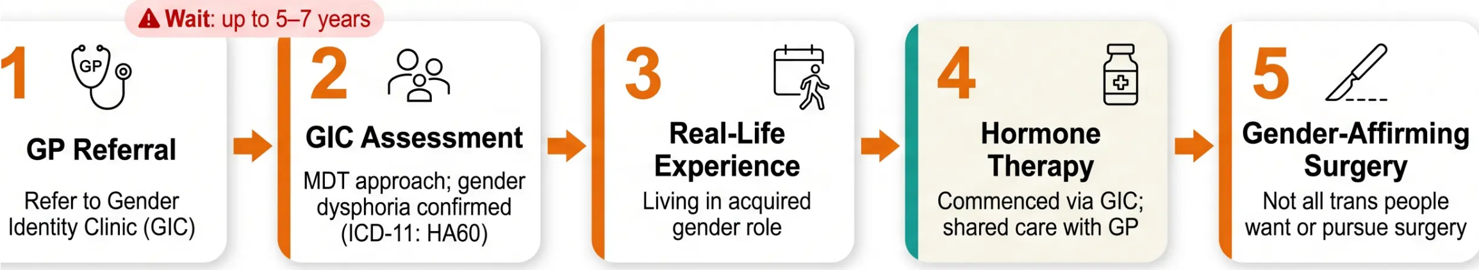
Bradford VTS
www.bradfordvts.co.uk
Trans Healthcare Pathway in the NHS
*From GP Referral to Gender-Affirming Care
GP SHARED CARE — MONITORING
REMEMBER
• FBC, LFTs, lipids — routine bloods
• Testosterone / oestrogen levels
• Blood pressure monitoring
• Safeguarding if hormones sourced externally
⚠️ Do NOT require evidence of surgery before
using correct pronouns or name
⚠️ Trans identity is valid at every stage of transition
⚠️ Patients may be self-medicating with internet-
sourced hormones — monitor and support
*Liaise with GIC for shared care protocol
Bradford VTS Teaching Deck — LGBTQ+ Health in Primary Care
Slide 10 of 21

Slide 10





Bradford VTS
www.bradfordvts.co.uk
Sexual Health of Gay and Bisexual Men
*MSM — Men Who Have Sex With Men |BASHH 2024 Guidelines
SCREENING FREQUENCY
WHAT TO TEST
PREVENTION
Annual
Swabs
HPV Vaccine
Urethra — Chlamydia, Gonorrhoea
Rectum — Chlamydia, Gonorrhoea
(separate swab)
Pharynx — Gonorrhoea especially
Offered to MSM up to age 45 via
sexual health clinics (NHS MSM
catch-up programme)
All gay and bisexual men (MSM)
Standard recommendation
Every 3 Months
Hep B Vaccine
Bloods
Offer to all unvaccinated MSM
Multiple partners
Condomless anal sex
Chemsex use
PrEP use
HIV
Syphilis
Hepatitis B
Hepatitis C (if risk factors present)
PrEP
Discuss eligibility with all at-risk
MSM — refer to HIV guidance
⚠️ AKT EXAM TRAP
MSM require rectal AND pharyngeal swabs — urethral
swab alone is INSUFFICIENT and will be marked wrong
Bradford VTS Teaching Deck — LGBTQ+ Health in Primary Care
Slide 11 of 21

Slide 11








Bradford VTS
www.bradfordvts.co.uk
Chemsex: Recognition & Management in GP
Primarily in gay/bisexual men communities — non-judgemental approach essential
Chemsex is the use of psychoactive substances specifically to enhance or facilitate sexual
experience. Primarily reported in gay and bisexual men communities, though not exclusive to them.
SUBSTANCES
HEALTH RISKS
GP ROLE
Mephedrone — 'meph', 'meow meow'
Non-judgemental enquiry — ask openly
Signpost to LGBTQ+ chemsex services
Address STI risk and offer sexual health
screen
Addiction services referral if needed
Monitor mental health
HIV & STI transmission — condomless
sex
GHB/GBL overdose — narrow
therapeutic window, deaths reported
Psychosis, anxiety, addiction
Chemsex-related deaths (GHB/GBL
toxicity)
Mental health deterioration
GHB / GBL — 'G' — narrow
therapeutic window
Crystal Methamphetamine — 'Tina',
'crystal meth'
How to ask: "Some people use substances to
enhance sexual experiences — is this
something relevant to you?"
Also used: cocaine, ketamine, MDMA
AKT TIP
GHB/GBL has a very narrow therapeutic window — overdose
risk is high. Know the substances and their specific dangers.
SCA TIP
Ask about chemsex sensitively in any MSM consultation —
non-judgemental tone is assessable.
Bradford VTS Teaching Deck — LGBTQ+ Health in Primary Care
Slide 12 of 21

Slide 12






Bradford VTS
www.bradfordvts.co.uk
Lesbian and Bisexual Women: Specific Health Needs
Cervical Screening
Pregnancy & Fertility
Breast Cancer
• Lower uptake among lesbian/bisexual women
• Myth: HPV cannot spread between women — FALSE
• HPV transmits via skin-to-skin genital contact and
shared sex toys
• Offer screening to ALL people with a cervix
• Same-sex female couples: IVF or donor
insemination options
• GP can refer to fertility services
• Partner not automatically on birth certificate
• Legal parenthood requires formal registration
• Similar risk to general population overall
• Slightly elevated risk due to:
↑ Full-term pregnancy rates (protective effect reduced)
↑ Rates of obesity and alcohol use
• Ensure routine breast screening uptake
Actively invite – do not assume immunity
Refer early – waiting lists can be long
Don't overlook – standard screening applies
Mental Health
Domestic Violence
Higher rates of depression, anxiety, and self-harm than heterosexual women
• Stigma, discrimination, and family rejection are key drivers
• Ask about mental health at every appropriate contact
• Signpost to LGBTQ+-affirming psychological services
• Occurs in same-sex relationships — do not assume otherwise
• Ask sensitively using the same approach as any consultation
• Same safeguarding principles apply regardless of relationship type
• Do not assume the perpetrator is male
Screen proactively – don't wait for disclosure
Same safeguarding response – always
SCA REMINDER
Never assume a female patient is heterosexual. Use 'partner' as default. Cervical screening applies to all people with a cervix – including trans men and lesbian women.
Bradford VTS Teaching Deck – LGBTQ+ Health in Primary Care
Slide 13 of 21

Slide 13







Bradford VTS
www.bradfordvts.co.uk
LGBTQ+ Young People in Primary Care
Identity, Confidentiality, Safeguarding & Support
Core Principles
Gillick & Confidentiality
Risk Assessment
Sexual orientation & gender identity
are normal variations – not pathology
Under-16s can consent to treatment
without parental involvement
Self-harm risk significantly elevated
in LGBTQ+ youth
Support identity exploration without
premature labelling
Confidentiality must be maintained –
LGBTQ+ identity is not a safeguarding
breach in itself
Assess mental health at every
appropriate contact
Respond with warmth and
normalisation
Bullying and family rejection are
major stressors
Only break confidentiality if genuine
safeguarding concern exists
Do NOT contact parents about
LGBTQ+ identity without consent
Forced conversion therapy by family
= safeguarding concern
Apply Fraser guidelines where relevant
SIGNPOST TO
Childline – www.childline.org.uk
Mermaids (gender support) – www.mermaidsuk.org.uk
LGBT+ Foundation – www.lgbt.foundation
SCA TIP
If a young person discloses LGBTQ+ identity – maintain confidentiality, respond warmly, and assess mental health. Do NOT involve parents without consent.
Bradford VTS Teaching Deck – LGBTQ+ Health in Primary Care
Slide 14 of 21

Slide 14






Bradford VTS
www.bradfordvts.co.uk
Intersex: Brief Overview for GPs
Variations in Sex Characteristics (VSC) — Sensitive, Non-Pathologising Care
DEFINITION
'Intersex' — now preferably termed 'Variations in Sex Characteristics (VSC)'
Umbrella term for conditions where sex characteristics do not fit typical male/female categories –
chromosomes, hormones, or anatomy.
Intersex ≠ Transgender – these are two distinct concepts
KEY CONDITIONS (EXAMPLES)
NHS POLICY — ENGLAND 2023
• Congenital Adrenal Hyperplasia (CAH)
• Klinefelter Syndrome (XXY)
• Turner Syndrome (XO)
• Androgen Insensitivity Syndrome (AIS)
» Non-urgent genital surgery on infants with VSC is no longer
recommended (NHS England 2023)
» Decisions deferred until the individual can participate in
informed consent
Identity: Intersex people may identify as male, female, non-binary, or other –
do not assume.
Specialist referral: endocrinology / urology / gynaecology
YOUR ROLE AS GP
Approach
Refer
Language
Sensitive, non-pathologising – treat the
whole person, not the condition
Specialist referral to endocrinology,
urology, or gynaecology as appropriate
Use 'variations in sex characteristics' –
avoid outdated or stigmatising jargon
Always verify against current NICE/BNF guidance
Bradford VTS Teaching Deck — LGBTQ+ Health in Primary Care
Educational Use Only
Slide 15 of 21

Slide 15
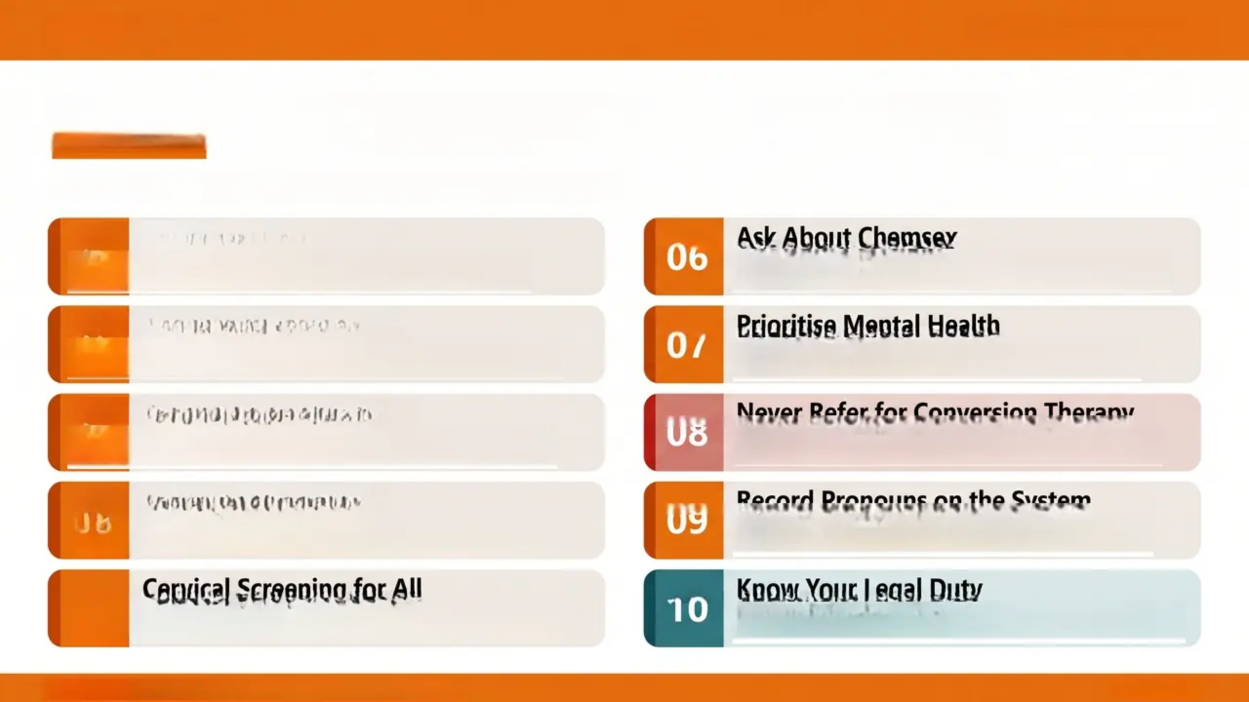
Bradford VTS
www.bradfordvts.co.uk
TOP TIPS: LGBTQ+ Health in Primary Care
Ten essential clinical pearls for inclusive primary care
01
Identity Is Not a Choice
06
Ask About Chemsex
Sexual orientation and gender identity are never
choices — never imply otherwise
Non-judgemental enquiry in MSM consultations — it's
a real and significant risk
02
Use Inclusive Language
07
Prioritise Mental Health
Say “partner” — not “husband/wife” until the patient
establishes this themselves
LGBTQ+ patients face significantly higher rates of
depression, anxiety, and self-harm — ask routinely
03
MSM Screening Protocol
08
Never Refer for Conversion Therapy
Annual sexual health screen; rectal AND pharyngeal
swabs — not just urethral
Harmful, unethical, and condemned by NHS England,
BMA, and GMC 2024
04
Respect Trans Identity
09
Record Pronouns on the System
Use preferred name and pronouns; never disclose trans
history without explicit consent
Not just in a consultation note — update the clinical
record permanently
05
Cervical Screening for All
10
Know Your Legal Duty
Offer to everyone with a cervix — including trans men;
do not assume exemption
Equality Act 2010 — legal obligation to treat all LGBTQ+
patients without discrimination
Bradford VTS Teaching Deck — LGBTQ+ Health in Primary Care
Slide 16 of 21

Slide 16




Bradford VTS
www.bradfordvts.co.uk
REVISION FOCUS
Exam Pearls: AKT & SCA
High-yield topics for MRCGP assessment — LGBTQ+ Health
AKT
Applied Knowledge Test
Knowledge & Data Interpretation
SCA
Structured Clinical Assessment
Consultation & Communication Skills
Equality Act 2010
Protected characteristics include
sexual orientation & gender reassignment
Non-judgemental tone When patient discloses LGBTQ+
identity — respond with warmth and normalisation
GRC Disclosure
Revealing trans history without consent
= criminal offence under GRA 2004
Correct pronoun use Use patient's stated pronouns
consistently, even if unfamiliar — marks lost if not
MSM Swabs
Urethral + rectal + pharyngeal
— urethral alone is WRONG
Parental conflict & young people
Confidentiality is paramount — Gillick competence applies under 16
Cervical Screening
Trans men with a cervix still require
screening — do not omit
Identity-specific health exploration
Address MSM screening, trans care, or chemsex as relevant to the patient
Chemsex Substances
Mephedrone, GHB/GBL, crystal
methamphetamine
Safeguarding awareness
Conversion Therapy
Domestic violence in same-sex couples — same response as any
safeguarding concern
Harmful and unethical — never
recommend or refer
Tip: Heteronormative assumptions in SCA (e.g. 'do you have a
boyfriend?') will cost marks
KEY TRAP: MSM patients need rectal AND pharyngeal swabs — not urethral only. This is the most commonly tested AKT error in this topic.
Bradford VTS Teaching Deck — LGBTQ+ Health in Primary Care
Slide 17 of 21

Slide 17









www.bradfordvts.co.uk
RED FLAGS: LGBTQ+ Health
Safety-critical concerns requiring immediate clinical action
Suicidal Ideation
Chemsex-Related Collapse
Domestic Violence
Significantly elevated in trans
and LGB young people — assess
at every relevant contact
Especially GHB/GBL overdose —
narrow therapeutic window —
emergency referral immediately
Occurs in same-sex relationships
— apply same safeguarding
response as any other case
Self-Harm: LGBTQ+ Youth
Unsupervised Hormone Use
Forced Conversion Therapy
Activate mental health crisis
pathway — do not minimise or
delay
Trans patients sourcing hormones
online — risk of serious adverse
effects; offer monitoring and support
By family or community — treat
as a safeguarding concern and
act accordingly
SAFETY CRITICAL
Any of the above requires prompt clinical action — do not defer or normalise
Bradford VTS Teaching Deck — LGBTQ+ Health in Primary Care
Slide 18 of 21

Slide 18
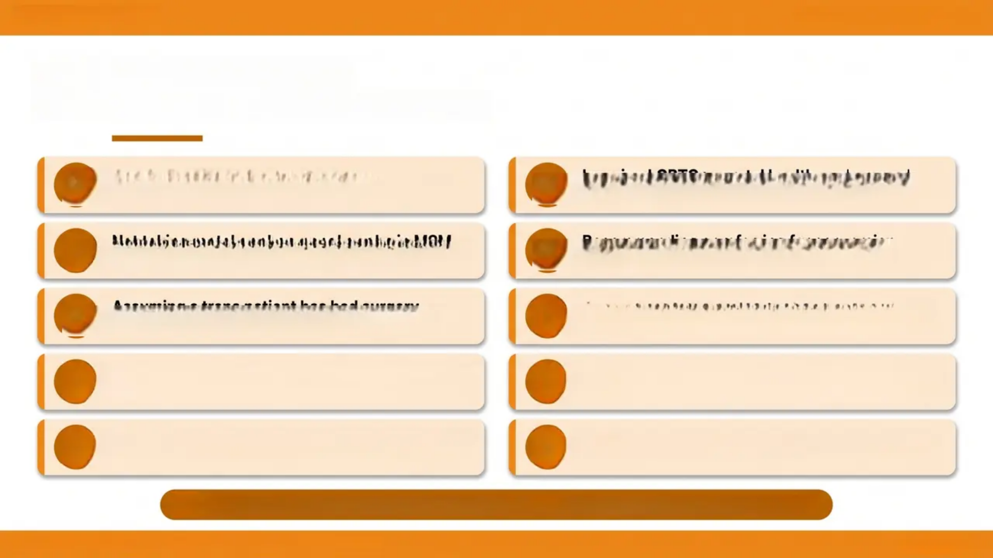


Bradford VTS
www.bradfordvts.co.uk
Common Pitfalls
GP Trainee Errors to Avoid
01
Asking ‘Do you have a husband/boyfriend?’ to
all patients — heteronormative assumption
06
Ignoring LGBTQ+ mental health — always ask
about mental health in consultations
02
Not taking rectal or pharyngeal swabs in MSM —
leads to missed GC and chlamydia
07
Recommending or referring for conversion
therapy — harmful and unethical
03
Assuming a trans patient has had surgery —
always ask about anatomy sensitively
08
Assuming a same-sex couple cannot have
biological children — IVF and donor options exist
04
Sharing a patient's trans history without consent
— illegal under GRA 2004
09
Overlooking domestic violence in same-sex
relationships — same safeguarding principles apply
05
Not inviting trans men for cervical screening — all
people with a cervix must be offered screening
10
Using ‘homosexual’ in clinical records — use gay,
lesbian, or bisexual instead
Recognising these errors in an SCA station will protect your marks — and your patients.
Bradford VTS Teaching Deck — LGBTQ+ Health in Primary Care
Slide 19 of 21

Slide 19


Bradford VTS
www.bradfordvts.co.uk
Quick Recall LGBTQ+ Health
10 must-know facts for AKT, SCA & clinical practice
Equality Act 2010
Chemsex
01
06
Protects sexual orientation + gender reassignment —
legal duty to treat without discrimination
Mephedrone, GHB/GBL, crystal meth — ask
sensitively and non-judgementally
Mental Health
02
Gender Recognition Certificate
07
Disclosing trans history without consent = criminal
offence under GRA 2004
LGBTQ+ patients at significantly higher risk — ask routinely
03
MSM Screening
08
Conversion Therapy
Annual screen; rectal + pharyngeal swabs always —
not just urethral
Harmful and unethical — NEVER recommend or refer
Trans Patients
Young LGBTQ+ People
04
Use correct name and pronouns; never disclose trans
history without consent
09
Confidentiality paramount; Gillick competence applies
under 16
Cervical Screening
Inclusive Language
05
10
Partner, pronouns, 'assigned at birth' — avoid
heteronormative assumptions
Offer to ALL people with a cervix — including trans men
Revision tip:
Cover the subtext — can you recall each fact from the number alone?
Bradford VTS Teaching Deck — LGBTQ+ Health in Primary Care
Slide 20 of 21

Slide 20




Bradford VTS
www.bradfordvts.co.uk
Final Disclaimer & Resources
LGBTQ+ Health in Primary Care — Bradford VTS Teaching Deck, May 2026
Important Clinical Disclaimer
Always double-check this advice and drug doses with the latest NICE/BNF guidance. This document is
for educational purposes only and does not replace clinical judgement or current NHS guidelines.
KEY RESOURCES
PATIENT SUPPORT RESOURCES
NICE Guidelines — nice.org.uk
BNF Online — bnf.nice.org.uk
BASHH Guidelines — bashh.org
NHS England Trans Healthcare — england.nhs.uk
GMC Good Medical Practice 2024 — gmc-uk.org
Stonewall — stonewall.org.uk
Mermaids (young people) — mermaidsuk.org.uk
LGBT+ Foundation — lgbt.foundation
Childline — childline.org.uk
56 Dean Street (chemsex/sexual health) —
56deanstreet.nhs.uk
Bradford VTS Teaching Deck
Created May 2026 | Updated to NHS England 2025, Equality Act 2010, GMC 2024 Standards
Educational Use Only
Bradford VTS — LGBTQ+ Health in Primary Care
www.bradfordvts.co.uk
Slide 21 of 21

