Slide 1

BRADFORD VTS TEACHING DECK
Postcoital Bleeding (PCB)
BRADFORD VTS · MAY 2026
A structured clinical reference for general practitioners. Covers assessment, investigation, and management of postcoital bleeding — with red flags, referral criteria, and exam tips.

Slide 2
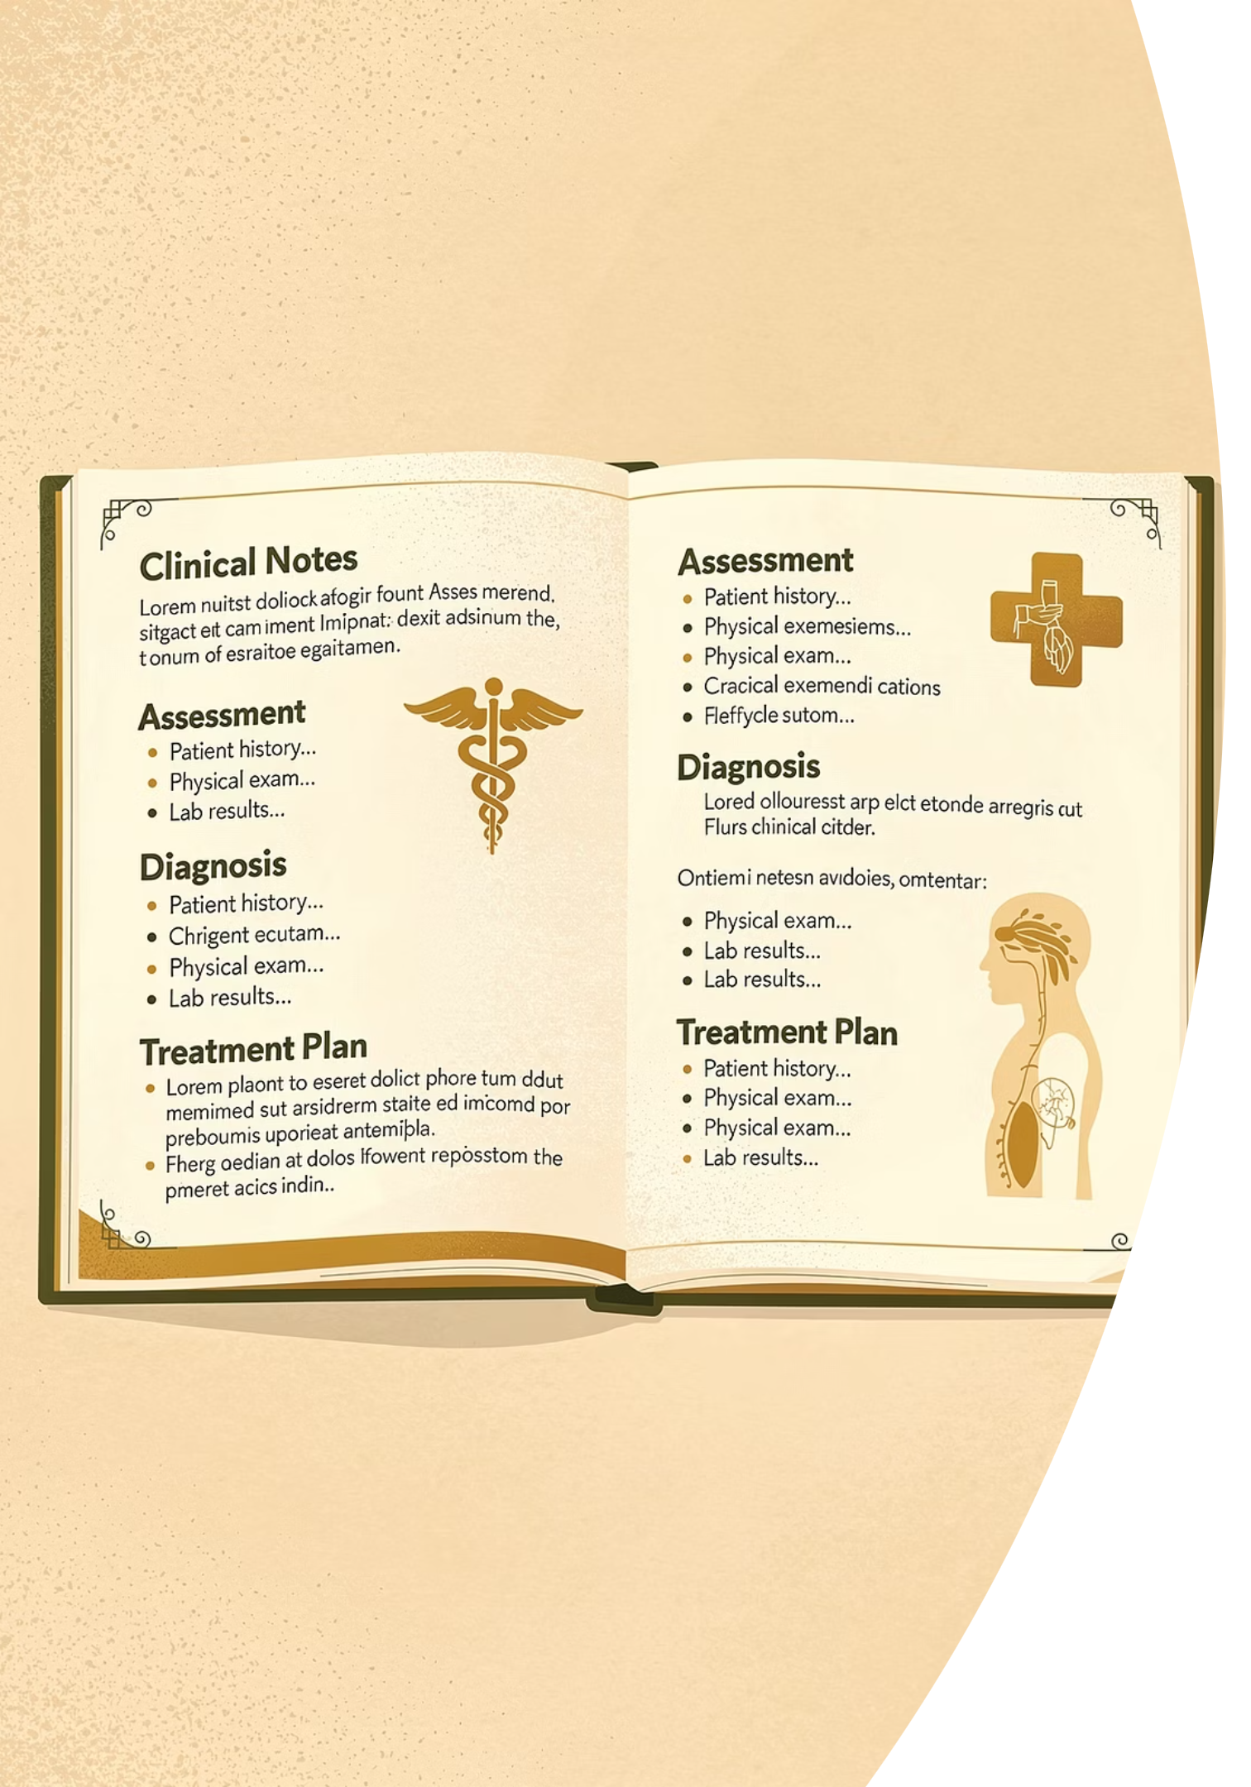

Definition
Postcoital bleeding (PCB) is non-menstrual bleeding that occurs during or after sexual intercourse. The most serious cause to exclude is cervical cancer.
Key Principle
Always investigate before referring. A systematic approach ensures serious pathology is not missed and unnecessary procedures are avoided.
PCB alone is NOT an indication for colposcopy — a structured assessment is required first.
Scope
Applies to all women presenting with bleeding during or after intercourse, regardless of age or menopausal status.

Slide 3

Causes of PCB
✔ Benign / Common
⚠ Less Common
🔴 Serious
Cervical ectropion (contact bleeding)
Cervical or endometrial polyps
Infection (Chlamydia, Gonorrhoea, TV)
Atrophic vaginitis (post-menopausal)
Trauma (piercings, sex toys)
Clotting disorder
Vaginal dryness / lubricant issues
Endometritis
Cervical malignancy
Endometrial cancer (especially post-menopausal women)
Always consider and actively exclude serious causes — particularly cervical malignancy — before attributing PCB to a benign aetiology.

Slide 4
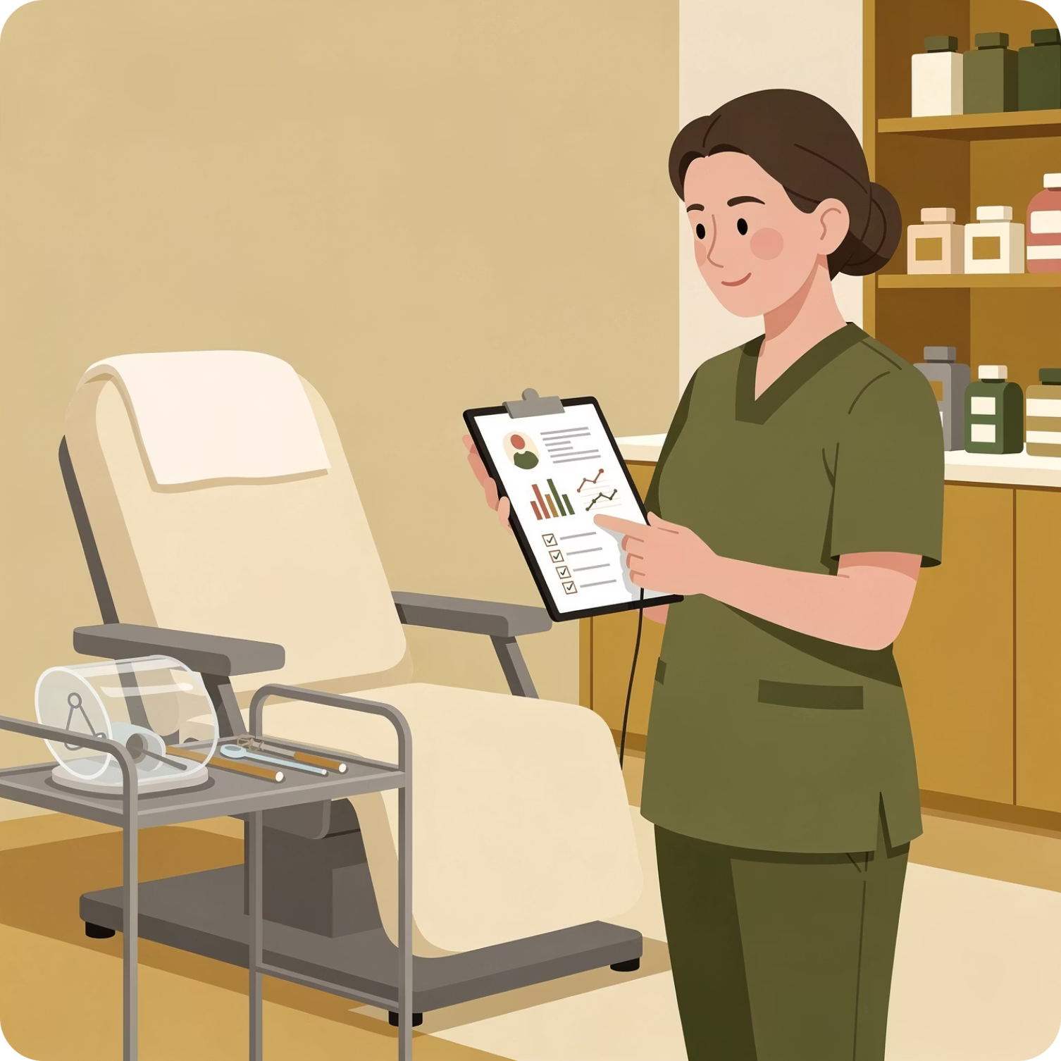
Initial Assessment: History and Examination
Full Sexual & Medical History
Including number of partners, contraception type, and STI history.
Cervical Smear History
Check if up to date with the current HPV-primary screening programme.
Age of Patient
Pre-menopausal vs. post-menopausal — different risk stratification applies.
Medication History
Especially hormonal contraception — OCP increases risk of cervical ectropion.
Speculum Examination
Inspect cervix carefully and document appearance in full.

Slide 5

Investigations
The following investigations should be considered based on clinical findings and patient history.
Investigation
Notes
STI screen (NAAT vulvo-vaginal / endocervical swab)
Chlamydia + Gonorrhoea; HVS for TV/BV if discharge present. Recommended at all ages.
Cervical smear (if due)
Do NOT bring forward smear if not due. Check HPV screening status. If smear is due — perform it.
USS pelvis
If endometrial pathology suspected — e.g. post-menopausal bleeding or irregular endometrium on examination.
HPV-primary screening is now the standard pathway. Do not perform a smear early simply because the patient presents with PCB.

Slide 6

Management by Cause
NICE NG12 2015, UPDATED 2025
Infection
Treat as per BASHH guidelines. Chlamydia: Doxycycline 100mg BD for 7 days (first line — updated 2024). Contact trace all partners.
Cervical Ectropion
Normal appearance: Consider OCP change (switch to progesterone-only); refer colposcopy for cryocautery. Abnormal/highly vascular: Fast track referral — do NOT wait for smear result.
Cervical / Endometrial Polyps
Cervical polyp on stalk: May be avulsed in surgery; send for histology. Broad base: Loop diathermy at colposcopy. Endometrial polyp: Refer for hysteroscopy.
Atrophic Vaginitis
Topical oestrogen cream (unless contraindicated); lubricants (e.g. SYLK, Replens).
Trauma
Reassure if minor; address underlying cause (sex toys, piercings). Consider safeguarding if history is inconsistent.
Post-Menopausal Bleeding
NICE NG12 (updated 2026): 2-week wait referral for women ≥55 with unexplained PMB not attributable to HRT. Urgent referral if cervix looks abnormal.
Suspected cervical malignancy: 2-week wait referral to colposcopy. Do NOT wait for smear result. Signs: irregular/friable cervix, offensive discharge, contact bleeding, visible tumour.

Slide 7



Red Flags & Exam Tips
🔴 Suspect Cervical Malignancy If:
🟣 AKT / SCA Exam Tips
Irregular / Friable Cervix
Offensive Discharge
PCB ≠ Colposcopy Indication
Persistent or unusual discharge alongside PCB.
PCB alone is NOT an indication for colposcopy. Investigate first: infection screen, smear history, speculum examination.
Abnormal texture or appearance on speculum examination.
Cervical Screening Age
Visible Lesion
Contact Bleeding
Cervical screening starts at age 25. Do NOT perform a smear early, even if the patient presents with PCB.
Any visible tumour or ulceration on the cervix.
Bleeding provoked by examination or intercourse.
HPV-Primary Screening
2-week wait referral required — do NOT await smear result.
HPV-primary screening is now the standard pathway — not smear first. Know this for the AKT.
Always perform annual cervical smear in HIV-positive women, regardless of standard screening intervals.

Slide 8
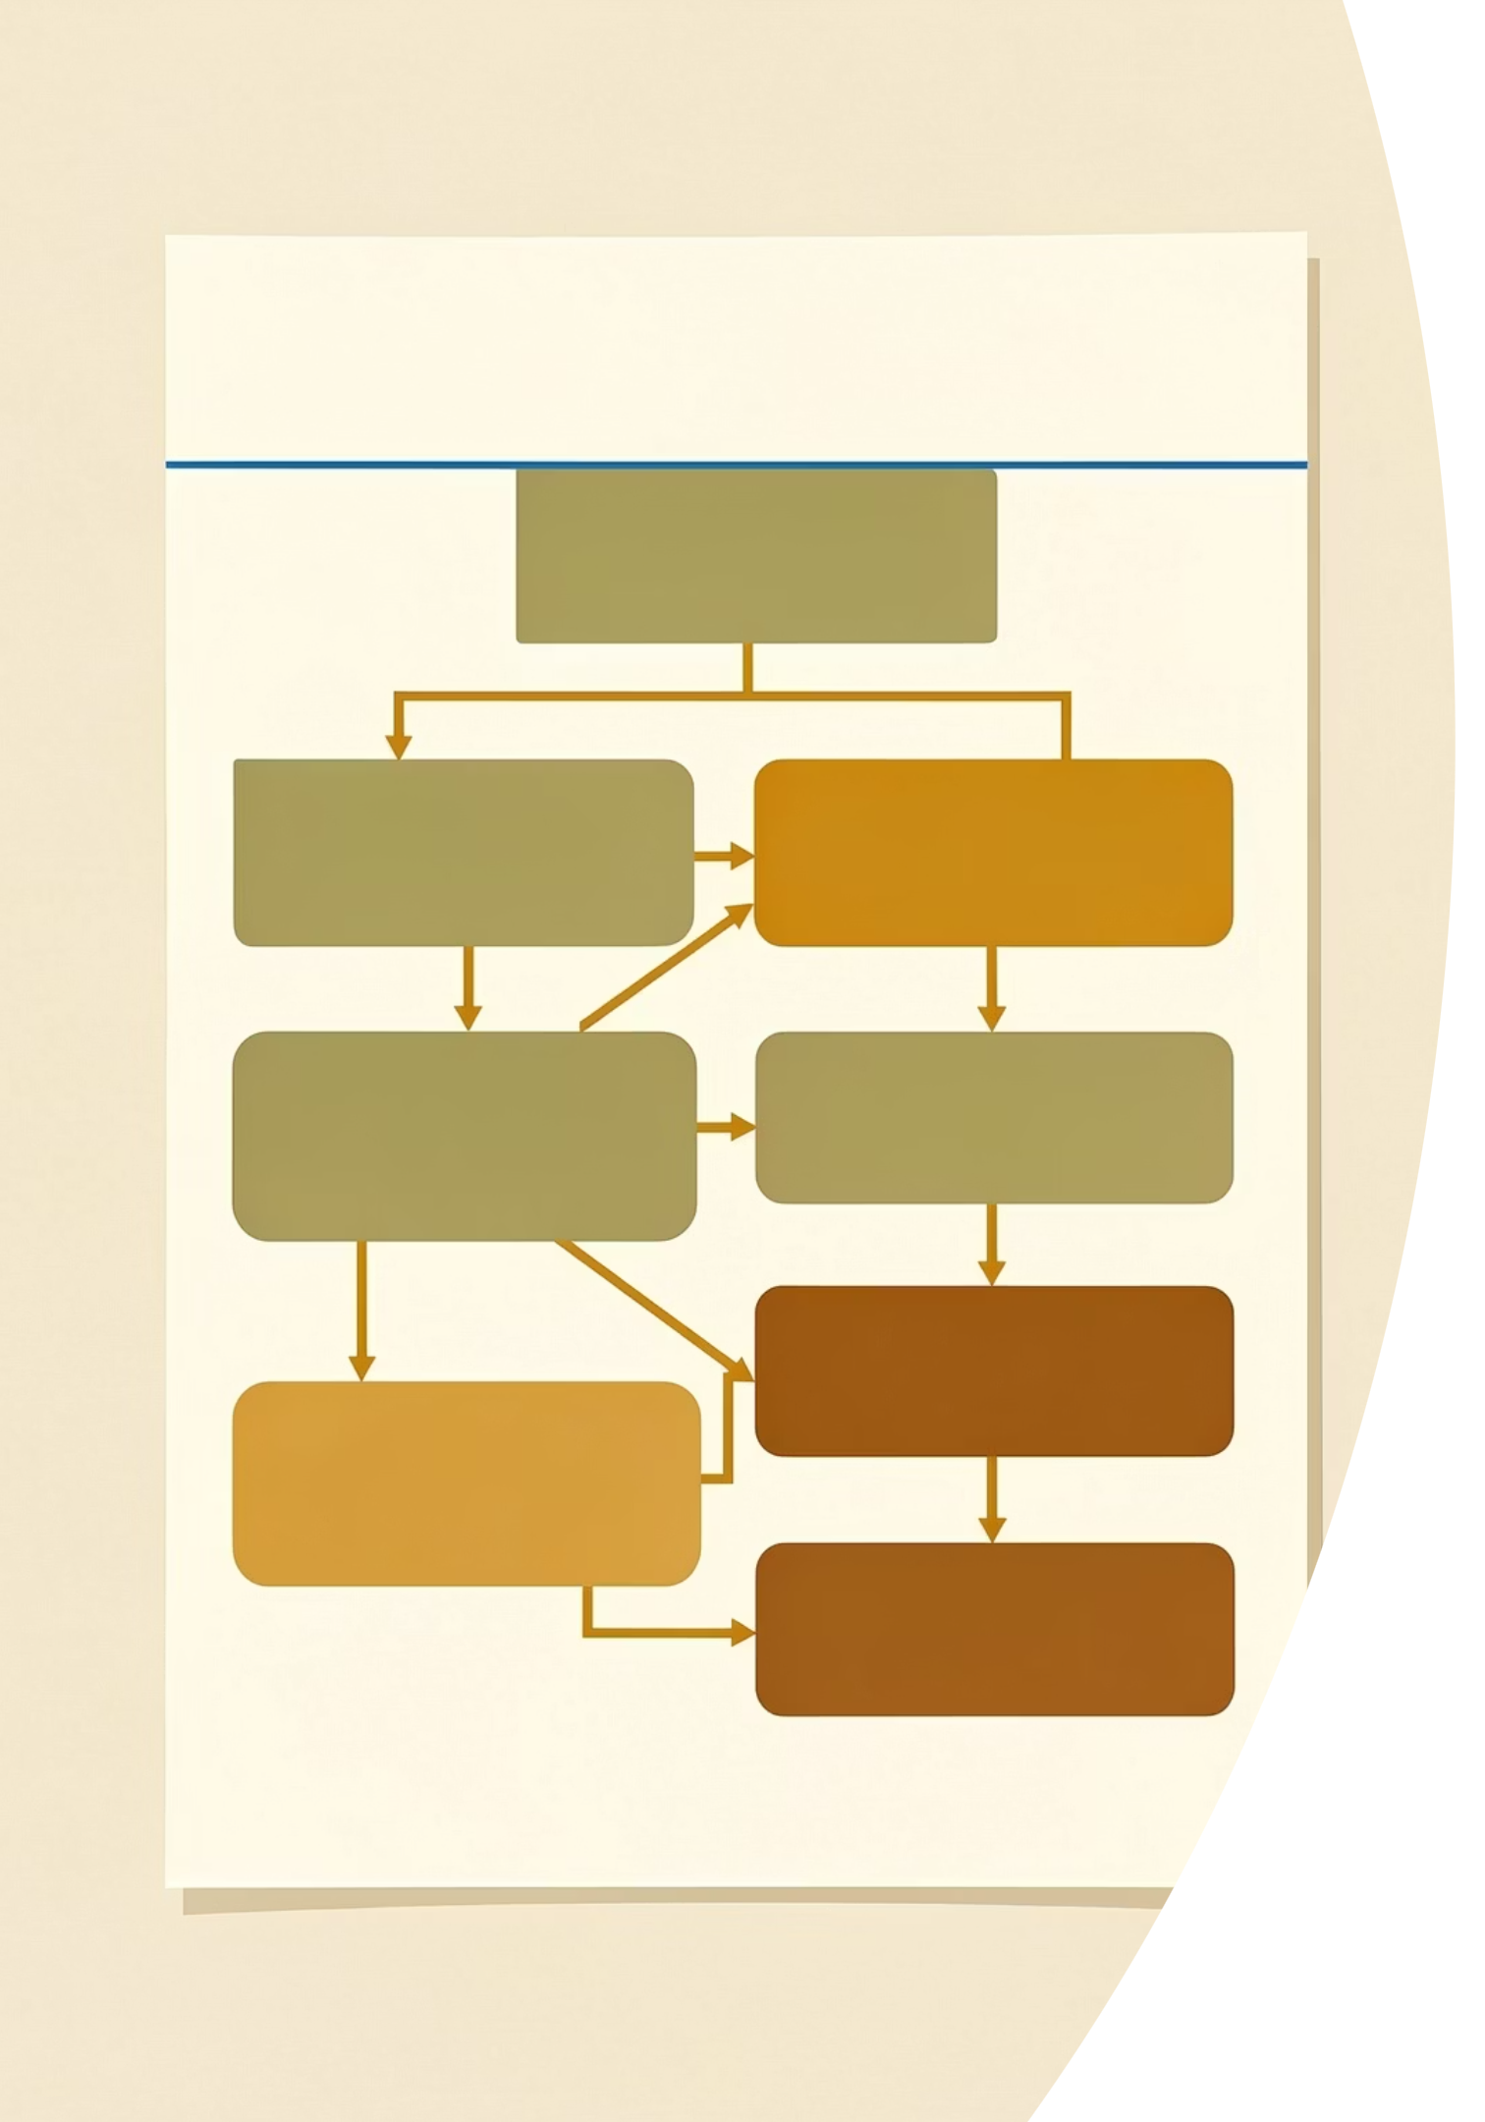

NICE NG12 Cervical Cancer Referral Criteria
UPDATED 2025
1
Cervical Cancer (2WW)
Suspected cancer pathway referral if cervix appears consistent with cervical cancer on examination.
2
Vulval Cancer (2WW)
Consider 2WW for unexplained vulval lump, ulceration, or bleeding.
3
Endometrial Cancer (2WW)
2WW if age ≥55 with unexplained post-menopausal bleeding not attributable to HRT (NICE NG12, 2026 amendment).
⚠ Disclaimer: Always double check this advice and drug doses with the latest NICE/BNF guidance. This document is for educational purposes only.
A free resource provided by www.bradfordvts.co.uk · Dr Ramesh Mehay · Revised May 2026

