Slide 1

Recognising inequality and the need for transformative change within GP training
GP Trainers Development Conference
November 2020
Facilitators: Dr Lucy Clark & Dr Shahzad Jamil
Notes:
Good morning, For those of who I haven’t met previously my name is Shahzad, I am a salaried GP at Idle MC, and intending trainer.
I will be introducing this segment exploring diversity within GP training and helping facilitate our cases alongside Lucy.
I have written brief summary notes to accompany the introductory slides that can be used as reference to be shared with your colleagues and trainees.

Slide 2
Introduction
Diversity in 2010 and Inequality in 2020 - a paradigm shift
Our personal capabilities as trainers and assessors within the context of WPBA
Our responsibilities as clinical leaders within the context of practice culture
Explore areas of challenge, interpretation and application within routine practice
Notes:
Essentially this session will focus on how diversity impacts 3 aspects of our professional life within the GP training environment:
WPBA
Practice culture
Subtleties and nuances within routine day-to-day practice
I am circulating a copy of the WPBA capabilities IPU descriptors statements and have circled 5 capabilities in which Diversity features explicitly. The distribution of statements is generally in the range of "excellent” indicating a higher, more complex set of professional behaviours, attitudes and skills.
Mapping to relevant Key Trainee capabilities:
Fitness to practice
Maintaining an ethical approach
Working with colleagues and in teams
Maintaining performance, learning and teaching
Organisation, management and leadership
Practicing holistically, promoting health and safeguarding
So we start by acknowledging this is a challenging professional capability for our trainees and by extension ourselves as trainers.
It is also useful to define this topic area as a professional capability. Often diversity features as mandatory training within professional environments and institutions and in some ways this is important as it gives background on legislation and codes of conducts but in other respects it is far too blunt a tool for discussing the complexity we are faced with as GP trainers.
It is within this complexity we will explore today aspects of unconscious bias, stigma and systemic inequality and how that plays out for our trainees and ourselves within practice. Here we are moving towards reflecting on the prevailing culture within our practice and our responsibilities as clinical leaders in evaluating, questioning and changing it where necessary.

Slide 3
Recognising diversity
Equality Act 2010
GMC – Good Medical Practice
HEYH – link to eLearning module
Notes:
This slide is a reference tool to refer back to as points of reference statements and position of our professional bodies. I will pick out a few segments of where
Equality Act 2010
What are protected characteristics?
It is against the law to discriminate against someone because of:
age
disability
gender reassignment
marriage and civil partnership
pregnancy and maternity
race
religion or belief
sex
sexual orientation
Three aims of public sector equality :
Eliminate discrimination, harassment, victimisation
Advance equality of opportunity
Foster good relations
Equalityhumanrights.com, (2020). Protected characteristics | Equality and Human Rights Commission [ONLINE] Available at: https://www.equalityhumanrights.com/en/equality-act/protected-characteristics [Accessed 18/11/2020].
GMC: Good medical practice
Statement 59 – recognising the importance of diversity and equality
You must not unfairly discriminate against patients or colleagues by allowing your personal views to affect your professional relationships or the treatment you provide or arrange. You should challenge colleagues if their behaviour does not comply with this guidance
This includes your views about a patient’s or colleague’s lifestyle, culture or their social or economic status, as well as the characteristics protected by legislation: age, disability, gender reassignment, race, marriage and civil partnership, pregnancy and maternity, religion or belief, sex and sexual orientation.
Gmc-uk.org, (2020). Good medical practice - GMC [ONLINE] Available at: https://www.gmc-uk.org/ethical-guidance/ethical-guidance-for-doctors/good-medical-practice [Accessed 18/11/2020].
HEYH – link to elearning
for anyone who sits anyone who sits on an interview panel, an ARCP panel or appeal, or is involved in investigations, especially in relation to bullying and harassment, should have undertaken training in Equality and Diversity
Yorksandhumberdeanery.nhs.uk, (2020). Equality and Diversity - online training | Health Education Yorkshire and Humber [ONLINE] Available at: https://yorksandhumberdeanery.nhs.uk/learner_support/policies/equality_diversity_courses [Accessed 18/11/2020].

Slide 4
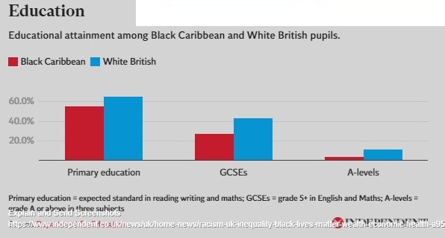
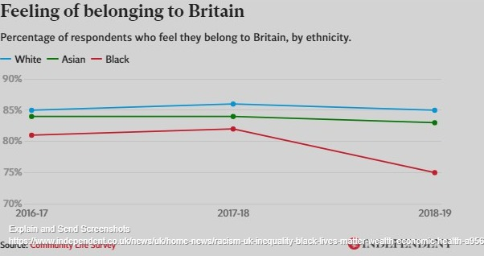
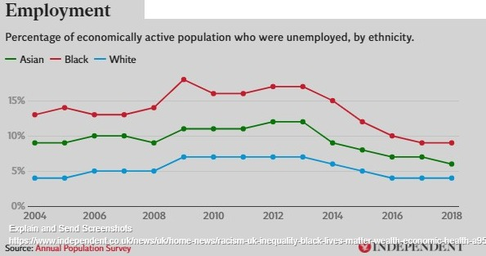
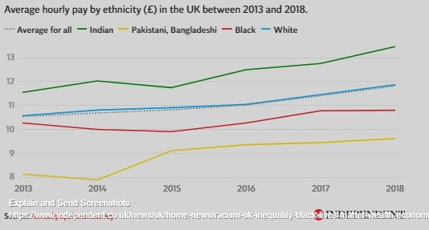
Independent.co.uk, (2020). Eleven charts that show extent of racial inequality in the UK | The Independent | The Independent [ONLINE] Available at: https://www.independent.co.uk/news/uk/home-news/racism-uk-inequality-black-lives-matter-wealth-economic-health-a9567461.html [Accessed 19/11/2020].

Slide 5
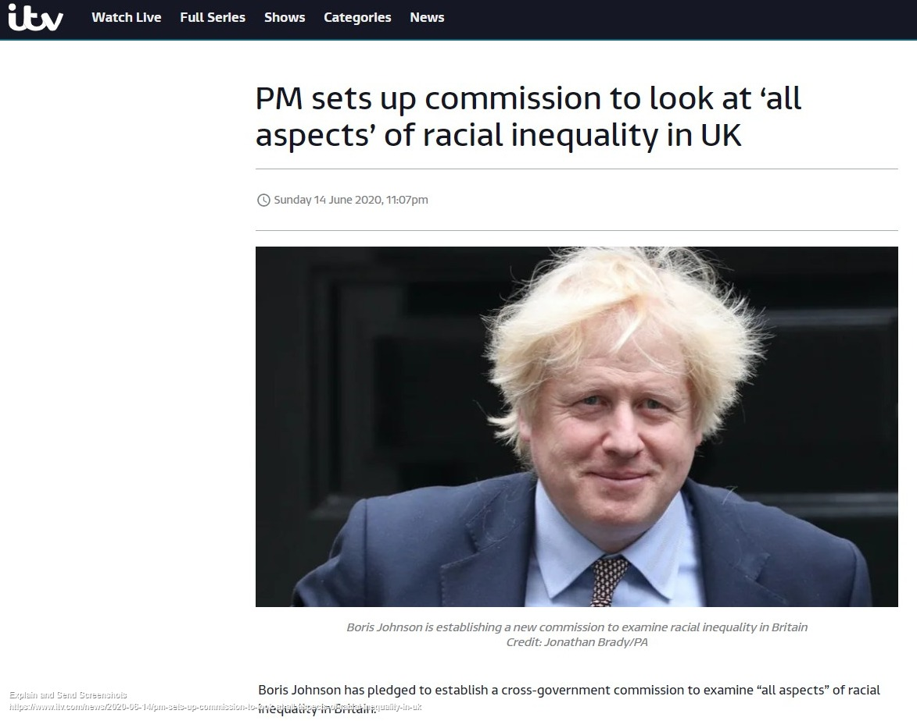
Itv.com, (2020). PM sets up commission to look at ‘all aspects’ of racial inequality in UK | ITV News [ONLINE] Available at: https://www.itv.com/news/2020-06-14/pm-sets-up-commission-to-look-at-all-aspects-of-racial-inequality-in-uk [Accessed 19/11/2020].

Slide 6
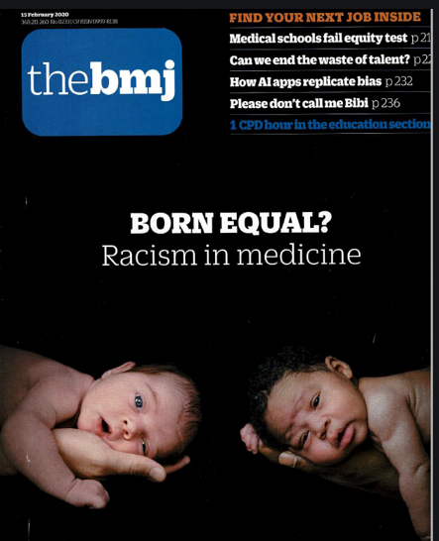
BMJ.com, (2020). Racism in medicine | The BMJ [ONLINE] Available at: https://www.bmj.com/racism-in-medicine [Accessed 18/11/2020]

Slide 7
Racism in medicine
Bmj.com, (2020). Racism in medicine | The BMJ [ONLINE] Available at: https://www.bmj.com/racism-in-medicine [Accessed 18/11/2020]
Differential attainment in medical education and training (BMJ 2020;368:m339)
Ethnic minority staff: trust boards still do not reflect NHS workforce (BMJ 2020;368:m618)
Neglect of older ethnic minority people in UK research and policy (BMJ 2020;368:m212)
Are medical schools turning a blind eye to racism? (BMJ 2020;368:m420)
Specialty training: ethnic minority doctors’ reduced chance of being appointed is “unacceptable” (BMJ 2020;368:m479)
Ethnic disparities in maternal care (BMJ 2020;368:m442)
What lies beneath: getting under the skin of GMC referrals (BMJ 2020;368:m338)
The perils of researching racial discrimination Blogs.bmj.com, (2020). Aneez Esmail and Sam Everington: The perils of researching racial discrimination - The BMJ [ONLINE] Available at: https://blogs.bmj.com/bmj/2020/02/13/aneez-esmail-and-sam-everington-the-perils-of-researching-racial-discrimination/ [Accessed 18/11/2020].
Notes:
In 2019, black and ethnic minority staff made up 19.7% of the NHS trust workforce in England but only 8.4% of them were members of trust boards, an increase from 7.4% in 2018 and 7.0% in 2017.
Maternal health—or lack of it—is one of the starkest examples of racial health inequalities in the United Kingdom and in the United States. Work in the UK by University of Oxford researchers found that between 2014 and 2016 the rate of maternal death in pregnancy was 8 in 100 000 white women, compared with 15 in 100 000 Asian women and 40 in 100 000 black women

Slide 8
A systemic problem in healthcare and health education
Differential attainment by ethnicity in medical workforce, career progression and senior appointment
Disproportionality in referrals to GMC and outcomes of those referrals
Differential attainment in postgraduate exams – CSA
Inequalities in service provision, access and outcomes – e.g. maternity care
Inequalities in research from BAME populations
Stigma associated with peer-reviewed published research on inequality
Notes:
The February edition of the BMJ was dedicated to research and detailing racial inequity within healthcare and training. Highlighting endemic issues right across the board from undergraduate education to senior staff appointments and career progression. The evidence and findings overwhelmingly points towards systemic advantage/disadvantage attributable to race.
The articles selected are referenced in the next slide below.
I have given a brief synopsis of what makes quite depressing reading:
Specialty career recruitment – disparities in speciality training, 25 years after the issue was initially raised
Undergraduate Training – poor recording and escalation of racial harassment complaints
Health – impact on victims of discrimination - poorer health outcomes /internalisation
Economic burden– the economic argument for addressing perpetual inequality
Impact on service provision and patient care fivefold higher maternal mortality amongst black women compared to white women
Performance – disproportionate employer referral to GMC x2 higher for BAME (in contrast referral rates from patient population were equal). Disproportionate rates of sanction & removal from GMC register amongst BAME.
Research – lack of BME patient populations. Impact of lack of study data on future digital technology likely to worsen health outcomes and exacerbate inequality
Stigma – The stigma and challenge experienced by researchers during and after publishing peer reviewed research.
What is needed ?
Leadership and vision – change culture where necessary. Taking individual responsibility
Mentoring and support within the training environment
Attitudes, behaviours and policy - professional bodies to widen scope of current diversity awareness training
Support for research – clinical research including BAME population groups and research on implicit bias – little research into effect of implicit bias in the UK

Slide 9
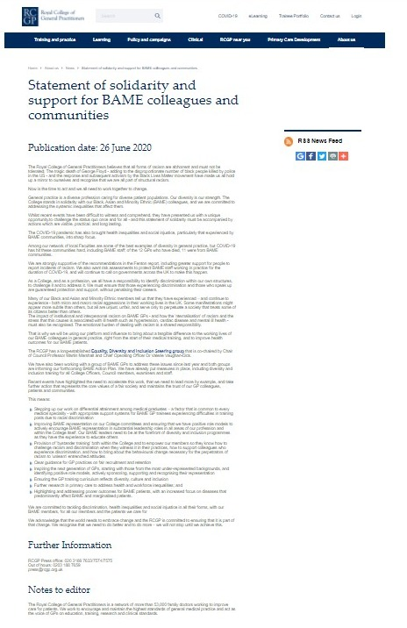
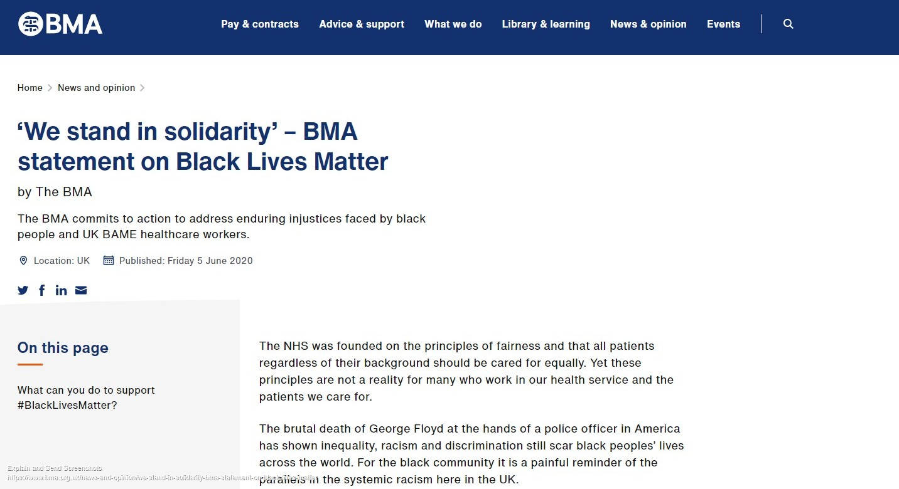
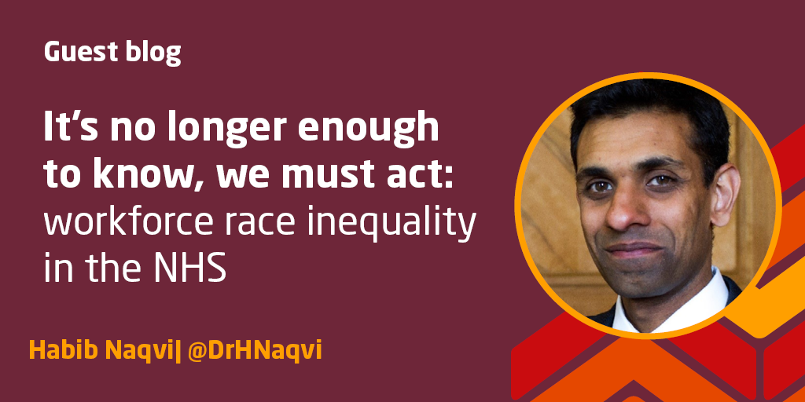
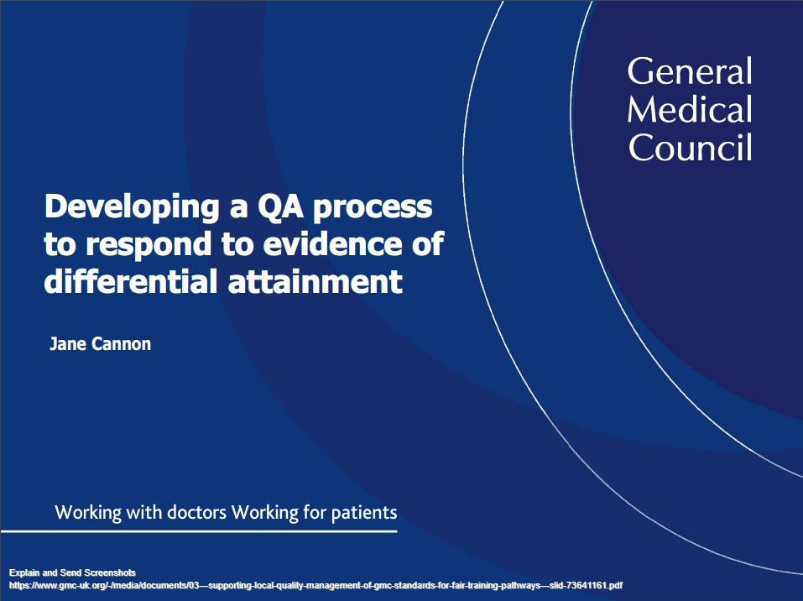
Acknowledging and ACTING on inequality
Notes:
GMC Quality Assurance Framework
Details responsibilities for people designing and involved local programmes of education
Expectations of organisations to meet standards and duties under the Equality Act 2010
Gmc-uk.org, (2020). Quality assurance framework - GMC [ONLINE] Available at: https://www.gmc-uk.org/education/how-we-quality-assure/quality-assurance-framework [Accessed 18/11/2020].
“there are different levels we can effect change from individual trainers thinking about bias to policy decision about the allocation of posts” GMC Head of Approvals and project sponsor for tackling differential attainment, Jane Canon
The GMC has produced guidance on evaluating interventions and has embedded work on differential attainment into it’s quality assurance framework
Giving responsibility to local deaneries based on data collection and expectation of action plans and evaluation of actions
Gmc-uk.org, (2020). V&M workshop on differential attainment [ONLINE] Available at: https://www.gmc-uk.org/-/media/documents/03---supporting-local-quality-management-of-gmc-standards-for-fair-training-pathways---slid-73641161.pdf [Accessed 18/11/2020].
RCGP statement: Equality and Diversity
Recognition of diversity as a strength within our profession and practice populations
Recognition of need to address systemic inequalities – accompanied by action
Responsibility to identify discrimination within structures and challenge and address it
Speaking up should not penalised and supported
Concept of macrolevel and microlevel of racism
Impact of institutional racism – internalisation and poorer health outcomes amongst workforce
Recommendations: “bystander training” – bringing about behavioural change amongst peers and encouraging to challenge behaviours and cultures
Goal of striving for a level playing field
Rcgp.org.uk, (2020). Equality and Diversity [ONLINE] Available at: https://www.rcgp.org.uk/about-us/equality-and-diversity.aspx [Accessed 18/11/2020].

Slide 10
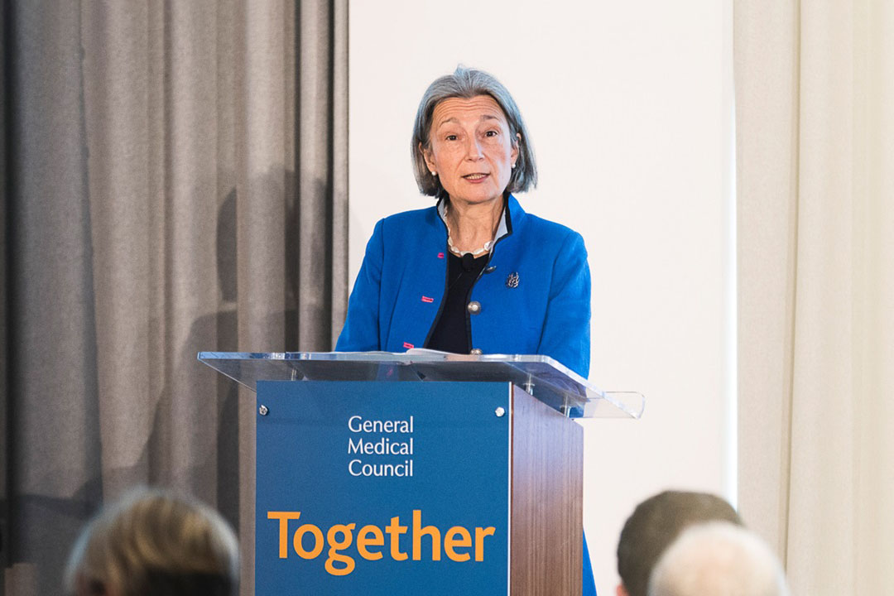
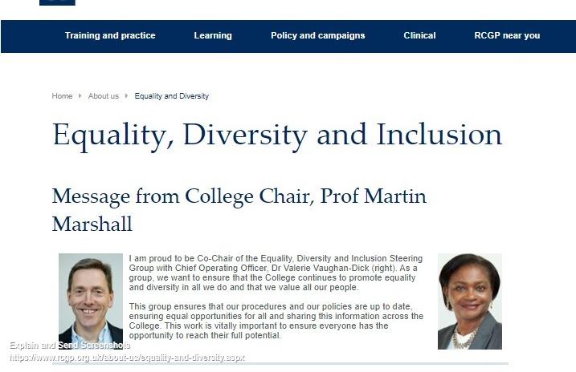
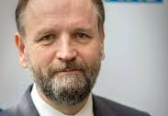
Statements of intent
“We see that racism and other forms of discrimination still exist in medicine, as in so many walks of life. That is why we have been working, not only in the GMC, but across the system to facilitate change.” Dame Clare Marx’s message to the profession, GMC Chair
“Racism is matter of organisational culture and culture is a matter of leadership” Simon Stevens, chief executive NHS England
“If we are truly address differential attainment, we need to focus on much wider factors than the exam, such as training environment, the early identification of the support and training needs of individual trainees” RCGP chair Martin Marshall

Slide 11

Our roles and responsibilities as trainers within General Practice
Potential burden and impact of trainee personal health
Impact on trainee professional development and attainment
Benchmarking – assessing diversity domains within GP trainee competence and capabilities and confidently identifying and developing trainee capability for our next generation of GPs
Personal leadership – how do I take responsibility for embodying values within the culture of my workplace and spaces and effect change
Notes:
If we focus on our GP training environments these issues may affect us specifically in 4 ways:
In terms of our trainees, the potential detrimental impact on health and professional development and attainment
In terms of our roles as assessors, benchmarking our assessment of WBPA capabilities featuring diversity and our role as educators in encouraging discussion and exploration of themes positively changing organisational culture
Also to consider our role and leadership within our teams and organisations

Slide 12
Terminology
Unconscious bias
Systemic inequality
Equality & Diversity
Institutional racism
Discrimination
Microaggressions
Workplace culture
Notes:
Terminology:
Direct discrimination - treated less favourably because of a protected characteristic
Harassment This is when you experience behaviour that makes you feel intimidated, humiliated, or degraded, or that creates a hostile environment.
Victimisation This is when you are treated unfairly as a result of making a complaint about discrimination or giving evidence when someone else makes a complaint.
Unconscious bias - are social stereotypes about certain groups of people that individuals form outside their own conscious awareness. Everyone holds unconscious beliefs about various social and identity groups, and these biases stem from one’s tendency to organize social worlds by categorizing. It can influence decisions in recruitment, promotion and performance management. It could be discriminatory when the unconscious bias relates to a protected characteristic.
Equality & Diversity -promotes equality of opportunity for all, giving every individual the chance to achieve their potential, free from prejudice and discrimination.
Systemic inequality - A system in which public policies, institutional practices, cultural representations, and other norms work in various, often reinforcing ways to perpetuate racial group inequity
Institutional racism - refers to the policies and practices within and across institutions that, intentionally or not, produce outcomes that chronically favour, or put a racial group at a disadvantage.
Microaggressions - Microaggressions are common, everyday slights and comments that relate to various intersections of one’s identity such as gender, sex, race, ethnicity, and age, among other aspects. They are thought to spring from unconsciously held prejudices and beliefs which may be demonstrated consciously or unconsciously through daily verbal interactions. Although these communications typically appear harmless to observers, they are considered a form of covert racism or everyday discrimination.

Slide 13
Cases – aims
Use of terminology: Identify potential unconscious bias, systemic inequity, examples of micro-aggressions and discrimination
How does the case link to demonstrating relevant personal professional capability and how would you approach discussion with the trainee and peers?
What aspects of the case relate to the workplace culture? How might this be addressed and changed?
Notes:
We recognise there is an element of subjectivity, opinion and application to the concepts discussed so far so we will use some cases shortly to explore these areas further in groups.
We will divide the group into 6 breakout rooms and each breakout room will be given one case and then we will rejoin the main room after 15 minutes to feedback

Slide 14
Cases

Slide 15
Reflective post-session questions
How might I use today’s session to inform my teaching/discussion with my trainee on the relevant WBPA capability
Are there areas within my workplace culture that could be changed? What are the barriers to doing this?
Recall the pen-picture from the start of the session, has it changed?

Slide 16
Close

