Slide 1
The Audio-COT (Clinically Observed Tool) – a friend or foe?
Assessment of GP trainers’ interest in and use of this clinical assessment tool
Bryony Sales
GP Medical Education and Quality Improvement Fellow 2013-14

Slide 2
The use of telephones in GP
  An ever increasing proportion of workload in GP:
  1995/96 : 3% telephone consultations
  2008/9 : 12% telephone consultations
  In 2008-9 GPs undertook 303.9 million consultations¹ including almost 36.5 million telephone consultations
Recent study highlighted 80% of patients were satisfied with GP telephone management of same-day consultation requests²
Notes:
Increasingly popular method of communication in GP to cope with increased work demands
There has also been a change in where consultations take place. In 1995/1996, 87% of GP consultations were conducted in surgery premises, 3% were on the telephone, 9% were home visits and 1% were conducted at other locations. By 2008/2009, 82% of GP consultations were conducted in surgery premises, 12% were on the telephone, 3% were home visits and 3% were conducted at other locations.

Slide 3
Telephone consultations
Integral to contemporary medical practice
Uses:
  In hours GP work : telephone consultations & triage
  Out of hours GP care relies on the telephone
  Hospital outreach and follow up appointments
  Primary/secondary care colleague interface
MPS state ‘it is absolutely imperative to make telephone consultations …clinically safe and effective’³
GP trainees need to develop face-to-face and telephone communication skills
Notes:
Telephone invented 1879 – Alexander Bell
Medicolegal - mention

Slide 4
Current assessment of telephone consultation skills
GP trainees MAY get one telephone consultation case in their GP Clinical Skills Assessment (CSA)
No mandatory formative assessment of telephone consultation skills during training at present
Limited clinical training for GP trainees on how to undertake telephone consultations
Limited training for GP trainers on how to facilitate trainees learning on conducting safe telephone consultations
Notes:
Patient Safety

Slide 5
Audio-COT
A supervised learning event
Assessed observed telephone consultation (either directly or via recording)
Constitutes a constructive learning experience
Ensures all trainees are assessed on their telephone consultations
Prepares GP trainees for career post qualification

Slide 6
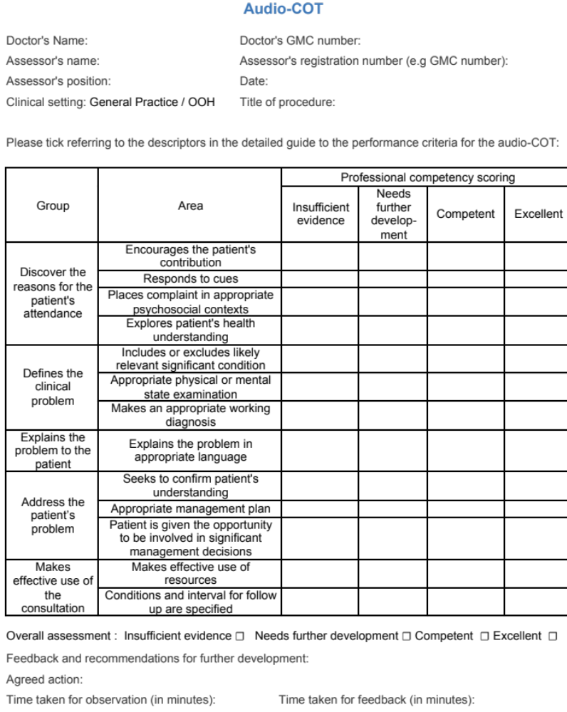
Example of an
Audio-COT
Professional competency scoring – same as other supervised learning events

Slide 7
Project so far…
Concept introduced to Portsmouth GP Trainers
Telephone consultation teaching experience shared
Trainers given experience of completing an audio-COT using a recorded telephone consultation, to consolidate learning and facilitate assessment benchmarking
Unanimous agreement of GP Trainers:
  Important to teach telephone consultation skills
  The usefulness of an audio-COT to facilitate learning and assessment in GP
  The trainers would like to learn further about audio-COTs

Slide 8
Summary
Increasing use of telephone consultations in GP setting
Currently GP trainees telephone consultation skills may not be formally assessed during training
Audio-COT is a tool for facilitating learning and assessment of GP trainee telephone consultations

Slide 9
Questions?

Slide 10
References
¹ The NHS information Centre (2009) Trends in Consultation Rates in General Practice 1995/1996 to 2008/2009: Analysis of the QResearch® database https://catalogue.ic.nhs.uk/publications/primary-care/general-practice/tren-cons-rate-gene-prac-95-09/tren-cons-rate-gene-prac-95-09-95-09-rep.pdf
² The effectiveness and cost-effectiveness of telephone triage of patients requesting same day consultations in general practice: study protocol for a cluster randomised controlled trial comparing nurse-led and GP-led management systems (ESTEEM); Campbell et al. Trials 2013, 14:4
³ MPS In the Dark: Risks of telephone consultations; (2012) Sessional GP; 4:2 http://www.medicalprotection.org/Default.aspx?DN=e636d167-4a53-4197-b63c-9222315e2c68

