Slide 1
Recorded Consultation Assessment
RCA
Bill Hall
MRCGP examiner
June 2020

Slide 2

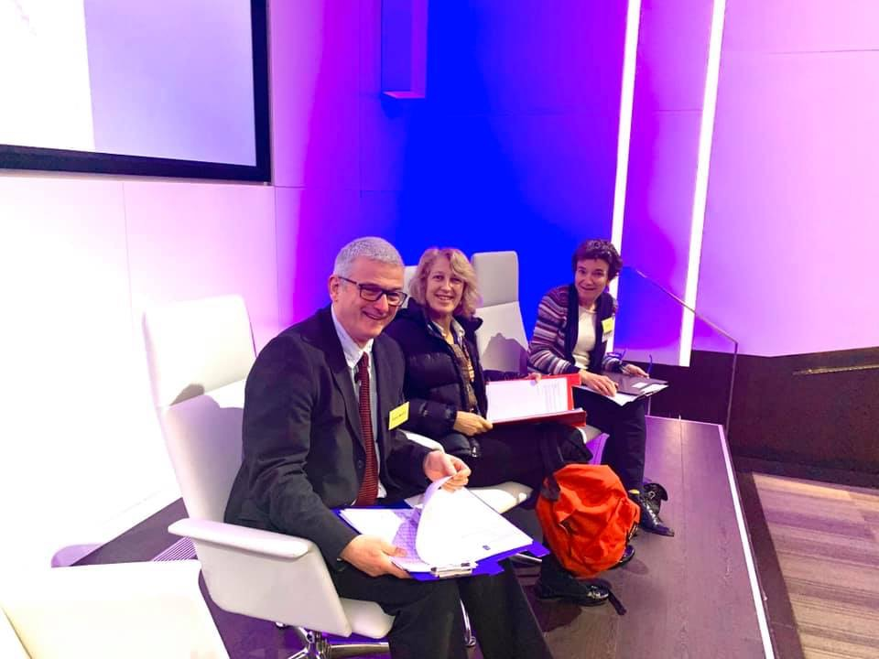
march 2020
My First time as Senior Marshal
Last-Ever CSA?

Slide 3
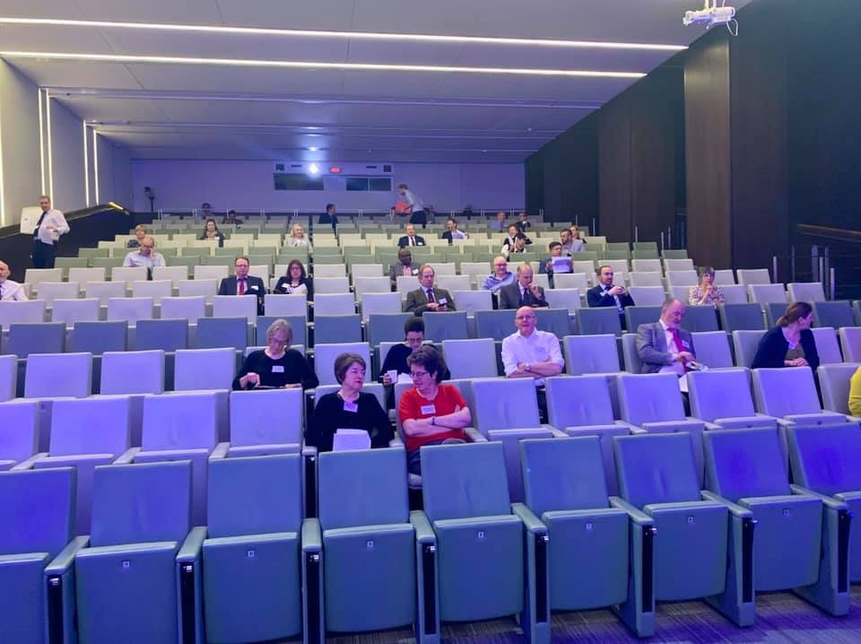
March CSA not safe
Around 100 role players and examiners
78 candidates
Sextet and briefing rooms too small
Stairs, Lifts, toilets, corridors, lunch
Aircon, interior
Travel

Slide 4
Need to do something quick
Fast work by HEE, GMC and RCGP
MRCGP Video consultation assessment ran to 2009
Still had GMC approval

Slide 5
RCA
“least unfair” method of Consultation Assessment
No travel
Face to face not necessary
Social Distance maintained
Shielding, pregnancy not an issue

Slide 6

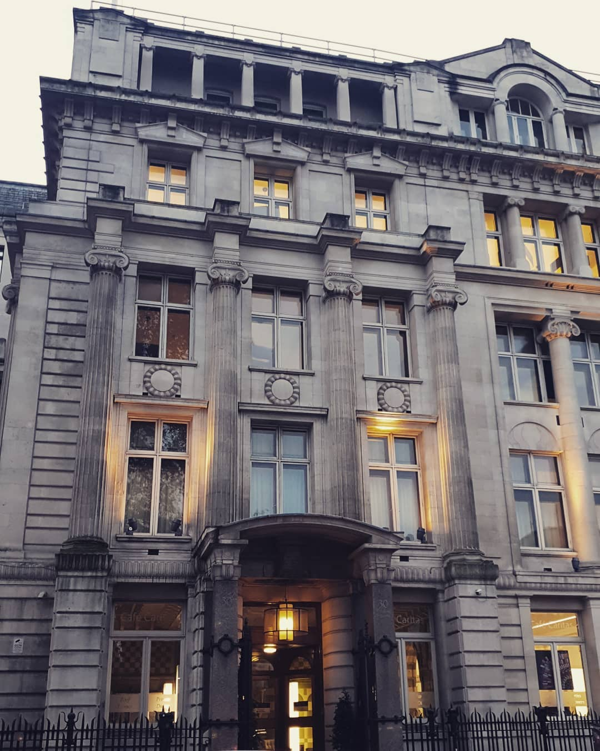
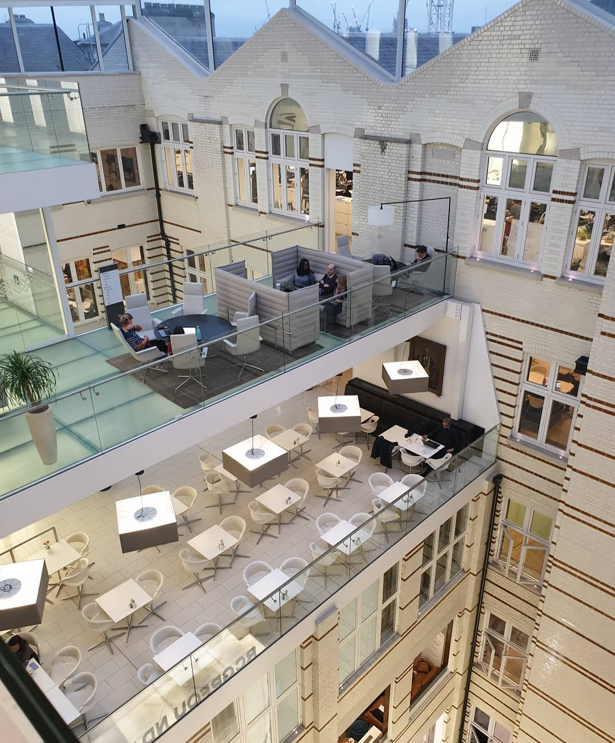
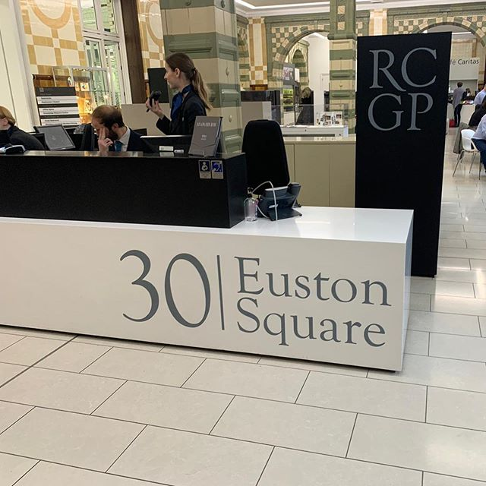
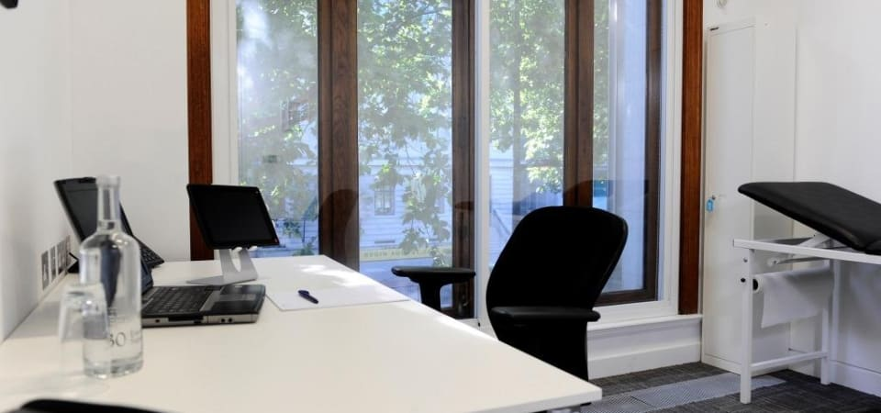
So, RCA not assessed at
30 Euston Square….

Slide 7
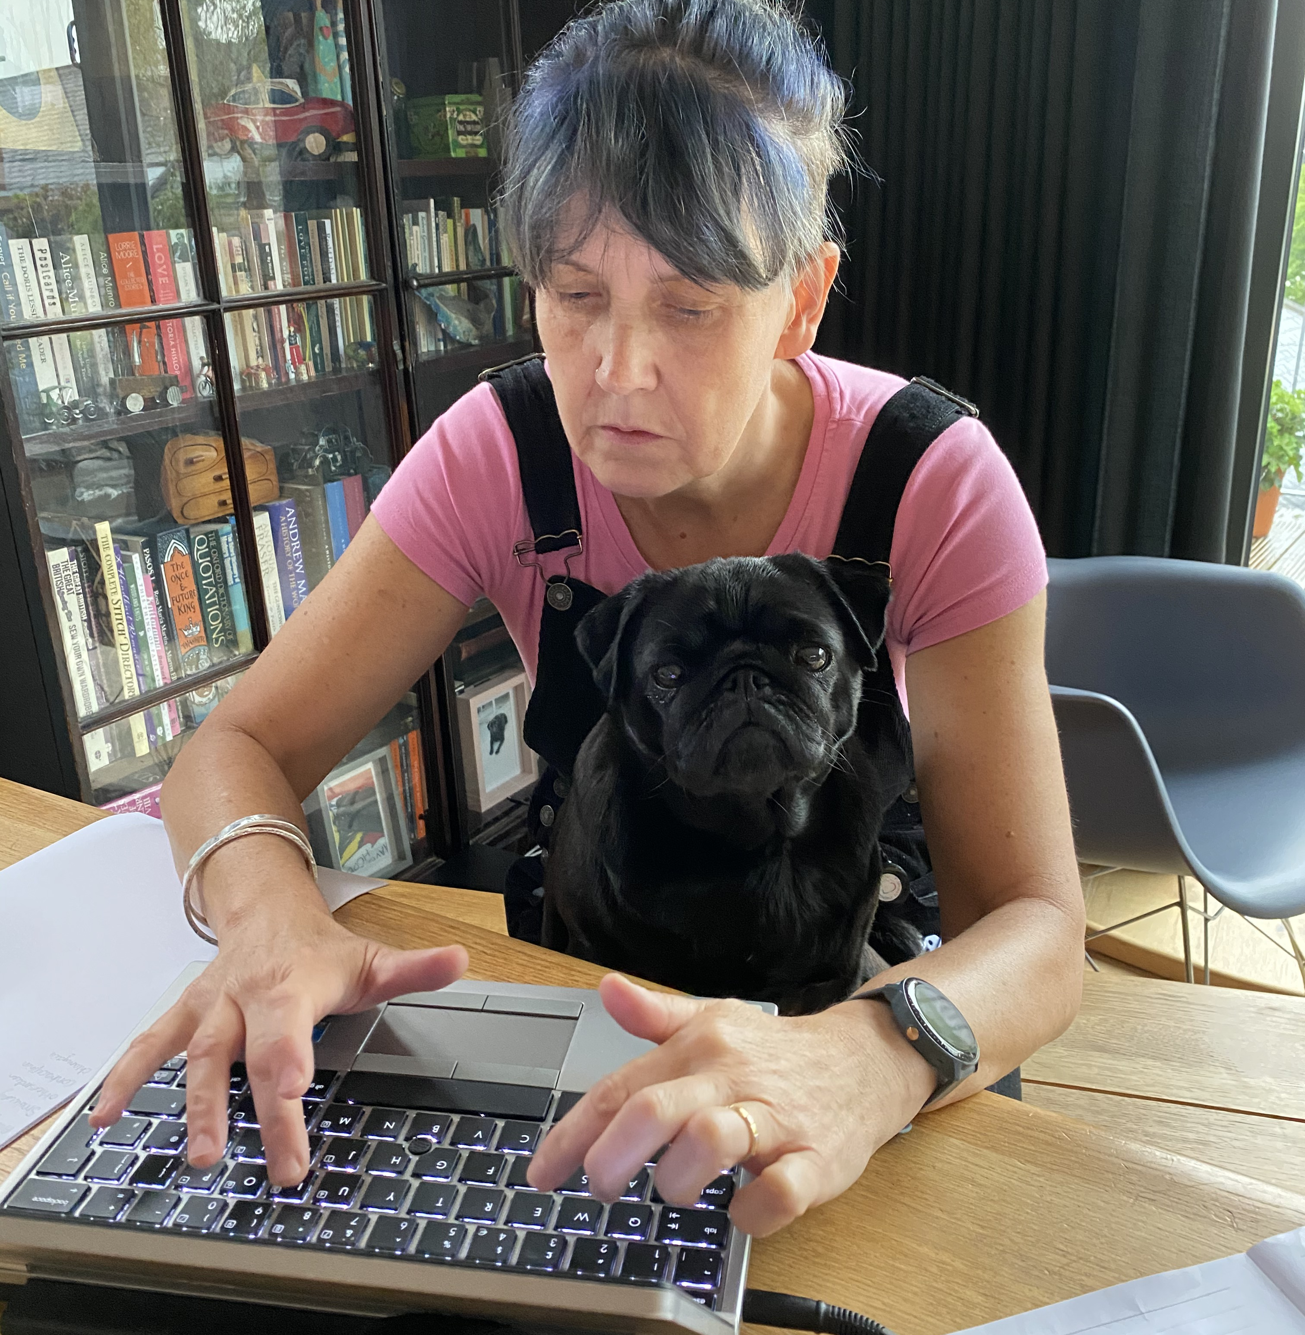
…but Providence Place, Skipton
(and 300+ other sites across UK )

Slide 8
RCA July 2020
13 x 10 minute consultation recordings
Video, audio or face to face
Submitted online to
14 Fish portal
Deadline late June
"Bonus go"
won't 'count' towards max four goes

Slide 9
RCA November
2020
13 x 10 minute consultation recordings
Video, audio or face to face
Submitted online to
14 Fish portal
"Bonus go"
won't 'count' towards max four goes
x
x

Slide 10
RCA Future?
RCA will be the sole consultation assessment until June 2021
Less expensive to run
Fees less
Seems popular with Trainees
…And No Need to worry about HST2…

Slide 11
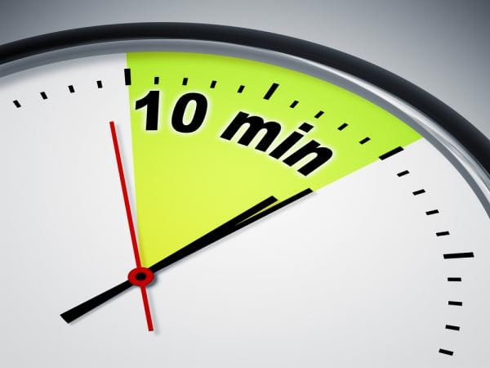
Ten minutes means ten minutes
Timer starts after consent and introduction
Examiner will switch off smack on 10 minutes
Will include time on screen, prescription, etc

Slide 12
RCA November 2020
2 examiners per case?
Different examiner for every case
Run live as a working day
Examiners under scrutiny
Tweaked marking structure
Tweaked grade descriptors

Slide 13
Grade descriptors; clear pass
The candidate demonstrates a high level of competence, with a justifiable clinical approach that is fluent, appropriately focussed and technically proficient.
There is sufficient evidence provided to demonstrate capability in this domain.
The candidate shows sensitivity, actively shares ideas and may empower the patient

Slide 14
Grade descriptors; PAss
The candidate demonstrates an adequate level of competence, with a clinical approach that may not be fluent but is justifiable and technically proficient.
The lack of complexity in the case presented restricts the achievement of a Clear Pass grade.
The candidate shows sensitivity and tries to involve the patient.

Slide 15
Generic grade descriptors; Fail
The candidate fails to demonstrate adequate competence, with a clinical approach that is at times unsystematic or inconsistent with accepted practice. Technical proficiency may be of concern.
There is limited (new) evidence provided to demonstrate capability of a doctor sufficient for safe independent UK General Practice.
The patient is treated with sensitivity and respect, but the doctor does not sufficiently facilitate or respond to the patient’s contribution.

Slide 16
Generic grade descriptors; Clear Fail
The candidate clearly fails to demonstrate competence, with a clinical approach that is incompatible with accepted practice, arbitrary or technically incompetent.
There is no evidence or very limited evidence provided to demonstrate capability of a doctor sufficient for safe independent UK General Practice in this domain.
The patient is not treated with adequate attention, sensitivity or respect for their contribution.

Slide 17

Marking scheme
Data gathering
Takes a focussed history to allow for a safe assessment to take place
Elicits and develops relevant new information
Rules in or out serious or significant disease
Considers and/or generates any appropriate diagnostic hypotheses
Explores where appropriate the impact and psychosocial context of the presenting problem
Plans, explains and where possible, performs appropriate physical/mental examinations and tests
Appears to recognise the issues or priorities in the consultation

Slide 18
Marking scheme Clinical Management
Appears to make a safe and appropriate working diagnosis/es
Offers appropriate and safe management options for the presenting problem
Where possible, makes evidence-based decisions re prescribing, referral and co-ordinating care with other health care professionals
Makes appropriate use of time and resources whilst attending to risks
Provides safety netting and follow up instructions appropriate to the nature of the consultation

Slide 19
Marking Scheme Interpersonal Skills
Encourages the patient's contribution, identifying and responding to cues appropriate to the consultation
Explores where appropriate, patient’s agenda, health beliefs & preferences
Offers the opportunity to be involved in significant management decisions reaching a shared understanding
When undertaken, explains and conducts examinations with sensitivity and obtains valid consent
Provides explanations that are relevant, necessary and understandable to the patient

Slide 20
Consent
14 Fish Integrated Template
Smart Phone (iPhone 6+)
Tablet
Consult built in: text to patient
Recording starts after consent
Poor Tech Rejected
Face to face included
Submitted online to 14 fish
Can use own kit
Consent may be on recording
Will be seen by Examiner
Paper consent forms submitted
No tech check

Slide 21
Types of case
Anything
Video
Audio
Face to face

Slide 22
Challenge….
Record
Workbook needs to be kept
Triage
Triage generally lower challenge
Challenge
Low challenge = low marks

Slide 23
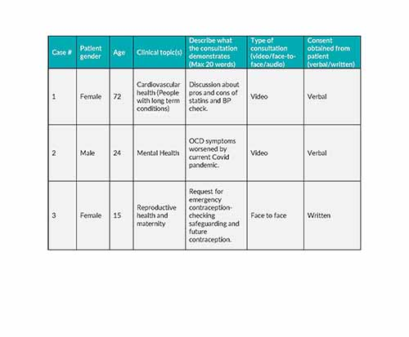
Challenge - Workbook

Slide 24

CASE Spread; now Mandatory
A spread of cases across curriculum
no more than two cases from any one curriculum area
A spread of ages (including a child and an elderly patient)
A case involving a mental health concern.
a case with a long-term condition for example, cancer, multimorbidity or disability.
A case related to urgent or unscheduled care.

Slide 25
Low challenge cases
Typically
Common topics
Straightforward management
Could it have been done by PN/HCA?
…but can become complex
Social situation
Patient perspective
Management dilemmas

Slide 26
Question:
Where does the challenge come from?
No examination
Often no definite diagnosis
Often referred elsewhere

Slide 27
Answer:
From being patient centred….
Interest in patient
Their situation
Their problem
Their ideas
Their response

Slide 28
Trainer’s Role
Facilitate recording
Progress to 10-minute consultations
Facilitate surgery timings
Checking challenge level
Assuring process
  Including consent
Lots of COTS
…but can’t submit COTS
Checking final submission?
Encourage writing up after

Slide 29
Problems - cases
Case difficulty and challenge
10 minutes
ONE problem only
Beginning, middle and end?
NEW cases

Slide 30
Problems - technology
Sound likely to be OK via 14 Fish template
Dodgy if using practice kit
  Sound
  Compatibility with 14 Fish
Smart phone picture framing & stability

Slide 31
Problems - trainees
Organisational ability
Finishing in 10 minutes
Likely to miss off key management points
Voicing differential diagnosis
Patient centredness
Getting 13 cases
Logbook
Checking & reviewing
Welsh speaker?

Slide 32
Declaring a disability?
Follow usual procedure
May be given extra time per consultation

Slide 33
Problems - practice
timetable
Consent collection
Reception involvement
4G wifi connection

Slide 34
Problems - trainer
Liaison with practice team
Time
How much to help?
Case selection
Challenge
Mono-training

Slide 35
Support available
Deanery
  1 session per trainee who needs it for November diet
  3 sessions for anyone who has previously failed
Training Program

Slide 36
Information
RCGP
14 fish
Both frequently updated
Lots of FAQs

Slide 37
Right, that’s it folks…
Anything else I can help with?

