Slide 1
MRCGP:
Recorded Consultation Assessment (RCA)
Dr Chris Webb October 2020

Slide 2
What is the RCA?
A summative assessment of a doctor’s ability to apply clinical, professional, communication & practical skills appropriate for general practice
Uses pre-recorded video or audio consultations to provide evidence from a range of encounters & also provides an opportunity to target particular aspects of clinical care & expertise

Slide 3
The aim of the RCA is to test a doctor’s ability to gather information & apply learned understanding of disease processes & person-centred care appropriately in a primary care context, make evidence-based decisions, & communicate effectively with patients & colleagues. Being able to integrate these skills effectively is a key element of this assessment

Slide 4
Format of the RCA
13 consultations / current working environment / ST3 / any combination of audio, video or face-to-face / cases submitted to FourteenFish platform / cases should be of an appropriate level to demonstrate safe & independent practice / assessed by trained & calibrated examiners / candidate must obtain consent from the patient under usual guidance for training & GDPR (directly on 14F, written or verbally) / material submitted for examination is deleted after Examination Board has ratified & published results or after 182 days after uploading to platform but not submitted / recordings should be continuous / camera should not be turned off during consultations / no editing in anyway

Slide 5
Examinations
Need to respect dignity of patients & observe good medical practice
A consultation in which clothing equivalent to vest top & shorts, or in the ‘swimsuit area’, is removed & captured on a visual recording must not be submitted for assessment
If a consultation is submitted, where this guidance is breached, examiners have been advised that they should not continue to watch or assess it, and no marks will be awarded for that consultation

Slide 6
Mandatory case submissions
At least one case involving a child aged 16 years or younger (including by proxy) - the case should reflect the impact of the patient being a child, rather than simply incidental to the clinical scenario
Minimum of one adult (over 65 years)
Essential clinical areas - minimum of one case involving each of:
An acute problem that needs urgent investigation or referral
Maternal & reproductive health
A mental health condition within the DSM or ICD classifications
A long-term condition eg cancer, multimorbidity or disability
Minimum of 2 cases requiring either a clinical examination or an explanation of the clinical examination required to the patient (psychiatric examinations included)

Slide 7
Recommended case selection criteria
No more than 2 cases where the focus of the consultation lies in any one of the Clinical Topic Areas as listed in the GP curriculum (these include Clinical Topic areas as listed in the GP Curriculum, Reproductive health and maternity, People with long-term conditions (including cancer) & People at the end of life (From Life stage Topics) - the spread of cases should be broad to demonstrate competence across the GP curriculum. The main focus of each case should be within a different clinical topic area of the curriculum
Varying spread of clinical cases & levels of challenge in the consultation - consideration should be given to the complexity of the consultations submitted, for example in terms of patient expectations, beliefs, social situation, psychological issues, hidden agendas

Slide 8
Exceptional circumstances
The only exceptions allowed will be military trainees working solely in military training practices during ST-3, where there is limited or no opportunity to consult with children under 16 or the elderly due to the practice demographic in these locations
Capability in consulting with these patient groups will be demonstrated & evidenced elsewhere during a military GPST programme. Confirmation of the limited demographic will be affirmed through the Defence Deanery PHC Dean
Compensatory evidence of capability in consulting with wider patient groups will be confirmed by the Defence Deanery through review of portfolio evidence by the end of the trainee programme
Candidates who are having difficulty meeting any of the mandated requirements because of the demographics of their practice, should approach their local HEE Office / Deanery to see if an alternative arrangement might enable them to fulfil the criteria

Slide 9
Case marking
Each consultation will be viewed independently by at least one examiner who will make a global judgement of that consultation, attributing marks in 3 domains - data gathering, clinical management and interpersonal skills
Each domain will earn a grade of Clear Pass / Pass / Fail or Clear Fail
The first 10 minutes of the consultation submitted will be assessed. This time will not include any time for verbal consent that is recorded
There may be allowance made for needing to leave the room for example, to collect a urine bottle, but the time taken for examinations will be part of that ten minutes. The camera should run continuously & not be turned off during the consultation submitted

Slide 10
Generic Grade Descriptors
Clear Pass (CP)
The candidate demonstrates a high level of competence, with a justifiable clinical approach that is fluent, appropriately focussed & technically proficient
There is sufficient evidence provided to demonstrate capability in this domain
The candidate shows sensitivity, actively shares ideas & may empower the patient

Slide 11
Pass (P)
The candidate demonstrates an adequate level of competence, with a clinical approach that may not be fluent but is justifiable & technically proficient. The lack of complexity in the case presented restricts the achievement of a Clear Pass grade
The candidate shows sensitivity & tries to involve the patient

Slide 12
Fail (F)
The candidate fails to demonstrate adequate competence, with a clinical approach that is at times unsystematic or inconsistent with accepted practice. Technical proficiency may be of concern
There is limited (new) evidence provided to demonstrate capability of a doctor sufficient for safe independent UK General Practice
The patient is treated with sensitivity & respect, but the doctor does not sufficiently facilitate or respond to the patient’s contribution

Slide 13
Clear Fail (CF)
The candidate clearly fails to demonstrate competence, with a clinical approach that is incompatible with accepted practice, arbitrary or technically incompetent
There is no evidence or very limited evidence provided to demonstrate capability of a doctor sufficient for safe independent UK General Practice in this domain
The patient is not treated with adequate attention, sensitivity or respect for their contribution

Slide 14
Marking Scheme
Data Gathering, Technical & Assessment Skills
Takes a focussed history to allow for a safe assessment to take place
Elicits & develops relevant new information
Rules in or out serious or significant disease
Considers &/or generates any appropriate diagnostic hypotheses
Explores where appropriate the impact & psychosocial context of the presenting problem
Plans, explains & where possible, performs appropriate physical/mental examinations & tests
Appears to recognise the issues or priorities in the consultation

Slide 15
Decision Making & Clinical Management Skills
Appears to make a safe & appropriate working diagnosis/es
Offers appropriate & safe management options for the presenting problem
Where possible, makes evidence-based decisions re prescribing, referral & co-ordinating care with other health care professionals
Makes appropriate use of time & resources whilst attending to risks
Provides safety netting & follow up instructions appropriate to the nature of the consultation

Slide 16
Interpersonal Skills
Encourages the patient's contribution, identifying & responding to cues appropriate to the consultation
Explores where appropriate, patient’s agenda, health beliefs & preferences
Offers the opportunity to be involved in significant management decisions reaching a shared understanding
When undertaken, explains & conducts examinations with sensitivity & obtains valid consent
Provides explanations that are relevant, necessary & understandable to the patient

Slide 17
Low challenge cases
Some concerns have been raised over the submission of ‘low challenge’ cases in the initial diet of the RCA
Of 14,521 cases in the July 2020 diet of the RCA, 16.5% of cases were flagged by at least one examiner as low challenge
The central idea is that the level of challenge in a case affects the opportunities for a candidate to display the professional capabilities which need to be demonstrated for licensing. The key issue is that where the level of challenge is low, there is likely to be insufficient evidence of these capabilities for an examiner to award a passing mark

Slide 18
An initial analysis of cases flagged by both examiners as low challenge (LCx2) in the July diet of the RCA shows some clear patterns. In some cases, there was doubt about whether the patient needed to see a GP – the case being more appropriately handled by a nurse practitioner or pharmacist, for example. In many cases, the patient already had a diagnosis, or the explanation & management had already been done, either by the candidate on a previous occasion or by somebody else

Slide 19
Clearly, in these cases there was comparatively little for the candidate to do & therefore limited opportunity to display the capabilities necessary for licensing (especially in Data Gathering and Clinical Management). An initial psychometric analysis of the marking of cases flagged as low challenge in the July diet showed a difference of just over one mark in the mean overall case mark compared with other cases (5.15 compared with 6.19. Note that a pass in all three domains would give a mark of 6.). This seems likely to be related to the limited opportunity to display relevant capabilities. There may be confounding factors. For example, weaker candidates may be more likely to submit LC cases

Slide 20
What are these cases?
Medication request / repeat prescription / adjust medication
Pill check
Follow up
Recurrence
Results
Sick note request / fitness to work

Slide 21
Clinical areas occurring frequently
Skin / dry skin / skin lesion / eczema (especially recurrence or flare) / acne (especially recurrence) / molluscum / ear wax / earache / conjunctivitis / sticky eye / blepharitis / stye / hayfever / sore throat / tonsillitis / sinusitis / cough

Slide 22
It is be dangerous to equate certain diagnoses with insufficient evidence (low challenge) in an overly simplistic way. The challenge could come from complicating factors such as patient expectations, beliefs, social situation, psychological issue, hidden agendas etc. It is only when the simple diagnosis is completely straightforward that there is likely to be insufficient evidence

Slide 23
Challenging areas
The diagnosis
A new diagnosis of myasthenia gravis is important but rare. If such a case were submitted for the RCA, the level of clinical challenge would probably be high even if the presentation was typical. Tennis elbow, on the other hand, is relatively common but if there was an atypical presentation, the clinical challenge might still be moderately high

Slide 24
The management
Even if the diagnosis is straightforward, the level of clinical challenge may be raised by factors which affect the management of the case. For example, the patient may have an established diagnosis of hypertension but have drug side effects or complications that require thought and debate

Slide 25
The patient
An apparently straightforward case can be more challenging if the patient has unreasonable expectations or beliefs. For example, recent weight loss and haemoptysis may suggest an obvious diagnosis & management but if the patient initially refuses to consider referral then the doctor has to engage in a different type of debate

Slide 26
The situation
Finally, a straightforward problem & a reasonable patient may be complicated by odd external circumstances. For example, consider the effects of an impending move abroad for work reasons when a woman presents with post-menopausal bleeding

Slide 27
The first two areas – diagnosis & management – determine the level of clinical challenge; the second two – patient & situation – represent complicating factors

Slide 28
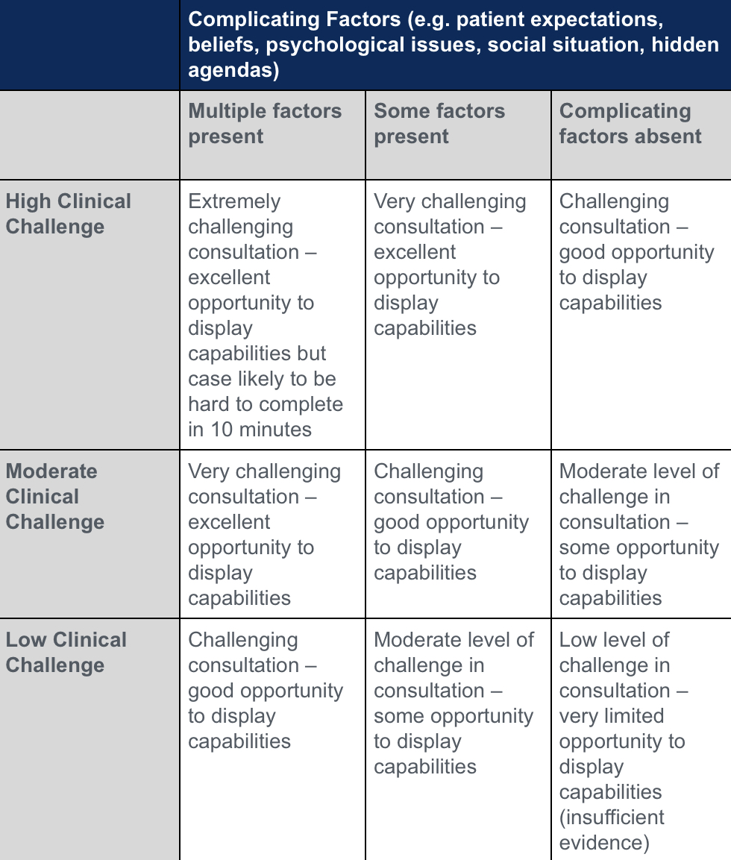

Slide 29
Key messages
The difficulty of cases is influenced both by the level of clinical challenge & by the presence & severity of complicating factors
Although certain diagnoses occur frequently in low challenge cases, candidates & examiners should beware of equating these diagnoses with low challenge
Examiners need to see evidence of a competence to give appropriate credit for it when marking. Low challenge cases offer very limited opportunities to display relevant capabilities & marking will reflect that. This will inevitably penalise candidates submitting large numbers of low challenge cases

