Slide 1
Teaching the Consultation
Intending Trainers 16th October 2020
Drs Chris Webb & Natalie Hodgson

Slide 2
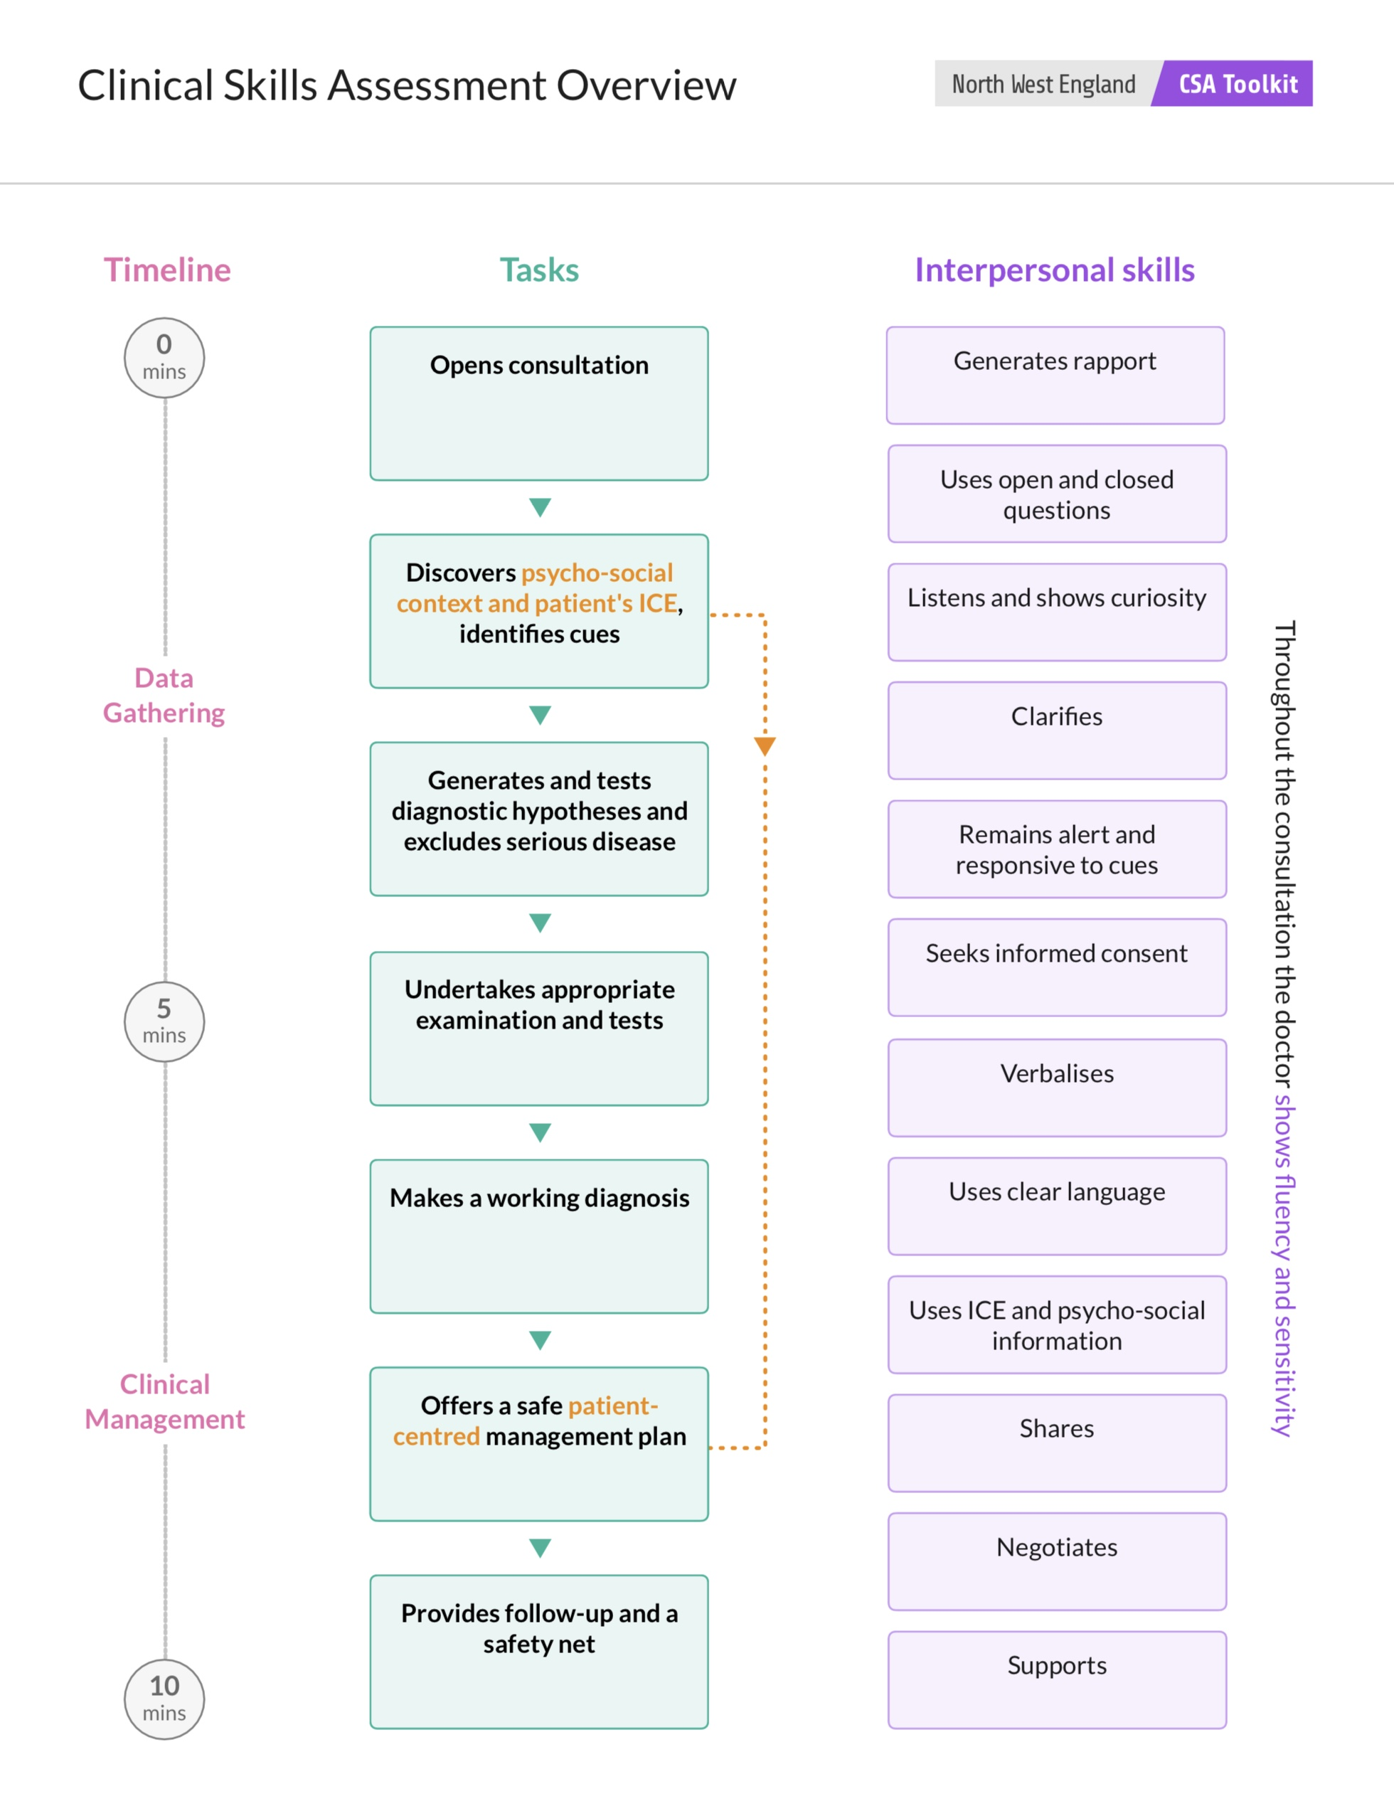

Slide 3
7 steps
Opens the consultation
Discovers psycho-social context, patient’s ICE, identifies cues
Generates & tests diagnostic hypotheses & excludes serious disease
Undertakes appropriate examination & tests
Makes a working diagnosis
Offers a safe patient-centred management plan
Provides follow-up & a safety net

Slide 4
Opens the consultation | The opening of the consultation is very important, and sets the scene for the whole consultation. Therefore if it goes badly, subsequent tasks can be adversely affected A good opening contributes to the establishment of rapport and puts the patient at ease
Behaviours contributing to a successful opening: Introducing himself/herself to the patient Demonstrating interested in the patient Non-verbal body language encourages the patient and helps them to feel ‘at ease’ Begin with an open question (eg, “How can I help today?”) Do not interrupt the patient until they have said what they need to say Remain focussed on the patient with good eye contact and positive non verbal body language | Interpersonal Skills Generates rapport Uses open and closed questions Listens and shows curiosity Clarifies

Slide 5
Discovers psycho-social context and patient's ICE, identifies cues | Discovers Psycho-social Context Obtaining information about psycho-social context is very important in developing patient centred management plans Discover the relevant psycho-social information from the patient including aspects of work life and home life Discover the impact of the problem on patient’s work and home life Discover the way that home and work life impacts on the presenting problem
Discovers Patient's Ideas Concerns And Expectations. Identifies Cues Clunky or formulaic ICE questions detract from the fluency of the consultation Discover the patient’s perspective which includes their ideas, concerns and expectations Identify both verbal and non verbal cues offered by the patient | Interpersonal Skills Generates rapport Uses open and closed questions Listens and shows curiosity Clarifies Remains alert and responsive to cues Verbalises Uses ICE and psychosocial information

Slide 6
Generates and tests diagnostic hypotheses and excludes serious disease | 3 processes History taking - Demonstrates comprehensive history of presenting complaint with focussed supplementary questions that are based on the probability of disease and are sufficient to support a diagnosis or diagnoses Diagnostic sift - Demonstrates clear evidence of diagnostic hypothesis generation and testing Ruling out disease - Demonstrates comprehensive assessment of red/yellow flag symptoms where appropriate and is able to reliably rule out and rule in serious illness
It is important to demonstrate a safe approach to making diagnoses and to ensure that important diagnoses are effectively ruled in or ruled out Generates a list of differential diagnoses based on the presenting symptom or problem. Uses diagnostic sift to test each hypothesis weighing up probability based on focussed history taking. Rules out or rules in serious disease during questioning | Interpersonal Skills Clarifies Uses ICE and psychosocial information

Slide 7
Undertakes appropriate examination and tests | Examinations (and tests) can be absent, or too brief, or too lengthy. Long and unfocused examinations waste time and may impair the hypothesis testing process Start to think of examinations (and tests) in the same way as you think about taking a history - their role is to rule in or rule out particular diagnoses and you should only perform an examination if it will help in this process (or reassure the patient about a particular concern)
Make a decision concerning the need for focussed examination/tests If examination/tests are needed to test diagnostic hypotheses, choice is focussed appropriately Obtain consent Perform a slick and competent examination/tests | Interpersonal Skills Seeks informed consent Verbalises

Slide 8
Makes a working diagnosis | No diagnosis or diagnosis not shared Making a diagnosis (and sharing it with the patient) are part of the marking scheme for clinical management and interpersonal skills Not sharing a (correct) diagnosis makes an effective patient centred management plan very difficult to achieve
Wrong diagnosis Making a wrong diagnosis makes it very difficult to produce an effective management plan. Many wrong diagnoses arise from insufficient knowledge, in particular incomplete knowledge of possible diagnoses and ineffective knowledge of the key diagnostic differences between diseases Sometimes inaccurate diagnoses originate from illogical decision making - even when the doctor has enough knowledge, and asks the right questions, he/she reaches a diagnostic decision that is not based on the information gained. This is sometimes because the doctor has already decided what the diagnosis is, and discounts any evidence to the contrary | Interpersonal Skills Remains alert and responsive to cues Verbalises Uses clear language Uses ICE and psychosocial information Shares Negotiates Supports

Slide 9
Offers a safe patient-centred management plan | The commonest cause of failure is an inability to manage conditions according to up to date guidelines. This is likely to be a knowledge problem. In addition, many doctors are disorganised and do not manage time well, so that the management part of the consultation is rushed and/or doctor centred
The doctor therefore needs to be able to: Have sufficient knowledge to offer to the patient effective management strategies Involve the patient so that the final management plan is patient centred rather than doctor centred Consult in such a way that there is sufficient time to allow the necessary discussion between patient and doctor | Interpersonal Skills Verbalises Uses clear language Uses ICE and psychosocial information Shares Negotiates Supports

Slide 10
Provides follow-up and a safety net | Safety netting and follow up are important for patient safety Bad or no safety netting/follow up can be dangerous for the patient or cause inappropriate anxiety
So the doctor needs to be able to: Develop a safety net for the patient that is SMART (Specific, Measurable, Achievable, Relevant and Timely) Offer appropriate follow up the patient, which is dependent on the nature of the condition | Interpersonal Skills Remains alert and responsive to cues Verbalises Uses clear language Uses ICE and psychosocial information Shares Negotiates Supports

Slide 11
Interpersonal Skills

Slide 12
Rapport | In simple terms, rapport is getting on well with a person. More technically, it is “a state of harmonious understanding with another individual that enables greater and easier communication”. Good rapport is essential in a consultation and will make the whole consultation go well Rapport is closely linked with showing empathy - in general a doctor who is good at showing empathy is good at developing rapport. Many of the skills that are needed to develop rapport and also needed to develop empathy Sometimes rapport with a patient is easy - you just naturally hit it off with the patient Over enthusiastic or insincere attempts at demonstrating empathy often contributes to a non-fluent consultation or a consultation full of jarring and formulaic expressions. These need to be avoided
Behaviours enhancing rapport Being relaxed and open Listening actively, showing curiosity, avoiding looking bored or disinterested Demonstrating that you understand by nodding etc Showing non verbal behaviours that enhance rapport such as leaning forward slightly, making eye contact, having an open stance (eg arms not folded) Asking open questions Not being judgemental | Related Tasks and Skills Opens the consultation Discovers psycho-social context and patient's ICE, identifies cues

Slide 13
Uses open and closed questions | Open questions are extremely valuable as an effective way to build trust and empathy, demonstrate interest, and to discover a lot of information in a short time. Open questions encourage the patient to tell their story and offer a natural way to discover the patient specific information about psycho-social context and ICE
Open questions should be used first to ‘open’ out the consultation and allow the patient to tell their own story. Only then should the doctor use closed questions to test their diagnostic hypotheses, and this will also help with time management and fluency in the consultation. Closed questions are particularly valuable as a way of ruling out and ruling in particular diagnoses | Related Tasks and Skills Opens the consultation Discovers psycho-social context and patient's ICE, identifies cues

Slide 14
Listens and shows curiousity | Being curious and interested in the patient is key to discovering the reason for their presentation to you and their ‘illness-behaviour’ .It is part of a ‘holistic’ approach to the patient which is the essence of both consulting ‘like a GP’ and being a GP
A curious approach to the patient (illness and life) is particularly important for the following reasons: It improves the identification of ICE and cues and psychosocial information It helps with rapport & understanding of the patients’ behaviours It helps the diagnostic process It helps the trainee to tailor a management plan to the specific needs of the patient | Related Tasks and Skills Opens the consultation

Slide 15
Clarifies | Clarifying is the process whereby doctors become clear about the patient’s presenting problem, concerns and expectations. The process involves the identification of patient statements that are confused, vague, incomplete or ambiguous and then attempting to resolve the ambiguity or vagueness Note that the above consultation skills are not compulsory - some patients are very clear about their symptoms and concerns - but with some consultations these sorts of skills can rescue a consultation that is becoming muddled or even dysfunctional.
This can be done by using: Repetition of the previous question with a different emphasis Further open questions A closed question to clarify an ambiguous or confusing point A summary to try and structure a complex history A check that the patient’s story has been understood completely | Related Tasks and Skills Opens the consultation Discovers psycho-social context and patient's ICE, identifies cues Generates and tests diagnostic hypotheses and excludes serious disease

Slide 16
Remains alert and responsive to cues | This skill has been added to emphasise the importance of remaining vigilant and responsive to the patient throughout the consultation Many feel that identifying cues is a ‘one-off” procedure which occurs early on in the consultation, typically within the process of data collection. However, cues can occur at any time in the consultation, and the doctor needs to be responsive to the patient throughout the whole consultation
Examples of cues that might occur later in the consultation include: A patient looking worried or doubtful when the diagnosis is presented A patient looking perplexed when management options are discussed A patient becoming angrier as the consultation progresses A patient looking baffled when safety netting is planned A patient leaving earlier than expected | Related Tasks and Skills Discovers psycho-social context and patient's ICE, identifies cues Makes a working diagnosis Offers a safe patient-centred management plan Provides follow up and a safety net

Slide 17
Seeks informed consent | Discusses choice of examination with patient and links to consent and need for chaperone. Performs....... examination with appropriate signposting and explanation Explains rationale for particular investigation (or absence of investigation) chosen and links explanation to consent process
Consent and chaperone offers show a respect for the patient and demonstrate ethical sensitivity. Importantly, obtaining informed consent is not a tick box process, but an important process where you share what is involved in the examination and ensure that the patient understands what is going to happen, and has no concerns about the examination or investigation | Related Tasks and Skills Undertakes appropriate examination and tests

Slide 18
Verbalises | Doctors are often reluctant to share with patients the thinking that lies behind the questions they ask patients and the advice they give patients. This process is known as ‘Verbalising’ and it helps the patient understand what is going on in the consultation, and also helps the doctor to get his/her thoughts in order
Verbalising can be seen at several points in the consultation, as listed below: Verbalising the reason for questions - to explain why the doctor is asking about (for example) home life, or work, or relationships with friends and family Verbalising the need for an examination - to explain why an examination needs to be done at all, particularly if the part of the body to be examined is not obviously related to the presenting symptoms Verbalising about the need for tests Verbalising about possible diagnostic uncertainty Verbalising about possible management plans Verbalising about possible types of follow up Verbalising about permission seeking (see below) Verbalising about structure to the consultation (signposting). Verbalising about confusion within the doctor’s thought processes | Related Tasks and Skills Discovers psycho-social context and patient's ICE, identifies cues Undertakes appropriate examination and tests Makes a working diagnosis

Slide 19
Uses clear language | Confusing or over-technical language will prevent the patient being involved in the consultation. It will also affect time management and potentially patient safety as the patient will not understand the management plan and the reasons for safety netting and follow up. As the patient does not understand their diagnosis and subsequent management, they will also feel unsupported and the outcome of the consultation will be unsatisfactory
Clear language also needs to be adapted to the patients’ educational level and cultural context and this is impossible to achieve unless you have discovered the patients psychosocial information and ICE | Related Tasks and Skills Makes a working diagnosis Offers a safe patient-centred management plan Provides follow up and a safety net

Slide 20
Uses ICE and psycho-social information | Discovering ICE (and Cues & Psycho-social information) is an essential component of the GP consultation which builds rapport, and enhances the diagnostic process The later step of using this patient-specific information is central to the formation of patient-centred management plans The reasoning behind this connection of ‘Discovers psycho-social context and patient's ICE, identifies cues’ and ‘Offers a safe patient- centred management plan’ is the observation that patient-centred management plans must involve the patients perspective in order to seem relevant to their lives. Without involving the patient and sharing the management options and plan with the patient, there is a risk the plan will seem unconnected with the patient’s concerns and therefore fail
In addition, there may be practical or psychological barriers to the implementation of management such as a failure to share the doctors assessment of risk. This is often most marked with a discordance between the patient and doctors ideas and expectations about lifestyle changes which may need to occur as part of evidence-based management. Similarly, a patient expecting referral or medical imaging is likely to remain recalcitrant if there has been no exploration of ICE earlier on Using the patient-specific information therefore often requires the closely linked skill of negotiation and the doctor who does this effectively will achieve improved patient outcomes with greater concordance and satisfaction | Related Tasks and Skills Discovers psycho-social context and patient's ICE, identifies cues Generates and tests diagnostic hypotheses and excludes serious disease Makes a working diagnosis Offers a safe patient-centred management plan Provides follow up and a safety net

Slide 21
Shares | Being able to share ideas about the options for management ensures that the patient is involved in, and endorses, the management plan. Unless the doctor is able to effectively share options for management, the patient can be left confused about what the doctor is proposing, and unable to move on to making a decision about their treatment Sharing ideas with the patient is closely linked with the three related skills of ‘Verbalises’, ‘Negotiates’ and ‘Supports’. Being able to verbalise what he/she is thinking allows the doctor to share management options. Being able to share options allows the doctor to negotiate with the patient. Sharing and supporting are linked skills that enable the patient to come to the best possible management decision
Effective sharing is characterised by the following features: If possible, is based on information that the patient has already provided - for example, from exploring the patient’s ICE or their psychosocial background. Any particular expectations for management that the patient has already expressed are particularly important. It goes at the patient’s pace and uses language that is understandable to the patient It is interactive - it feels like a conversation rather than a lecture. The term “chunks and checks” captures the conversational aspect of the process - the doctor presents small chunks of information about a particular option, then expects the patient to respond to that information It incorporates concerns expressed by the patient (both verbally and non-verbally) about the management options | Related Tasks and Skills Makes a working diagnosis Provides follow up and a safety net

Slide 22
Negotiation | Negotiation is most commonly required to persuade patients to adopt a particular management plan, as in the examples below. Patients who request unsafe or unhelpful or overly-expensive treatments (for example, strong opiates for mechanical back pain) when the doctor needs to negotiate towards an alternative treatment plan Patients who would be helped by a change in their lifestyle (for example, stopping smoking, or losing weight) but are initially reluctant to make these changes Patients who would be helped by a particular type of medication (for example lipid-lowering medication) but are initially unwilling to consider such treatment Patients who need to be admitted, but have other plans which they are reluctant to abandon in order to access hospital care Patients who have disengaged from their management plan and need to be persuaded that this treatment is still important
Some useful generic strategies for negotiation include: Never begin negotiation until you have collected sufficient information to allow you to negotiate successfully. Some of the information may already be available from earlier in the consultation. Other information may have to be sought as part of the negotiation process Always ask yourself the question - “Why?” So if a patient refuses a particular treatment option, or demands what you think might be a risky treatment option, then try to explore the patient’s reasons for taking this approach. Try and find out what is really important for the patient and begin the negotiation from this point, rather than from what you think is important. For example, if a patient is over-using Diazepam, explore if the patient has any concerns about the amount of medication he is taking. Let’s say that the patient is fed up of being drowsy all the time - then use this problem as the starting point for your negotiation. If you start by accusing the patient of being addicted to Diazepam the negotiation will soon break down. If by contrast, you start by asking - “Would you be interested in improving your drowsiness by gradually reducing your dose of Diazepam, but managing your anxiety in other ways….?” - then this approach is likely to meet with more interest Don’t feel you have to achieve everything in one consultation. For example, stopping smoking is a big ask for a patient and all you may be able to achieve is for the patient to think about stopping or perhaps be willing to speak to the practice nurse about stopping. Always be clear about your own limits. For example if a patient wants a month’s supply of sleeping tablets, then giving this amount of medication may be something you would never ever do - your limit. But you may be prepared to give a five day course, along with sleep advice, and be able to negotiate towards this - and this may be enough to satisfy the patient. Never promise something you cannot give - this will quickly lead to a break down of trust | Related Tasks and Skills Makes a working diagnosis Offers a safe patient-centred management plan Provides follow up and a safety net

Slide 23
Support | Sharing management options, and supporting the patient in making a decision are closely related and overlapping skills. Whereas sharing is mainly concerned with information giving and discussion, supporting is the process where the doctor helps the patient settle on a particular management plan. Many trainees fail to offer real support to the patient in their decision making - they offer a menu of options to patient and say something like: “Which one do you want to choose?” This is unhelpful for the patient - they are left having to make a difficult choice on their own when what they need is support from the doctor. Support in decision making builds on the sharing process described in ‘Shares’ and involves the following steps: Being alert to verbal and non-verbal cues expressed by patients about particular management options Exploring how particular management options might effect the patient’s day to day life If appropriate, checking that the patient understands what is involved in the various management options Answering and clarifying any patient questions Being aware when the patient has reached a decision about management, and summarising this decision Offering further support should the patient’s need this
Checking understanding Checking the patient’s understanding of both the management options and the final management decision can be an important part of both sharing and supporting, and can make the consultation more effective. But it can be very clunky, can antagonise the patient, and can waste valuable time. So be selective in how you use this in the CSA examination. It is particularly useful in the following situations: When the consultation options are complex When there is evidence that the patient is struggling to understand the management options When the patient has a learning disability | Related Tasks and Skills Makes a working diagnosis Offers a safe patient-centred management plan Provides follow up and a safety net

