Slide 1
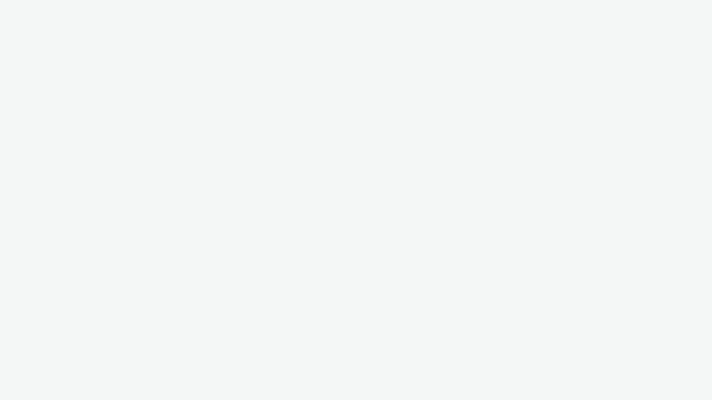
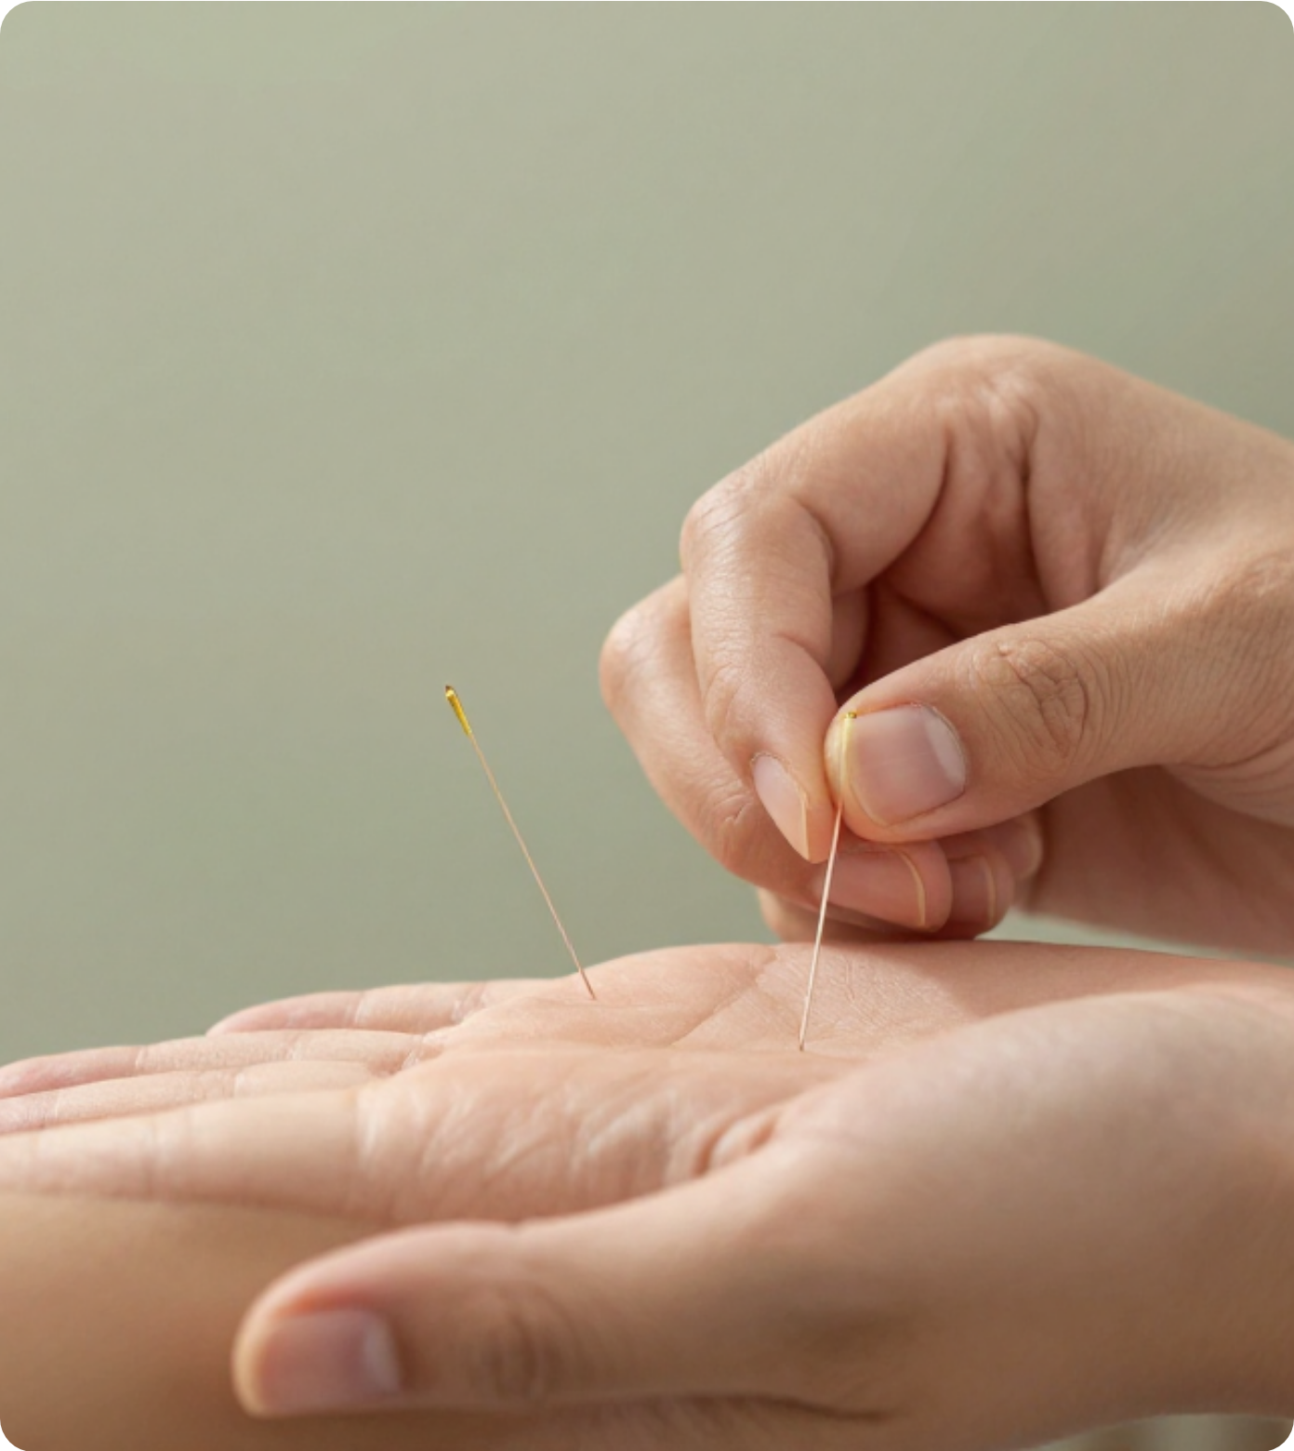


Bradford VTS Teaching Deck
ACUPUNCTURE IN
GENERAL PRACTICE
A clinical review of Traditional Chinese Medicine foundations, Western scientific mechanisms, and current NICE guidance for primary care practitioners.
Disclaimer: This educational material is for training purposes only and should be used in conjunction with current clinical guidelines. Content verified against NICE NG193 (2021) standards as of May 2026.
www.bradfordvts.co.uk

Slide 2
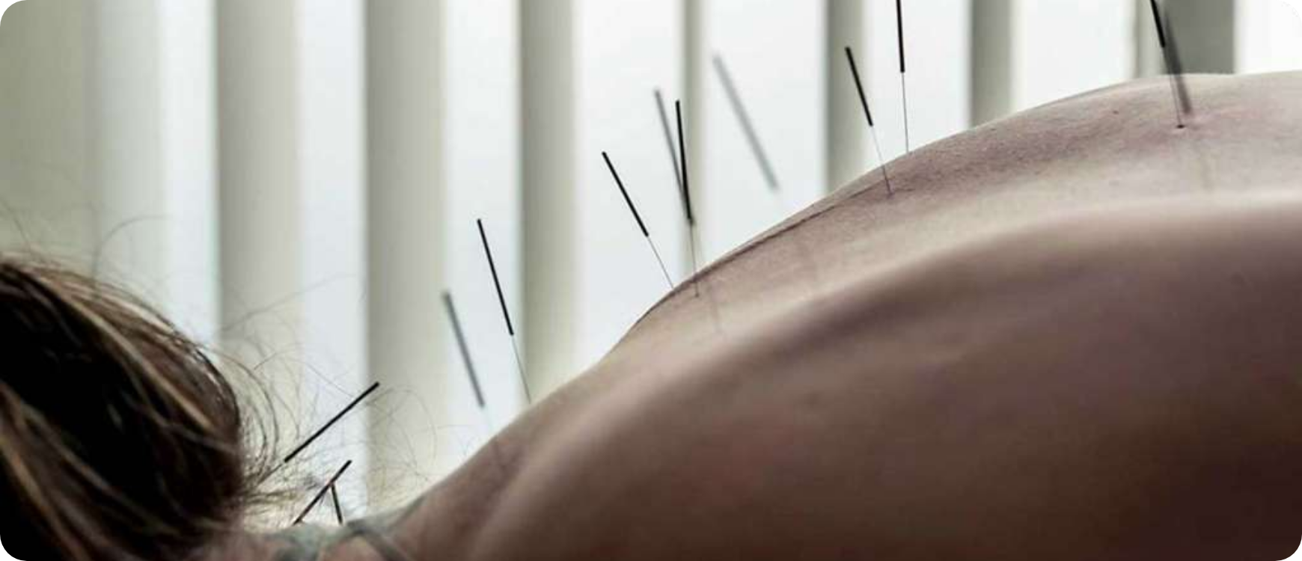







INTRODUCTION TO ACUPUNCTURE
Acupuncture in General Practice | Bradford VTS
TRADITIONAL CHINESE MEDICINE (TCM)
Holistic Energy Framework
Based on restoring balance and the flow of Qi (vital energy). Illness is viewed as a disharmony between Yin and Yang or a disturbance in the meridians.
Definition & 4,000-Year Origins
WESTERN (SCIENTIFIC) APPROACH
Acupuncture is the stimulation of specific body points, primarily through the insertion of fine needles.
Conventional Medical Framework
Most common among UK medically-trained practitioners. Focuses on:
Ancient Roots: Originating in TCM; the Yellow Emperor's Classic (200 BC) described 349 points.
Neurophysiology: Gate control theory, endorphin release, and descending inhibition.
Modern Standards: The WHO has now standardised 361 core points plus additional extra points.
Musculoskeletal: Treatment of myofascial trigger points.
www.bradfordvts.co.uk

Slide 3























TRADITIONAL CHINESE MEDICINE CONCEPTS
Acupuncture in General Practice | Bradford VTS
Qi (Chi): Vital Energy
Yin and Yang
Holistic Philosophy
Definition: The "vital energy" or life force that maintains biological functions.
Quality
Yin
Yang
No Mind-Body Split: Psychological and physical health are inseparable.
Activity
Inhibited / Hypo
Excited / Hyper
Flow: Qi travels along specific pathways called Meridians.
Contextual View: The person is treated in relation to nature and social environment.
Nature
Quiescent / Cold
Fidgety / Heat
Pathology: Illness is viewed as a disturbance, blockage, or imbalance of Qi flow.
Prevention First: Focus on harmonious lifestyle, nutrition, and regular exercise.
Appearance
Pale / Dark
Bright / Red
Individualised: Treatments are tailored to the patient's specific pattern of disharmony.
Gender/Type
Action: Acupuncture points are "access ports" to manipulate this energy flow.
"Female" qualities
"Male" qualities
Clinical Goal: Restore the dynamic balance between these opposing forces.
www.bradfordvts.co.uk

Slide 4



















MERIDIANS AND THE FIVE ELEMENTS
Acupuncture in General Practice | Bradford VTS
The Meridian System
Five Elements Theory
14 Major Channels: Comprising 12 paired meridians (linked to specific organs) plus 2 unpaired midline vessels (Du and Ren).
ELEMENT
YIN / YANG ORGANS
EMOTION
SENSE
Liver / Gallbladder
Wood
Anger
Eyes
Function: Pathways through which Qi (vital energy) travels. Acupuncture points are specific nodes where Qi can be accessed and influenced.
Heart / Small Intestine
Fire
Joy
Tongue
WHO Standardisation: 361 standardised acupuncture points globally recognised, though many "extra" points exist outside the main channels.
Earth
Spleen / Stomach
Worry
Mouth
GP Perspective: Many classical points (approx 70%) coincide with modern Myofascial Trigger Points used in Western medical acupuncture.
Lung / Large Intestine
Metal
Grief
Nose
Water
Kidney / Bladder
Fear
Ears
*Traditional diagnosis considers these relationships to determine systemic disharmony.
www.bradfordvts.co.uk

Slide 5











WESTERN SCIENTIFIC MECHANISMS OF ACTION
Acupuncture in General Practice | Bradford VTS
Segmental Effects (Gate Control)
Neurochemical Release
Stimulation activates large-diameter A-beta sensory fibres.
Stimulates release of endogenous opioids (endorphins, enkephalins).
Inhibits transmission of pain signals from C-fibres in the spinal cord dorsal horn.
Increases levels of serotonin (5-HT) and dopamine in the CNS.
Promotes a systemic "feel-good" effect and long-term analgesia.
Effectively "closes the gate" on nociceptive input to the brain.
Descending Inhibition (DNIC)
Myofascial Trigger Points
Activates Diffuse Noxious Inhibitory Controls (DNIC) via the brainstem.
Targets hypersensitive nodes within taut bands of muscle.
Stimulation of one area inhibits pain in distant regions of the body.
70% correspondence between trigger points and TCM acupuncture points.
fMRI shows deactivation of limbic structures (emotional pain processing).
Local needling causes "twitch response," resetting muscle spindle activity.
AKT PEARL
The Western approach uses a conventional medical diagnosis framework. Know the Gate Control Theory and Endorphin Release as the primary evidence-based mechanisms for exams.
www.bradfordvts.co.uk

Slide 6

















NICE GUIDANCE: CHRONIC PRIMARY PAIN (NG193)
Acupuncture in General Practice | Bradford VTS
Key Recommendation (2021)
Defining Chronic Primary Pain
Consider a single course of acupuncture for adults with chronic primary pain.
Pain persisting for longer than 3 months in one or more regions.
No identifiable underlying cause (e.g., malignancy, inflammation).
Course duration typically ranges from 6 to 10 sessions.
Or pain that is disproportionate to any observable tissue damage.
Use alongside other non-pharmacological options: exercise, ACT, or CBT.
The Evidence Base
AKT Exam Pearl: The NICE Trap
Based on 27 high-quality studies comparing acupuncture to usual care or sham.
Acupuncture is recommended in NG193 (Chronic Primary Pain), but it is NOT recommended for low back pain with or without sciatica in NG59 (2016).
Always check if the pain is classified as "Primary" before applying this guidance in AKT questions.
Demonstrated reduction in pain and improvement in Quality of Life.
Benefits shown in the short term (up to 3 months post-treatment).
www.bradfordvts.co.uk

Slide 7











LOW BACK PAIN AND OTHER INDICATIONS
Acupuncture in General Practice | Bradford VTS
NICE NG59: Low Back Pain & Sciatica
Other Evidence-Based Indications
Acupuncture is NOT RECOMMENDED for low back pain (with or without sciatica) in NG59.
Headache & Migraine: Effective for prophylaxis in primary care settings.
Manual therapy (spinal manipulation, mobilization, massage) is recommended.
Osteoarthritis: Some evidence for pain relief in knee OA.
Musculoskeletal: Neck pain, tennis elbow, and chronic shoulder pain.
Contrast with NG193 (2021): Acupuncture is recommended for Chronic Primary Pain.
Other: Chemotherapy-induced nausea and vomiting (CINV).
Primary vs. Secondary Pain:
WHO List: Historically cited for sinusitis, asthma, and IBS (limited evidence).
Acupuncture is for pain where there is no clear underlying cause (Primary), not specifically for mechanical LBP (Secondary).
AKT EXAM PEARL: THE LOW BACK PAIN TRAP
Examiners frequently test the discrepancy between NG59 (LBP) and NG193 (Chronic Primary Pain). If a question asks about acupuncture for simple low back pain, the answer is usually 'No' according to NICE. If the diagnosis is chronic primary pain, the answer is 'Yes'.
www.bradfordvts.co.uk

Slide 8













CONTRAINDICATIONS AND SAFETY
Acupuncture in General Practice | Bradford VTS
Absolute Contraindications
Relative Cautions
Needle Phobia: Patients who are unable to provide valid consent due to severe distress.
Pregnancy: Avoid "forbidden points" (LI4, SP6, BL67) known to stimulate uterine contractions.
Local Infection: Never insert needles through infected skin or cellulitis sites.
Diabetes & Epilepsy: Risk of poor healing/sensation and needle-induced seizures.
Anticoagulants: Patients on Warfarin or NOACs have significant bleeding/haematoma risk.
Medical Implants: Pacemakers (no electroacupuncture) and Heart Valve Disease (endocarditis risk).
Bleeding Disorders: Haemophilia or thrombocytopenia (platelets < 50).
Vulnerability: Lymphoedema (avoid affected limb) and immunosuppression.
AKT EXAM PEARL
Core Safety Standards & Red Flags
Anticoagulants are a frequent exam distractor. For AKT, remember they are an absolute contraindication for standard acupuncture.
Mandatory use of single-use sterile needles. Ensure accurate medical diagnosis before pain treatment. Be aware of "Risky" points: LU1 (Apex of lung) carries a high risk of iatrogenic pneumothorax. Always record treatment sites and patient response.
www.bradfordvts.co.uk

Slide 9







REGULATION AND PROFESSIONAL BODIES
Acupuncture in General Practice | Bradford VTS
Statutory Regulation Status
Key Professional Bodies
Acupuncture is NOT statutorily regulated in the UK, unlike osteopathy or chiropractic. The title "acupuncturist" is not legally protected, meaning anyone can practice without formal training.
British Acupuncture Council (BAcC)
The largest body for traditionally trained acupuncturists. Requires a minimum of 3 years of accredited training.
British Medical Acupuncture Society (BMAS)
For medically qualified practitioners (GPs, Consultants) using Western scientific acupuncture within their clinical practice.
Clinical Referrals & Safety
When advising patients or referring, GPs should ensure the practitioner is registered with a recognised voluntary professional body.GP Tip: Always check credentials to ensure the practitioner adheres to strict codes of hygiene and professional conduct.
Acupuncture Assoc. of Chartered Physiotherapists (AACP)
For registered physiotherapists who integrate acupuncture into their physiotherapy treatments.
www.bradfordvts.co.uk

Slide 10














CLINICAL ADVICE AND PATIENT COUNSELING
Acupuncture in General Practice | Bradford VTS
SCA PEARL: THE CLINICAL DIALOGUE
Essential Questions
"Have you tried or are you considering any complementary therapies for your pain?"
"Are you taking any herbal remedies or supplements alongside your prescribed medication?"
"What are you hoping to achieve or get from trying acupuncture treatment?"
What to Tell Patients
Evidence:"Acupuncture may help with chronic pain; NICE specifically recommends it for chronic primary pain."
Checking Credentials
Advise patients to seek practitioners registered with recognized bodies:
Safety:"We must check your medical history first, particularly for blood thinners or local infections."
BAcC:British Acupuncture Council (Traditional training)
BMAS:British Medical Acupuncture Society (Medical practitioners)
Holistic Plan:"It works best as part of a broader management plan (exercise/CBT), not as a standalone cure."
Note: Results vary—some people benefit significantly, others less so.
www.bradfordvts.co.uk

Slide 11











EVIDENCE SUMMARY AND LIMITATIONS
Acupuncture in General Practice | Bradford VTS
STRONGEST EVIDENCE
Cochrane Reviews
Chronic musculoskeletal pain
Headache & migraine prophylaxis
Systematic reviews show statistically significant benefits for chronic pain compared to "sham" acupuncture, though actual effect sizes remain modest.
Osteoarthritis of the knee
Neck pain
MODERATE EVIDENCE
Chemotherapy-induced nausea/vomiting
Methodological Challenges
Tennis elbow / MSK pain
Blinding Difficulty
Practitioners cannot be blinded; patients often sense the needle.
Sham Design
WEAK / INSUFFICIENT EVIDENCE
Non-penetrating needles still cause physiological stimulation.
IBS, fertility, and depression
Placebo Effect
Smoking cessation and weight loss
High therapeutic ritual impact due to the physical nature of needling.
www.bradfordvts.co.uk

Slide 12









TOP TIPS FOR GP TRAINEES
Acupuncture in General Practice | Bradford VTS
NICE GUIDELINE MASTERY
MULTIDISCIPLINARY APPROACH
Know NG193 (2021): Recommends acupuncture specifically for chronic primary pain.
Position acupuncture as a complementary tool, not a standalone cure or a replacement for therapy.
Avoid the trap: NG59 (2016) does NOT recommend acupuncture for low back pain or sciatica.
Proactively ask every patient: "Are you using any complementary therapies (CAM)?"
Always clarify the diagnosis (Primary vs Secondary pain) before discussing acupuncture.
Discuss patient expectations; the benefit is a mix of specific and therapeutic relationship effects.
INFECTION CONTROL & SAFETY
REGULATION & REFERRALS
Single-use sterile needles are mandatory; infection control is non-negotiable in UK practice.
Acupuncture is not statutorily regulated; the title "acupuncturist" is not legally protected.
Assess for Red Flags (cancer, fracture) before recommending acupuncture for any pain presentation.
Advise patients to check for registration with BAcC (Traditional) or BMAS (Medical) bodies.
Identify anticoagulants (Warfarin/DOACs) as a critical safety check for bleeding risks.
Check if local NHS commissioning (ICB) provides acupuncture services or requires private referral.
www.bradfordvts.co.uk

Slide 13



















EXAM PEARLS: AKT AND SCA
Acupuncture in General Practice | Bradford VTS
AKT: NICE Guideline Traps
SCA: Communication Framing
NICE NG193 (2021): Recommended for Chronic Primary Pain (duration >3 months).
Validate & Screen: Acknowledge interest in CAM, but screen for anticoagulants and pacemakers first.
NICE NG59 (2016): Acupuncture is NOT recommended for Low Back Pain/Sciatica.
Expectations: Explain it works best as part of a multidisciplinary pain management plan.
Registration: Advise checking for BAcC (traditional) or BMAS (medical) registration.
Statutory Status: Acupuncture is NOT statutorily regulated in the UK.
AKT: Mechanism & Safety
SCA: Clinical Scenarios
Mechanism: Gate Control Theory, Endorphin release, and Descending Inhibition.
Non-Response: Consider acupuncture if pharmacological options for primary pain are ineffective.
Absolute Contraindications: Local infection and current anticoagulant therapy (Warfarin/DOACs).
Warfarin Case: Discuss with anticoagulant team; specific distal points may be safer than deep torso points.
Infection Control: Single-use, sterile needles are mandatory by law for all practitioners.
Red Flag: Sudden dyspnoea post-treatment suggests Pneumothorax (refer for CXR).
www.bradfordvts.co.uk

Slide 14













RED FLAGS AND COMMON PITFALLS
Acupuncture in General Practice | Bradford VTS
SERIOUS SAFETY CONCERNS
GUIDELINE MISCONCEPTIONS
Pathology Exclusion: Always exclude cancer, infection, or fracture before starting acupuncture for pain.
NG59 Error: Assuming NICE recommends acupuncture for low back pain. NICE NG59 does NOT recommend it.
Pneumothorax Risk: Needle insertion at chest/upper back points (e.g., LU1). Refer for urgent CXR if post-needling dyspnoea occurs.
NG193 Specificity: Acupuncture is for Chronic Primary Pain only—not all pain conditions.
Infection: Avoid sites with local skin infection; monitor for systemic sepsis signs post-treatment.
Herbal Confusion: Mistaking acupuncture for Chinese herbal medicine (herbal risk involves drug interactions/toxicity).
COMMON ADVERSE EVENTS
PRACTICAL & REGULATORY ERRORS
Vasovagal Episodes: Dizziness or fainting is common; ensure patient is lying down if prone to needles.
Regulation Assumption: Believing "Acupuncturist" is a protected title. It is NOT statutorily regulated in the UK.
Bleeding/Bruising: High risk at specific points; always review anticoagulant status (Warfarin/NOACs).
Referral Fail: Sending patients to unregistered practitioners. Always check BAcC or BMAS registration.
www.bradfordvts.co.uk

Slide 15





















QUICK RECALL AND SUMMARY
Acupuncture in General Practice | Bradford VTS
AKT Quick Recall: Guidelines
Safety & Red Flags
Chronic Primary Pain (NG193)? Acupuncture Recommended
Absolute CI: Needle phobia, infection at site, anticoagulants.
Low Back Pain (NG59)? Acupuncture NOT Recommended
Pneumothorax: Rare risk at chest/upper back points.
Statutory Regulation in UK? No (Voluntary via BAcC/BMAS)
Pregnancy: Specific points (LI4, SP6) must be avoided.
Key Mechanisms (Western)
Practical GP Takeaways
Ask about CAM/Herbal use to identify drug interactions.
Gate Control Theory: A-beta fiber stimulation inhibits pain.
Counsel: It's part of a multidisciplinary pain plan.
Neurotransmitters: Endorphin, Serotonin, and Dopamine release.
Referral: Ensure practitioner is BAcC, BMAS, or AACP registered.
Descending Inhibition: DNIC pathways from the brainstem.
Medical Education Disclaimer: This deck is for educational and revision purposes only (AKT/SCA). Clinical decisions must be based on the most current NICE guidance, local protocols, and professional judgment. The information is verified as of May 2026.
Useful Links
• NICE Guideline NG193 (Chronic Pain)
• British Medical Acupuncture Society (BMAS)
• British Acupuncture Council (BAcC)
www.bradfordvts.co.uk

