Slide 1

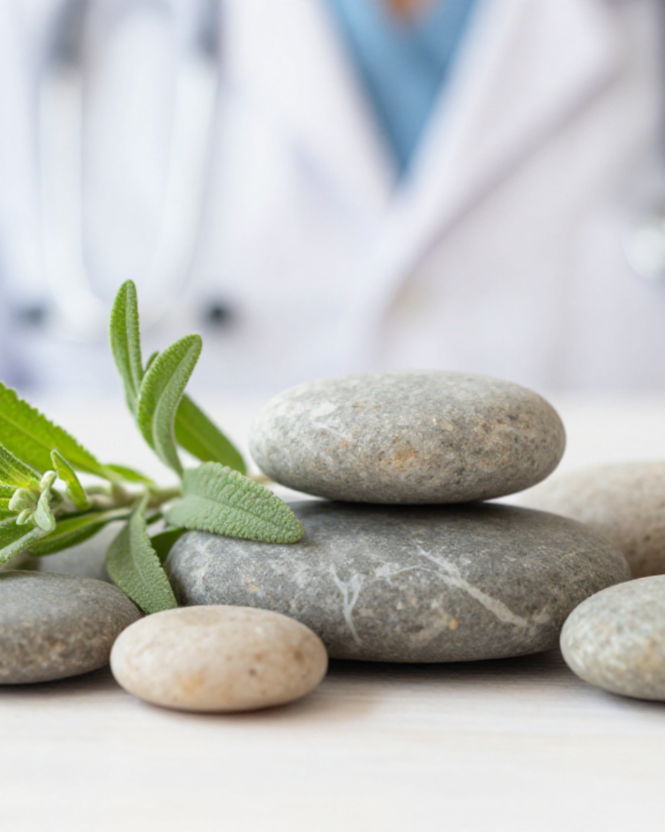


BRADFORD VTS TEACHING DECK
Complementary and Alternative Medicine
An Evidence-Based Overview for GP Trainees
MAY 2026
Teaching Deck — ST1-ST3

Slide 2







BRADFORD VTS | CAM OVERVIEW
WHAT IS CAM?
DEFINITION
"A broad domain of healing resources that encompasses all health systems, modalities, and practices and their accompanying theories and beliefs, other than those intrinsic to the politically dominant health systems of a particular society or culture in a given historical period."
— Cochrane Collaboration
Alternative
Complementary
Used instead of conventional medical treatments.
Used alongside conventional medical treatments.
Replaces evidence-based orthodox medicine.
Aims to enhance wellbeing or manage side effects.
Example: Using homeopathy for cancer instead of chemotherapy.
Example: Acupuncture used with analgesia for chronic pain.
High-risk: May lead to dangerous delays in diagnosis/treatment.
Generally supportive and integrated into care plans.
GPs must distinguish these carefully to ensure patient safety.

Slide 3










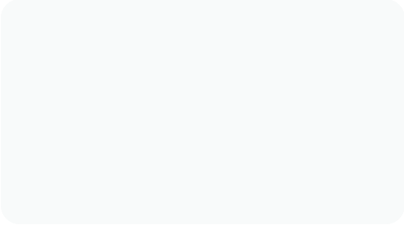
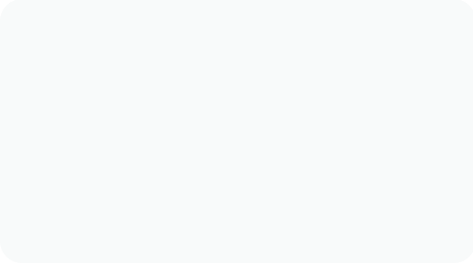





BRADFORD VTS | CAM OVERVIEW
Why It Matters and Usage Data
UK USAGE PREVALENCE
WHY PATIENTS SEEK CAM
1 in 4
11%
Chronic conditions poorly managed by conventional medicine
Seeking holistic, person-centred care and longer consultations
Adults (Lifetime)
Annual Consultations
Avoiding side effects from orthodox pharmacological drugs
More popular in women (40%) than men (27%)
Desire for greater personal control over health decisions
Higher usage in patients aged 35+ years
Concentrated in South and West of UK
GPS AND CAM INVOLVEMENT
CLINICAL FOCUS AREA
45%
21%
10%
88%
Endorse/Recommend
Refer to Practitioners
Practise CAM
of CAM consultations are for Musculoskeletal problems
Understanding CAM builds therapeutic relationships and ensures safe advice on interactions.
38% of patients use multiple CAM forms simultaneously
SAFETY FIRST
Patients often do NOT volunteer CAM use — You must ask about herbal remedies and supplements.

Slide 4







BRADFORD VTS | CAM OVERVIEW
House of Lords Classification (2000)
Group 1
Group 2
PROFESSIONALLY ORGANISED / EVIDENCE BASE
COMPLEMENTARY PRACTICE / LESS EVIDENCE
Acupuncture and Osteopathy
Aromatherapy, Massage, and Yoga
Chiropractic and Herbal Medicine
Hypnotherapy and Meditation
Homeopathy
Reflexology and Counselling
Group 3a
Group 3b
TRADITIONAL SYSTEMS / SPECIFIC TRAINING
LEAST EVIDENCE / LEAST REGULATION
Ayurvedic & Chinese Herbal Medicine
Crystal Therapy and Iridology
Traditional Chinese Medicine (TCM)
Kinesiology and Dowsing
Naturopathy and Anthroposophy
Radionics
AKT PEARL
Group 1 therapies are the only ones with established professional bodies and some evidence base accepted by the Lords. Statutory regulation (GOsC/GCC) currently only applies to Osteopathy and Chiropractic.

Slide 5






















BRADFORD VTS | CAM OVERVIEW
Regulatory Status of Main Therapies
Statutory Regulation
Only Osteopathy and Chiropractic are governed by Acts of Parliament. This ensures mandatory standards of training, conduct, and professional indemnity.
Therapy
Regulatory Status
Registration Body
General Osteopathic Council (GOsC)
Osteopathy
STATUTORY
General Chiropractic Council (GCC)
Chiropractic
STATUTORY
Protected Titles
National Institute of Medical Herbalists (NIMH)
Herbal Medicine
VOLUNTARY + MHRA
"Osteopath" and "Chiropractor" are protected titles. It is a criminal offence to use these titles without being registered with the GOsC or GCC.
British Acupuncture Council (BAcC), BMAS
Acupuncture
VOLUNTARY
Society of Homeopaths, Faculty of Homeopathy
Homeopathy
VOLUNTARY
GP Advice Point
Aromatherapy Council, IFPA
Aromatherapy
VOLUNTARY
For unregulated therapies, always advise patients to verify that the practitioner belongs to a reputable Voluntary Register accredited by the PSA.
CNHC (PSA Accredited), National Hypnotherapy Society
Hypnotherapy
VOLUNTARY

Slide 6
















BRADFORD VTS | CAM OVERVIEW
Current NICE Guidance on CAM (2026)
Pain Management (NG193 & NG59)
Homeopathy & Herbal Medicine
Chronic Primary Pain (NG193):
Homeopathy Decommissioned (2018)
Acupuncture is recommended as a treatment option (pain >3 months with no clear underlying cause). Based on 27 studies showing QoL benefits.
NHS England formally ceased funding. NICE position: Insufficient evidence to recommend for any condition. Annual saving: ~£92,400.
Low Back Pain & Sciatica (NG59):
Herbal Medicine:
Manual therapy (spinal manipulation, mobilisation, soft tissue massage) is recommended, often delivered by chiropractors/osteopaths.
No NICE guideline currently recommends prescribing herbal medicines in primary care. Regulated via MHRA THR scheme only.
Low Back Pain (NG59) Exclusion:
Acupuncture is recommended for low back pain or sciatica (unlike primary pain).
AKT EXAM PEARL
Contrast NG193 vs NG59: Acupuncture is "YES" for Chronic Primary Pain, but "NO" for Low Back Pain in NICE guidance.
Mental Health & Other
Depression Relapse Prevention:
Mindfulness-Based Cognitive Therapy (MBCT) is recommended for patients with recurrent depression.
Irritable Bowel Syndrome (CG61):
Hypnotherapy/hypnosis is recommended as an option for refractory IBS.
Osteoarthritis (CG177):
Manual therapies are not specifically endorsed; exercise remains first-line management.

Slide 7

















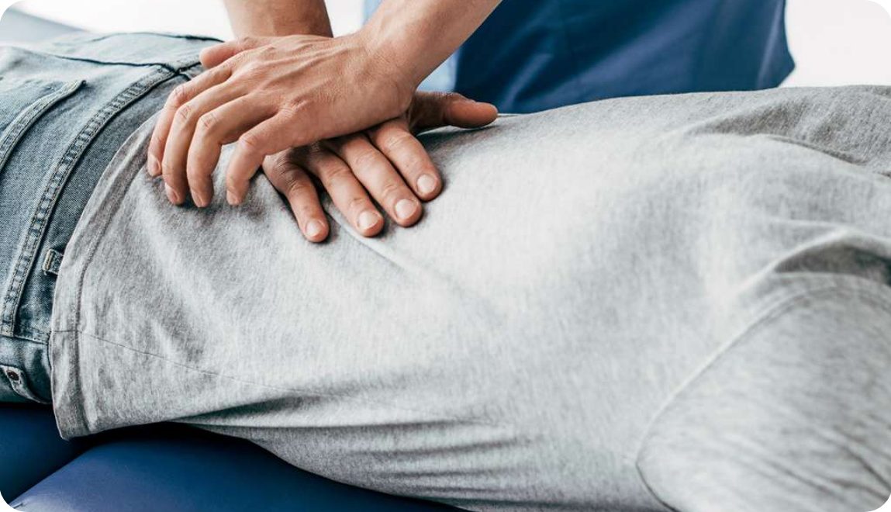
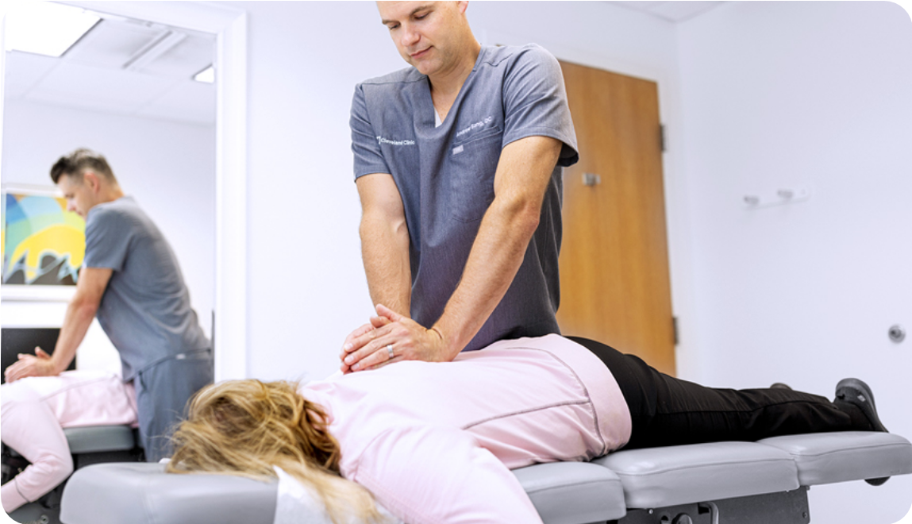
BRADFORD VTS | CAM OVERVIEW
Overview of Key Therapies: Part 1
Acupuncture
Osteopathy
Chiropractic
VOLUNTARY (BACC / BMAS)
STATUTORY (GOSC) - PROTECTED TITLE
STATUTORY (GCC) - PROTECTED TITLE
Insertion of fine needles; Gate control mechanism & endorphin release.
Focus on musculoskeletal structure and function via manipulation.
Specialises in joint dysfunction and effects on the nervous system.
Traditional (Qi/Meridians) vs Western (Trigger points) approaches.
Strong evidence for LBP, neck, and shoulder pain.
"Adjustment" involves high-velocity, low-amplitude thrusts.
NICE NG59: Manual therapy (including manipulation) recommended for low back pain.
AKT PEARL
NICE NG193: Recommended for chronic primary pain.
NICE NG59: NOT recommended for low back pain.
SAFETY NOTE
Rare risk of vertebral artery dissection with cervical manipulation.

Slide 8


















BRADFORD VTS | CAM OVERVIEW
Overview of Key Therapies: Part 2
Herbal Medicine
MHRA THR SCHEME
Hypnotherapy
Uses whole plant preparations; primary medicine for 80% of the world.
Uses hypnotic trance for therapeutic suggestion.
High risk of drug interactions: St John's Wort (CYP450 inducer) affects OCP, Warfarin, and SSRIs.
NICE CG61: Specifically recommended for refractory IBS.
Regulated via the Traditional Herbal Registration (THR) scheme.
Aromatherapy
Essential oils used via inhalation or massage for relaxation.
Commonly used in palliative care and for managing anxiety.
Homeopathy
Based on "like cures like" and ultra-dilute preparations (succussion).
Scientific consensus: No clinical evidence beyond placebo effects.
Reflexology
Pressure on foot/hand points corresponding to internal organs.
No plausible mechanism; used as safe supportive care for relaxation.
AKT Tip: NHS decommissioned funding in 2017/18. Not recommended by NICE for any condition.

Slide 9













BRADFORD VTS | CAM OVERVIEW
Drug Interactions — Critical for GPs
St John's Wort (Hypericum perforatum)
Other Key Herbal Interactions
Potent CYP450 Inducer — Reduces plasma levels of key drugs
Garlic & Ginkgo biloba: Antiplatelet effects. Significant bleeding risk when combined with warfarin or NSAIDs.
Warfarin
Reduces anticoagulation (risk of VTE)
Ginseng: May interact with warfarin, MAOIs, and hypoglycaemic agents (risk of unexpected hypos).
Oral Contraceptive
Failure of efficacy (unwanted pregnancy)
Antiretrovirals
HIV treatment failure
Valerian: Sedative properties. Additive effects with CNS depressants and general anaesthetics.
Cyclosporin
Transplant rejection risk
Echinacea: Immunomodulation. Caution in patients with autoimmune conditions or those on immunosuppressants.
SSRIs
Increased risk of Serotonin Syndrome
Statins / Digoxin
Reduces therapeutic levels
MHRA Warning: Avoid St John's Wort in any patient taking the above medications.
EXAM PEARL (AKT/SCA)
"Always ask: 'Are you taking any herbal remedies or supplements?' – Especially before surgery, starting anticoagulation, or prescribing the OCP."

Slide 10










BRADFORD VTS | CAM OVERVIEW
Patient Consultation Skills (SCA)
Opening the Conversation
Navigating Conflict & Safety
"Some of my patients find complementary therapies helpful. Have you ever tried any?"
Validate: Don't dismiss—acknowledge the desire for holistic care.
Educate: Provide evidence-based guidance honestly without ridicule.
Credentials: Advise checking registration with main professional bodies.
"Are you taking any herbal remedies, vitamins, or supplements at the moment?"
Safety: "I want to ensure therapies don't interfere with your prescribed meds."
Normalize the topic to encourage honest disclosure.
Patients often omit CAM; explicit questioning is essential for safety.
Exploring ICE in CAM
SCA Exam Pearl: The Red Flag Scenario
Ideas: "What made you want to try this specific therapy?"
If a patient on the Oral Contraceptive Pill (OCP) starts St John’s Wort:
Concerns: "Are there any worries you have about your current conventional treatment?"
URGENT SAFETY MESSAGE
Expectations: "What are you hoping the acupuncture/herbal remedy will help with?"
Explain that St John's Wort significantly reduces OCP effectiveness. Provide specific advice on alternative contraception and stop the herbal supplement immediately.
Always check they aren't delaying conventional diagnosis/treatment.

Slide 11








BRADFORD VTS | CAM OVERVIEW
Evidence Base Overview
Methodological Challenges
Strongest Evidence Base
Blinding is difficult for physical therapies like acupuncture, massage, or spinal manipulation.
Acupuncture: Strong RCT data for chronic primary pain and tension-type headaches (NICE NG193).
Many trials are underpowered with small sample sizes and significant publication bias.
Manual Therapy: Proven benefit for low back pain and sciatica (NICE NG59) and neck pain.
Standardizing highly individualized "holistic" treatments for RCT protocols is problematic.
Mindfulness & Hypnosis: Strong evidence for depression relapse and IBS management (NICE CG61).
The Placebo Effect
Weakest / No Evidence
Estimated 20–40% of clinical improvement in CAM trials is attributable to the placebo response.
Homeopathy: Scientific consensus confirms no evidence beyond the placebo effect.
Placebo is a powerful therapeutic tool; non-specific healing effects can still benefit patient well-being.
Reflexology & Energy: No credible evidence base for Reiki, crystal therapy, or radionics.
GP trainees should recognize that "feeling better" is clinically valuable even without biological proof.
Anthroposophical Medicine: Lacks robust RCT data for most clinical indications.

Slide 12
















BRADFORD VTS | CAM OVERVIEW
TOP TIPS FOR GP TRAINEES
ROUTINE INQUIRY
CLINICAL SAFETY
MSK DOMINANCE
Always ask: "Are you taking any herbal remedies or supplements?" Patients often omit this unless explicitly prompted, especially during medication reviews.
St John’s Wort is the most critical interaction. It is a potent CYP450 inducer that can lead to:
88% of CAM consultations are for musculoskeletal issues. Manual therapy (osteopathy/chiropractic) has the strongest evidence base for these patients.
Contraceptive failure (OCP)
Reduced anticoagulation (Warfarin)
Organ rejection (Cyclosporin)
STATUTORY REGULATION
NICE GUIDANCE
HOMEOPATHY STATUS
Only Osteopathy (GOsC) and Chiropractic (GCC) have statutory regulation. Advise patients to check professional registers for all other voluntary therapies.
Acupuncture is recommended for chronic primary pain (NG193), but is not recommended for isolated low back pain (NG59).
NHS England decommissioned homeopathy in 2018. Be honest about the lack of evidence beyond placebo while maintaining the therapeutic relationship.
EVIDENCE-BASED PRACTICE
BRADFORD VTS TEACHING DECK | MAY 2026

Slide 13



















BRADFORD VTS | CAM OVERVIEW
EXAM PEARLS (AKT/SCA)
AKT: NICE & EVIDENCE
SCA: CLINICAL CONSULTATION
Acupuncture (NG193): Recommended for Chronic Primary Pain; strictly not recommended for Low Back Pain (NG59).
Patient Requests Homeopathy: Validate desire for care, be honest about evidence without ridiculing, and check for diagnostic delay.
Hypnotherapy (CG61): Evidence-based recommendation for IBS if conventional pharmacological therapy fails at 12 months.
Practitioner Advice: If recommending CAM, advise patients to check the Voluntary Register (e.g., BAcC for acupuncture).
Homeopathy: Formally decommissioned from NHS funding (2018); NICE indicates insufficient evidence for any condition.
AKT: REGULATION & MEDS
SCA: SAFETY SCENARIOS
Statutory Regulation: Only Osteopathy (GOsC) and Chiropractic (GCC) have protected titles and mandatory UK registration.
The OCP Crisis: If a patient on OCP starts St John’s Wort, provide urgent safety counselling regarding contraceptive failure.
St John's Wort: Potent CYP450 inducer. Reduces efficacy of OCP (pregnancy risk) and Warfarin (clot risk).
Alternative vs. Complementary: Identify if a patient is using CAM instead of life-saving treatment (e.g. Cancer/HIV) — this is a major Red Flag.
GP TRAINEE TEACHING SERIES | MAY 2026
AKT & SCA HIGH-YIELD REVIEW

Slide 14














BRADFORD VTS | CAM OVERVIEW
RED FLAGS — WHEN CAM IS DANGEROUS
ST JOHN’S WORT INTERACTIONS
ALTERNATIVE VS. COMPLEMENTARY
OCP Failure: Potent CYP450 induction reduces contraceptive efficacy, leading to unwanted pregnancy.
Alternative Use: Patient chooses CAM INSTEAD of conventional care (e.g., homeopathy for cancer chemotherapy).
Warfarin: Reduces anticoagulation levels; high risk of thromboembolic events (stroke/PE).
Safety Concern: This leads to avoidable morbidity and mortality. GP must intervene urgently and compassionately.
Antiretrovirals: Leads to HIV treatment failure and potential viral resistance.
Transplants: Interacts with Cyclosporin, causing critical organ rejection risks.
Always ask about herbal supplements before prescribing new conventional medication.
THE RISK OF DELAYED DIAGNOSIS
Patients seeking CAM relief for "back pain" or "bloating" may mask underlying malignancy (e.g., spinal mets or ovarian cancer).
PATIENT SAFETY CRISES
Homeopathy used for serious infections, malaria, or acute psychosis instead of evidence-based intervention.
Action: Ensure conventional "Red Flag" screening is completed before supporting CAM use.
Unregulated practitioners with no formal medical training providing advice on complex chronic diseases.
Validate the patient's choice but ensure they understand the conventional diagnostic pathway.
SCA TIP: If a patient on the OCP mentions starting St John's Wort, treat this as a clinical safety emergency. Use your SCA skills to counsel on the immediate pregnancy risk and provide alternative advice without being dismissive.

Slide 15
















BRADFORD VTS | CAM OVERVIEW
Common Pitfalls & Quick Recall
Communication & Safety
AKT High-Yield Stats
Prescribing Blind: Failing to ask about herbal supplements (especially St John's Wort) before starting OCP or Warfarin.
Prevalence: 1 in 4 UK adults use CAM; 88% of consultations involve musculoskeletal issues.
The "Alternative" Trap: Not identifying when a patient is using CAM instead of conventional cancer or HIV treatment.
Statutory Bodies: GOsC (Osteopathy) and GCC (Chiropractic) hold protected professional titles.
Skeptical Alienation: Dismissing all CAM as "rubbish," which damages the therapeutic bond and discourages patient disclosure.
Placebo Effect: 20–40% of CAM efficacy is often attributed to the clinical ritual and placebo response.
Knowledge & Regulation
Safety & NICE Recall
Regulation Confusion: Assuming all CAM therapists are regulated; only Osteopaths and Chiropractors have statutory regulation.
St John's Wort: Potent CYP450 inducer. Reduces levels of OCP, Warfarin, Ciclosporin, and Antiretrovirals.
Missing NICE Guidance: Overlooking that Acupuncture is now recommended for Chronic Primary Pain (NICE NG193).
NICE IBS (CG61): Explicitly recommends Hypnotherapy if symptoms persist after 12 months.
Homoeopathy Funding: Suggesting NHS funding for homoeopathy—it was fully decommissioned across the UK in 2018.
Manual Therapy: Recommended by NICE for Low Back Pain (NG59), but not acupuncture for this specific indication.
Always document: "Discussed evidence base and potential interactions."

