Slide 1




Bradford VTS TRAINING DECK
Herbal Medicine in Primary Care
Teaching Deck for GP Trainees:
High-Yield Preparation for AKT & SCA Exams
Reference Date: May 2026
Standards: MHRA • BNF • NICE Verified
Clinically focused evidence-based phytotherapy for UK primary care.

Slide 2










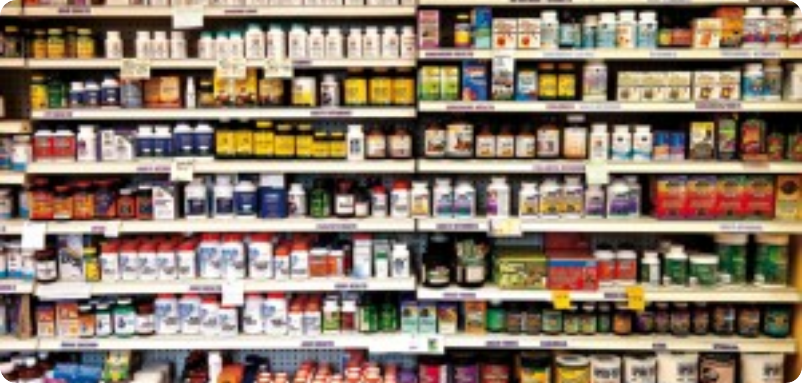



Definition and Popularity
BRADFORD VTS | HERBAL MEDICINE IN PRIMARY CARE
What is Herbal Medicine?
UK Popularity & Market
The use of whole plants or plant parts (roots, leaves, bark, berries, seeds) for health promotion and disease treatment.
1 in 5 UK adults regularly use Complementary and Alternative Medicine (CAM).
Focuses on synergy within and between plants.
Herbal medicine is the most popular CAM type in the UK.
European market exceeds €3 billion annually.
Aims to restore homeostasis and cellular nutrition.
Over 1,300 registered herbalists (Western, Chinese, Ayurvedic) in the UK.
Historical Context
Human use dates back over 60,000 years.
Neanderthal burial sites (Iraq) show pollen from yarrow, marshmallow, and ephedra.
Primary medicine for 80% of the world's population.

Slide 3












Herbal Medicine vs. Homeopathy
BRADFORD VTS | HERBAL MEDICINE IN PRIMARY CARE
Herbal Medicine
Homeopathy
Material Doses: Uses whole plant parts (roots, leaves, seeds) in pharmacologically active amounts.
Ultra-Diluted: Substances diluted until potentially no molecules of the original matter remain.
Tradition: Ancient practice with over 60,000 years of recorded human use.
Origins: Developed ~200 years ago based on "Like Cures Like" (Law of Similars).
Mechanism: Complex synergy of phytochemicals acting on physiological pathways.
Mechanism: Focuses on "vital force" and energetic imprints rather than biochemistry.
Safety: Genuine risk of Herb-Drug Interactions (e.g., CYP450 induction).
Safety: Negligible risk of biochemical interaction due to lack of material substance.
CRITICAL EXAM PEARL: Do NOT assume they are the same. Herbal medicines are material drugs. They WILL interact with conventional medications like Warfarin and SSRIs.

Slide 4
















UK Regulation and the THR Scheme
BRADFORD VTS | HERBAL MEDICINE IN PRIMARY CARE
MHRA THR Scheme
Registered Herbalists
Governed by Human Medicines Regulations 2012 (Post-Brexit framework).
National Institute of Medical Herbalists
NIMH
Requires "Traditional Use" for ≥30 years (15 of which in UK/EU).
Register of Chinese Herbal Medicine
RCHM
Guarantees Quality and Safety (Standardised manufacture, no adulteration).
Association of Master Herbalists
AMH
CRITICAL: Does NOT require evidence of clinical efficacy.
Statutory Status: Herbalists are statutorily regulated in the UK. Unlike Doctors or Osteopaths, the title "Herbalist" is not legally protected.
AKT EXAM PEARL
The THR logo (Traditional Herbal Registration) on a pack ensures the product is regulated for safety/quality, but it is proof that the herb works for the condition.
OTC Advice for Patients
Advise patients to always look for the THR Number and Logo on labels.
Caution against internet-purchased products (Risk of heavy metals/steroid adulteration).

Slide 5













The Herbal Consultation
BRADFORD VTS | HERBAL MEDICINE IN PRIMARY CARE
AKT / SCA CONTEXT
45–60 Minutes
Comprehensive History
STANDARD INITIAL CONSULTATION DURATION
Full medical history, current medications, and client details including GP name.
Significantly longer than the standard 10-minute GP appointment, allowing for deep exploration of underlying causes.
Clinical Assessment
Physical examination, diagnosis, and prognosis discussion tailored to the individual.
Individualised Prescription
Bespoke dispensing of herbal preparations (tinctures, teas, powders, or creams).
GP Insight: Medical herbalists often request GP details to ensure integrated care and patient safety.
The consultation focuses on homeostasis, synergy, and cellular nutrition, aiming for a broader view of disease beyond immediate symptoms.

Slide 6











St John's Wort: Critical Interactions
BRADFORD VTS | HERBAL MEDICINE IN PRIMARY CARE
AKT PEARL: Enzyme Induction Mechanism
St John's Wort is a potent inducer of CYP450 (specifically 3A4) and P-glycoprotein (P-gp). This increases drug metabolism/clearance, drastically reducing the serum concentration of many life-saving medications.
DRUG CLASS / AGENT
INTERACTION MECHANISM
CLINICAL RISK (SCA FOCUS)
Warfarin
Reduced anticoagulant effect (CYP1A2, 2C9, 3A4 induction)
Thromboembolism / Stroke
Oral Contraceptives
Reduced estrogen/progestogen levels via CYP3A4
Unwanted Pregnancy
Immunosuppressants
Ciclosporin & Tacrolimus levels drop significantly
Organ Transplant Rejection
HIV Antiretrovirals
Indinavir and NNRTI concentrations reduced
Treatment Failure / Resistance
SSRIs / Triptans
Pharmacodynamic additive effect (Serotonergic)
Serotonin Syndrome
Digoxin / Statins
P-glycoprotein induction / CYP3A4 induction
Reduced Therapeutic Effect
CLINICAL SAFETY MANDATE (BNF)
Patients taking SJW with critical drugs (e.g., Warfarin, Ciclosporin, Antiretrovirals) must STOP SJW immediately and notify their GP/Consultant. INR and drug levels must be monitored closely during withdrawal as levels will rise.

Slide 7





















Clinically Important Herbs: Part 1
BRADFORD VTS | HERBAL MEDICINE IN PRIMARY CARE
Ginkgo biloba
Echinacea
Ginkgoaceae family
E. purpurea / angustifolia
PRIMARY USES
PRIMARY USES
Memory & Cognitive function enhancement
Immune stimulant for cold/flu
Peripheral Vascular Disease (Claudication)
Prevention and treatment of URI
Tinnitus & Macular degeneration
Evidence: Modest benefit for URI duration.
Evidence: Modest for claudication; weak for dementia.
IMMUNE CAUTIONS
BLEEDING RISK
Avoid in Autoimmune conditions (MS, Lupus, RA) and HIV. May interfere with immunosuppressants.
Antiplatelet effects: Increased risk with Warfarin, Aspirin, NSAIDs, and Clopidogrel.
Valerian
Garlic
Valeriana officinalis
Allium sativum
PRIMARY USES
PRIMARY USES
Insomnia and sleep quality improvement
Cardiovascular health (BP & Cholesterol)
Mild anxiety and restlessness
Natural antimicrobial properties
Evidence: Some RCT evidence for sleep quality.
Evidence: Modest reduction in BP and total cholesterol.
CNS DEPRESSION
ANTICOAGULANT RISK
Additive effects with Benzodiazepines, Alcohol, and Anaesthetics. Caution pre-operatively.
Increased bleeding risk with Warfarin, NSAIDs, and Aspirin. Discontinue before surgery.

Slide 8










Clinically Important Herbs: Part 2
BRADFORD VTS | HERBAL MEDICINE IN PRIMARY CARE
Saw Palmetto (Serenoa repens)
Feverfew (Tanacetum parthenium)
Traditional use for Benign Prostatic Hyperplasia (BPH) symptoms.
Moderate RCT evidence for migraine prophylaxis.
AKTCochrane review (2012) showed no benefit over placebo for BPH symptoms.
Note: Antiplatelet effects and rebound headache on cessation.
Interactions: Antiplatelet effects; increased bleeding risk.
Black Cohosh (Cimicifuga racemosa)
Used for menopausal hot flushes. AKT MHRA Warning: Reported hepatotoxicity; contraindicated in liver disease. Caution with Tamoxifen.
Milk Thistle (Silybum marianum)
Traditional use for liver conditions, cirrhosis, and hepatitis.
Evidence: Some data supports hepatoprotective effects in trials.
KAVA KAVA (PIPER METHYSTICUM)
Safety: May affect CYP450; monitor drugs with narrow windows.
BANNED for sale in the UK (MHRA, 2002). Severe hepatotoxicity and risk of liver failure. A high-yield AKT pearl for UK trainees.

Slide 9















Drug-Herb Interactions Summary
BRADFORD VTS | HERBAL MEDICINE IN PRIMARY CARE
Herb
Key Interaction
Clinical Risk
St John's Wort
Warfarin, OCP, HIV drugs, Ciclosporin, SSRIs
Thrombosis, pregnancy, treatment failure, organ rejection, serotonin syndrome
Garlic
Warfarin, NSAIDs, Aspirin
Increased bleeding risk; antiplatelet additive effect
Ginkgo
Warfarin, Antiplatelets, Anticonvulsants
Increased bleeding risk; potential seizure control interference
Echinacea
Immunosuppressants
Transplant rejection; flare-up of autoimmune conditions
Valerian
Benzodiazepines, Alcohol, Anaesthetics
Excessive CNS depression; caution pre-operatively
Black Cohosh
Tamoxifen, Hepatotoxic drugs
Hepatotoxicity risk; potential oestrogenic interaction
Kava Kava
—
BANNED IN UK
Severe hepatotoxicity and risk of liver failure
Feverfew
Warfarin, NSAIDs
Bleeding risk; rebound headache on sudden cessation
Ginseng
Warfarin, MAOIs, Hypoglycaemics
Bleeding risk; hypertensive crisis; severe hypoglycaemia

Slide 10


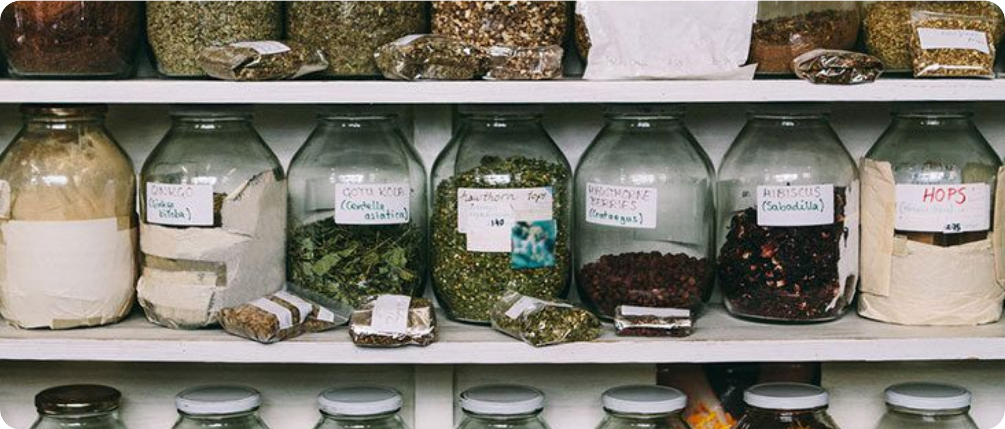









Safety Concerns and Adverse Effects
BRADFORD VTS | HERBAL MEDICINE IN PRIMARY CARE
Interactions & Quality
St John's Wort is a potent CYP450 inducer. Unregulated OTC products vary significantly in quality; always advise patients to look for the THR mark.
Adulteration & Toxicity
Risk of contamination with heavy metals (especially in imported products) or illegal adulteration with steroids and prescription medications.
Pre-Surgery Protocol
Stop ALL herbal medicines at least 2 weeks before elective surgery to avoid anaesthetic interactions and bleeding risks.
RED FLAG: HEPATOTOXICITY
Identification & Allergies
Black Cohosh and Kava Kava are associated with severe liver damage. Monitor for:
Wild harvesting errors can be fatal (e.g., Hemlock). Caution with Asteraceae family plants (Chamomile, Echinacea) in patients with ragweed allergies.

Slide 11


















Clinical Evidence and Peppermint Oil
BRADFORD VTS | HERBAL MEDICINE IN PRIMARY CARE
Herbal Medicine
Indication / Condition
Evidence Level
Peppermint Oil (Mentha x piperita)
Mild–moderate depression
GOOD (COCHRANE)
Licensed Medicines: Available as enteric-coated capsules (e.g., Colpermin, Mintec) and listed in the BNF.
St John's Wort
Insomnia / Sleep quality
Valerian
MODERATE
NICE Guidance (CG61): Acknowledged as an effective antispasmodic for IBS symptom relief.
Common cold (duration)
Echinacea
MODERATE
Mechanism: Local smooth muscle relaxation in the GI tract; enteric coating prevents gastric release (reducing heartburn).
Migraine prophylaxis
MODERATE
Feverfew
Intermittent claudication
Ginkgo biloba
MODERATE
Benign Prostatic Hyperplasia
AKT / SCA Pearl
Saw Palmetto
WEAK (COCHRANE)
Peppermint oil is unique as a herbal derivative licensed for NHS prescription. For AKT, remember SJW has the strongest evidence for depression but the highest interaction risk. For SCA, recommend THR-marked products or licensed peppermint oil to ensure standardised quality.
Menopausal symptoms
MOD / SAFETY RISK
Black Cohosh
Verified against NICE CG61 and BNF Standards | May 2026

Slide 12













GP Clinical Approach and History Taking
BRADFORD VTS | HERBAL MEDICINE IN PRIMARY CARE
The Consultation (SCA Focus)
Clinical Management Steps
Be Non-Judgemental: Patients often fear "disapproval" and may hide supplement use.
Document: Record the specific herb, dose, and reason for use in the medical record.
1
Essential History: This is a standard part of any medication history, not an optional extra.
2
Check: Use the BNF or a specialist interaction checker (e.g., Stockley’s) for every herb.
"How to Ask" Prompts:
• "Are you taking any herbal remedies, vitamins, or food supplements?"
• "Are you using any natural or traditional medicines alongside your prescriptions?"
3
Explain: Discuss safety concerns/interactions clearly. If safe, no action beyond documentation.
Referral & Shared Care
Mandatory before prescribing: OCP, Warfarin, Immunosuppressants, or Anticonvulsants.
Advise patients to see NIMH-registered herbalists for professional practice.
Request that the herbalist communicates directly with the GP regarding prescriptions.

Slide 13











Top Tips and Exam Pearls
BRADFORD VTS | HERBAL MEDICINE IN PRIMARY CARE
St John’s Wort is the single most important herb to know—interactions are extensive and dangerous.
The THR mark equals a quality standard and traditional use, NOT a proof of efficacy.
Stop all herbal medicines at least 2 weeks before elective surgery (bleeding/anaesthetic risk).
AKT HIGH-YIELD PEARLS
SCA CONSULTATION PEARLS
CYP450 Inducer: St John’s Wort reduces efficacy of Warfarin, OCP, Ciclosporin, and HIV drugs.
The OCP Scenario: If a patient starts St John’s Wort, advise additional contraception or to stop the herb immediately.
Banned Substance: Kava Kava is banned in the UK due to severe hepatotoxicity (common AKT question).
The Warfarin Scenario: Garlic/Ginkgo/Ginseng increase bleeding risk. Plan for more frequent INR monitoring if use persists.
Licensed in UK: Enteric-coated Peppermint Oil is listed in the BNF and NICE-recommended for IBS.
Non-Judgmental Approach: Explore ICE; patients often feel embarrassed. Use: "Are you using any natural or traditional medicines?"
Contraindications: Echinacea should be avoided in patients with Autoimmune Disease or on immunosuppressants.
Safety Documentation: Always record the herb name, dose, and your safety advice in the medical notes.
REMEMBER: Herbal medicine uses material doses and can cause genuine drug interactions, unlike ultra-diluted homeopathy.

Slide 14












Red Flags and Common Pitfalls
BRADFORD VTS | HERBAL MEDICINE IN PRIMARY CARE
Critical Interaction Risks
The Omission Pitfall
St John's Wort in patients on Ciclosporin/Tacrolimus (Transplant Rejection) or HIV Antiretrovirals (Treatment Failure).
Failing to ask "Are you taking any herbal remedies?" during a standard medication history—it is a mandatory clinical question.
Hepatotoxicity & Toxicity
The "Natural = Safe" Fallacy
Signs of Liver Damage (Jaundice, dark urine, RUQ pain) in users of Black Cohosh or Kava Kava.
Assuming herbal products are benign. Many have potent drug-herb interactions (especially SJW and the OCP).
AKT Pearl: SJW induces CYP450 3A4, reducing efficacy of contraceptives.
Adulteration & Misuse
The Surgical Pitfall
Unregulated Chinese herbs (Heavy metal risk) or self-treating serious cancer/infections instead of conventional care.
Neglecting to advise patients to stop all herbal medicines at least 2 weeks before elective surgery to avoid bleeding/anaesthetic risks.

Slide 15












Quick Recall Summary
BRADFORD VTS | HERBAL MEDICINE IN PRIMARY CARE
The "Big One": St John's Wort
Banned: Kava Kava
Potent CYP450 inducer: Reduces levels of Warfarin, OCP, HIV drugs, and Ciclosporin.
Banned for sale in the UK since 2002 due to severe hepatotoxicity.
Watch for: Patients buying online or importing from abroad.
SSRIs + St John's Wort = High risk of Serotonin Syndrome.
Pre-Operative Safety
THR Mark = Quality
Advise all patients to STOP herbal medicines at least 2 weeks before elective surgery.
THR number proves traditional use (30 yrs) and pharmaceutical quality.
CRITICAL: THR does NOT mean the product is proven to be clinically effective.
Reason: Potential for bleeding (Garlic, Ginkgo) and anaesthetic interactions (Valerian).
Evidence-Based: Peppermint
The Essential Question
Enteric-coated peppermint oil is licensed in the UK for IBS symptom relief.
Included in the BNF and NICE guidelines — considered conventional practice.
"Are you taking any herbal remedies, vitamins, or food supplements?"
Document use in the medical record and check the BNF for all prescriptions.
Non-judgemental documentation + Safety-first interaction checks = Best Practice

